Slide 1
γ-ray astrophysics: news from the astronomical frontier
J. Cortina (IFAE Barcelona)

Slide 2
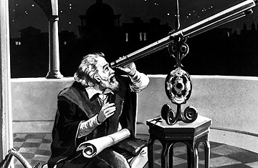
Electromagnetic spectrum: astronomical windows
Traditional astronomy was restricted to the “optical astronomical window” which is accessible to the naked eye: ~400-700 nm.

Slide 3
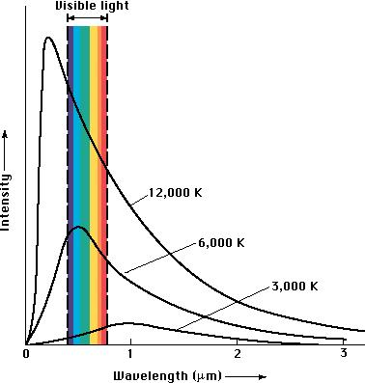
Electromagnetic spectrum: astronomical windows
Stars range in temperature from ~3000 K to ~40000 K, so their black body emission spans from UV to IR.
Conventional astronomical wisdom end of 19th century: the sky is dark beyond these wavelengths.

Slide 4
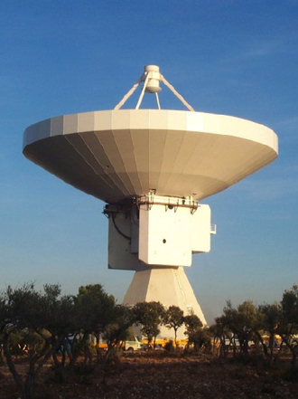
Electromagnetic spectrum: astronomical windows
Radio astronomy: started actually by engineers partly because astronomers expected nothing and partly because astronomers didn’t know how to detect radio waves.
The sky is full of radio sources and they are not main sequence stars.
In some galaxies, radio emission only comes from the very core of the galaxy: supermassive black holes powered by accretion and not by stellar fusion
Cosmic microwave background.

Slide 5
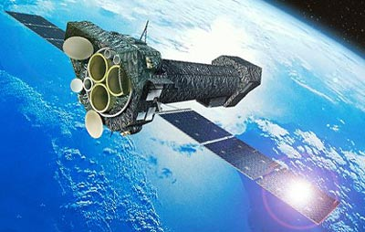
Electromagnetic spectrum: astronomical windows
X-ray astronomy: only possible when detectors could fly on rockets or satellites:
The sky is full of X-ray sources and they are not main sequence stars
Brighest sources are X-ray binaries: systems made of a star and a compact object (pulsar or black hole), powered by accretion.

Slide 6
Electromagnetic spectrum: astronomical windows
The last astronomical window to open is the γ-ray window: everything beyond 511 keV.
The atmosphere is opaque to γ-rays. Let’s see how we can detect them and how the sky looks like in this window.

Slide 7
Detection techniques

Slide 8
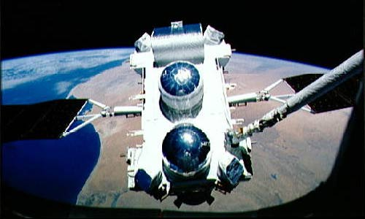
Space-based detectors
γ-rays inmediately interact when they enter the Earth’s atmosphere
γ
e⁺
e⁻
The obvious solution is to get the detector out of the atmosphere, on board of balloons, rockets or satellites.
Several such detectors have operated since the 1970’s: SAS-2, COS-B and EGRET. EGRET catalogued ~350 γ-ray sources.
Currently: Italian Agile detector and Fermi/LAT

Slide 9
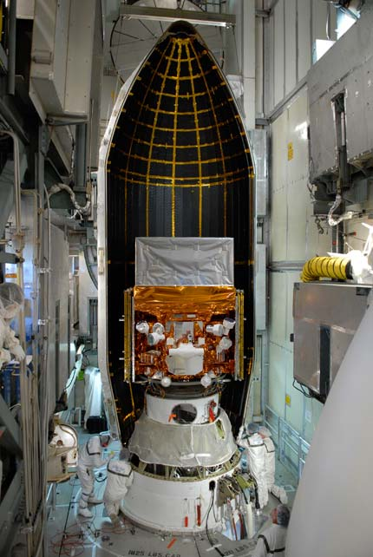
Fermi satellite
Fermi Gamma-ray Space Telescope
Launched on 11 June 2008.
Joint venture of NASA, the US Department of Energy, and funding agencies in France, Germany, Italy, Japan, and Sweden.
Two scientific instruments:
The Large Area Telescope (LAT): 30 MeV - 300 GeV
Gamma-ray Burst Monitor (GBM). 8 keV to 30MeV. Detects gamma-ray bursts across the whole of the sky not occulted by the Earth.

Slide 10
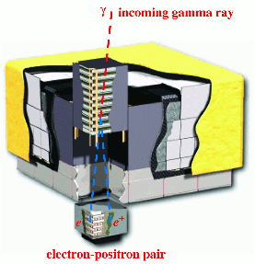
Fermi/LAT
LAT detects γ-rays in the 30 MeV - 300 GeV range.
Tracker: converts γ-ray into e⁻/e⁺ and measures their trajectories to determine the γ-ray incident direction.
Calorimeter: measures energy of electron & positron.
Veto: external shield to eliminate charged particle background.

Slide 11
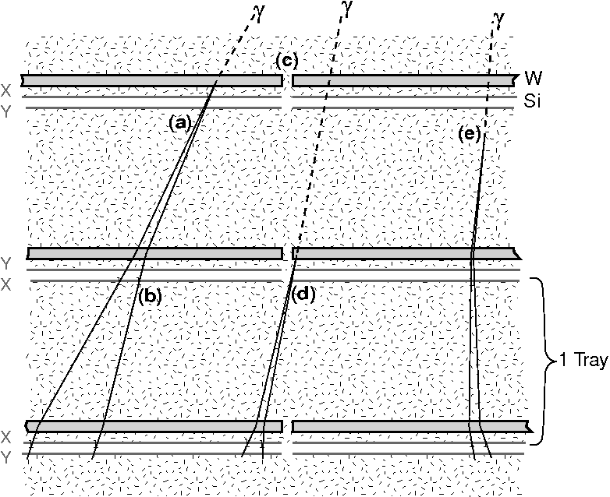
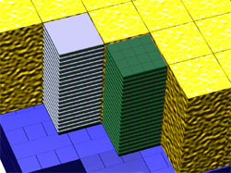
Fermi/LAT tracker
High Z tungsten layers to convert γ-ray into e⁺e⁻ pair.
Four-by-four array of tower modules.
In each module, there are 19 pairs of planes of Si - in each pair, one plane has the strips oriented in the "x-direction", while the other has the strips oriented in the perpendicular "y-direction".

Slide 12
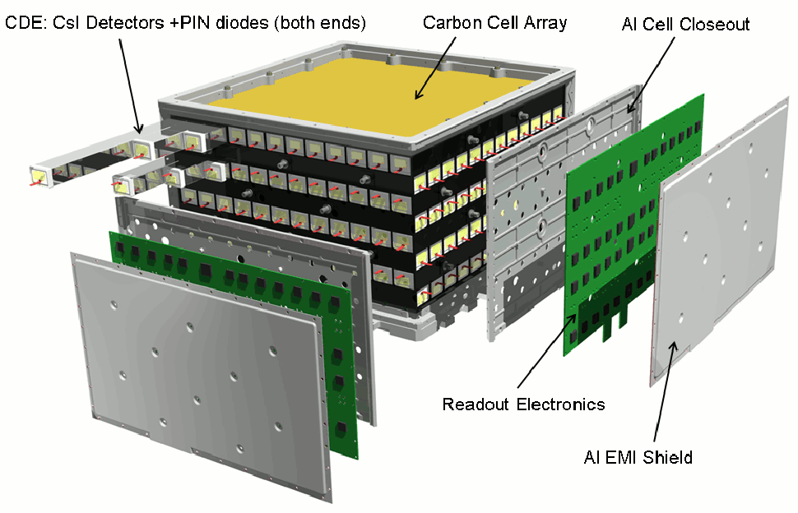
Fermi/LAT calorimeter
CsI(Tl) scintillator: high light yield, coupled with photodiodes to measure energy of the pair.
Bars, arranged in a segmented manner, give both longitudinal and transverse information about the energy deposition pattern.

Slide 13
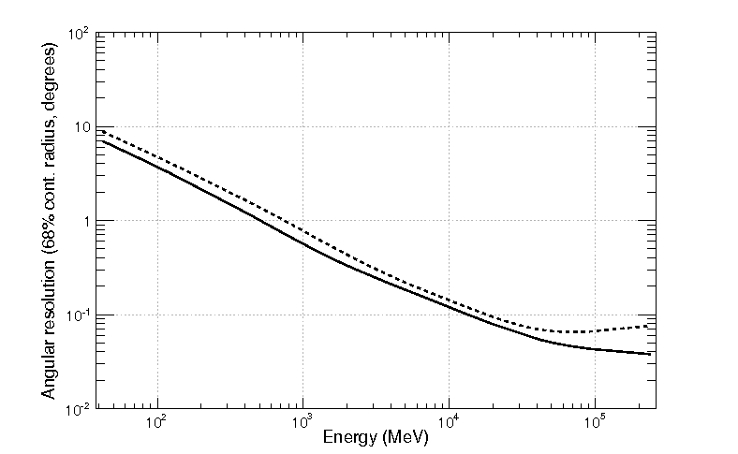
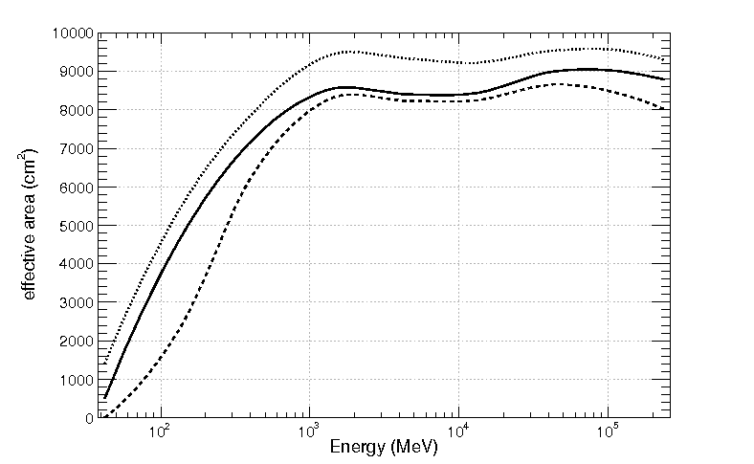
Fermi/LAT: performance
Angular resolution
60° off-axis
on-axis
Lines represent 3 different cuts to remove background
Effective area

Slide 14
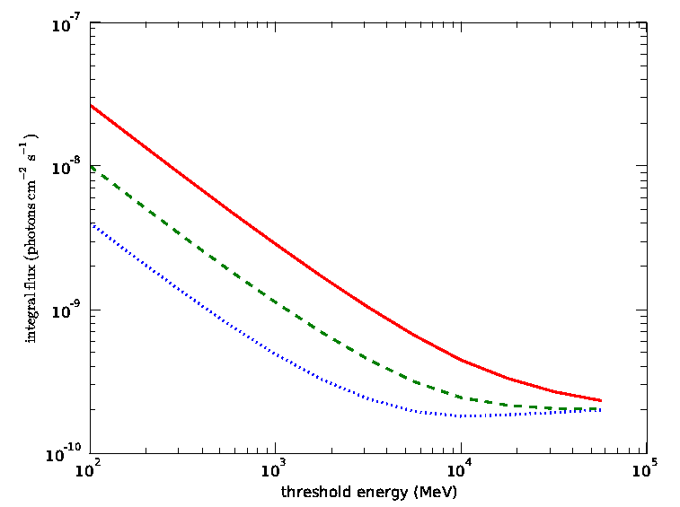
1-year sensitivity to γ-rays
Galactic plane
Near plane
High latitude

Slide 15
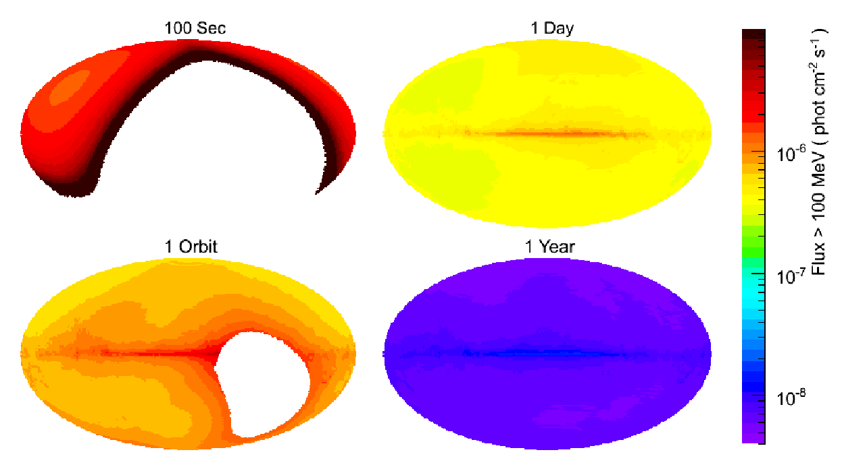
Field of view and operation
Fermi/LAT operates in “survey mode”: it images the whole γ-ray sky essentially every 1.5 hours.
Data are processed automatically and made freely available together with the necessary tools to analyze them.
(1.5h)

Slide 16
Limitations of space-based telescopes
Space-based detectors suffer from two limitations which prevent them to cover the energy range above ~100 GeV:
Area cannot exceed ~1 m² while the strongest flare ever reported above 200 GeV featured 1 photon / m² in 8 h.
At such energies, the detection volume is too small to contain the shower developed by the γ-ray.
~1 m²
Calorimeter
depth ≤ 10 X₀

Slide 17
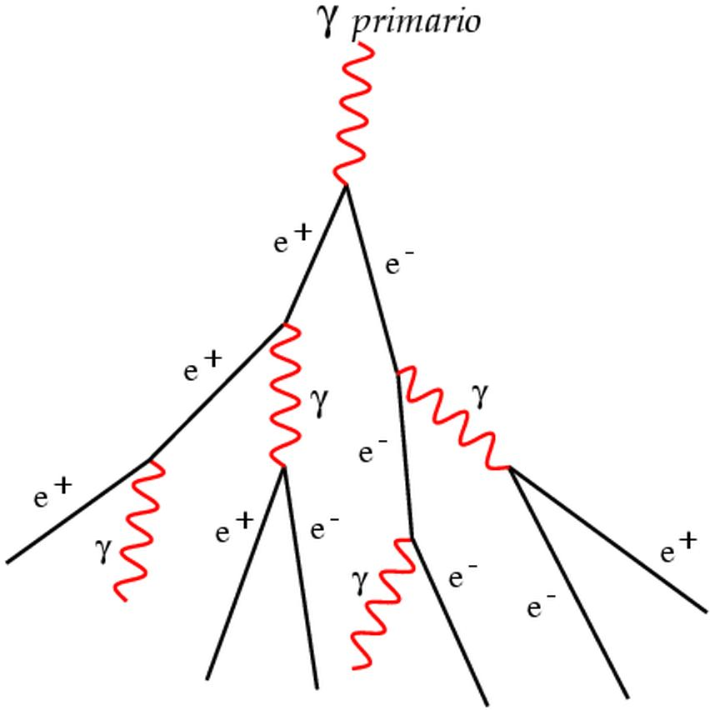
Ground-based γ-ray astronomy
Observe particle showers induced in the atmosphere (28 X₀ at s.l.) by γ-rays
Most successful technique:
Imaging
Atmospheric
Cherenkov
Telescopes
primary γ-ray
Very High Energy = E_{γ} > 30 GeV

Slide 18
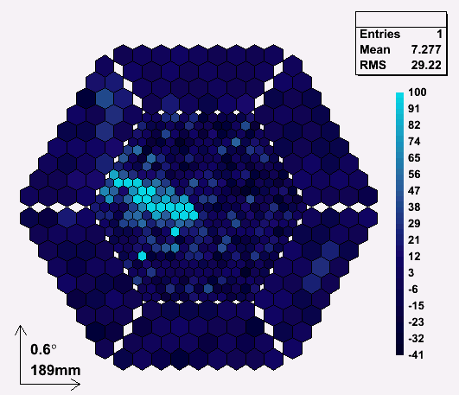
Gamma-
ray
How to detect γ-ray showers: with IACTs
Particle
shower
~ 10 km
~ 1º
Cherenkov light
~ 120 m
Notes:
18

Slide 19
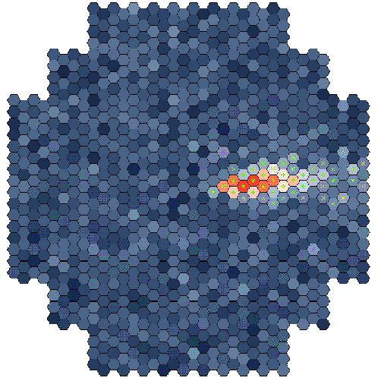
Arrays of IACTs
Intersection point of major axes allows simple and more precise source position reconstruction, i.e. better discrimination and angular resolution.
More images means better estimation of shower shape, i.e. better discrimination from cosmic ray background.
Slide from W. Hofmann
Notes:
19

Slide 20
Two generations of IACTs
Pioneer IACT: Whipple 10m telescope in Arizona since 1969.
First array of IACTs: HEGRA in La Palma, Spain (German groups + UCM).
Last 10 years: 2nd IACT generation with lower energy thresholds and better flux sensitivities:
HESS
Array of 4 x 12 meter (100 m² mirror) IACTs
Mainly German-French collaboration
Located in Namibia (Southern Hemisphere)
Fully operational since 2003.
V ERITAS
- 4x 12m telescopes in operation in Arizona since 2007.
- Mainly US-UK coll.

Slide 21
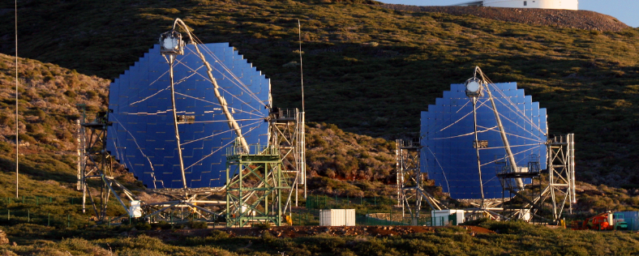
MAGIC telescopes
Collaboration of Spain, Germany, Italy… Located in La Palma, Spain.
Spanish groups: IAA, IAC, IFAE, ICE, UAB, UB, UCM
Single telescope (MAGIC-I): largest IACT yet constructed (17m Ø), i.e. lowest energy threshold.
Fastest sampling (2GSps), ultralight CF frame and mirrors, fast repositioning (<20 secs/180º), active mirror control…
MAGIC telescope array: stereo observations down to 50 GeV regularly since Fall 2009.
M-II is an improved copy of M-I.

Slide 22
Performance of MAGIC
Energy threshold is 50 GeV, the lowest among IACTs and overlapping with Fermi/LAT.
Flux sensitivity=
0.76% crab >300 GeV
Angular resolution: 0.1º at 100 GeV, down to 0.04º at >1 TeV.
Energy resolution: 20% at 100 GeV, down to 15% around 1 TeV.

Slide 23
Physics in the γ-ray astronomical window

Slide 25
Galactic cosmic rays
Maybe too shameful to mention: cosmic rays were discovered 100 years ago (1912), but we don’t know where they come from.
They represent a significant fraction of the energy content of our galaxy.

Slide 26
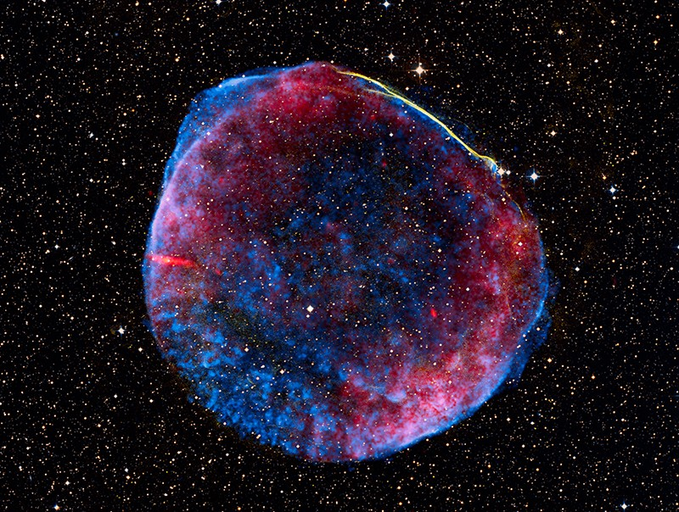
CR/γ-ray connection
Galactic cosmic rays (CR) are believed to originate in Supernova Remnants (SNR).
E < 10¹⁵ eV
Accelerated in the sh0ck between SN ejecta and interestellar medium.
Eventually they diffuse away from the SNR and fill up the galaxy.
Cosmic rays generate γ-rays via π⁰ when they interact with nuclei of the interestellar medium.
Since the density of CR is higher in the nearby of SNR, one expects SNR to “shine” in γ-rays.

Slide 27
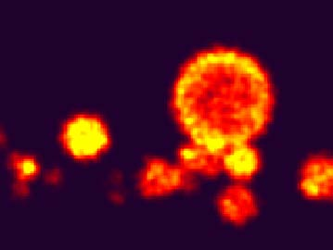
CR/γ-ray connection
Detecting 10’s to 100’s of SNR was one of the physics drivers of the
first generation of IACTs (e.g. HEGRA). However they discovered no γ-ray bright SNR.
The second generation of IACTs have managed to discover a few.

Slide 28
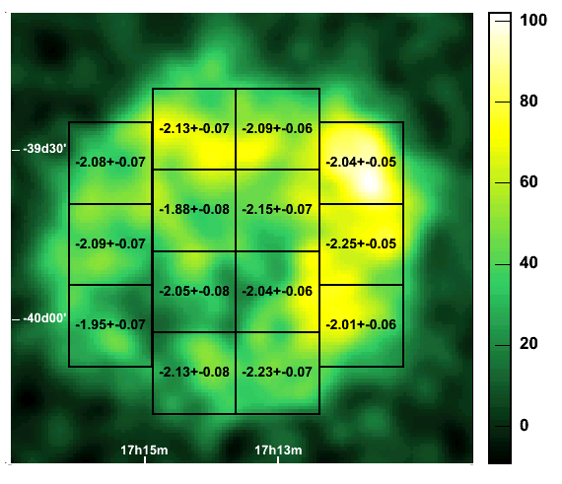
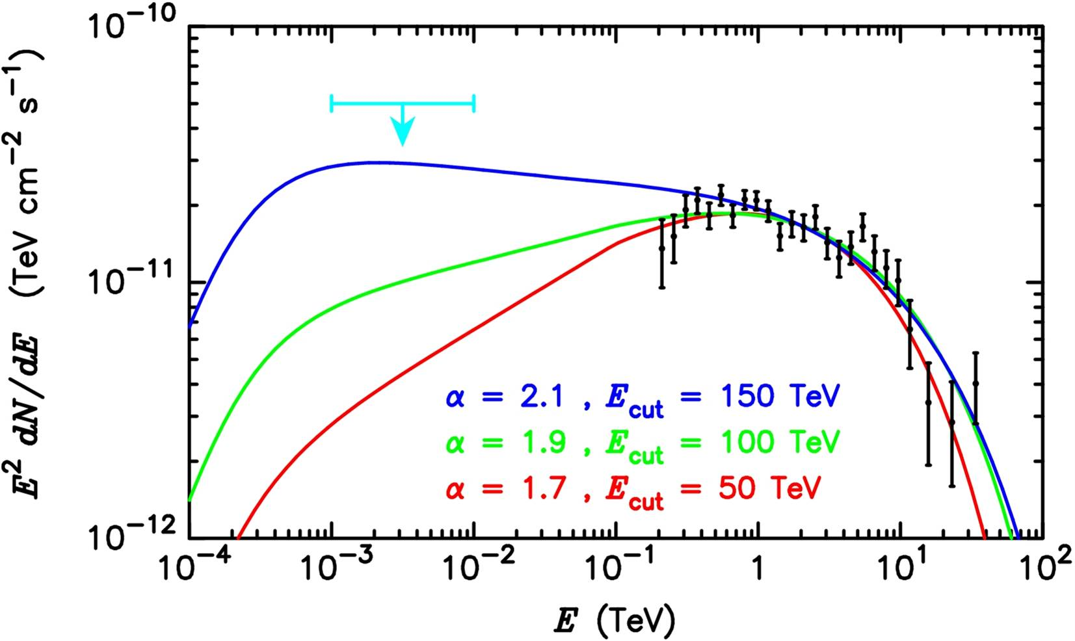
γ-rays from SNR
We have not only detected them, but we can even resolve their morphology.
We can study spatial correlations with other wavelengths, and test dependence on magnetic field intensity and mass density.
However:
γ-rays may also originate through Inverse-Compton emission of electrons/positrons accelerated in the SNR.
We do not have spectra up to the Knee (>100 TeV) to prove that they can generate the CR spectrum.
RXJ1713 (HESS): spatial distribution of TeV spectral indices
RXJ1713:hadronic vs leptonic

Slide 29
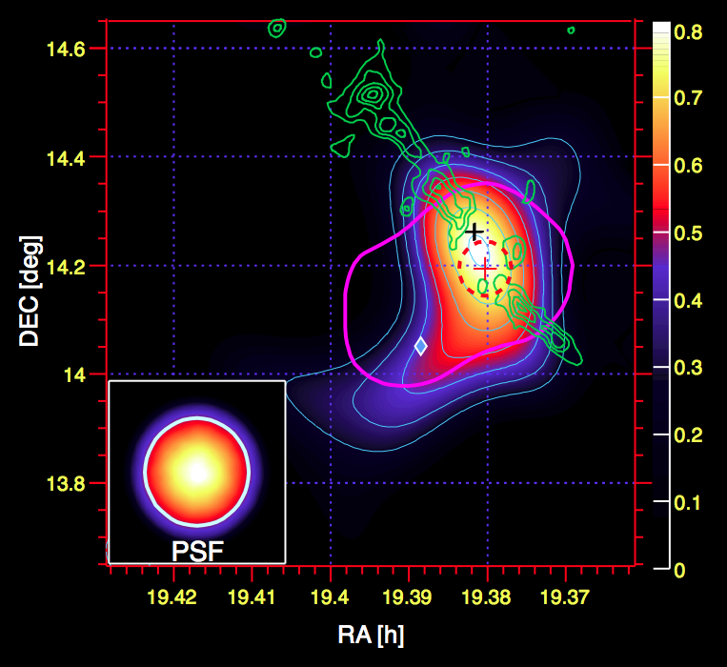
γ-rays from SNR
The situation may improve for SNR which seems to be interacting with nearby molecular clouds.
The cloud increases the mass density and correspondingly the γ-ray emissitivity.
If γ-rays only come from the cloud, they must come from protons, He… and not from electrons.
MAGIC: IC-443
MAGIC: W51
Molecular clouds

Slide 30
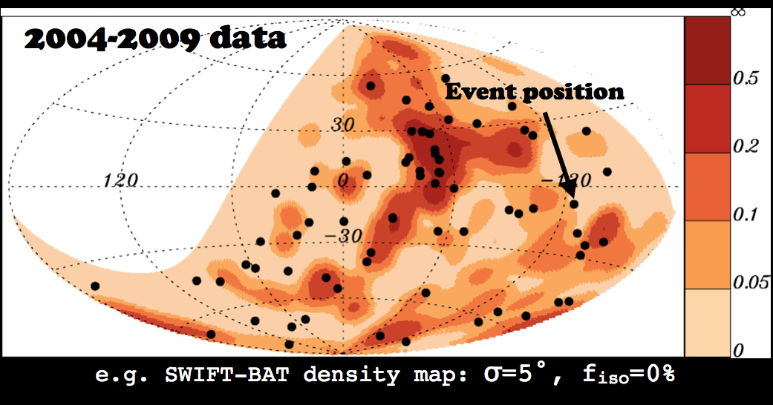
Extragalactic cosmic rays
Above ~10¹⁵ eV CR are of extragalactic origin. Pierre Auger E>10¹⁷ eV.
Unfortunately there is no clear correlation with any source or source population.
Can γ-ray telescopes help to establish their origin? As with SNR, γ-rays are always a by-product of CR interaction with interstellar or intergalactic matter.
Unfortunately: VHE<~10¹⁴ eV very different energy ranges!!
PIERRE AUGER (E~10¹⁹ eV)
AGN

Slide 31
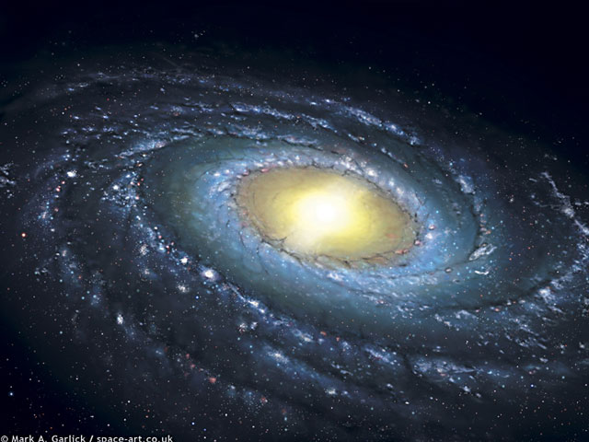
Extragalactic cosmic rays
Nearby normal galaxies
e.g Andromeda=M31:
ρ_{CR} (M31) ~ ρ_{CR} (Milky Way)
➔ Not luminous enough in CRs.
Starburst galaxies
e.g. M82 or NGC253
Extreme star formation:
ρ_{CR} (M82) ~ 500 x ρ_{CR} (Milky Way)
Radiogalaxies
e.g. Cen A or M87
Active galaxies: CR production in jet developing from central Supermassive Black Hole
Clusters of galaxies
e.g. Virgo or Perseus
Accumulated emission of all galaxies or acceleration in large scale shocks.

Slide 32
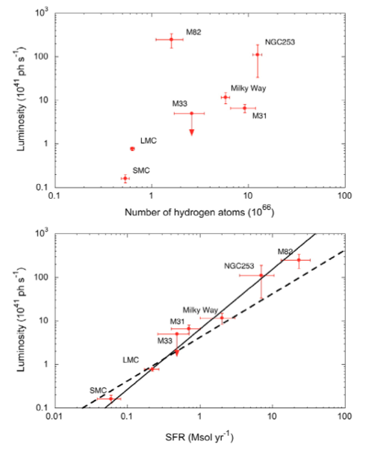
Fermi/LAT: local galaxies
Fermi/LAT has already detected emission from nearby normal galaxies and starbursts.
γ-ray luminosity does not correlate with total mass but with star formation rate (SFR).
SFR probably correlated with rate of SN explosions and CR density.

Slide 33
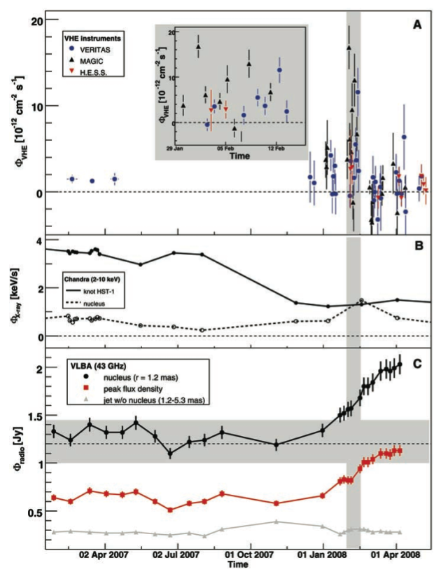
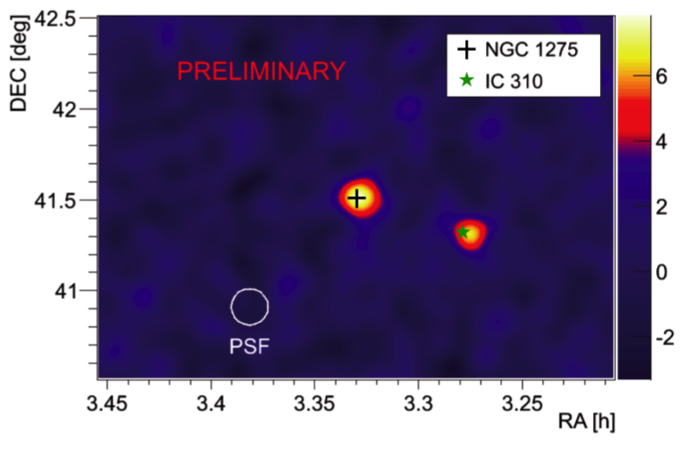
Radiogalaxies
Flare at VHE
IACTs have discovered four radiogalaxies at VHE: Cen-A, M87, NGC 1275 and IC 310.
Emission comes from the jet and is strongly variable: unclear if energy in jet is transported by hadrons and CR may produce the γ-rays.
MAGIC+VERITAS+HESS: Science 325 (2009) 444
MAGIC
Brightening of radio core

Slide 35
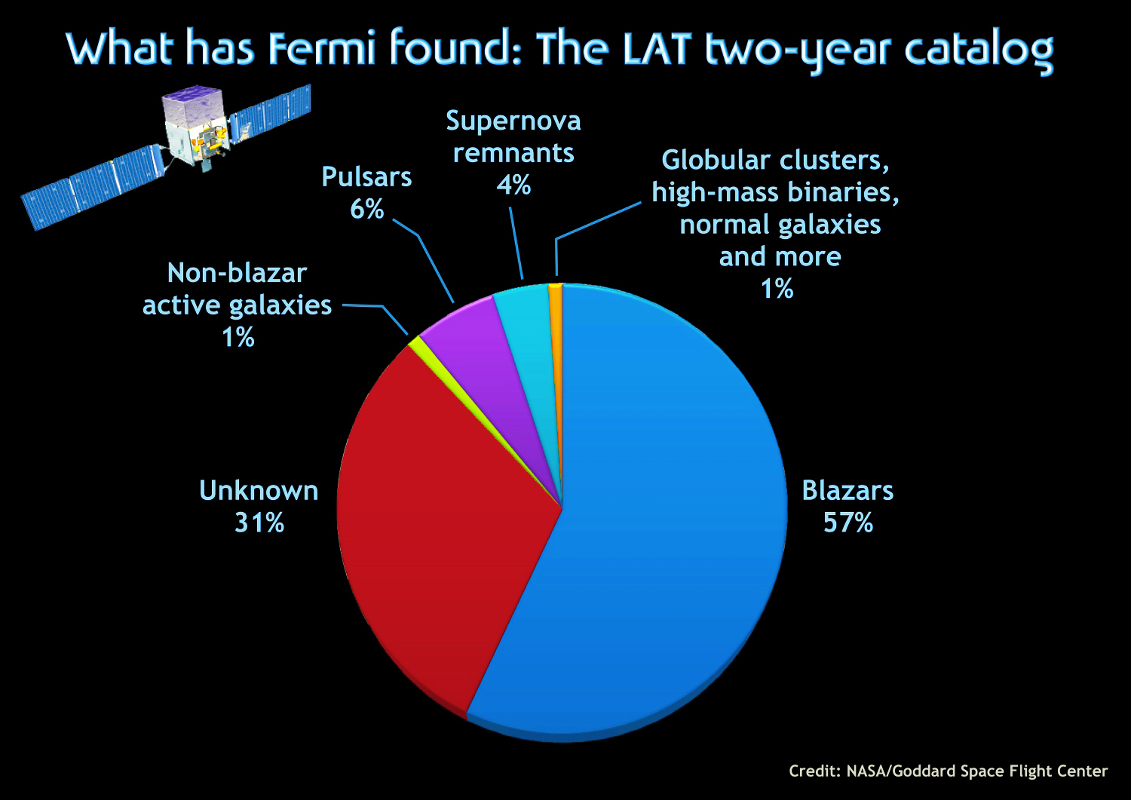
Unidentified Fermi Objects (UFOs)
About half of the sources in the EGRET catalogue were unidentified.
Even after improvement in sensitivity and angular resolution, about 1/3 of the sources in the Fermi/LAT catalogue remain without a counterpart.
Meaning: there is plenty of room for surprises: new sources classes, even dark matter….

Slide 36
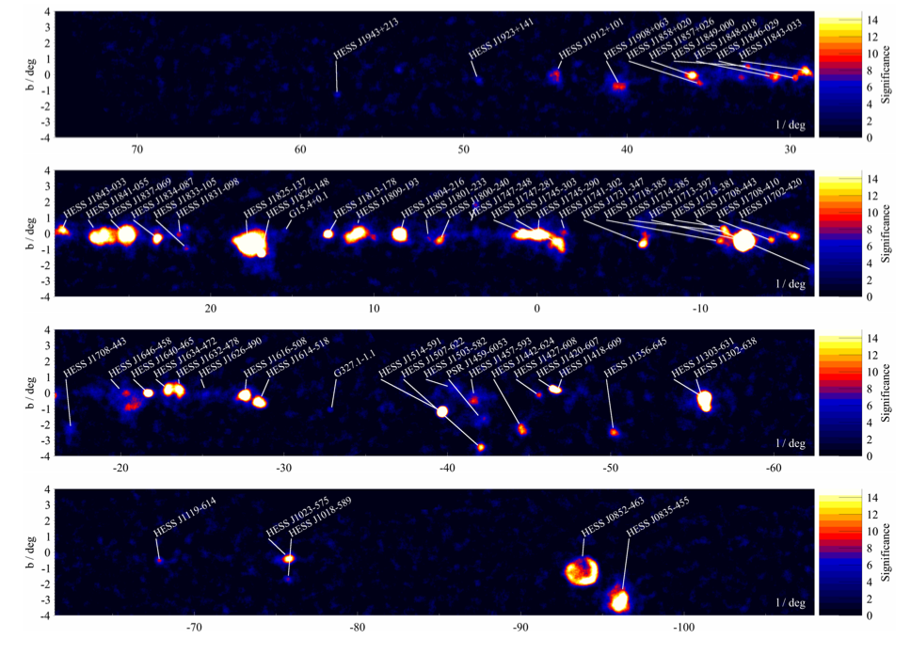
HESS galactic survey
HESS has made the 1st complete scan of the galactic plane at VHE.
About 60 new sources.
Emission dominated by pulsar wind nebulae (PWN).
1/3 of the sources still unidentified.
HESS, ICRC2011

Slide 37
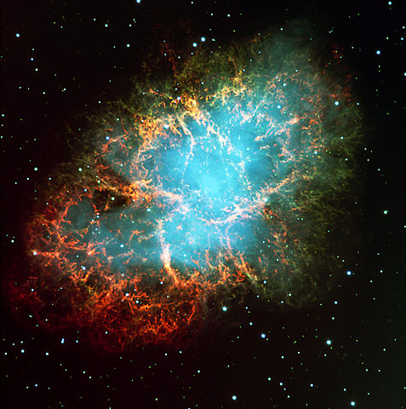
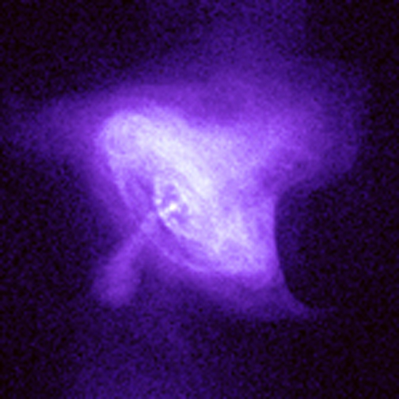
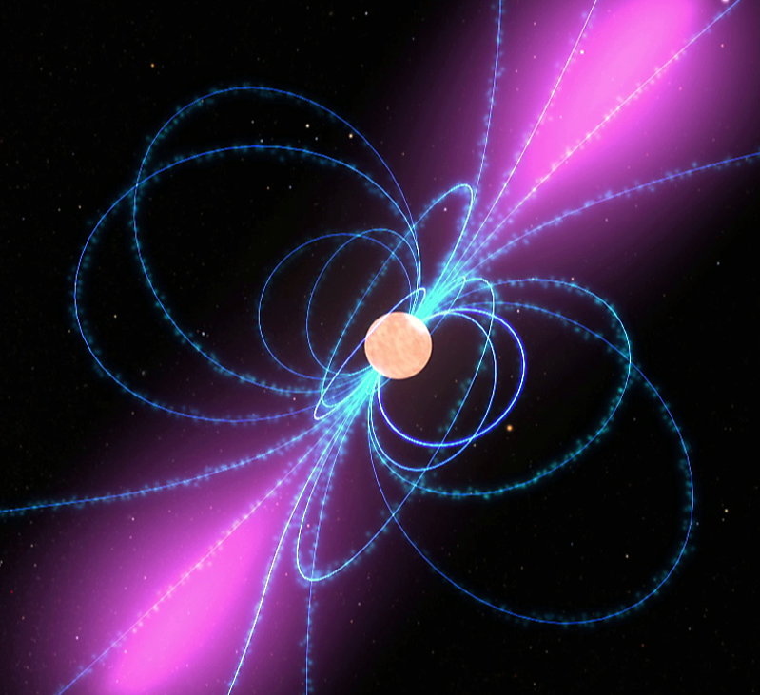
Surprise: pulsars and PWN all over the place
The largest population of sources in the HESS survey are Pulsar Wind Nebula. So what’s a PWN?
1
2
3
Crab Nebula
Optical+X-ray images
X-ray: Chandra
Artist’s view

Slide 38
Surprise: pulsars and PWN all over the place
Pulsars are rotating (P~1-1000 ms) neutron stars with magnetic fields ~10⁸ T.
All phenomena in pulsars are powered by spindown of rotation.
Electric field generated by star’s rotation can accelerate particles up to 10¹² eV.
Pulsar also generates a steady wind of particles+magnetic field which carries away most of pulsar’s power L_{crab}~10³¹ W (Sun’s L=10²⁶ W).
Fermi/LAT has detected hundreds of pulsars up to ~10 GeV.
MAGIC and VERITAS have detected pulsed VHE emission >400 GeV, in contradiction to all existing models. γ-rays may originate from magnetosphere or particle wind.
Magnetosphere:
size ~1000 km
Neutron star:
size ~10 km

Slide 39
Surprise: pulsars and PWN all over the place
The particle wind expands into the surrounding dense medium.
Eventually it generates a shock.
Particles get isotropized and are re-accelerated to energies up to ~100 TeV, with a power law energy distribution.
As many electrons as positrons: may explain results of PAMELA.
e⁺
e⁻
NEBULA
WIND
~0.1 pc
SHOCK

Slide 40
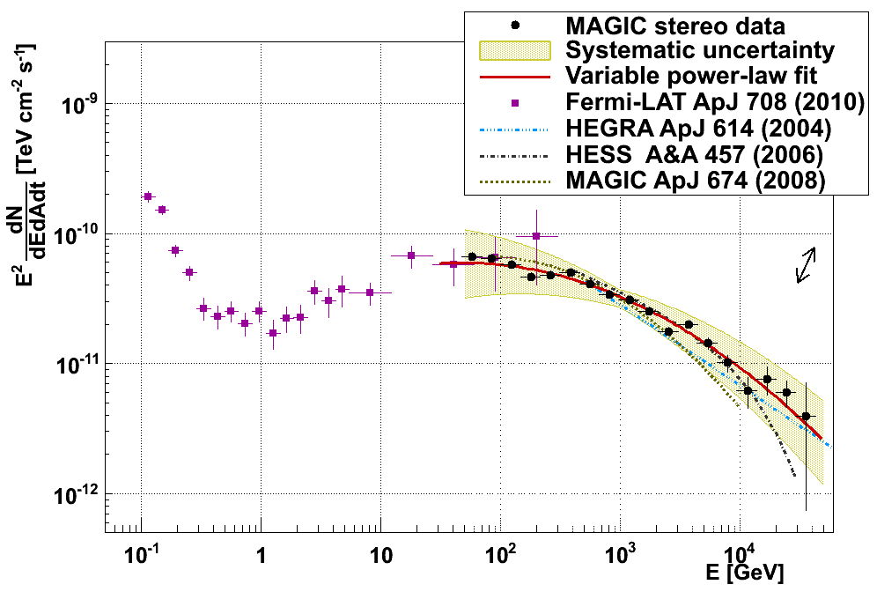
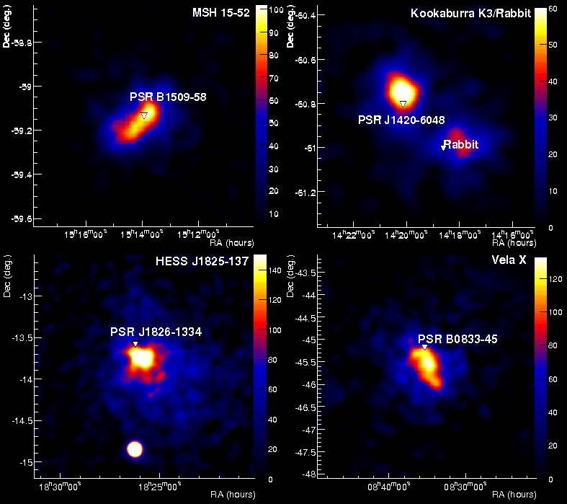
PWN at γ-rays
The emerging particles produce electromagnetic radiation at all wavelengths as they expand into the interstellar medium: PWN.
Electrons generate synchrotron emission up to ~1 MeV energies and Inverse Compton emission up to ~100 TeV (VHE).
More mysterious: Agile and Fermi have reported GeV flares lasting a few days in Crab.
synchr
Fermi+MAGIC
IC
HESS

Slide 41
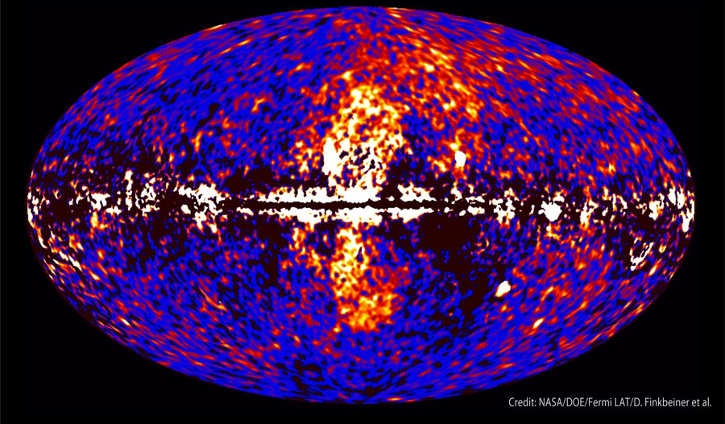
Totally unexpected: huge structure in our galaxy
Su, Slatyer & Finkbeiner, using public Fermi data: two large gamma-ray bubbles, extending 50 degrees above and below the Galactic center, with a width of about 40 degrees in longitude.

Slide 42
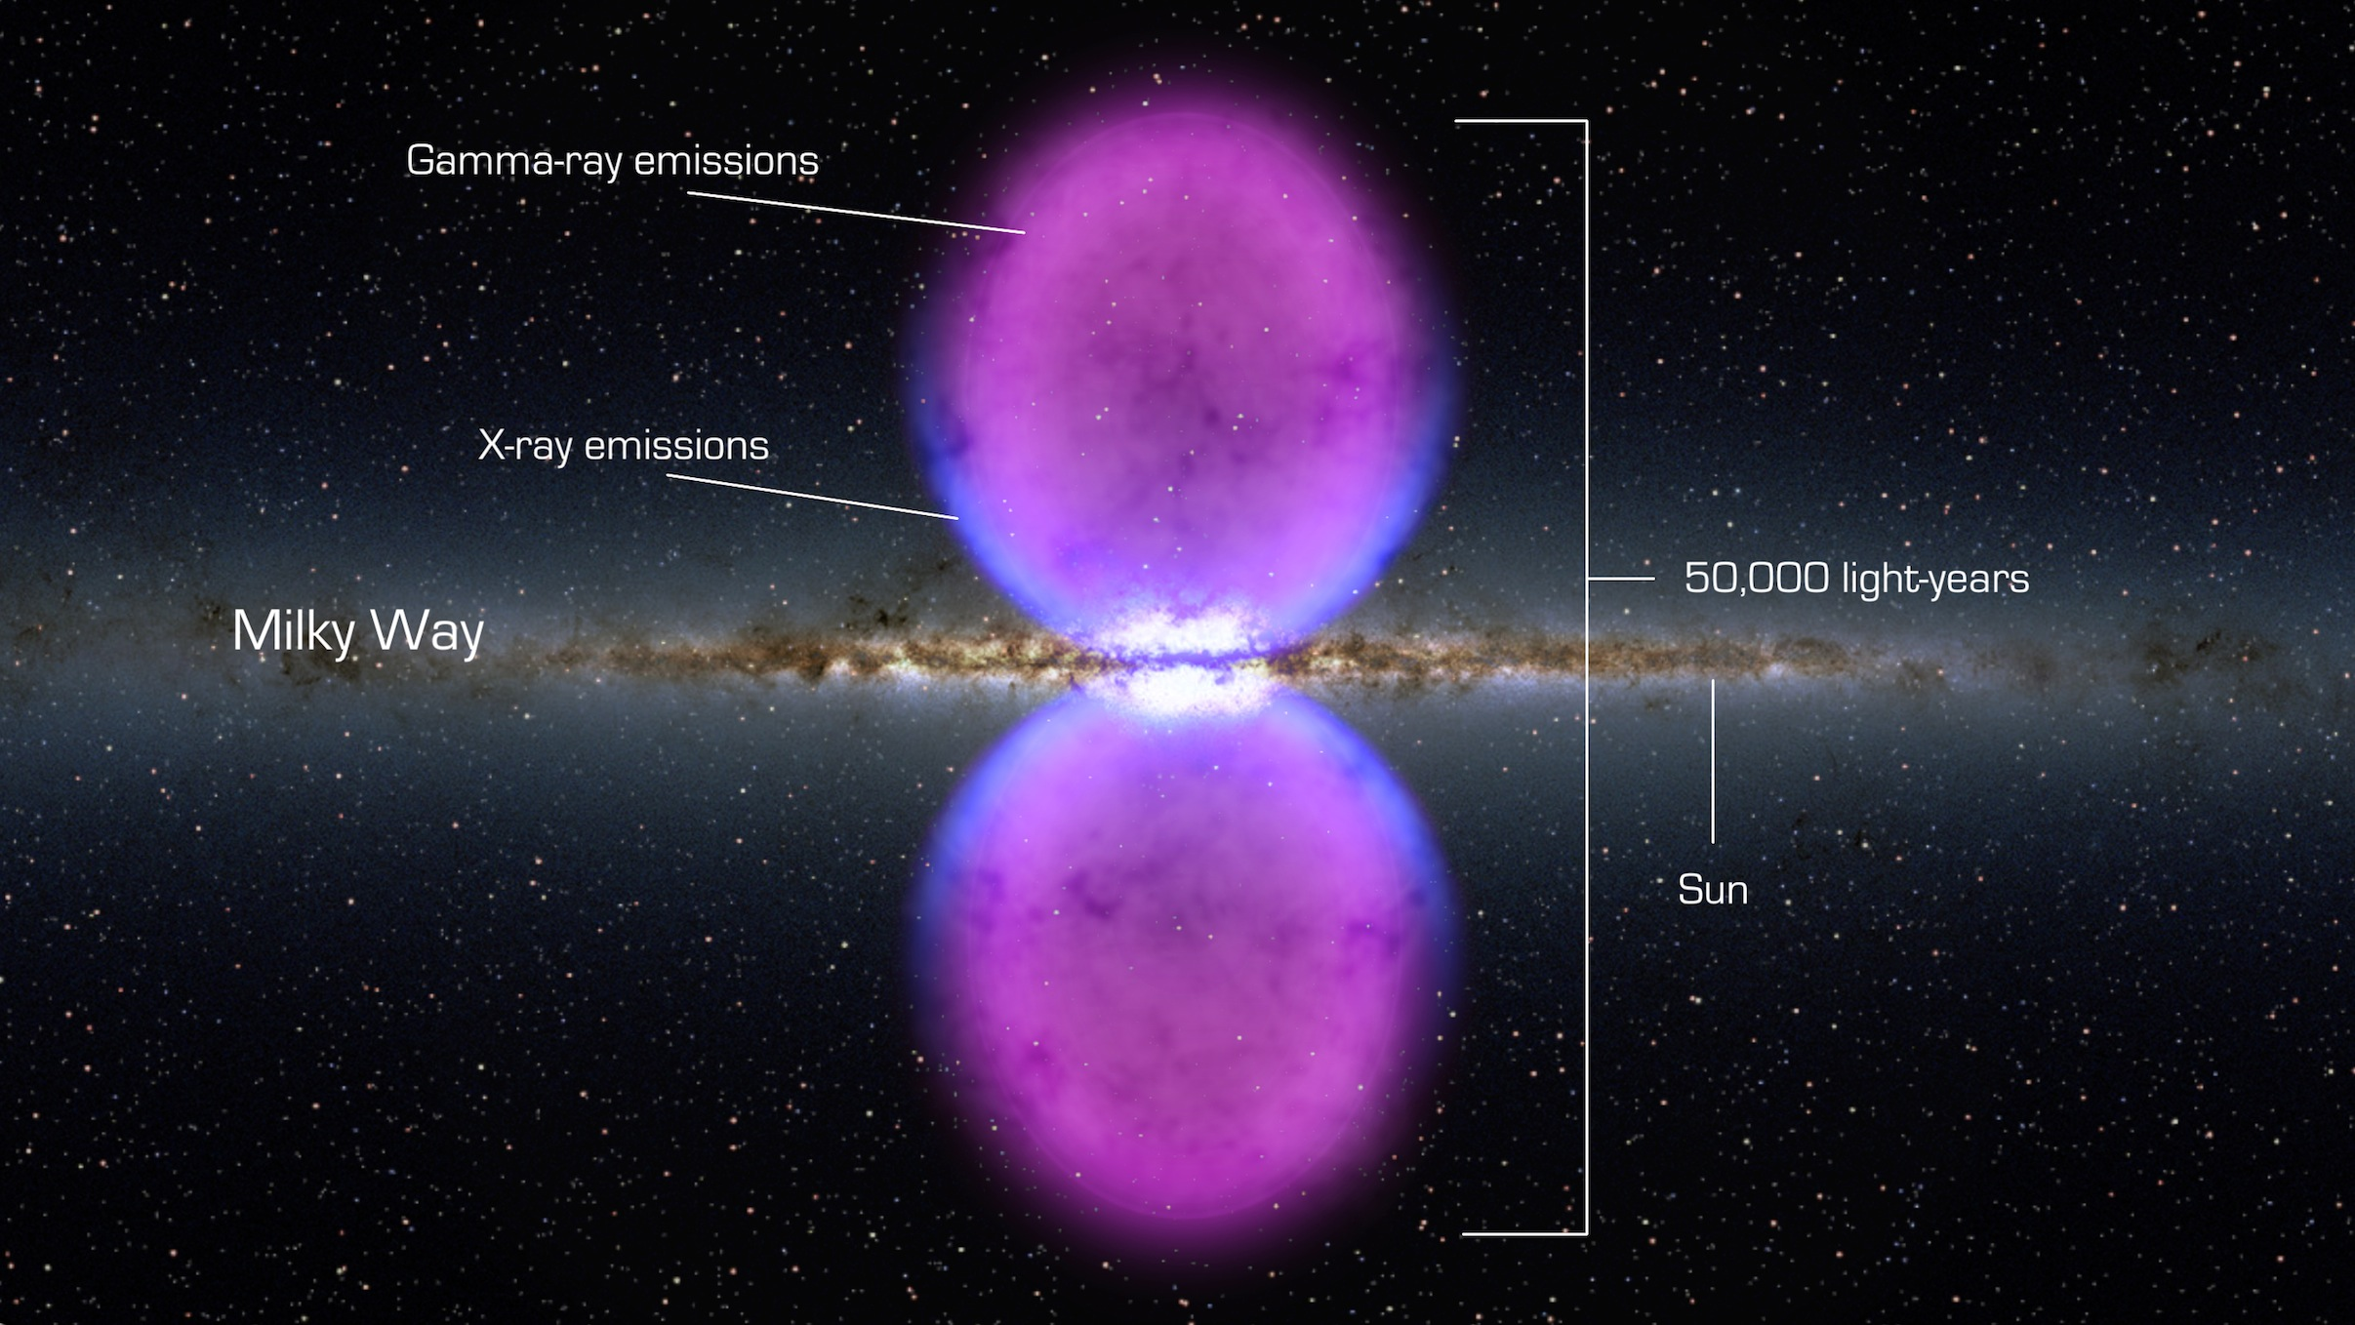
Fermi bubbles
Su, Slatyer & Finkbeiner, using public Fermi data: two large gamma-ray bubbles, extending 50 degrees above and below the Galactic center, with a width of about 40 degrees in longitude.

Slide 43
Totally unexpected: huge structure in our galaxy
γ-ray emission associated with these bubbles has a significantly harder spectrum (dN/dE ∼ E−2) than IC emission from galactic electrons, or γ-rays produced by decay of pions from CR-ISM collisions,
Bubbles are spatially correlated with the hard-spectrum microwave excess known as the “WMAP haze”. Edges are correlated with X-ray emission detected by ROSAT.
May have been created by some large episode of energy injection in the Galactic center, such as past accretion events onto the central massive black hole, or a nuclear starburst in the last ∼ 10 Myr.
Other alternatives: in situ acceleration in shocks at the edge of the bubble, steady wind of particles from galactic center…

Slide 44
Wrap up
γ-rays are the last window to the universe so far: space- and ground-based detectors have consolidated the field during the last 10 years.
Space-based detectors like Agile and Fermi/LAT: high efficiency to remove background and reconstruct g-ray parameters, but limited area. Ground-based IACTs replace them above 30 GeV.
Wealth of discoveries. Just few examples:
Study of cosmic rays through detection of γ-rays in our galaxy and beyond.
Unexpected objects: proliferation of pulsar nebulae, Fermi bubbles.

