Slide 1

Graphene plasmonics: hybrid devices
A. N. Grigorenko
The University of Manchester

Slide 2
Authors:
Manchester: A. K. Geim, K. S. Novoselov, V. G. Kravets, F. Schedin, R. Jalil, L. Britnell, R. V. Gorbachev, D. Ansell, B. Thackray
Cambridge: A. C. Ferrari, T. J. Echtermeyer, P. K. Jasnos, A. Lombardo, E. Lidorikis,
Marseille: A. V. Kabashin
EPSRC, EC FP7 Metachem, Samsung

Slide 3
Talk Overview
Plasmonics
Graphene
Graphene plasmonics
Graphene optics modified by plasmonic nanostructures (SERS and photodetection)
Plasmonic response modified by graphene presence (collective resonances)
Conclusions

Slide 4

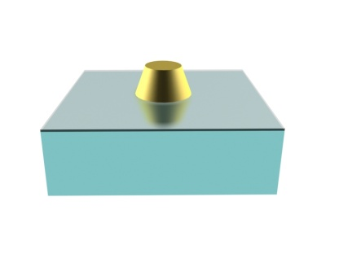
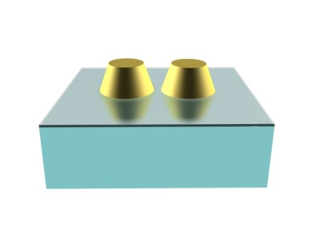
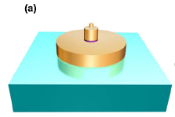
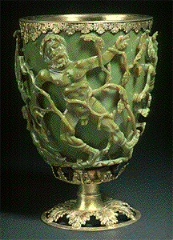
Plasmonics
Light interaction with a structured material that contains electron plasma
Plasmon resonances in the visible light!
Strong near-fields!
What Romans did for us?

Slide 5

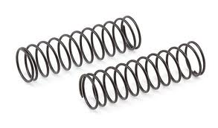
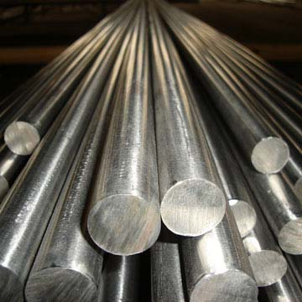
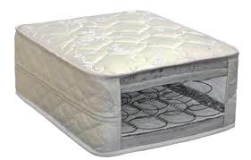
New properties from structuring
Soft spring
Hard Steel
Huge Young modulus
Mattress metamaterial

Slide 6
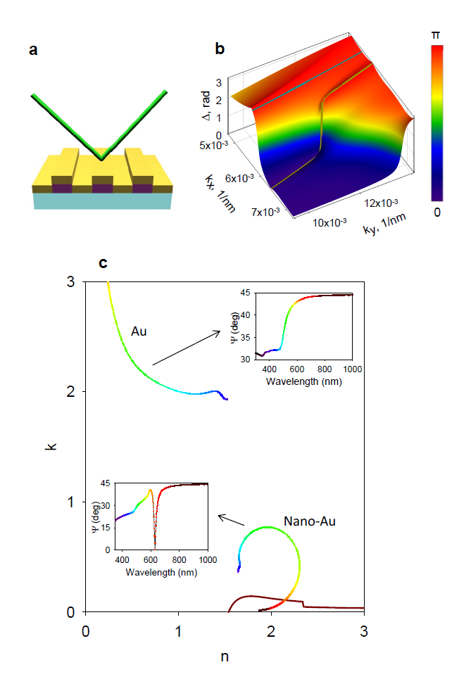
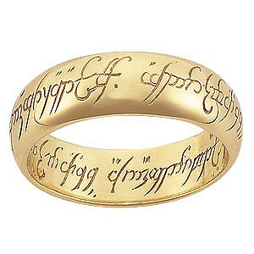
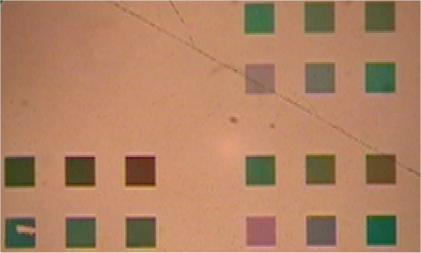
Example: Singular optics from nanostructuring
Phys. Rev. B, 78, 205405, 2008

Slide 7
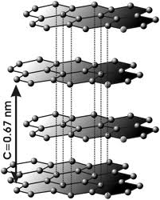
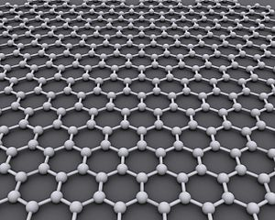
New properties from structuring
Graphene
Graphite

Slide 8
Graphene
Extracted in Manchester!
The strongest
The thinnest
The fastest
The impenetrable
The cheapest
The ...

Slide 9
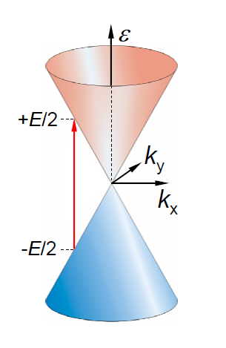
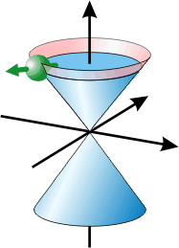
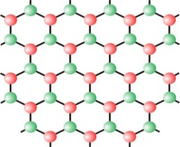
Graphene’s “true colors” in optics
massless
Dirac fermions
Broadband operation
Fast response
Gating using low voltage and power
Small physical signature
monolayer graphene

Slide 10
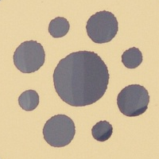
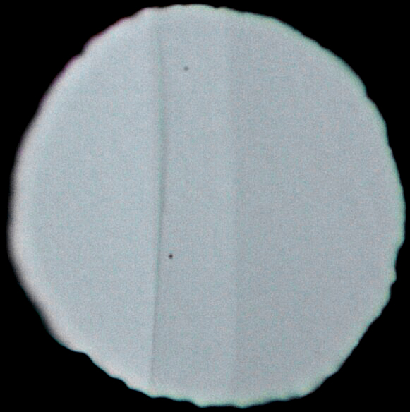
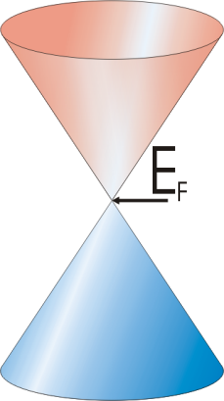
Visualisation of Fine Structure Constant
number of layers
100
1
2
3
4
5
100
graphene
πα
white light transmittance (%)
96
98
bilayer
white light transmittance (%)
πα
air
96
92
0
25
50
88
distance (μm)
the fine structure constant observed
“with a naked eye”
α = 1/137 (±2%)
πα = 3.14.. x 1/137
Manchester, Science ‘08

Slide 11
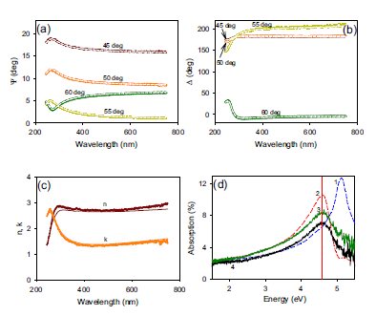
Graphene optics – really grey – except ultraviolet
Problem – the interaction with light is relatively weak – graphene absorbs only 2.3% of visible light
V. G. Kravets et al., Phys. Rev. B 81, 155413 (2010)

Slide 12
To add some colours to graphene:
Graphene Plasmonics
Intrinsic graphene 2D plasmons
Combination of graphene with conventional plasmonic structures with idea to boost both graphene and plasmonics applications.
Reviews:
FHL Koppens, DE Chang, FJ García de Abajo, Nano Lett, 11, 3370-3377 (2011)
Nature Photonics 6, 749–758 (2012)

Slide 13
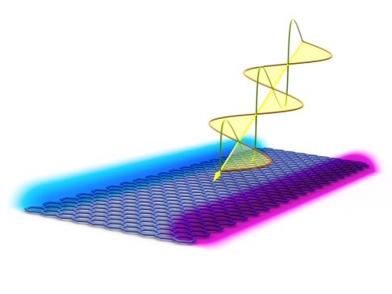
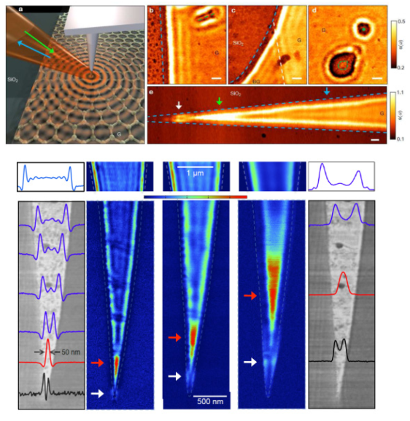
Intrinsic graphene plasmons
Graphene plasmons are fascinating for the following other reasons:
Graphene (Dirac) plasmons can be easily manipulated by gating and structuring;
Strong localization is possible;
the Dirac‐plasmon dispersion is affected by exchange and correlation effects;
it is easy to couple Dirac plasmons to light provided that the momentum mismatch between the latter and the former is compensated by a sufficiently “sharp" object (a periodic pattern, the tip of an AFM probe, a nanoscale defect, etc);
The lifetime of Dirac plasmons is predicted to be much longer than that of plasmons in metals or semiconductors;
Other 2D plasmonic materials are now available (bilayer, trilayer, etc.);
Koppens and Basov groups

Slide 14
Hybrid graphene/plasmonics devices
Non-linear optics – graphene as a reliable “sensor” of electromagnetic fields.
Plasmonics to help graphene – photovoltaics.
Graphene to help plasmonics – “active” and sensing plasmonics.

Slide 15
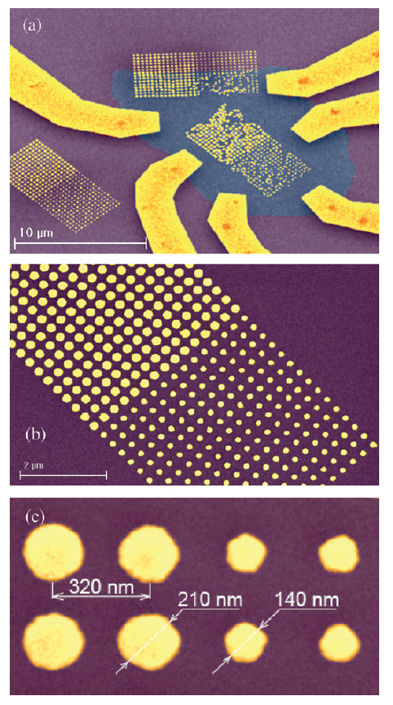
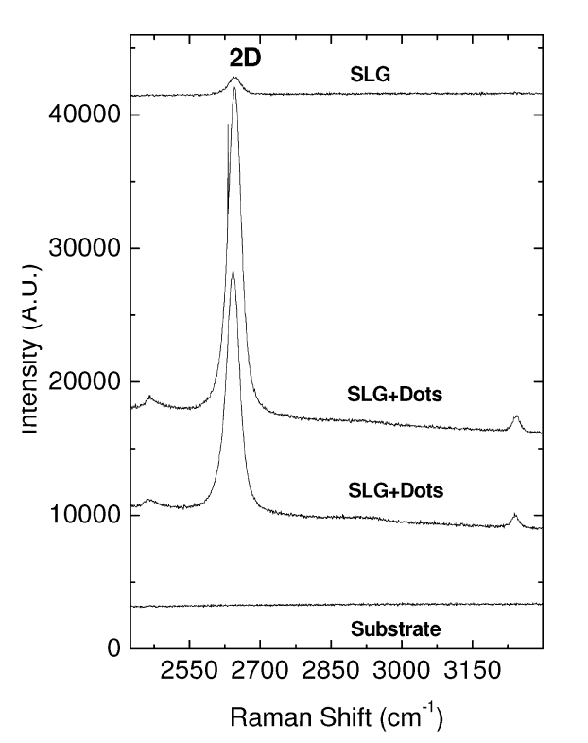

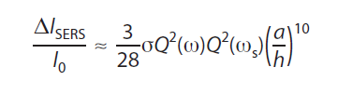
A. Graphene as a tool to measure enhancements of electromagnetic fields
Enhancement of Raman ~30 - just!
Absorption enhancement
Raman enhancement
ACS Nano 4, 5617 (2010).

Slide 16
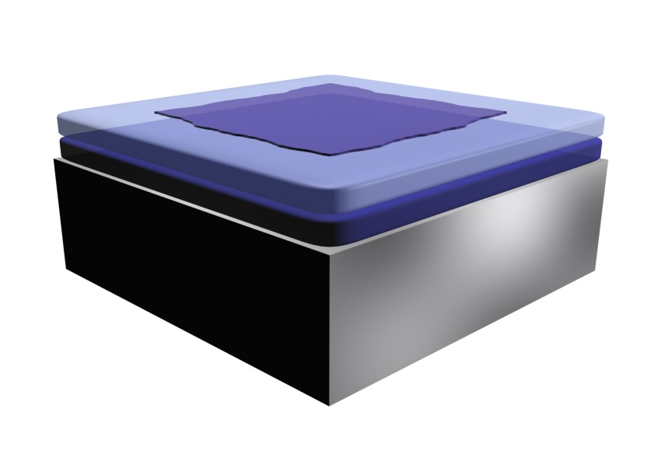
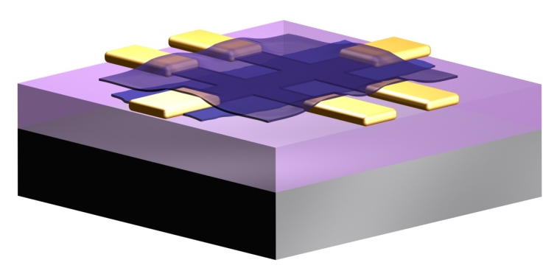
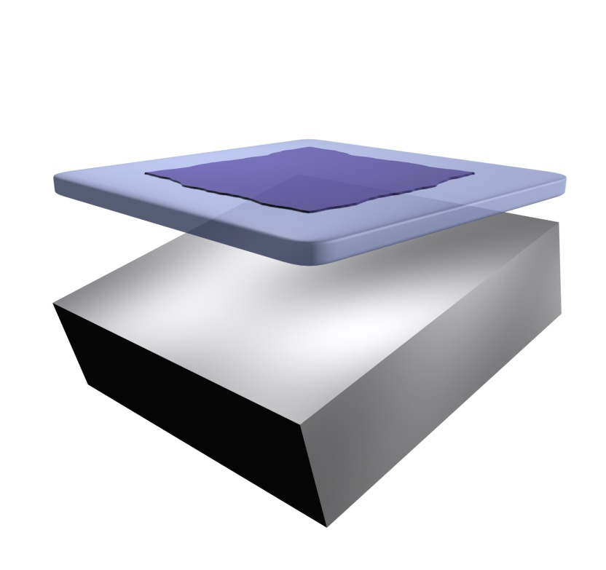
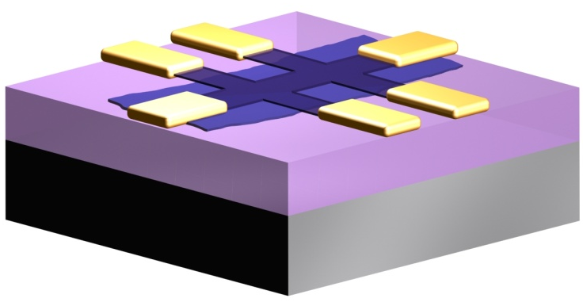
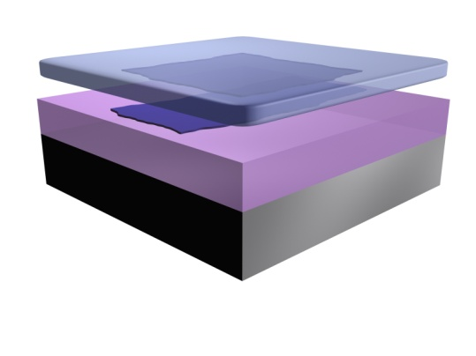
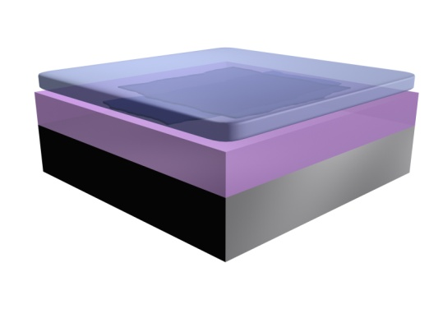
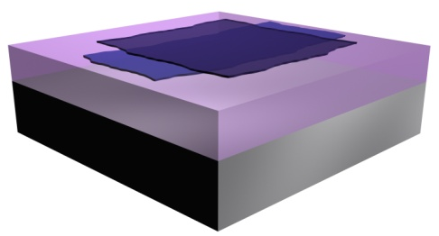
Layered material fabrication - transfer procedure
place another layer of BN on top
remove
sacrificial
layer
REPEAT as many times as you can
develop contacts & mesa
Layer-by-Layer
Material
Engineering
orient graphene
facing down
place on a substrate carrying BN
remove supporting layer

Slide 17
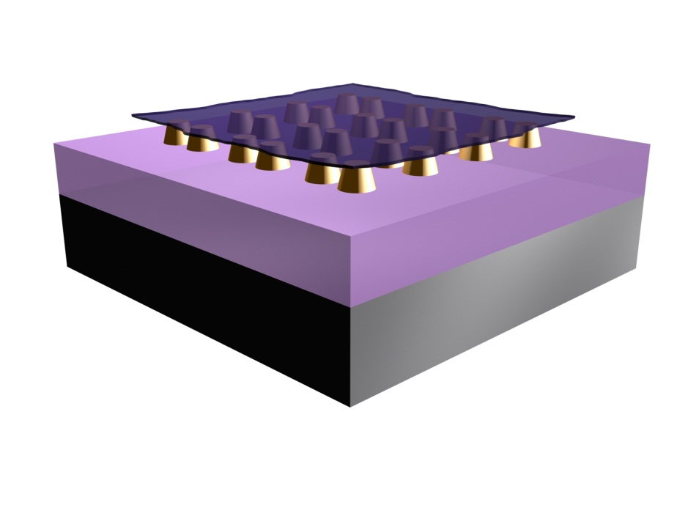
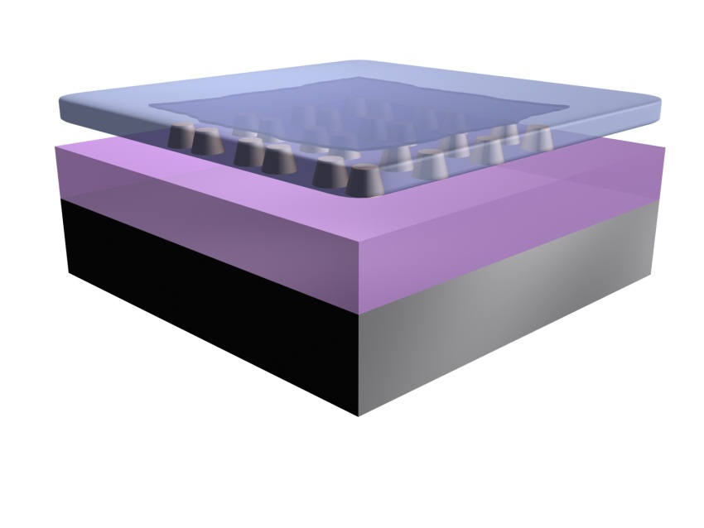
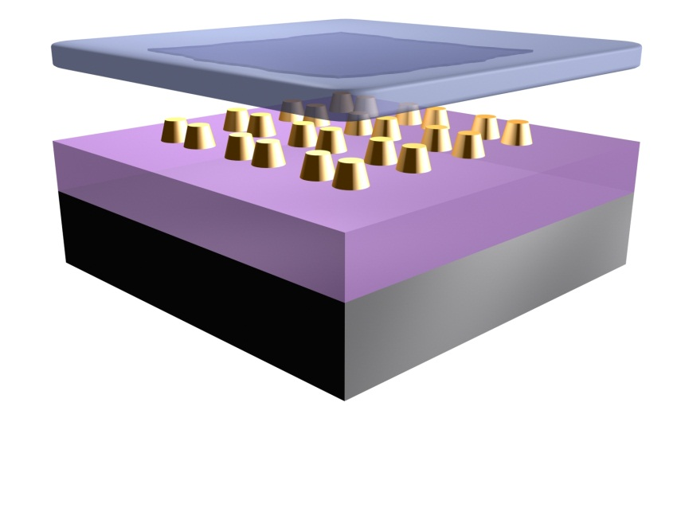
Graphene transfer onto plasmonic nanoarray
remove
sacrificial
layer

Slide 18
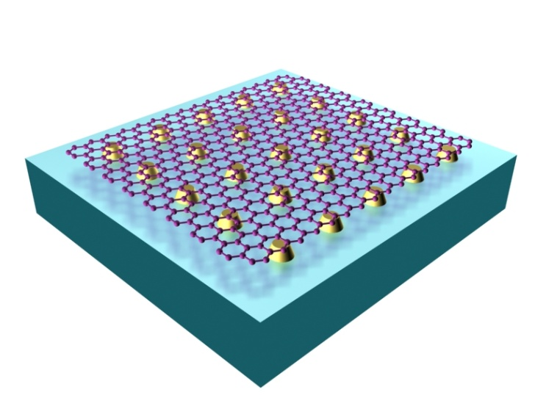
Graphene based plasmonics – graphene on the top
Enhancement of Raman ~1000
J. Phys. Chem. C, 2012, 116 (6), pp 3882–3887

Slide 19
Unusual conclusion
In case of graphene, SERS is described very well by electromagnetic mechanism – maybe because of the simple 2D geometry of graphene sheet!
Hence, graphene can help to quantify field enhancement in composite plasmonic structures!
Graphene could become a test object of choice for studying field amplification in plasmonics.

Slide 20
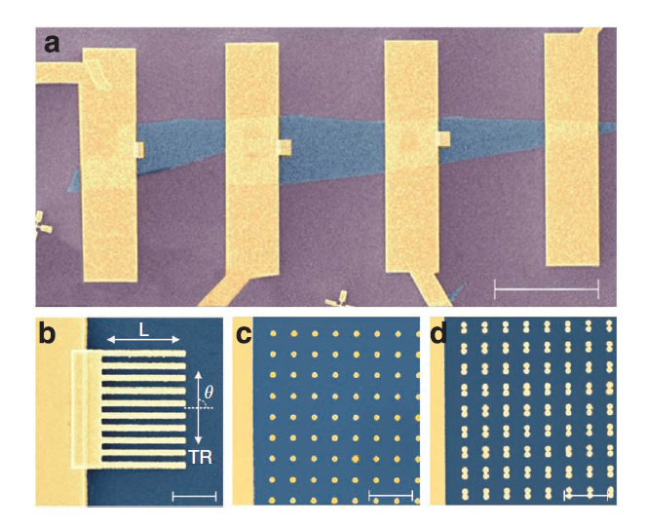
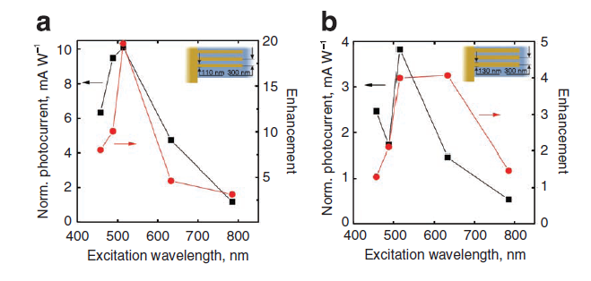
B. Plasmonic enhancement of graphene photo-response
Graphene photo-detectors enhanced by plasmonics
Nature Communications 2, art. no.458 (2011)

Slide 21
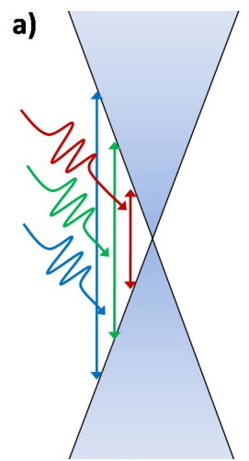
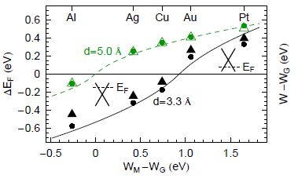
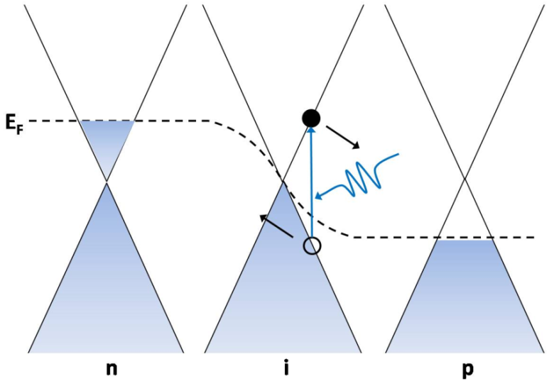
Working principle of graphene photovoltaics
e-h pair creation
e-h separation
Metal-induced doping
Metal
Giovanetti et. al., Phys. Rev. Lett. 101, 026803 (2008).

Slide 22
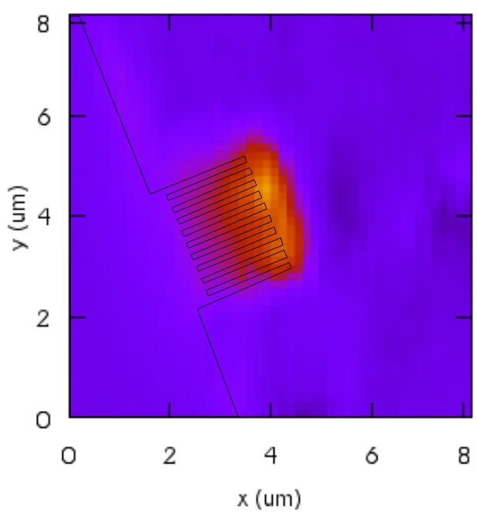
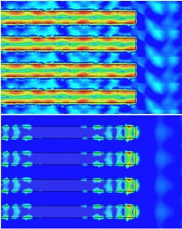
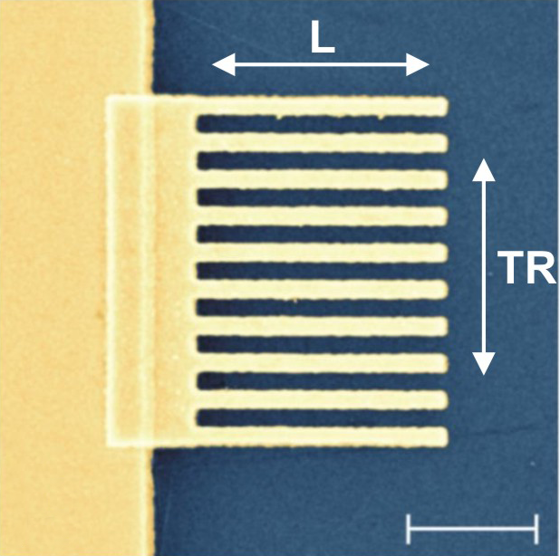
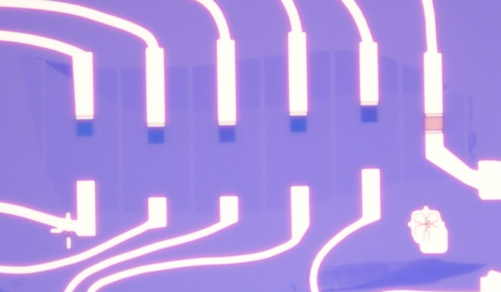
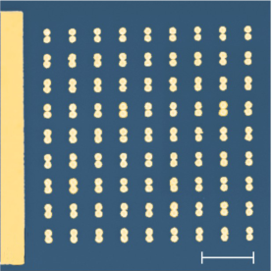
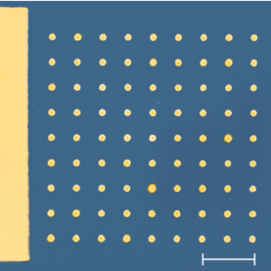

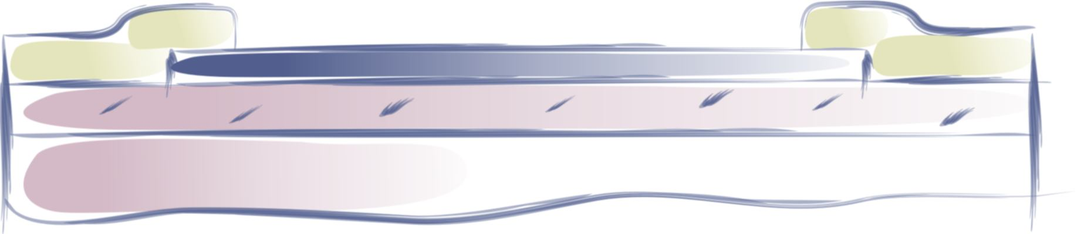
Graphene Photovoltaics
Marry Graphene & Plasmonics
Photovoltage, 633nm
Contacts
Enhancement : x20
Can be illuminated by flood light

Slide 23
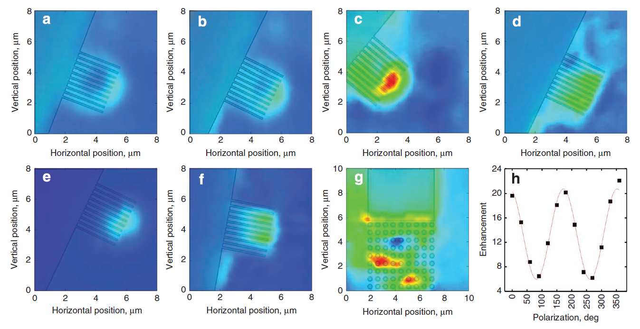
Graphene-plasmonic photocells
(a)-(f) Wavelength dependence 457nm-785nm

Slide 24
Details of photoconversion
Not clear yet!
thermoelectric effects have been demonstrated in direct measurements of the symmetry of six‐fold photovoltage patterns as a function of bottom‐ and topgate voltages: at low temperatures nonlocal hot carrier transport dominates the intrinsic photoresponse in plain graphene with non‐structured electrodes
Gabor et al. Science 334, 648 (2011).

Slide 25
Another open question - resistive coupling of plasmonic resonances
Graphene allows resistive coupling of plasmonic resonances – active plasmonics?
E
E
j
-
+
-
+
-
+
-
+

Slide 26
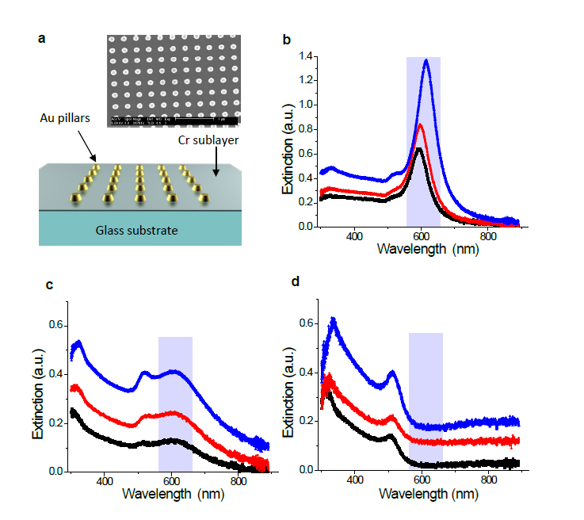
Nanoparticles on a conducting sub-layer
No sublayer
5nm Ti sublayer
5nm Cr sublayer
Nature Communications, vol. 3, 640, 2012.

Slide 27
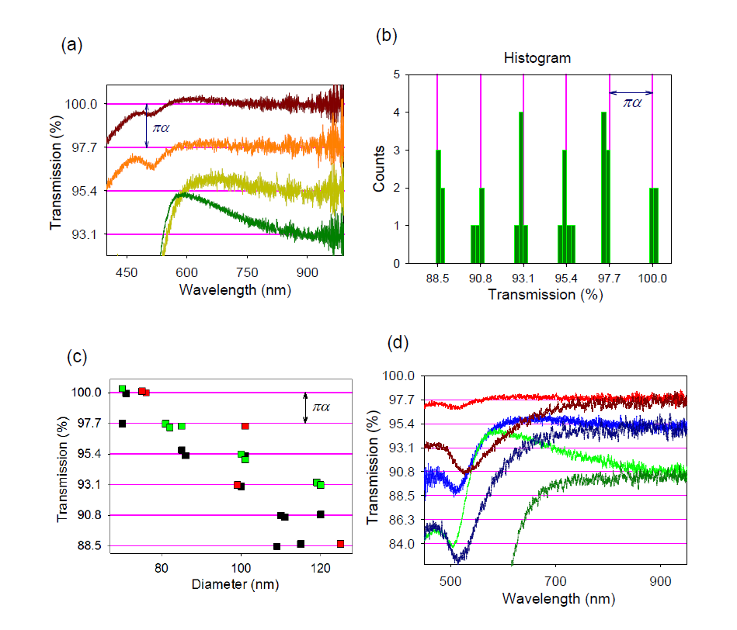
Nanoparticles on a conducting sub-layer
Size dependence
Ambient medium
Nature Communications, vol. 3, 640, 2012.

Slide 28


Graphene Photovoltaics – future directions
Vertical geometry – Novoselov et al.
Other 2D materials for charge separation.
Optimization of plasmonic elements.
Broadband emitters.

Slide 29
C. Graphene to help plasmonics
Holy Grail: active graphene based plasmonics (small, cheap, fast, low power consumption, etc.)
Problems:
Gating difficult to arrange (to much metal around)
Graphene doping by metal.
Graphene ripples, bubbles, etc.

Slide 30
Example: graphene affecting optical properties of plasmonic elements
Diffractive coupled plasmonic resonances = aka geometric resonances = aka collective plasmon resonances
1
0-order
2
-1
When a diffracted mode becomes grazing – it sees a lot of gold – should demonstrate strong absorption (Wood, Rayleigh, Markel, Schatz)

Slide 31


Diffractive coupled resonances
Phys. Rev. Lett., vol. 101, 087403, 2008.

Slide 32

Diffractive coupled resonances can result in huge phase sensitivity!
Opt. Lett. 35, 956 (2010)
Optics Express, vol. 17, No. 23, 21191-21204, 2009.

Slide 33

Darkness = phase sensitivity!
Appl. Phys. Lett. 75, 3917 (1999)

Slide 34


Huge phase sensitivity is connected to singular optics
Nye, J. F. & Berry, M. V., Dislocations in Wave Trains. Proceedings of the Royal Society of London. A. Mathematical and Physical Sciences 336, 165-190 (1974)
E=0 phase is not defined!
Phase is atan(y/x)

Slide 35


Singular Optics
Photons with J>1 – Requires E=0 – points (lines) of darkness

Slide 36


Singular Optics – Topological Darkness from structured metal
Reflection=0
a
b
Natural materials do not like this region
Nature Materials (2013) doi:10.1038/nmat3537

Slide 37

Singular Optics – Topological Darkness
Ag

Slide 38
Topological Darkness
Exists even for extremely thin subwavelength layers.
The point of zero reflection is topologically protected owing to the Jordan curve theorem.
Topologically stable under small imperfections in structure.

Slide 39
Use transfer procedure to create hybrid devices
remove
sacrificial
layer

Slide 40


Graphene modified plasmonics
J. Phys. Chem. C, 2012, 116 (6), pp 3882–3887

Slide 41

Graphene modified plasmonics - surface chemistry of graphene
To modify graphene properties we used graphene hydrogenation by atomic H produced by hydrogen plasma exposure.
Hydrogenation changes graphene conductivity and dielectric constants
Hydrogenation can be monitored using Raman

Slide 42


Graphene hydrogenation studied by collective resonances
J. Phys. Chem. C, 2012, 116 (6), pp 3882–3887

Slide 43

Graphene hydrogenation
1% hydrogenation
mass density of <1 pg/mm²
was detected!
the areal mass phase sensitivity could be better than 0.1 fg/mm²
This corresponds to just ~10 H atoms per one nanodot!
Nature Materials (2013) doi:10.1038/nmat3537

Slide 44
Sensitivity comparison
Localized plasmons – areal sensitivity 1000 pg/mm²
Surface Plasmon Resonance – areal sensitivity 1 pg/mm²
Phase sensitive nano-optics – areal sensitivity 0.1 fg/mm²
Due to the well defined 2D geometry and possibility to monitor hydrogenation ratio using Raman, graphene could become a test object of choice for studying areal mass sensitivity in plasmonic nano-sensors!

Slide 45



Biosensing
Streptavidin
Biotin
Nature Materials (2013) doi:10.1038/nmat3537

Slide 46
Biosensing - sensitivity
Experimental sensitivity of 1-4 molecules per nanodot. We used Biotin-Streptavidin pair with the size of detected Streptavidin 60 kDa – Hydrogen is just 1 Da, for comparison.
Sensitivity limit for biosensing: attachment of 1 Streptavidin molecule per ~300 nanodots (areal sensitivity of 1 fg/mm²)
We are close to single molecule detection using optical transduction!

Slide 47
Conclusion
Graphene plasmonics is not that grey!
Graphene can benefit from plasmonic nanostructures - SERS and photodetection.
Graphene can be a test object for measuring electromagnetic field enhancement in plasmonic nanostructures .
Graphene chemistry can be used to calibrate plasmonic nanosensors.
Future of hybrid graphene/plasmonics devices : vertical geometry, graphene derivatives, active optical elements.
Thank you for your attention!

