Slide 1

Searches for Supersymmetry at hadron colliders
SUPER
Monica D’Onofrio,
University of Liverpool
TAE School, Spain, 25/09/2013

Slide 2
Outline
Part I : Searching for SUSY at the LHC: main ingredients
  Targeted models and search strategy
  Objects definition and trigger selections
  Discriminating SUSY signal from SM background
  Estimate of SM background
  Systematic uncertainties
  Results and their interpretation
Part II: SUSY results so far (an overview) and prospects
  Recent results on R-parity conserving scenarios
    Inclusive sq/gl production
    Third generation squarks and natural scenarios
    EWK production
  R-parity violating scenarios and long-Lived particles
  Prospects and concluding remarks
Disclaimer: ATLAS bias !
Thanks: to many people who gave great lectures in the past (in particular A. Hoecker, P. Pralavorio)

Slide 3

PART I
main ingredients

Slide 4
SUSY: a lot of new particles!
As you have seen from Michael’s talk
  Particles spectrum more than doubled even in the minimal extension of the SM (MSSM, 105 new parameters)
SM
SUSY
Spin 0 | Spin 1/2 | Spin 1
 | l
 | q
h ⁰, H ⁰, A⁰, H ±
 |  | γ, Z ⁰, W ±
 |  | g_{a}
Phenomenology depends on breaking mechanism and R-parity conservation
Breaking SUSY. Ie:
  mSUGRA
  Gauge Mediated SB
  Anomalous Med SB
Eigenstates of mass
R-parity = (-1)^{3(B-L)+2s}
(R = 1 for SM particles, -1 for MSSM partners)
  concentrate on SUSY scenarios that lead to particles
  in the GeV – 1 TeV range (Weak scale SUSY)

Slide 5
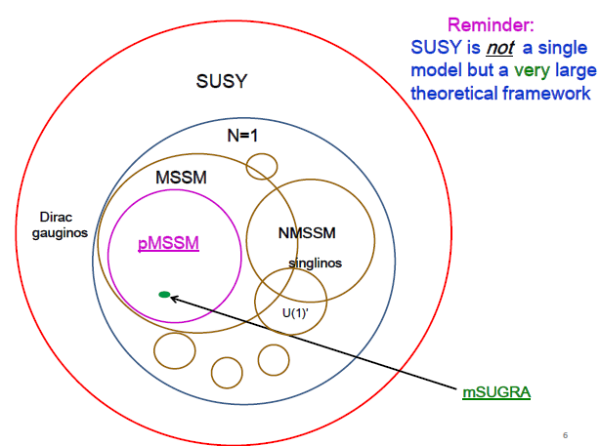
Many SUSY models
Still, a lot to consider:
  Hint: various scenarios come with interesting features that can be exploited …
T.Rizzo
+
Split SUSY
AMSB
Stealth (hidden) SUSY
… and others

Slide 6
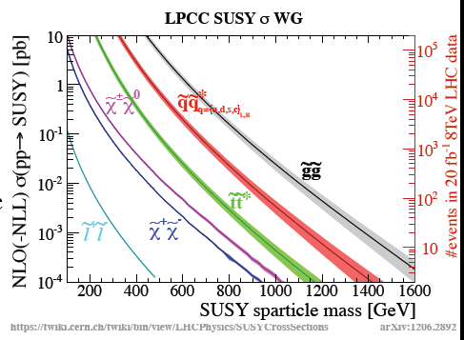
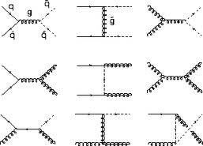

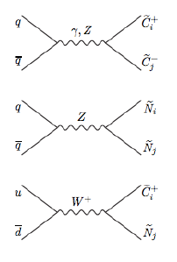
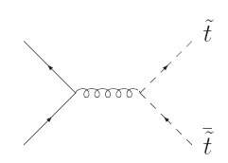


SUSY production
Most of the time, assume R-parity conserved at production:
  Sparticles are paired produced at the LHC
Gluinos and 1st, 2nd generation squarks:
high cross section up to > 1 TeV mass
Top and bottom squarks
moderate cross section up to ~0.5 TeV
Charginos, neutralinos, sleptons:
small cross section, feasible with current dataset

Slide 7
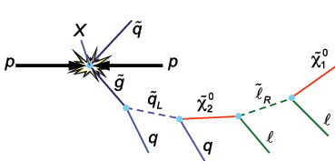
IF: R-parity conservation at decays
RPC at decays:
  LSP (=lightest SUSY particle) is stable, missing transverse momentum due to undetected sparticles
  Possibly complex decay chain
    Leptons, jets, b-jets for strong production
    Mostly leptons for weak production
  Need guidance on mass ranges
If GMSB/GGM:
Missing Transverse Energy
or stau NLSP
Jets

Slide 8

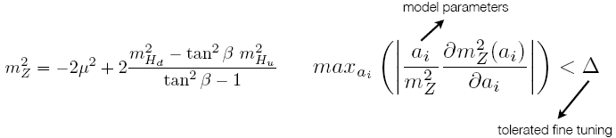
Guiding principle: the need of fine tuning
How arbitrary can sparticle masses be?
Some of the sparticles must be ‘light’ for the higgs mass to be at O(100 GeV)
Fine tuning → quantified in terms of stability of EWK scale (MZ) wrt model parameters (NP B306(1987))
Low level of fine tuning → Natural scenarios
Relevant parameters a_{i}:
μ (higgs mass parameter) → enters at tree level → higgsino masses
A_{t}, M_{Q3}, M_{u3} → related to stop masses
M₃ → gluino masses (entering at second order via stop mass corrections)

Slide 9
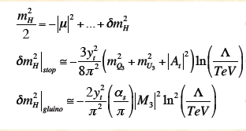
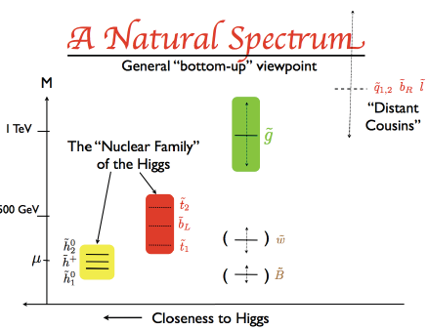
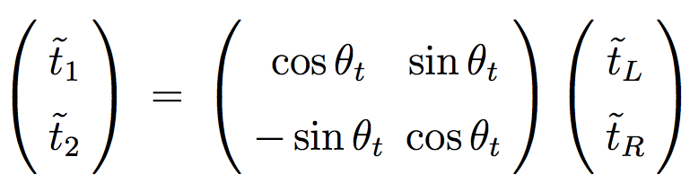
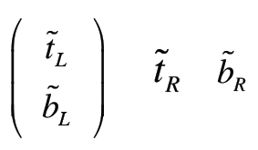
Naturalness
A closer look to the various terms:
Light higgsinos
Light stop (t1 < 1 TeV)
Light gluinos (< 1-2 TeV)
light stops
often light t1
imply light b_{L} (same
weak isospin multiplet as t_{L})
Other Sparticles can be ‘decoupled’
L. Hall (LBL Workshop, 21-Oct11)

Slide 10
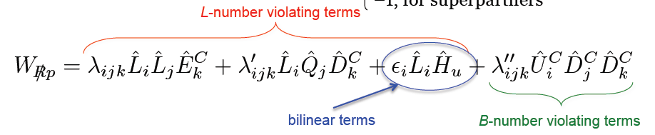
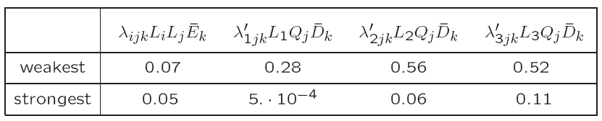
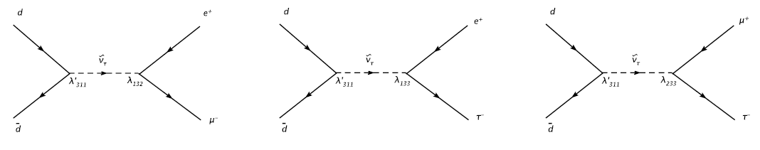
IF: R-parity violation at decays
R-parity might be not conserved in sparticles decays (*)
→ different terms, couplings constraint by proton decay
ΔL =1, 9 λ couplings, 27 λ’ couplings
Plethora of new couplings, only partially constraints (m/100 GeV)
(*) in some cases, also look at RPV at production: ie sneutrinos in eμ, eτ, μτ
λ₁₃₂
λ’₁₃₃
λ’₂₃₃
λ’₃₁₁
eμ
eτ
μτ

Slide 11
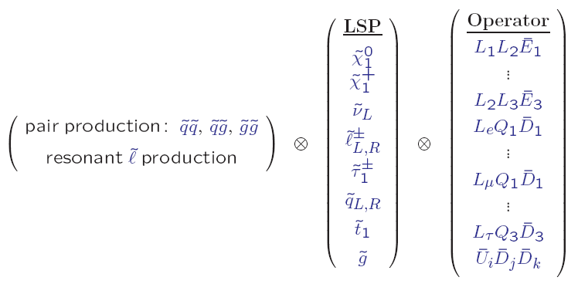
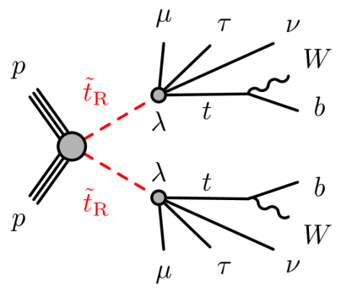
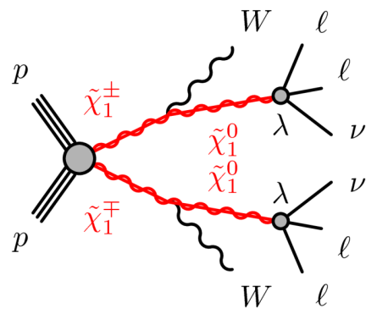
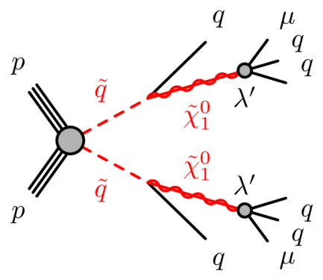
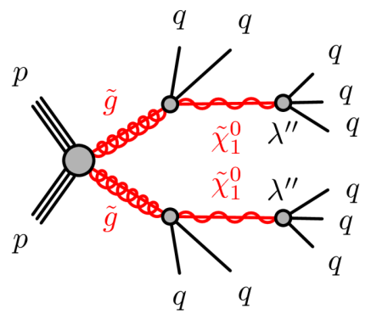
RPV scenarios
Many final states to explore:
  Couplings via λ, λ’,λ’’. Ie:
  LSP no longer stable
  Something like > 700 possibilities, final state signatures involving leptons and/or jets
  If λ, λ’,λ’’ very small, can lead to long-lived LSP
Multilepton production (including taus)
Multijets, possibly resonances (ie 2 x 3 jets)

Slide 12
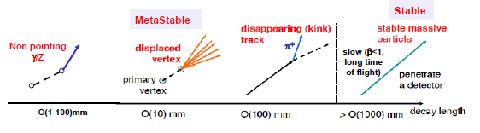
IF: (s)particles are Long-Lived
Long-lived (LL) particles in RPV and RPC scenarios:
  In RPV: if lambda couplings are very small
  In RPC: If ΔΜ(chargino-neutralino) ≈ 100 MeV (eg. in AMSB):
    Long-lived charginos → disappearing tracks
  In RPC: If very heavy squarks mediate gluinos decay (strong virtuality ):
    Long-lived gluinos → R-hadrons (eg. Split SUSY)
  In RPC: If NLSP-gravitino GMSB couplings are weak:
    Non pointing photons or Z; long-lived sleptons
To be noticed: Several new physics models could give raise to new, massive particles with long-lifetime!

Slide 13
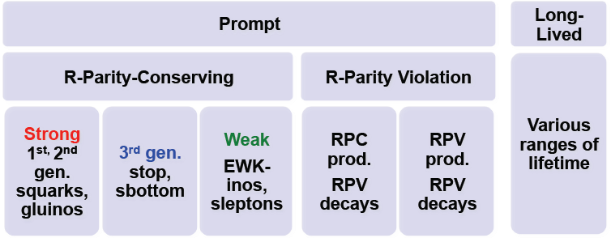
SUSY search strategy
→ Search strategy designed to provide coverage for a broad class of SUSY models
For each search, a number of signal regions is optimized based on a variety of models

Slide 14
Models for optimization
“full” physics models:
  SUSY breaking model @ high scale: non degenerate spectrum at EWK scale → (Higgs aware) mSUGRA, GMSB, AMSB etc.
generalized models:
  parameters @ EWK scale: spectrum at EWK scale
  pMSSM, General Gauge Mediated
simplified models:
  described by a minimal set of parameters including the particle masses and the production cross sections
  Most models assume sparticle BR=100% to final state of interest

Slide 15
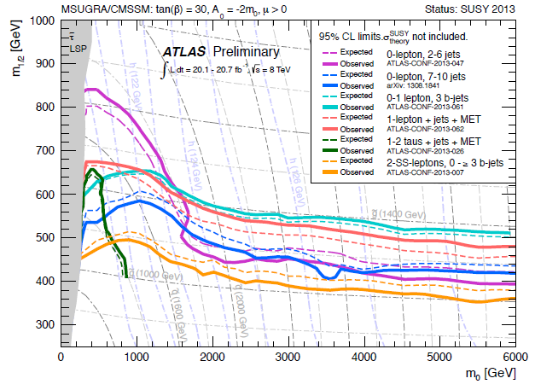
Example: mSUGRA
As a function of m0 and m1/2
  m0 = mass of the scalar at unification scale (GUT); m1/2 = mass of the gauginos at GUT
tan(β) = 30, A₀ = -2m₀, μ > 0
  Ratio of the higgs vacuum expectation values, trilinear couplings, sign of Higgs mass term
Various analyses might be
sensitive in different regions
Masses and decays very dependent on the choice of parameters
m(squarks)
m(higgs)
m(gluinos)
Useful to calibrate our exclusion and compare with other results

Slide 16
Models for optimization
“full” physics models:
  SUSY breaking model @ high scale: non degenerate spectrum at EWK scale → (Higgs aware) mSUGRA, GMSB, AMSB etc.
generalized models:
  parameters @ EWK scale: spectrum at EWK scale
  pMSSM, General Gauge Mediated
simplified models:
  described by a minimal set of parameters including the particle masses and the production cross sections
  Most models assume sparticle BR=100% to final state of interest

Slide 17
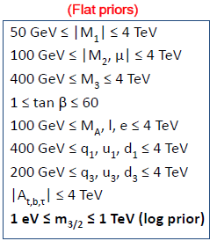
Example: pMSSM
Reduces the # of MSSM parameters to a managable level (105 → 24, or 19) with experimentally motivated assumptions & is ‘unprejudiced’ wrt high-scale SUSY.
Can lead to complex spectra & decay patterns
Allows for correlations & ‘unusual & unexpected situations’ → less constrained SUSY.
Example: 19-parameters pMSSM (ie 1206.4321, 1206.5800 et al.)
General CP-conserving MSSM with R-parity
• MFV at the TeV scale (CKM)
• Lightest neutralino/gravitino is the LSP.
• 1st/2nd generation sfermions degenerate
• Ignore 1st/2nd generation Yukawa’s.
• No assumptions wrt SUSY-breaking
Obtain a variety of 225K models
However:
  not easy to interpret
To be checked when designing our signal regions

Slide 18
Models for optimization
“full” physics models:
  SUSY breaking model @ high scale: non degenerate spectrum at EWK scale → (Higgs aware) mSUGRA, GMSB, AMSB etc.
generalized models:
  parameters @ EWK scale: spectrum at EWK scale
  pMSSM, General Gauge Mediated
simplified models:
  described by a minimal set of parameters including the particle masses and the production cross sections
  Most models assume sparticle BR=100% to final state of interest

Slide 19
Example: simplified models (SMS)
From 29 sparticles consider 2 or 3, decouple all others, force a specific decay mode (100% Branching Ratio)
Assumptions on the chirality and nature of particle involved
A
m(B)
m(A)<m(B) not allowed
A’
or
Fix one of ΔM
B = LSP
m(A)
Very helpful to design analyses.
Well suited for natural SUSY and direct production
→ an example: stop pair production

Slide 20
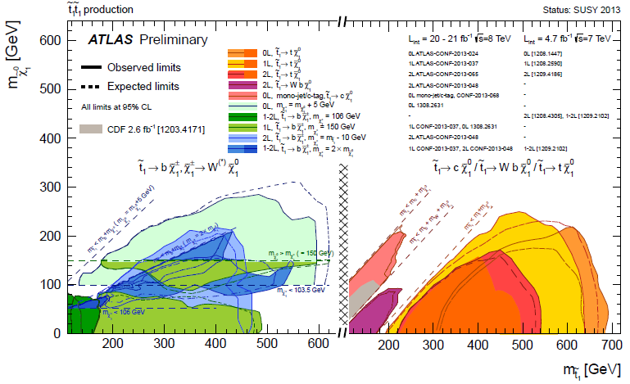
A typical example: searches for stop
stop
stop
chargino
via top
(onshell or offshell)
Fix one of ΔM
neutralino
neutralino

Slide 21
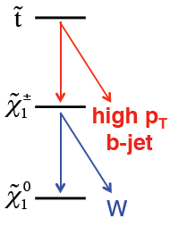
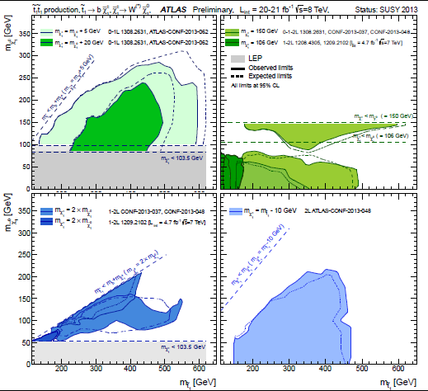
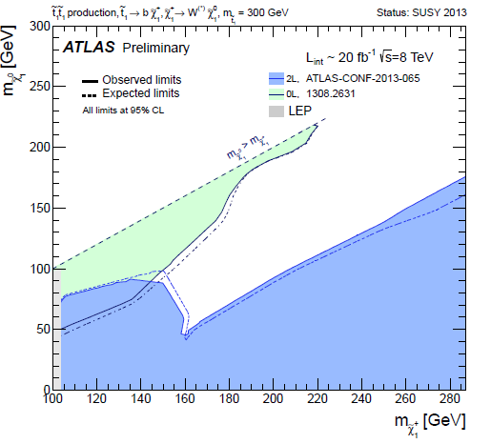
More on simplified models
Various assumptions of ΔM(stop-chargino) and ΔM(chargino-neutralino)
21
if ΔM(t1,C) large
p_{T} lepton high if ΔM(C,N) large
Fixed mass stop, function of
chargino-neutralino mass
m(stop)=300 GeV

Slide 22
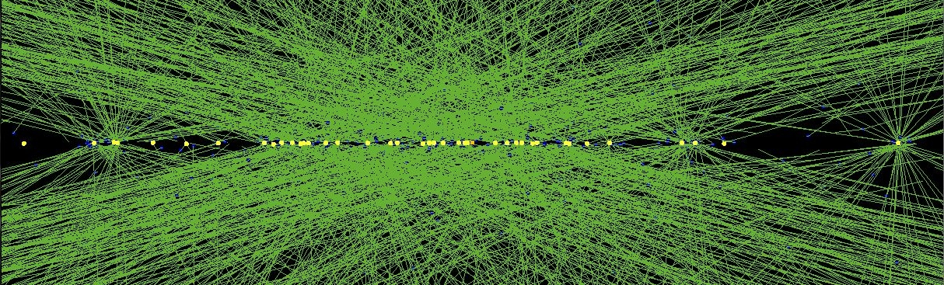
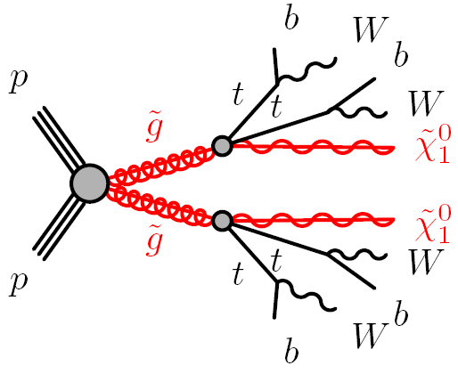
The Experimental Challenge
Example: 40 reconstructed vertices
2012 data @ 8 TeV, High PU run October 25, 2011
Measured hits in detector
use hits to reconstruct particle paths and energies
estimate background processes
understand the underlying physics
How to find this?

Slide 23
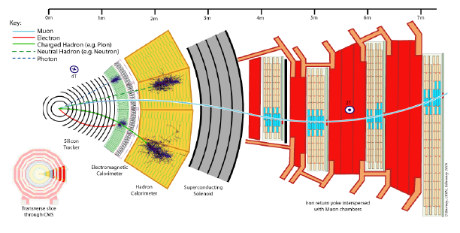
Physics objects
Jets → clusters in EM/HAD calorimeters
Photons → EM cluster w/o matching track
Electrons → same with matching track
Muons → track in Tracker and Muon chambers
Tau → narrow jets with 1 or 3 tracks
Missing ET (MET) → unbalanced pT
But also → More complex objects:
B-jets → jet identified as originated
from B-hadron

Slide 24
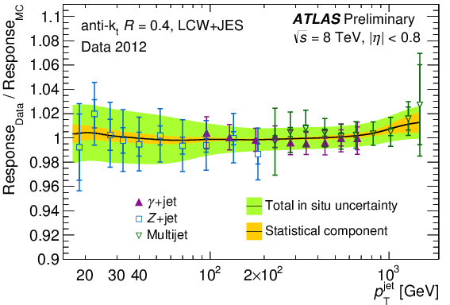
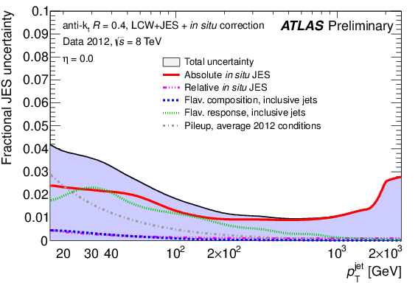
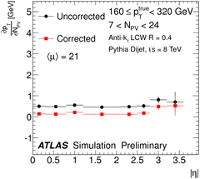
Jet reconstruction
Anti-kt Jet. Radius R=0.4/0.5 (ATLAS/CMS)
Uncertainties on Jet Energy Scale (JES) and Resolution are generally the dominant exp. syst.
Good performance in MC as well
Several techniques to remove pile-up dependence
ATLAS and CMS now reach the 1% level for JES Uncert. (even with high pile-up) !

Slide 25
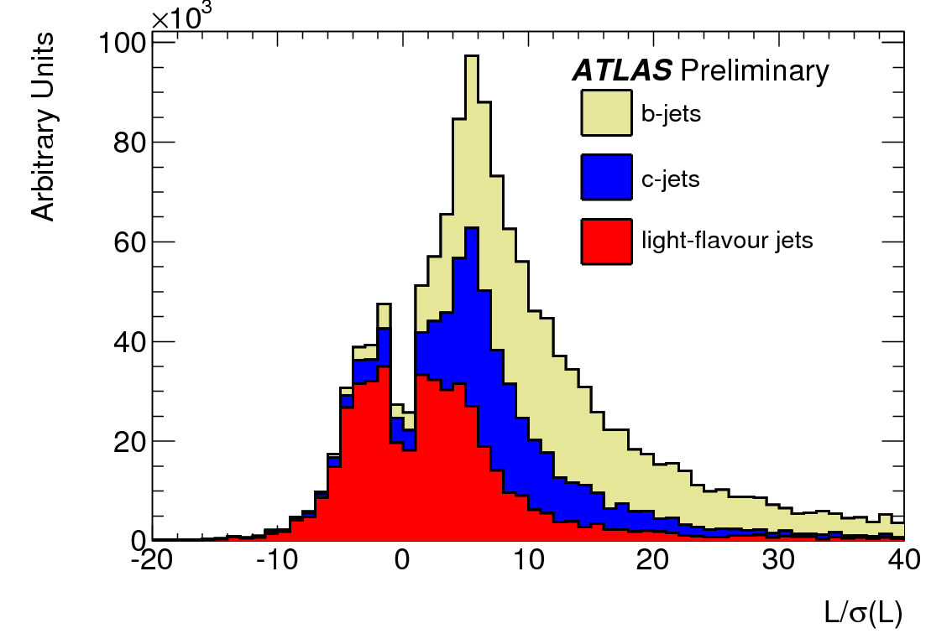
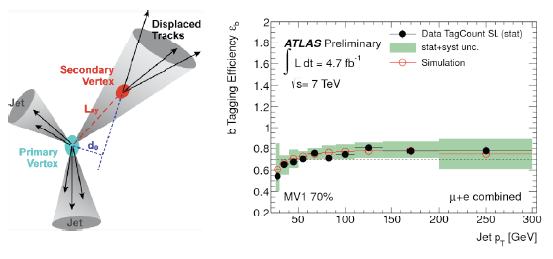
Finding the b-jets
Exploit large lifetime of the b-hadron
  B-hadron flies before it decays: d=cτ
    Lifetime τ =1.5 ps⁻¹
    d=cτ = 460 μm
    Can be resolved with silicon detector resolution
Procedure “Secondary Vertex”
Many sophisticated techniques exist

Slide 26
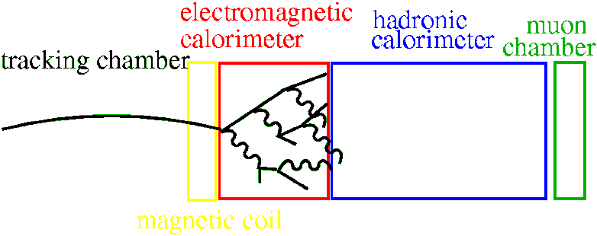
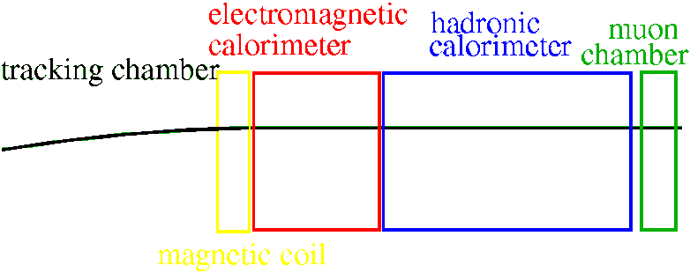
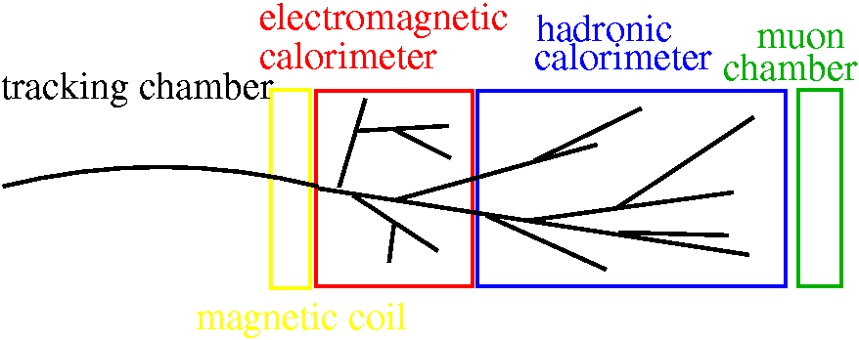
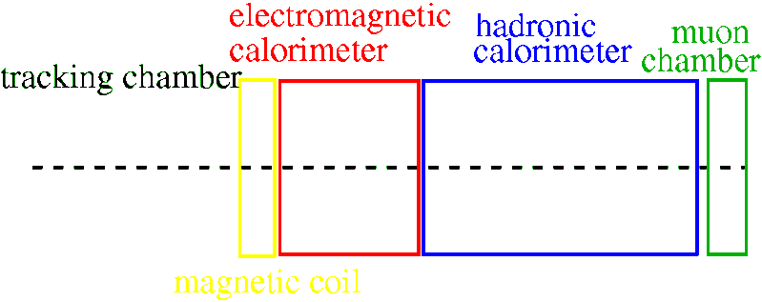
Lepton Identification
Electrons:
  compact electromagnetic cluster in calorimeter
  Matched to track
Muons:
  Track in the muon chambers
  Matched to track
Taus:
  Narrow jet
  Matched to one or three tracks
Neutrinos:
  Imbalance in transverse momentum
  Inferred from total transverse energy measured in detector

Slide 27
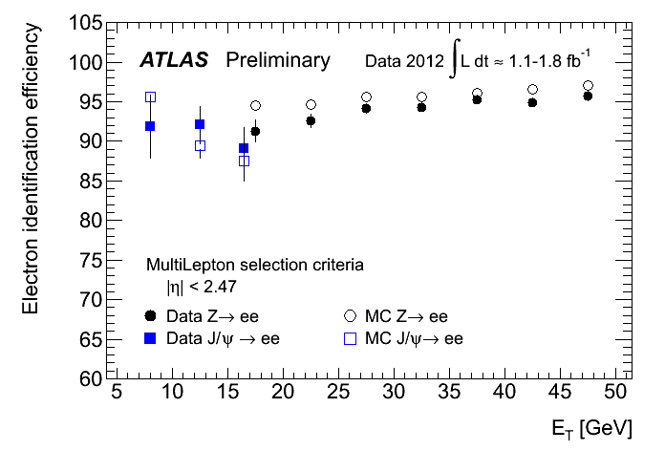
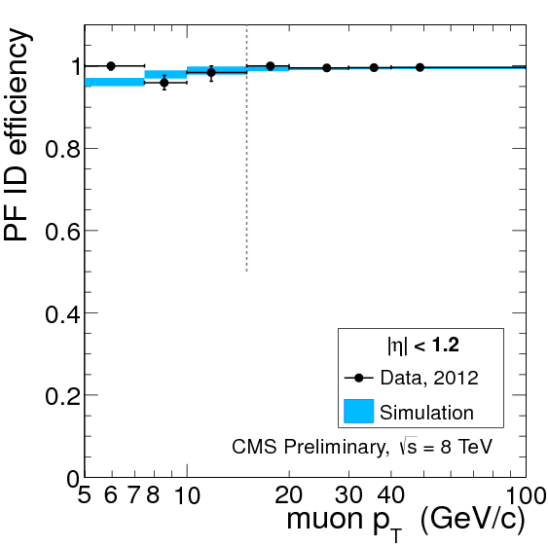
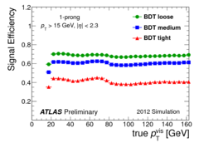
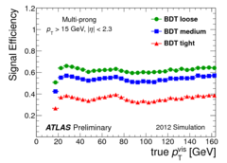
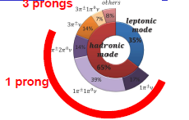
Lepton identification performance
Isolated leptons (e,μ)
Good reco and ID efficiency down to few GeV
electrons
muons
Hadronic taus reconstructed with Neural Network techniques
  Various working points can be used
Tau decays

Slide 28
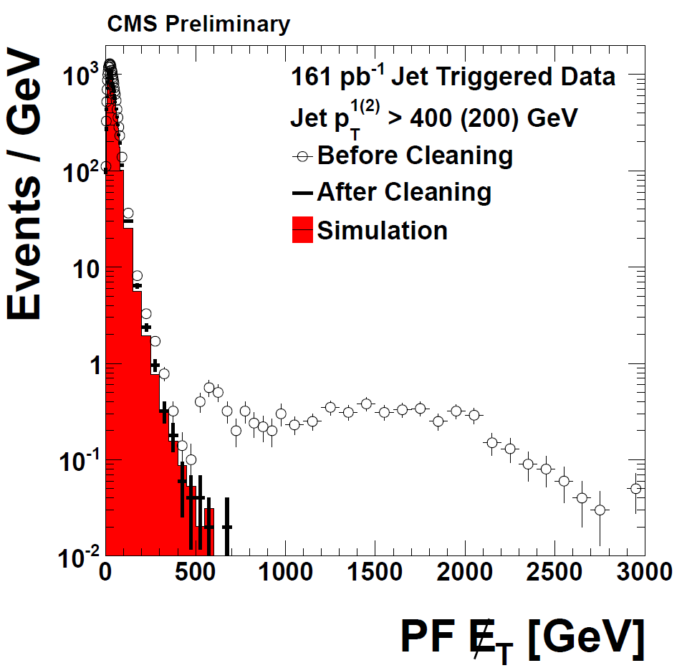
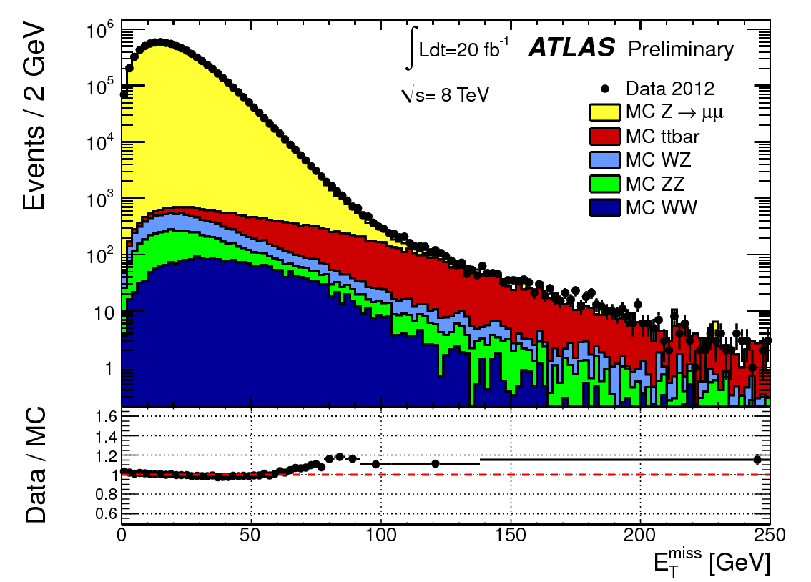
Missing Transverse Energy
Energy conservation (transverse plane):
Real MET: presence of neutral weakly interacting particle in the event (ex neutrinos)
Fake MET: mismeasurements + detector malfunctions, poorly instrumented regions
Performance in Z→μμ (2012)
Fake MET
(resolution effect)
Fake MET
(Detector mismearurments)
Fake MET (high pT
mis-reconstructed jet)
Real MET

Slide 29
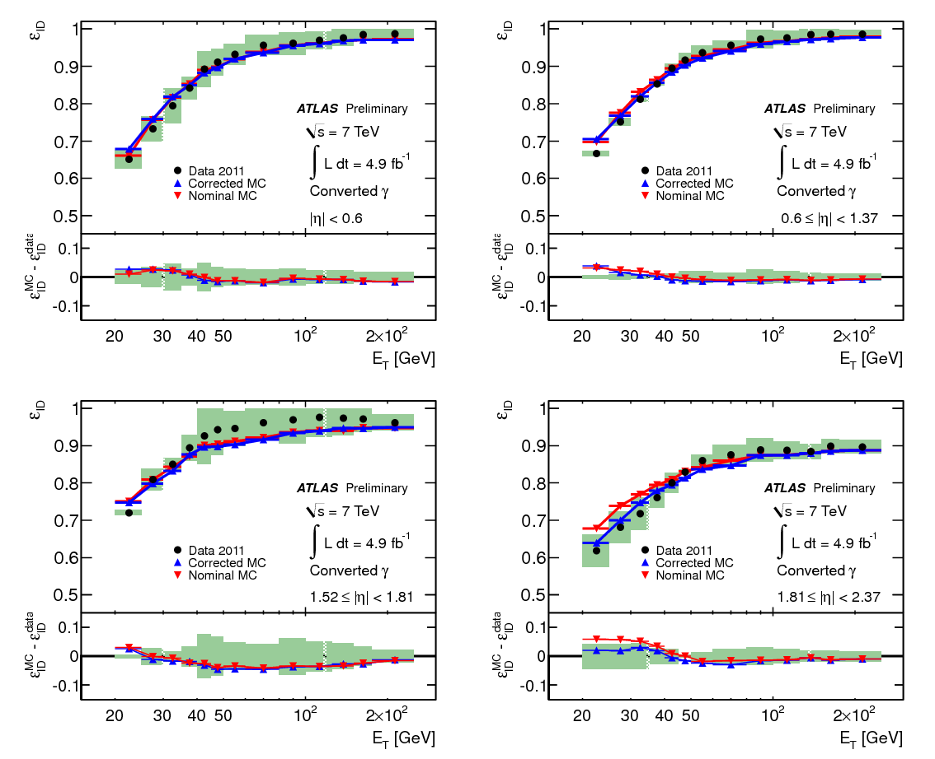
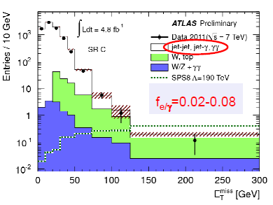
Photons
Good reconstruction efficiency in various eta regions (here, unconverted photons)
Ex of γγ + MET (7 TeV)
Good electron/photon fake rate

Slide 30
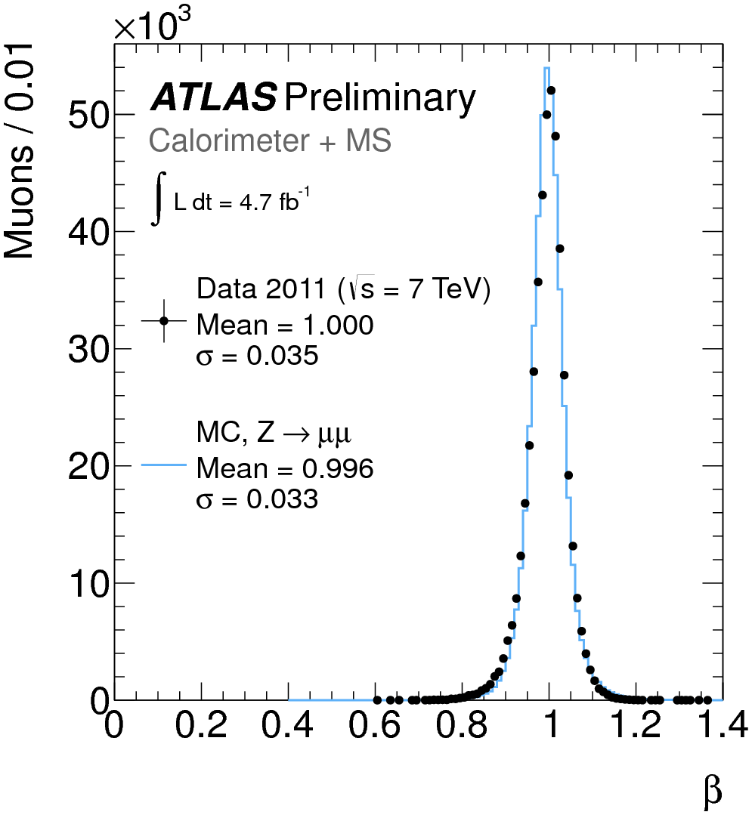
β measurements for muons
Speed measurements of muons crucial for long lived particle searches
Use Z→μμ events to calibrate β
measurements
  If β measurements from different
  systems are > 0.2 and internally
  consistent → combined in a weighted
  average.
measure charged particle momentum p in ID and MS
measure energy loss dE/dx in several subdetectors
  For these analyses, use Pixel
  dE/dX is related to relativistic boost factor βγ
measure time-of-flight in several sub-detectors
  For these analyses, use Tile, RPC, MDT
  Can measure velocity β
Stable
Massive
Particle
MASS
p=βγm

Slide 31

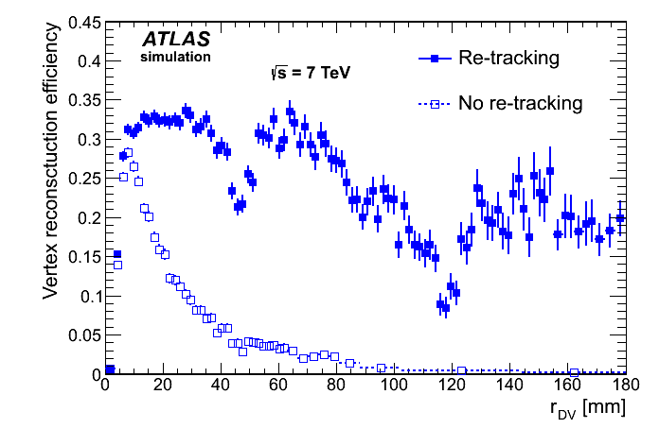
Tracking
Standard ATLAS tracking: optimized for tracks coming from the primary interaction point (IP)
Re-tracking: iterative procedure to recover tracks not from PV
  Relevant for SUSY searches (displaced vertex from metastable part.)
→ increase efficiency for secondary tracks : re-run Silicon-seeded tracking algorithm, with looser cuts on transverse impact parameter, using “left-over” (shared) hits from Standard tracking.
Signal example
Radius

Slide 32




Trigger
A lot more “uninteresting” than “interesting” processes
  Interesting events must be selected first of all at trigger level
Typical
ATLAS SUSY
triggers:
Cross section (nb)
CMS a bit more flexible in HLT
Work on the trigger plateau (>95% efficient, low systematics)
Triggering is really challenging and may limit what we can do : soft MET, soft jet

Slide 33

Extracting possible SUSY signals from SM background
  understand SM background contributions

Slide 34

SM background suppression
Consider MET-based searches
  More specialized and dedicated techniques for RPV or LLP searches
First: tight selections on basic objects (MET, jets and/or leptons)
  Trigger-driven:
    tight requirements at trigger level to reduce rate
  Background-driven:
    to reduce fake MET and lepton backgrounds
  Signature-driven:
    SUSY particles are heavy
Missing Transverse Energy
Jets
Second:add powerful discriminating variables → SR

Slide 35






Signal region definitions (I)
Most of the discriminants: transverse-mass like
Effective mass (or H_{T}): inclusive transverse mass
m_{T} (tranverse mass, in 1lepton)
  Cut above W Mass end-point (smeared by resolution)

Slide 36






Signal region definitions (II)
Exclusive transverse mass: m_{T2}, m_{CT}
  Endpoint different for SM andd SUSY signal
Ex: 2lep + E_{T}^{miss} _{(jet-veto)}
Ex: 0lep + 2b-jets + E_{T}^{miss}
Sbottom pair production
Chargino or slepton pair production
end-point:
(similar for m_{T2})

Slide 37







Signal region definitions (III)
α_{T} and Razor variables: group particles in 2 hemisphere (megajets)
Razor also uses longitudinal info
α_{T} = 0.5 if perfect mega-jet balance, < 0.5 means unbalance
Boost in ‘R frame’ where p(J1)=p(J2)
If no ISR: R frame = C.o.M Frame
If MΔ high: signal peaks at MR = MΔ
Increase discrimination with R²

Slide 38

Background strategy
Step 1
Example: top, W/Z+jets
In ETMiss-based analyses
Example: multi-jet, fake leptons

Slide 39



Irreducible background
Normalisation done in dedicated Control Regions (CR)
Assuming ΣN_{CR}^{j,MC} is small:
  systematic uncertainties associated to the transfer factor
  Need to define the regions
  keeping good statistics, low
  systematics uncertainties and
  low signal contamination

Slide 40




‘Fake’ (reducible) background
Fake MET: Sizeable contributions from jet mis-measurement
  can be relevant for processes with no real E_{T}^{miss} and high σ (multi-jet, Z→ll)
Derive jet response function from MC
Use it to ‘smear’ jets in real data with low E_{T}^{miss}
obtain events with large “fake” E_{T}^{miss}
Validate estimation in dedicated control regions
core – pT balance in di-jet
tail – 3-jet events
Fake leptons: can arise from different sources
  e.g.: off-axis HF semi-leptonic decays, photon conversions
General approach (extendable to multi-lepton signatures): matrix method
  define a “loose” (pre-selected) and “tight” (signal) lepton selection
  solve the following system of equations:
Measured Independently from data
Count how many of them

Slide 41









An example: 0-lepton signature
Searches in inclusive jets + E_{t}^{miss} events
  from 2 (A) to 6 (E) jets
Region
C, D, E
Expect significant
‘’effective mass’’
Region B
→ ≥ 4 jets
Squark Mass
Region A, A’
→ ≥ 2 jets
Gluino Mass
Top CR
W+jets CR
Normalizations obtained in all CR and extrapolated to signal regions simultaneously by combined maximum likelihood fit
Multijet CR
Z+jets CR

Slide 42

Systematic uncertainties
Often driving our sensitivity, crucial element in a search !

Slide 43
Background strategy
Example: top, W/Z+jets
In ETMiss-based analyses
Example: multi-jet, fake leptons
Step I1
VR used to check the bkg estimates.
usually blinded in intermediate step

Slide 44




Example of VR checks
ATLAS search for strong production in 2L final states using Razor variables
Example SR2
SR: high R and high MR’
CR: low R or low MR’ , for ttbar and Z bkg;
VR: intermediate between CR and SR

Slide 45


Putting all together: combined fit
Combine all info in a global fit. Likelihood based on CR and SR (mutually exclusive)
Each region described with a Poisson p.d.f
Statistical and systematic uncertainties on the expected values included in the ﬁt as nuisance parameters → typically constrained by a Gaussian function with width corresponding to the size of the uncertainty considered
  correlations between these parameters are taken into account
Inputs: Transfer factors (c), N events for data in SR(s) and CRj(bj)

Slide 46


Results
Perform background-only fits (μ=0)
  Predict the background in the SR by maximizing the likelihood
  SR not in the fit + no signal contamination in CR
  Prediction compared to data: SRs usually blinded till the end!
Quantify the agreement between data and SM prediction
  Test: compatibility of data with background only hypothesis in the signal region
  Test statistic: based on one-sided profile log likelihood ratio

Slide 47



Example
1L stop analysis: 1L(e/μ)+>=4 jets(1 bjet)+MET
  m_{T} selection above 100 GeV
  2 CRs per each SR, one for W+jets bkg, one for top + 1 VR
p-value < 0.5
if N obs > N exp,,
0.5 otherwise

Slide 48





Interpretation of the results
Model independent limits
  Limit on visible cross-section on non-SM: σvis = σ x A x ε
A and ε given for a well-defined SUSY model :
Obs
Exp
Result can be recasted in other models than the one considered

Slide 49



Interpretation of the results
Model dependent limits
  Perform fit with signal hypothesis (μ=1)
  Signal contamination in CR correctly accounted for

Slide 50



Interpretation of the results: Recasting in pMSSM
pMSSM can be used as a benchmark for various searches:
  combine all of the searches to obtain a complete picture of the overall search coverage of the SUSY parameter space
  Example:
PRD 88, 035002 (2013)
+ … many more ATLAS and CMS searches
each excluding a % of models
Fraction of Models excluded
Limits from simplified models

Slide 51
Recent highlights from the LHC
Only a few examples

Slide 52

Gluino production in b/top
Final state contains up to 4 bjets for stop+top
up to 12 jets and 4 leptons (possibly same sign):
  Many different analyses developed to target this final state.
Process and assumptions | Search
Gluinos in stop + top, stop → top+neut1 / b+chargino | 0 lepton + ≥ 3 b-jets + MET
 | Same-sign leptons + jets (+b-jets) + MET
 | 0 lepton + 7-10 jets
 | 3L+jets+MET
In this lecture
Gluinos in stop+ top, stop → c+neut1 | 0 lepton + 2-6 jets+ MET
Gluinos in sbottom + b, sbottom → b+neut1 | 0 lepton + 3 b-jets + MET

Slide 53





Gluino Mediated Stop/Sbottom
4 b-quarks in the final state → most sensitive search 0/1lep + ≥3b-jets + E_{T}^{miss}
Bkg estimates:
Reducible: ttbar + light jets
→ data-driven method
Irreducible: ttbar+HF:
→ MC estimates, validated in VR

Slide 54

Gluino Mediated Stop/Sbottom
4 b-quarks in the final state → most sensitive search 0/1lep + ≥3b-jets + E_{T}^{miss}

Slide 55



Same Sign leptons
ATLAS-CONF-2013-007
Gluino is a majorana fermion → SS lepton final states enhanced
Signature: e± e±, μ± μ±, e± μ±
≥ 3, 4 jets (0, ≥ 1, 3 b-tagged jets)+ E_{T}^{miss}
Irreducible background tested
in validation regions .
Ex: 3L, MET<120 GeV, 86<m(ll)<96 GeV
Backgrounds (little reliance on MC)
Irreducible ttbar+V, VV
Reducible Z+jets charge flip, ttbar, W+jets

Slide 56




Same sign leptons: results
SR 0b
SR 1b

Slide 57


Summary: Stop via gluino pair production

Slide 58



CMS-Razor analysis
Relatively inclusive initial selection:
  >= 2 jets with pT>40 GeV (80 GeV leading), >=1 bjet
Classify events based on N jets & N leptons
  Subdivide each box in smaller box (Nb=1, =2, >2)
Background parameterized in 2D
simultaneous fits (sideband of full) for interpretation

Slide 59



Interpretation of the results
Results of sideband fit on S+Bkg (S=gluino pair production with gluino in bb+MET). Agreement is shown for each bin in R² and M_{R}
Various ‘boxes’ can be sensitive to different SUSY processes →

Slide 60

Stop and sbottom pair production
Usually target lightest eigenstate (t1, b1)
Several decay modes possible
  For stop:
  For sbottom:
    if neutralino2 masses are decoupled:
      Final states b+neut1 or t+chargino
      Case of b+neut2 (neut2 → Z / higgs + neut1) not considered here
For decay modes involving charginos, phenomenology depends on ΔM chargino-neutralino and ΔM stop-chargino
if ΔM(t1,C) large
p_{T} lepton high if ΔM(C,N) large

Slide 61
Stop and sbottom overview
Process and assumptions | Search
Direct stop in top+neutralino | 0 lepton + ≥ 6 jets +≥ 2 b-jets + MET (ATLAS)
 | 1 lepton + ≥ 4 jets +≥ 1 b-jets + MET (ATLAS/CMS)
 | Razor (Multi-box)
Direct stop in b+chargino | 0 leptons + 2 bjets + MET (ATLAS/CMS)
 | 1 lepton + ≥ 4 jets +≥ 1 b-jets + MET (ATLAS/CMS)
 | 2 leptons (+jets)+MET(ATLAS)
Stop2 production and GMSB stop (Z-enhanced) | 2(3) leptons + bjets + MET(ATLAS)
Stop in charm+LSP | 0l+jets(cjets)+MET (ATLAS)
Direct sbottom in b+neutralino (ATLAS/CMS) | 0 lepton + 2 b-jets + MET
Direct sbottom in top+chargino (ATLAS/CMS) | Same-sign leptons + jets (+b-jets) + MET

Slide 62



Many searches for stop looking from different perspectives
An example: stop in charm

Slide 63




Stop in charm+MET
If ΔM(stop-LSP)<m(W)
Need one hard ISR/FSR jet to boost the stop in order to trigger and separate signal from background. Two selections:
  If ~20<ΔM(stop-LSP)<m(W), charm jets might have sufficient transverse momentum to be detected and tagged
    Ask for ≥4 jets, some charm tagged, large MET, high p_{T} untagged leading jet
  If ΔM(stop-LSP) < 20 GeV very low, the charm are too soft to be efficiently detected → ‘mono-jet like’ signature
    Ask for 1 to 3 jets, high pT , leading jet, large MET
    → Selection potentially sensitive to Dark-Matter production and any ‘compressed scenario’

Slide 64



Stop in charm: results
Backgrounds:
  W+jets, Z+jets estimated from W(µν), Z(µµ), W(eν)+jets control selections
  Top pairs: from MC for mono-jet like selection, from an eµ control region for the charm tagged selection
  Multi-jet from data but small
  Other (small) backgrounds from MC
Monojet-like
High stats, systematics play a very important role

Slide 65
Charginos, neutralinos and sleptons overview
Process and assumptions | Search
Direct sleptons (e, m) | 2L + MET (e,μ)
Direct chargino (low slepton masses / WW) | 2L + MET (e,μ)
Direct chargino (low stau masses) | 2 τ + MET (ATLAS)
Chargino-neut2 (low slepton masses) | 3L+MET
Chargino-neut2 (WZ) | 3L+MET (e,μ)
Chargino-neut2 (WH) | 1L(bb) + MET or (CMS: 3L, SS+jets)
Chargino-neut2 (low stau masses) | 2 τ + MET
Neut2-Neut3 (low slepton masses) | 4L(+MET) (e,μ,τ)
Neutralino1 decays via light leptons (λ121) or taus (λ133) | 4L(+MET) (e,μ,τ)
Gravitino LSP, Higgsino-like neutralinos NLSP | 4L(+MET) (e,μ)

Slide 66






Direct sleptons and charginos (2 e,μ)
Five signal regions (2l+MET):
Use mT2 as discriminant
Also: Δφ(ll), p_{T}(ll), m(ll)
charginos decaying via W bosons
Slepton pair, charginos decaying via sleptons
WW CR (ex. for SR-WWb/c)
Top CR (ex. for SR-WWa)
Background modeling:
Reducible: data driven
Irreducible (Dominant: WW, ttbar): MC predictions normalized in dedicated control regions
CR defined with at least one reverted cut

Slide 67







Interpretations
First limits from LHC on pure right-handed sleptons (σ(LH)~4 σ(RH))
First study on chargino decays via W
Extend ~ 100 GeV chargino limits (decay via sleptons)

Slide 68



Chargino-neutralino pair production in 3L (e,μ)
ATLAS-CONF-2013-035
Light 1st & 2nd generation sleptons
Heavy sleptons are well motivated in natural SUSY
Signature: 3 leptons (e, μ), SFOS pair + E_{T}^{miss}
Loose, medium, tight signal regions that are Z-rich / Z depleted
SM Backgrounds
Irreducible (MC)
WZ, ZZ, VVV, ttbar+V
SM background checked in several validation regions
Reducible (matrix method)
Ttbar, Z+jets

Slide 69




Results
Intermediate Z-depleted signal region
Good agreement data/SM expectations in all regions
Z-enhanced signal regions

Slide 70


Interpretations
Exclude degenerate chargino-neutralino2 up to 600 GeV(310 GeV) for low(high) slepton masses
Sensitivity in the very challenging WZ* region
Need to complement this with searches for W+higgs - if neut2-neut1 Δm > m(h)

Slide 71



Chargino-neutralino2 in Higgs
CMS: target H→bb and H→ 2 light leptons (generic for WW*,ZZ* etc) (+1L / SS and MET)
ATLAS: H→ bb (+1L and MET)
1L + bb + E_{T}Miss (>100,125,150,175 GeV)
SS + jets (from W) and moderate E_{T}Miss

Slide 72


Chargino-neutralino2 in Higgs
Neutralino1 = bino-like; chargino/neutralino2 = wino-like
BR of Higgs assumed SM-like: H→bb(=56%); H→WW(=23%); H→ττ(=6.2%)
The three analyses are statistically combined and all correlations are taken into account:
  Best expected sensitivity for 1L analysis; single SR for SS; binned SRs for 3L

Slide 73




Ewk production summary

Slide 74

Summary of searches so far
‘Natural’ SUSY scenarios discussed → pushing the boundaries to ‘unnatural’ corners?
Still not the end of the story:
  Constraints derived in 100% BR final states
  Higgsino-like ewkinos produced at lower rate → need 13 TeV!
  Loop-holes in stop exclusion in difficult regions (≥ top mass)
OR: Naturalness might not be the solution…

Slide 75




SUSY ‘unnatural’ scenarios
Ex.: Split-SUSY: focus on other issues from SM (DM, flavor / CP problems).
Ex.: search for long-lived particles (ie gluinos or squarks)

Slide 76


Displaced vertex (DV) searches
An example:
Search for displaced vertices with muons
  Specific RPV operators give these decays
Recover signal tracks performing special ‘re-tracking’
Vertex must be at least 4mm from any primary vertex, in |z|<300mm and r<180mm, and away from ID material
Signal region optimized on number of tracks in the vertex and vertex mass
Example Signal sample

Slide 77


DV results
Very small background:
0.02 ± 0.02
Setting limits on cross section as a function of lifetime for various mass hypotheses
MH/ML/HL for medium/ medium/ heavy squark and heavy/ light/ light neutralino
More to come soon!

Slide 78

The big picture
similar for CMS
78
Incl. searches
Natural SUSY
LLP + RPV
Extended
MSSM

Slide 79

Concluding remarks
Performing SUSY searches means having knowledge of:
  the various flavors SUSY might have
    Important to define targeted SR (but not for a too specific model!)
  the detector and its performance
  MC generators tools to compare with data
  Various sources of systematic uncertainties
A lot has been done, but much more to explore
Need to keep our eyes opened!
Courtesy of D. Stuart
A long journey in front of us …
13 TeV ?

Slide 80
References
https://twiki.cern.ch/twiki/bin/view/AtlasPublic/SupersymmetryPublicResults
https://twiki.cern.ch/twiki/bin/view/CMSPublic/PhysicsResultsSUS

Slide 81
Back up material

Slide 82



Gluino Mediated Stop
ATLAS-CONF-2013-054
20.3 fb⁻¹@8 TeV
0lep + (7-10) jets + E_{t}^{miss} → targeting signals with long decay chains
MET Significance in Control Regions

Slide 83


0 lepton – 7-10 jets
Multijet SM background estimated from data:
  ‘ABCD’ method exploiting no correlations between jet multiplicity and E_{t}^{miss} /√H_{T}
Top pair production, W/Z+jets: MC predictions normalized in 1-lepton and 2-lepton CRs

Slide 84




Results
Good agreement data/SM estimates
In case of no excess:
Provide 95% CL model independent limits on σ_{vis} = σ x A x ε
compute A x ε and extract exclusion curves

Slide 85


Direct stop pair production: 0 lepton
ATLAS-CONF-2013-024
Search for fully hadronic decays of the top
→ Target heavy stop
Signature: ≥ 6 jets (≥ 2 b-tagged jets) + E_{T}^{miss}
Backgrounds
Reducible: multijets → jet smearing method
Irreducible: Semi-leptonic ttbar, Z+jets → from CR
SR: Loose, medium, tight signal regions using E_{T}^{miss}

Slide 86


Direct stop pair production: 0 lepton
ATLAS-CONF-2013-024
Search for fully hadronic decays of the top
→ Target heavy stop
Signature: ≥ 6 jets (≥ 2 b-tagged jets) + E_{T}^{miss}
Backgrounds
Reducible: multijets → jet smearing method
Irreducible: Semi-leptonic ttbar, Z+jets → from CR

Slide 87



Results

Slide 88




Direct stop production: 1 lepton
Stop in top+neutralino
Stop in b+chargino:
Loose: low Δ stop,top
Relying on selections on MET and tranverse mass, mT
Tag one b-jet, reconstructed one hadronic mass (for t+neut1)
Signal regions
medium
high-mass
tight
high-mass
Signal regions
loose
medium, tight

Slide 89



Direct stop production: 1 lepton
Dominant SM backgrounds:
  dileptonic top (W in tau), W+b.jets
  → reduced thanks to dedicated selections (ex.: aM_{T2})
  Residual bkg → in CRs
Results: good agreement data/SM expecations

Slide 90



Direct stop production: 1 lepton
Stop in top+neutralino
Stop in b+chargino:
Sensitivity depends on mass hiearchy of stop, chargino, neut1

Slide 91


Direct Stop production: 2-leptons
ATLAS-CONF-2013-048
2lep (OS) + E_{T}^{miss}
  Sensitive to decays via chargino,
  depending on the mass hiearchy
  Discriminant: di-lepton m_{T2} variable → an upper bound for W-boson events
  SM dominant background: dilepton ttbar, WW, WZ and ZZ → use appropriate CR regions
Soft b-jets
For signal bounded to:

Slide 92




Direct Stop production: 2-leptons
Results in good agreement with SM predictions
Exclusion limits for low LSP masses
Complement 1-lepton analysis

Slide 93


Direct stop production in 0-lepton,2-bjets+MET
ATLAS-CONF-2013-053
0lep + 2b-jets + E_{T}^{miss}
Sensitive to
If mass splitting is small, W is virtual, → chargino decay products very soft
Exclusive selection in N jets (2), N leptons (0)
m_{cT}(bb) = boost-corrected co-transverse mass
end-point at
Main bkgnds:
  Z(→nn) +jets, semi-lep ttbar, W+jets
Minor contribution:
  single top, di-boson, ttbar+W/Z

Slide 94



Direct Stop in 2-bjets+MET
Difference in kinematics between sbottom and stop signal

Slide 95


Direct Sbottom production
2-bjets+MET & 2lep (SS) + 0, ≥1, ≥3 b-jets (≥3,4 jets) + E_{T}^{miss}
χ±₁
t

Slide 96





Results
SR-WWa
SR-mT90
Good agreement between data and SM
Note: SM renormalized to CR: WW rescaled by ~1.2 (consistent with SM measurements wrt theory)

Slide 97



Weak SUSY production: 2τ
ATLAS-CONF-2013-028
First search for production with light staus from the LHC
Light staus are well motivated in natural SUSY
Signature:
2 OS hadronic τ + E_{T}^{miss}
2 Signal regions:
High E_{T}^{miss} and m_{T2} and (b) jet veto
m_{T2} as before: generalised transverse mass for two visibles particles (taus)
SM Backgrounds
Reducible (fully data-driven)
W+jets, multijets
Irreducible (MC)
Z+jets, VV, ttbar, ttbar+V
ABCD method
Validation regions as cross check

Slide 98







Results
Good agreement data/SM predictions
Interpretations in light stau scenarios:
(Direct stau production has very low σ → upper limits only)

