Slide 1
Detector Technologies applied to Life Science
Mokhtar Chmeissani

Slide 2
Introduction
Detectors for X-ray and Nuclear medicine
X-ray tube
Detectors for Mammography
Image Quality
Dual Image subtraction and contrast agent
PET and Gamma Camera
Summary

Slide 3
Introduction

Slide 4
The topic is too general and I will not be possible to cover it in 60 minutes presentation. I will limit my talk to imaging/detector related X-ray and Gamma-ray a closer subject to what we do in HEP research and in Particular for Mammography and Nuclear Medicine.

Slide 5
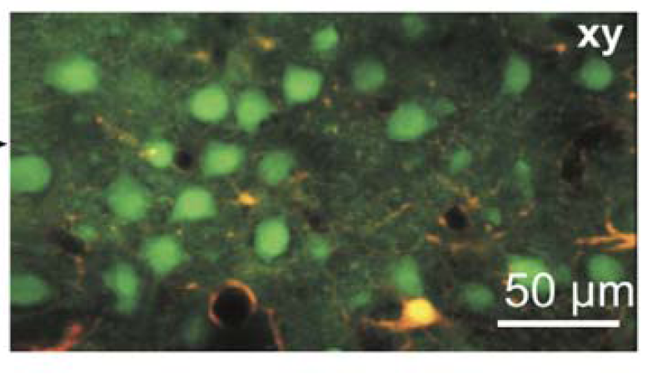
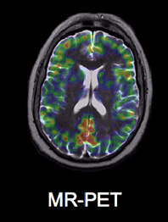
Photonics vs Ionization Imaging
With Microscopic Imaging one can achieve excellent spatial resolution making it possible to see in vivo living cells, the neurons cells as shown above with 2 photons excitation microscopy but with very small FOV
With radiation we can achieve resolution of few mm but with large FOV
Principles of Two-Photon Excitation Microscopy and Its Applications to Neuroscience by
Karel Svoboda , Ryohei Yasuda, Neurons Volume 50, Issue 6, 15 June 2006
MR and PET data acquired simultaneously. (D. Townsend and C. Nahmias, and H-P Schlemmer et al)

Slide 6
Risk of Death
Cause | In one year
20 cigarettes/day | 1 in 200
Traffic accident | 1 in 9500
Home accident | 1 in 26000
Work accident | 1 in 43000
Exposed to radiation (1mSv) | 1 in 20000
Normal dose/year for regular person is 1mSv
1 Sv = 1 J/kg equivalent
From ICRP60

Slide 7
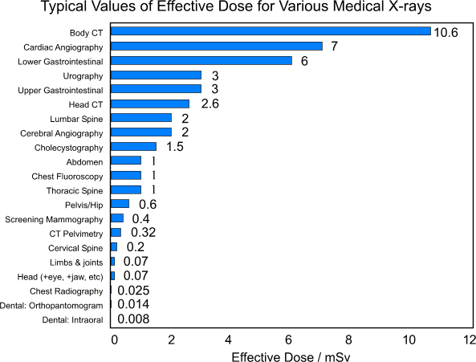
Flight from London to New York: 0.03 mSv (assuming 6 hours flight)

Slide 8
Detectors for X-ray and Nuclear Medicine

Slide 9
Comparison of different types for X-ray Detection
 | Cost | Handling | Stopping Power | Signal resolution | Real time | Energy Range
Gas | Cheap | difficult | Very low | good | yes | Soft X-ray
Crystal Scintillator | Moderate | easy | Excellent | very Good | yes | X-ray and Gamma
Semi conductor | Expensive | easy | Good | excellent | yes | X-ray and Gamma
Phosphor storage plate | cheap | easy | O.K | ? | No | X-ray
Film Cassette | cheap | difficult | poor | ? | No | X-ray

Slide 10
Semiconductor Detectors
Material | Z | Density (gr/cm³) | Atten. Coefi. μ(1/cm) @511keV | Band gap (eV)
Si | 14 | 2.3 | 5.0 | 1.1
a-Se | 34 | 4.3 | 2.8 | 2.2*
Ge | 32 | 5.3 | 2.4 | 0.7
GaAs | 31,33 | 5.3 | 2.2 | 1.4
Cd(Zn)Te | 52,(30),48 | 6.2 | 1.8 | 1.6
HgI₂ | 80,53 | 6.4 | 1.3 | 2.1
TiBr | 83,35 | 7.5 | 1.0 | 2.7
BGO | 83,32,8 | 7.1 | 1.1 | 3.5
NaI | 53,11 | 3.7 | 2.0 | 3.9
W_{i}=2.8E_{g}+0.75 ev is the energy needed to create e-h pair
* 50eV is needed to create e-h

Slide 11
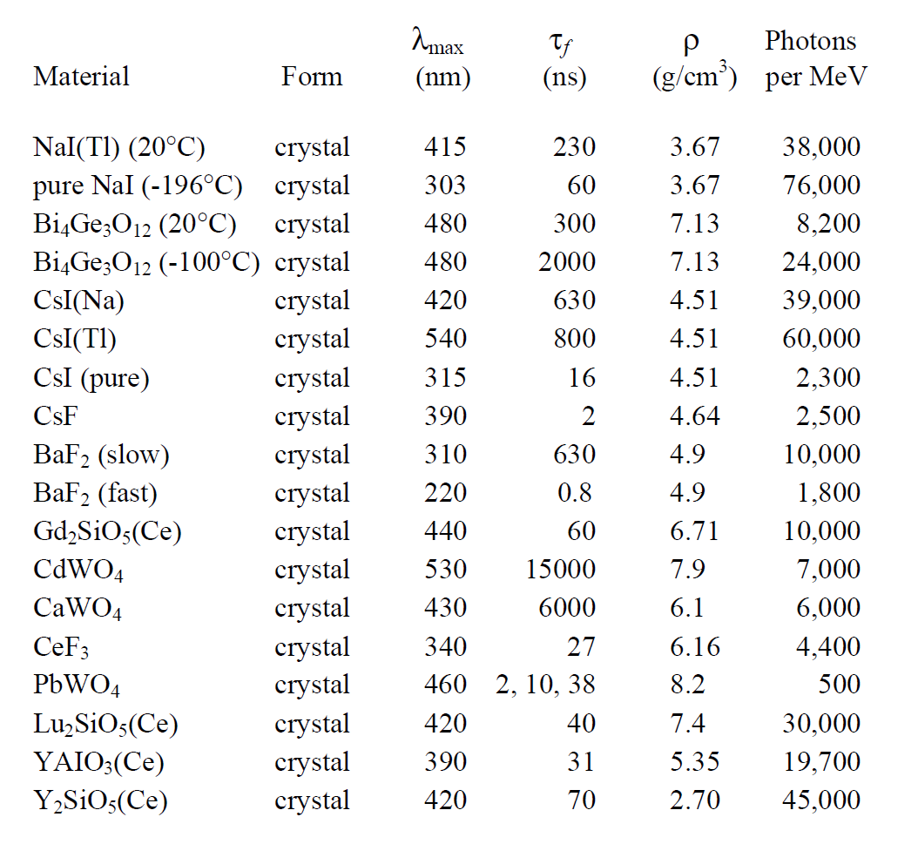
Inorganic Crystal Scintillator
have high Z ,high density, and with good decay time. This makes them good detectors for X-ray and nuclear medicine.

Slide 12
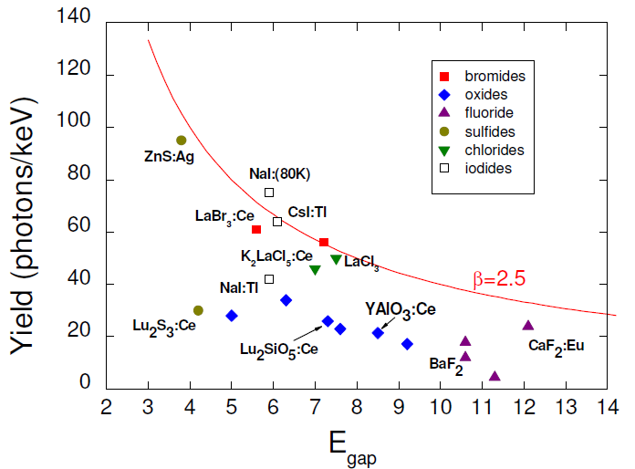
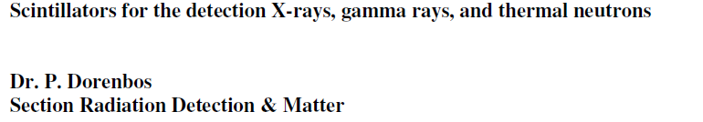
Yield(photons/keV) vs E_{gap}
Y_{ph}= (10⁶SQ/βE_{g} )photon energy (in MeV)

Slide 13
Yield signal in e⁻

Slide 14
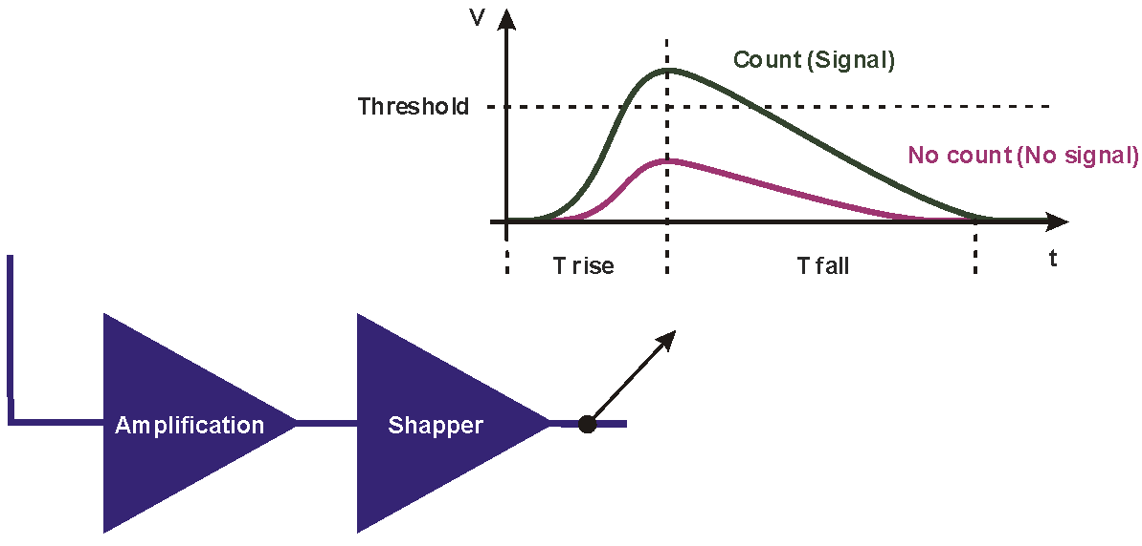
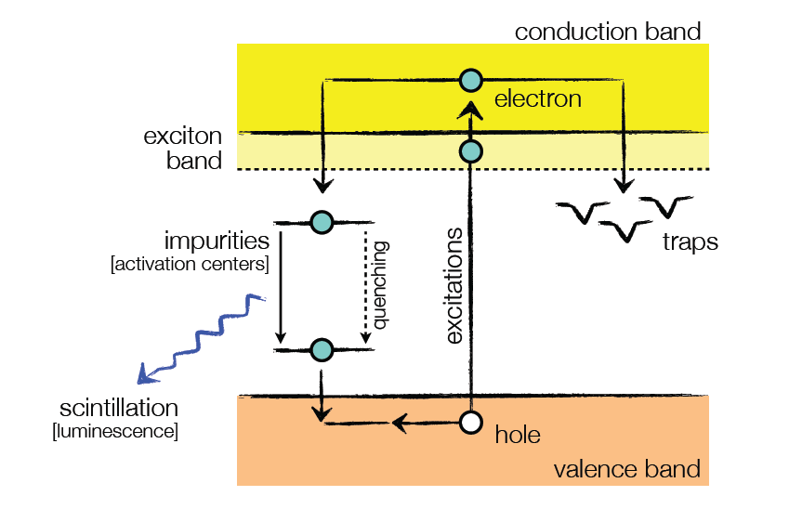
Light and Electric signal generation
Cathode
Anode

Slide 15
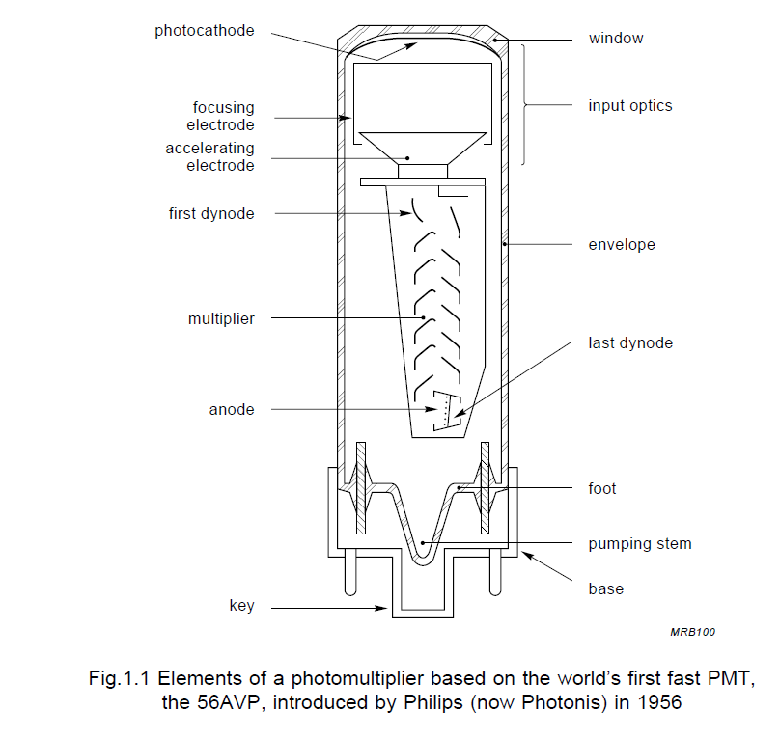
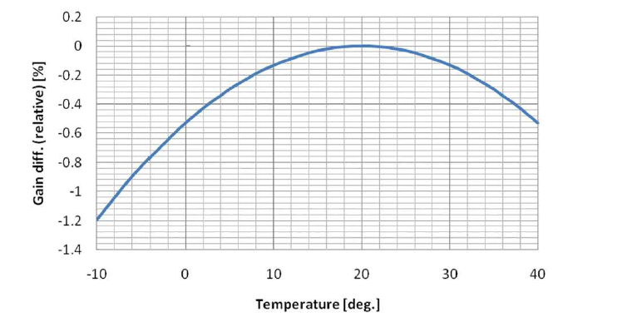
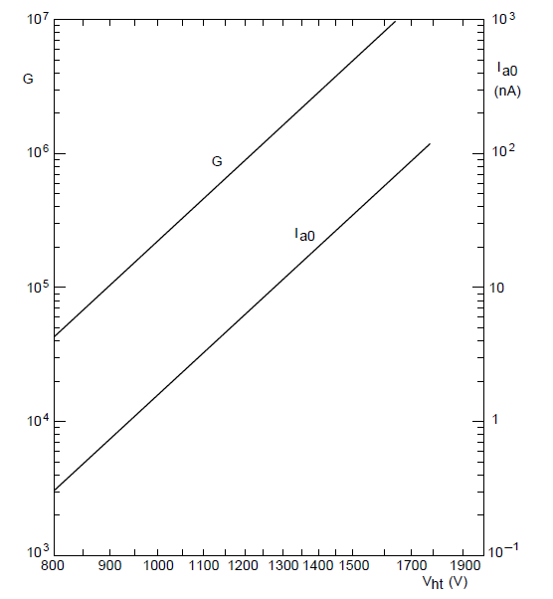
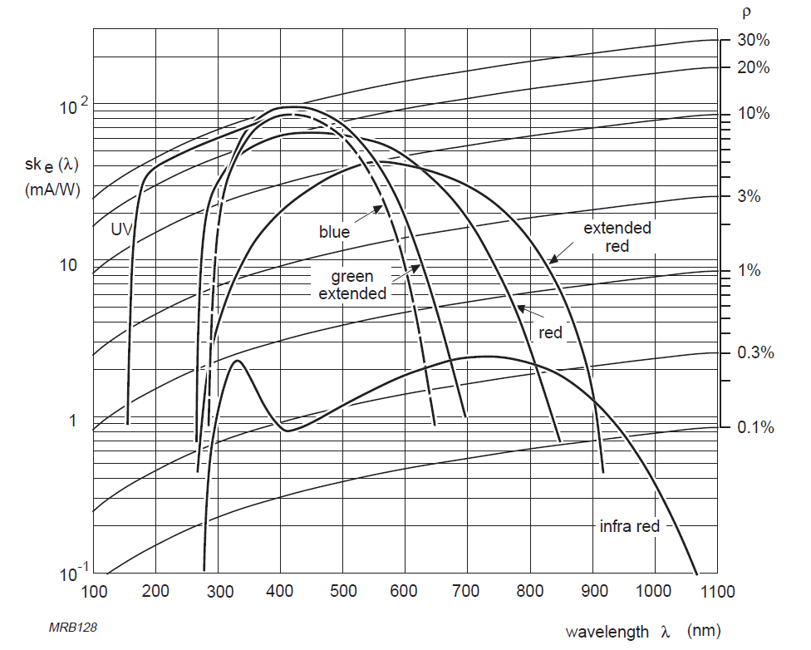
Photomultiplier Tube
Gain increases by a factor of 2 for every
ΔV = 100
Phillips Guide for PMT

Slide 16
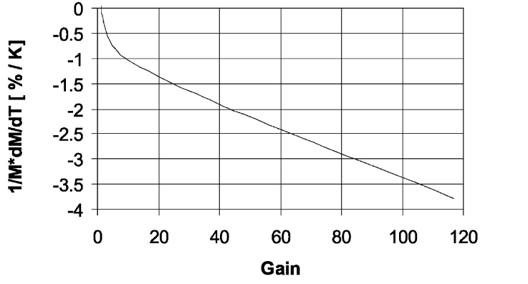
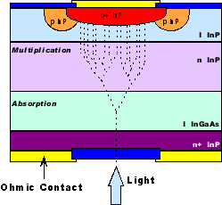
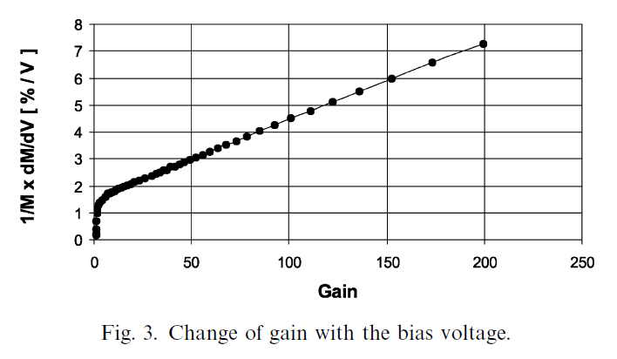
Avalanche Photo Diode (APD)
2.2%
Change of Gain with temp.
3%
Change of gain with bias votlage
Properties of the avalanche photodiodes for the CMS electromagnetic calorimeter . By K Deiters et al. Nuclear Instruments and Methods in Physics Research A 453 (2000) 223}226

Slide 17
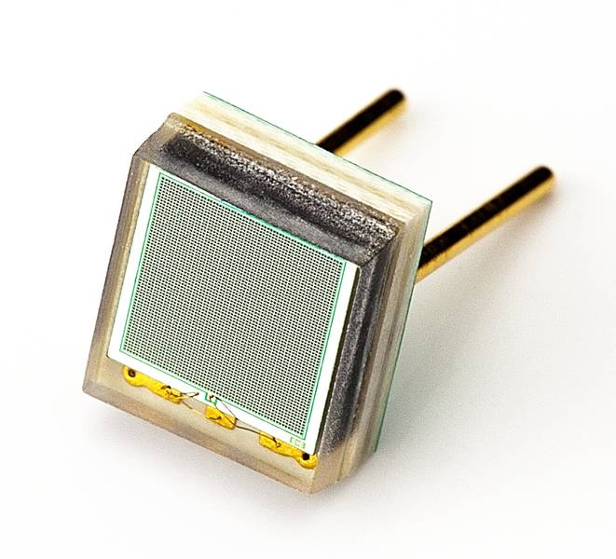
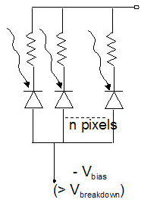
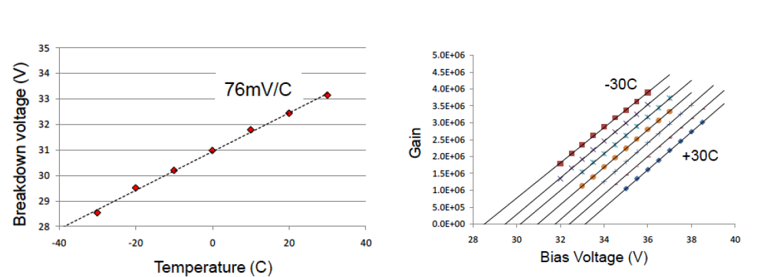
SiPM/APD
C. Piemonts, IRPD10, Sienna, June 2010

Slide 18
Photo Sensor
 | PMT Photomultiplier Tube | APD Avalanche Photodiode | SiPM Silicon Photomultiplier
Quantum Efficiency | 25% … 40% | … 80% | … 80%
Single Photon Resolution | Yes | NO | YES**
Operation Voltage | 1 - 3 kV | 100 - 500 V | 20 - 80 V
Gain | 10⁴ - 10⁹ | 30 - 300 | 10⁵ - 10⁷
Signal ready for processing | YES | NO Needs shaping and amplification | YES
TOF | YES | NO | YES
Sensitive to Magnetic Field | Yes | No | NO
Compactness | NO | YES | YES
Production Costs/Ch | Medium | Low | Potentially Low

Slide 19
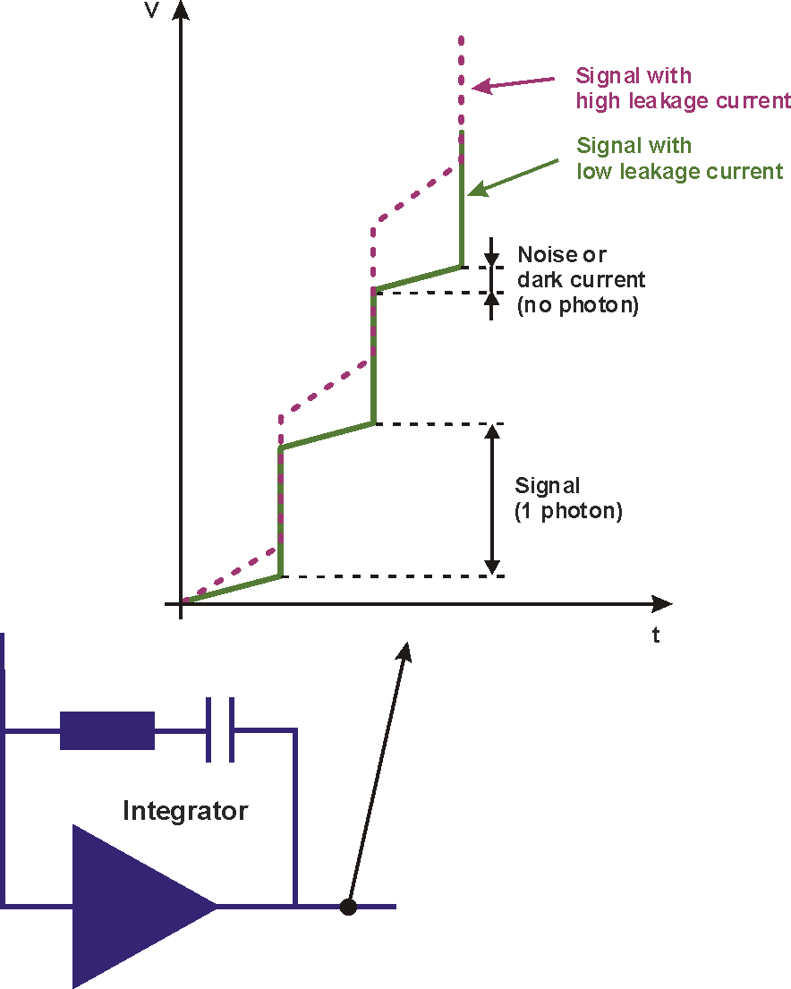
Electric Signal processing
Charge integration. The common way of reading the charge generated in one pixel
Photon counting is new approach comes from HEP background. It counts every photon capture in the pixel

Slide 20
Yield e- direct vs indirect conversion
1MeV in NaI(Tl) yields about 40000 photons. About 20% generate e- This means we should expect around 8000 +/- 90 e (Fano factor =1)
1MeV in Si yield 278000 +/- 167 e- (Fano Factor =0.1)
This means with Si we have direct conversion and the signal is 35 times bigger than that of NaI(Tl)

Slide 21
X-ray tube

Slide 22
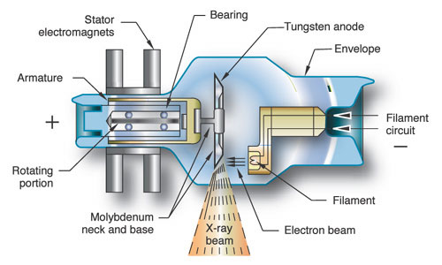
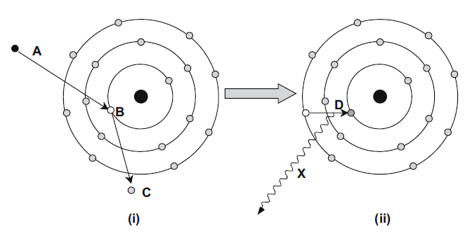
X-ray tube
Though it is the common way for generating X-ray beam, it is very inefficient process! We use about 0.1% of the power for the X-ray beam and the rest dissipate as heat. For this reason the X-ray tube used for short periods (seconds)

Slide 23
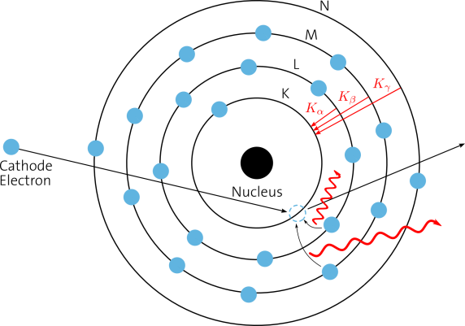
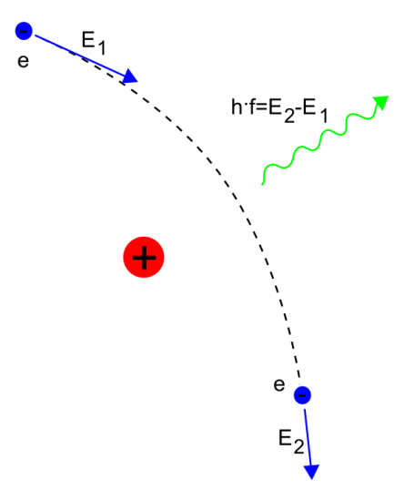
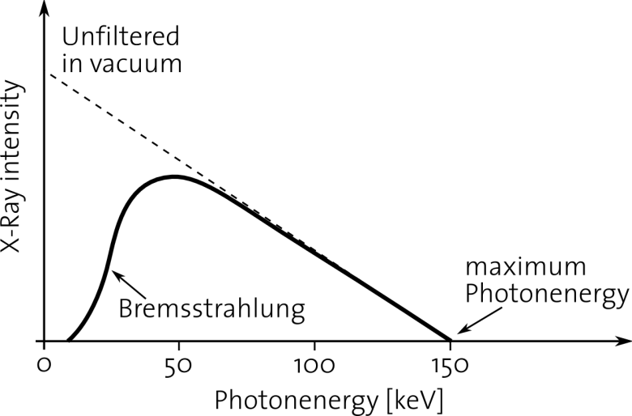
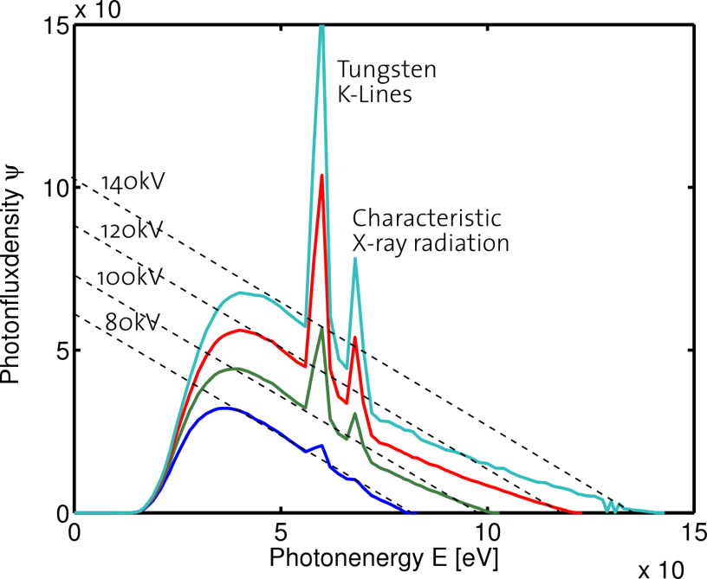
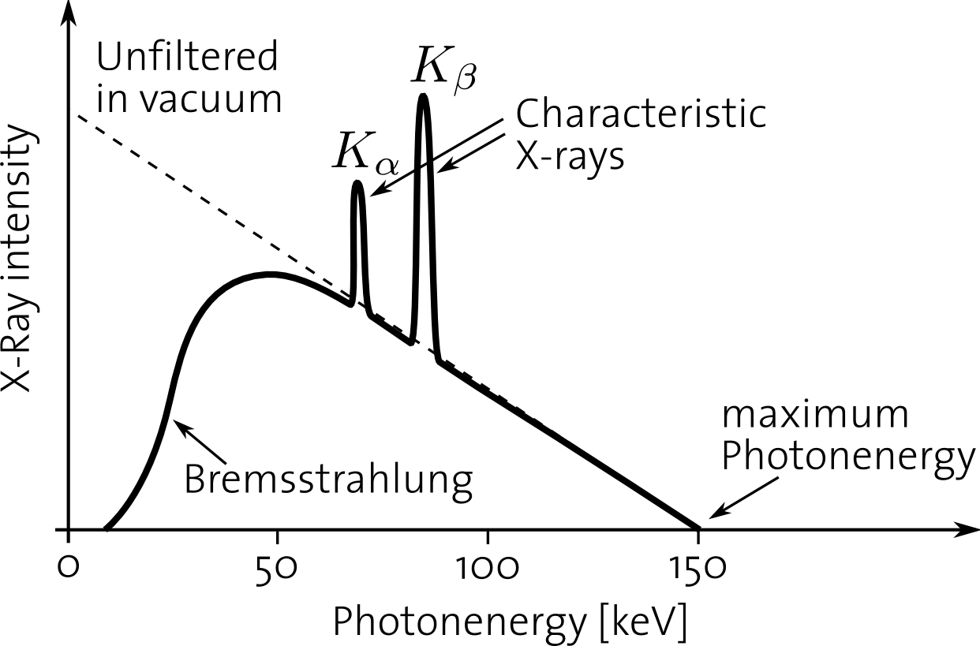
Spectra of an X-ray tube

Slide 24
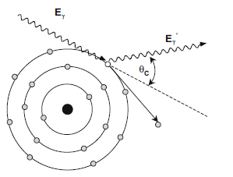
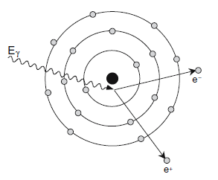
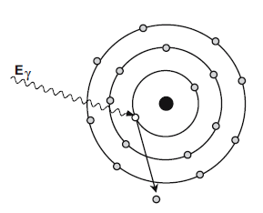
Interaction of Photon with Matter
Photoelectric effect all the energy from the photon get transferred to the inner shell electron causing ionization of the atom
In Compton scattering, part of the energy of the incoming photon is transferred to an electron. This electron is know as the recoil electron . The photon is deflected through an angle proportional to the amount of energy lost
The pair production process takes place if the photon passes close to the nucleous and has an energy above 1.022MeV

Slide 25
Detectors for Mammography

Slide 26
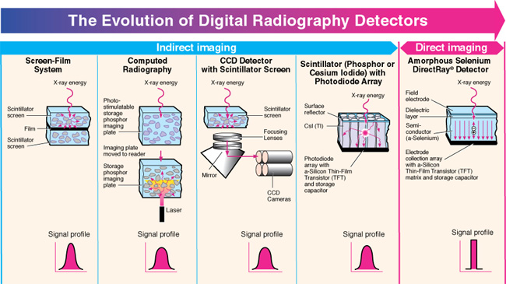
Different X-ray imaging detectors

Slide 27
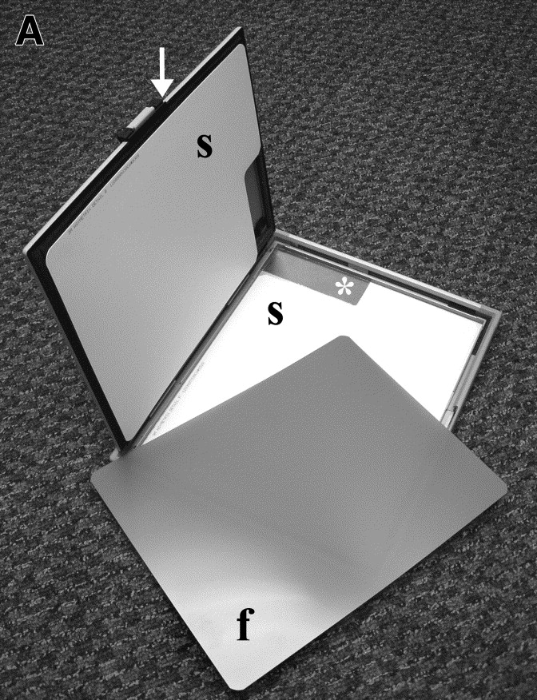
Mammography Detector Evolution

Slide 28
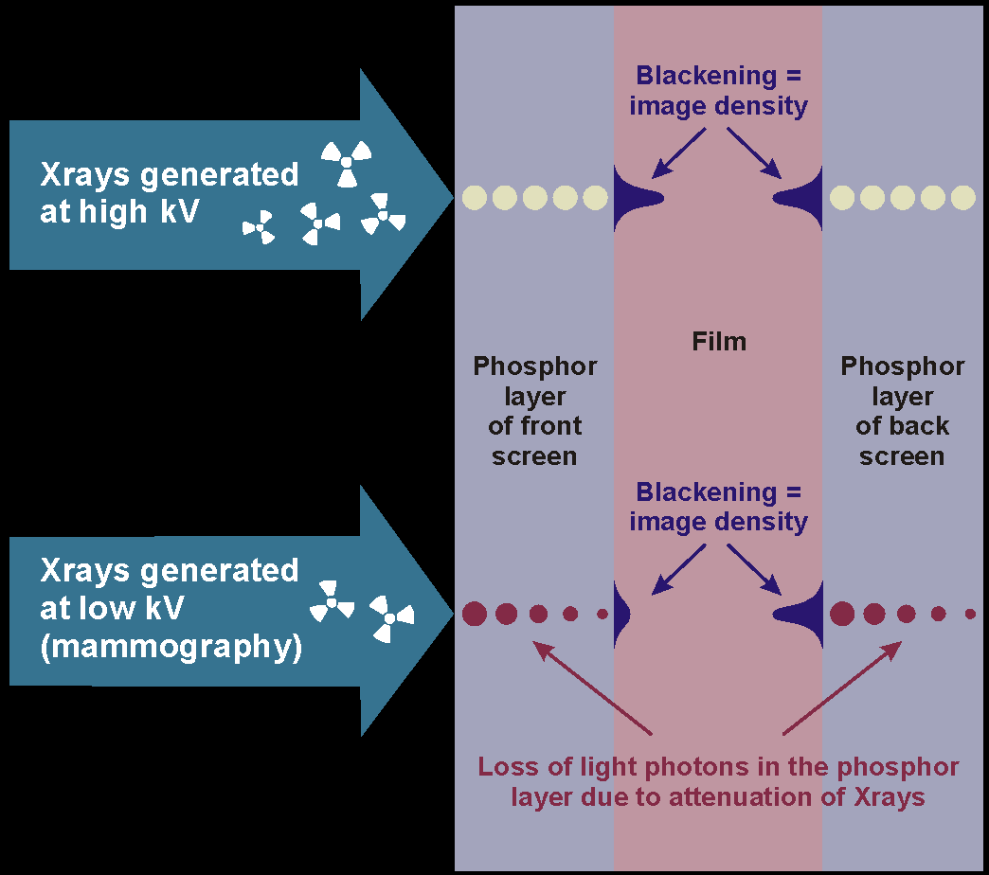
Increasing the QE if the film cassette

Slide 29
Analog Mammography (film cassette)

Slide 30
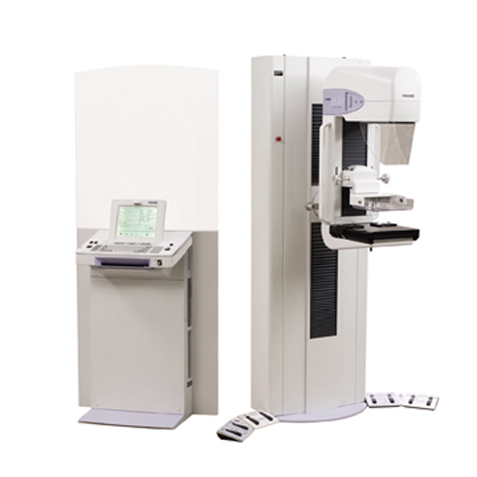
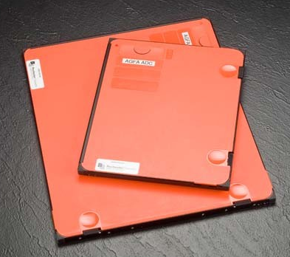
Mammography with CR Imaging Plate

Slide 31
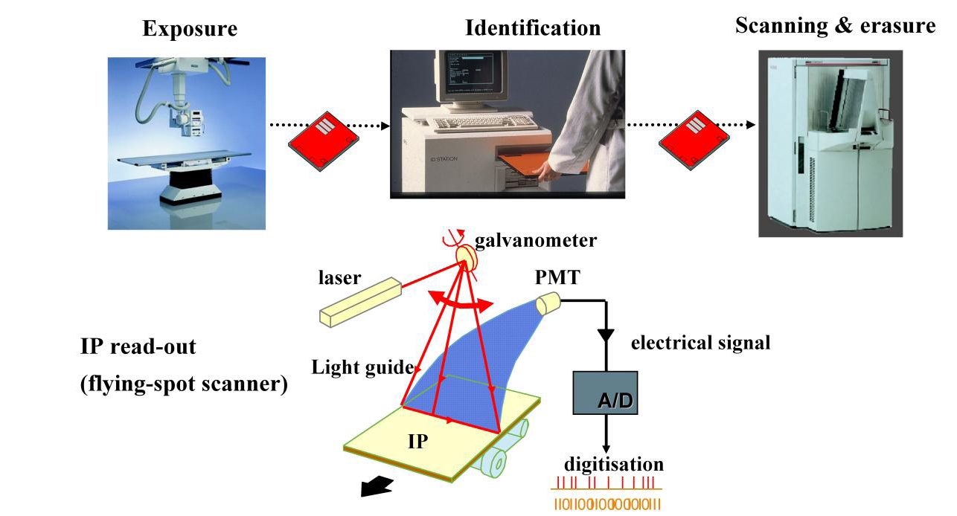
CR Storage Phosphor plate image acquisition
BaFBr:Eu²⁺

Slide 32
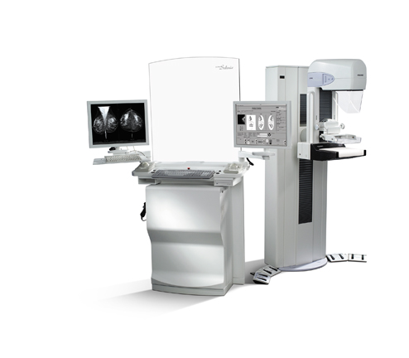
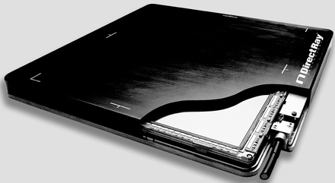
Digital Mammography
CsI deposited on a-Si (GE type)….this is indirect conversion
a-Se deposited on a-Si (Hologic type)…direct conversion

Slide 33
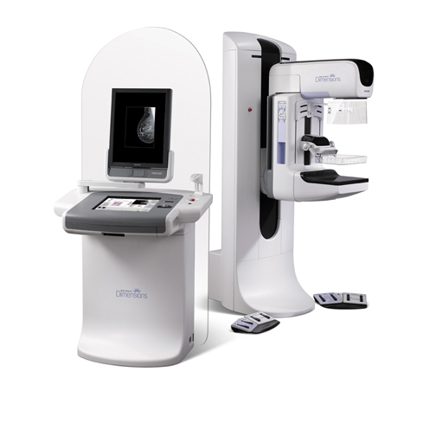
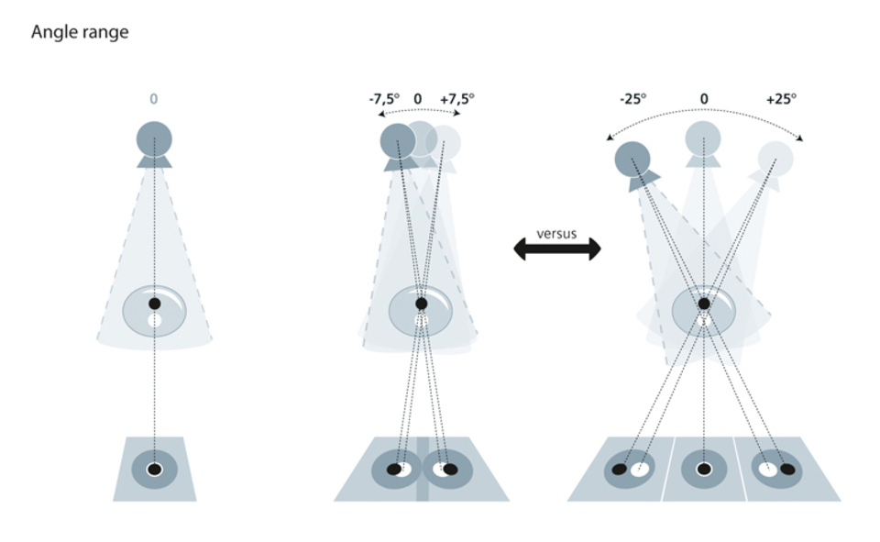
Mammoraphy Tomosynthesis

Slide 34
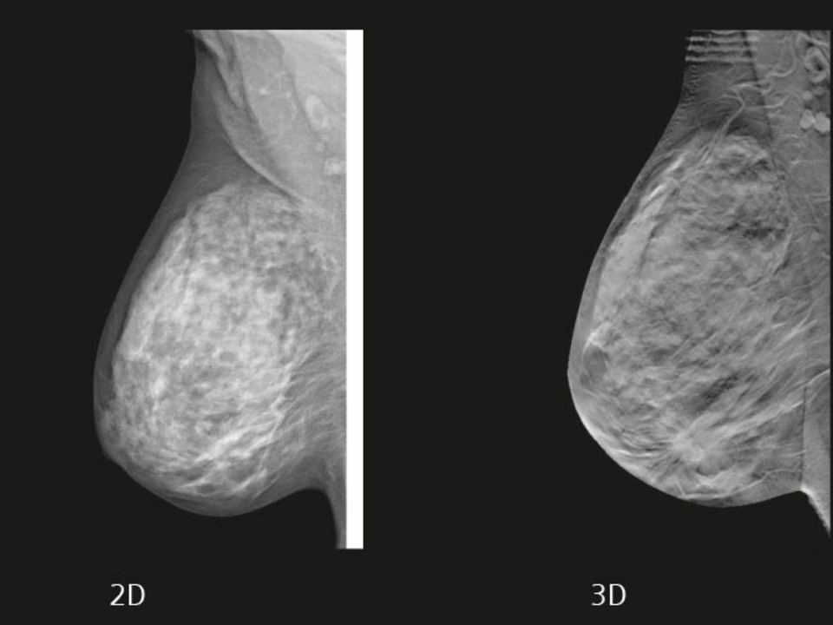
Mammograms of 3D v 2D

Slide 35
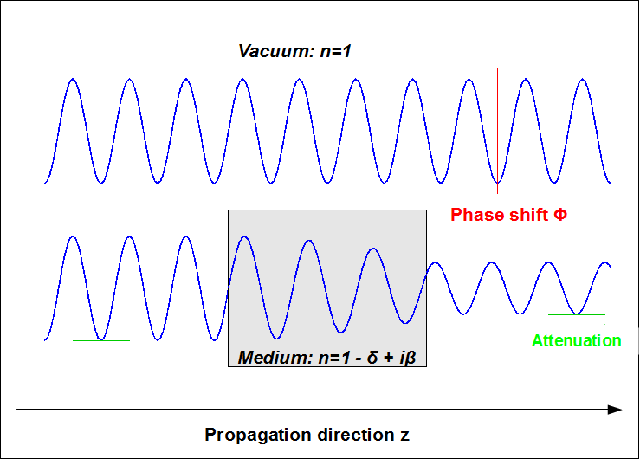
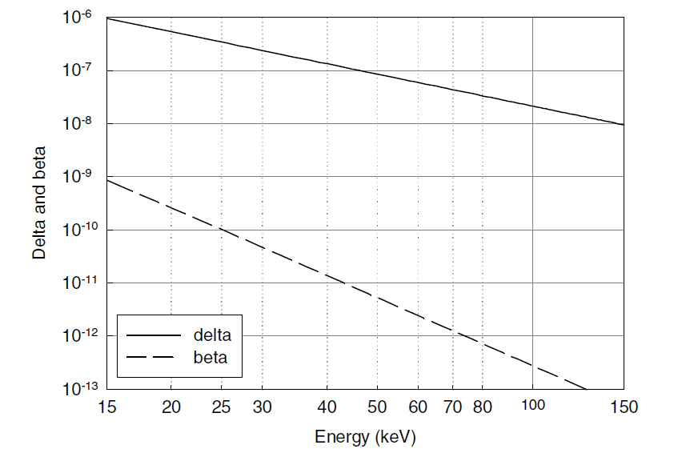
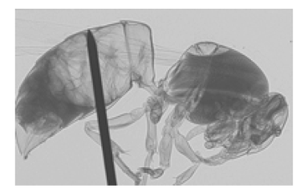
X-ray Phase shift contrast
n= 1-δ +iβ
Phase shift attenuation coef.
Radiography of a wasp using phase shift contrast
δ and β as function X-ray energy (Chantler et. at. 2003)

Slide 36
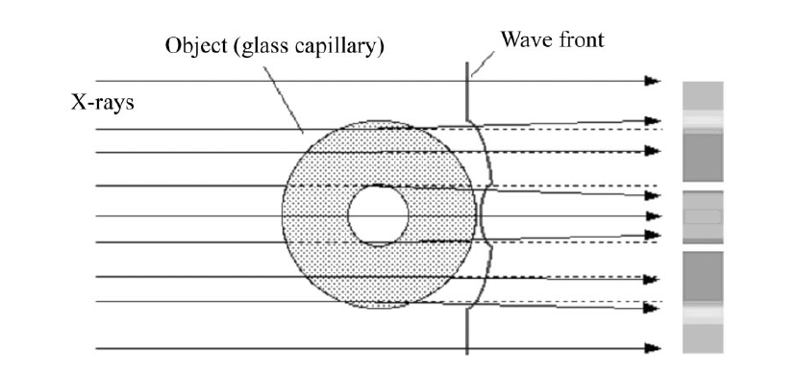
X-ray refraction
Illustrating the X-ray wafe front and trajectories through an object (plastic tube). The
Directions of the X-rays is slighted deflected at the interfaces in accordance with Snell’s law for refraction as in geometrical optics. However the direction of the deflectio is not the same as the visible light because the refractive index for X-rays is slightly smaller than unity. This means X-rays are focused by a concave lens, and defocused by a convex lens.

Slide 37
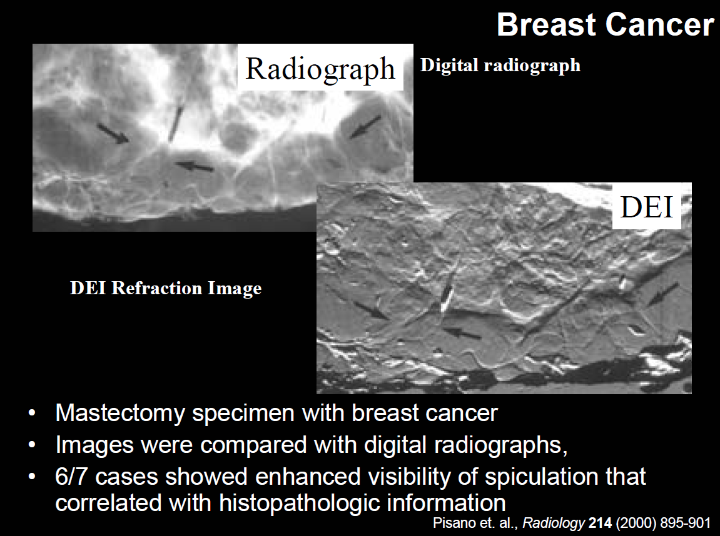
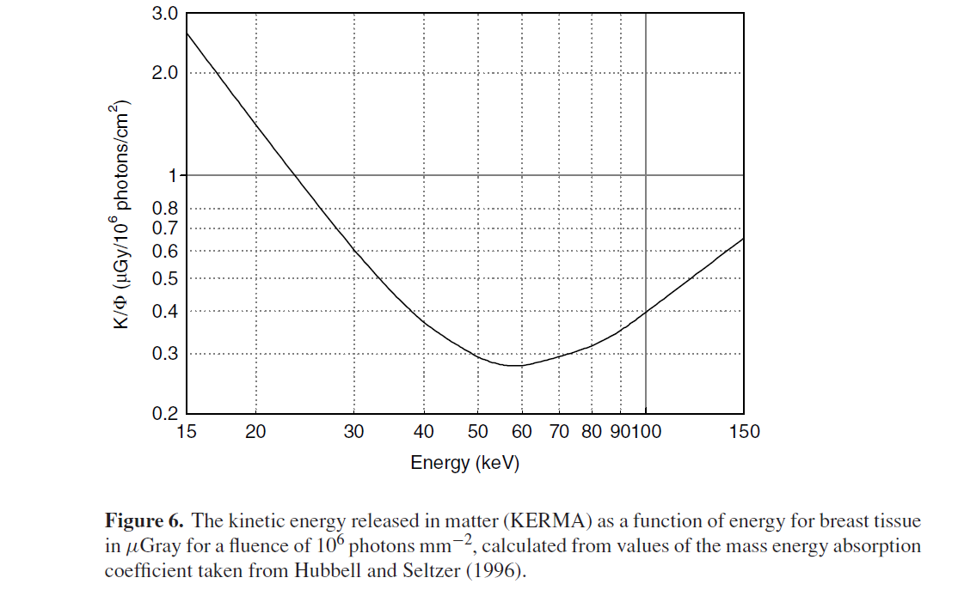
X-ray Phase Shift contrast
The kinetic energy released in matter as function of energy for breast tissue in μGray scale for a fluence of 10⁶ photons/mm² calculation of energy absorption coefficient.

Slide 38
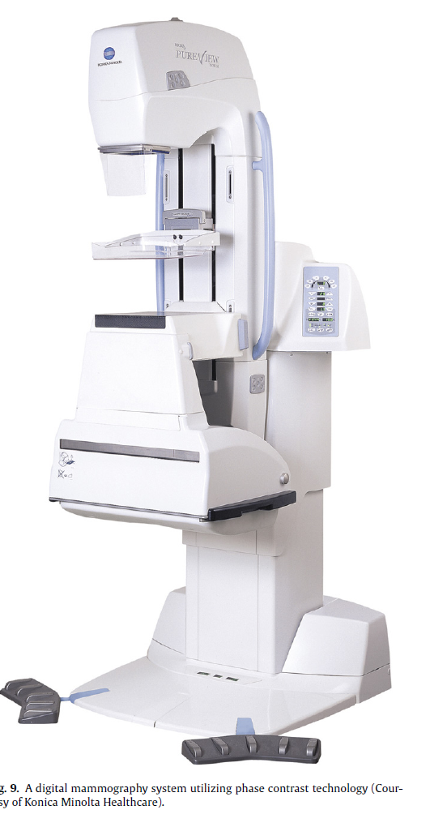
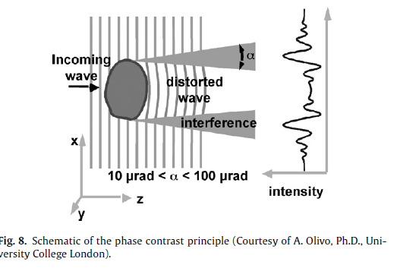
Phase-Shift Contrast Mammography

Slide 39
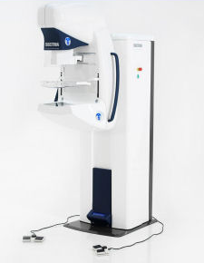
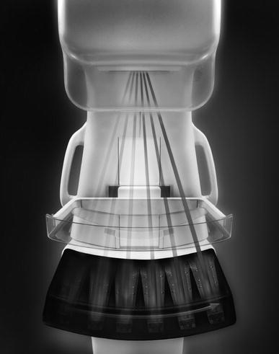
Photon Counting Mammography
Sectra MicroDose mammography machine

Slide 40

Sectra photon counting detector
Silicon strip detector with edge pointing to the X-ray tube

Slide 41



Photon Counting with Medipix2
24 cm
30 cm
Dear-Mama mammography detector based on Medipix2 chip

Slide 42
Image Quality

Slide 43






Image Quality
-Pixel size, detection efficiency, noise level are critical to image quality
-Making the pixel very small will not improve image quality because of charge sharing

Slide 44


MTF and DQE
@zero frequency
DQE(0) = # X-rays detected/ # X-rays emitted

Slide 45

Module Transfer Function (MTF)

Slide 46


MTF and DQE
MTFs of Commercial mammography system
Detectors for digital mammography by M. J. Yafee

Slide 47
Dual Energy Subtraction and Contrast Agent

Slide 48

Dual Energy Subtraction

Slide 49
Using Contrast Agent

Slide 50
Nano gold particles vs Iodine contrast agent

Slide 51
Gold nanoparticles: a new X-ray contrast agent
J.H. Hainfeld et al. Britich Journal of Radiology 79 (2006)

Slide 52
PET and Gamma Camera

Slide 53

PET/SPECT

Slide 54

Positron Emission Tomorgaphy

Slide 55

End Points of the LOR
Siemens Health Care Brochure

Slide 56

PET-CT Scan
CT Scan PET Scan Fused PET/CT Scan
Organ/bones Cell activity Exact locations of
Density profile high cell activity

Slide 57



PET/CT
Phillips PET/CT Ingenuity
Siemens PET/CT Biograph mCT
GE PET/CT OPTIMA

Slide 58

Time of Flight in PET
Δt_{A}=δt_{B}= 0.6nsec ( the decay of BaF₂ and using SiPM)
Δt_{tot}=0.8nsec
(d+d₁)-(d-d₁)=2d₁=cδ_{tot}=24cm.
d1= +/- 6cm as minimum blurring from BaF₂ time resolution

Slide 59

TOF in PET
The principle of TOF PET is illustrated schematically: photons travel at the speed of light, c, and, therefore, one of the annihilation photons will arrive at the detector with a time-delay of 2∆/c, where ∆ is the distance of the positron–electron annihilation from the axis of the tomograph. 800ps time will result in +/-6cm uncertainty in the origin of the PET event. Effectively this information will help to reduce the scan time by half.
The future of hybrid imaging—part 2: PET/CT by Beyer, Thomas; Townsend, David W.; Czernin, Johannes; Freudenberg, Lutz S. Journal: Insights into Imaging Vol. 2 Issue 3

Slide 60
Nuclides used for PET imaging
Nuclide | Radio-Pharmaceutical | Used for imaging | Half life (min) | β⁺ energy max (MeV) | Max/Mean free path (mm)
C-11 | C11-L-methyl-methionine | Brain tumor | 20.4 | 0.96 | 3.9/1.1
N-13 | N13-Ammonia | Myocardial blood flow | 9.96 | 1.19 | 5.1/1.5
0-15 | O15-Water | Cerebral blood flow | 2.03 | 1.723 | 8/2.5
F-18 | F18-FDG (Fluorodeoxyglucos) | Brain, heart and oncology | 109.8 | 0.635 | 2.4/0.6
 | F18-Sodium Fluoride | Brain
 | F18-Fluorocholine | Prostate tumor
Ga-68 | Ga68-Dotatoc | Neuroendocrine tumor | 68 | 1.899 | 8.9/2.9

Slide 61
MRI-PET modality
Simultaneous PET and MR images acquired on a Siemen's Magnetom Trio MRI equipped with BrainPET insert. From left-to-right: T₂ turbo spin echo (TSE) sequence, FDG PET image, fusion of TSE and PET image. MR and PET data acquired simultaneously. (D. Townsend and C. Nahmias, University of Tennessee; and H-P Schlemmer et al.,University of Tübingen.)

Slide 62


MRI-PET modality
PET FDG
MRI
Frederik Barkhof et al. Alzheimer Centre and Image Analysis Centre, Vrije Universiteit Medical Center, Amsterdam and the Rijnland Hospital, Leiderdorp, The Netherlands

Slide 63



PET/MRI
Phillips PET/MRI device using PET and MRI side-by-side. SiPM as photo sensor and TOF for image reconstruction
Siemens has the PET inside the MRI coil. A true PET/MRI. Uses APD as photo sensor

Slide 64
Resolution of different PET Scanners
Feature\Model | Phillips Gemini TF | Siemens Biograph mCT | GE Discovery VCT | ? VIP
Sensitivity (CSP/Kbq) | 7.2 | 9.5 | 9.1 | 14.4
Transverse Resol. at 1cm (mm) | 4.7 | 4.4 | 5.1 | 0.7
Transverse Resol. at 10cm (mm) | 5.2 | 5.8 | 5.6 | 0.9
Axial Resol. at 1cm (mm) | 4.7 | 4.5 | 5.6 | 1.3
Axial Resol. at 10cm (mm) | 5.2 | 4.8 | 6.3 | 1.9
Peak noise equiv. count rate (kcps) | 94 | 100 | 76 | 122
Scatter fraction(%) | 31 | 36 | 38 | 4

Slide 65


VIP Conceptual Design

Slide 66


Anger Gamma Camera

Slide 67


Parallel-hole Collimator

Slide 68

Pin-hole Collimator

Slide 69

Collimator Efficiency
Invariance of collimator efficiency with source to collimator distance applies to point sources, line sources and uniform sheet source in air with parallel hole collimators.
For b= 1mm, θ=0, L=D=100mm,
Then Spatial resolution =2mm, and efficiency ≈10⁻⁵

Slide 70

Coded-Aperture Gamma Camera
Development of Coded-Aperture Imaging With a Compact Gamma Camera M. Gmar, et al. IEEE TRANSACTIONS ON NUCLEAR SCIENCE, VOL. 51, NO. 4, AUGUST 2004

Slide 71



VIP Compton Camera
For each scattered gamma event is sitting on a cone. The cones intersect in a common point, the source of the gamma events
Scatter detector 2cm thick of Si and the absorber detector is 4cm thick of CdTe

Slide 72


VIP Compton Camera Spatial
- For a¹⁸F isotope source the sensitivity is 12 cps/kBq
- For a^{99m}Tc isotope source the sensitivity is 15 cps/kBq

Slide 73

Radiopharmaceutical for Gamma Camera
From Health Physics Society

Slide 74

Siemens Gamma Camera
Integrated CT
Dual camera to get a stereo view improving image quality

Slide 75
Summary

Slide 76
 | Resolution (mm) | Detection efficiency (%)
Mammography | 0.1 – 0.2 | 30
PET | 3 - 5 | 1
Gamma Camera | 10 - 20 | 0.01
- With big leaps in technology we should expect to have better diagnostic systems when it comes to better spatial resolution and lower dose in particular for PET/Gamma Camera
One should be creative by innovating new techniques to improve image quality such as the use of new contrast agents or something like Tomosynthesis
New smart design of X-ray tube similar to the LED will make it possible to have monochromatic beam with few Watts power yield
- We, High Energy Physicists, can have important contribution in this field because the detector technology is similar to our field.

Slide 77
Thank you for your attention

