Slide 1
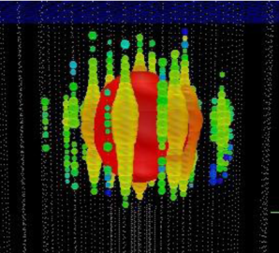


High-Energy Neutrino Telescopes:
Breakthrough?
XLII Int. Meeting on Fundamental Physics, Benasque, Jan 31 2014
Christian Spiering

Slide 2
Physics with neutrino telescopes
Search for the sources of high-energy cosmic rays
Dark Matter and Exotic Physics
  WIMPs
  Magnetic Monopoles and other superheavies
  Violation of Lorentz invariance
Neutrino and Particle Physics
  Neutrino oscillations (incl. mass hierachy)
  Charm physics
  Cross sections at highest energies
Supernova Collapse Physics
  MeV neutrinos in bursts → early SN phase, neutrino hierarchy, ...
Cosmic Ray Physics
  Spectrum, composition and anisotropies

Slide 3
Physics with neutrino telescopes
Search for the sources of high-energy cosmic rays
Dark Matter and Exotic Physics
  WIMPs
  Magnetic Monopoles and other superheavies
  Violation of Lorentz invariance
Neutrino and Particle Physics
  Neutrino oscillations (incl. mass hierachy)
  Charm physics
  Cross sections at highest energies
Supernova Collapse Physics
  MeV neutrinos in bursts → early SN phase, neutrino hierarchy, ...
Cosmic Ray Physics
  Spectrum, composition and anisotropies

Slide 4
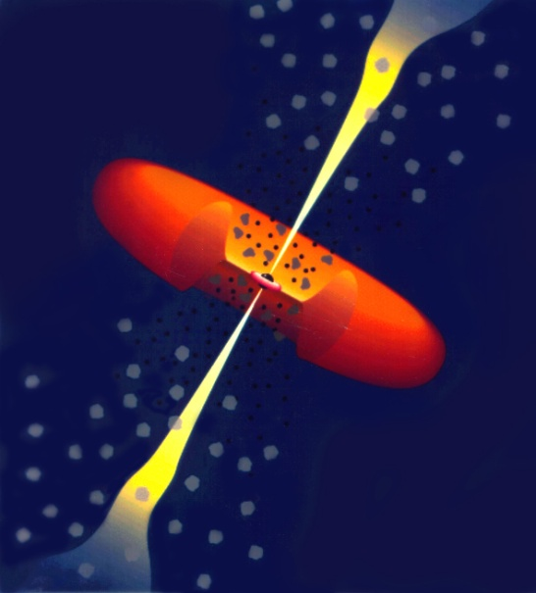
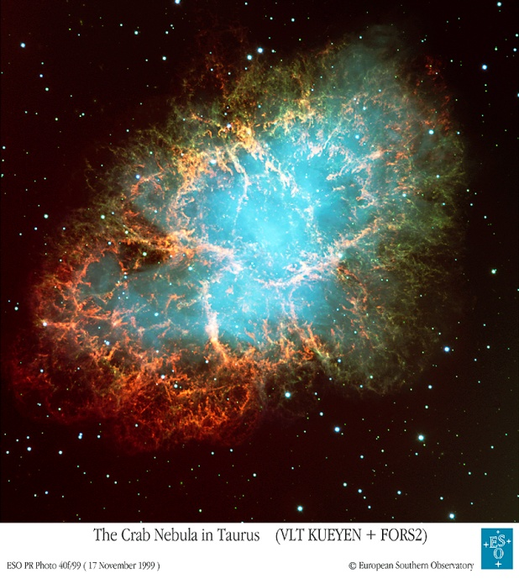
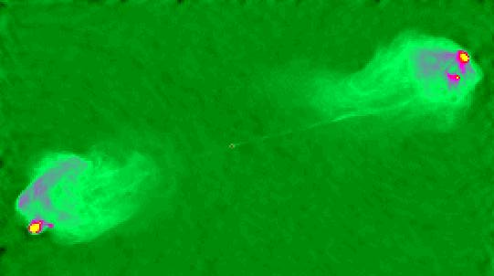
Prominent Source Candidates
Extra-Galactic
Galactic
AGN
Starburst Galaxies
Galaxy Clusters
GRB
SNR
Microquasars
Young SN shells
Pulsars

Slide 5
Prominent Source Candidates
Extra-Galactic
Galactic
10¹⁶⁻¹⁷ eV
AGN
Starburst Galaxies
Galaxy Clusters
GRB
SNR
Microquasars
Young SN shells
Pulsars

Slide 6
Prominent Source Candidates
Extra-Galactic
Galactic
10¹⁶⁻¹⁷ eV
AGN
Starburst Galaxies
Galaxy Clusters
GRB
10²⁰⁻²¹ eV
SNR
Microquasars
Young SN shells
Pulsars

Slide 7
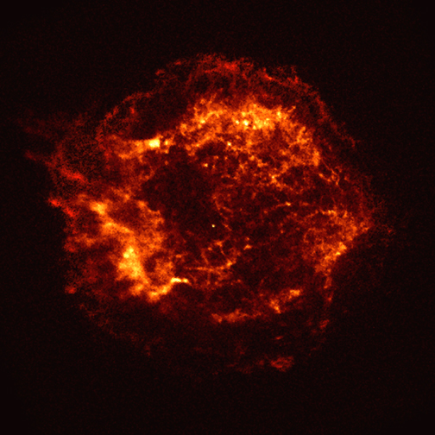
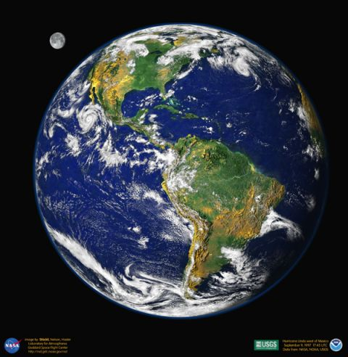
Charged cosmic rays vs. gamma rays and neutrinos
Charged particles
γ,ν
ν

Slide 8
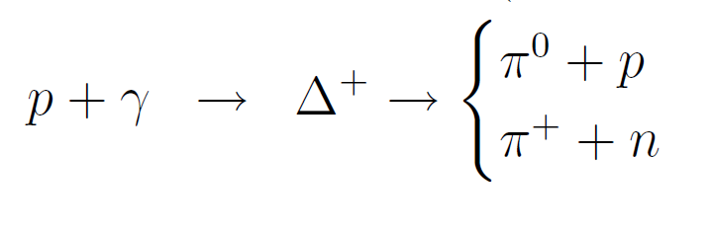

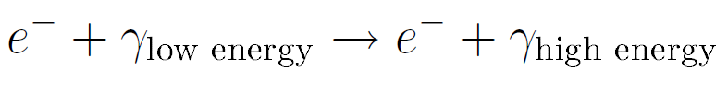
Gamma Rays: hadronic or electromagnetic origin?
Hadronic:
Electromagnetic (Inverse Compton Scattering):

Slide 9
p + target → π⁺ + …..
→ μ⁺ + ν_{μ}
→ e⁺ + ν_{e} + ν_{μ}
at source: ν_{e} : ν_{μ} : ν_{τ} = 1:2:0
at Earth: ν_{e} : ν_{μ} : ν_{τ} = 1:1:1

Slide 10

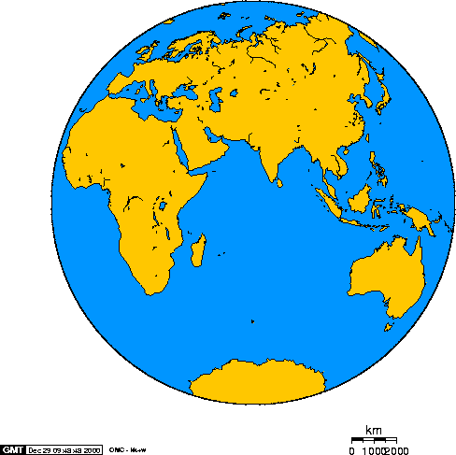
The devices
Baikal
Antares
AMANDA
IceCube

Slide 11
Detection: Signal and Background
generic: E⁻² ~ E^{-3.7}

Slide 12
Detection Modes
Muon track from CC muon neutrino interactions
  Angular resolution < 1°
  dE/dx resolution factor 2-3
Cascade from CC electron/tau and NC all flavor interactions
  Angular resolution 10° at 100 TeV
  Energy resolution ~ 15%

Slide 13
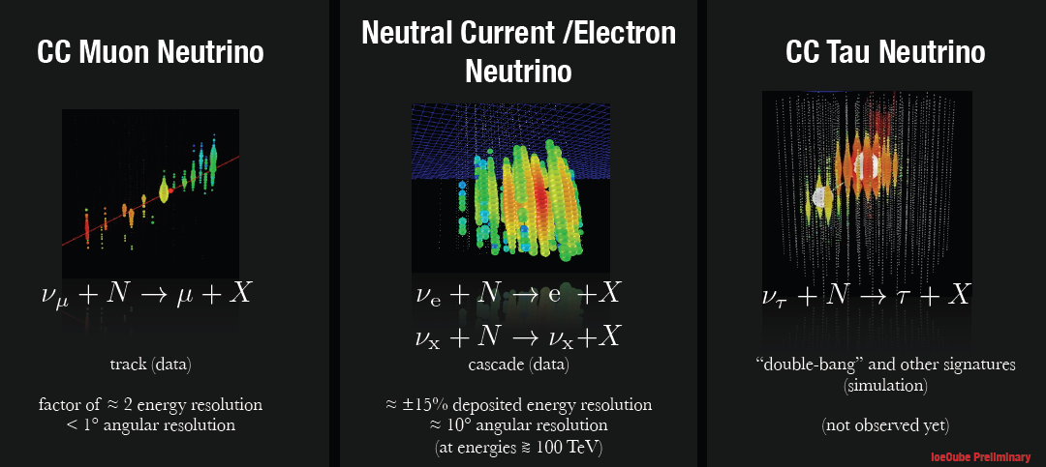
Detection Modes
Muon track from CC muon neutrino interactions
  Angular resolution < 1°
  dE/dx resolution factor 2-3
Cascade from CC electron and NC all flavor interactions
  Angular resolution 10° at 100 TeV
  Energy resolution ~ 15%

Slide 14
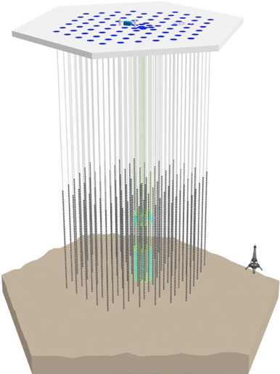
IceCube Neutrino Observatory
IceTop air shower detector
81 pairs of water Cherenkov tanks
IceCube
86 strings including 8 Deep Core strings
60 PMT per string
DeepCore
8 closely spaced strings
1450m
~220 ν/day
Threshold
- IceCube ~ 100 GeV
- DeepCore ~10 GeV
2450m
2820m

Slide 15
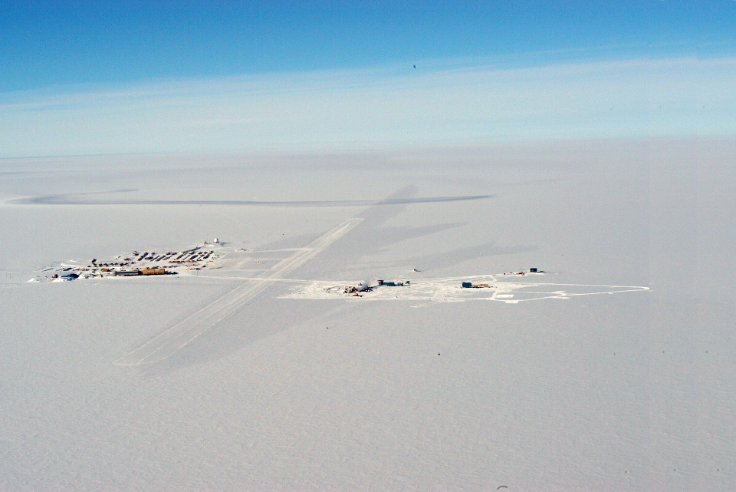
The Amundsen-Scott Station
South Pole Station Building Astronomy Sector
IceCube
AMANDA
skiway

Slide 16
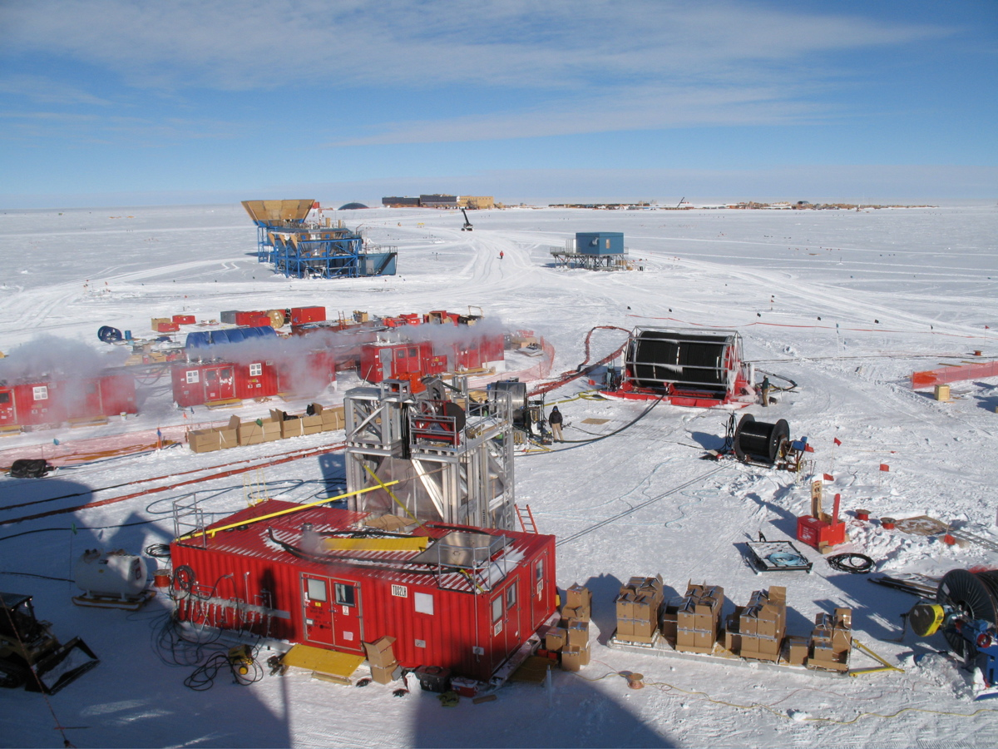
The Drill Camp
- 5 MW power
- 16 m³ kerosine
per hole

Slide 17
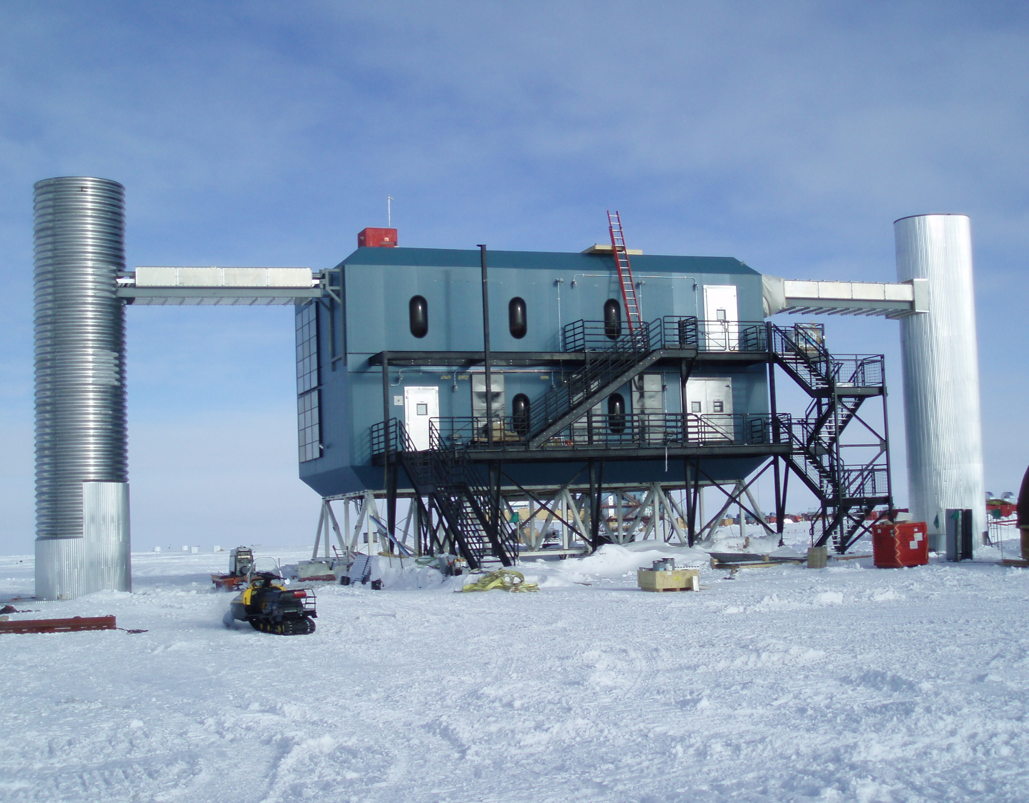
IceCube Laboratory and Data Center

Slide 18
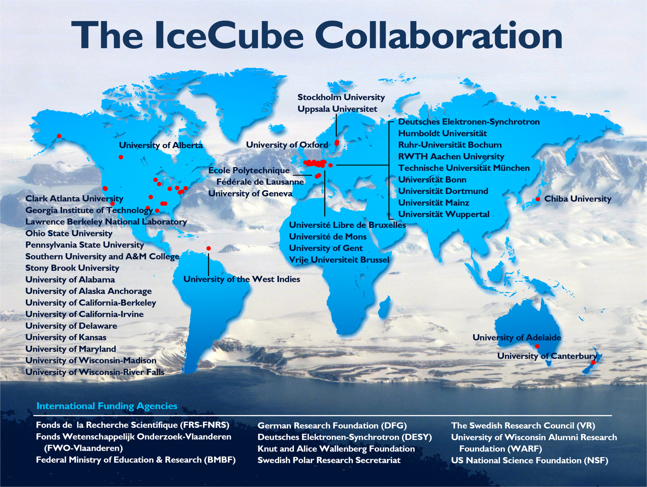

Slide 19
atmospheric neutrinos

Slide 20
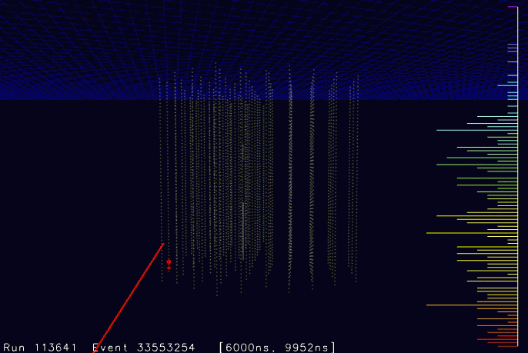
Upward moving muon in IceCube

Slide 21
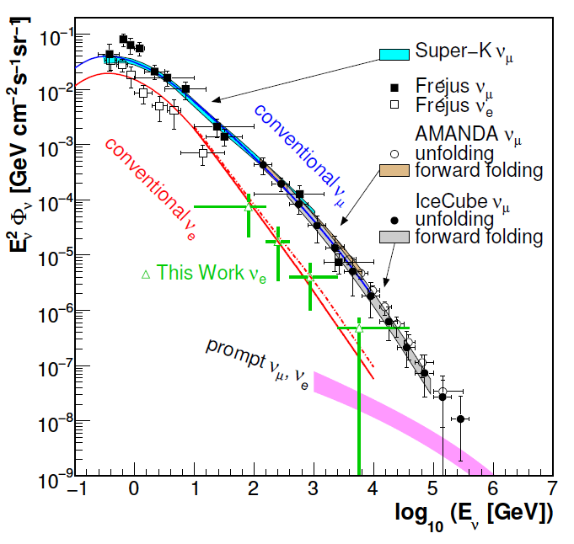
Atmospheric neutrinos in IceCube
proton
c,(b)
prompt
e,μ
νe,μ
π
μ
νμ
e
νμ
νe
conventional

Slide 22
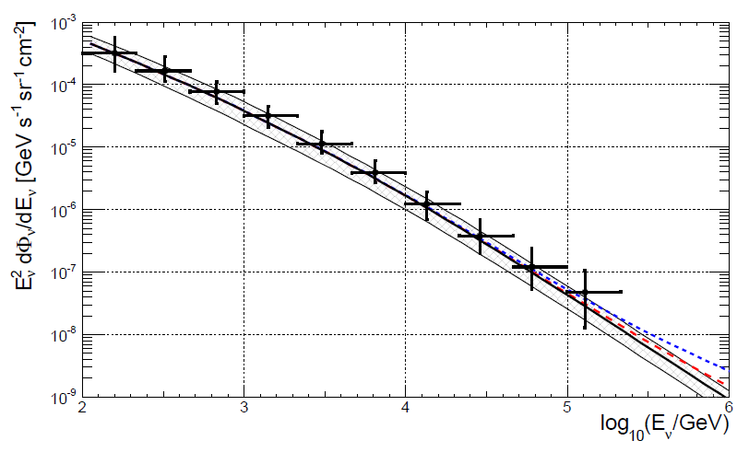
Atmospheric neutrinos in IceCube
.. and ANTARES
arXiv:1308.1599

Slide 23
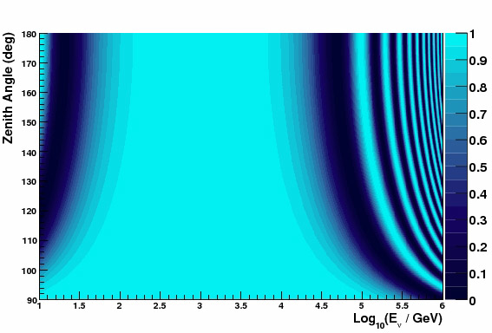
Oscillations of atmospheric neutrinos
Muon neutrino survival probability
Vertically upward
cosmic
ray
ANTARES/DeepCore
ν
Earth
L
θ
Horizontal

Slide 24
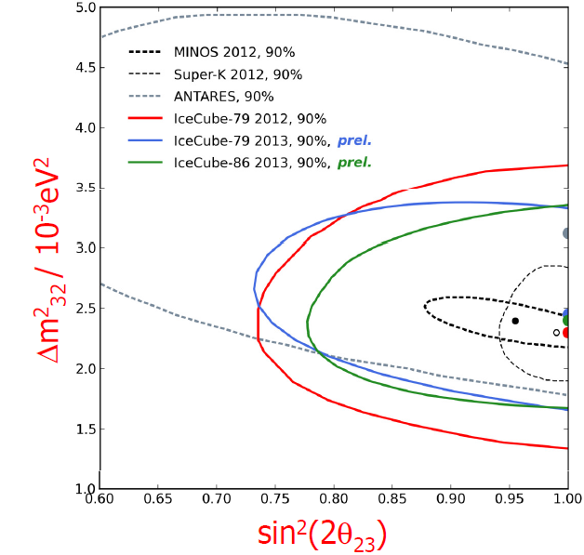
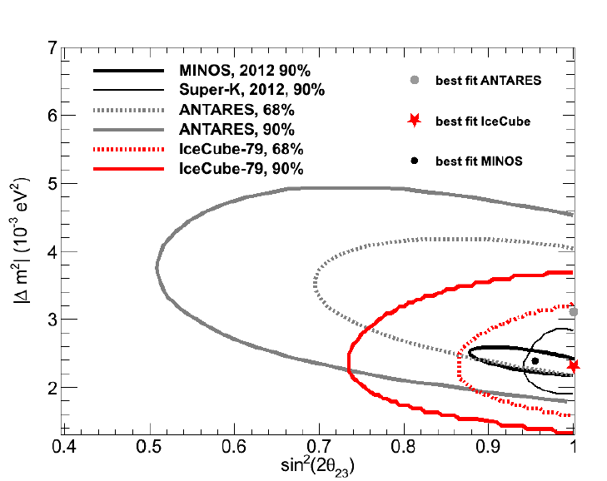
Oscillations of atmospheric neutrinos
Muon neutrino survival probability
Vertically upward
cosmic
ray
ANTARES/DeepCore
ν
Earth
L
θ
Horizontal

Slide 25
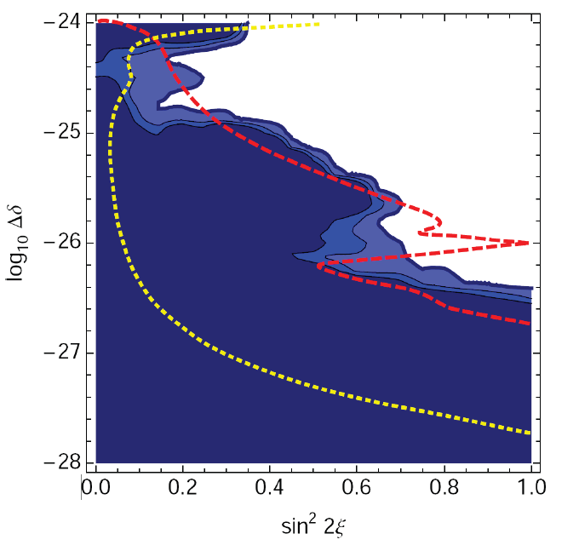
Oscillations of atmospheric neutrinos
Muon neutrino survival probability
Vertically upward
Oscillations
to sterile ν
Non-standard
oscillations due
to VLI
ANTARES/DeepCore
δc/c = 10⁻²⁷
Standard
oscillations
VLI
AMANDA
90%, 95%, 99%
SK + K2K
90%
Horizontal
IceCube
10y, 90%

Slide 26
Search for extra-terrestrial neutrinos
• Steady point sources
• Transient sources: GRB
• Diffuse flux

Slide 27
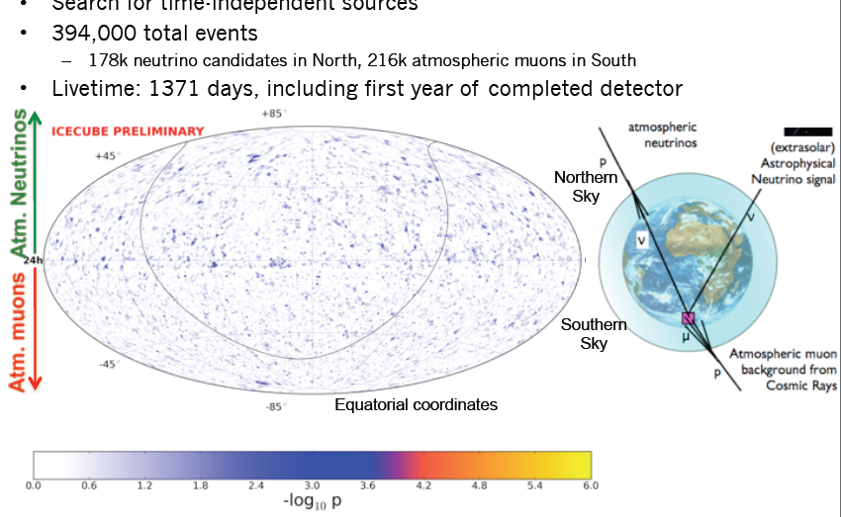
Point Source IceCube 4 years IC40/59/79/86
April 2011-March 2012
N o r t h
S o u t h

Slide 28
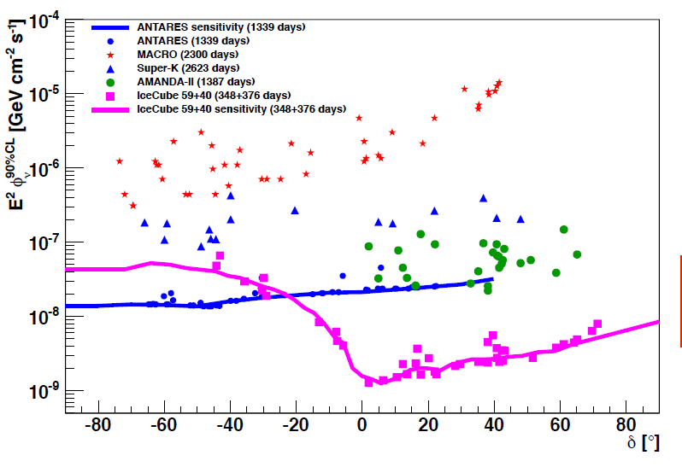
Limits for steady point sources
Factor 1000 in 12 years
No detections yet
ANTARES is best at Southern Sky IceCube sensitivity at Southern sky only for cut-off at >> PeV
Expect another factor 3 for IceCube in 2016
KM3NeT/GVD would give ~ factor 50 w.r.t. Antares
early Amanda limit
IceCube 4 years
preliminary
Southern Sky | Northern Sky

Slide 29
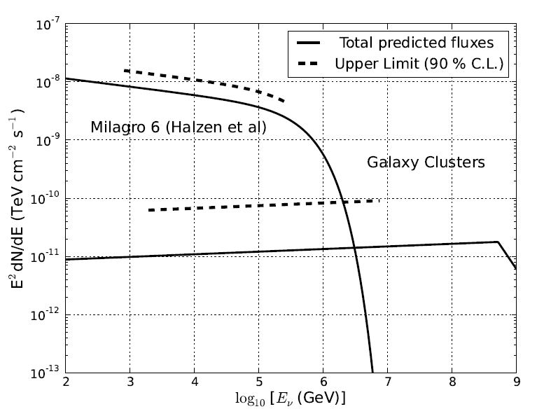
IceCube 3 years: upper limits and predictions

Slide 30
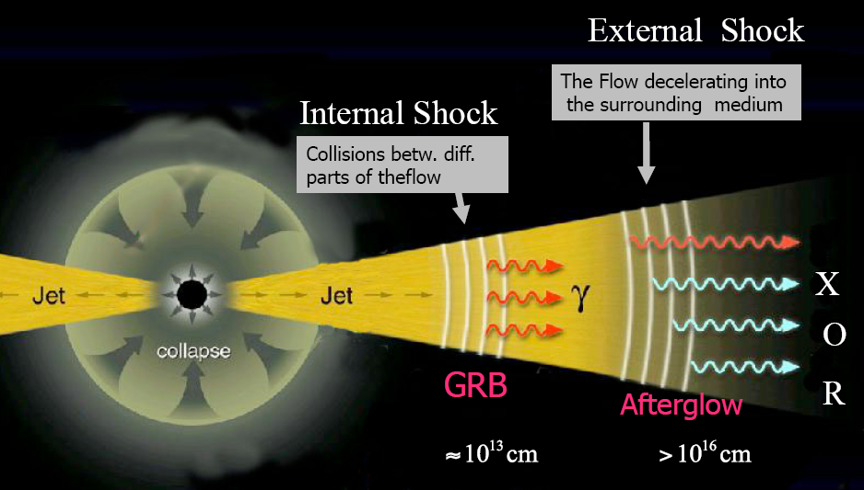
Gamma Ray Bursts

Slide 31
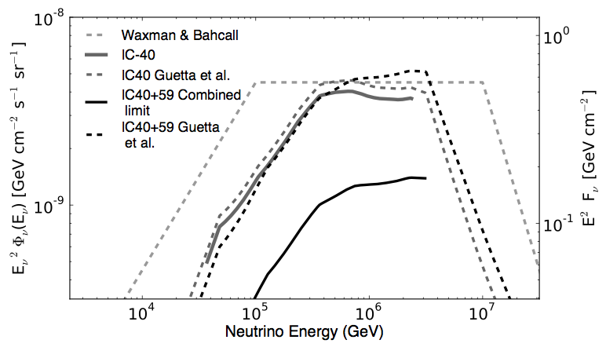
GRB Coincidence Search: IceCube
225 GRB at Northern sky (IC40 + IC59)
No IceCube event in time and direction coincidence
5.1 coincidences expected (Guetta et. al)
Standard fireball model à la Waxman or Guetta excluded with > 3σ (Nature 484 (2012) 351)
Winter et al. have modeled the fireball numerically, using more realistical particle energy distributions, and got fluences less by nearly one order of magnitude !

Slide 32
Diffuse extraterrestrial neutrino fluxes
Topologies:
Upward going muons
Downward muons with track starting in detector
Contained cascades
Selection criteria:
High Energy
Flavour ratio
Angular distribution
Accompanying muons (IceCube) or air showers (IceTop)

Slide 33
Search for an extraterrestrial diffuse ν flux
proton
c,(b)
prompt
e,μ
νe,μ
π
μ
νμ
e
Extra-terrestrial
νμ
νe
conventional

Slide 34
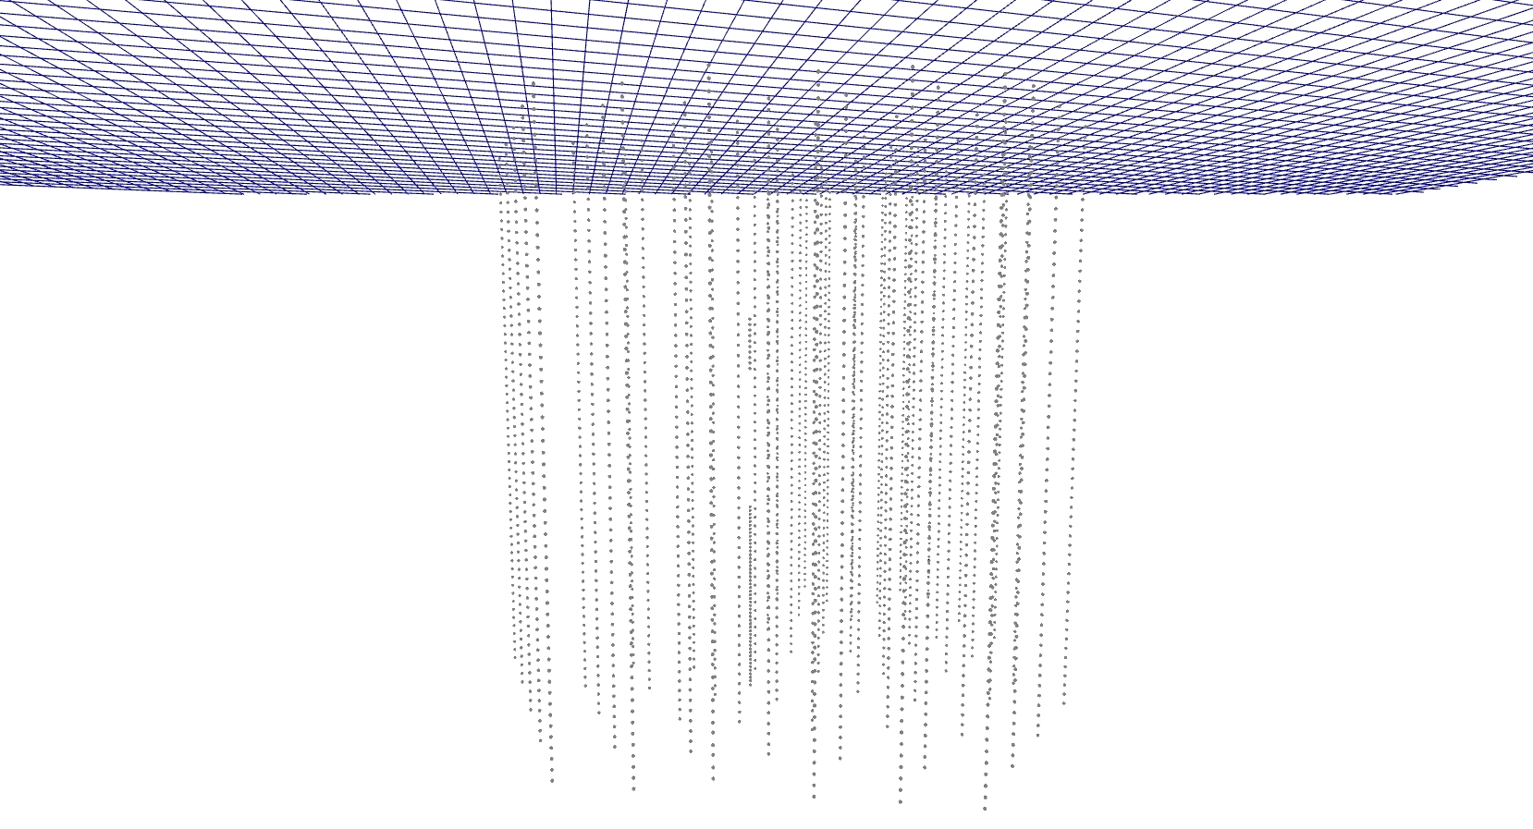
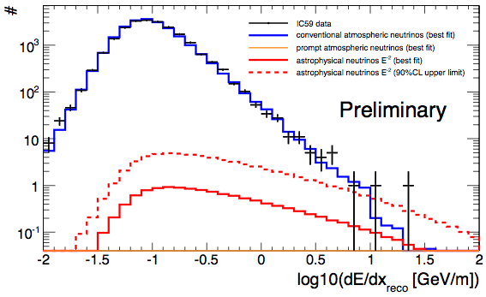
IceCube-59: upward muons
A 400 TeV muon crossing IceCube
Most likely neutrino energy 0.5 – 1 PeV
1.8σ excess
IC-79 data: unblinded but still confidental

Slide 35
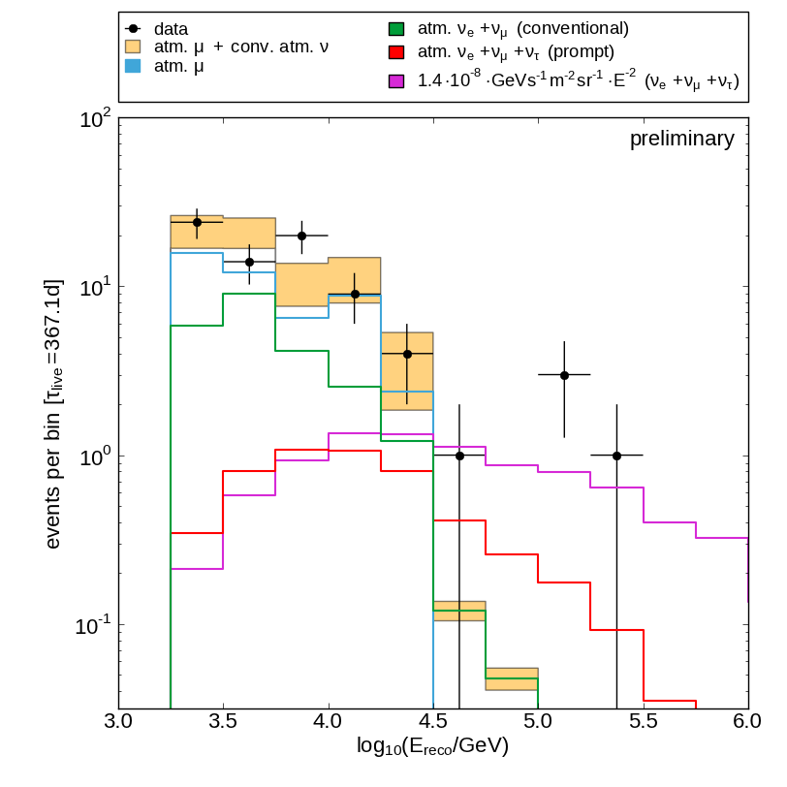
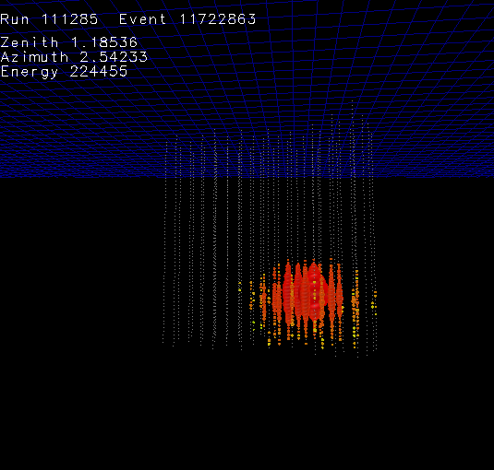
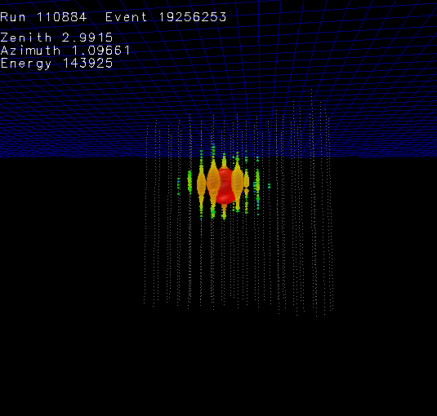
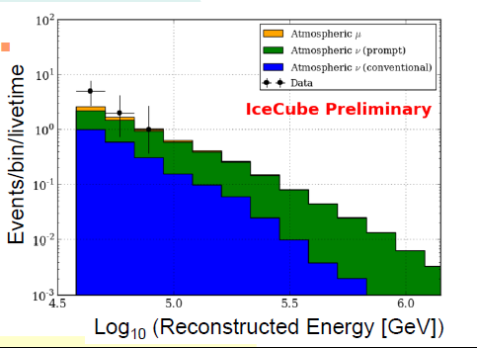
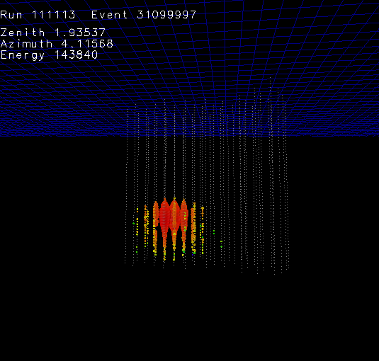
IceCube contained cascades
IceCube-40
3 cascade events 2.7 σ excess
IceCube-59
Mild excess over conventional atm. neutrinos
~ 220 TeV
~ 140 TeV
~ 140 TeV

Slide 36
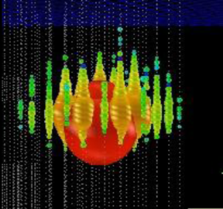
Special Search for cosmogenic ν (Berezinsky Zatsepin)
Ernie Bert
~1.04 PeV ~ 1.14 PeV
IC79/IC86
2.8 σ
Both downgoing
Unbroken E⁻² would give 8-9 events at higher energy → cut-off

Slide 37
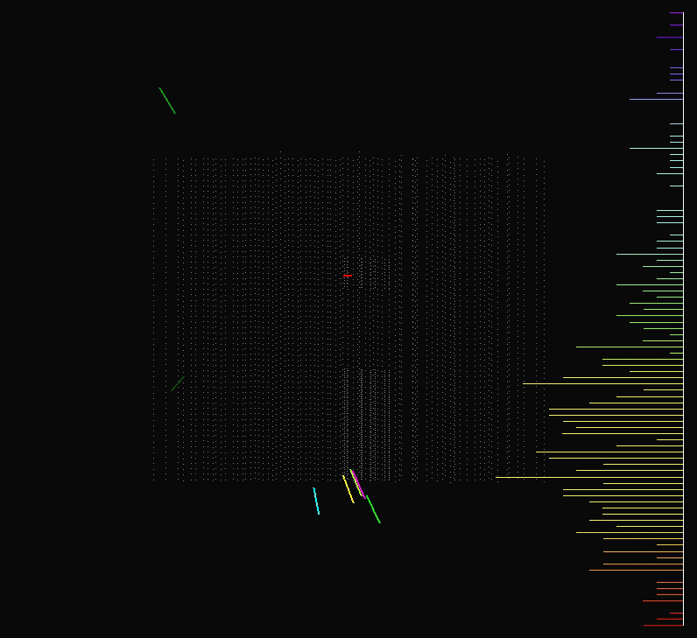

Slide 38
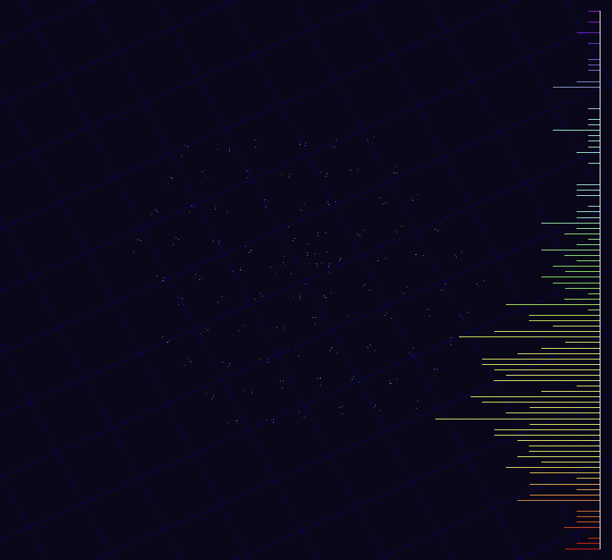

Slide 39
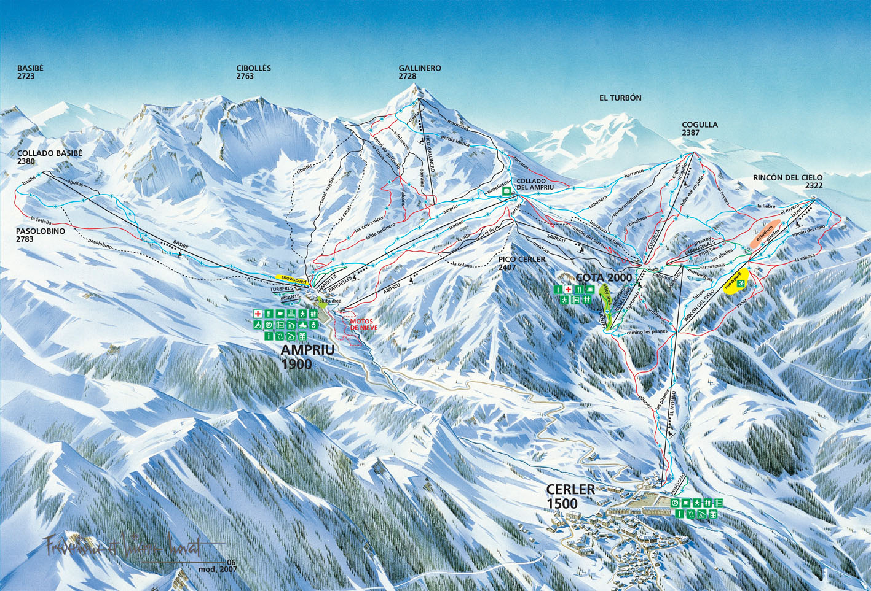
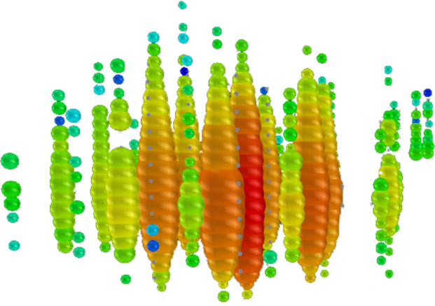

Slide 40
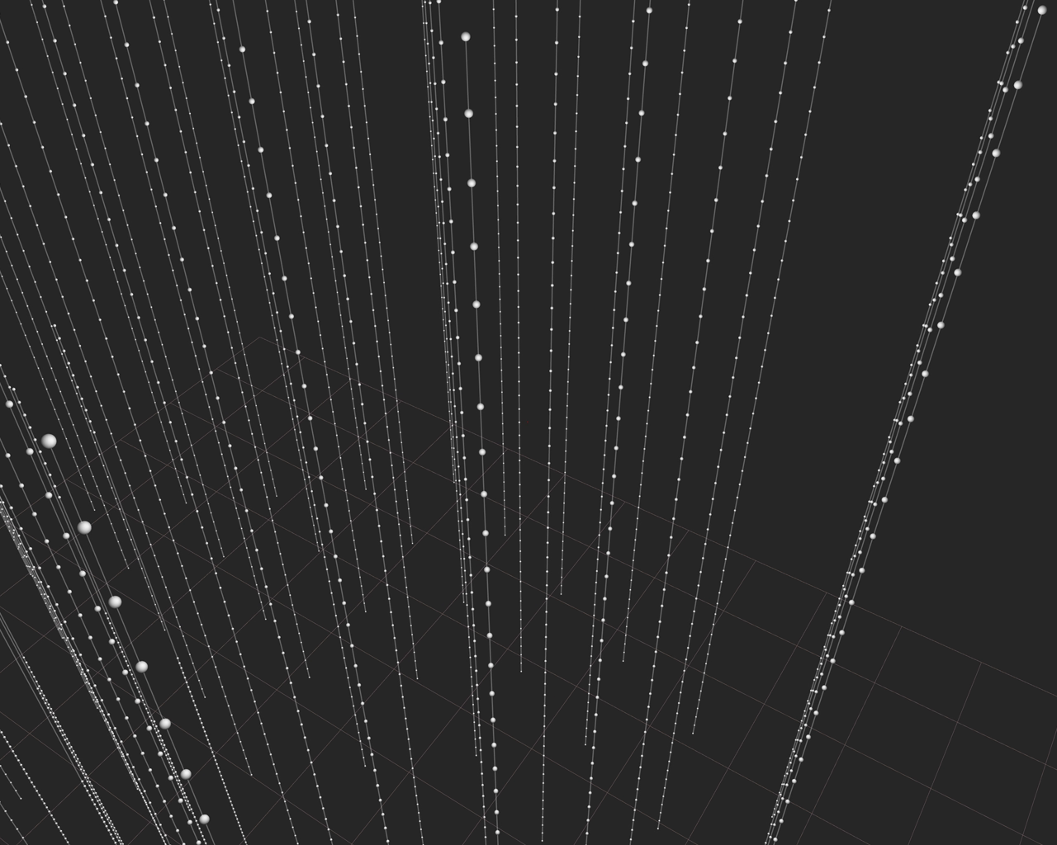

Slide 41


Slide 42
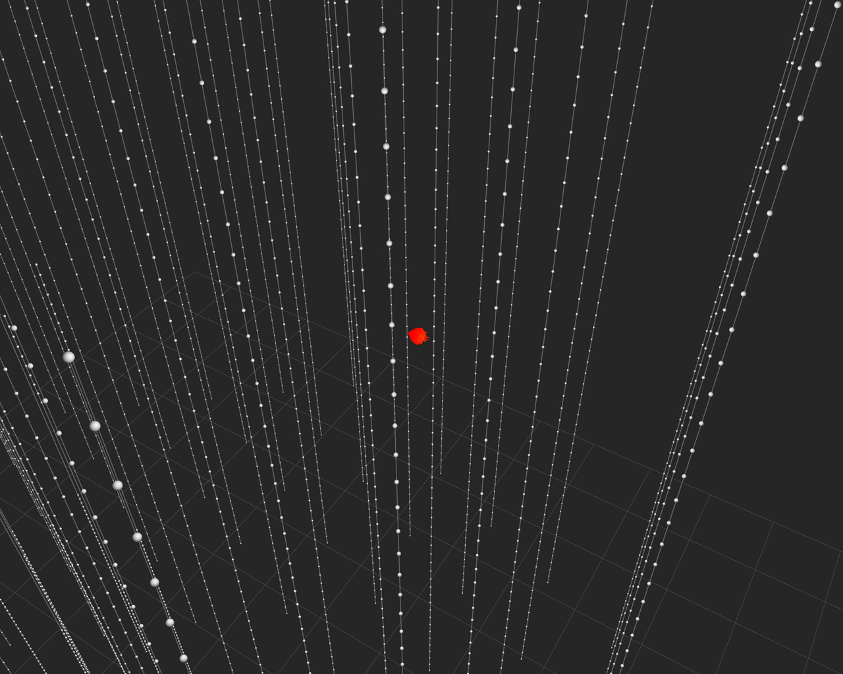

Slide 43
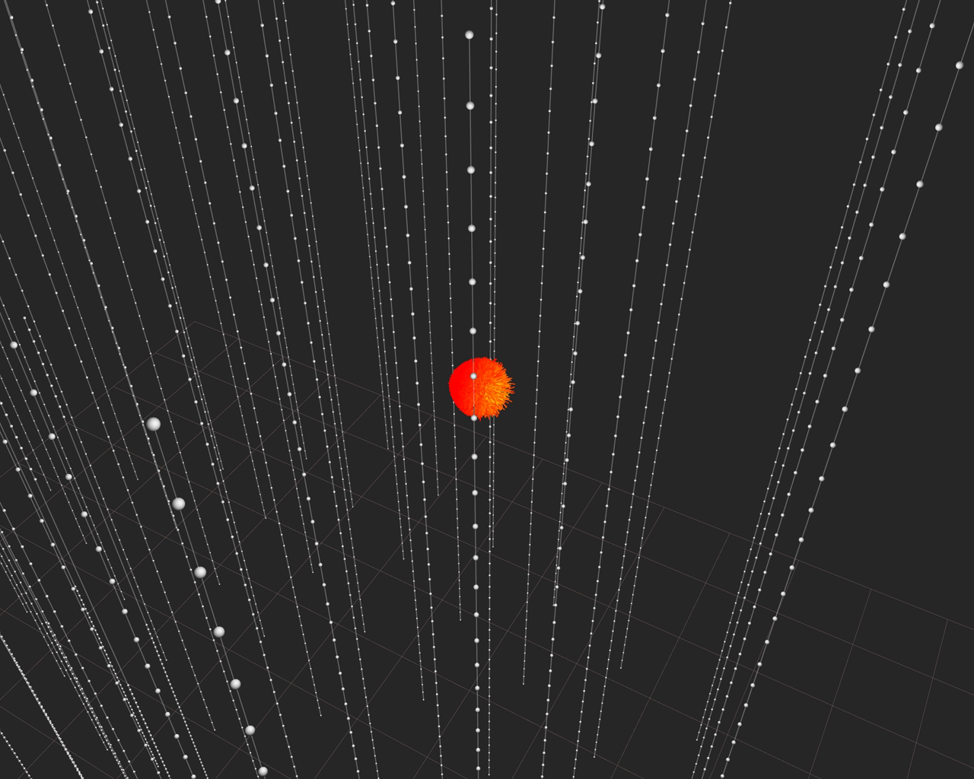

Slide 44
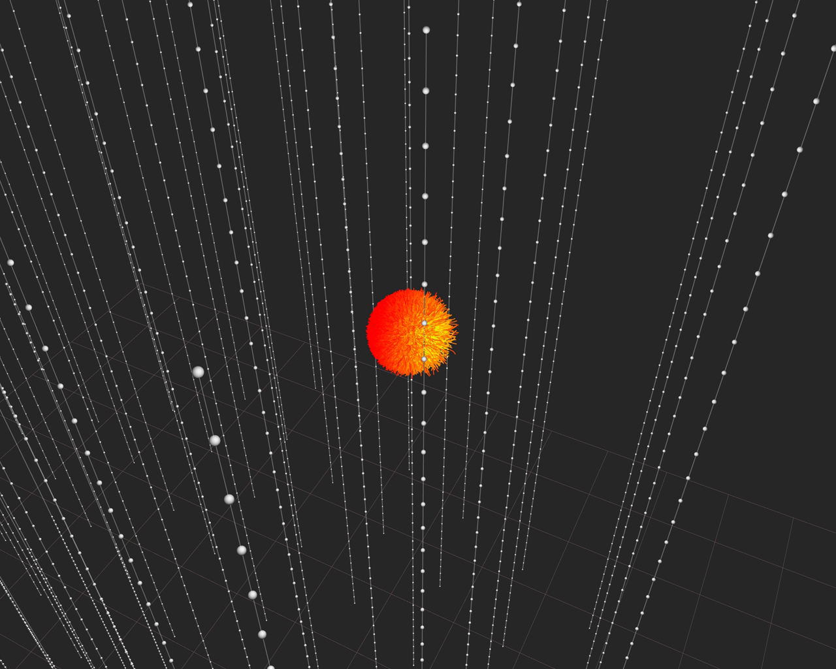

Slide 45
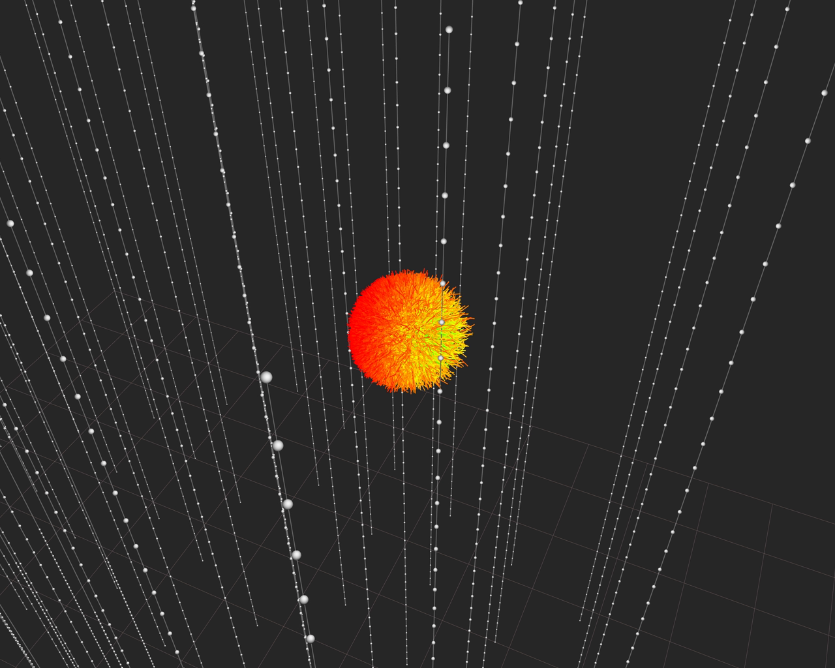

Slide 46
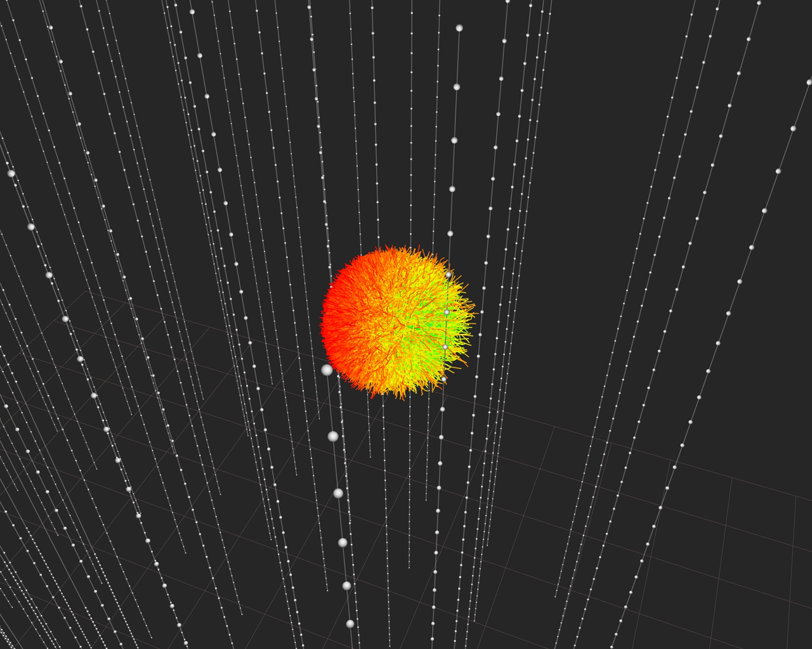

Slide 47
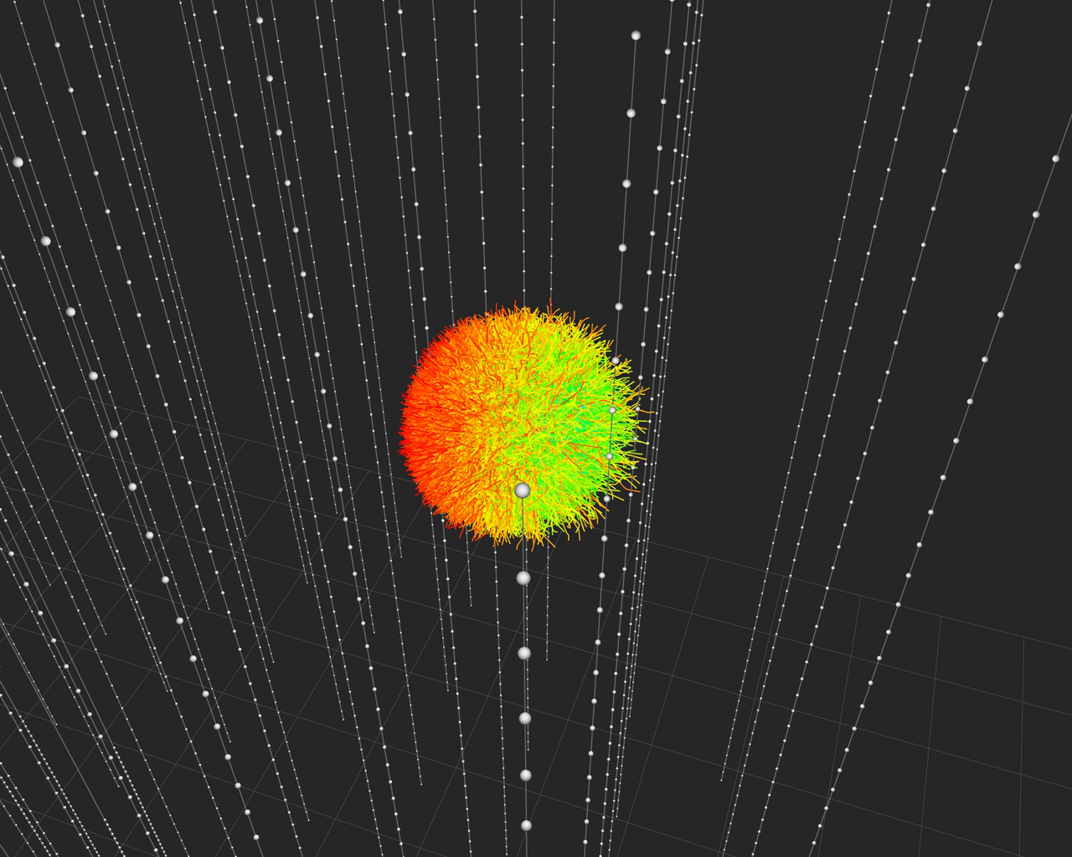

Slide 48
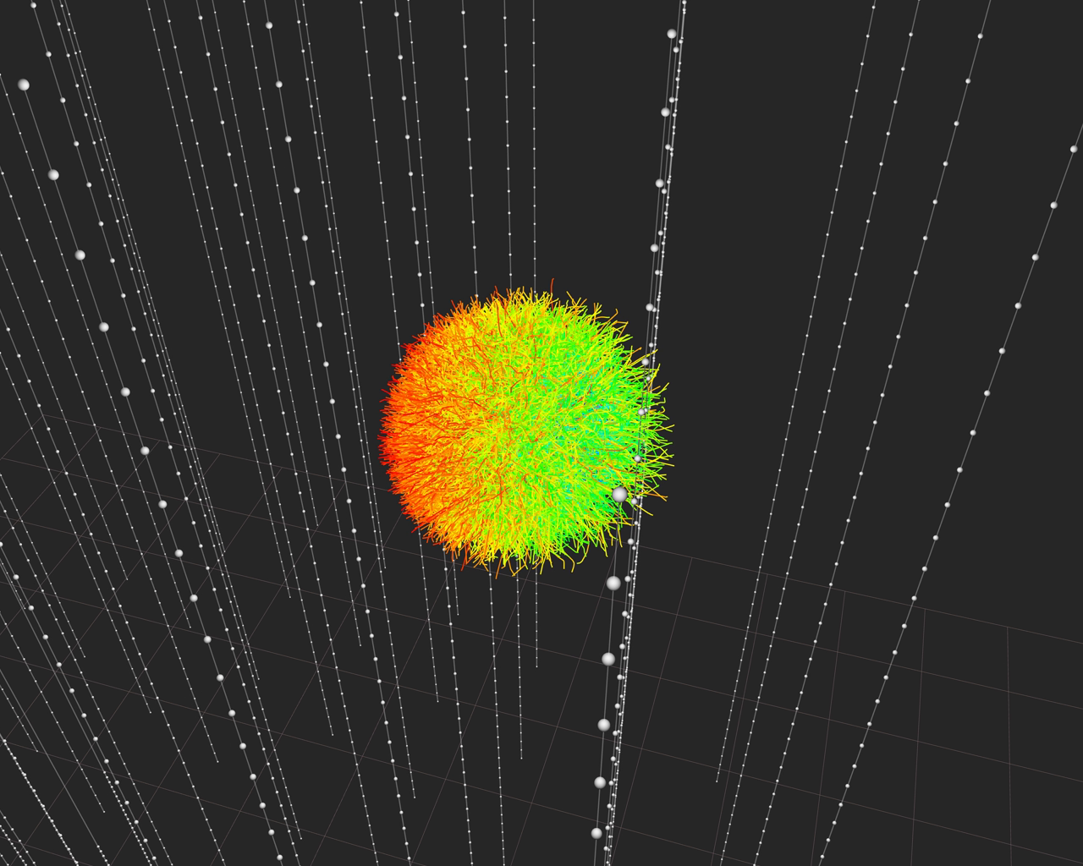

Slide 49
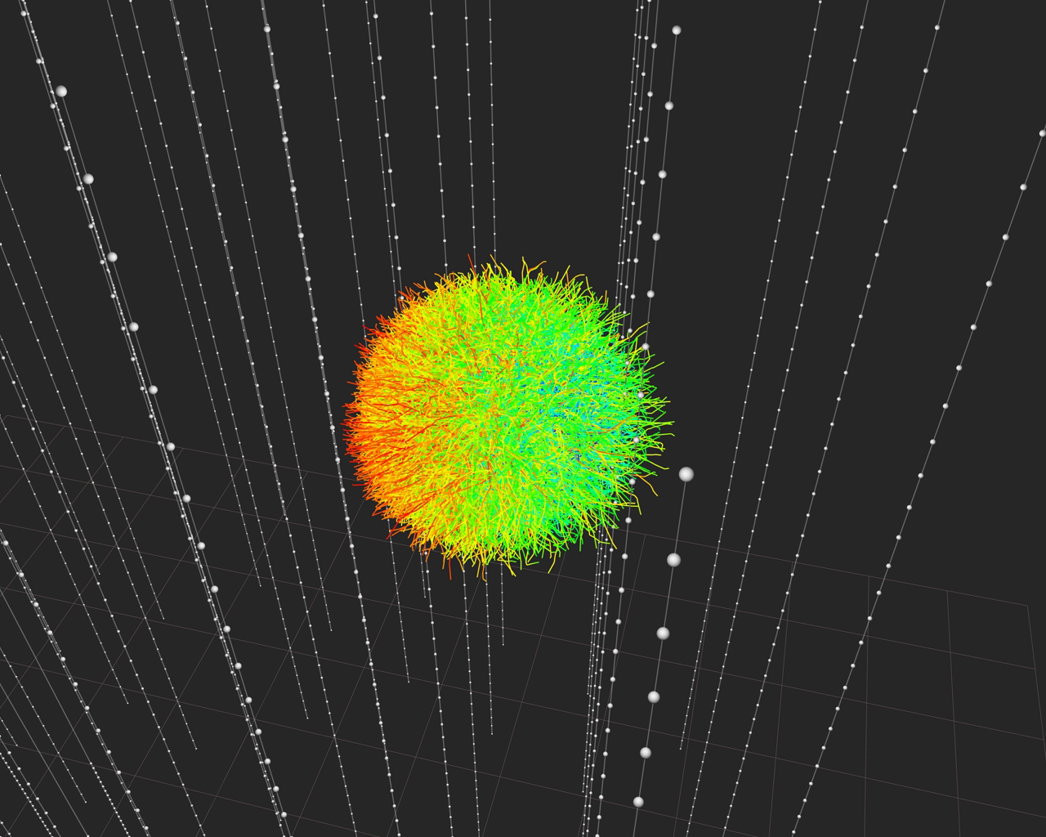

Slide 50
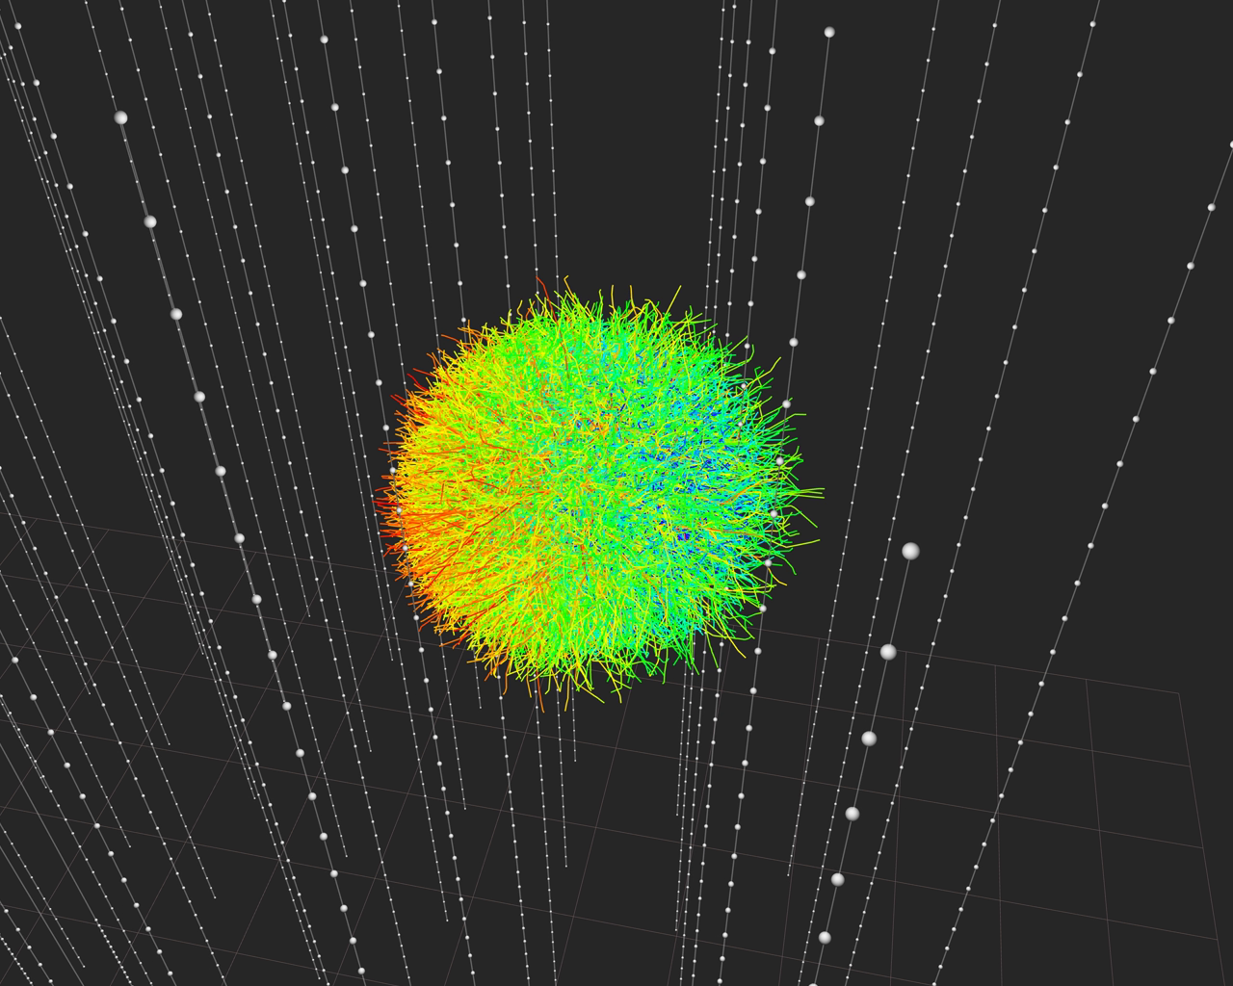

Slide 51
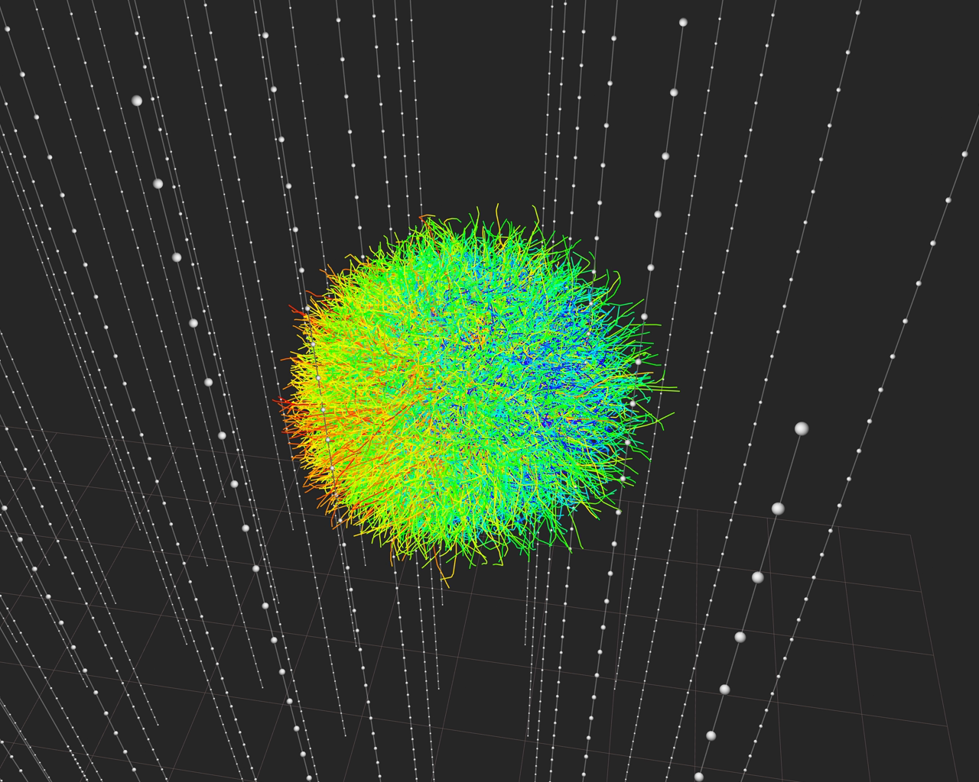

Slide 52


Slide 53


Slide 54


Slide 55


Slide 56


Slide 57


Slide 58


Slide 59


Slide 60


Slide 61


Slide 62


Slide 63


Follow-up Analysis: HESE published in SCIENCE
High Energy Starting Event Analysis
Muon Veto
Q_{tot} > 6000 photoelectrons
400 Mton eff. Volume
Sensitive to all flavors above 60 TeV
100 TeV 1 PeV

Slide 64
HESE Results: Ernie & Bert + 26 additional events
Significance of all 28 events: 4.1 σ
Background 10.6^{+5.0}_{-3.6}
Best fit for E⁻² spectrum:
E²Φ = 1.2 × 10⁻⁸ GeV cm² s-¹ sr⁻¹
Cut-off at 1.5-5 PeV
Ernie and Bert

Slide 65


Cover Pictures:

Slide 66


Slide 67

HESE Skyplot: Nothing significant (yet?)
Northern Sky
Southern Sky

Slide 68

Looking Ahead
One very high-energy event in the 10% „burn sample“ of 2012 data: BigBird
2012 HESE results known but not public (they confirm the 2010/11 data)
Also:
upgoing muon analysis IC79 (2010)
Cascade analysis IC79
We have >5σ !
BigBird

Slide 69
Future projects

Slide 70
GNO: The Global Neutrino Network
GVD
Antares
KM3NeT
GNN
IceCube

Slide 71


KM3NeT
Distributed infrastructure
- KM3NeT-France (Toulon) ~2500m
- KM3NeT-Italy (Capo Passero) ~3400m
- KM3NeT-Greece (Pylos) ~4500m
Until 2015: construction of KM3NeT phase I detectors in France and Italy (~40 M€)

Slide 72

KM3NeT
6 building blocks, 2 per site. Overall volume ~ 5 km³
115 strings at 90 m distance
18 OMs per string, 36 m vertical distance
1 km

Slide 73


Gigaton Volume Detector, Lake Baikal
Stage 1: volume ~0.5 km³
Stage 2: volume ~ 1.5 km³
Stage 2
27 clusters with 8 strings each
Height 700 m (depth 600 m– 1300 m)
48 OMs per string
PMT
Hamamatsu
R7081-HQE
∅ = 10”
QE ~ 35%

Slide 74
South Pole infrastructure for neutrino (astro-)physics
Device Volume Threshold Primary Goal
PINGU few Mton 2-3 GeV ν mass hierarchy
DecaCube* 7-12 km³ ~10 TeV ν astronomy
cosmogenic neutrinos
Surface veto ~120 km² veto for IceCube
CR physics
ARA ~120 km² ~50 PeV cosmogenic neutrinos
* including IceCube (1 km³ with 100 GeV threshold)

Slide 75


PINGU: determine nu mass hierarchy
P(νμ → νμ) for θ=130º
1
IH
NH
0.5
P (νx → νμ)
νμ
νe
0
1
5
10
Eν [GeV]
Maximum difference NH ↔ IH for θ = 130° at 7 GeV
For anti-ν, NH and IH are approximately swapped → effect cancels if detector cannot distinguish μ⁺ and μ⁻
However: flux of atm.ν ~ 1.3 × flux of atm. anti -ν
and σ(ν) ~ 2 × σ(anti-ν) at low energies
→ Count N_{μ}(θ, E) from ν_{μ} + N →μ + X and compare with NH/IH predictions
~40 additional strings
Proposal to be submitted to P5 process in December
Cost 40-50 M$ (European Counting)

Slide 76
PINGU: sensitivity to mass hierarchy

Slide 77

DecaCube Version with 240 m spacing
100 strings
~ 7 km³ volume
Muons: 3 times IC
Cascades: 7 times IC
Threshold ~ 10 TeV
Fiducial region | Volume Gton | #events >60TeV | #events > 1PeV
HESE | 0.4 | 8 | 1
IC+1ring | 1.6 | 32 | 4
IC+3rings | 4 | 80 | 10

Slide 78
Summary
Exotics: Record limits on exotic particles (MM), exotic physics (LVI), WIMP DM
Cosmic rays: Best measurement spectrum, anisotropies
Atmospheric neutrinos: - entered the field of oscillation physics
- PINGU may be able to determine mass hierarchy
Astrophysical Neutrinos: Factor of 1000 improvement over last 12 years
No indications of point sources yet
  Further factor 3 in sensitivity will bring us to the level of optimistic predictions for some SNR
  KM3NeT and GVD look to central part of the Galaxy and could eventually find point sources
  Another (better!) option: DecaCube
  IceCube constrains models for GRB
First evidence for a diffuse flux of extraterrestrial high-energy neutrinos
After 40 years: we are entering a new era!

Slide 79
End

