Slide 1
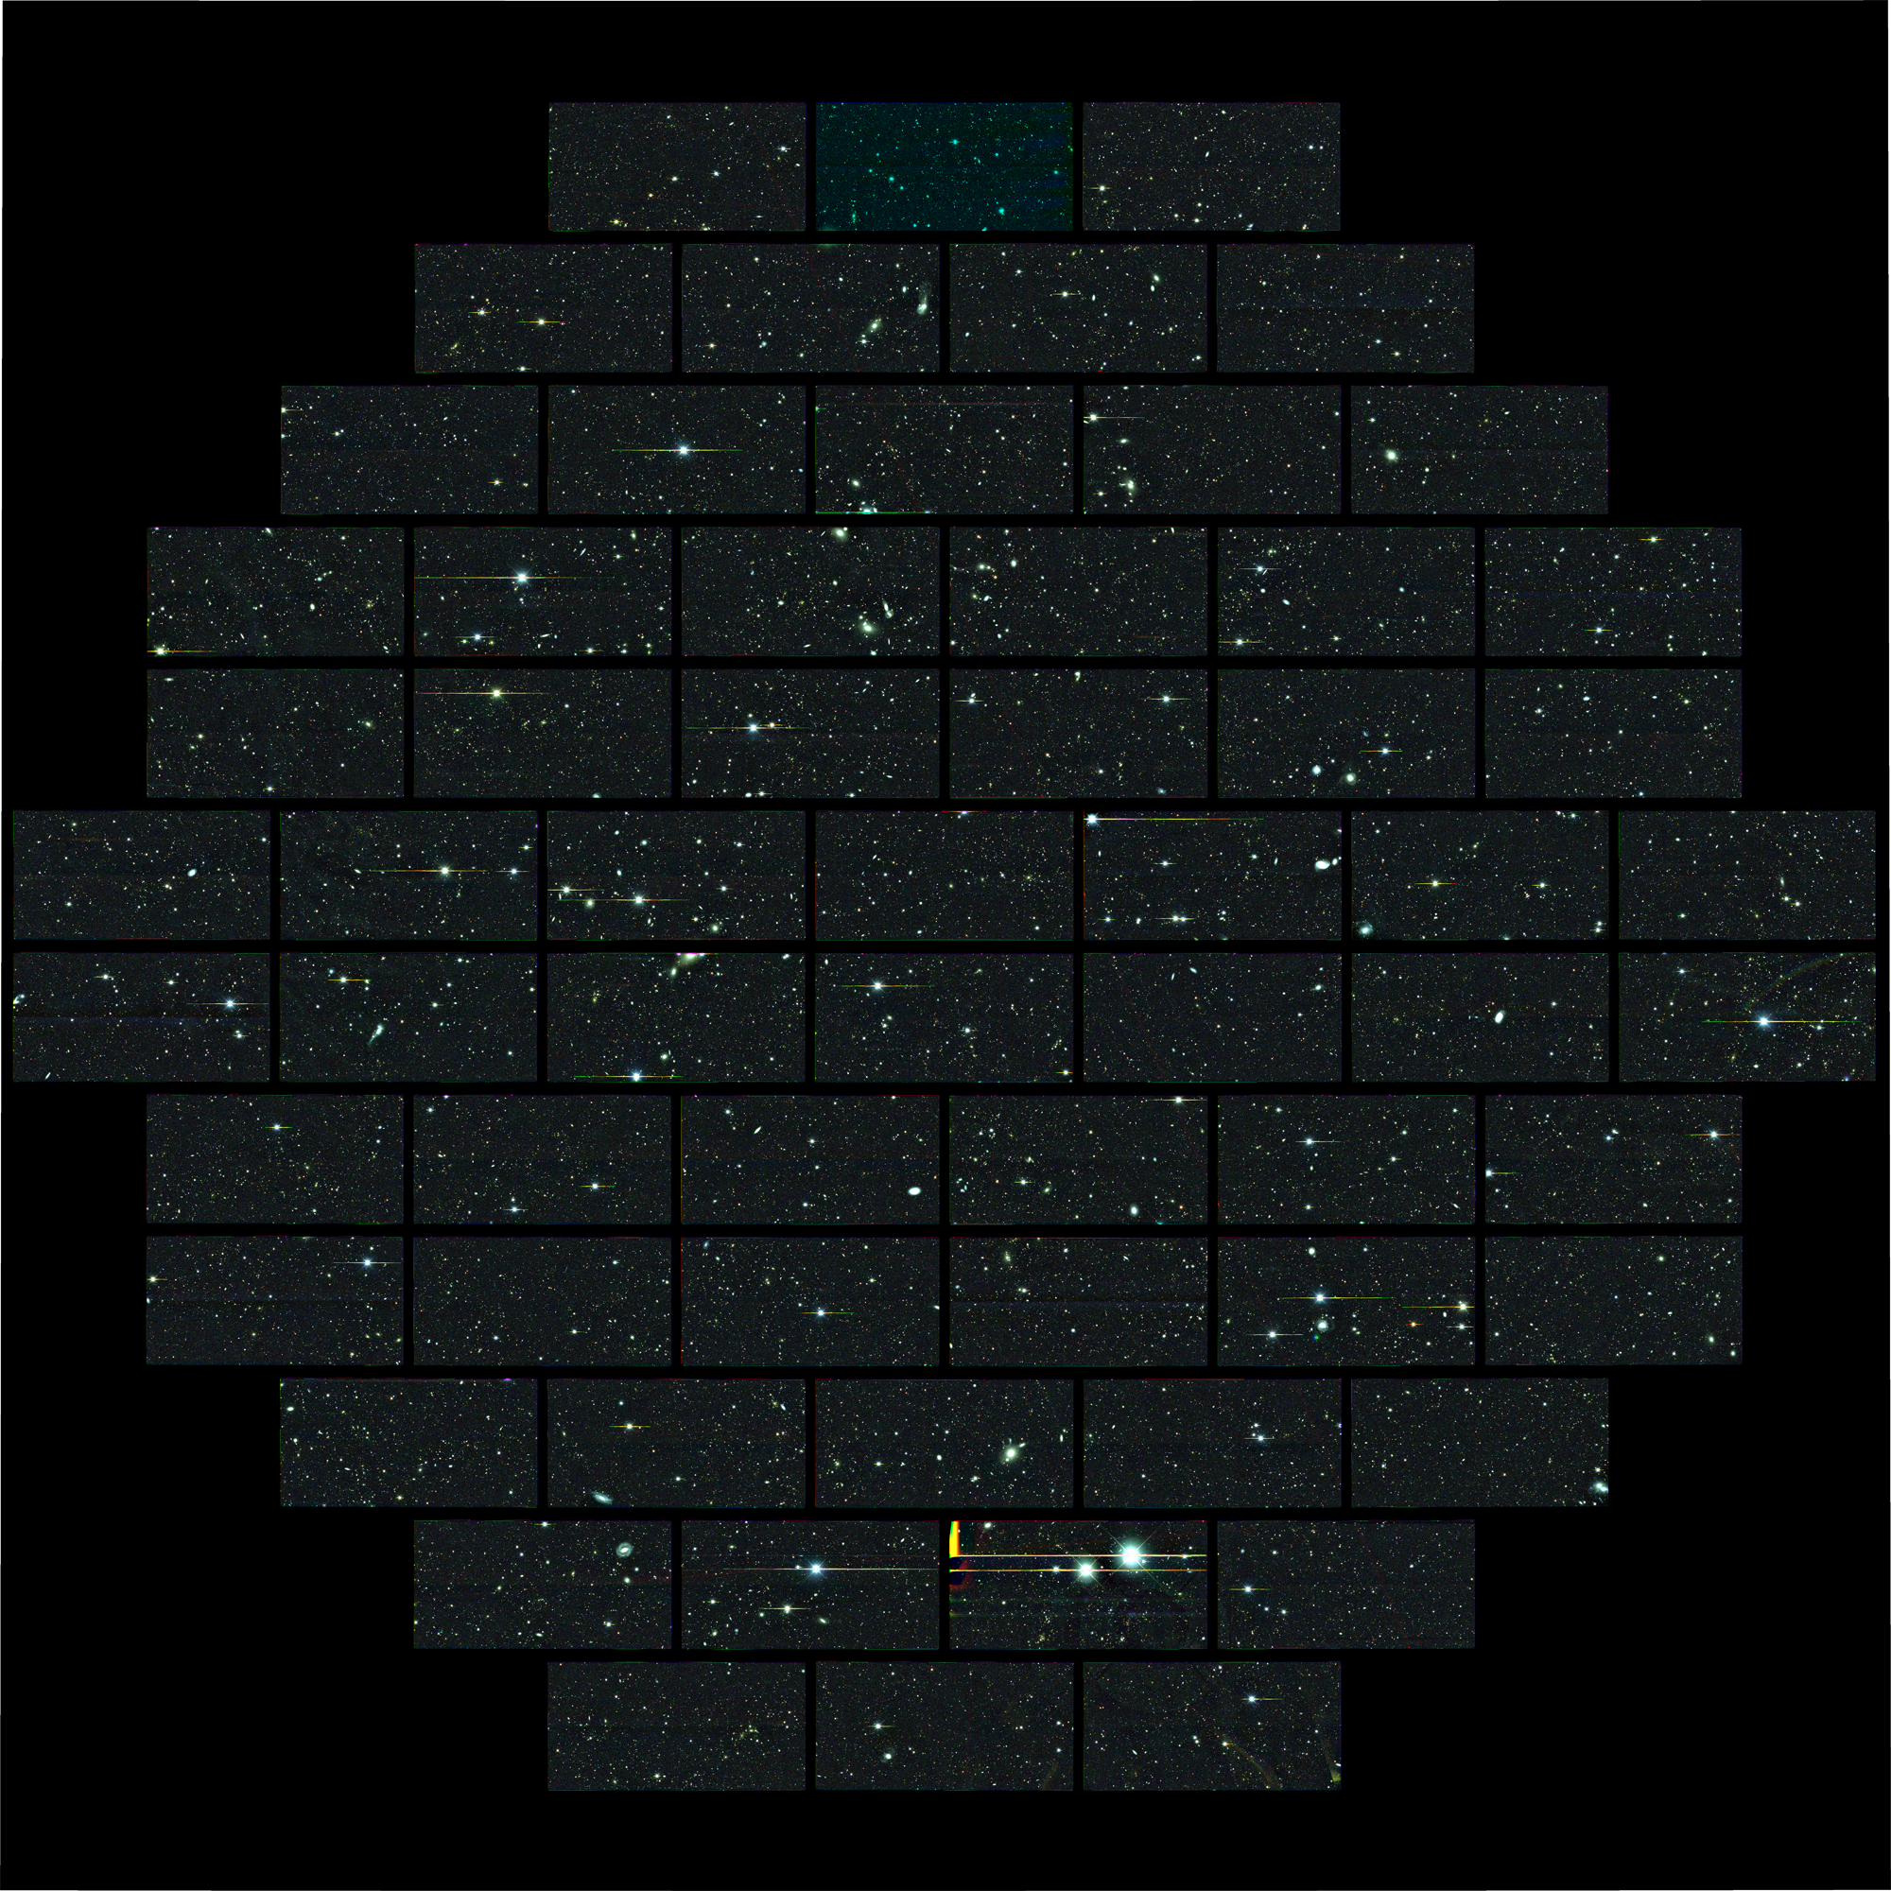
Observational Cosmology
Ramon Miquel
ICREA / IFAE Barcelona
TAE, Benasque (Spain), September 25-26, 2014

Slide 2
Outline (I)
Preliminaries
The Cosmic Microwave Background
Intro
Origin
The temperature fluctuations
Cosmological parameters from the CMB
Polarization

Slide 3
Outline (II)
Dark Energy
Discovery: Type-Ia SNe
Growth of structure: the large-scale structure of the Universe
Baryon accoustic oscillations (BAO)
Galaxy clusters
Weak gravitational lensing
Current status

Slide 4
Outline (III)
Current and Future Galaxy Surveys
The Dark Energy Survey (DES)
The PAU Survey at the WHT
The Dark Energy Spectroscopic Instrument (DESI)

Slide 5
Preliminaries

Slide 6
Robertson-Walker Metric
Cosmological Principle: we assume the universe is homogeneous and isotropic at all times (at least at large scales)
Then the curvature has to be constant everywhere, either positive, negative or zero (flat space).
This leads to the Robertson-Walker metric for the universe:
with three options:
positive curvature
flat
negative curvature
a : scale factor of the universe (dimensionless) t : proper time
R : radius of curvature (constant) r : co-moving distance

Slide 7
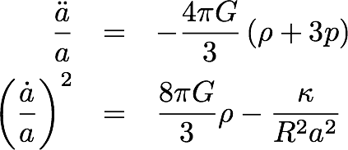
Friedmann-Lemaître Equations
Introducing the Robertson-Walker metric into Einstein’s field equations of GR we can easily obtain the Friedmann-Lemaître equations:
G: Newton’s constant
𝜌: energy density
p : pressure
Since a, p and 𝜌 all depend on t, to solve for a(t) we have to specify an equation of state p = p(𝜌) for each component of the universe:
matter (baryonic or dark): p = 0, so w = p/𝜌 = 0
radiation: p = 𝜌 / 3, so w = 1/3
cosmological constant: p = -𝜌, so w = -1
general dark energy: w = w(t) < -1/3, for acceleration to take place.

Slide 8
Friedmann-Lemaître Equations
Assuming for simplicity a flat universe, the Friedmann-Lemaître equations can be used to obtain:
so, for w = const, one has
Defining now and , one can cast the second Friedmann-Lemaître equation as:
H²(a) = H²₀ [Ω_{M} a⁻³ + Ω_{R} a⁻⁴ + Ω_{DE} a^{-3(1+w)}]
where 0 means now, and a₀ = 1
matter radiation dark energy
Ω_{i} = ρ⁰_{i} / ρ_{c} (density now). We assume flat universe, constant w
It is easy to see that Ω_{M} + Ω_{R} + Ω_{DE} = 1 + κ / R²H²₀ = 1 (flat)
Measuring the history of the expansion rate, H(a), we can learn about
the universe constituents: Ω_{M}, Ω_{DE}, w, etc.

Slide 9
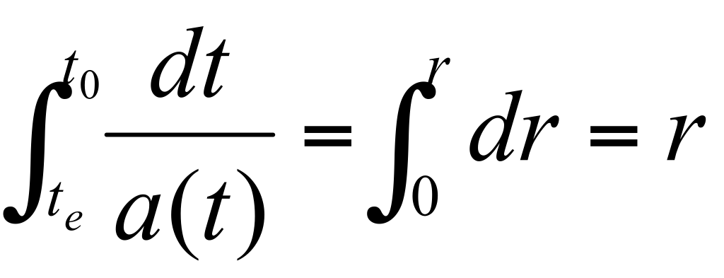
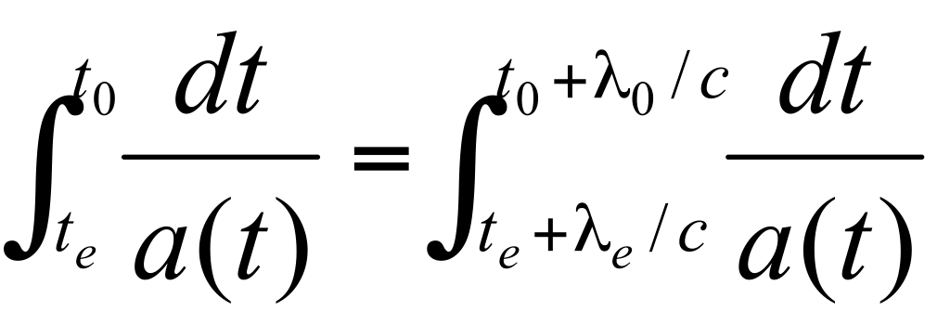
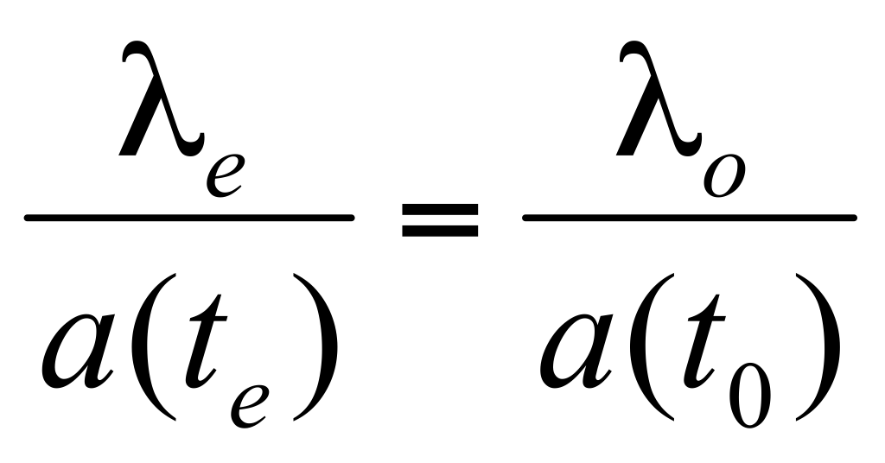
The Cosmological Redshift
Because of the expansion of the universe, the light from a distant source is observed on Earth redder than was emitted:
z = (λ_{o} - λ_{e}) / λ_{e} > 0 is the redshift of the source.
The redshift z can be easily related to the scale factor a(t_{e}). Imagine two wave-fronts emitted at times t_{e} and t_{e}+λ_{e}/c. Since light travels in geodesics (ds²=0), we have:
and
so that
or
Since the expansion is very slow compared to the frequency of light,
or

Slide 10
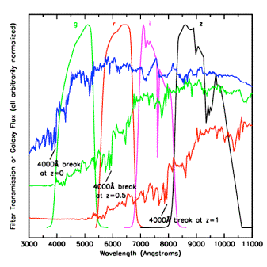
Measuring Redshifts

Slide 11
Distances
The co-moving distance between a source at z and us can be computed as:
Several distances can be measured observationally:
Luminosity distance: if we have a “standard candle” with luminosity L, we define d_{L} such that the measured flux is Φ = L / 4πd_{L}². It is easy to see that d_{L}(z) = S_{κ}(r(z)) (1+z) = r(z) (1+z) (flat).
Angular distance: if we have a “standard ruler” with length l, we define d_{A} such that the measured angle subtended by l is Δθ = l / d_{A}. It is easy to see that d_{A}(z) = S_{κ}(r(z)) / (1+z) = r(z) / (1+z) (flat).
So by having a collection of either standard candles or standard rulers at different known redshifts, we will have many integrals of 1/H(z), from where one can reconstruct H(z) and, hence, Ω_{M},Ω_{DE},w, etc.
so, it gives us integrals of 1/H(z).

Slide 12
Particle Horizon
The most distant object we can see is one for which the light emitted at t = 0 is just now reaching us at t = t0. The co-moving distance to this object is called the particle horizon:
The integral is dominated by what happens at early times. Since the early universe was radiation-dominated, H = ȧ / a ~ a⁻², from which a ~ t^{1/2}, the integral converges, and the proper horizon distance becomes a(t0)dhor(t0) ~ 2c t0 ~ c / H(t0).

Slide 13
CMB

Slide 14
The Cosmic Microwave Background Radiation
The early Universe had two main components:
A plasma of protons and electrons interacting through photons
Dark matter
Throughout the expansion, the Universe cooled down.
About 380 000 years after the Big Bang, the temperature dropped enough (to ~ 3000 K) to allow for protons and electrons to combine into neutral hydrogen atoms.
The Universe became transparent to light: Cosmic Microwave Bkgd.
The CMB light allows us to know how the Universe was only 380 000 years after the Big Bang. This epoch corresponds to z ~ 1100.
Before it reached 380 000 years of age, the Universe was opaque and, hence, we can’t observe it directly.

Slide 15
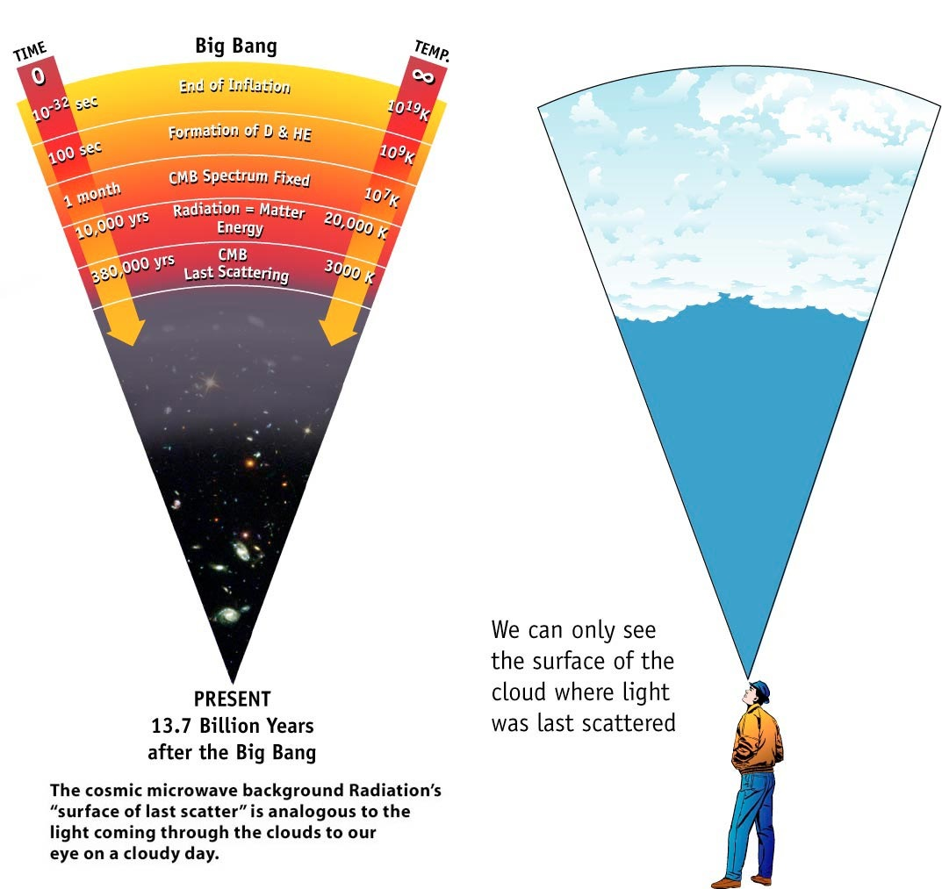
WMAP web page

Slide 16
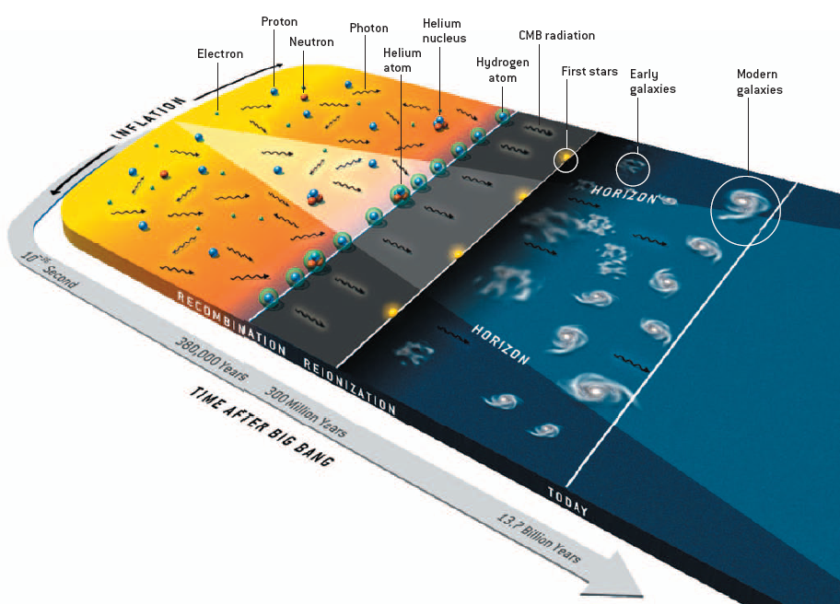
History of the Universe
Opaque
Transparent
Hu & White, Sci. Am., 290 44 (2004)

Slide 18
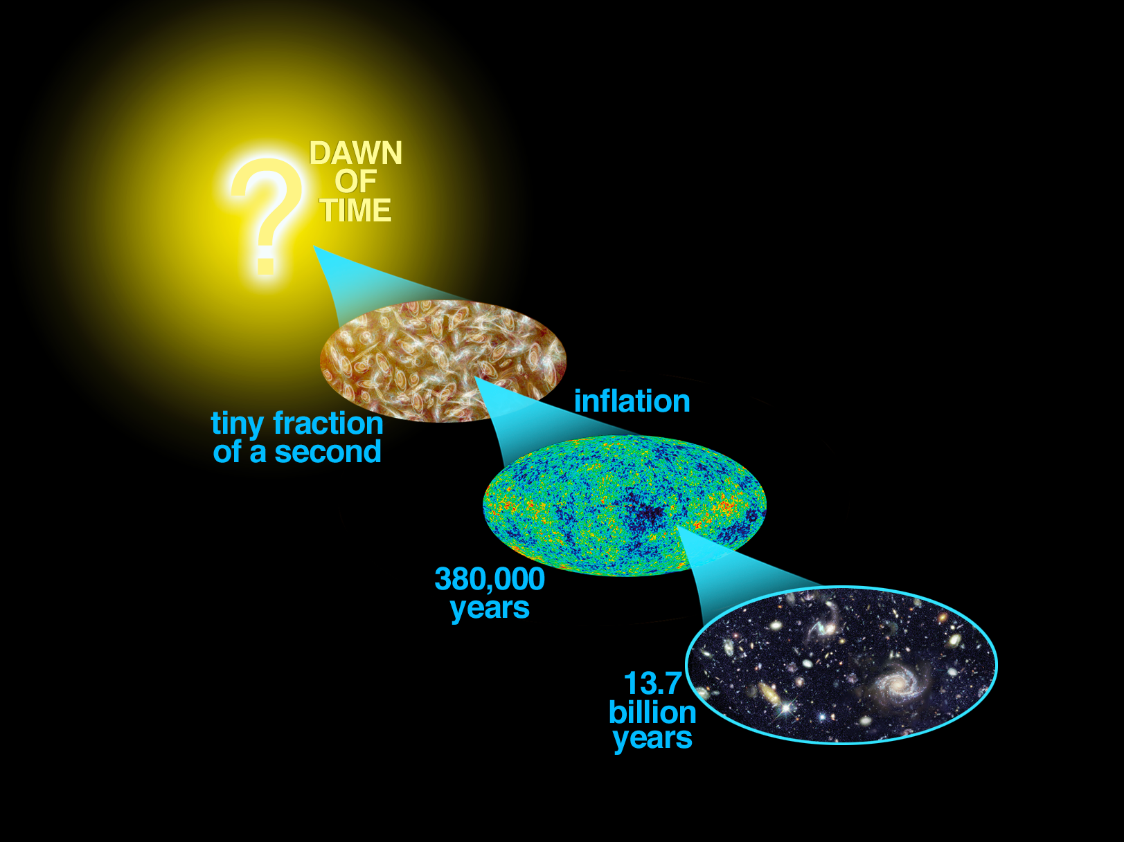
History of the Universe
Hot universe: e⁻ and p interact through γ
CMB: a snapshot of the universe
at an age of 380 000 years
Cold universe: e⁻ and p bound
in H. γ's travel freely

Slide 19
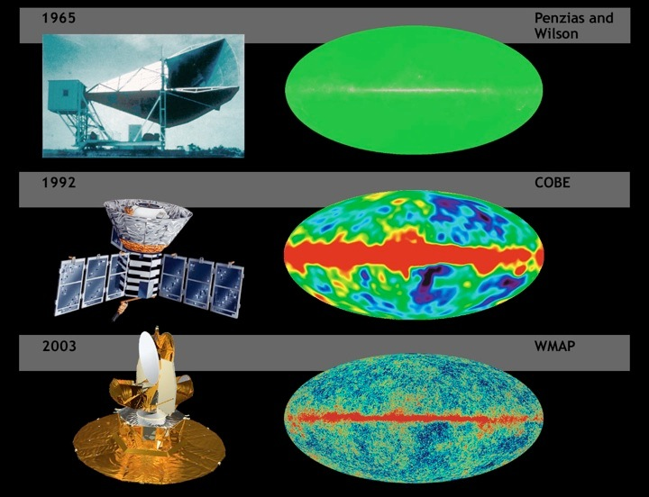

Slide 20
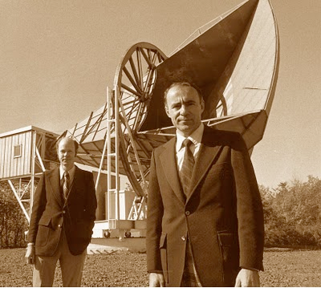
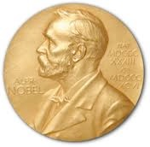
1978 Nobel Prize in Physics

Slide 21
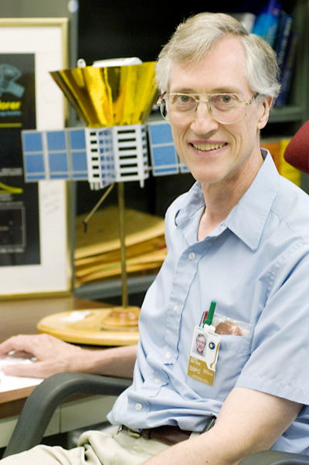
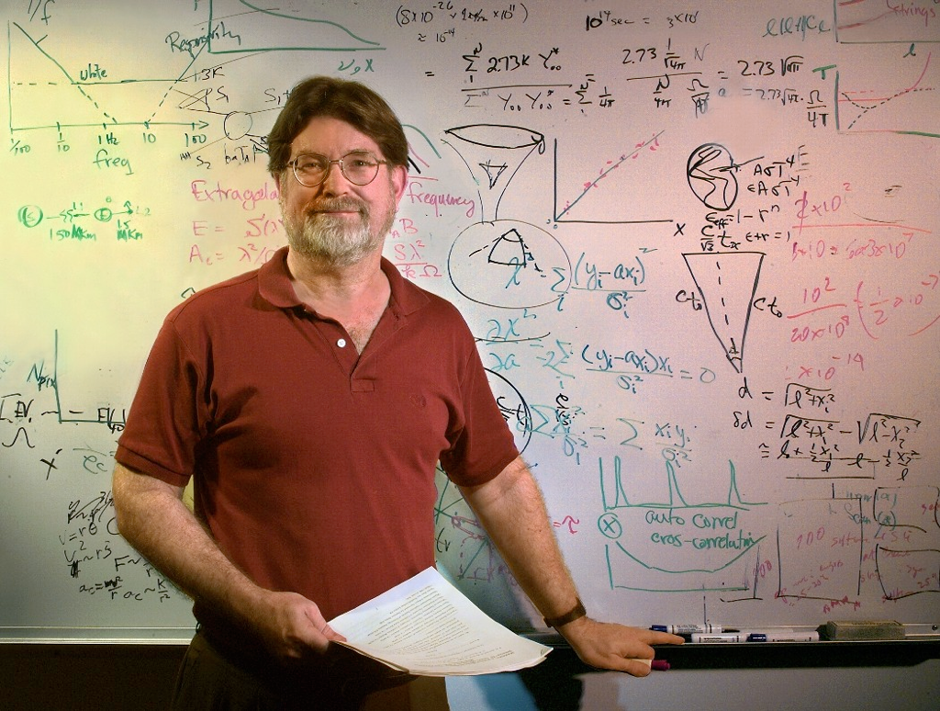
1978 Nobel Prize in Physics
John Mather & George Smoot
2006 Nobel Prize in Physics

Slide 22
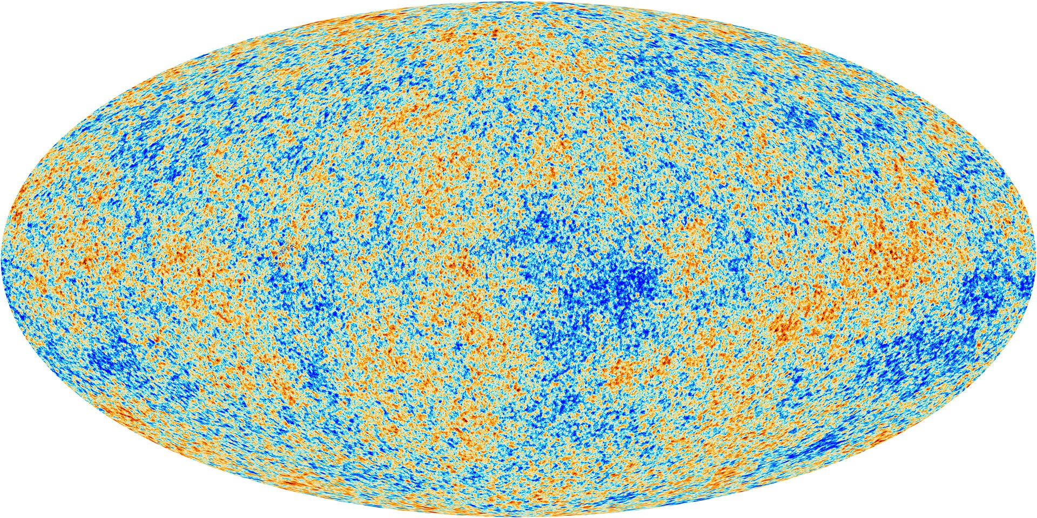
Planck (2013)
gravitation

Slide 23
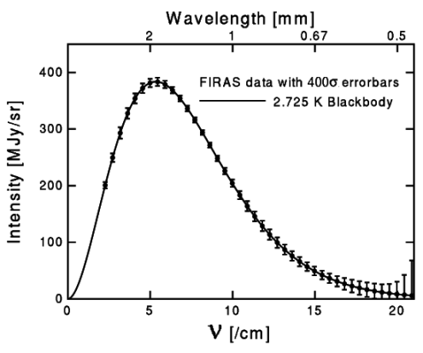
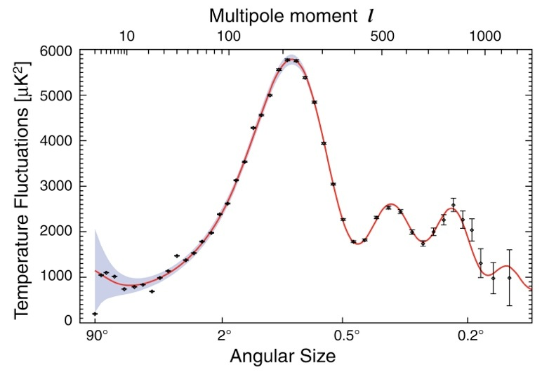
CMB Results
WMAP 2010
The spectrum corresponds to a black body with temperature
T = 2.725 K ~ 3000 K / (1+1100)
There are about 410 CMB photons per cm³
Very uniform: thermal contact
→ Big Bang
Temperature, and hence density, fluctuations tell us how galaxies were formed
The angle where we find the maximum of the fluctuations tells us that the Universe is flat

Slide 24
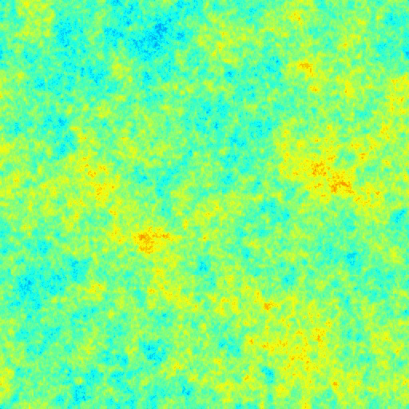
What’s the Origin of the Fluctuations?
Inflation
makes them >10³⁰ times bigger
Quantum Mechanical
microscopic fluctuations
After inflation
Huge size, amplitude ~ 10⁻⁵

Slide 25
Predicting the CMB Phenomenology
Ingredients:
Thomson scattering for e⁻ γ collisions
Physics of recombination e⁻ + p ⥦ H + γ
General Relativity
Boltzmann equation

Slide 26
(Re-)Combination (I)
Why did recombination happen at T ~ 3000 K, when the binding energy of H is 13.6 eV / kB ~ 1.6 × 10⁵ K?
The photon energy distribution follows a black-body (Planck) spectrum:
Peak of the energy distribution ~ mean energy ~ 2.7 kBT ~ 0.7 eV, but with long exponential tail: one in 30 × 10⁹ has E > 30 kBT ~ 8 eV, and there are ~10⁹ photons per electron (and proton).
Let’s define the recombination time as the time at which
X ≡ np / (np+nH) = ne / (np+nH) = 0.5
np: number density of ionized protons
ne: number density of ionized electrons ( = np)
nH: number density of neutral H atoms

Slide 27
(Re-)Combination (II)
Because e⁻ + p ⥦ H + γ is in equilibrium and e⁻, p and H are non-relativistic, their number densities are given by (x = e⁻, p, H)
Therefore, we can write:
Which can be simplified to
And now we can introduce η ≣ nbaryon / nγ = np / (X nγ) and compute nγ by integrating the number density of photons (uPL(𝜈) / h𝜈):
Maxwell-Boltzmann
gx = 2 (e⁻, p), 4 (H)
Q = 13.6 eV

Slide 28
(Re-)Combination (III)
Finally, we get the Saha equation for X:
From where we can solve for X as a function of T, or z (T = 2.725 K × (1+z))
with η ~ 5.5 ×10⁻¹⁰
X = 0.5 ⇒ kBTrec = 0.323 eV = Q / 42
Trec = 3740 K
zrec = 1370
trec = 240 000 years
Why not z ~ 1100?

Slide 29
(Re-)Combination (IV): Decoupling
The photon decoupling occurs when the rate of photon scattering, Γ, falls below the expansion rate, H. We have
When the hydrogen is partially ionized, we have
The expansion rate in the matter dominated era is given by
Therefore, imposing Γ = H, we have
The small discrepancy is due to non-equilibrium effects…
with
the photon mean free path
σe ~ 6.65 × 10⁻²⁹ m² (Thomson)
(assuming Ωbaryons,0 = 0.04)
(assuming Ωm,0 = 0.3)
⟹ zdec = 1120

Slide 30
(Re-)Combination (V): Last Scattering Surface
The number of collisions that a photon has experimented between a time t and now, t0, is given by the optical depth τ :
The time of last scattering is given by τ =1. Changing variables from t to z,
From which imposing τ =1, we get zls ~1100.
In reality, the LSS is a thin layer with a width Δz ~200 (non-equilibrium…)
So in summary
zrec ~ 1370, Trec ~ 3740 K, trec ~ 240 000 years
zdec ~ zls ~ 1100, Tls ~ 3000 K, tls ~ 350 000 years

Slide 31
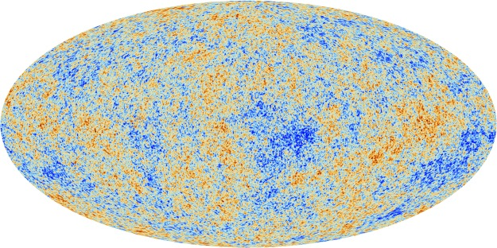
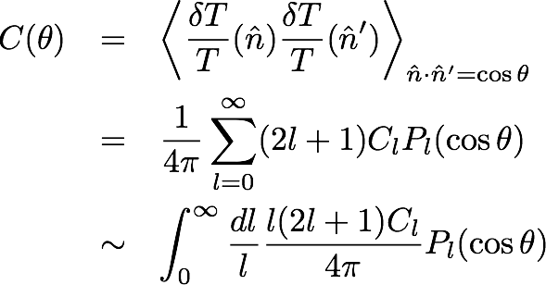
Perturbations: Statistical Analysis
Interested in temperature fluctuations, δT = T(θ,Φ) − 2.725 K
Since the measurement is on a sphere, use spherical harmonics:
Then, measure angular correlations:
Results given in Dl = l(l+1) Cl / 2π as a function of l ~ 180º / θ
Planck 2013

Slide 32
Three Different Regimes
Accoustic oscillations
First peak is at 𝛳 ~ 1º ~ dhor(zls) / dA(zls)
Large-scale plateau
(Sachs-Wolfe)
Damping tail
(photon diffusion)
Large errors due to
"cosmic variance"

Slide 33
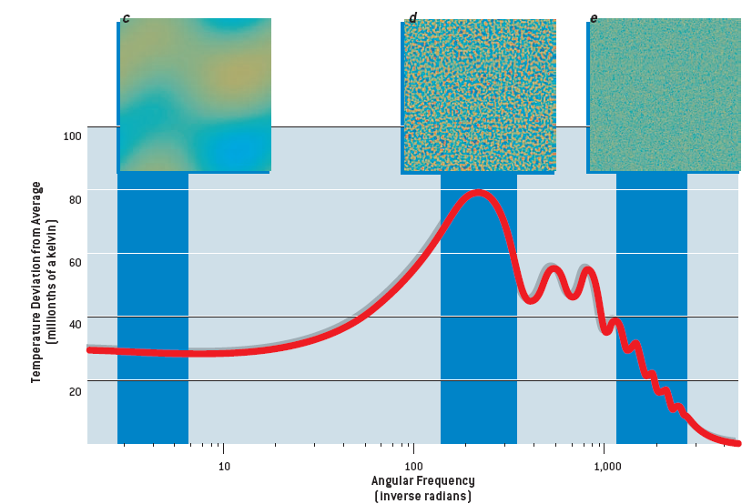
Three Different Regimes
Large-scale plateau
(Sachs-Wolfe)
Accoustic oscillations
Damping tail
(photon diffusion)
Primordial
fluctuations
(inflation)
Hu & White, Sci. Am., 290 44 (2004)

Slide 34
Large-Scale Plateau
Matter density at LSS is not homogeneous:
When a photon is at a minimum of the gravitational potential at the LSS: redshift
When a photon is at a maximum of the gravitational potential at the LSS: blueshift
Sachs-Wolfe
redshift
ψ
ψ
blueshift
The temperature fluctuations at large 𝛳 tell us about the gravitational potential fluctuations at the LSS

Slide 35
Accoustic Oscillations
The photon-baryon plasma will fall into the gravitation potential wells created by the inhomogeneities in the distribution of the (dominant) dark matter.
Being compressed there, pressure will increase (w = p / ρ ~1/3) and the fluid will expand outwards, until pressure decreases and gravity pulls the fluid back into the well
These are pressure (sound) waves with cs ~ c (dp / dρ)^{1/2} = c / √3.
W. Hu

Slide 36
Analogy: Bouncing Balls
Let’s drop a series of balls from different heights and wait 10 seconds.
Balls dropped from low heights bounce a large number of times.
Balls dropped from high enough don’t even reach the ground in 10 s.
There is a certain height from which the ball just touches the ground after those 10 s.

Slide 37
Analogy: Bouncing Balls
Bouncing balls
10 seconds
Bounces
Height of the ball that just reaches the ground
Balls dropped from higher heights don’t bounce
Photon-baryon plasma oscillating
Age of the Universe at the last scattering surface
Accoustic peaks in CMB
Position of first peak: sound horizon at the last scattering surface: 𝛳 ~ cs/c × dhor(zls) / dA(zls) ≲ 1º
(This corresponds to maximal compression: maximal temperature)
No acoustic oscillations at scales 𝛳 ≳ 1º (only Sachs-Wolfe effect)

Slide 38
Three Different Regimes
Accoustic oscillations
First peak is at 𝛳 ~ cs/c × dhor(zls) / dA(zls) ≲ 1º
Large-scale plateau
(Sachs-Wolfe)
Damping tail
(photon diffusion)

Slide 39
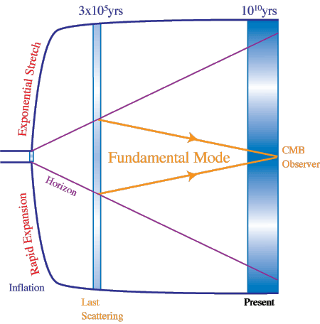
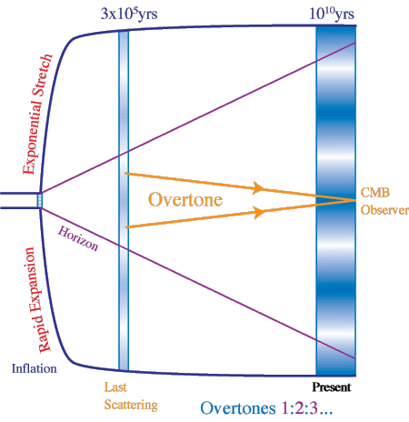
Structure of Peaks

Slide 40
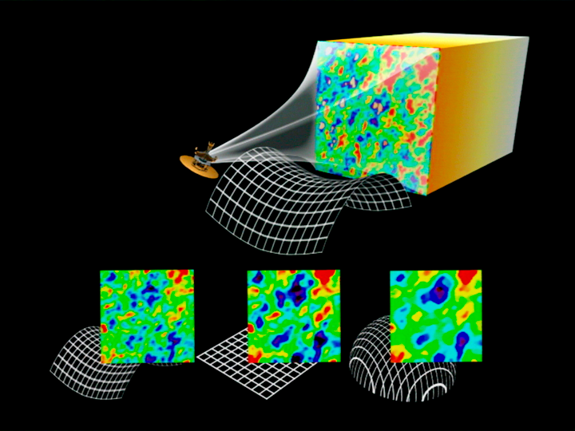
The Universe Is Flat

Slide 41
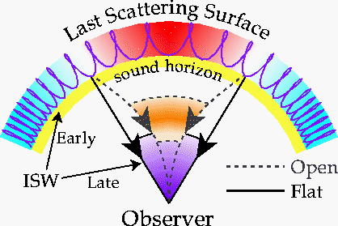
The Universe Is Flat

Slide 42
Diffusion Tail (Silk Damping)
At small enough scales, photon random walk collisions erase the signature of acoustic oscillations
Recall that mean free path was . The scale of diffusion due to random walk is , where N is the number of collisions since the Bing Bang: , so that
And, therefore, the damping should start at angular scales
(co-moving)

Slide 43
Three Different Regimes
Accoustic oscillations
Large-scale plateau
(Sachs-Wolfe)
Damping tail
(photon diffusion)

Slide 44
What Can We Learn from the CMB?
Ωk : Curvature affects the relationship between sound horizon at last scattering surface and current angular scale: position of peaks

Slide 45
What Can We Learn from the CMB?
Ωb : Larger baryon density enhances odd-numbered peaks (compression), and decreases even-numbered peaks (expansion)

Slide 46
What Can We Learn from the CMB?
Ωm : The 3rd and higher peaks are sensitive to the ratio between the matter and radiation energy densities

Slide 47
What Can We Learn from the CMB?
Flat universe
baryonic
matter
dark
matter
baryonic and
total matter

Slide 48
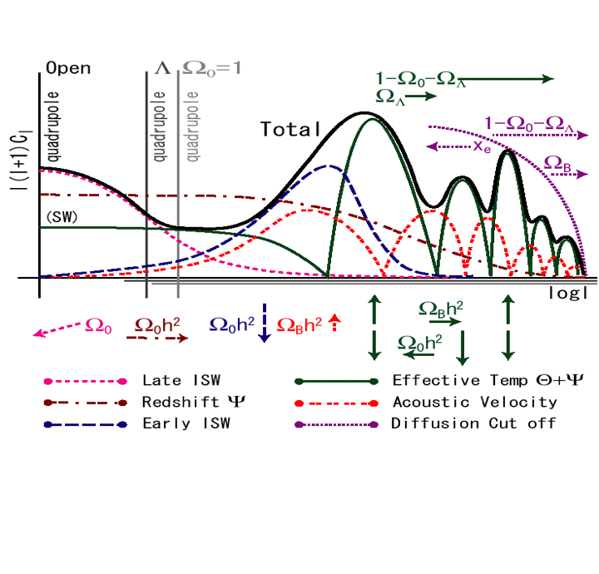
What Can We Learn from the CMB?

Slide 49
Planck Results

Slide 50
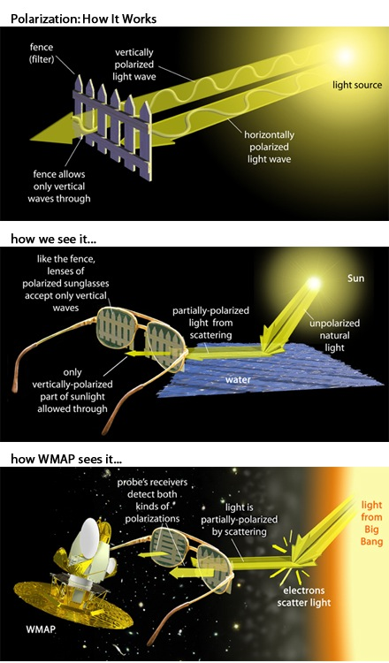
CMB Polarization (I)
Polarization of the CMB comes from Thomson scattering of photons off electrons
Wayne Hu’s CMB tutorials:
http://background.uchicago.edu/index.html

Slide 51
CMB Polarization (II)
CMB polarization also necessitates a quadrupole anisotropy in the CMB
The direction of polarization corresponds to the direction of the anisotropy
Sources of quadrupole anisotropy: density perturbations (scalar), vorticity (vector, negligible), gravitational waves (tensor, inflation)
photon from the left +
photon from the top
with quadrupole anisotropy
photon from the left +
photon from the top
photon from the left

Slide 52
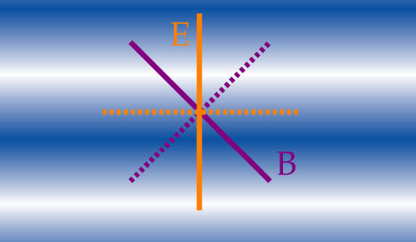
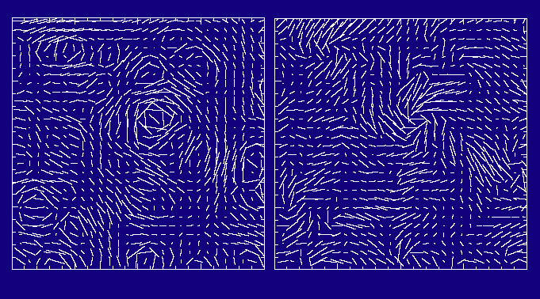
CMB Polarization (III)
Scalar fields only generate E modes, while tensor fields generate both E and B modes
E: parallel or perpendicular
B: 45 degrees
E mode
B mode

Slide 53
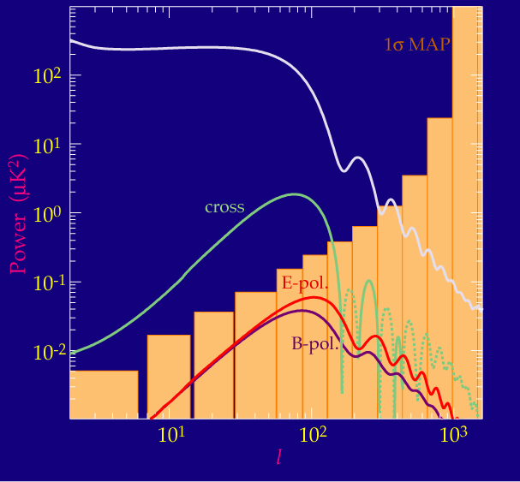
All Fluctuations if Only Gravitational Waves
TT
TE
EE
BB

Slide 54
All Fluctuations as a Function of r = T / S
TT
TE
EE
BB

Slide 55
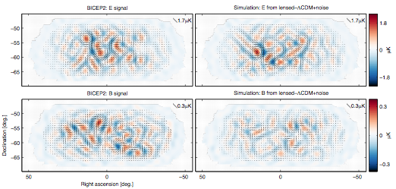
BICEP II Results (2014)

Slide 56
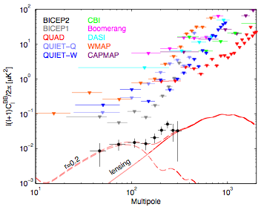
BICEP II Results (2014)
Discovery of primordial gravitational waves? If so, "smoking gun" of inflation

Slide 57
BUT

Slide 58
Planck Results (Sep 22, 2014)
The BB power spectrum of dust in the BICEP2 field looks very similar to the claimed signal

Slide 59
Dark Energy

Slide 60
What Do We Mean by Dark Energy?
In 1998 two teams of astronomers and physicists studying type-Ia supernovae found that the expansion rate of the universe is increasing with time: accelerated expansion
Gravity tends to slow down the expansion
Whatever mechanism causes the acceleration, we call it “dark energy”:
Einstein’s cosmological constant?
Some dynamical field (“quintessence”) not unlike the Higgs field?
Modifications to General Relativity?
…
Perlmutter et al. 1999
7677 citations
Riess et al. 1998
7508 citations

Slide 61
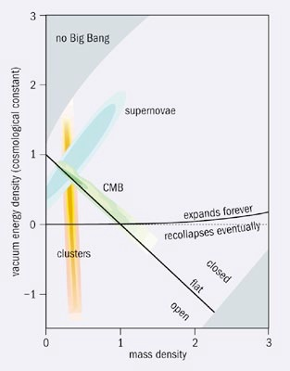
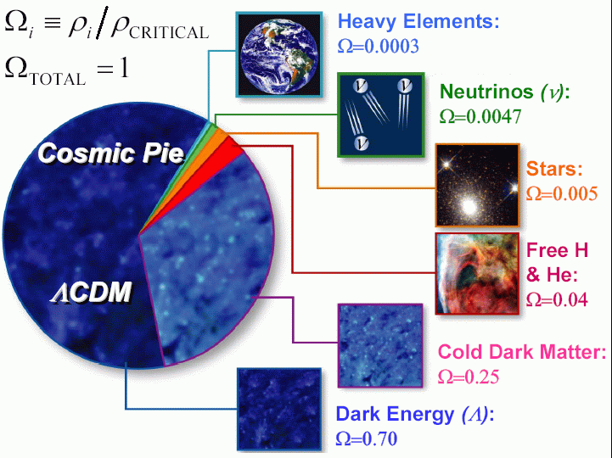
The New Standard Model
“The last Copernican revolution. (...) Not only we are not at the center of the universe, we are not even made of the stuff most of the universe is made of.”
B. Sadoulet

Slide 62
Friedmann-Lemaître Equations
Assuming for simplicity a flat universe, the Friedmann-Lemaître equations can be used to obtain:
so, for w = const, one has
Defining now and , one can cast the second Friedmann-Lemaître equation as:
H²(a) = H²₀ [Ω_{M} a⁻³ + Ω_{R} a⁻⁴ + Ω_{DE} a^{-3(1+w)}]
where 0 means now, and a₀ = 1
matter radiation dark energy
Ω_{i} = ρ⁰_{i} / ρ_{c} (density now). We assume flat universe, constant w
It is easy to see that Ω_{M} + Ω_{R} + Ω_{DE} = 1 + κ / R²H²₀ = 1 (flat)
Measuring the history of the expansion rate, H(a), we can learn about
the universe constituents: Ω_{M}, Ω_{DE}, w, etc.

Slide 63
Friedmann-Lemaître Equations
Assuming for simplicity a flat universe, the Friedmann-Lemaître equations can be used to obtain:
so, for w = const, one has
Defining now and , one can cast the second Friedmann-Lemaître equation as:
H²(a) = H²₀ [Ω_{M} a⁻³ + Ω_{R} a⁻⁴ + (1-Ω_{M}-Ω_{R}) a^{-3(1+w)}]
where 0 means now, and a₀ = 1
now
matter radiation dark energy
Ω_{i} = ρ⁰_{i} / ρ_{c} (density now). We assume flat universe, constant w
It is easy to see that Ω_{M} + Ω_{R} + Ω_{DE} = 1 + κ / R²H²₀ = 1 (flat)
Measuring the history of the expansion rate, H(a), we can learn about
the universe constituents: Ω_{M}, Ω_{DE}, w, etc.

Slide 64
Distances
The co-moving distance between a source at z and us can be computed as:
Several distances can be measured observationally:
Luminosity distance: if we have a “standard candle” with luminosity L, we define d_{L} such that the measured flux is Φ = L / 4πd_{L}². It is easy to see that d_{L}(z) = S_{κ}(r(z)) (1+z) = r(z) (1+z) (flat).
Angular distance: if we have a “standard ruler” with length l, we define d_{A} such that the measured angle subtended by l is Δθ = l / d_{A}. It is easy to see that d_{A}(z) = S_{κ}(r(z)) / (1+z) = r(z) / (1+z) (flat).
So by having a collection of either standard candles or standard rulers at different known redshifts, we will have many integrals of 1/H(z), from where one can reconstruct H(z) and, hence, Ω_{M},Ω_{DE},w, etc.
so, it gives us integrals of 1/H(z).

Slide 65
Probes of Dark Energy
Geometric tests
Standard Candles Type-Ia SNe Luminosity distance d_{L}(z) = r(z) (1+z)
Standard Rulers BAO Angular distance d_{A}(z) = r(z) / (1+z)
Standard Population Clusters Volume Element dV / dzdΩ = r²(z) / H(z)
Tests based on growth of structure
The rate of the growth of structure in the universe depends on the expansion:
Weak Lensing, Clusters
(also probe geometry)

Slide 66
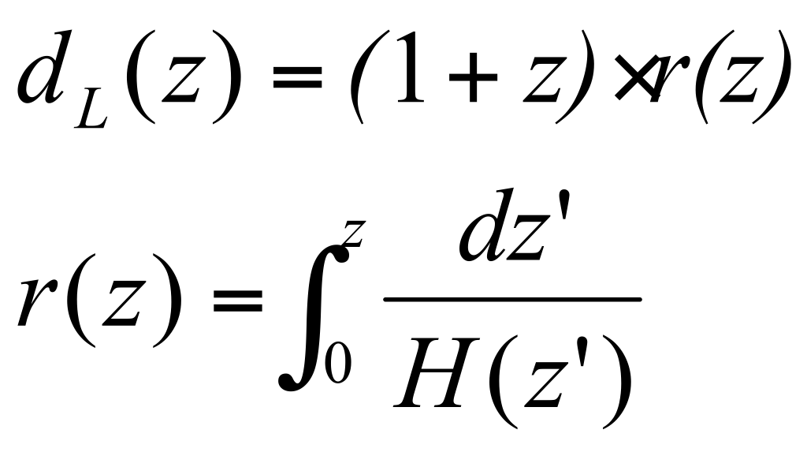
Probing Dark Energy with Type-Ia SNe
Standard candles provide a measurement of the luminosity distance as a function of redshift:
φ : flux
L : intrinsic luminosity
d_{L} : luminosity distance
r(z) : co-moving distance
Astronomers measure the apparent magnitude and redshift:
M is the (assumed unknown) absolute magnitude of a type-Ia SN.
H₀ d_{L} does NOT depend on H₀
(geometric test of dark energy)

Slide 67
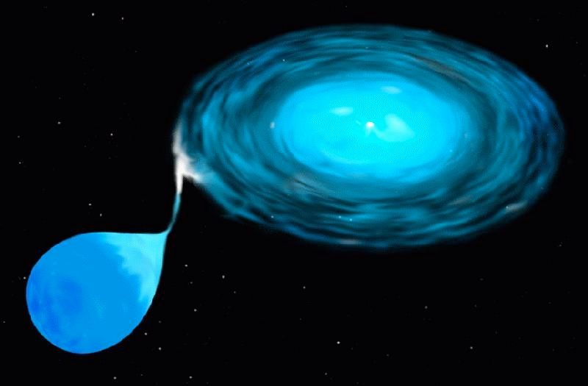
Type-Ia Supernovae (I)
Defined empirically as supernovae without Hydrogen but with Silicon in spectrum.
Progenitor understood as a white dwarf accreting material from a binary companion.
As the white dwarf approaches Chandrasekhar mass, a thermonuclear runaway is triggered.
A naturally triggered and standard bomb.

Slide 68
Type-Ia Supernovae (II)
General properties:
Homogeneous class of events: luminosity, color, spectrum at maximum light. Only small (correlated) variations
Rise time: ~ 15 – 20 days
Decay time: ~ 2 months
Bright: M_{B} ~ –19.5 at peak
No hydrogen in the spectra:
Early spectra: Si, Ca, Mg, ...(absorption)
Late spectra: Fe, Ni,…(emission)
SN Ia found in all types of galaxies, including ellipticals
Progenitor systems must have long lifetimes

Slide 69
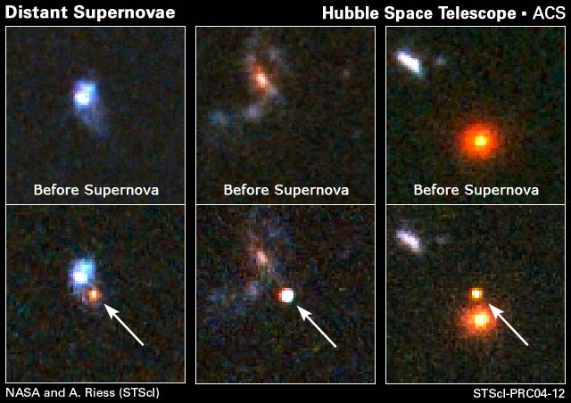
Discovering Supernovae

Slide 70
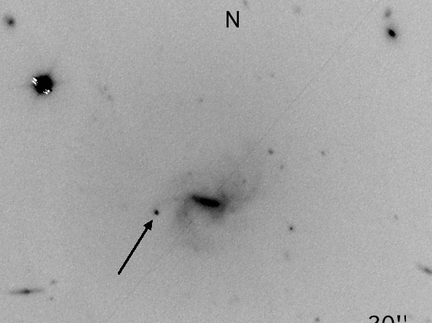
SN 2007qd, z = 0.043
dL ~ 200 Mpc

Slide 71
Are Type-Ia SNe Standard Candles?
apparent magnitude → distance → time

Slide 72
Type-Ia SNe as Standardizable Candles
Nearby (z < 0.1) supernovae used to study SNe light curves
Brightness not quite standard
Intrinsically brighter SNe last longer
Correction needed
Peak-magnitude dispersion of 0.25 – 0.30 mag
After correction, standard
candles in optical region (at least).
~ 0.10 – 0.15 mag dispersion
(5 – 7% precision in distance)

Slide 73
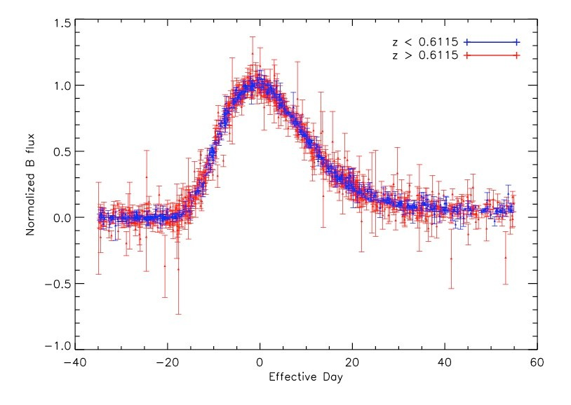
SNLS Light Curves After Stretch Correction
Conley et al. 2006

Slide 74
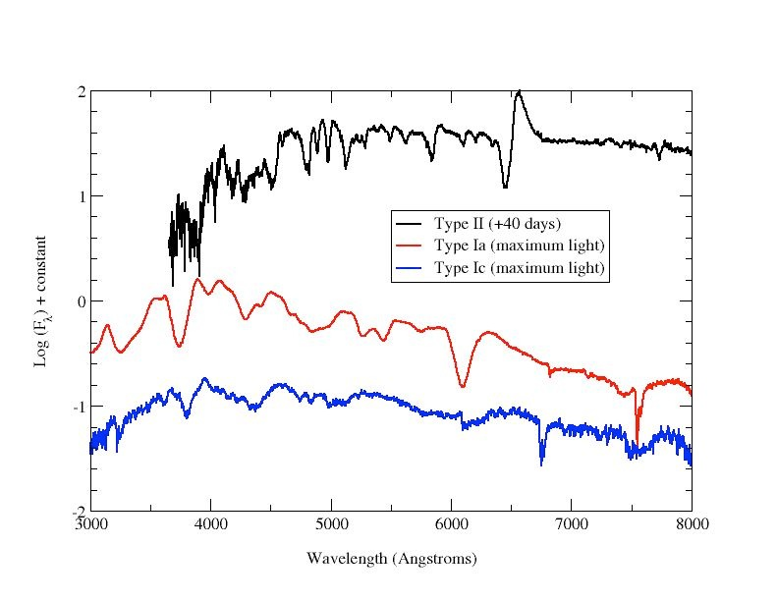
Type-Ia SN Spectral Features
Spectra at near maximum light are used to determine type of SN (Si-II feature)
And to measure the redshift, z, by observing the shift in the spectrum
Si-II

Slide 75
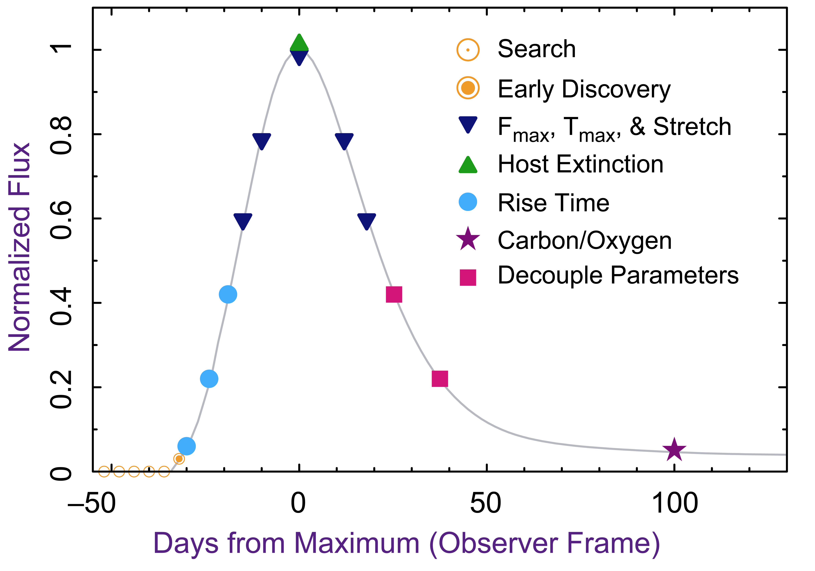
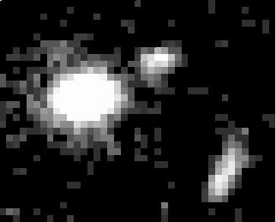
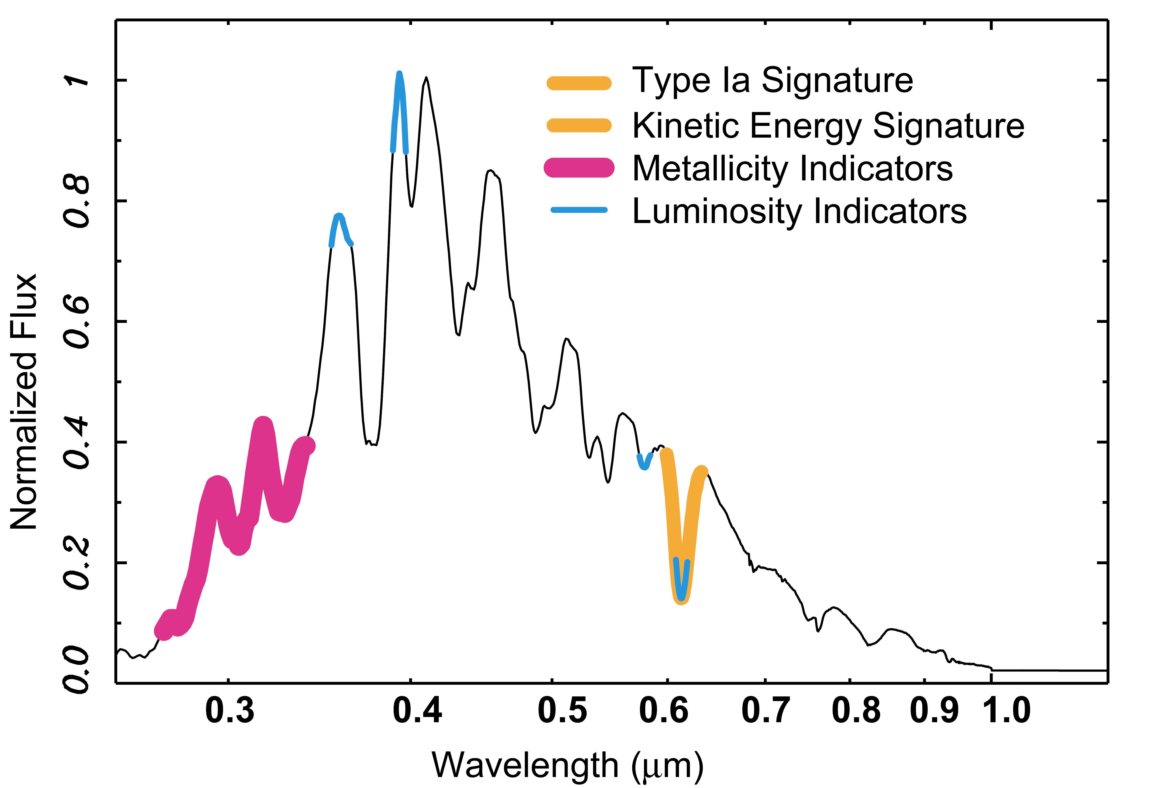
SN Analysis
Light Curves
Images
Redshift & spectral properties
Ω_{M} and w
Spectra
Data
Analysis
Science

Slide 76
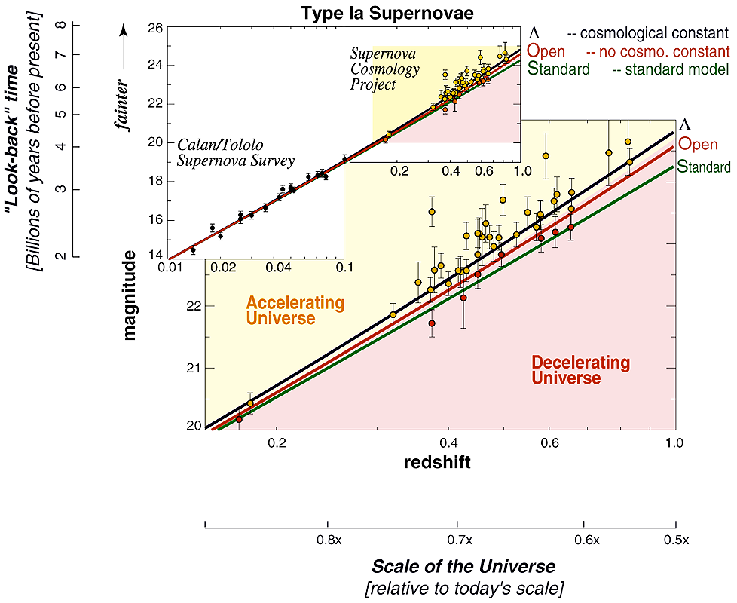
Hubble Diagram

Slide 77
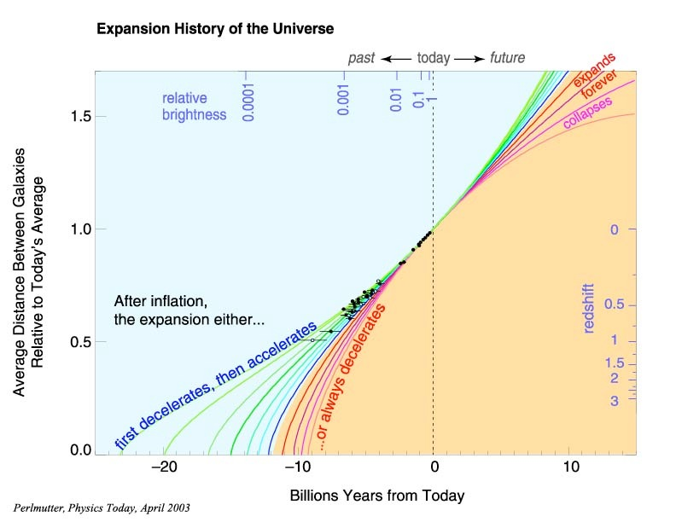
Hubble Diagram

Slide 78
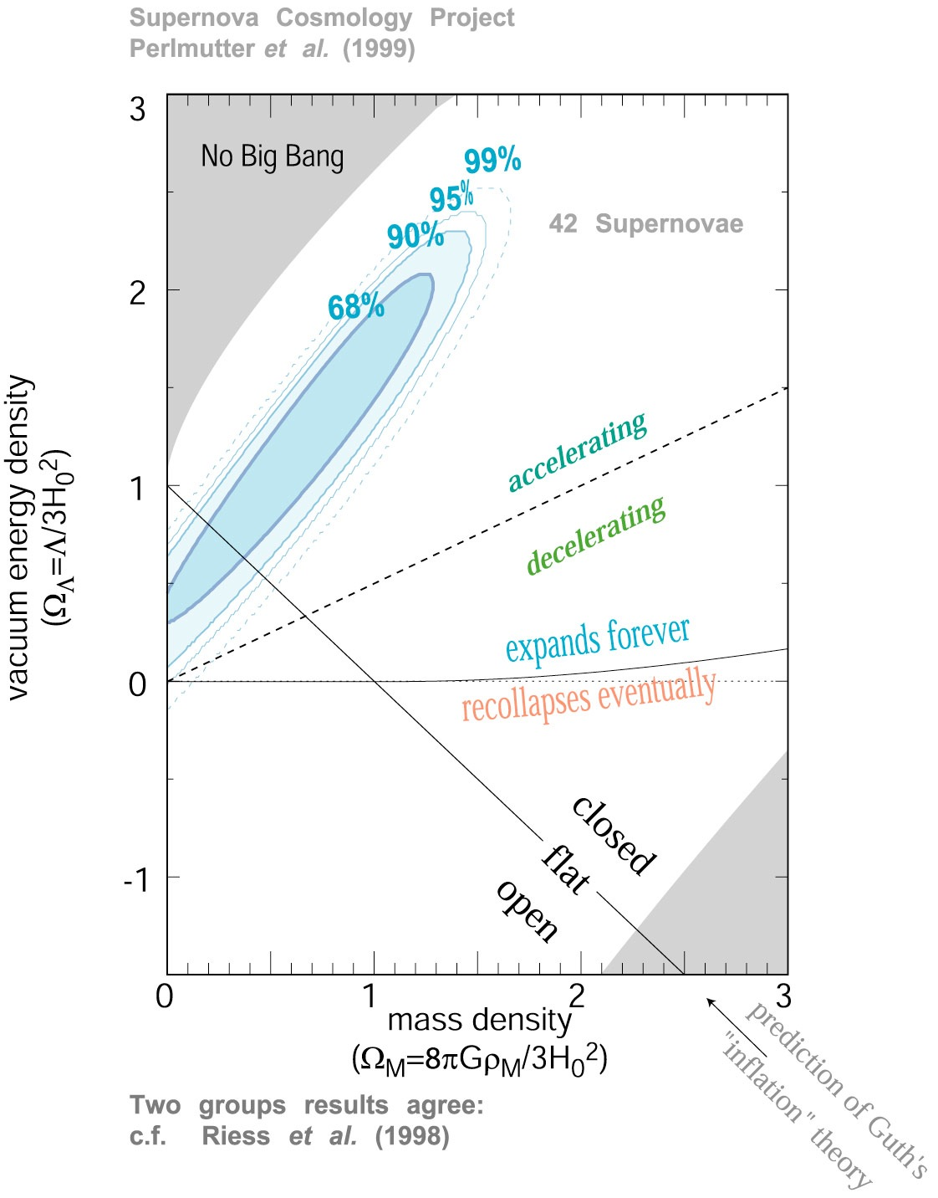
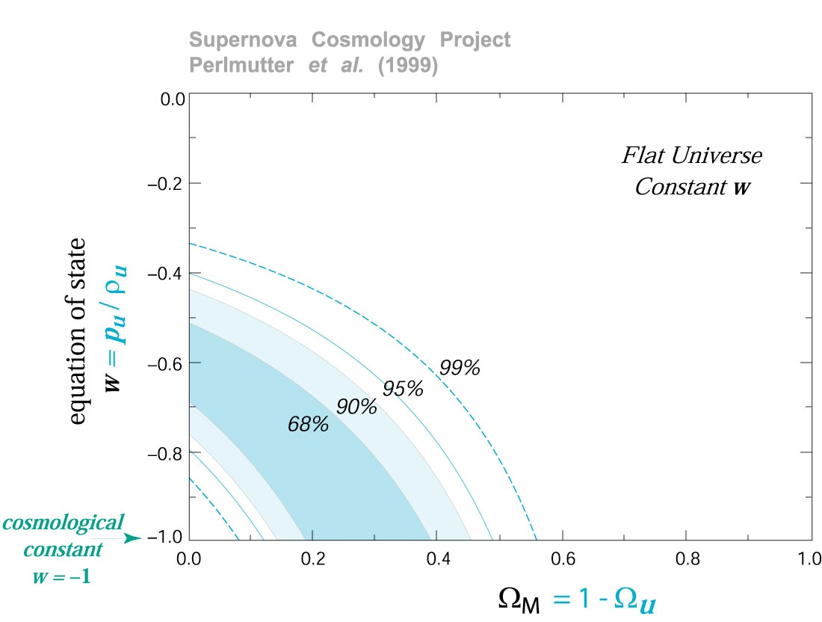
Discovery of Acceleration

Slide 79
Systematic Errors
Statistical error is dominated by intrinsic SN peak magnitude dispersion σ_{int} = 0.10–0.15
Many systematic errors will be totally correlated for SNe at similar redshifts
Current and near-future surveys will have O(100) SNe for Δz = 0.1 redshift bin.
Therefore, systematic errors of order σ_{int}/√N_{SN} = 0.01–0.02 will already become important or even dominant.

Slide 80
Sources of Systematic Errors
Error Source | Control
Host-galaxy dust extinction | Wavelength-dependent absorption identified with high S/N multi-band photometry.
Supernova evolution | Supernova sub-classified with high S/N light curves and peak-brightness spectrum.
Flux calibration error | Program to construct a set of 1% error flux standard stars.
Malmquist bias | Supernova discovered early with high S/N multi-band photometry.
K-corrections | Construction of a library of supernova spectra.
Gravitational lensing | Measure the average flux for a large number of supernovae in each redshift bin.
Non-Type-Ia contamination | Classification of each event with a peak-brightness spectrum.
*
*
*
*
Kim, Linder, Miquel, Mostek, MNRAS 347 (2004) 909

Slide 81
Extinction by Dust
Dust in the path between the SN and the telescope attenuates the amount of light measured
Milky Way dust is well measured and understood (Schlegel, Finkbeiner & Davis 1998)
Host galaxy extinction leads to reddening of supernova colors:
A_{V} = R_{V} · E(B-V)
In another band j, the extinction is (Cardelli, Clayton & Mathis 1989)
6956 citations
A_{V} : increase in magnitude in V band
E(B-V): excess in B-V color over expected
R_{V} ≈ 3.1 in nearby galaxies
3709 citations
known
(≈ 0-0.10)
What is the value of R_{V} in distant galaxies?

Slide 82
Extinction by Dust (II)
Different approaches to R_{V} determination:
Riess et al. 2004 (HZT) assume R_{V} = 3.1, as it appears to be in the local universe. Include exponential prior on A_{V}. Bias?
Astier et al. 2006 (SNLS) instead determine one R_{V} value for all their high-z SNe, coming up with a much lower value R_{V} = 0.57 ± 0.15
Their R_{V} effectively includes any other effect that might correlate SN color and magnitude.
SNAP will determine R_{V} for each SN independently.
Needs at least 3 bands for each SN

Slide 83
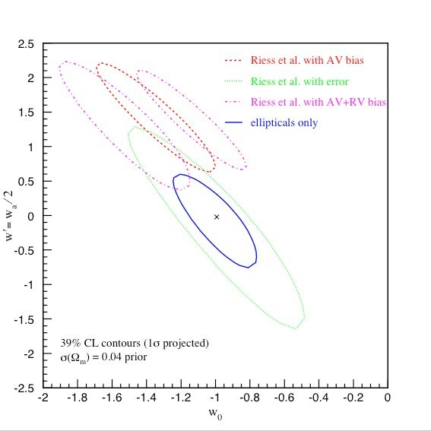
Dust Biases
No extinction (e.g. only SNe in ellipticals)
Extinction corrected
With A_{V} bias
With A_{V} and R_{V} biases
Current data quality
Linder & Miquel 2004
w(z) = w₀ + (1-a) w_{a}

Slide 84
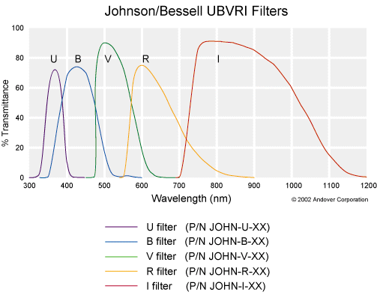
Near-Optical Bands
g
r
i
z

Slide 85
Near-Optical Bands
λ → λ·(1+z)
z = 0.5
U
B
V
R
I
z = 1.0
U
B
V
R

Slide 86
K-corrections
λ → λ·(1+z)
z = 0.5
U
B
V
R
I
At high z, one needs to relate measured fluxes in, say, R, I, z filters with fluxes in SN rest frame B, V, R bands.
Good empirical model for SN spectrum from B to z is needed.
≈ O(0.5 mag)

Slide 87
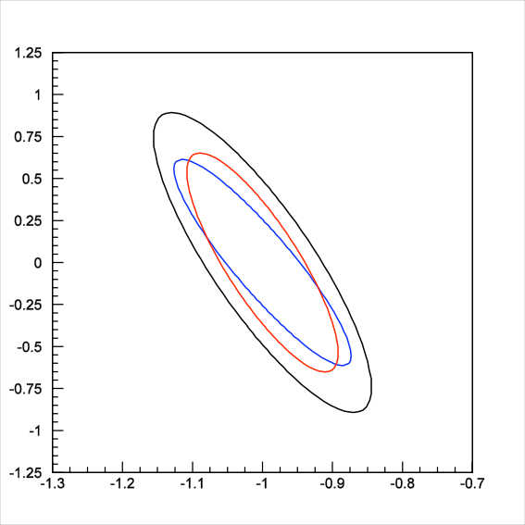
Calibration
Calibration ≡ determining the “zero-points” φ_{0,j} of each filter j
Overall normalization is irrelevant
Relative filter-to-filter normalization is crucial (K-corrections, dust-extinction corrections)
Standard σ_{cal} = 0.005
Standard σ_{cal} = 0.001
Self σ_{cal} = 0.005
Standard procedure uses well-understood stars to get σ_{cal} = 0.01 at best
Alternative procedure using also SN data themselves achieves a large degree of self-calibration (Kim & Miquel 2006)
Example for SNF + "SNAP" (300 + 2000 SNe up to z = 1.7)
w_{a}
*
68% CL contours
w₀
Kim & Miquel 2006

Slide 88
Current Cosmological Results from SNe
Betoule et al. (SNLS+SDSS-II/SNe), 2014

Slide 89
Summary: Type-Ia Supernovae
Type-Ia SNe provided the “smoking gun” for acceleration.
Mature technique still being perfected.
Control of systematic errors key to future improvements.
Vigorous current and future program:
Low-z from ground: SNF, SDSS-II/SNe, CfA, Carnegie…
Medium- to high-z from ground: SNLS, DES, Pan-STARRS, LSST
High-z from space: HST, Euclid
Expect more insight on the nature of Dark Energy from type-Ia SNe studies

Slide 90
Large-Scale Structure of the Universe
2-Degree-Field Galaxy Redshift Survey
(~250 000 galaxies)

Slide 91
Growth of Structure in the Universe
Consider a sphere of radius R and mass M, and add to it a small amount of mass so that .
Then the gravitational acceleration at the edge of the sphere is
Mass conservation throughout the expansion implies that
Differentiating two times with respect to t yields
Combining the two equations, we get . And subtracting the equation for δ = 0, we finally get
. Since ρ(t) = ρ0 / a³, then R(t)∝a(t) [1+δ(t)]^{−1/3}
(δ ≪ 1)
with

Slide 92
Radiation Dominated
H = 1 / (2t) and Ωm ≪ 1, so
The solution is δ(t) = C1 + C2 ln t
Overdensities grow only logarithmically with time. ✘

Slide 93
Cosmological Constant Dominated
H = HΛ and Ωm ≪ 1, so
Solution: δ(t) = C1 + C2 exp (-2HΛt)
Overdensities decrease with time. ✘
C1 = 0, C2 = 1

Slide 94
Matter Dominated
H = 2 / (3t) and, for Ωm ~ 1, we have
Solution: δ(t) = C1 t ⁻¹ + C2 t ^{2/3}
Overdensities grow with time as δ(t) ∝ t ^{2/3} ∝ a(t) ✔︎
Structure formation is only possible in the matter dominated era

Slide 95
The Jeans Length (1)
Forgetting the expansion for a moment, we have , which implies an exponential growth of the perturbation with
Astrophysical objects are stabilized against collapse by pressure gradients, which travel at the speed of sound cs = c (dp / dρ)^{1/2} = c w^{1/2}
If the density perturbation occupies a region of size R, pressure gradients need tpre ~ R / c w^{1/2} to stabilize it. If tpre > tcol → collapse
So collapse occurs when
Being more precise, collapse occurs when the characteristic size of an object is larger than the Jeans length: λJ = 2π (2/3)^{1/2} w^{1/2} c / H

Slide 96
The Jeans Length (2)
Collapse occurs when the characteristic size of an object is larger than the Jeans length: λJ = 2π (2/3)^{1/2} w^{1/2} c / H
Prior to decoupling, wgas ~ 1/3 and we get λJ ~ 3c / H(zdec). Larger than the horizon! ✘
Right after decoupling, wbaryon ~ (kBT / mc²) ~ 2.3×10⁻¹⁰, so λJ ~ 15 pc, which now is ~15 pc × (1+zdec) ~ 16 kpc, the size of a dwarf galaxy. ✔︎
However, this growth is too slow to produce the structures we see. ✘

Slide 97
Dark Matter
Dark matter is not coupled to photons. Therefore, its w is always very small.
Density fluctuations in dark matter can start growing from the start of the matter-dominated era (zrm ~ 3300).
At the time of decoupling, the baryons fell in the pre-existing gravitational wells of dark-matter and the baryon perturbations grew from there.
This explains the observed structure.

Slide 98
Analysis of Galaxy Maps
Galaxy surveys provide galaxy maps.
Similarly to the CMB, we want to study the statistical properties of the density fluctuations
Since the maps are in 3D, we use Fourier transforms and the power spectrum:

Slide 99
Baryon Acoustic Oscillations
At z>>1000 the universe was made of dark matter (DM), neutrinos and a highly-coupled relativistic photon-“baryon” (nucleons and electrons) gas.
Any initial over-density (in DM, neutrinos and gas) creates an overpressure that launches a spherical pressure (sound) wave in the gas.
This wave travels outwards at the speed of sound in the gas, c_{s} = c / √3
At z ~ 1100 (t ~ 350 000 yr), temperature drops enough (T ~ 3000 K) for protons and electrons to combine into neutral hydrogen atoms. Pressure-providing photons decouple and free-stream to us (CMB).
Sound speed of baryons plummets. Wave stalls at a radius of ~150 Mpc = 500 million light-yr, the co-moving sound horizon at recombination.
Over-density in shell (gas) and in the original center (DM) both seed the formation of galaxies.
Preferred separation of galaxies is 150 Mpc standard ruler

Slide 100
Acoustic Wave

Slide 101
Acoustic Wave

Slide 102
Propagation of Density Perturbations
D. Eisenstein, http://scholar.harvard.edu/files/deisenstein/files/acoustic_anim.gif

Slide 103
Final Density Profile

Slide 104
Galaxy-Galaxy Correlation Function
Based on 55000 “luminous red galaxies” from the SDSS spectroscopic galaxy survey
or
3.5-σ detection of BAO at <z> = 0.35
(confirmed by 2DF and SDSS
photometric survey at about 2.5 σ,
ανδ τηεν βψ μανψ οτηερσ)
h = H₀ / (100 km s⁻¹ Mpc⁻¹) ~ 0.7
Eisenstein et al. 2005

Slide 105
Probing Dark Energy with BAO
A standard ruler provides a measurement of the angular distance as a function of redshift:
Δθ : angle subtended
l : intrinsic length
d_{A} : angular distance
r(z) : co-moving distance
In principle, one can also put the ruler along the line of sight:
(geometric test of dark energy)
Δz : redshift subtended
Direct determination of H(z), but in this case one needs to
measure redshifts very precisely.

Slide 106
BAO Sensitivity to Dark Energy
Tough measurement
Worse if one wants to
measure dw/da
BAO not as sensitive
as SNe to w

Slide 107
Galaxy Redshift Surveys
Galaxy redshift surveys are used to measure the 3D clustering structure of matter: only need position and z, no flux, no shape.
There can be several sources of systematic errors:
Light from galaxies is a “biased” estimator of matter content
Non-linear physics involved in galaxy formation
Redshift distortions
However, all effects tend to predominantly change the amplitude of the correlations, but not the position of the measured acoustic peak
BAO are very insensitive to systematic
errors, and in any case, they are
very different from those of SNe.
But small effect only visible at
large scales leads to huge
surveys.

Slide 108
Galaxy Survey Strategy
Statistical errors on galaxy-galaxy correlation functions are determined by “sample variance” and “Poisson (shot) noise”.
Sample variance: how many independent samples of the relevant scale (150 Mpc)³ one has volume
Poisson noise: how many galaxies included in each sample density
Given a fixed number of galaxies (in a spectroscopic survey), the optimal choice for measuring the correlation function is an intermediate density:
n >10⁻⁴ h³ Mpc⁻³ at low redshift; somewhat higher at high redshift
P(k): power spectrum
Fourier transform of ξ(r)
n: galaxy density

Slide 109
Which Galaxies?
Many surveys concentrate on “Large Red Galaxies”: old elliptical galaxies, which are very bright and have a characteristic spectrum with a prominent break at 4000Å easy to measure redshift (spectrum or photometric)

Slide 110
Cosmological Results from BAO
~ 6 σ
Anderson et al. (BOSS) 2013
w(z) = w₀ + (1-a) w_{a}
w_{a} ≡ - (dw / da)₀

Slide 111
Summary: BAO
The BAO scale was observed in 2005-2007 at the 2.5-3.5σ level in two surveys using three techniques.
It provides very important constraints on Dark Energy properties (orthogonal to SNe).
Statistics is crucial. Haven’t reached systematics limit yet.
Explosion of BAO surveys:
Photo-z from ground: Pan-STARRS, DES, LSST
Spectroscopy from ground: BOSS, DESI, Sumire
Spectroscopy from space: Euclid
Expect a lot more insight on the nature of Dark Energy from BAO studies
PAU

Slide 112
Weak Gravitational Lensing

Slide 113
Weak Gravitational Lensing

Slide 114
Weak Gravitational Lensing

Slide 115
Weak Gravitational Lensing
Background sources
Dark matter halos
Observer
Statistical measure of shear pattern, ~1% distortion
Radial distances depend on geometry of Universe
Foreground mass distribution depends on growth of structure

Slide 116
Weak Lensing and Dark Energy
We can measure a power spectrum, just like CMB and BAO.
WL can divide source galaxies into many distance slices and measure many power spectra. Combine them to determine the history of dark energy.
WL sees non-linear, non-Gaussian growth and collapse of mass structures.
WL can measure and use the relation between visible matter and dark matter.
WL can measure the growth of Universe’s size and growth of structure within it.
This allows us to test whether GR is correct

Slide 117
A Weak Lensing Survey
Take pictures of many galaxies (ideally one billion).
Carefully measure the shape of each one.
Determine the mean lensing distortion to an accuracy of about 0.0001.
Main systematic: knowledge of PSF: space much better suited for WL studies than ground-based telescopes.
Space:
Small PSF: larger number of resolved
galaxies
Stable PSF: lower systematics after
calibration with stars
NIR photometry: better photo-z's
weak lensing shear

Slide 118
Summary: Weak Lensing
Weak Lensing is a statistically extremely powerful dark energy probe.
Needs large galaxy-shape surveys.
Systematics are tough from the ground. Less so from space.
Vigorous future program:
From ground: DES, KIDS, HSC, LSST
From space: Euclid
Weak Lensing might be the ultimate technique for determining the nature of dark energy

Slide 119
Galaxy Clusters
Galaxy clusters are the largest collapsed structures.
Their mass density function dn / dVdM can be predicted. It depends on DE through the growth of structure.
The measured cluster density involves both the mass density function and the volume element, which depends on DE through geometry:
Mohr
dV / dzdΩ = r²(z) / H(z)
Volume effect
Growth effect

Slide 120
Cosmology with Galaxy Clusters: Requirements
Quantitative understanding of the formation of dark matter halos in an expanding universe.
Clean way of selecting a large number of galaxy clusters over a range of redshifts.
Redshift estimates for each cluster (photo-z's adequate).
Observables that can be used as mass estimates at all redshifts.

Slide 121
What is a Cluster?
Large peak in matter density:
Dark matter clump (~75% of mass)
Many luminous galaxies (~2.5%: 10% of baryons)
BCG and red sequence
Additional galaxies
Diffuse light
Hot gas (~22.5%: 90% of baryons)
Emits x-rays
Causes Sunyaev-Zel’dovich (SZ) decrement in CMB
weak lensing
optical astronomy
x-ray astronomy
sub-millimeter astronomy

Slide 122
Cosmology with Galaxy Clusters: Systematics
Relationship between observable and mass is complicated: need to understand bias and resolution (dn/dM falls exponentially).
Sample selection function: completeness, contamination.
Projection effects (SZ, optical, weak lensing).
Photo-z calibration.
& Controls
Self-calibration of mass-observable: clustering of clusters, shape of mass function.
Cross-compare identification and mass determination techniques.
Weak Lensing mass calibration: cluster-mass correlation function.
Spectroscopic training sets.

Slide 123
Summary: Clusters
Galaxy cluster counting is a powerful technique that requires a multi-observable approach.
Systematics can probably be understood with multi-probe approach.
Large surveys just starting
Main program: SPT + DES
Galaxy cluster studies are the most uncertain. Great potential, big challenges

Slide 124
The Concordance Model

Slide 125
Current Situation
Anderson et al. (BOSS) 2013
w(z) = w0 + (1-a) wa
wa ≡ - (dw / da)0
If we assume w = const, data compatible with Λ
Very little sensitivity to dw/da

Slide 126
So What is the Dark Energy?
Einstein’s cosmological constant?
Data so far seems to point towards Λ, but see next slide
Some dynamical field (“quintessence”)?
Needs large fine-tuning
Modifications to General Relativity?
If GR is not the right theory of gravity at large scales, then the properties of DE inferred from geometrical probes (SNe, BAO) will not, in general, coincide with the properties inferred from growth of structure probes (clusters, WL).
V(ϕ)
(10^{–3} eV)⁴
ϕ
10²⁸ eV

Slide 127
A Cosmological Constant?
Data is so far compatible with dark energy being just Λ
w ~ –1 ± 0.05 (assuming w = constant)
However, there is no physical (microscopical) explanation for Λ. It just can be added to Einstein’s field equations:
R^{μν} – ½ g^{μν}R = 8πGT^{μν} + Λg^{μν}
Since Λ is constant in space and time, a good obvious candidate is vacuum energy. However:
Ω_{Λ} ~ 0.7 ➔ ρ_{Λ} ~ (10 meV)⁴ [ ~ m⁴_{ν} …]
while a naïve estimate would give
ρ_{Λ} ~ M⁴_{Planck} ~ 10¹²⁰ × (10 meV)⁴
Before 1998 it was hoped that some exact symmetry would turn ρ_{Λ} into 0
Now some broken symmetry is needed, leaving only one part in 10¹²⁰
Quite a fine-tuning problem!!!

Slide 128
Curent and Future Galaxy Surveys

Slide 129
Dark Energy Studies
What is causing the acceleration of the expansion of the universe?
Einstein’s cosmological constant Λ?
Some new dynamical field (“quintessence”, Higgs-like)? “Dark Energy”
Modifications to General Relativity?
Dark energy effects can be studied in two main cosmological observables:
The history of the expansion rate of the universe: supernovae, weak lensing, baryon acoustic oscillations, galaxy-cluster counting
The history of the rate of the growth of structure in the universe: weak lensing, galaxy distribution (LSS), galaxy-cluster counting
For most probes, large galaxy surveys are needed:
Spectroscopic: 3D (redshift), medium depth, low density, selection effects
Photometric: “2.5D” (photo-z), deeper, higher density, no selection effects
}

Slide 130
Spectroscopic Redshift vs. Photo-z
Spectroscopy:
Photo-z:

Slide 131
The Importance of Redshift Resolution
z-space, Δz = 0.03(1+z) + peculiar velocities (DES)
z-space, Δz = 0.003(1+z) + peculiar velocities (PAU)
z-space, perfect resolution + peculiar velocities
(DESI)
Real space

Slide 132
DES

Slide 133
DES: Dark Energy Survey
5000 deg² galaxy survey to iAB < 24 in grizY. 300M galaxies up to z < 1.4. Also 4000 SNe.
Involves groups in USA (led by FNAL), Spain, UK, Brazil, Germany, Switzerland.
525 nights in 5 years
Started on Aug 31st 2013
2.2 deg ∅ FoV
3556 mm
Blanco, CTIO, Chile
Imager
Scroll
Shutter
1575 mm
570 Mpixels
Filters
Optical Lenses
2.2 deg. FoV

Slide 134
DES Science Program
Four Probes of Dark Energy
Galaxy cluster counting: N(M,z)
Measure redshifts and masses
~10,000 clusters to z>1 with M > 2x10¹⁴ M
Weak lensing (shear)
>200 million galaxies with shape measurements to z>1
Large-scale structure (LSS). Includes BAO
~300 million galaxies to z<1.4
Supernovae
~4000 type-Ia SNe to z>1
Probes are complementary in both systematic error and cosmological-parameter degeneracies
w = pDE/ρDE, w(z) =w₀+w_{a}(1–a)
DETF Figure of
Merit: inverse
area of ellipse
geometric+
growth
68% CL
Stage III
project
geometric
Planck prior
assumed
Huterer, Ma, Miquel, Weller, et al. 2007

Slide 135
The DES Collaboration

Slide 136
DES/Spain
Color Code
Senior Scientists
Post-docs
Engineers
Doctoral Students
CIEMAT
E. Sánchez
I. Sevilla
F. J. Rodríguez, J. de Vicente
M. García, R. Ponce, F. J. Sánchez
ICE/IEEC
F. J. Castander, E.Gaztañaga, P. Fosalba
A. Bauer, M.Crocce
S. Serrano
K. Hoffman, A. Izard, A. Pujol
IFAE
E. Fernández, R. Miquel
J. Aleksić, Ch. Bonnett, A. Kovács (starting in October)
O. Ballester, L. Cardiel
P. Martí, C. Sánchez, P. Vielzeuf
UAM
J. García-Bellido
D. Sapone, S. Nesseris, R. Villamariz
S. Ávila, A. Salvador

Slide 137
Main Spanish Contributions to DES
Electronics:
Design of the Clock & Bias Board (CIEMAT), Transition Board (IFAE / CIEMAT) and Master Control Board (IFAE)
Production, test and commissioning of the whole read-out electronics for DECam: 108 boards, finished in 2010 (IFAE / CIEMAT)
CCD characterization (CIEMAT / IFAE / ICE)
Simulations:
Large-scale simulations of the universe (ICE)
Data management (IFAE / PIC)
Data quality checks (CIEMAT)

Slide 138
DES/Spain in DES Governance
Two voting members in Management Committee (EG, RM)
Science Working Group coordination:
Large-scale structure (including BAO) (EG)
Photo-z (FC)
Publication board (RM)
Membership committee (ES)
Data Management users coordinator (IS)
Speakers bureau (RM, Chair)
Builders committee (EF)
Publication policy committee (RM)
Membership policy committee (ES)
Search committee for new DES director (RM)
Front-end electronics panel (ES, GM, MM (Chair))
Organized three DES Collaboration meetings: 2006, 2010, 2013

Slide 139
DECam Systems
Filter changer, Univ. of Michigan
Imager, FNAL
Barrel and
cage, FNAL
CCDs, wafers from LBL, packaged at FNAL
Electronics, Spain and FNAL
Hexapod, Italy
Shutter, Germany
Lenses, UK

Slide 140
DES Optical Detectors
New LBNL technology: thick back-illuminated CCD detector.
Better red response (up to λ = 1 μm) than “thinned” CCDs devices in use at most telescopes.
High-purity silicon has better radiation tolerance for space applications (developed for SNAP)

Slide 141
DECam Installation
July 2012
May 2012

Slide 142
DECam on the Blanco (Sep '12)

Slide 143
First DECam Image
Sep 12, 2012
NGC 1365
Fornax cluster

Slide 144
~150 000 galaxies in this single image

Slide 145
Measuring Galaxy Shapes
Shear
Josh Frieman, DOE-NSF Review, May 1-3, 2007

Slide 146
Measuring Galaxy Shapes
Shear+ PSF
Josh Frieman, DOE-NSF Review, May 1-3, 2007

Slide 147
Measuring Galaxy Shapes
Shear+ PSF
+ pixelization
Josh Frieman, DOE-NSF Review, May 1-3, 2007

Slide 148
Measuring Galaxy Shapes
Shear+ PSF
+ pixelization + noise
Josh Frieman, DOE-NSF Review, May 1-3, 2007

Slide 150
Science Verification (SV): Nov 12 - Feb 13
~200 sq. deg. at nominal DES depth
~10 million galaxies
Data processed and released in Aug 13

Slide 151
SN Observations During SV
SN fields include photo-z calibration fields

Slide 152
SN Observations During SV
SN fields include photo-z calibration fields

Slide 153
First DES Paper Out on May 16th
P. Melchior et al.
arXiv:1405.4285

Slide 154
First DES Paper Out on May 16th
P. Melchior et al.
This paper proves that DES can measure galaxy shapes, even in the Science Verification preliminary data set.

Slide 155
Second DES science paper
arXiv:1406.4407
(in press in MNRAS)

Slide 156
Photo-z Calibration Fields in DES SV
Photometry:
grizY
18 < iAB < 24
0 < g-r < 2
0 < r-i < 2
Spectroscopy:
0.01 < z < 1.4
3 ≤ z_flag < 5
about 15600 gal

Slide 157
13 Photo-z Algorithms Have Been Tried
7

Slide 158
Four Algorithms Studied in More Detail
7

Slide 159
Calibrated True N(z) in Photo-z Bins
7

Slide 160
Example: DESDM Artificial Neural Net
σ68 ~ 0.05×(1+z)
Photo-z vs. spectroscopic z
Pull distribution: (photo-z − spec z) / σ(photo-z)
Photo-z distribution compared to spectroscopic z distribution
This paper proves that DES can measure colors, even in the Science Verification preliminary data set.

Slide 161
Other SV Analyses in the Pipeline
Joint Optical and Near Infrared Photometry from DES and VHS ✔︎
Galaxy Clustering and validation against CFHTLS
DES SV Galaxies cross-correlated with CMB lensing
SPT-SZE signature of DES SV RedMaPPer clusters
Galaxy Populations within SPT Selected Clusters
DES/XCS: X-ray properties of galaxy clusters in DES SV
The Dark Energy Survey SV Shear Catalogue: Pipeline and tests
Calibrated Ultra Fast Image Simulations for the Dark Energy Survey
DES13S2cmm: The first Super-luminous Supernova from DES
The Dark Energy Survey Supernova Survey: Search Strategy and Algorithm
Wide-Field Mass Mapping with the DES SVA1 data

Slide 162
SV Data Analyses
LSS: Galaxy-galaxy correlations
Weak lensing: Galaxy-shear correlations
Shape measurements are blinded!
Analyses on LSS and on WL+LSS combination in DES-SV are led by DES/Spain scientists

Slide 163
Year 1 of 5 (Sep ’13 - Feb ’14)
Data being processed

Slide 164
PSF FWHM for Y1 Data
Requirement: 0.9"

Slide 165
DES Summary
DES successfully started data taking in Nov. 2012, with a Science Verification (SV) period.
Science Verification data have enough quality to do first science with them.
DES/Spain leading in several areas of SV analysis: calibration, photo-zs, galaxy-galaxy correlations, galaxy-galaxy lensing.
Very fruitful collaboration between DES/Spain institutions: CIEMAT / ICE (IEEC-CSIC) / IFAE / UAM.
DES survey started in Aug. 2013, will last till Feb. 2018.
Looking forward to analyses with Year 1 data sample and beyond.
Josh Frieman, DOE-NSF Review, May 1-3, 2007

Slide 166
PAU

Slide 167
The PAU Survey at the WHT

Slide 168
The PAU@WHT Project in a Nutshell
New camera for WHT with 18 2k x 4k CCDs covering 1 deg ∅ FoV.
40 100Å-wide filters covering 4500-8600 Å in 5 movable filter trays, plus standard ugrizY filters.
As a survey camera, it can cover ~2 deg² per night in all filters.
It can provide low-resolution spectra (Δλ/λ ~ 2%, or R ~ 50) for >30000 galaxies, 5000 stars, 1000 quasars, 10 galaxy clusters, per night.
Expected galaxy redshift resolution σ(z) ~ 0.003×(1+z).
Plan: 100-night survey in 4 years.

Slide 169
PAU@WHT Personnel
PI : E. Fernández (UAB/IFAE)
Co-Is: E. Sánchez (CIEMAT), E. Gaztañaga(IEEC/CSIC), R. Miquel (IFAE/ICREA), J. García-Bellido (IFT/UAM), M. Delfino (PIC)
PAU Camera PI: F. Castander
Project Manager: C. Padilla. Systems Engineer: L. Cardiel
DAQ: J. de Vicente. Mechanics: F. Grañena. Control: O. Ballester. Optics and integration: R. Casas, J. Jiménez
PAUDM & Science PI: E. Gaztañaga
Simulations: F. Castander. Operations: N. Tonello. Data Reduction: S. Serrano. QA & Validation: I. Sevilla
The Survey Team
D. Alonso⁴, J. Asorey², O. Ballester³, A. Bauer², C. Bonnett², A. Bueno⁴, J. Campa¹, L. Cardiel³, J. Carretero²,
R. Casas², F. Castander², J. Castilla¹, M. Crocce², M. Delfino⁵, J.F. de Vicente¹, M. Eriksen², S. Farrens²,
E. Fernández³, P. Fosalba², J. García-Bellido⁴, E. Gaztañaga², F. Grañena³, A. Izard², J. Jiménez², C. López²,
L. C. López³, F. Madrid², M. Maiorino³, P. Martí³, G. Martínez¹, R. Miquel³, C. Neissner⁵, L. Ostman³,
A. Pacheco⁵, C. Padilla³, C. Pio³, A. Pujol², J. Rubio⁴, E. Sánchez¹, D. Sapone⁴, S. Serrano², I. Sevilla¹,
P. Tallada⁵, N. Tonello⁵.
¹ ²
³ ⁴ ⁵

Slide 170
Requirements on Redshift Precision (BAO)
H(z)
Inverse of area of w₀-w_{a} error ellipse
d_{A}(z)
spec
photo
photo
spec
photo
PAU
Δz / (1+z)
PAU
Δz / (1+z)
N. Padmanabhan

Slide 171
The Importance of Redshift Resolution
z-space, Δz = 0.03(1+z) + peculiar velocities (DES)
z-space, Δz = 0.003(1+z) + peculiar velocities (PAU)
z-space, perfect resolution + peculiar velocities
Real space

Slide 172
PAUCam at WHT
WHT Telescope
• Diameter: 4.2 m
• Prime focus: 11.73 m
• Focal ratio: f/2.8
• FoV: 1 deg ∅, 40’ unvignetted
• Scale: 17.58’’/mm ⬄ 0.26”/pixel
PAUCam will be mounted at the prime focus:
Strong limitation in the weight: max. 235 kg.

Slide 173
PAUCam
Body of camera made of carbon fiber, shaped to minimize wall thickness

Slide 174
PAUCam Detectors
Hamamatsu new CCDs:
18 4k x 2k 15 μm pixels
Excellent sensitivity across the entire wavelength range from 0.3 to over 1 μm.
20 delivered and characterized at CIEMAT and IFAE
²⁸

Slide 175
PAUCam Filter System
40 narrow-band filters
FWHM = 100 Å
Spectral range: λ=4400-8500 Å
Rectangular transmission profile
6 broad-band filters
ugriZY (SDSS & DES)
¹⁰

Slide 176
PAUCam Filter Trays
Efficiency: filters need to be very close to sensors to avoid vignetting
More filters than CCDs ➜ movable trays
Jukebox-like system
Movements in vacuum are technologically challenging
¹¹

Slide 177
PAUCam Filter Trays
Cut-out showing filter-tray movable system

Slide 178
PAU Camera Construction
Cryogenics and vacuum tests on prototype
CCD test station
Aluminum mold of camera body
Camera body in carbon fiber

Slide 179
PAUCam: Measurements
Filter transmission (r-band)
CCD image (30 min dark)
CCD noise reading 2 CCDs
CCD QE
RMS ~ 8.5 ADU ~ 6 e-

Slide 181
PAU Camera: Details
Shutter
Entrance window
18 CCDs in the focal plane
r-band filter

Slide 182
PAU Camera
Full camera
Telescope simulator

Slide 183
PAUCam Control System
Telescope
Control
System
Instrument
Control
System
Slow Control
TCS
In
ter
fa
ce
Alarms
Image View
and
Quality Analysis
Guider
Observation Control System
GUI
Focal
Plane
Data Acquisition
System
5-day
Storage
Transfer
to PAUdm
Science Data Flow
One computer already installed at the WHT. Tests of interface are already taking place.

Slide 184
Data Management System

Slide 185
Pipelines

Slide 186
PAUCam Simulations

Slide 187
PAU Filter Transmissions

Slide 188
PAU Survey Strategy
Use 8 central CCDs to define the survey footprint, use the other CCDs to increase S/N.
Each central CCDs covers the whole survey area twice.
5 filters trays with 8 NB central filters.
Broad bands reach ~1.4 magnitudes deeper than narrow bands.
Detect objects in the broad bands, and then get flux in the narrow bands.
Push to low signal to noise.
Surveying capability: sample 2 deg² / night to iAB < 22.5 mag in all NBs and iAB < 23.7 in all BBs ➜ >30000 galaxies / night
Exposure times depend on tray: ~90 s for bluest, ~150 s for reddest.
No selection effects.

Slide 189
PAU Limiting Magnitudes

Slide 190
PAU Photo-z Performance (iAB < 22.5)
Martí, Miquel, Castander, Gaztañaga, Eriksen, Sánchez
MNRAS 442 (2014) 92 (arXiv:1402.3220)

Slide 191
PAU Photo-z Performance (22.5< iAB < 23.7)
Martí, Miquel, Castander, Gaztañaga, Eriksen, Sánchez
MNRAS 442 (2014) 92 (arXiv:1402.3220)

Slide 192
PAU Science
Survey strategy produces two samples:
“Spectroscopic” sample: excellent photo-z’s with NB filters to iAB < 22.5
“Photometric” sample: medium photo-z’s with BB filters to iAB < 23.7
Science case depends on amount of time available
Current science case, assuming 100 nights (200 deg²):
Use bright sample for redshift-space distortions (typical of spectroscopic surveys)
Use faint sample for weak lensing magnification and/or shear (typical of imaging surveys)
Exploit the gains of cross-correlating both samples on the same area
Gaztañaga et al. 2012, MNRAS 422 2904 (astro-ph/1109.4852)

Slide 193
PAU Survey Samples
22.5 < iAB < 24
iAB < 22.5

Slide 194
PAU’s Primary Science Drivers (I)
Redshift-space distortions (RSD):
Peculiar velocities of galaxies trace the matter density fields.
Anisotropies in the galaxy 2-point correlation function measure the growth of structure at a given redshift: probe of dark energy.
Relevant scales are ~10 Mpc/h, well matched to PAU’s z precision.
σz = 0.000 × (1+z)
σz = 0.003 × (1+z)
Gaztañaga et al., astro-ph1109.4852

Slide 195
PAU’s Primary Science Drivers (I)
σz = 0.000 × (1+z)
σz = 0.003 × (1+z)
Gaztañaga et al., astro-ph1109.4852

Slide 196
PAU’s Primary Science Drivers (II)
Lensing magnification (MAG):
Gravitational lensing affects the measured galaxy number density.
Main observable is the cross-correlation between galaxies in different redshift bins as a function of angular separation.
Very precise photo-z’s allow PAUCam to perform cross-correlations between well-defined narrow redshift bins.
Combination of RSD and MAG includes:
3D galaxy clustering, which is degenerate with galaxy bias.
Weak lensing magnification, which is unbiased.
Redshift-space distortions, which also measure bias, and growth.
Probes dark energy through both growth of structure and geometry.

Slide 198
PAU Survey Science Reach
The combination of RSD and MAG in the same data set is very powerful in breaking degeneracies between cosmological parameters ➔ a unique advantage of PAU.
Figures of merit with free Ωm, ΩDE, h, σ8, Ωb, w0, wa, γ, ns, 4 bias parameters.
F200, iAB < 24
B200, iAB < 22.5
(including Planck and stage-II SNe priors)
E. Gaztañaga, M. Eriksen, M. Crocce, F. Castander, P. Fosalba, P. Martí, R. Miquel, A. Cabré, MNRAS 422 (2012) 2904

Slide 199
Other Science
Intrinsic alignment of galaxies (main systematic for future weak-lensing surveys, e.g. Euclid)
Photo-z calibration of future photometric surveys (DES, HSC, LSST, Euclid)
Large Scale Structure, including BAO
Galaxy clusters
Galaxy evolution
Quasars and the Lyα forest
Multiply imaged gravitational lenses
High redshift galaxies
Low surface brightness galaxies
Intergalactic dust
Halo stars
Local group stars
Brown dwarfs and cool stars
Exoplanets
....

Slide 200
PAU Conclusions
PAUCam is essentially completed, with many tests being done.
First commissioning in Fall 2014.
Regular data taking expected in 2015.
PAUCam will be the most powerful imaging instrument at the Roque de los Muchachos

Slide 201
DESI

Slide 202
The Dark Energy Spectroscopic Instrument (DESI)

Slide 203
Photometric Galaxy Surveys
Instrument | Telescope | Bands | No. Gal. | Sq. Deg. | z max | Leader
KiDS | VST 2.6 | ugri | 90M | 1500 | 1.5 | ESO
VHS | Vista 4 | YJHKs | 400M | 20000 | 1.2 | ESO
Viking | Vista 4 | ZYJHK | IR complement to KiDS | 1500 | 1.5 | ESO
PS1 | Hawai’i 1.8 | grizy | 1B | 30000 | 1.0 | USA
DES | Blanco 4 | grizy | 300M | 5000 | 1.5 | USA
SuMIRe HSC | Subaru 8.2 | grizy | 100M | 1400 | 1.5 | Japan
PAU | WHT 4 | 42 narrow bands | 2M | 100-200 | 1.2 | Spain
J-PAS | OAJ 2.5 | 54 narrow bands | 14M LRG | 8000 | 1.2 | Spain
LSST | LSST 8.4 | ugrizy | 4B | 20000 | 3.0 | USA
Euclid | Space 1.2 | R+I+Z YJH | 1.5B | 14700 | 2.0 | ESA
Now

Slide 204
Spectroscopic Galaxy Surveys
Instrument | Telescope | No. Gal. | Sq. Deg. | z max | Leader
SDSS | APO 2.5 | 85K LRGs | 7600 | 0.6 | USA
Wiggle-Z | AAT 3.9 | 239K | 1000 | 0.7 | Australia
BOSS | APO 2.5 | 1.4M LRGs + QSOs | 10000 | 0.7 | USA
HETDEX | HET 9.2 | 1M | 420 | 3.0 | USA
eBOSS | APO 2.5 | 600K | 7500 | 1.0 | CH / Fr / US (J.-P. Kneib)
DESI | Mayall 4 | 25M + QSOs | 14000 | 1.7 (3.5 with QSOs) | USA
SuMIRe PFS | Subaru 8.2 | 4M | 1400 | 2.4 | Japan
4MOST | VISTA 4.1 | ?? | 15000 | 1.5 | ESO
Euclid | Space 1.2 | 50M | 15000 | 2.0 | ESA
Now

Slide 205
DESI: Dark Energy Spectroscopic Instrument
Scale up BOSS to a massively parallel fiber-fed spectrometer at a 4-meter telescope.
Stage-IV BAO and power spectrum, built upon BOSS
Broad range of target classes: LRGs, ELGs, QSOs, Ly-α QSOs
Broad redshift range: 0.2 < z < 3.5
Sky area: ~14,000 sq. deg.
Number of redshifts: ~25 M
Medium resolution spectroscopy, R ~ 3000 - 5000
Spectroscopy from blue to NIR
Automated fiber system: N_{fiber} ~ 5000
5000 fiber actuators
New 3 deg ∅ FoV corrector
Mayall
4-m
Telescope
New spectrographs
Requesting ~100% of dark time for 3 - 5 years

Slide 206
What is the DESI survey?
Four target classes spanning redshifts z=0 ➔ 3.5
SDSS ~2h⁻³Gpc³ BOSS ~6h⁻³Gpc³ DESI 50h⁻³Gpc³
0.6 million Ly-α QSOs + 1.6 million QSOs
24 million ELGs
4 million LRGs

Slide 207
LRG Targets
Luminous Red Galaxies
~4 x 10⁶ goal
0.4 < z < 1.0
Expansion Rate

Slide 208
ELG Targets
Emission Line Galaxies
~24 x 10⁶ goal
0.7 < z < 1.6
Expansion Rate

Slide 209
QSO Targets
Quasar Tracers
~1.6 x 10⁶ goal
0.9 < z < 2.2
Expansion Rate

Slide 210
Ly-α Forest QSO Targets
Quasar Ly-α Forest
~0.6 x 10⁶ goal
2.2 < z < 3.5
Expansion Rate

Slide 211
DESI on the Hubble Diagram
Expansion Rate

Slide 212
DESI Broad Science Goals

Slide 213
DESI Broad Science Goals
P. McDonald (LBNL)

Slide 214
Comparison With Other Surveys
Fractional Distance Error
DESI

Slide 215
Institutions Interested in DESI (Jul 2013)
AAO
Argonne
Brazil
Brookhaven
Carnegie Mellon Univ.
Durham
EPFL
ETH Zurich
FNAL
Harvard
IAA et al.
Kansas
KASI
LAM/CPPM
Mexico
NOAO
New York Univ.
Portsmouth
Saclay
SJTU
SLAC
IFAE/ICE/CIEMAT/UAM
Texas A&M
The Ohio State Univ.
Univ. College London
UC Berkeley
UC Irvine
UC Santa Cruz
U. Edinburgh
U. Michigan
U. Pittsburgh
U. Utah
USTC
Yale

Slide 216
DESI Current Schedule
DESI notional timeline
Oct 2018: Commissioning / pilot observations
April 2019: Survey starts
April 2020: 1st data set defined
Nov 2020: BAO results on 1st year data
Nov 2022: BAO results with 60% of data, surpasses science requirements
*
*Conceptual Design Review: Passed on September 11, 2014

Slide 217
IFAE/ICE/CIEMAT/UAM Contributions
Design, production and test of 10+2 Guiding, Focusing and Alignment (GFA) units (IFAE, CIEMAT, ICE). ✔
Software for guiding (ICE). ✔
Imaging of ~5000 sq. deg. in the z band using PAUCam for targeting purposes (All). Under discussion
Provision of large galaxy simulations tailored to DESI’s needs (ICE, CIEMAT, UAM). Proposed

Slide 218
GFA Unit
It is the only imaging component of DESI
10 (+2 spare) identical cameras: one CCD + mechanical packaging + read-out electronics. Stand-alone system.

Slide 219
GFA Unit

Slide 220
DESI Summary
DESI will be a Stage-IV dark energy project, prior and complementary to Euclid. Very exciting science:
Dark Energy
Inflation
Neutrino mass, including hierarchy
Expect to operate for 5 years starting in 2019
Possible very interesting synergies with the PAU survey.

Slide 221
Summary
Cosmology has blossomed into a quantitative science in the last two decades
The CMB is a magnificent tool to study the early Universe
In 1998, the discovery of the accelerated expansion of the Universe changed completely our understanding of the Universe and its components.
Ten years on, the quest to understand what causes the acceleration continues with many galaxy surveys.
A (the?) most pressing problem in fundamental science
Cosmology has already become part of “Particle Physics”

