Slide 1
Lecture 2: Benasque Lecture 2, 17 March 2015
Results from Extensive Air Shower Observatories
What is an air-shower?
Measurements in the knee region and above
Highest Energy Cosmic Rays
The Pierre Auger Observatory:
Introduction and the energy spectrum

Slide 2
Flux of Cosmic Rays
1 particle m⁻² s⁻¹
Air-showers
AMS
PAMELA
CREAM
Argo
KASCADE-Grande
Auger
Telescope Array
32 decades
in intensity
‘Knee’
1 particle m⁻² per year
Ankle
1 particle km⁻² per year
S Swordy
(Univ. Chicago)
LHC
11 Decades
in Energy

Slide 3
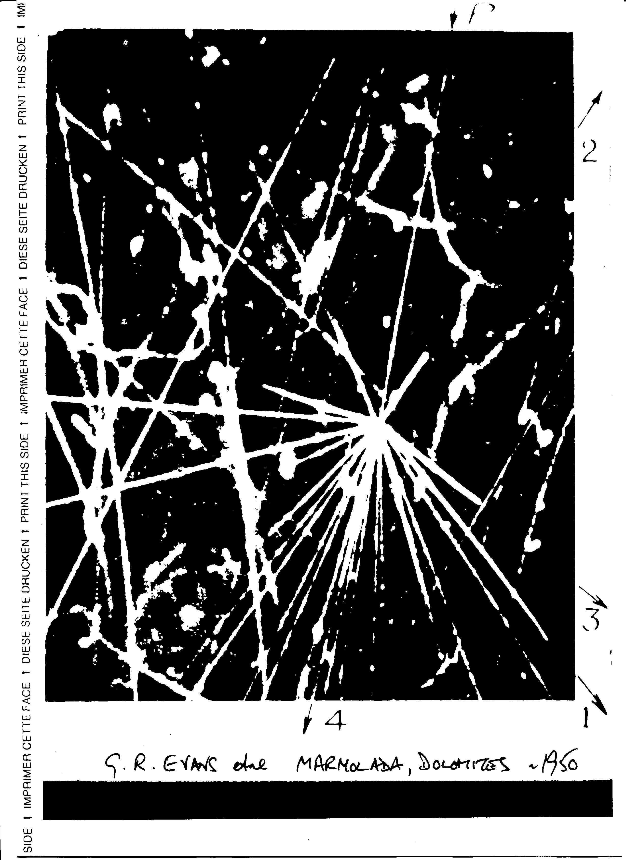
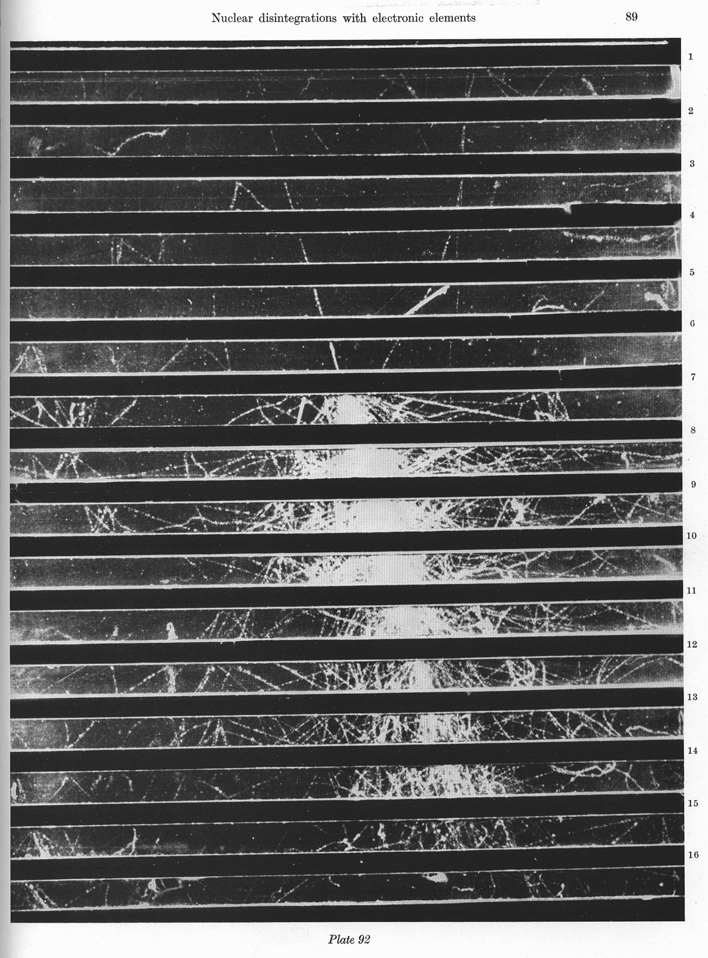
1.3 cm Pb
10 GeV proton
Shower initiated by
proton in lead plates
of cloud chamber
Detectors can find
particle number and
arrival times
Fretter: Echo Lake, 1949

Slide 4
What is going on in the region of the knee near 10¹⁵ eV?
First inferred that there was a change in the energy spectrum
in 1956 by Khristiansen et al in Moscow by looking at density
spectrum of cosmic rays
Controversy for decades as to whether this was a feature of
hadronic physics or of rigidity
Not resolved completely for about 40 years until work using
the KASCADE project in Karlsruhe begun in late 1980s
Aim was to study the mass composition in the knee region
by measuring muons and electrons in showers – although hadrons are of interest they are only found very close to the centre of showers and are little studied

Slide 5
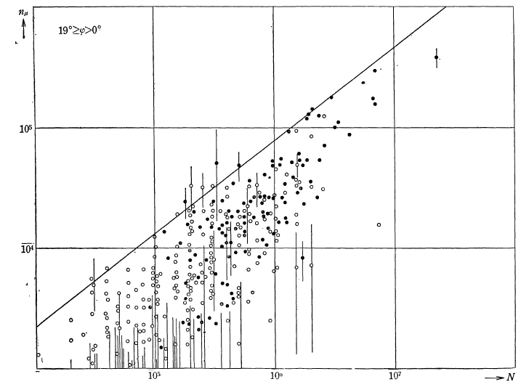

Japanese work at INS in late 1950s
Iron-initiated showers
richer in muons than
p-initiated showers
Established by Japanese
N_{µ} - N_{e} plot
N_{µ}
N_{e}
Attempts to implement this technique were
largely unsuccessful because muon detectors were too small: MONEY!

Slide 6
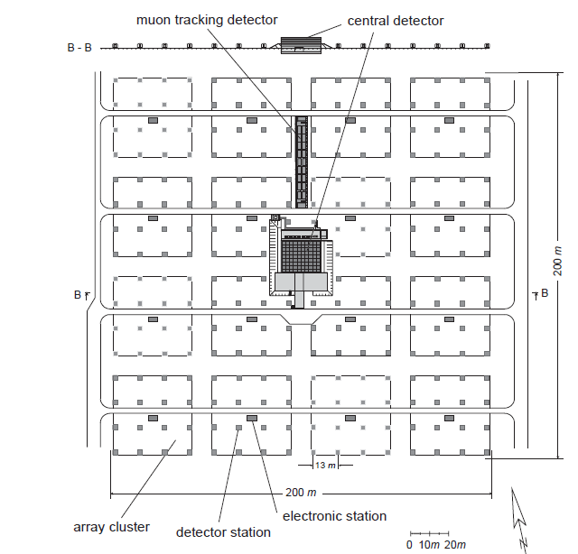
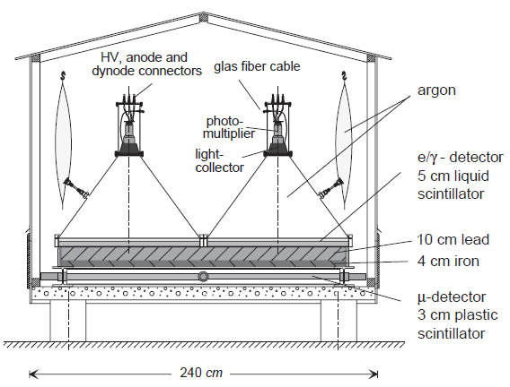
The KASCADE array
Inspiration of Gerd Schatz
in late 1980s
As well as high quality data, a Monte Carlo Code, CORSIKA, was developed to interpret the data

Slide 7
KASCADE
GRANDE Array
37 detector stations
370 m² e/γ:
Scintillation counter
KASCADE
200 m x 200 m
700 m
700 m
G. Navarra et al., Nucl Instr & Meth A 518 (2004) 207

Slide 8
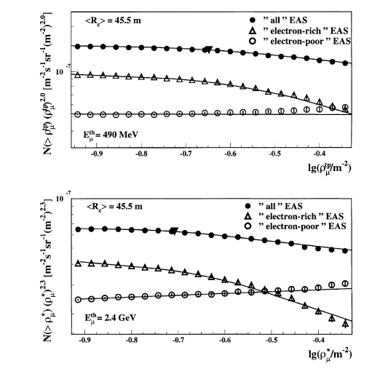
Model-free analysis of KASKADE data showed
that knee was a ‘light’ nucleus feature

Slide 9
Two dimensional shower size spectrum lg N_{e} vs. lg N_{μ}
KASCADE
A
E₀
derive E₀ and A from N_{e} and N_{μ} data
Fredholm integral equations of 1st kind:
M Roth et al, 28th ICRC, Tsukuba 1 (2003) 139

Slide 10
KASCADE: Energy spectra for individual elemental groups
T. Antoni et al., Astropart. Phys. (2005)

Slide 11
KASCADE: Energy spectra for individual elemental groups
T. Antoni et al., Astropart. Phys. (2005)

Slide 12
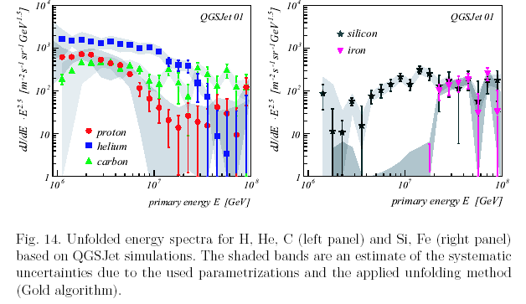
KASCADE result: Antoni et al: Astroparticle Physics (in press)

Slide 13
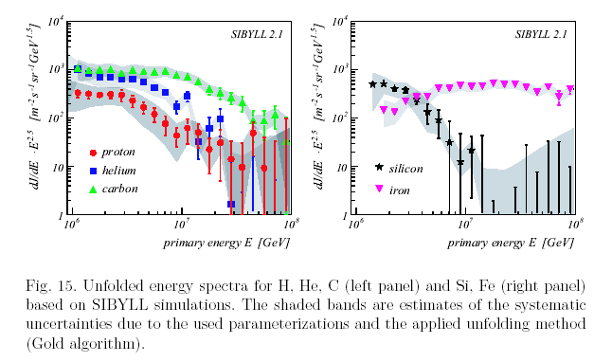
Kascade: Antoni et al Astroparticle Physics (in press)

Slide 14
Comparison of features at the knee
ALL PARTICLE SPECTRUM
Knee γ₁ γ₂
QGSJET01 4.0 +/-0.8 PeV -2.70 +/- 0.01 -3.10 +/- 0.07
Sibyll 2.1 5.7 +/- 1.6 PeV -2.70 +/- 0.06 -3.14 SSSSSSSSSS+/- 0.06
This gives a strong warning about the sensitivity of spectral details to mass and models – and this is at LOW energies.

Slide 15
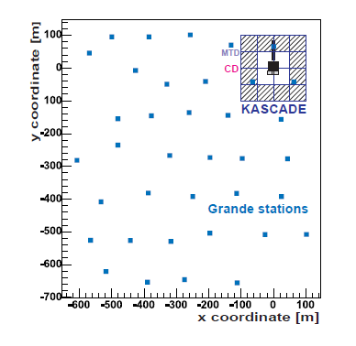
KASCADE-Grande
Data on second knee
Initiated by Kampert
and Navarra

Slide 16
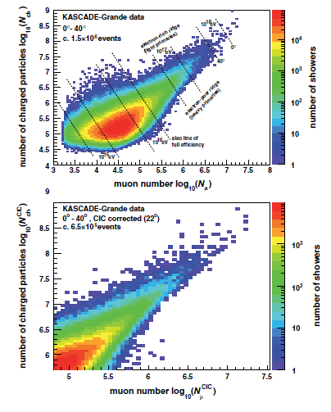

Slide 17
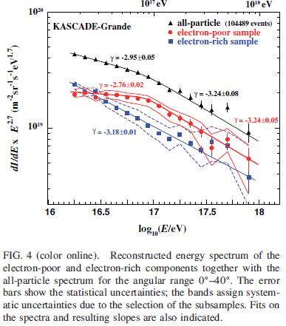
PRL 107 171104 2011

Slide 18
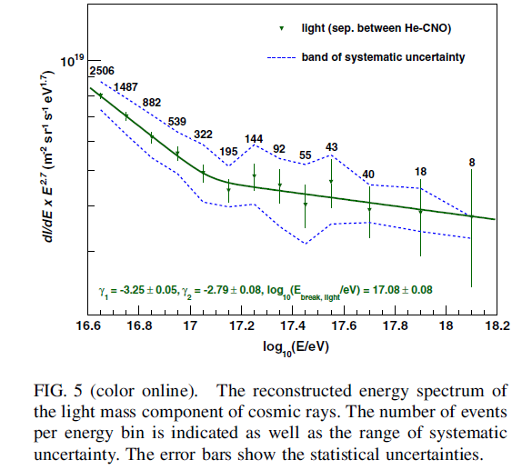
With more
events

Slide 19
Highest Energy Cosmic Rays > ~ 10¹⁸ eV
The only prediction in cosmic ray physics relates
to this energy range – apart from claim that SN are sources at lower energies
The Greisen- Zatsepin-Kuzmin effect (GZK) predicted in 1966 shortly after the discovery of the CMB radiation

Slide 20
Does the Cosmic Ray Energy Spectrum terminate?
Greisen-Zatsepin-Kuz’min – GZK effect (1966)
γ_{2.7 K} + p → Δ⁺ → n + π⁺ or p + πº
and
γ_{IR/2.7 K} + A → (A – 1) + n
Sources must lie within ~ 100 Mpc
Note that neutrinos - of different energies - come from the decay of π⁺ and n

Slide 21
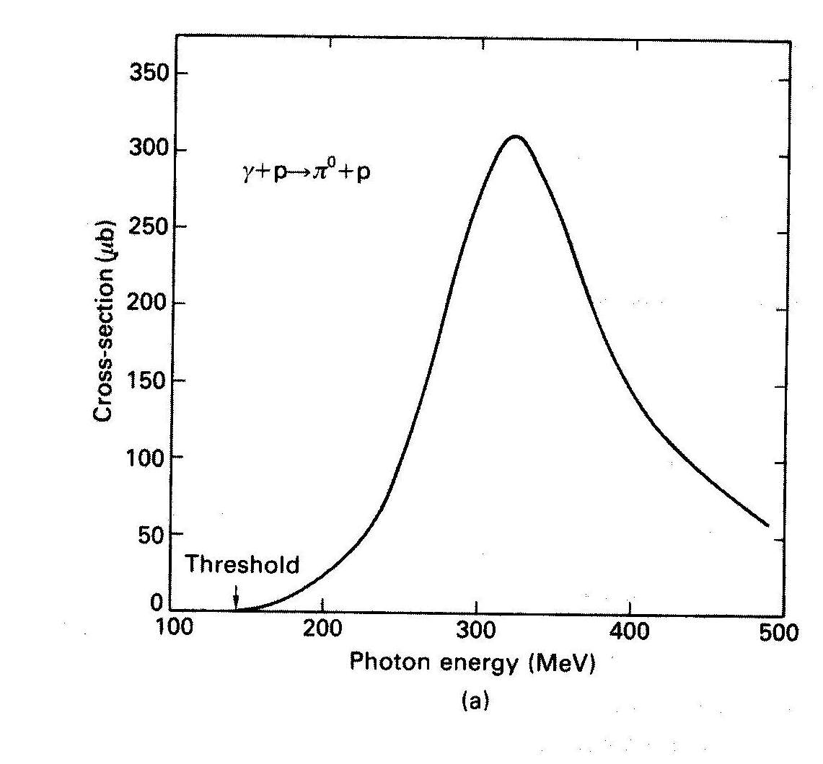
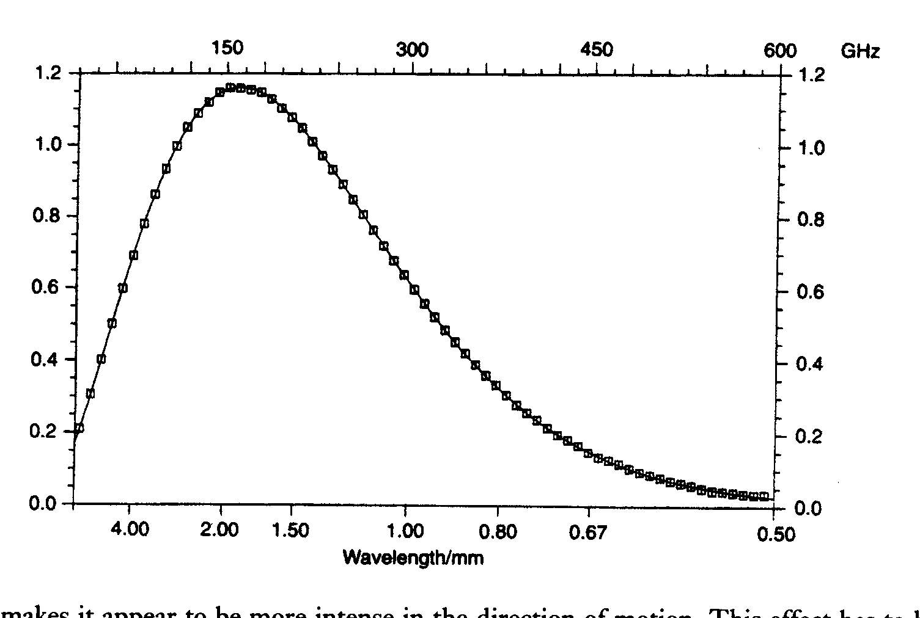
Resonance
γ + p → Δ+
150 MeV
Black Body Spectrum
T=2.75 K
(1965: T = 3.5 ± 0.3 K)

Slide 22
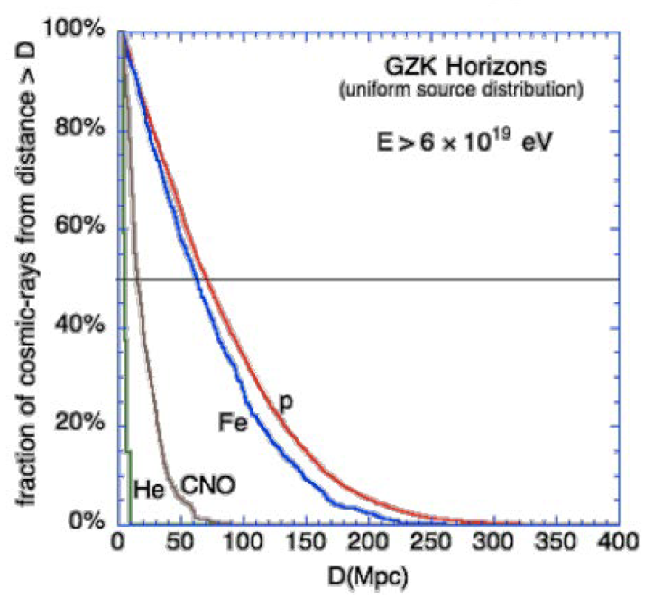
Interaction Length of protons as function of energy
Taylor and Aharonian 2008

Slide 23
LOCAL: If particles are seen > 5 x 10¹⁹ eV, then they must be local
Local depends on energy:
>4 x 10¹⁹ eV 50% from within 130 Mpc
>10²⁰ eV 50% from within 20 Mpc
So ANISOTROPIES might be expected from nearby sources

Slide 24
Are there excesses from some regions of sky?
– can there be a cosmic-ray astronomy?
Deflections in magnetic fields:
at ~ 10¹⁹ eV: still ~ 10° in Galactic magnetic field
- depending on the direction
For interpretation, and to help deduce the B- fields,
we really need to know Z
- hard enough to find A - as we will see further

Slide 25
The Energy Spectrum
So a Holy Grail of much UHE Cosmic Ray work since 1966
has been to find this spectral steepening
Difficult task:-
Small fluxes (~ 1 per sq km per century at 10²⁰ eV - 100 EeV)
Energy estimates for surface arrays alone require use
of hadronic models

Slide 26
Detection I
Cherenkov Light emission in water
Muon,µ
photomultiplier
2.25 m²
41°
1.2 m
Steel
tank
At Haverah Park (Yorkshire) ~ 200 tanks each with ~ 2.7 tonnes of water

Slide 27
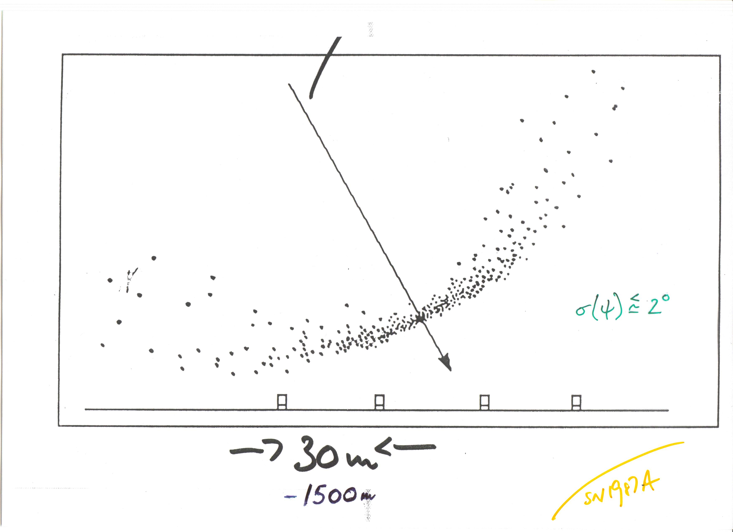
Accuracy of finding
direction ~ 1 - 2°
Water-Cherenkov detectors
‘Fast timing’ gives the direction

Slide 28
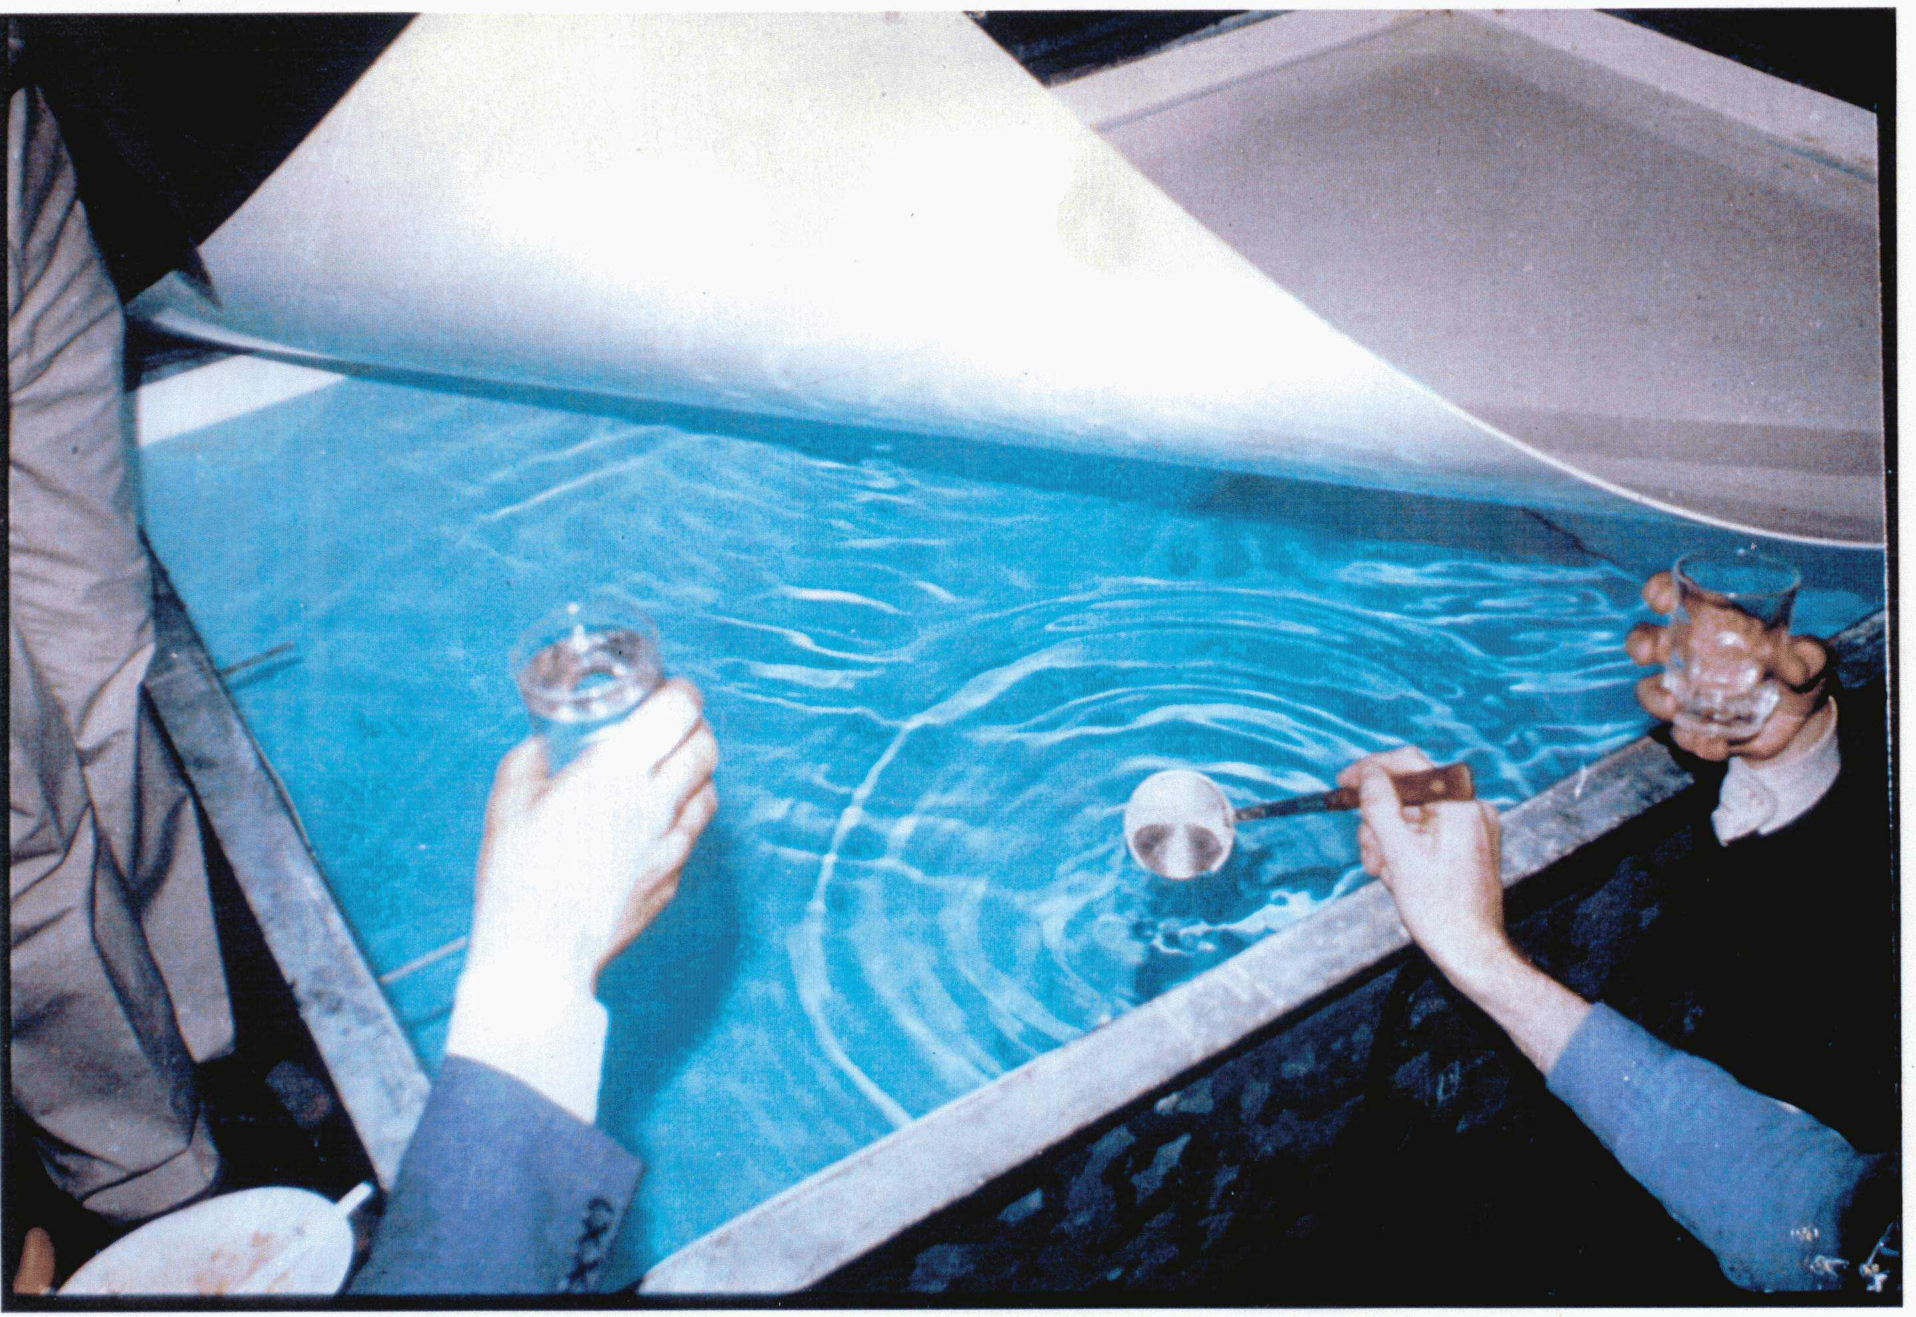
A tank was opened at the ‘end of project’ party on 31 July 1987. The water shown had been in the tank for 25 years but was quite drinkable!
Notes:
Haverah Park tank open at end of experiment

Slide 29
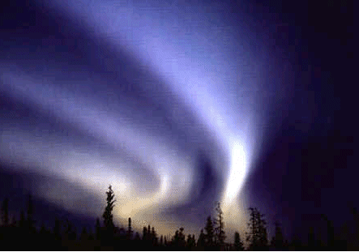
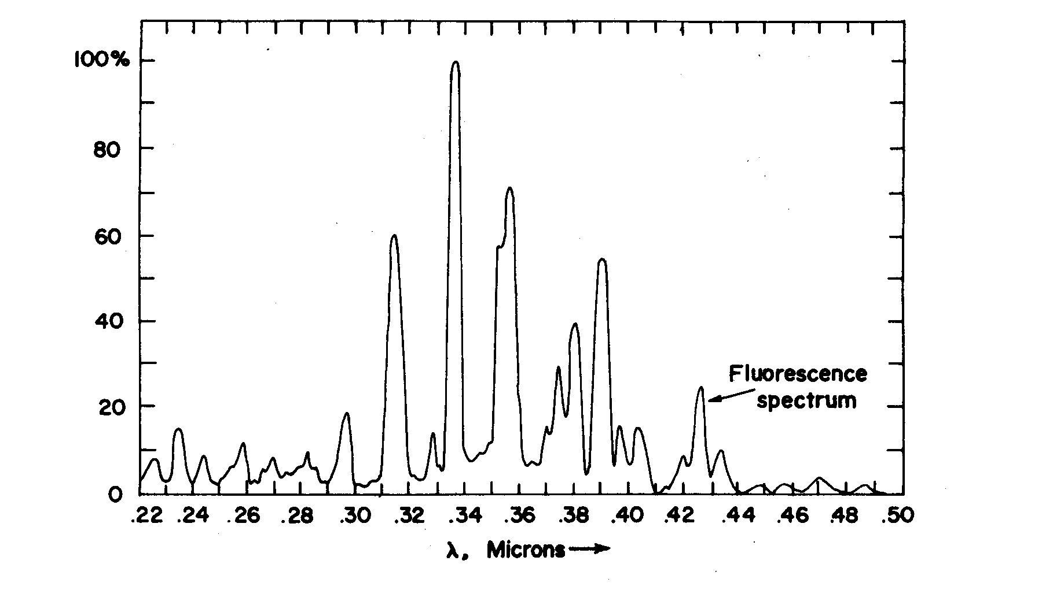
5 W blue light bulb
moving at velocity of
light ~ 15 km away
at ~ 3 x 10¹⁸ eV
Auroral
Light
Detection II
250 300 350 400 450 nm

Slide 30
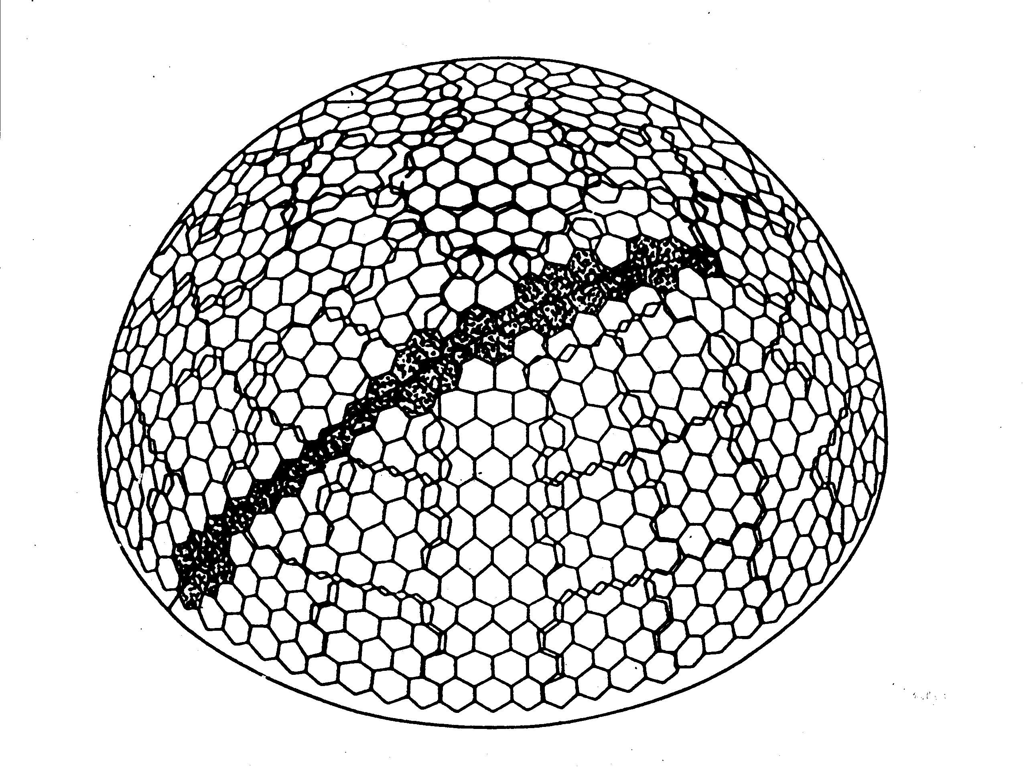
Idea of Fly’s Eye Detector (University of Utah): 880 photomultipliers

Slide 31
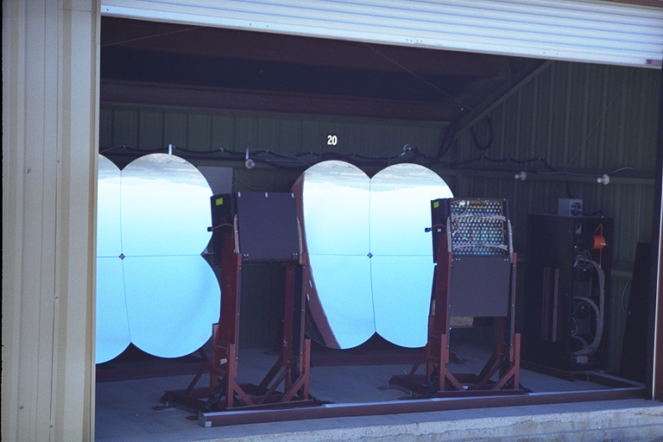
A Fluorescence Detector of the Utah University Group - HiRes

Slide 32
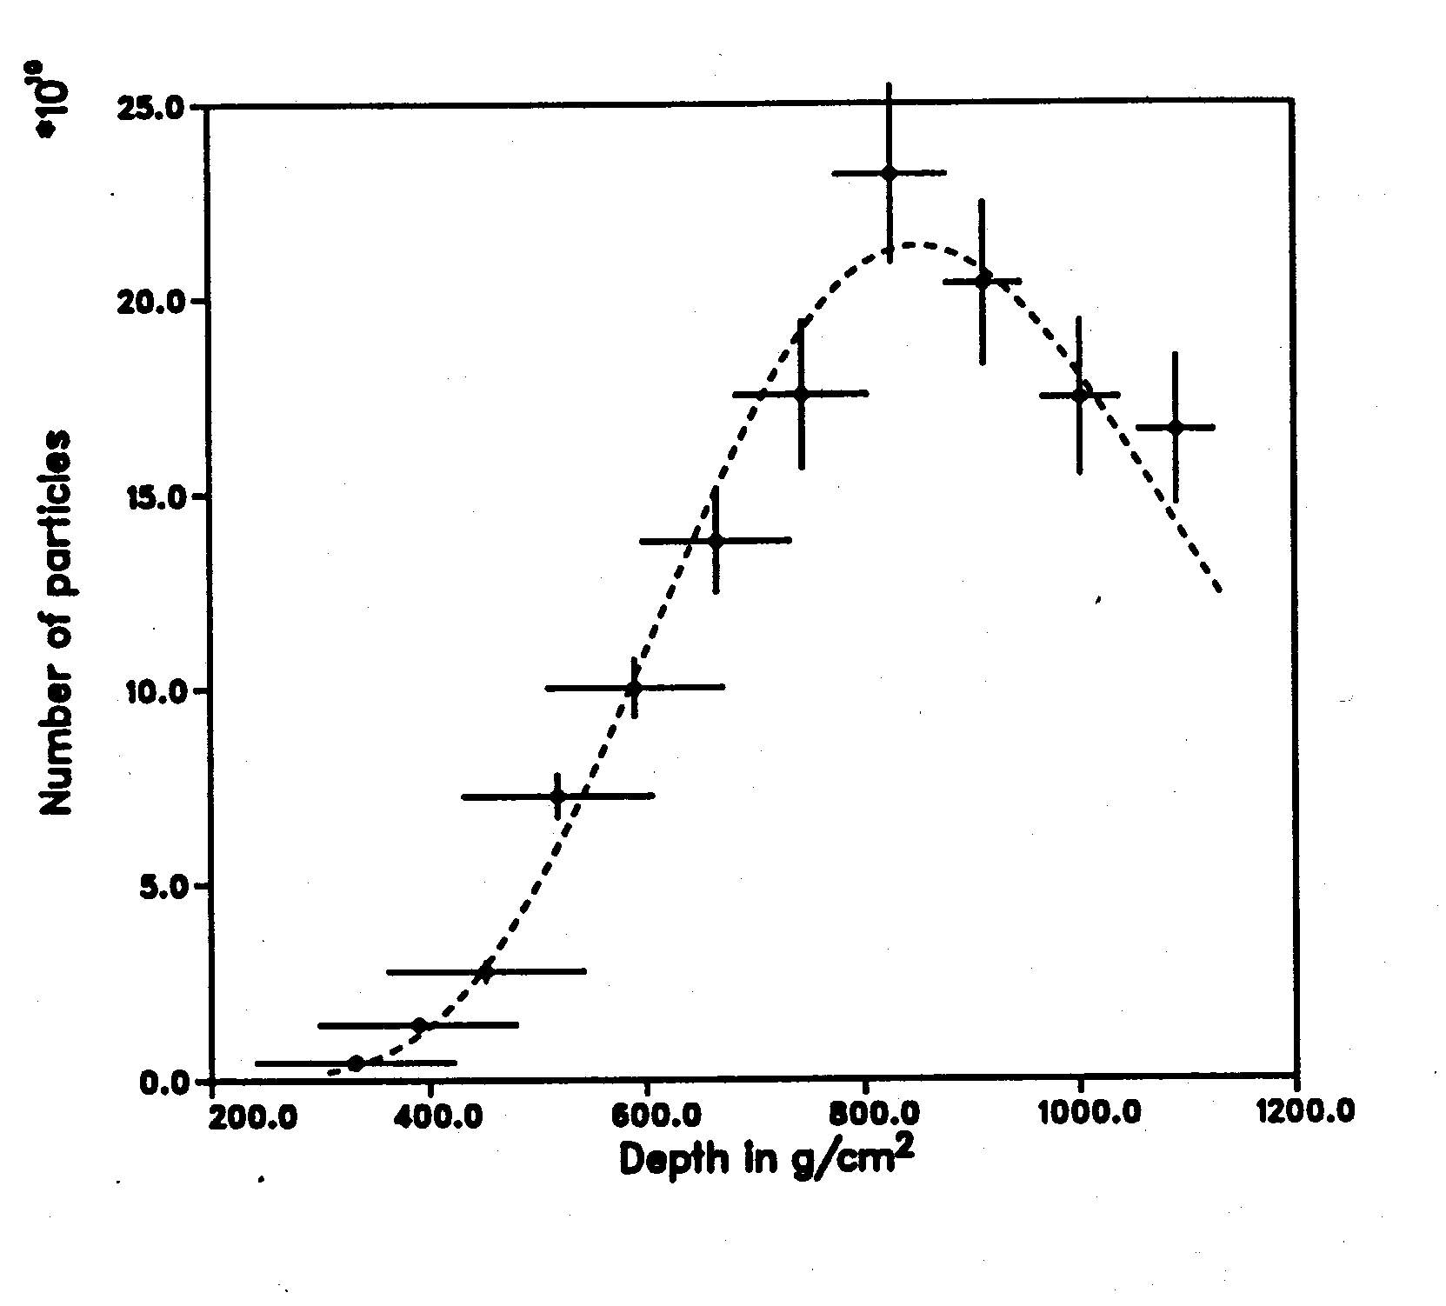
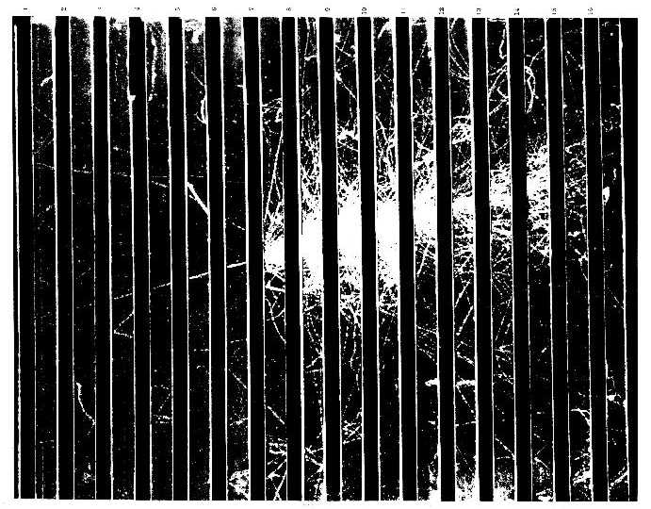

x 10¹⁰
E =
3 x 10²⁰ eV !!!
Fly’s Eye Event: reported in 1993, no similar event has been seen since

Slide 33
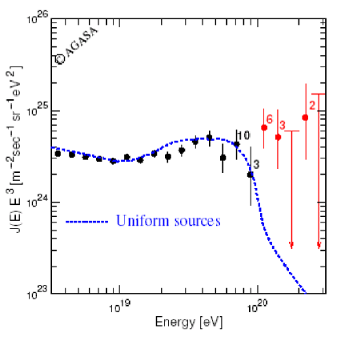
Most extreme claimed violation of GZK prediction
Results of AGASA group: Hamburg 2001 and Astroparticle Physics (2003)

Slide 34
Different techniques gave different results
but they all agreed that rate of energetic cosmic rays
is low:-
~ 1 per km² per century at 10²⁰ eV
(~ 10/min on earth’s atmosphere)
1990: Need larger areas > 1000 km²
1991: Started working with Jim Cronin
(University of Chicago) on the tasks of forming
a collaboration to design and build such an
instrument (3000 km²) of raising the money
Our efforts helped create the Pierre Auger Observatory

Slide 35
The Pierre Auger Collaboration
Croatia* Czech Republic France Germany Italy Netherlands Poland Portugal Rumania Slovenia Spain (United Kingdom) | Argentina Australia Brasil Bolivia* Colombia* Mexico USA Vietnam* *Associate Countries ~ 400 PhD scientists from ~ 100 Institutions in 17 countries
Aim: To measure properties of UHECR with unprecedented
statistics and precision – first discussions in 1991

Slide 36
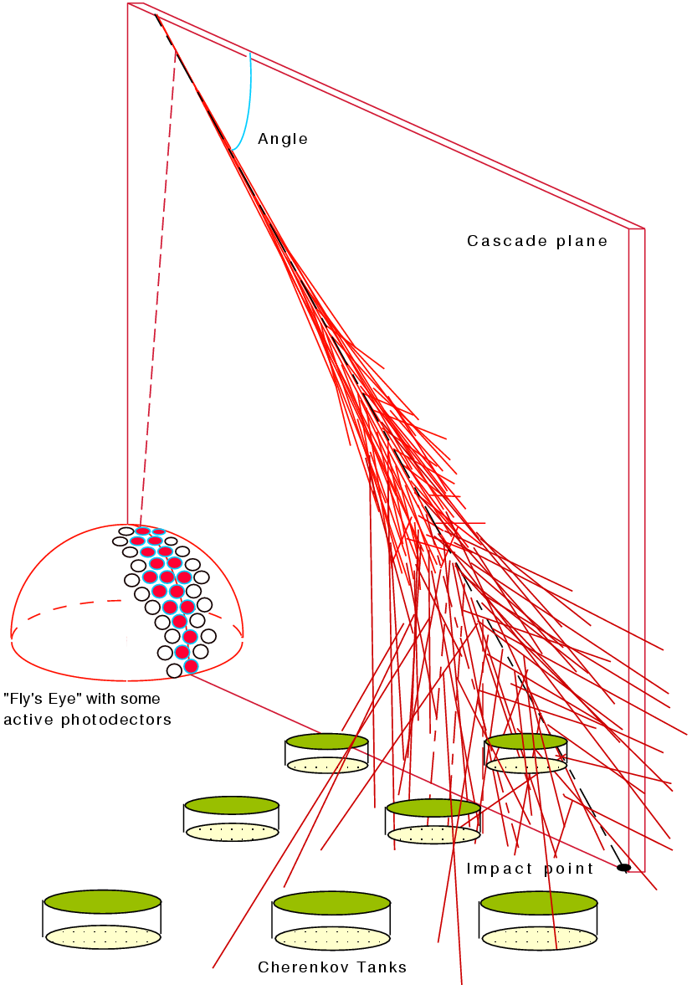
The Design of the Pierre Auger Observatory marries the two
techniques just described in
the ‘HYBRID’ technique
Fluorescence →
AND
Array of water- Cherenkov detectors →
11
Enrique Zas, Santiago de Compostela

Slide 37
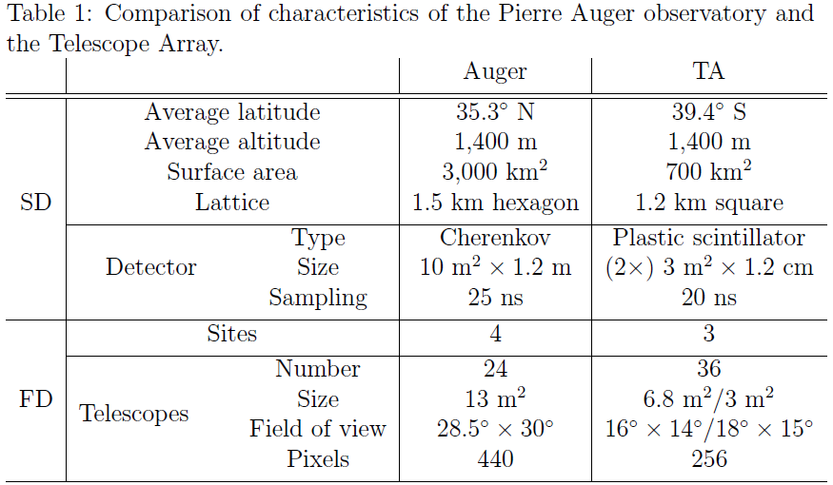
Enrique Zas: European Symposium, Kiel 2015

Slide 38
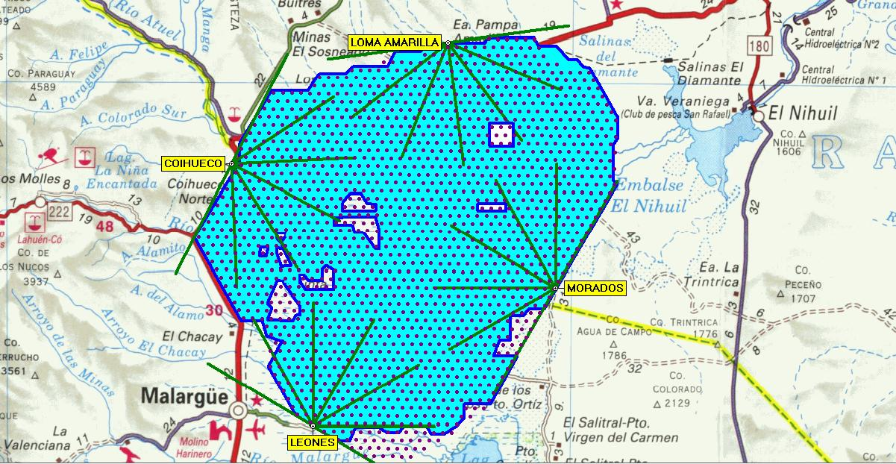
3000 km²
Madrid metropolitan area
including 20 surrounding
Municipalities ~ 5400 km²
Surface Array 1600 detectors
Fluorescence 4 stations
Last Tank deployed June 2008
Everything still working well
1390 m above sea level

Slide 39
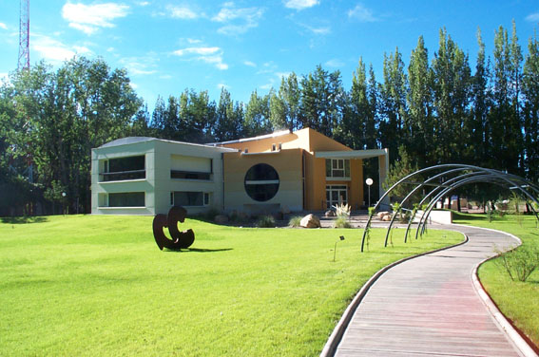
The Auger Observatory Campus in Argentina
The Office and Assembly Buildings in Malargüe
- funded by the University of Chicago ($1M)

Slide 40
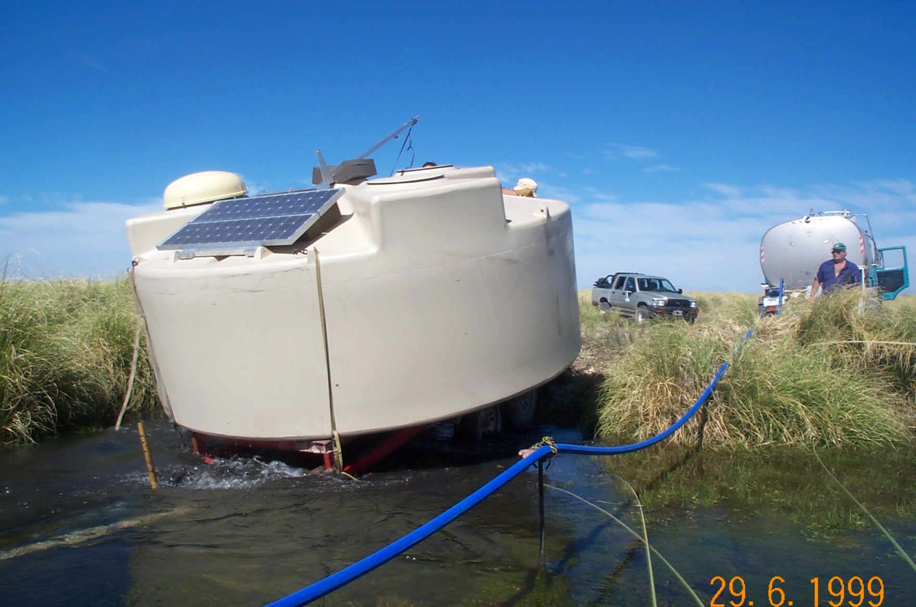

Slide 41
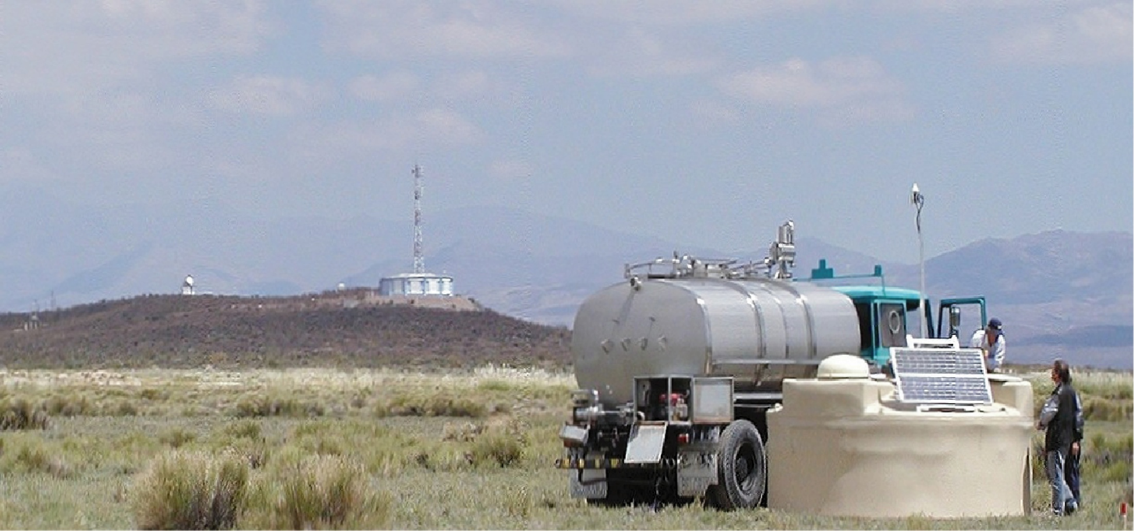
GPS Receiver
and radio transmission

Slide 42
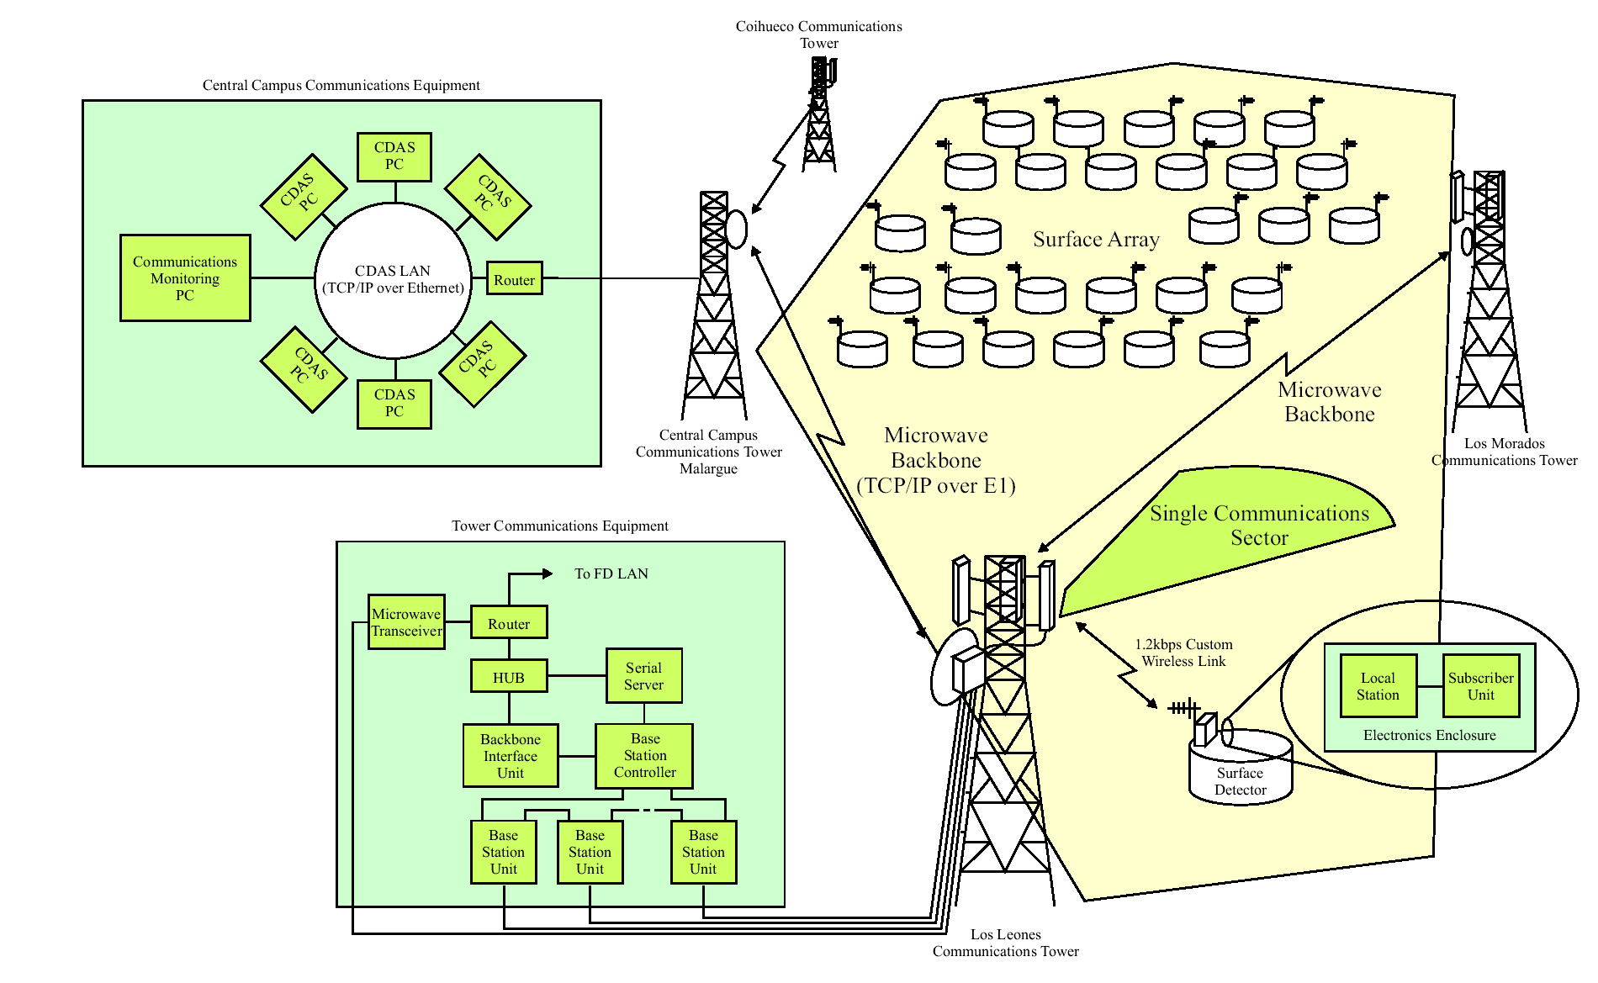
Telecommunication system

Slide 43
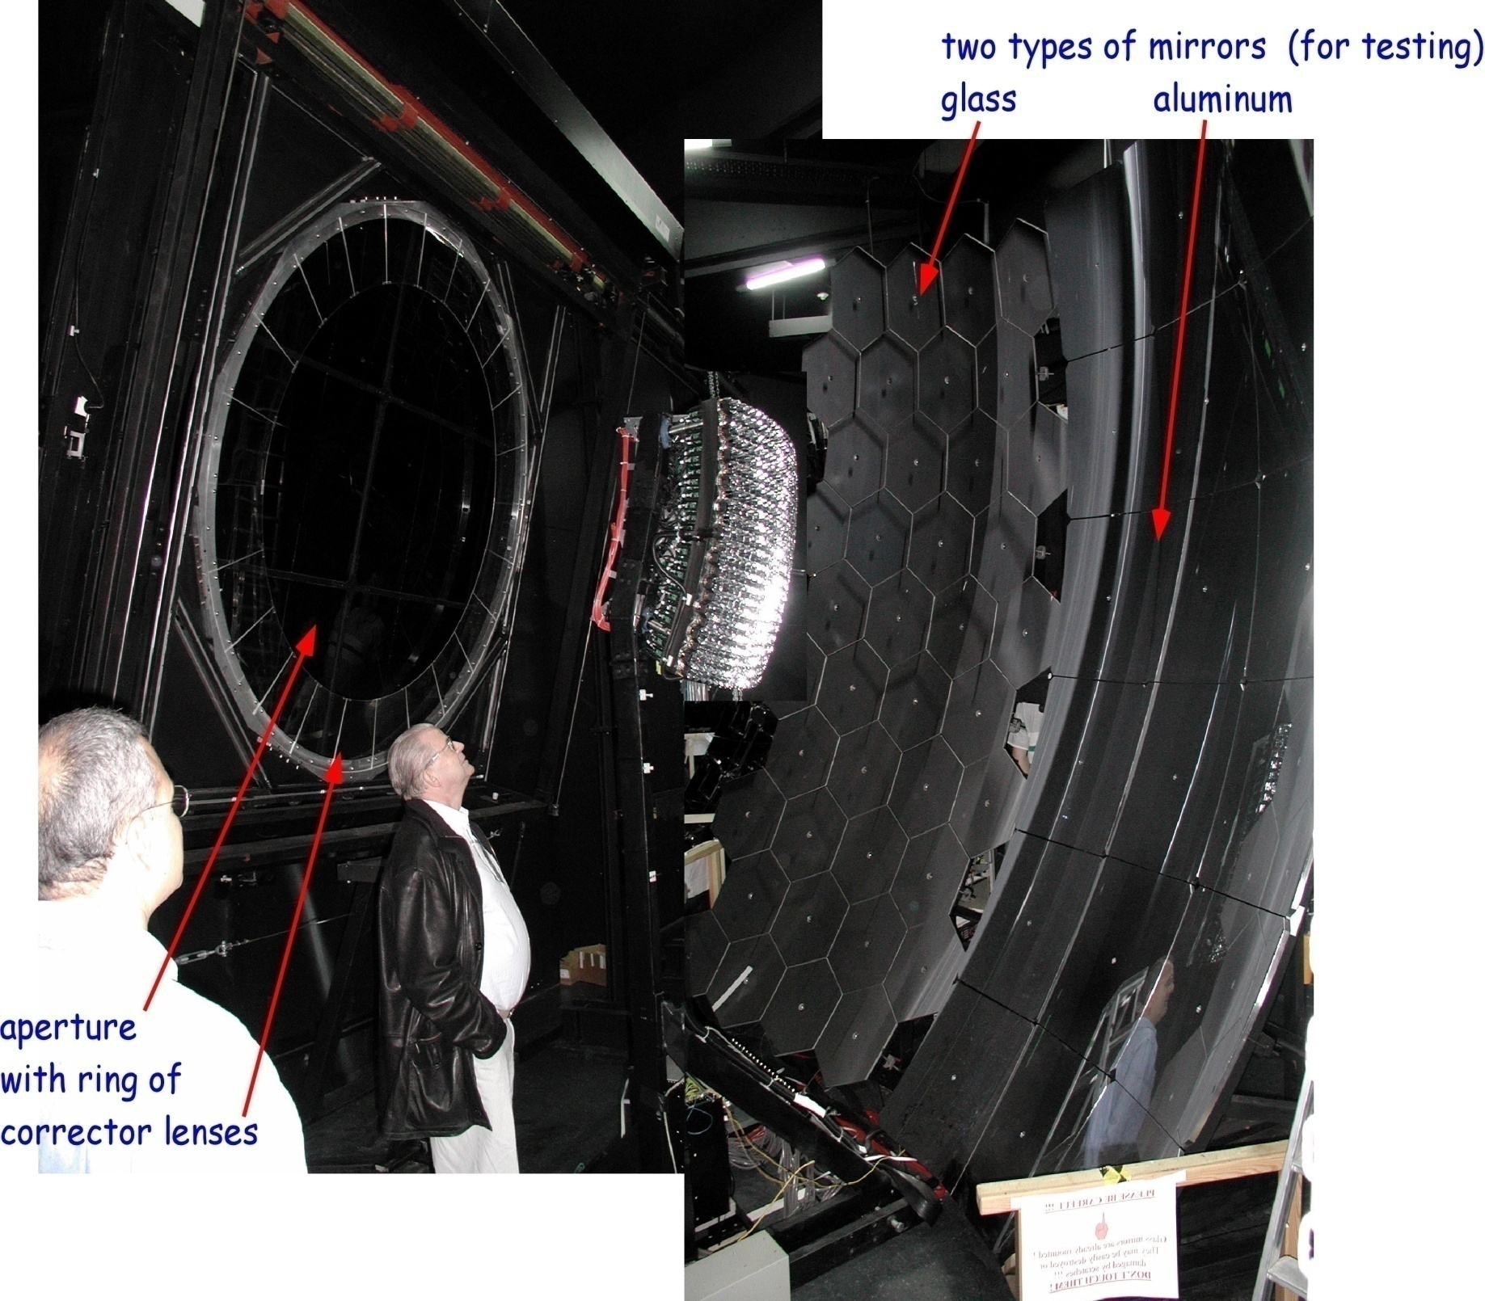
Fluorescence detector at Los Leones
Notes:
Fluorescence Detector

Slide 44
FD reconstruction
Signal and timing:-
Direction and energy
Pixel geometry
shower-detector plane

Slide 45
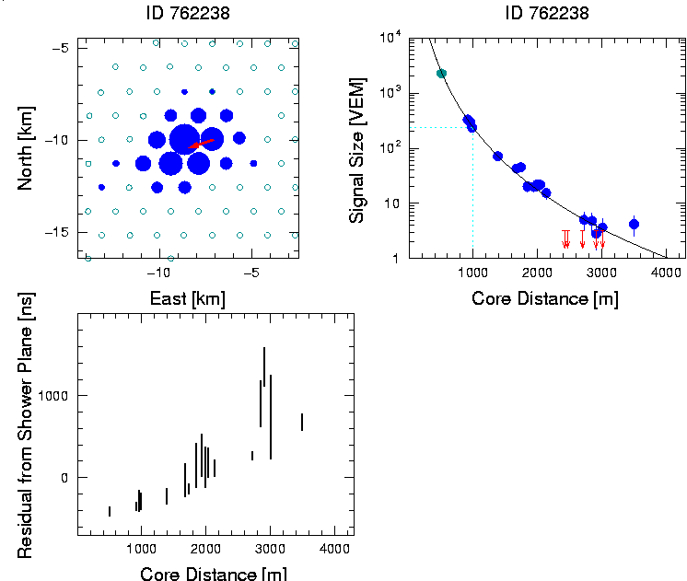
A large event: 7 x 10¹⁹ eV
Signal at 1000 m from
densest part of shower
is chosen to define the
‘size’ of the shower
Fall-off of signal
with distance
Footprint ~ 25 km²

Slide 46
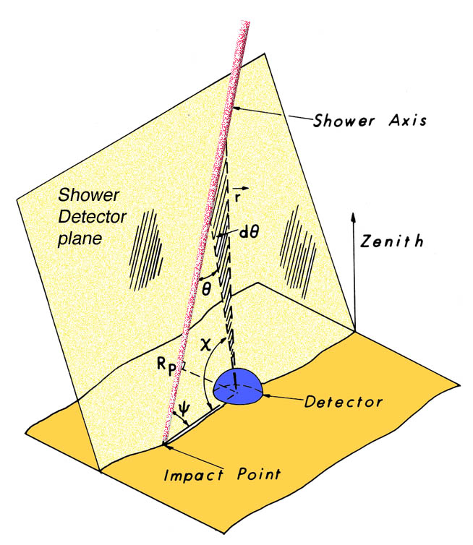
Important feature of the hybrid approach
Precise shower geometry from
degeneracy given
by SD timing
Essential step towards high quality energy and X_{max} resolution
Times at angles, χ , are key to finding R_{p}

Slide 47
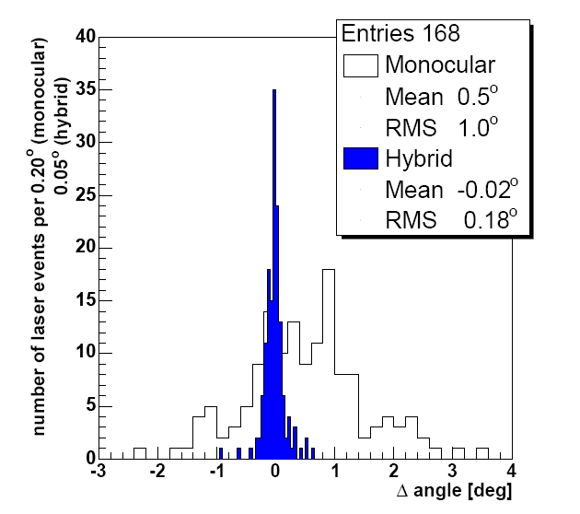
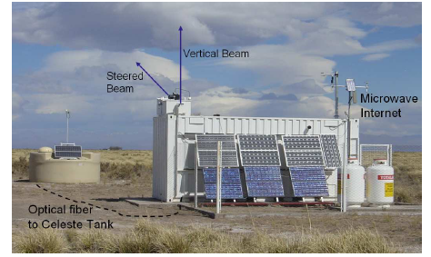
Angular Resolution from Central Laser Facility
355 nm, frequency tripled, YAG laser,
giving < 7 mJ per pulse: GZK energy
Mono/hybrid rms 1.0°/0.18°

Slide 48
A Hybrid Event
Energy Estimate
from area under
curve
(2.1 ± 0.5) x 10¹⁹ eV
must account for
‘missing energy’

Slide 49
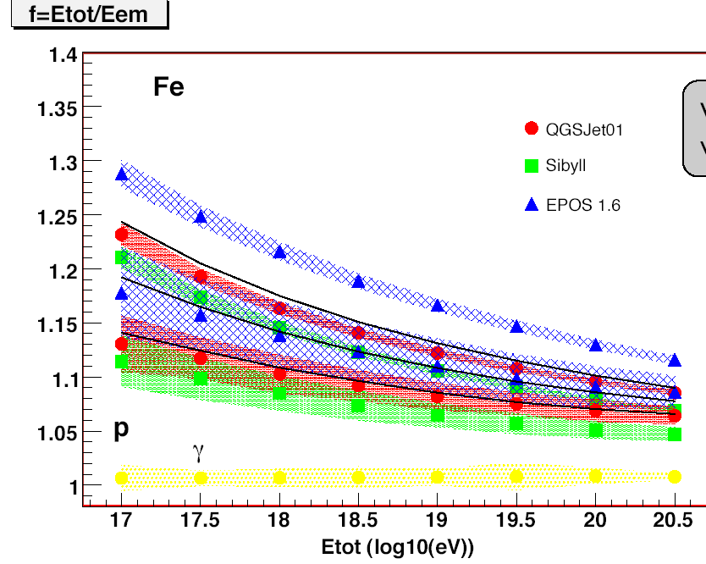
f = E_{tot}/E_{em}
Invisible Energy
1.17
f
1.07
E_{tot} (log₁₀(eV))

Slide 50
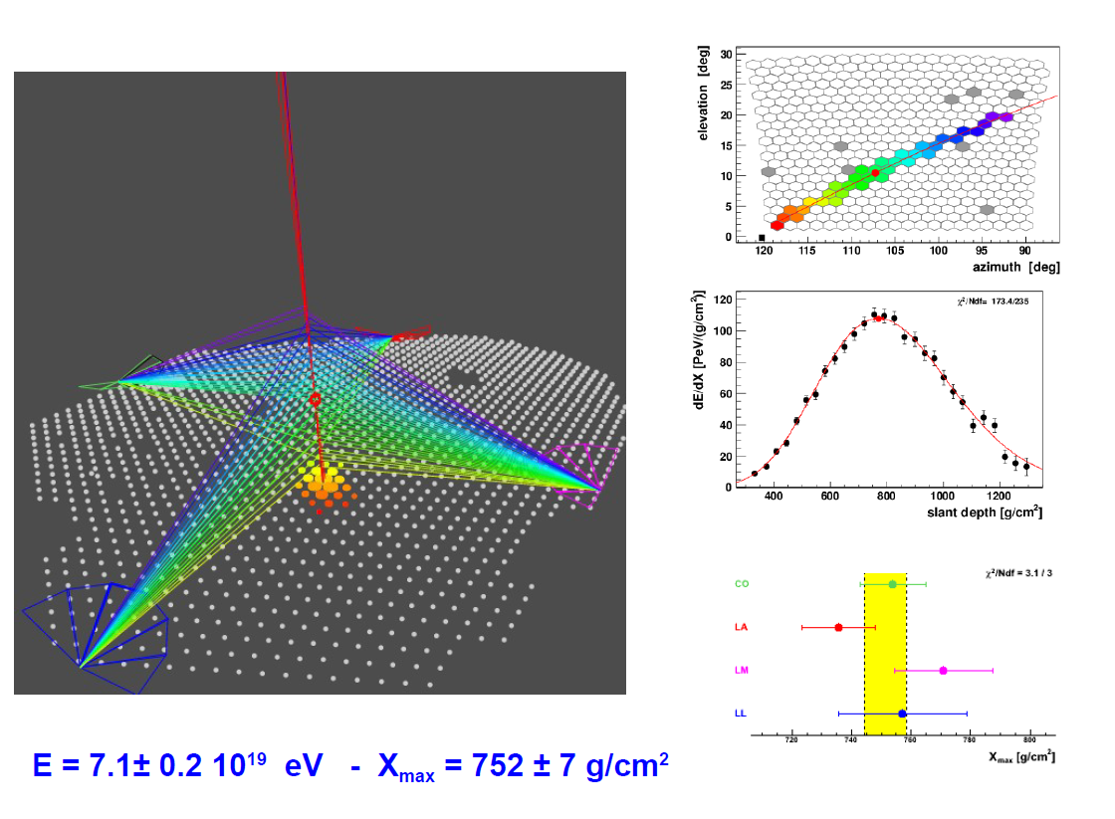
Getting the Energy

Slide 51
839 events
7.5 x 10¹⁹ eV
Auger Energy Calibration

Slide 52
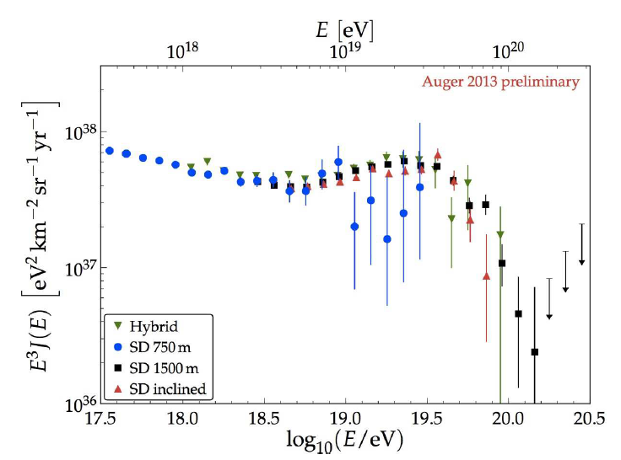
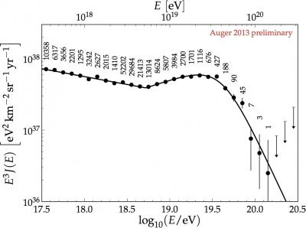
Auger Energy Spectrum 2013

Slide 53
However the steepening itself is INSUFFICIENT for us to claim
that we have seen the Greisen-Zatsepin-Kuz’min
effect
It might simply be that the sources cannot raise particles
to energies as high as 10²⁰eV – Nature could be teasing us!
Remember the coincidence of energy densities
It would be enormously helpful if the arrival directions were
anisotropic
Also knowing the mass composition would be useful

