Slide 1
Taller de Altas Energías 2016
http://benasque.org/2016tae/cgi-bin/talks/allprint.pl
• Particle Detectors •
Mar Capeans
CERN
Experimental Physics Department
8-10 September 2016

Slide 2
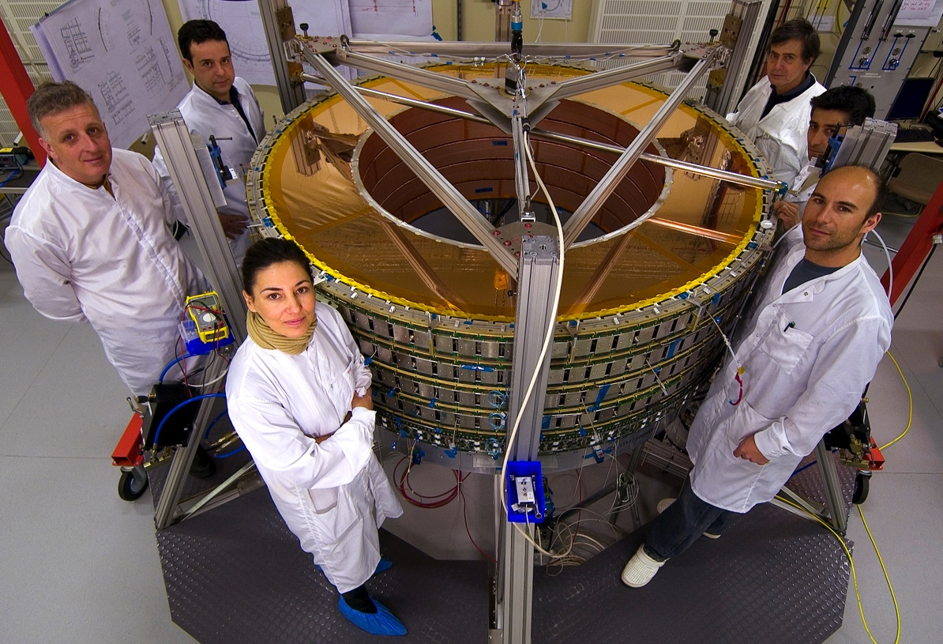
• Lecturer’s perspective •
I am a detector builder
ATLAS TRT Endcap, CERN 2004
mar.capeans@cern.ch
September 2016
<number>

Slide 3
• Lecture’s Perspective •
Detector Technologies
How detectors are designed and used in HEP experiments, taking into account system aspects
R&D trends, Future detectors
For an in-depth, more academic exposure please see:
  Semiconductor Radiation Detectors - Device Physics, G.Lutz, Springer
  Gaseous Radiation Detectors, F.Sauli, Cambridge University Press, 2014
  Calorimetry, R. Wigmans, Oxford Science Publications, 2000
  …and detector lectures of last year’s school (benasque.org)
mar.capeans@cern.ch
September 2016
<number>

Slide 4
• Particle Detectors•
OUTLINE
Particle Detector Challenges at LHC
Interactions of Particles with Matter
Detector Technologies
How detector technologies are used in HEP
Detector R&D Trends
mar.capeans@cern.ch
September 2016
<number>

Slide 5
• Particle Physics Tools•
Accelerators
  Luminosity, energy…
Detectors
  Efficiency, granularity, resolution…
Trigger/DAQ (Online)
  Efficiency, filters, through-put…
Data Analysis (Offline)
  Large scale computing, physics results…
mar.capeans@cern.ch
September 2016
<number>

Slide 6
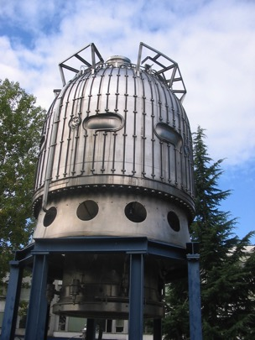
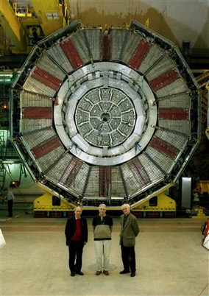
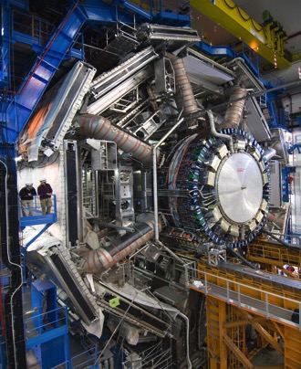
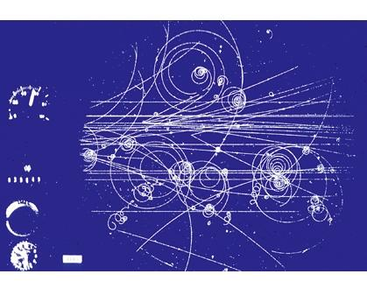
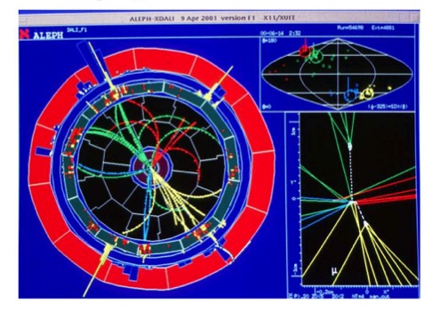
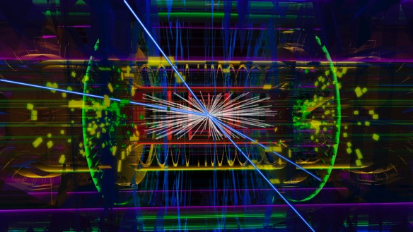
• Imaging Events•
50’s – 70’s
LEP: 88 - 2000
LHC
mar.capeans@cern.ch
September 2016
<number>

Slide 7
• ATLAS Event •
mar.capeans@cern.ch
September 2016
<number>

Slide 8
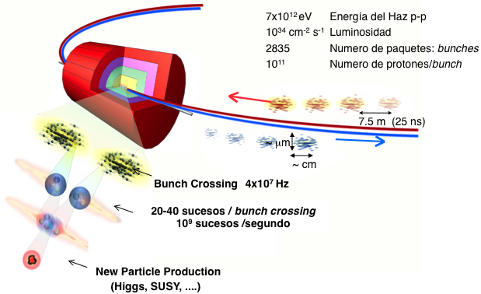
• LHC•
p-p Beam Energy
Luminosity
Nb of bunches
Nb p/bunch
Bunch collisions 40 million/s
~25 interactions / Bunch crossing overlapping in time and space
1000 x 10⁶ events/s
> 1000 particle signals in the detector at 40MHz rate
1 interesting collision in 10¹³
mar.capeans@cern.ch
September 2016
<number>

Slide 9
• Past VS LHC•
Dozens of particles/s | VS | 10⁹ collisions/s
No event selection |  | Registering 1/10¹² events
‘Eye’ analysis |  | GRID computing
LHC: “Large Hostile Conditions”
At each bunch crossing ~1000 individual particles to be identified every 25 ns …. High density of particles imply high granularity in the detection system … Large quantity of readout services (100 M channels/active components)
Large neutron fluxes, large photon fluxes capable of compromising the mechanical properties of materials and electronics components. Induced radioactivity in high Z materials (activation) which will add complexity to the maintenance process
Large Magnetic Fields in large volumes, which imply usage of superconductivity (cryogenics) and attention to magnetic components (electronics components, mechanical stress, ….)
mar.capeans@cern.ch
September 2016
<number>

Slide 10
Slide: W.Riegler, CERN
• Particle Detection•
Only a few of the numerous known particles have lifetimes that are long enough to leave tracks in a detector
Most of the particles are measured through the decay products and their kinematic relations (invariant mass)
Some short lived particles have lifetimes in the laboratory system such that their decay vertex can be distinguished from the primary vertex → helps us to identify these particles
Detectors are built to measure few charged and neutral particles (and their antiparticles) and photons: e±, μ±, π±, K±, Kº, p±, n, ϒ
Their difference in mass, charge and interaction is the key to their identification
mar.capeans@cern.ch
September 2016
<number>

Slide 11
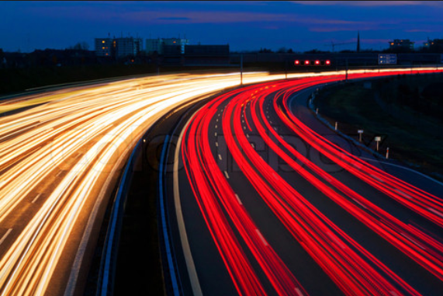
mar.capeans@cern.ch
September 2016
<number>

Slide 12
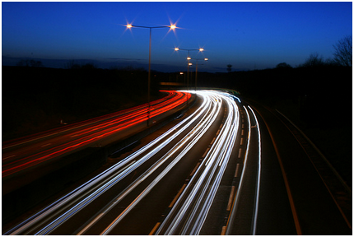
mar.capeans@cern.ch
September 2016
<number>

Slide 13
• Particle Detection•
Usually we can not ‘see’ the reaction itself, but only the end products of the reaction
In order to reconstruct the reaction mechanism and the properties of the involved particles, we want the maximum information about the end products
The ideal particle detector should provide…
  Coverage of full solid angle (no cracks, fine segmentation)
  Measurement of momentum and/or energy
  Detect, track and identify all particles (mass, charge)
  Fast response, no dead time
  Practical limitations: technology, space, budget
mar.capeans@cern.ch
September 2016
<number>

Slide 14
• Particle Detectors•
OUTLINE
Particle Detector Challenges at LHC
Interactions of Particles with Matter
Detector Technologies
How HEP Experiments Work
Detector R&D Trends
mar.capeans@cern.ch
September 2016
<number>

Slide 15
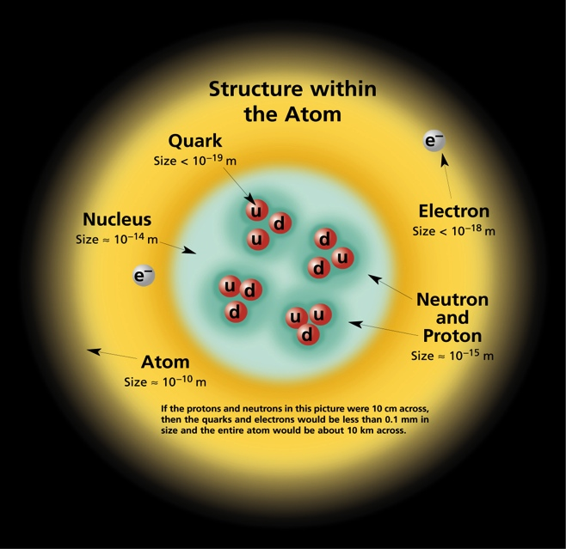
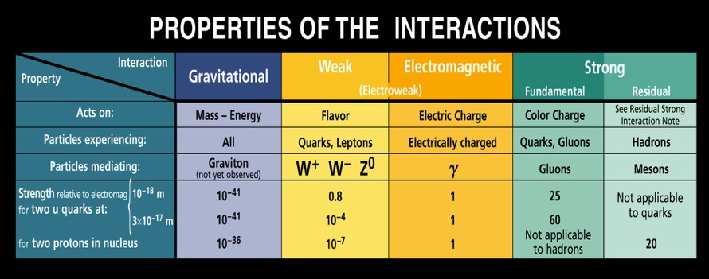
• Interactions•
mar.capeans@cern.ch
September 2016
<number>

Slide 16
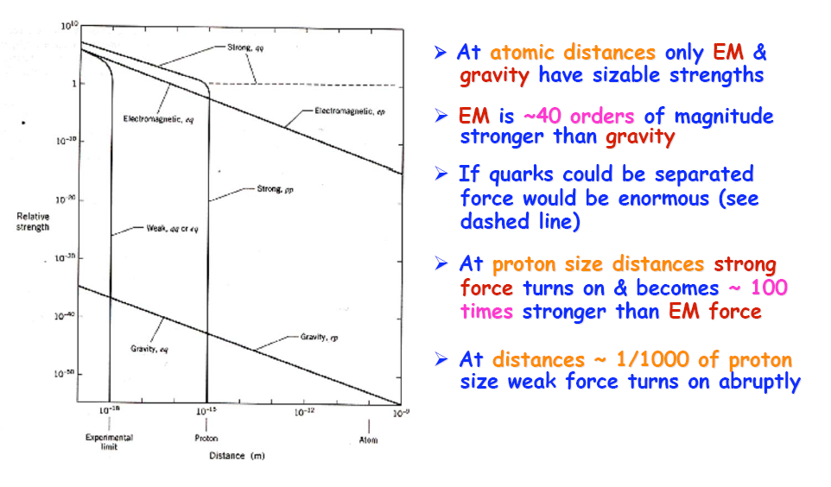
• Forces VS Distance•
Strong
Atomic distances: Only EM and Gravity have sizable strengths.
EM is 40 orders of magnitude stronger than G
At proton distances, the Strong Force turns on and becomes 100 times stronger than EM
At distances 1/1000 of proton size, the Weak Force turns on abruptly
EM
Weak
Gravity
Mar Capeans
10/7/2015
<number>

Slide 17
• EM Interaction of Particles •
Slide: W.Riegler, CERN
mar.capeans@cern.ch
September 2016
<number>

Slide 18
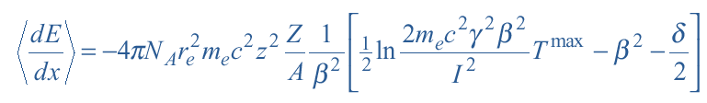
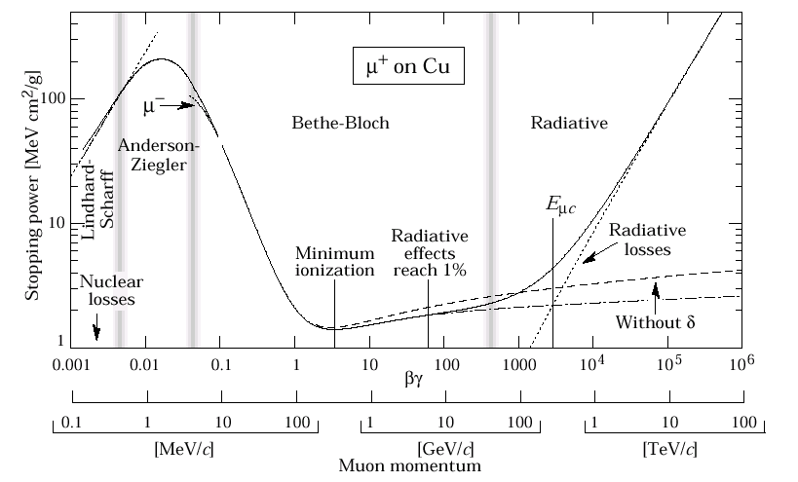
• Heavy Charged Particles•
Bethe-Bloch formula gives the mean rate of energy loss (stopping power) for a heavy charged particle (m₀ >> m_{e}), e.g. proton, k, π, μ
N: Avogadro’s Nb
m_{e}: e- mass
Z, A: medium Atomic, Mass nb
I: effective ionization potential
β: projectile velocity
dE/dx depends only on β, independent of m
relativistic particles loose roughly the same amount of E per unit distance
mar.capeans@cern.ch
September 2016
<number>

Slide 19
Interaction of charged particles
Real detector (limited granularity) can not measure <dE/dx> !
It measures the energy ΔE deposited in a layer of finite thickness δx.
For thin layers or low density materials:
→ Few collisions, some with high energy transfer.
→ Energy loss distributions show large
fluctuations towards high losses: ”Landau tails”
ΔE_{most probable} <ΔE>
e⁻
δ electron
ΔE
Example: Si sensor: 300 μm thick. ΔE_{most probable} ~ 82 keV <ΔE> ~ 115 keV
ΔE_{m.p.} ≈ <ΔE>
For thick layers and high density materials:
→ Many collisions.
→ Central Limit Theorem → Gaussian shaped distributions.
e⁻
ΔE
L2-<number>

Slide 20
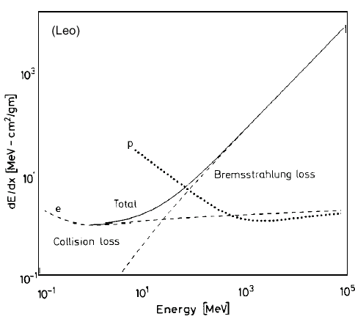
• Electrons and Positrons•
Electrons/positrons; modify Bethe Bloch to take into account that incoming particle has same mass as the atomic electrons
Bremsstrahlung (photon emission by an electron accelerated in Coulomb field of nucleus) in the electrical field of a charge Z comes in addition :  goes as 1/m²
e-
γ
Deceleration of a charged particle when deflected by another charged particle, typically an electron by an atomic nucleus
mar.capeans@cern.ch
September 2016
<number>

Slide 21
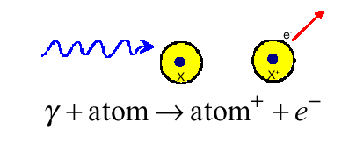
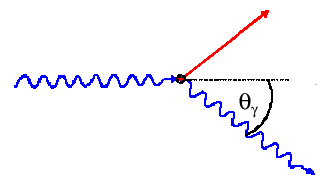
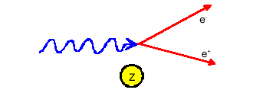
• Neutral Particles•
Contrary to charged particles that deposit energy continuously due to ionization, photons usually suffer one-off interactions producing charged particles
Photoelectric effect (Z⁵); absorption of a photon by an atom ejecting an electron. The cross-section shows the typical shell structures in an atom.
Used in various detector technologies (very imp. In medical imaging)
Compton scattering (Z); scattering of a photon against a free electron (Klein Nishina formula). This process has well defined kinematic constraints (giving the so called Compton Edge for the energy transfer to the electron etc) and for energies above a few MeV 90% of the energy is transferred (in most cases).
Pair-production (Z²+Z); essentially bremsstrahlung; threshold at 2 m_{e} = 1.022 MeV. Dominates at a high energy.
Most important in our field, Initiates EM shower in calorimeters
Energy (~KeV to MeV)
mar.capeans@cern.ch
September 2016
<number>

Slide 22
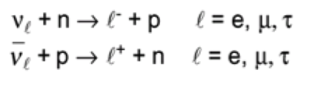
• Neutrinos •
Neutrinos interact only weakly, tiny cross-sections
To detect neutrinos, we need first a charged particle (again)
  Possible reactions:
The cross-section of the reaction ν_{e} + n → e⁻ + p is of the order 10⁻⁴³ cm² (per nucleon, E_{n} ~ few MeV), therefore
  Detection efficiency ε_{det} = σ x N^{surf} = σ ρ N_{A} d /A
  1m Iron: ε_{det} ~ 5 x 10⁻¹⁷
Neutrino detection requires big and massive detectors (kT) and high neutrino fluxes
In collider experiments, a fully hermetic detector allow to detect neutrinos indirectly: we sum up all visible energy and momentum, and attribute missing energy and momentum to neutrino
mar.capeans@cern.ch
September 2016
<number>

Slide 23
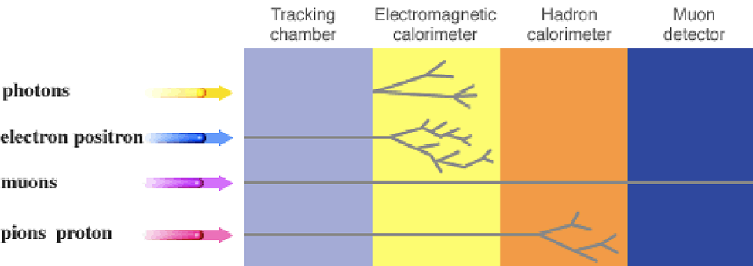
• Interactions in the Detector•
Low density → High density
High precision → Low precision
High granularity → Low granularity
undetected
neutrinos...
electromagnetic hadronic
shower
momentum measurement
by curvature in magnetic field
energy measurement
by creation and total
absorption of showers
muon detection with
improved momentum
measurement (long
lever arm)
mar.capeans@cern.ch
September 2016
<number>

Slide 24
• Detector Systems•
Fix Target Geometry
Collider Geometry
Tracking
Calorimeter
Muon Filter
Beam
Beam
Beam
Target
Magnet
Endcap
Barrel
Endcap
Limited solid angle coverage
Easy access (cables, maintenance)
“Full” coverage
Restricted access
mar.capeans@cern.ch
September 2016
<number>

Slide 25
• Particle Detectors•
OUTLINE
Particle Detector Challenges at LHC
Interactions of Particles with Matter
Detector Technologies
How HEP Experiments Work
Detector R&D Trends
mar.capeans@cern.ch
September 2016
<number>

Slide 26
• Detector Technologies•
How are reactions of the various particles with detectors turned into electrical signals. We would like to extract position and energy information channel by channel from our detectors.
Three effects/technologies are usually used :
and these are used in either for tracking (and triggering), energy measurements, photon detectors for Cherenkov or TRT, etc
and from then on, it is all online (trigger, DAQ) and offline treatment and analysis.
Ionisation detectors | Semiconductors | Scintillators
If a particle has enough energy to ionize a gas atom or molecule, the resulting electrons and ions cause a current flow which can be measured.
When a charged particle traverses Si, it produces ionizing and non-ionizing E Loss. The latter produces radiation damage, while ionization loss causes the creation of e-hole pairs which produce the signal.
Scintillators are materials that produce sparks or scintillations of light when ionizing radiation passes through them. The charged particle excites atoms in the scintillator, e- returns to ground state by emitting a photon.
mar.capeans@cern.ch
September 2016
<number>

Slide 27
• Technology VS Function•
Silicon Detectors
Tracking
Gas Detectors
Muon systems
Scintillator Detectors
Calorimetry
Resolution (time/space/energy)
Operation environment
Physics
Cost (area, electronics…)
Manufacturability
Lifetime
mar.capeans@cern.ch
September 2016
<number>

Slide 28
• Key Wording •
Detector Energy Resolution
Detector Spatial Resolution
Impact Parameter Resolution
Momentum Resolution
Response time
Detector Efficiency
mar.capeans@cern.ch
September 2016
<number>

Slide 29
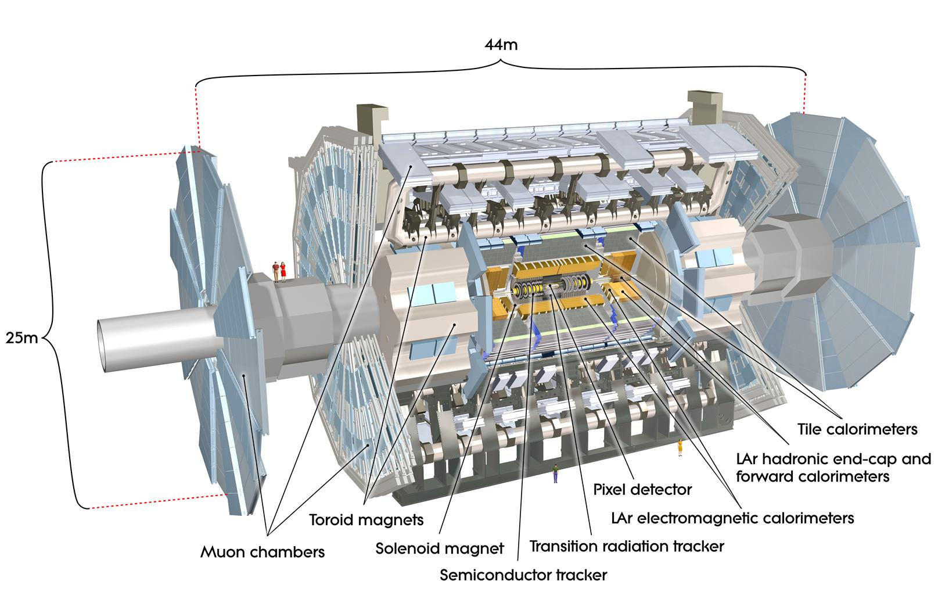
• ATLAS Detector •
mar.capeans@cern.ch
September 2016
<number>

Slide 30
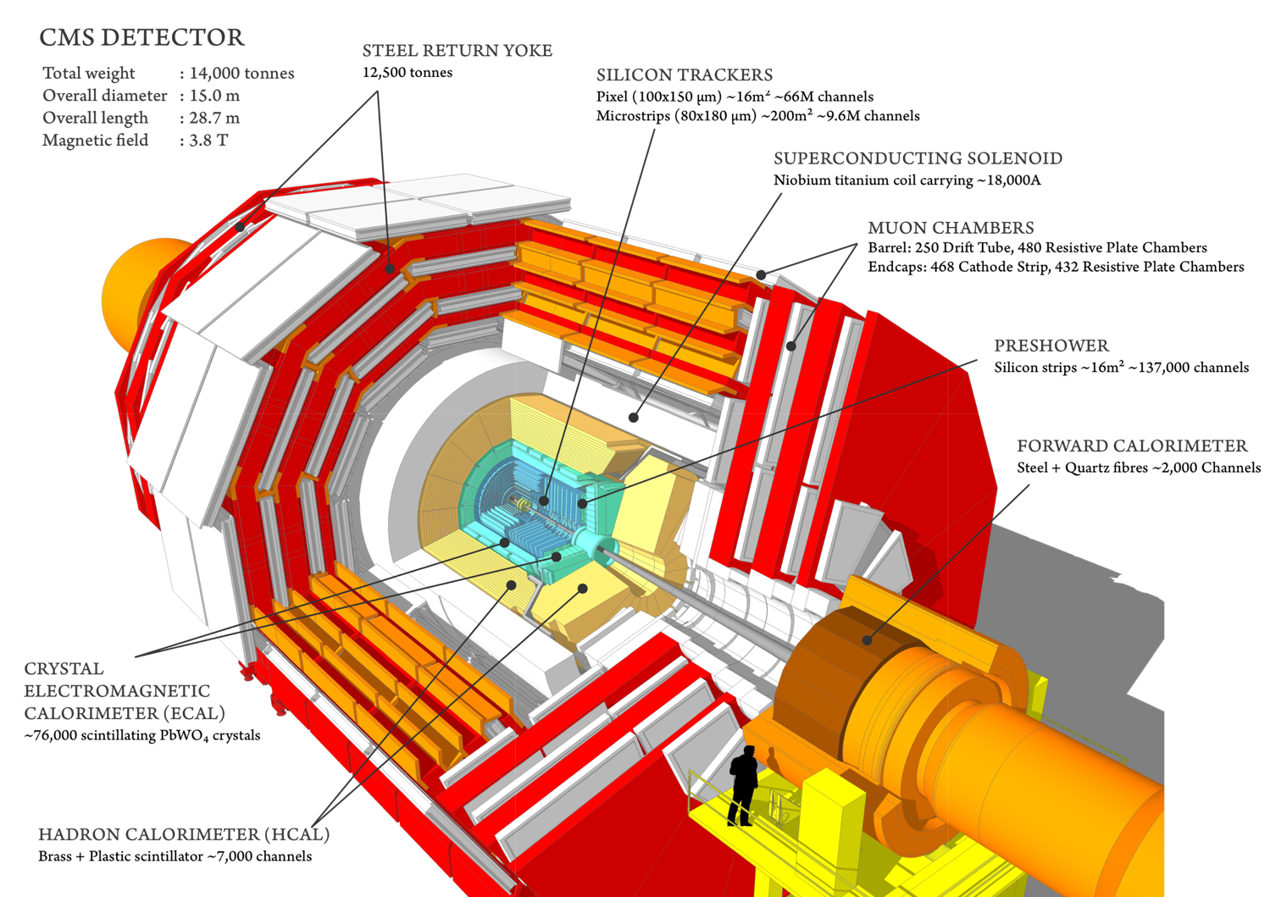
mar.capeans@cern.ch
September 2016
<number>

Slide 31
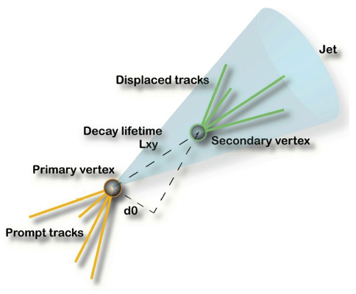
• Trackers•
Measure charged particles as they emerge from the interaction point, disturbing them as little as possible
Measure the trajectory of charged particles
  Measure several points (hits) along the track and fit curves to the hits (helix, straight line)
Determine their momentum
  From their curvature in a magnetic field
Extrapolate back to the point of origin
  Reconstruct vertices
Reconstruct secondary vertices
    Long-lived particles have a measurable displacement between primary vertex and decay
Match tracks with showers in the calorimeters or tracks in the muon systems
Trackers also contribute to particle identification (PID)
  Measuring rate of energy loss (dE/dx) in the tracker
  Using dedicated detectors to distinguish different particle types (TR, TOF, RICH)
Want a compact detector, inside a magnetic field, to register as many hits as possible but light to minimise interactions of charged (and neutral) particles before they reach the calorimeter systems
mar.capeans@cern.ch
September 2016
<number>

Slide 32
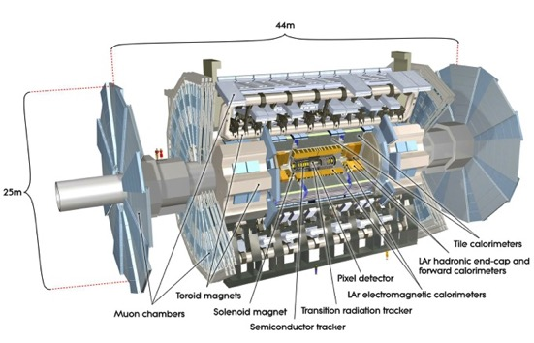
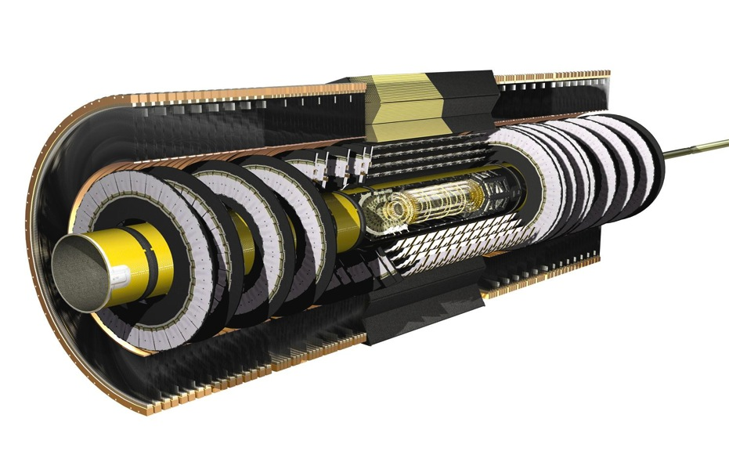
• ATLAS Tracker •
6.2 m
2.1 m
Endcap
Barrel
Endcap
mar.capeans@cern.ch
September 2016
<number>

Slide 33
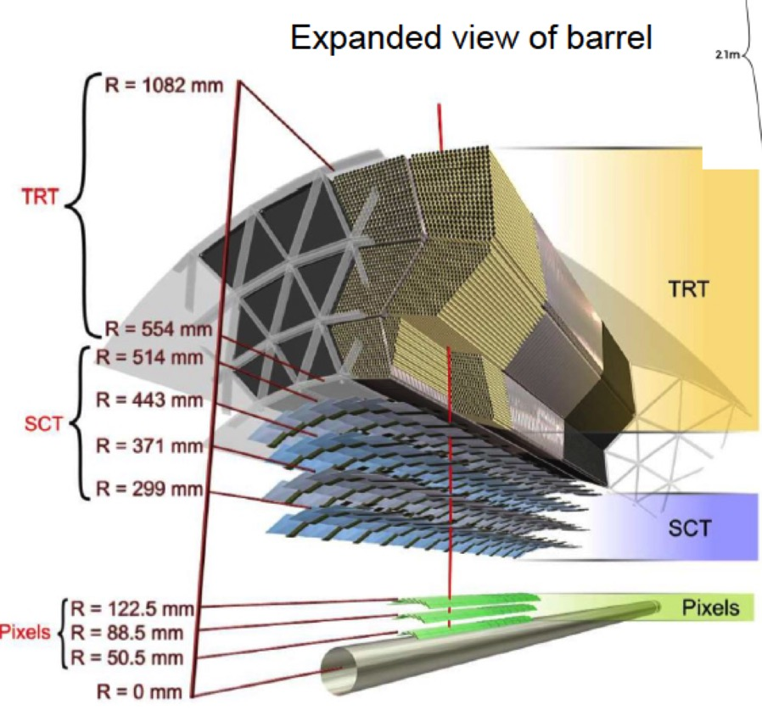
• ATLAS Tracker•
TRT (Straws-Gas)
350 kchannels
36 track points
? ~130 μm
SCT (Silicon strips)
6.2 Mchannels
4 track points
? ~16 μm
Pixel (Silicon pixels)
80 Mchannels
3 track points
? ~10 μm
mar.capeans@cern.ch
September 2016
<number>

Slide 34
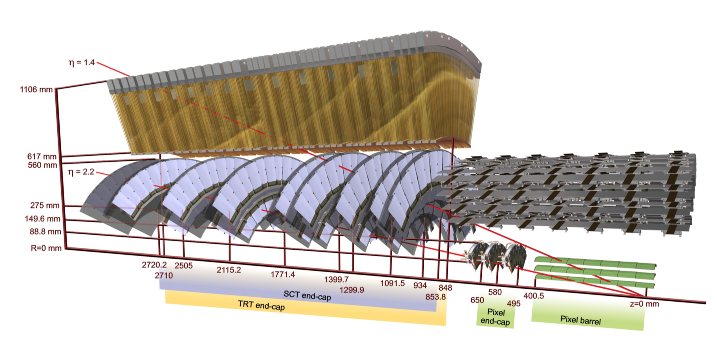
• Track Points •
nnn
ATLAS ID elements crossed by two charged particles of 10 GeV pT
A particle at |η| = 1.4 traverses the beam-pipe, 3 pixel layers, 4 SCT disks with double layers of sensors, and approximately 40 straws in the TRT end-cap.
A particle at |η| = 2.2 traverses the beam-pipe, only the first pixel layer, 2 end-cap pixel disks and the last 4 disks of the SCT end-cap.
mar.capeans@cern.ch
September 2016
<number>

Slide 35
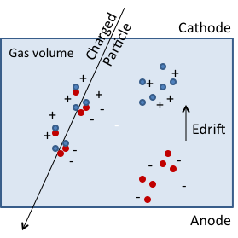
• Gaseous Detectors •
Any charged particle traversing a gas will loose energy due to interactions with the atoms of the gas. This results in:
  Excitation, the particle passes a specific amount of energy to a gas atom
  Ionization, the particle knocks an electron off the gas atom, and leaves a positively charged ion
Resulting primary e⁻ will have enough kinetic energy to ionize other atoms of gas. The sum is called Total Ionization
mar.capeans@cern.ch
September 2016
<number>
Notes:
<number>

Slide 36
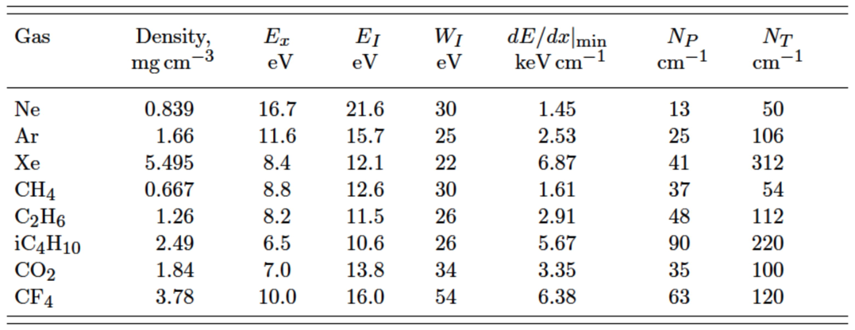
• Ionization •
N_{P}: Primary nb of ion-pairs
N_{T}: Total nb of ion-pairs
W: Effective E to produce 1 pair
Energy Loss of Charged Particles in Gases
n_{p} = 25 ion pairs/cm
n_{T} = ΔE/W_{i} = 2.5 keV/cm / 25 eV = 100 ion pairs/cm
100 pairs are not easy to detect, typical noise of an amplifier is ~1000 e⁻
Need to MULTIPLY the electrons
mar.capeans@cern.ch
September 2016
<number>
Notes:
<number>

Slide 37
• Amplification •
Multiplication requires fields where the e⁻ energy occasionally is sufficient to ionise
Cathode
-
Gas volume
+
+
+
+
+
+
-
+
+
-
+
Edrift
Edrift
-
-
-
-
-
-
Egain
Charged Particles
Anode
mar.capeans@cern.ch
September 2016
<number>
Notes:
<number>

Slide 38
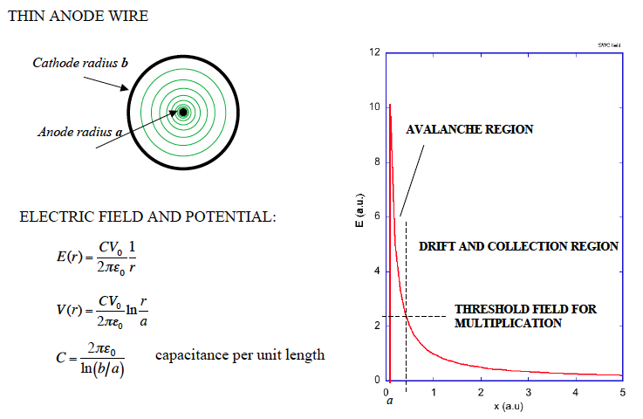
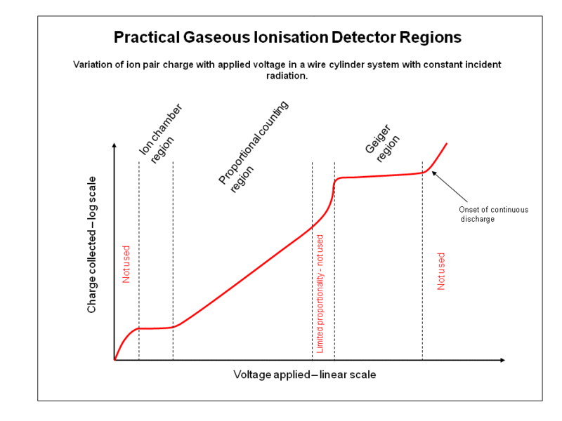
• Amplification •
Electron avalanche occurs very close to the wire, with first multiplication occurring ~2x the wire radius.
Electrons move to the wire surface very quickly (<<1ns), but the ions drift to the tube wall more slowly (~100 μs).
Total charge induced by the electrons is only ~1-2 % of the total charge.
mar.capeans@cern.ch
September 2016
<number>
Notes:
<number>

Slide 39
• Choice of Gas •
With an appropriate field, avalanche multiplication occurs in all gases
But, there are many requirements:
  Low working voltage
  High Gas Gain
  Good proportionality
  High Rate capability
  Long lifetime
  Fast response/recovery
  Safety (flammable, corrosive, irritants, toxics, etc.)
  Stable (rad-hard)
  Cost
Mar Capeans
November 2013
<number>
Notes:
<number>

Slide 40

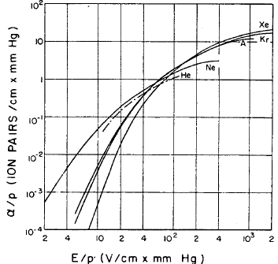
• Noble Gases •
Light
Abundant
Inert
Cheap
Expensive
Noble gases require the lowest electric field for formation of avalanches
mar.capeans@cern.ch
September 2016
<number>
Notes:
<number>

Slide 41
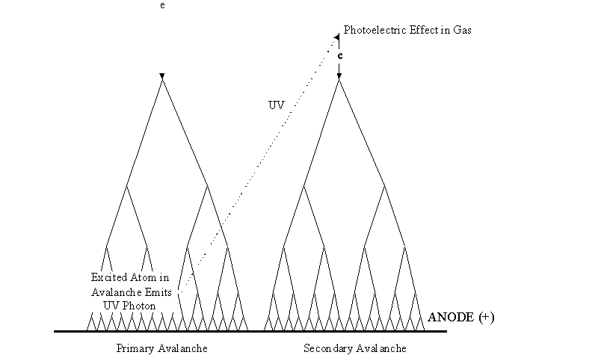
The amplification (Multiplication Factor) cannot be increased at will. Secondary processes (photon emission, space-charge) eventually result in spark breakdown.
De-excitation of noble gases occur only via emission of photons
Primary avalanche
Secondary avalanche
mar.capeans@cern.ch
September 2016
<number>
Notes:
<number>

Slide 42
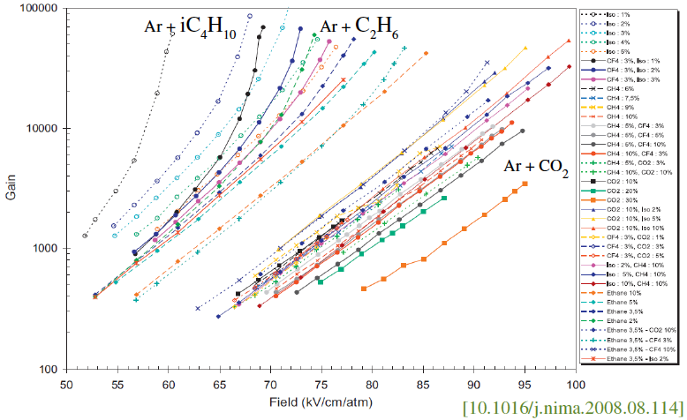
• Quencher Gases•
A polyatomic gas acts as a QUENCHER, i.e., absorbs photons in a large energy range due to the large amount of non-radiative excited states (rotational and vibrational)
  Most organic compounds in the HC and -OH families. The quenching efficiency increases with the nb of atoms in the molecule
  Freons, BF₃
  CO₂: non flammable, non polymerizing, easily available
mar.capeans@cern.ch
September 2016
<number>
Notes:
<number>

Slide 43
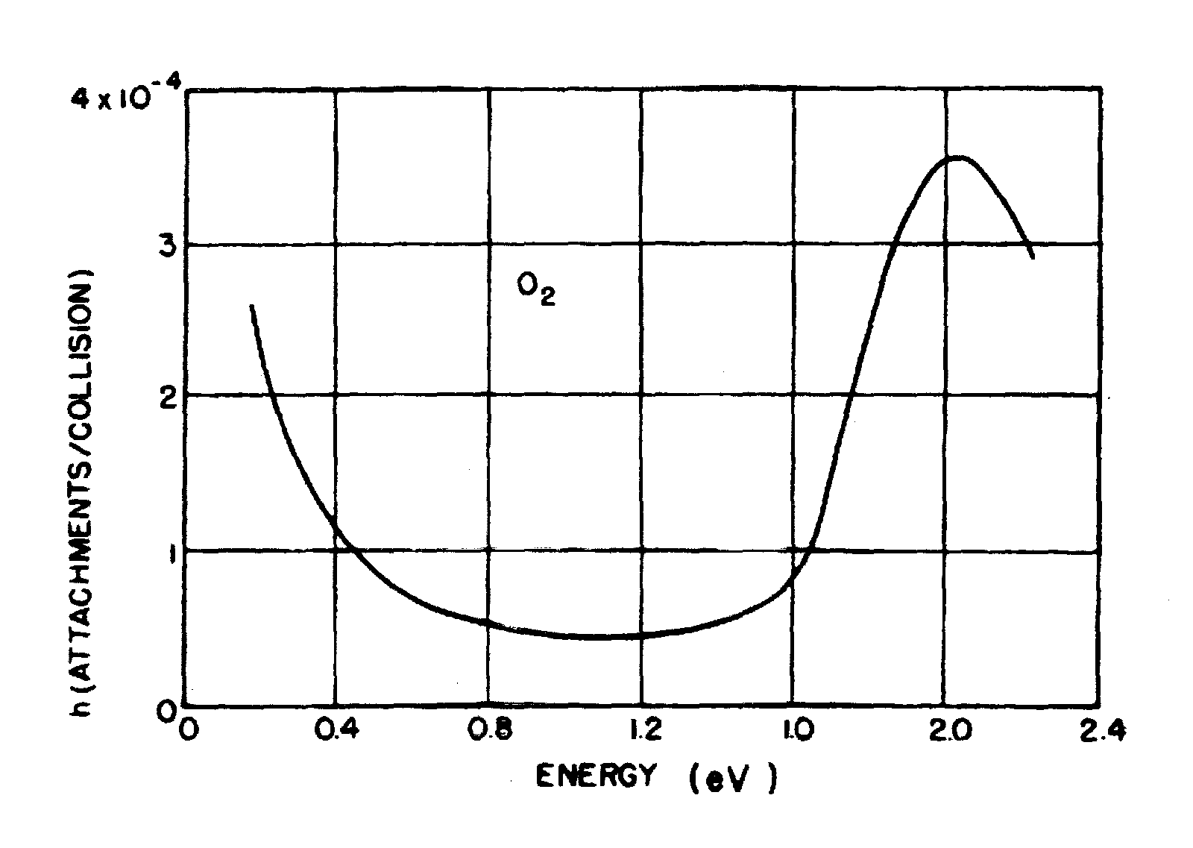
• Electronegative Gases •
Small additions of electronegative gases allows to obtain the highest possible gains
  They have a photon-quenching capability
  They capture free electrons forming negative ions that cannot induce avalanches
  Some examples
    Freons (e.g. CF₃Br)
    O₂
    H₂O
    CF₄
    SF₆
The attachment cross section is energy-dependent, therefore strongly depends on the gas composition and electric field
Mar Capeans
<number>

Slide 45
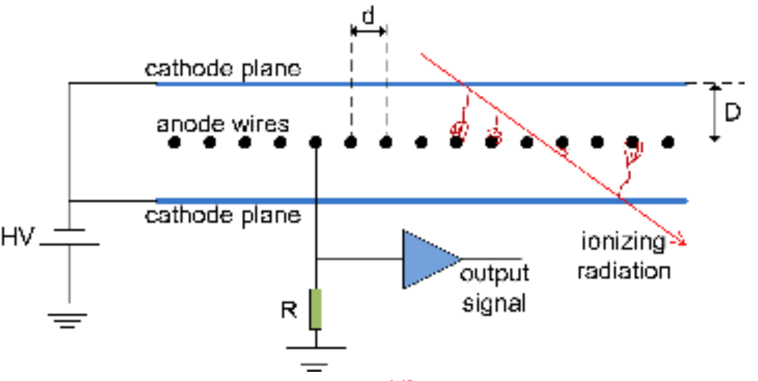
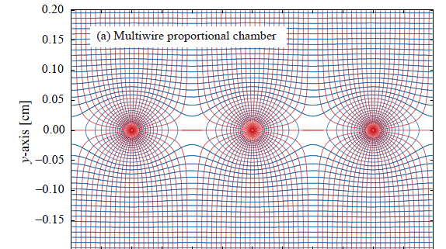
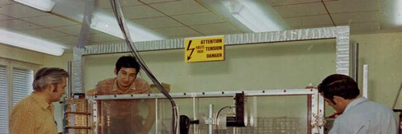
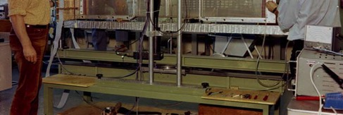
• MWPC •
Fast position-sensitive detectors (1968)
Continuously active
Efficient at particle fluxes up to several MHz/cm2
Sub-mm position accuracy (~wire distance/√12)
First electronic device allowing high statistics experiments !!
G.Charpak, Noble Prize in 1992
mar.capeans@cern.ch
September 2016
<number>

Slide 46
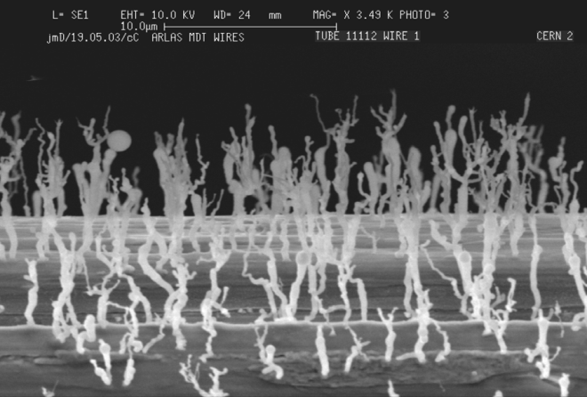
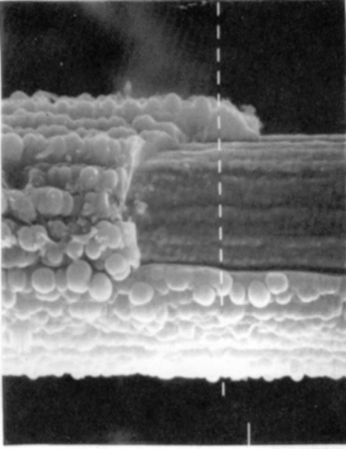
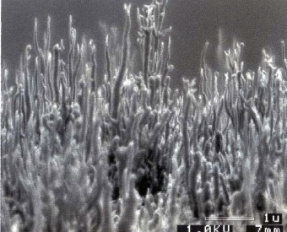
• MWPC Limitations•
Limited multi-track separation:
  mechanical instabilities due to electrostatic repulsion
Fast gain drop at particle high fluxes:
  field-distorting space charge accumulation due to the long time taken by the ions produced in the avalanches to clear the region of multiplication
Aging:
  permanent damage of the structures after long-term exposure to radiation due to the formation of solid deposits on electrodes.
Anode Aging: drop of the gain, discharges
Cathode Aging: Malter effects
mar.capeans@cern.ch
September 2016
<number>

Slide 47
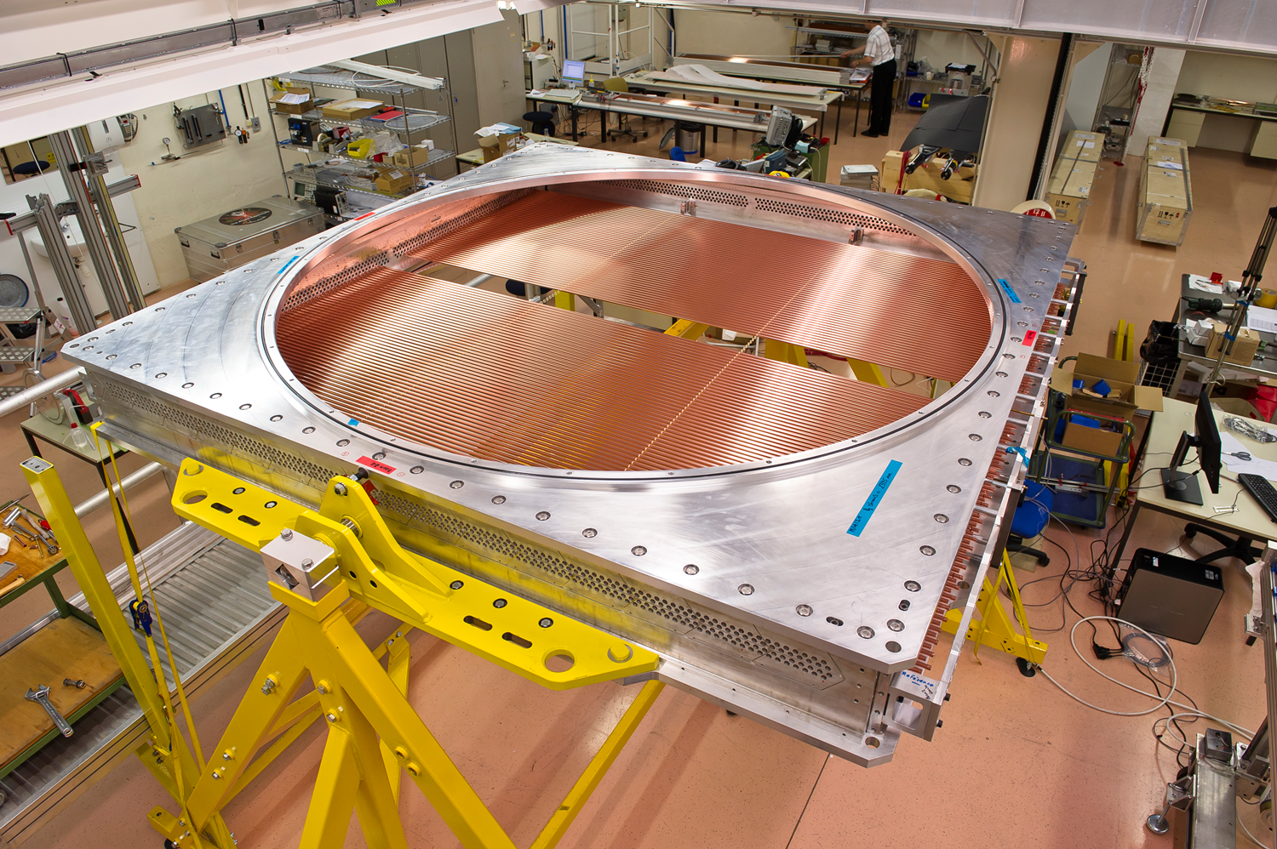
• Straw Tubes •
STRAW TUBES
Anode-cathode distance ~ 2 mm
Spatial resolution ~ 130-300 μm
Straw or tube chambers are basically proportional chambers constructed with a single anode wire centered in a metalized plastic tube forming the grounded cathode
The typical sizes of the tube are several millimeters to a centimeter in diameter
Straws can obtain resolutions of 45-100 microns, by operating them at high gains in order to detect the time of the arrival of the first electron from the ionization path of the charged tracks
5 mm
CERN NA62 Straw chamber
mar.capeans@cern.ch
September 2016
<number>

Slide 48
• Straw Tubes •
Advantages over MWPC
  Inexpensive, robust and relatively simple to construct (can cover very large areas)
  Minimal damage and possible downtime caused by a broken wire, since it is isolated in the tube cell and will only need to be disconnected
  Minimized signal cross talk as the straw cathode provides a complete ground shield between nearby wires
  Problems of electrostatic alignment distortions are minimal when the anode is kept reasonably centered in the straw (but tricky for long/thin tubes)
mar.capeans@cern.ch
September 2016
<number>

Slide 49
• TRT Challenges at the LHC •
Very high occupancy: up to 30%
Very high counting rate: up to 20 MHz/straw
  Ionization current density up to 0.15 mA/cm
  Ionization current per wire up to 10 mA
  Power dissipated by ionization current: per straw ~15 mW/straw, ~5 kW in detector volume
Short bunch crossing interval: 25 ns
High spatial resolution, good pattern recognition
  Need many points/measurement
  Fast gas
Radiation environment: ~10 MRad (charged) and 10¹⁴ n/cm² year (neutrons)
  Radiation resistant to 10 C/cm in 10 years
Minimum amount of material (10% Radiation length)
Extremely precise, robust yet light mechanical structure
Stable Temperature environment: cooling
Very limited accessibility
Mar Capeans
<number>

Slide 50
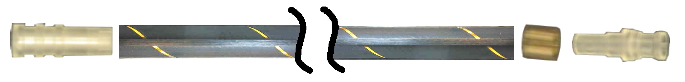
• Transition Radiation Tracker •
TRT is an array of small diameter drift tubes
350 000 read-out channels
Volume 12 m³
Basic detector element: reinforced Kapton straw tube with 4mm diameter with a 0.03 mm diameter gold-plated tungsten wire in the center
50 000 straws in Barrel, each straw 144 cm long, ends of straws are read out separately
250 000 straws in both endcaps, each straw 39 cm long
Precision measurement of ~ 0.16 mm (worse than Si-det, but large nb hits/track (~30) and long lever-arm)
Transition radiation: TRT provides additional information on the particle type that flew through the detector, i.e. if it is an electron or pion
  Straws are embedded in polymer foil/foam to create transition radiation, which may be emitted by highly relativistic charged particles as they traverse a material boundary
Mar Capeans
<number>

Slide 51
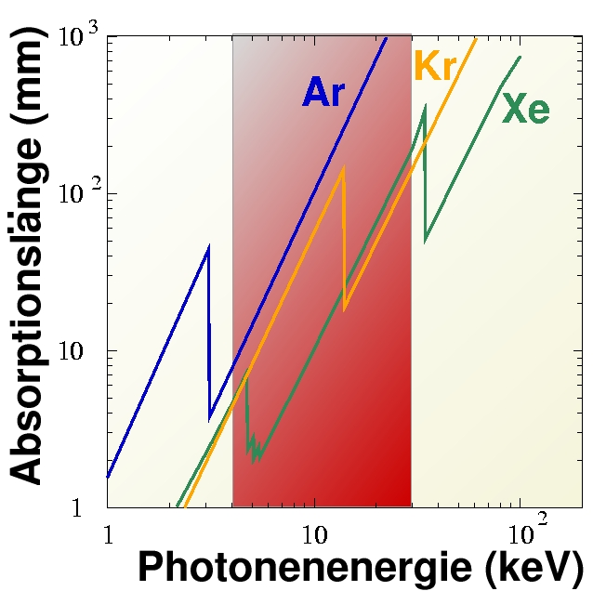
• Transition Radiation •
TR: photon emitted by a charged particle when traversing the boundary between materials with different dielectric constants
This effect depends on the relativistic factor γ = E/m and is strongest for electrons, which means it can be used for particle identification
Typical TR photon energy depositions in the TRT are 5-15 keV, while mips, such as pions, deposit ~2 keV. The parameter used in electron identification is the number of local energy depositions on the track above a given threshold (300 eV VS 6 keV) .
_{Absorption length (mm)}
_{Photon energy (keV)}
CO₂ Envelope
_{Cross section view}
_{4mm}
Straw
Xe-based mix
_{TR photon}
_{electrons}
15 x15μm polyethylene foils
_{0.03mm}
Mar Capeans
November 2013
<number>

Slide 52
• Increasing Cell Granularity •
Moving down in size!
STRAW TUBES
Anode-cathode distance: 2 mm
Spatial resolution ~ 130-300 μm
5 mm
MICRO STRIP GAS CHAMBERS
(MSGC - A.Oed,1988)
Semiconductor industry technologies
Anode-cathode distance: 40 μm
Spatial resolution ~ 40 μm
200 μm
MSGC… Very high rate capability due to small pitch and fast ion collection, but delicate structures with very high fields in electrodes edges…. sparks
mar.capeans@cern.ch
September 2016
<number>
Notes:
<number>

Slide 53
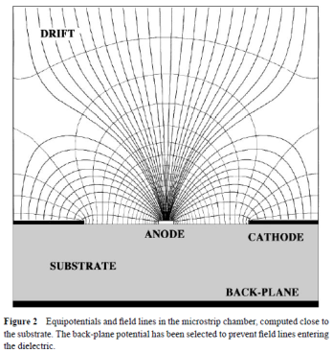
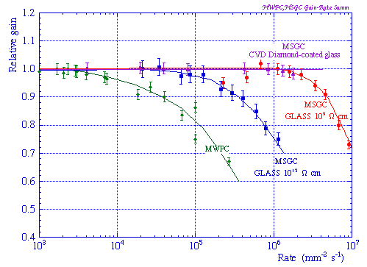
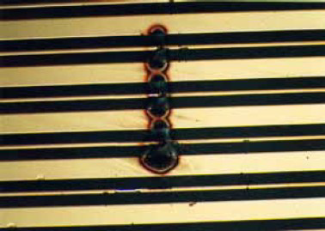
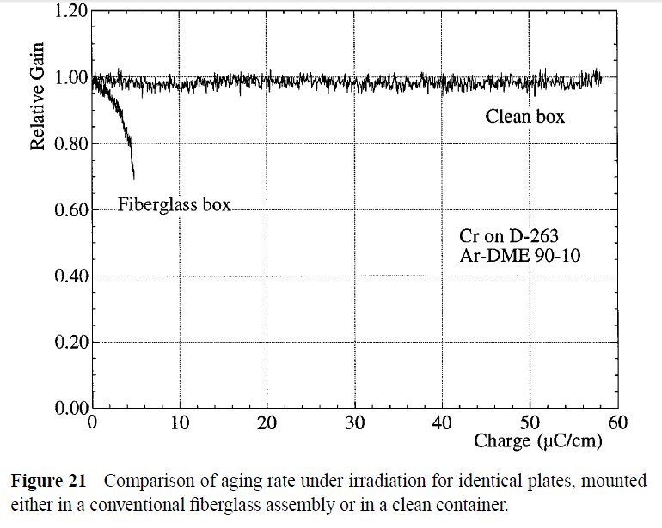
• MSGC •
Observed instabilities:
Time-dependent gain shifts (charge movement in the substrate, polarization and charge accumulation)
Tendency to discharge
Permanent deterioration (aging) during sustained irradiation
Medium- and long-term stability determined by physical parameters used to manufacture and operate the detectors: substrate material, metal of the strips, gas type and purity
mar.capeans@cern.ch
September 2016
<number>
Notes:
<number>

Slide 54

• Decoupling Multiplication from Charge Collection •
Micro Strip Gas Chamber
200 μm
Gas Electron Multiplier
(GEM – F.Sauli, 1998)
Spatial resolution ~ 50 μm
Time resolution better than 10 ns
GEM foil
400 μm
Charge collection
Multiplication
mar.capeans@cern.ch
September 2016
Thin metal-coated polymer foils
70 µm holes at 140 mm pitch
<number>
Notes:
<number>

Slide 55


• GEM Detectors •
DRIFT
Primary electrons are released by ionizing radiation in the gas (E-field between drift plane and GEM)
By applying a suitable voltage difference between the two metal sides of the GEM, an electric field with an intensity as high as 100kV/cm is created inside the holes which act as multiplication channels
Readout electrodes are at ground potential; electron charge is collected on strips or pads, ions are partially collected in the bottom of the GEM foil
GEM
RO
mar.capeans@cern.ch
September 2016
<number>
Notes:
<number>

Slide 56


•Multi-GEM detectors•
Multi-stage detectors
Two or more amplification layers to achieve a high gas gain with a low discharge probability (low spark rate)
mar.capeans@cern.ch
September 2016
<number>

Slide 57


• Time Resolution •
Cylindrical geometries have an important limitation:
Primary electrons have to drift close to the wire before the charge multiplication starts
Limit in the time resolution ∼ 0.1μs
In a parallel plate geometry the charge multiplication starts immediately because all the gas volume is active (uniform and very intense field). This results in much better time resolution (∼ 1 ns)
mar.capeans@cern.ch
September 2016
<number>

Slide 58
• RPC •
Developed in the 80s as an affordable, robust, large area detector with:
Fast timing: < 1 ns to ps for MRPC
Space resolution: ~mm
Rate capability: up to ~100 Hz/cm²
RPC developments for LHC
Large Area Coverage (> 5000 m²) – Industrialization
Increased Rate Capability (~kHz/cm²)
Large Background Radiation
Radiation-hard Gas Mixtures
READOUT STRIPS X
INSULATOR
HV
2 mm
RESISTIVE ELECTRODES:
BAKELITE PLATE
with ρ ∼ 10⁹ Ω·cm
(linseed oil)
+
GRAPHITE COATING
2 mm
GAS GAP
2 mm
GND
READOUT STRIPS Y
mar.capeans@cern.ch
September 2016
<number>
Notes:
<number>

Slide 59


•MicroMegas•
MICRO Mesh Gaseous Structure, two-stage parallel-plate avalanche chamber of small amplification gap
Small amplification gap, high field: fast movement of positive ions that are mostly collected on the mesh (small space-charge accumulation) and very fast signals. Well suited for high rate applications!
mar.capeans@cern.ch
September 2016
<number>

Slide 60

Slide: E.Oliveri, CERN
MPGD detectors already running at CERN….
TOTEM (GEM)
LHC
Compass (GEM, micromegas)
NA48 (micromegas)
LHCb (GEM)
LHC
CAST (micromegas)
DIRAC (MSGC-GEM)

Slide 61
Slide: E.Oliveri, CERN
…. And upgrades are on the way
COMPASS(TGEM, micromegas upgrade)
TOTEM (GEM)
LHC
Compass (GEM, micromegas)
CMS(GEM)
1000 m² Large-area Triple_GEM chambers
GLACIER(LEM)
NA48 (micromegas)
LHCb (GEM)
LHC
ALICE(GEM)
LHCb(GEM)
LHC
LHC
CAST (micromegas)
CAST(InGrid)
ATLAS(micromegas)
Large-area (≈2 x 1 m²) bulk-MicroMegas chambers for high-rate applications that combine precision measurement and trigger functionality
2M readout channels
1200 m² of detection layers
DIRAC (MSGC-GEM)
… and other proposals in progress for future upgrades

Slide 62









Micro Gap Chambers
Slide: E.Oliveri, CERN
Micro Gap Wire Chamber
Micro Wire Chamber
E. Christophel et al, Nucl. Instr. and Meth, vol 398 (1997) 195
B. Adeva et al., Nucl. Instr. And Meth. A435 (1999) 402
Angelini F, et al. Nucl. Instrum. Methods A335:69 (1993)
MicroDot
MicroWELL
MicroGroove
R. Bellazziniet al
Nucl. Instr. and Meth. A423(1999)125
Biagi SF, Jones TJ. Nucl. Instrum. Methods A361:72 (1995)
μPIC
MicroPin
R. Bellazzini et al
Nucl. Instr. and Meth. A424(1999)444
P. Rehak et al., IEEE Nucl. Sci. Symposium seattle 1999
<number>
Ochi et al NIMA471(2001)264

Slide 63

• Muon Systems (Large&Fast) •
Function: muon detection; Muons are charged particles that are just like electrons and positrons, but 200 times heavier.
Because muons can penetrate several metres of iron without interacting, unlike most particles they are not stopped by calorimeters. Therefore, chambers to detect muons are placed at the very edge of the experiment where they are the only particles likely to register a signal.
Detection principle: Ionization detectors (gas), similar to precision trackers but usually of lower spatial resolution.
They are fast detectors and are part of the Trigger system to select events
ATLAS,12 000 m², 1.1 Mchannels
Alignment precision <±30 mm
mar.capeans@cern.ch
September 2016
<number>

Slide 64


• Muon Spectrometer•
CMS
Traditional Technology
DRIFT TUBES (DT)
4 Stations, Central coverage
Tracking (100 μm) & trigger
CATHODE STRIP CHAMBERS (CSC)
Forward coverage (6000 m2)
Tracking (1mm) & trigger
540 detectors, 0.5 MChannels
Designed to operate in intense magnetic field and neutron background ~1 kHz/cm²
RESISTIVE PLATE CHAMBERS (RPC)
Central and forward coverage
Redundant Trigger (3 ns)
2000m², 612 detectors
mar.capeans@cern.ch
September 2016
<number>

Slide 66
• Gas Detectors •
  Good spatial resolution
  Good dE/dx
  Good Rate capability
  Fast & Large Signals
  Low radiation length
  Large area coverage
  Multiple configurations, flexible geometry
Gas VS Silicon
Semiconductor detectors perform better very close to the interaction region, where a precision of a few microns is required and the radiation is extremely high.
At large radius where large areas have to be covered, e.g. the muon chambers, it is unrealistic to use anything other than gas detectors.
In the intermediate region between about 20 cm and 2 m radius silicon and micropattern gas detectors meet as rivals, as both fulfill all the necessary requirements concerning precision, rate capability and radiation hardness.
mar.capeans@cern.ch
September 2016
<number>

Slide 67
Recap
Challenges of detectors @ LHC
Basics of interactions of particles with matter
Detector technologies
Detector layers/functions
  Tracking
    Gas detectors
    New Gas detectors: improved timing, rate capability and spatial resolution
      Future detectors for large area coverage: MPGD for LHC muon systems (tracking and triggering)
mar.capeans@cern.ch
September 2016
<number>

Slide 68
• ATLAS Tracker•
TRT (Straws-Gas)
350 kchannels
36 track points
? ~130 μm
SCT (Silicon strips)
6.2 Mchannels
4 track points
? ~16 μm
Pixel (Silicon pixels)
80 Mchannels
3 track points
? ~10 μm
mar.capeans@cern.ch
September 2016
<number>

Slide 69
• Semiconductors •
(more generally, solid state detectors)
Used in nuclear physics for Energy measurements since the 50ies
Appear in HEP in the 70ies
In the 80ies, planar technique of producing silicon radiation sensors, permitting segmentation of one side of the junction and the use of signals recorded on the segments to determine particle positions
A Si detector takes advantage of the special electronic structure of a semiconductor
Semiconductors are crystalline or amorphous solids with distinct electrical characteristics.
They are of high resistance, but still of much lower resistance than insulators. Their resistance decreases as their temperature increases, which is behavior opposite to that of a metal.
Their conducting properties may be altered in useful ways by the deliberate, controlled introduction of impurities ("doping") into the crystal structure, which lowers its resistance but also permits the creation of semiconductor junctions between differently-doped regions of the extrinsic semiconductor crystal.
The behavior of charge carriers which include electrons, ions and electron holes at these junctions is the basis of diodes, transistors and all modern electronics.
September 2016
<number>

Slide 70



• Semiconductors •
hole
current
electron
current
Basic element of a solid state (silicon) detector is… a diode
p-type (more holes) and n-type (more electrons) doped silicon material is put together
Please watch this fun video on transistors
https://www.youtube.com/watch?v=IcrBqCFLHIY
Current flow through
diode if connects like this
For particle detectors: reverse bias the diode to create an active detection layer
Depletion layer: zone free of mobile charge carriers
    no free holes, no electrons so that we can observe the ionization charge
    thickness of depletion region depends on voltage, doping concentration
depleted
region
Charged particle can create new
electron/hole pairs in depletion
area sufficient to create a signal
mar.capeans@cern.ch
September 2016
<number>

Slide 71
• Semiconductors •
In order to understand well how a semiconductor works and how semiconductor particle detectors are done, one has to look/understand some fundamentals:
Material properties of insulators, semiconductors and metals
Crystal structure of semiconductors
Doped materials
Bond model of semiconductors
Energy bands
Drift velocity and mobility
Resistivity of materials
pn junctions
… manufacturing silicon detectors
Not the scope of this lecture!
mar.capeans@cern.ch
September 2016
<number>

Slide 72

• Semiconductors •
(more generally, solid state detectors)
DC coupled strip detector
Through going charged particles create e⁻h⁺ pairs in the depletion zone (about ~25000 pairs in standard detector thickness).
These charges drift to the electrodes.
The drift (current) creates the signal which is amplified by an amplifier connected to each strip.
From the signals on the individual strips the position of the through going particle is deduced.
September 2016
<number>

Slide 73
• Semiconductors •
Very attractive in HEP because of:
  Good intrinsic energy resolution
    Silicon: 1 e-hole pair for every 3.6 eV released by a crossing particle
    Gas: 30 eV required to ionize a gas molecule
    High primary ionization (larger signal), no amplification
  Si high density reduces the range of secondary e, thus good spatial resolution
    10 μm, the best ~1 μm
  The granularity (cell size) can be very high
  Thin, therefore can be positioned close to the interaction point
  Easy integration with electronics (both made of silicon)
  Industrial process (high yield, continuous development…)
mar.capeans@cern.ch
September 2016
<number>

Slide 74




• Strips VS Pixels •
Strips
Each strip is connected to one electronic readout channel
First prototypes: ~ 1980
Strip pitch: ~10-100 µm
Position resolution: ~few µm due to charge sharing between neighboring strips
Double-sided: Production, handling, tests are more complicated and hence are expensive
Pixels
2D resolution
First prototypes ~1990
Can be used for tracking or imaging:
  particle tracking = detection of individual charged particles
  imaging = count/integrate particles or photons
Pixels: large nb of elec channels, power...
<number>

Slide 75
Slide: P. Riedler, CERN
• Hybrid Pixels •
Development closely linked to progress in microelectronics and interconexión technologies (sensor & chip)
Each pixel cell in the sensor is connected to a pixel cell in the readout chip via a bump bond
Sensor and readout are optimized separately
Thinning of readout wafers (~150µm at LHC)
Mature technology employed in all LHC experiments
Readout Chip
Bump Bonds
Si Sensor
mar.capeans@cern.ch
September 2016
<number>

Slide 76








Silicon Detectors at LHC
ALICE Pixel Detector
LHCb VELO
ATLAS Pixel Detector
CMS Pixel Detector
ALICE Detector
ALICE Strip Detector
ATLAS SCT Barrel
CMS Strip Tracker IB
mar.capeans@cern.ch
September 2016
<number>

Slide 77

ATLAS, Barrel SCT module
Hybrid assembly
with readout chips
12.8 cm
6 binary readout chips on either sensor side; sig:noise = 14:1
4 Silicon sensors
280 μm thick
2.3° stereo angle
Overlap in φ & z to adjacent modules
768 p⁺ microstrips Cell size: 80 μm [φ pitch] × 13 cm [z]
Overall 6.3 10⁶ channels
Be module baseboard with mounting points & central TPG
TPG (thermal pyrolythic graphite) plate for sensor cooling
Connector
Power & data
Fully equipped double sided electrical module with baseboard and readout hybrids
mar.capeans@cern.ch
September 2016
<number>

Slide 78



• Systems•
Slide: P. Riedler, CERN
How to efficiently cover large surfaces? Ladders (modules)
  sensor size limited by wafer size and bump bonding requirements (flatness!), LHC experiments today: ~7cm x 2cm
  chip size limited by process rules (larger chip means lower yield in production)
A. Pepato/INFN Padova
mar.capeans@cern.ch
September 2016
<number>

Slide 79

• Systems•
What is a system?
  Sensor
  Readout electronics
  Interconnections
  Mechanical supports
  Cooling, thermal aspects
  Power supplies
  Services: cables, pipes, fiber links…
  Monitoring, sensors, alignment
mar.capeans@cern.ch
September 2016
<number>

Slide 80

Slide: S.McMahon, Oxford/RAL
• Large systems•
Pursuing simplicity for ease of construction
  E.g. silicon modules glued directly onto a cooled carbon fibre sandwich structure
Designed to reduce radiation length
  Minimizes material by shortening cooling path
  Manifold and multiplex services
Components tested independently before construction
  Leads to early systems-like testing
Design aims to be low cost
  Minimize specialist components
mar.capeans@cern.ch
September 2016
<number>

Slide 81

Slide: P. Riedler, CERN
• Pushing the Limits Now•
ALICE ITS Upgrade: Inner Layer Stave
Installation in 2019
Light weight, compact modules to minimize material budget:
Monolithic sensors: integrated sensor and electronics
Integrated mechanical support and cooling
50 µm silicon sensors connected via solder points (direct on chip laser soldering/wire-bonding) to a 2-layer Al(Cu)-polyimide flex cable
Power and signal connections to each chip
mar.capeans@cern.ch
September 2016
<number>

Slide 82


Slide: P. Riedler, CERN
•Hybrid VS Monolithic•
Hybrid Pixel Detector
Monolithic Pixel Detector (example)
50 µm
Goal: get low mass, highly granular silicon pixel detectors without interconnection to a sensor.
Integrate charge generation volume into readout chip.
“Disadvantages”
Signal ~ 80e-h/µm: <1000 e-h
Less radiation tolerant compared to hybrid pixel
New technology
mar.capeans@cern.ch
September 2016
<number>

Slide 83
• Other Si Detector Structures•
Additional interesting silicon detector structures are:
Charged Coupled Devices (CCD)
Silicon Drift Detectors (SDD)
Monolithic Active Pixels (MAPS)
Depleted Field Effect detectors (DEPFET)
Silicon On Oxide (SOI)
3D detectors
Avalanche Photo Diodes (APD) and Silicon Photo Multiplier (SiPM)
mar.capeans@cern.ch
September 2016
<number>

Slide 84


Scintillation Particle Detector
Scintillators are materials that produce sparks or scintillations of light when ionizing radiation passes through them. The charged particle excites atoms in the scintillator, e- returns to ground state by emitting a photon
Principle
dE/dx converted into visible light
Detection via photosensor [e.g. photomultiplier, SiPM, human eye ...]
Main Features
Sensitivity to energy
Good linearity over large dynamic range
Fast time response
Pulse shape discrimination
Scintillating fibres
mar.capeans@cern.ch
September 2016
<number>

Slide 85

• Scintillators •
Different types of scintillators
  Inorganic crystalline scintillators (NaI, CsI, BaF₂...)
  Nobel Gas (Ar)
  Organic (Liquids or plastic scintillators)
Many different geometries
The amount of light produced in the scintillator is very small. It must be amplified before it can be recorded as a pulse or in any other way.
External wavelength shifters and light guides are used to aid light collection in complicated geometries.
Large plates of scintillators
Coupled to single PMT
mar.capeans@cern.ch
September 2016
<number>

Slide 86

Slide: C.Joram, CERN
• Photo-detectors •
Purpose: Convert light into detectable electronic signal
Principle: Use photoelectric effect to ‘convert’ photons (γ) to photoelectrons (pe)
Details depend on the type of the photosensitive material. Many photosensitive materials are semiconductors, but photoeffect can also be observed from gases and liquids.
Photon detection involves often materials like K, Na, Rb, Cs (alkali metals) . They have the smallest electronegativity → highest tendency to release electrons.
mar.capeans@cern.ch
September 2016
<number>

Slide 87
Slide: C.Joram, CERN
• Photo-detection •
The classical domains of application:
Calorimetry
  Readout of organic and inorganic scintillators, lead glass, scint. or quartz fibres → Blue/VIS, usually 10s – 10000s of photons
Particle Identification
  Detection of Cherenkov light →UV/blue, single photons
  Time Of Flight → Usually readout of organic scintillators (not competitive at high momenta) or Cherenkov radiators
Tracking
  Readout of scintillating fibres → blue/VIS, few photons
mar.capeans@cern.ch
September 2016
<number>

Slide 88
Slide: C.Joram, CERN
• Photodetector Requirements •
High sensitivity, usually expressed as quantum efficiency
Good Linearity: Output signal ∼ light intensity, over a large dynamic range (critical e.g. in calorimetry (energy measurement).
Fast Time response: Signal is produced instantaneously (within ns), low jitter (<ns), no afterpulses.
Low intrinsic noise. A noise-free detector doesn’t exist. Thermally created photoelectrons represent the lower limit for the noise rate ∼ A_{o}T²exp(-eW_{ph} /kT). In many detector types, noise is dominated by other sources.
+ many more: size, fill factor, radiation hardness, cost, tolerance/immunity to B-field...
mar.capeans@cern.ch
September 2016
<number>

Slide 89

Slide: C.Joram, CERN
LHCb SciFi in numbers
Fi-based downstream tracking stations
Single technology that can perform similarly to a silicon tracker, but cost-effective enough to cover the 30m2 of acceptance of each layer. The result is a light and uniform tracking detector without the need for cooling or signal cables entering into the detector acceptance.
Fibre mat
× 8
SciFi Module
× 12
Detector Layer
× 4 (stereo angles
0°, +5°, -5°, 0°)
1× SciFi Module
SiPM
Tracking Station
× 3
Scintillating Fibre Tracker
5m
mirror
Beam pipe
1152 mats, 144 modules
360 m² total area
almost 11,000 km of fibre
~590’000 SiPM channels, operation of SiPM at -40°C (radiation damage)
SiPM
6m
September 2016
<number>

Slide 90
• Calorimeters •
Experimental technique in nuclear and particle physics where the detection of a particle and the measurement of its properties is based on total or partial absorption in the detector volume
It is a destructive process: particle’s energy is converted in a detectable signal until the particle is absorbed (or leave the detector)
First calorimeters in Particle Physics appeared in the ‘70s as need to measure energies of all particles, charged and neutrals, except muon (heavy) & neutrinos (weak interaction)
Calorimeters measure charged and neutral particles (γ, e, jets (q,g), missing transverse energy i.e. neutrinos), performance improves with energy and is ~constant over 4π, high rate capabilities and fast making them suitable for trigger applications.
mar.capeans@cern.ch
September 2016
<number>

Slide 91
• Calorimeters •
An incident particle interacts with the calorimeter passive and active material
A cascade process is initiated: shower development depends on particle type and on detector material
Visible energy -heat, ionization, excitation of atoms, Cherenkov light- deposited in the active media of the calorimeter produces a detectable signal
Signal produced is proportional to the total energy deposited by the particle
Calorimeter’s calibration establishes a precise relationship between the ‘visible energy’ detected and the energy of the incoming particle
mar.capeans@cern.ch
September 2016
<number>

Slide 92


• Calorimeter Types •
By Particle Type
Electromagnetic Calorimeter | Hadronic Calorimeter
Photons and electron showers (γ,e,πº) | Charged and neutral hadrons, jets (π, p, n)
EM Shower
Energy losses result from different mechanisms, at high energy the most important processes:
  Electron/Positrons: Bremsstrahlung dE_{e±}/E_{e±} = - dx/Xo
  Photons: Pair productions dE_{γ}/E_{γ} = - (7/9)dx/Xo
Hadronic Shower
They develop as result of inelastic interaction with the media nuclei through a cascade process
A multitude of effects are produced in the shower development which make the hadron calorimeters a more complicated detector to optimize and with a significantly worse intrinsic resolution
<number>

Slide 93


• Calorimeter Types •
By Construction Type
Homogenous Calorimeter | Sampling Calorimeters
Full absorption detectors, fully active medium for both energy degradation and signal generation | Alternating layers of absorber material to degrade the particle energy and active media to provide detectable signals
Scintillation Semiconductor Cherenkov Ionization (Common: LAr) | Common absorbers are Pb, Fe, Cu, U
mar.capeans@cern.ch
September 2016
<number>

Slide 94



• Calorimeters •
Homogeneous EM Calorimeter (CMS)
Sampling EM Calorimeter (ATLAS)
Clear advantage: good energy resolution, good linearity
  The entire shower is kept in active detector material (no shower particle is lost in passive absorber)
Disadvantages
  Limited granularity, no information on shower shape in longitudinal direction (along particle flight direction), cost
Only a fraction of the energy deposited is detectable: less precision
Typical sampling calorimeters use iron or lead absorber material, variety of detectors in between possible
ATLAS is using LAr with “accordion” shaped steel absorbers (accordion geometry to provide better uniformity of response, less cabling, and fast signal extraction)
  LAr is ionized by charged shower particles
  Charge collected on pads
      ionization chamber, no “gas” amplification
      pads can be formed as needed  high granularity
mar.capeans@cern.ch
September 2016
<number>

Slide 95

• Calorimeter Systems •
Homogenous ECAL based on scintillating Lead/Tungstate crystals.
HCAL: The hadron barrel (HB) and hadron endcap (HE) calorimeters are sampling calorimeters with 50 mm thick copper absorber plates interleaved with 4 mm thick scintillator sheets. Hadron Forward (HF) is a SS absorber and quartz fibers emitting Cherenkov light.
ECAL based on liquid argon sampling calorimeter; Lead absorber. In the forward regions (FCAL), used Cu rods.
HCAL is a sampling calorimeter using iron as absorber material and scintillating tiles as active material. The HEC (End-Cap calo) is an LAr sampling calorimeter with Cu plate absorbers.
mar.capeans@cern.ch
September 2016
<number>

Slide 96

• Signals•
Energy
Light
Current
Voltage
Bits
Light
Current
Voltage
Bits
Light
mar.capeans@cern.ch
September 2016
<number>

Slide 97
Data Acquisition, Storage, Distribution and Processing is as complex as the detector itself
Large data production (~PB/sec) versus storage capability (~GB/sec) forces huge online selection
3 levels of triggers (first level fully electronics based)
Data distribution for offline processing using GRID system
Trigger | Method | Input Events/s | Output Events/s | Reduction Factor
Level 1 | HW (μ, Calo) | 40 000 10³ | 100 10³ | 400
Level 2 | SW (RoI, ID) | 100 10³ | 3 10³ | 30
Level 3 | SW | 3 10³ | 0.2 10³ | 15
Worldwide LHC Computing Grid
Tier O
mar.capeans@cern.ch
September 2016
<number>

Slide 98
• HEP Detectors•
Last generation of HEP detectors are incredibly complex and state of the art pieces of technology
The data flow and data processing is unprecedented
Large use of (semiconductors/gas) radiation-hard technology for trackers
Calorimeters precise as never before
Clever trigger systems
Large magnet systems
Projects span over a lifetime of 3-4 decades, involving thousands of scientists
  Civil engineering started on 1997 (300 000 t of rock extracted to construct the experimental cavern), the installation of infrastructure (3000 km of cables) and detectors started in 2003. First physics in 2010
Experiment | Countries | Institutions | Scientists
ALICE | 36 | 131 | ~1200
ATLAS | 38 | 177 | ~ 3000
CMS | 42 | 182 | ~ 3000
LHCb | 16 | 65 | ~ 700
mar.capeans@cern.ch
September 2016
<number>

Slide 99
R&D
• Distributed/Collaborative Projects•
Example, the ATLAS Transition Radiation Tracker (non-exhaustive list!)
Installation
Module Construction
Tests
RU, US
Design
Prototyping
Electronics
CERN, RU, US
CERN, US, DK, SE
Integration
CERN, US
Commissioning
Procurement in Firms
EU, US, RU, FR, etc
CERN
Services
(gas, cooling, cables, sensors, etc)
CERN, US, DK, RU, SE, PO
All
mar.capeans@cern.ch
September 2016
<number>

Slide 100
4 for 1
Physics exploitation
Operation and Maintenance
LHC Upgrades in 2 phases
mar.capeans@cern.ch
September 2016
<number>

Slide 101
• Particle Detectors•
OUTLINE
Particle Detector Challenges at LHC
Interactions of Particles with Matter
Detector Technologies
How HEP Experiments Work
Detector R&D Trends
mar.capeans@cern.ch
September 2016
<number>

Slide 102

• Future•
The discovery of the Higgs boson is the start of a major programme of work to measure this particle’s properties with the highest possible precision for testing the validity of the Standard Model and to search for further new physics at the energy frontier. CERN’s priority is the explotation of the LHC to its maximum potential.
Today
Must replace inoperable detector elements (radiation damage)
Must upgrade detectors&electronics to cope with increased rates
mar.capeans@cern.ch
September 2016
<number>

Slide 103





Slide: C.Gargiulo, CERN
• LHC Tracker Upgrades•
+IBL PIXEL,
CO₂ , ~1.5 KW (2)
<BEAMPIPE DIAM, OD=50mm
NEW TRACKER
NEW TRACKER
+PIXEL REPLACEMENT,
CO₂ , 10 kW (15)
LS1
LS2
LS3
2013 | 2014 | 2015 | 2016 | 2017 | 2018 | 2019 | 2020 | 2021 | 2022 | 2023 | 2024 | 2025
VELO,
SILICON MICRO-CHANNEL,
CO₂ , 1.8 kW
UT TRIGGER
(STRIPS)
CO2, 4 kW
NEW TRACKER (ITS)
ALL SILICON
<BEAMPIPE DIAM, OD=38mm
mar.capeans@cern.ch
September 2016
<number>

Slide 104

• Tracker Upgrades•
Challenges for HL-LHC
Collisions to start mid-2026
Maximum leveled instantaneous luminosity of 7.5x10³⁴ cm⁻² s⁻¹. Currently ~1x10³⁴ cm⁻² s⁻¹
3,000 fb-1 Integrated luminosity to ATLAS/CMS over ten years of operation
200 (mean number of) proton-proton interactions per bunch crossing. Design was 23, recently extended capability to > 50 pp interactions per bunch crossing
Higher particle fluences: increased radiation tolerance
Higher occupancies: finer segmentation
Larger Area (~200 m² for strips and 16 m² for pixels): cheaper sensors, ease of construction, distributed production
Low noise and power
 | Silicon Area (m²) | MChannels
Pixel | 8.2 | 638
Strip | 193 | 74
30cm
mar.capeans@cern.ch
<number>

Slide 105


• Tracker Upgrades•
Requirements for the Trackers design (so, R&D Efforts)
Radiation Tolerance to extreme values
Mechanics: material reduction, manifolding and multiplexing services, ease of construction (industry & distributed production), installation, access and repair, 2-phase CO₂-cooling, component alignment, micron-level mechanical stability over entire volume
Powering schemes
Track-triggering (L1), data rates, front-end, electrical to optical conversion
Sensors:
  Optimization of sensor thickness (reduced leak current) and geometry (better overlap, less material)
  3D sensors, Combined sensor and electronics in one chip (MAPS on CMOS)
    at 5 cm : ~10 MGy; 2x10¹⁶ n_{eq}/cm²
    at 25cm : ~1 MGy; 2x10¹⁵ n_{eq}/cm²
INTEGRATED
mar.capeans@cern.ch
September 2016
<number>

Slide 106


Slide: S.McMahon, Oxford/RAL
• Sensors (Pixel Trends)•
Guard Rings
n⁺
p-stop
n or p bulk
Al
p⁺
Planar Sensors
“Classic” sensor design
Oxygenated n-in-n or n-in-p FZ
100-150μm thick (inner layers)
200-250μm thick (outer layers)
100-200μm thick (disc layers)
Radiation hardness proven up to 2.4×10¹⁶ p/cm²
HV >1000 V needed
3D Silicon
Electrodes are columns processed into detector bulk
Max. drift and depletion distance set by electrode spacing
Reduced collection time and depletion voltage
Part of IBL 3D
Diamond
Intrinsic radiation tolerance, no cooling needed, BUT expensive
Used in ATLAS beam monitoring, current and replacement in 2014
Can be planar of 3D
mar.capeans@cern.ch
September 2016
<number>

Slide 107

• Active Sensors (CMOS)•
Driven by the need/hope for low cost large area detectors: more pixel layers in trackers, commercial available, less material, less power… but facing the rate/radiation challenges of the HL-LHC
Commercial process (8” or 12”)
Multiple candidate vendors
Potentially cheaper processes available
Smaller pitch due to separation between CMOS sensor/analog tier and digital tier
Thin sensor (15-100um): less material and reduce cluster size at large eta
Connectivity facilitated
CMOS already realized in STAR experiment at RHIC
CMOS will be used for the upgrade of the ITS for ALICE
Important to demonstrate sufficient radiation tolerance for HL-LHC
mar.capeans@cern.ch
September 2016
<number>

Slide 108






• Monolythic VS Smart Hybridization•
~200 trans/pixel
> 100 M trans
Diode+preamp +discr.
Hybrid pixels using passive CMOS technology
sensors (cheap, large area pixels)
Smart CMOS pixel sensor + FE-chip
bonding or capacitive coupling
Fully monolithic providing the complete R/O architecture on-chip (FE-I3 or FE-I4 like)
Planar Pixel Sensor
CMOS Active Pixel Sensor
mar.capeans@cern.ch
September 2016
<number>

Slide 109


Slide: N.Wermes, UBonn
• Monolythic VS Smart Hybridization•
Planar Pixel Sensor
CMOS Active Pixel Sensor
 | Standard Hybrid Pixel Detector | CMOS Active Pixel Hybrid Detector | Fully Depleted Monolithic Pixel Detector
TID radiation hardness (electronics) | reference (65nm) | similar / worse (65nm R/O chip, ~150nm sensor) | similar, possibly worse (130nm -180 nm technology)
NIEL radiation hardness (sensor) | good (planar) very good (3D) | good (as planar, tbc) | good (as planar, tbc)
Power consumption | reference | worse (increased input capacitance) | worse (increased input capacitance, non std. digital logic)
Material budget (silicon only) | reference | equal | better
Assembly costs | reference (bump bonding) | equal (still needs bump bonding or glue + TSV) | best
Silicon costs | reference (high) | better (active CMOS sensor cheaper than planar) | best
Integration density (min. pixel size) | reference (50µm pixels) | possibly better | likely worse
mar.capeans@cern.ch
September 2016
<number>

Slide 110


• M-engineers’ view of Monolithic •
Silicon Microchannel Cooling
No CTE mismatch | Low material budget
Active/distributed cooling | Radiation resistance
130 μm Silicon Cooling Plate
(~100 cm² surface)
NA62 GTK
mar.capeans@cern.ch
September 2016
<number>

Slide 111
• HL-LHC Detector Upgrades•
Calorimeters R&D Efforts, towards rad tolerant systems
  Rad-tolerant crystal scintillators (LYSO, YSO, Cerium Fluoride), WLS fibres in quartz capillaries, rad-tolerant photo-detectors (e.g. GaInP), change layout of tile calorimeter using WLS fibres within scintillator to shorten the light path length, High granularity Particle flow / Imaging Gas Calorimetry (CALICE)…
  Electronics upgrades: On-detector front-end electronics with sufficient resolution and large dynamic range
Muon systems R&D Efforts
  Improved rate capability and timing, using novel detector technologies (MPGD)
Electronics
  Development of new front-end chips to cope with increased channel densities, develop high density interconnects, optimize power distribution, develop High speed links (≳10 Gbps)
Trigger/DAQ/Offline computing
  New trigger strategies, processing, networks, storage, CPU, CLOUD-computing…
mar.capeans@cern.ch
September 2016
<number>

Slide 112



• Diverse R&D•
Driven by Study Projects
LCD
  The Linear Collider Detector focuses on physics and detector studies for a future e+e- collider at the TeV-scale
FCC
  The Future Circular Collider Study explores different designs of circular colliders (100 TeV) for the post-LHC era
Neutrino Platform
  Fundamental research in neutrino physics at particle accelerators worldwide
mar.capeans@cern.ch
September 2016
<number>

Slide 113

• CLIC Detector•
Slide: L.Linssen, CERN
LHC: high rates of QCD backgrounds, need of complex triggers and high levels of radiation.
Linear colliders imply collisions e+e- that are pointlike, with initial state well-defined and therefore with a clean experimental environment: possible trigger-less readout, and most important, low radiation levels. Makes it easier to use new technologies.
return yoke (Fe) with muon-ID detectors
forward region with compact calorimeters
superconducting solenoid, 4 Tesla
e⁻
And other designs…
e⁺
fine grained calorimetry,
Si-W ECAL, Sc-Fe HCAL
main silicon tracker,
(large pixels / short strips)
ultra low-mass
vertex detector,
~25 μm pixels
5.7 m
mar.capeans@cern.ch
September 2016
<number>

Slide 114
Slide: L.Linssen, CERN
• CLIC Tracking•
Tracking Requirements
 | VERTEX | TRACKING
Cell | 25*25 μm2 pixels (2 billion pixels) | Large pixels/short strips
Single Point accuracy | 3 μm | 7 μm
Time measurement | to 10 ns | to 10 ns
Radiation length | 0.2%X₀ per layer | ~2%X₀ per layer
Radiation level | ~10⁴ lower than LHC | ~10⁴ lower than LHC
Very light
Technologies involved:
Very thin (50 μm) silicon sensor
Full electronics circuit per pixel (microelectronics)
Ultra-light power delivery and cables
Ultra-light supports, stable with air cooling
mar.capeans@cern.ch
September 2016
<number>

Slide 115


• FCC-hh•
Basic Assumptions
pp centre-of-mass energy | 100 TeV
Tracker η coverage | up to η= 4 (~2 degrees, tracking+ECAL) η= 6 (~0.3 degrees, tracking+jets)
Luminosity | 5×10³⁴ in 1st phase (≤30×10³⁴ in 2nd phase)
Pile-up | [170, then up to 1000] events at 25 ns spacing [34, then up to 200] events at 5 ns spacing
Average/maximum occupancy | ~50% higher than at 14 TeV
Expected radiation level | 3x10¹⁶ cm⁻² 1MeVneq fluence (1st phase, 2.5 ab⁻¹ ) 10MGy Dose (1st phase, with 25 ab⁻¹ )
Tracking Requirements
Time Resolution | few ns hit timing accuracy assumed (25ns or 5ns bunch spacing)
Momentum Resolution | Need σ(pT)/pT of ±15% for isolated high-pT objects (10 TeV)
Impact parameter resolution | Aim for significantly better than current LHC performances σ(rϕ) << 70 μm at 1 GeV σ(rϕ) << 10 μm at 1 TeV
mar.capeans@cern.ch
September 2016
<number>

Slide 116
Comparison of requirements (Tracking)
weaker
very strong
HL-LHC ALICE upgrade FCC-hh CLIC
Position resolution
ALICE upgrade HL-LHC CLIC FCC-hh
Timing accuracy
HL-LHC ALICE upgrade FCC-hh CLIC
Low mass
CLIC ALICE upgrade HL-LHC FCC-hh
Radiation hardness
The 4 listed projects have many individual requirements in common,
though their combination is different
Lucie Linssen, Nov 24th 2015
<number>

Slide 117


Slide: L.Linssen, CERN
• CLIC Calorimetry•
magnet coil
muon
detector
Extremely heavy and compact
80 M readout channels (400x larger than LHC)
Technologies involved:
ECAL Silicon-Tungsten, Scintillators+SiPM
HCAL RPC-Steel, Scintillators+SiPM, Scintillator-Tungsten
calorimeter
Exploring Fined-Grained Calorimetry:
Allows to separate showers from nearby particles => better accuracy for quark-jets
Possible thanks to modern semiconductor technologies and sophisticated reconstruction software!
  Use the best information (=best detectors) to understand the jet composition
    Measure charged particles in tracker
    Measure photons in ECAL
    Measure neutral hadrons in ECAL+HCAL
  In order to reduce the problem of shower overlaps and double counting, one can reduce the shower dimensions and decrease the calorimeter cell size to “allow for more ‘resolution’ to the PFA algorithms that identify energy deposits from each individual particle.
mar.capeans@cern.ch
September 2016
<number>

Slide 118

• CMS Calorimetry •
CMS experiment is planning new end-cap calorimeters for year 2024, exploring a Fine-grained design with silicon sensors, initially developed for Linear Collider experiments
Large-scale project: 600 m² silicon, 6 million readout cells
mar.capeans@cern.ch
September 2016
<number>

Slide 119

• Neutrino Detectors•
DUNE Overview
mar.capeans@cern.ch
September 2016
<number>

Slide 120

• LAr TPC Technologies•
Ionization charge extracted into Ar-gas phase, charge amplification via large electron multipliers (LEM) before readout, 2 dimensional charge collection
mar.capeans@cern.ch
September 2016
<number>

Slide 121

mar.capeans@cern.ch
September 2016
<number>

Slide 122
• Detector Trends •
Detectors for HL-LHC must cope with 5x increased radiation and occupancy requirements as compared to LHC. Clever trigger algorithms have to be employed in order to keep sufficient selectivity for interesting events.
Detectors for ILC and CLIC are of similar size as LHC detectors but have to deal with much lower rates. This allows to use technologies like monolithic silicon detectors or TPCs to arrive at ultimate vertex and tracking resolution.
FCC detectors must be ‘general general’ purpose detectors with very large η acceptance and extreme granularity. Detectors will operate at collision rates similar to HL-LHC but have to scale according to L²/B in order to measure the 10 times higher particle energies at similar precision.
Silicon sensors will play a key role in these future detectors, for tracking and probably also for High Granularity Calorimetry. Rapid silicon technology development (Sensors+FE) is a key factor in achieving improved radiation hardness and performance in the future.
mar.capeans@cern.ch
September 2016
<number>

Slide 123
• Detector Trends •
Sensors & FE
Increased position resolution (~μm level)
Increased timing accuracy (~ns)
Very low mass
Increased radiation hardness
Integration sensors&electronics
Engineering
Interconnect technologies
Powering, Cooling
Services, Light-weight supports
New materials
Alignment, Stability…
Development of integrated designs, carried out in close collaboration with physicists, microelectronics experts, mechanical/thermal engineers, material/micro/nano technology scientists…
New directions in science are launched by new tools much more often than by new concepts
Close relationship between physics discoveries, and developments in instrumentation (Accelerators, Detectors, Electronics and Computing)
September 2016
mar.capeans@cern.ch
<number>

Slide 124


• Other Fields of Application•
Fast and Therma Neutron Detection
Non-destructive diagnotic, Biology, Nuclear plants, …
Xray Low Energy
Radioactive waste…
Pixelated GEMs
Microdosimetry, Direct measurements with real tissue, Radon monitors….
Gamma High Fluxes
Radiotherapy…
High Intensity Beam Monitors
Hadrontherapy, Ions beam monitoring…
Highly sensitive GEM-based UV flame and smoke detector
RETGEM-based detectors are able to reliably detect a 1.5 m³ fire at a ~1 km distance
Ref. http://arxiv.org/pdf/0909.2480.pdf
mar.capeans@cern.ch
September 2016
<number>

Slide 125

Detectors for Medicine
In 1932 Anderson discovers the antiparticle of the electron (predicted by Dirac in 1928)
The F-18 and Carbonio-11 emit positrons that annihilate when they find electrons producing two photons
Decades after, this process has found application in PET (positron emission tomography) for diagnosis in oncology and neurology
mar.capeans@cern.ch
September 2016
<number>

Slide 126
Thanks for your attention!
mar.capeans@cern.ch
September 2016
<number>

Slide 127
+
CERN summer student lectures by W.Riegler: http://indico.cern.ch/conferenceDisplay.py?confId=134370
ICFA Schools on Instrumentation
  The last one: http://fisindico.uniandes.edu.co/indico/conferenceTimeTable.py?confId=61#20131125
CERN Notes:
Fabjan & Fischer - Particle Detectors CERN-EP 80-27, Rep. Prog. Phys. 43 (1980) 1003
F. Sauli - Principles of Operation of Multiwire Proportional and Drift Chambers, CERN 77-09
mar.capeans@cern.ch
September 2016
<number>

Slide 128
Spare Slides
mar.capeans@cern.ch
September 2016
<number>

Slide 129



Detectors interleaved with the magnet yoke steel layers
September 2016
mar.capeans@cern.ch
<number>
Notes:
<number>

Slide 130

mar.capeans@cern.ch
September 2016
<number>
Notes:
<number>

Slide 131



mar.capeans@cern.ch
September 2016
<number>
Notes:
Muon: passing through CMS, bending in the field (both ways, depending on when it is inside or outside of the solenoid) leaving hits in the Tracker layers and the muon chambers before escaping completely
<number>

Slide 132



mar.capeans@cern.ch
September 2016
<number>
Notes:
Electron: Bending in the magnetic field, leaving hits in the tracker layers and being “stopped” by the electromagnetic calorimeter
<number>

Slide 133



mar.capeans@cern.ch
September 2016
<number>
Notes:
Charged hadron: Bends in the magnetic field and leaves signals in the tracker layers; passes through the electromagnetic calorimeter leaving essentially no signal, and is “stopped” by the hadron calorimeter
<number>

Slide 134


mar.capeans@cern.ch
September 2016
<number>
Notes:
Neutral hadron: Does not bend in the magnetic field and does not leave any signal in the tracker layers; passes through the electromagnetic calorimeter leaving essentially no signal, and is “stopped” by the hadron calorimeter
<number>

Slide 135



mar.capeans@cern.ch
September 2016
<number>
Notes:
Photon: passes through the tracker without bending in the magnetic field or leaving hits, is “stopped” by the electromagnetic calorimeter
<number>

