Slide 1
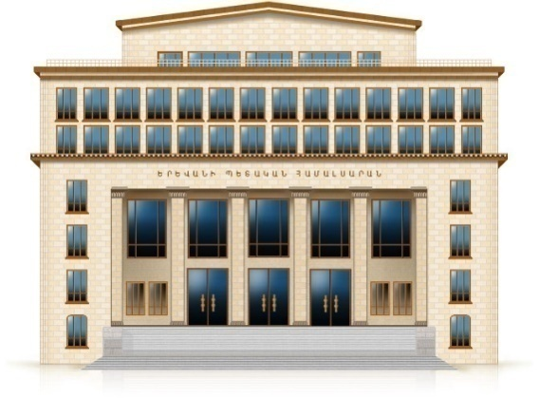
Electromagnetic Casimir densities for a conducting plate
in dS and AdS spacetimes
Kotanjyan Anna, Saharyan Aram, Saharyan Astghik
Yerevan State University, Armenia
CQV16, Centro de Ciencias de Benasque Pedro Pascual, Spain

Slide 2
An interesting topic in the investigations of the Casimir effect is its dependence on the geometry of the background spacetime
Relevant information is encoded in the vacuum fluctuations spectrum and analytic solutions can be found for highly symmetric geometries only
Because of the high symmetry, numerous problems are exactly solvable on dS and AdS bulks and this may shed light on the influence of a classical gravitational field on the quantum matter in more general geometries
Questions of principal nature related to the quantization of fields propagating on curved backgrounds
By taking into account that the models in spatial dimensions other than 3 play an important role in high-energy physics, in particular, in string theories and in supergravity, and in condensed matter physics we assume a general value of the spatial dimension D

Slide 3
Problem under consideration
Outline
We study the changes in the properties of the quantum vacuum induced by the presence of boundaries in the background of (D + 1) - dimensional curved spacetime
The two-point functions of the vector potential and of the field tensor for the electromagnetic field in background of anti-de Sitter (AdS) and de Sitter (dS) spacetimes are evaluated
two-point functions in the boundary-free geometry
in the presence of a reflecting boundary
VEV of the energy-momentum tensor
A.S.K., A.A. Saharian, H.G. Sargsyan, D.H. Simonyan, PoS(MPCS2015)021; A.S.K., A.A. Saharian, H.A. Nersisyan, Phys. Scr. 90 (2015) 065304; A.A. Saharian, A.S.K., H.A. Nersisyan, Physics Letters B 728 (2014) 141; A.S.K., A.A. Saharian, H.A. Nersisyan, (2014) J. Phys.: Conf. Ser. 496, 012027
CQV16, Centro de Ciencias de Benasque Pedro Pascual, Spain

Slide 4
Quantum vacuum
The interaction of a ﬂuctuating quantum ﬁeld with the background gravitational ﬁeld leads to vacuum polarization
The boundary conditions imposed on the ﬁeld give rise to different types of vacuum polarization. They can arise because of the presence of boundaries having various physical natures:
macroscopic bodies in QED
extended topological defects
horizons and branes in higher-dimensional models
Boundary conditions modify the zero-point modes of a quantized ﬁeld and, as a result, forces arise acting on constraining boundaries
The Casimir effect
The particular features of the forces depend on the nature of a quantum field, the type of spacetime manifold, the boundary geometry, and the specific boundary conditions imposed on the field
CQV16, Centro de Ciencias de Benasque Pedro Pascual, Spain

Slide 5
Why AdS? Why de Sitter spacetime?
AdS spacetime generically arises as a ground state in extended supergravity and in string theories
AdS/Conformal Field Theory correspondence relates string theories or supergravity in the bulk of AdS with a Conformal
Field Theory living on its boundary
Braneworld models formulated on AdS bulk
CQV16, Centro de Ciencias de Benasque Pedro Pascual, Spain

Slide 6
Why AdS? Why de Sitter spacetime?
In accordance with the inﬂationary cosmology scenario, in the early stages of the cosmological expansion our Universe passed through a phase in which the geometry is well approximated by dS spacetime, that’s way most inflationary models an approximately dS spacetime is employed to solve a number of problems in standard cosmology
During an inﬂationary epoch, quantum ﬂuctuations in the inﬂaton ﬁeld introduce inhomogeneities which play a central role in the generation of cosmic structures from inﬂation
Recent observations of high redshift supernovae, galaxy clusters and cosmic microwave background have indicated that at the present epoch the Universe is accelerating and can be approximated by a world with a positive cosmological constant
CQV16, Centro de Ciencias de Benasque Pedro Pascual, Spain

Slide 7
Characteristics of the vacuum state
Evaluation scheme
All properties of the quantum vacuum are encoded in two-point functions
Complete set of normalized mode functions for the vector potential
Mode-sum formula for two-point function of vector potential
CQV16, Centro de Ciencias de Benasque Pedro Pascual, Spain

Slide 8
Background geometry: dS spacetime
We consider the change in the properties of the electromagnetic vacuum induced by the presence of a perfectly conducting plate in the background of (D + 1)-dimensional dS spacetime
dS spacetime is described by the line element in the inflationary coordinates:
conformal time defined as
In terms of this coordinate the metric tensor takes a conformally flat form:
CQV16, Centro de Ciencias de Benasque Pedro Pascual, Spain

Slide 9
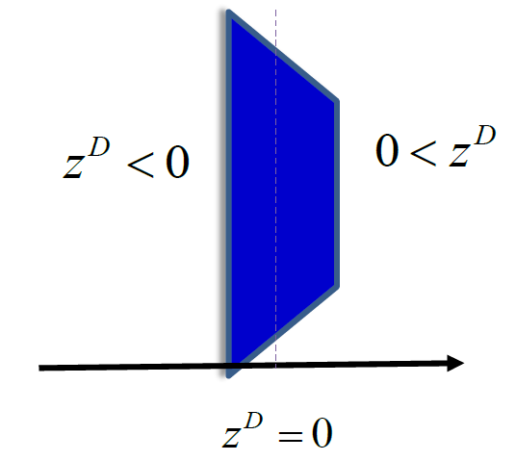
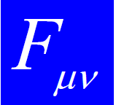
Geometry with a conducting plate
Perfectly conducting plate placed at
Boundary condition
the tensor
dual to
is the normal to the plate
In the presence of the plate, due to the imposition of perfect conductor boundary condition two regions are causally independent
CQV16, Centro de Ciencias de Benasque Pedro Pascual, Spain

Slide 10
Mode functions
The action for electromagnetic fields in (D+1)-dimensional spacetime
Imposing the gauge conditions
The principle of least action
Different solutions of equation correspond to different vacuum states
We assume that the field is prepared in dS invariant Bunch-Davies vacuum state which is the only dS invariant vacuum state with the same short-distance structure as the Minkowksi vacuum
CQV16, Centro de Ciencias de Benasque Pedro Pascual, Spain

Slide 11
Mode functions
The corresponding mode-functions for the vector potential
correspond to different polarizations
The polarization vectors obey the relations
CQV16, Centro de Ciencias de Benasque Pedro Pascual, Spain

Slide 12
Plate induced parts in two-point functions
Two-point functions are presented in the decomposed form
perfectly conducting plate
is the image of
with respect to the plate
CQV16, Centro de Ciencias de Benasque Pedro Pascual, Spain

Slide 13
Plate induced parts in two-point functions
Two-point functions are presented in the decomposed form
For points away from the boundary the divergences are the same as for the dS spacetime without boundary
The renormalization of the VEVs is reduced to the renormalization of the part corresponding to the geometry without boundary
VEVs of the characteristics of vacuum state decomposed into the boundary-free and plate-induced parts. We have explicitly extracted the boundary induced part
CQV16, Centro de Ciencias de Benasque Pedro Pascual, Spain

Slide 14
Energy-momentum tensor
In addition to describing the local structure of the vacuum state, VEV of the energy-momentum tensor acts as the source of gravity in the quasi classical Einstein’s equations and plays an important role in modelling self-consistent dynamics involving the gravitational field.
VEV of the energy-momentum tensor is decomposed into the boundary-free and plate-induced parts:
For points outside the plate the renormalization is required for the boundary-free part only. Because of the maximal symmetry of the background geometry, the latter is proportional to the metric tensor:
CQV16, Centro de Ciencias de Benasque Pedro Pascual, Spain

Slide 15
Plate-induced energy-momentum tensor
For the VEVs of the diagonal components one finds (no summation over l = 1, . . . ,D − 1)
Off-diagonal component
corresponds to the energy flux along the direction normal to the plate
CQV16, Centro de Ciencias de Benasque Pedro Pascual, Spain

Slide 16
General features
The VEV of the energy-momentum tensor depends on the coordinates and in the combination
proper distance from the plate measured in units of dS curvature radius
This is a consequence of the maximal symmetry of the background spacetime and of the Bunch-Davies vacuum state
For D = 3 we can see that . This result is a direct consequence of the conformal invariance of the electromagnetic field in D = 3
CQV16, Centro de Ciencias de Benasque Pedro Pascual, Spain

Slide 17
Asymptotics
At small distances (compared with the de Sitter curvature scale)
At large distances
for D = 4 one has the stresses are
CQV16, Centro de Ciencias de Benasque Pedro Pascual, Spain

Slide 18
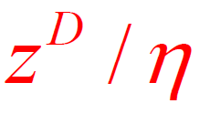
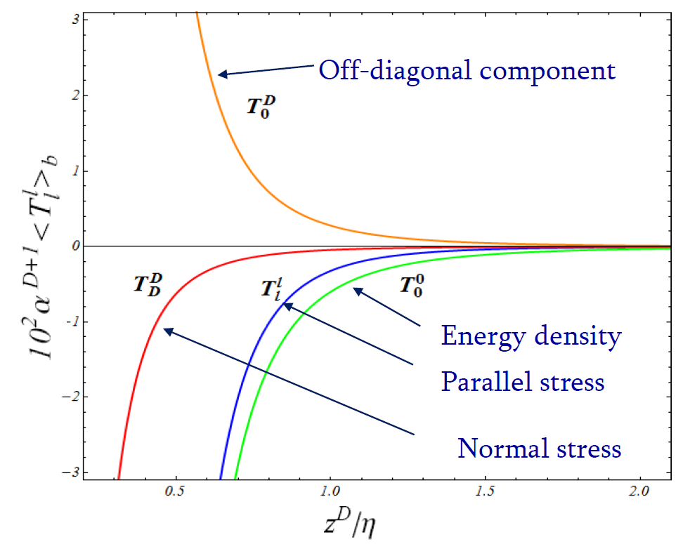
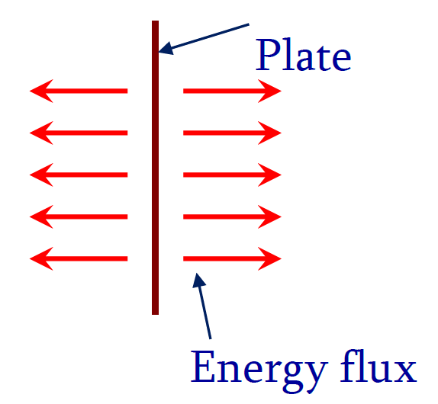
Numerical results
Plate-induced parts in the components of the vacuum energy-momentum tensor as functions of (proper distance from the plate measured in units of dS curvature radius)
Diagonal components are negative, whereas the off-diagonal component corresponding to the energy flux is positive
Energy flux is directed from the plate
CQV16, Centro de Ciencias de Benasque Pedro Pascual, Spain

Slide 19
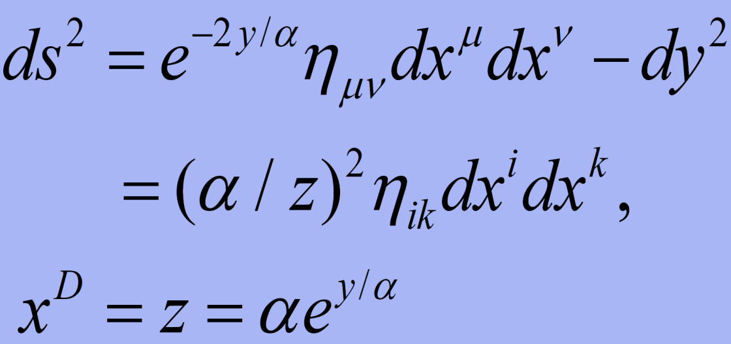
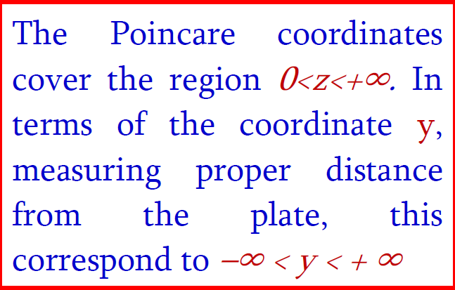
Background geometry: AdS spacetime
We consider the changes in the properties of the electromagnetic vacuum induced by the presence of a perfectly conducting plate in the background of (D + 1) - dimensional AdS spacetime.
AdS spacetime is described by the line element:
the metric for the Minkowski spacetime
by making a coordinate transformation the metric tensor takes a conformally flat form
Here and below i,k=0,1,...,D, and μ,ν=0,1,...,D-1
CQV16, Centro de Ciencias de Benasque Pedro Pascual, Spain

Slide 20
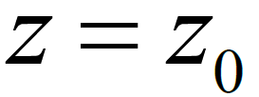
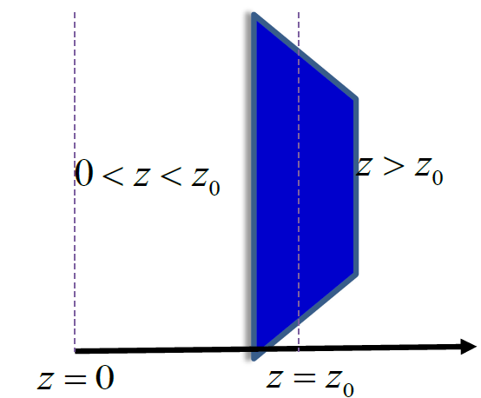
Boundary geometry: AdS spacetime
Perfectly conducting plate placed at
Boundary condition
the tensor
dual to
is the normal to the plate
Gauge conditions
We suppose, that A_{D} is the component of the vector potential in direction y, D-th spatial coordinate.
CQV16, Centro de Ciencias de Benasque Pedro Pascual, Spain

Slide 21
Electromagnetic modes
First we consider the region
From the boundary condition it follows that
CQV16, Centro de Ciencias de Benasque Pedro Pascual, Spain

Slide 22
Two-point functions
Complete set of normalized mode functions for the vector potential
For points away from the boundary the divergences are the same as for the AdS spacetime without boundary
The renormalization of the VEVs is reduced to the renormalization of the part corresponding to the geometry without boundary
VEVs of the characteristics of vacuum state decomposed into the boundary-free and plate-induced parts. We have explicitly extracted the boundary induced part
CQV16, Centro de Ciencias de Benasque Pedro Pascual, Spain

Slide 23
Plate-induced energy-momentum tensor
For the boundary-induced contributions in the VEVs of the diagonal components one gets (no summation over l)
We could expect this result from the conformal relation to the corresponding problem in Minkowski bulk.
The boundary-induced contribution in the VEV of the energy-momentum tensor for the region 0 < z < z0 is obtained by the replacements In ⇄Kn .
CQV16, Centro de Ciencias de Benasque Pedro Pascual, Spain

Slide 24
Plate-induced energy-momentum tensor
CQV16, Centro de Ciencias de Benasque Pedro Pascual, Spain

Slide 25
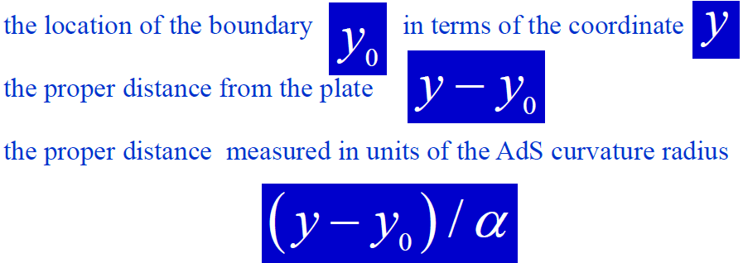
Plate-induced energy-momentum tensor: AdS
Boundary-induced parts depend on the distance from the plate in the form
The VEVs depend on the distance from the plate only and not on the absolute location of the boundary.
The latter property is a consequence of the maximal symmetry of AdS spacetime.
CQV16, Centro de Ciencias de Benasque Pedro Pascual, Spain

Slide 26
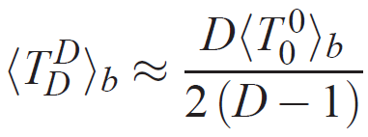
Asymptotics: AdS
The proper distance from the plate is much larger than the curvature radius of AdS spacetime.
At large distances the VEVs are suppressed exponentially as functions of the proper distance.
CQV16, Centro de Ciencias de Benasque Pedro Pascual, Spain

Slide 27
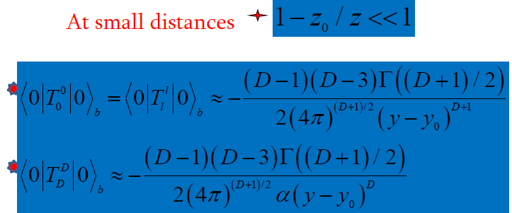
Asymptotics: AdS
For the energy density and parallel stresses the leading terms do not depend on the curvature radius α and coincide with the corresponding asymptotic for the plate in Minkowski spacetime.
Hence, near the plate the effects of gravity on the energy density and parallel stresses are small.
CQV16, Centro de Ciencias de Benasque Pedro Pascual, Spain

Slide 28
Asymptotics near the AdS boundary
CQV16, Centro de Ciencias de Benasque Pedro Pascual, Spain

Slide 29
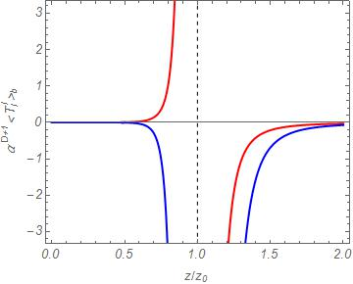
Numerical results: AdS
Normal stress
Energy density
Parallel stresses
Because of surface divergences, for the evaluation of the Casimir force additional renormalization is required
Proper distance from the plate measured in units of AdS curvature radius
CQV16, Centro de Ciencias de Benasque Pedro Pascual, Spain

Slide 30
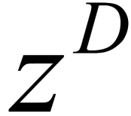
Conclusions
Behavior of boundary induced VEVs of energy momentum tensor at large distances from the plate is essentially different for dS and AdS bulks.
The appearance of off diagonal component in the dS case is related to the dependence on time and coordinates.
In AdS case the only dependence is on

