Slide 1
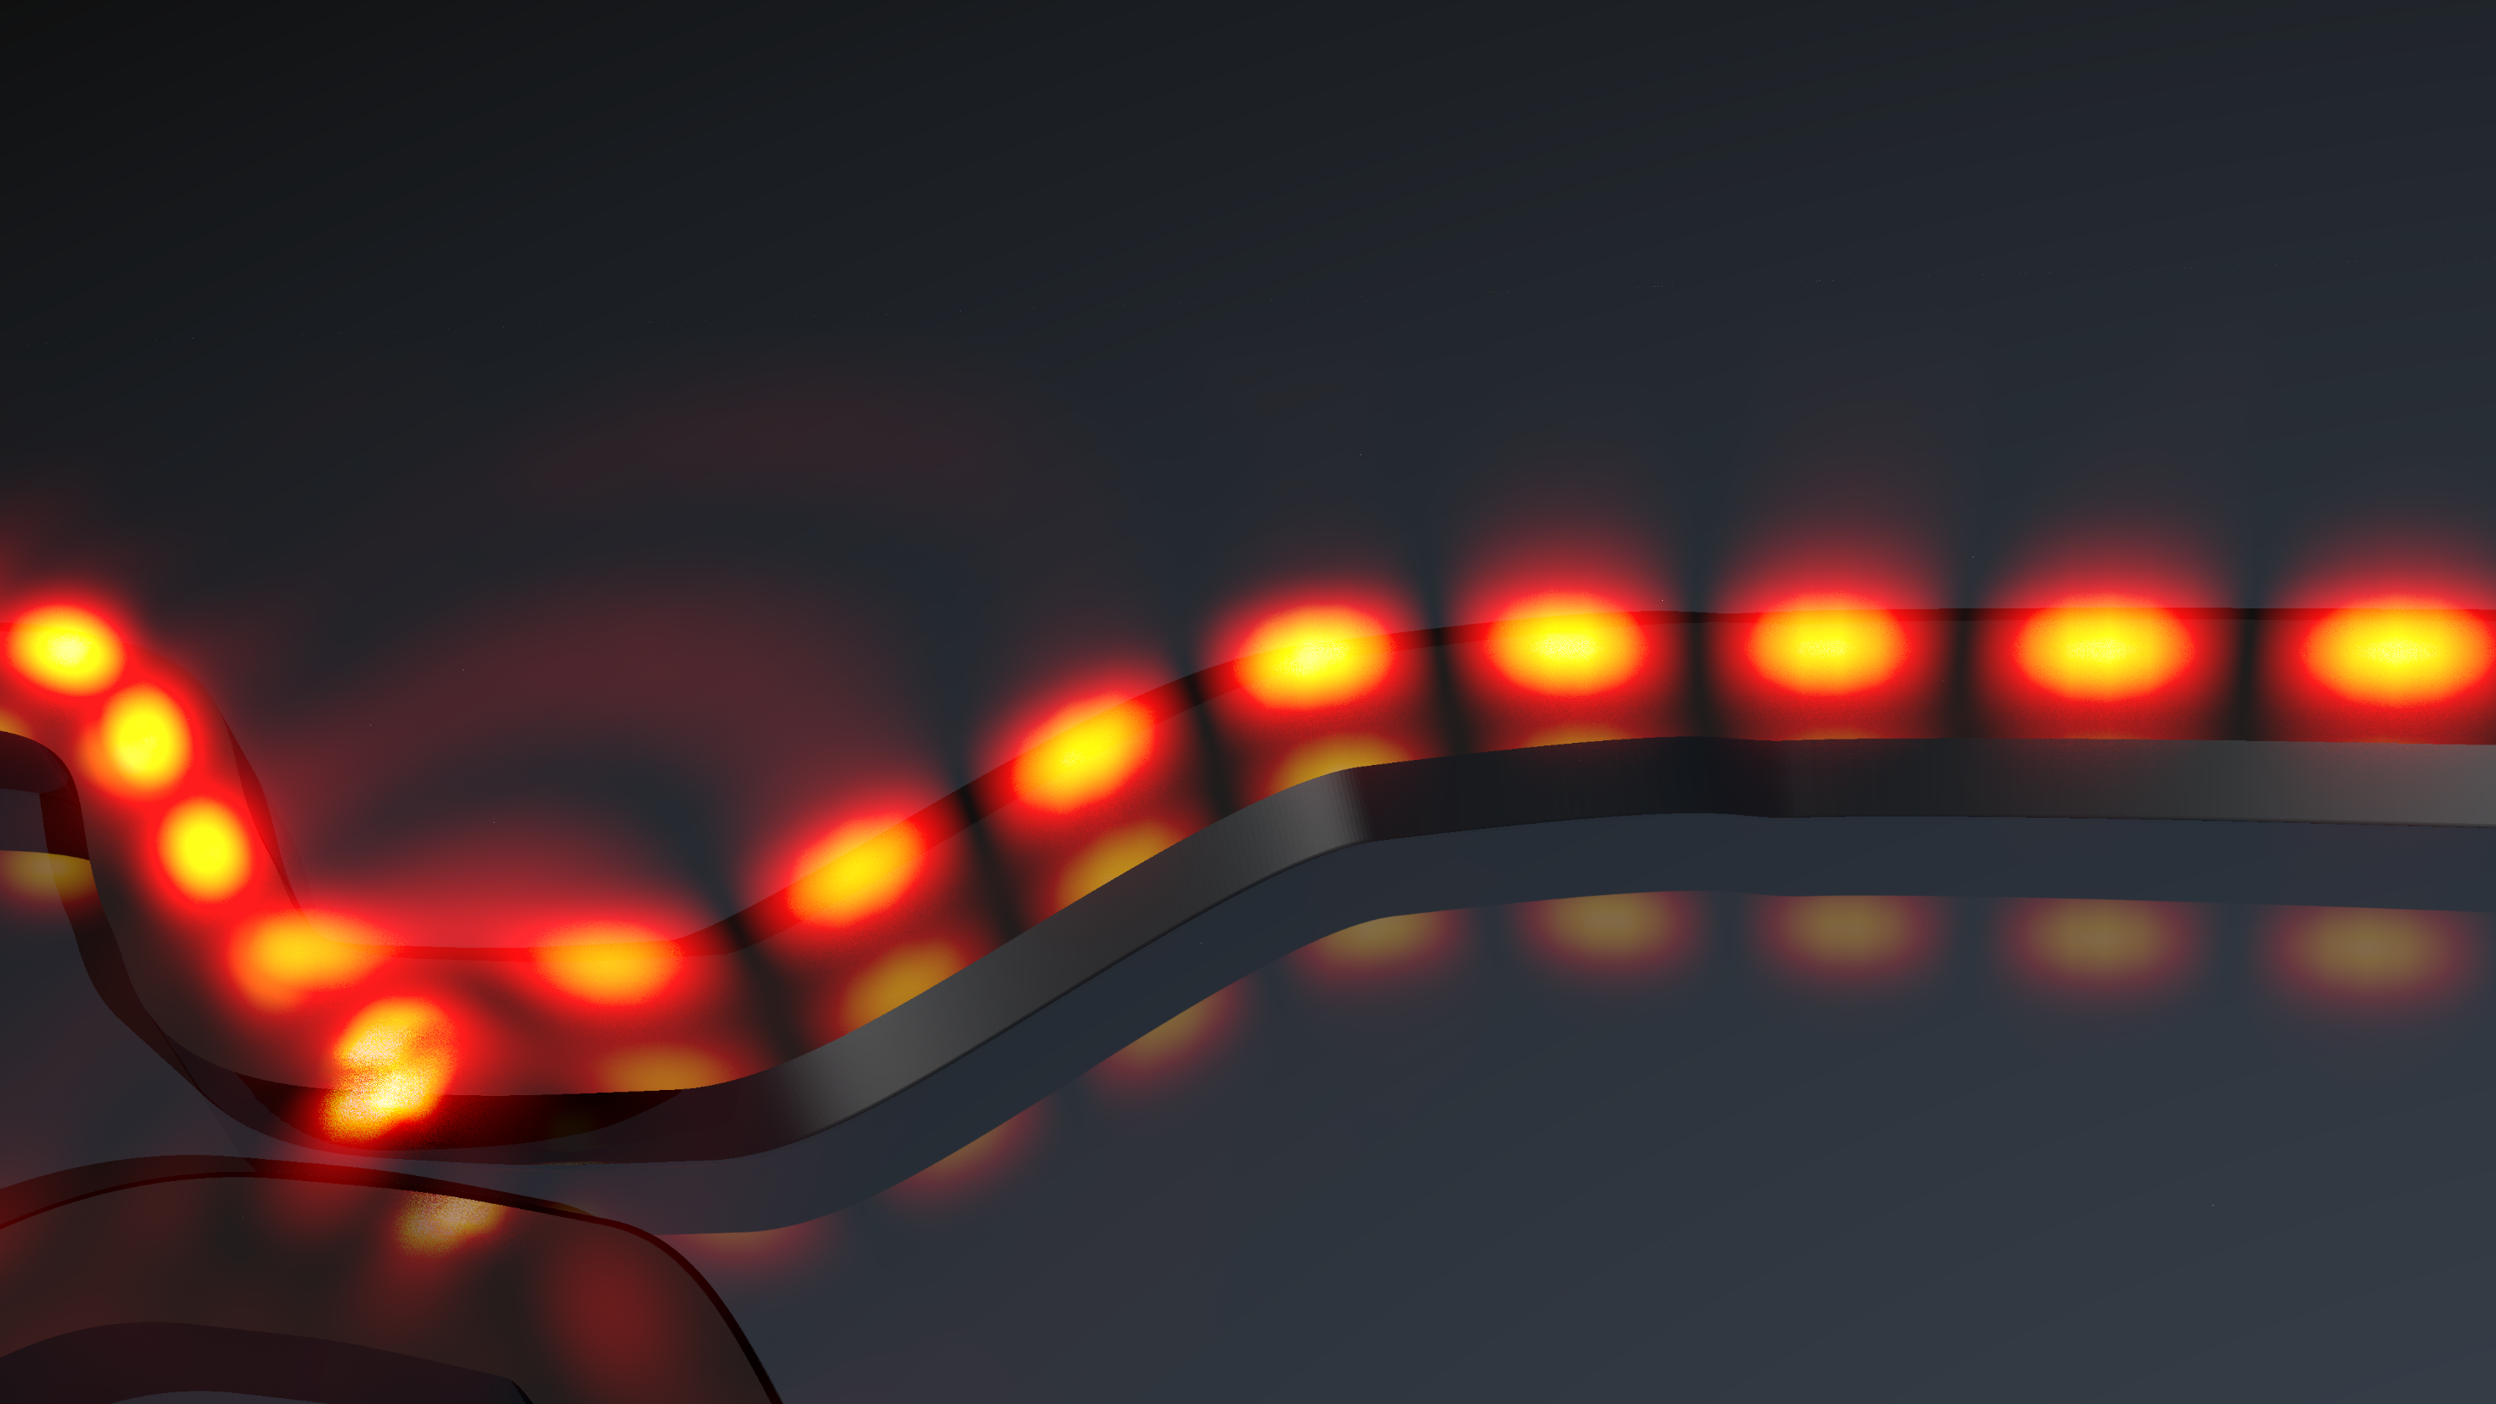



Janus and Huygens’ dipoles: novel sources for near-field directionality
Michela Florinda Picardi
Nanolight - 12th Mar 2018

Slide 2
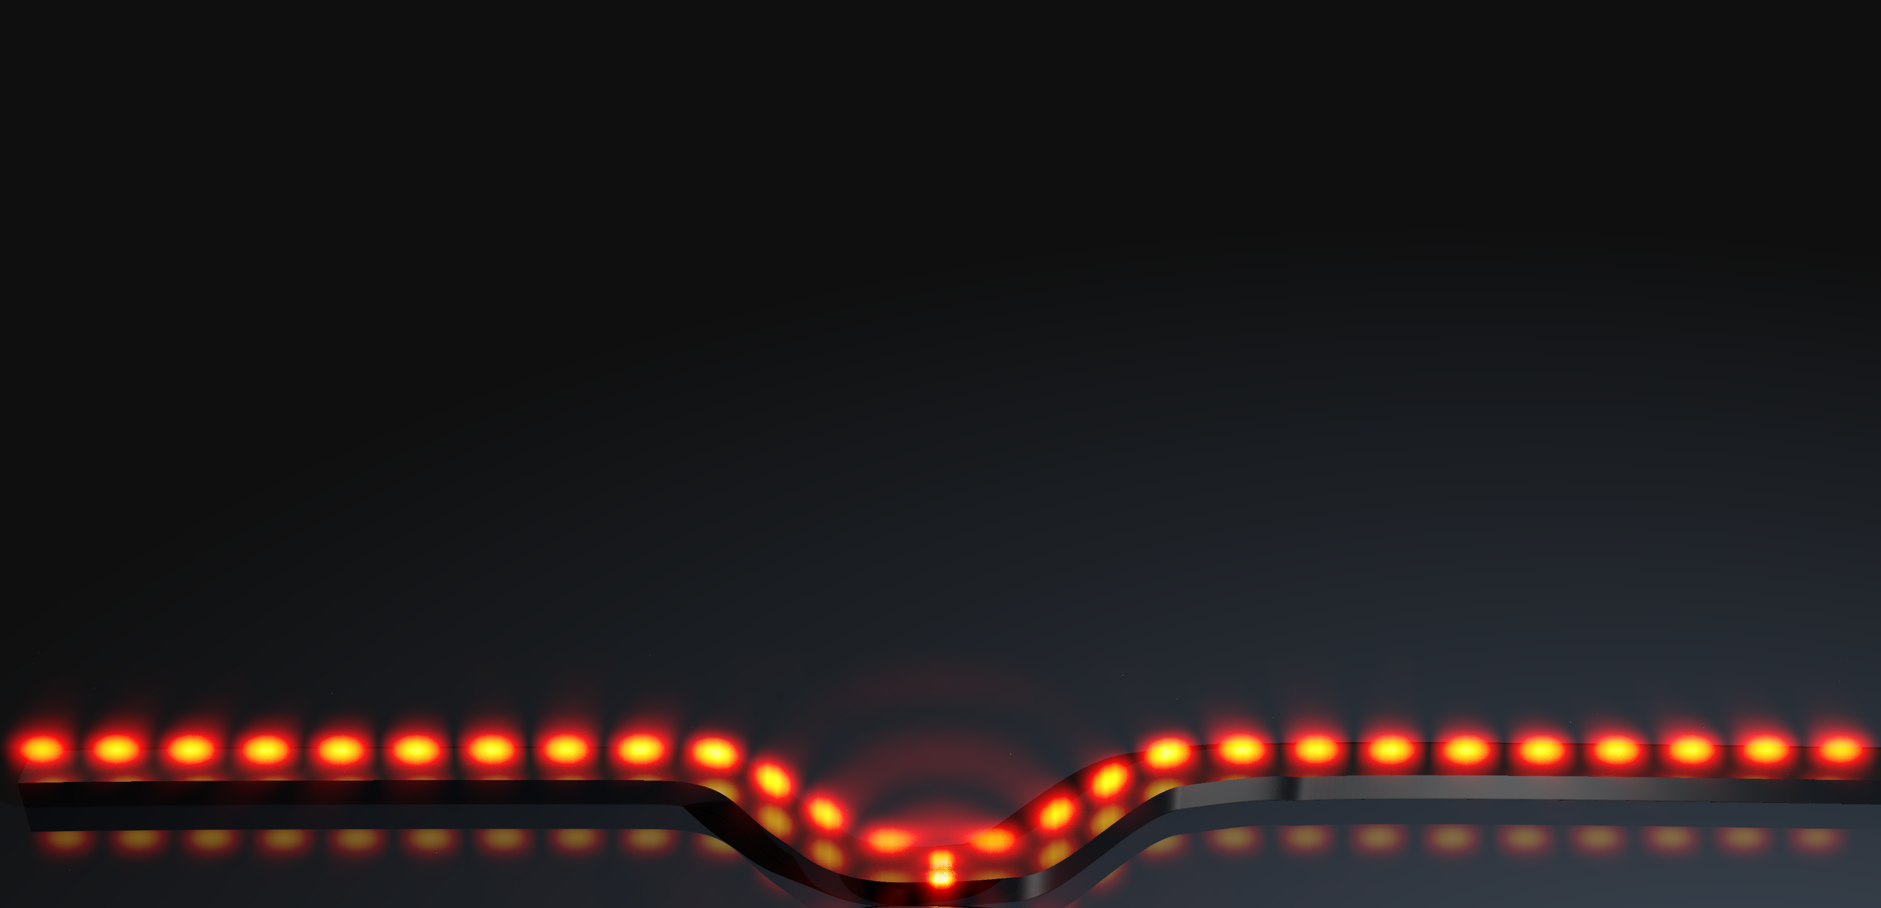
Outline:
Near-field coupling: angular spectra of sources and waveguides
  Mode-matching
Controlling near-field coupling
  Unidirectionality
  Circular, Huygens’ and Janus dipoles
  More and more modes

Slide 3
Why?
Controlling light’s propagation exploiting light

Slide 4
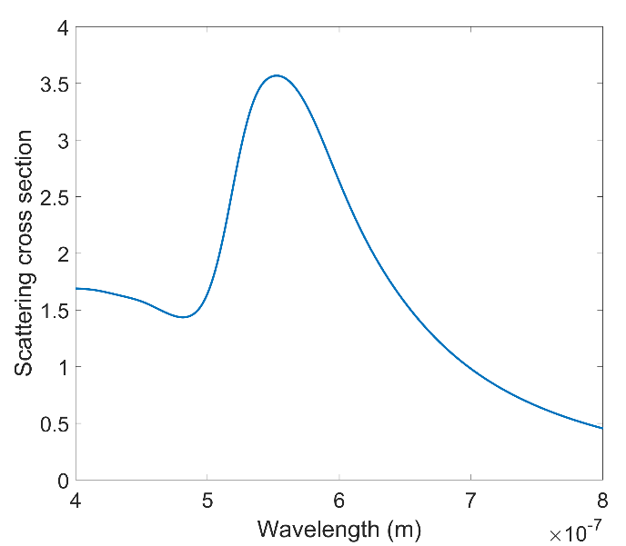
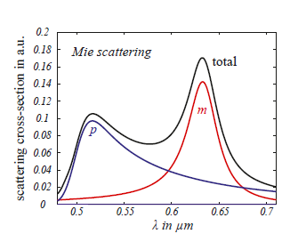
Electric and magnetic dipoles
Metallic nanoparticles:
Electric dipoles
Dielectric nanoparticles:
Electric and magnetic dipoles
p
Credits F. Lotti
Credits M. Neugebauer

Slide 5


The angular spectrum
The electric field generated by a superposition of electric and magnetic dipoles can be written as:
$$E\left(x,y,z\right)= \iint{{\left[E\left(k_{x},k_{y}\right)\right] e}^{i(k_{x}x+k_{y}y+k_{z}\left|z−z_{0}\right|)}{dk}_{x}{dk}_{y}}$$
${ E}^{ED}$+ ${ E}^{MD}$
Amplitudes of the field for each (k_{x},k_{y})
Novotny – Principles of Nano-Optics

Slide 6

Mode-matching
k₄
k₁₀
k₁₂
k₃
The source
k₅
The waveguide
k₆
k₉
k₇
k₂
k₂
k₁
k₈
k₂

Slide 7
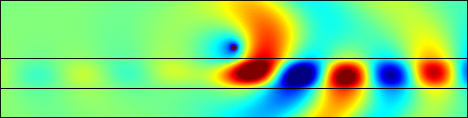
Single mode waveguide
-k₁
+k₁
+k₄
-k₃
The source
+k₂
+k₁
-k₁

Slide 8



The angular spectrum
$$E\left(x,y,z\right)= \iint{{\left[{ E}^{ED}\left(k_{x},k_{y}\right)+{ E}^{MD}\left(k_{x},k_{y}\right)\right] e}^{i(k_{x}x+k_{y}y+k_{z}\left|z−z_{0}\right|)}{dk}_{x}{dk}_{y}}$$
Can be written in terms of the 6 dipole components
$${F(p}_{x}, p_{y}, p_{z},m_{x}, m_{y}, m_{z})$$
$$=0$$
For a given (k_{x},k_{y})
Picardi et. al – Phys. Rev. B 95 (2017)
Picardi et. al – Phys. Rev. Lett. (March 2018)

Slide 9
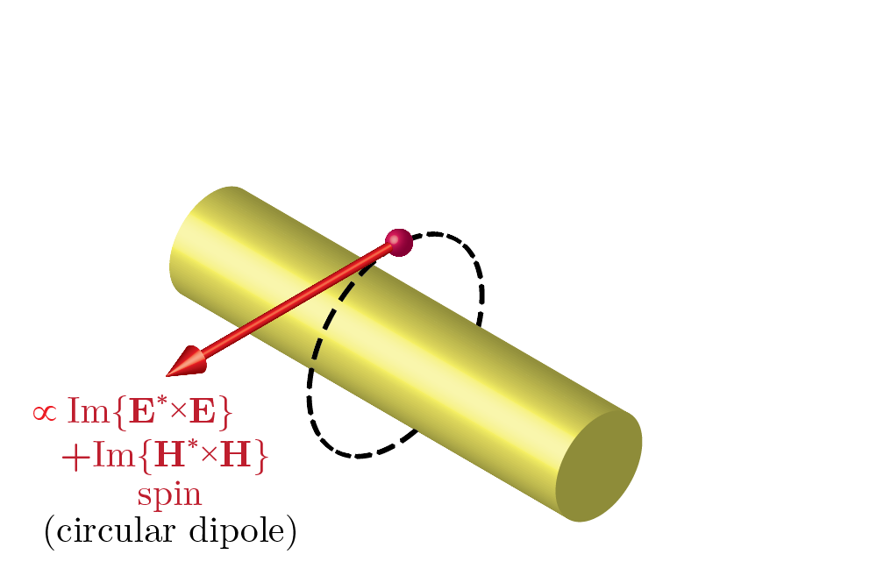
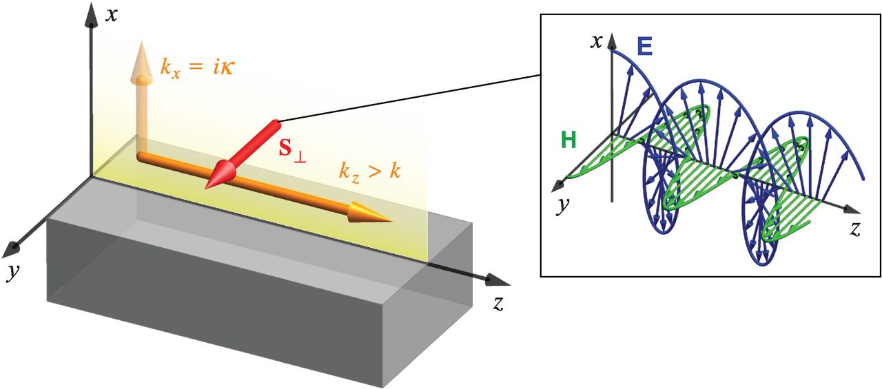



$$E_{x}, H_{y}, E_{z}$$
$$E_{x}, H_{y}, E_{z}$$
$$k$$
Bliokh et. al – Science 348 (2015)

Slide 10
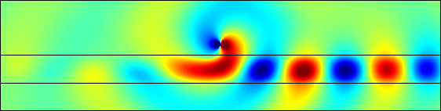
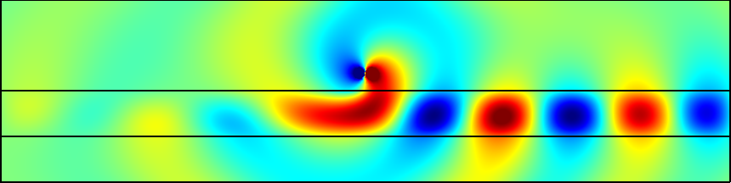
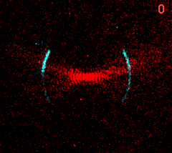


i
i
$$E_{x}, H_{y}, E_{z}$$
1
1
$$k$$
$$k$$
O’ Connor et. al – Nat. Comm. (2014)
Rodríguez-Fortuño et. al – Science 340 (2013)

Slide 11
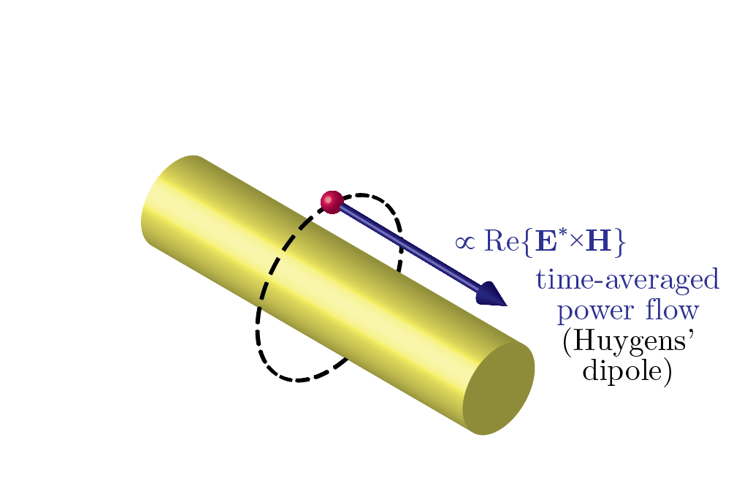
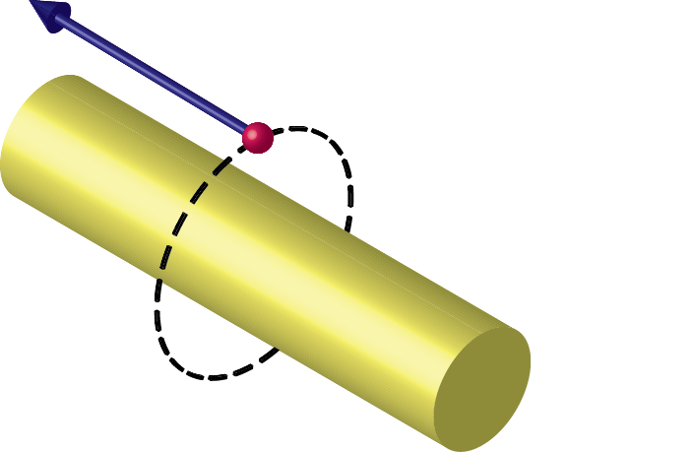

i
$$E_{x}, H_{y}, E_{z}$$
$$E_{x}, H_{y}, E_{z}$$
1
$$k$$
1
c
c
1
$$k$$
Rodríguez-Fortuño et. al – Science 340 (2013)
Picardi et. al – Phys. Rev. Lett. (March 2018)

Slide 12
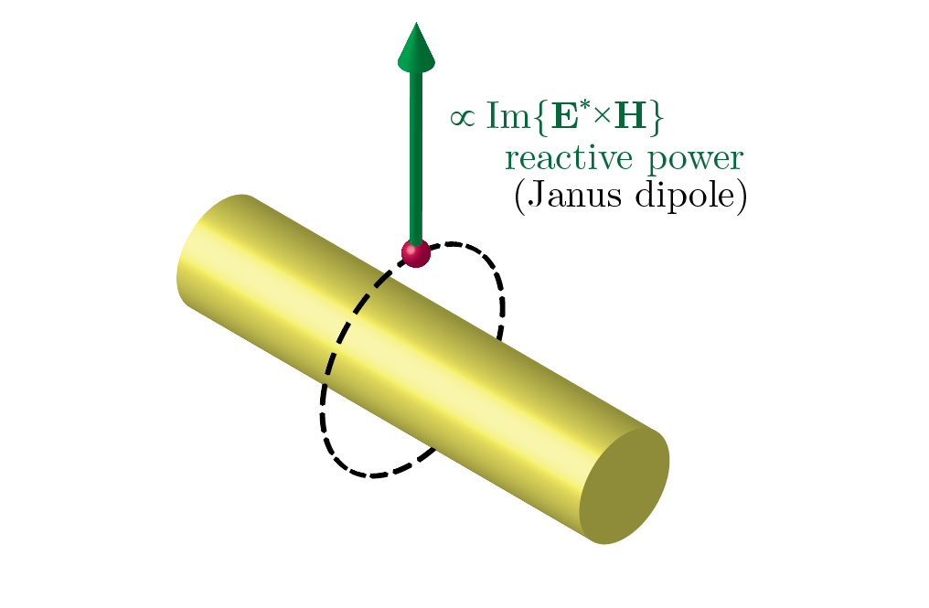
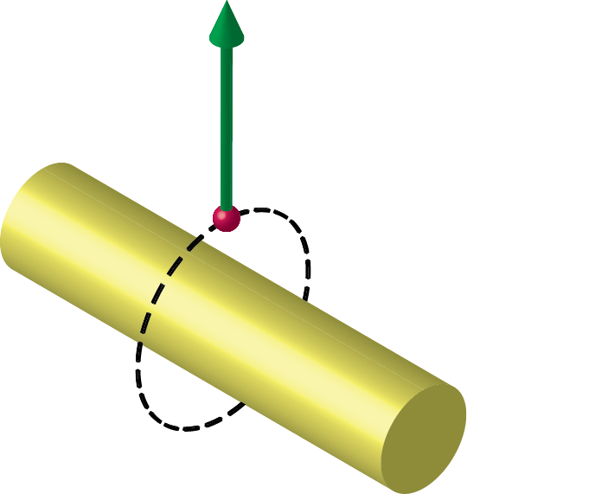
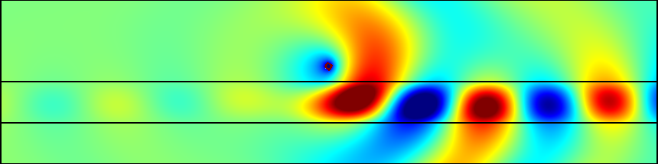
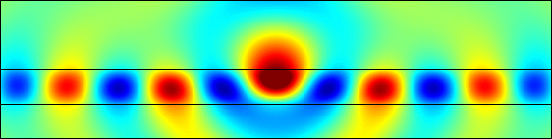
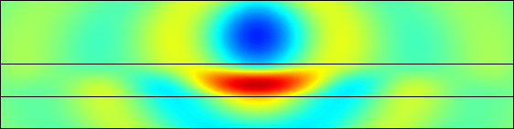


i
$$E_{x}, H_{y}, E_{z}$$
1
$$E_{x}, H_{y}, E_{z}$$
$$E_{x}, H_{y}, E_{z}$$
$$k$$
1
c
$$k$$
1
1
ic
ic
Picardi et. al – Phys. Rev. Lett. (March 2018)

Slide 13
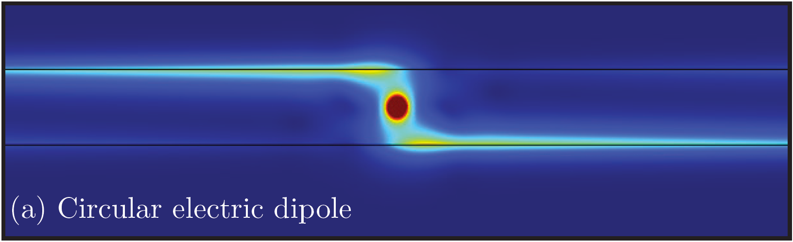
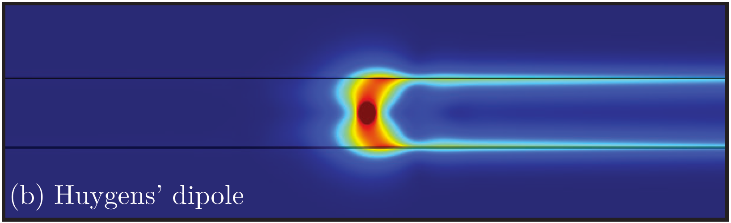
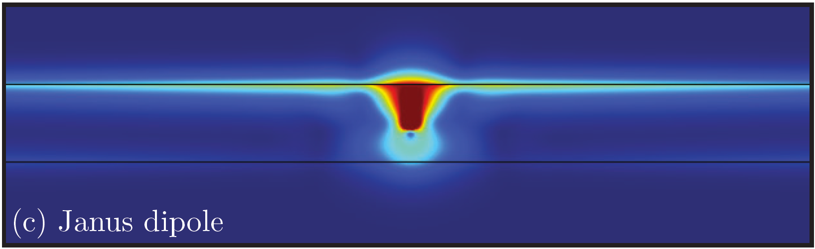

i
1
i
1
i
1
1
c
c
1
ic
1
1
ic
Picardi et. al – Phys. Rev. Lett. (March 2018)

Slide 14
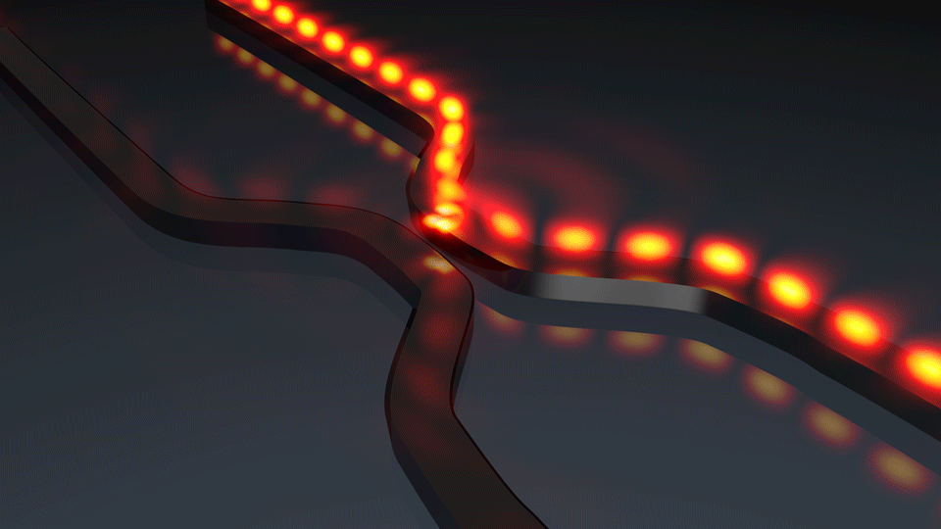
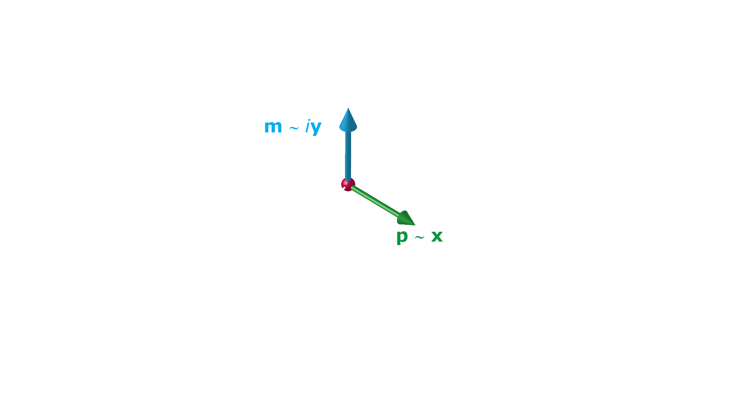
Picardi et. al – Phys. Rev. Lett. (March 2018)

Slide 15

2 modes waveguide
-k₁, -k₂
+k₁, +k₂
Manuscript in preparation

Slide 17



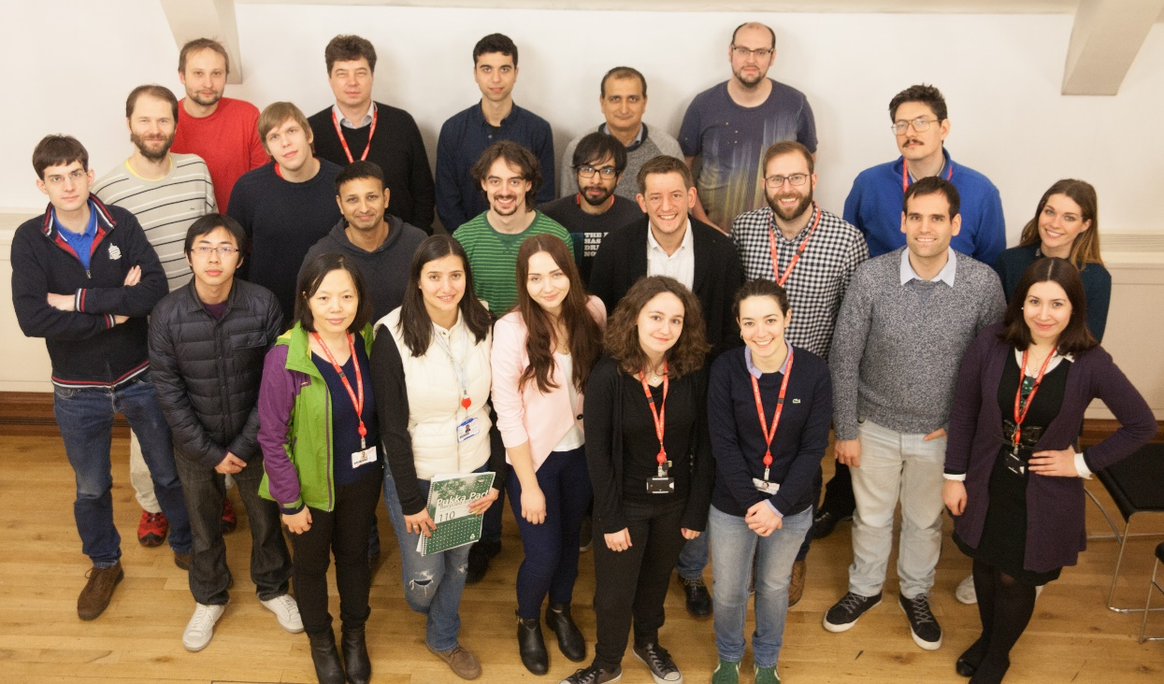
Thank you for your attention
Dr. Francísco Rodriguez-Fortuño
Dr. Lei Wei
Jack Kingsley-Smith
Prof. Anatoly V. Zayats

