Slide 1
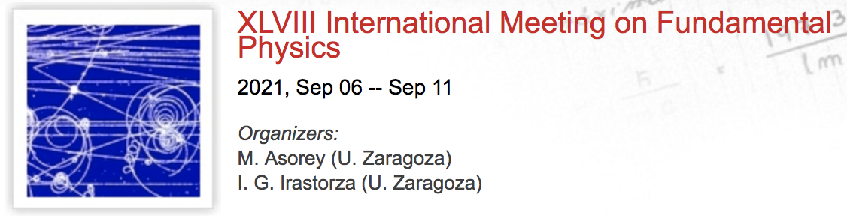


Cosmic rays and gamma rays
J. Cortina (CIEMAT)
International meeting on fundamental physics, Benasque 2021

Slide 2
Outlook
No IMFP last year -> cover relevant news in the last ~2 years.
This is about the timing of the “International Cosmic Ray Conference”: ICRC 2021, last July.
Main focus on results of running experiments.
Let me start with Cosmic Rays and then shift to Gamma Rays.
I’ll try not to overlap with G. Sigl, so I’ll skip UHECRs.

Slide 3
COSMIC RAYS, UP TO 1 TeV
TYPICALLY FROM SPACE

Slide 4
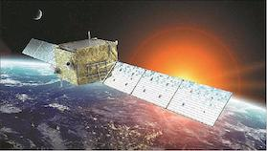
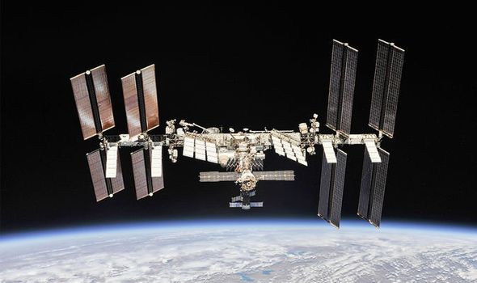
Major detectors
DAMPE (China), standalone satellite,
2015--, >5 GeV, ~1 m² area
AMS (US, Spain, Italy, France…..)
2011--, >1 GeV, ~1 m² area
ISS-CREAM (US, Korea, France, Mexico)
2017-2019, >1 TeV, ~1 m² area
CALET (Japan, US, Italy)
2015--, >1 GeV, ~0.25 m² area

Slide 5
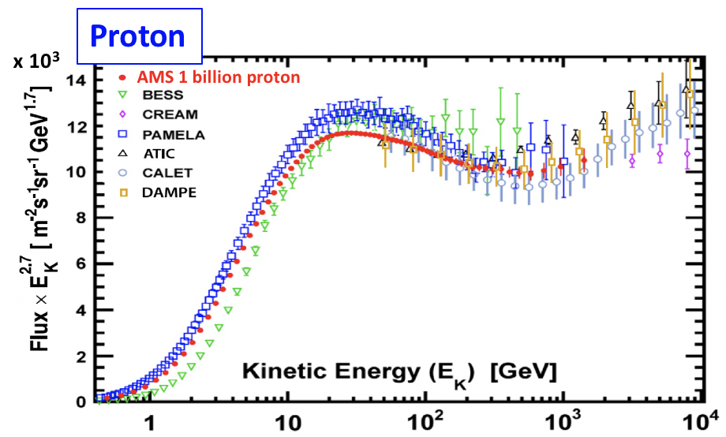
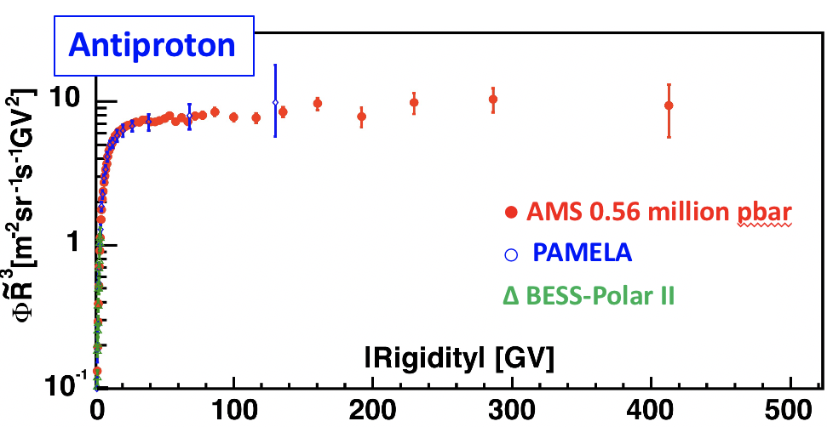
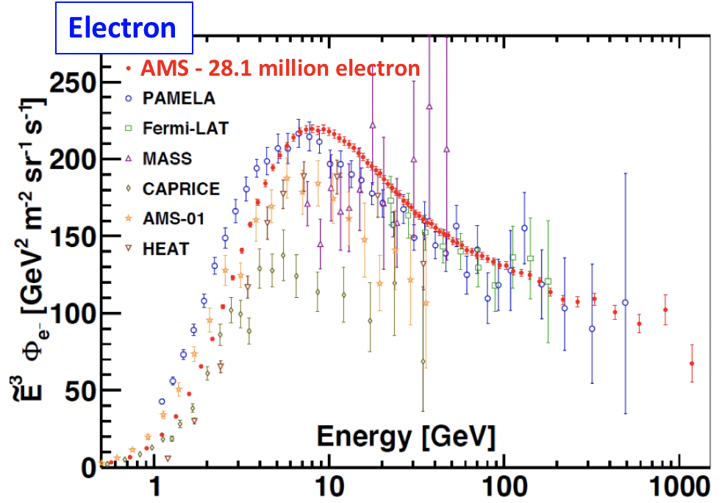
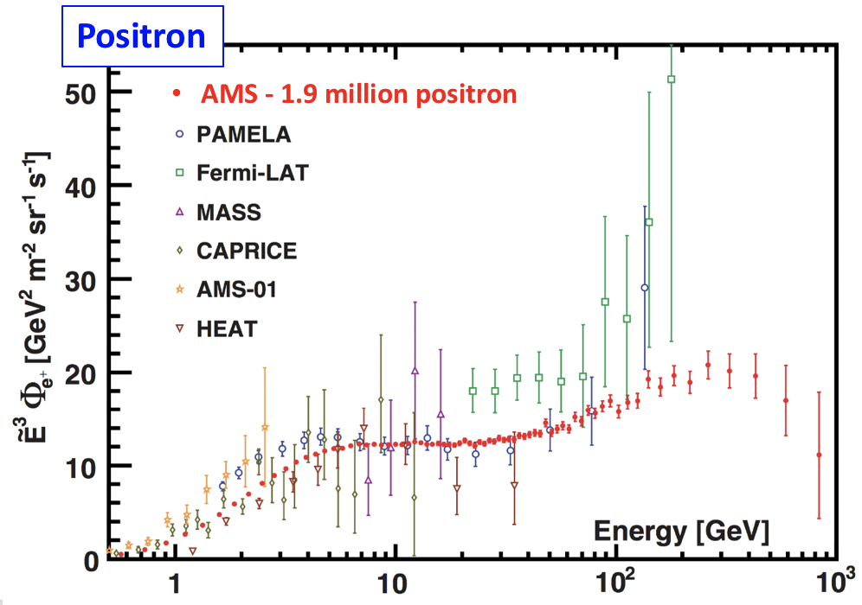
protons, antiprotons, e⁻, e⁺
Phys. Rep. 894 (2021) 1-116
Notes:
Sheer number, linear scale so small features

Slide 6
Positrons
Positron flux shows an excess above 10 GeV that is not consistent with
the sole secondary production of positrons.
AMS 1.9 million positrons
Model based on positrons from cosmic ray collisions.
Astrophysical Journal 729, 106 (2011)
Cosmic ray collisions
Requires primary source
with a particle physics or an astrophysical origin.

Slide 7
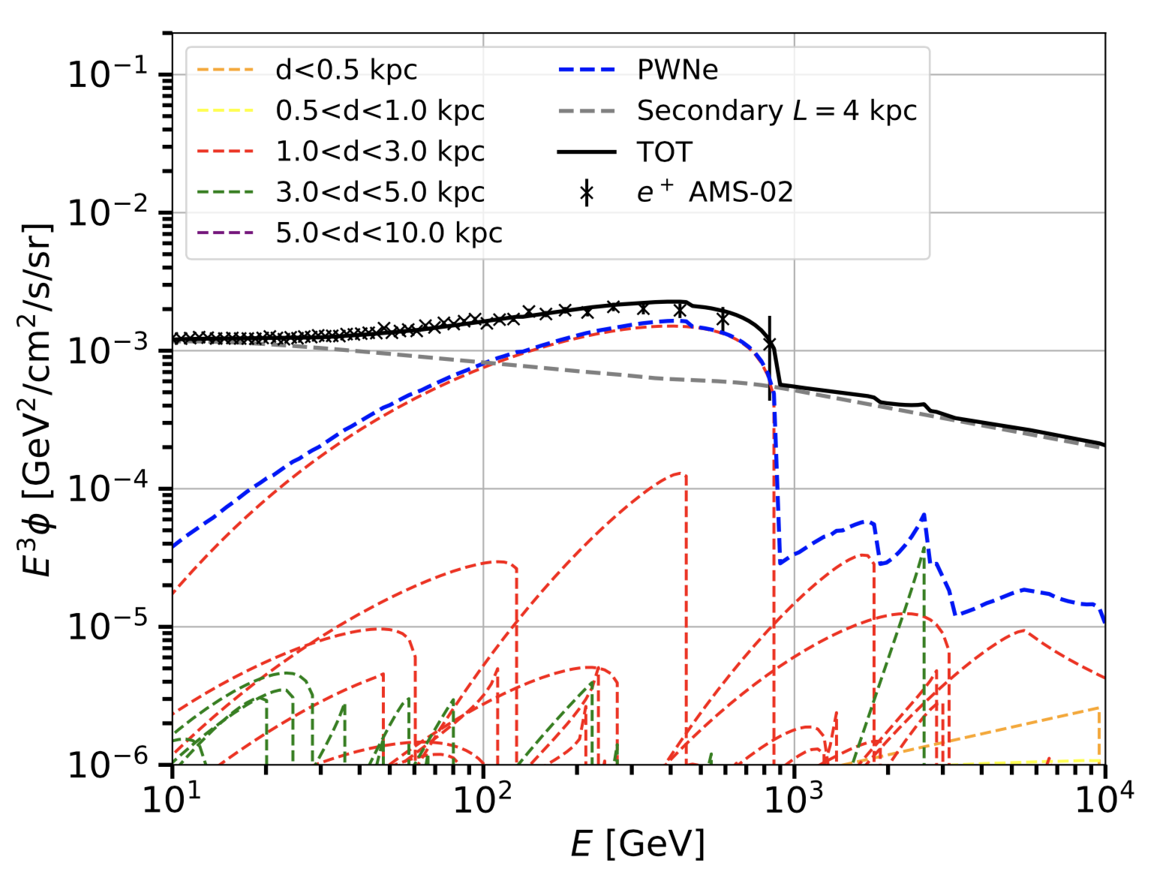
What is that second source of positrons?
“Conventional astrophysics”:
  Pulsar Wind Nebulae
    Probably the most popular.
    Recently discovered TeV halos
  Just one nearby source (Vela?, unknown SNR?)
  Old SNRs…
Some troubles:
  Antiproton spectrum is amazingly similar in slope to positron spectrum, but PWN should not produce antiprotons.
    But antiprotons could still be fully secondary products…
  One would expect to observe some anisotropy in positrons. AMS observes none (Molero ICRC).
    But expected anisotropy may be too small… Need more statistics!
Orusa, ICRC 2021
PWN at different distances

Slide 8
What is that second source of positrons?
Or it could be the product of dark matter annihilation…

Slide 9
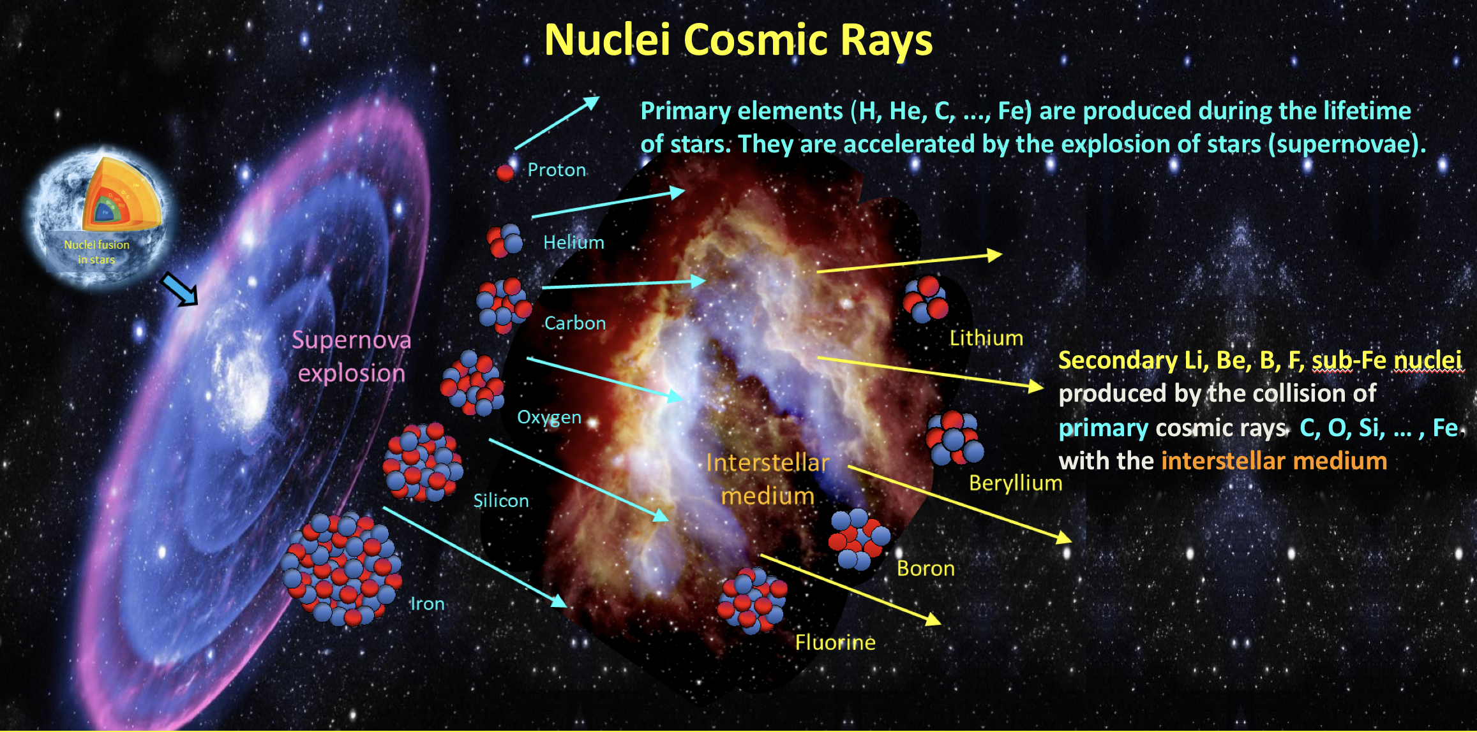
CR secondaries
Credit: AMS

Slide 10
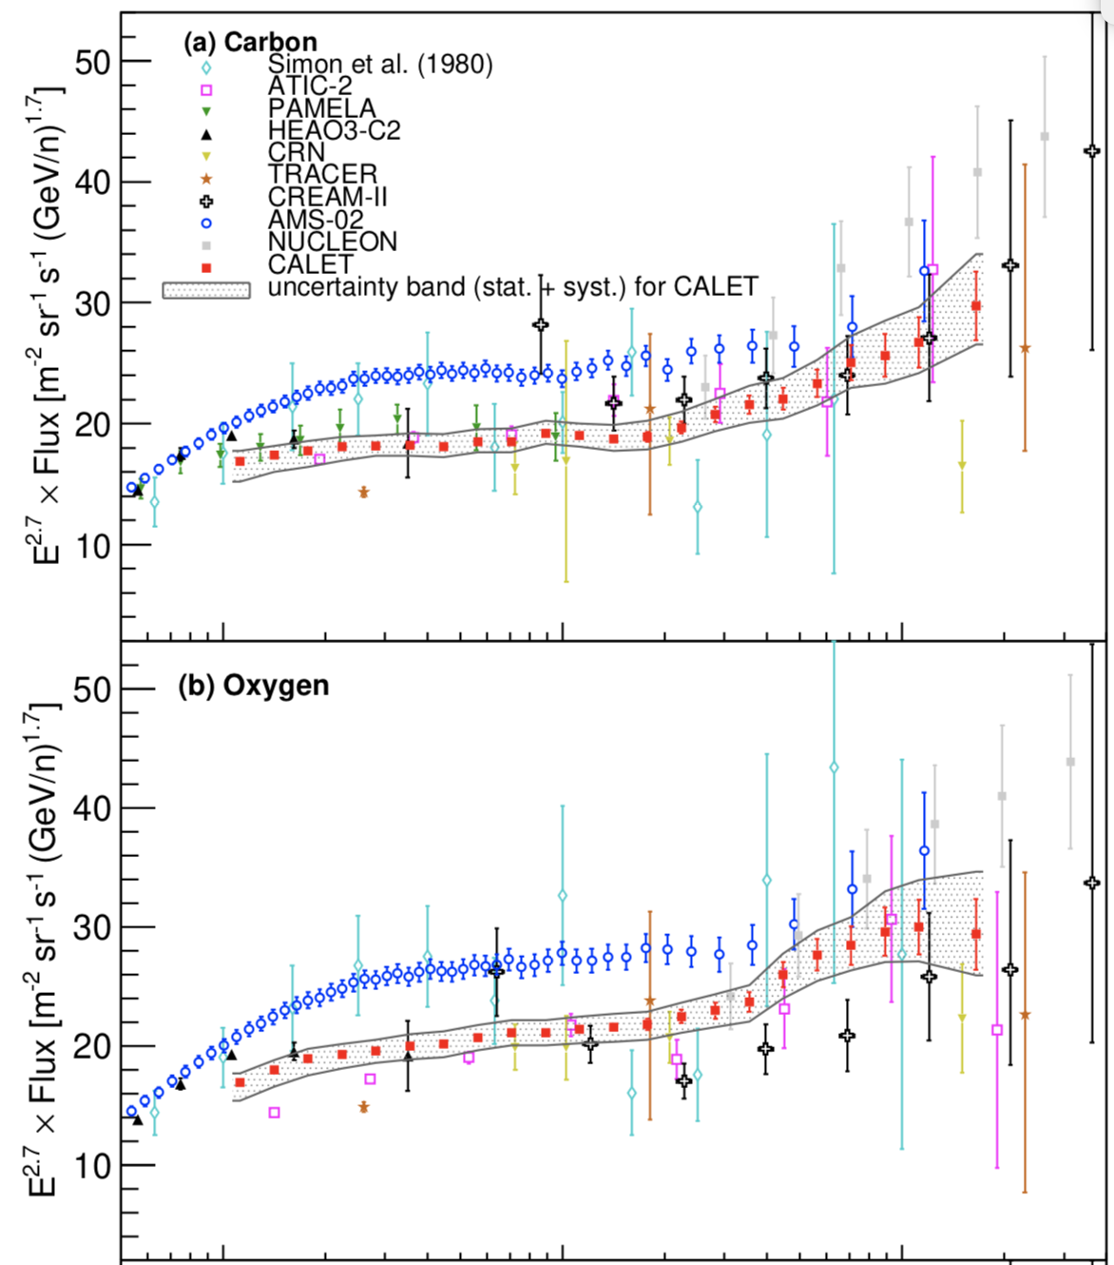
Unprecedented wealth of data
Data are there but they are always local data.
Not so easy to extract information about the sources:
  Composition at the source depends on local reservoir of elements, dust and ISM.
  CR propagate. Diffusion may be inhomogeneous (TeV halos again), depend on energy or be anisotropic (galactic magnetic lines).
Maestro, ICRC 2021

Slide 11
Unprecedented wealth of data
Same as for positrons: could two population of sources contribute to the proton spectrum?

Slide 12
GAMMA RAYS, TECHNIQUE
From space and from the ground

Slide 13
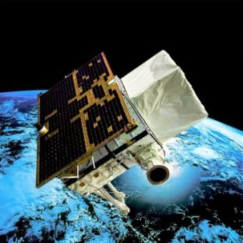
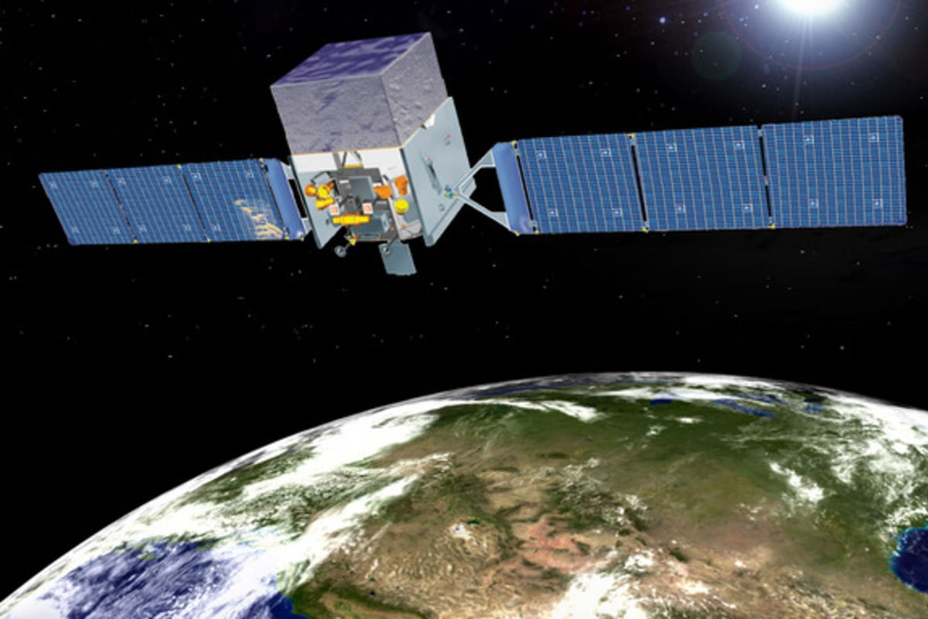
From space
Agile (Italy…..)
2007--, >30 MeV, 3 srad, ~0.5 m² area
Fermi-LAT (US, France, Italy…..)
2008--, >20 MeV, 2 srad, ~1 m² area

Slide 14
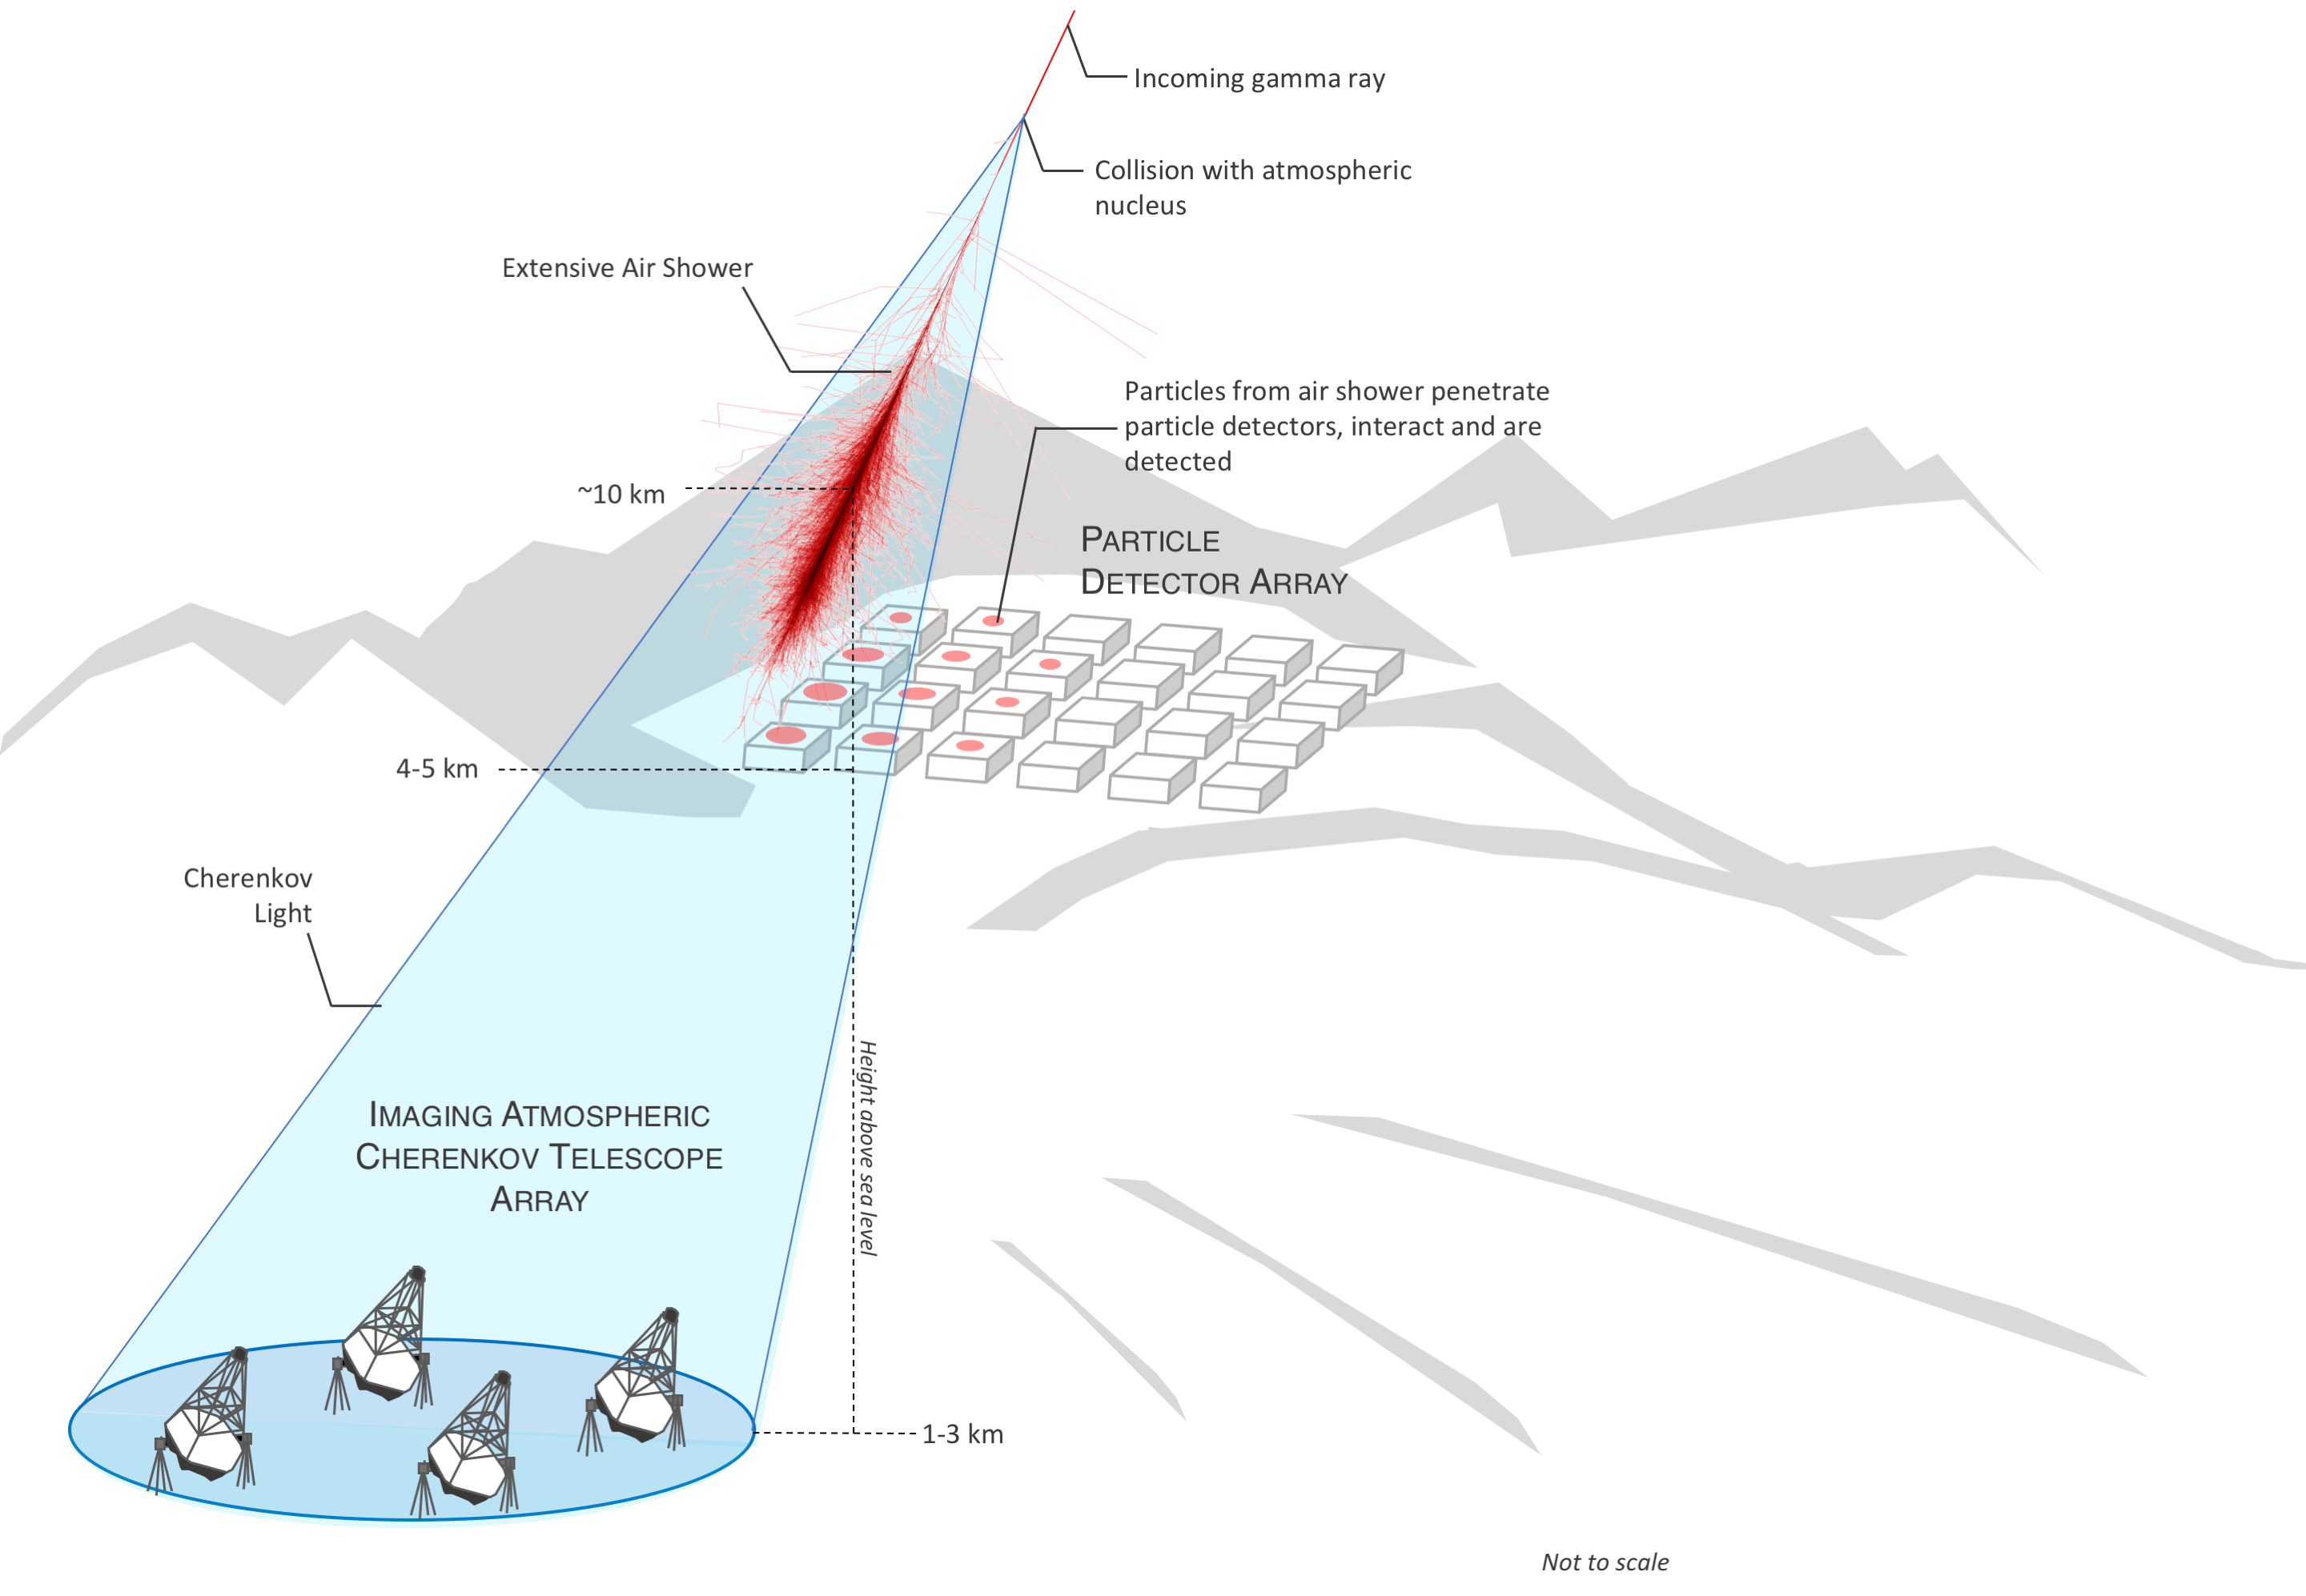
From the ground

Slide 15
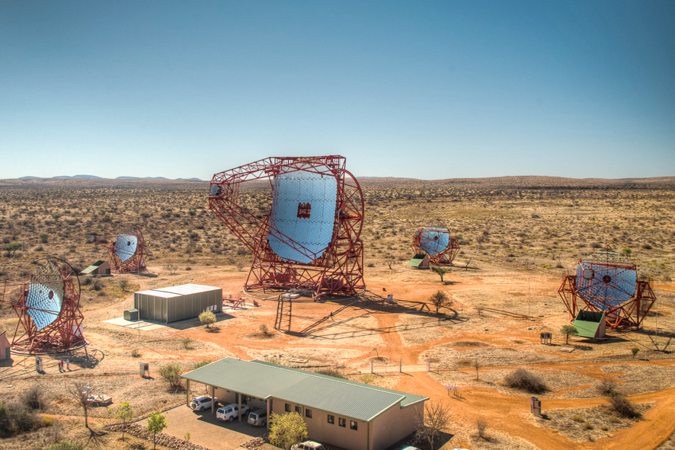
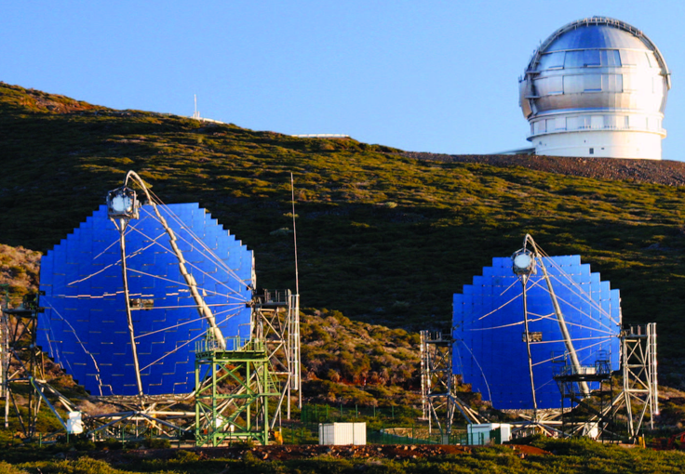
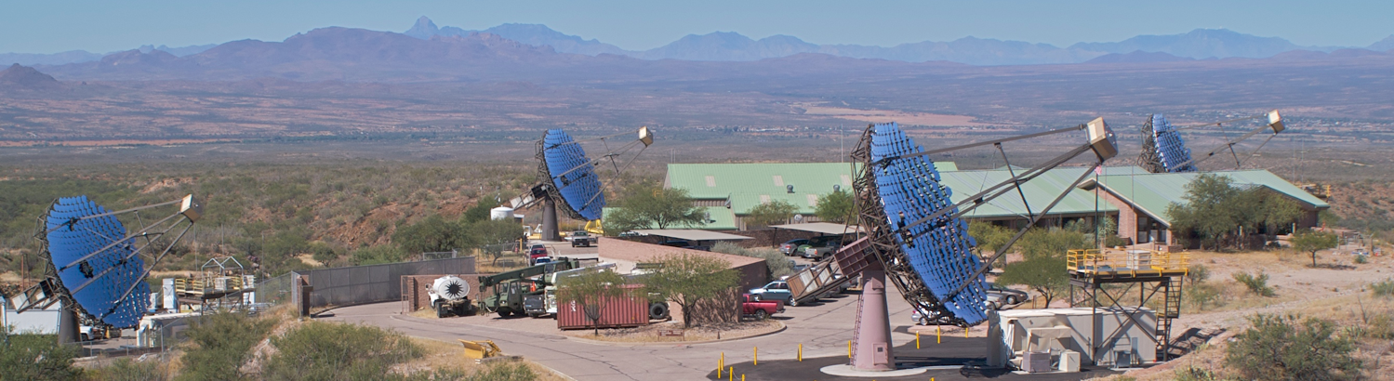
H.E.S.S. (Namibia)
4 x 108 m² (since 2003)
1 x 614 m² (since 2012)
MAGIC (La Palma)
2 x 236 m² (since 2003 / 2009)
VERITAS (Arizona)
4 x 110 m² (since 2007)

Slide 16
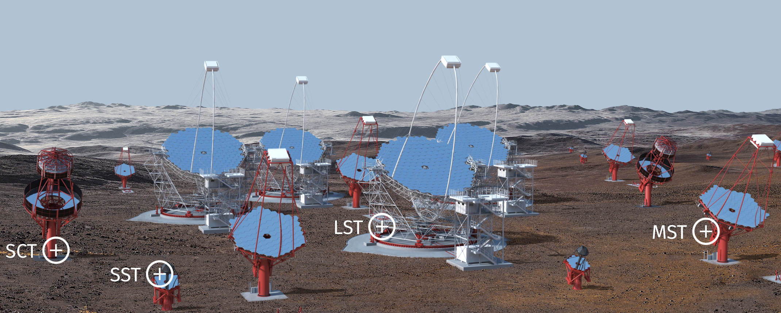

Cherenkov Telescope Array
Under construction

Slide 17
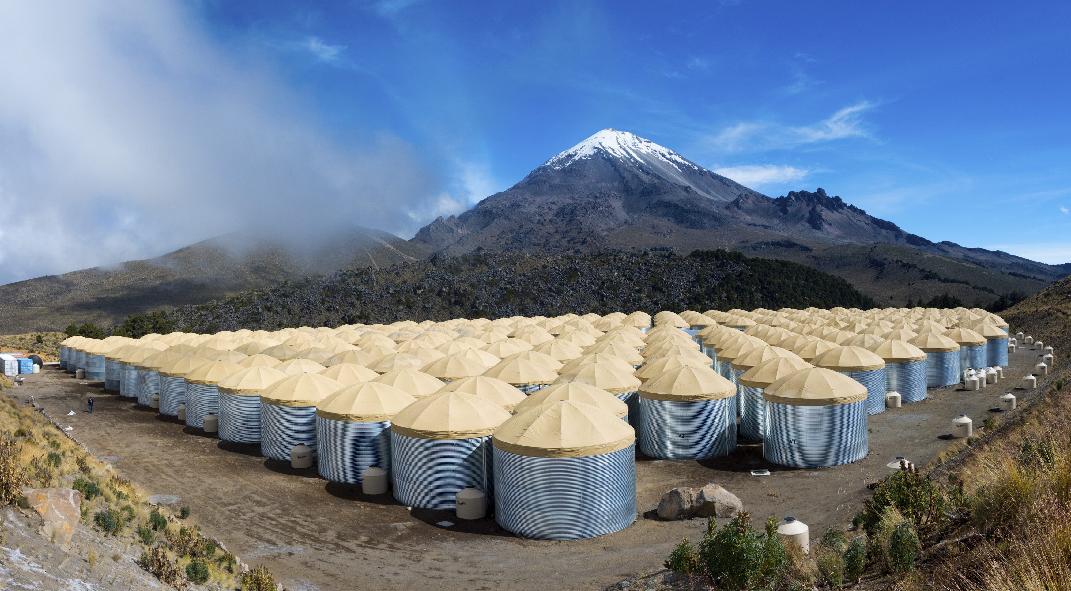
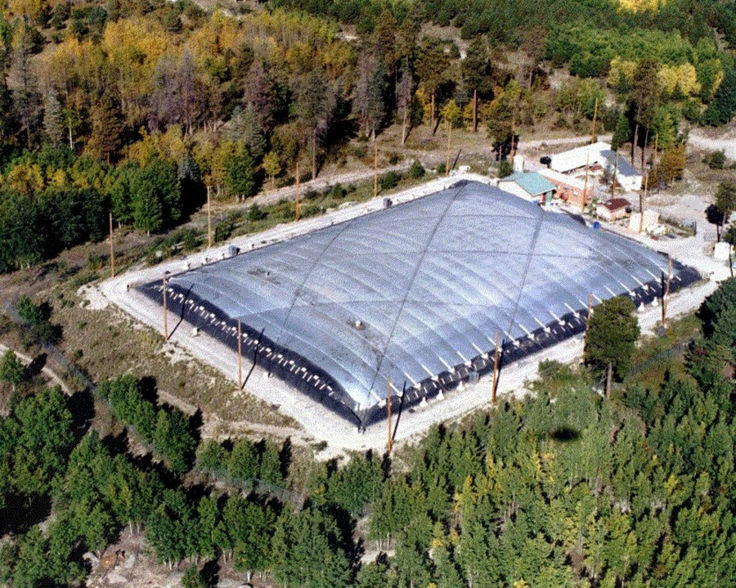
γ-ray particle detectors: water tanks
SWGO?
1990’s
2000’s
2010’s
Milagrito (US)
1sr, few m² area
Milagro (US)
1sr, 5000 m² area
HAWC (US, Mexico)
1sr, ~40000 m² area, >100 GeV

Slide 18
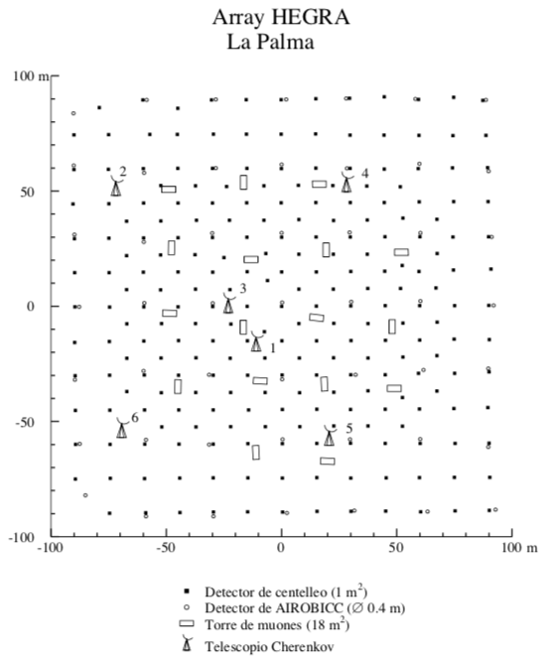
γ-ray particle detectors: scintillators
PhD thesis Juan Cortina, 1997
HEGRA
TOTAL AREA ~0.04 km²
~250 scintillator counters
~20 muon counters
2,200 m above sea level

Slide 19
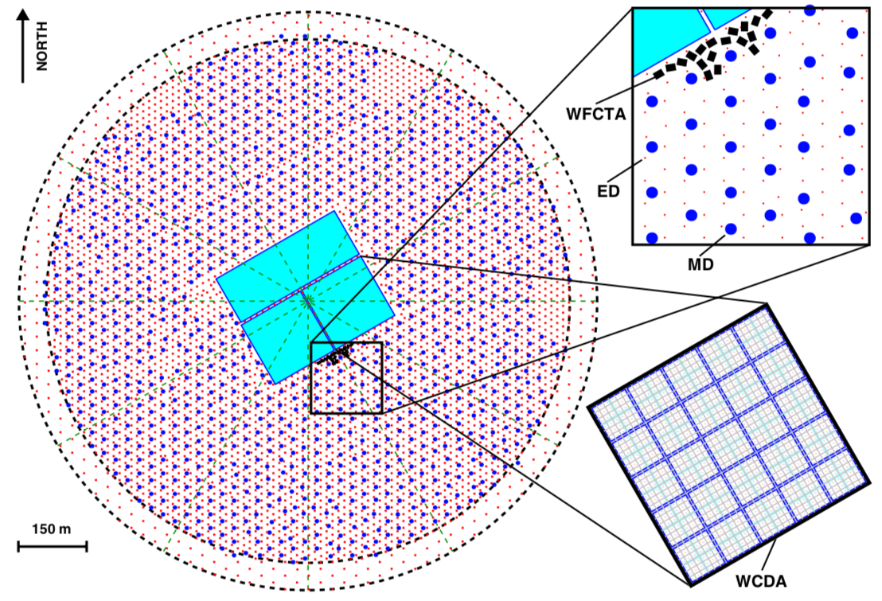
LHAASO
HEGRA
TOTAL AREA 1.3 km²
~5000 scintillator counters
~1200 muon counters
+ 80000 m2 water Cherenkov
+ Cher/fluorescence telescopes
4,410 m above sea level

Slide 20
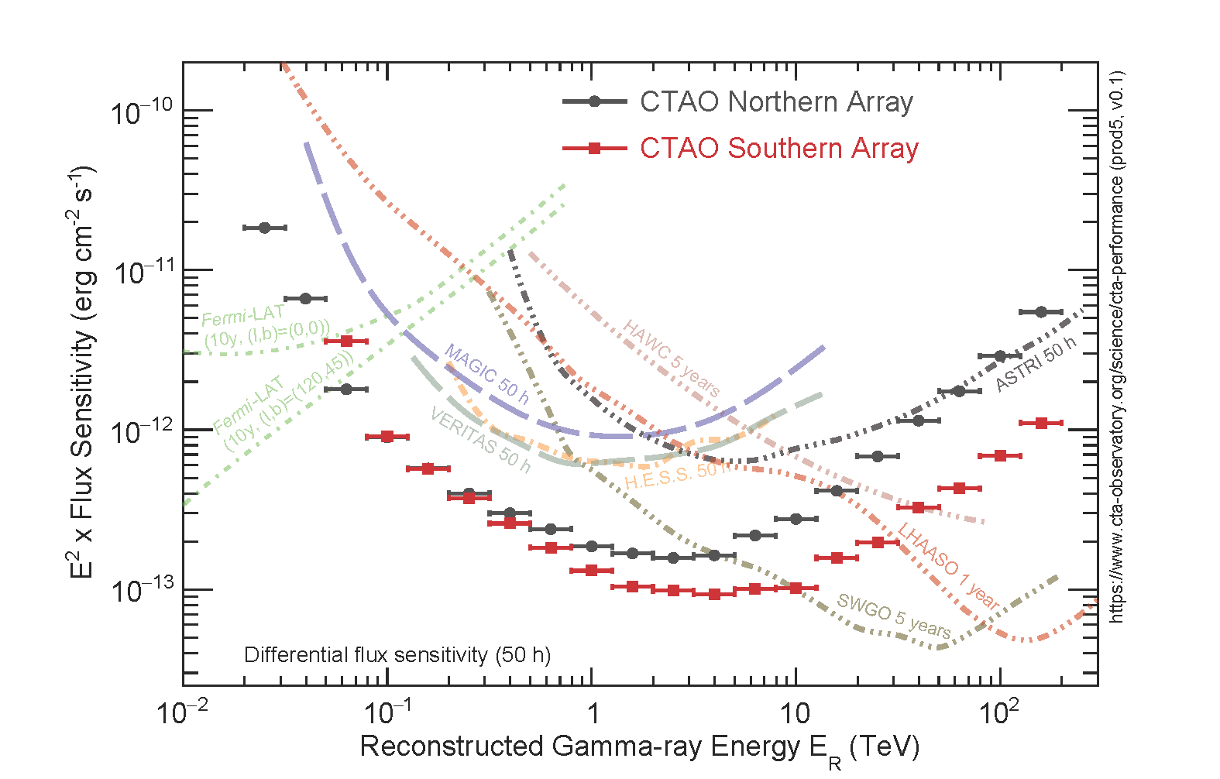
Sensitivity

Slide 21
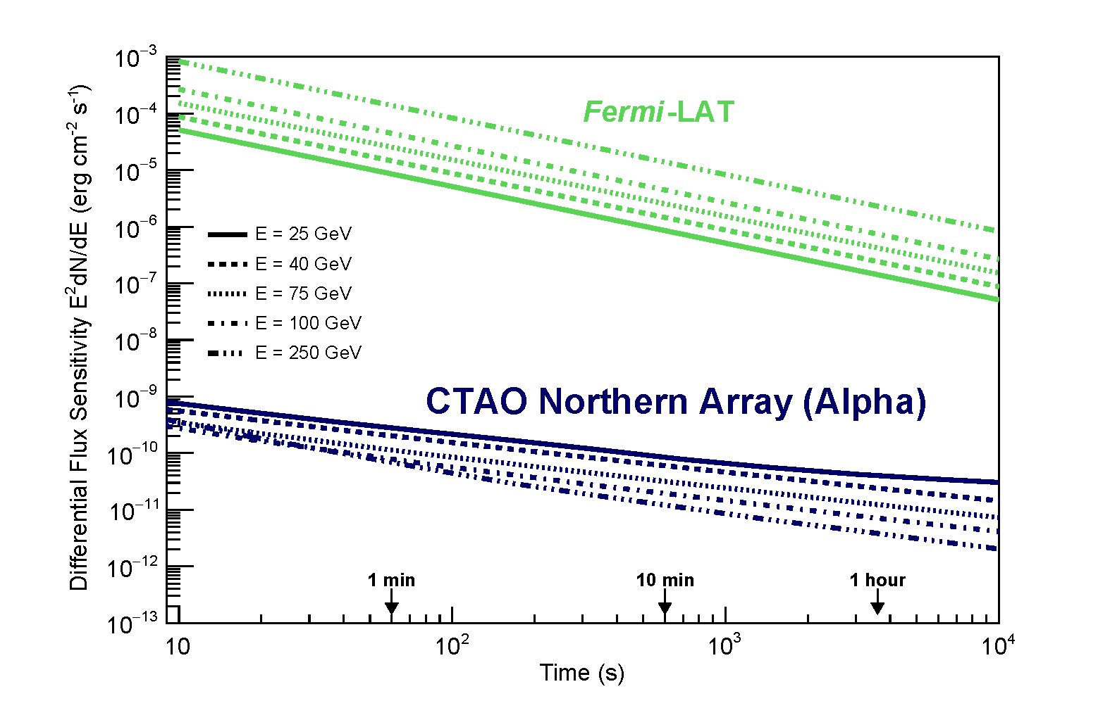
Short term sensitivity

Slide 22
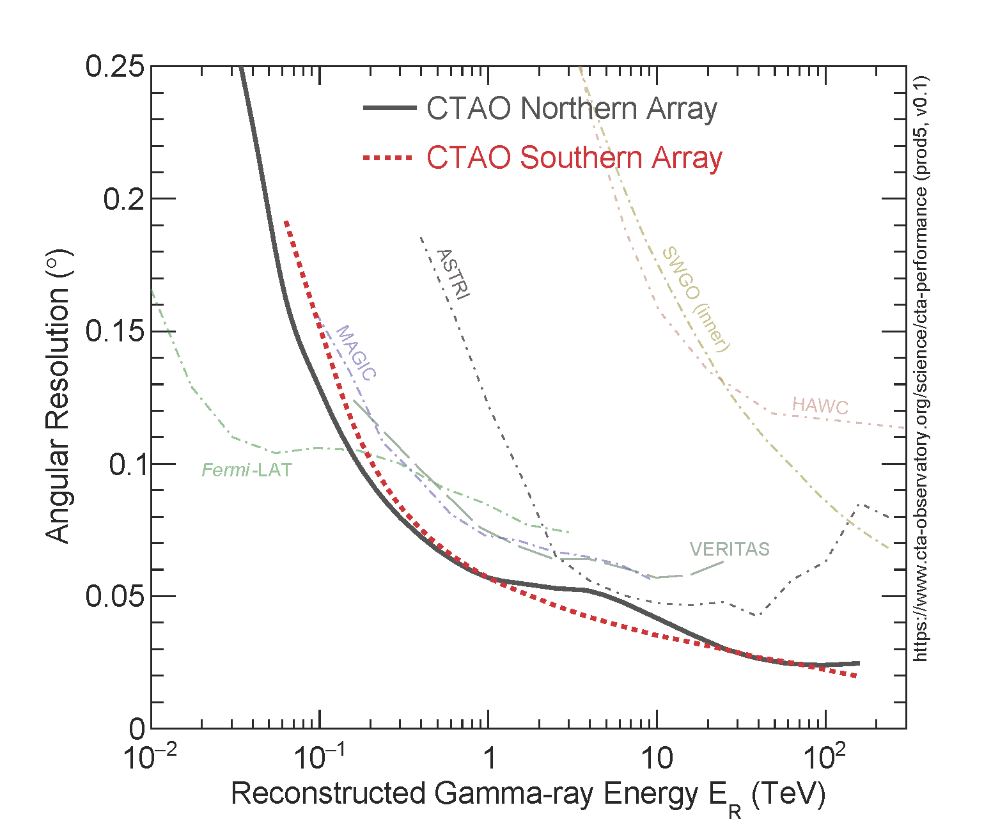
Angular resolution

Slide 23
GAMMA RAYS, RECENT RESULTS
Notes:
Experimentall driven!!!!

Slide 24
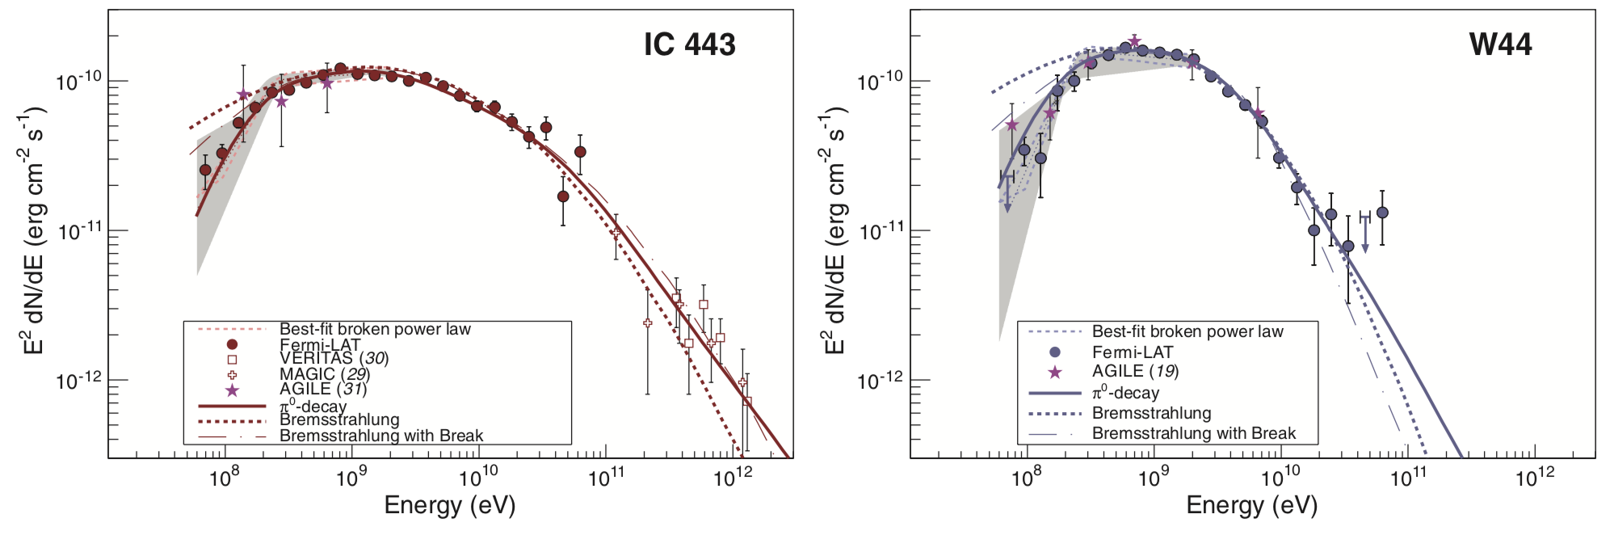
We know that SNRs produce CRs
Fermi
Fermi and Agile: e.g Ackermann+ 2013, Science 339, 807
Cherenkov telescopes
CR protons interact with matter, produce π⁰, π⁰ -> γγ, each γ with 67.5 MeV (in the rest frame of the π⁰). This leads to a γ-ray break at E ∼ 200–300 MeV in the E² dN/dE representation.
Bump first observed for two SNRs in interaction with clouds (W44 and IC 443). Later on for a few more, including Cas A, a prototypical CR-accelerator.

Slide 25
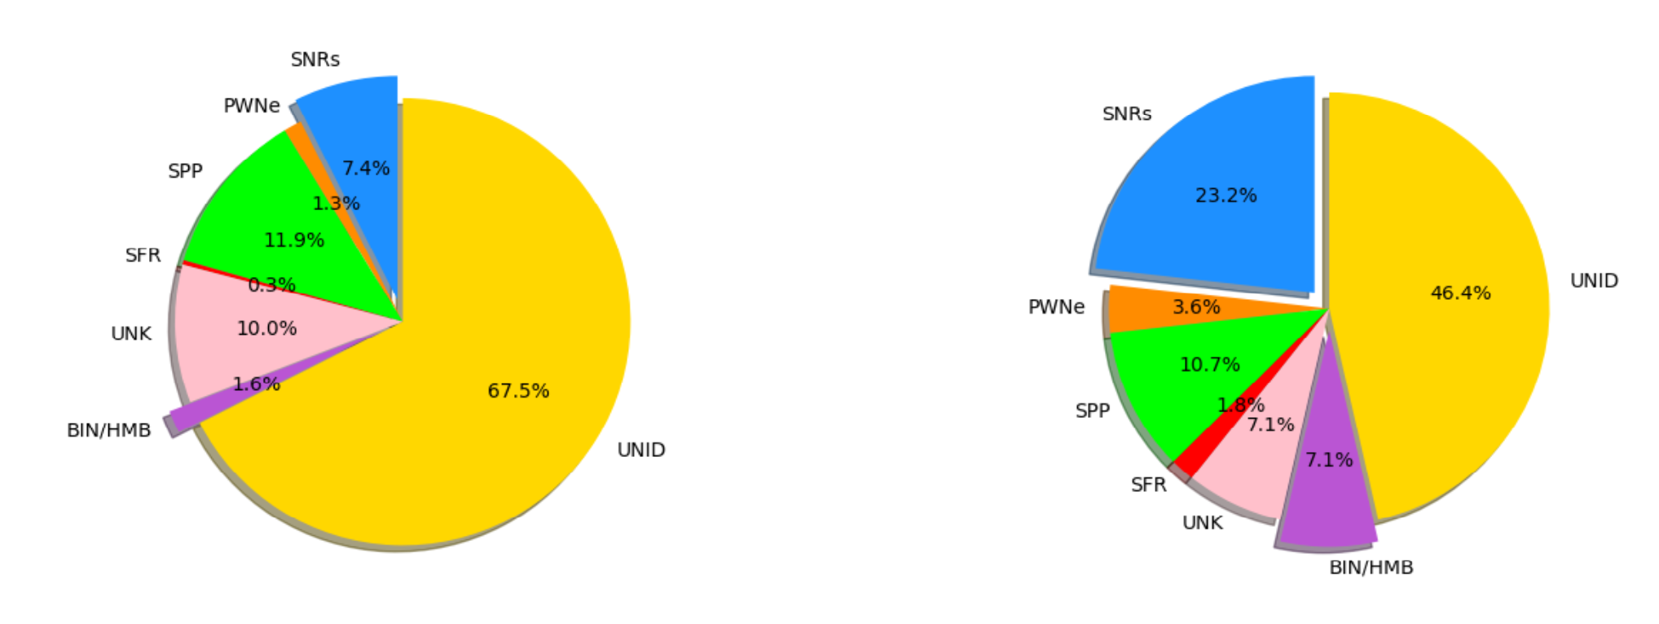
More pion bumps
New analysis of 311 candidates in 8 yrs of Fermi data: detection of 77 sources presenting a significant energy break in their low-energy spectrum.
SNR and binaries most common sources of galactic CRs at low energies.
POPULATION UNDER STUDY
Lemoine-Goumard, ICRC2021
SOURCES WITH A PION BUMP

Slide 26
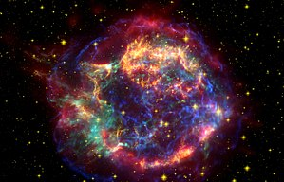
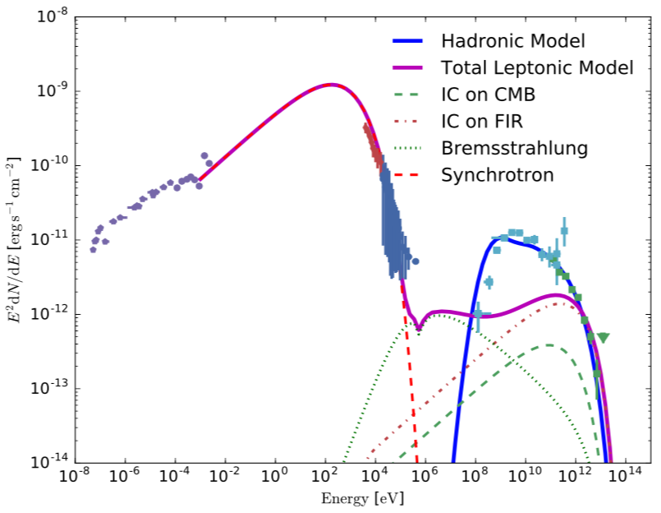
SNRs don’t make it to the Knee
Cassiopeia A: young SNR, always identified as a prime candidate for a “PeVatron” = an object that can accelerate CRs up to the Knee.
But spectrum clearly drops well before the Knee.
From all IACT observations: No obvious candidates in our Galaxy!
D. Guberman, PhD thesis IFAE
MAGIC cutoff ~1 TeV

Slide 27
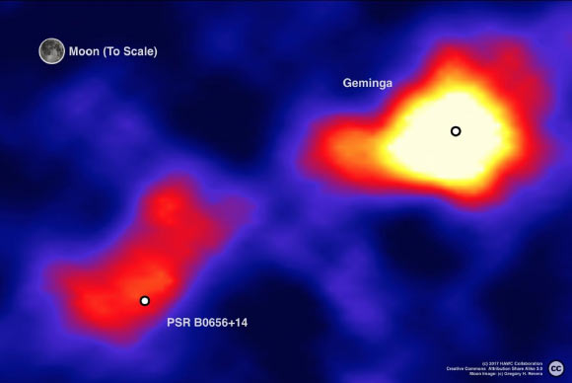
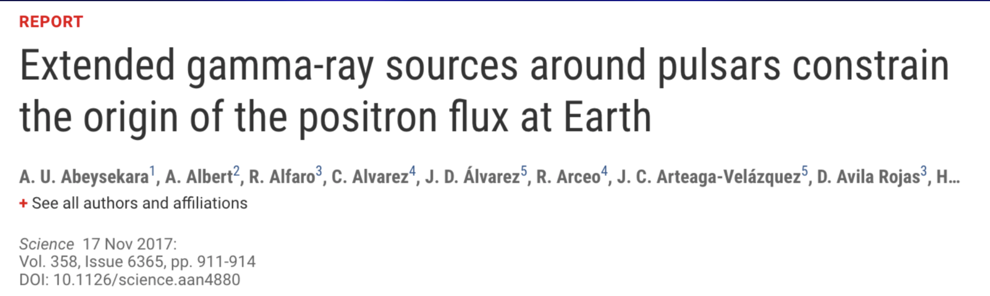
TeV halos
HAWC collaboration
Notes:
Beautiful example how low angular resolution + low sensitivity but huge FOV can contribute!

Slide 28
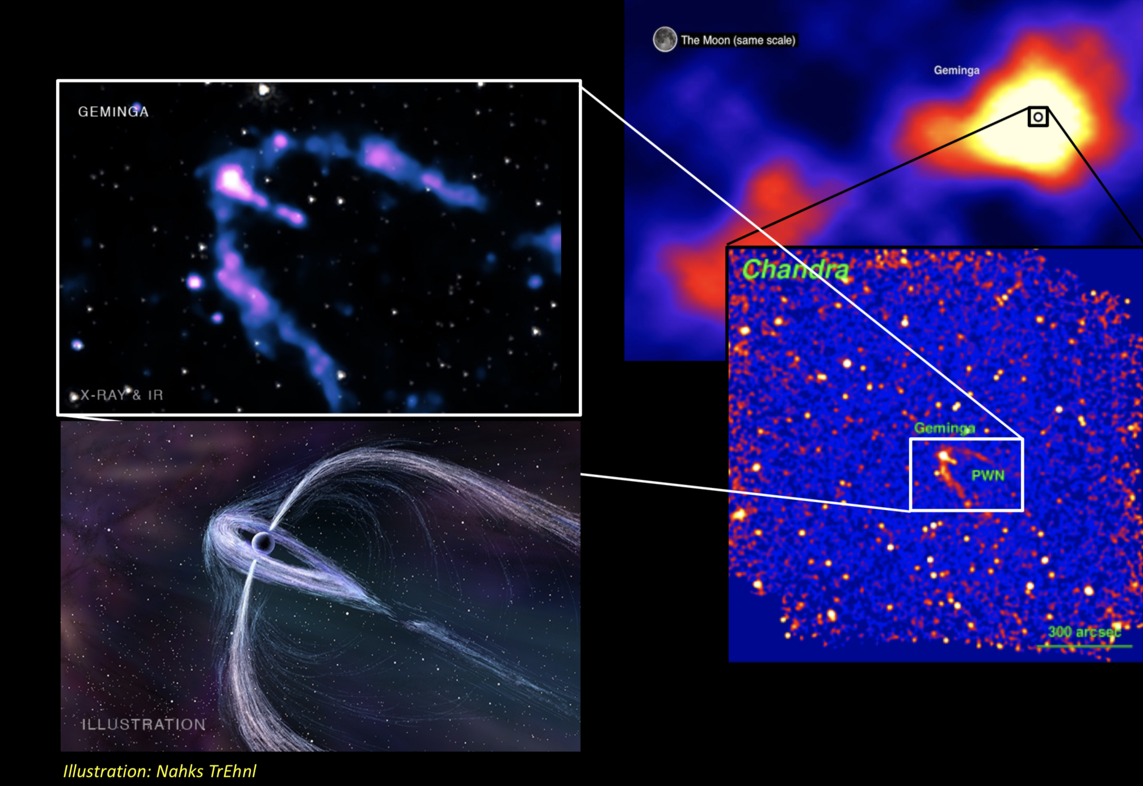
Notes:
Different scales, Different phenomena, Different detectors

Slide 29
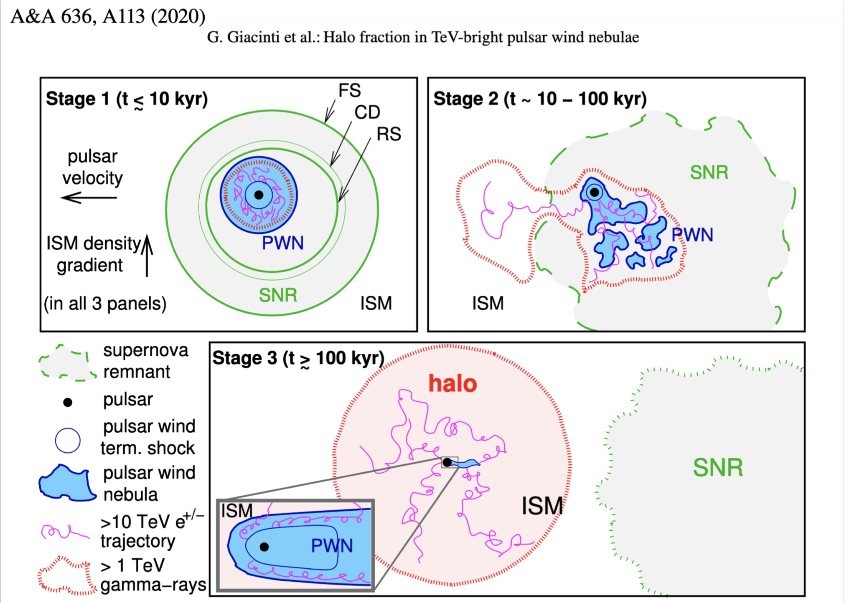

Slide 30
TeV halos
Very old (10⁵ y) low power systems – visible because they are very close – 200 pc
Outside the PWN and very large: 10 pc
Energy density inferred for electrons <1% ISM
But lots of energy: pulsar is converting 10% of rotational energy (spin-down power) into relativistic electrons + positrons!

Slide 31
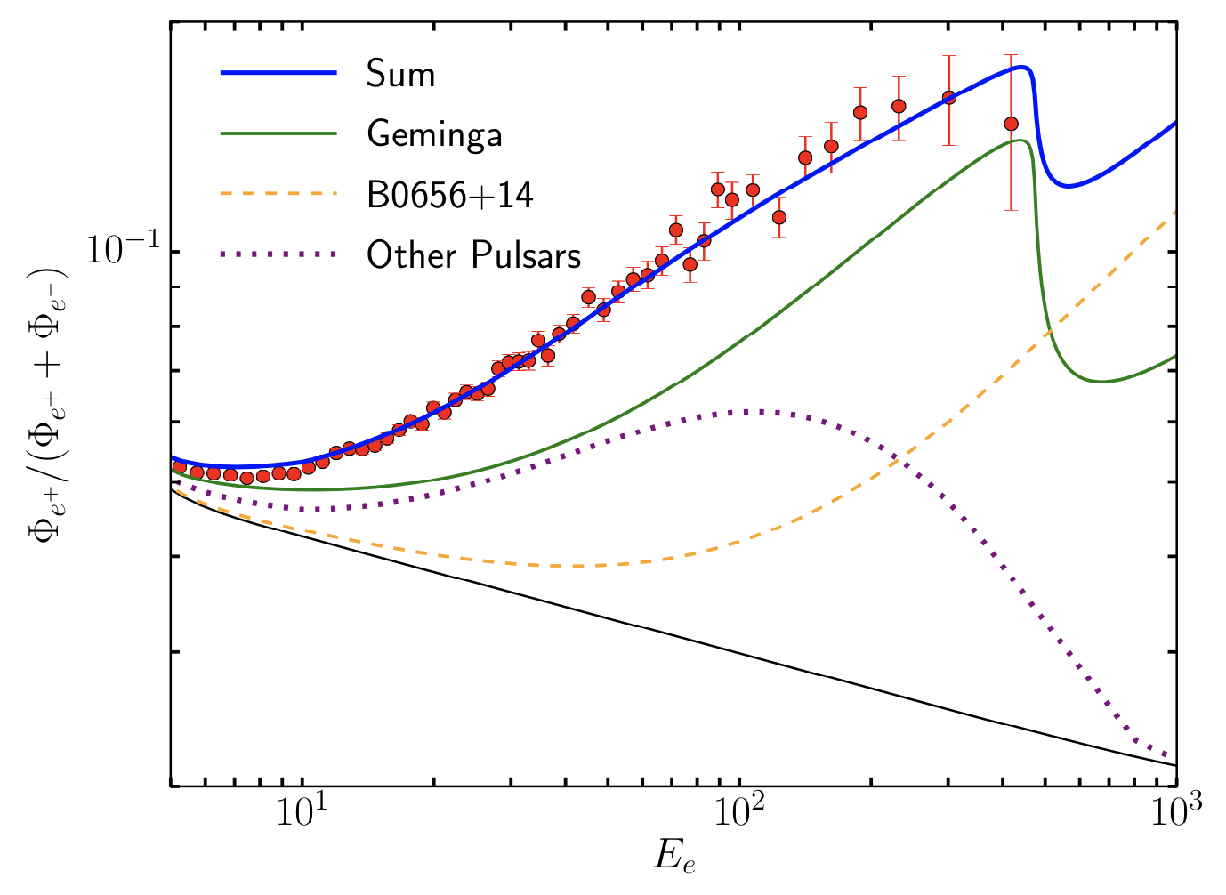
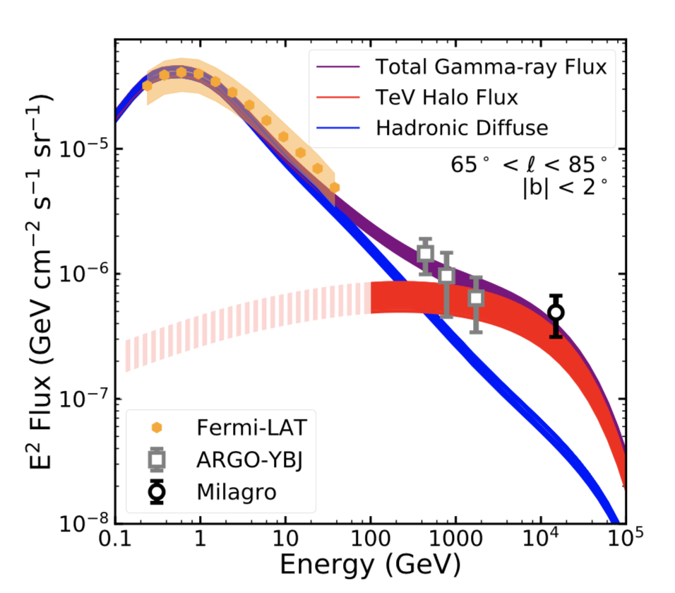
TeV halos
D. Hooper et al, PRD 96, 103013 (2017)
Very old (10⁵ y) low power systems – visible because they are very close – 200 pc
Outside the PWN and very large: 10 pc
Energy density inferred for electrons <1% ISM
But lots of energy: pulsar is converting 10% of rotational energy (spin-down power) into relativistic electrons + positrons!
T. Linden et al, PRL. 120, 121101 (2018)

Slide 32
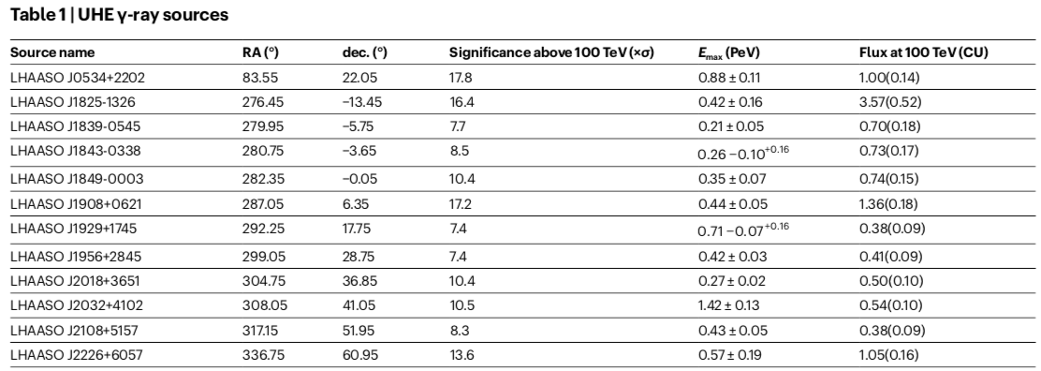
LHAASO: Lots of PeVatrons!
LHAASO, Nature 2021, https://doi.org/10.1038/s41586-021-03498-z

Slide 33
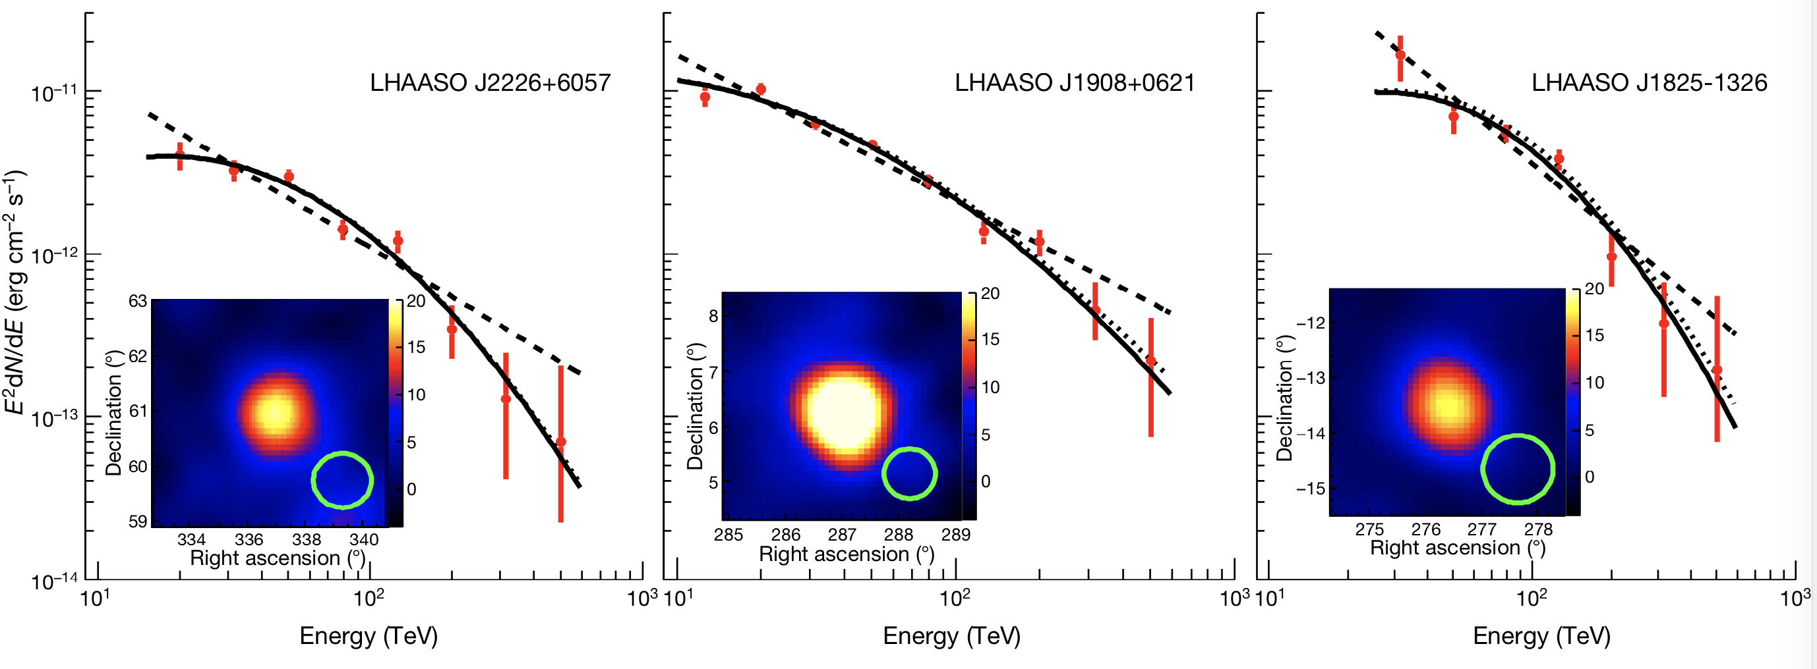
LHAASO pevatrons
LHAASO, Nature 2021, https://doi.org/10.1038/s41586-021-03498-z
Notes:
IACTs are crucial at low E: angular resolution!

Slide 34
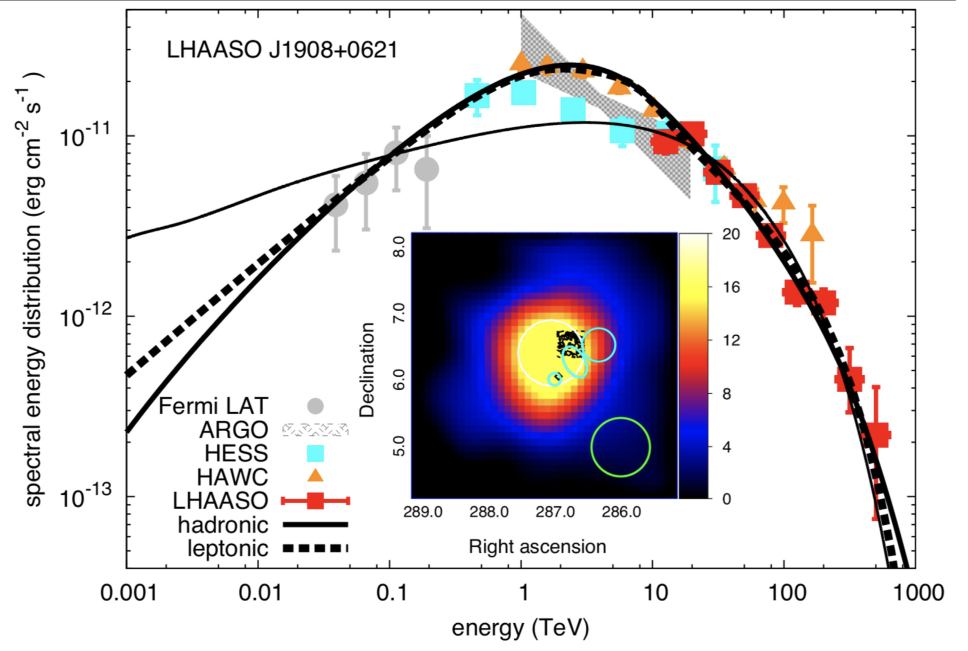
LHAASO pevatrons: origin?
Could be:
Leptonic:
  Pulsar Wind Nebula
  TeV halo.
Hadronic:
  Supernova remnant
LHAASO, Nature 2021, https://doi.org/10.1038/s41586-021-03498-z
Notes:
IACTs are crucial at low E: angular resolution!

Slide 35
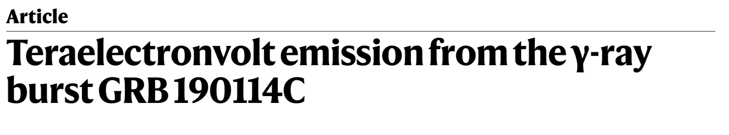
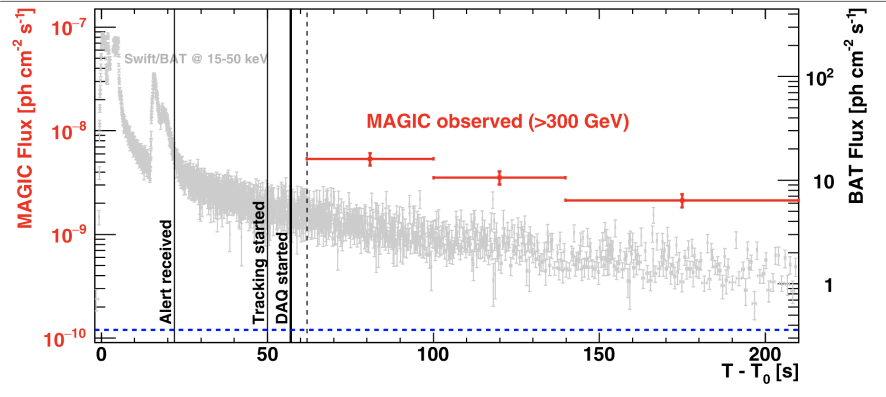
MAGIC: first GRB at VHE
MAGIC, Nature 2019,
https://doi.org/10.1038/s41586-019-1750-x

Slide 36
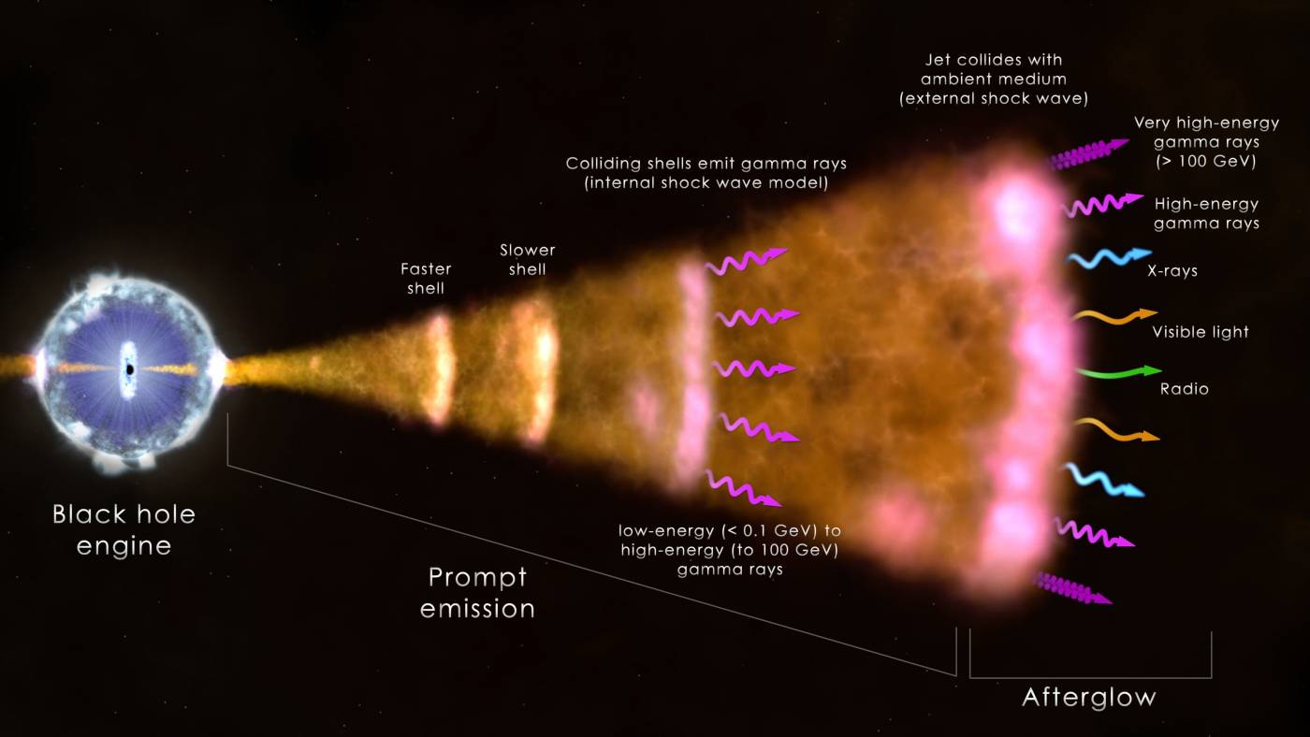

Slide 38
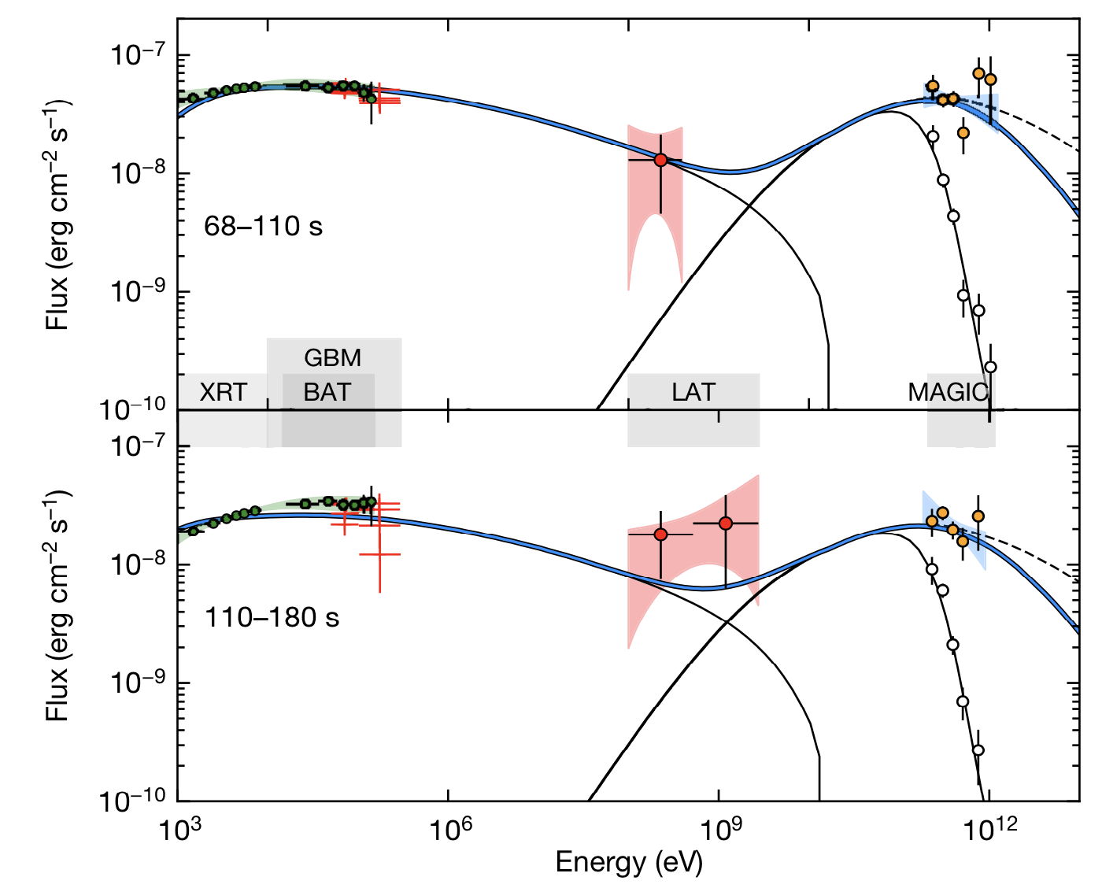

MAGIC: emission mechanism
New component: Inverse Compton of jet photons with jet electrons, i.e. Self-Synchroton Compton
Similar amount of energy radiated in synchroton and VHE!
Nothing special with this GRB
MAGIC, Nature 2019,
https://doi.org/10.1038/s41586-019-1754-6

Slide 39
GRB: common VHE sources!!
No discovery for 15 years and then 4 GRBs in a row:
  GRB 190114C, z~0.4245 (MAGIC)
  GRB 180720B, z~0.654 (H.E.S.S.)
  GRB 190829A, z~0.08 (H.E.S.S.)
  GRB 201216C, Z~1.1 (MAGIC)
Are we stupid or what?
  We were just pessimistic: we were focusing too much on the prompt emission, we didn’t believe the afterglow was so bright so we didn’t observe long enough.
We expect to detect many more GRBs. Goals now:
  Prompt emission.
  Short GRB (together with a GW event!)

Slide 40
CTA: LATEST NEWS

Slide 41
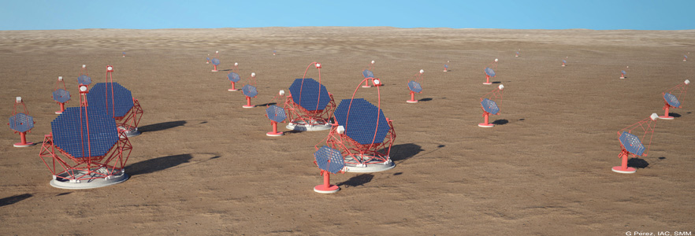
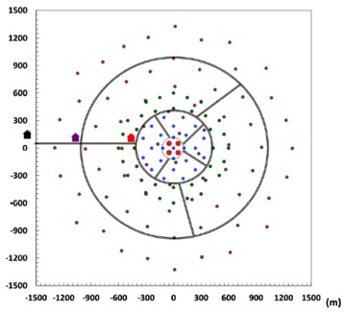
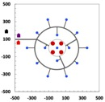

How does CTA work?
...
LST (23m)
SST (4m)
MST (12m)
South: Paranal
Characteristics
2 sites (north & south) → full sky coverage
3 telescope size classes → wider energy range
Tens of telescopes in total → higher sensitivity
0.8 km
2x2 km²
North:
La Palma

Slide 42

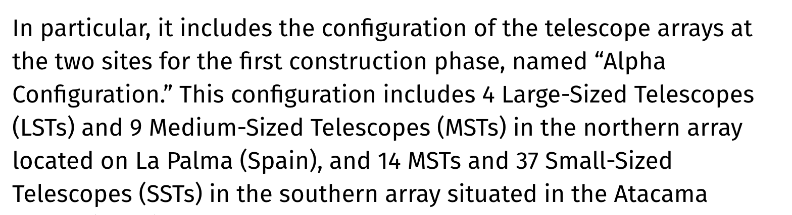
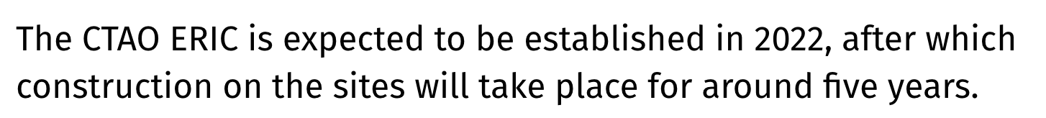
June 2021

Slide 43
Translation: After a 6 month marathon of biweekly CTAO council meetings:
Country representatives of Germany, Italy, Spain, France, Japan, Poland etc agreed to finance a somewhat scaled-down version of CTA.
What will be built: the “alpha configuration”
  4 LSTs + 9 MSTs in the north
  14 MSTs + 37 SSTs in the south
A new organization called CTAO will be setup. It’s legally a European entity called ERIC.
EU must approve it. Stage 1 is ready. Stage 2 is ongoing and should be over Spring next year. Then money flows.

Slide 44

Which doesn’t mean we’ve been idle…

Slide 45
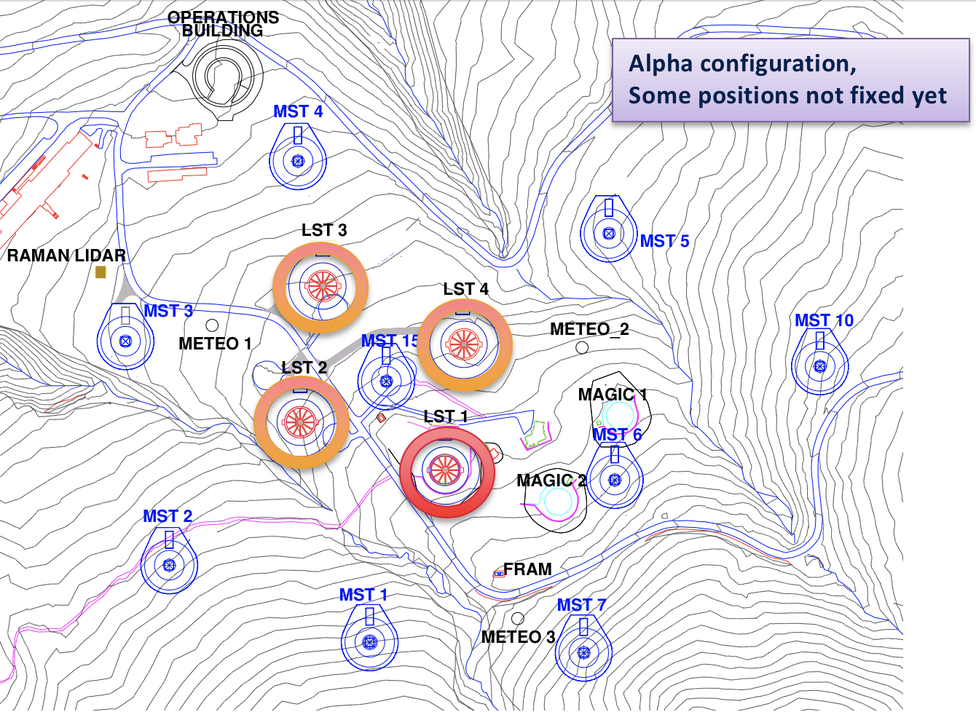
CTA-North: construction stages
- The first construction stage (alpha configuration) in CTA-North involves the construction of 4 LSTs and 9 MSTs over 5 years:
LST1, a fully functional prototype, is already built.
The 3 remaining LSTs and 1 MST should be in place by 2023.
The 8 remaining MSTs should be installed shortly afterwards.

Slide 46
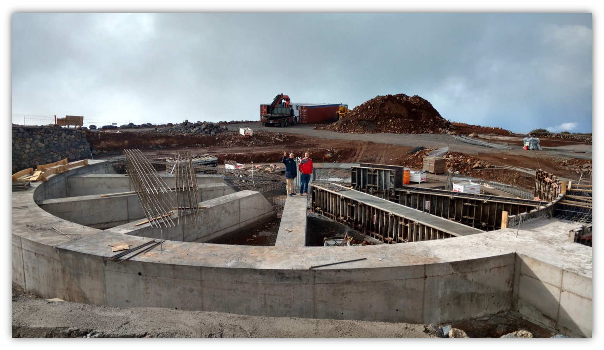
First LST: civil works 2016

Slide 47
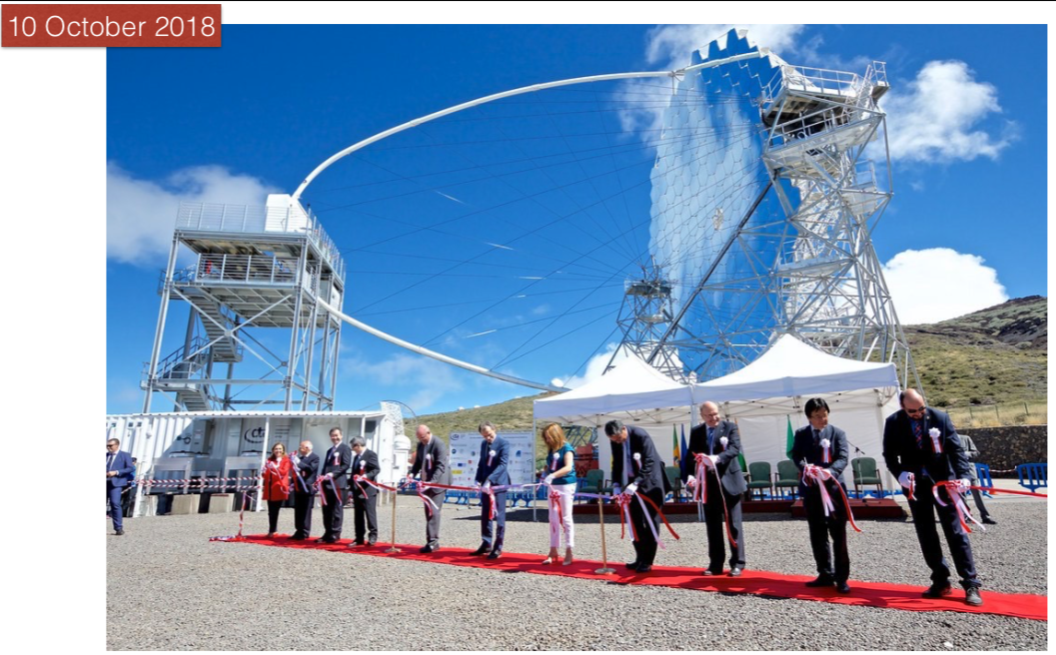
LST1: inauguration

Slide 48
LST1: commissioning status
Mechanics: no major issues after 2 years. Already went through major storms. Reached speed <20 s for 180 deg repositioning in azimuth.
Optics: active mirror adjustment working using Look-up tables (LUTs). Achieved optical PSF ～33 mm (80% light containment diameter). LUTs are stable.
Camera: stable, no major issues after 2 years. Achieved specs: charge and time resolution, less than 5% deadtime even for 7.5 kHz event rate.
Control: low level control software is generally finished. Working on high level control of all sub-systems and full automation: especially important for automatic reaction to transients. Telescope largely operative from remote: good during Covid-19 times!
General operation pretty successful: already achieved ～ 80% duty cycle. Aiming at nominal duty cycle >95% after the Summer.

Slide 49
LST1: commissioning status
Mechanics: no major issues after 2 years. Already went through major storms. Reached speed <20 s for 180 deg repositioning in azimuth.
Optics: active mirror adjustment working using Look-up tables (LUTs). Achieved optical PSF ～33 mm (80% light containment diameter). LUTs are stable.
Camera: stable, no major issues after 2 years. Achieved specs: charge and time resolution, less than 5% deadtime even for 7.5 kHz event rate.
Control: low level control software is generally finished. Working on high level control of all sub-systems and full automation: especially important for automatic reaction to transients. Telescope largely operative from remote: good during Covid-19 times!
General operation pretty successful: already achieved ～ 80% duty cycle. Aiming at nominal duty cycle >95% after the Summer.
In spite of covid!!!

Slide 50
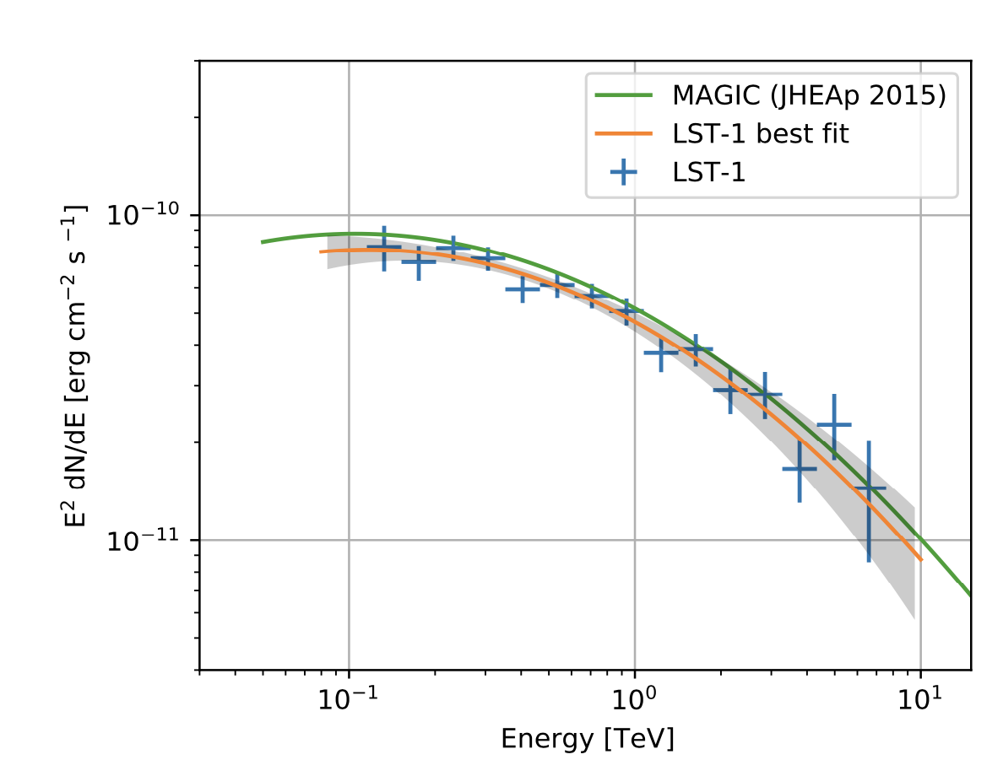

LST1: Crab Nebula observations
Detection achieved “off-the-shelf”: ～18σ in 36 min for energy threshold ～50 GeV. Stay tuned for Crab flares.
Reconstructed spectrum < 1 TeV is already consistent with previous measurements.
Preliminary
Preliminary

Slide 51

LST1: Crab PULSAR
Only 4 pulsars are detected at VHE. First detection by MAGIC took years. Now detection of Crab pulsar is achieved matter-of-factly.
Preliminary ratio of P1 and P2 points to an energy threshold ～50 GeV.
Preliminary

Slide 52

LST1: AGNs
Frequent follow-up observations of flaring AGNs.
Clear detections of Mrk 421, Mrk 501, 1ES 0647, 1ES 1959 and PG 1553 (LST most distance source, z=0.36)
All Preliminary

Slide 53

Next three LSTs in CTA-North
98% of the component production on its way or finished

Slide 54

Performance outlook next years
As more CTA-North telescopes come online, sensitivity will progressively increase.
LST1 already takes engineering runs with MAGIC: clear sensitivity improvement.
(SV-N3)
R. Zanin, CTA prod3b simulation/ arXiv: 1907.07508
Preliminary
E[TeV]

Slide 55
Conclusions
CR measurements at low energies have reached an unprecedented level of detail. The ball is in the roof of theorists: model source distribution and propagation in the Galaxy. This is essential before coming to conclusions regarding dark matter.
Major advance in gamma ray detectors: IACTs still very active,CTA is coming, particle detectors opening a new window.
Observationally-driven field, constant surprises: clear pion bumps, TeV halos, Gamma Ray Bursts at VHE.

Slide 56

Thank you!

Slide 57

Proposed space g-ray detectors (1/2)

Slide 58

Proposed space g-ray detectors (2/2)

Slide 59
Gamma ray loops
Guđlaugur Jóhannesson and Troy A. Porter 2021 ApJ 917 30

Slide 60
UHE COSMIC RAYS
FROM THE GROUND, >Pev energies

Slide 61




Major detectors
JEM-EUSO program
2 ∙10¹⁵ eV … 2 ∙ 10²⁰ eV
Spain… 16 countries
>10000 km²
And many of the gamma ray detectors at E<1 PeV
PAO
10¹⁶ eV... 2 ∙ 10²⁰ eV
Spain… 18 countries
3,000 km²
TA
2 ∙10¹⁵ eV … 2 ∙ 10²⁰ eV
US, Japan, Korea, Russia, Belgium
600 km²

Slide 62

Higher statistics –> more complexity
Novotny, ICRC 2021

Slide 63

Consistent among experiments
Novotny, ICRC 2021

Slide 64

UHECR sky > 40 EeV viewed from the Pierre Auger Observatory
17 years of observations!
No significant association to galaxy catalogs.
Most significant: Centarus region but only p=1.4% post-trial.
Significance seems to grow with √time -> 5σ could be reached in 2025-2030
Biteau, ICRC 2021

Slide 65

backup

Slide 66

New CR detectors

Slide 67

Auger anisotropy: significance

Slide 68


LST collaboration
2018 LST general meeting, La Palma
Czech Republic
A collaboration of ~300 scientists and engineers are in charge to build the LSTs

