Slide 1
Bragg Interferometer Gyroscope in a Time-Orbiting Potential
Cass Sackett
University of Virginia

Slide 2
Inertial Navigation
Potential application for cold atom devices
Significant industry interest
Practical system: combine atomic and conventional sensors
Model on masers and atomic clocks, but more complicated
Need to develop atomic instruments suitable for navigation use

Slide 3
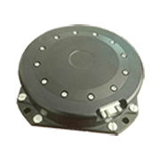
Rotation Sensing
In many cases, gyroscope is limiting element for INS
Good conventional sensor: Fiber Optic Gyro (FOG)
noise $≈$ ${10}^{−3}$ deg/$√$hr
drift $≈$ ${10}^{−2}$ deg/hr
Hope to use atomic sensor to correct for drift
Use atomic Sagnac interferometer
Advantageous to have atoms in trap
SENNAV SNF-120

Slide 4
Sagnac effect
If interferometer encloses an area, phase depends on rotation rate
Same for atoms, light, sound, etc
Basis for FOG, ring lasers gyro, MEMS gyro
Phase shift
atom mass $m$
area $A$
$$φ=\frac{2m}{ℏ} ΩA$$
$$Ω$$

Slide 5
Interferometer concept
$$V=\frac{1}{2}mω^{2}\left(x^{2}+y^{2}\right)$$
Cylindrical harmonic trap
Start at rest, center of trap
y
x

Slide 6
Sagnac in trap
$$V=\frac{1}{2}mω^{2}\left(x^{2}+y^{2}\right)$$
Cylindrical harmonic trap
Start at rest, center of trap
Bragg kick $v_{0}$
Move to $R=v_{0}/ω$
y
R
x

Slide 7
Sagnac in trap
$$V=\frac{1}{2}mω^{2}\left(x^{2}+y^{2}\right)$$
Cylindrical harmonic trap
Start at rest, center of trap
Bragg kick $v_{0}$
Move to $R=v_{0}/ω$
$⊥$ Bragg split $±v_{0}$
y
x

Slide 8
Sagnac in trap
$$V=\frac{1}{2}mω^{2}\left(x^{2}+y^{2}\right)$$
Cylindrical harmonic trap
Start at rest, center of trap
Bragg kick $v_{0}$
Move to $R=v_{0}/ω$
$⊥$ Bragg split $±v_{0}$
Travel around circle
y
x

Slide 9
Sagnac in trap
$$V=\frac{1}{2}mω^{2}\left(x^{2}+y^{2}\right)$$
Cylindrical harmonic trap
Start at rest, center of trap
Bragg kick $v_{0}$
Move to $R=v_{0}/ω$
$⊥$ Bragg split $±v_{0}$
Travel around circle
y
x

Slide 10
Sagnac in trap
$$V=\frac{1}{2}mω^{2}\left(x^{2}+y^{2}\right)$$
Cylindrical harmonic trap
Start at rest, center of trap
Bragg kick $v_{0}$
Move to $R=v_{0}/ω$
$⊥$ Bragg split $±v_{0}$
Travel around circle
y
x

Slide 11
Sagnac in trap
$$V=\frac{1}{2}mω^{2}\left(x^{2}+y^{2}\right)$$
Cylindrical harmonic trap
Start at rest, center of trap
Bragg kick $v_{0}$
Move to $R=v_{0}/ω$
$⊥$ Bragg split $±v_{0}$
Travel around circle
y
x

Slide 12
Sagnac in trap
$$V=\frac{1}{2}mω^{2}\left(x^{2}+y^{2}\right)$$
Cylindrical harmonic trap
Start at rest, center of trap
Bragg kick $v_{0}$
Move to $R=v_{0}/ω$
$⊥$ Bragg split $±v_{0}$
Travel around circle
y
x

Slide 13
Sagnac in trap
$$V=\frac{1}{2}mω^{2}\left(x^{2}+y^{2}\right)$$
Cylindrical harmonic trap
Start at rest, center of trap
Bragg kick $v_{0}$
Move to $R=v_{0}/ω$
$⊥$ Bragg split $±v_{0}$
Travel around circle
Recombine
y
x

Slide 14
Sagnac in trap
$$V=\frac{1}{2}mω^{2}\left(x^{2}+y^{2}\right)$$
Cylindrical harmonic trap
Start at rest, center of trap
Bragg kick $v_{0}$
Move to $R=v_{0}/ω$
$⊥$ Bragg split $±v_{0}$
Travel around circle
Recombine
Detect interference
- fraction of atoms brought to rest
y
$${N \sim cos}^{2}{φ}/2$$
x

Slide 15
Dual interferometers
y
Actually two simultaneous interferometers
Rotation phase is differential
Most other effects common
Acceleration
Trapping potential
Bragg laser noise
How to implement trap?
x

Slide 16
Magnetic trap
Zeeman effect:
$$E$$
$$m=2$$
$$1$$
Atoms in Zeeman state $m>0:$potential $E≈μ_{B}|\vec{B}|$
Magnetic fields can be stable, smooth, symmetric
more so than laser trap
But $μ_{B}$ is very large ~ MHz/G
~mG environment field gives ${10}^{3}$ rad phase in 1 s
Field noise swamps Sagnac signal?
$$0$$
$$−1$$
$$−2$$
$$B$$

Slide 17
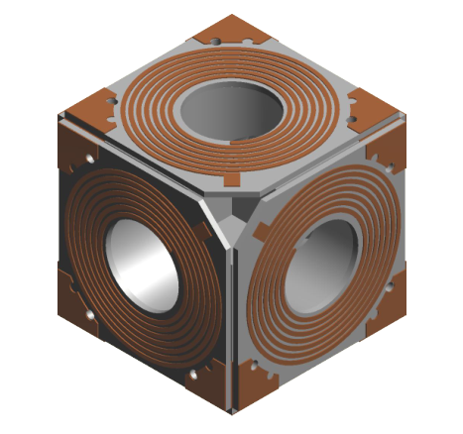
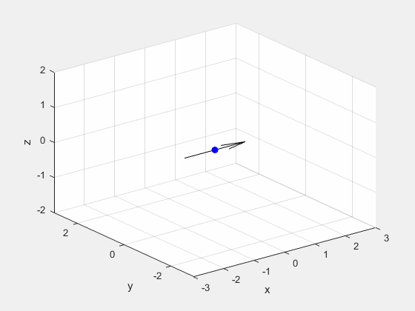
Time-orbiting potential trap
TOP trap:
Trap fields rotate at 10 kHz
Atomic moments follow adiabatically
Atoms insensitive to low-freq noise
Provides adjustable gradient to cancel gravity
Atom oscillation frequency 2 to 10 Hz
= B field
= field zero
= atoms

Slide 18
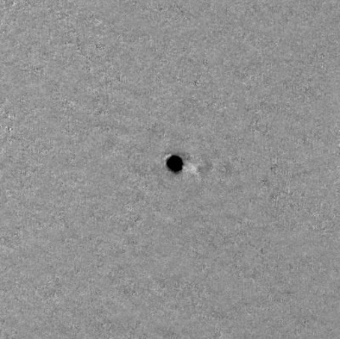
Sagnac interferometer
Original implementation:
Appx $2×{10}^{4}$ ⁸⁷Rb atoms
9 Hz trap (orbit time 0.11 s)
Diameter = 0.4 mm
Net enclosed area = 0.5 mm²
0.5 mm

Slide 19
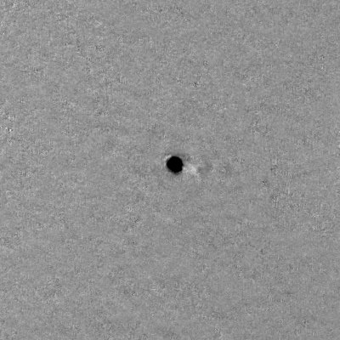
Sagnac interferometer
Original implementation:
Appx $2×{10}^{4}$ ⁸⁷Rb atoms
9 Hz trap (orbit time 0.11 s)
Diameter = 0.4 mm
Net enclosed area = 0.5 mm²
0.5 mm

Slide 20
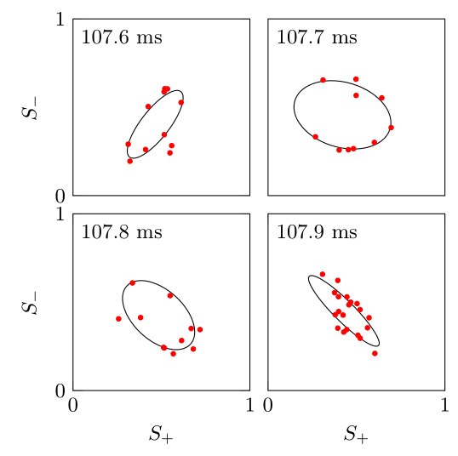
Results
Absorption image:
$$+$$
$$−$$
$$N_{0}$$
$$S_{±}=\frac{N_{0}\left(±\right)}{N\left(±\right)}$$
Two interferometers, signals
Both noisy
Extract differential phase $Δφ$:
Plot $S_{−}$ vs $S_{+}$ ⇒ ellipse
Fit ellipse to get phase, visibility
$$Δφ=1.1±0.2$$
$$1.7±0.2$$
$$2.0±0.3$$
$$2.5±0.2$$
Original experiment results:
Appx 40% visibility
Phase noise appx 0.2 rad at $N=10$

Slide 21
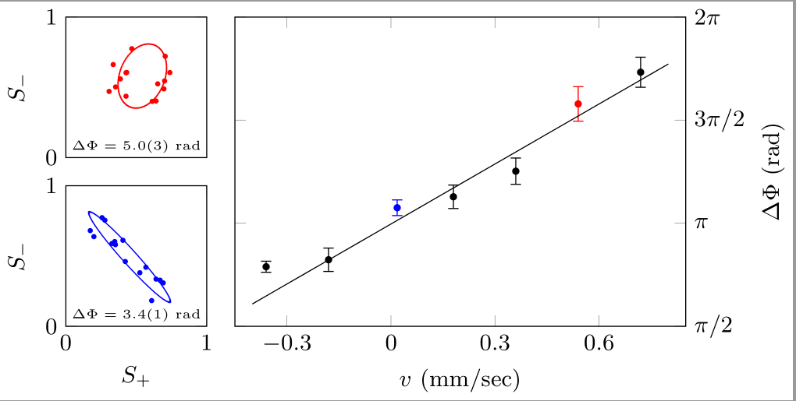
Rotation sensing
${10}^{−4}$ rad
Sagnac phase contributes to $Δφ$
Observe by rotating optical table:
Sensitivity ~ 2000 rad/(rad/s)
Earth rate ⇒ 0.1 rad $≈$ error bar in graph
Floating air legs
Measurement time:
~ 30 min/point
Rotation sensitivity :
~ 10 deg/$√$hr

Slide 22
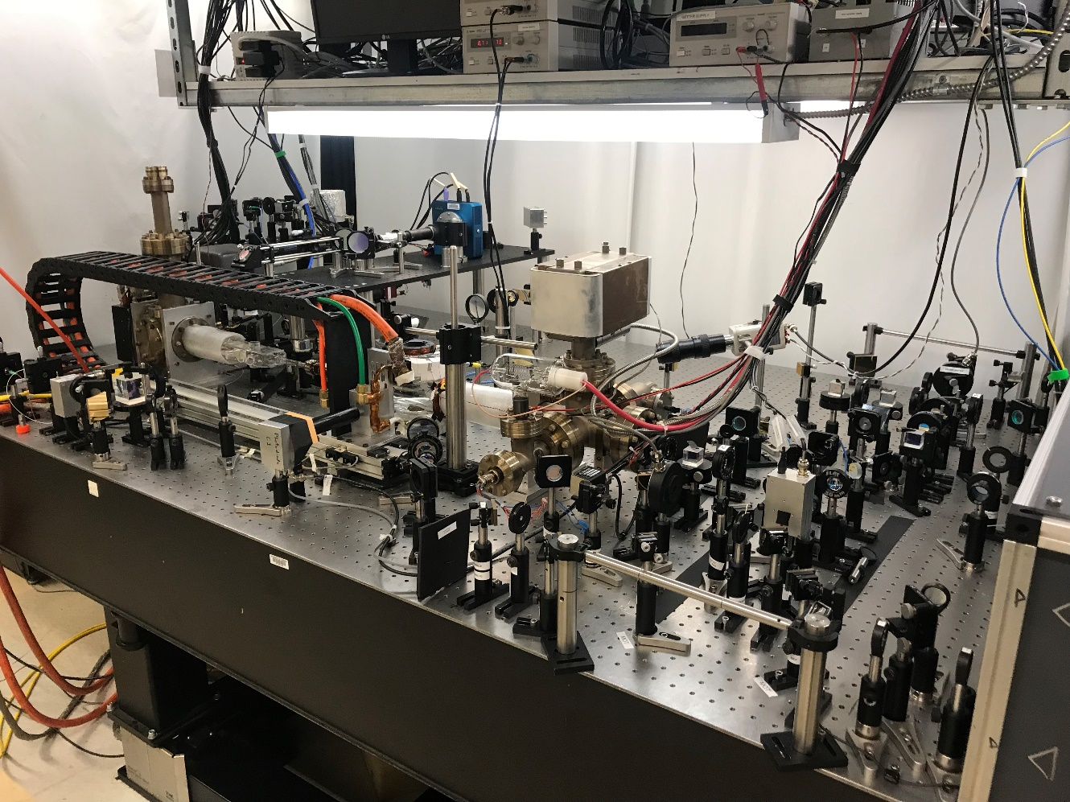
Limitations
Thermal drifts ⇒ $ω$ varies
Visibility declines over time
Slow repetition rate ~ 120 s
Large system volume
For BEC production
Not suitable for field use

Slide 23
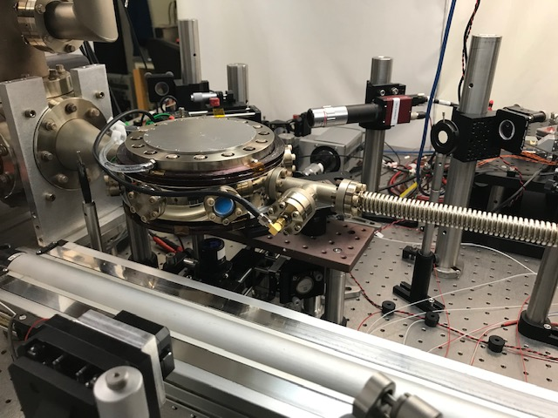
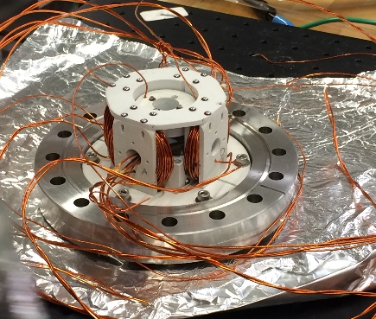
Improved system
Better thermal stability, optical access
But eddy currents
distort trap
Trap potential stability better than ${10}^{−3}$
Position
Time

Slide 24
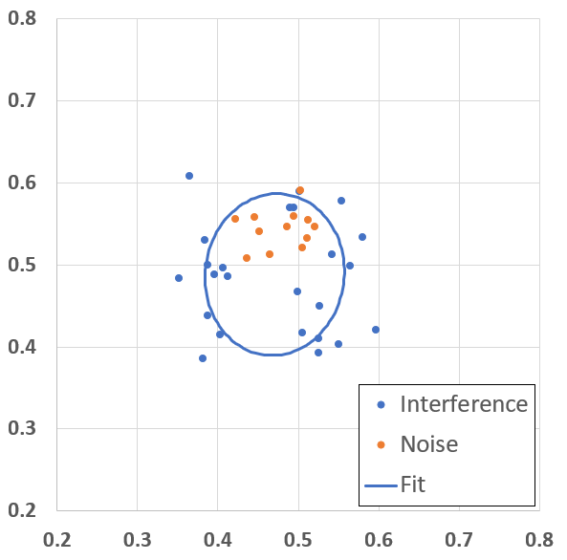
Improved system
mirror
atoms
Reduce trap frequency 9 Hz → 3.3 Hz
Let atoms orbit twice
Diameter = 1.1 mm, area = 6.6 mm²
Two orbit results:
to camera
1 mm
probe
laser
Visibility ≈ 20%

Slide 25
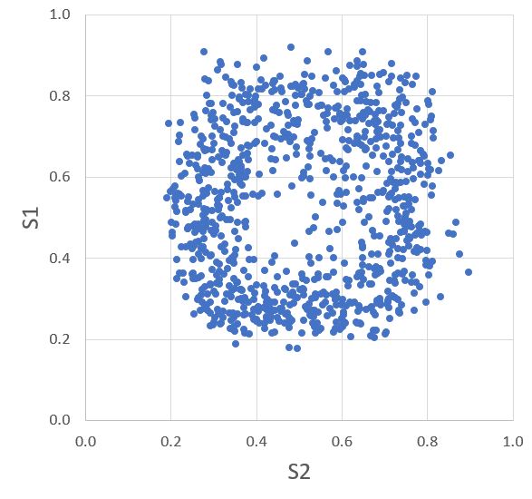
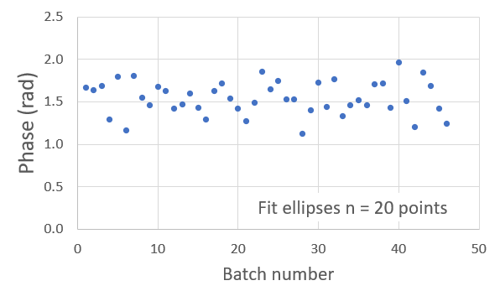
Noise Performance
Run for 24 hours, get large data set
One orbit
Phase stability:
Visibility = 0.51
Phase = 1.47(3) rad
Cycle time = 80 s

Slide 26
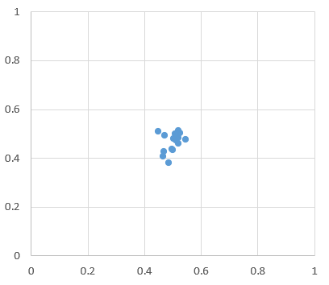
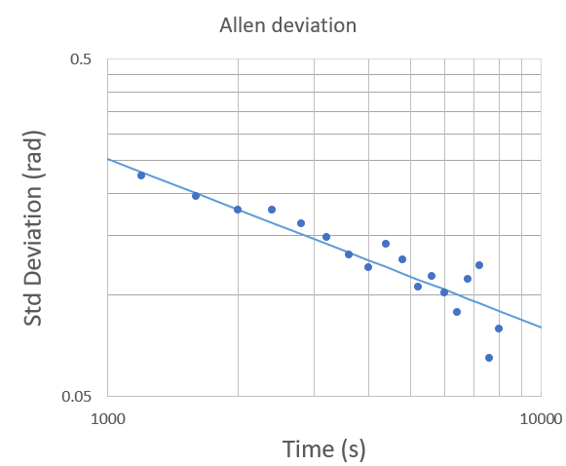
Noise Performance
Imaging noise:
Measure Allen deviation $σ=7$ rad/$√$Hz
Angle noise 2 deg/$√$hr
Compare FOG ${10}^{−3}$ deg/$√$hr
Does average down well
Why so noisy?
a) Slow cycle time, few atoms
Imaging noise limit 0.4 s^{-1/2}
b) Ellipse fitting adds noise
c) Technical noise in system
$$σ=0.03$$

Slide 27
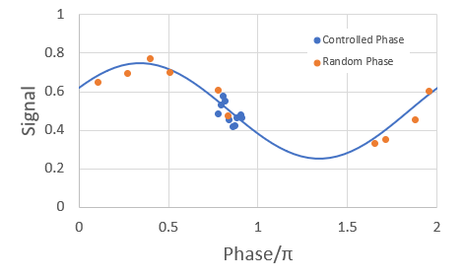
Ellipse fitting
Normal interferometer operates at center of fringe
We sample whole fringe
Model with simulated data
At $σ_{meas}≈0.03,$expect 3× noise
Predicts $σ\left(1 s\right)≈1 \text{s}\text{−1/2}$
Fix? If vibrations are only noise, could isolate or measure, stabilize phase

Slide 28
Technical noise
Conclude $≈$6 $\text{s}\text{−1/2}$ contribution from technical noise
Interferometer is measuring a fluctuating differential phase
Not rotation, some other source?
Noise appears fast, not thermal drifts
Likely culprit: noise in trap magnetic fields
Alternatives:
Bragg laser pointing
Ambient B-field gradient noise

Slide 29
Noise modeling
Current noise ⇒ fluctuating trap potential
Measure relative current noise $≈{10}^{−4}/√$Hz
In harmonic trap, differential phase $Δφ=0$
But trap not perfectly harmonic
Model potential
$c_{λμν}$ = dimensionless error terms
$R=$ orbit radius, $v_{B}=$ Bragg velocity
Also include Bragg beam angles, pulse timing, initial motion
Calculate semi-classical phase $φ=\frac{1}{ℏ}∫T−V dt$
Accuracy of semi-classical approx?

Slide 30
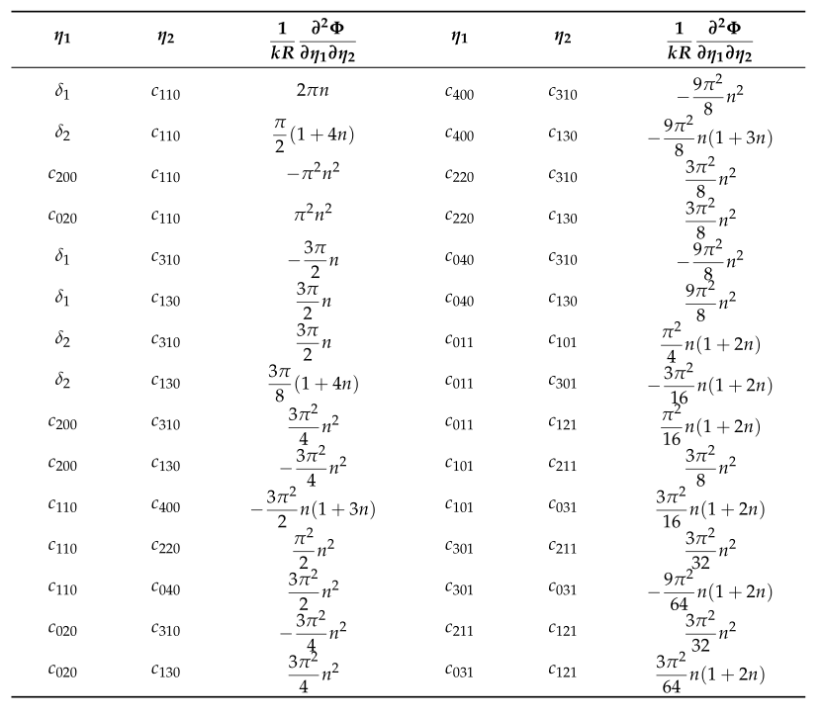
Noise modeling
Luo et al, Atoms 9 21 (2021)
Leading terms 2nd order
Example:
$V=\frac{1}{2}mω^{2}\left(r^{2}+εx^{2}+βxy\right)$
Gives phase
$|Δφ|=π^{2}kRεβ≈5×{10}^{4} εβ$
If $δε≈{10}^{−4}$, phase noise $σ≈5β$
Explain results if $β≈1$
But measure $β≈0.01$
Need to consider many other terms
Know that anharmonic terms are bigger
$k=$ Bragg wavevector
$R=$ trap radius
$n=$ number of orbits

Slide 31
Noise mitigation
1) Find noise source by characterizing trap parameters
Reduce by making trap more ideal:
ie, if $β$ is too big, can make it smaller
Control anharmonic terms using shim coils, TOP waveform
2) Improve current source stability
New drivers approx 10× lower noise
3) Run faster ⇒ better averaging
Use atom chip

Slide 32
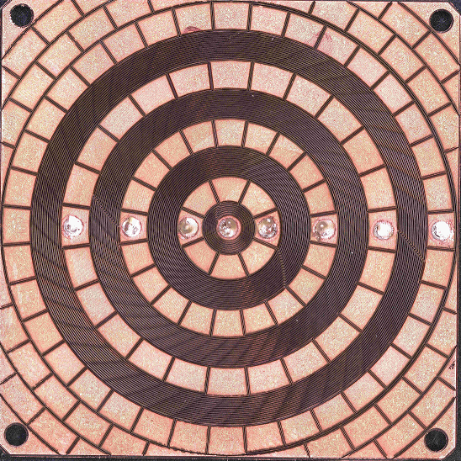
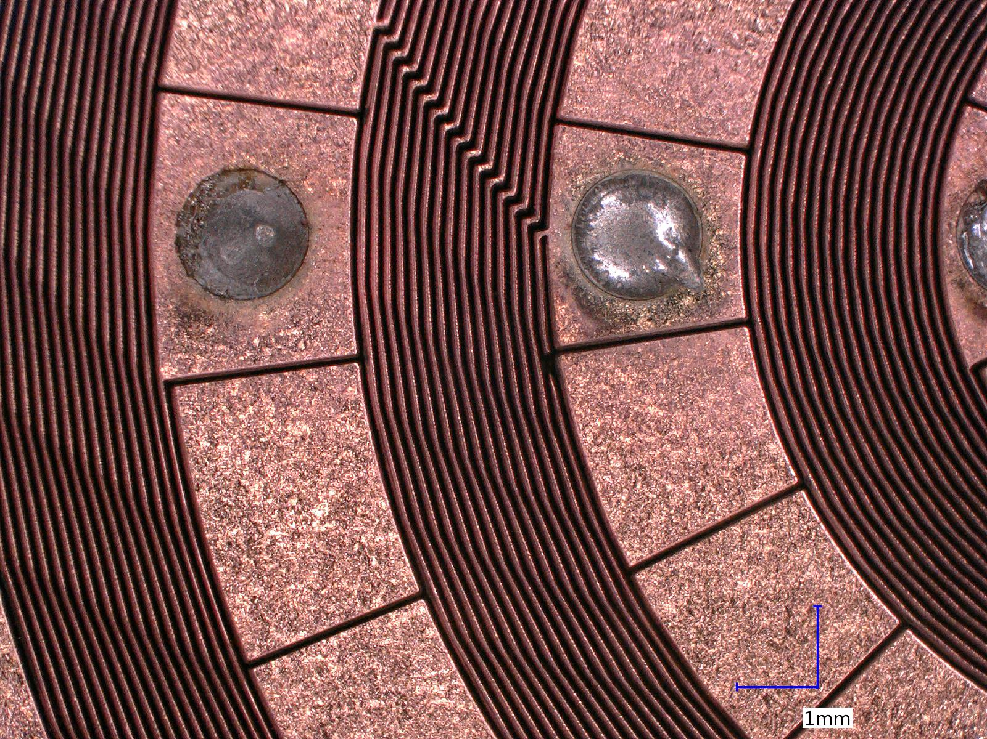
Atom chips
35 mm
Laser milled copper on AlN
Cut by AFRL (Kirtland)
Double sided with solder vias
Wire pitch 72 $μ$m
Symmetric pads reduce eddy currents
Small coil makes strong gradient
$→$ tight trap $→$ faster BEC
Four coils allow fine tuning of trap parameters

Slide 33
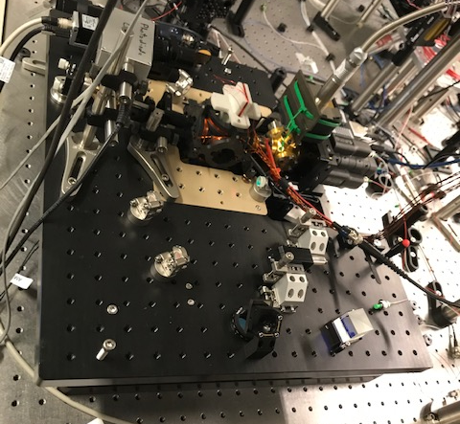
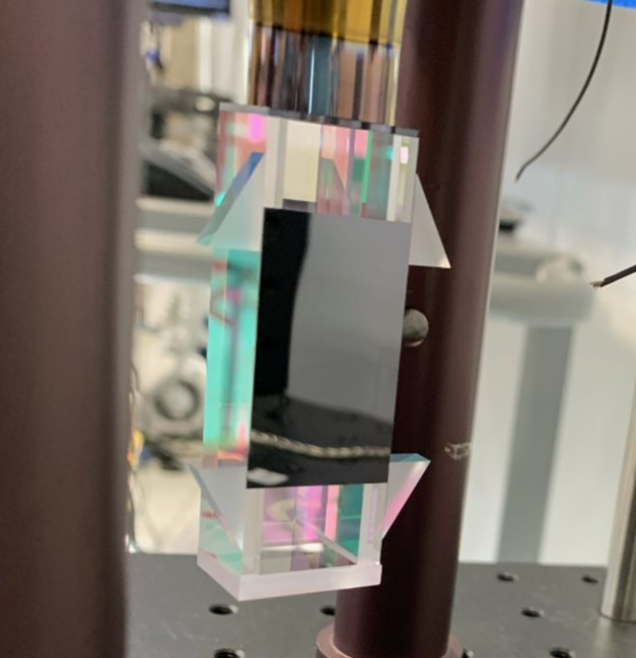
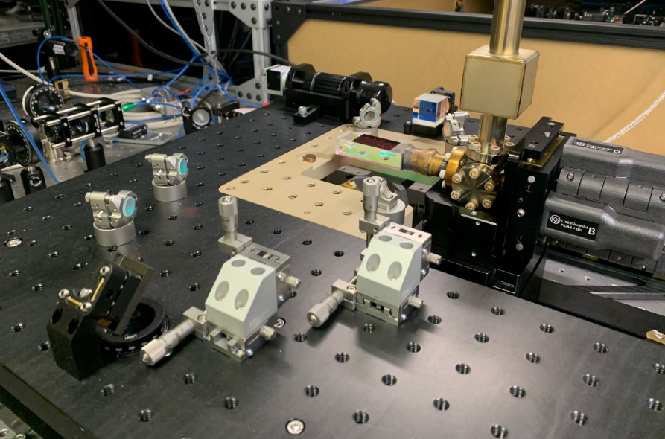
Compact system
Use atom chips with new vacuum system
Constructed by ColdQuanta and Northrop Grumman
All vacuum and trap components on 18”×18”×12” platform
Air-side magnet coils and chip assembly
Apparatus
Cell detail
Optics assembly

Slide 34
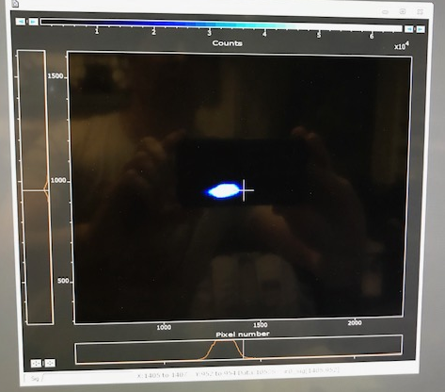
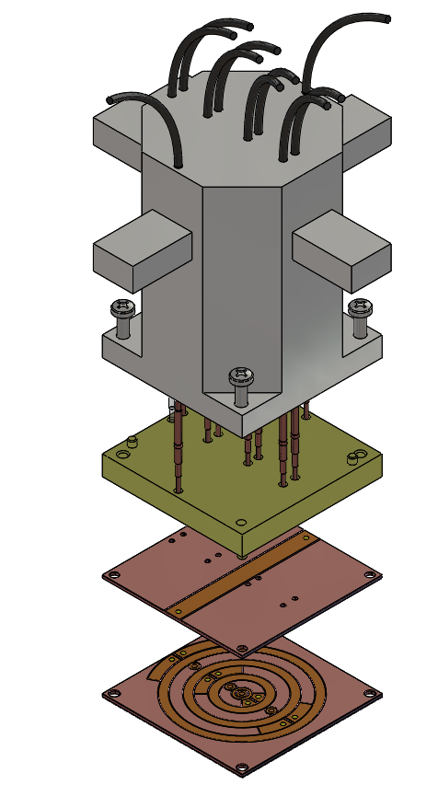
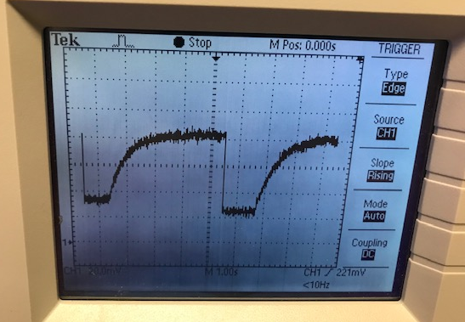
Status
Compact system constructed and delivered
MOT at UVA
Atom chip in place, ready to load atoms
Chip mounting:
MOT loading:

Slide 35
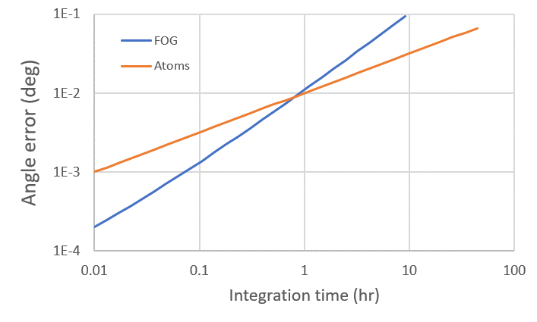
Performance goals
Expect to run at 10 s rate
Aim for noise level 0.2 rad/$√$Hz
Increase area to 15 mm²
ie, 2 orbits in 2 Hz trap
Gives rotation noise ${10}^{−2}$ deg/$√$hr
Compare fiber gyro ${10}^{−3}$ deg/$√$hr ?
Fiber gyro drift = ${10}^{−2}$ deg/hr
At 1 hr or longer, atom gyro better
Improve combined system
How long will atoms curve follow $t^{1/2}$?

Slide 36
Conclusions
Demonstrate good interferometer performance with trapped atoms
Coherence over mm distance, seconds time
Reliable enough for noise characterization
See significant technical noise
Clear route to improve
Close to performance levels that would be navigationally useful
Compact vacuum system starts to address issues with SWAP
Many engineering problems still ahead

Slide 37
Credits
Postdoc: Eddie Moan
Grad students: Marybeth Beydler, Seth Berl, Zhe Luo
Undergrads: Aaron Osborne, Malcolm Schlossberg
Collaborators:
Funding:
Eric Imhof (Northrop Grumman)
Evan Salim (ColdQuanta)
Jim Stickney (Space Dynamics Lab)
Mark Edwards (GSU)

