Slide 1
Shot noise in graphene and the Coulomb interaction
Anatoly Golub and Baruch Horovitz
Ben Gurion University, Israel
arXiv (today, arXiv:0908.0071)
Non-interacting: analogy with dirty metals →
experiment on 2 step distribution.
2. Coulomb interaction → experiment on ω dependence
Benasque 2009

Slide 2

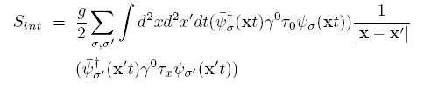

Keldysh Formalism:

Slide 3
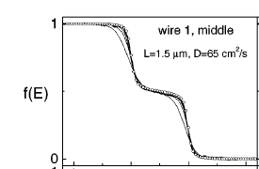
Non interacting case
H. Pothier, S. Guéron, Norman O. Birge, D. Esteve, and M. H. Devoret, PRL 79, 3490 (1997)

Slide 4
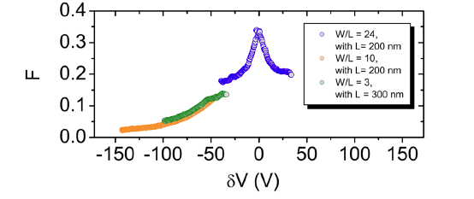
J. Tworzydlo, B. Trauzettel, M. Titov, A. Rycerz, and C.W.J. Beenakker, Phys. Rev. Lett. 96, 246802 (2006)
A. Schuessler, P.M. Ostrovsky, I.V. Gornyi, and A.D. Mirlin, Phys. Rev. B 79, 075405 (2009)
S. Ryu, C. Mudry, A. Furusaki, and A.W.W. Ludwig, Phys. Rev. B 75, 205344 (2007)
F. Miao, S. Wijeratne, Y. Zhang, U. C. Coskun, W. Bao, and C. N. Lau, Science 317, 1530 (2007)
L. DiCarlo, J.R.Williams, Yiming Zhang, D.T. McClure, and C.M. Marcus, Phys. Rev. Lett. 100, 156801 (2008)
R. Danneau, F. Wu, M.F. Craciun, S. Russo, M.Y. Tomi, J. Salmilehto, A.F. Morpurgo, and P.J. Hakonen, Phys. Rev. Lett. 100, 196802 (2008) → figure

Slide 5
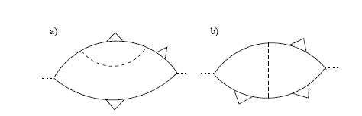
Coulomb interaction:
I. F. Herbut, V. Juričič and O. Vafek, Phys. Rev. Lett. 100, 046403 (2008)
12 J. Gonzalez, F. Guinea, M. A. Vozmediano Nuclear Physics B424 ,595 (1994)
13 T. Stauber, F. Guinea, M. A. Vozmediano Phys. Rev B 71, 041406 (2005)
Fano factor remain 1/3 !
Proposed experiment: measure S(ω) to identify interaction term.

