Slide 1
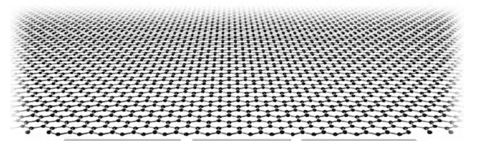
Mott phases, phase transitions, and the role of zero-energy states in graphene
Igor Herbut (Simon Fraser University)
Collaborators:
Bitan Roy (SFU)
Vladimir Juricic (SFU)
Oskar Vafek (FSU)

Slide 2
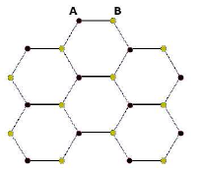
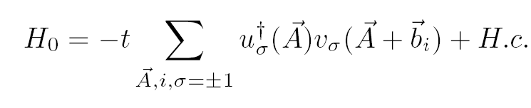


Graphene: 2D carbon (1s2, 2s2, 2p2)
Two triangular sublattices: A and B; one electron per site (half filling)
Tight-binding model ( t = 2.5 eV ):
(Wallace, PR , 1947)
The sum is complex => two equations for two variables for zero energy
=> Dirac points (no Fermi surface)

Slide 3
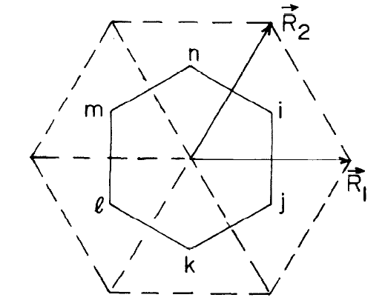
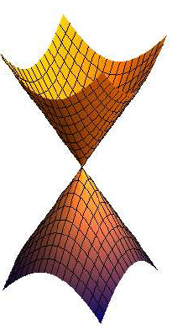





Brillouin zone:
Two inequivalent (Dirac) points at :
+K and -K
Dirac fermion:
“Low - energy” Hamiltonian:
i=1,2
,
(v = c/300 = 1, in our units)

Slide 4

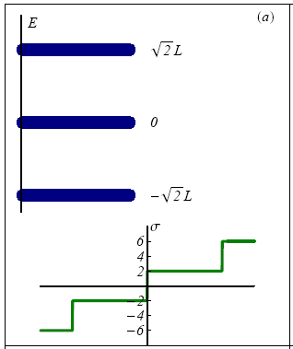
Experiment: how do we detect Dirac fermions?
Quantum Hall effect (for example):
Landau levels: each is
2 (spin) x 2 (Dirac) x eB (Area)/hc
degenerate => quantization in steps of
four !
(Gusynin and Sharapov, PRL, 2005)

Slide 5
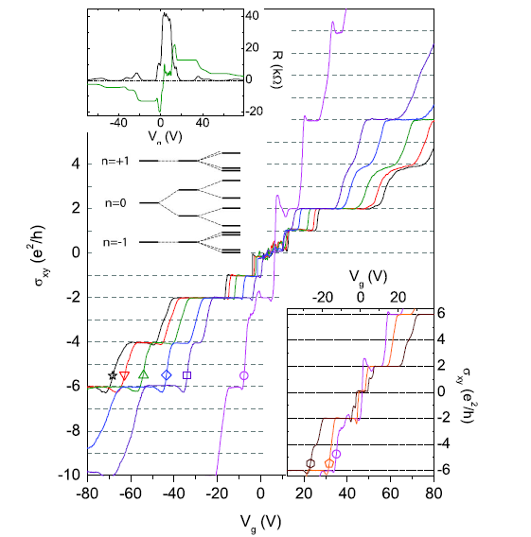
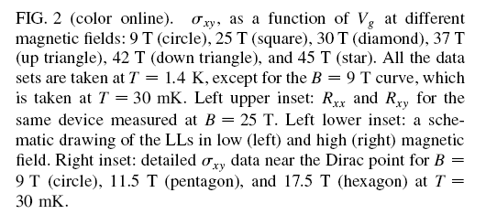
(Y. Zhang, PRL, 2006)

Slide 6





Symmetries: exact and emergent
Lorentz
(microscopically, only Z2 (A <-> B) x Z2 ( K <-> -K) = D2, dihedral group)
2) Chiral :
=
,
Generators commute with the Dirac Hamiltonian (in 2D). Only two are emergent!
3) Time-reversal (exact) :
( + K <-> - K and complex conjugation )
(IH, Juricic, Roy, PRB, 2009)

Slide 7





4) Particle-hole (supersymmetry): anticommute with Dirac Hamiltonian
,
= >
and so map zero-energy states, when they exist, into each other!
Only the zero-energy subspace is invariant under both symmetry (commuting) and supersymmetry (anticommuting) operators.

Slide 8








“Masses” = supersymmetries
1) Broken chiral symmetry, preserved time reversal
→
+
2) Broken time reversal symmetry, preserved chiral
→
+
In either case the spectrum becomes gapped:
,
=
,

Slide 9


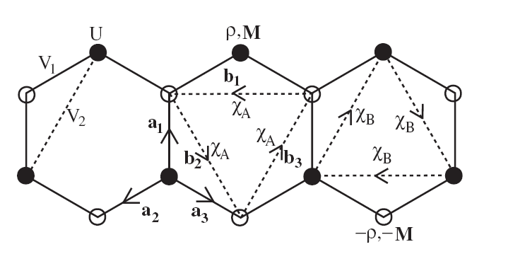
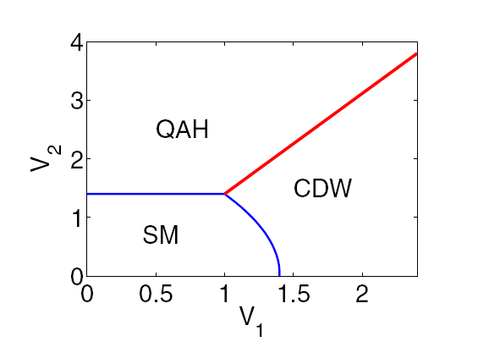
On lattice?
1) m
staggered density, or Neel (with spin); preserves translations (Semenoff, PRL, 1984)
2)
circulating currents (Haldane, PRL, 1988)
( Raghu et al, PRL, 2008, generic phase diagram IH, PRL, 2006 )

Slide 10




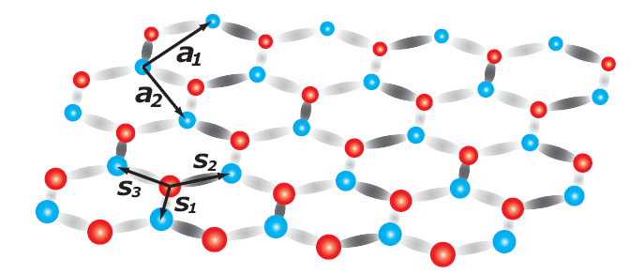
+
Kekule hopping pattern
3)
( Hou, Chamon, Mudry, PRL, 2007)

Slide 11




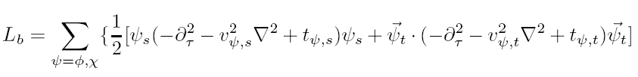


Relativistic Mott criticality (IH, Juricic, Vafek , arXiv:0904.1019)
Order parameters:
Haldane; singlet, triplet
singlet (CDW), triplet (SDW)
Field theory:

Slide 12
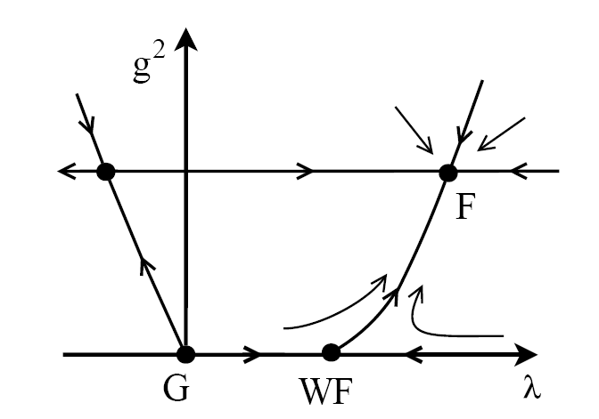







RG flow:
singlet (triplet)
Exponents:
Long-range “charge”:
Irrelevant!
Analogous to QED4? (Kogut-Strouthos, PRD 2005)

Slide 13


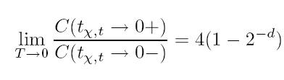
Emergent relativity: define small deviation
and it is irrelevant perturbation :
Consequence: universal ratio of fermionic and bosonic specific heats
Transition: from Dirac fermions to Goldstone bosons!

Slide 14

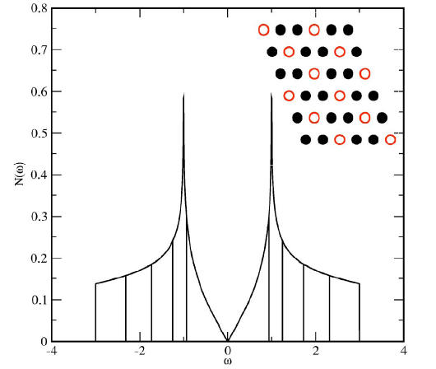


“Catalysis” of order: magnetic and otherwise
Strong interactions are needed for the gap because there are very few states near the Fermi level:
Density of states is linear near Dirac point:
and
( IH, Viewpoint, Physics 2009 )

Slide 15
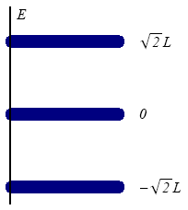
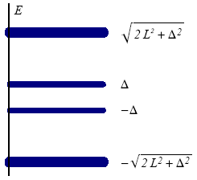
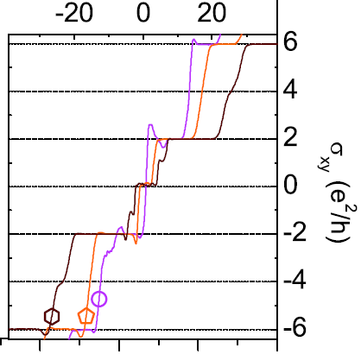
In the magnetic field: Landau quantization => DOS infinite
=> critical interaction infinitesimal
( Gusynin, Miransky, Shovkovy, PRL, 1994)
→
Zero-energy level is split, others only shifted
=> quantum Hall effect at new filling factor at
zero!
IH, PRB 2006, PRB 2007, IH and Roy, PRB 2008

Slide 16






But which order is catalyzed?
The Hamiltonian is :
so that,
where,
is TRS breaking mass.
so all zero energy states have the same eigenvalue ( +1 or -1) of
for a uniform magnetic field.

Slide 17
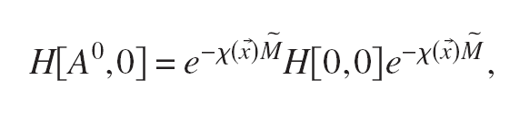


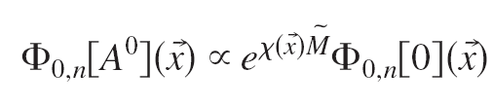


For a non-uniform magnetic field:
where
( In Coulomb gauge,
.)
Zero-energy states with and without magnetic field are simply related:
since at large distance, for a localized flux F
normalizability requires them to be -1 eigenstates of
!!

Slide 18



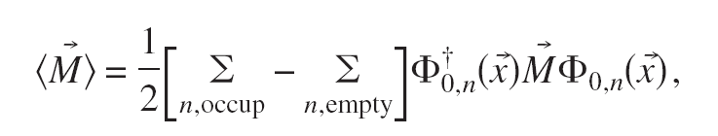
Since, however,
half of zero-energy states have +1, and half -1 eigenvalue of
For any anticommuting traceless operator, such as
(IH, PRL, 2007)
So:
TRS broken explicitly => CS broken spontaneously

Slide 19









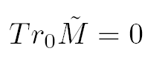



Is the opposite also true?
Consider the non-Abelian potential:
which manifestly breaks CS, but preserves TRS. Since,
for example, represents a variation in the position of the Dirac point,
induced by height variations or strain.
still anticommutes with
but also with
so
CS broken explicitly => TRS broken spontaneously
(IH, PRB, 2008)

Slide 20



Pseudo-magnetic catalysis:
Flux of non-abelian pseudo-magnetic field
=>
Subspace of zero-energy states (Atiyah-Singer, Aharonov-Casher)
Equally split by TRS breaking mass
=>
=>
With next-nearest neighbor repulsion, TRS spontaneously broken
In a non-uniform pseudo-magnetic field (bulge):
local TRS breaking!

Slide 21
In sum:
1) Dirac Hamiltonian in 2D has plenty of (emergent) symmetry
2) Chiral symmetry + Time reversal => plethora of insulators
3) Mott QCP controllable near 3+1D: emergent relativity
4) Interactions need to be strong for Mott transition in 2+1D ,
but
5) Ubiquitous zero-energy states => catalyze insulators
(QHE at filling factors zero and one in uniform magnetic field)
6) Non-abelian flux catalyzes time-reversal symmetry breaking!

