Slide 1
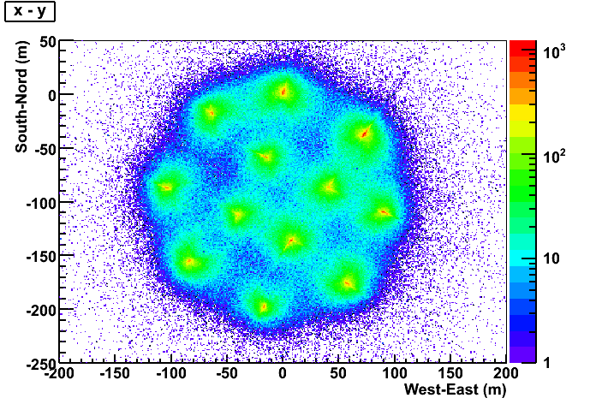


Neutrino Telescopes
IceCube, ANTARES and KM3NeT
J.J. Hernández-Rey
IFIC
XXXVII International Meeting on Fundamental Physics, Benasque, February 2009

Slide 2
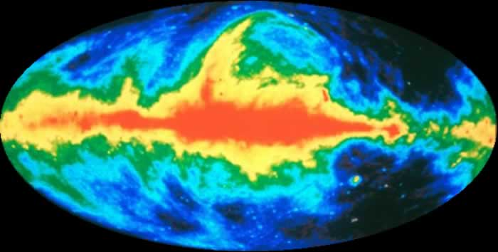
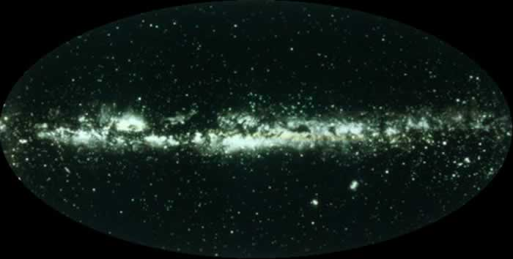
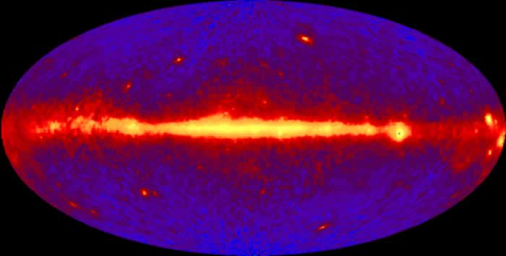
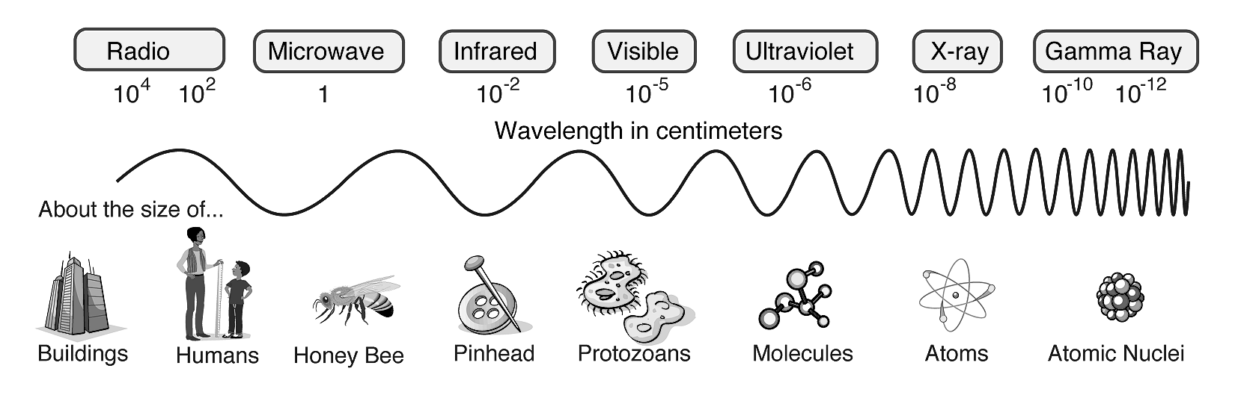
Motivations
408 MHz – Bonn, Jodrell Banks & Parks
Photomosaic - Lausten et al.
>100 MeV – CGRO / EGRET
ANTARES/AMANDA/KM3Net/IceCube
?
Radio continuum
Optical
Gamma ray
Neutrinos
If E_{ν} ≈ 10 GeV–10² EeV → 10 orders of magnitude range
(same span as radio to X-ray in EM radiation, but at λ<10⁻¹⁴ cm)
2
Notes:
Why neutrino astronomy, the reason is because we are physicists and curious and we have survey the universe with the em spectrom from low to high frequencies and wanted to know how it will look like using other cosmic messenger such as neutrinos. We expect to provide here a neutrino map (maybe labelled by ANTARES).
2

Slide 3
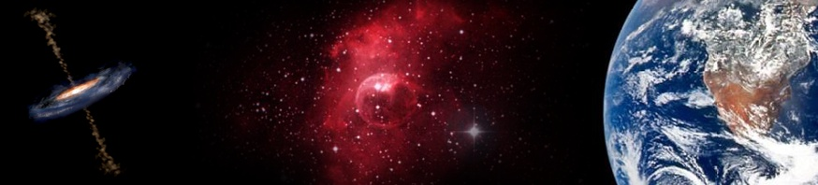
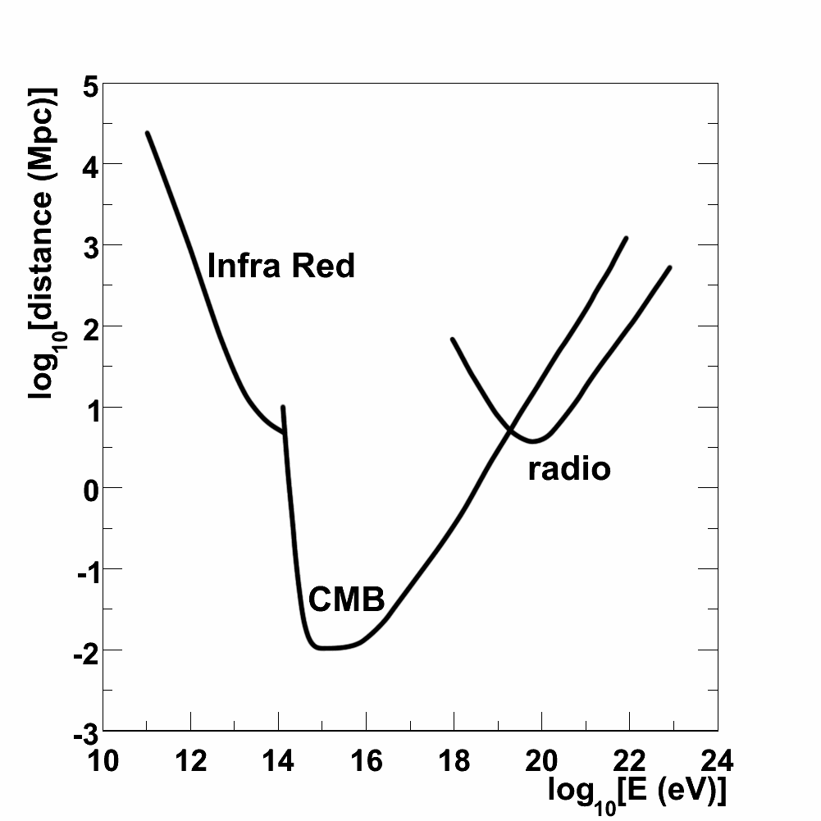
Cosmic messengers
Why neutrino astronomy?
p
n
γ
ν
Protons are deflected by magnetic fields (E_{p}< 10¹⁹ eV) UHE protons interact with the CMB (E_{p}> 10¹⁹ eV → 30 Mpc)
Neutrons decay (~10 kpc at E ~ EeV).
Photons interact with the EBL (~100 Mpc)
and CMB (~10 kpc).
Neutrinos are neutral weakly interactive particles.
e⁺e⁻
Mkn 421
CMB
Local group
Protons
GC
Photons
Notes:
Why neutrinos, aren´t there other cosmic messengers. And the answer is yes, but protons for instance, are charge particles deviated by magnetic fields and that also intercats with the CMB in the GZK effect. And neutrons decay reaching onlu distances of kpc. Photons are neutral but they are absorbed and they interact with the EBL, and CMB, here you can see the mean path travelled by photons (black) and protons (orange) and some interesting distances as a reference. So if we want to explore the high and dense Universe we need neutrinos, because they are neutral weakly interactive particles, so the come from the dense parts of the universe in straight line.

Slide 4
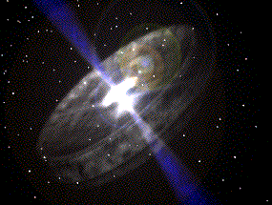
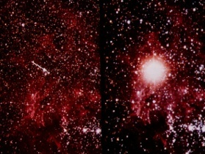
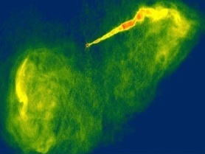
Scientific scope
Less amount of light
Lower ranges
⁴⁰K background
?
~MeV | GeV-100 GeV | GeV-TeV | TeV-PeV | PeV-EeV | EeV
Earth opacity
Decreasing neutrino flux

Slide 5
Where can neutrinos come from?
WIMP decay products
HE neutrinos are the decay sub-products of the annihilation of WIMPs which may concentrate in astrophysical objects.
Astrophysical objects
HE neutrinos appear as the sub-product of interactions of accelerated protons or nuclei with matter or radiation

Slide 6

High energy cosmic rays

Slide 7
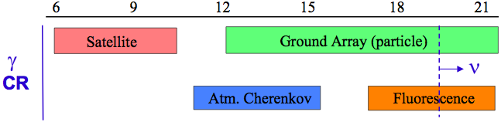
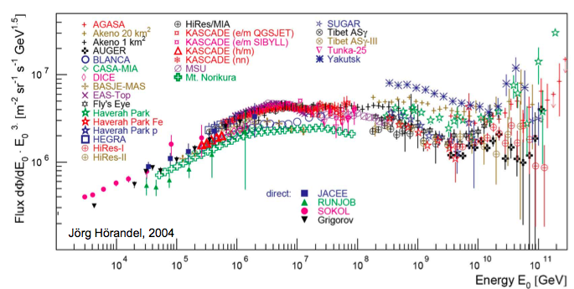
A close-up of the CR spectrum
ln E (eV)
Balloons
Balloons
dip
knee
2nd knee
GZK
ankle
From A. Castellina using J.R.Hoerandel

Slide 8
Cosmic Rays, Gamma-rays and Neutrinos
black holes,
merging neutron stars,...
Leptonic acceleration
Electrons are accelerated in cosmic environments via Fermi Mechanism.
Gamma rays are produced in the interaction of multi-TeV electrons with ambient light (IC scattering).
Neutrinos are not foreseen in this context.
shock
γ
e⁻
γ
Hadronic acceleration
shock
Protons and heavy nuclei are accelerated via Fermi Mechanism and interact with ambient photons.
Gamma rays are produced via π⁰–meson decay.
Neutrinos are also produced via π⁺-meson decay.
p
γ
π⁰
p
γ
e⁻
γ
e⁺
e⁺
e⁻
X-ray observations indicate that leptonic acceleration exists. But we observe CR protons, hence there should be hadronic acceleration.
Notes:
There is a relation ship between CR, gamma rays and Neutrinos. There are two main mechanism to explain CR acceleration in the bottom-up scenarios. Both invoke the Fermi Mechanism in shock waves of astronomical objects to accelerate charge particles, but in the leptonic model electrons are accelerated, and in hadronic model hadrons are accelerated. Only in this second case neutrinos are expected from the interaction of protons with ambient light realising pions. Neutrial pions will produced gamma rays, but charge pions will decay emitiing neutrinos. X-ray obserbation indicate that there are evidence of leptonic accelerations, but we observed CR protons, hence an hadronic acceleration (and neutrino emission) should be present.

Slide 9
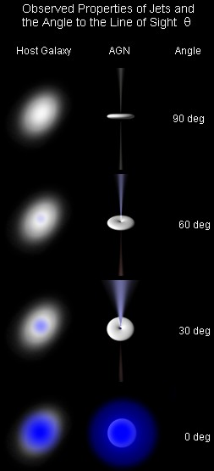
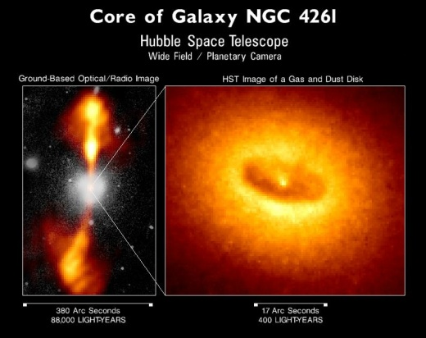
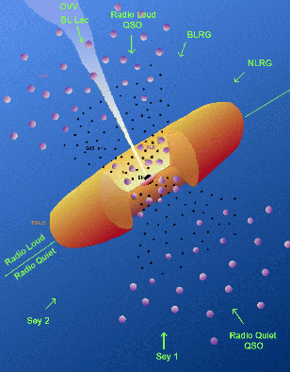
Neutrinos sources
Extra-Galactic sources
The two most promising candidates are: Active Galactic Nuclei (AGN) and Gamma-ray Bursts (GRB)
AGNs
A high luminosity compact region at the centre of some galaxies that are believed to be supermassive black holes that acrrete matter.
“Different objects” are just AGNs with different features: “Blazars” (BL Lac, FSRQs, etc.) are AGNs with jets pointing to Earth.
The P.A. Observatory sees a
Correlation between UHECR and nearby AGNs
Notes:
The neutrino sources candidates can be divided in galacic and extragalacit sources. Among galactic source we have. Specially interesting is the SNR RX 1713 which gamma-ray spectrum is better explaind by a neutral pion decay. Gamma ray and AGN are the candidates for ectra galacitc sources, there is a limit on the expected neutrino flux from these sources based on CR observations for transparent sources. This upper limit is known as the Waxman-Bahcall limit.

Slide 10
P.A.O results on UHECRs
UHECRs and AGNs
Some remarks
Correlation of UHECRs with AGNs positions: 20 out of 27 CRs with E>57 EeV correlate (within 3.2º) with nearby AGNs from the Véron-Cetty&Véron catalogue ( 292 AGNs with D < 75 Mpc).
The observed pattern has a probability of 10⁻⁵ to come from isotropically distributed sources
Correlation is not a proof of causality
The VCV catalogue is known to be incomplete

Slide 11
Extra-Galactic sources and the CR – Neutrino relationship
Extra-Galactic sources
Waxman & Bahcall limit
E² dN/dE ≈ 10⁴⁴ erg Mpc⁻³ yr⁻¹
(E ~ 100 PeV)
Estimate the relation between
E² dN/dE for CR and neutrinos
Assume optically thin sources
Assume some evolution with z
Take into account the effect of
oscillations:
(ν_{e}:ν_{μ}:ν_{τ})→(1:2:0) → (1:1:1)
MPR
Possibility of some other effects (different injection spectra, optically thin sources, neutron escape)
Some controversy
Waxman-Bahcall limit based on CR observations for transparent sources:
E²_{ν} Φ_{ν} < 4.5 x 10⁻⁸ GeV cm⁻² s⁻¹ sr⁻¹
11
Notes:
The neutrino sources candidates can be divided in galacic and extragalacit sources. Among galactic source we have. Specially interesting is the SNR RX 1713 which gamma-ray spectrum is better explaind by a neutral pion decay. Gamma ray and AGN are the candidates for ectra galacitc sources, there is a limit on the expected neutrino flux from these sources based on CR observations for transparent sources. This upper limit is known as the Waxman-Bahcall limit.
11

Slide 12
SNRs - RX J1713.7–3946
A special SNR
A clear shell-type SN discovered in soft X-rays by ROSAT. Bright X-ray emission by ASCA. In HE gamma by CANGAROO AND CANGAROO-II.
CANGAROO-II hinted a possible hadronic origin. HESS (2003-2005) confirms the difficulty to explain it by leptonic acceleration.
Unnaturally low B fields have to be assumed to avoid too high synchroton radiation
(B ≤ 10 μG, even interestellar fields are higher and shocks are expected to amplify fields. Measurments in other SNRs indicate B ~ 100 μG)
Spectrum up to several tens of TeV. If gammas come from π⁰, then protons are accelerated at E > several hundreds of TeV.
Two other cases (RX J0852.0-4622 and RCW86, acceleration still unclear)
12
Notes:
The neutrino sources candidates can be divided in galacic and extragalacit sources. Among galactic source we have. Specially interesting is the SNR RX 1713 which gamma-ray spectrum is better explaind by a neutral pion decay. Gamma ray and AGN are the candidates for ectra galacitc sources, there is a limit on the expected neutrino flux from these sources based on CR observations for transparent sources. This upper limit is known as the Waxman-Bahcall limit.
12

Slide 13
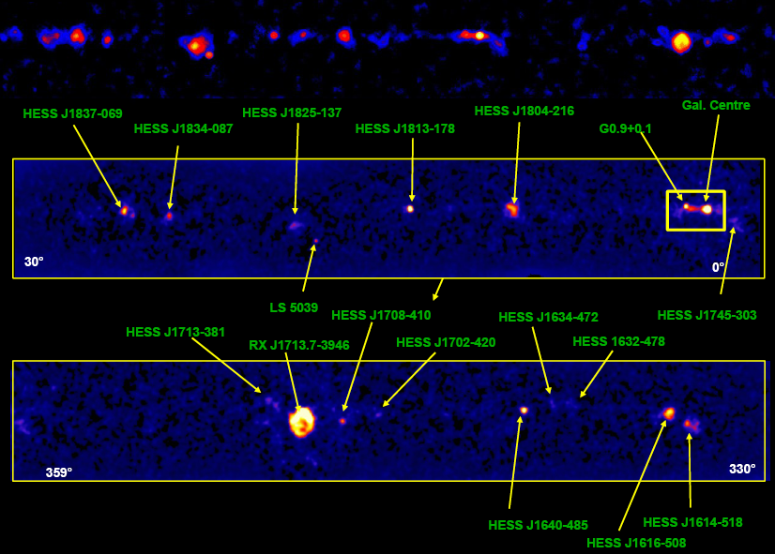
The Galactic centre and plane by HESS
Sgr A* (a radio source) lies on the position of a super-massive black hole (~ 3 x 10⁶ solar masses in 17 light-hours) in the Galaxy (according to star movements).
Sgr A* emits X-rays (among others) HESS J1745-290 seems to be very near Sgr A*(excluded to come from Sgr A East, a SNR)
No coincide of X-ray flares and γ-rays observed
There is a PWN nearby (G259.95-0.04)
Several gamma-ray sources in the Galactic plane

Slide 14
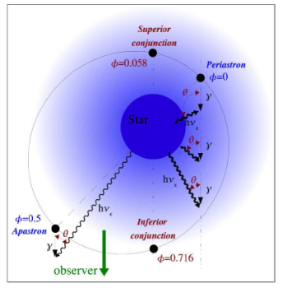
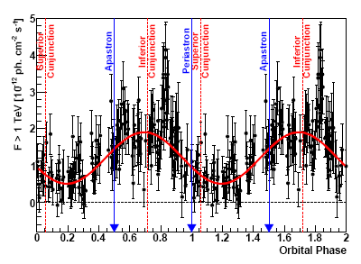
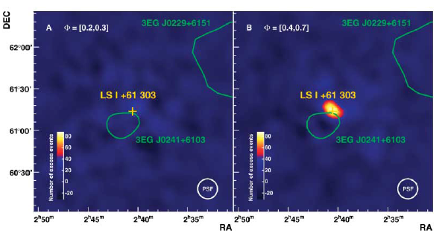
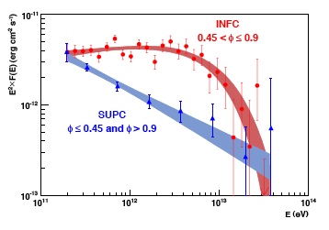
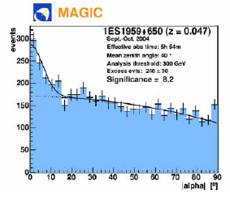
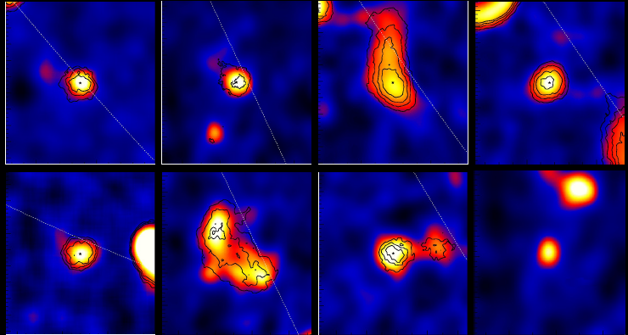
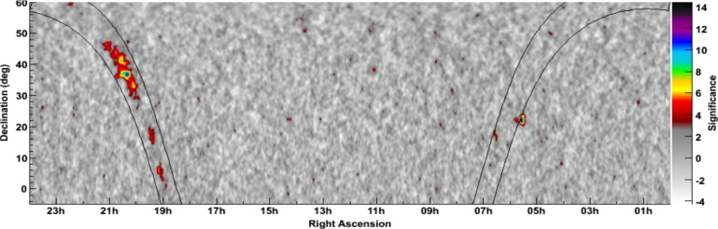
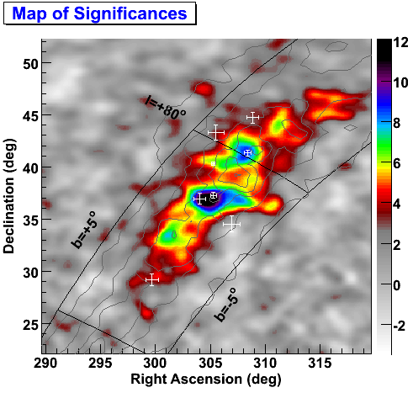
A plethora of new γ sources
binary pulsars
galactic periodic sources
Micro-quasars
AGNs with “orphan” flares
1ES 1959+650
“Dark sources”
(not seen in X-rays or visible)
Extended sources
Notes:
The neutrino sources candidates can be divided in galacic and extragalacit sources. Among galactic source we have. Specially interesting is the SNR RX 1713 which gamma-ray spectrum is better explaind by a neutral pion decay. Gamma ray and AGN are the candidates for ectra galacitc sources, there is a limit on the expected neutrino flux from these sources based on CR observations for transparent sources. This upper limit is known as the Waxman-Bahcall limit.
14

Slide 15
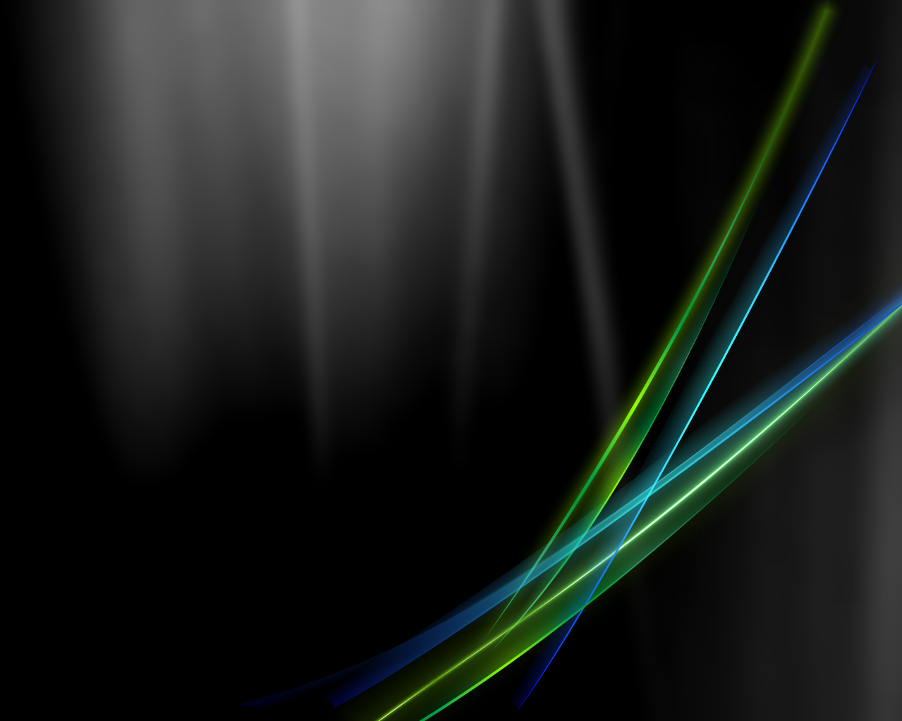
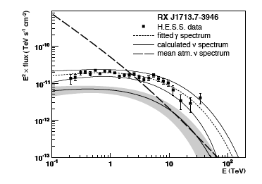
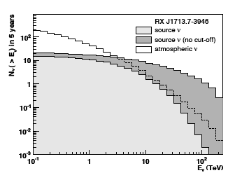
Predictions
Within some natural assumptions
a few neutrino events are predicted
in a km3 detector
Kappes et al, astro-ph/0607286

Slide 16
Required neutrino fluxes
Powerful sources
Some distances
Required luminosity in neutrinos is:
N – Observed neutrinos ; D – Source distance
A – Effective area ; T – Data taking time
For a few observed neutrinos in one year in a detector of
A ~ 1 km² coming from 4 Gpc → L_{ν} ~ 10⁴⁷ erg/s
10¹³ times the power of our Sun: Only AGNs (10⁴⁸ erg/s, continuous) and GRBs (10⁵² erg/s, instantaneous) are known to deliver such power)
In the Galaxy (D ~ few kpc) → L_{ν} ~ 10³⁴ erg/s.
Only SNRs, PWN and micro-quasars could deliver such power.
The Milky Way
~ 30 kpc across
Andromeda
D ~ 0.8 Mpc
Virgo Cluster
(the nearest large cluster)
D ~ 18 Mpc
Galaxy RXJ1242-11
(a supermassive black hole)
D ~ 200 Mpc
The observable Universe
D ~ 14 Gpc
To give you an idea:
1 attoparsec ≈ 1 inch
(as useless for intuition as any other equivalence)

Slide 17
Detection of extra-terrestrial neutrinos
Optical Cherenkov
Atmospheric showers
Radio
Acoustic
In Ice
In water
Earth based
In space
Earth based
In space
AMANDA B-10
AMANDA II
IceCube
Baikal
ANTARES
NEMO
NESTOR
Auger
EUSO
OWL
RICE
GLUE
SalSA
CODALEMA
ARIANNA
ANITA
FORTE
SAUND
SADCO (Greece)
ANTARES R&D
IceCube
AUTEC
AGAM
KM3NeT

Slide 18
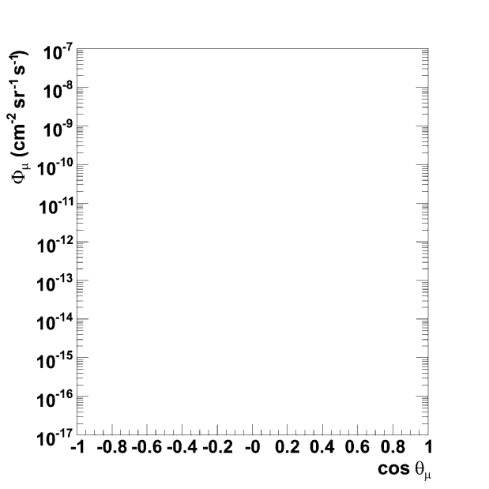
νμ
μ
p
Cosmic neutrinos can interact in the Earth and release a muon
W
N
X
μ
Atmospheric muons and neutrinos can also induce a signal at the detector
atmospheric µ
ν_{atm}
ν_{μ}
ν induced µ
p
Detection principle

Slide 19
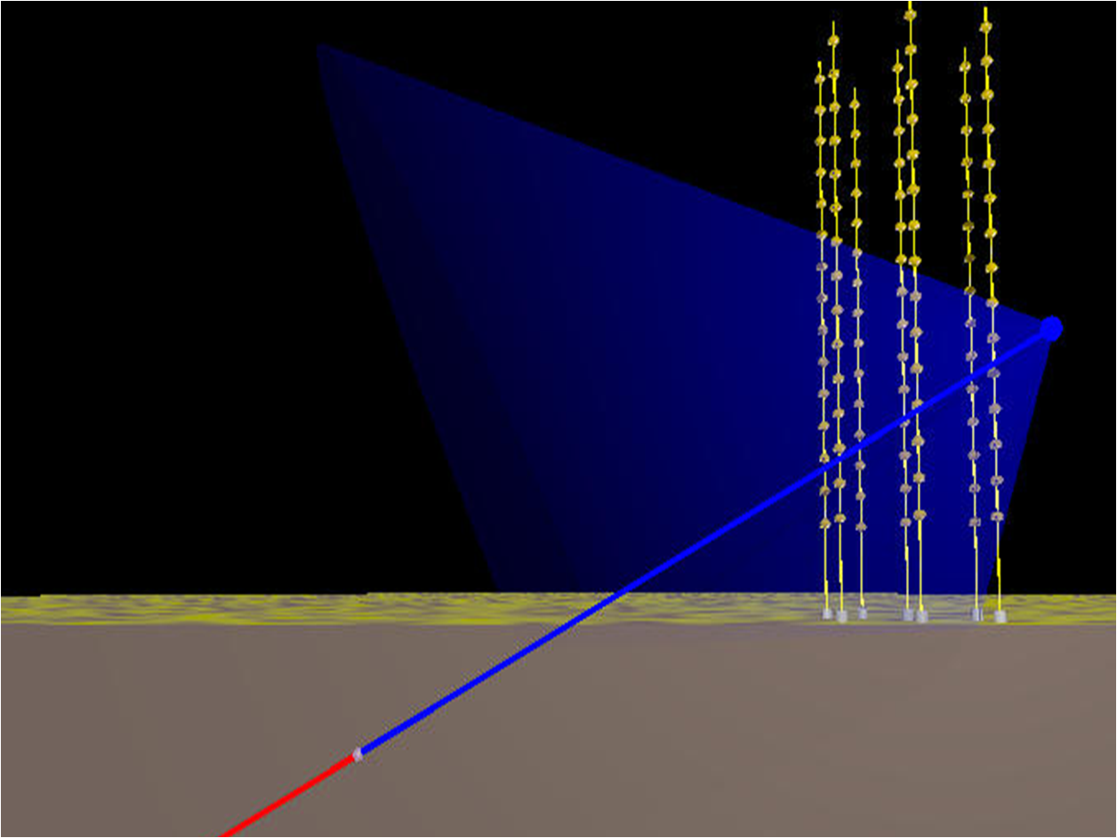
Requires a large dark transparent medium (ice/water)
Muon neutrinos are well suited for HE detection (cross-section and muon range increase with energy)
Muons emit Cherenkov light collected by a lattice of PMTs.
Other signatures can also be detected. Long track → angular resolution
γ_{c}
θ_{c}
μ
ν
Cherenkov Neutrino detection

Slide 20
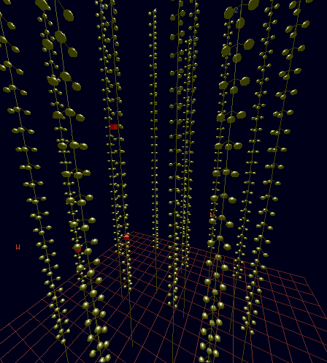
Simulation of a 1.2 TeV muon

Slide 21
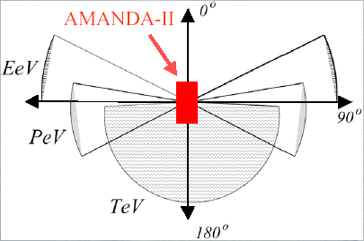
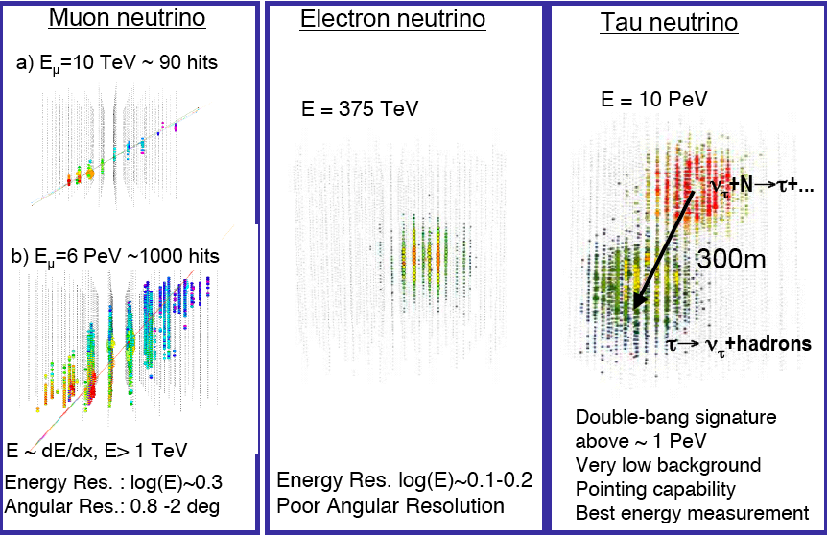
Different channels, different energy regions
Earth starts to become opaque at E~1 PeV
Below the horizon PeV neutrinos can be detected
Downgoing tracks at high energies (EeV) can only come neutrinos
Detector
In addition to muons, EM showers can be identified.
Tau neutrinos can be identified by double bang events (production and decay).
21
Notes:
First I will explain the detection principle of ANTARES and any other Cherenkov neutrino detection. It is the following, being weakly interactive particles cosmic neutrinos can cross the Earth and a fraction of them will interact in the sour of the detector realising a muon that reaches the detector. This detection principle entails two unavoidable physical background both related with CR interaction in the upper shells of the atmosphere.
21

Slide 22
Effective Area and Energy response

Slide 23
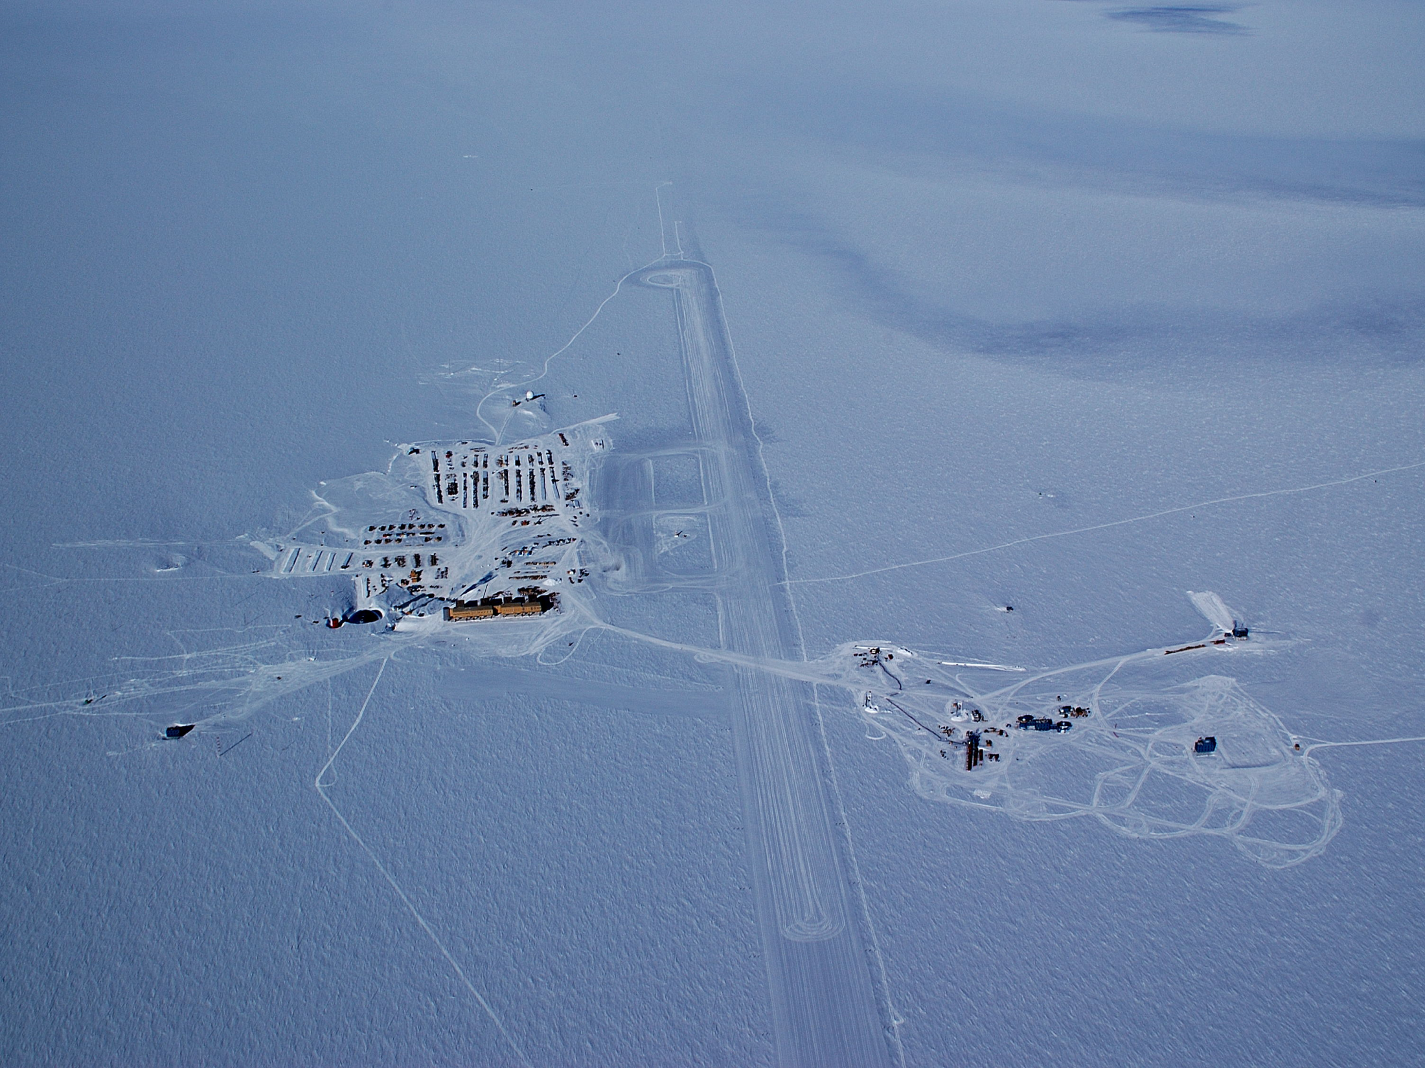
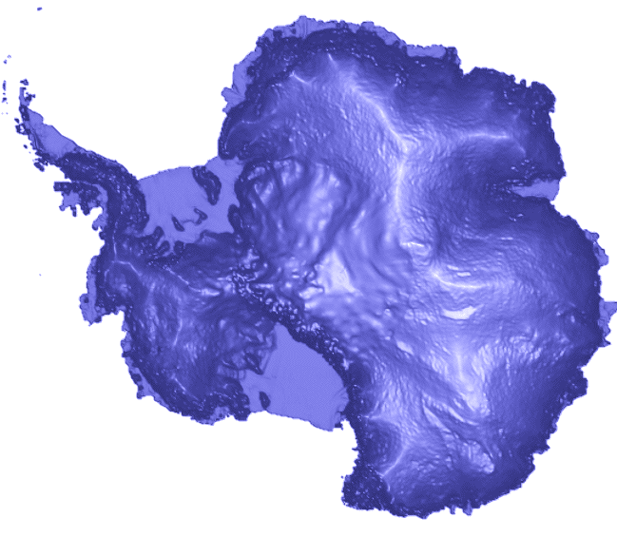
Amundsen-Scott South Pole Station
Where are we ?
runway
South Pole
AMANDA-II
IceCube

Slide 24
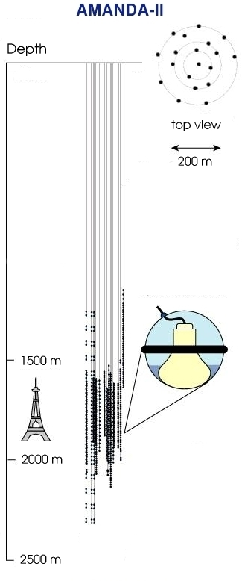
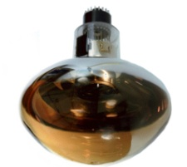
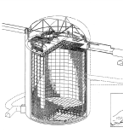
AMANDA Detector
1997-99: AMANDA-B10
(inner lines of AMANDA-II)
10 strings
302 PMTs
Since 2000: AMANDA-II
19 strings
677 OMs
20-40 PMTs / string
merged into IceCube
Year | Livetime
2000 | 197 d
2001 | 193 d
2002 | 204 d
2003 | 213 d
2004 | 194 d
2005 | 199 d
2006 | 187d
Total | 3.8 years
50 m
SuperK !

Slide 25
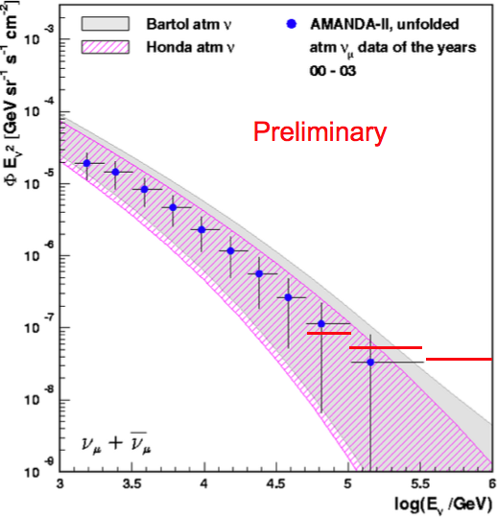
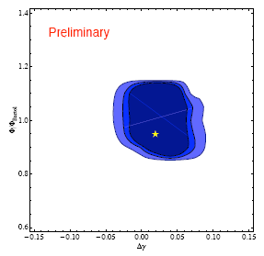
Diffuse flux limits
Expected precision (90%, 95% and 99% C.L.)
in flux (wrt Bartol) and spectral index for the
whole AMANDA data set.
Limits on a possible E⁻² component

Slide 26
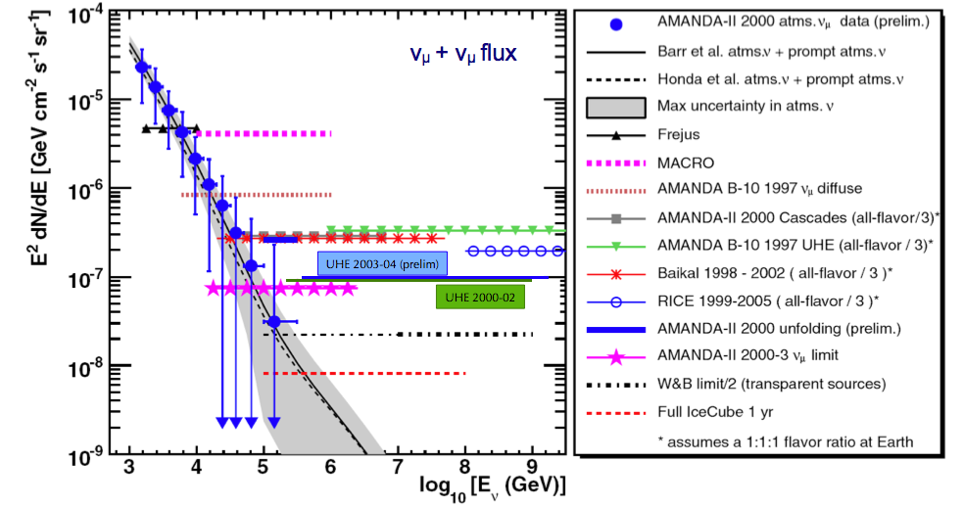
Diffuse fluxes
From the lack of excess wrt atmospheric
limits can be set on neutrino diffuse fluxes
assuming E⁻² spectrum
-

Slide 27
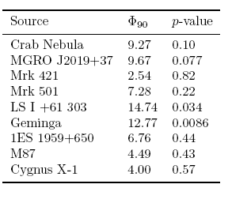
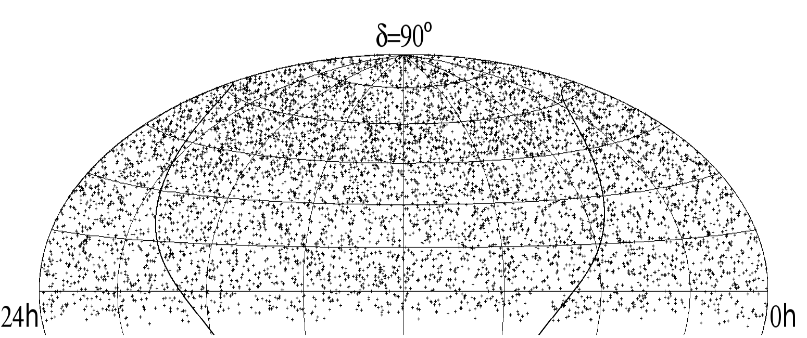
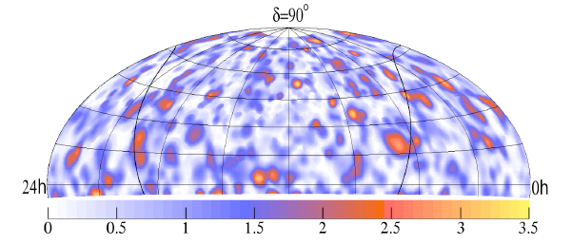
AMANDA Point sources
26 sources selected for search
For 26 sources, p ≤ 0.0086
occurs 20% of the time for
at least one source.
Equatorial sky map of 6595 events recorded by AMANDA II in 2000-2006
The most significant point has 3.4σ but this should happen 95% of the time with the present statistics.

Slide 28
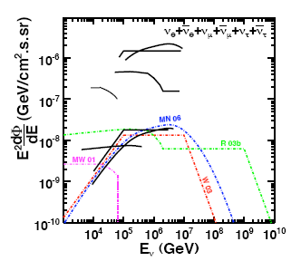
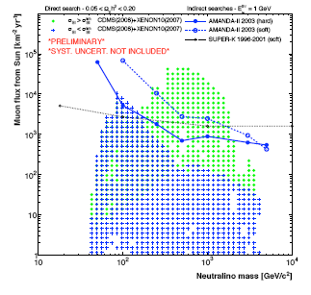
Other searches
No coincidence of ν cascade events
with 73 GRBs in all the sky. Limits
on several GRB models.
Indirect limits on neutralino
annihilation in the Sun
(soft or hard annihilation)

Slide 29
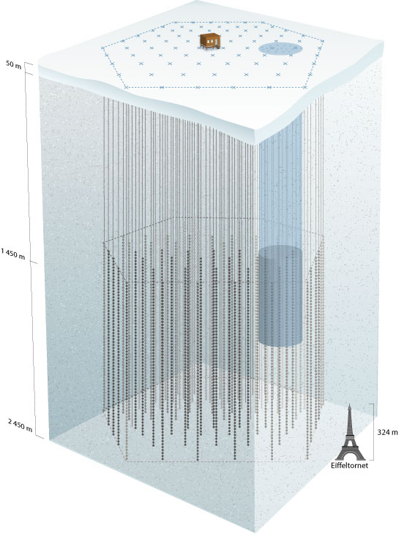

IceCube
2006-2007:
13 Strings
2007-2008:
18 Strings
~1 km
2008-2009:
18+1 Strings
2004-2005 :
1 String
IceTop
80 pairs of ice Cherenkov tanks
Threshold ~300 TeV
2005-2006:
8 Strings
At present a total
of 59 strings
(74% of detector)
Full detector by 2011
InIce
1450 m
80 strings with 60 OMs
17 m between OMs
125 m between strings
1 km³. A 1-Gton detector
2450 m

Slide 30
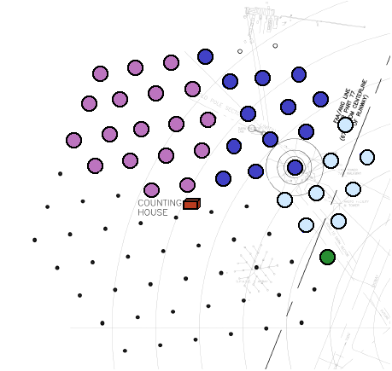
IceCube Datasets
#Strings | Year | Run Length | CR μ Rate | ν_{μ} rate
IC1 | 2005 | 164 days | 5 Hz | ~0.01/day
IC9 | 2006 | 137 days | 80 Hz | ~ 1.5/day
IC22 | 2007 | 319 days | 550 Hz | ~ 20/day
IC40 | 2008 | ~ 1year | 1400 Hz
IC%9 | 2009
IC80 | 2011 | 10 years | 1650 Hz | ~ 200/day
IC1
+
IC9
+
IC22
+
IC40

Slide 31
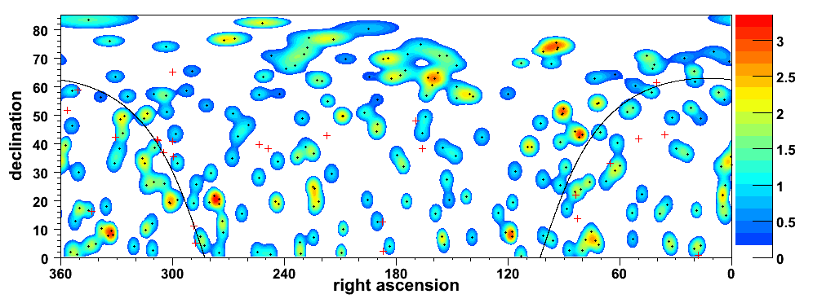
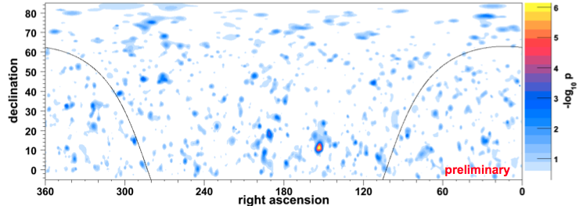
IceCube Point Source Searches
IC9
26 a priori source locations
60% of random datasets had a sigma higher than 3.35σ - no excess seen
• Unbinned likelihood
+ energy information
• Hottest spot at
r.a.153º, dec.11º
• p‐value (pre-trials):
7×10^{‐7} (4.8σ)
• p‐value (post-trials)
1.34% (2.2σ)
• Consistent with
background fluctuation
IC22

Slide 32
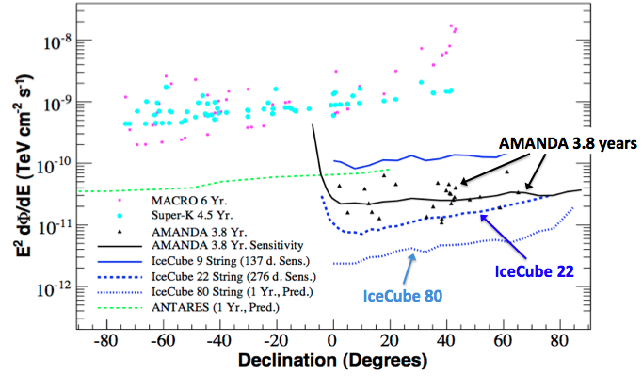
Flux Limits for Point Sources

Slide 33




Indirect search for WIMPs
No excess with IC22
90% CL limit (from Sun)
IC22: Best limit for
spin-dependent cross-section

Slide 34

Indirect search for WIMPs
σ_{SI} > σ_{Si}^{lim}
CDMS (2008) + XENON10 (2007)
AMANDA-II 2003
IceCube-22 2007
SUPER-K 1996-2001
BAKSAN 1978-95
MACRO 1989-98
models disfavoured
by direct searches
E_{μ}^{th} = 1 GeV
+ models not disfavoured
by direct searches
Muon flux from the Sun (km⁻² yr⁻¹)
Full IceCube 5-years:
Neutralino Mass (GeV)
34

Slide 35

GRBs in AMANDA & IceCube
AMANDA
− ν_{μ} search
Over 400 GRBs in Northern Hemisphere
Cascade search
Triggered search for 73 GRBs in both hemispheres
Rolling search for 2001-2003
IceCube
93 SWIFT bursts during IC22
GRB080319B: brightest (optical) burst ever
~0.1 ν_{μ} events predicted in IC22 using fireball model
~1 ν_{μ} event predicted for equivalent burst in IC80
Cascade (Rolling)
Cascade (Trig & Roll)
R03b
 search
WB03
MN06
R03a
R03b: Supranova model
WB03: Waxman-Bahcall model
R03a: Choked Burst model
MN06: Murase Nagataki model
IceCube will be able to detect Waxman-Bahcall or similar GRB fluxes within the next few years

Slide 36




IceCube construction
A logistic exploit
500 Tons of material
brought to South Pole
A 5 MW power plant
Unprecedented drilling
capabilities
More than 50 flights

Slide 37




String cable 2500 m Weight ~6 tons

Slide 38


Future Plans
Deep Core
Greatly enhances IceCube sensitivity to lower energy ν’s
Lower mass solar WIMPs
Atmospheric neutrinos
Six new strings
60 high QE DOMs in clear ice
First string deployed 08/09,
Remaining strings deployed 09/10
Multi-messenger astronomy
Correlations with ROTSE, AGILE, MAGIC, and LIGO
New Technologies
3 Prototype digital radio strings deployed with IceCube strings
4 Hydrophones deployed above IceCube
Dust concentration
Very
clear
ice
D. Cowen, Neutrino 2008

Slide 39



Telescopes in the
Northern Hemisphere
ANTARES
43º North
2/3 of time: Galactic Centre
0.5 π sr instantaneous common view
1.5 π sr common view per day
AMANDA/IceCube
South Pole
Notes:
Dateien
Dateien

Slide 40

> 25%
> 75%

Slide 41


The Antares collaboration
NIKHEF Amsterdam
KVI Groningen
NIOZ Texel
Erlangen
ITEP
Moscow
APC Paris
IFREMER, Brest
DAPNIA, Saclay
IReS, Strasbourg Mulhouse
CPPM Marseille
IFREMER,Toulon
COM, Marseille
OCA, Nice
ISS, Bucharest
INFN Bari
INFN Bolgna
INFN Catania
INFN Genova
LNS
INFN Pisa
INFN Roma
7 countries, 25 institutes,
~150 engineers, sea scientists
& physicists
IFIC Valencia
UPV

Slide 42






Slide 43





12 lines (900 PMTs)
25 storeys / line
3 PMTs / storey
Buoy
14.5 m
Horizontal layout
350 m
Junction Box
100 m
40 km to shore
 Astropart. Phys 13 (2000) 127-136 (Background light)
 Astropart. Phys 19 (2003) 253-267 (Sedimentation & Fouling)
 Astropart. Phys 23 (2005) 131-155 (Light transmission)
The detector is located in the Mediterranean Sea (42º50’N, 6º10’E) at 2500 m depth, in the south coast of Toulon (France).
The Antares Telescope

Slide 44






Basic detector element: storey
Titanium frame: support structure
Optical Beacon with blue LEDs:
timing calibration
 NIM A578 (2007) 498
Optical Module: 10” Hamamatsu PMT in
17” glass sphere
photon detection
NIM A484 (2002) 369
NIM A555 (2005) 132
Local Control Module (Ti):
Front-end ASIC, DAQ/SC, DWDM, Clock, tilt/compass, power distribution…
Hydrophone:
acoustic positioning

Slide 45




Detector performance
Neutrino effective area is > 1 m² for energies > 100 TeV
Angular resolution better than 0.3° above a few TeV,.
Sky view
Antares/KM3NeT
Amanda/IceCube

Slide 46



































Deployment
Data taking periods:
MILOM : Mar ’05 – Mar ‘06
Line 1 : Mar ’06 - Sep ’06
Line 1-2 : Sep ’06 - Jan ’07
Line 1-5 : Jan ’07 - Dec ’07
Line 1-10 : Dec ’07 - May ’08
Complete : May’08 onwards
La Seyne-sur-Mer
(40 km)
(2.5 km depth)

Slide 47



Optical background
2006
2007
⁴⁰K decays (rate ~60 kHz)
Bioluminescence =
Bursts from macroorganisms
(strongly affected by current velocity)

Slide 48

Optical background
Proportion of time < rate

Slide 49


(multi-) Muon Event
Example of a reconstructed down-going muon, detected in all 12 detector lines:

Slide 50


Neutrino candidate
Example of a reconstructed up-going muon (i.e. a neutrino candidate) detected in 6/12 detector lines:

Slide 51






Showers from μ’s can be reconstructed
LED beacons – K40
σ = 0.4 ns
Rate [Hz]
Time calibrated to < 0.5 ns
ANTARES as seen by
atmospheric muons
^{γ}
Cherenkov light
e⁻ (β decay)
⁴⁰K
LED Beacon
⁴⁰Ca
K40
Positioning ~ 10 cm

Slide 52


5-line data
140 active days
168 upward events
(65% multi-line)

Slide 53


2008 data
10/9/12 lines
174 active days
819 upward events
(71% multi-line )

Slide 54


List of 25 sources
No excess found
Point source search
5-line data, 140 active days,
94 upward events

Slide 55



Dark Matter Search
ANTARES and KM3NeT
3 year data taking
(From the Sun)
S.I. WIMP-proton x-section (cm²)
0 < m₀ < 8 TeV ; 0 < m_{1/2} < 2 TeV
0 < tanβ < 60 ; 0 < A₀ < 3m₀
Upper branch: Focus point region
m₀> 2TeV; m_{1/2}>200 GeV to right upper corner
Middle branch: A-annihilation
tanβ=50-60
Lowest branch: co-annihilation-region
Low m₀ ; m_{1/2} <1.5 TeV
Muon flux (km⁻² yr⁻¹)

Slide 56


NESTOR: Rigid Structures Forming Towers
Tower based detector (titanium structures).
Dry connections (recover − connect − redeploy).
Up- and downward looking PMs (15’’).
4000-5200 m deep.
Test floor (reduced size) deployed & operated in 2003.
Deployment of 4 floors planned in 2009
Vision: Tower(s) with12 floors
→ 32 m diameter
→ 30 m between floors
→ 144 PMs per tower

Slide 57




NESTOR: The Delta-Berenike Platform
A dedicated deployment platform
In the final stage of construction
Can be important asset for KM3NeT deployment

Slide 58


The NEMO Project
Example: Flexible tower
16 arms per tower, 20 m arm length, arms 40 m apart;
64 PMs per tower;
Underwater connections;
Up- and downward-looking PMs.
Extensive site exploration (Capo Passero near Catania, depth 3500 m);
R&D towards km³: architecture, mechanical structures, readout, electronics, cables ...;
Simulation.

Slide 59





NEMO Phase I: First steps
Shore station
Geoseismic station SN-1 (INGV)
Test site at 2000 m depth operational.
Funding ok.
5 km e.o. cable
21 km e.o. Cable with single steel shield
J
J
BU
2.5 km e.o. Cable with double steel shield
J
5 km e.o. cable
January 2005: Deployment of
2 cable termination frames (validation of deep-sea wet-mateable connections)
acoustic detection system (OνDE).
10 optical fibres standard ITU- T G-652
6 electrical conductors Φ 4 mm²

Slide 60




NEMO Phase-1: Current Status
Nov. 2006: Deployment of JB and mini-tower
Deployed January 2005
Junction Box (JB)
NEMO mini-tower
(4 floors, 16 OM)
TSS Frame
300 m
Mini-tower, unfurled
Mini-tower, compacted
15 m

Slide 61

NEMO: Phase-1 Results
Successful deployment and system test, all components functional
Data being analysed (example: muon angular distribution)
Some problems:
Missing buoyancy (tower “laying down”) traced back to buoy production error
Junction Box: Incident at deployment, data transmission problem after some weeks, short after ~5 months → recovery & analysis → some redesign for Phase-2

Slide 62
NEMO: Phase-2
Objective: Operation of full NEMO tower (16 floors) and Junction Box at 3400 m depth (Capo Passero site)
Some design modifications (cabling, calibration, power system, bar length 15 m → 12 m, …)
Infrastructure:
Shore station in Portopalo di Capo Passero (→ under renovation)
Shore power system ( → under construction)
100 km main electro-optical cable (50 kW, 20 fibres) (→ laid)
cable termination frame with DC/DC converter (Alcatel)

Slide 63



KM3NeT
A research facility in the Mediterranean Sea
A next generation neutrino telescope
Cabled observatory for Earth and Marine sciences
+
+
+…
40 institutes from 10 European countries

Slide 64
Design goals
Substantially better sensitivity than IceCube
> 1 km³
Core process: ν_{μ}+N → μ+X at neutrino energies above 100 GeV
Construction and deployment < 4 years
Data taking period > 10 year
Optimized for energy range 1 TeV – 1 PeV
Angular resolution < 0.1º
Zenith angle:
Full acceptance for neutrinos originating from directions up to at least 10° above the horizon
For energies > 100 TeV angular acceptance limited only by the absorption of the Earth

Slide 65




















Design proceeding well…
Several photo-sensors and optical module arrangements studied.
Self-unfolding structures
for massive deployment
… + studies on data transmission, power distribution, time calibration and positioning, marine operations,
Performance in terms of effective area and resolution for different configurations have been studied
■ triangle-like
beam-like
Notes:
Charteror buy

Slide 66

Conceptual Design Report
Released on April 2008
Available at www.km3net.org
Includes:
Science case
Site studies
Design goals
Technical implementation
Design Study funded by the 6th Framework Programme of the European Commission

Slide 67

KM3NeT project timeline
NOW
funded by the 7th Framework Programme
funded by the 6th Framework Programme

Slide 68
Conclusions
IceCube > 70% complete, finished by 2011. Approaching the km3 scale
ANTARES completed. The largest neutrino telescope in the Northern
Hemisphere. Competitive limits from 5-lines (140 days).
KM3NeT Conceptual Design Report ready. Technical Design Report
next year.
Supported by ESFRI, ASPERA and ASTRONET.
Design Study and Preparatory Phase funded respectively
by the 6th and 7th Framework Programmes of the European
Commission
Construction could start as early as 2011

