Slide 1
Precision Measurement of the Casimir Force For Au using a Dynamic AFM
U. Mohideen
University of California-Riverside
Notes:
Put V0 slide back
Coorrect patch writing on first slide

Slide 2
Acknowledgements
Experiment
C.C. Chang
A.B. Banishev
R. Castillo
Theoretical Comparison
V.M. Mostepanenko
G.L. Klimchitskaya
Research Funded by:
DARPA, National Science Foundation & US Department of Energy

Slide 3
Outline
Measure Casimir Force for Au Sphere and Au Plate
Method (Dynamic measurement)
Force Gradient Determination
Errors
Data analysis
Results
Notes:
Here is my outline at first I will simply introduce the dynamic measuremet and enter the main body of my talk aout experimental part. Data analysis ….

Slide 4
Why Need Another One?
Understand the role of free carrier relaxation
Average Casimir Force from 30 scans
Harris et al., Phys Rev. A, 62, 052109 (2000)
Decca et al., Euro Phys J. C 51, 963 (2007)
Sushkov et al. Nat Phys 7, 230 (2011)
Chan et al., Science, 291, 1941 (2001)
Jourdan et al., Europhys. Lett, 85,31001 (2009)

Slide 5
Lifshitz Formula
R>>z
R
1
z
2
Reflection Coeffs:
Matsubara Freqs.
At l=0, ξ=0

Slide 6
Puzzles in Application of Lifshitz Formula
For two metals and for large z (or high T), ξ=0 term dominates
For ideal metals put ε→ ∞ first and l,ξ=0 next (Schwinger Prescription)
Milton, DeRaad and Schwinger, Ann. Phys. (1978)
Recover ideal metal Casimir Result

Slide 7
For Real Metals if use Drude
and γ is the relaxation parameter
For ξ=0, , only half the contribution even at z≈100 mm, where it should approach ideal behavior
Get large thermal correction for short separation distances z~100 nm
Biggest problem: Entropy S≠0 as T→0 (Third Law violation) for
perfect lattice where γ (T=0)=0
If there are impurities γ (T=0) ≠0 , Entropy S=0 as T→0
Bostrom & Serenelius, PRL (2000); Physica (2004)
Geyer, Klimchitskaya & Mostepanenko, PR A (2003)
Hoye, Brevik, Aarseth & Milton PRE (2003); (2005)
Svetovoy & Lokhanin , IJMP (2003)
Paris Group, Florence Group, Oklahoma group

Slide 8
Experimental Results
Decca et al., Euro Phys J. C 51, 963 (2007)
Sushkov et al. Nat Phys 7, 230 (2011)
Plasma Model
Drude Model

Slide 9
Requirements for high precision Casimir force measurement
High force sensitivity system.
Very clean sample surface.
Precise, independent, and reproducible measurement of separation between two sample surfaces.
Notes:
Before introduce my experiment, here is some things we must know. For having precise casimir force measurement. First clean samle surface. We provide very high vacuum carefully design sample. Second by interferometer we can have ….. By care fully make sample coating and metal………

Slide 10
New Experimental Methodology
Dynamic AFM
Measure Frequency Shift instead of Cantilever
Deflection

Slide 11

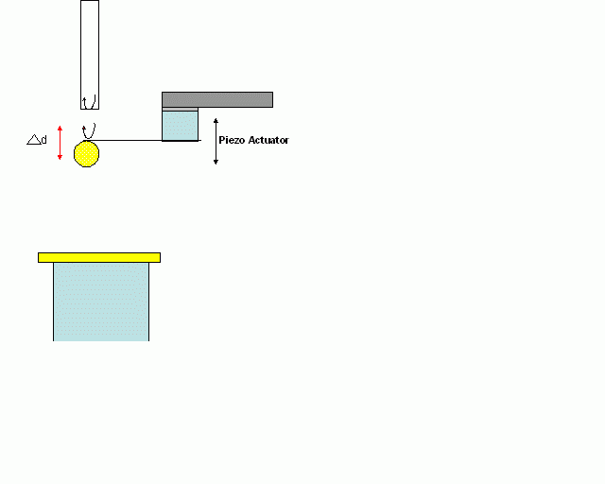


Dynamic AFM Method Used
Cantilever small oscillations in a force field
For small cantilever oscillations, we can take Taylor expansion of Fint at the mean equilibrium position
Notes:
Here we consider the cantilever as a simple harmonic oscillator drive by a sinusoidal excitation and have small perturbation by interaction force. Therefore, we can taylor expand for this force into a new equilibrium position z0 and z0 determined by this equation ….eq will go to here when we ……interaction certain soften the cantilever…….

Slide 12
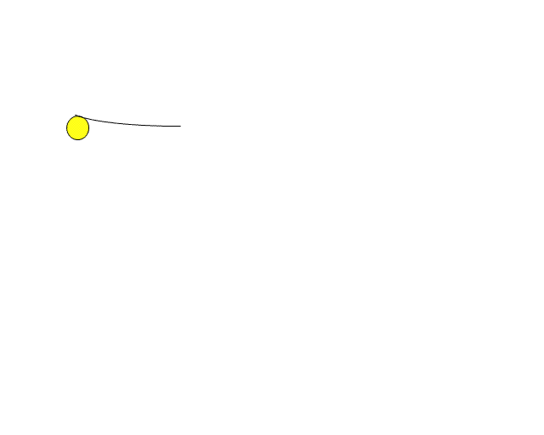
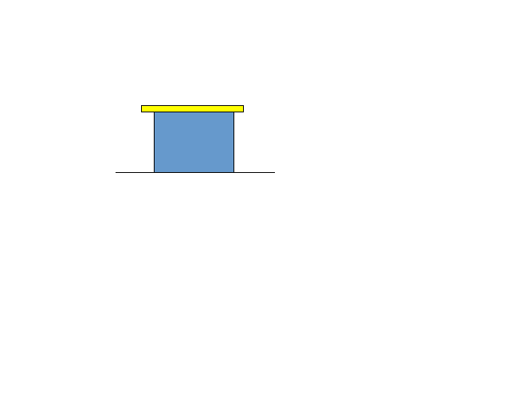
Interferometer 2
(Short coherence length)
interferometer 1
DC+AC
Band-pass
filter
Interference signal
AC
Low-pass
Filter
FM technique
Phase detector
(PhaseLockedLoop)
Vacuum
DC
10⁻⁸ Torr
Separation “d” PID control
in Q point
Drive
∆f
d
Piezo1
Piezo2
∆V
High voltage power supply
linear voltage applied on
Piezo-tube repeatedly
Notes:
This flow chart basically describe my experiment setup and way I used to measure Casimir
First here is our Casimir sensor attached a sphere with gold coating, the interferometer 1 used to monitor motion of cantilver and translate the motion into electric signal DC +Ac with DC signal we used to feed back signal to maintain separation distance between fiber and cantilever for certain reasons we will explain later and Ac signal we used to detect the frequency by FM tech.
At the mean time, the sample piezo move to cantilever linearly repeated by high voltage power supply which repeatedly applied linear voltage. the piezo movement which related to voltage will be monitor by interferometer 2. also, we applid the voltage difference between sphere and plate. All action I describe is working simultaneously and control automatically by labview program.
SLD is 1550 nm
Piezo moved with triangular wave at 0.01 Hz
Band pass filter is 1.2-1.82 KHz
Low pass filter is 260 Hz
Delta f the frequency shift is a voltage
Resonant frequency 1.6 KHz
Sphere Radius 41.34 +/- microns
Casimir delta f is ~10 Hz at 230 nm
Highest voltages delta f ~20 Hz at 230 nm
Resolution of the PLL 5 mHz

Slide 13
Determination of Au Sphere- Plate Potential Difference
Electrostatic Force Formula:
STEPS
Repeat Experiment for 12 Voltages applied to
Au plate – not sequentially
Correct separation for plate or sphere drift
Use Parabolic dependence of force gradient on
Voltage, to draw parabolas at every separation
4. Vertex of Parabola, which denotes zero electrostatic
force gives the residual potential
Notes:
Do not apply sequential potential

Slide 14
Correcting for Drift in Sphere-Plate Separation
During Experiment- Method
If Experiment Repeated for Same Applied Voltage to the Plate,
Change in Signal is due to Drift
Frequency Shift
Sphere-Plate Separation
Change in time of one
Repitition
separation (nm)

Slide 15
Correcting for Drift in Sphere-Plate Separation
During Experiment- Data
If Experiment Repeated for Same Applied Voltage to the Plate,
Change in Signal is due to Drift
10 curves at V₀
Separation (nm)
15
points
200 sec
time (sec)
0
100 sec
separation (nm)
<drift>=0.002 nm/sec
Drift
Notes:
2) Measurement of each curve starts after 100 sec (50 sec for curve measurement when piezo extend and 50 sec when piezo retract). The each point of the curves should be corrected due to the thermal drift. To calculate the drift we measure the last 10 curves at the same compensate V₀ voltage and calculate the drift at 15 points, then calculate average drift value.

Slide 16
Determination of Au Sphere- Plate Potential Difference
Electrostatic Force Formula:
Overbeek et.al
1971
STEPS
Repeat Experiment for 12 Voltages applied to
Au plate – not sequentially
Correct separation for plate or sphere drift
Use Parabolic dependence of force gradient on
Voltage, to draw parabolas at every separation
4. Vertex of Parabola, which denotes zero electrostatic
force gives the residual potential
Notes:
Do not apply sequential potential

Slide 17
Stability Checks Residual Potential V_{o}
<V₀>=-0.0275±0.003 V
Residual Potential Independent of Sphere-Plate Separation
No Anamalous Electrostatic Behavior

Slide 18
Determination of Absolute Sphere-Plate Separation
& Spring Constant
Fit Parabola Curvature
To Electrostatic Theory
<z₀>=196.1±0. 4 nm
<k>=0.01206±0.00005 N/m

Slide 19
Raw Experimental Data: Electrostatic+ Casimir Force

Slide 20
Complete Dataset – 12 applied Voltages to the Plate
Subtract Electrostatic Force Gradient from Frequency Shift
Mean
Notes:
12 Voltages between 0.0326 to -0.0874 applied to the plate

Slide 21
Repeat Experiment
Total of 4 x 12=48 experiments
Dataset 2
Dataset 1
Dataset 3
Dataset 4
Notes:
12 Voltages between 0.0326 to -0.0874 applied to the plate

Slide 22
Error Bars with Sphere-Plate Separation

Slide 23
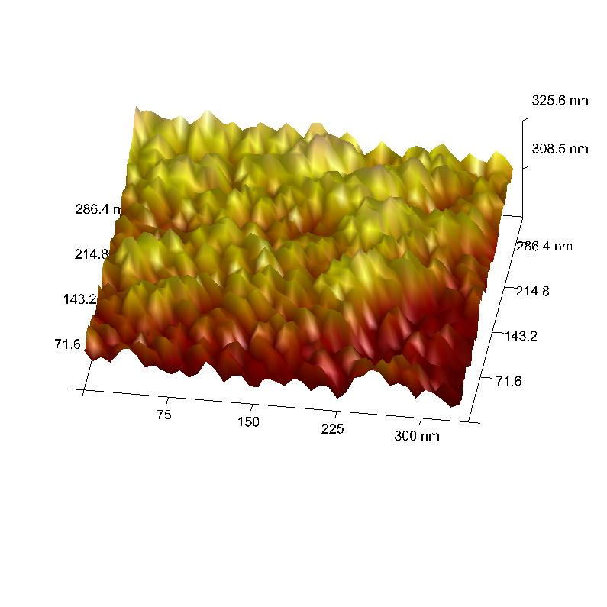
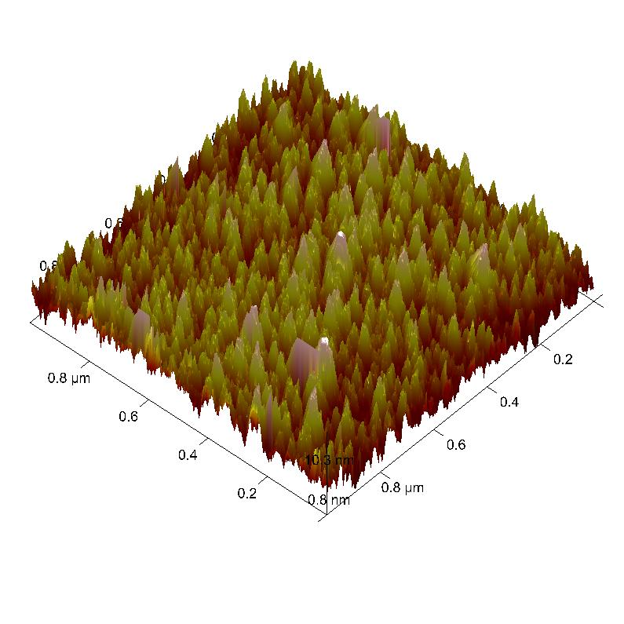
Sphere and Plate Roughness
Percent v_{i} of the surface area covered by roughness with heights h_{i}
RMS 2.3 nm
Plate
Sphere
nm | %
0 | 0.129
0.503 | 0.129
1.006 | 0.129
1.509 | 0.258
2.012 | 2.323
2.515 | 4.129
3.018 | 8.387
3.521 | 8.387
4.024 | 11.226
4.527 | 11.871
5.03 | 9.032
5.533 | 9.419
6.036 | 9.806
6.539 | 5.161
7.042 | 6.194
7.545 | 5.161
8.049 | 2.323
8.552 | 2.71
9.055 | 1.806
9.558 | 1.161
10.061 | 0.258
nm | %
0 | 0.296
0.532 | 1.481
1.063 | 2.222
1.595 | 4.444
2.127 | 5.926
2.658 | 7.556
3.19 | 8.444
3.722 | 9.333
4.254 | 11.259
4.785 | 9.778
5.317 | 9.63
5.849 | 7.556
6.38 | 4.296
6.912 | 4.444
7.444 | 3.556
7.975 | 2.963
8.507 | 3.259
9.039 | 2.074
9.571 | 0.741
10.102 | 0.593
10.634 | 0.148
RMS 2.1 nm
Plate
Sphere
Roughness Effects much less than 1%

Slide 24


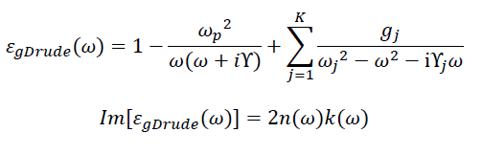
Lifshitz Theory Comparison
Generalized plasma-like permittivity : fitting by tabulated optical data
ω_{p}
= 8.9 eV
Drude-like permittivity
γ
= 0.035 eV
Proximity force approximation (PFA)
R
If
z
a
Notes:
Wp =

Slide 25
Comparison with Theory
Notes:
Error bars at 70% confidence level . No multiplication factor

Slide 26
Arbitrarily Shift Data by 3 nm to Fit Drude Model
At Smallest Separation
If separation shifted by 3 nm, then also do not fit the Drude model

Slide 27
Comparison with Theory
AGREEMENT ONLY WITH
PLASMA MODEL!
Even though Drude Model
Describes the metal best.
Decca et al., Euro Phys J. C 51, 963 (2007)
Notes:
Error bars at 70% confidence level . No multiplication factor
Use of other Plasma Freq only makes disagreement with Drude Model worse

Slide 28
Understanding the Patch Effect by
Electrostatic Simulation

Slide 29
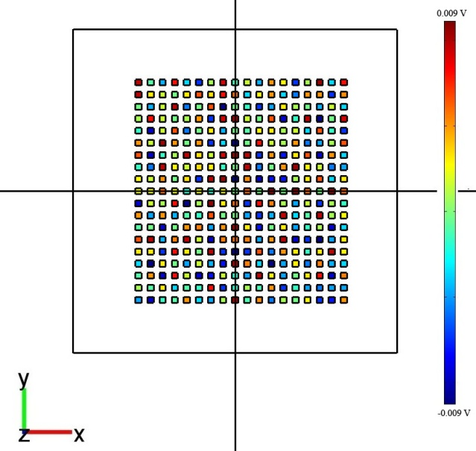

Electrostatic simulation with COMSOL software package
A_{eff}=2πRd
Δ-
ε₀ε_{r}
V=0
ε_{r} – relative permittivity
Δ
We solved the Poisson equation for conductive plate (variable potential V_{plate}) with dielectric patches on the surface (random potential distribution in [-90;90] mV) and conductive sphere on the distance z from the plate
F_{total} (V_{plate}) between
the sphere and plate = 0
V_{plate} =V₀
Patches
Plate size = 32×32 μm;
Patch size = 0.6×0.6 μm;
V_{plate}=0.018 mV , V_{sphere}=0,
V_{patches}=random in [-90;90] mV, Δ~0.7 mV.
Area filled by patches has been chosen
according to condition: Surface area > A_{eff}=2πRd
(for z=0.1 μm plate size should be higher then 8 μm)
Notes:
Random voltages on the patches between -90 to +90 mV

Slide 30
Electrostatic simulation with COMSOL software package
A_{eff}=2πRd
Δ-
ε₀ε_{r}
V=0
Δ
ε_{r} – relative permittivity
We solved the Poisson equation for conductive plate (variable potential V_{plate}) with dielectric patches on the surface (random potential distribution in [-90;90] mV) and conductive sphere on the distance d from the plate
In the pictures:
Sphere radius R = 100 μm;
Plate size = 32×32 μm;
Patch size = 0.3×0.3 μm to 0.9×0.9 μm;
V_{patches}=random in [-90;90] mV, Δ~0.7 mV.
Patches
Plate
Sphere
Apply voltages to the plate and find voltage when electrostatic force goes to zero
This compensating voltage (V_{o}) is found for different separations.
Notes:
Use Comsol . Apply voltages to the plate and find voltage when electrostatic force goes to zero
This compensating voltage (V_{o}) is found for different separations.

Slide 31
Simulation Results of Compensating Voltage
Distance Independent
As in Observed in
Experiment –Well
Compensated

Slide 32
Conclusions
Measured Casimir Force Gradient Between Au Sphere & Plate using a Dynamic AFM.
No anamalous Behavior of Sphere-Plate Residual Potential
Independent determination of Absolute Sphere-Plate separation
distance
The Force Gradient is in Agreement with the Plasma Model for Sphere-Plate Separations below 500 nm.
Verified unique curvature of the Plasma Model.

Slide 33
Simulation Results
Different distance between the patches

Slide 34
Simulation Results
Different sizes of the patches

Slide 35
Acknowledgements
Experiment
C.C. Chang
Banishev
R. Castillo
Theoretical Analysis
V.M. Mostepanenko
G.L. Klimchitskaya
Research Funded by:
DARPA, National Science Foundation & US Department of Energy

Slide 37
Thermal Correction Procedure
2) Measurement of each curve starts after 100 sec (50 sec for curve measurement when piezo extend and 50 sec when piezo retract). The each point of the curves should be corrected due to the thermal drift. To calculate the drift we measure the last 10 curves at the same compensate V₀ voltage and calculate the drift at 15 points, then calculate average drift value.
10 curves at V₀
Separation (nm)
15
points
200 sec
time (sec)
0
100 sec
separation (nm)
<drift>=0.002 nm/sec
Drift

Slide 38
Experimental Forces
Electrostatic Force Formula:
where,

Slide 39

Cantilever small oscillations in a force field
For small oscillation, we can take Taylor expansion of Fint
at point Z0 corresponding to the equilibrium position
Notes:
Here we consider the cantilever as a simple harmonic oscillator drive by a sinusoidal excitation and have small perturbation by interaction force. Therefore, we can taylor expand for this force into a new equilibrium position z0 and z0 determined by this equation ….eq will go to here when we ……interaction certain soften the cantilever…….

Slide 40
Proximity force approximation (PFA)
R
If and plate area
z
a
Notes:
So we can have a solution from equaiton of motion in the equilibrium state. And the first term and third term which are related to the technique we used to measure casimir force. Here we introduce the PFA.. Because experimentally it is hard to maintain parellel plate. We use this approxmation to have casimir force related to casimir energy in two palte with first derivertive of this eqaution we will be able to have casimir pressure the other parameters we need to calibricate by anyother method.
Once we have frequency shift related to force gradient we can combine with PFA
To have casimir pressure.
Beta ~0.4 at 300nm R>>a 0.4*(1/50)=<0.008

Slide 41
Thermal Correction Procedure
1) At long distances (2.1 µm) all forces should be negligible. The signal at large separation distances of 1.8-2.1 µm was fit to a straight line. This straight line was subtracted from the measured signal measured at all sphere plate separations to correct for the effects of mechanical drift.
0
0
separation (nm)
separation (nm)

Slide 42
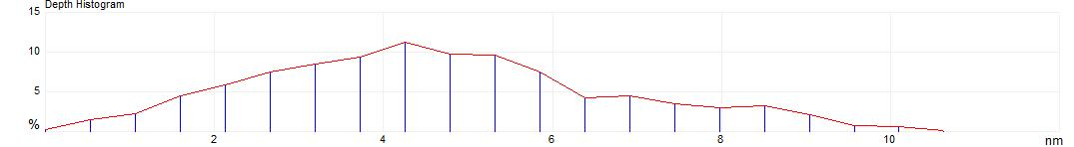
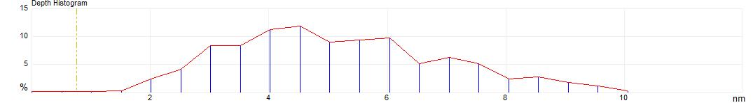
Plate
The Roughness
Sphere
nm | %
0 | 0.129
0.503 | 0.129
1.006 | 0.129
1.509 | 0.258
2.012 | 2.323
2.515 | 4.129
3.018 | 8.387
3.521 | 8.387
4.024 | 11.226
4.527 | 11.871
5.03 | 9.032
5.533 | 9.419
6.036 | 9.806
6.539 | 5.161
7.042 | 6.194
7.545 | 5.161
8.049 | 2.323
8.552 | 2.71
9.055 | 1.806
9.558 | 1.161
10.061 | 0.258
Percent v_{i} of the surface area covered by roughness
with heights h_{i}
nm | %
0 | 0.296
0.532 | 1.481
1.063 | 2.222
1.595 | 4.444
2.127 | 5.926
2.658 | 7.556
3.19 | 8.444
3.722 | 9.333
4.254 | 11.259
4.785 | 9.778
5.317 | 9.63
5.849 | 7.556
6.38 | 4.296
6.912 | 4.444
7.444 | 3.556
7.975 | 2.963
8.507 | 3.259
9.039 | 2.074
9.571 | 0.741
10.102 | 0.593
10.634 | 0.148
RMS 2.3 nm
RMS 2.1 nm
Plate
Sphere
Sphere
Plate

Slide 43
Determination of Au Sphere- Plate Potential Difference
Electrostatic Force Formula:
STEPS
Repeat Experiment for 12 Voltages applied to
Au plate – not sequentially
Correct separation for plate or sphere drift
Use Parabolic dependence of force gradient on
Voltage, to draw parabolas at every separation
4. Vertex of Parabola, which denotes zero electrostatic
force gives the residual potential
Notes:
Do not apply sequential potential

