Slide 1

Casimir Effect of Proca Fields
Quantum Field Theory Under the Influence of
External Conditions
Teo Lee Peng
University of Nottingham Malaysia Campus
18th-24th , September 2011

Slide 2
Casimir effect has been extensively studied for various quantum fields especially scalar fields (massless or massive) and electromagnetic fields (massless vector fields).
One of the motivations to study Casimir effect of massive quantum fields comes from extra-dimensional physics.
Using dimensional reduction, a quantum field in a higher dimensional spacetime can be decomposed into a tower of quantum fields in 4D spacetime, all except possibly one are massive quantum fields.

Slide 3
In [1], Barton and Dombey have studied the Casimir effect between two parallel perfectly conducting plates due to a massive vector field (Proca field).
The results have been used in [2, 3] to study the Casimir effect between two parallel perfectly conducting plates in Kaluza-Klein spacetime and Randall-Sundrum model.
In the following, we consider Casimir effect of massive vector fields between parallel plates made of real materials in a magnetodielectric background. This is a report of our work [4].
[1] G. Barton and N. Dombey, Ann. Phys. 162 (1985), 231.
[2] A. Edery and V. N. Marachevsky, JHEP 0812 (2008), 035.
[3] L.P. Teo, JHEP 1010 (2010), 019.
[4] L.P. Teo, Phys. Rev. D 82 (2010), 105002.

Slide 4
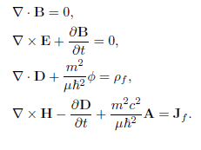
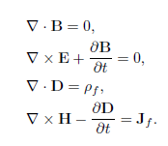

From electromagnetic field to Proca field
Maxwell’s equations
Proca’s equations

Slide 5


Continuity Equation:
(Lorentz condition)

Slide 6


Equations of motion for and A:

Slide 7



For Proca field, the gauge freedom
is lost. Therefore, there are three polarizations.
transversal waves
Plane waves
longitudinal waves

Slide 8


For transverse waves,
Lorentz condition
Equations of motion for A:
These have direct correspondences with Maxwell field.

Slide 9
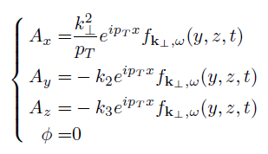
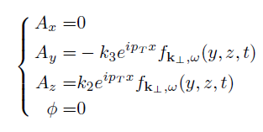


Transverse waves
Type II (TM)
Type I (TE)
Dispersion relation:

Slide 10
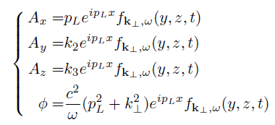


Longitudinal waves
Dispersion relation:
Note: The dispersion relation for the transverse waves and the longitudinal waves are different unless

Slide 11

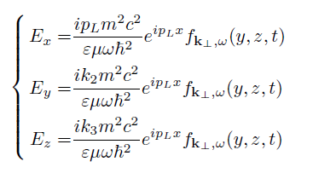

Longitudinal waves

Slide 12






[5] N. Kroll, Phys. Rev. Lett. 26 (1971), 1396.
Boundary conditions:
and
must be continuous
and
must be continuous [5]
must be continuous
must be continuous

Slide 13



continuous
continuous
continuous
continuous
Lorentz condition
continuous
continuous
continuous
continuous

Slide 14


Independent Set of boundary conditions:
or
are continuous
are continuous

Slide 15
A five-layer model
Two parallel magnetodielectric plates inside a magnetodielectric medium

Slide 16
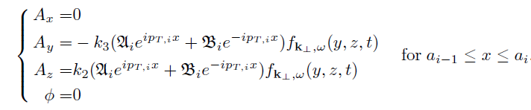


For type I transverse modes, assume that
and
are automatically continuous.

Slide 17





Slide 18

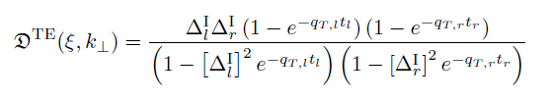


Contribution to the Casimir energy from type I transverse modes (TE)

Slide 19
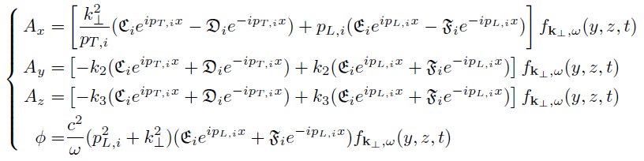

There are no type II transverse modes or longitudinal modes that satisfy all the boundary conditions. Therefore, we have to consider their superposition.
For superposition of type II transverse modes and longitudinal modes (TM), assume that

Slide 20

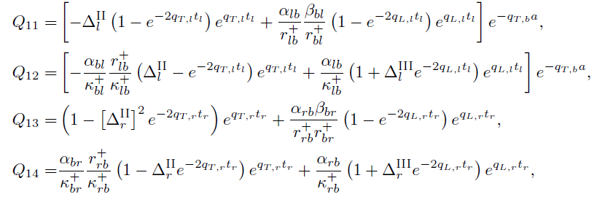
Contribution to the Casimir energy from combination of type II transverse modes and longitudinal modes (TM):
Q, Q∞ are 4×4 matrices

Slide 21
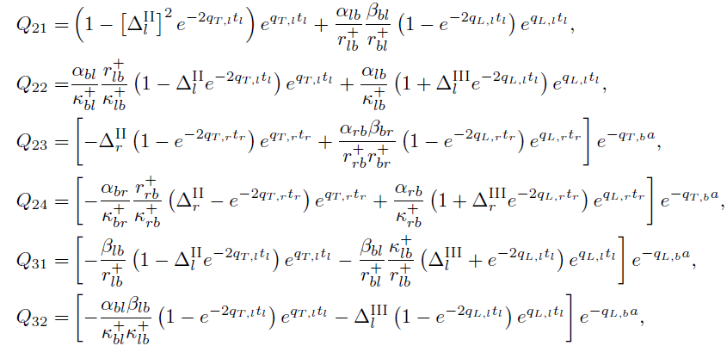

Slide 22
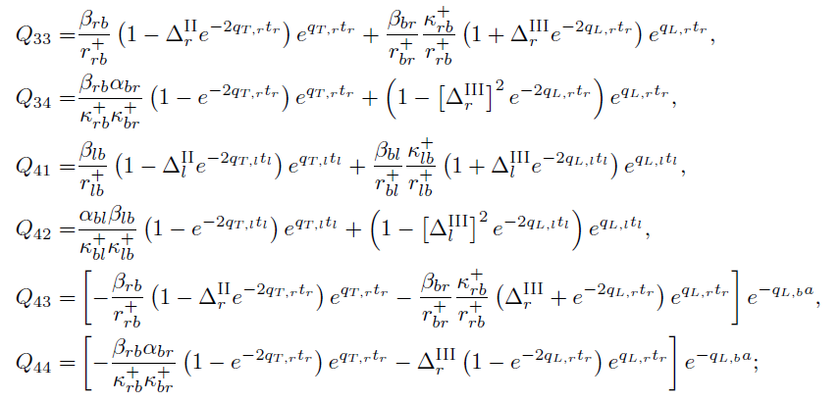

Slide 23
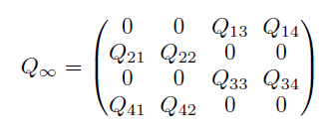

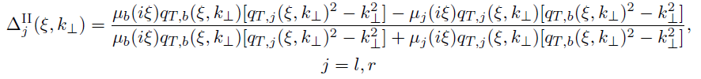

Slide 24

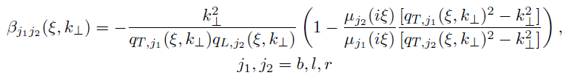



Slide 25


In the massless limit,
one recovers the Lifshitz formula!

Slide 26



Special case I: A pair of perfectly conducting plates

Slide 27
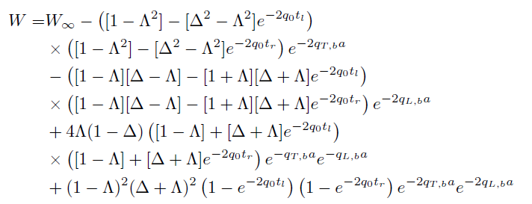



Slide 28

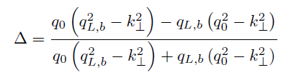
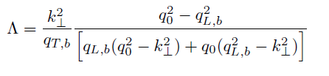

Slide 29


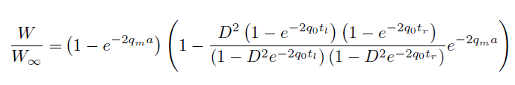

When

Slide 30





It can be identified as the TE contribution to the Casimir energy of a pair of dielectric plates due to a massless electromagnetic field, where the permittivity of the dielectric plates is [2]:

Slide 31
The dependence of the Casimir forces on the mass m when the background medium has refractive index 1 and 2. Here a = t_{l} = t_{r} = 10nm.

Slide 32

Special case II: A pair of infinitely permeable plates

Slide 33

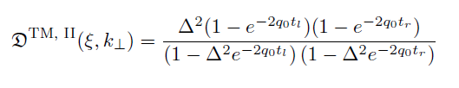

It can be identified as the TE contribution to the Casimir energy of a pair of dielectric plates due to a massless electromagnetic field, where the permittivity of the dielectric plates is:

Slide 34
The dependence of the Casimir forces on the mass m when the background medium has refractive index 1 and 2. Here a = t_{l} = t_{r} = 10nm.

Slide 35



Special case III: One plate is perfectly conducting and one plate is infinitely permeable.

Slide 36

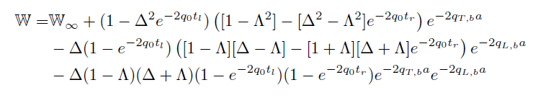

Slide 37
The dependence of the Casimir forces on the mass m when the background medium has refractive index 1 and 2. Here a = t_{l} = t_{r} = 10nm.

Slide 38
Perfectly conducting concentric spherical bodies

Slide 39
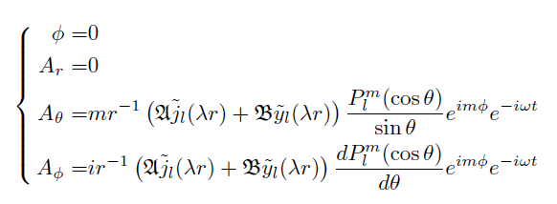


Contribution to the Casimir energy from TE modes

Slide 40





Slide 41
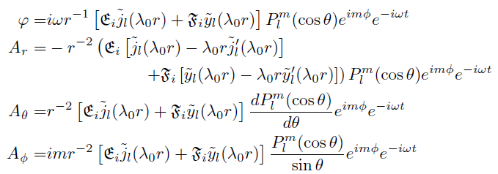
Contribution to the Casimir energy from TM modes
The continuity of implies that in the perfectly conducting bodies, the type II transverse modes have to vanish.
In the perfectly conducting bodies,

Slide 42
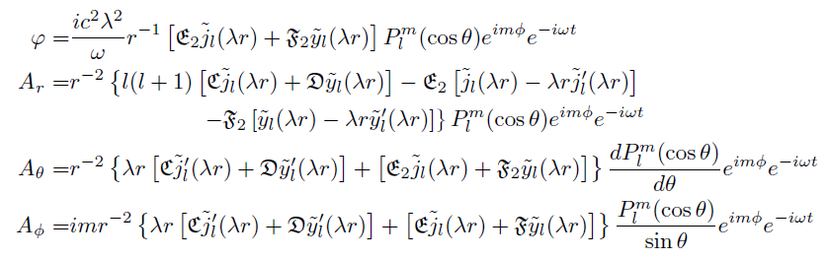

In the vacuum separating the spherical bodies,

Slide 43
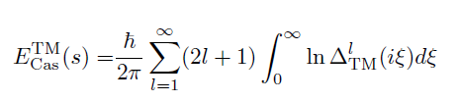


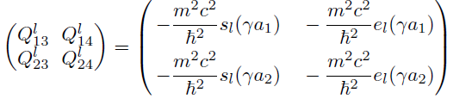

Slide 44

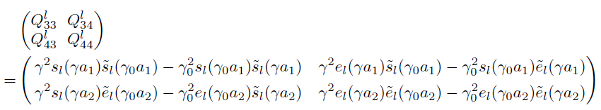
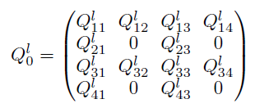


Slide 45


Slide 48
THANK YOU

