Slide 1
Observation of reduction in Casimir Force Without Change of Dielectric Permittivity (?)
U. Mohideen
University of California-Riverside

Slide 2
Motivation to measure Casimir force with
Indium Tin Oxide (ITO)
Use Transparent Electrodes to Reduce the Casimir Force
Manipulation of the Casimir Force using UV Light
Explore same puzzles in the Lifshitz Theory with dielectrics

Slide 3

Transparent Electrodes to Reduce Casimir Force
Rationale:
Reduce Casimir Force by Reducing Boundary Reflectivity
at characteristic frequency (~c/2z)
z
In devices z~ 1μm
Gold Electrodes have ~100% Reflectivity
Use electrodes which are transparent around
1μm to reduce reflectivity and reduce Casimir force
De Mann et al, PRL, 103,040402 (2009)

Slide 4
UV treatment to Reduce Casimir Force (?)
Rationale:
UV treatment known to change mobility of Charge Carriers in ITO
C.N. Li et al, Appl Phys. , 80,301 (2005)

Slide 5
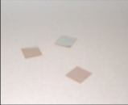
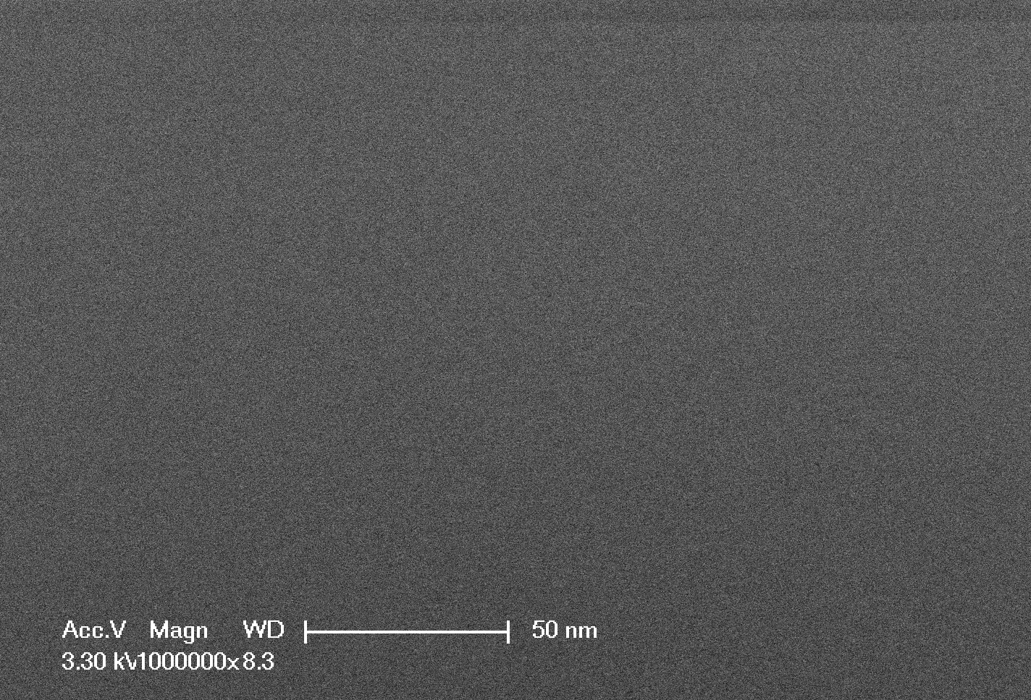
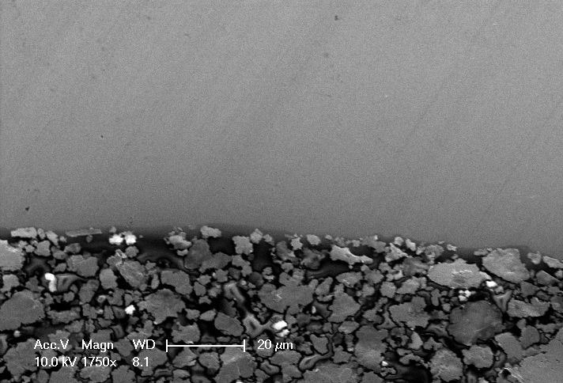
ITO Sample Properties
Sputter coated ITO film made in a loadlocked and cryo-pumped system with a base pressure of 5X10⁻⁷ Torr or better.
The substrates (Quartz) are sputter etched cleaned and then sputter coated with ITO on one side.
The resistivity of ITO taking by four point probe measurement is 42 ohms/sq.
The thickness of ITO measured by AFM is 74.6 ± 0.2nm
Notes:
Ianuzzi thickness 190 nm, resistivity 8.5 ohms/sq or 1.6 x 10 ^-4 ohm cm

Slide 6
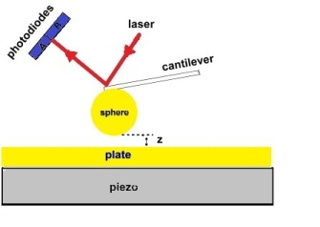
EXPERIMENT
Compare the Casimir force using Au &
ITO Plates (with and without UV Treatment)
Experiment:
i. Measure Casimir force between Au Sphere and Au plate
ii.Replace Au plate with ITO plate → Compare
iii. UV Treat ITO plate and Measure Casimir Force→ Compare
Results:
1.Casimir force reduces by x 2 with ITO
2.Casimir Force reduces additional ~35% with UV treatment
Notes:
Benchmark the ITO transparent electrodes against the standard gold electrodes.
The dutch paper shows a factor of 2 decrease due to
It was an ambient experiment ie done in air. With thin samples as these if done ambiently, the role of the moisture layer on top can be very important.
The properties of our sample are also different.

Slide 7
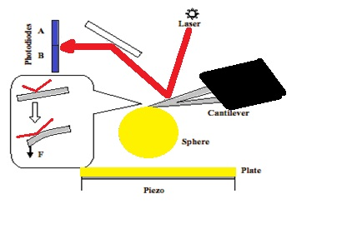
Force Measurements Using Cantilever Deflection
Plate :Au or ITO
Radius of Au coated Sphere= 101.23±0.25 µm
Smooth Au coating 0f 105±1 nm
10 nm Cr followed by 20 nm of Al then Au coating
Au Coating done at 3.75 Ẩ/min

Slide 8
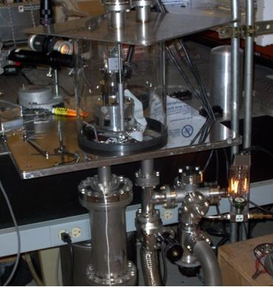
Experimental set-up scheme for contact mode
Oil Free vacuum at 10⁻⁷ Torr
Temperature 2 º C
Vibration Isolation
Notes:
The main chamber is cylinder glass jar, connecting the turbo-pump (V-70LP, Varian) followed by an oil-free dry scroll pump (SH-110, Varian). The steel bellows, connecting the turbo pump and the chamber, goes through the damper (massive reservoir with sand). The damper is used for reducing the mechanical vibration, which can propagate from pumps along the bellows to the chamber.
The chamber is placed on a damped optical table, designed to have a large mass to reduce the mechanical noise. The chamber system can be separate from the pump system by gate valve. To connect the AFM (Veeco diMultimode V) with controller (Veeco diNanoScope V) the electrical feed-through is used.
To prevent the AFM laser overheated in vacuum we added the cooling system. For this purpose we attached the Cu tight plait to the surface of laser source. Other side of plait we attached to the reservoir with liquid nitrogen, which could be refilled during the experiment through the liquid feedthrough to keep the temperature of laser surface constant.

Slide 9
Method: Measured Total Force(Electrostatic+Casimir) between
Au Sphere and ITO Plate
Cantilever deflection signal:
Electric Force
10 Different Voltages V
V _{o} = Residual Potential
X(z)~ Capacitance
k’ = cantilever spring constant
Parabolas Drawn at each Separation

Slide 10
Residual Electrostatic Potential between Au Sphere and ITO Plate
<V₀>=-196.8±1.5 mV
Residual Voltage independent of Au Sphere-ITO plate separation
This allows easy subtraction of the electrostatic force

Slide 11
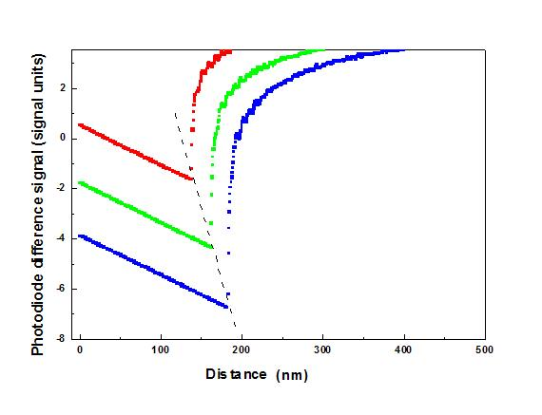
Experimental Procedure
Cantilever deflection signal:
z=z₀+ z_{piezo}-S_{photodiode signal} * m
Parameters defined from parabolas:
m from
Use sphere- plate electrostatic formula
z₀ = Surface separation on contact
m= cantilever deflection per signal unit
- residual potential difference
between the sphere and the plate
- Curvature

Slide 12
Determination of contact separation z_{o} & cantilever spring constant k
<z₀>=29.5±0.4 nm
<k>=0.0139±0.0001 N/m
Both z_{o} & k independent of separation
Critical for precision measurement

Slide 13
Correction for Sphere or Plate Movement
during Measurement
Will lead to Dependence of V_{o} on Separation Distance (Anamalous Behaviour Due to Skewed Parabola)
Force vs. Separation Curves for Same Applied Voltage
Shifted due to Sphere/Plate Movement
1st time
0
2nd time
Cantilever Deflection
Sphere- Plate separation (nm)
Notes:
At long distances (2.1 µm) all forces should be negligible. The signal at large separation distances of 1.8-2.1 µm was fit to a straight line. This straight line was subtracted from the measured signal measured at all sphere plate separations to correct for the effects of mechanical drift.

Slide 14
Correction due to Sphere-Plate Drift
1. Find Precise Sphere Plate
Contact Point- Extrapolate
2. Repeat Electrostatic Force
Measurement for same applied
V and look at change in contact
point.
0.08 nm/sec
Contact points as a function of time
Notes:
0.05 Hz repitition

Slide 15
Errors due to Sphere-Plate Separation Drift
Corrected
Uncorrected
<V₀>=-196.8±1.5 mV
<z₀>=29.5±0.4 nm

Slide 16
Measured Casimir Force from Au Sphere- ITO Plate
Subtract Electric Force from Total Force
100 Voltages Applied to Plate
Notes:
The red line are for the mean values of the measured force. The grey dots represent all individual (nonaveraged) experimental forces at each 5th point (at all points at an inset) for the sample before the UV treatment.

Slide 17
Measured Casimir Force
Comparison of Au plate to ITO plate
Number of voltages V = 10
Number of repetitions = 10
z (nm)
F_{Cas} (pN)
ITO/Au
85
-123.42
0.57
100
-81.62
0.61
120
-50.1
0.59
40% Reduction in Casimir
Force with ITO

Slide 18
UV Treatment of ITO Plate
Penray Hg Lamp 9.0 inch long and 0.375 inch diameter
λ=254 nm → 5.4 mWatt/cm² at 1.9 cm
λ=365 nm → 0.2 mWatt/cm² at 1.9 cm
12 hr
Cleaned as before (Acetone, Methanol, Ethanol, water rinse and Nitrogen dry)

Slide 19
Insert UV Treated ITO Plate
& Repeat Measurement

Slide 20
Measured Total Force(Electrostatic+Casimir) between
Au Sphere and ITO Plate
Cantilever deflection signal:
Electric Force
10 Different Voltages V on plate
V _{o} = Residual Potential
X(z)= Capacitance
k’ = cantilever spring constant
Use sphere- plate electrostatic formula
- residual potential difference
between the sphere and the plate
Parabola Curvature

Slide 21
Check Stability of Measurements of
Au Sphere and ITO Plate (after UV treatment)
Fit Electrostatic Force Curve
Distance independence of residual
potential V_{o}
2. Distance independence of
contact separation z_{o}
3. Distance independence of
Spring constant
<V₀>=65± 2 mV
<k>=0.0138±0.0001 N/m
<z₀>=29±0.6 nm

Slide 22
Repeat Casimir Force between
Au Sphere and ITO Plate (after UV treatment)
Subtract Electric Force from Total Force
100 Voltages Applied to Plate
Grey Bars represent the complete range of data every 5 nm
Notes:
The blue line are for the mean values of the measured force. The grey dots represent all individual (nonaveraged) experimental forces at each 5th point (at all points at an inset) for the sample after the UV treatment.

Slide 23
Casimir Force between Au Sphere and ITO Plate
(Before and After UV comparison)
z (nm)
After UV/Before UV
85
0.72
21-35% Reduction with UV treatment
21% at 60 nm and 35% at 130 nm
100
0.68
120
0.66

Slide 24
Histograms of the Experimental Data
- No Overlap
ITO After UV
ITO Before UV
60 nm
80 nm
100 nm
Notes:
The histograms of the experimental data and the corresponding Gaussian distributions are shown for the separations 60 nm, 80 nm and 100 nm, respectively.

Slide 25
Experimental Errors at 95% Confidence Level
ITO Before UV
ITO After UV
Error due to use of Proximity Force Approx <0.3%
Radius of Sphere= 101.2±0.5 μm
Notes:
The errors at a 95% confidence level are shown for the samples before (after) UV.
The grey line is for the systematic error, the dashed line is for the random error. The total experimental errors are shown by the solid color lines.
Systematic

Slide 26
Comparison with Lifshitz Theory

Slide 27
Lifshitz Formula
R>>z
R
1
z
2
Reflection Coeffs:
Matsubara Freqs.
At l=0, ξ=0

Slide 28
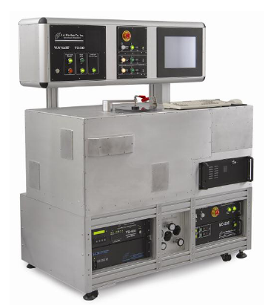
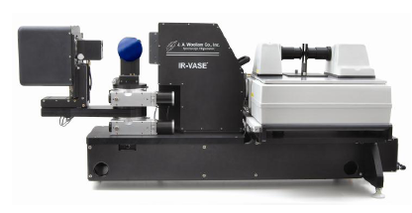
Measure Permittivity
Ellipsometry Measurements
J.A. Woollam Co., Inc.
VUV-VASE
Spectral range 0.14 – 1.7 µm;
Angle of incidence is computer controlled from 10° to 90° ;
IR-VASE
Spectral range 1.7–33 µm;
Angle of incidence is computer controlled from 30° to 90°.
Notes:
The VUV-VASE (variable angle spectroscopic ellipsometer) for the vacuum ultraviolet was used for measurements. The VUV-VASE features a wide spectral range from 140nm – 1700nm. The angle of incidence is computer controlled from 10° to 90° (25° minimum for longer wavelengths), with automated sample tilt and height adjustment. The entire optical path is enclosed inside a dry nitrogen purge to eliminate absorption from ambient water vapor and oxygen. The VUV-VASE uses a rotating analyzer ellipsometer (RAE) configuration with the addition of our patented AutoRetarder. The AutoRetarder changes the polarization state of light before the sample to maximize measurement accuracy.
The IR-VASE variable angle spectroscopic ellipsometer for the infrared was used for measurements in this report. The IR-VASE collects data from about 1.7 um – 33 um based on a Fourier-transform spectrometer. The angle of incidence is computer controlled from 30° to 90°. The IR-VASE uses our patented rotating compensator ellipsometer (RCE) configuration for fast, accurate measurements.

Slide 29
Comparison with Theory:
Casimir Force between Au Sphere and ITO Plate
Dielectric Permittivity Measured by Ellipsometry from 0.04 eV to 8.47 eV. Fit to
Lorentz oscillators and Drude type free electron behavior
a_{A}=111.52; w₀=8.eV, g₀= 4.eV.
Extrapolated to lower Frequency with Drude Model [ω_{p} =1.5 eV, γ=0.128 eV]
Notes:
The dashed lines in inset show the limits of possible extrapolations of the data to higher frequencies. The two dashed lines in lower figure correspond to two limiting extrapolations to higher frequencies
shown in the upper figure. The dielectric permittivities as a function of imaginary frequency is shown for an untreated ITO sample with charge carriers included (solid lines) and neglected (dashed lines)

Slide 30
Dielectric Permittivity in Imaginary Frequency
No UV
After UV
Drude Model Parameters
[ω_{p} =1.5 eV, γ=0.128 eV (No UV),
γ=0.132 eV (UV)]
a_{A}=111.52; w₀=8.eV, g₀= 4.eV;
a_{A}=240.54, w₀=9.eV, g₀=8.5eV.
Very Little Difference between Before and After UV in imaginary frequency
Notes:
The dielectric permittivities along the imaginary frequency axis are shown for the samples before-red (after-blue) UV. In both cases the results with included and ignored free charge carriers are shown.
The inset is the imaginary parts of the dielectric permittivity obtained by using the ellipsometry are shown for the samples before (after) UV.
(3) The expression for the oscillator, used for an extrapolation to high frequencies xW, is:
epsOsc = aA*g0*xW/((xW^2 - w0^2)^2 + g0^2*xW^2).
The parameters used for the bottom and top curves are,
respectively:
aA=111.52; w0=8.eV,g0= 4.eV;
aA=240.54, w0=9.eV, g0=8.5eV.
Only one oscillator for each data. Oscillator only for the extrapolation. The epsilon expression is in imaginary frequency

Slide 31
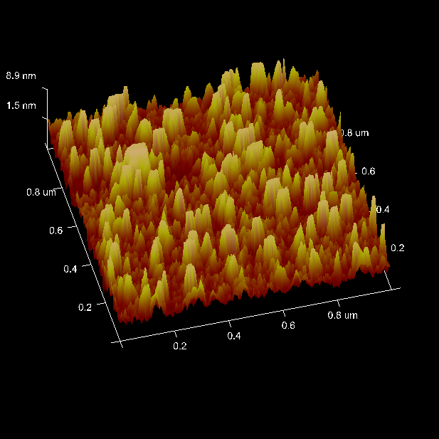
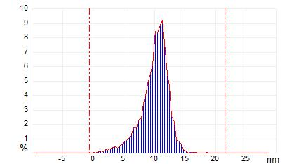
ITO Plate Roughness
Fractions v_{i} of the surface
area covered by roughness
with heights h_{i}
h_{i}, nm | v_{i}
0.097 | 4.40E-04
0.483 | 1.50E-04
0.87 | 0.00102
1.257 | 0.0016
1.644 | 8.70E-04
2.03 | 0.00262
2.417 | 0.00189
2.804 | 0.00277
3.191 | 0.00408
3.577 | 0.00452
3.964 | 0.00335
4.351 | 0.0051
4.738 | 0.00641
5.124 | 0.0083
5.511 | 0.0086
5.898 | 0.01049
6.285 | 0.01311
6.671 | 0.01734
7.058 | 0.01734
7.445 | 0.02273
7.832 | 0.02389
8.218 | 0.03395
8.605 | 0.04006
8.992 | 0.05041
9.379 | 0.05522
9.765 | 0.06148
10.152 | 0.08421
10.539 | 0.08362
10.926 | 0.08858
11.312 | 0.09237
11.699 | 0.07605
12.086 | 0.05478
12.473 | 0.04691
12.859 | 0.02608
13.246 | 0.02171
13.633 | 0.00874
14.02 | 0.00758
14.406 | 0.00626
14.793 | 000262
15.18 | 0.00102
RMS Roughness=2.04 nm
Roughness effect
<0.5 % for >116 nm
<1% for > 90 nm
<2.2% at 60 nm

Slide 32
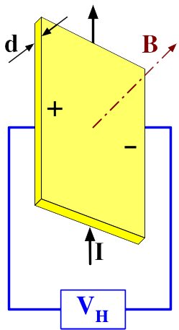
Carrier Density Measurement
No UV
After UV
wikipedia
Slope = B/dne is same
Same Carrier Density = 7 x 10²⁰ /cc

Slide 33
Comparison with Theory: Casimir Force between Au Sphere and ITO Plate Before UV
ITO Before UV
DC Conductivty Included – Good Agreement
Notes:
The data for samples before-red (after-blue) UV are compared with the respective theory (including the charge carriers before UV and ignoring charge carriers after UV).

Slide 34
Comparison with Theory:
Casimir Force between Au Sphere and ITO Plate After UV
++ Data
----Theory with
DC Conductivity
Effect of inclusion of DC Conductivity
ITO After UV
No Agreement if we include Free Carriers
Notes:
The experimental data for the sample after the UV treatment are compared with the theory including free charge carriers

Slide 35
Comparison with Theory: Casimir Force between Au Sphere and ITO Plate After UV
DC Conductivity Not Inclduded
Good Agreement only if we drop the DC conductivity of ITO Afer UV
Assume it to be a perfect dielectric
ITO After UV
Notes:
The data for samples before-red (after-blue) UV are compared with the respective theory (including the charge carriers before UV and ignoring charge carriers after UV).

Slide 36
Understanding the Patch Effect by
Electrostatic Simulation

Slide 37
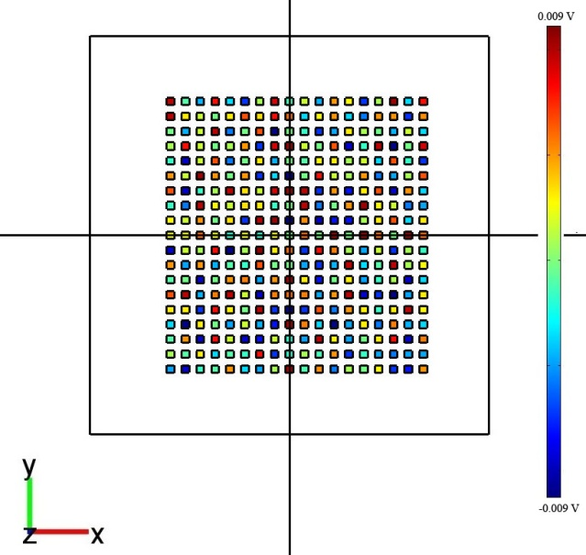

Electrostatic simulation with COMSOL software package
A_{eff}=2πRd
Δ-
ε₀ε_{r}
V=0
ε_{r} – relative permittivity
Δ
We solved the Poisson equation for conductive plate (variable potential V_{plate}) with dielectric patches on the surface (random potential distribution in [-90;90] mV) and conductive sphere on the distance z from the plate
F_{total} (V_{plate}) between
the sphere and plate = 0
V_{plate} =V₀
Patches
Plate size = 32×32 μm;
Patch size = 0.6×0.6 μm;
V_{plate}=0.018 mV , V_{sphere}=0,
V_{patches}=random in [-90;90] mV, Δ~0.7 mV.
Area filled by patches has been chosen
according to condition: Surface area > A_{eff}=2πRd
(for z=0.1 μm plate size should be higher then 8 μm)
Notes:
Random voltages on the patches between -90 to +90 mV

Slide 38
Electrostatic simulation with COMSOL software package
A_{eff}=2πRd
Δ-
ε₀ε_{r}
V=0
Δ
ε_{r} – relative permittivity
We solved the Poisson equation for conductive plate (variable potential V_{plate}) with dielectric patches on the surface (random potential distribution in [-90;90] mV) and conductive sphere on the distance d from the plate
In the pictures:
Sphere radius R = 100 μm;
Plate size = 32×32 μm;
Patch size = 0.3×0.3 μm to 0.9×0.9 μm;
V_{patches}=random in [-90;90] mV, Δ~0.7 mV.
Patches
Plate
Sphere
Apply voltages to the plate and find voltage when electrostatic force goes to zero
This compensating voltage (V_{o}) is found for different separations.
Notes:
Use Comsol . Apply voltages to the plate and find voltage when electrostatic force goes to zero
This compensating voltage (V_{o}) is found for different separations.

Slide 39
Simulation Results of Compensating Voltage
Distance Independent
As in Observed in
Experiment –Well
Compensated
Notes:
The Amsterdam Group in air experiment observed same decrease in Casimir force without UV. Their samples are completely different. It would be
Extremely fortuitous if two experiments with two different samples in two different countries had the same patch potential effects which mask the
Casimir force.

Slide 40
Conclusions
UV Modification of the Casimir Force was demonstrated.
No Anamalous distance dependence of the Compensating Voltage
21-35% reduction of Casimir force by UV treatment even though there is not much change in ε(iξ)
The Casimir force measurements have the correct distance dependence.
Inclusion of DC conductivity in the Lifshitz formula for the ITO after UV leads to disagreement with the experimental results.
A Study of the Temperature Dependence of the Carrier Mobility might shed light on the discrepancy.
Precision Measurement of Casimir Force with Au Using a
Dynamic AFM at 15:30 pm
Notes:
The Amsterdam Group in air experiment observed same decrease in Casimir force without UV. Their samples are completely different. It would be
Extremely fortuitous if two experiments with two different samples in two different countries had the same patch potential effects which mask the
Casimir force.

Slide 41
Acknowledgements
Experiment
C.C. Chang
Banishev
R. Castillo
Theoretical Analysis
V.M. Mostepanenko
G.L. Klimchitskaya
Research Funded by:
DARPA, National Science Foundation & US Department of Energy

Slide 42
Comparison with Theory: Casimir Force between Au Sphere and ITO Plate
ITO Before UV
ITO After UV
DC Conductivty Included
Comparison
DC Conductivity Not Inclduded
Good Agreement only if we dropthe DC conductivity of ITO
Afer UV
Notes:
The data for samples before-red (after-blue) UV are compared with the respective theory (including the charge carriers before UV and ignoring charge carriers after UV).

