Slide 1

Irreducible Many-Body
Casimir Energies (Theorems)
M. Schaden
QFEXT11
Irreducible Many-Body Casimir Energies of Intersecting Objects
Euro. Phys. Lett. 94 (2011) 41001
Many-body contributions to Green’s functions and Casimir , Phys.Rev.D 83 (2011) 125032 (2011), with K.V. Shajesh
(Shajesh, Thursday 18:30C)
Advertisement: arXiv:1108.2491
(Holographic) Field Theory Approach to Roughness Corrections

Slide 2
outline
Irreducible N-Body Casimir energies.
  Recursive definition and statement of a theorem:
  finiteness for N-objects with empty common intersection
  An analytic example: Casimir tic-tac-toe in any dimension
The theorem for irreducible N-body spectral functions:
  no power corrections in asymptotic heat kernel expansion.
  relation between irreducible spectral functions and irreducible Casimir energies.
A massless scalar with local potential interactions
  Irreducible spectral functions as conditional probabilities
  The sign of the irreducible N-body scalar vacuum energy
Numerical world-line examples of finite intersecting N-body Casimir energies
  2-dim tic-tac-toe and 3-intersecting lines.
Summary

Slide 3
Irreducible Many-Body Casimir Energies
The total energy in the presence of N objects can be (formally)
decomposed into irreducible 0-,1-,2-,…, N- body parts as:
For objects that interact locally with quantum fields we proved the
Theorem: The irreducible N-body Casimir energy is finite
if the common overlap of the objects
-- a (non-trivial) extension to N-bodies that need not all be mutually disjoint of the theorem by Kenneth and Klich that irreducible (interaction) Casimir energies of 2 disjoint bodies are finite.

Slide 4
pictorially…
generally
NOT
finite
But (Kenneth and Klich 2006):
IS FINITE!

Slide 5
…we now can also show that….
IS FINITE!
- the “objects” can be 3-, 4-,.. dimensional
- the irreducible many-body energy in general depends on the objects

Slide 6



Tic-Tac-Toe: an Analytic Example
Scalar field with Dirichlet b.c. on hypersurface tic-tac-toe
l₁
l₂

Slide 7

More about Casimir tic-tac-toe
2 is the length of periodic classical orbits that touch all hypersurfaces, i.e. the irreducible tic-tac-toe Casimir energy is given semiclassically.
The result for the irreducible tic-tac-toe Casimir energy is finite and exact (and independent of any regularization).
The expression vanishes when any hyperplane is removed, i.e. it does NOT give the 2-plate result when a pair of parallel plates is widely separated.
The irreducible Casimir energy remains finite even if two or more pairs of plates coincide – giving ½ the irreducible tic-tac-toe Casimir energy in d-1 dimensions!

Slide 8



Why?
Simple explanation:
In the alternating sum of an irreducible N-body vacuum energy, Volume divergences, surface divergences, corner and curvature divergences…, i.e. all divergences associated with local properties cancel precisely among the various configurations.
Sophisticated explanation:
Spectral function of the domain D_{s} containing the subset s of objects,
where is the spectrum of a local Hamiltonian.
has vanishing asymptotic Hadamard-Minakshisundaram-DeWitt-Seeley expansion:

Slide 9

…Hadamard-Minakshisundaram-….
- All volume terms cancel, all surface terms cancel, all curvature
terms cancel, all intersection terms cancel, etc…
ALL LOCAL TERMS CANCEL !!
-

Slide 10





The Massless Scalar Case
Feynman-Hibbs (1965) Kac (1966);
Worldline approach of Gies & Langfeld et al. (2002 ff.)
for massless scalar:
Scalar
Theorem:
Finite
AND

Slide 11
Scalar with Dirichlet objects
probability BB is killed by all N objects
For Dirichlet b.c.: probability that BB touches all N objects
X
X
X
X
X
X
X
X
X
X
X
X
does NOT contribute
X
contributes

Slide 12
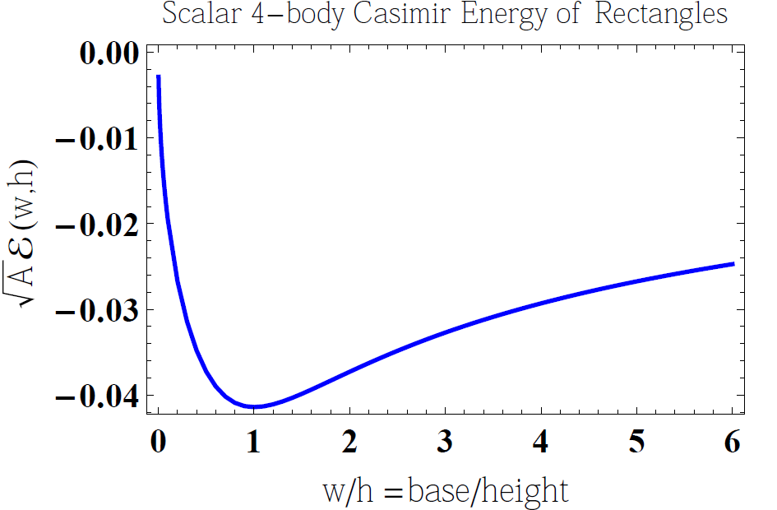
Irreducible Casimir energy of tic-tac-toe
Analytical irreducible
4-line vacuum energy:
Stochastic numerics:
1000x7 hulls of 10000pt
worldlines.
Error< 0.1%
w
h
square

Slide 13
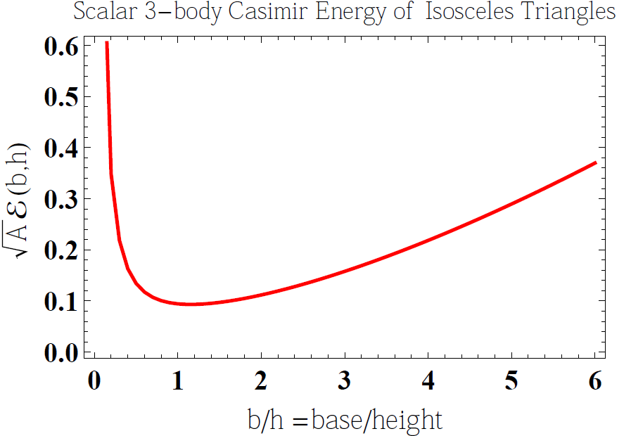
Irreducible Casimir energy of a triangle
Equilateral triangle has minimal irreducible 3-body Casimir energy
Stochastic numerics:
1000x7 hulls of 10000pt
worldlines.
Error< 0.1%
h
b
equilateral triangle

Slide 14
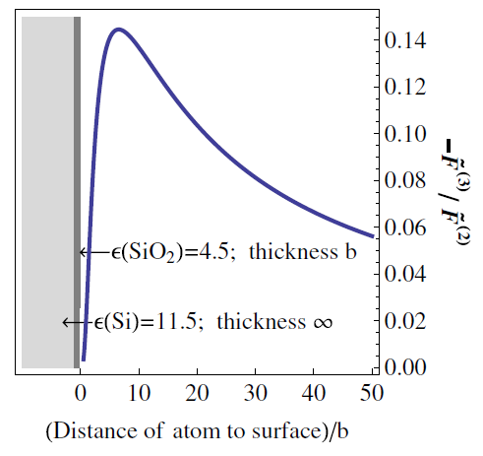
Summary
Irreducible N-body Casimir Energies are finite if the N objects have no common intersection and are finitely computable [See Shajesh’s talk on Thursday]
Irreducible N-body Casimir Energies can be be sizable and important:
The asymptotic power expansion of
irred. N-body spectral functions vanishes
The irreducible N-body spectral function
of a massless scalar interacting with
the N “objects” through local potentials (or Dirichlet boundary conditions) is a conditional probability on random walks!
The irreducible N-body Casimir energy of such a scalar is not just finite (if the common overlap of the bodies vanishes) but negative for even and positive for odd N.

