Slide 1


Quantum Faraday effect in graphene systems
GIANT
I.V. Fialkovsky^{1,2}, D. Vassilevitch^{2,3}
¹ Instituto de Física, Universidade de São Paulo, Brasil
² Department of Theoretical Physics, St. Petersburg State University, Russia
³ Universidade Federal ABC, São Paulo, Brasil

Slide 2
Contents
A reminder on Dirac description of Graphene
One-loop effective theory:
  Polarization operator
  Matching conditions
  Light propagation
Conductivity and Faraday effect:
  Non-Drudeness of the conductivity
  Cyclotron resonance: fitting of existing experiment
  Predicting new results
Pictures’ courtesy:
Novoselov & Geim’s group
Kuzmenko et al.
Related talks
Earlier today, by V. Marachevskiy
Tomorrow by D. Vassilevich

Slide 3
Tight-binding model
Two sub-lattices, two atoms in a primitive cell.
Strong covalent -bonds in the graphene plane,
Weekly-intersected -orbitals perpendicular to the plane.
Hamiltonian function of -electrons hopping to the nearest atom

Slide 4
The Linearity of Spectrum
In vicinity of Dirac (K-)points energy of quasy-particles has
linear dispersion
Fermi velocity
Thus the low-energy quasy-particles are quasy-relativistic Dirack fermions
Note 8-fold degeneracy: 2 sub-lattices * 2 valleys * 2 spins
Wallace, 47, Semenoff, Apelquist,Redlich, 80-s

Slide 5
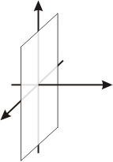
Action functional
The action of the systems is straightforward (with EM field)
With a second plate – Casimir effect, see the talk by Valeriy Marachevsky
The model is well established and proved by several experiments:
absorption of light, etc.
Gusynin et al, 2004

Slide 6
QFT approach
The generating functional of the theory is
The Casimir energy in this approach is given by
To calculate the generating functional we first ‘integrate out’ the fermions
where the effective action is given by

Slide 7
QFT approach II
In the quadratic approximation the effective action is given by polarization operator
The full line denotes the fermion propagtor of considered system
and the one-loop polarization operator is defined in a standard way

Slide 8
Effective EM theory
Thus in the lowest order approximation we had the following effective action
This gives the modification to the Maxwell equations
the delta potential is equivalent to the following matching conditions
This lets one to describe the plane waves propagation in the system:
- reflection coefficients (for TE,TM modes, etc.)
- rotation of polarization (if any)
- absorption of light

Slide 9
Normal Incidence
For our purposes we need to consider the normal incidence only
when the tensorial structure of PO is quite simple
In the language of condensed matter physics, polarization operator П corresponds to ac (and dc) conductivity

Slide 10
Propagation of light
For linearly polarized waves one has
the (cumbersome) calculation of the reflection coefficient gives
If both P-even and P-odd parts of polarization operator are real, the flux is conserved

Slide 11
Faraday Effect
The transmission coefficient is then given in the first order in
while the rotation of the angle of the polarization and elipticity of transmitted wave are defined as
Earlier predictions on the issue:
Mikhailov, Volkov 1985, O’Connell, Wallace, 1982
See also works by Morimoto, Hatsugai, Aoki
IVF, D. Vassilevitch, 09

Slide 12
Polarization Operator
Just to remind you
The full line denotes the fermion propagator of considered system
We will be interested in the case of zero temperature but with external magnetic field and non-vanishing chemical potential.

Slide 13
Propagator, B>0
In presence of external magentic field perpendicular to the graphene plane one has for the propagator
where L_{n} are the Laguerre polynomials, and
Initially the propagator in this case was calculated in the field of the heavy ions collisions.
Chodos, Evering, Owen, 1990

Slide 14
Polarization Operator
In the normal incidence case, the internal moment integration can be resolved analytically due to the orthogonality of the Laguerre polynomials
which lead to the following expressions for P-odd and P-even components
where

Slide 15
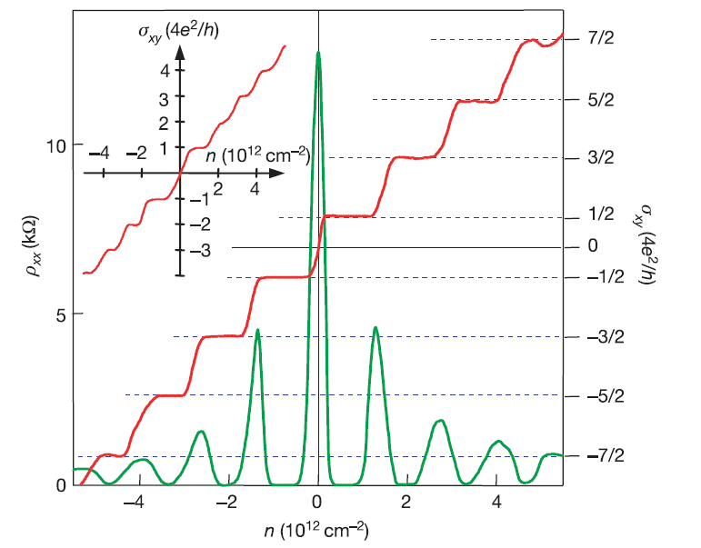
Relativistic Hall effect
In the limit we obtain the relativistic Hall conductivity
For graphene N=4, and thus
Novoselov et al, 2005
Experimental: Novoselov et al, 2005; Kim et al, 2005
Theory: Zheng, Ando 2002; Gusynin, Sharapov, 2005, Peres et al., 2006

Slide 16
Non-Drudeness of conductivity
The next step is in resolving the frequency integration which leads to
Surprisingly, G has NO POLES in the complex plane!! Only a tricky combination of logarithmic divergences:
However, its behavior on real axe only is almost undistinguishable from the Drude conductivity, see below!

Slide 17
Non-Drudeness of conductivity
A similar results holds for the P-even part: NO POLES
Unlike P-odd part the P-even is neither odd, nor even as a function of chemical potential for non vanishing mass gap.
Actually, polarization operator in 2+1 is power-counting divergent. It reveals itself in the even part
However, at our level of consideration it does not effect the results since

Slide 18
Small chemical potential
Small chemical potentials corresponds to suspended graphene layers. In this limit we have
the maximum/minimum of rotation angle is of the order of
and are achieved, correspondingly, at
In idealistic case, the chemical potential as well as Г are identically zero. However, in a realistic situation there is an interplay between them due to unavoidable presence of impurities.

Slide 19
Suspended graphene
Thus, possible experimental curves should have the following form
Just 1Å of graphene at B=7T rotates polarization of light by about 4.5 degrees and absorbs 25%!

Slide 20
Epitaxial graphene
Large Fermi energy shifts are usually invoked by the interaction with a substrate. For big chemical potential one can show
i.e. in cyclotron resonance the main contribution is coming from around
For numerical investigation it is sufficient consider
This holds already for
No nicer formulas can be obtained.

Slide 21
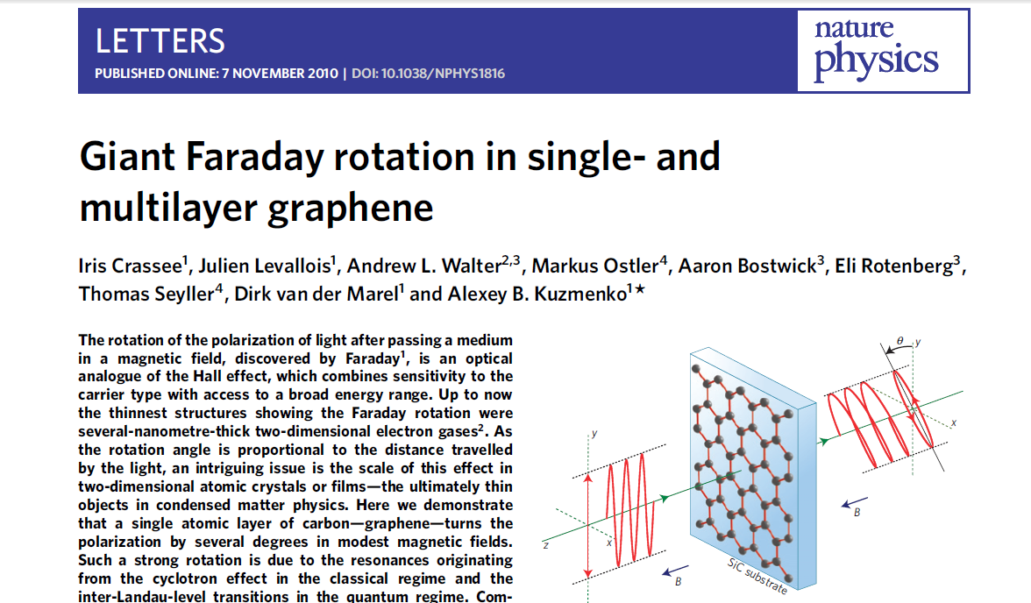

Slide 22
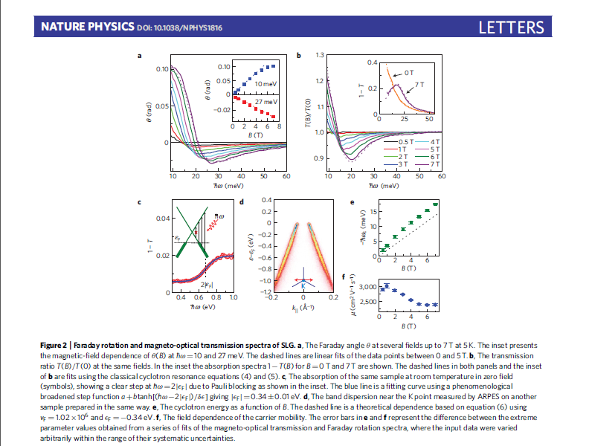

Slide 23
Data fitting
Aims:
Yet again to check the Dirac model
Reveal possible field dependence of the parameters
(mass, scattering rate, chemical potential)
The fit was performed around the following initial values
The Diraс model (nicely) fits the experimental curves:
mass gap doesn’t influence the result (in a reasonable interval)
Gamma’s dependence on the magnetic filed is about +/- 10-15%. So,
it cannot be resolved at this stage.
The fitted value of chemical potential is essentially lower then the Fermi
energy shift measured at zero field, and grows with magnetic field

Slide 24
Data fitting

Slide 25
Data fitting

Slide 26
Chemical potential
Chemical potential (as a parameter entering the Dirac model) grows with magnetic field:
while experimentally measured Fermi energy shift at zero magnetic field
Self-consistent perturbation theory seems to be a possible solution for the apparent discrepancy.

Slide 27
vs Drude
As promised we can compare our results with the Drude ones
Thus, the predictions for the real frequencies are rather indistinguishable, while analytical properties in the whole complex plane are completely different!

Slide 28
Conclusions
After reminding of the Dirac description of graphene we
revealed the non-Drudeness of the conductivity
predicted a new regime to observe ‘Giant Faraday Rotation in Graphene’
showed that model nicely describes the experimental curves in the cyclotron resonance regime
Attn.: tomorrow at 18.15h “Quantum Field Theory in Graphene”
by D. Vassilevich
Fialkovsky I.V., Vassilevitch D.V.
Parity-odd effects and polarization rotation in graphene
J. Phys. A: Math. Theor. 42 (2009) 442001, arXiv: 0902.2570 [hep-th]
Bordag M., Fialkovsky I. V., Gitman D. M., Vassilevich D. V.,
Polarization rotation and Casimir effect in suspended graphene films, arXiv:1003.3380 [hep-th]

Slide 29
Thank you!

Slide 30
QFT approach II
No caso mais simples
o laço dos férmions foi calculado muitos anos atrás e muitas vezes
onde as funções tem seguinte forma explicita
Semenoff, 1984, Redlich, 1984, Appelquist, 1986, Dunne, 1996-1999, etc.

Slide 31
QFT approach II
Onde a velocidade da media pode ser escolhida como
As funções escalares A,B se expressam através dos alguns dois componentes

