Slide 1
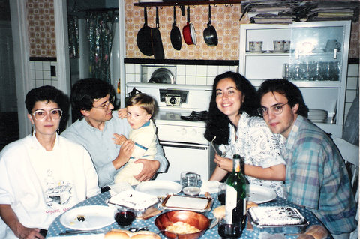
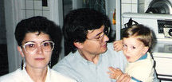
What is QFT?
Manolo Fest
Benasque, 16 September 2011

Slide 3
QFT has a reacher structure: Symmetries
Space-time symmetry , Poincaré Conservation laws
CPT , T is not a symmetry, arrow of time
Global symmetry, e.g. charge conservation
Scale transformations, Renormalization group
Local Gauge symmetry, Dynamical principle

Slide 4
QFT offers further possibilities
Supersymmetry
  Gran Unification
Space-time reparametrization (diffeomorphisms)
  Gravity
Topological invariants
Chern Simons, Knots Theory, Seiberg-Witten, …
Duality, Holography, …

Slide 5
QFT applies to many domains
High energies: Standard Model
  QED, QCD, Weak interactions
Low energies: Effective lagrangians
  Fermi theory, Chiral lagrangians, Nambu-Jona-Lasinio
Condensed Matter
  QHE, Conformal Field Theory, Hubbard model, …
Mathematics
  Chern- Simons (knot theory), Topological models (Donaldson theory), index theorems, solitons, instantons, skyrmions, Morse theory, central extensions, …

Slide 6
There was a time when QFT was one option
Physics follows from basic constraints
S-matrix period: Unitarity, Causality, Analiticity
QFT was ugly and inconsistent(?)
  Infinities (are swept under the carpet (Dirac))
  QED is inconsistent at high energies (Landau pole)

Slide 7
Our goal is to compute observables
(probability amplitudes)
Unitarity

Slide 8
A first surprise

Slide 10
Perturbation theory
Non-perturbative physics is lost
Series is asymptotic: singularity at λ=-ε
Perturbartive expansion forces to use the theory beyond its domain of validity
The local form of the interaction is ultimately responsible for UV divergences

Slide 11
Yet
e.g. g-2
4-loop = 891 diagrams error= 10⁻¹²
Yet, yet, unitarity constraints, symmetry constraints, RG constraints,
unexpected relations (holography?), ….
There must be a simpler way

Slide 12
Manolo’s guidance:
First high-level lectures: Choosing my first postdoc
Anomalies

Slide 13
A rapid look at renormalization

Slide 14
Regularized amplitudes
Independence of substraction point
Renormalized field and coupling
Renormalized amplitude
Explicit matches implicit
Beta and gamma function
RG equation

Slide 15
IR divergences, γ₅, composite operators, gauge symmetry, evanescent operators,
RG invariants, unitarity, Landau pole, asymptotic freedom, renormalizability,…

Slide 16
Differential Renormalization
(K. Johnson, D. Z. Freedman, JIL)
But, the product of distributions is not a distribution
The bare amplitude is ok for x≠0. A cut-off regulator excises a region around
this point and extends the distribution.

Slide 17
Extend the distribution by pulling derivatives in front!
The integration constant μ becomes the renormalization scale

Slide 18
QED anomaly: Steinberger, Schwinger, Johnson, Adler, Bell, Jackiw
Vector symmetry
Axial symmetry
But violates gauge invariance

Slide 19
Add a counterterm!
It follow that QED carries an anomaly
Take
Anomalies in d=2n dimensions appear for n+1 vertex graphs

Slide 20
Regulator free anomaly: pull derivatives in front of amplitudes
Two singular forms are extended

Slide 21
Vector and axial Ward identities cannot be fulfilled simultaneously
The system is overdetermined
The anomaly is an renormalizaiton ambiguity at short distances which
Is fixed by long-distance properties (heat kernel analogy)

Slide 22
Manolo’s guidance:
Take home work for my second postdoc
non-perturbative physics
C-theorem

Slide 23
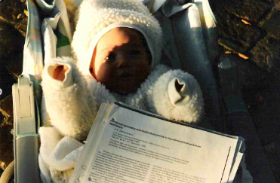

Slide 24
RG flows
UV
Are RG flows irreversible?
IR
Wilson Exact Renormalization Group Equation

Slide 25
Preliminary 1: OPE
A QFT theory is defined by a set of operators
that close an algebra
Weinberg sum rules, deep inelastic, renormalons, QCD sum rules, Heavy quark eff th, CFT

Slide 26
Preliminary 2: CFT
In 1+1 critical theories, the OPE is constraints by conformal symmetry
Stress tensor does not develop anomalous dimensions: central charge
Scaling dimensions
Structure constants

Slide 27
Zamolodchikov’s c-theorem
Hypothesis: d=1+1, unitarity, renormalizability, Poincaré invariance
Thesis:
Poincaré+absence of anomalous dimensions
Conservation laws (Ward Identities contact terms are irrelevant at x≠0)

Slide 28
C is observable
Unitarity (reflection positivity)
Art CFT,

Slide 29
CUV
d=1+1, unitarity
RG flows are irreversible
Cuv > CIR
CIR

Slide 30
Spectral proof of irreversibility (A. Cappelli, D. Friedan, JIL)
The spectral density carries spinless intermediate states
It is positive for unitary theories
The c-th can be formulated in terms of Quantum Information theory
Unitarity = strong subadditivity of Von Neuman entropy

Slide 31
Manolo’s guidance:
Pay attention to condensed matter models
(clock models, spin chains, DMRG,…)
(also to topology, Chern-Simons, …)
Scaling of entropy

Slide 32
Information
Theory
Quantum Physics
Classical Physics

Slide 33
Quantification and classification of entanglement
Product state
Classically correlated states
Entangled states
Can we quantify entanglement?
How entangled is the ground state of a QFT?

Slide 34
Pure states: Schmidt decomposition
A B
Diagonalize A
χ = min(dim H_{A}, dim H_{B}) is the Schmidt number
Entanglement

Slide 35
Von Neumann entropy of the reduced density matrix
χ =1 corresponds to a product state
Large χ implies large superpositions
e-bit

Slide 36
Scaling of entropy for the XY model
(G. Vidal, E. Rico, A. Kitaev, JIL)
How does entanglement entropy scales in spin chains?
Diagonalization:
Jordan-Wigner transformation
Fourier transformation
Bogoliubov transformation

Slide 37
Jordan-Wigner transformation to spinless fermions
Lieb, Schultz, Mattis (1961)

Slide 38
Fourier transform

Slide 39
Bogoliubov transformation

Slide 40
Some intuition
  The XY chain reduces to a gaussian hamiltonian
    We have the exact form of the vacuum
    We can compute exact correlators
  The partial trace of n-L does not imply interaction
    Each k mode becomes a mixed state
L

Slide 41
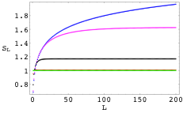
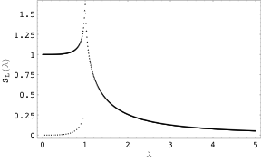
Scaling
Saturation away from criticality
Monotonicity along RG flows

Slide 42
Universality of scaling of entanglement entropy
At d=1+1 quantum phase transition point
In higher dimensions, Area Law
Entanglement entropy vs Balck-hole entropy!
Entanglement entropy limits simulation of QFT (DMRG, PEPS, MERA, tensor networks)

Slide 43
Scaling of entropy of entanglement summary
Non-critical spin chains | S ~ ct
Critical spin chains | S ~ log₂ n
Spin networks in d-dimensions “Area Law” | S ~ n^{d-1/d}
Shor algorithm | S ~ r ~ n
NP-complete problems | S ~ n
Large entanglement for time evolution, long-range interactions, ….
Black-hole, Tensor Networks, Compression, …

Slide 44
Hilbert space
Local interactions
Area Law

Slide 45
What is QFT?
Lagrangian encapsulates dynamical principles based on symmetries
Perturbative QFT is about RG
Nonperturbative QFT is about RG, nontrivial configurations,
measure of path integral, reshuffling of Hilbert space, integrability
Monte Carlo gives meaning to QFT
Sign problem, understanding the measure
Is QFT a sophisticated corner of Information Theory?
Is QFT about effective theories?
Is QFT a poor man’s vision of some grand scheme?
(holography, duality, string th, missing gravity)

Slide 46
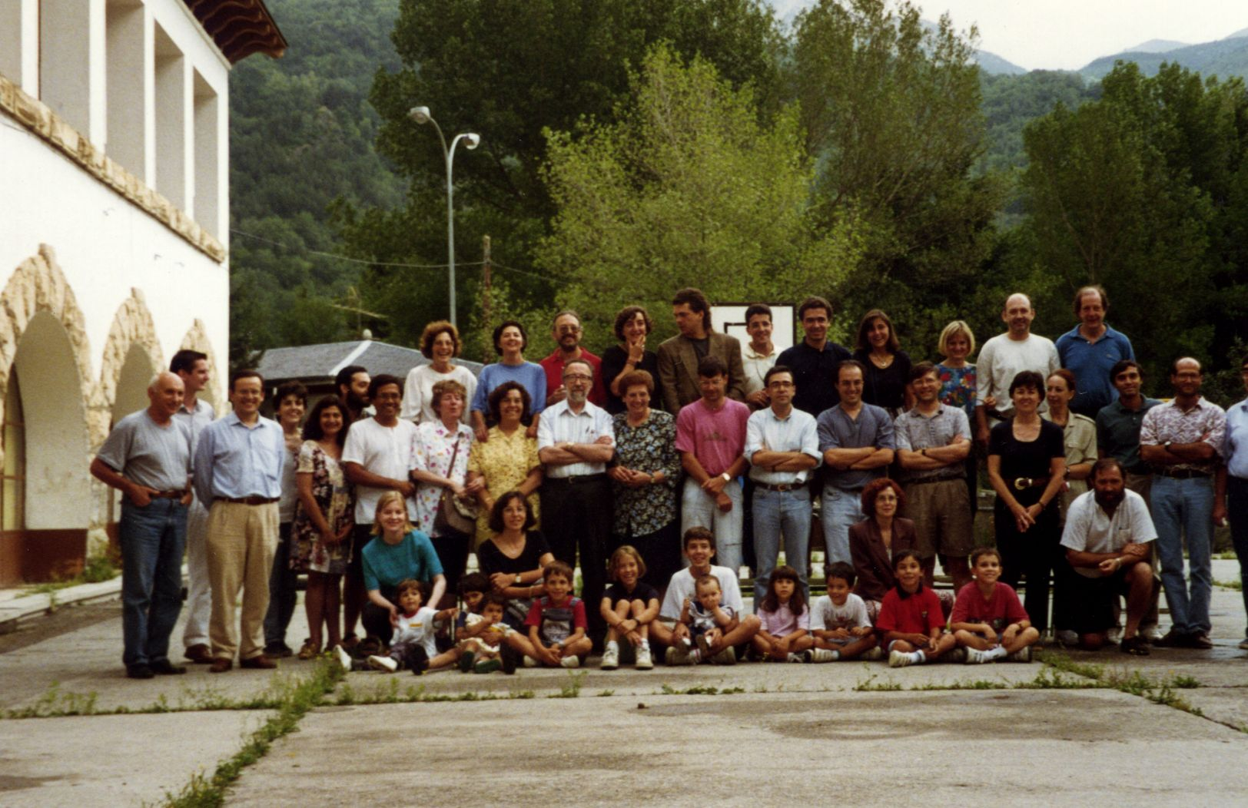
Happy Birthday Manolo!

