Slide 1
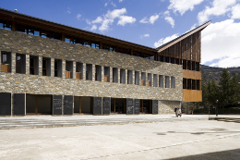

Experimental Status Flavour and CP
and
Future with SuperB
Achille Stocchi
LAL Orsay
Université Paris-Sud
IN2P3-CNRS
SuperB: Flavour Physics
2011, Jan 18 - Jan 21

Slide 2
Short Introduction – Main motivations
Actual Situation (CKM – CP)
What we learned sofar
(using selected topics)
Future : SuperB for CP and Flavour
Some comparison with LHCb and SLHCb

Slide 3
Flavour Physics in the Standard Model (SM) in the quark sector:
10 free parameters
~ half of the
Standard Model
6 quarks masses
4 CKM parameters
Wolfenstein parametrization : λ ,A, ρ, η
η responsible of CP violation in SM
In the Standard Model, charged weak interactions among quarks
are codified in a 3 X 3 unitarity matrix : the CKM Matrix.
The existence of this matrix conveys the fact that the quarks
which participate to weak processes are a linear combination
of mass eigenstates
The fermion sector is poorly constrained by SM + Higgs Mechanism
mass hierarchy and CKM parameters

Slide 4

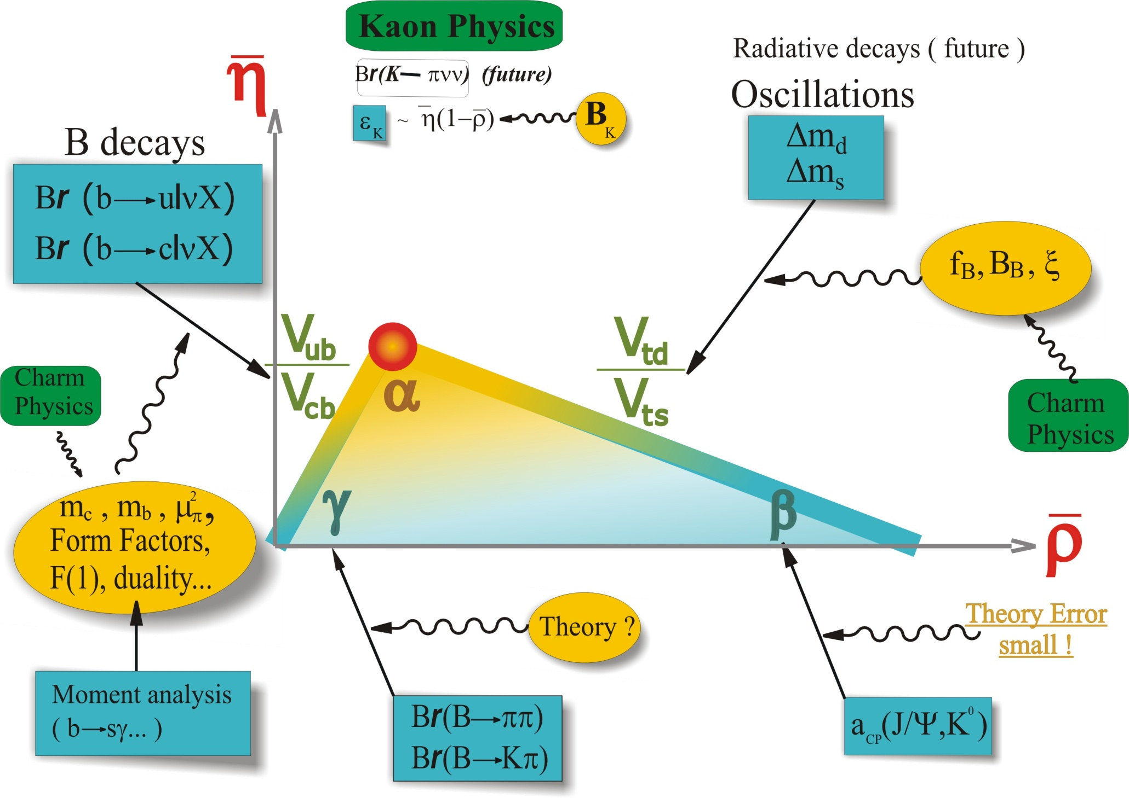
The Unitarity Triangle:
radiative decays X_{s}γ,X_{d}γ, X_{s}ll
B→ ππ, ρπ, ρρ...
B→ τν
theo. clean
?
B→ DK
Charm Physics
(Dalitz)
+other charmonium
+from Penguins

Slide 5
Beyond the Standard Model with flavour physics
More said
in Marco Ciuchini
talk
The indirect searches look for “New Physics”
through virtual effects from new particles in loop corrections
1
~1970 charm quark from FCNC and GIM-mechanism K⁰→ μμ
~1973 3rd generation from CP violation in kaon (ε_{K}) KM-mechanism
~1990 heavy top from B oscillations Δm_{B}
~2000 success of the description of FCNC and CPV in SM
2
3
4
“Discoveries” and construction of the SM Lagrangian
SM FCNCs and CP-violating (CPV) processes occur at the loop level
SM quark Flavour Violation (FV) and CPV are governed by weak interactions
and are suppressed by mixing angles.
SM quark CPV comes from a single sources ( if we neglect θ _{QCD} )
New Physics does not necessarily share the SM behaviour of FV and CPV

Slide 6
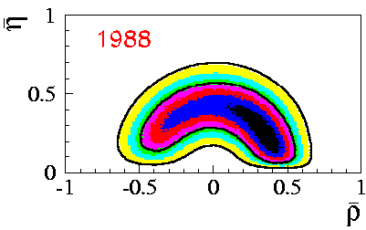
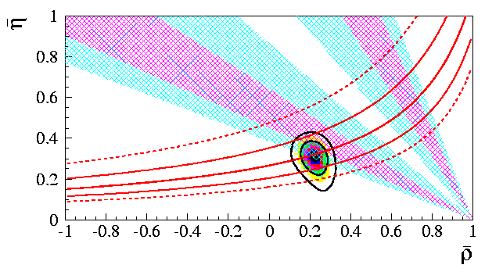
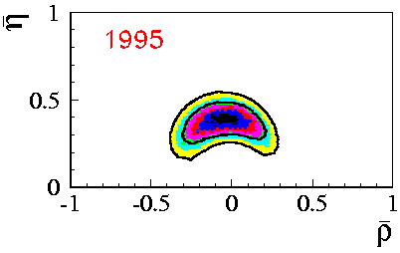
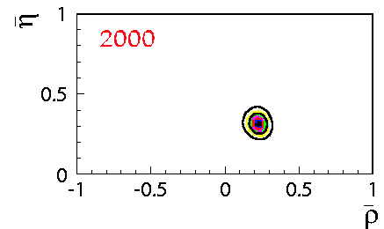
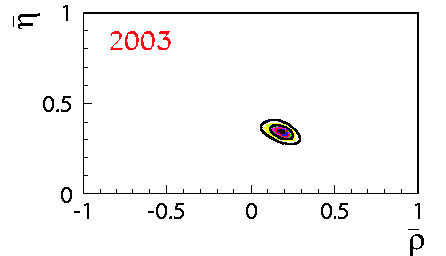
From Childhood
Dominated by
Δm_{d}, V_{ub},V_{cb}, εK, limit on Δm_{s} and Lattice
In ~2000 the first fundamental
test of agreement between
direct and indirect measurements of sin2β
To precision era

Slide 7
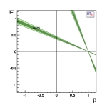
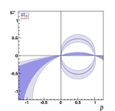
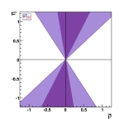
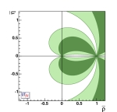
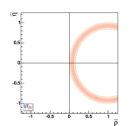
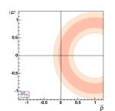
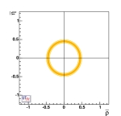
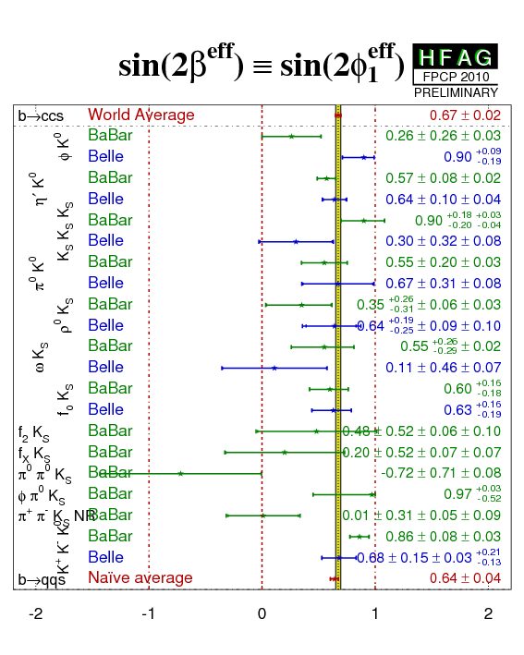
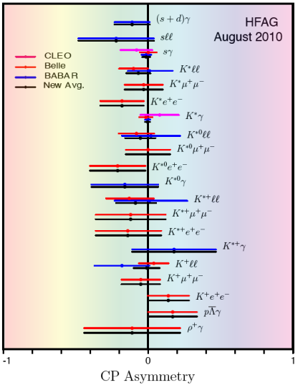
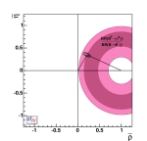
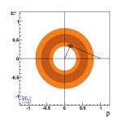
What happened since….
Many new (or more precise) measurements
to constraint UT parameters and test New Physics
α
γ
sin(β+γ)
β_{s}
sin(2β)
the angles..
Δm_{s}
Δm_{d}
V_{ub}/V_{cb}
the sides...
CP asymmetries in
radiative decays
B→Κ∗(ρ)γ
B→τν
…
Rare decays...
sensitive to NP

Slide 8
What happened since….
Improved measurement of V_{ub}, V_{cb} (6-7)%, 1.5% (B factories)
(improved theory, moment analyses…)
Measurement of the B_{s} oscillation Δm_{s} (Tevatron)
Improvement of the β angle measurement 4% (B factories)
Surpise.. B-factory also measured quite precisely the other angles
(mainly B-factories, Tevatron also performed some measurement)
α ~7% ; γ ~15%
Measurement of the direct CP violation in charmless decays (B factories)
Measurement of Penguins diagram → β from Penguins (B factories)
First measurement of the leptonic decay B→ τ ν (B factories)
Measurement of the CP violation in the B_{s} sector (Tevatron)
Measurement of Br and CP asymmetries in radiative and di-lepton (B factories)

Slide 9
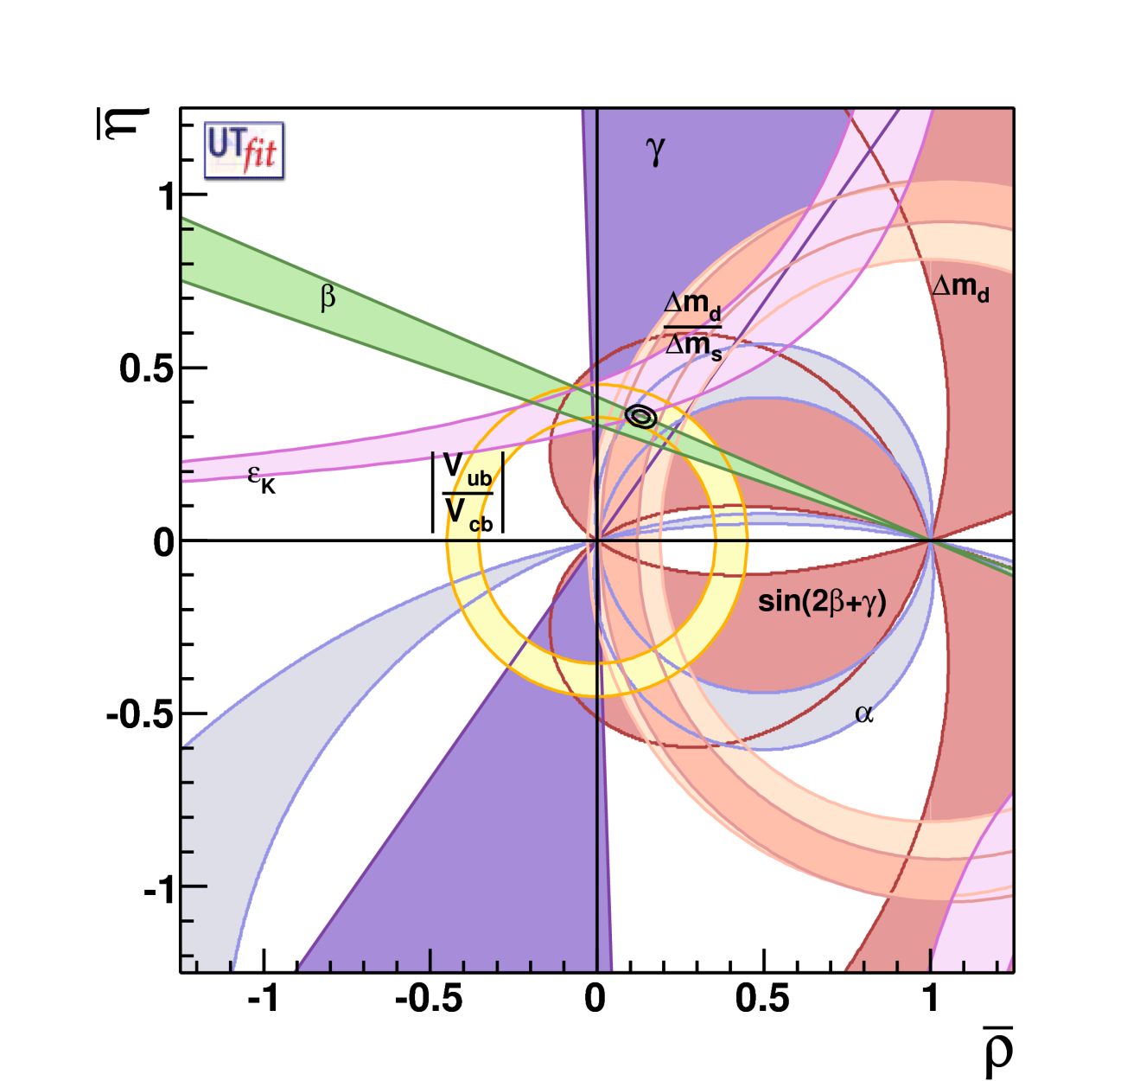
Global Fit within the SM
Coherent picture of FCNC and CPV processes in SM
Consistence on an
over constrained fit
of the CKM parameters
Discovery : absence of
New Particles up to the
~2×Electroweak Scale !
ρ = 0.132 ± 0.020
η = 0.358 ± 0.012
With a precision of
σ(ρ) ∼15% and σ(η) ~4% !
CKM matrix is the dominant source of flavour mixing and CP violation

Slide 10
Is the present picture showing a
Model Standardissimo ?
I’ll try to answer this question looking
at the different measurements (separately)
and their agreement with the SM predictions.
One of the mail goal of this exercise for this talk is also to
show if the measurements (or the theory) have to be improved

Slide 11
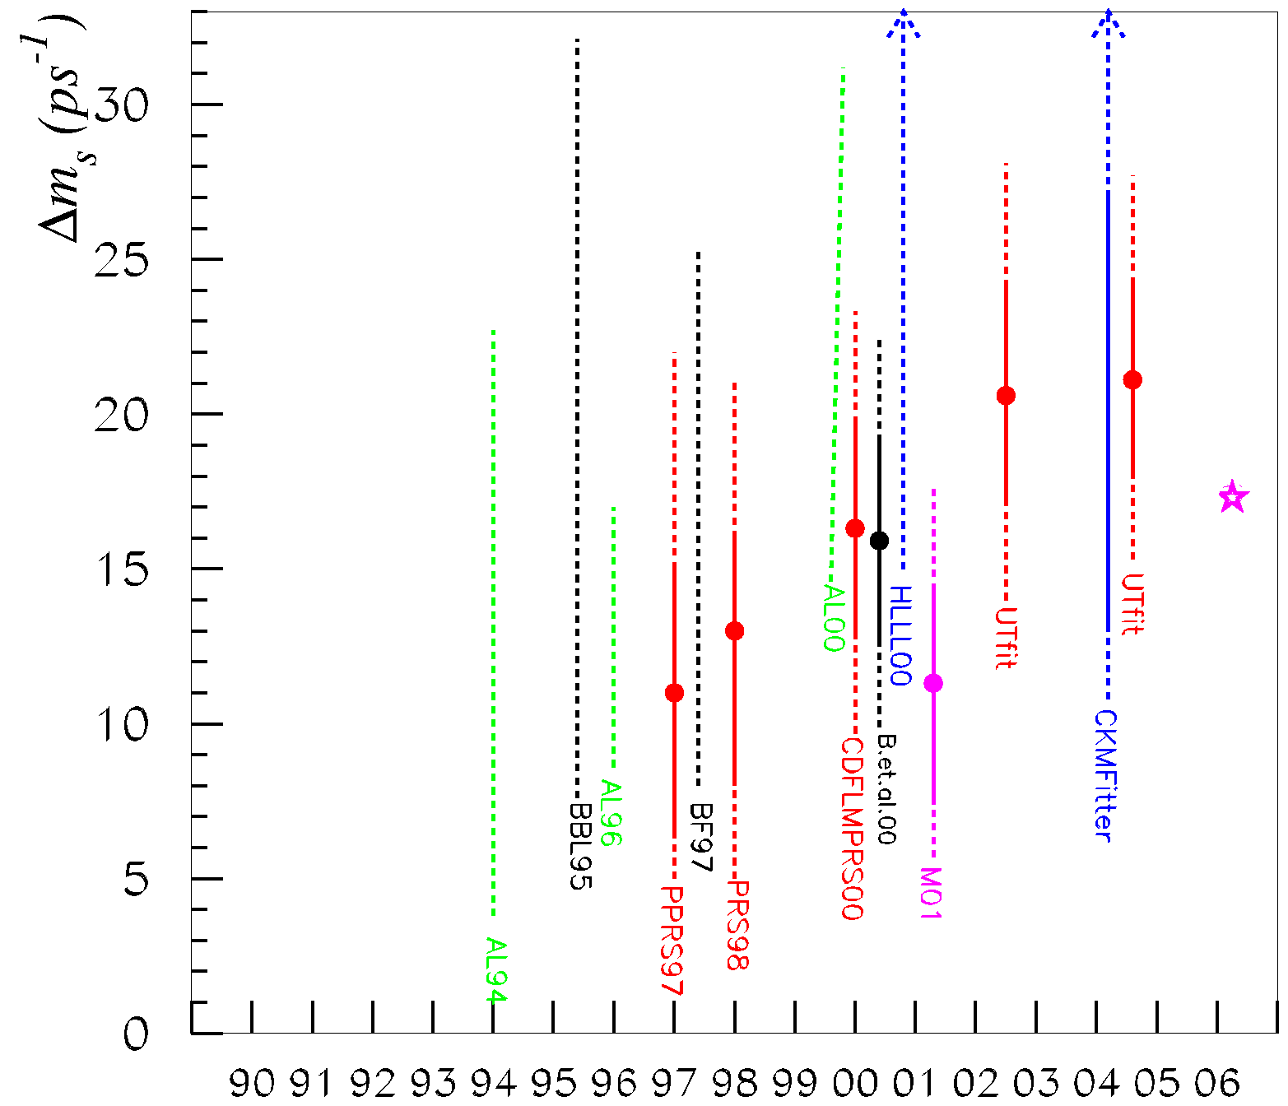
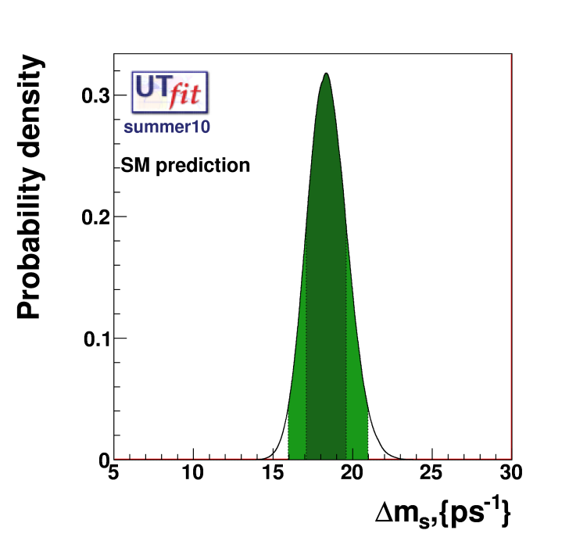
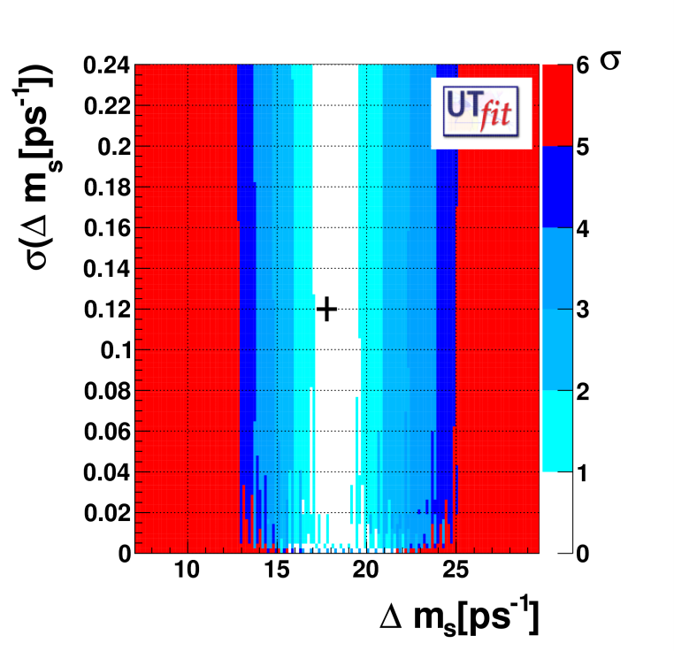
SM predictions of Δms
Δm_{s}
SM expectation
Δm_{s} = (18.3 ± 1.3 ) ps⁻¹
10
Prediction “era”
Monitoring “era”
Legenda
agreement between the predicted values
and the measurements at better than :
1σ
3σ
5σ
2σ
4σ
6σ

Slide 12
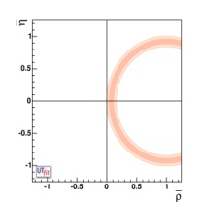
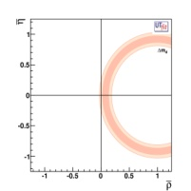
Δm_{s}
Δm_{d}
Dominated by theo.
error
Message : very stringent test of the SM, perfect compatibility. Improving Lattice
calculations would have important impact.

Slide 13
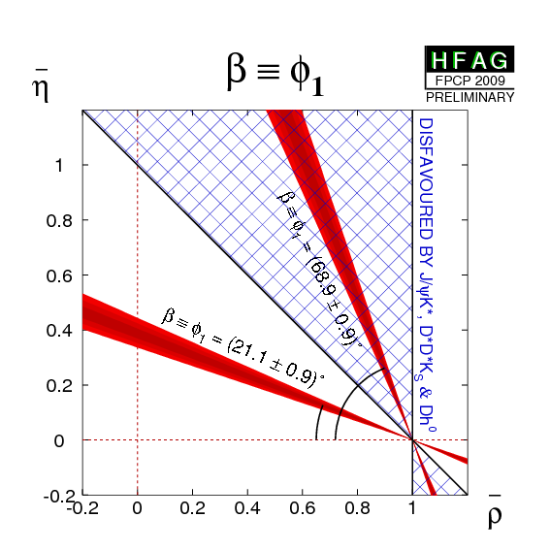
β from b→ccs transitions
The precision era :
β=(21.1 ± 0.9)o (~4%)
sin2β=0.654 ± 0.026
From direct measurement
sin2β =0.771 ± 0.036
from indirect determination
+2.2σ deviation*
*The theoretical error on the sin2β is considered as in CPS
the disagreement decreases If FFJM approach is used → 1.6σ)
Message :
“old” tension between sin2β measured and predicted (know as V_{ub}-sin2β tension). Improvement in predictions and measurements are of the outmost importance.

Slide 14
sin2β from “s Penguins” (b→qqs )…a lot of progress..
W⁻
b
s
φ
t
s
B⁰_{d}
s
K⁰
d
d
~
g
b
~
~
s
b
s
New Physics contribution (2-3 families)
Message :
After a long story of disagreement…
Today there is a rather good agreement
between sin2β from
b→ccs 0.672 ± 0.023 (0.028 with theo. error)
b→qqs 0.64 ± 0.04

Slide 15
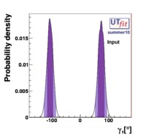
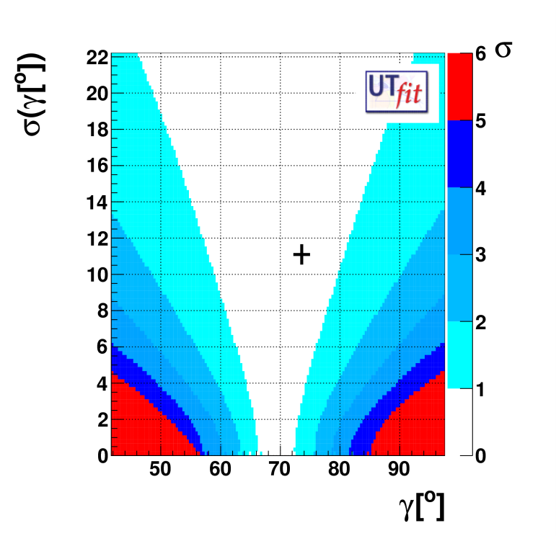
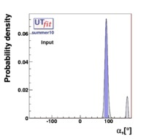
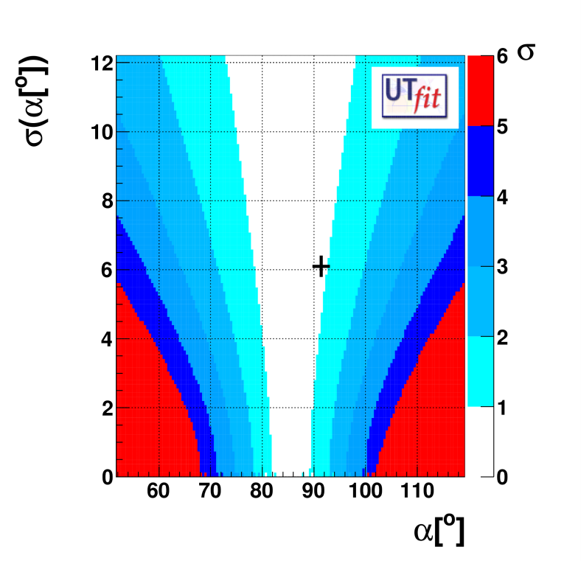
γ
tree level B→ DK
Measurements of γ, α were not really expected at B factories (at least at this precision)
Direct measurement SM prediction
(74 ± 11)º (69.6 ± 3.1)º
Message : precision on γ should be improved by factor at least four to have stringent test of SM
γ, α, Δm_{s} deviations within 1σ
α
using B→ππ (ρπ) ρρ
Direct measurement SM prediction
(91.4 ± 6.1)º (85.4 ± 3.7)º
Message : precision on α should be improved by factor two to have stringent test of SM

Slide 16

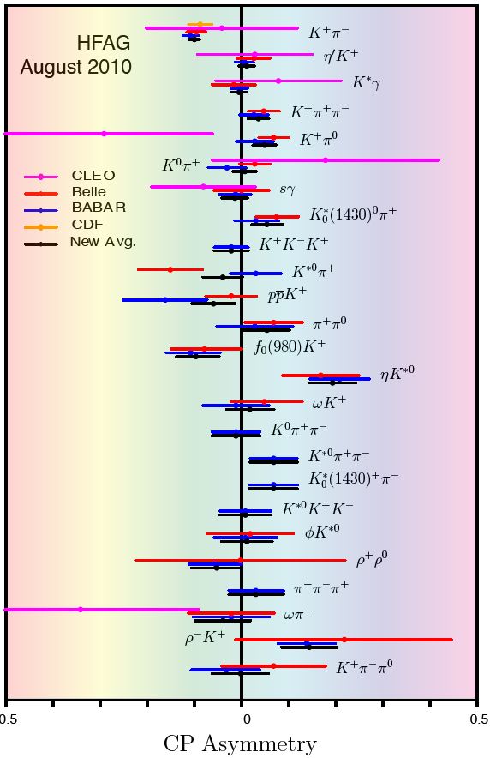
Many other CP asymmetry measurements are performed in different decay modes
(with corresponding measurments of branching fractions)
A_{CP} in charmless B decays
A_{CP} in radiative and Leptonic
Direct CP
violation in
B decays
Difficult to use these measurements
to constrain UT parameters
or looking for NP
Shown here only the most precise
A_{CP} all compatible with zero
A_{CP} in radiative and leptonic decays
expected to be almost zero in the SM.
Null Test for new physics search.
Crucial to improve the precision

Slide 17
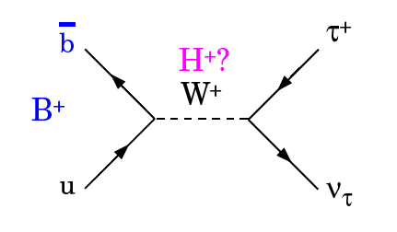

Br(B→τν)
First leptonic decay seen on B meson
Br(B→τν) =(1.72± 0.28)10⁻⁴
From direct measurement
Br(B→τν) =(0.805± 0.071)10⁻⁴
SM prediction
-3.2σ deviation
Nota Bene → To accommodate Br(B→τν) we need larger value of V_{ub}
→ To accommodate sin2β we need lower value of V_{ub}
Message : we need to measure more precisely this branching fraction !
Precise determination of f_{B} is also important

Slide 18
ε_{Κ}
Very old measurement (not from B physics..)
But three “news” ingredients
Buras&Guadagnoli BG&Isidori corrections
→ Decrease the SM prediction by 6%
Improved value for BK
→ BK=0.731±0.07±0.35
3) Brod&Gorbhan charm-top contribution at NNLO
→ enanchement of 3%
(not included yet in this analysis)
-1.7σ devation

Slide 19
Summary Table of the Some Pulls
 | Prediction | Measurement | Pull
γ | (69.6 ±3.1)° | (74 ±11)° | -0.4
α | (85.4 ±3.7)° | (91.4 ±6.1)° | -0.8
sin2β | 0.771±0.036 | 0.654±0.026 | +2.2
V_{ub} [10³] | 3.55 ±0.14 | 3.76 ±0.20 * | -0.9
V_{cb} [10³] | 42.69 ±0.99 | 40.83 ±0.45 * | +1.6
ε_{K} [10³] | 1.92 ±0.18 | 2.23 ±0.010 | -1.7
Br(B→τ ν) | 0.805±0071 | 1.72±0.28 | -3.2
Δm_{s} (ps⁻¹) | 17.77±0.12 | 18.3±1.3 | -0.4
Both in V_{cb} and V_{ub} there is some tensions between Inclusive and Exclusive
determinations. The measurements shown is the average of the two determinations
Message/conclusion. Overall good agreement with the SM. There are “interesting” tensions here and there. Many measurements (and often theory related to) have to be improved to transform these measurements in stringent tests.

Slide 20
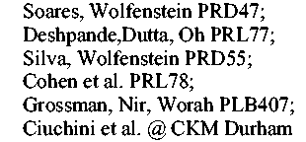
NP model independent Fit
ΔF=2
Parametrizing NP physics in ΔF=2 processes
 | ρ , η | C_{d} | ϕ_{d} | C_{s} | ϕ_{s} | C_{εK}
γ (DΚ) | X
V_{ub}/V_{cb} | X
Δm_{d} | X | X
ACP (J/Ψ Κ) | X |  | X
ACP (Dπ(ρ),DKπ) | X |  | X
A_{SL} |  | X | X
α (ρρ,ρπ,ππ) | X |  | X
A_{CH} |  | X | X | X | X
τ(Βs), ΔΓ_{s}/Γ_{s} |  |  |  | X | X
Δm_{s} |  |  |  | X
ASL(Bs) |  |  |  | X | X
ACP (J/Ψ φ) | ~X |  |  |  | X
ε_{K} | X |  |  |  |  | X
Tree
processes
More details in
Marco Ciuchini
talk
1↔3
family
2↔3
family
1↔2
familiy

Slide 21
5 new free parameters
C_{s},ϕ_{s} B_{s} mixing
C_{d},ϕ_{d} B_{d} mixing
C_{εK} K mixing
Today :
fit is overcontrained
Possible to fit 7 free parameters
(ρ, η, C_{d},ϕ_{d} ,C_{s},ϕ_{s}, C_{εK})
SM analysis
NP-ΔF=2 analysis
ρ = 0.132 ± 0.020
ρ = 0.135 ± 0.040
η = 0.358 ± 0.012
η = 0.374 ± 0.026
ρ,η fit quite precisely in NP-ΔF=2 analysis and
consistent with the one obtained on the SM analysis
[error double]
(main contributors tree-level γ and V_{ub})
Please consider these numbers when you want to get CKM parameters
in presence of NP in ΔF=2 amplitudes (all sectors 1-2,1-3,2-3)

Slide 22
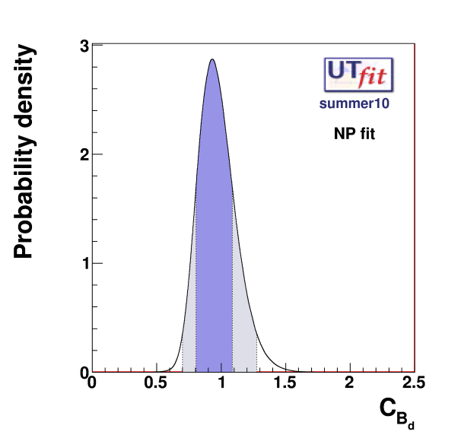
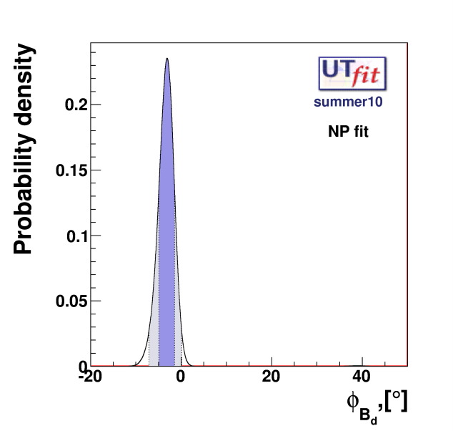
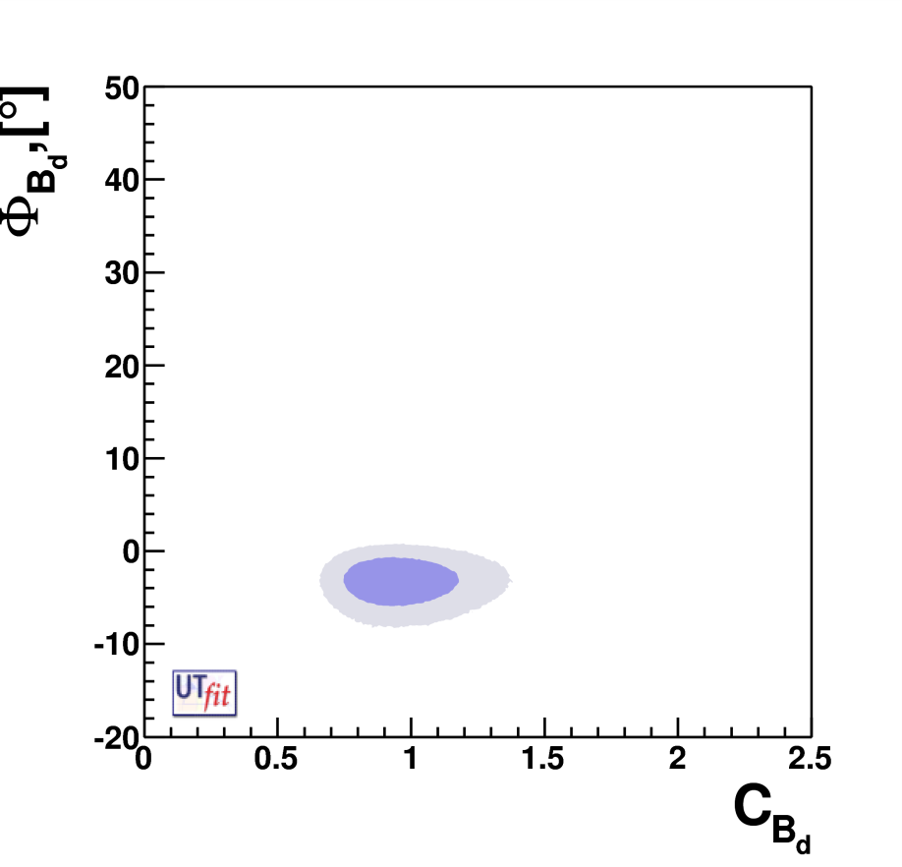
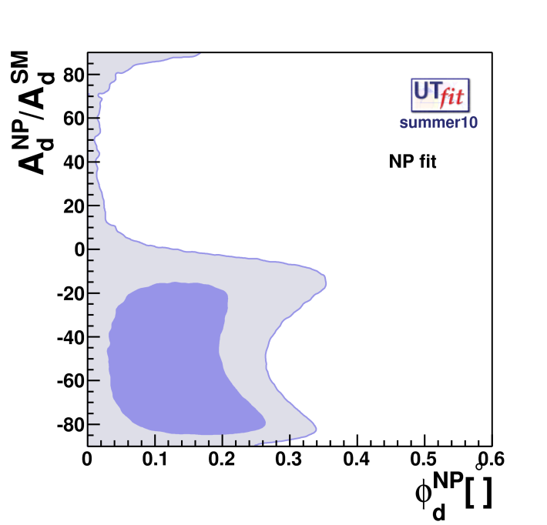
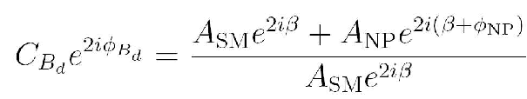

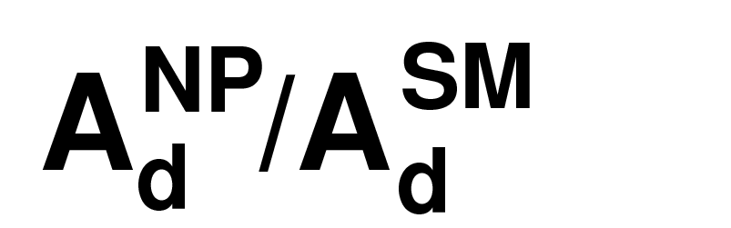
Β_{d}
C_{Bd} = 0.95± 0.14
[0.70,1.27]@95%
φ_{Bd} = -(3.1 ± 1.7)º
[-7.0,0.1]º @95%
1.8σ deviation
1.8σ agreement takes into account the theoretical error on sin2β
With present data A_{NP}/A_{SM}=0 @ 1.5σ
A_{NP}/A_{SM} ~0-30% @95% prob.

Slide 23
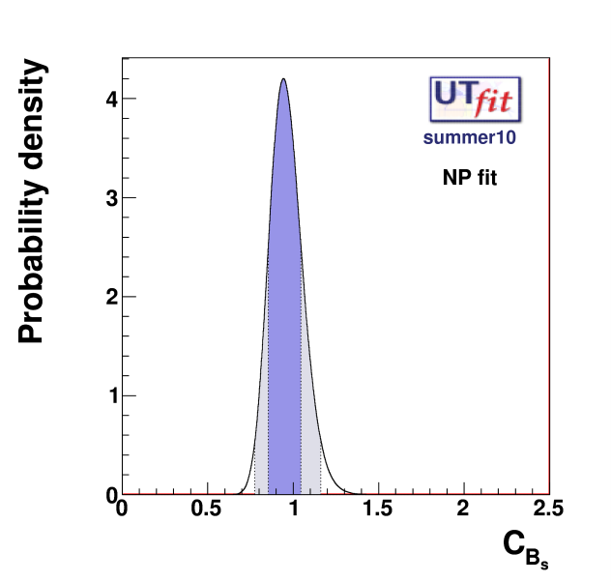
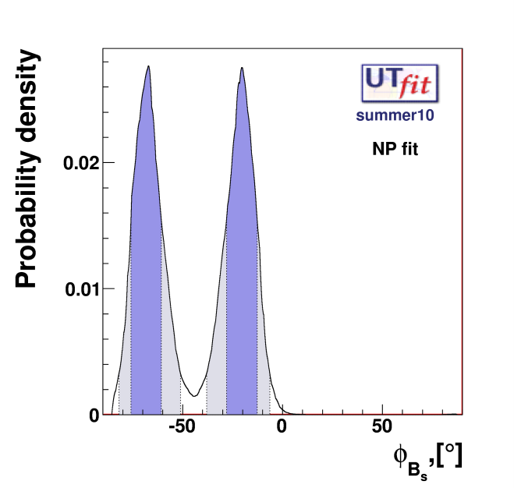
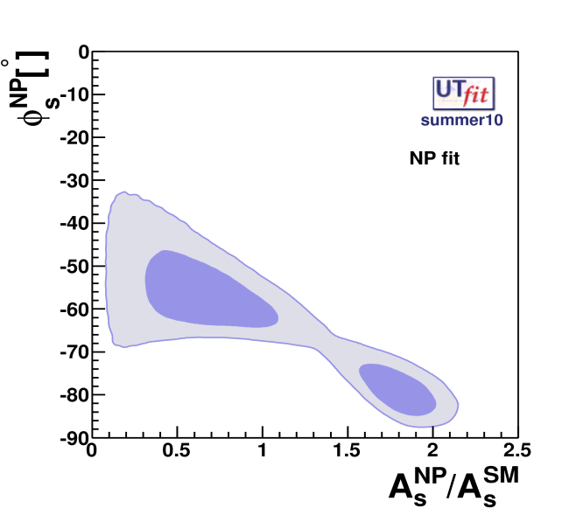
Β_{s}
C_{Bs} = 0.95± 0.10
[0.78,1.16]@95%
φ_{Bs} = (-20 ± 8)º U (-68 ± 8) º
[-38,-6] U [-81,-51] 95% prob.
3.1σ deviation
New results tends to
reduce the deviation
(see next talk)
New : CDF new measurement reduces the significance of the disagreement.
Likelihood not available yet for us.
New : a_{μμ} from D0 points to large βs, but also large ΔΓs → not standard Γ₁₂ ??
( NP in Γ₁₂ / bad failure of OPE in Γ₁₂.. Consider that it seems to work on Γ₁₁ (lifetime)

Slide 24
CKM matrix is the dominant source of flavour mixing and CP violation
σ( ρ)∼15% σ(η) ∼4%
Nevertheless there are tensions here and there that should
be continuously and quantitatively monitored :
sin2β (+2.2σ), ε_{K} (−1.7σ) , Br(B→τ ν) −(3.2σ)
[CP asymmetry in Bs sector (3.1σ)]
Other way of looking at :
Model Independent fit show some discrepancy on the NP phase parameters
φ_{Bd} = -(3.1 ± 1.7)º ; φ_{Bs} = (-20 ± 8)º U (-68 ± 8) º
To render these tests more effective we need to improve the measurements but also (in same case) the predictions
Other measurements are interesting, not yet stringent tests :
α,γ, β from Penguins, A_{CP} (and Br) in radiative and dileptonic decays…

Slide 25
Next : a SuperB Factory. See Alberto Luisiani talk
Definition of a SuperB factory/minimal requirements
L= 10³⁴ cm⁻² s⁻¹ → 150 fb⁻¹ → 1.5 × 10⁸ Υ(4s) produced by year
L= 10³⁶ cm⁻² s⁻¹ → 15 ab⁻¹ → 1.5 × 10¹⁰ Υ(4s) produced by year
B factories have shown that a variety of
measurements can be performed in the clean environment.
Asymmetric
B factory
The systematic errors are very rarely irreducible and can almost on all cases be controlled with control samples. (up to..50-100ab⁻¹)
High luminosity
Many and interesting measurements at different energies (charm/τ threshold, U(5S), other Upsilons.. )
and with polarised beam
Flavour factories
SuperB factory potential discovery evaluated with 75ab⁻¹

Slide 26
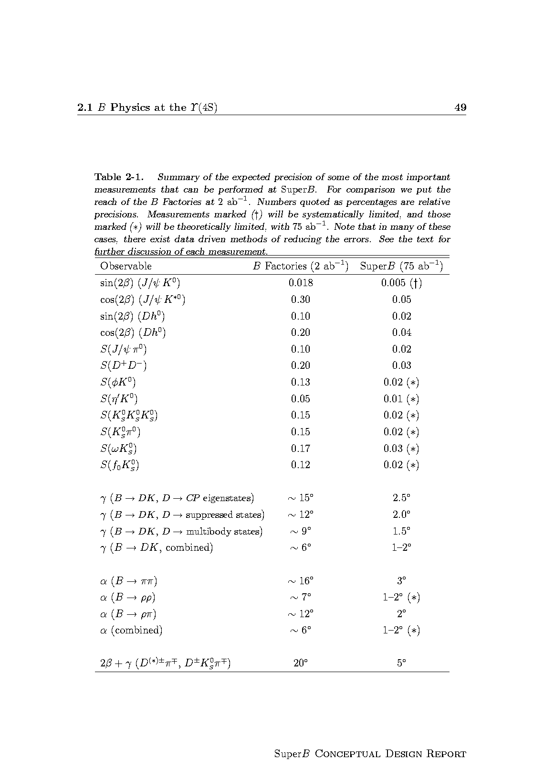
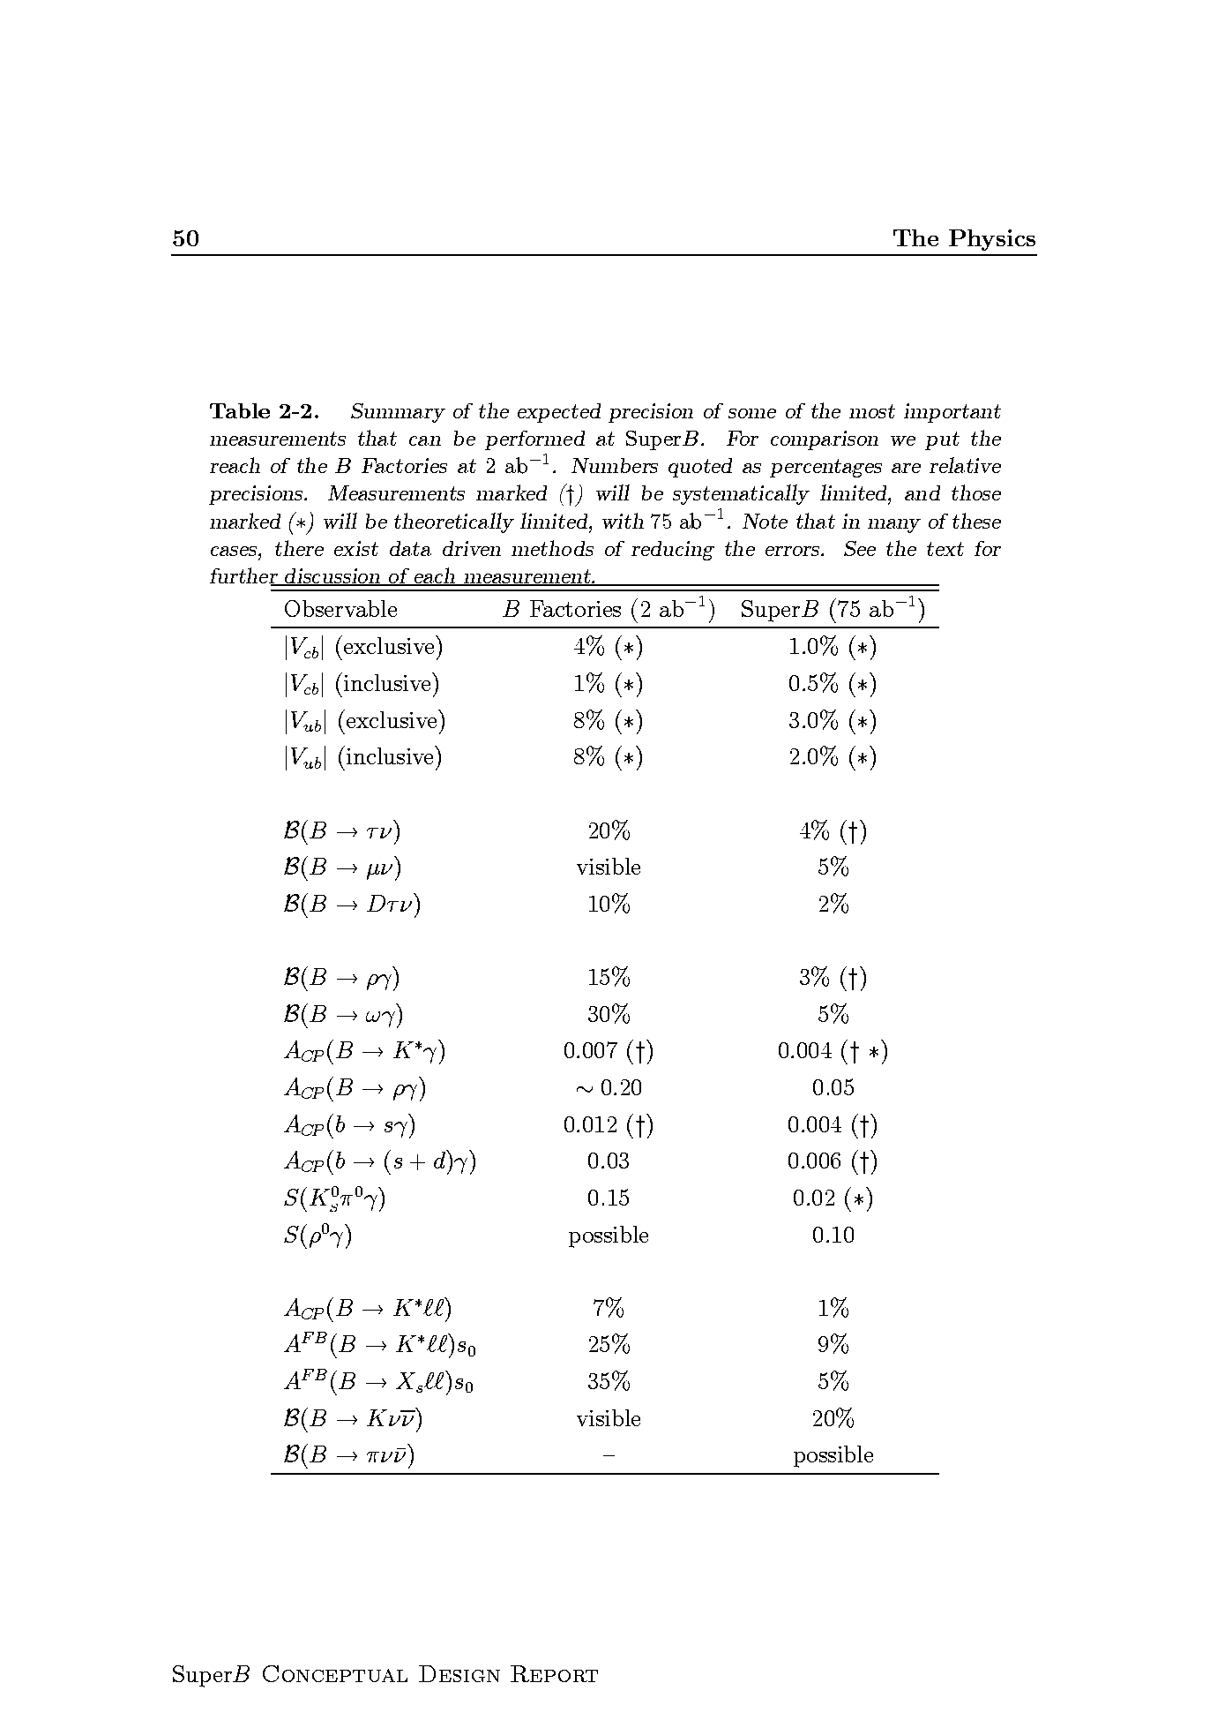
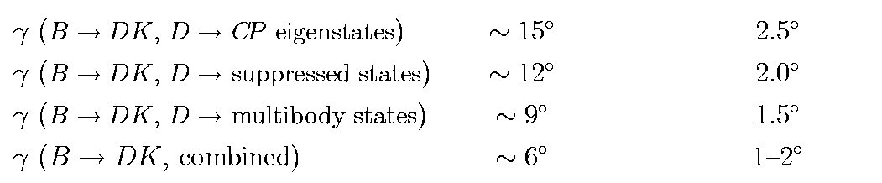
B physics @ Y(4S)
Variety of measurements for any observable
Possible also at LHCb
Similar precision at LHCb
Example of « SuperB specifics »
inclusive in addition to exclusive analyses
channels with π⁰, γ’s, ν, many Ks…

Slide 27
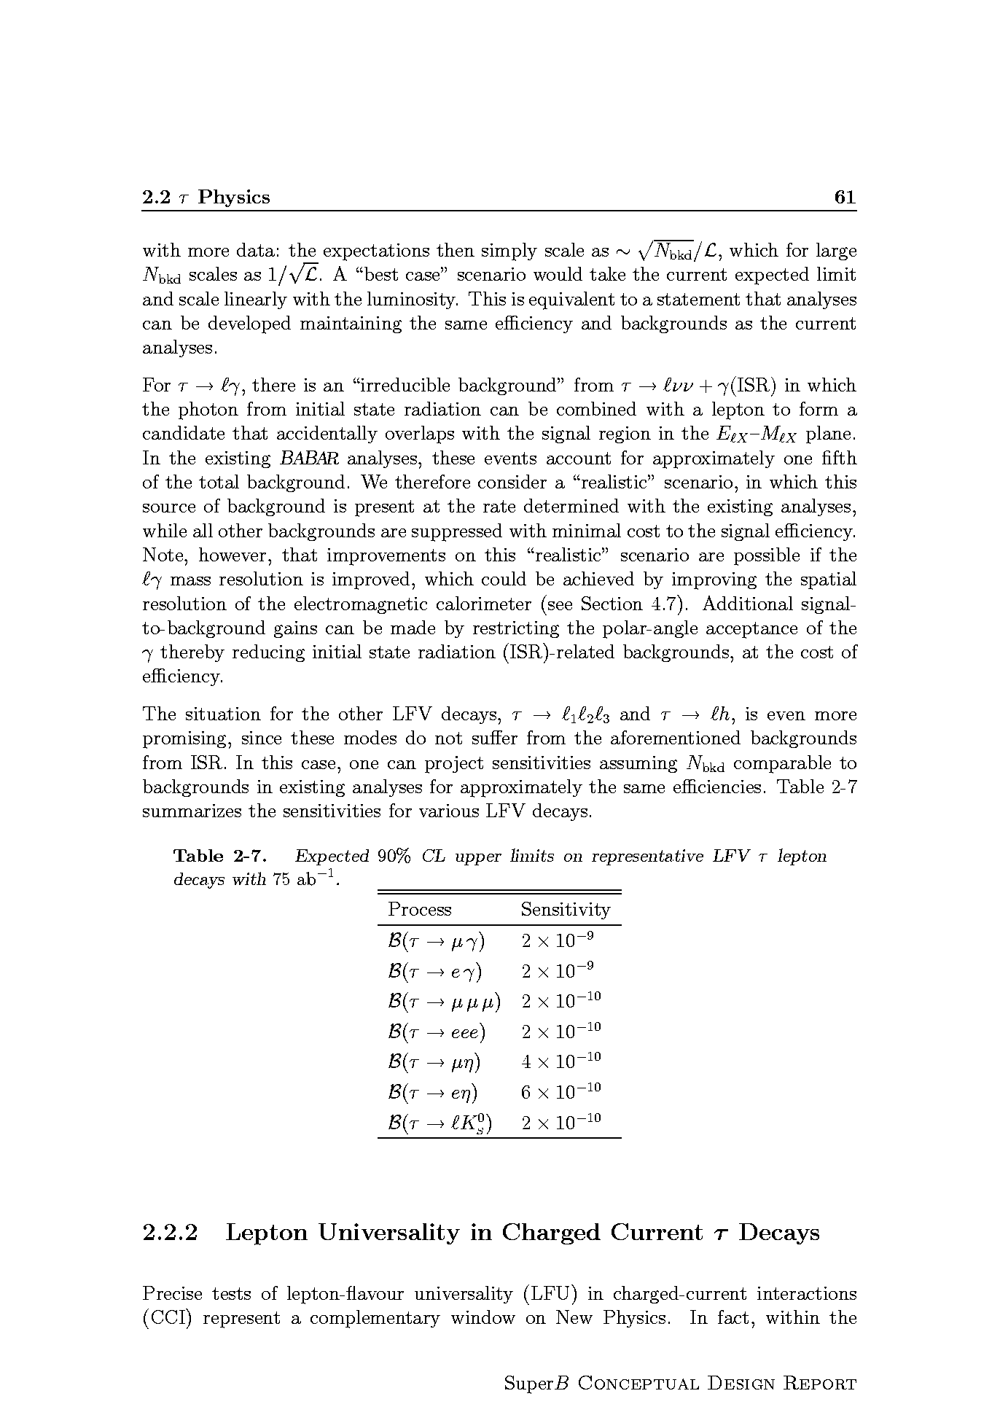
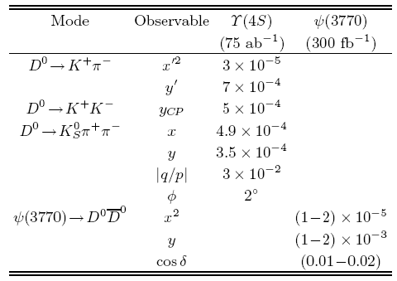
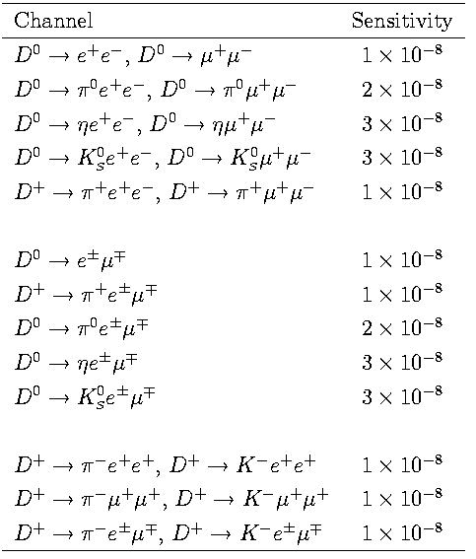
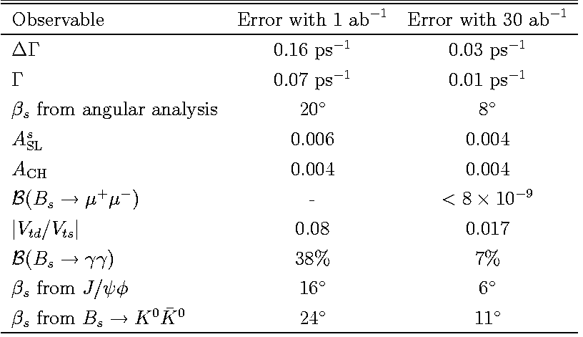
τ physics (polarized beams)
Charm at Y(4S) and threshold
To be evaluated
at LHCb
See Alberto Maria Jose Herrero and
Jorge Vidal talks
B_{s} at Y(5S)
See Alberto Nicola Neri talk
Bs : Definitively better at LHCb

Slide 28
Let’s consider (reductively) the GOLDEN MATRIX for B physics
X
X
X- CKM
X
X
X- CKM
X
X
The GOLDEN channel for the given scenario
Not the GOLDEN channel for the given scenario,
but can show experimentally measurable deviations from SM.
X
« SuperB specifics »
inclusive analyses
channels with π⁰, γ, ν, many Ks…
In the following some examples of

Slide 29
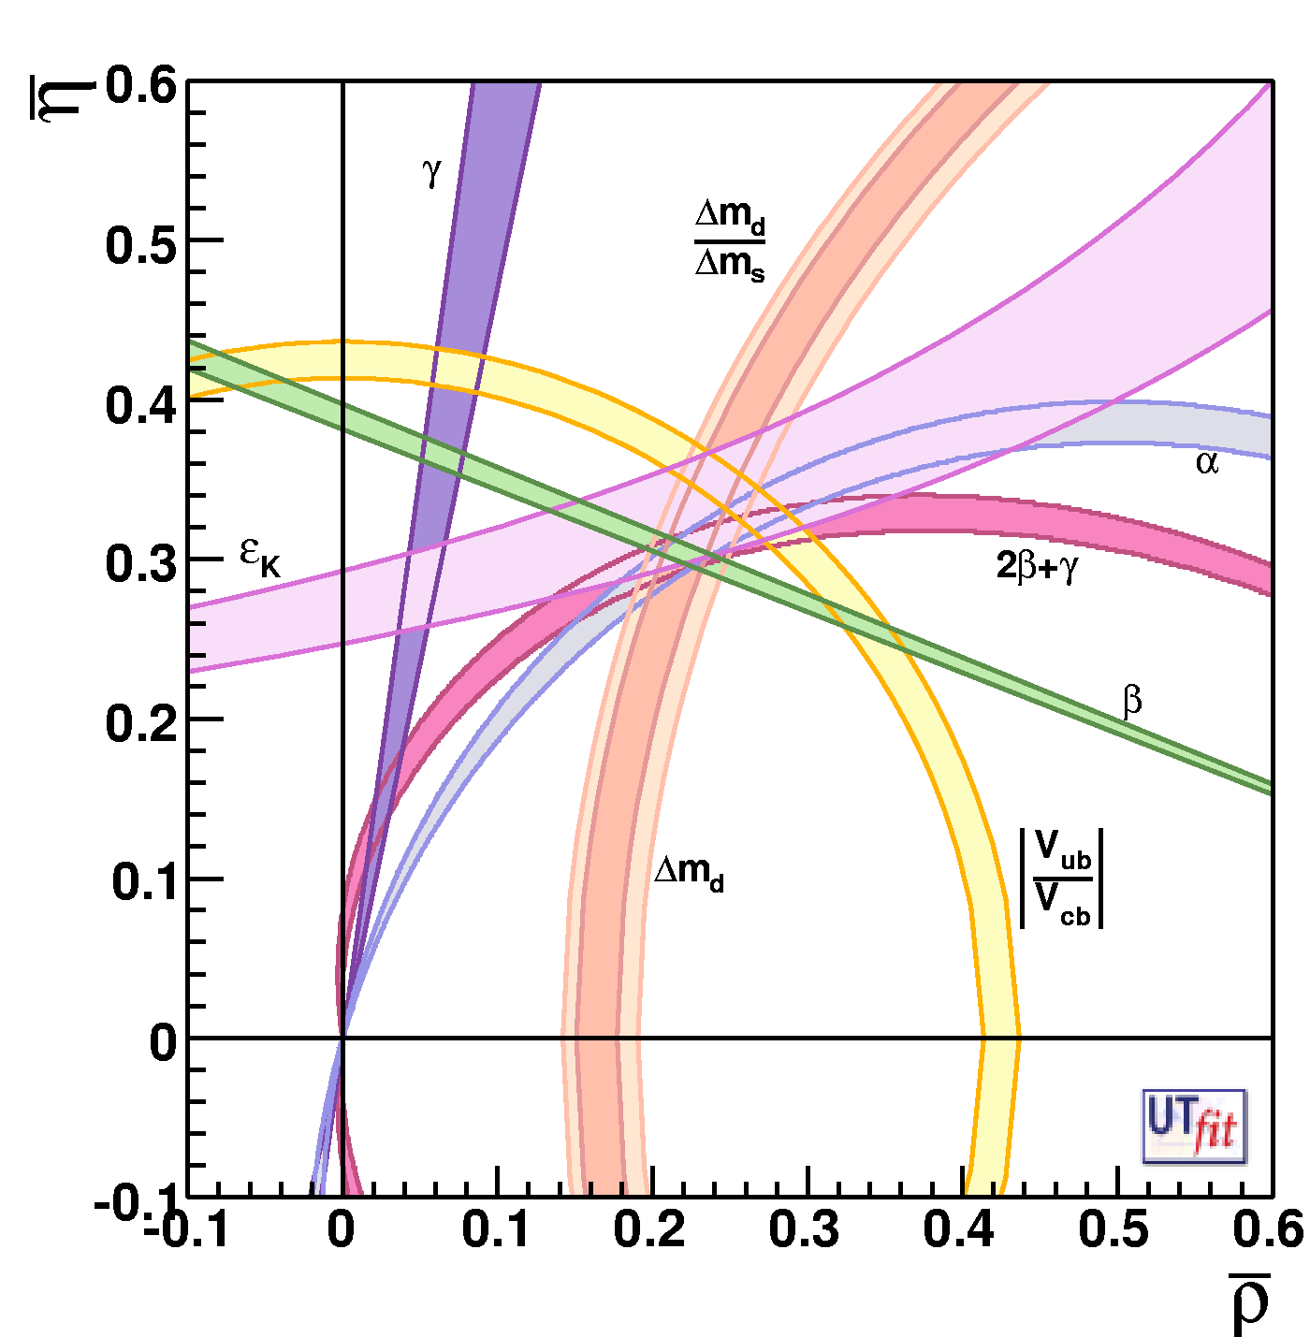
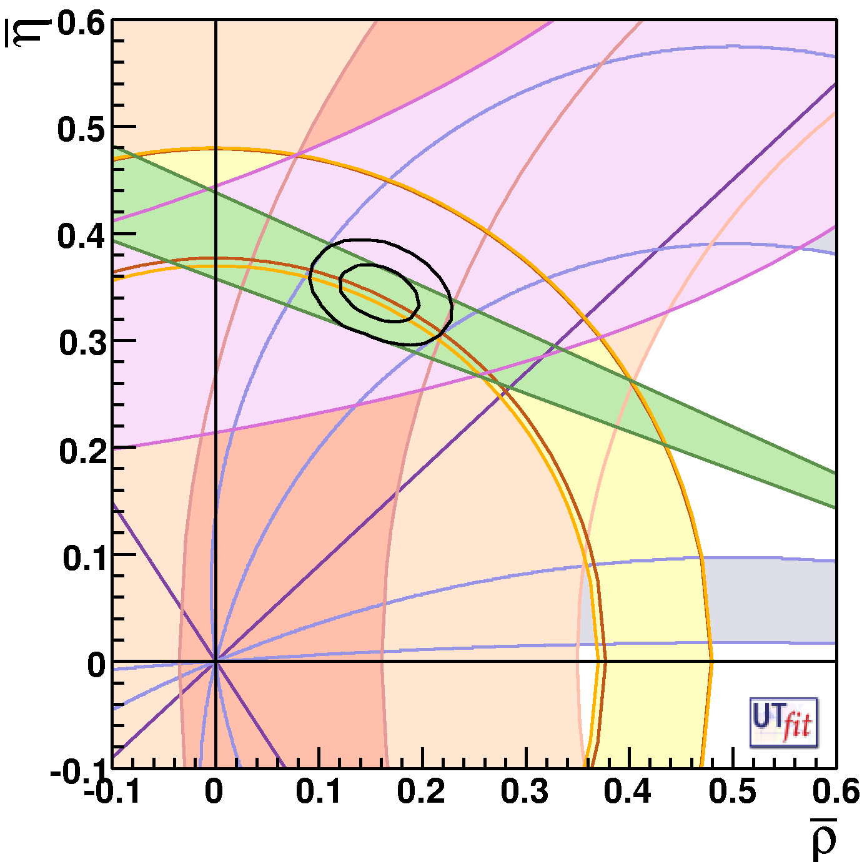

1
Determination of CKM parameters and New Physics
Today
Future (SuperB) + Lattice improvements
This situation will be different @2015 thanks to LHCb
players are :
γ,α,β..,V_{ub}
and Lattice !
ρ = 0.163 ± 0.028
η = 0.344± 0.016
ρ = ± 0.0028
η = ± 0.0024
Improving CKM is
crucial to look for NP
Important also in K physics :
K→ π ν ν , CKM errors dominated
the error budget

Slide 30
Part of the program could be accomplished if SM theoretical predictions are @ 1%
See Federico Mescia talk
Shown by Vittorio Lubicz at the SuperB Workshop LNF Dec2009
Hadronic matrix element | Lattice error in 2006 | Lattice error in 2009 | 6 TFlop Year | 60 TFlop Year | 1-10 PFlop Year
 | 0.9% | 0.5% | 0.7% | 0.4% | < 0.1%
 | 11% | 5% | 5% | 3% | 1%
f_{B} | 14% | 5% | 3.5 - 4.5% | 2.5 - 4.0% | 1 – 1.5%
 | 13% | 5% | 4 - 5% | 3 - 4% | 1 – 1.5%
ξ | 5% | 2% | 3% | 1.5 - 2 % | 0.5 – 0.8 %
☞ _{B → D/D*lν} | 4% | 2% | 2% | 1.2% | 0.5%
 | 11% | 11% | 5.5 - 6.5% | 4 - 5% | 2 – 3%
 | 13% | 13% | ---- | ---- | 3 – 4%
[2009]
[2011 LHCb]
[2015 SuperB]
30
30
The expected accuracy has been reached! (except for Vub)

Slide 31

2
Leptonic decay B → l ν
SuperB
SuperB -75ab⁻¹
M_{H}~1.2-2.5 TeV
for tanβ~30-60
2HDM-II
MSSM
75ab⁻¹
2ab⁻¹
LEP m_{H}>79.3 GeV
SuperB
ATLAS 30fb⁻¹
SuperB excludes
SuperB excludes
ATLAS 30fb⁻¹
B-factories exclude
B-factories exclude
ATLAS 30fb⁻¹

Slide 32

3
MSSM+generic soft SUSY breaking terms
New Physics contribution
(2-3 families)
Flavour-changing NP effects in the squark propagator
NP scale SUSY mass
flavour-violating coupling
~
g
b
~
~
s
b
s
1
10⁻¹
10⁻²
In the red regions the δ
are measured with a
significance >3σ away
from zero
Here the players are :
= (0.026 ± 0.005)
(B→X_{s} γ)
(B→X_{s} l⁺l⁻)
A_{CP}(B→X_{s} γ)
Arg(δ₂₃)_{LR}=(44.5± 2.6)º
1 10
1 TeV

Slide 33
Br(B → K ν ν) – Z penguins and Right-Handed currents
4
today
η
SM
Only theo. errors
ε
If these quantities are measured @ <~10%
deviations from the SM can be observed
~[20-40] ab⁻¹ are needed for observation
>>50ab⁻¹ for precise measurement

Slide 34
Some Golden Modes
No result
Moderate
Precise
Very Precise
Observable | Babar/ Belle | LHCb (10fb⁻¹) | SLHCb (100fb⁻¹) | SuperB (75ab⁻¹) | Some Comment | Theo
γ
V_{ub}/V_{cb} |  |  |  |  | Excl. needs Lattice & Inclusive @ 2% ?
β |  |  |  |  | Theo. error to be controlled on data (ex: J/ψπ⁰)
S(J/ψφ) |  |  |  |  | At 1º theo error controlled with data ?
B→ τ ν, μν |  |  |  |  | Very precise if detector is improved
S-Penguins |  |  |  |  | SLHCb (very) precise for B→φK, Bs→φφ Not possible for Ksπ^{0,}ksksks,ηks, ωKs..
A_{CP}(B→ X_{s}γ) |  |  |  |  | Control syst. Is an issue
Br (B→ X_{s}γ) |  |  |  |  | Syst. Controlled with data ?
Br (B→ X_{s} l l) Angular var.
Br(B→K*l l ), Angular var. |  |  |  |  | Could theory control @20%? Angular analysis are clean ? →
Br (B→ K^{(*)}ν ν) |  |  |  |  | Stat. limited. With more stat. angular analyses also possible
Br (B→K_{s}π⁰γ)
Br(B_{s}→φγ) |  |  |  |  | As precise as Br →K_{s}π⁰γ) ?
Br (B_{s}→μμ)
τ◊μγ |  |  |  |  | profit of polarized beams
CPV charm |  |  |  |  | CPV in SM negligible. So clean NP probe
THEORY
Moderately
Clean
Clean
Need Lattice
Clean

Slide 35
Conclusions and perspectives
Flavour Physics with FCNC and CPV processes has played in the past
a crucial role in constructing and testing the SM
Some observable are already precise.
Flavour Phyiscs is a major actor in NP search @ few-TeV range and a unique player in the reconstruction of the NP Lagrangian
Part of the program could be accomplished if SM theoretical
predictions are @ 1%.
….
B-Factories today
LHCb (MEG, NA62..) tomorrow
And the day after tomorrow..?
SLHCb could improve some LHCb golden measurements γ, B_{s}→μμ, B_{s}→φγ
SuperB factories have a much wider Physics Case,
which can naturally follow the B-factory+LHCb era.

Slide 36
BACKUP
MATERIAL

Slide 37





Another example of sensitivity to NP :
sin2β from “s Penguins”…
W⁻
b
s
φ
t
s
B⁰_{d}
s
d
d
K⁰
~
g
b
~
~
s
b
s
Many channels can be measured with ΔS~(0.01-0.04)
SuperB
(*) theoretical limited

Slide 38
Part of the program could be accomplished if SM theoretical predictions are @ 1%
Shown by Vittorio Lubicz at the SuperB Workshop LNF Dec2009
Hadronic matrix element | Lattice error in 2006 | Lattice error in 2009 | 6 TFlop Year | 60 TFlop Year | 1-10 PFlop Year
 | 0.9% | 0.5% | 0.7% | 0.4% | < 0.1%
 | 11% | 5% | 5% | 3% | 1%
f_{B} | 14% | 5% | 3.5 - 4.5% | 2.5 - 4.0% | 1 – 1.5%
 | 13% | 5% | 4 - 5% | 3 - 4% | 1 – 1.5%
ξ | 5% | 2% | 3% | 1.5 - 2 % | 0.5 – 0.8 %
☞ _{B → D/D*lν} | 4% | 2% | 2% | 1.2% | 0.5%
 | 11% | 11% | 5.5 - 6.5% | 4 - 5% | 2 – 3%
 | 13% | 13% | ---- | ---- | 3 – 4%
[2009]
[2011 LHCb]
[2015 SuperB]
38
The expected accuracy has been reached! (except for Vub)

Slide 39
Some Golden Modes
No result
Moderate
Precise
Very Precise
Observable | Babar/ Belle | LHCb (10fb⁻¹) | SLHCb (100fb⁻¹) | SuperB (75ab⁻¹) | Some Comment | Theo
γ
V_{ub}/V_{cb} |  |  |  |  | Excl. needs Lattice & Inclusive @ 2% ?
β |  |  |  |  | Theo. error to be controlled on data (ex: J/ψπ⁰)
S(J/ψφ) |  |  |  |  | At 1º theo error controlled with data ?
B→ τ ν, μν |  |  |  |  | Very precise if detector is improved
S-Penguins |  |  |  |  | SLHCb (very) precise for B→φK, Bs→φφ Not possible for Ksπ^{0,}ksksks,ηks, ωKs..
A_{CP}(B→ X_{s}γ) |  |  |  |  | Control syst. Is an issue
Br (B→ X_{s}γ) |  |  |  |  | Syst. Controlled with data ?
Br (B→ X_{s} l l) Angular var.
Br(B→K*l l ), Angular var. |  |  |  |  | Could theory control @20%? Angular analysis are clean ? →
Br (B→ K^{(*)}ν ν) |  |  |  |  | Stat. limited. With more stat. angular analyses also possible
Br (B→K_{s}π⁰γ)
Br(B_{s}→φγ) |  |  |  |  | As precise as Br →K_{s}π⁰γ) ?
Br (B_{s}→μμ)
τ◊μγ |  |  |  |  | profit of polarized beams
CPV charm |  |  |  |  | CPV in SM negligible. So clean NP probe
THEORY
Moderately
Clean
Clean
Need Lattice
Clean

