Slide 1
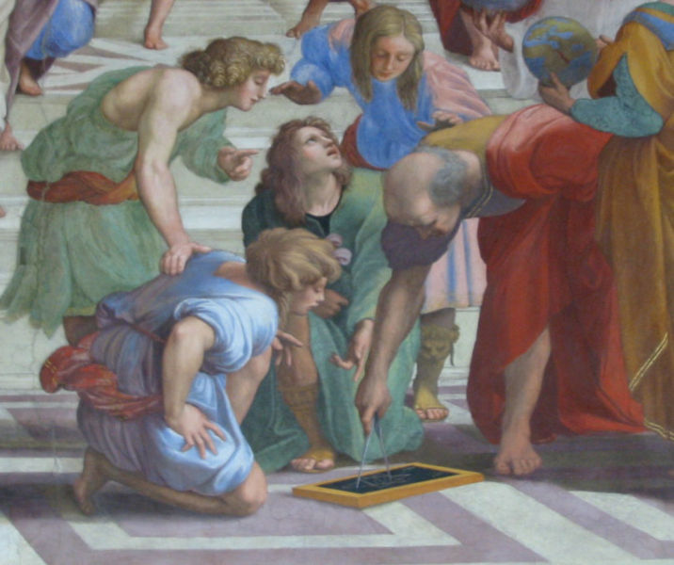
Horndeski Lagrangian:
too big to fail?
Luca Amendola
University of Heidelberg
in collaboration with Martin Kunz, Mariele Motta, Ippocratis Saltas, Ignacy Sawicki
Notes:
Da fare: fit SN nel void model; animazione ?; check timing

Slide 2
Observations are converging…
…to an unexpected universe
Notes:
It is certainly interesting to observe something that should explain 70% of the whole universe. Many explanation for this…

Slide 3
Classifying the unknown, 1
Cosmological constant
Dark energy w=const
Dark energy w=w(z)
quintessence
scalar-tensor models
coupled quintessence
mass varying neutrinos
k-essence
Chaplygin gas
Cardassian
quartessence
quiessence
phantoms
f(R)
Gauss-Bonnet
anisotropic dark energy
brane dark energy
backreaction
void models
degravitation
TeVeS
oops....did I forget your model?
Notes:
It is certainly interesting to observe something that should explain 70% of the whole universe. Many explanation for this…

Slide 4
Classifying the unknown, 2
Lambda and w(z) models (i.e. change only the expansion)
modified matter (i.e. change the way matter clusters)
modified gravity (i.e. change the way gravity works)
non-linear effects (i.e. change the underlying symmetries)
Notes:
It is certainly interesting to observe something that should explain 70% of the whole universe. Many explanation for this…

Slide 5
Prolegomena zu einer jeden künftigen Metaphysik ©Kant
Prolegomena zu einer jeden künftigen Dark Energy physik ©Kant
Observational requirements:
Isotropy
Large abundance
Slow evolution
Weak clustering
Physical requirements:
Scalar field
V$V≈{H_{}^{2}}_{0}$
V$V′≪V$
V$V′′≪V$
Notes:
What dark energy can do for us

Slide 6
Theorem 1: A quintessential scalar field
The most general 4D scalar field theory with second order equation of motion
First found by Horndeski in 1975
rediscovered by Deffayet et al. in 2011
no ghosts, no classical instabilities
it modifies gravity!
it includes f(R), Brans-Dicke, k-essence, Galileons, etc etc etc
Notes:
Simple and very felxible…toy model of mod grav.: f(R)

Slide 7
Simplest MG: f(R)
The simplest Horndeski model which still produces
a modified gravity: f(R)
equivalent to a Horndeski Lagrangian without kinetic terms
easy to produce acceleration (first inflationary model)
high-energy corrections to gravity likely to introduce higher-order terms
particular case of scalar-tensor and extra-dimensional theory
Notes:
Simple and very felxible…toy model of mod grav.: f(R)

Slide 8
Theorem 2: the Yukawa correction
Every Horndeski model induces at
linear level, on sub-Hubble scales, a Newton-Yukawa potential
where α and λ depend on space and time
Every consistent modification of gravity
based on a scalar field generates
this gravitational potential
Notes:
a kind of built-in chameleon mechanism

Slide 9
The next ten years of DE research
Combine observations of background, linear
and non-linear perturbations to reconstruct
as much as possible the Horndeski model
… or to rule it out!
Notes:
a kind of built-in chameleon mechanism

Slide 10
The great Horndeski Hunt
Let us assume we have only
1) pressureless matter
2) the Horndeski field
and
Notes:
a kind of built-in chameleon mechanism

Slide 11
Background: SNIa, BAO, …
Then we can measure H(z) and
$$Ω_{k0}$$
and therefore
Then we can measure everything up to
$$Ω_{m0}$$
Notes:
a kind of built-in chameleon mechanism

Slide 12
Two free functions
The most general linear, scalar metric
At linear order we can write:
$$∇^{2}Ψ=4πG Y\left(k,a\right)ρ_{m}{δ }_{m}$$
Poisson’s equation
anisotropic stress
Notes:
Supponiamo ora che I constraints locali siano irrilevanti…

Slide 13
Modified Gravity at the linear level
standard gravity
Boisseau et al. 2000
Acquaviva et al. 2004
Schimd et al. 2004
L.A., Kunz &Sapone 2007
scalar-tensor models
f(R)
Bean et al. 2006
Hu et al. 2006
Tsujikawa 2007
DGP
Lue et al. 2004;
Koyama et al. 2006
coupled Gauss-Bonnet
see L. A., C. Charmousis,
S. Davis 2006
Notes:
nota che per la f(R) nel limite m->0 tutto ritorna standard, anche perche’ F= const. per m->0.

Slide 14
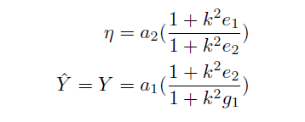
Modified Gravity at the linear level
Every Horndeski model is characterized in the linear regime
and for scales by the two functions
$$c_{s}k≫1$$
de Felice, Tsujikawa 2011
Notes:
nota che per la f(R) nel limite m->0 tutto ritorna standard, anche perche’ F= const. per m->0.

Slide 15
Linear observables
Matter conservation equation
If we could observe directly the
growth rate…
$$−\frac{3}{2}Y(k,z)Ω_{m}$$
$$\left(f=\frac{δ′}{δ}\right)$$
we could test the HL…
Notes:
nota che per la f(R) nel limite m->0 tutto ritorna standard, anche perche’ F= const. per m->0.

Slide 16
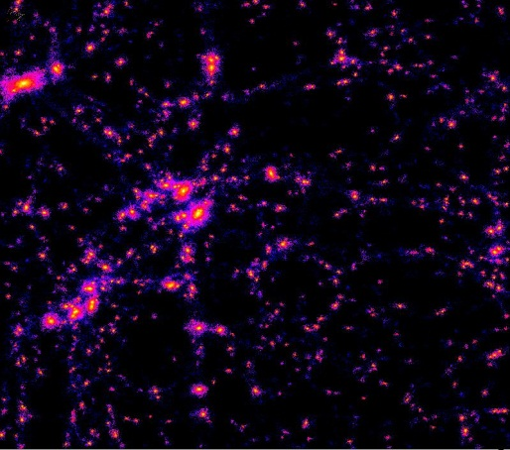
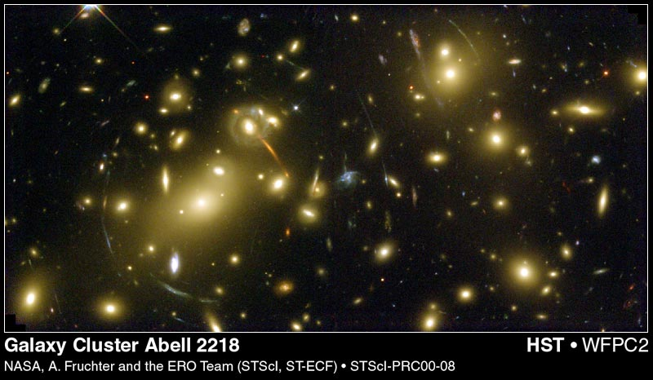
Reconstruction of the metric
massive particles respond to Ψ
massless particles respond to Φ-Ψ
Notes:
however we do not see matter perturbations but only their biased version

Slide 17
Linear observables
$$δ_{gal}\left(k,z\right)=$$
$$G(k,z)$$
$$b(k,z)$$
$$σ_{8}$$
$$δ_{t,0}(k)$$
Notes:
nota che per la f(R) nel limite m->0 tutto ritorna standard, anche perche’ F= const. per m->0.

Slide 18
Three linear observables
Redshift distortion
Amplitude
clustering
lensing
$$Σ=Y(1+η)$$
Lensing
Notes:
nota che per la f(R) nel limite m->0 tutto ritorna standard, anche perche’ F= const. per m->0.

Slide 19
Two model-independent ratios
Amplitude/Redshift distortion
Lensing/Redshift distortion
Notes:
nota che per la f(R) nel limite m->0 tutto ritorna standard, anche perche’ F= const. per m->0.

Slide 20
Observing the HL
Lensing/Redshift distortion
If we can obtain an equation for P2
then we can test the HL
Notes:
nota che per la f(R) nel limite m->0 tutto ritorna standard, anche perche’ F= const. per m->0.

Slide 21
Two model-independent ratios
We combine now growth rate and lensing
Notes:
nota che per la f(R) nel limite m->0 tutto ritorna standard, anche perche’ F= const. per m->0.

Slide 22
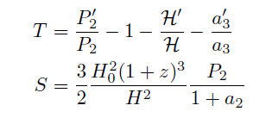
A consistency equation
Differentiating P2 and
combining with the growth rate and lensing equations we obtain
a consistency relation for the HL valid for every k
that depends on 8 functions of z
$C\left[k;f_{i}\left(z\right)\right]$=
Notes:
nota che per la f(R) nel limite m->0 tutto ritorna standard, anche perche’ F= const. per m->0.

Slide 23
A consistency equation
$$f_{i}=$$
If we estimate P2(k,z) for many k’s we
have an overconstrained system of equations
$C(k_{1};f_{i}(z)$) = 0
$C(k_{2};f_{i}(z)$) = 0
$C(k_{3};f_{i}(z)$) = 0
$C(k_{4};f_{i}(z)$) = 0
……..
If there are no solutions, the HL is disproven!
Notes:
nota che per la f(R) nel limite m->0 tutto ritorna standard, anche perche’ F= const. per m->0.

Slide 24
Reconstructing the HL ?
We can estimate
$$f_{j}=$$
And therefore partially reconstruct the HL
but the reconstruction is not unique:
an infinite number of HL will give the same background
and linear dynamics
Notes:
nota che per la f(R) nel limite m->0 tutto ritorna standard, anche perche’ F= const. per m->0.

Slide 25
Conclusions
The (al)most general dark energy model is the Horndeski Lagrangian
It contains a specific prescription for how gravity is modified, the Yukawa term
Linear cosmological observations constrain a particular combination of the HL functions
Quantities like are unobservable with linear observations
In principle, observations in a range of scales and redshifts can rule out the HL
$$Ω_{m0}, f, fσ_{8}(z)$$
The HL is not too big to fail!
(but it is too big to be reconstructed)

