Slide 1
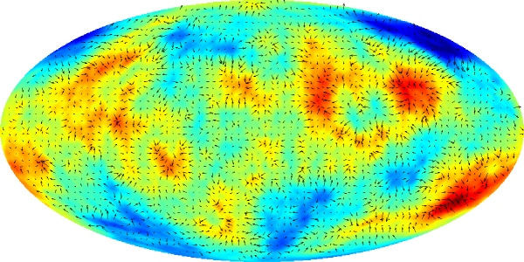
Primordial squeezed non-Gaussianity and observables in the CMB
Antony Lewis
http://cosmologist.info/
Lewis arXiv:1204.5018 see also Creminelli et al astro-ph/0405428, arXiv:1109.1822, Bartolo et al arXiv:1109.2043
Lewis arXiv:1107.5431
Lewis, Challinor & Hanson arXiv:1101.2234
Pearson, Lewis & Regan arXiv:1201.1010
Benasque August 2012

Slide 2
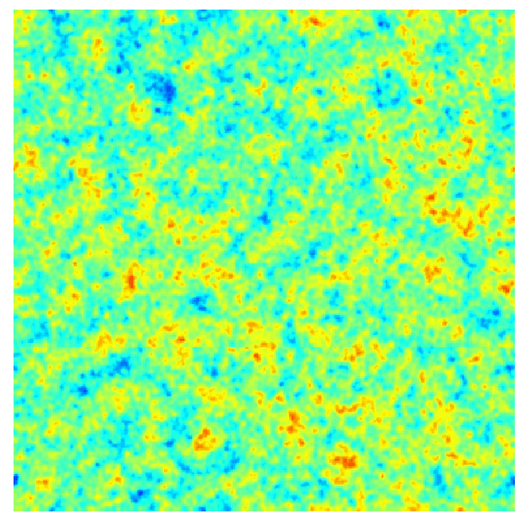
CMB temperature
End of inflation
Last scattering surface
gravity+ pressure+ diffusion
Perturbations super-horizon
Sub-horizon acoustic oscillations + modes that are still super-horizon

Slide 3
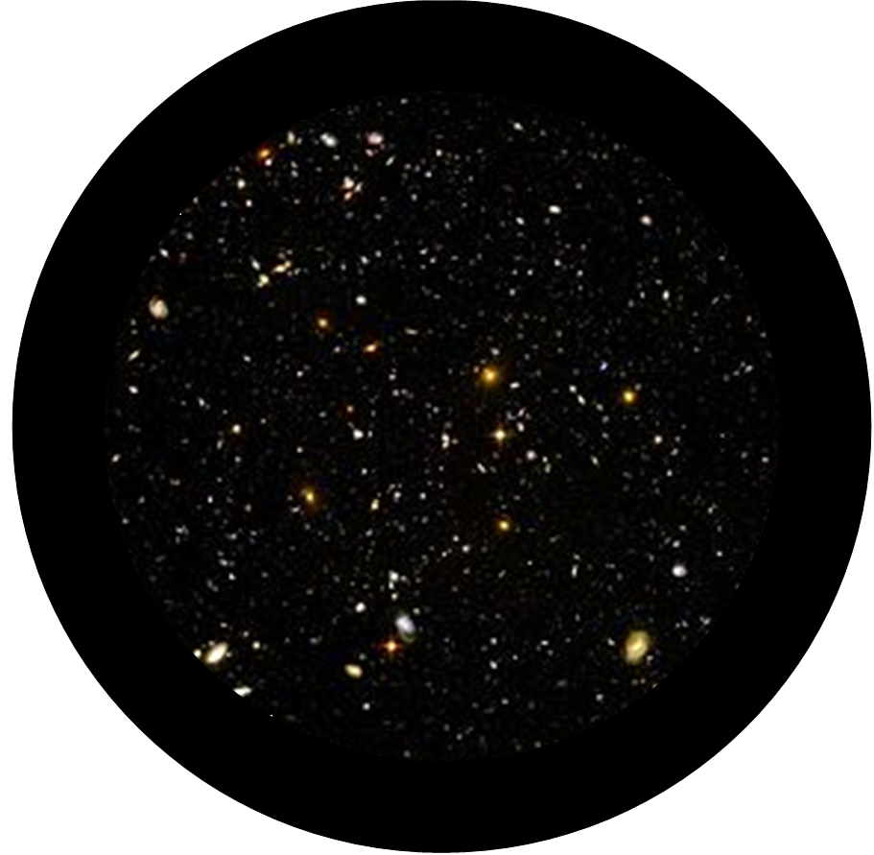
z=0
θ
14 000 Mpc
z~1000

Slide 4
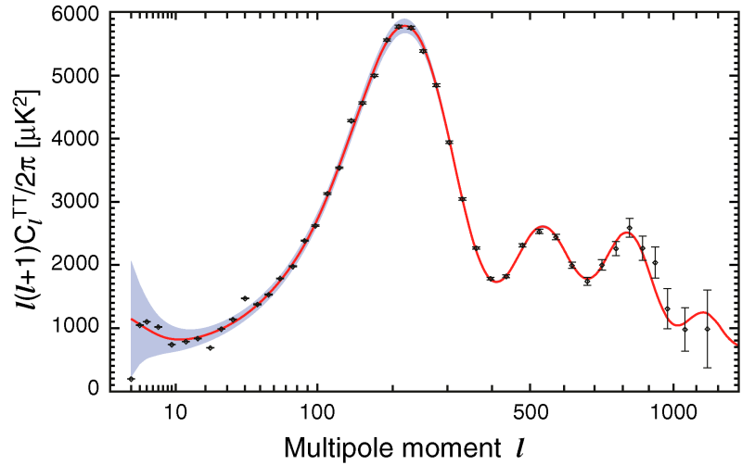
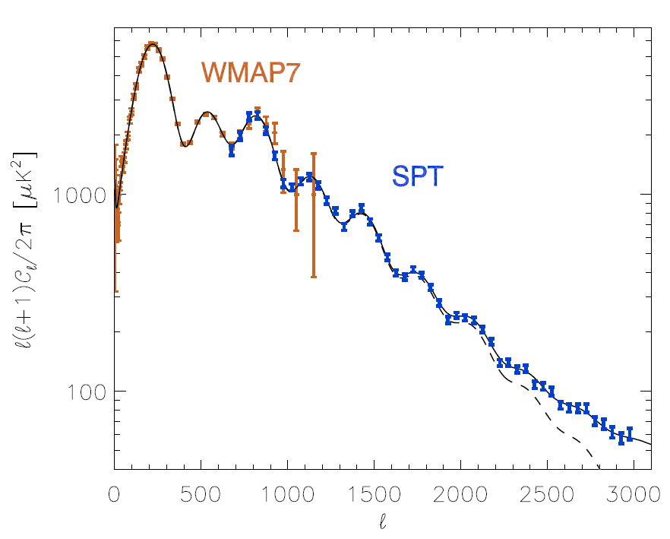
Observed CMB temperature power spectrum
WMAP 7
Larson et al, arXiv:1001.4635
Keisler et al, arXiv:1105.3182
Constrain theory of early universe + evolution parameters and geometry
Observations

Slide 5
Beyond Gaussianity – general possibilities
Flat sky approximation: $Θ\left(x\right)=\frac{1}{2π}∫d^{2}l {Θ(l)e}^{ix⋅ l }$
$$(Θ=T)$$
Gaussian + statistical isotropy
$〈Θ\left(l_{1}\right)Θ\left(l_{2}\right)〉=δ\left(l_{1}+l_{2}\right)C_{l}$ - power spectrum encodes all the information - modes with different wavenumber are independent
Higher-point correlations
Gaussian: can be written in terms of $C_{l}$
Non-Gaussian: non-zero connected $n$-point functions

Slide 6
Bispectrum
$$l_{3}$$
$$l_{1}$$
$$l_{1}+l_{2}+l_{3}=0$$
$$l_{2}$$
Flat sky approximation:
$$〈Θ\left(l_{1}\right)Θ\left(l_{2}\right)Θ(l_{3})〉=$$
$$\frac{1}{2π}δ\left(l_{1}+l_{2}+l_{3}\right)b_{l_{1}l_{2}l_{3}}$$
If you know $Θ\left(l_{1}\right), Θ\left(l_{2}\right)$, sign of $b_{l_{1}l_{2}l_{3}}$tells you which sign of $Θ\left(l_{3}\right)$ is more likely
Trispectrum
$$l_{4}$$
$$l_{1}$$
$$L$$
$$l_{3}$$
N-spectra…
$$l_{2}$$

Slide 7
Equilateral
$$k_{1}+k_{2}+k_{3}=0, \left|k_{1}\right|=\left|k_{2}\right|=|k_{3}|$$
$$k_{3}$$
$$k_{1}$$
$$k_{2}$$
+
b>0
$$T(k_{3})$$
=
+
+
b<0
$$T(k_{1})$$
$$T(k_{2})$$
$$−T(k_{3})$$

Slide 8
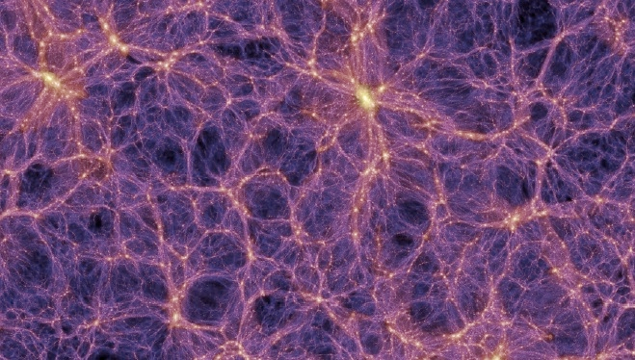
Millennium simulation

Slide 9
Near-equilateral to flattened:
b>0
b<0
$$k_{1}$$
$$k_{3}$$
$$k_{2}$$

Slide 10
Local (squeezed)
$$k_{1}+k_{2}+k_{3}=0, k_{1}≪k_{2},k_{3}$$
$$k_{2}∼−k_{3}$$
$$k_{1}$$
$$k_{2}$$
$$k_{3}$$
b>0
+
+
$${T(k}_{3})$$
=
+
$${T(k}_{1})$$
T($k_{2})$
b<0
$${−T(k}_{3})$$
Squeezed bispectrum is a correlation of small-scale power with large-scale modes
For more pretty pictures and trispectrum see: The Real Shape of Non-Gaussianities, arXiv:1107.5431

Slide 11
Squeezed bispectrum
‘Linear-short leg’ approximation very accurate for large scales where cosmic variance is large
$$l_{1}≪l_{2}≤l_{3}$$
with modulation field(s) $X_{i}$
Correlation of the modulation
with the large-scale field
Response of the small-scale power
to changes in the modulation field
(non perturbative)
Note: uses only the linear short leg approximation, otherwise non-perturbatively exact
Example: local primordial non-Gaussianity
Primordial curvature perturbation is modulated as
$l_{1}≪100:$ modulation super-horizon and constant through last-scattering, $ζ_{g}=ζ_{0}^{∗}$

Slide 12
Even with $f_{NL}=0$, we observe CMB at last scattering modulated by other perturbations
z=0
θ
14 000 Mpc
Horizon size at recombination
z~1000

Slide 13
What is the modulating effect of large-scale super-horizon perturbations?
Single-field inflation: only one degree of freedom, e.g. everything determined by local temperature (density) on super-horizon scales
Cannot locally observe super-horizon perturbations (to $O(\frac{k^{2}}{H^{2}})$)
Observers in different places on LSS will see statistically exactly the same thing
(at given fixed temperature/time from hot big bang) - local physics is identical in Hubble patches that differ only by super-horizon modes

Slide 14
BUT: a distant observer will see modulations due to the large modes <~ horizon size today - can see and compare multiple different Hubble patches
Super-horizon modes induce linear perturbations on all scales linear CMB anisotropies on large scales ($l<100$)
Sub-horizon perturbations are observed in perturbed universe: -small-scale perturbations are modulated by the effect large-scale modes squeezed-shape non-Gaussianities

Slide 15
Linear CMB anisotropies
Linear perturbation theory with
Using the geodesic equation in the Conformal Newtonian Gauge:
All photons redshift the same way, so $kT∼E.$
Recombination fairly sharp at background time $η_{∗}$: ~ constant temperature surface. Also add Doppler effect:

Slide 16
$$⇒$$
Temperature perturbation at recombination
Sachs-Wolfe
Doppler
ISW

Slide 17
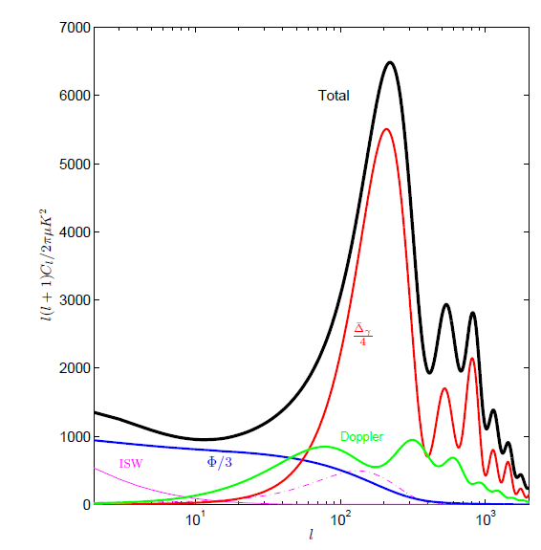
Note: no scale on which Sachs-Wolfe $Φ/3$ result is accurate Doppler dominates at $l∼60$ because other terms cancel

Slide 18
$$A$$
$$\hat{n}$$
Alternative
$$dη$$
$$dΦ=\frac{∂Φ}{∂η} dη+\frac{∂Φ}{∂χ} dχ$$
$$χ$$
$$η_{∗}$$
Gauge-invariant 3-curvature on constant temperature hypersurfaces;
Redshifting from $δN$ expansion of the beam makes the $δN$expansion from inflation observable (but line of sight integral is larger on large-scales: overdensity looks colder)

Slide 19
Non-linear effect due to redshifting by large-scale modes?
Large-scale linear anisotropies are due to the linear anisotropic redshifting of the otherwise uniform (zero-order) temperature last scattering surface
$$T→\left(1+ΔT\right)T$$
Also non-linear effect due to the linear anisotropic redshifting of the linear last scattering surface
$ΔT_{small}→\left(1+ΔT_{large}\right)ΔT_{small}$
Reduced bispectrum
Large-scale
power spectrum
Small-scale (non-perturbative)
power spectrum
(Actually very small, so not very important)

Slide 20
Linear effects of large-scale modes
Redshifting as photons travel through perturbed universe
Transverse directions also affected: perturbations at last scattering are distorted as well as anisotropically redshifted

Slide 21
Jabobi map relates observed angle to physical separation of pair of rays
$$A$$
$$δθ_{J}$$
$$ζ_{I}$$
$$λ$$
Physical separation vector orthogonal to ray
Angular separation seen by observer at $A$
Jacobi map
Evolution of Jacobi map:
Optical tidal matrix depends on the Riemann tensor:
($k^{a}$ is wave vector along ray, $E_{I}^{a}$ projects into ray-orthogonal basis)

Slide 22
‘Riemann = Weyl + Ricci’
Non-local part (does not depend on local density): - e.g. determined by Weyl (Newtonian) potential $\frac{1}{2}(Φ+Ψ)$ differential deflection of light rays $⇒$
convergence and shear of beam
- (Weyl) lensing
Einstein equations relate Ricci to stress-energy tensor: depends on local density $⇒$ ray area changes due to expansion of spacetime as the light propagates
- Ricci focussing
(can be modelled as transverse deflection angle)
(cannot be modelled by deflection angle)
FRW background universe has Weyl=0, Ricci gives standard angular diameter distance
At radial distance $χ_{∗}$, trace of Jacobi map determines physical areas:

Slide 23
Beam propagation in a perturbed universe, e.g. Conformal Newtonian Gauge
Trace-free part of Jacobi map depends on the shear:
Area of beam determined by trace of Jacobi map:
CMB is constant temperature surface:
$$η=η_{∗}+δη$$
Radial displacement (small, $δχ≪χ_{∗}$)
Local aberration
Ricci focussing
(Weyl) convergence

Slide 24
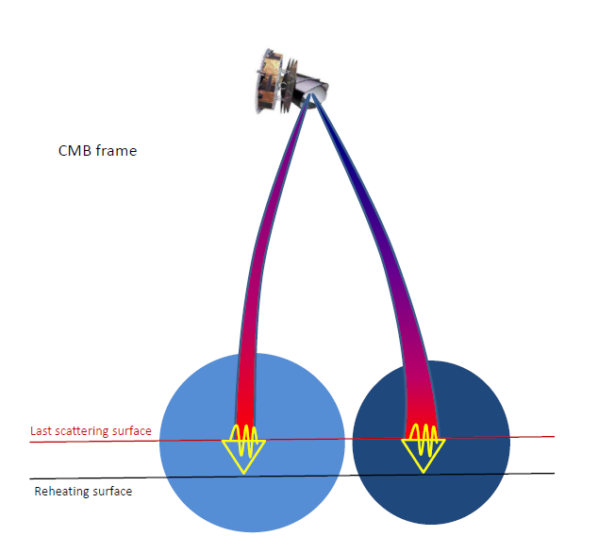
$$\frac{D}{2}≈χ_{∗}a_{∗}(1+ζ_{γ} −κ)$$
Ricci focussing:
beam contracts more leaving LSS $⇒$same physical size looks smaller
Overdensity ($ζ$ larger)
underdensity
(Weyl lensing effect not shown and partly cancels area effect)

Slide 25
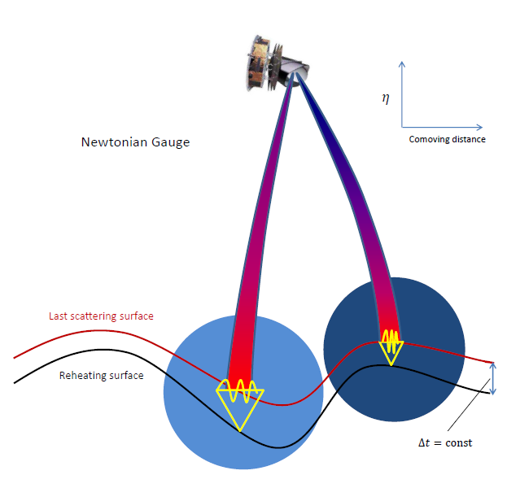
Gauge-invariant Ricci focussing

Slide 26
Observable CMB bispectrum from single-field inflation
Linear-short leg approximation for nearly-squeezed shapes:
Where $X_{i}$ here is $δT$, $κ$ and $ζ_{γ}$, with $\frac{D}{2}≈χ_{∗}a_{∗}\left(1+ζ_{γ} −κ\right)$. For super-horizon adiabatic modes $ζ_{γ}=ζ_{0}$.
Weyl lensing bispectrum
+ perms
Squeezed limit ($l_{1}≪l)$
Ricci focussing bispectrum
Squeezed limit ($l_{1}≪l)$
+ anisotropic redshifting bispectrum (from before)

Slide 27
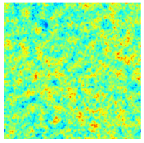
Weyl lensing bispectrum
$C_{l}^{Tκ}$: Correlation between lenses and CMB temperature?
Overdensity: magnification correlated with positive Integrated Sachs-Wolfe (net blueshift)
Underdensity: demagnification correlated with negative Integrated Sachs-Wolfe (net redshift)

Slide 28
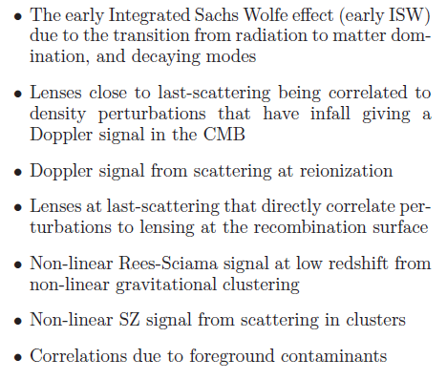
$C_{l}^{Tκ}$: Correlation between lenses and CMB temperature?
+
Linear effects,
All included in self-consistent
linear calculation with CAMB
Non-linear growth effect - estimate using e.g. Halofit
Potentially important,
but frequency dependent - ‘foregrounds’

Slide 29
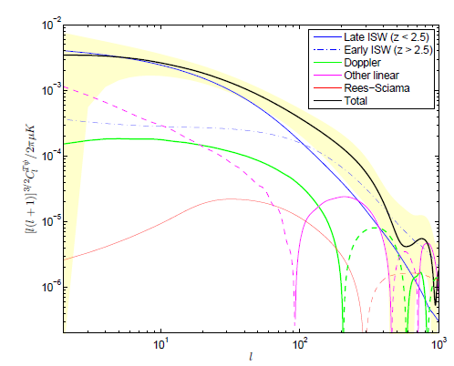
Contributions to the lensing-CMB cross-correlation, $C_{l}^{Tψ}$
(note Rees-Sciama contribution is small, numerical problem with much larger result of Verde et al, Mangilli et al.; see also Junk et al. 2012 who agree with me)

Slide 30
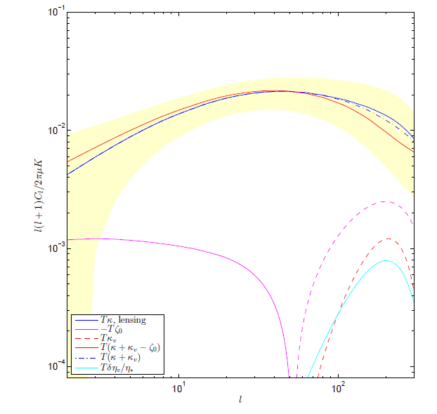
Weyl lensing total + Ricci focussing (+ estimates of sub-horizon dynamics)

Slide 31
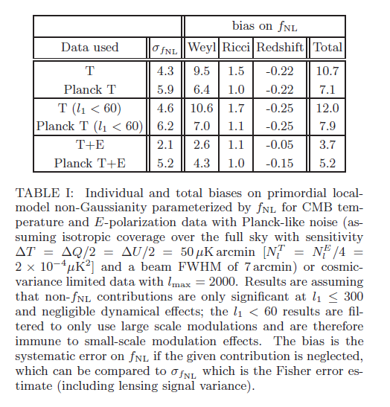
Does this look like squeezed non-Gaussianity $f_{NL}$ from multi-field inflation (local modulation of small scale perturbation amplitudes in each Hubble patch)?
Dominated by lensing $f_{NL}∼6−10$
Ricci is an $O(1)$ correction
Calculation reliable for $l_{1}<60$where dynamical effects suppressed by small $\frac{k^{2}}{H^{2}}:$ do not need fully non-linear dynamical calculation of bispectrum a la Pitrou et al to make reliable $f_{NL}$ constraint

Slide 32
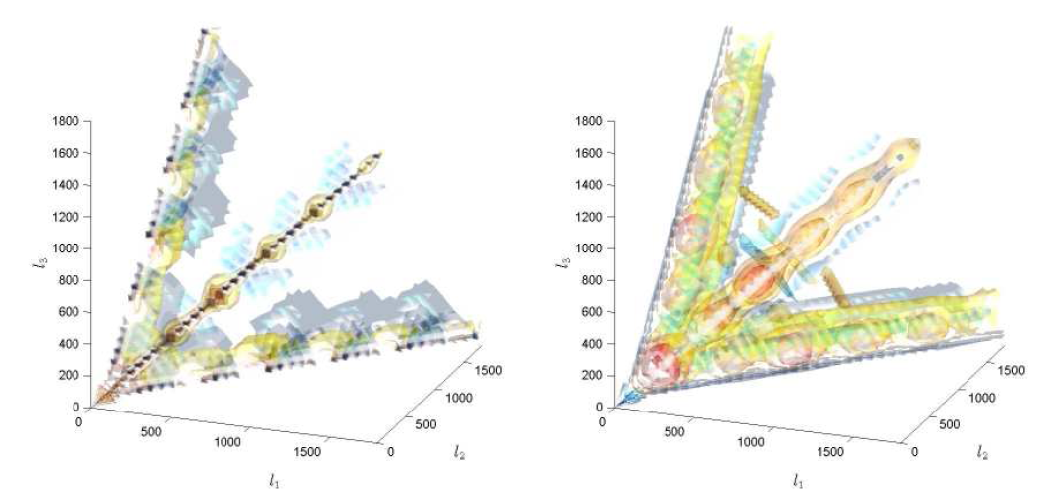
Signal easily modelled Squeezed shape but different phase, angle and scale dependence
Lensing
$$f_{NL}$$
Lewis, Challinor, Hanson 1101.2234

Slide 33
Note: ‘Maldacena’ bispectrum
Consistency relation: $f_{NL}∼O(n_{s}−1)$
is not an observable
- cannot measure comoving curvature perturbations on scales larger than the horizon directly
- $d/d(\ln{k})$ and CMB transfer functions do not commute: cannot get correct result from primordial $f_{NL}∼(n_{s}−1)$
Observable CMB analogue is Ricci focussing bispectrum
- larger because of acoustic oscillations, non-zero for $n_{s}=1$
- different shape to $f_{NL}$ in CMB, but projects as $f_{NL}=O(1)$
Question: primordial bispectrum calculations includes time shift $\frac{d}{d\ln{k }}$ terms - not correct to calculate effective $f_{NL}$ at end of inflation, what to do? (e.g. features)

Slide 34
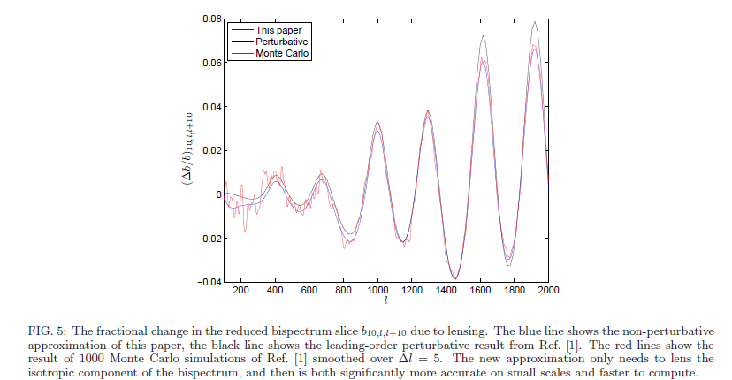
Lensing of primordial non-Gaussianity
General case at leading order: Hanson et al. arXiv:0905.4732
Fast non-perturbative method: Pearson, Lewis, Regan arXiv:1201.1010
Bispectrum slices are smoothed by lensing, just like power spectrum
BUT lensing preserves total power: expect $∼0$ bias on primordial $f_{NL}$ estimators

Slide 35
Squeezed trispectrum
Lensing gives large trispectrum, this is what is used for lensing reconstruction
Also want to look for primordial trispectrum
e.g. from primordial modulation
Squeezed shape, constant modulation
$$⇒$$
Easy accurate estimator for $τ_{NL}$ is
(optimal to percent level)
Lensing bias on $τ_{NL}$
All $τ_{NL}$ signal at low $l<\sim 10$: cut to avoid blue lensing signal at higher $l$
Then fairly small, 17 to 40 depending on data: small compared to $σ_{τ_{NL}}≥150$
Lensing not a problem for $τ_{NL}$ constraints (because they are so weak!)

Slide 36
Conclusions
Single field inflation predicts significant non-Gaussianity in the observed CMB - mostly due to (Weyl) lensing - total projects onto $f_{NL}∼7$ for Planck temperature - Ricci focussing expansion of beam recovers the $δN$ from inflation, : gives equivalent of consistency relation, but larger : small and not quite observable, projects on to $f_{NL}∼1$ - Squeezed calculation reliable at $l_{1}<60$ : robust constraints on $f_{NL}$ without 2nd order dynamics - effect on trispectrum is small
Lensing bispectrum signal important but distinctive shape - dominated by late ISW correlation, but other term important (eg. early ISW) - predicted accurately by linear theory (Rees-Sciama is tiny)
On smaller scales, and non-squeezed shapes, need full numerical calculation of non-linear dynamical effects in CMB
Question: for numerical calculation of squeezed non-linear effects, how to you handle/separate the large lensing signal? ($f_{NL}∼3$ sounds like mostly lensing to me)

