Slide 1
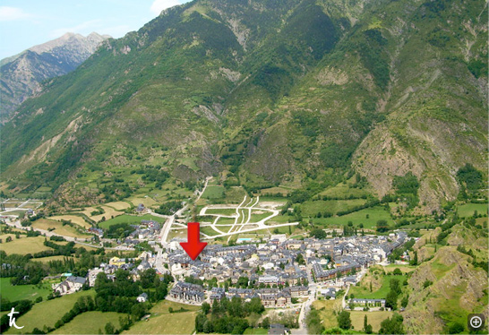
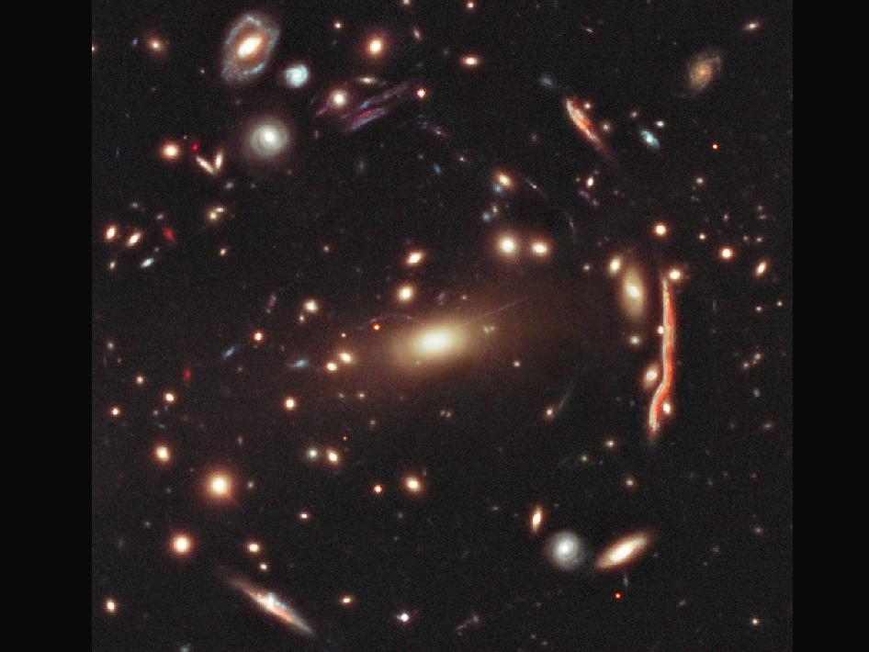




Galaxy surveys: from controlling systematics to new physics
CLASH MACS1206
Ofer Lahav (UCL)

Slide 2
Outline
Which surveys, what science, what methods
Systematics: photo-z, star/galaxy separation, biasing
Combining imaging and spectroscopy
Excess power and primordial non-Gaussianity
Neutrino masses
Modified gravity

Slide 3
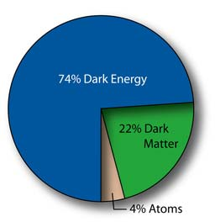
Darkness Visible
Cosmic Probes:
Gravitational Lensing
Peculiar Velocities
Galaxy Clusters
Cosmic Microwave Background
Large Scale Structure
Type Ia Supernovae
Integrated Sachs-Wolf

Slide 4
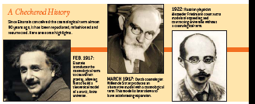
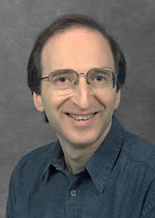
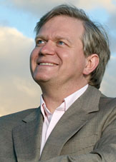
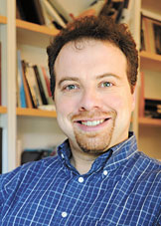
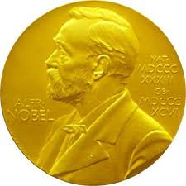

What is causing the acceleration of the Universe?
The old problem:
Theory exceeds observational limits on Λ by 10¹²⁰ !
New problems:
- Is Λ on the LHS or RHS?
- Why are the amounts of Dark Matter and Λ so similar?

Slide 5
Dark Matter or Modified Gravity?
“Dark Matter”: Neptune (discovered 1846)- predicted to be there based on unexplained motion of Uranus.
“Modified Gravity”: Mercury’s precession- a new theory (Einstein’s General Relativity, 1917) required to explain it.

Slide 6
Pre-Supernovae paradigm shift
Peebles (1984) advocated Lambda
APM result for low matter density (Efstathiou et al. 1990)
Baryonic fraction in clusters (White et al. 1993)
The case for adding Lambda (Ostriker & Steinhardt 1995)
Cf. linear Lambda-like force (Newton 1687 !)
Calder & Lahav (2008, 2010)

Slide 7
The Landscape of Large Surveys
(some under construction, some proposed)
Photometric surveys: DES, VISTA, VST, Pan-STARRS, HSC,
Skymapper, PAU, LSST, …
Spetroscopic surveys: WiggleZ, BOSS, e-BOSS, BigBOSS, DESpec, HETDEX, Subaru/Sumire, VISTA/spec, SKA, …
Space Missions: Euclid, WFIRST

Slide 8
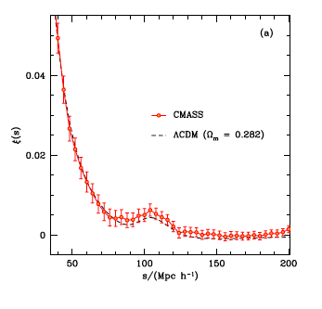
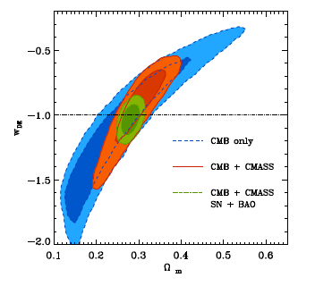
New Results - BOSS
w =-1.03 +- 0.07
Sanchez et al. 2012

Slide 9

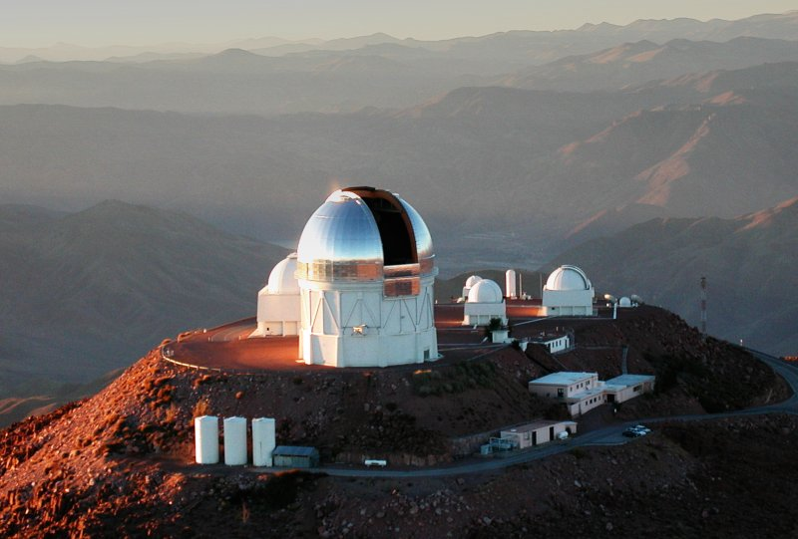
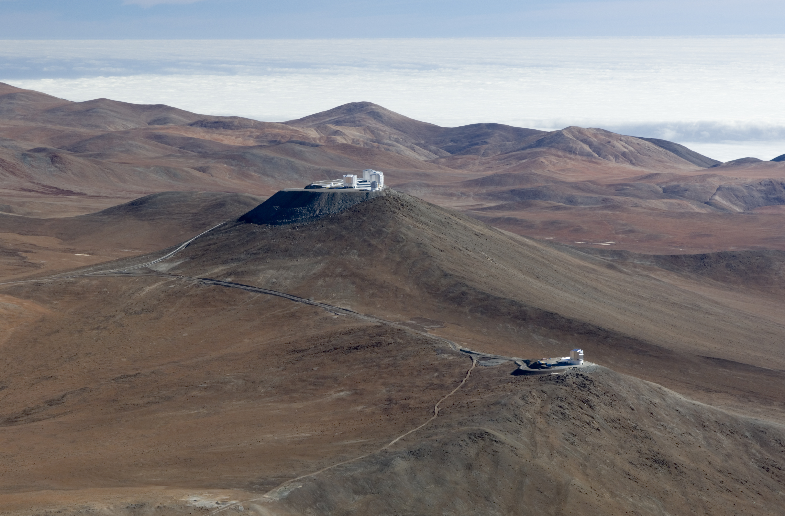
The Dark Energy Survey
First Light in September 2012
Multi-probe approach
Cluster Counts
Weak Lensing
Large Scale Structure
Supernovae Ia
8-band survey
5000 deg² grizY
300 million photometric redshifts
+ JHK from VHS (1200 sq deg covered at half exposure time)
+SPT SZ (550 clusters observed over 2500 sq deg)
CTIO
VISTA

Slide 10
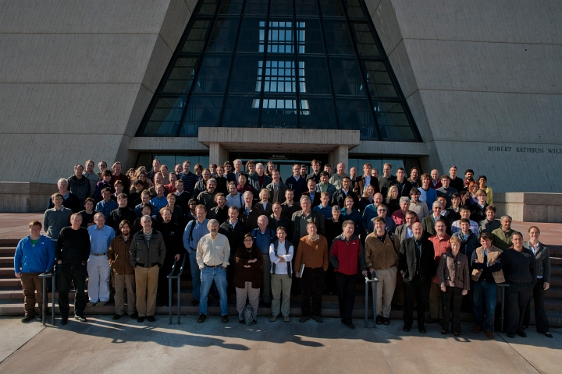
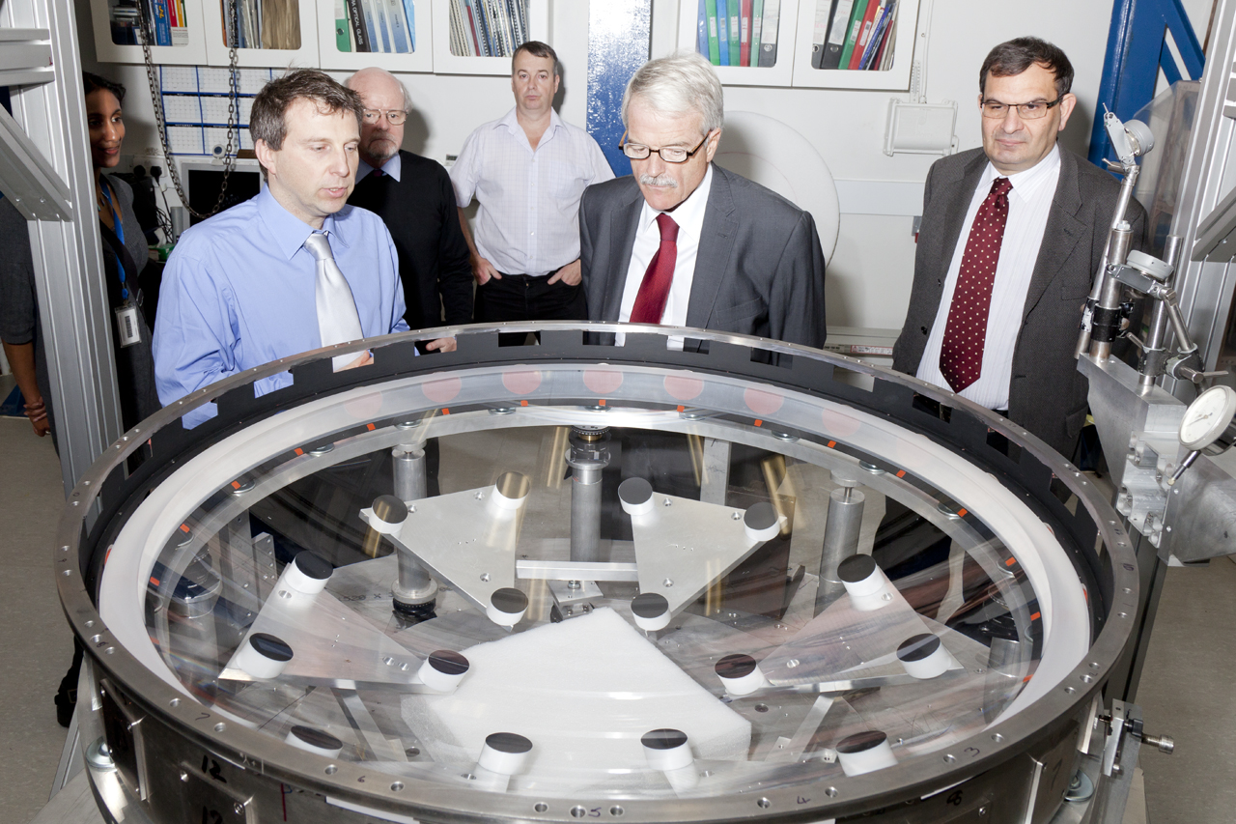
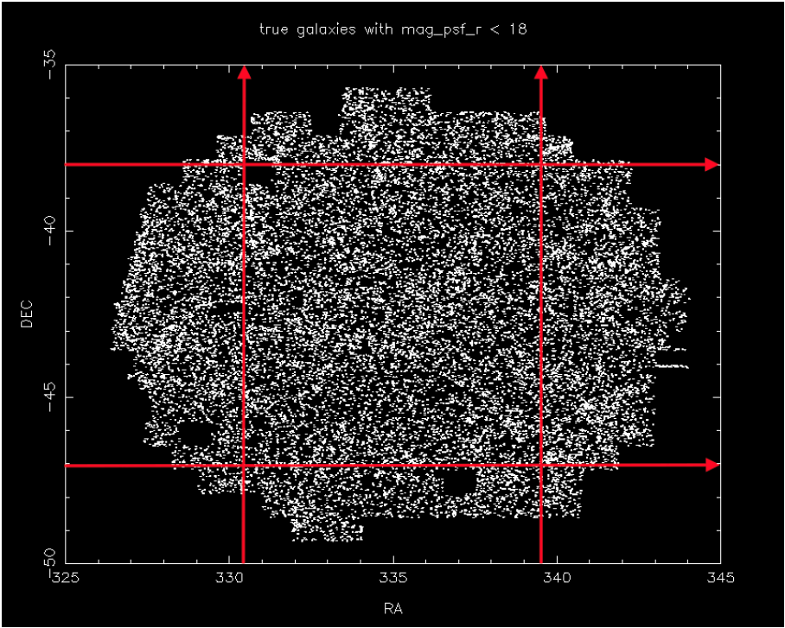
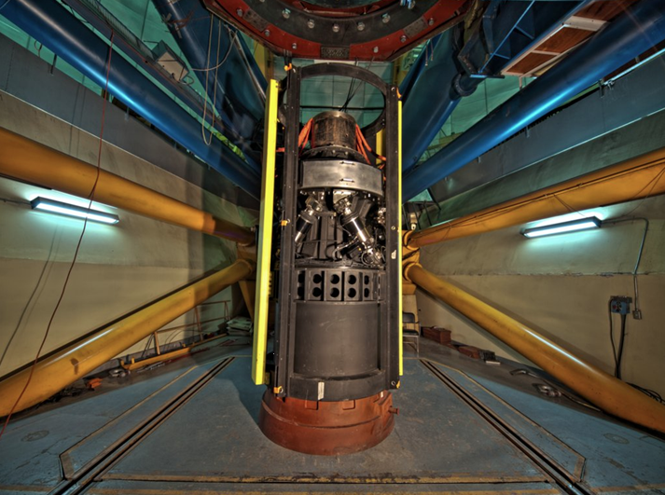
The Dark Energy Survey

Slide 11
DES Science Committee
SC Chair: O. Lahav
Large Scale Structure: E. Gaztanaga & W. Percival
Weak Lensing: S. Bridle & B. Jain
Clusters: J. Mohr & C. Miller
SN Ia: M. Sako & B. Nichol
Photo-z: F. Castander & H. Lin
Simulations: G. Evrard & A. Kravtsov
Galaxy Evolution: D. Thomas & R. Wechsler
QSO: P. Martini & R. McMahon
Strong Lensing: L. Buckley-Geer & M. Makler
Milky Way: B. Santiago & B. Yanny
Theory & Combined Probes: S. Dodelson & J. Weller
+ Spectroscopic task force: F. Abdalla & A. Kim
+ Ad-hoc Committees
Regular WG telecons; Monthly SC telecons; sessions at collaboration meetings; reports to the DES Director & MC

Slide 12
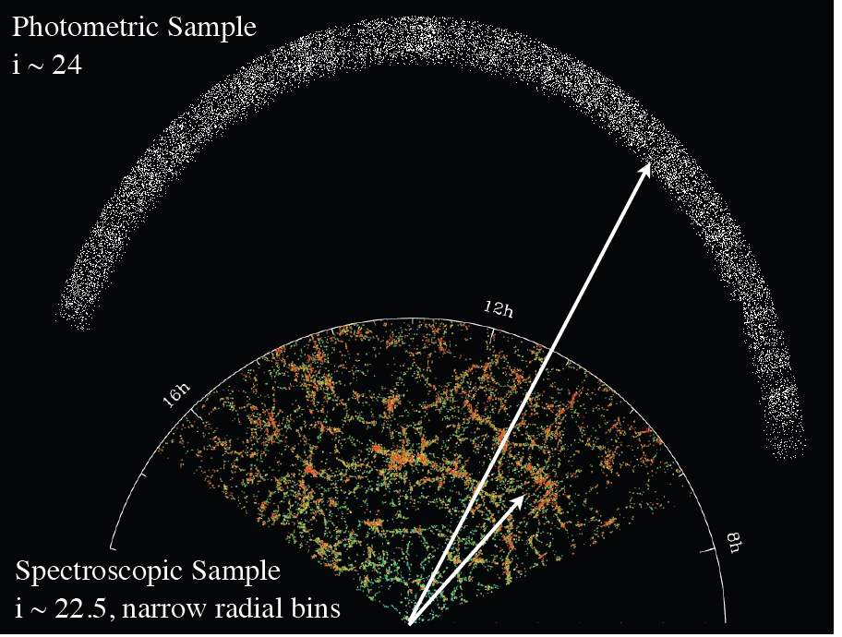
Spectroscopic follow-up of DES
Gaztanaga et al.

Slide 13
DESpec: Spectroscopic follow up of DES
Proposed Dark Energy Spectrometer (DESpec)
4000–fibre instrument for the 4m Blanco telescope in Chile, using DES optics and spare CCDs
7 million galaxy spectra, target list from DES, powerful synergy of imaging and spectroscopy, starting 2017-18
Spectral range approx 600 to 1000nm, R=3300 (red end)
DES+DESpec can improve DE FoM by 3-6,
making it DETF Stage IV experiment
DES+DESpec can distinguish DE from ModGrav
Participants: current international DES collaboration
+ new teams

Slide 14
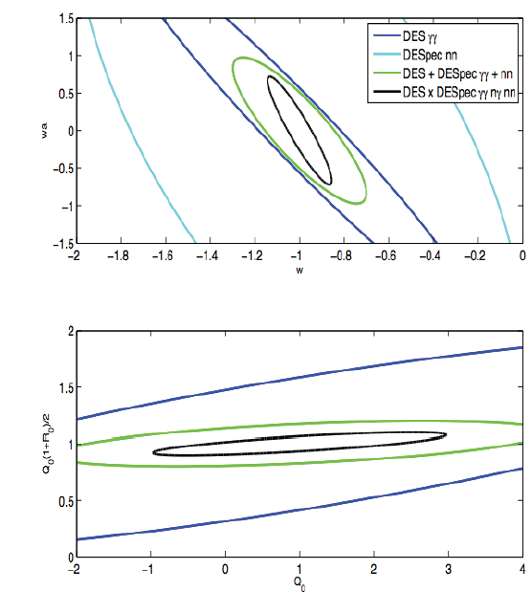
DES (WL) + DESpec (LSS)
Kirk, Lahav, Bridle et al. (in preparation)
Cf. Gaztanaga et al 2012, Bernstein & Cai 2012

Slide 15
The benefits of same sky
DES imaging provides natural target list for DESpec
WL & LSS from same sky could constrain better biasing (both r and b), leading to muck higher FoMs (Gaztanaga et al, Cai & Bernstein, Kirk et al, BB-DES report)
Reducing cosmic variance (MacDonald& Seljak, Bernstein & Cai)

Slide 16
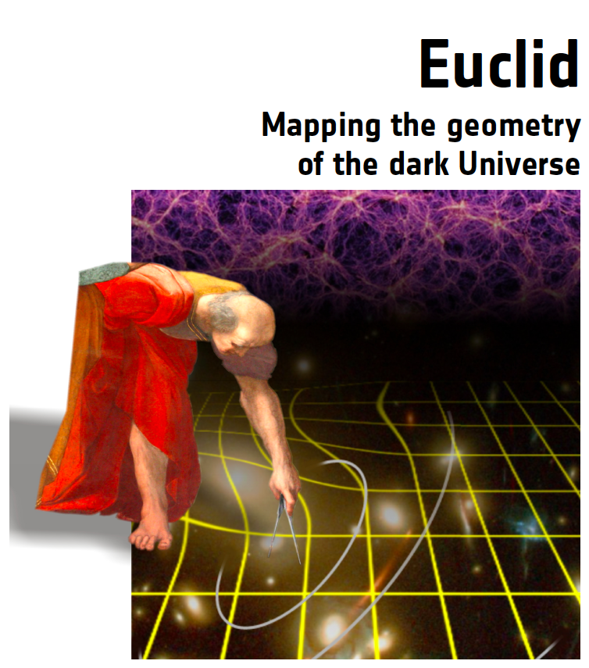
EUCLID
ESA Cosmic Vision
planned launch 2019
The key original ideas:
weak lensing from space
and photo-z from the ground (DUNE) + spectroscopy (SPACE)
The new Euclid: 15000 sq deg
1B galaxy images + 50M spectra
(+ground based projects,
e.g. PS, DES, LSST,…)

Slide 17
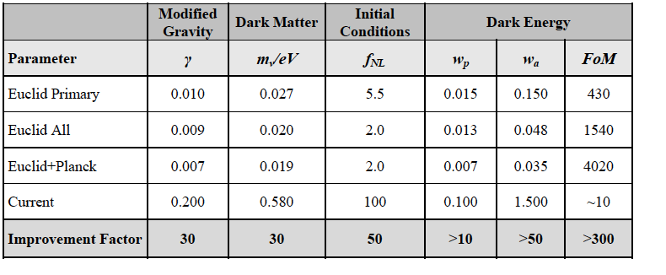
Euclid Forecast

Slide 18
Sources of Systematics in Cosmology
Theoretical (the cosmological model & parameters, e.g. w/out neutrino mass)
Astrophysical (e.g. galaxy biasing in LSS, dust in SN, intrinsic alignments in WL)
Instrumental (e.g. image quality, photo-z)

Slide 19
Photo-z –Spectra cross talk
Approximately, for a photo-z slice:
(δw/ w) = 5 (δz/ z) = 5 (σ_{z}/z) N_{s}^{-1/2}
=> the target accuracy in w
and photo-z scatter σ_{z} dictate the number of required spectroscopic redshifts
N_{s} =10⁵-10⁶

Slide 20
PHOTO-Z CODES
CODE | METHOD | REFERENCE
HyperZ | Template | Bolzonella et al. (2000)
BPZ | Bayesian | Benitez (2000)
ANNz | Training | Collister & Lahav (2004)
ImpZLite | Template | Babbedge et al. (2004)
SDSS Template | Hybrid | Padmanabhan et al. (2005)
ZEBRA | Hybrid, Bayesian | Feldmann et al. (2006)
LePhare | Template | Ilbert et al. (2006)

Slide 21
LRG - photo-z code comparison
SDSS
ANNz
HpZ+BC
HpZ+WWC
Le PHARE
Zerba

Slide 22
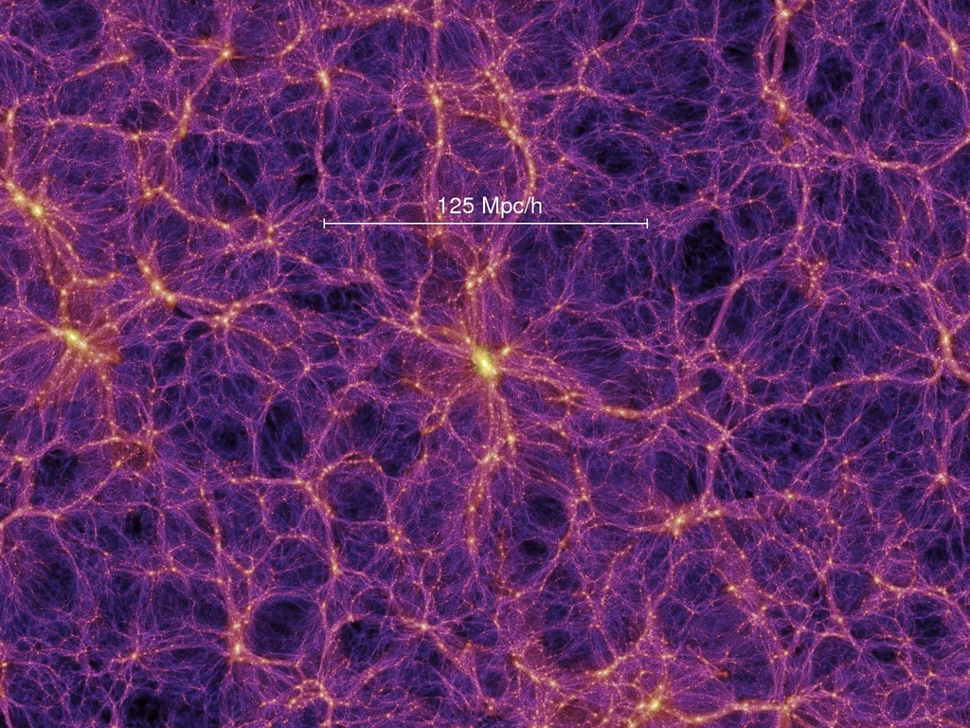
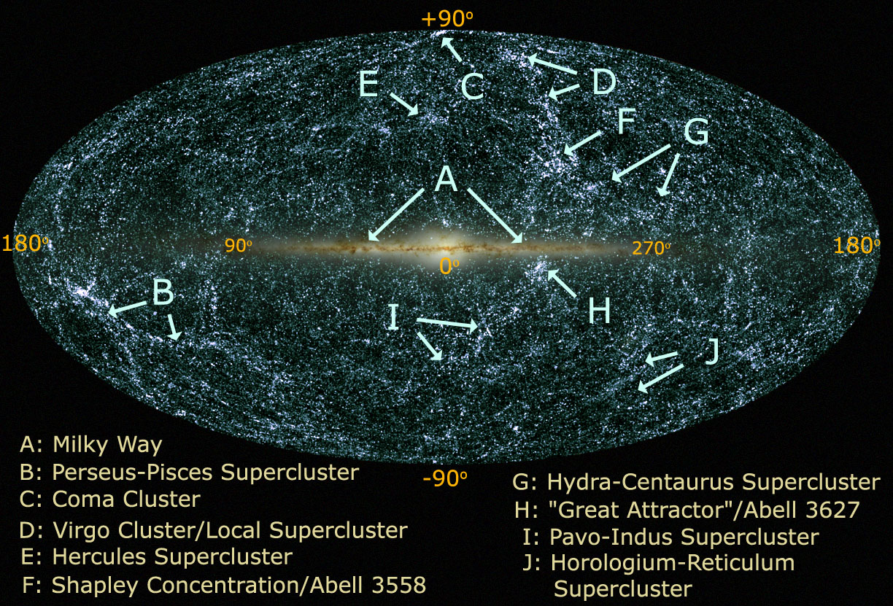
Dark Matter => Halos => Galaxies
Dark Matter Millenium simulations 2MASS galaxies

Slide 23
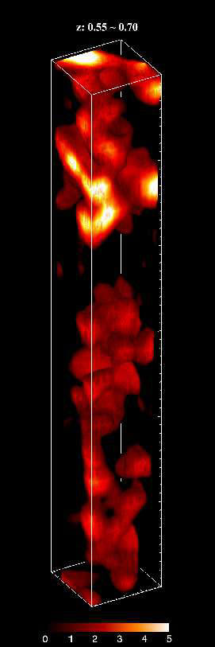
How many biasing scenarios?
To b or not to b?
Local/global bias
Linear, deterministic bias
Non-linear, stochastic bias
Halo bias
Luminosity/colour bias
Non-Gaussian bias
Velocity bias
Galaxy/IGM bias
Time/scale-dependent bias
Eulerian/Lagrangian bias
zCosmos

Slide 24
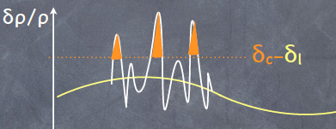
Models of biasing
b=1 (Peebles 1980)
»_{gg} = b² »_{mm} (Kaiser 1984; BBKS 1986)
±_{g} = b ±_{m} (does NOT follow from the previous eq, but used in numerous papers…)
±_{g} = b₀ + b₁±_{m}+ b₂ ±_{m}² +…(since late 90s)
Non-linear & Stochastic biasing
(Dekel & OL 1999)
Halo model (review by Cooray & Sheth 2002)
Non-Gaussian imprint ¢b(k) (Dalal et al. 2008)
N-Body, perturbation theory, semi-analytic, hydro simulations etc.

Slide 25
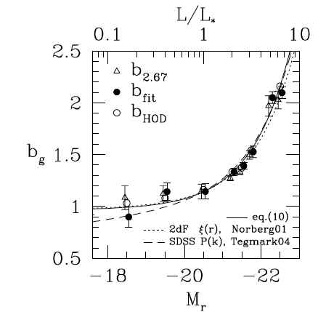
Luminosity bias
SDSS DR7 (Zehavi et al. 2011)

Slide 26
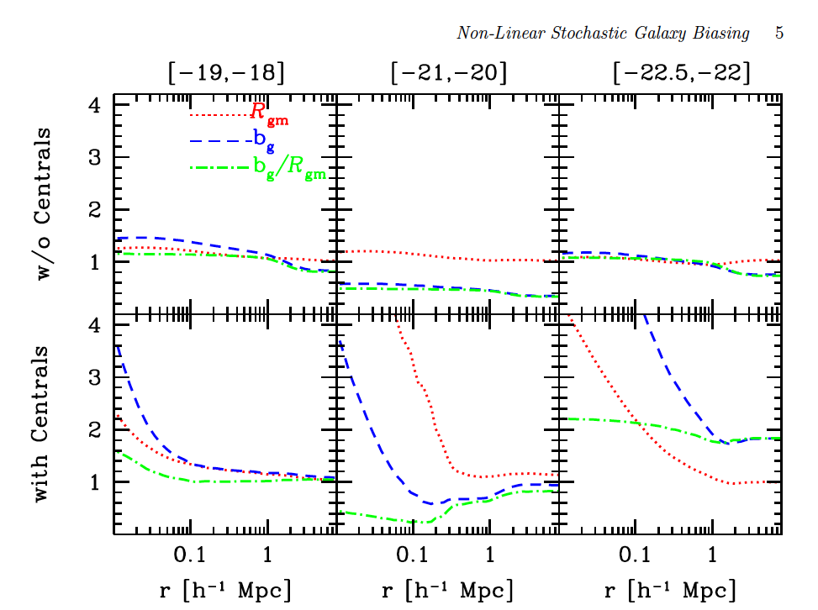
Identifying Non-linear Stochastic Biasing in the Halo Model in the Halo Model
Cacciato, Lahav, van den Bosch, Hoekstra, Dekel (2012)

Slide 27
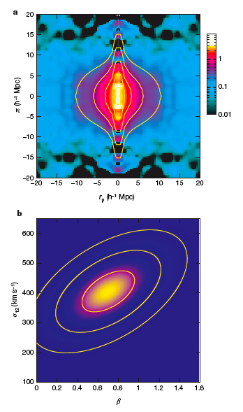
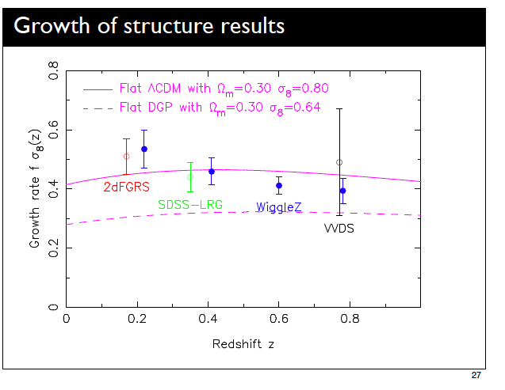
Redshift Distortion as a test of Dark Energy vs. Modified Gravity
±_{g} (k) = (b + f ¹²) ±_{m}(k)
f = Ω°
Guzzo et al. 2008
Blake et al. 2011

Slide 28
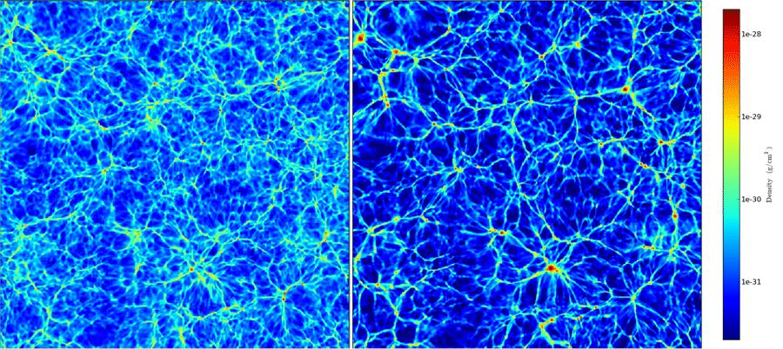
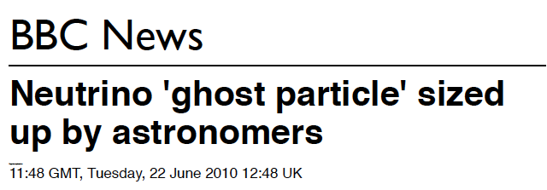
Neutrino mass from galaxy surveys
0.05 eV < Total neutrino mass < 0.28 eV (95% CL)
Thomas, Abdalla & Lahav, PRL (2010, 2011)
Notes:
here at two plots. For the 1D profile the dashed lines are 2sigma.WMAP < 1.3 eVWMAP + SN + BAO < 0.67 eVWMAP + SN + BAO + MegaZ (DR4) < 0.3eV (DR4 l_max = 300)parameters: omega_b h^2, omega_c h^2, omega_l, tau, n_s, log(10^10 A_s),A_SZ, sum_nu, bias_1, bias_2, bias_3, bias_4

Slide 29
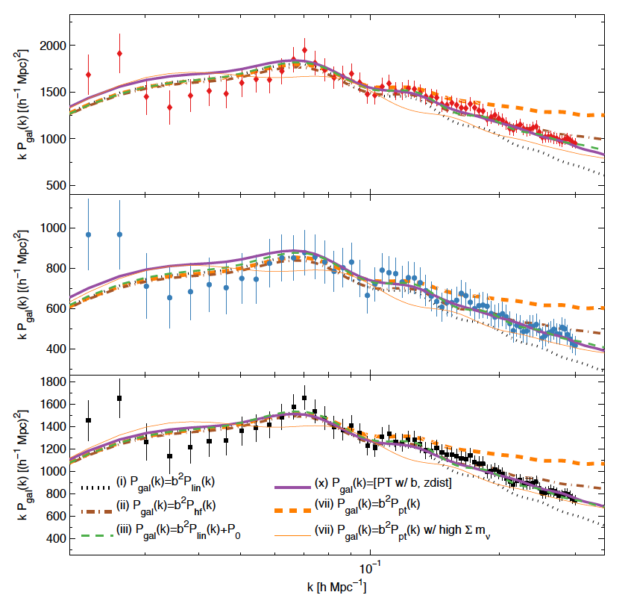
Neutrino mass from red vs blue SDSS galaxies
red
blue
all
upper limit in the range 0.5-1.1 eV
Swanson, Percival & Lahav (2010)
red and blue within 1–sigma

Slide 30
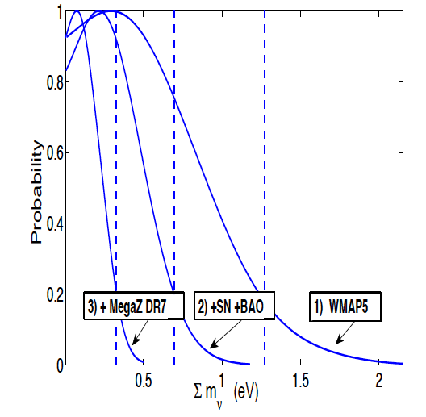
Neutrino mass from MegaZ-LRG
700,000 galaxies within 3.3 (Gpc/h)^3
0.05 <Total mass < 0.28 eV (95% CL)
Thomas, Abdalla & Lahav (PRL, 2010)
Notes:
here at two plots. For the 1D profile the dashed lines are 2sigma.WMAP < 1.3 eVWMAP + SN + BAO < 0.67 eVWMAP + SN + BAO + MegaZ (DR4) < 0.3eV (DR4 l_max = 300)parameters: omega_b h^2, omega_c h^2, omega_l, tau, n_s, log(10^10 A_s),A_SZ, sum_nu, bias_1, bias_2, bias_3, bias_4

Slide 31



Imprints of primordial non-Gaussianity on halo bias
Dalal et al. 2008
⬆
Note:
Guassian initial conditions also generate Non-G (e.g S₃ = 34/7)
Systematics – challenging
- Ideally, test for inflation models

Slide 32
Excess power on Gpc scale: systematics or new physics?
Thomas, Abdalla & Lahav (2011)
Using MegaZ-LRG (ANNz Photo-z)

Slide 33
Systematics in LSS
Star-galaxy separation
Galactic extinction
Seeing
Sky brightness
Airmass
Calibration offsets
Others…

Slide 34
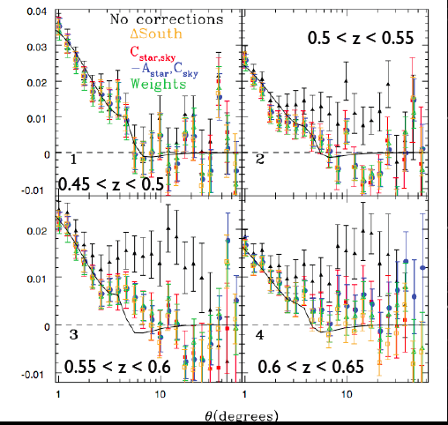
Corrections to angular correlation function
Angular correlation function
Ross et al. 2010

Slide 35
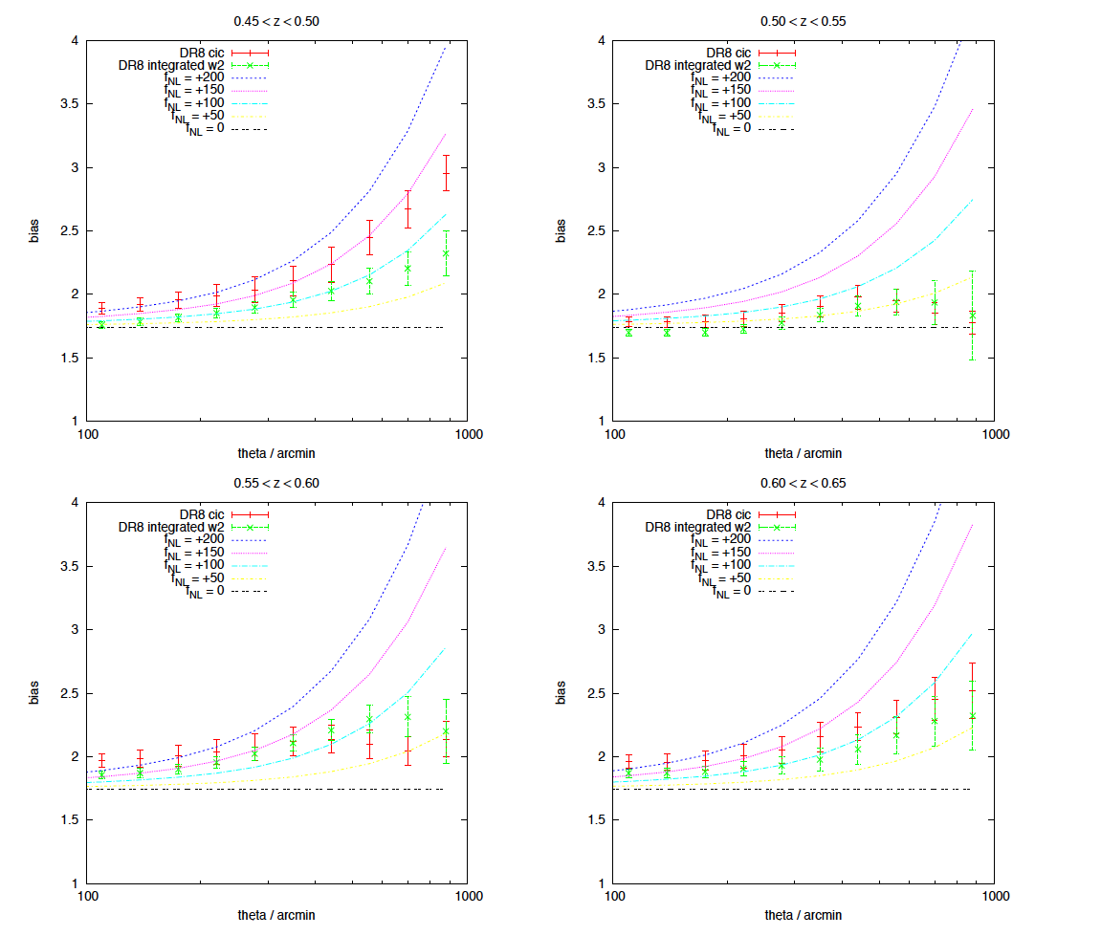
Excess power in LRGs DR8?
(post stellar correction)
400 Mpc/h
Adam Hawken, PhD, in preparation

Slide 36
The case for
“Vanilla systematics”
We model the whole universe with 6-12 parameters.
How many parameters should we allow as “nuisance parameters” for unknown astrophysics –
10, 100, 1000?
Great to have the technical ability to add as many parameters as we like, however...
There is some knowledge from theory and simulations on galaxy biasing (and e.g. intrinsic alignments).
A small number of physically motivated free parameters are easier for comparison with other analyses.
These can be useful to test the1000-parameter setup
(or their PCA-compressed version).

Slide 37
Points for discussion
How to control systematics?
How to handle nuisance parameters?
How to uitlize simulations?
Could rule out w=-1?
Could measure neutrino mass?
Could distinguish DE from ModGrav?
Could measure PnonG from LSS and CMB?
A new paradigm shift?

Slide 38
END

Slide 39
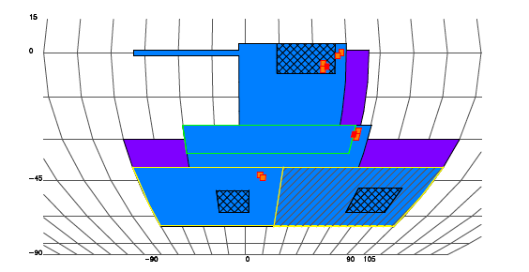

Revised DES Footprint

Slide 40
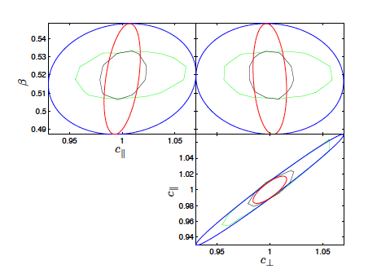
LSS (DESpec-like) +CMB Synergy
With 1% prior (WMAP) on
the 150 Mpc sound horizon
Hawken, Abdalla, Hutsi, Lahav (arXiv: 1111.2544)

Slide 41
DESpec: benefits per probe
Photo-z/spec: better photo-z calibration (also via cross-correlation)
LSS: RSD and radial BAO, FoM improved by several (3-6)
Clusters: better redshifts and velocity dispersions, FoM up by several
WL: little improvement for FoM (as projected mass), but helps with intrinsic alignments
WL+LSS: offers a lot for both DE and for ModGrav
SN Ia: spectra of host galaxies and for photo-z training, improving FoM by 2
Galaxy Evolution: galaxy properties and star-formation history
Strong Lensing: improved cluster mass models

Slide 42
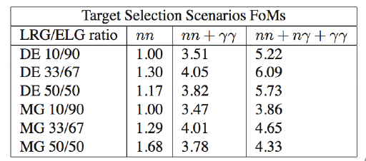
DESpec target selection & FoMs
Kirk et al, in preparation

