Slide 1

Abrahams

Slide 2
Abrahams
The volume is edited by E Abrahams.
A distinguished group of experts, each of
whom has left his mark on the developments
of this fascinating theory, contribute their
personal insights in this volume. They are:
A Amir, P W Anderson, G Bergmann ,
M Büttiker, K Byczuk , J Cardy,
S Chakravarty , V Dobrosavljević ,
R C Dynes, K B Efetov,
F Evers, A M Finkel'stein, A Genack,
N Giordano, I V Gornyi, W Hofstetter,
Y Imry , B Kramer, S V Kravchenko,
A MacKinnon , A D Mirlin ,
M Moskalets, T Ohtsuki,
P M Ostrovsky , A M M Pruisken,
T V Ramakrishnan, M P Sarachik. K Slevin ,
T Spencer, D J Thouless, D Vollhardt,
J Wang, F J Wegner and P Wölfle

Slide 3
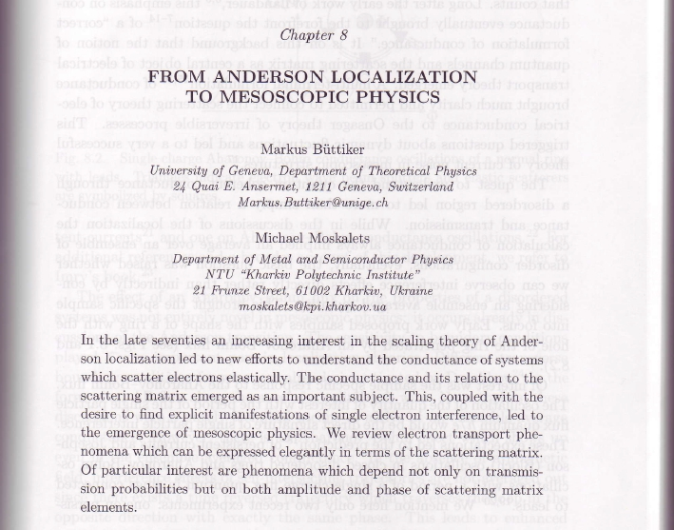
MBMM Anderson
arXiv:1002.2342

Slide 4
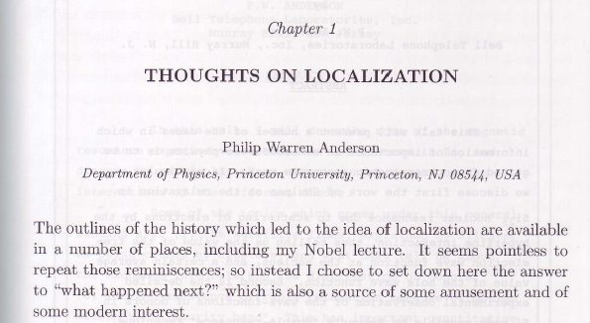
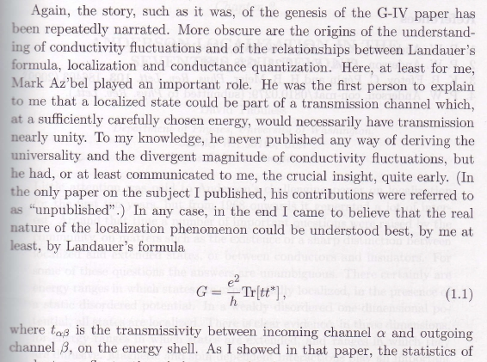
Anderson
Anderson on
Anderson localization
Page 5: In
« 50 Years of Anderson Localization »
Edited by Elihu Abrahams
Word Scintific Singapur
New Jersey, 2010

Slide 5

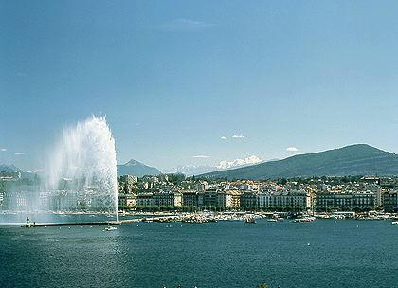



Localization
NANO-CTM
Localization at bilayer graphene and toplogical insulator edges
Markus Büttiker
with
Jian Li and Pierre Delplace
Ivar Martin and Alberto Morpurgo
8th International Workshop on Disordered Systems
Benasque, Spain 2012, Aug 26 -- Sep 01
http://benasque.org/2012disorder/

Slide 6
Localization at bilayer graphene edges*
Part I
*The sildes in this part of my talk have been given to me by Jian Li (and are reproduced here with only minor modifications.

Slide 7
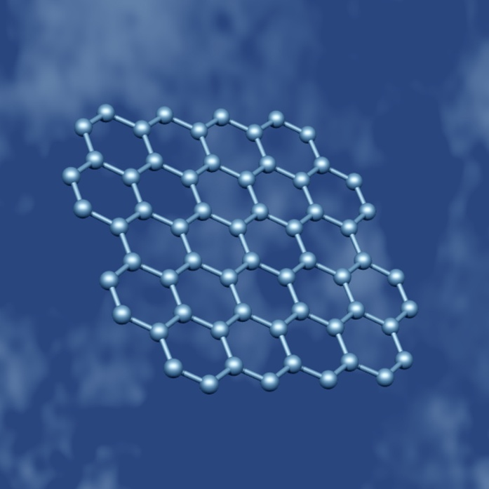
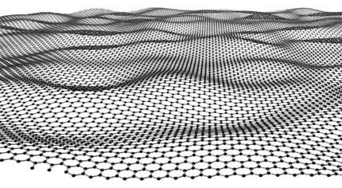
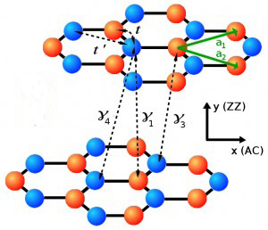
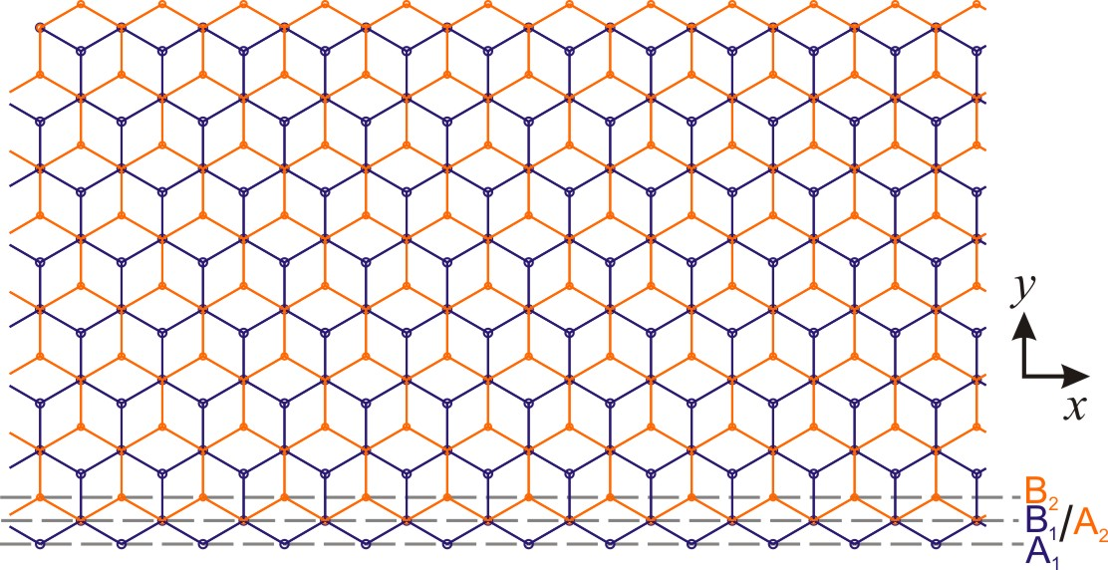
Single and bilayer graphene

Slide 8
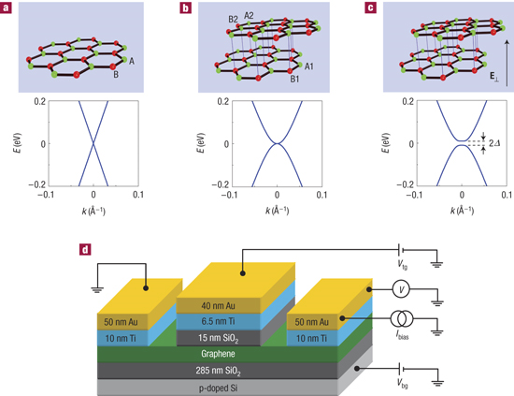
Tuneable gap in bilayer graphene
“Gate-induced insulating state in bilayer graphene devices”, Morpurgo group, Nature Materials 7, 151 (2008); Yacoby group w/ suspended bilayer graphene, Science 330, 812 (2010).
“Direct observation of a widely tunable bandgap in bilayer graphene”, Zhang et al., Nature 459, 820 (2009); Mak et al. PRL 102, 256405 (2009).
Transport measurement
2∆ ~ 10meV
Gap size does not agree!
Optical measurement
2∆ ~ 250meV

Slide 9
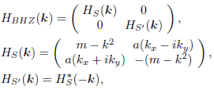
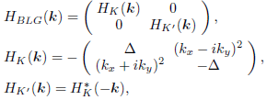


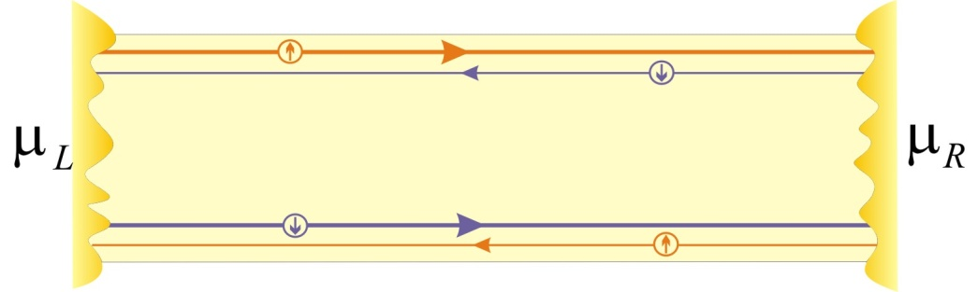
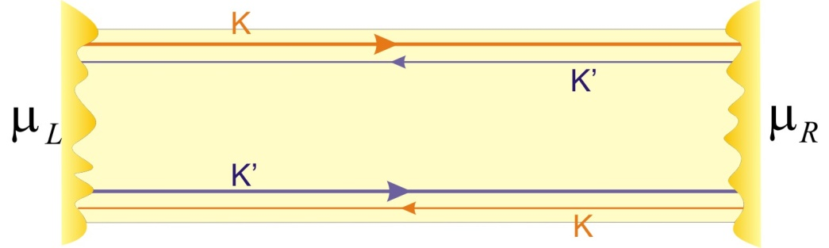
BLG: Marginal topolgical insulator
Quantum spin Hall effect
Quantum valley Hall effect
Bernevig, Hughes and Zhang
Castro et al
≠
time reversal symmetry
time reversal symmetry
HgTe/CdTe

Slide 10
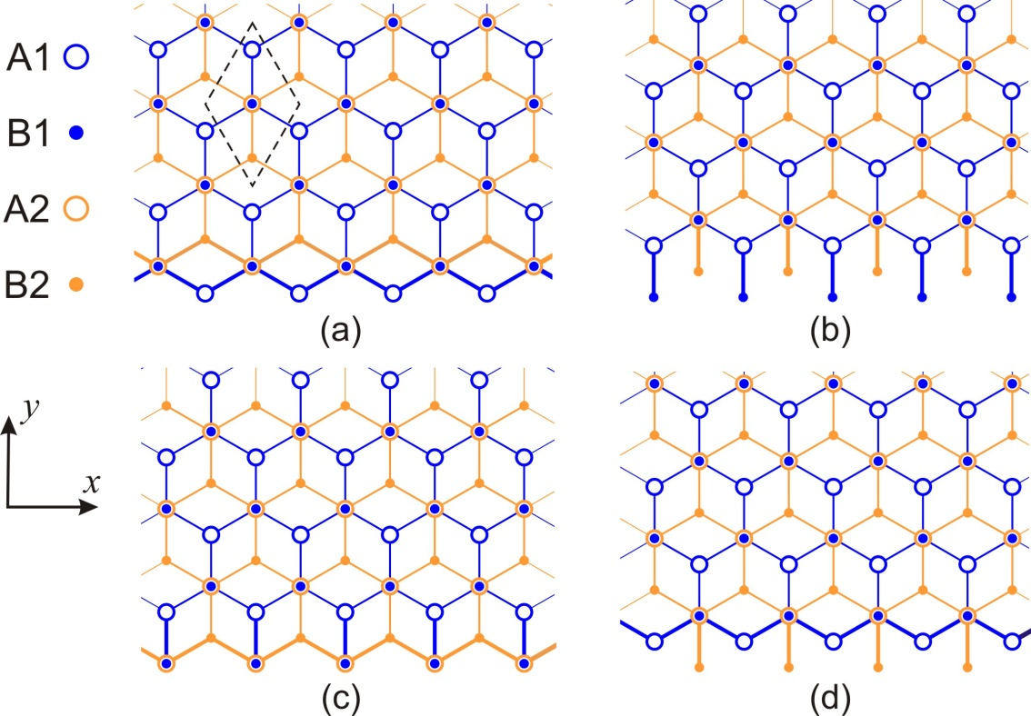
Edge states in BLG: Clean limit
Li, Morpurgo, Buttiker, and Martin, PRB 82, 245404 (2010)
a) and b) one, c) two , d) no edge mode
No subgap edge states!
Neither in armchair edges!

Slide 11
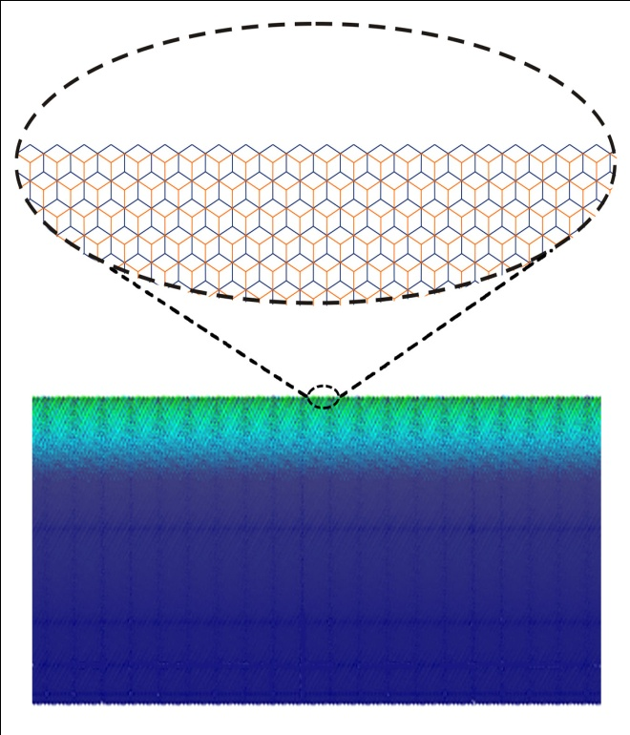
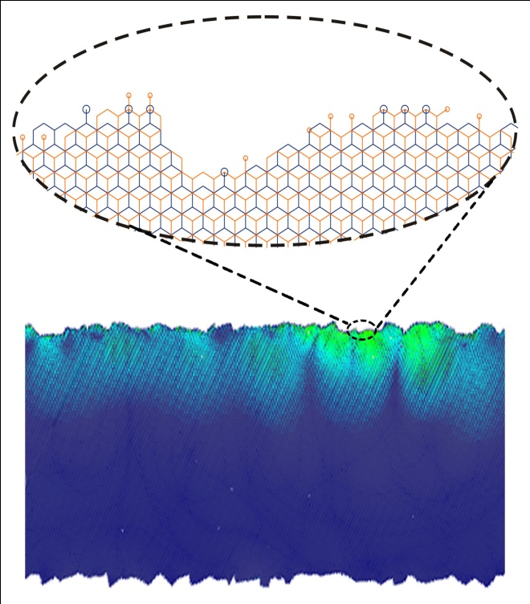
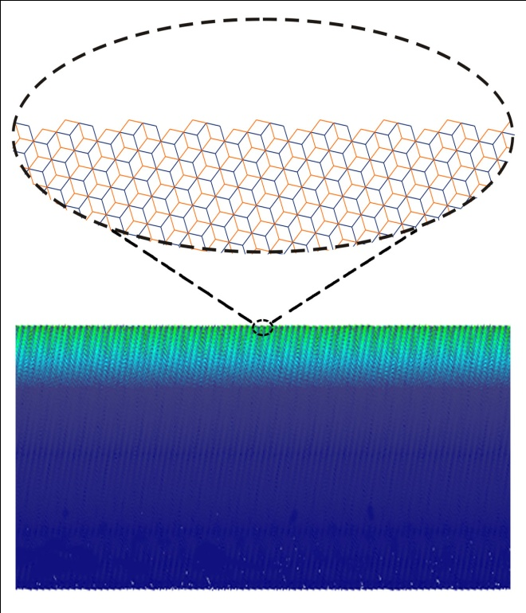
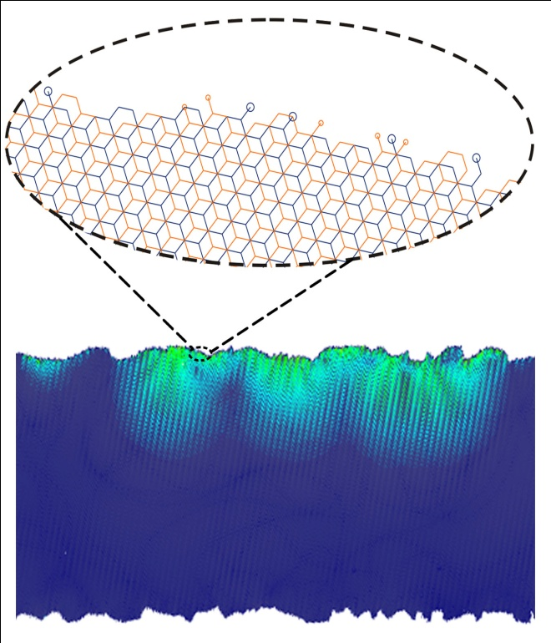
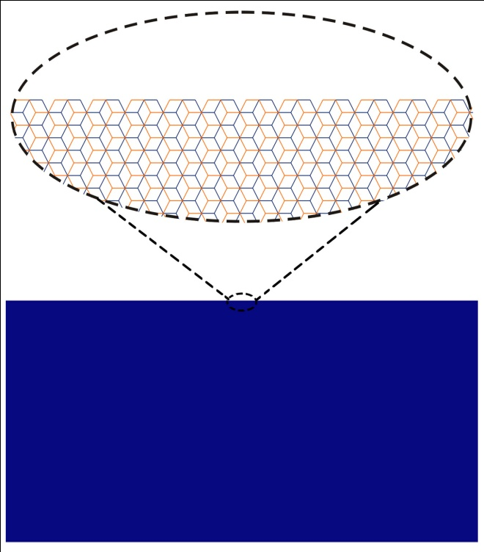
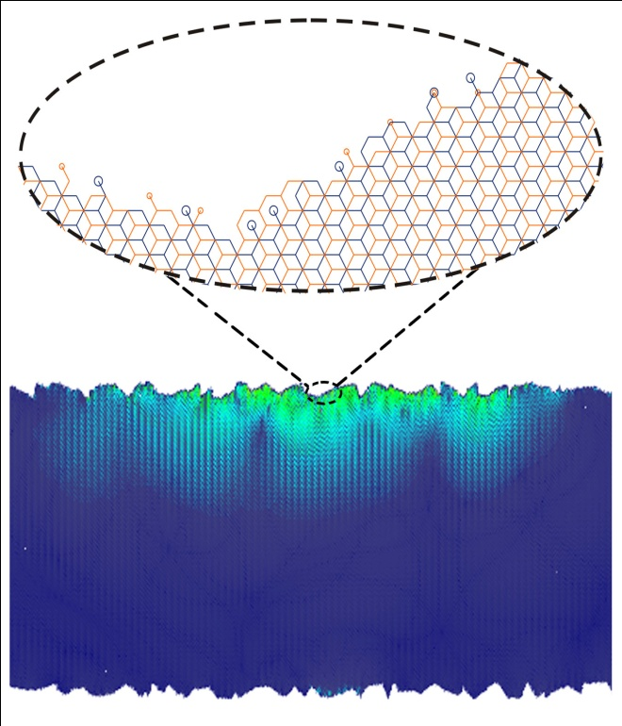
BLG: Rough edges
Jian Li, Ivar Martin, Markus Büttiker, Alberto Morpurgo, Nature Physics 7, 38 (2011).
zigzag
armchair

Slide 12
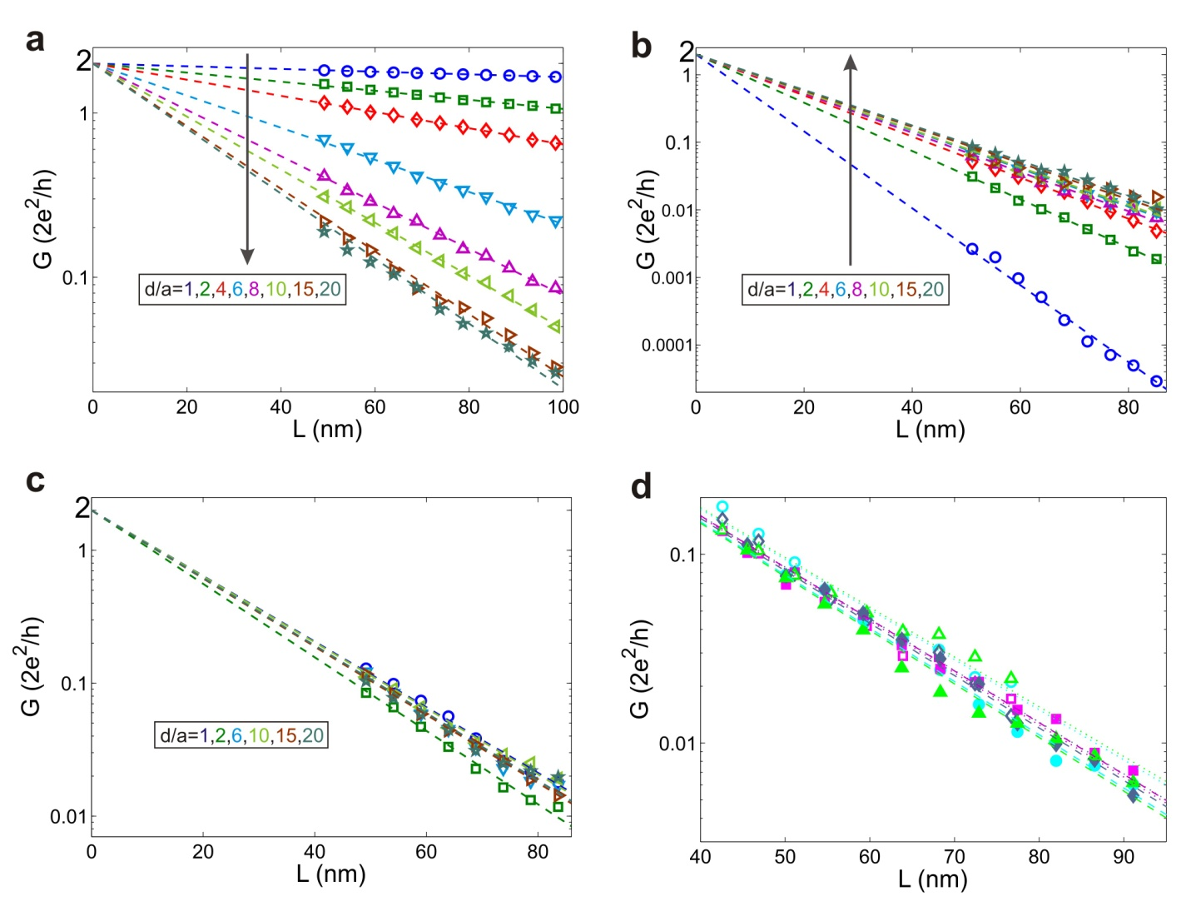
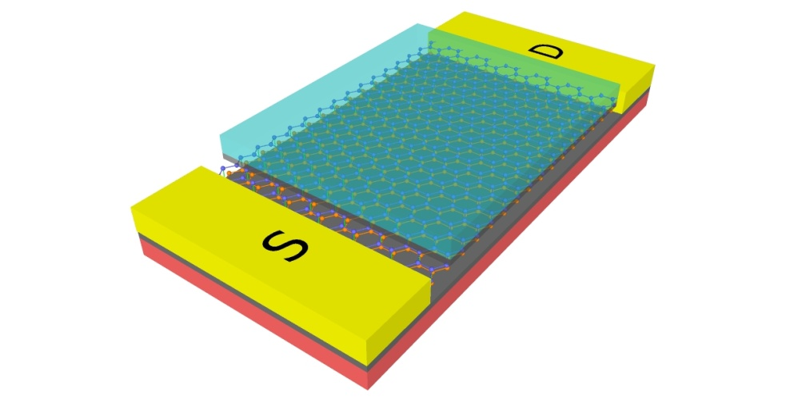

Conductance of disordered BLG stripes
Jian Li, Ivar Martin, Markus Büttiker, Alberto Morpurgo, Nature Physics 7, 38 (2011).
zigzag
armchair
L
d: roughness depth
zigzag
w/ “chemical” disorder

Slide 13
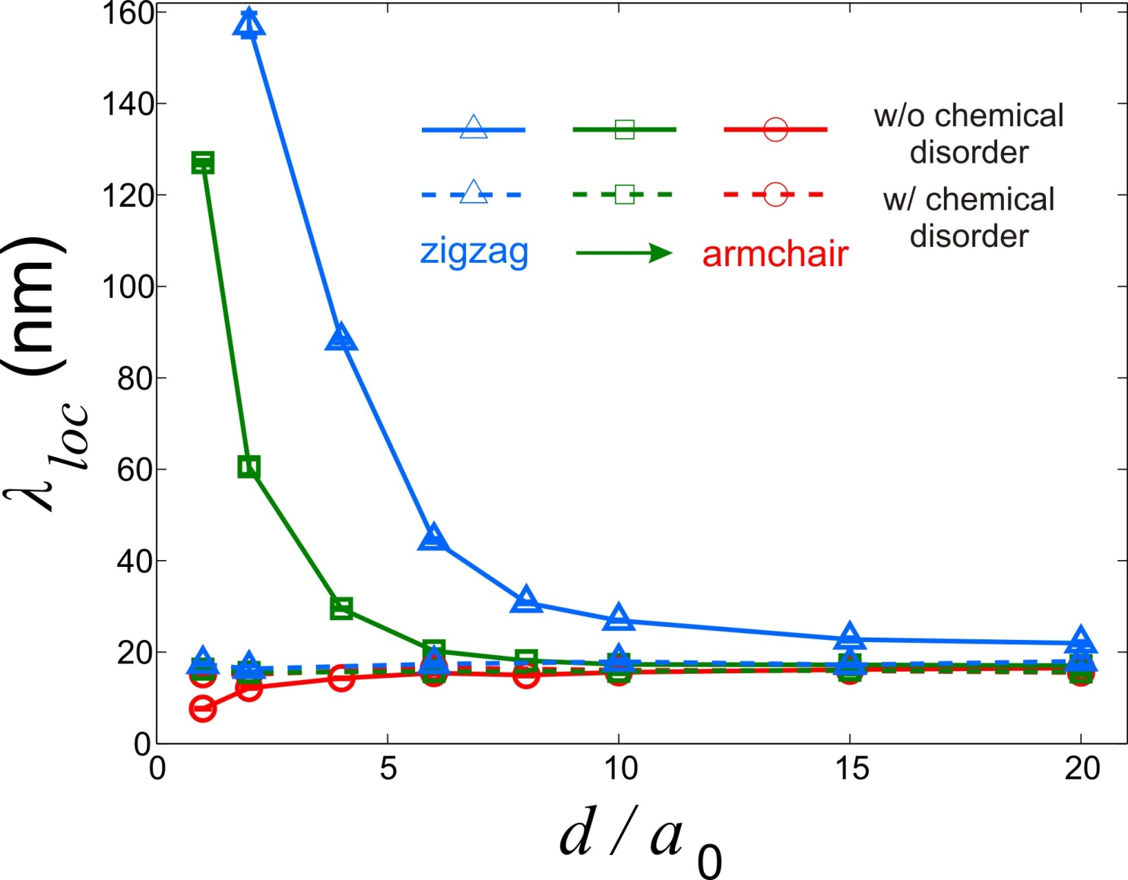
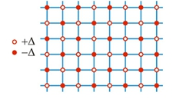
Universal localization length
Jian Li, Ivar Martin, Markus Büttiker, Alberto Morpurgo, Nature Physics 7, 38 (2011).
Compare w. trivial

Slide 14
Summary : Bilayer graphene
J. Li, I. Martin, M. Buttiker, A. Morpurgo, Phys. Scr. Physica Scripta T146, 014021 (2012)
Gapped bilayer graphene is a marginal topological insulator.
Edge states of bulk origin exist in realistic gapped bilayer graphene.
Strong disorder leads to universal localization length of the edge states.
Hopping conduction through the localized edge states may dominant low-energy transport.

Slide 15
Magnetic field induced edge state localization in toplogical insulators
Part II

Slide 16
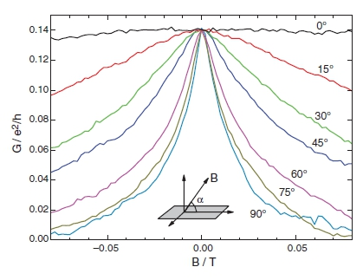
Magnetic field induced loclization in 2D topological insulators
Time reversal invariant Tis
2D (HgTe/CdTe Quantum Well)
  Kane & Mele (2005)
  Bernevig, Hughes, Zhang (2006)
  Molenkamp’s group (2007, 2009)
M. Buttiker, Science 325, 278 (2009).
M. König, Science 318, 766 (2007)
Magnetoconductance (four terminal)

Slide 17
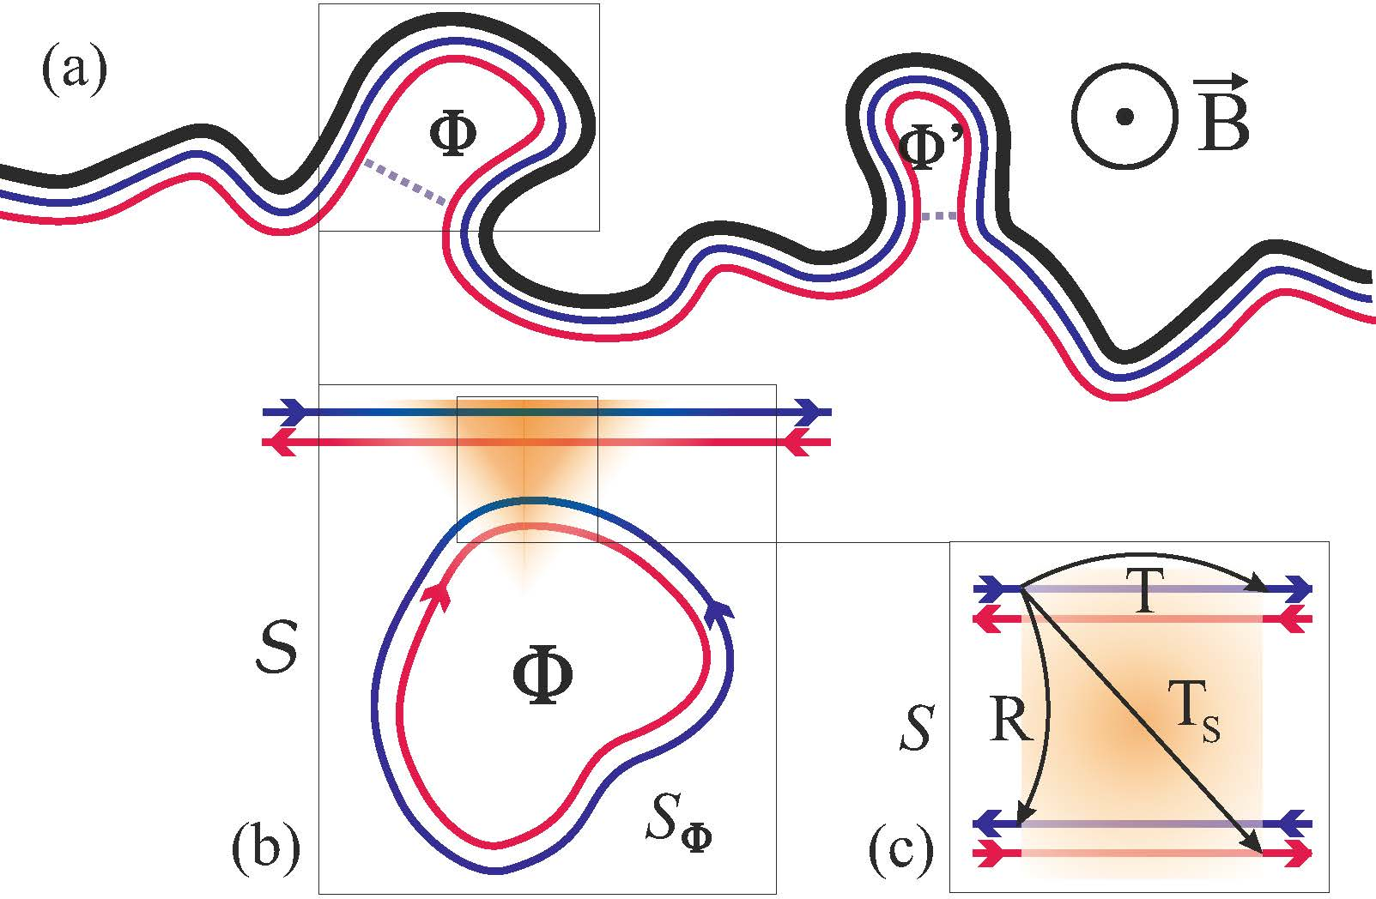
Magnetic field induced localization in 2D topological insulators
Pierre Delplace, Jian Li, Markus Buttiker, arXiv:1207.2400
Model of disorderd edge

Slide 18
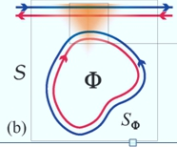
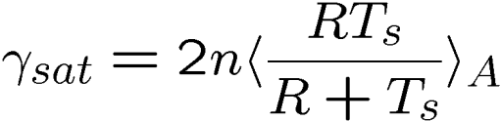
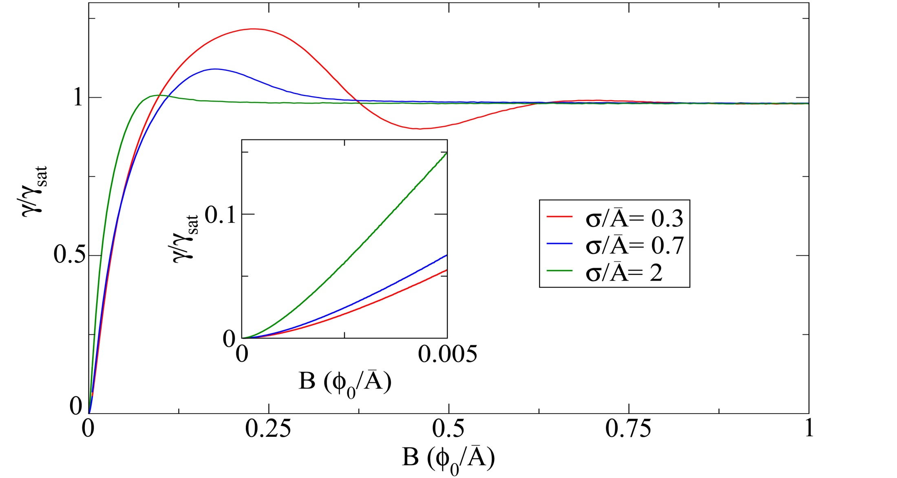
Inverse localization length
Pierre Delplace, Jian Li, Markus Buttiker, arXiv:1207.2400
Quadratic in B at small B
Independent of B at large B
Oscillating at intermeditae B for A normal distributed:

Slide 19
Summary: Magnetic field induced localization in 2D topological insulators
Pierre Delplace, Jian Li, Markus Buttiker, arXiv:1207.2400
Novel phases of matter (topological insulators) offer many
opportunities to investigate localization phenomena
Localization of helical edge states in a loop model due to random fluxes
Quadratic in B at small B
Independent of B at large B

