Slide 1


Single parameter scaling of 1d systems with long-range correlated disorder
Greg Petersen and Nancy Sandler

Slide 2
Why correlated disorder?
Long standing question: role of correlations in
Anderson localization.
Potentially accessible in meso and nanomaterials:
disorder is or can be ‘correlated’.

Slide 3
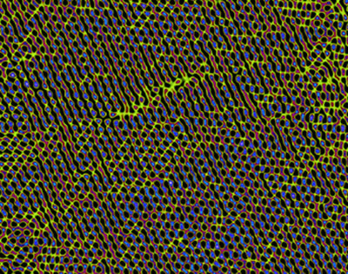
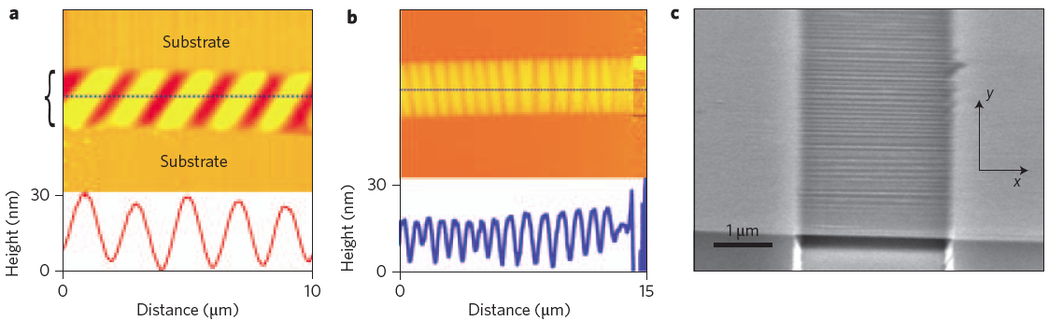
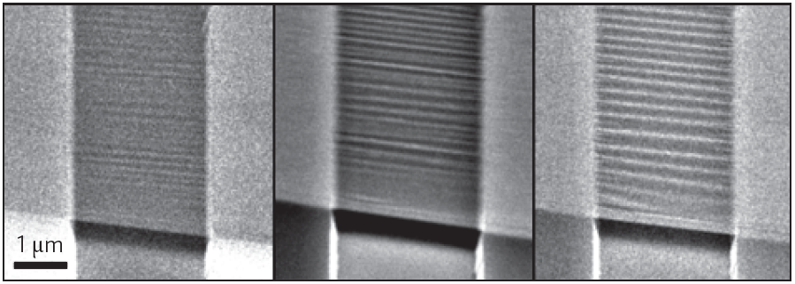
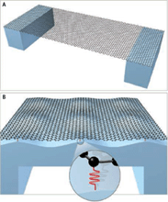
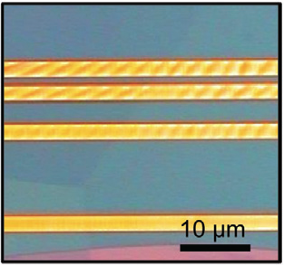
Graphene: RIPPLED AND STRAINED
http://www.materials.manchester.ac.uk/
E.E. Zumalt, Univ. of Texas at Austin
Bao et al. Nature Nanotech. 2009
Lau et al. Mat. Today 2012

Slide 4
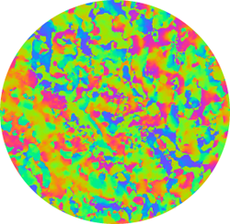
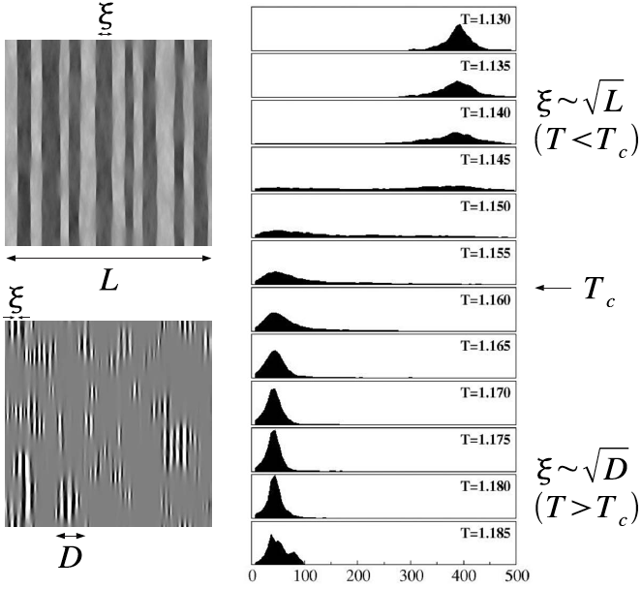
Multiferroics: magnetic tweed
Scaling exponent
Correlation length of disorder
N. Mathur Cambridge
http://www.msm.cam.ac.uk/dmg/Research/Index.html
Theory: Porta et al PRB 2007
Notes:
Magnetic alloys such as CoNiAl, tweed (modulation of the magnetic regions) is caused by fluctuations in the statistical composition or static disorder that can be very well modeled by stretched exponentials or power law type.

Slide 5
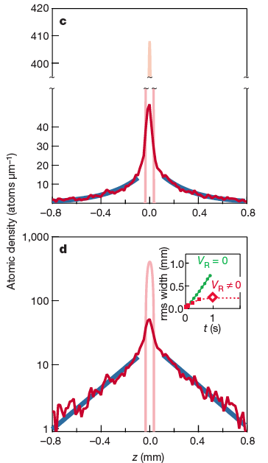
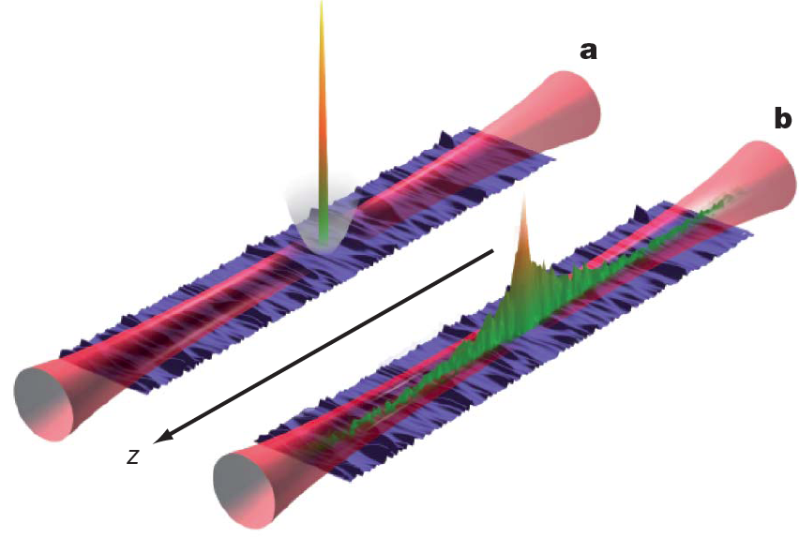
BEC in Optical lattices
Billy et al. Nature 2008
http://www.lcf.institutoptique.fr/Groupes-de-recherche/Optique-atomique/Experiences/Transport-Quantique
Theory: Sanchez-Palencia et al. PRL 2007.
Notes:
They confine the BEC laterally with optical waveguides and put a magnetic field perpendicular (parabolla). They induced a disorder potential in the waveguide by speckle laser fields and shut off the magnetic trap. They look at how the condensate evolve. Upper plot is in real units, lower is in semilog scale showing the stretched exponential indicating Anderson localization.

Slide 6
Disorder correlations
Discrete number of extended states
Quasi-periodic real space order
Random disorder amplitudes chosen from a
discrete set of values.
Specific long range correlations (spectral function)
This work: scale free power law correlated potential (more in Greg’s talk).
Some (not complete!) references:
Johnston and Kramer Z. Phys. B 1986
Dunlap, Wu and Phillips, PRL 1990
De Moura and Lyra, PRL 1998
Jitomirskaya, Ann. Math 1999
Izrailev and Krokhin, PRL 1999
Dominguez-Adame et al, PRL 2003
Shima et al PRB 2004
Kaya, EPJ B 2007
Avila and Damanik, Invent. Math 2008
Reviews:
Evers and Mirlin, Rev. Mod. Phys. 2008
Izrailev, Krokhin and Makarov, Phys. Reps. 2012
Mobility edge: Anderson transition

Slide 7
Outline
Scaling of conductance
Localization length
Participation Ratio
G. Petersen and NS submitted.

Slide 8
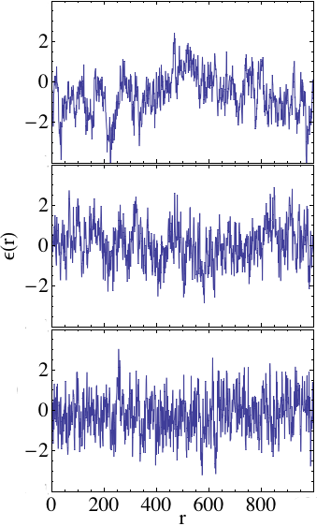
How does a power law long-range disorder look like?
Smoothening effect as correlations increase

Slide 9
Model and generation of potential
Tight binding Hamiltonian:
Correlation function:
Spectral function:
Fast Fourier Transform
(Discrete Fourier transform)

Slide 10
Conductance Scaling I: Method
Conductance from transmission function T:
Green’s function*:
Self-energy:
Hybridization:
*Recursive Green’s Function method

Slide 11
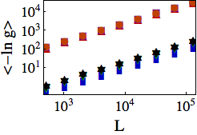
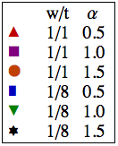
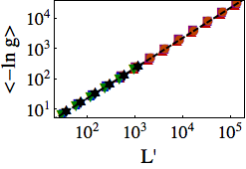
Conductance Scaling II: BETA FUNCTION?
NEGATIVE!
COLLAPSE!
IS THIS SINGLE PARAMETER SCALING?
Notes:
NOTES: first to mention that it is negative => all states are localized.
Then remark that this is valid for weak and strong disorder. Say that L’ is a function of \alpha and w/t.

Slide 12
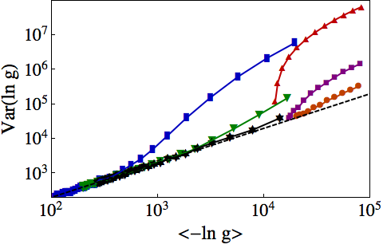
CONDUCTANCE Scaling III: Second moment
Single Parameter Scaling:
Shapiro, Phil. Mag. 1987
Heinrichs, J.Phys.Cond Mat. 2004 (short range)
E_{SPS}

Slide 13
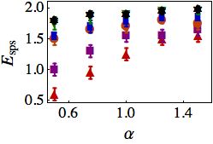
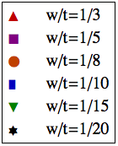
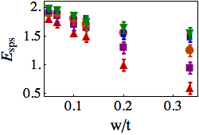
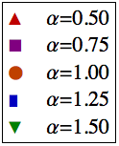
Conductance Scaling IV: E_{SPS}
WEAK DISORDER
CORRELATIONS

Slide 14
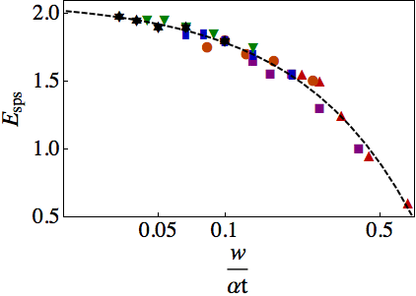
CONDUCTANCE Scaling V: Rescaling of disorder strength
Derrida and Gardner J. Phys. France 1984
Russ et al Phil. Mag. 1998
Russ, PRB 2002
Notes:
Very reminiscent of the expression found by Gardner and Derrida using perturbation expansion methods for weak disorder for states near the band edge of the pure system E=2

Slide 15
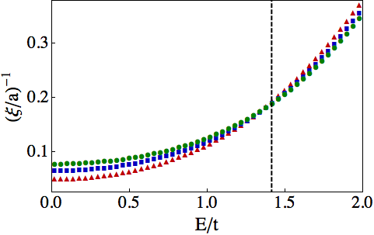
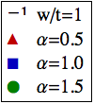
Localization length I
Lyapunov exponent obtained from Transfer Matrix:
E_{C}
w/t =1
Russ et al Physica A 1999
Croy et al EPL 2011
Notes:
For weak disorder it is expected that \xi ~ W^{-2}. Also mention the scaling results obtained in the weak disorder regime for states near the band edge and the center. Also mention paper by Croy here.

Slide 16
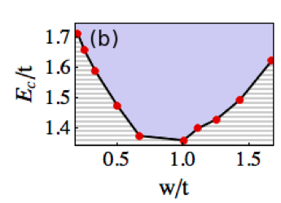
Localization length II: E_{C}
Enhanced localization
Enhanced localization length

Slide 17
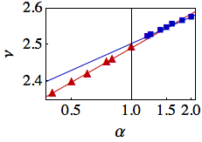
Localization length III: CRITICAL EXPONENT
w/t=1
Notes:
What disorder strength here???

Slide 18
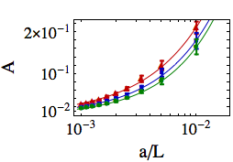
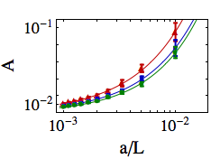

Participation Ratio I
E/t = 0.1
IS THERE ANY DIFFERENCE?
E/t = 1.7

Slide 19
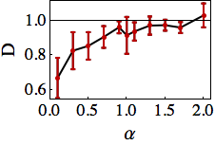
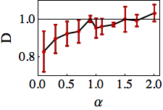
Participation Ratio II: Fractal exponent
E/t = 0.1
E/t = 1.7

Slide 20
How does disorder affect critical exponents?
Classical systems: Harris criterion (‘73):
“A 2d disordered system has a continuous phase
transition (2nd order) with the same critical exponents
as the pure system (no disorder) if ν ≥ 1”.
Consistency criterion: As the transition is approached, fluctuations should grow less than mean values.

Slide 21
Extended Harris criterion
Weinrib and Halperin (PRB 1983): True if disorder has short-range correlations only.
For a disorder potential with long-range correlations:
There are two regimes:
Long-range correlated disorder destabilizes the classical critical point! (=relevant perturbation => changes critical exponents)

Slide 22
Bringing all together: Conclusions
No Anderson transition !!!!!
Scaling is ‘valid’ within a region determined by disorder strength that is renormalized by
and D appear to follow the Extended Harris Criterion

Slide 23

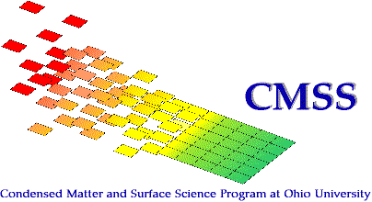

Support
NSF- PIRE
NSF- MWN - CIAM
Ohio University
Condensed Matter and Surface Science
Graduate Fellowship
Ohio University
Nanoscale and Quantum Phenomena
Institute

