Slide 1
Numerical analysis for the metal-insulator transition in doped semiconductors using density functional theory in the local density approximation
Yosuke Harashima, Keith Slevin
Department of Physics, Osaka University, Japan
Notes:
Good morning, everyone. My name is Yosuke Harashima and my collaborator is Prof. Slevin. First I’d like to thank organizers for letting me have such nice opportunity. Today I’ll talk about our research for metal-insulator transition in disordered interacting systems.

Slide 2
Metal-insulator transition in doped semiconductors
Disorder
Metal-insulator transition
Electron-electron interaction
ex. Critical exponent
Notes:
Our interest is the detailed mechanism, especially the critical behavior of the metal-insulator transition considering both the disorder and interactions between electrons. Suppose impurities are doped into a semiconductor. At zero temperature the conductivity is suddenly increased at some impurity concentration. This metal-insulator transition is observed in some semiconductors with some impurities, for example in silicon doped with phosphorus. In these systems the impurities are randomly distributed. They generate a random potential.

Slide 3
Impurity band for low concentration
Notes:
Suppose donor impurities are doped in a semiconductor. The impurity band appears between a conduction band and valence band. Assume the band is completely occupied and this system becomes an insulator. Here the positions of the impurities are random. In the disordered system the band could have a tail and the tail states are the Anderson localized states. When more impurities are doped,…

Slide 4
For high concentration
Notes:
The impurity band merges the upper band. Now, the system seems to become from an insulator to metal in terms of the band theory. However, note that the states at the band edge could be Anderson localized states. The system could be still an insulator. As impurity concentration is more increased the system can become a metal. Here the electrons interact with each other. By considering this situation we attempt to make clear the critical behavior of the metal-insulator transition affected by the Anderson localization and electron-electron interaction.

Slide 5
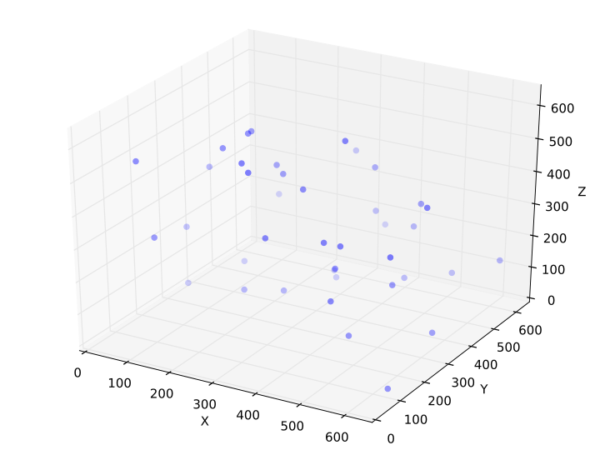
Model
Donor impurities distributed randomly in space
Long range Coulomb interaction for electron-electron pairs
Notes:
To study this metal-insulator transition we use a following model. We consider that donor impurities are randomly distributed in an effective medium. Since we have in mind phosphor in silicon, we assume that each donor supplies one electron. And the electrons interact with these impurities and with each other via long range Coulomb interaction. The Hamiltonian of this system is written as following.

Slide 6
Schrödinger equation for impurity band
= 0.32
= 12.0
Notes:
We use an effective mass and dielectric constant of a host medium. Hereafter I use the atomic units.
The capital R’s are random positions of impurities. The random spatial distribution of the donors produces a random potential. The third term describes the interaction between the electrons. Since we have in mind silicon as the host semiconductor, we set the dielectric constant and effective mass from experimental results. This Hamiltonian is difficult to solve due to the disordered potential term and electron-electron interaction term. To solve this disordered interacting problem we use density functional theory.

Slide 7
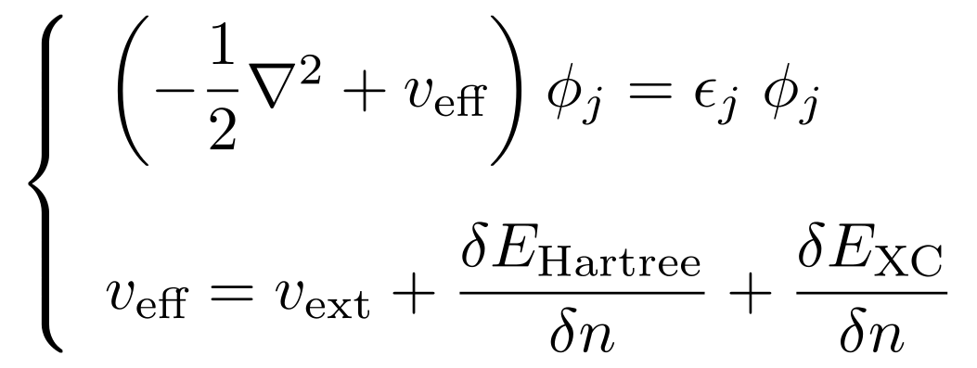
Kohn-Sham equations
Auxiliary system:
Notes:
Density functional theory gives Hohenberg-Kohn theorem that any physical quantities are a functional of a ground state density. Using the Hohenberg-Kohn theorem the problem can be replaced by solving Kohn-Sham equations which describes an non-interacting auxiliary system. The first equation is similar to single particle Schroedinger equation and the second is a definition of an effective potential appearing in the first equation. The second equation consists of an external potential term, Hartree energy term which is the classical Coulomb energy, and an exchange-correlation energy term which is remaining contribution of electron-electron interaction. The first equation has the effective potential and the second equation is calculated from electron density. So we solve these equations self-consistently.

Slide 8
Exchange-correlation energy
in an effective medium
Notes:
The functional form of exchange-correlation energy is originally given in free space. Here we need the functional form in an effective medium. The exchange-correlation energy in an effective medium relates with that in free space using rescaling with the effective mass and dielectric constant. If the functional form is known in free space one can derive that in an effective medium.

Slide 9
Local density approximation
Notes:
However, unfortunately the exact functional form of exchange-correlation energy is not known. In this study we use the local density approximation in which the exchange-correlation energy density is given by local density only. The exchange-correlation energy density in this approximation corresponds to that of a homogeneous system.

Slide 10
Calculation details
Real space finite difference approximation
In this study M=2 and h=18[Bohr]
Complete spin polarized case (for simplicity)
Notes:
To solve Kohn-Sham equation numerically we use second order real space finite difference approximation. This is discretization of Laplacian and we set grid spacing as 18Bohr. And in this study, for simplicity we restrict to the case that the electron spin is completely polarized instead of the non-magnetic case. This is because the non-magnetic states are unlikely in low impurity concentration.

Slide 11
Multi-fractal analysis for Kohn-Sham orbital
A. Rodriguez et al (2011)
Notes:
Once the electronic state is obtained, next, one has to estimate the localization. We use a multi-fractal exponent as a measure of localization. First, I define coarse grained intensities mu_k. The system is divided into small boxes and mu_k is calculated in a small box, for example, in this red region. From mu_k R_q and S_q are defined. Lambda is defined as a ratio between small l and capital L. It is helpful to consider asymptotic behavior of this alpha.

Slide 12
Asymptotic behavior
Extended states:
Localized states:
Notes:
For extended states, we assume the orbital is a plain wave. And mu_k becomes lambda to the dimension of the system. R_q and S_q become as this and alpha becomes the dimension of the system. As the orbital localizes, R_q becomes close to 1 and S_q becomes 0 for positive q and minus infinity for zero and negative q. Eventually the alpha goes to zero for positive q and to infinity for zero and negative q. We calculate the multi-fractal exponent for highest occupied Kohn-Sham orbital with some q values. I will show you impurity concentration dependence of this alpha and apply the finite size scaling for this quantity.

Slide 13
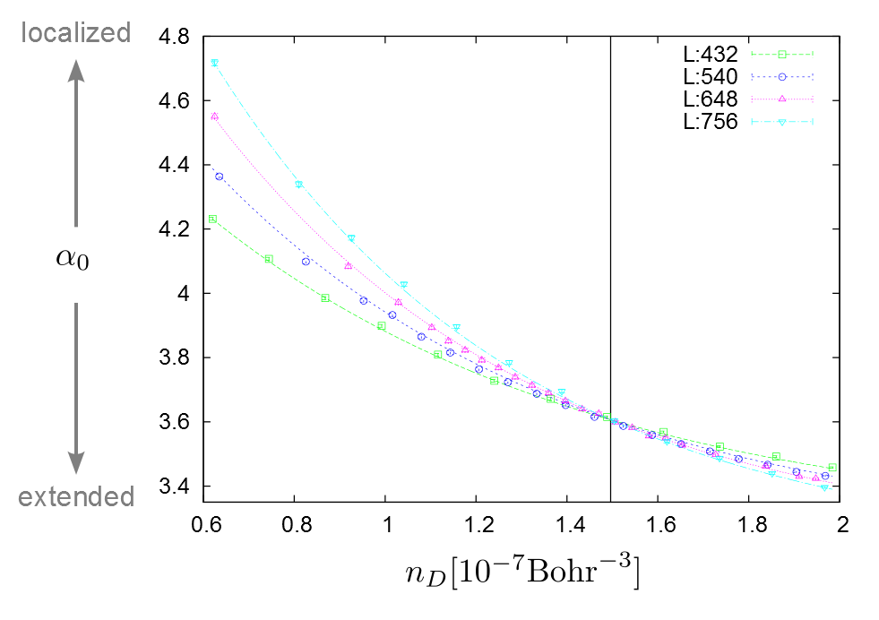
Metal-Insulator Transition around n_{D} ≈ 1.5 [10⁻⁷ Bohr⁻³]
Notes:
This figure shows the alpha-zero for some different system sizes. L is a system size. For lower concentration the alpha shifts to higher as system size increases. This is a typical behavior of the localized states. On the other hand the alpha shifts to lower and it means Kohn-Sham orbital is extended. The transition can be found around 1.5.

Slide 14
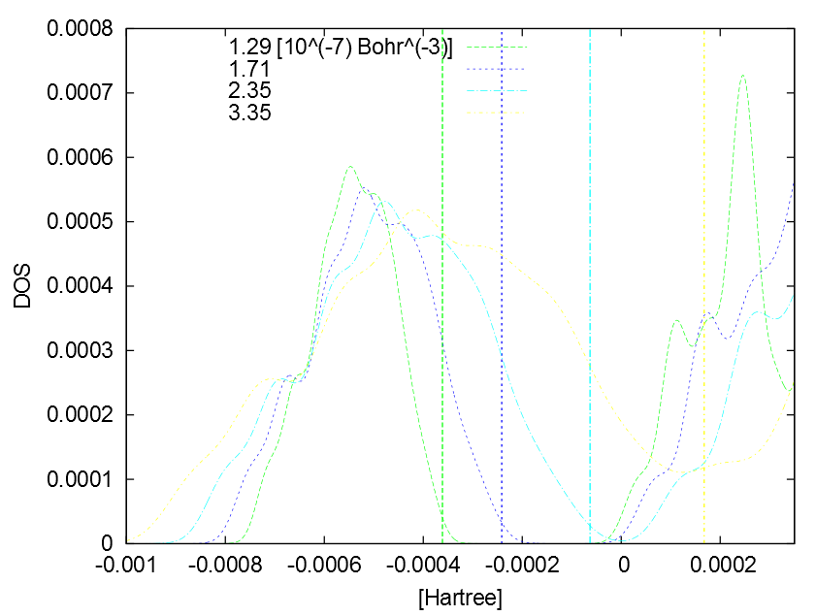
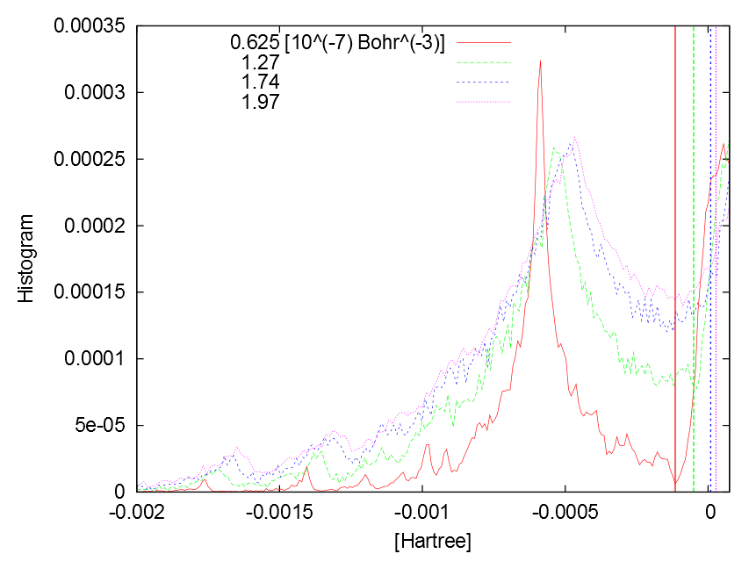
Density of states
Periodic system
Disordered system
Notes:
The left figure shows the density of states in periodic systems. This is calculated using kernel polynomial method. The each vertical line in the left figure indicates the highest occupied level. As concentration increases the band gap closes around 2.35. This value is higher than the transition concentration in a disordered system, 1.5. The right figure is the average density of states in disordered systems. This is a histogram of Kohn-Sham eigenvalues. The each vertical line indicates Fermi level. In the disordered systems the band gap does not exist even at lower concentration 0.6. The transition concentration in a disordered system is 1.5 and even if the band gap disappears the system can be still insulator. Disorder makes the band tail broader and also makes the tail states localize. Finally the disordered system changes from an insulator to metal before the periodic system does.

Slide 15
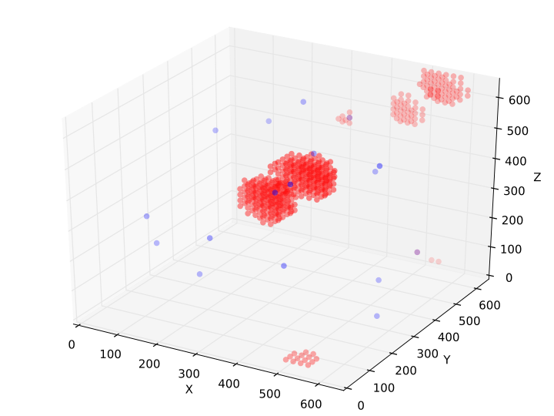
n_{D} ≈ 0.6 [10⁻⁷ Bohr⁻³]
Notes:
This is one sample for low impurity concentration, 0.6. The finite size scaling for multi-fractal exponents shows the insulating behavior at this concentration. The blue points are impurities and the red cloud is the density of highest occupied Kohn-Sham orbital. The orbital resembles a molecular orbital on clusters of a few impurities.

Slide 16
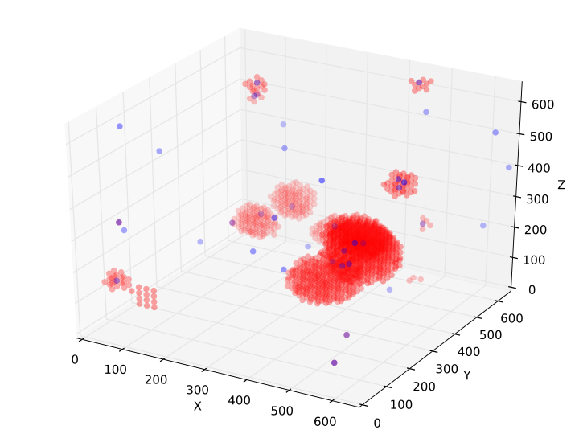
n_{D} ≈ 1.4 [10⁻⁷ Bohr⁻³]
Notes:
As the concentration is increased, the orbital spreads out over more impurities. Here the band gap has been already closed. But it remains localized.

Slide 17
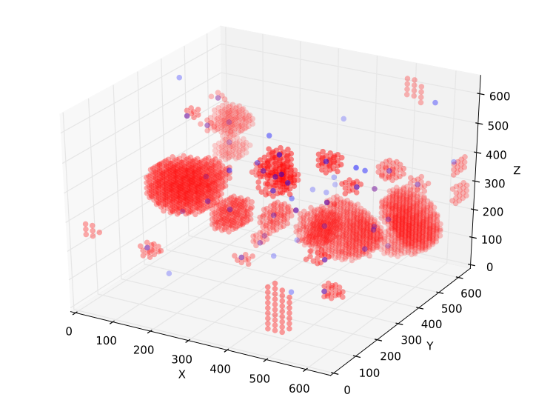
n_{D} ≈ 1.9 [10⁻⁷ Bohr⁻³]
Notes:
For higher concentration, the orbital is extended across the entire sample.

Slide 18
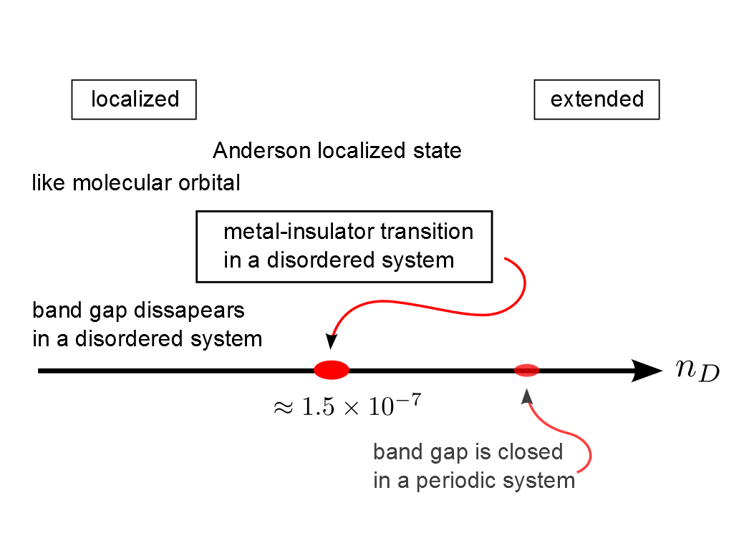
Notes:
The results can be summarized as this figure. In a disordered system we can’t find the band gap in our calculation. And as the impurity concentration is increased the metal-insulator transition is observed at about 1.5. I don’t show the critical exponents of this metal-insulator transition today. The analysis for finite size scaling is now in progress. I’d like to summarize my talk.

Slide 19
Summary
The model taking into account,
Random positions of impurities.
Electron-electron interaction using DFT in LDA.
The existence of the Metal-Insulator transition around n_{D} ≈ 1.5 [10⁻⁷ Bohr⁻³] is shown in this model.
We are calculating the critical exponents.
As extension,
Spin of electrons using local spin density approximation.
Compensation of impurities.
Notes:
We simulated the electronic states in a disordered interacting system. The model exhibits the metal-insulator transition using finite size scaling of multi-fractal analysis. We are now calculating the critical exponents of this metal-insulator transition. As extension, we will relax the restriction for electronic spin using the local spin density approximation. And we also would like to consider a compensated system. Thank you for your attention.

