Slide 1

Localization Properties of 2D Random-Mass Dirac Fermions
M. E. Raikh
Department of Physics
University of Utah
In collaboration with
V. V. Mkhitaryan
Phys. Rev. Lett. 106, 256803 (2011).
Supported by: BSF Grant No. 2006201

Slide 2
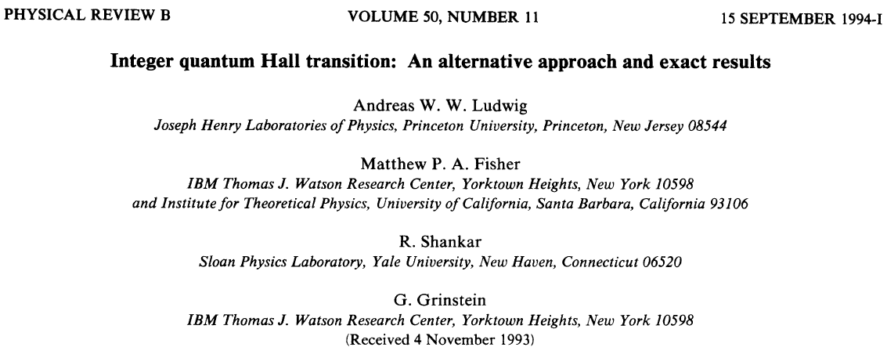
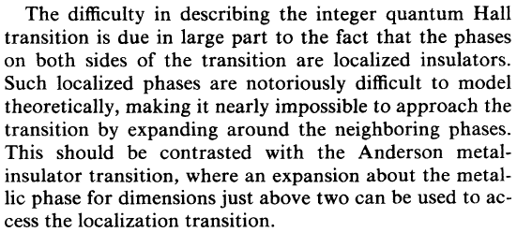
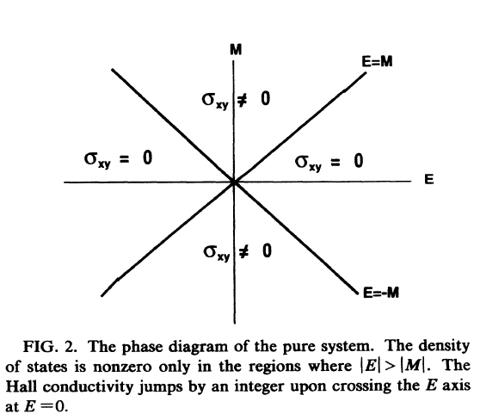
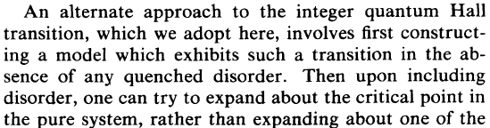
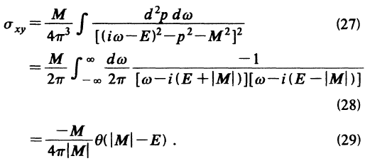

time reversal symmetry is sustained due to two species
of Dirac fermions
clean Dirac fermions of a
given type are chiral
they exhibit quantum
Hall transition upon
for energies inside the gap
from Kubo formula:
for zero energy,

Slide 3
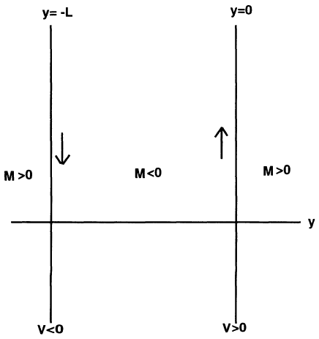
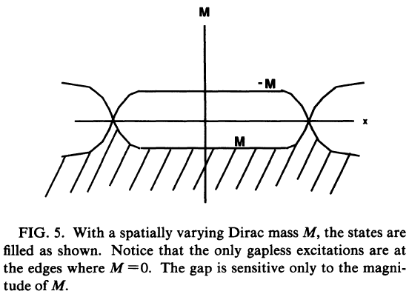

Contact of two Dirac systems with opposite signs of mass
in-gap (zero energy)
chiral edge states
line f=0 supports an edge state
states with the same chirality
bound to y=0, y=-L
pseudospin structure:
pseudospin is directed
along x-axis
D-class: no phase accumulated in course of propagation along the edge
sign of defines the direction of propagation (chirality)

Slide 4

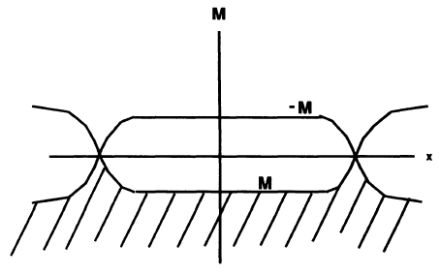
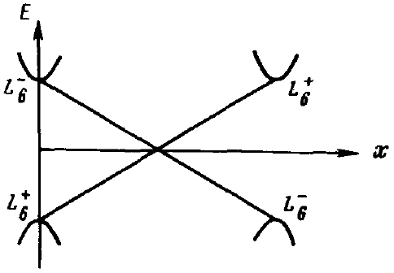
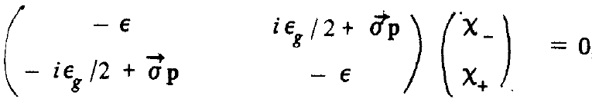
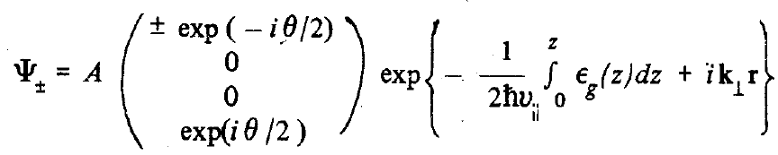
Hamiltonian contains both Dirac species

Slide 5
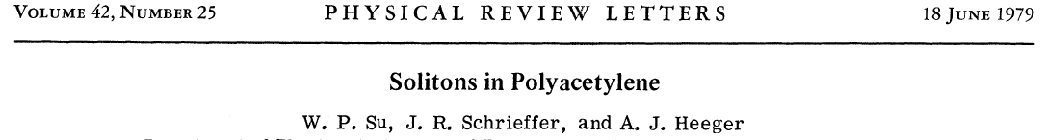
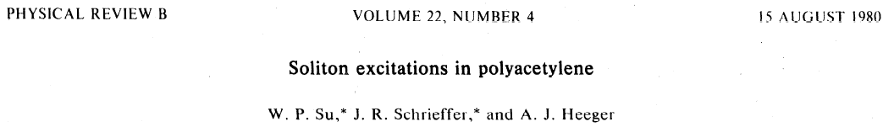
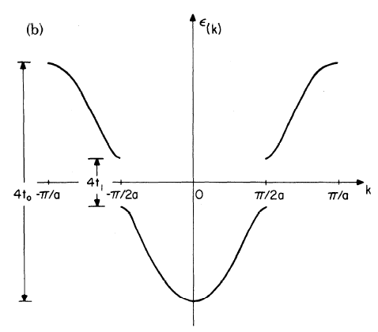
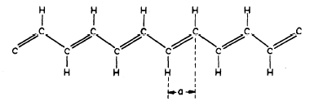

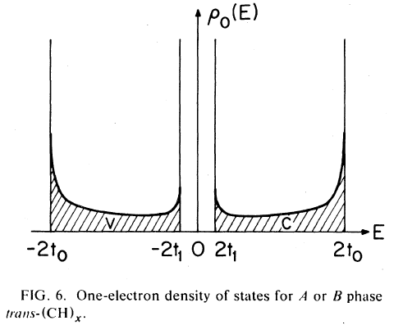
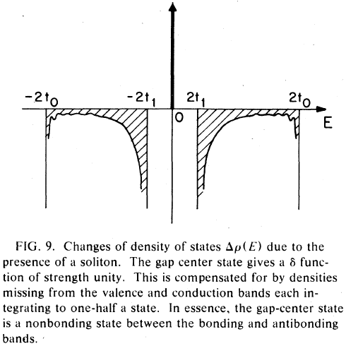
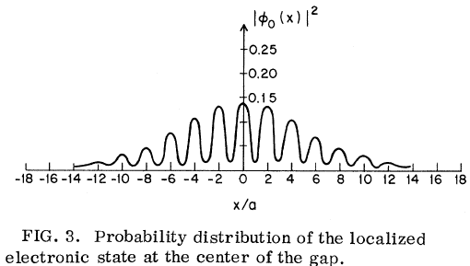
“vacuum” A
A and B correspond to different
pseudospin directions
in-gap state

Slide 6
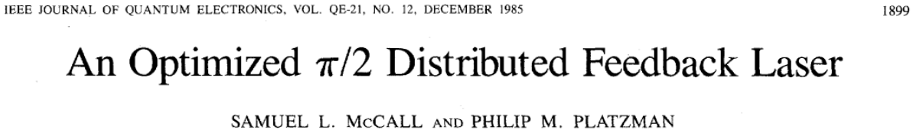
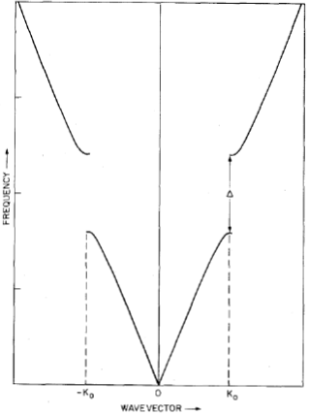
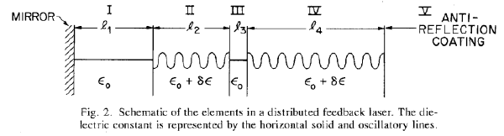
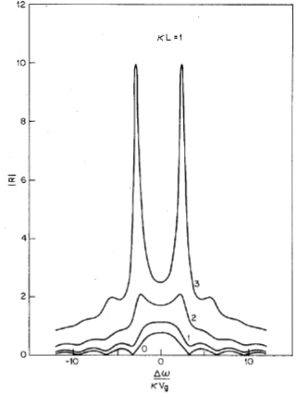

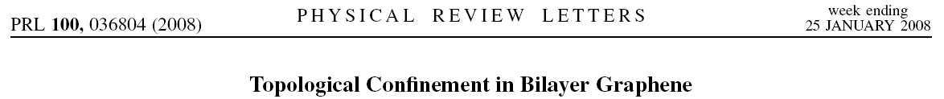
left: Bloch functions
right: Bloch functions

Slide 7
Closed contour
Example: azimuthal symmety:
Dirac Hamiltonian in polar coordinates
zero-mass contour with radius a
zero-energy solution
pseudospin
picks up a phase along a
contour arround the origin
divergence at
is multiplied by a small factor

Slide 8
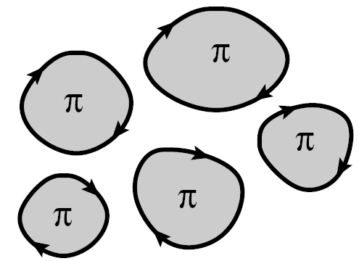
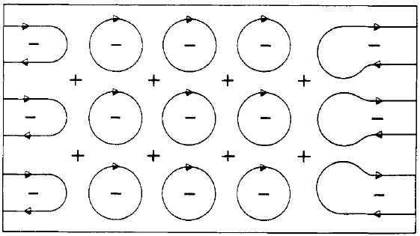
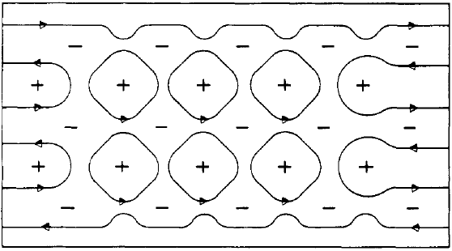
Chiral states of a Dirac fermion on the contours M(x,y)=0 constitute chiral network
scalar amplitudes on the links
2D electron in a strong magnetic field:
chiral drift trajectories along equipotential V(x,y)=0 also constitute a chiral network
Chalker-Coddington network model
J. Phys. C. 21, 2665 (1988)
no edge state
fluxes through the contours
account for the vector structure
of Dirac-fermion wave functions
can Dirac fermions delocalize at ?
J. H. Bardarson, M. V. Medvedyeva, J. Tworzydlo,
A. R. Akhmerov, and C. W. J. Beenakker,
Phys. Rev. B. 81, 121414(R) (2010).
edge state
K. Ziegler, Phys. Rev. Lett. 102, 126802 (2009);
Phys. Rev. B. 79, 195424 (2009).
in CC model delocalization occurs
at a single point where
the same as classical percolation
in random potential

Slide 9
The answer: It depends ...
on details of coupling between two contours
general form of the scattering matrix:
small contour does
not support an edge state
flux through small
contour is zero
the effect of small contours: change of singns of and
without significantly affecting their absolute values
results in overall phase factor
elimination of two fluxes
change of sign is equivalent to elimination of fluxes through contacting loops
unlike the CC model which has random
phases on the links, sign randomness
in and is crucial for D-class
in the language of scattering matrix:
N. Read and D. Green, Phys. Rev. B. 61, 10267 (2000).
N. Read and A. W. W. Ludwig, Phys. Rev. B. 63, 024404 (2000).
one small contour:
M. Bocquet, D. Serban, and M. R. Zirnbauer, Nucl. Phys. B. 578,
628 (2000).

Slide 10
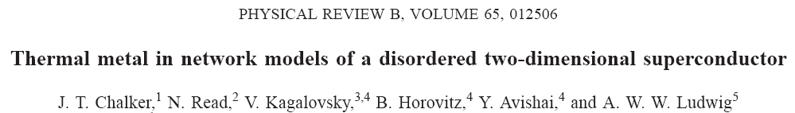
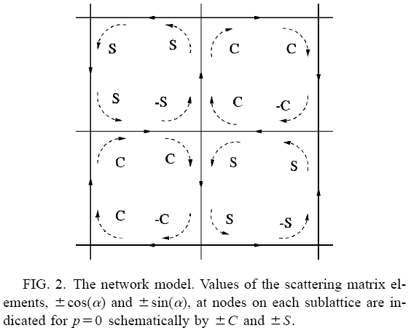
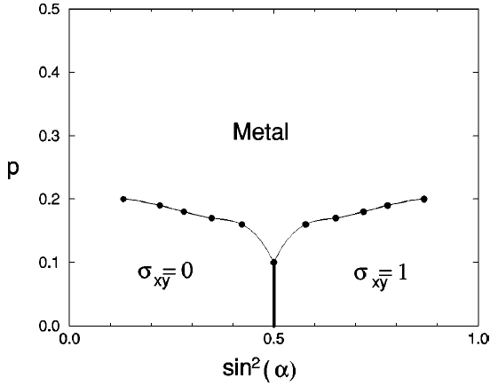
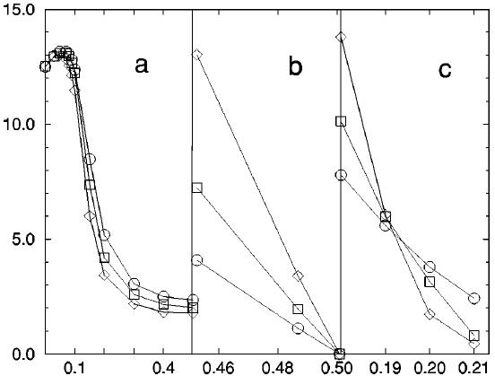
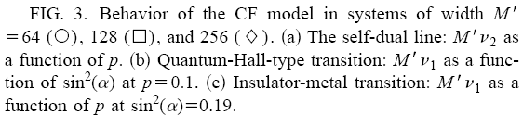
(2001)
arrangement insures a
-flux through each
plaquette
- percentage of “reversed”
scattering matrices

Slide 11
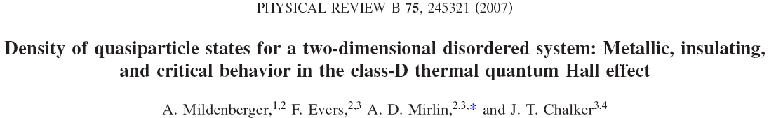
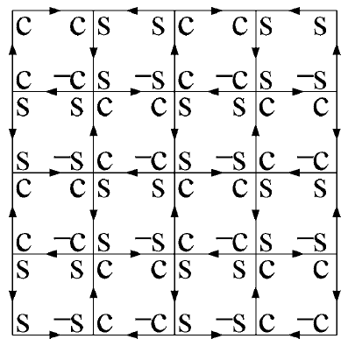
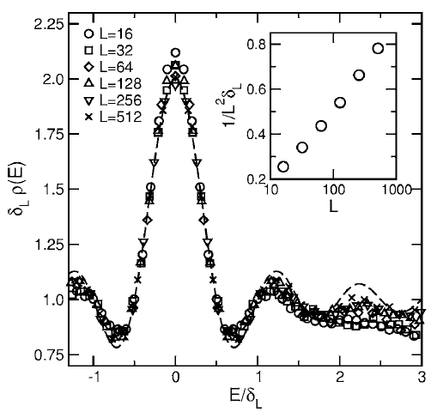
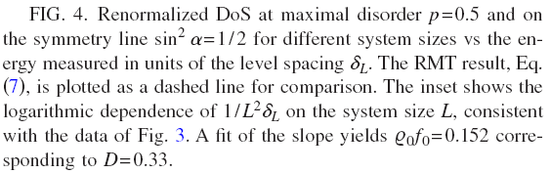
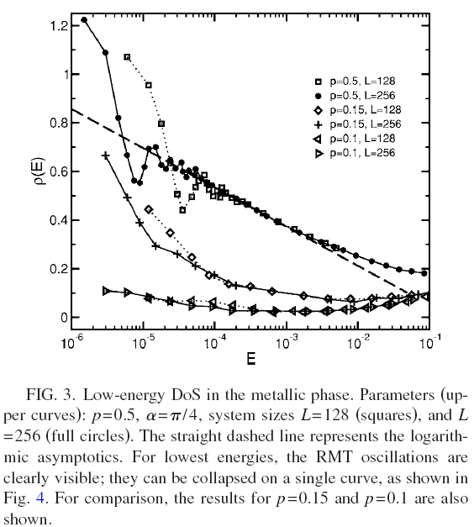


From the point of view of level statistics
RMT density of states in a sample with size , L

Slide 12
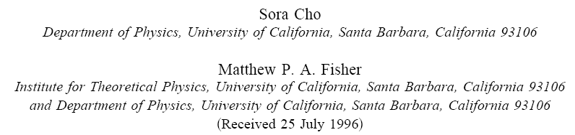
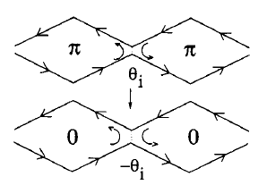
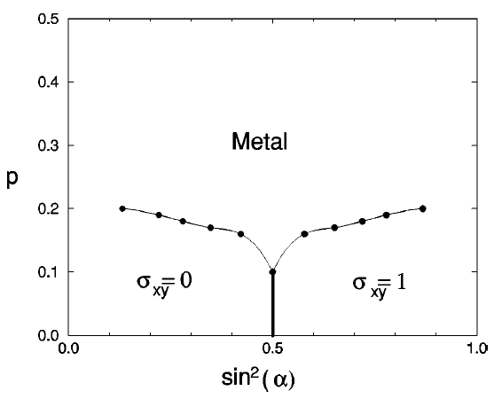
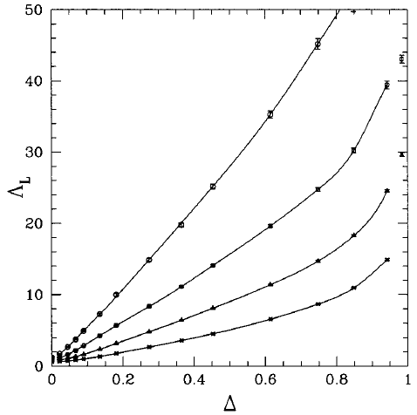
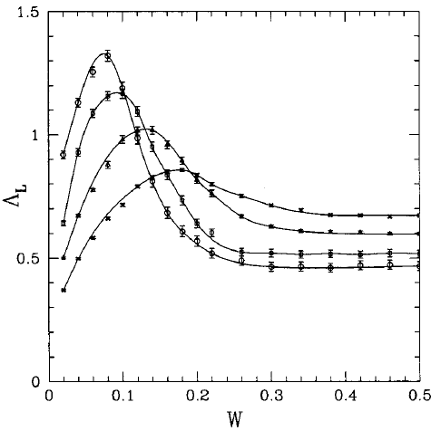


Historically

Slide 13
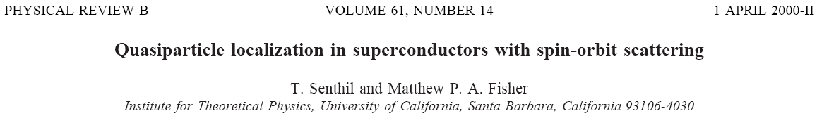
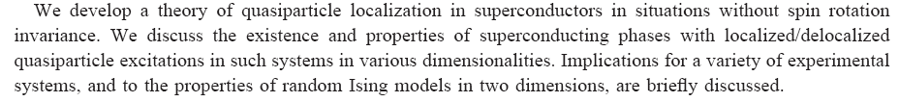
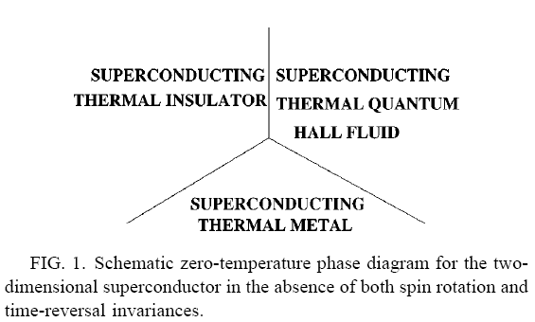
bare Hamiltonian with SO
pairing
tricritical point

Slide 14
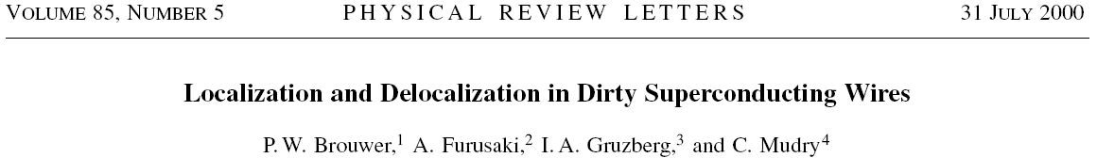
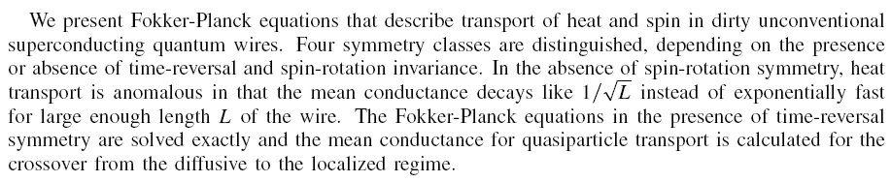


From quasi-1D perspective

Slide 15
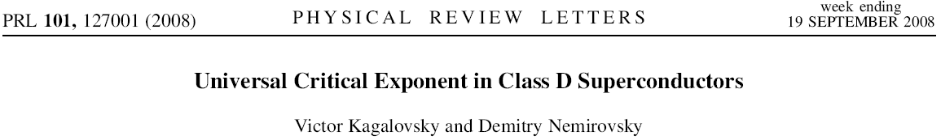
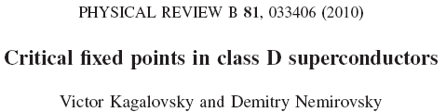
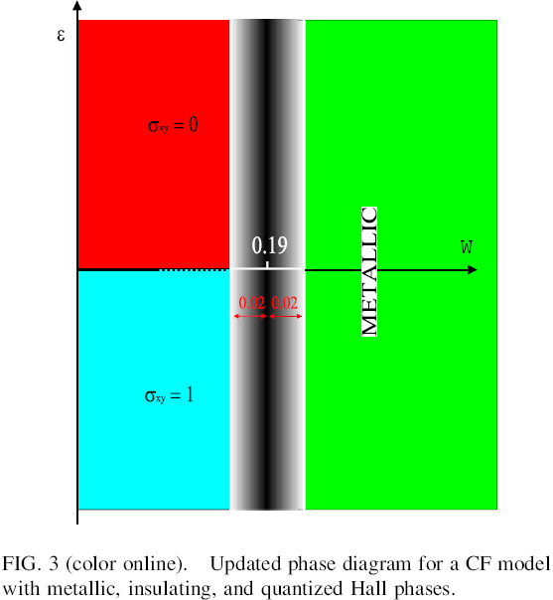
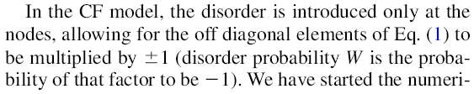



Lately
from
from
Transfer matrix of a slice of width, M, up to M=256
new attractive fixed point

Slide 16





is randomly distributed in the interval
weak antilocalization
random sign of mass:
transition at

Slide 17
Principal question:
how is it possible that delocalization takes place when
coupling between neighboring contours is weak?
classically must be localized
has a classical analog
microscopic mechanism of delocalization due to the disorder in signs of transmission coefficient?

Slide 18

Nodes in the D-class network
transmission
1. change of sign of
transforms -fluxes in
plaquetts and
into -fluxes
reflection
2. change of sign of
transforms -fluxes in
plaquetts and
into -fluxes
signs of the S- matrix elements ensure fluxes
through plaquetts
Cho-Fisher disorder in the signs of masses
A. Mildenberger, F. Evers, A. D. Mirlin,
and J. T. Chalker,
Phys. Rev. B 75, 245321 (2007).
O(1) disorder: sign factor -1
on each link with probability w

Slide 19


the limit of strong
inhomogeneity:
with probability ;
with probability (1-P)
bond between and connects
bond between and is removed
RG transformation for bond percolation on the square lattice
bonds
RG equation
superbond
one bond is removed
three bonds are removed
probability that
probability that a
fixed point
a bond connects
superbond connects
scaling factor
localization
radius

Slide 20



Quantum generalization

Slide 21



Quantum generalization
supernode for the
red sublattice
truncation
second RG step
green sublattice
red sublattice

Slide 22
S- matrix of the red supernode
reproduces the structure of S for
the red node
-1 emerges in course of truncationand
accounts for the missing green node
from five pairs of linear equations we find
the RG transformations for the amplitudes
S- matrix of supernode consisting of four green
and one red nodes reproduces the structure
of the green node

Slide 23

Evolution with sample size, L
five pairs
generate a pair
introducing a vector of a unit length
with “projections”
RG transformation
Zero disorder
fixed point
distribution remains symmetric
and narrows
fixed-point distribution :
expanding

Slide 24

the rate of narrowing:
no mesoscopic fluctuations at
Critical exponent
If is centered around ,
where
the center of moves to the left as
from
&
critical exponent:
exceeds exact by 15 percent
no sign disorder & nonzero average mass
insulator

Slide 25
Finite sign disorder
if all are small and , we expect
special realization of sign disorder:
choosing and ,
we get
identically
resonant tunneling!

Slide 26



Disorder is quantified as
portion of resonances is 27%
1. resonances survive a spread
in the initial distributon of
2. portion of resonances weakly depends
on the initial distribution
portion of resonances is 26%
portion of resonances is 24%
origin of delocalization: disorder prevents the flow towards insulator

Slide 27


Evolution with the sample size
no difference after
the first step
distribution of
reflection amplitudes
difference between two
distributions is small
with removed
more resonances for
stronger disorder
universal distribution
of conductance,
resonances are suppressed,
system flows to insulator
resonances drive the system
to metallic phase

Slide 28

Delocalization in terms of unit vector
metallic phase corresponds to
no disorder: initial distribution
with flows to insulator
is almost homogeneously
distributed over unit circle
resonances at intermediate sizes
spread homogeneously
over the circle
upon increasing L
with disorder

Slide 29










Delocalization as a sign percolation
at small L, the difference between and is minimal for ,
but is significant in distribution of amplitudes
ratio of peaks is

Slide 30



evolution of the portion, , of negative values of reflection coefficient with the sample size
Phase diagram

Slide 31


Critical exponent of I-M transition
as signs are “erased” with L, we have
fully localize after steps
fully localize after steps
: not a critical region

Slide 32




Tricritical point
all are small, and are close to 1
“analytical” derivation of
resonance: only one of these brackets is small
probability that only one of the above brackets is small:

Slide 33


Conclusions
RG
numerics
metallic phase emerges even for vanishing transmission of the nodes due to resonances
delocalization occurs by proliferation of resonances to larger scales

Slide 34







Bilayer graphene:
gap of varying sign is generated spontaneously
chiral propagation within a
given valley
in-gap state
symmetry between
the valleys is lifted
at the edge
Topological origin of subgap conductance in insulating bilayer graphene
J. Li, I. Martin, M. Buttiker, A. F. Morpurgo, Nature Physics 7, 38 (2011)

Slide 35







Quantum RG transformation
super-saddle point

Slide 36



Determination of the critical exponent
insulator

