Slide 1
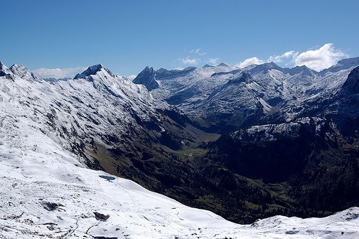
Searches for Higgs Boson at CMS

Slide 2

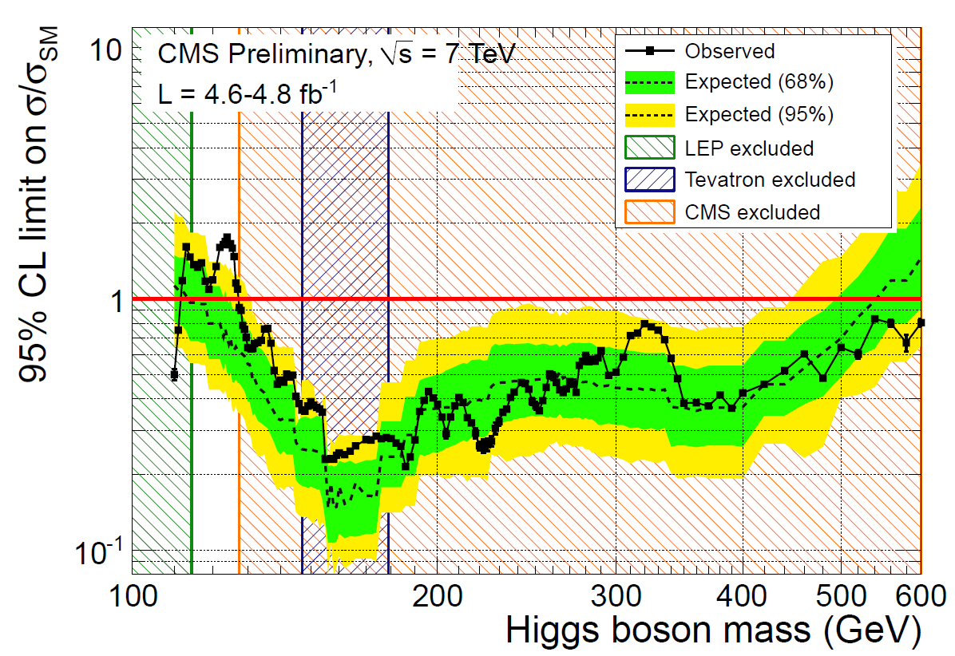
Standard Model Higgs Boson
SM Higgs boson in mass range 127.5-600 GeV excluded @95% CL
◊ Excess of events at low mass makes the limit weaker then expected

Slide 3
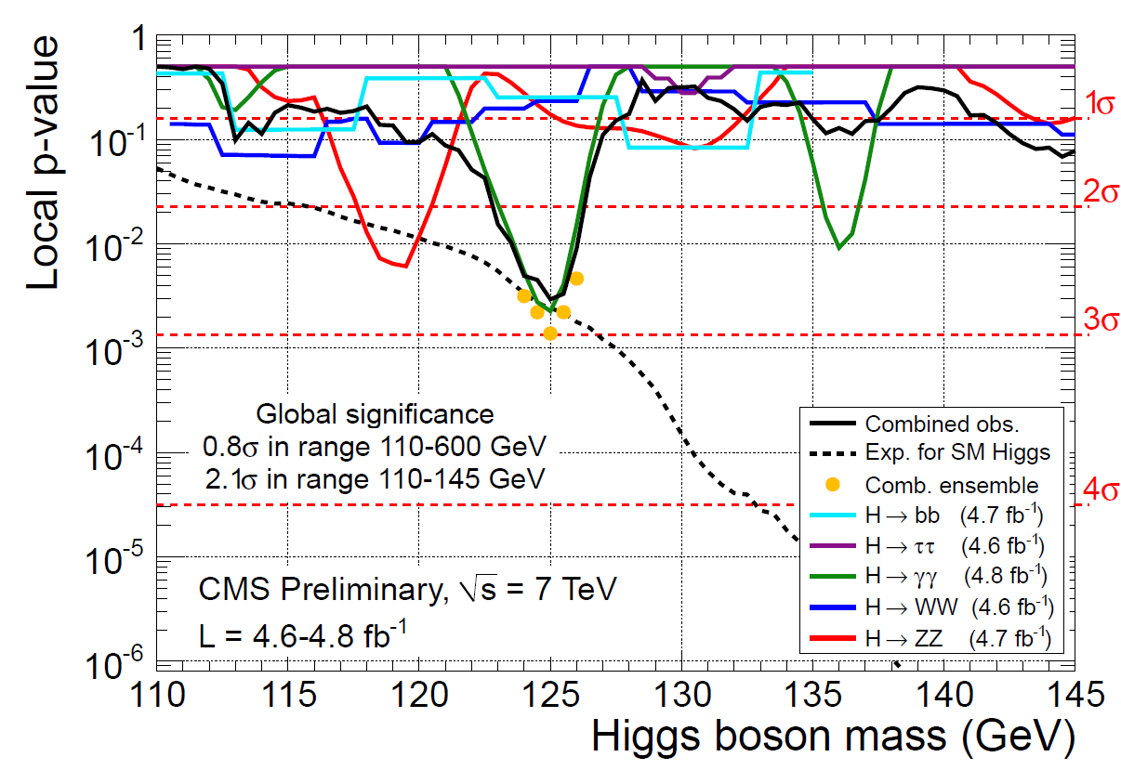
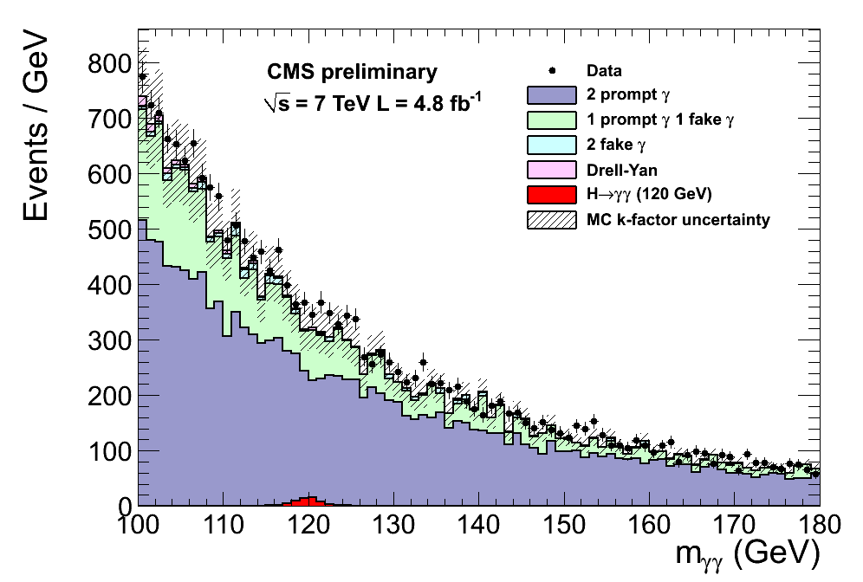
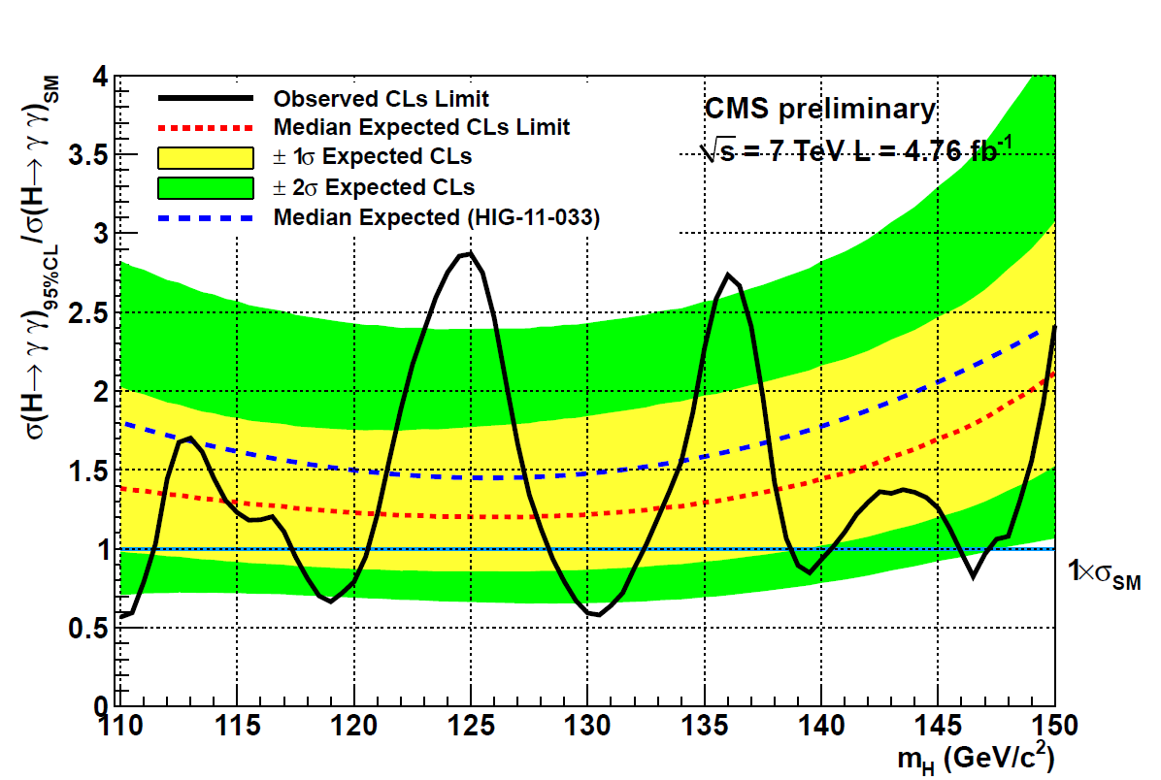
Focus on Low Mass: H → γγ
Minimum p-value for M_{H} = 125 GeV: ◊ Local significance: 2.8σ
◊ Estimated global significance:
- 0.8σ in [110-600] GeV
- 2.1σ in [110-145] GeV

Slide 4
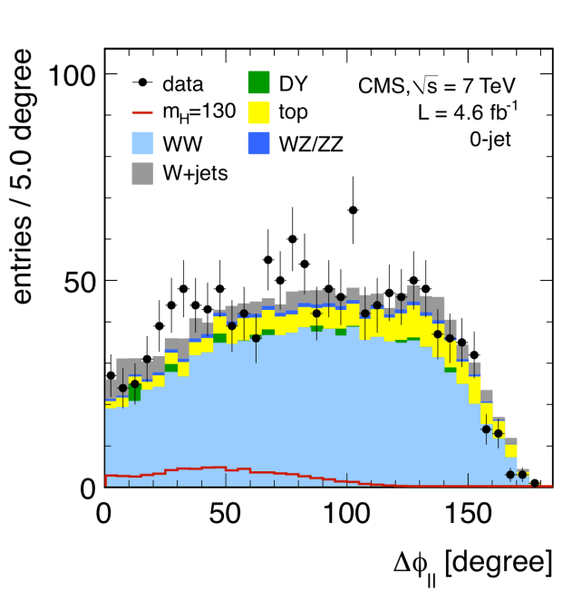
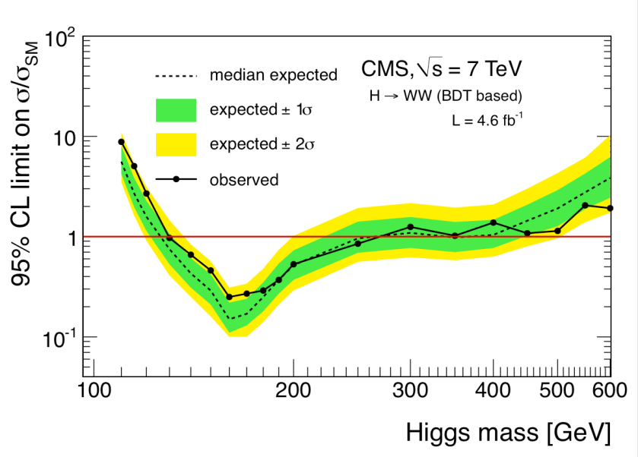
Focus on Low Mass: H → WW
Decay channel H → WW → lνlν:
◊ 0, 1 and 2 jets bins
◊ cut based and BDT analyses
Excluded mass range for SM Higgs:
◊ Expected: 127-270 GeV
◊ Observed: 129-270 GeV

Slide 5
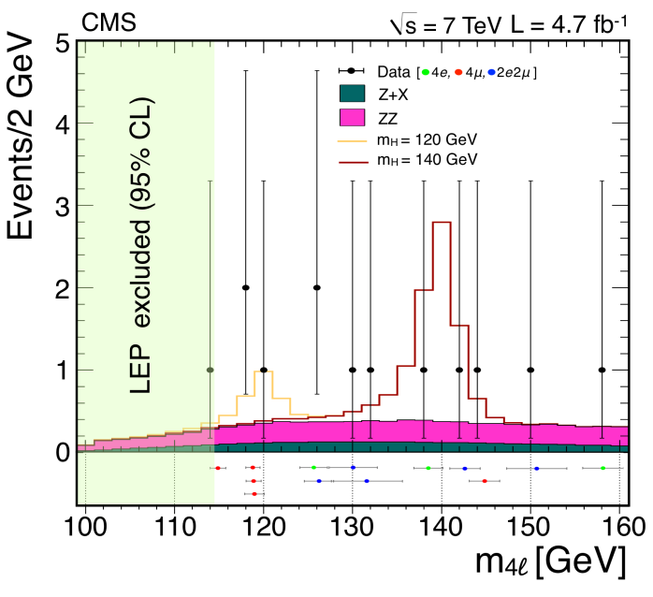
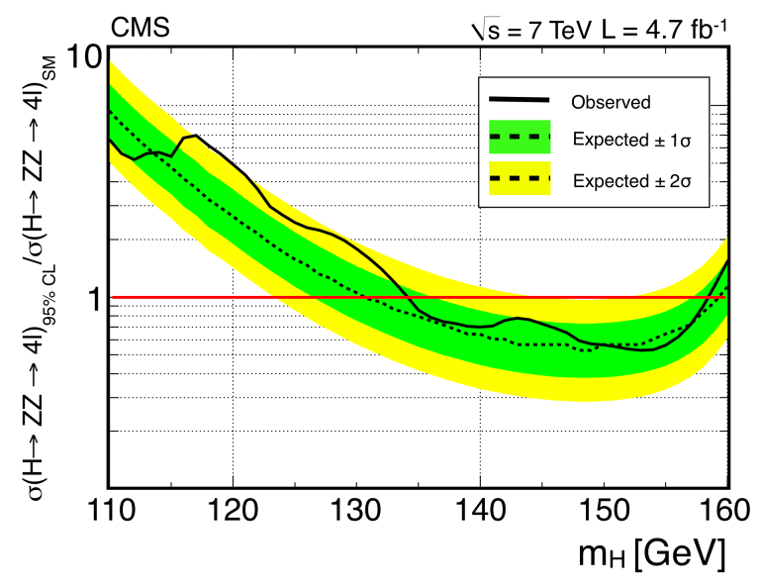
Focus on Low Mass: H → ZZ
Decay channel H → ZZ → llll:
◊ Golden channel
◊ Thirteen events with 100<M_{4l}<160 GeV
expected: 9.5 ± 1.3
Excluded mass ranges for SM Higgs:
◊ Low mass: 134-158 GeV
◊ Higher mass: 180-305, 340-465 GeV

Slide 6
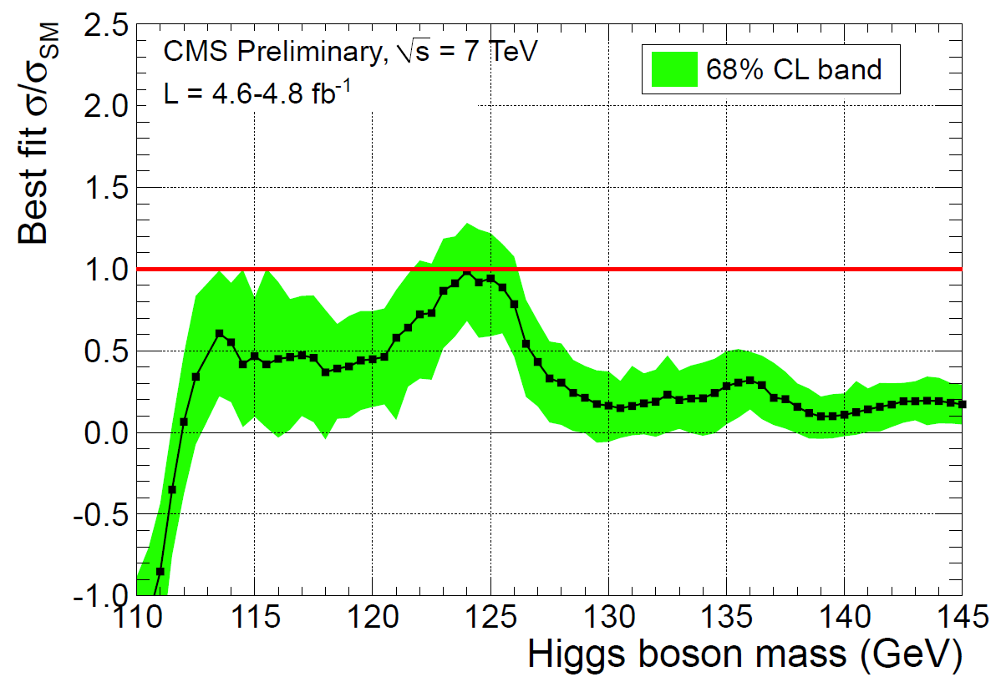
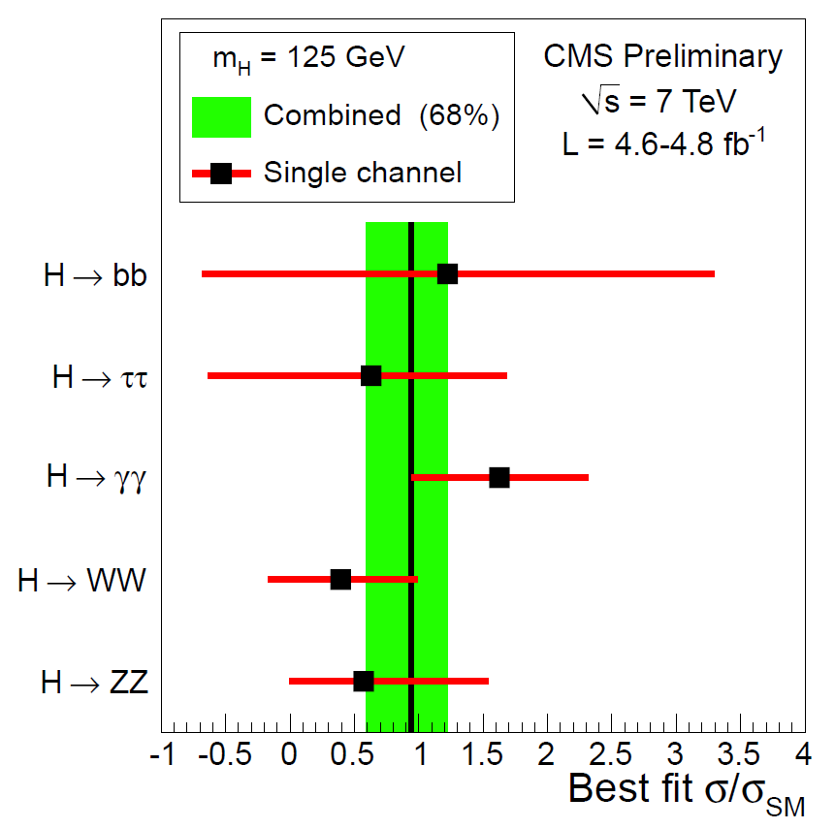
Signal Strength
Best fit to signal strength µ=σ/σ_{SM} as a function of the Higgs mass
At low mass several channels show modest excess:
◊ For M_{H}=125 GeV, sensitive channels show consistent excess
◊ More data needed to exclude background-only hypothesis

Slide 7
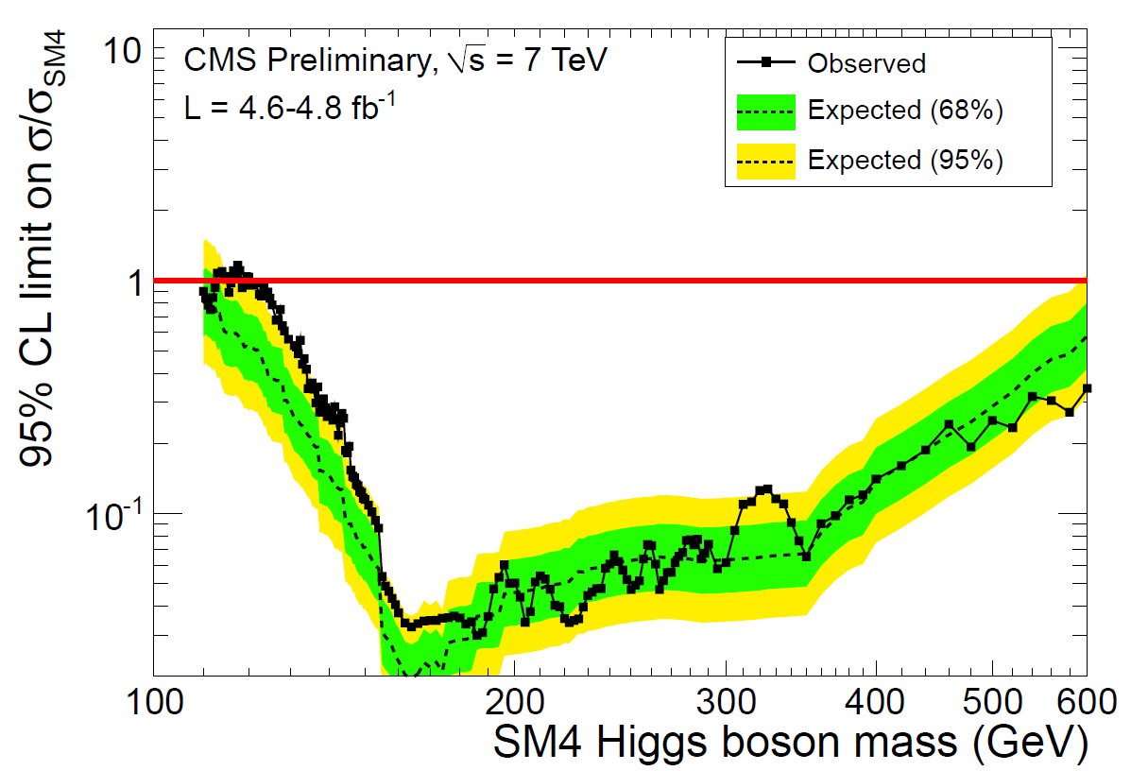
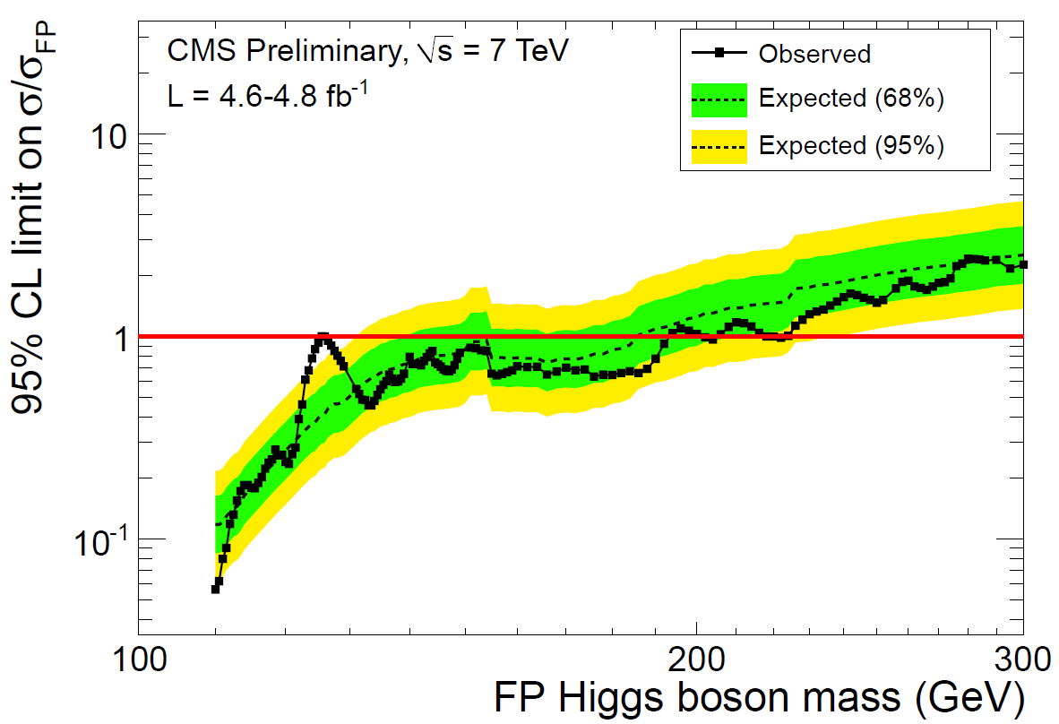
BSM Higgs Boson
Interpreting SM Higgs boson search’s results in BSM scenarios
SM with fourth generation:
◊ Higgs boson excluded in mass
range [120-600]GeV @95% CL
Fermiophobic Higgs boson:
◊ Higgs boson excluded in mass
range [110-192]GeV @95% CL

Slide 8
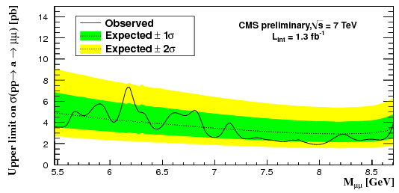
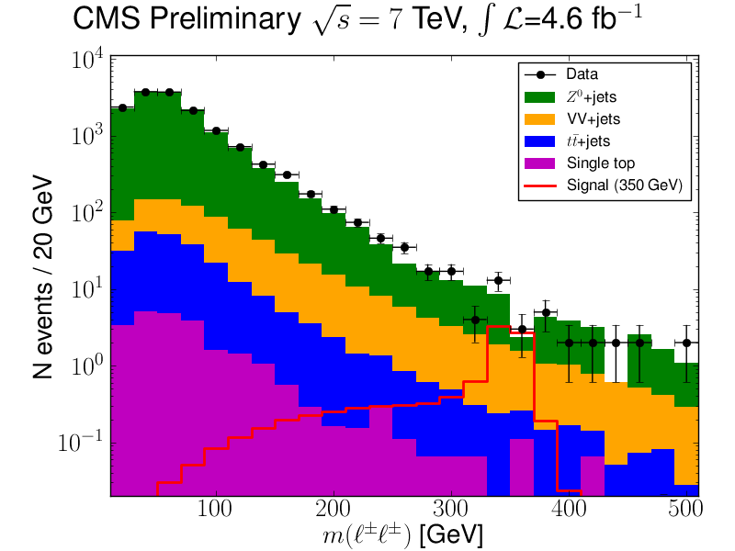
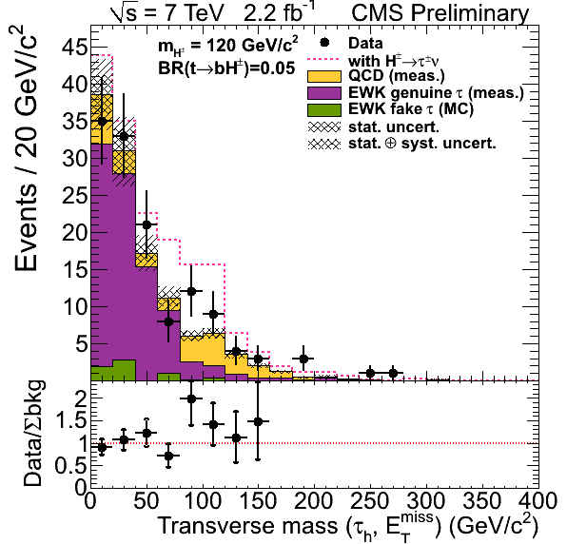
BSM Higgs Boson
Light pseudoscalar Higgs boson a₀:
◊ Dimuon decay channel
◊ Limit on production rates in NMSSM
Light charged Higgs boson (M_{H}+<m_{t}):
◊ tt→H⁺bW⁻b, H⁺→τ⁺υ
◊ BR(t→H⁺b)<2-3% for 80<M_{H}+<160 GeV
Doubly charged Higgs boson H⁺⁺:
◊ Pair production: ≥3 leptons in final states
◊ M_{H}++ >[380-410] GeV for a type-II seesaw model
_
_

Slide 9
Backup Material
~

Slide 10
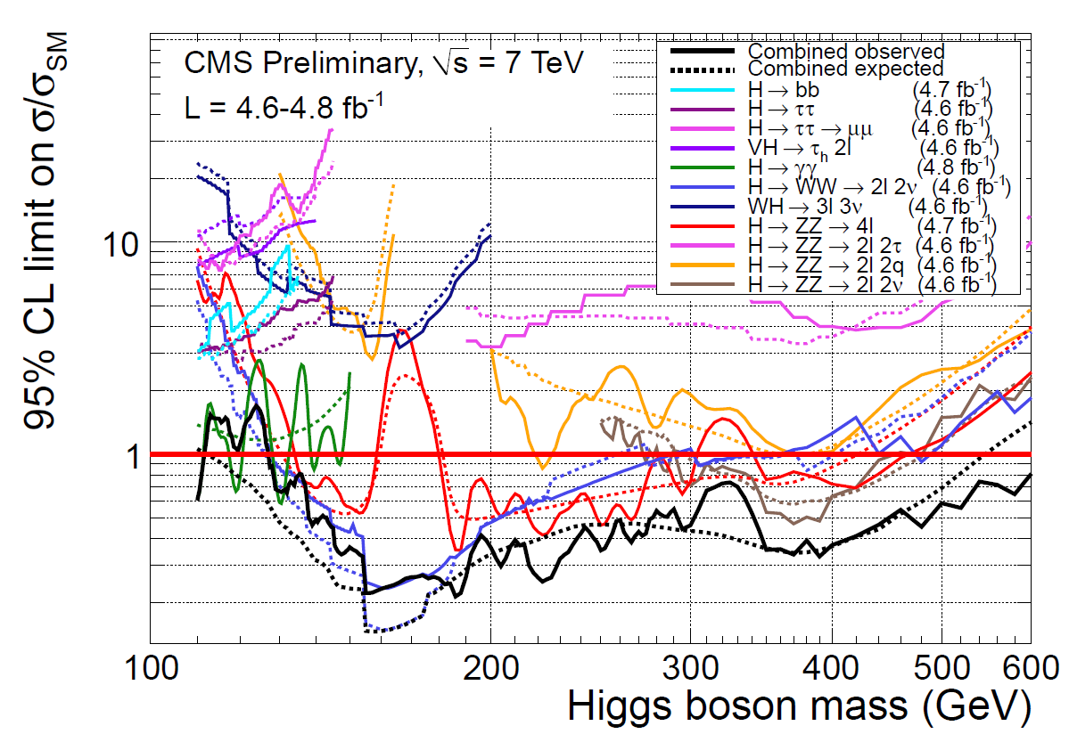
Standard Model Higgs Boson
CMS searches for the SM Higgs boson in eleven different decay channels in the mass range 110-600 GeV
γγ
WW→lυlυ
ZZ→llll
ZZ→llυυ
95% Expected Exclusion
Range 114.5-543 GeV

