Slide 1
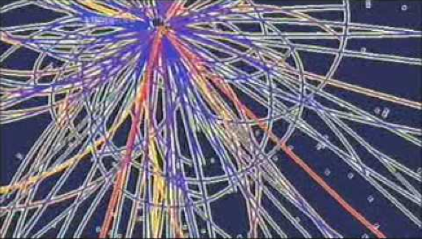




XL International Meeting on Fundamental Physics, June 1st, 2012
Searches for the Standard Model Higgs Boson at the Tevatron
Aurelio Juste
ICREA/IFAE, Barcelona
For the CDF and DØ Collaborations

Slide 2
Today’s Presentation
Introduction
  The Higgs mechanism in a nutshell
  Experimental indications in the pre-hadron collider era
  Search strategies at hadron colliders
Standard Model Higgs boson searches at the Tevatron
Summary and outlook

Slide 3
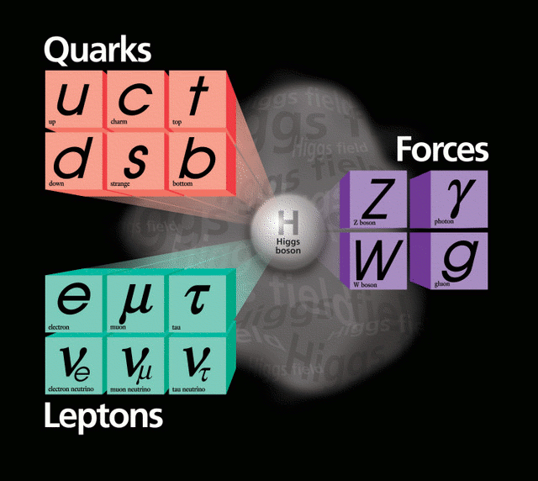
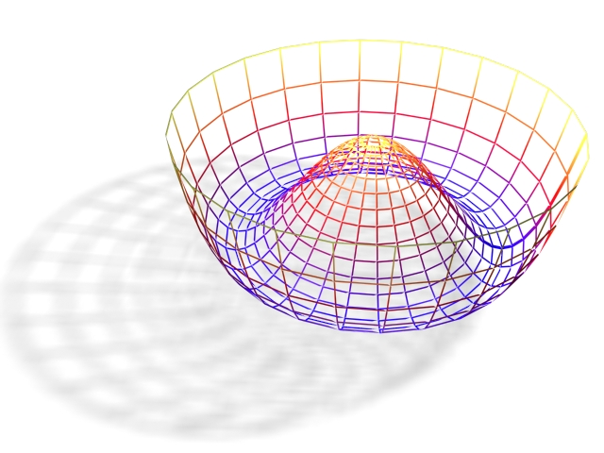
The Case for the Higgs Boson
Massive weak gauge bosons and fermions implies that there must exist an outside sector of interactions that break the electroweak (EW) symmetry: the “Higgs sector”.
There is no preferred model of the Higgs sector, we just have theories of it.
Simplest realization in the Standard Model:
  Single scalar doublet field
  Self interacting; non-zero vacuum expectation value breaks EW symmetry
  gives mass to W/Z bosons
  gives mass to fermions (through Yukawa interactions)
  a physical scalar particle remains:
  the Higgs boson
  Its mass is not predicted, though!

Slide 4
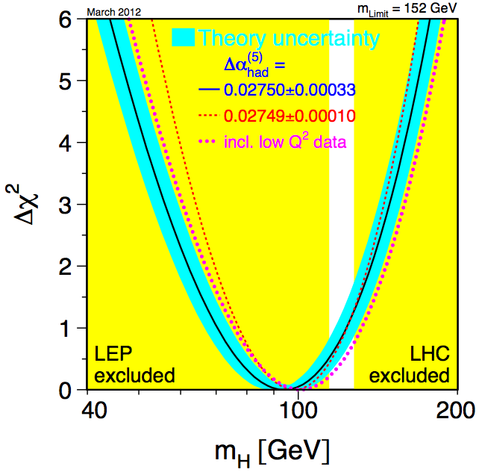
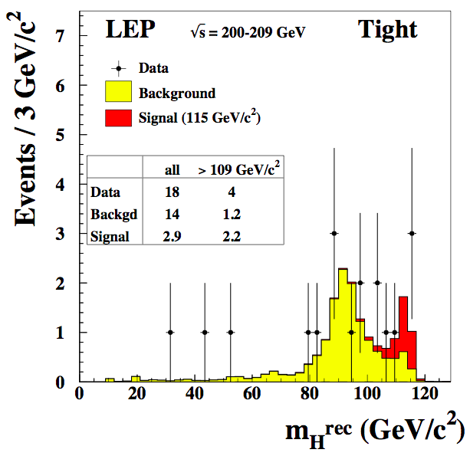
Stalking the Higgs Boson
Indirect constraints
Precision electroweak observables are sensitive to the Higgs boson mass via quantum corrections.
Direct searches at LEP
Some hints (~1.7σ) of a SM-like Higgs boson with m_{H}~115 GeV:
Combining indirect and LEP direct constraints
m_{H}< 152 GeV (95% CL)
m_{H}> 114.4 GeV (95% CL)
This is precisely the range where the Tevatron is sensitive!
114.4 < m_{H}< 171 GeV (95% CL)

Slide 5

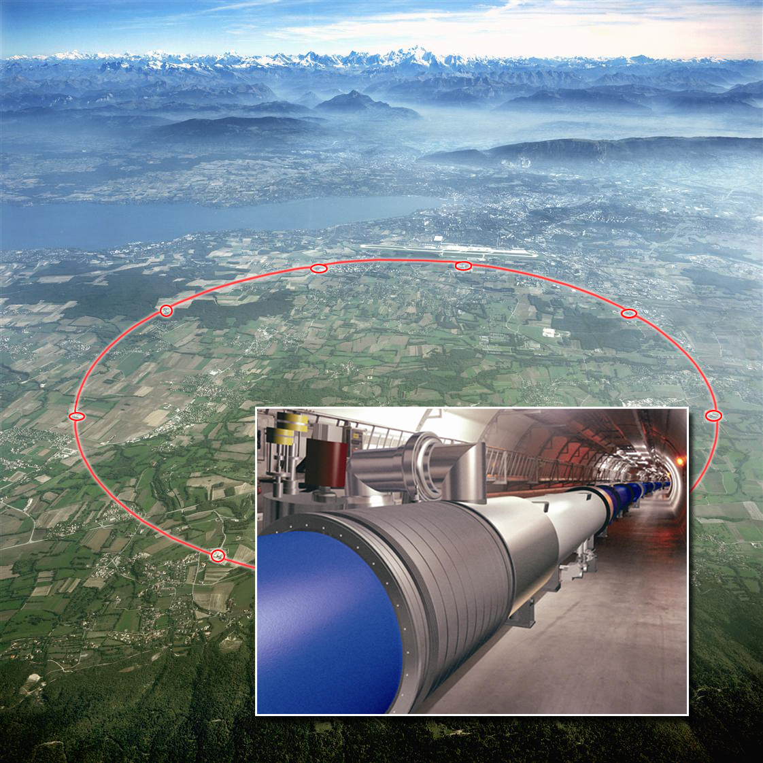
The Hadron Collider Era
Fermilab’s Tevatron Collider: 10-year long Run II ended Sept. 30th, 2011.
  proton-antiproton collisions at 1.96 TeV.
➔ expected to be sensitive to a SM Higgs boson in the EW-preferred mass region.
CERN’s Large Hadron Collider (LHC): only hadron collider in operation today.
  proton-proton collisions at 8 TeV (for now).
➔ should be able to discover a SM Higgs boson up to at least m_{H}~600 GeV.
Large Hadron Collider
5

Slide 6
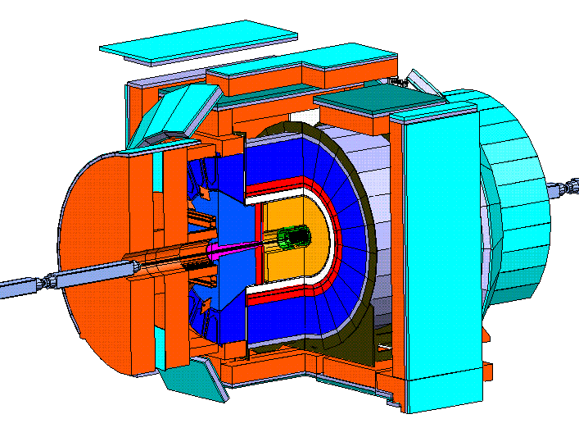
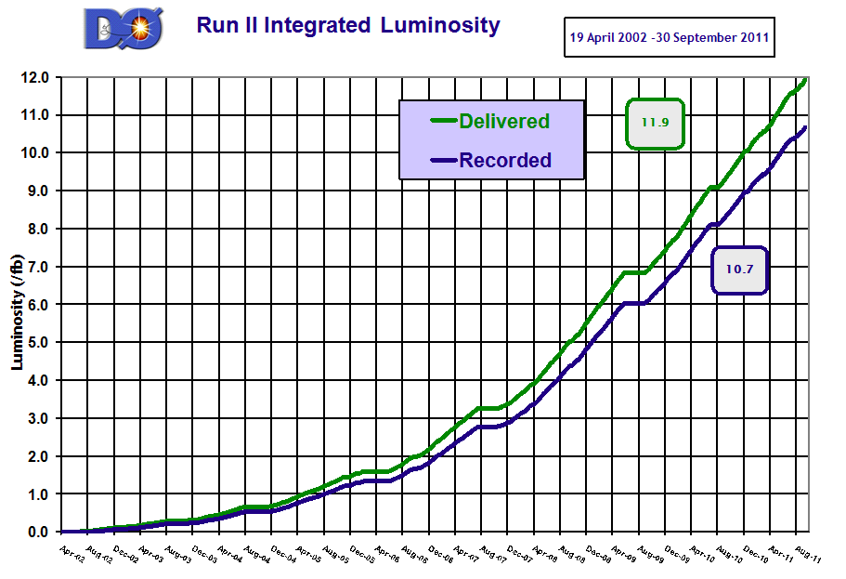
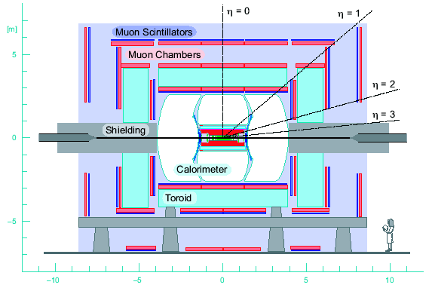
Tevatron Experiments
Excellent performance by the Tevatron accelerator and CDF and DØ detectors.
  Almost 12 fb⁻¹ delivered
  Up to 10 fb⁻¹ in analysis
11.9
10.7
6
6
6
6

Slide 7
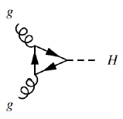
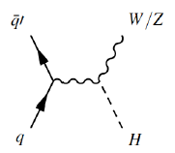
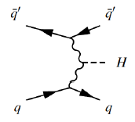
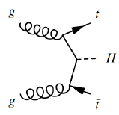
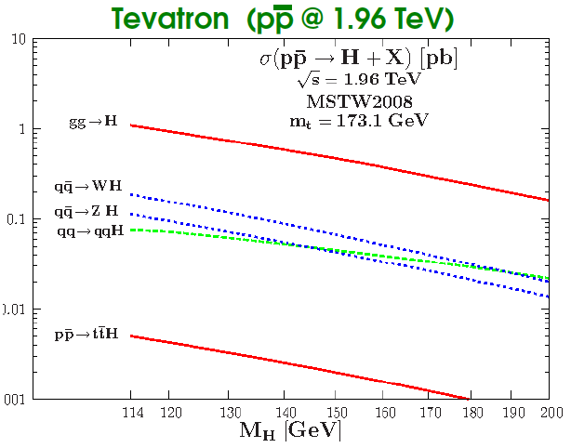
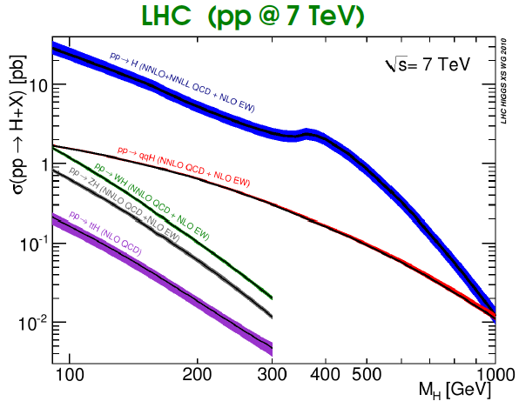
SM Higgs Production at Hadron Colliders
Main production mechanism

Slide 8
SM Higgs Production at Hadron Colliders
Next most important production mechanism

Slide 9
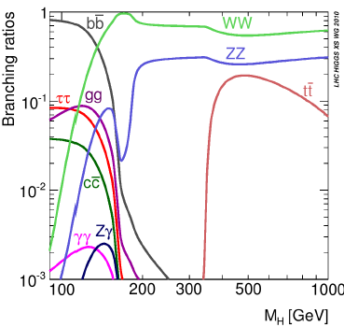
SM Higgs Decay Modes
m_{H}=135 GeV
m_{H}<135 GeV: H→bb dominates
m_{H}>135 GeV: H→WW dominates

Slide 10
SM Higgs Decay Modes
m_{H}=135 GeV
m_{H}<135 GeV: H→bb dominates
m_{H}>135 GeV: H→WW dominates
Main mode
Supporting mode
LHC
Many decay modes being explored to increase the sensitivity of the
search to the SM Higgs boson, but also to a non-SM one!

Slide 11
SM Higgs Decay Modes
m_{H}=135 GeV
m_{H}<135 GeV: H→bb dominates
m_{H}>135 GeV: H→WW dominates
Main mode
Supporting mode
LHC
Tevatron
Many decay modes being explored to increase the sensitivity of the
search to the SM Higgs boson, but also to a non-SM one!

Slide 12
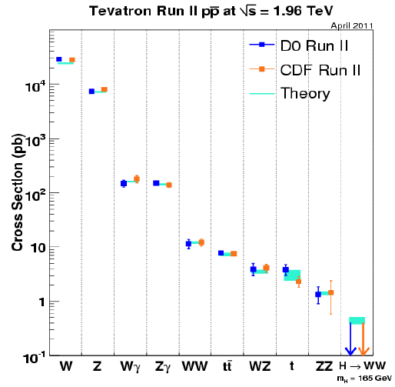
The Stairway to the Higgs
Higgs boson searches at the Tevatron are background-dominated.
Instrumental backgrounds: measured directly from data
  QCD multijet production with mismeasured jets leadings to missing transverse energy or jets misidentified as leptons.
Physics backgrounds: estimated using simulation and state-of-art theoretical predictions, and further calibrated to data whenever possible
  W/Z+jets production (w/ real or misidentified heavy flavor jets)
  Diboson production
  Double and single top quark production
Experiments have established a solid foundation to search for the Higgs boson through precise measurements of SM processes.

Slide 13
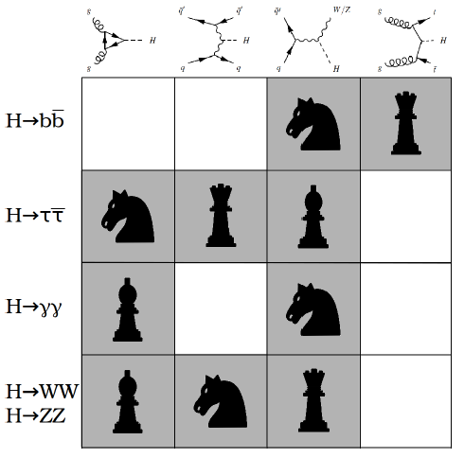
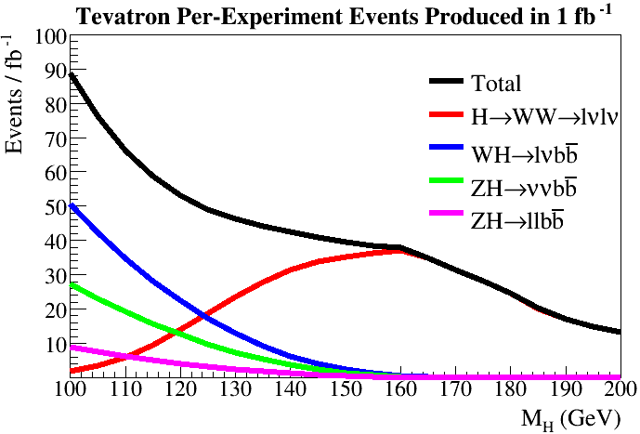
Search Strategies
Defined by a combination of theoretical and experimental considerations (large σxB but experimentally feasible: trigger, backgrounds….).
~600-1200 Higgs events produced at the Tevatron
in the main search channels with 10 fb⁻¹!

Slide 14
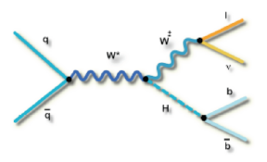
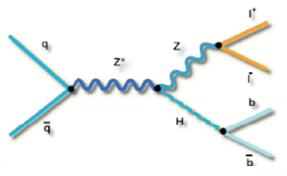
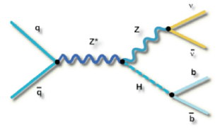
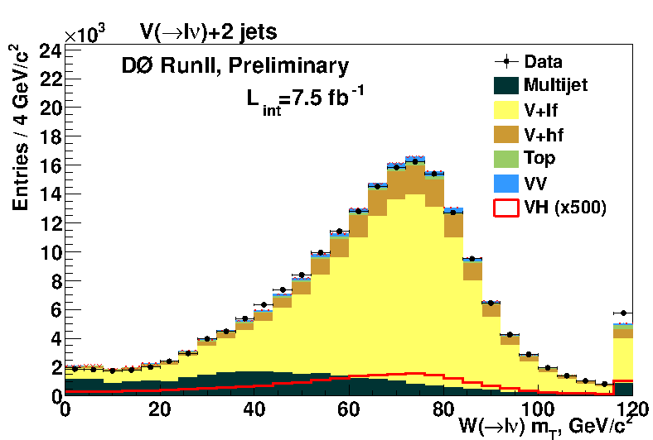
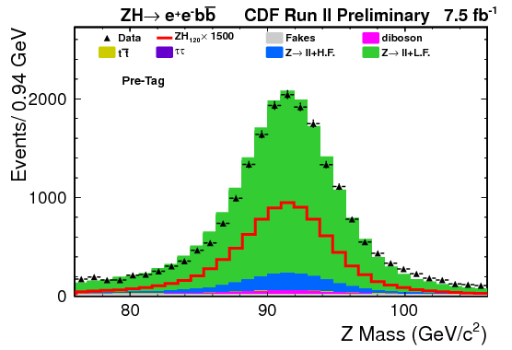
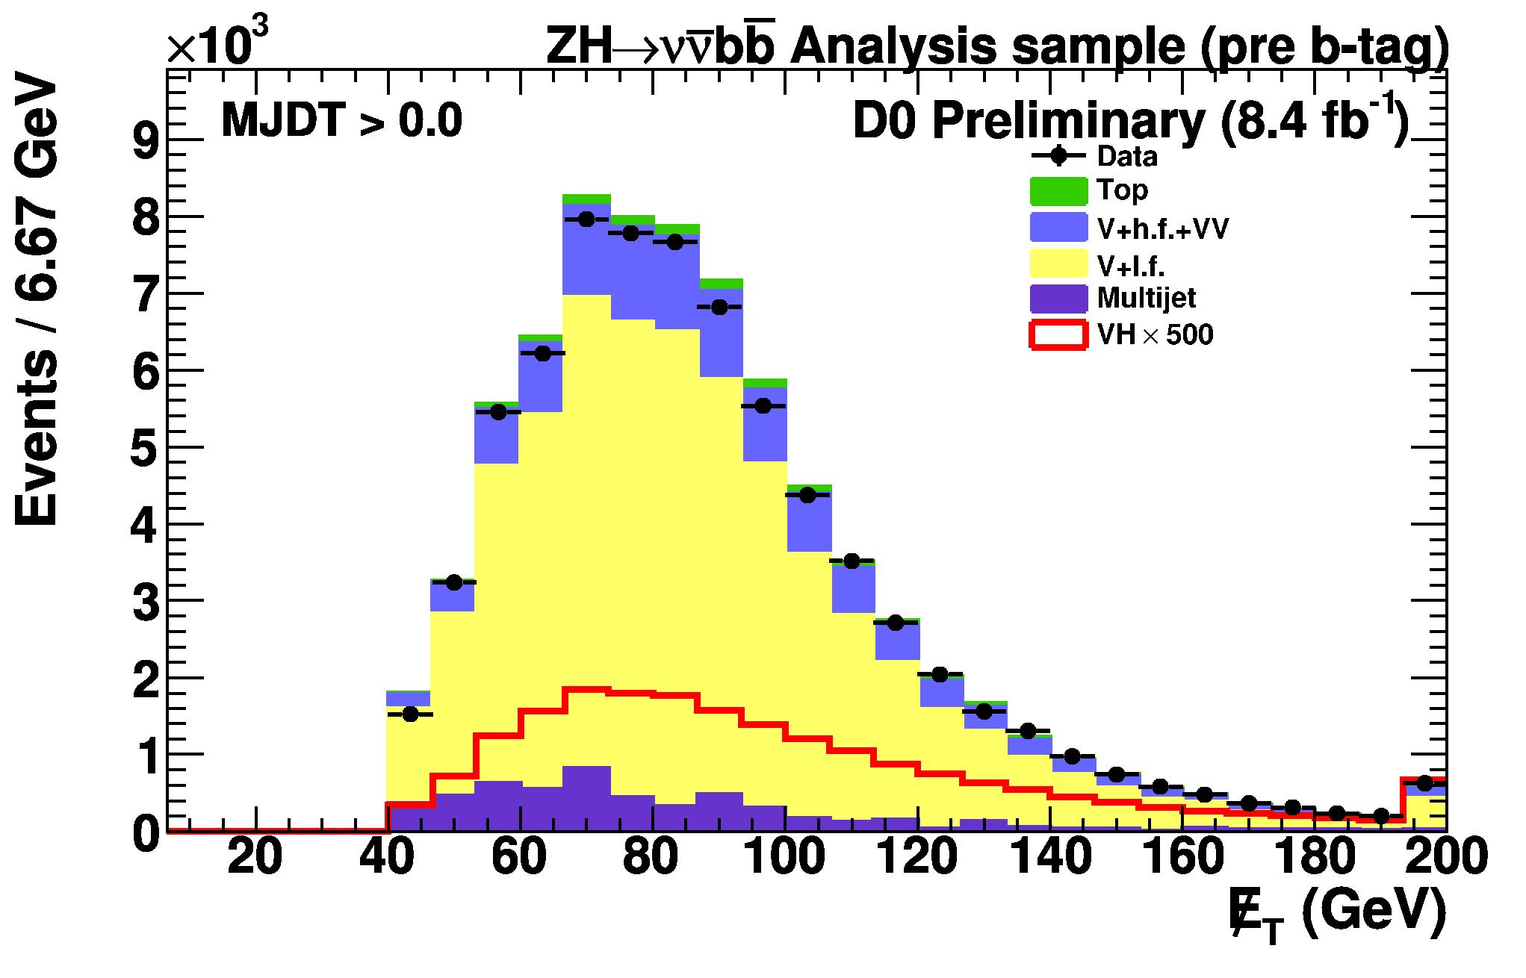
Searching for H→bb
Highest sensitivity channel at the Tevatron for m_{H}<130 GeV.
Identify events consistent with leptonic W/Z decays in association with jets
  Trigger on high p_{T} electrons, muons or missing transverse energy ( )
  W→lν: e or μ and high
  Z→ll: ee or μμ consistent with Z resonance
  Z→νν: no charged leptons; two acoplanar jets and

Slide 15
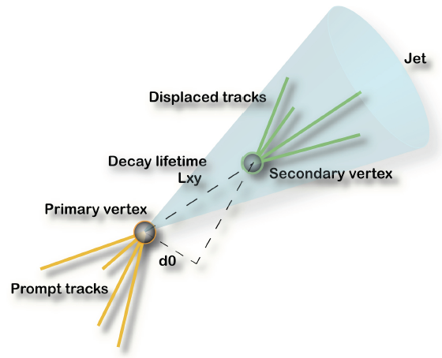

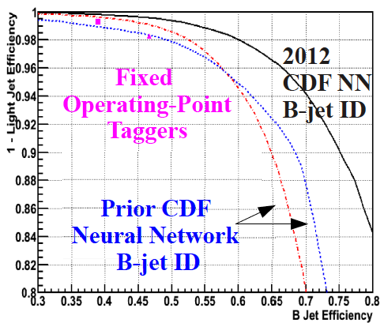
Heavy Flavor Identification
Critical for searches involving H→bb.
B-tagging exploits information on:
  Lifetime: displaced tracks and/or vertices
  Mass: secondary vertex mass
Both experiments use multivariate techniques for improved performance:
  b-to-light discrimination: continuous tagger (multiple operating points)
  b-to-c discrimination
Typical performance:
  B-tagging efficiency: ~50-80%
  Mistag rate: ~0.5-10%
  Calibrated in data control samples.
Winter 2012: major progress at CDF by using new NN b-tagger.
E.g. ε_{b}~39%→54% @ 1.4% fake rate
38% increase in per-jet b-tagging efficiency!

Slide 16
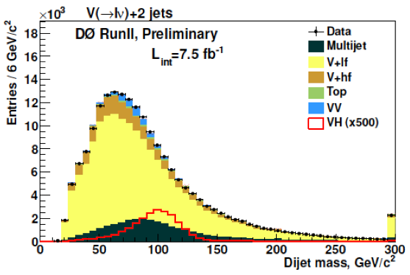
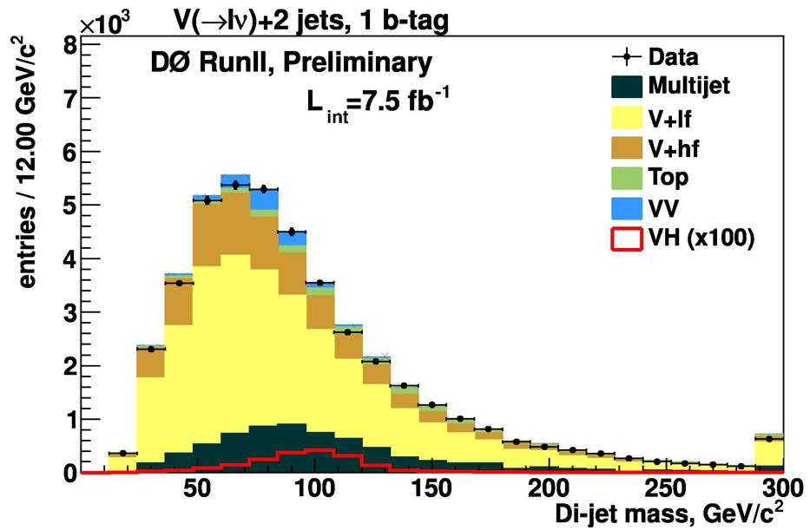
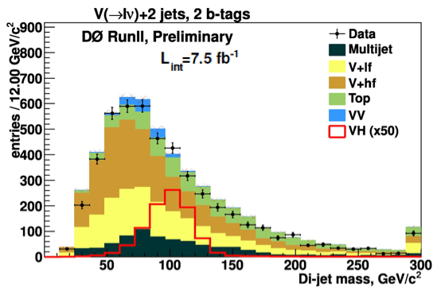
Searching for H→bb: After B-Tagging
B-tagging brings significant improvement to S:B
WH→lνbb
Dijet invariant mass
➔ single most discriminant variable
Before b-tagging
=1 b-tag
S:B ~ 1:4000
≥2 b-tags
S:B ~ 1:400
S:B ~ 1:75

Slide 17
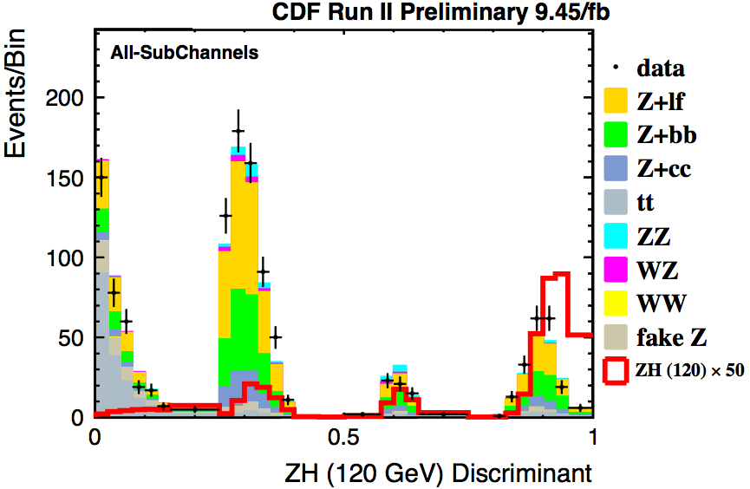
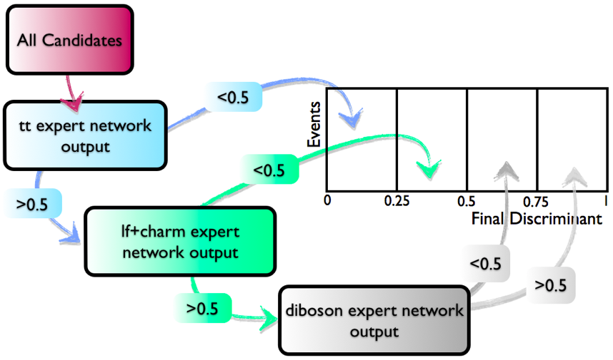
Signal-to-Background Discrimination
Most Higgs analyses use multivariate
analysis (MVA) techniques:
Used against:
  Instrumental backgrounds: increase signal acceptance in event selection
  Physics backgrounds: as final discriminant. Typical sensitivity gain compared to single variable ~15-20%.
Typically achieve S/B of ~1/1-1/25
S/B ~1/100 for dijet mass alone
Increase sensitivity by splitting analysis
into subchannels with different S:B
(e.g. by lepton quality, number of jets,..)
and combine at the end.
ZH→llbb

Slide 18
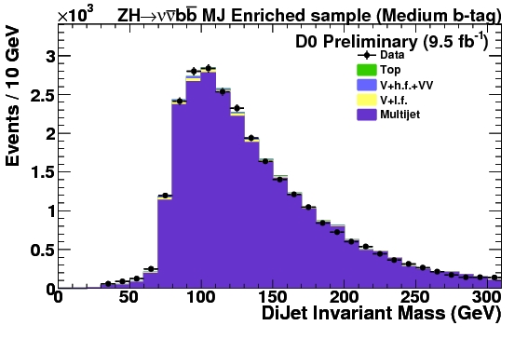
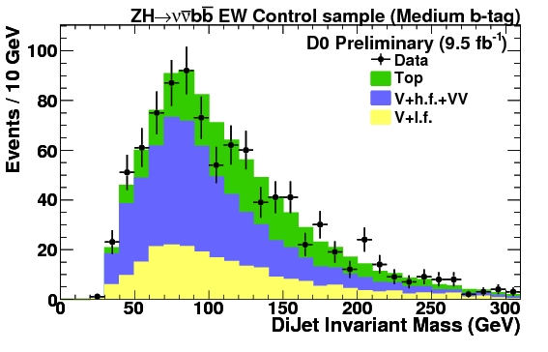
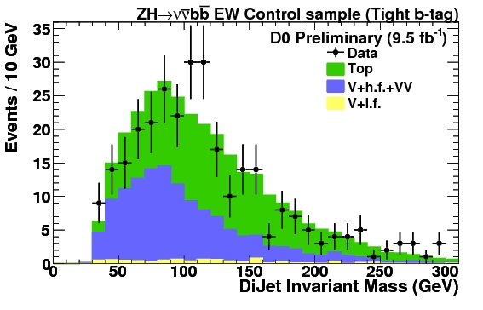
Control Regions
Validate background modeling in signal depleted “side-bands”
Example: +2 b-jets
Multijet-enriched
W+jets-enriched
Top-enriched

Slide 19
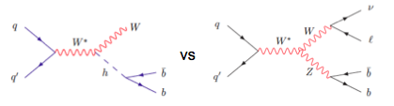
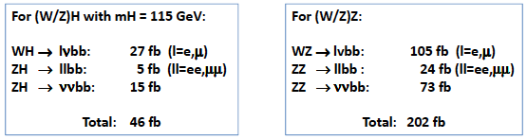
Validation of H→bb Search Techniques
Validate search strategy by looking for a known SM signal with similar signature
  Differences:
    Cross section for diboson production is x4.5 larger than for W/ZH.
    There is relatively more signal contribution from Z→cc than from H→cc.
    Diboson signal sits at low mass where there is a significant peaking background from WW→lνcs and systematic uncertainties are larger.

Slide 20
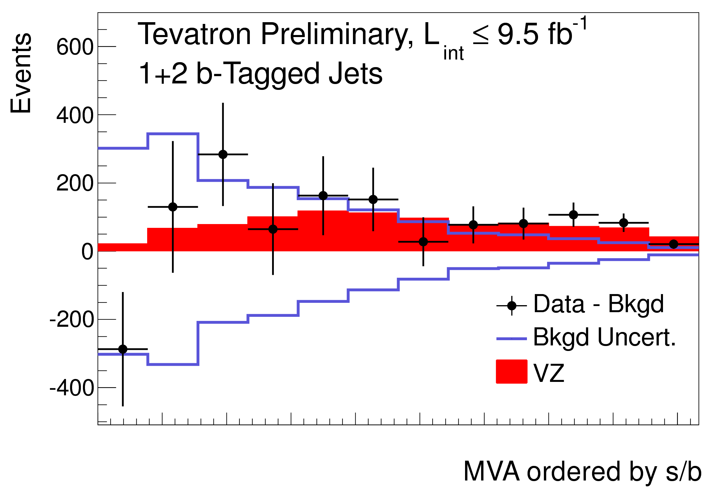
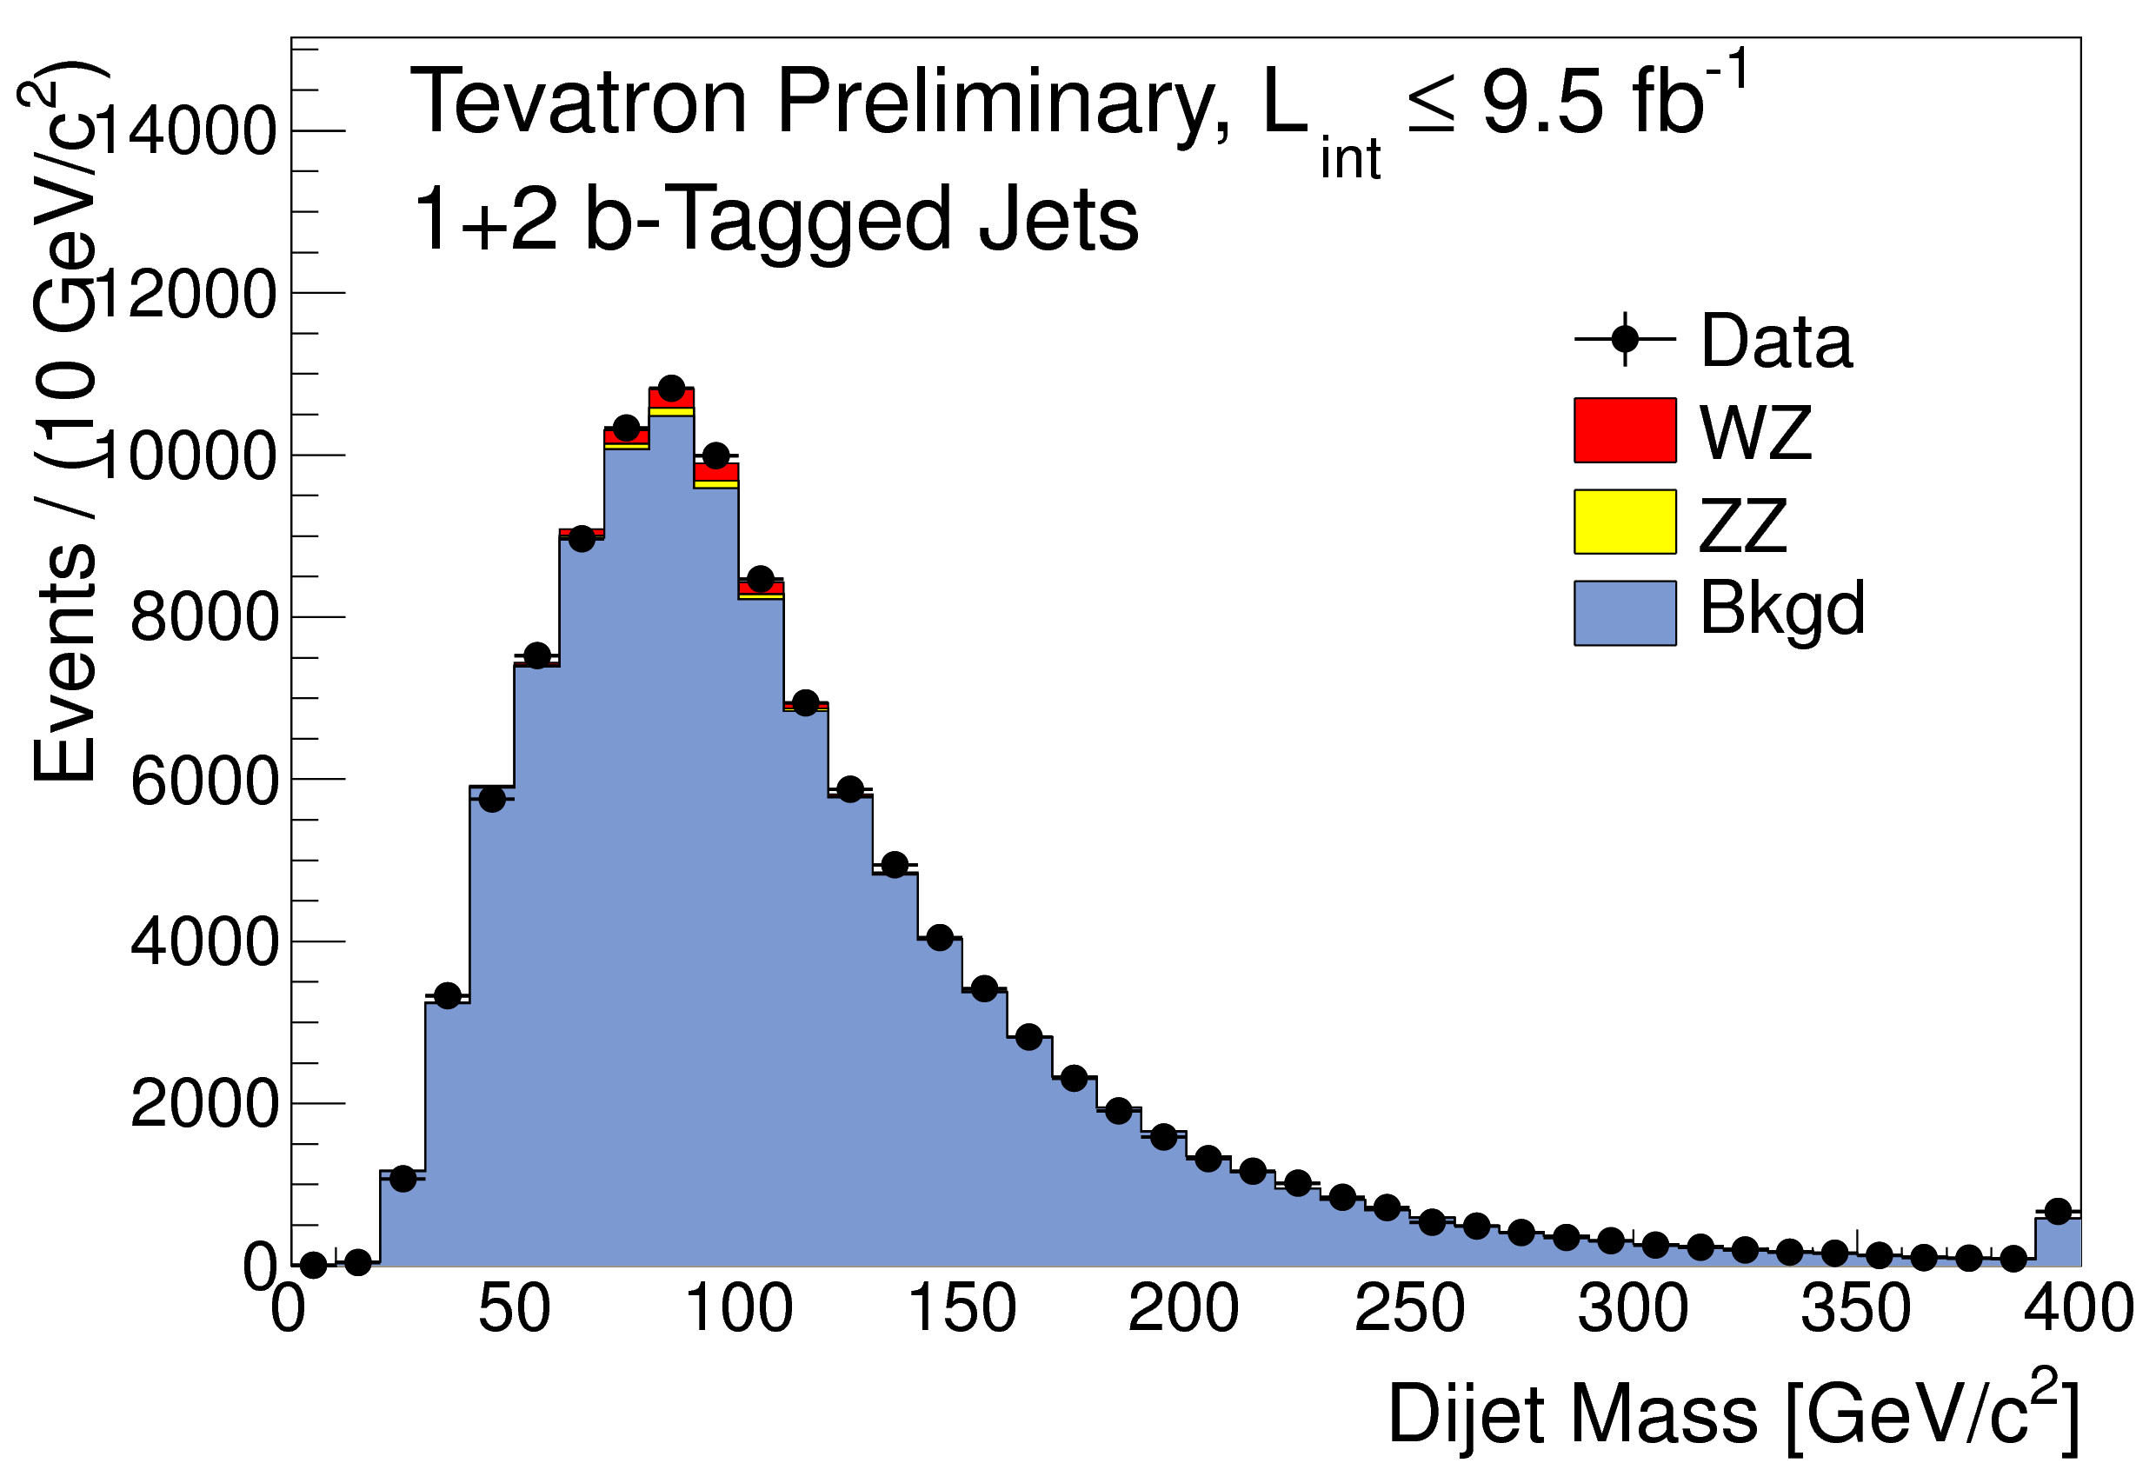
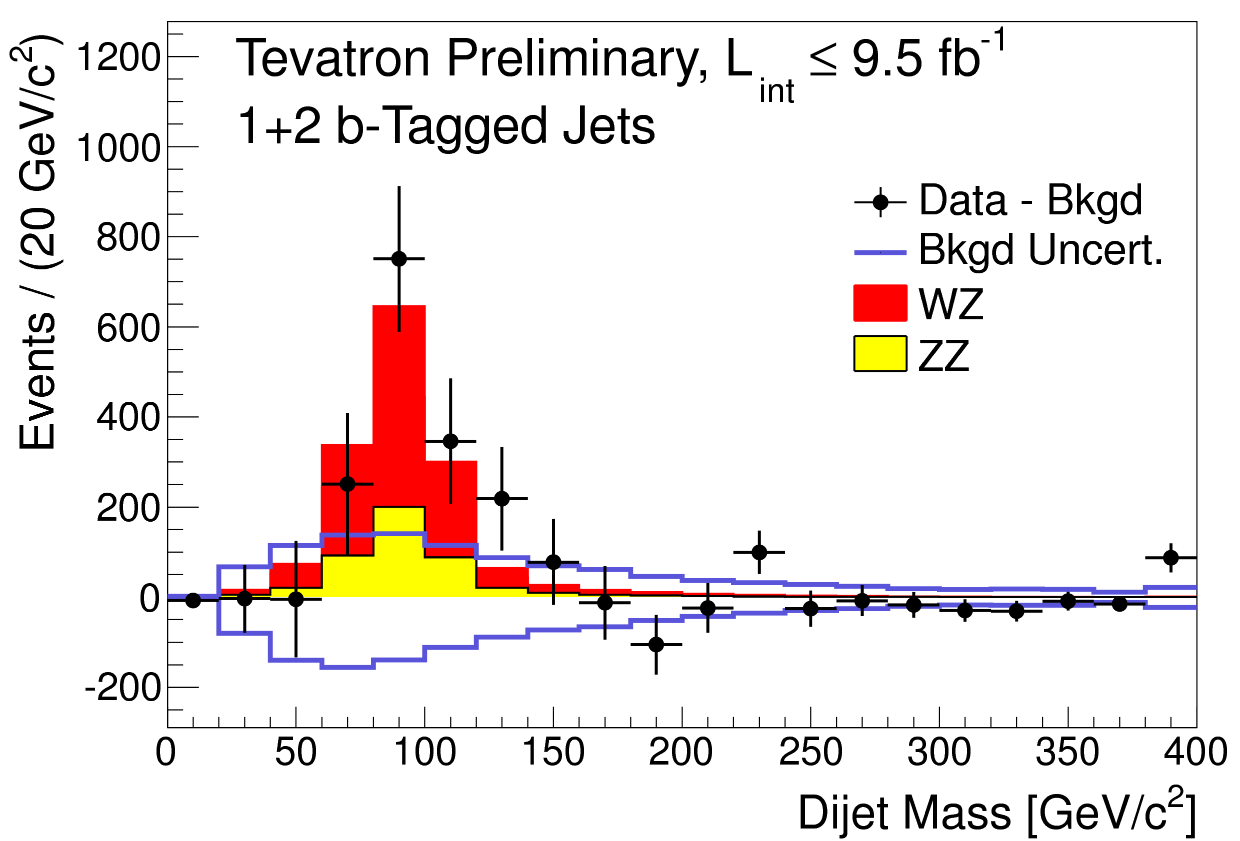
Validation of H→bb Search Techniques
Combination of CDF and DØ searches for WZ/ZZ in lνbb, llbb, ννbb
  Exact copies of the corresponding Higgs analysis.
  Global fit to the final discriminant distributions in all subchannels.
Data-PostFit Background
Data-PostFit Background
Measured cross section in good agreement with the SM:
σ_{WZ+ZZ} = (1.01 ± 0.21) σ_{SM}
Obs. significance of 4.6 s.d (4.8 s.d. exp.).

Slide 21
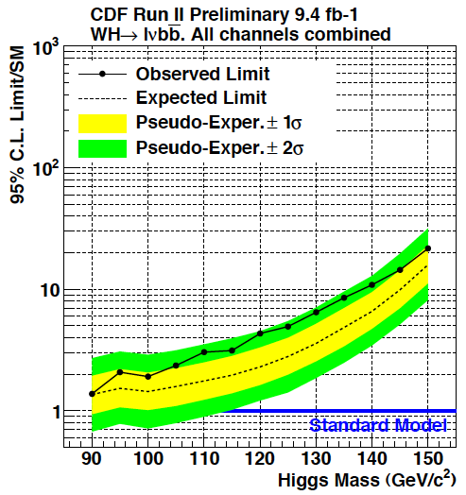

Summary of H→bb Results
95% CL Limits at m_{H} = 115 GeV
Channel | Exp/obs Limit (σ/SM)
WH→lνbb (9.4 fb⁻¹) | 2.0/3.1
ZH→ννbb (9.4 fb⁻¹) | 2.7/2.7
ZH→l⁺l⁻bb (9.4 fb⁻¹) | 2.6/4.7
WH→lνbb (9.7 fb⁻¹) | 3.2/4.0
ZH→ννbb (9.5 fb⁻¹) | 3.0/2.5
ZH→l⁺l⁻bb (9.7 fb⁻¹) | 4.2/3.7
VH/VBF→jjbb (9.4 fb⁻¹) | 8.3/7.2
ttH→l+jets (9.4 fb⁻¹) | 10.1/14.5
ttH→jets (5.7 fb⁻¹) | 20.2/28.1
Limits from individual VH, H→bb channels at ~2-3xSM at m_{H}=115 GeV and quickly degrading towards high mass.
Important to consider additional channels with different mass dependence.

Slide 22
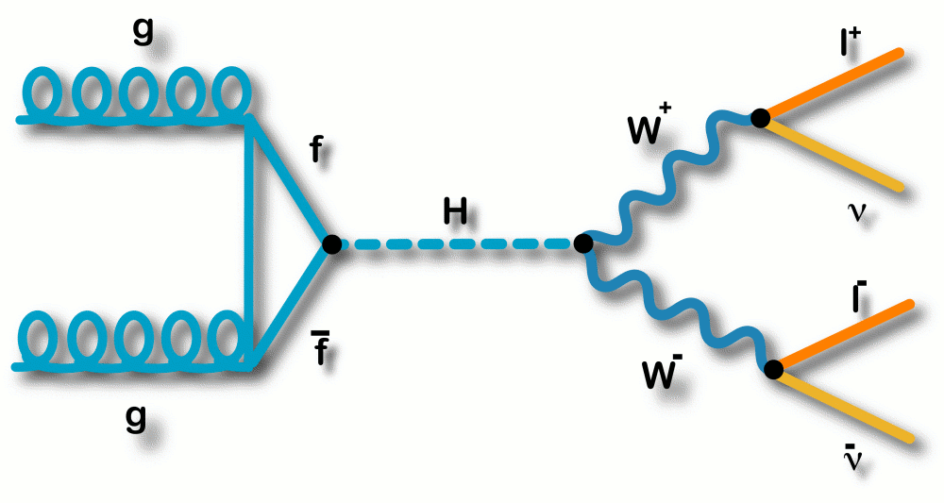
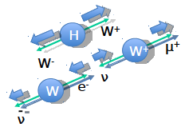
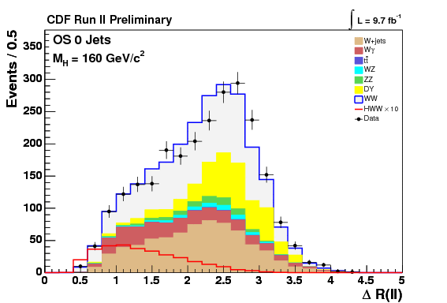
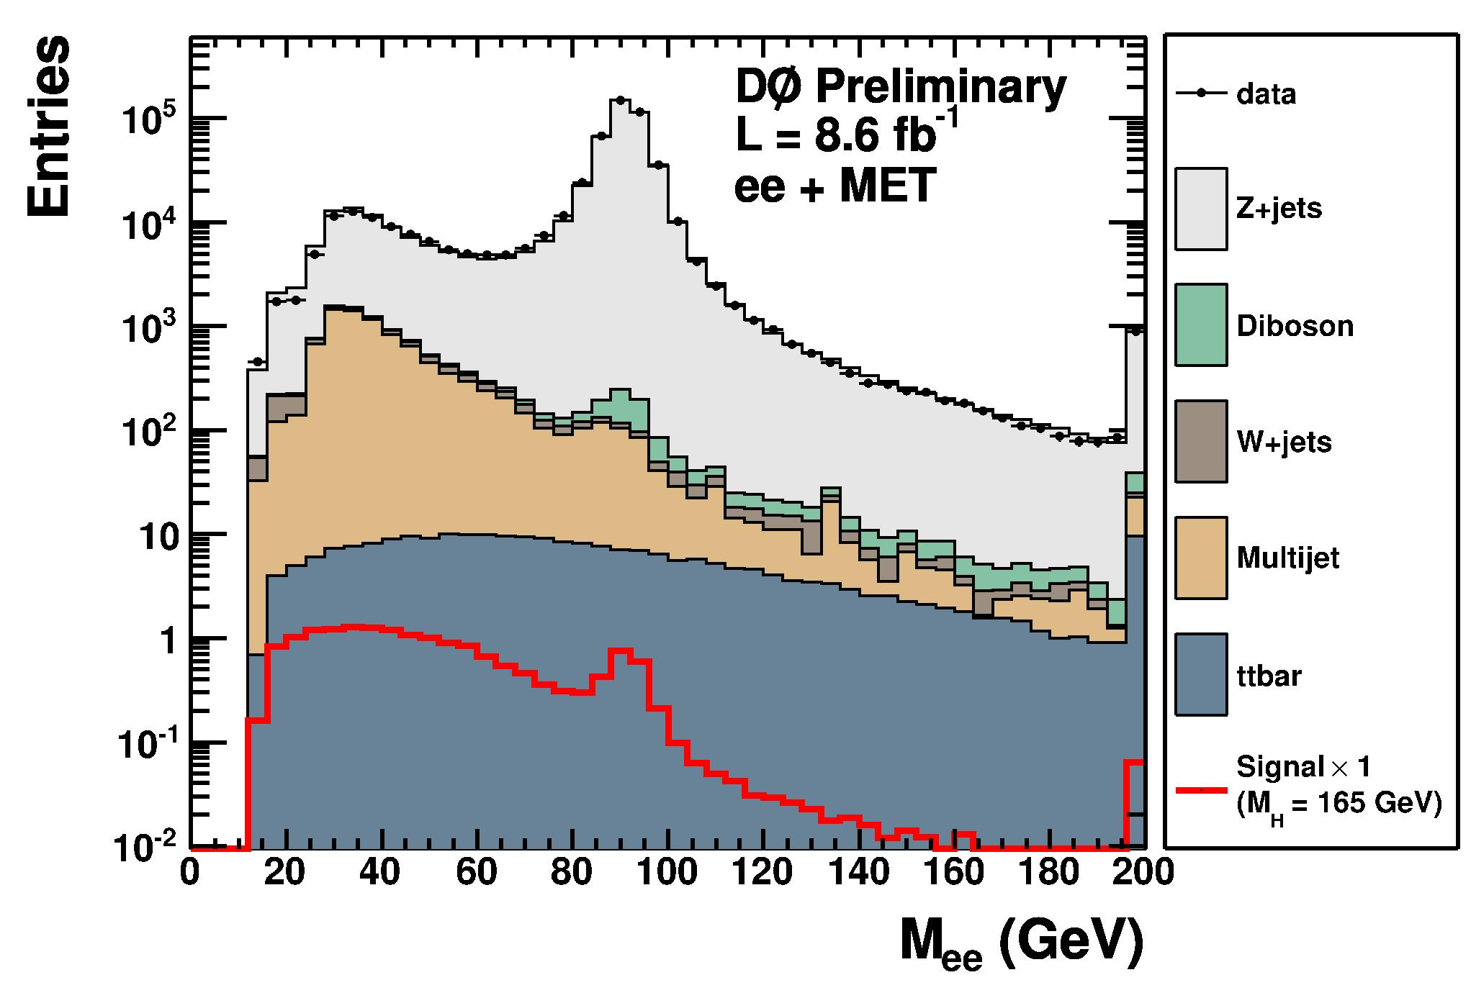
Searching for H→WW→lνlν
Highest sensitivity channel in m_{H}~130-200 GeV range.
Clean dilepton+ signature.
Main backgrounds after cut: WW, W/Z+jets.
After final selection expect (m_{H}=165 GeV):
~7 signal events/fb⁻¹/experiment with S:B~1:50-1:100
Exploit spin correlation between dibosons.
➔ Small angular separation between leptons
Before MET cut
After MET cut
0-jet

Slide 23
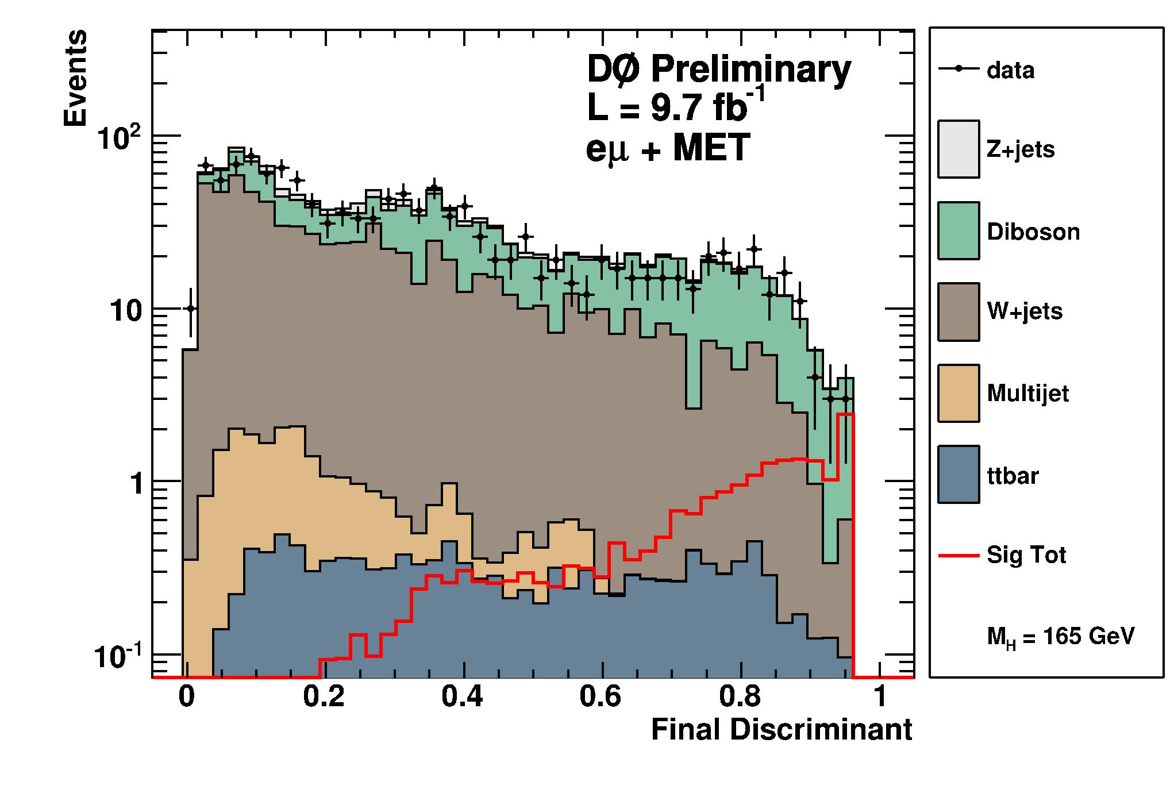
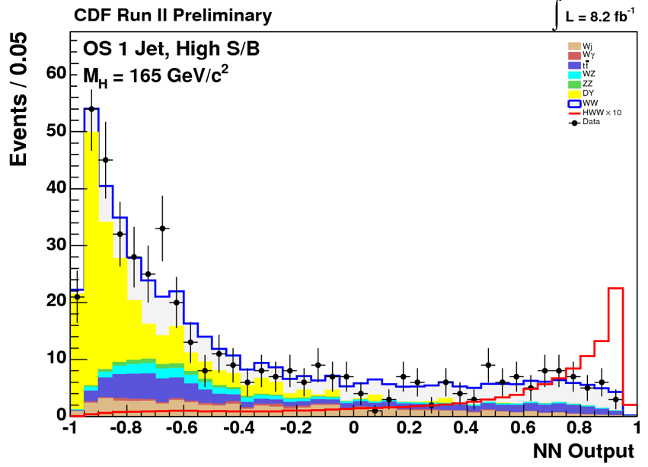
Searching for H→WW→lνlν
eμ/0-jet
To increase the sensitivity:
Build multivariate discriminants combining several variables
Split samples with different S:B and combine at the end:
  by lepton flavor (DØ) or quality (CDF)
  by jet multiplicity
Add additional requirements for particular subsamples:
  Suppress Z/γ*→e⁺e⁻,μ⁺μ⁻ by cutting on dedicated MVA variable (DØ)
  Suppress top quark pairs by vetoing b-tag in 2-jet events (CDF)
1-jet
Signal x10

Slide 24
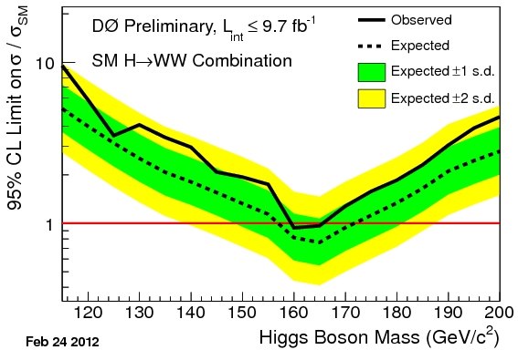
Low Mass Results from H→WW,ττ,γγ
95% CL Limits at m_{H} = 115 GeV
Channel | Exp/obs Limit (σ/SM)
H→WW→lνlν (9.7 fb⁻¹) | 7.1/11.5
H→WW→lνlν (9.7 fb⁻¹) | 7.7/11.8
H+X→ττ+jets (8.3 fb⁻¹) | 12.6/12.2
VH→ττl(l) (6.2 fb⁻¹) | 17.3/18.5
H+X→ττjj (6.2 fb⁻¹) | 14.3/21.8
VH→ττμ (7.0 fb⁻¹) | 14.2/10.7
H→γγ (10.0 fb⁻¹) | 10.6/12.7
H→γγ (9.7 fb⁻¹) | 11.5/8.4
Additional channels contribute useful sensitivity
at low/intermediate m_{H}:
H→WW→lνlν: improving towards high m_{H}.
H+X→ττjj, H→γγ : ~flat vs m_{H}.
➔ Combination of all contributing channels crucial

Slide 25
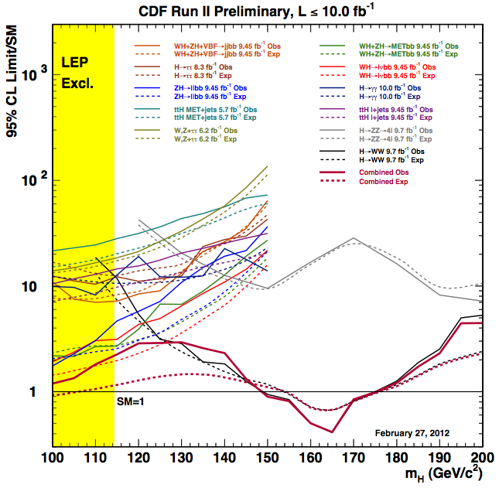

Combined Limits on SM Higgs Production
Combination of multiple channels (and experiments!) yields the greatest sensitivity.
  Assumes SM prediction for ratio of production cross sections and branching ratios.
More than 50 different sources of systematic uncertainties are considered (including correlations among channels and experiments), and constrained in sidebands.
Use different techniques to cross check calculations (Bayesian, modified frequentist)
➔ results agree within ≤5%.

Slide 26
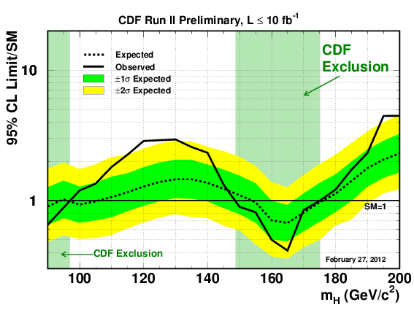

CDF and DØ Individual Results
At m_{H} = 115 GeV:
Exp. limit: 1.16 x SM
Obs. limit: 2.25 x SM
At m_{H} = 125 GeV:
Exp. limit: 1.39 x SM
Obs. limit: 2.89 x SM
At m_{H} = 115 GeV:
Exp. limit: 1.58 x SM
Obs. limit: 2.17 x SM
At m_{H} = 125 GeV:
Exp. limit: 1.85 x SM
Obs. limit: 2.53 x SM
95% CL exclusion: 147 < m_{H} < 175 GeV
95% CL exclusion: 159 < m_{H} < 166 GeV

Slide 27



Visualizing the Tevatron Data
Display all input histogram bins ordered according to S/B in one plot.
The background model has been constrained by the data.

Slide 28


Visualizing the Tevatron Data
Display all input histogram bins ordered according to S/B in one plot.
The background model has been constrained by the data.
Data consistent with the B-only hypothesis within the systematic uncertainties.

Slide 29



Visualizing the Tevatron Data
Display all input histogram bins ordered according to S/B in one plot.
The background model has been constrained by the data.
Data consistent with the B-only hypothesis within the systematic uncertainties.

Slide 30

Combined Tevatron Expected Limits
Expected exclusion: 100 < m_{H} < 120 GeV, 141< m_{H} < 184 GeV
95% CL limit at m_{H}=125 GeV: 1.10xSM (expected)

Slide 31

Combined Tevatron Observed Limits
Expected exclusion: 100 < m_{H} < 120 GeV, 141< m_{H} < 184 GeV
Observed exclusion: 100 < m_{H} < 106 GeV, 147 < m_{H} < 179 GeV
95% CL limit at m_{H}=125 GeV: 1.10xSM (expected), 2.22xSM (observed)

Slide 32



Visualizing the Excess
Display all input histogram bins ordered according to S/B in one plot.
The background model has been constrained by the data.

Slide 33

Quantifying the Excess: p-values
Local p-value distribution for background-only hypothesis:
Median expected p-value for B-only hypothesis
Median expected p-value for S+B hypothesis
  Minimum local p-value: 2.7 standard deviations
  Minimum global p-value with look-elsewhere factor of 4: 2.2 standard deviations

Slide 34


Quantifying the Excess: p-values
Local p-value distribution for background-only hypothesis:
H→bb channels
H→WW channels
H→bb channels: main contribution to excess in 115<m_{H}<135 GeV region
  Minimum local p-value: 2.8 standard deviations
  Minimum global p-value with look-elsewhere factor of 2: 2.6 standard deviations
H→WW channels: no significant excess in 115<m_{H}<135 GeV region

Slide 35


Quantifying the Excess: Best Fit Signal Rate
Maximum likelihood fit to data with signal rate as free parameter.
Δχ² test with fixed signal prediction from SM theory agrees well with freely floating signal rate estimation:
  Δχ² minimum in 115 < m_{H} < 135 GeV range.

Slide 36
Summary and Outlook
Tevatron program now analyzing full dataset in most search channels.
Tevatron combination has reached SM sensitivity over most of 100<m_{H}<185 GeV range.
Tantalizing excess in 115<m_{H}<135 GeV region with global p-value of 2.2 s.d. (2.7 s.d. local) .
H→bb only: 2.6 s.d. global (2.8 s.d. local).

Slide 37

Summary and Outlook
Tevatron program now analyzing full dataset in most search channels.
Tevatron combination has reached SM sensitivity over most of 100<m_{H}<185 GeV range.
Tantalizing excess in 115<m_{H}<135 GeV region with global p-value of 2.2 s.d. (2.7 s.d. local) .
H→bb only: 2.6 s.d. global (2.8 s.d. local).
These are by no means the final Tevatron results!
Further improvements expected in the near future, particularly in searches targeting the 115<m_{H}<135 GeV region.
Tevatron and LHC are sensitively probing the Higgs sector in complementary ways.
In particular, Tevatron currently provides a unique window into the H→bb mode.
Looking forward to a LHC-Tevatron combination!
LHC
Tevatron

Slide 38



Further Information
http://www-cdf.fnal.gov/physics/new/hdg/hdg.html
http://www-d0.fnal.gov/Run2Physics/WWW/results/higgs.htm
http://tevnphwg.fnal.gov/

Slide 39
Backup

Slide 40






2010 Sakurai Prize for Theoretical Particle Physics
"For elucidation of the properties of spontaneous symmetry breaking in four-dimensional relativistic gauge theory and of the mechanism for the consistent generation of vector boson masses"
Robert Brout
Francois Englert
Peter W. Higgs
Univ. of Edinburgh
Gerald S. Guralnik
Brown University
Carl R. Hagen
Univ. of Rochester
T.W.B. Kibble
Imperial College
Universite Libre de Bruxelles

Slide 41

Combined Tevatron Observed Limits
Expected exclusion: 100 < m_{H} < 120 GeV, 141< m_{H} < 184 GeV
Observed exclusion: 100 < m_{H} < 106 GeV, 147 < m_{H} < 179 GeV
95% CL limit at m_{H}=125 GeV: 1.10xSM (expected), 2.22xSM (observed)

Slide 42



Lepton Identification
Major effort to improve lepton acceptance:
Electrons in inter-cryostat region (DØ): ~+10%
Isolated tracks pointing to un-instrumented regions in the muon system (CDF, DØ): ~+10%
Not all these lepton categories fire the trigger! ➔ collect events through e.g. +jets trigger
(>+20% signal acceptance in CDF’s ZH→μμbb)
42

Slide 43



Searching for H(→ττ)+X
H→ττ: second largest BR(~8%) at low mass.
Many possible signal topologies to be explored!
arXiv:1203.4443 [hep-ex]
H+X→μτ_{had}jj
43
43
43
43

Slide 44



Searching for H(→ττ)+X
Many possible signal topologies to be explored!
μττ
3 or 4 leptons+MET
44
44
44
44

Slide 45


Searching for H(→γγ)+X
Tiny BR in SM (~0.2%) but large enhancements possible in some beyond-SM scenarios (e.g. fermiophobic Higgs).
Typical event selection:
2 photons with p_{T}>25 GeV in central calorimeter
NN-based photon ID.
Main backgrounds estimated from data:
  Sideband fitting (CDF)
  Full background breakdown (DØ):
    Direct QCD γγ (~50%): normalization from data, shape from SHERPA MC
    γ+j and dijet (jet →γ): both norm and shape from data
Recent improvements:
  Additional categories (CDF): converted central photon, central-forward, etc
  MVA analysis (DØ): 10 variables
➔ ~20% improvement in sensitivity
45

Slide 46



Searching for VH, H→WW
Additional sensitivity at intermediate/high mass from VH production with H→WW.
Control backgrounds via:
  Same-sign leptons: main backgrounds are instrumental (Z/γ*→l⁺l⁻ with charge mismeasurement, multijet, W+jet/γ)
  Trileptons: main backgrounds are WZ/ZZ and Z+jets/γ
Small signal rate but good S:B: ~1:15-1:70 depending on channel.
q
q
l±l±+≥1 jets
eeμ+MET

Slide 47


Log-Likelihood Ratio Distributions: Signal Injection
Data
3 s.d. Signal Injection Study
Question: is the global signature observed consistent with a SM Higgs signal?
Evaluate expected LLR after injecting a SM Higgs signal at m_{H}=125 GeV; integrated luminosity scaled so that excess is 3 s.d. above background expectation.
Expect broad excess over whole mass range.
Observed LLR consistent with what would be expected from signal+background.

Slide 48

Log-Likelihood Ratio Distributions
The log-likelihood ratio test-statistic helps to gauge the relative agreement of the data with the background or signal-plus-background hypotheses.
Pseudo-experiments are drawn according to both hypotheses taking into account both statistical (Poisson fluctuations) and systematic uncertainties (Gaussian fluctuations).

Slide 49


Combined Tevatron Observed Limits
H→bb channels
H→WW channels
H→bb and H→WW channels have comparable sensitivity (<2xSM) at m_{H}=130 GeV.
Excess most prominent in H→bb channels.
49

Slide 50


Log-Likelihood Ratio Distributions
The log-likelihood ratio test-statistic helps to gauge the relative agreement of the data with the background or signal-plus-background hypotheses.
Pseudo-experiments are drawn according to both hypotheses taking into account both statistical (Poisson fluctuations) and systematic uncertainties (Gaussian fluctuations).
H→bb channels
H→WW channels

Slide 51


CDF and DØ Individual Results
Summer 2011
Winter 2012

Slide 52


Quantifying the Excess: Best Fit Signal Strength
Maximum likelihood fit to data with signal strength as free parameter:
H→bb channels
H→WW channels
52

Slide 53


CDF Observed Limits
H→bb channels
H→WW channels
53

Slide 54

DØ Observed Limits
H→bb channels
H→WW channels
54

Slide 55

H→γγ Combined Tevatron Observed Limits
55

Slide 56

Log-Likelihood Ratio Distributions

Slide 57


Visualizing the Excess
Simple overlay of H→bb signal prediction (m_{H}=120 GeV) on dijet mass spectrum.
  Use Tevatron low mass inputs for WZ/ZZ, Z→bb combination.
  Data not inconsistent with containing a signal.
57

Slide 58


What’s the Expected Mass Resolution?
Steeply falling cross section provides opportunity to determine mass with good resolution.
Curvature of the observed LLR vs m_{H} is the most accurate estimate of such resolution.
Ensemble testing assuming signal at 3σ level yields a mass resolution of ~5-6 GeV below m_{H}~135 GeV. Resolution degrades at higher masses.

Slide 59


Tevatron SM Higgs Prospects
Orange band: assumed analysis improvements wrt 2007 analysis (x1.5 and x2.25)
Limits have improved faster than 1/√L due to analysis improvements.
Major effort underway to continue to improve intrinsic sensitivity:
  Optimized object identification/resolution
  Optimized selections and signal-to-bckg discrimination
  Reduced systematic uncertainties
  Adding new channels…

Slide 60

SM Higgs Prospects
Median projected reach assuming improvements. These are “a-priori sensitivities” (i.e. not taking into account current observed limits).
There is a band of possibilities around these lines.
End of 2011: 10 fb⁻¹/exp
>2.4σ for m_{H}<185 GeV
3σ for m_{H}~115 GeV

Slide 61
Theoretical Uncertainties
Progress in Higgs searches at the Tevatron has relied on advances in theory and development of MC generators over the years.
Since we combined searches in different production/decay modes:
  Cross section limits given relative to the SM prediction
  Need to incorporate theoretical uncertainties for cross sections and branching ratios.
  Following the prescriptions of the LHC Higgs cross section WG.
Recent theoretical developments:
  Effect of splitting H→WW search in jet multiplicity bins (Berger at al.): currently using BNL accord
  Interference between H→WW and non-resonant WW production: not implemented yet.
More than 50 different sources of systematic uncertainties are considered (including correlations among channels and experiments), and constrained in sidebands.
Use different techniques to cross check calculations (Bayesian, modified frequentist) ➔ results agree within ≤5%.
61
61
61

Slide 62


Interpreting the Data
Use the final discriminant distribution to perform hypothesis testing (S+B vs B-only).
In absence of an excess, set limits using:
  The CL_{s} method or
  A Bayesian method
CL_{s} method
Compute the likelihood ratio for S+B vs B-only hypothesis using Poisson statistics:
Generate pseudo-experiments for S+B and B-only hypotheses via Poisson trial.
  Systematics are folded in via Gaussian marginalization
  Correlations held amongst signals and backgrounds
Define CL_{s}:
62

Slide 63
Interpreting the Data
Use the final discriminant distribution to perform hypothesis testing (S+B vs B-only).
In absence of an excess, set limits using:
  The CL_{s} method or
  A Bayesian method
CL_{s} method
Compute the likelihood ratio for S+B vs B-only hypothesis using Poisson statistics:
Generate pseudo-experiments for S+B and B-only hypotheses via Poisson trial.
  Systematics are folded in via Gaussian marginalization
  Correlations held amongst signals and backgrounds
Define CL_{s}:
Signal cross sections for which CL_{s}<0.05
are excluded at the ≥95% CL.
63

Slide 64


Interpreting the Data
ZH→ννbb
Data deficit
Data excess
Dashed lines show S+B and B-only mean value.
Shaded bands indicate 1 and 2σ variation of B-only distribution
Solid black line indicates data observation

Slide 65



Constraining Systematic Uncertainties
LEP: small background, small systematic uncertainties
Tevatron: large background, large systematic uncertainties (particularly at low mass)
NEW wrt LEP: to counteract the degrading effects of systematic uncertainties, we use
a “profile likelihood”, obtained by fitting MC expectations to data for each outcome
(analogous to “side-band fitting”).
Capitalizes on shape and statistics of data to constrain background uncertainties.
ZH→llbb

Slide 66

Systematic Uncertainties
Example: ZH→ννbb
Systematic uncertainties
can affect both shape
and normalization of
signal and background.
➔ Main systematic uncertainties from b-tagging and background modeling.
66

Slide 67


Nature May Just Be More Complicated…
Probing multiple production and decay modes critical for model discrimination
Composite Higgs Models
arXiv:1003.3251
m_{H}=135 GeV
m_{H}=135 GeV
Enhanced B(H→bb)
Suppressed couplings to fermions
(also means no gg→H production!)
67
67
67

Slide 68
The Stairway to the Higgs
Higgs boson searches at the Tevatron are background-dominated.
Instrumental backgrounds: measured directly from data
  QCD multijet production with mismeasured jets leadings to missing transverse energy or jets misidentified as leptons.
Physics backgrounds: estimated using simulation and state-of-art theoretical predictions, and further calibrated to data whenever possible
  W/Z+jets production (w/ real or misidentified heavy flavor jets)
  Diboson production
  Double and single top quark production
Experiments have established a solid foundation to search for the Higgs boson through precise measurements of SM processes.
68
68
68

