Slide 1



Neutrinoless Double Beta Decay
Andrea Giuliani
CSNSM Orsay, CNRS/INP23
France

Slide 2
Outline
Introduction
Why Double Beta Decay is important
Challenges in front of us
Approaches and technologies
Some relevant experiments
A critical comparison of technologies
Conclusions

Slide 3
Outline
Introduction
Why Double Beta Decay is important
Challenges in front of us
Approaches and technologies
Some relevant experiments
A critical comparison of technologies
Conclusions

Slide 4
Decay modes for Double Beta Decay
2ν Double Beta Decay
allowed by the Standard Model
already observed – τ ~10¹⁸ – 10²¹ y
①
(A,Z) → (A,Z+2) + 2e⁻ + 2ν_{e}
②
neutrinoless Double Beta Decay (0ν-DBD)
never observed (except a discussed claim)
τ > 10²⁵ y
(A,Z) → (A,Z+2) + 2e⁻
③
(A,Z) → (A,Z+2) + 2e⁻ + χ
Double Beta Decay
with Majoron (light neutral boson)
never observed – τ > 10²² y
Processes ② and ③ would imply new physics beyond the Standard Model
violation of total lepton number conservation
They are very sensitive tests to new physics since the phase space term
is much larger for them than for the standard process (in particular for ②)
interest for 0ν-DBD lasts for 70 years !
Goeppert-Meyer proposed the standard process in 1935
Racah proposed the neutrinoless process in 1937

Slide 5
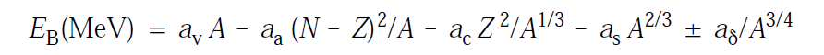
Double Beta Decay and elementary nuclear physics
Even-even
Weiszaecker’s formula for the binding energy of a nucleus
Odd-odd
Nuclear mass as a function of Z,
with fixed A (even)
MASS
Odd-odd
β
X
β⁺β⁺
ECEC
Even-even
DBD
Q-value
Z

Slide 6
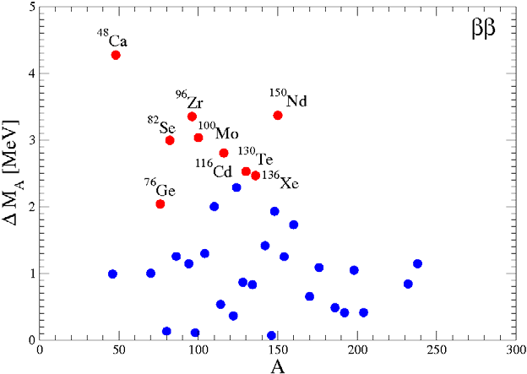
How many nuclei in this condition?
Limit of the ²²²Rn induced radiactivity
Q-value [MeV]
Limit of the γ natural radioactivity
A

Slide 7
Outline
Introduction
Why Double Beta Decay is important
Challenges in front of us
Approaches and technologies
Some relevant experiments
A critical comparison of technologies
Conclusions

Slide 8
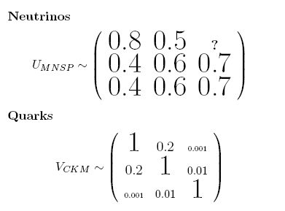

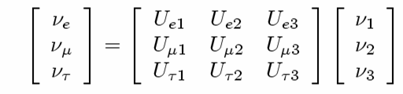
Info from neutrino oscillations
0.026
①
oscillations do occur
neutrinos are massive

given the three ν mass eigenvalues M₁, M₂, M₃ we have
approximate measurements of two ΔM_{ij}²
(ΔM_{ij}² ≡ M_{i}² – M_{j}²)
ΔM₁₂² ~ (9 meV)² Solar
|ΔM₂₃² | ~ (50 meV)² Atmospheric
③
measurements of the 3 angles which parametrize U_{lj}
elements of the
ν mixing matrix
ν₃
ν₂
ν₁
ν_{e}
ν_{μ}
ν_{τ}

Slide 9
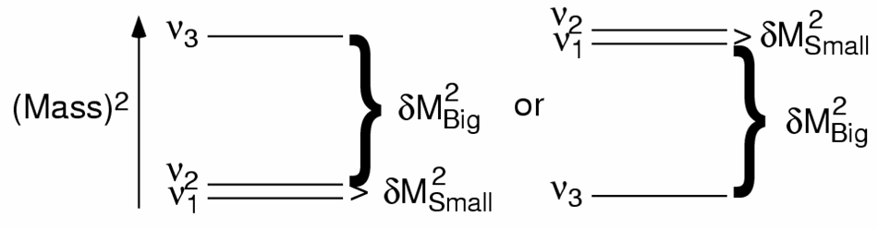
What oscillations don’t tell us
①
absolute neutrino mass scale
degeneracy ? (M₁~M₂~M₃ )
②
neutrino mass hierarchy
direct
inverted
Future oscillation experiments will have access to this parameter
③
DIRAC or MAJORANA nature of neutrinos
ν ≠ ν
ν ≡ ν
small masses (see-saw)
matter-antimatter asymmetry (leptogenesis)

Slide 10
Cosmology, single and double β decay
Cosmology, single and double β decay measure different combinations
of the neutrino mass eigenvalues, constraining the neutrino mass scale
In a standard three active neutrino scenario:
cosmology
simple sum
pure kinematical effect
3
Σ ≡
Σ M_{i}
i=1
1/2
3
β decay
incoherent sum
real neutrino
⟨M_{β}⟩ ≡
Σ M_{i}² |U_{ei}|²
i=1
3
double β decay
coherent sum
virtual neutrino
Majorana phases
⟨M_{ββ}⟩ ≡
|Σ M_{i} |U_{ei}|² e^{iα} |
i
i=1

Slide 11
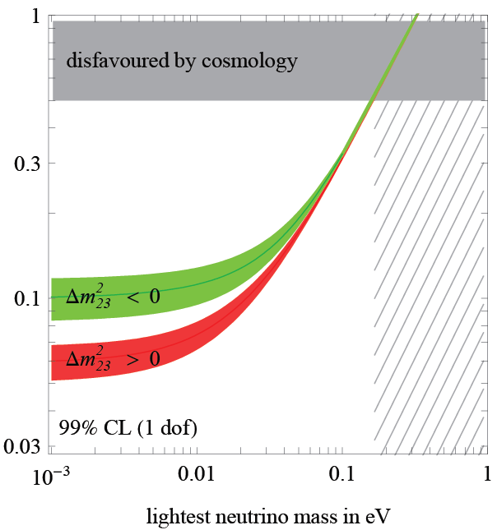
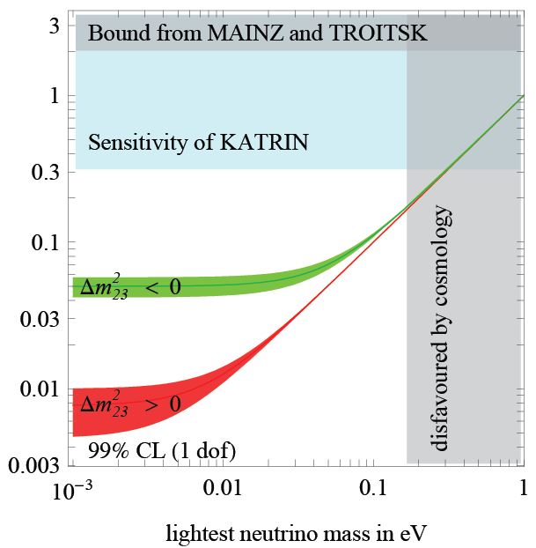
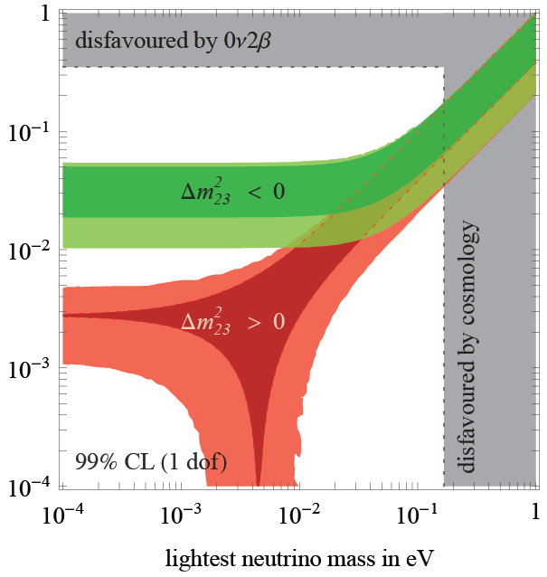
Present bounds
The three constrained parameters
can be plot as a function of the
lightest neutrino mass
Σ [eV]
Two bands appear in each plot,
corresponding to inverted and direct
hierarchy
The two bands merge in the degenerate
case (the only one presently probed)
⟨M_{β}⟩ [eV]
⟨M_{ββ}⟩ [eV]

Slide 12
More in detail: double beta decay and neutrino
u
a LH neutrino (L=1)
is absorbed at this vertex
e⁻
d
With massless neutrinos, the process is forbidden because neutrino has no correct helicity / lepton number to be absorbed at the second vertex
W⁻
ν_{e}
W⁻
ν_{e}
a RH antineutrino (L=-1)
is emitted at this vertex
d
u
e⁻
IF neutrinos are massive DIRAC particles:
0ν-DBD
is forbidden
Helicities can be accommodated thanks to the finite mass,
BUT Lepton number is rigorously conserved
IF neutrinos are massive MAJORANA particles:
0ν-DBD
is allowed
Helicities can be accommodated thanks to the finite mass,
AND Lepton number is not relevant

Slide 13
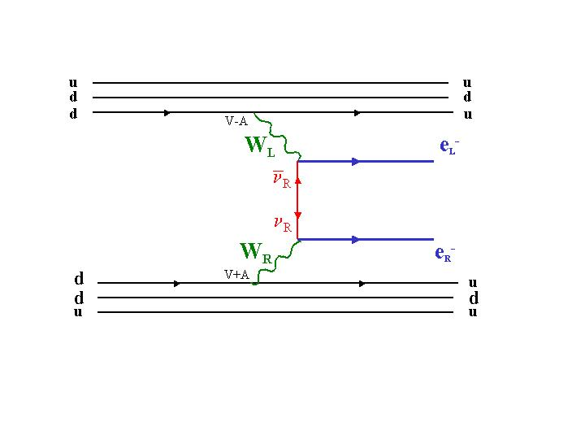
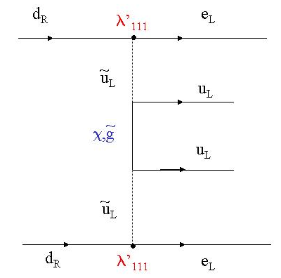
Other possible mechanisms
(V+A) current
<m_{ν}>,<λ>,<η>
SUSY
λ’₁₁₁,λ’₁₁₃λ’₁₃₁,…..
However, independently of the mechanism, the Schechter-Valle theorem states that
m_{ν} ≠ 0
ν ≡ ν
Observation of 0ν-DBD
even if the light neutrino exchange should not provide the dominant contribution

Slide 14
More on the mass mechanism
how 0ν-DBD is connected to neutrino mixing matrix and masses
in case of process induced by light ν exchange (mass mechanism)
neutrinoless
Double Beta Decay
rate
Phase
space
Nuclear
matrix elements
Effective
Majorana mass
1/τ = G(Q,Z) |M_{nucl}|²⟨M_{ββ}⟩ ²
0.026
what the experimentalists
try to measure
parameter containing
the physics:
Effective Majorana mass
what the nuclear theorists
try to calculate
⟨M_{ββ}⟩ = ||U_{e1} | ²M₁ + e^{iα1} | U_{e2} | ²M₂ + e^{iα2} |U_{e3} | ²M₃ |

Slide 15
⟨M_{ββ}⟩
[eV]

Slide 16
Outline
Introduction
Why Double Beta Decay is important
Challenges in front of us
Approaches and technologies
Some relevant experiments
A critical comparison of technologies
Conclusions

Slide 17

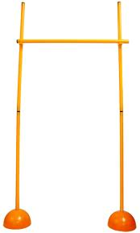
Three hurdles to leap over
⟨M_{ββ}⟩
[eV]
100-1000 counts/y/ton
~300 meV
Klapdor’s claim
0.5-5 counts/y/ton
20 meV
0.1-1 counts/y/(100 ton)
1 meV

Slide 18
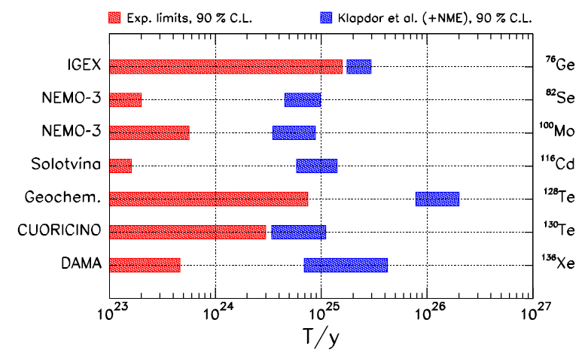
The first leap looks easy but one year ago nobody did it…
Ge experimental range (Klapdor)
1990’s
2000’s
2000’s
Adapted from
A. Faessler et al., Phys. Rev. D79,053001(2009)

Slide 19
…but something new is appearing at the horizon: Xe is coming
KamLAND-ZEN
EXO
Adapted from
A. Faessler et al., Phys. Rev. D79,053001(2009)

Slide 20
Background demands
Present generation experiments, under commissioning or construction, aim at scrutinizing Klapdor’s claim and possibly attacking the inverted hierarchy region
To start to explore the inverted hierarchy region
Sensitivity at the level of 1-10 counts / y ton
To cover the inverted hierarchy region
Sensitivity at the level of 0.1 -1 counts / y ton
The order of magnitude of the target bakground is
~ 1 counts / y ton

Slide 21
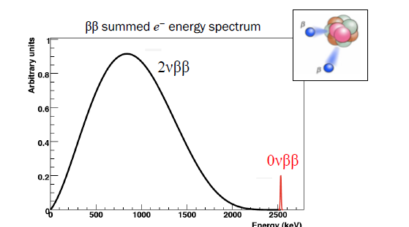
Signal and Background sources
Natural radioactivity of materials
(source itself, surrounding structures)
¹⁰⁰Mo ⇒ 7.1x10¹⁸
¹³⁶Xe ⇒ 2.2x10²¹
Neutrons (in particular muon-induced)
Cosmogenic induced activity (long living)
2 ν Double Beta Decay
δ=ΔE/Q

Slide 22
Experimental approaches
Two approaches:
☹ constraints on detector materials
☺ very large masses are possible
demonstrated: up to ~ 50 kg
proposed: up to ~ 1000 kg
e⁻
①
e⁻
Source ≡ Detector
(calorimetric technique)
☺ with proper choice of the detector,
very high energy resolution
scintillation
phonon-mediated detection
solid-state devices
gaseous/lquid detectors
Ge-diodes
bolometers
☺ in gaseous/liquid xenon detector,
indication of event topology
e⁻
detector
②
source
☹ it is difficult to get large source mass
e⁻
detector
☺ neat reconstruction of event topology
Source ≠ Detector
scintillation
gaseous TPC
gaseous drift chamber
magnetic field and TOF
☺ several candidates can be studied
with the same detector

Slide 23
The sensitivity
sensitivity F: lifetime corresponding to the minimum detectable number
of events over background at a given confidence level
b ≠ 0
b: specific background coefficient
[counts/(keV kg y)]
b = 0
live time
energy resolution
source mass
F ∝ (MT / bΔE)^{1/2}
F ∝ MT
importance of the nuclide choice
(but large uncertainty due to nuclear physics)
1
bΔE
1/4
sensitivity to ⟨M_{ββ}⟩ ∝
Q^{1/2}
|M_{nucl}|
MT

Slide 24
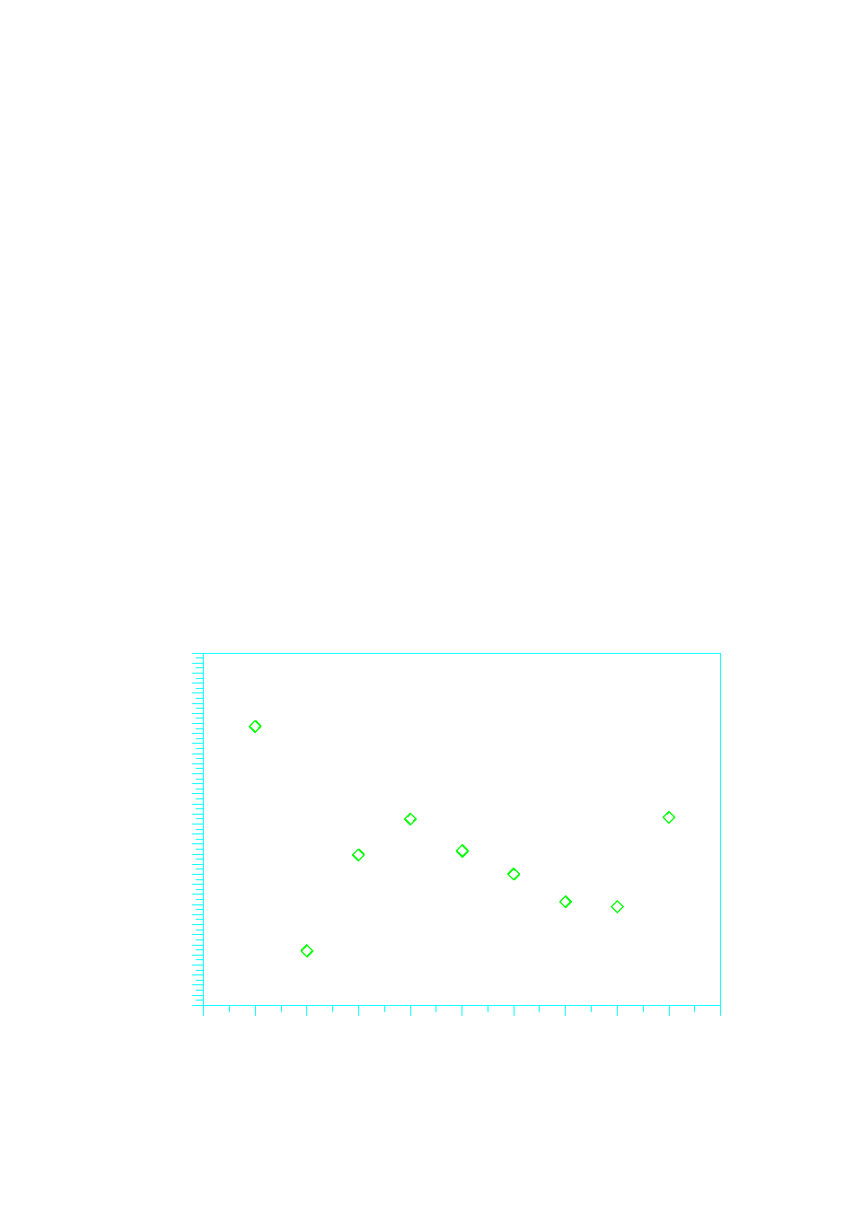

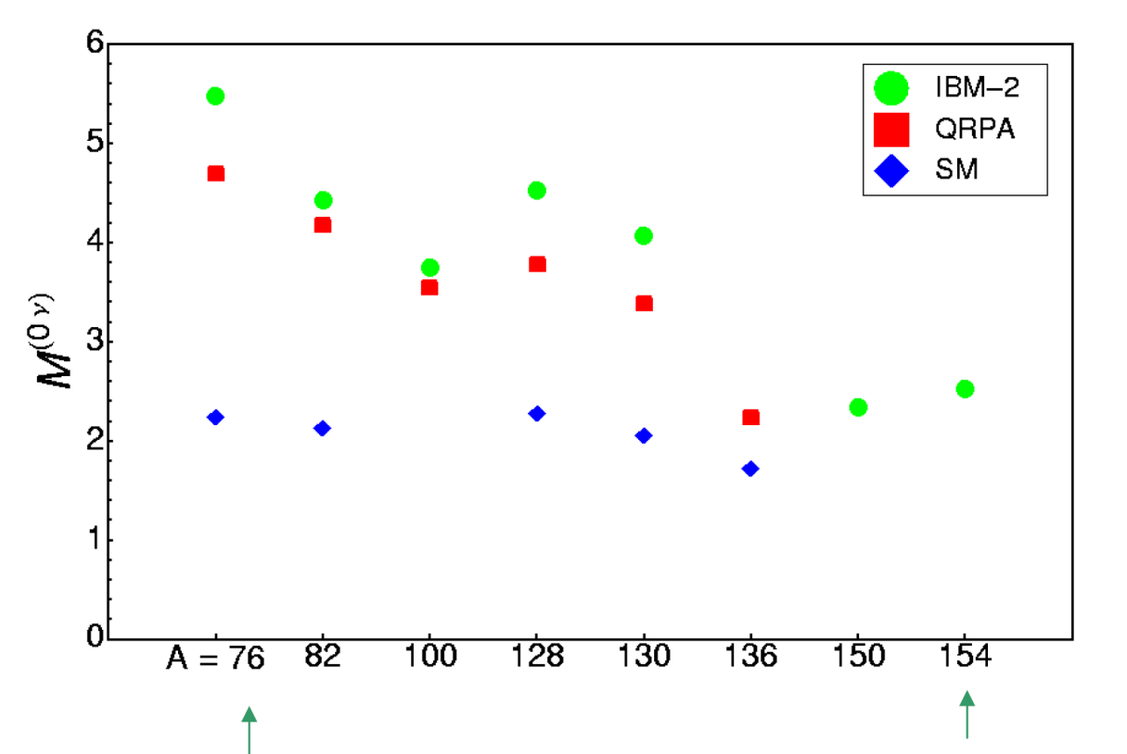
Choice of the nuclide
Transition energy (MeV)
Isotopic abundance (%)
5
40
4
20
3
2
0
Nuclear Matrix Element
⁴⁸Ca
⁷⁶Ge
⁸²Se
⁹⁶Zr
¹⁰⁰Mo
¹¹⁶Cd
¹³⁰Te
¹³⁶Xe
¹⁵⁰Nd
⁴⁸Ca
⁷⁶Ge
⁸²Se
⁹⁶Zr
¹⁰⁰Mo
¹¹⁶Cd
¹³⁰Te
¹³⁶Xe
¹⁵⁰Nd
No super-favoured isotope !
Sign of convergence!

Slide 25
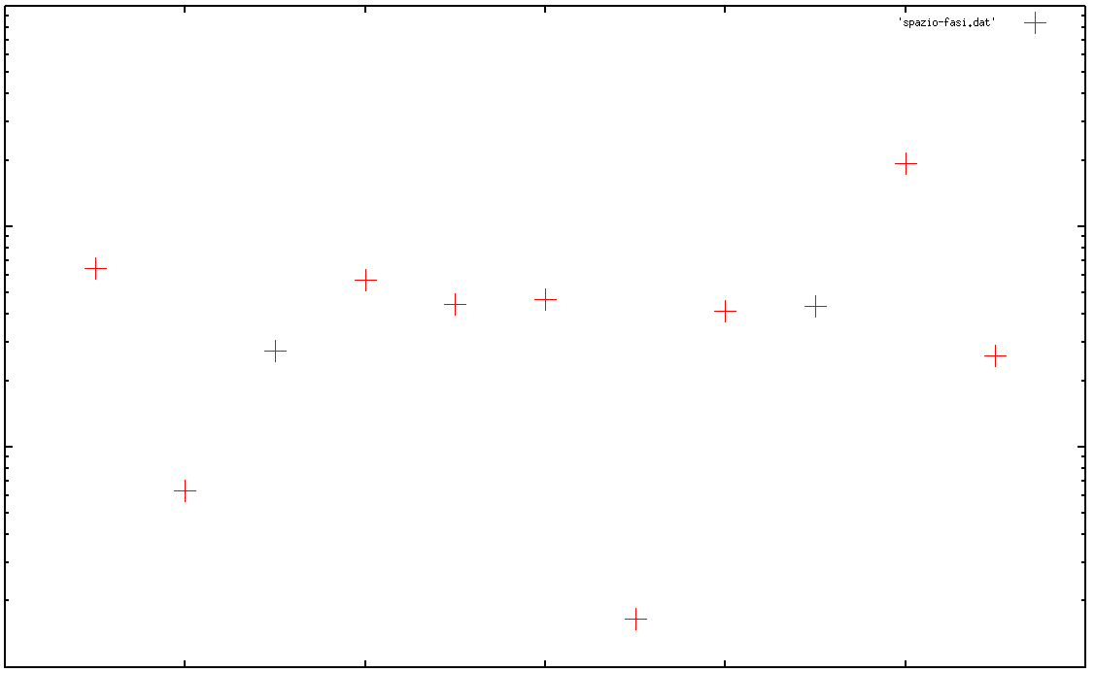
R0=1.2fm & gA=1.25
But do not forget the phase space!
G_{ον} [y⁻¹]
Suhonen et al., R₀ =1.2 fm & g_{A} = 1.25
10⁻¹²
10⁻¹³
10⁻¹⁴
10⁻¹⁵
⁴⁸Ca ⁷⁶Ge ⁸²Se ⁹⁶Zr ¹⁰⁰Mo ¹¹⁶Cd ¹²⁸Te ¹³⁰Te ¹³⁶Xe ¹⁵⁰Nd ¹²⁴Sn

Slide 26
Outline
Introduction
Why Double Beta Decay is important
Challenges in front of us
Approaches and technologies
Some relevant experiments
A critical comparison of technologies
Conclusions

Slide 27
Experiment classification criteria
e⁻
e⁻
High energy resolution (<1%)
Source ≡ Detector
Easy to reject 2ν DBD background
Easy to approach the ton scale
e⁻
detector
source
e⁻
detector
Tracking / topology capability
Source ≠ Detector
Easy to get tracking capability
Easy to identify events

Slide 28
Class 1 experiments
e⁻
e⁻
High energy resolution (<1%)
Source ≡ Detector
Easy to reject 2ν DBD background
Easy to approach the ton scale
GERDA – ⁷⁶Ge
Array of enriched Ge diodes operated in liquid argon
First phase: 18 Kg; second phase: 40 Kg - LNGS
Proved energy resolution: 0.2 % FWHM
CUORE – ¹³⁰Te
Array of low temperature natural TeO₂ calorimeters operated at 10 mK
First step: 200 Kg (2014) – LNGS – it can take advantage from Cuoricino experience
Proved energy resolution: 0.2 % FWHM
MAJORANA – ⁷⁶Ge
Array of enriched Ge diodes operated in conventional Cu cryostats
Based on modules; first step (demonstrator): 2x20 Kg modules
Proved energy resolution: 0.16 % FWHM
LUCIFER – ⁸²Se – ¹¹⁶Cd – ¹⁰⁰Mo
Array of scintillating bolometers operated at 10 mK (ZnSe or ZnMoO₄ or CdWO₄ )
First step: ~ 10 Kg (2014) – LNGS – essentially R&D project to fully test the principle
Proved energy resolution: 0.3 – 0.7 % FWHM
e⁻
detector
source
e⁻
detector
Tracking / topology capability
Source ≠ Detector
Easy to get tracking capability
Easy to identify events

Slide 29
Class 2 experiments
e⁻
KamLAND-ZEN – ¹³⁶Xe
Dissolve Xe gas in KAMLAND liquid scintillator – feasible at 3% wt
Use a dedicated balloon immersed in the main vessel
Increase number of PM and change scintillator – 300 kg of enriched Xe in the first phase
SNO+ – ¹⁵⁰Nd
SNO detector filled with Nd-loaded liquid scintillator
0.1% loading with natural Nd → 1000 Kg Nd in 1000 tons scintillators → 56 Kg of isotope
Crucial points: Nd enrichment and purity; ¹⁵⁰Nd nuclear matrix elements
XMASS – ¹³⁶Xe
Multipurpose scintillating liquid Xe detector (Dark Matter, Double Beta Decay, solar neutrinos)
Three development stages: 3 Kg (prototype) ⇒ 1 ton ⇒ 10 ton
DBD option: low background in the MeV region
Special development with an elliptic water tank to shield high energy gamma rays
High light yield and collection efficiency ⇒ energy resolution down to 1.4% ⇒ control 2ν background
Target: to cover inverted hierarchy with 10 ton natural or 1 ton enriched
CANDLES – ⁴⁸Ca
Array of natural pure (not Eu doped) CaF₂ scintillators
Prove of principle completed (CANDLES I and II)
Proved energy resolution: 3.4 % FWHM (extrapolated from 9.1 % at 662 keV)
The good point of this search is the high Q-value of ⁴⁸Ca: 4.27 MeV
out of γ (2.6 MeV end point), β (3.3 MeV end point) and α (max 2.5 MeV with quench)
Other background cuts come from PSD and space-time correlation for Bi-Po and Bi-Tl
e⁻
High energy resolution (<1%)
Source ≡ Detector
Easy to reject 2ν DBD background
Easy to approach the ton scale
e⁻
detector
source
e⁻
detector
Tracking / topology capability
Source ≠ Detector
Easy to get tracking capability
Easy to identify events

Slide 30
Class 3 experiments
e⁻
e⁻
High energy resolution (<1%)
EXO – ¹³⁶Xe
TPC of enriched liquid (first phase) and gaseous (second phase) Xenon
Event position and topology; in prospect, tagging of Ba single ion (DBD daughter) through optical spectroscopy ⇒ only 2ν DBD background
EXO-200: funded, taking data: 200 kg – WIPP facility
Further steps: 1-10 ton
In parallel with the EXO-200 development, R&D for Ba ion grabbing and tagging
COBRA - ¹¹⁶Cd competing candidate – 9 ββ isotopes
Array of ¹¹⁶Cd enriched CdZnTe of semiconductor detectors at room temperatures
Small scale prototype at LNGS
Proved energy resolution: 1.9% FWHM
Pixellization can provide tracking capability
Source ≡ Detector
Easy to reject 2ν DBD background
Easy to approach the ton scale
e⁻
detector
source
e⁻
detector
Tracking / topology capability
Source ≠ Detector
Easy to get tracking capability
Easy to identify events

Slide 31
Class 4 experiment
e⁻
e⁻
High energy resolution (<1%)
Source ≡ Detector
Easy to reject 2ν DBD background
Easy to approach the ton scale
NEXT – ¹³⁶Xe
High pressure gas TPC
Total mass: 100 kg
Aims at energy resolution down or below 1% FWHM exploiting electroluminesce in high field region
Two prototypes have substantially proved the detection concept and the performance
e⁻
detector
source
e⁻
detector
Tracking / topology capability
Source ≠ Detector
Easy to get tracking capability
Easy to identify events

Slide 32
Class 5 experiments
SUPERNEMO - ⁸²Se or ¹⁵⁰Nd
Modules with source foils, tracking (drift chamber in Geiger mode) and calorimetric (low Z scintillator) sections - Magnetic field for charge sign
Possible configuration: 20 modules with 5 kg source for each module ⇒ 100 Kg in Modane extension
Energy resolution: 4 % FWHM
It can take advantage of NEMO3 experience
BiPo construction to measure the source activity (Canfranc)
First step: construction of a single module (demonstrator)
MOON - ¹⁰⁰Mo or ⁸²Se or ¹⁵⁰Nd
Multilayer plastic scintillators interleaved with source foils + tracking section (PL fibers or MWPC)
MOON-1 prototype without tracking section (2006)
MOON-2 prototype with tracking section
Proved energy resolution: 6.8 % FWHM
Final target: collect 5 y x ton
DCBA - ¹⁵⁰Nd
Momentum analyzer for beta particles consisting of source foils inserted in a drift chamber with magnetic field
Realized test prototype DCBA-T2: space resolution ~ 0.5 mm; energy resolution 11% FWHM at 1 MeV
⇒ 6 % FWHM at 3 MeV
Test prototype DCBA-T3 under construction: aims at improved energy resolution thanks to higher magnetic field (2kG) and higher space resolution
Final target: 10 modules with 84 m² source foil for module (126 through 330 Kg total mass)
e⁻
e⁻
High energy resolution (<1%)
Source ≡ Detector
Easy to reject 2ν DBD background
Easy to approach the ton scale
e⁻
detector
source
e⁻
detector
Tracking / topology capability
Source ≠ Detector
Easy to get tracking capability
Easy to identify events

Slide 33
Outline
Introduction
Why Double Beta Decay is important
Challenges in front of us
Approaches and technologies
Some relevant experiments
A critical comparison of technologies
Conclusions

Slide 34
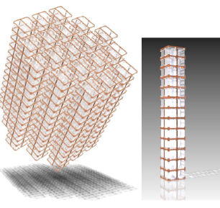
Class 1
CUORE
Technique/location: natural 988 TeO₂ bolometers at 10-15 mK– LNGS (Italy)
evolution of Cuoricino
Source: TeO₂ – 741 kg with natural tellurium - 9.5x10²⁶ nuclides of ¹³⁰Te
Sensitivity: 41 – 95 meV (5 years) – approach/attack inverted hierarchy region
Timeline: first CUORE tower in 2012 (CUORE-0)
data taking with full apparatus in 2015
Detector in the custom fridge
Structure of the detector

Slide 35
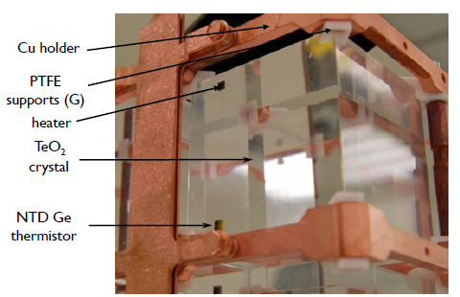
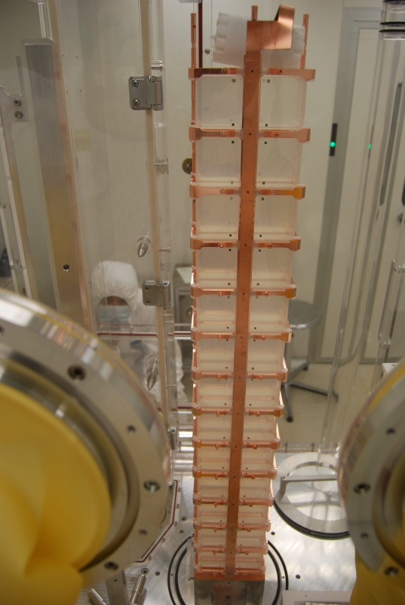
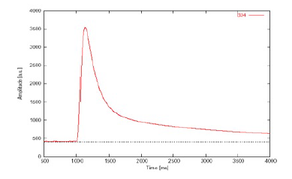
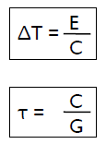
Class 1
CUORE-0
First CUORE tower, just assembled (April 2012) – waiting to be cooled down in former Cuoricino cryostat (LNGS)

Slide 36
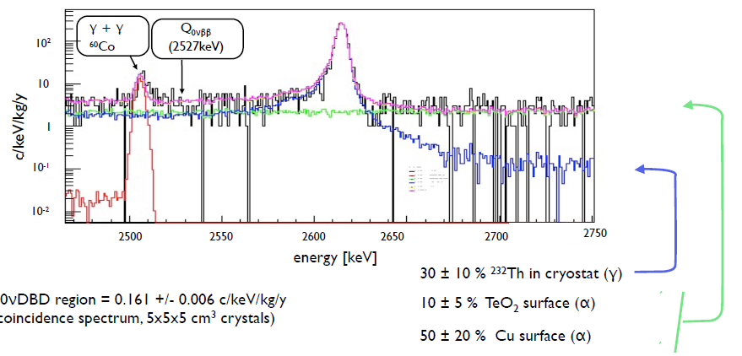
Class 1
CUORE background
Cuoricino experience + dedicated tests in the CUORE R&D phase clearly shows the most critical background component
Cuoricino background model
Background budget
Dominant contribution: energy-degraded alphas from Cu surface facing detectors
It will contribute at a level of 2.5x10⁻² counts/(keV kg y)
If removed, 1 order of magnitude lower background would be possible!

Slide 37
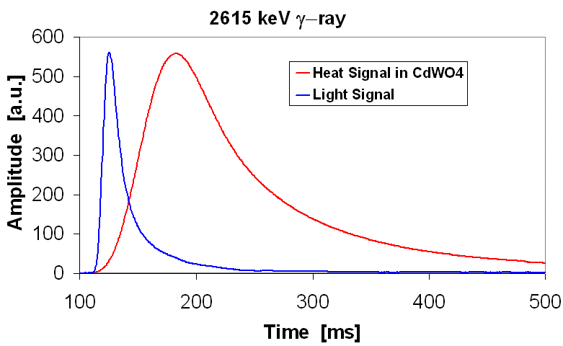
LUCIFER and scintillating bolometers
Class 1
Technique/location: scintillating enriched bolometers at 10 mK – LNGS (Italy)
Source: options: ⁸²Se, ¹⁰⁰Mo, ¹¹⁶Cd – realistic amount: 7x10²⁵ ⁸²Se nuclides
Sensitivity: ~100 meV in 5 years but difficult to state now
(uncertainty on enrichment and purification processes)
Timeline: R&D set-up with significant mass: 2014
Real light and heat signals acquired with a CdWO₄ scintillating bolometer

Slide 38
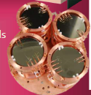
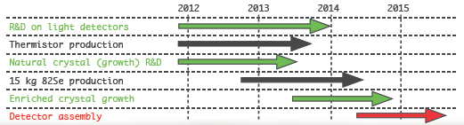
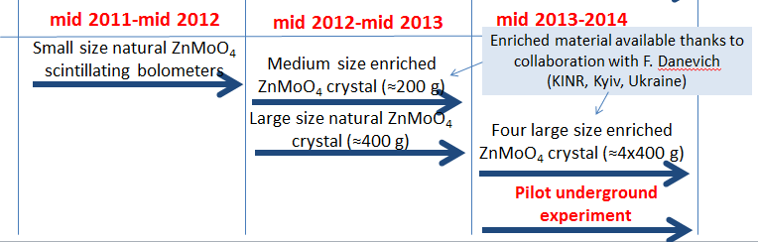
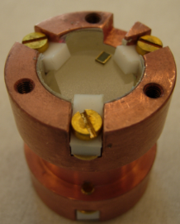
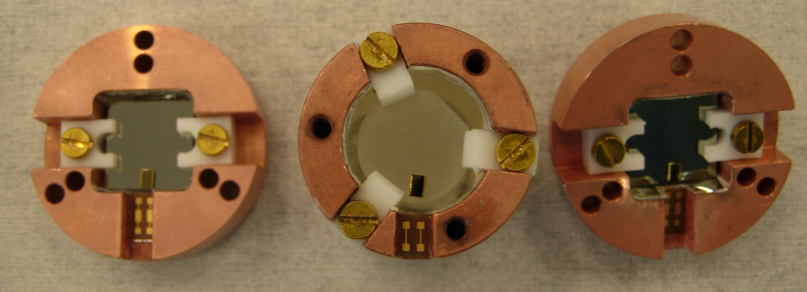
Class 1
LUCIFER and scintillating bolometers
Two lines
(1) ⁸²Se – ZnSe crystals - funded by ERC advanced grants – LNGS
10-15 kg enriched isotope
(2) ¹⁰⁰Mo – ZnMoO₄ crystals – approved for funding in France (ANR LUMINEU)
1 kg enriched isotope

Slide 39
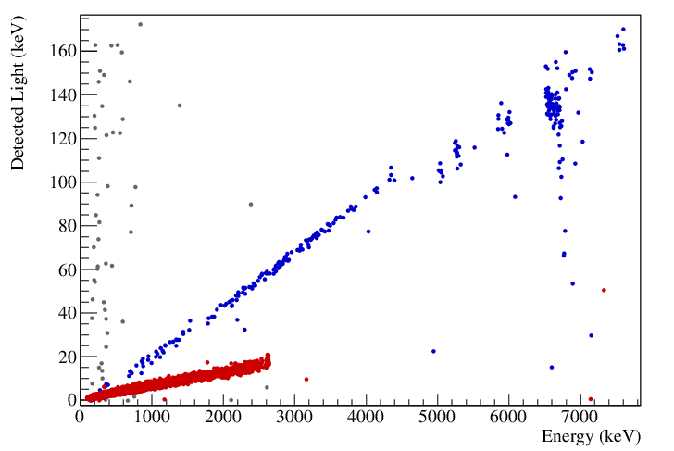
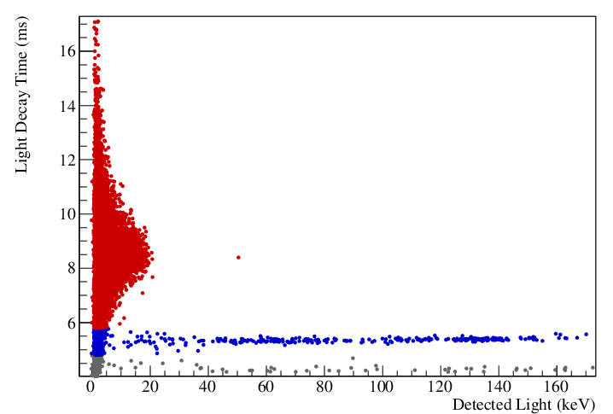
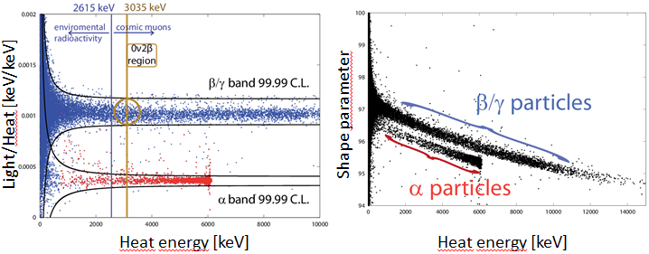
LUCIFER and scintillating bolometers
Class 1
Example of alpha/beta separation in large ZnSe crystal (~400 g) - LNGS
Light vs Heat
Decay time in the light signal vs Light
alphas
betas
Example of alpha/beta separation in prototype ZnMoO₄ bolometer (Orsay)
Pulse shape discrimination in the heat signal
MC estimation of the background:
4x10⁻⁴ counts/(keV kg y)
Phys. Lett. B 710, 318 (2012)

Slide 40
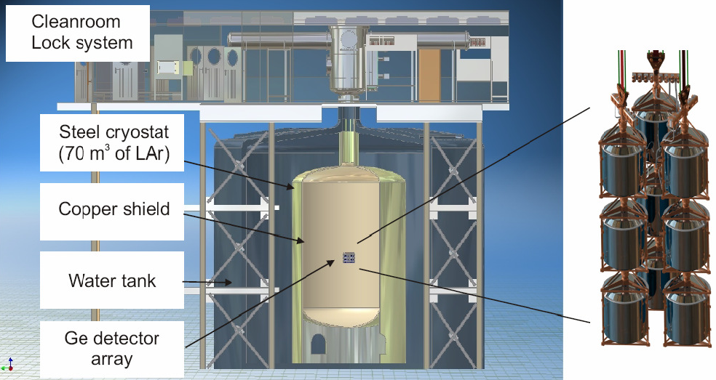
Class 1
GERDA
Taking data
Technique/location: bare enriched Ge diodes in liquid argon – LNGS (Italy)
Source: Ge - 14.6 kg – ⁷⁶Ge enriched at 86% - 9.7x10²⁵ nuclides (phase 1)
Sensitivity: it can scrutinize Klapdor’s claim in ~1 year data taking
Timeline: GERDA phase-I is taking data in a physics run

Slide 41
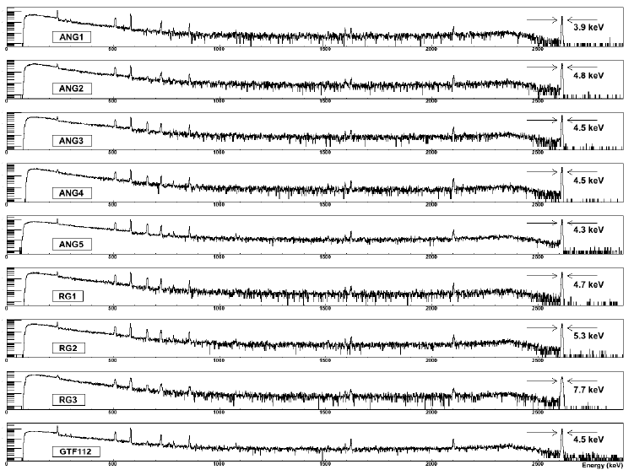
Class 1
GERDA-phase 1 - status
After some excess background in the debugging phase with normal crystals due to a higher than expected contamination of ⁴²Ar, now with enriched crystals the background is close to the expectation: 1.7x 10⁻² counts/(keV kg y)
Two detectors out of nine exhibit anomalous leakage current and have been eliminated
Typical calibration energy spectra with energy resolution at 2615 keV
(typically ~5 keV FWHM)

Slide 42
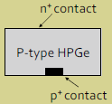
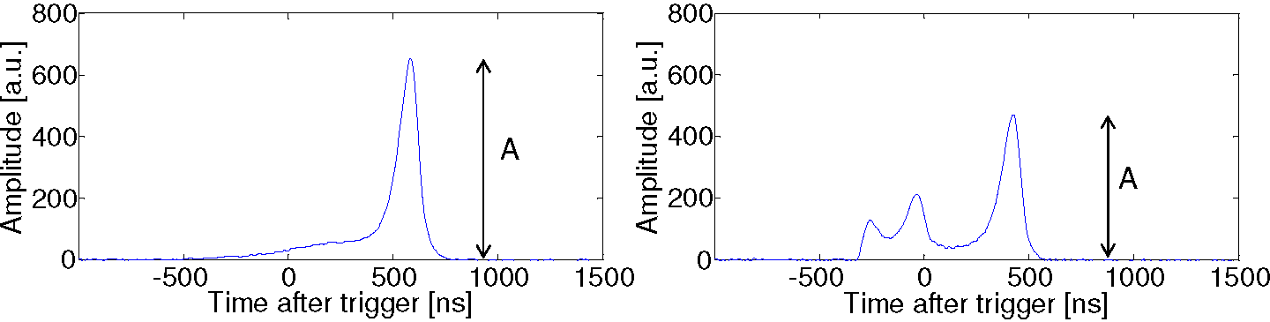
Class 1
GERDA – new detectors
BEGe detectors are p-type HPGe’s with a n+ contact covering the whole outer surface and a small p+ contact located on the bottom. Main properties: enhanced Pulse Shape Discrimination properties, which can be exploited for background reduction purposes
Single site event
Multi site event
γ event
ββ event

Slide 43
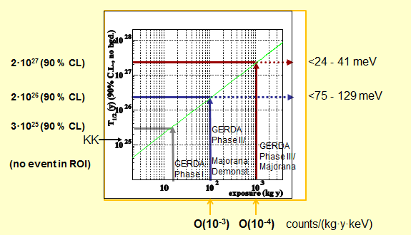
Class 1
GERDA - prospects

Slide 44
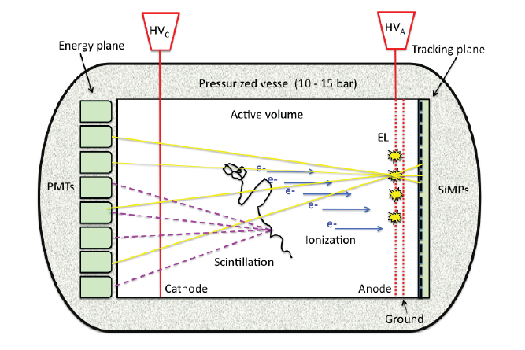
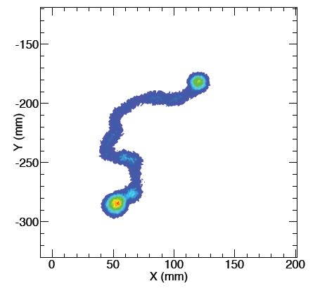
Class 4
NEXT
Technique/location: High pressure (10 bar) enriched Xe TPC – Canfranc (Spain)
Source: ¹³⁶Xe enriched at 90% - 89 kg corresponding to 3.9x10²⁶ nuclides
Sensitivity: better than 100 meV in 5 years
Timeline: prototypes are working – commissioning of full detector in 2014
Energy: both electroluminescence and direct scintillation are recorded in the photosensor plane behind the transparent cathode
Tracking: exploit electroluminescence light generated at the anode and recorded in the photosensor plane behind it
Double beta decay event (MC)
Energy resolution is crucial in Xe
¹³⁶Xe Q-value: 2458 keV
Highest energy line of ²¹⁴Bi: 2447 keV
arXiv:1202.0721

Slide 45
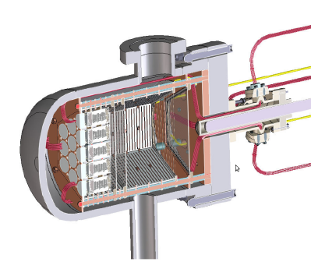
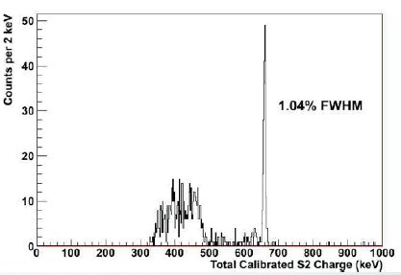
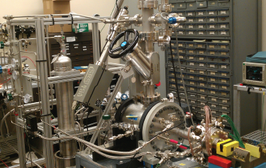
Class 4
NEXT – energy resolution in prototype (1)
NEXT-DBDM (LBNL) : short drift, high solid angle, one plane of PMTs (SiPM plane under way) -
¹³⁷Cs calibration
~0.53 % at DBD energy
(but in central region)

Slide 46
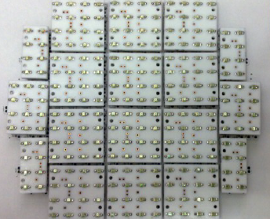
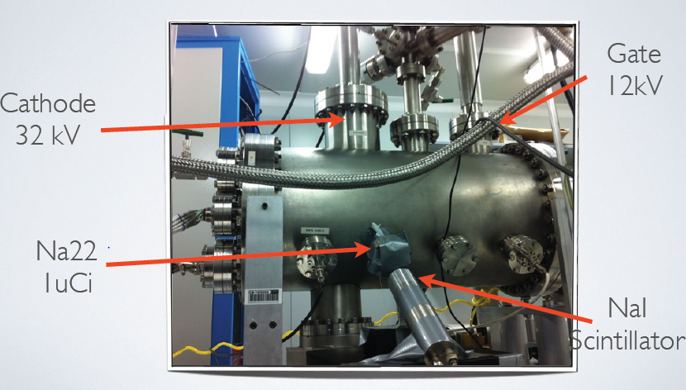
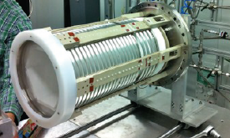
Class 4
NEXT – energy resolution in prototype (2)
NEXT-DEMO: long drift, “small” solid angle, two plane of PMTs (SiPM plane starting soon)
Energy resolution in all fiducial volume: 1.1 % FWHM in DBD region
(after applying corrections taking into account the zone of the interaction)

Slide 47
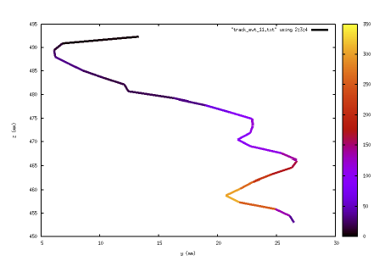
Class 4
NEXT – tracking in prototype (2)
NEXT-DEMO: track of an electron produced by a 662 keV gamma

Slide 48
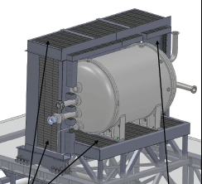
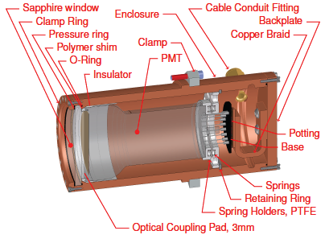
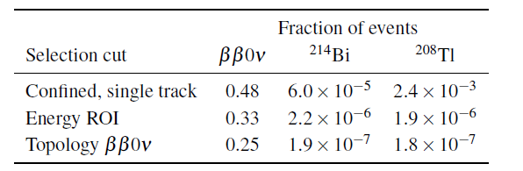
Class 4
NEXT – background
Shielding
Estimation od the background generated by high energy gammas (²¹⁴Bi line at 2447 keV and ²⁰⁸Tl line at 2615 keV) reaching the active volume by applying 3 selection cuts:
single track confined within the active volume
energy falls in the region of interest, defined as 0.5 FWHM around Q
the spatial pattern of energy deposition corresponding to that of a DBD track (blobs in both ends).
Estimated background:
8x10⁻⁴ counts/(keV kg_{isotope} y)

Slide 49
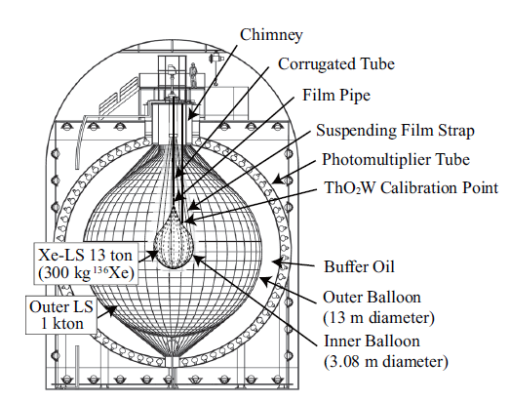
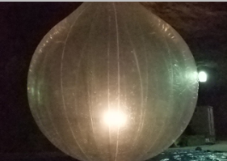
Class 2
KamLAND-ZEN
Taking data
Technique/location: enriched Xenon dissolved in liquid scintillator - Kamioka
Source: ¹³⁶Xe enriched at 91% - 300 kg (129 kg fiducial ⇒ 5.2x10²⁶ nuclides)
Sensitivity: limit obtained: 300 – 600 meV
Timeline: presently in pause
Totally different approach wrt NEXT
Moderate energy resolution
No tracking/topology but impact point (fiducial volume)
Coincidence cuts
arXiv:1201.4664v2

Slide 50

Class 2
KamLAND-ZEN – results
For the second time (see EXO) 2ν DBD of ¹³⁶Xe is measured, resulting ~5 times faster than a previous limit
T^{2ν}_{1/2} = 2.38 ± 0.02(stat) ± 0.14(syst) × 10²¹
The background in the region of interest is almost two orders of magnitude higher than expected: monochromatic contributions of unclear origin
The low energy resolution (~9% FWHM) doesn’t help in the comprehension of the background
T^{0ν}_{1/2} > 5.7 × 10²⁴ (90% c.l.)
77.6 days X 129 kg (fiducial volume)

Slide 51

Class 3
EXO
Taking data
Technique/location: phase 1: liquid enriched Xe TPC – WIPP (New Mexico, US)
Source: Xe - 200 kg – ¹³⁶Xe enriched at 80% - 7.1x10²⁶ nuclides
Sensitivity: limit obtained 140 – 380 meV
Timeline: phase 1 data taking – phase 2: R&D (Ba tagging)
Spatial resolution offered by the charge and light readout allows to distinguish single site (SS) events – signal – from multisite (MS) events – background.

Slide 52



Class 3
EXO
Detail of the field cage
Detail of the LAAPD read-out plane
Detail of the wires

Slide 53

Class 3
EXO - results
For the first time 2ν DBD of ¹³⁶Xe is measured, in excellent agreement with the KamLAND-ZEN result
T^{2ν}_{1/2} = 2.11 ± 0.04(stat) ± 0.21(syst) × 10²¹
Multisite events
Single site events
PRL 107, 212501 (2011)

Slide 54

Class 3
EXO - results
In the 0ν DBD of ¹³⁶Xe the limit obtained by EXO is excellent and starts to attack seriously the Klapdor claim
Zoom in the region of DBD
32 kg y
Multisite events
Single site events
(potential signal)
Background:
1.5x10⁻³ counts/(keV kg y)
arXiv:1205.5608v1

Slide 55

Class 3
EXO - results
Energy resolution: improved thanks to charge-light correlation (~3.9% FWHM)

Slide 56

Class 3
EXO and Klapdor

Slide 57
Outline
Introduction
Why Double Beta Decay is important
Challenges in front of us
Approaches and technologies
Some relevant experiments
A critical comparison of technologies
Conclusions

Slide 58
The path to the limit
Take energy resolution [keV]
ΔE
Take specific background coefficient [counts/(keV kg y)]
b
Multiply them [counts/(kg y)]
ΔExb
Multiply by detector mass, live time → bkg counts
ΔExbxMxT
Calculate limit
N_{lim}
Invert, multiply by number of atoms and live time
T x N_{at}/ N_{lim}
Figure of Merit for the technology
Scalability of the technology

Slide 59
The experiments from the ΔExb point of view
1
Cuoricino
done/running/proved
anticipated by MC
10⁻¹
HM
CUORE
SNO+
10⁻²
GERDA-1
EXO-200
KamLAND-ZEN
b [counts/(keVkg(isotope) y)]
MAJORANA
LUCIFER
Or upgrade of
bolometers
10⁻³
GERDA-2
NEXT
NEMO-3
1 c/(kg y)
Super
NEMO
10⁻⁴
0.1 c/(kg y)
0.001 c/(kg y)
KamLAND-ZEN
0.0001 c/(kg y)
10⁻⁵
1
10
100
1000
0.01 c/(kg y)
ΔE _{FWHM} [keV]

Slide 60

A dimension is missing…
Scalability of the technique
Excellent for Xe-based techniques
Reasonable for Ge/bolometers
Bad for external source approach

Slide 61
Outline
Introduction
Why Double Beta Decay is important
Challenges in front of us
Approaches and technologies
Some relevant experiments
A critical comparison of technologies
Conclusions

Slide 62
Future bounds
Exciting times for neutrino masses:
degeneracy will be deeply probed
discovery potential in case of
inverted hierarchy
PLANCK +
larger surveys
Σ [eV]
Present generation
⟨M_{β}⟩ [eV]
⟨M_{ββ}⟩ [eV]

