Slide 1

Status of PAU
(Physics of the Accelerating Universe)
Consolider Project
Enrique Fernández (UAB/IFAE)
XL International Meeting on Fundamental Physics, Benasque 31/5/12.

Slide 2
PAU precedents
The PAU Project originated in the
Consolider Ingenio 2010 Program of (former) MICINN.
Project was approved in 2007 (ref. CSD2007-0060).
CIEMAT (Madrid), IAA (Granada), ICE-IEEC (Barcelona), IFAE-UAB (Barcelona),
IFIC-UV (Valencia), IFT-UAM (Madrid), PIC (Barcelona).
Effective start: beginning of 2008.
Have asked for a year extension.
Ref.: http://www.pausurvey.org/home-PAU.html

Slide 3
PAU precedents
Main ideas:
Conduct large photometric red-shift survey.
Emphasis in measuring Dark Energy probes.
Build appropriate instrument with Consolider funds (PAUCam).

Slide 4
PAU at the WHT
Fall 2009: approached the ING management about the possibility of installing PAUCam at the prime focus of WHT (4.2 m). Encouraged to pursue the idea.
April 2010: submitted detailed proposal to ING board for wide-field camera, equipped with large number of narrow-band filters.
June 2010: we got further encouragement from the ING board as a visiting instrument:
“The Board has approved the instrument visitor status for now, and is very keen on exploring additional means of access to the telescope that would give you the number of WHT nights needed for the proposed science).”
PAUS (PAU Survey)

Slide 5
PAUS Team (almost 100% correlation with DES-Spain)
CIEMAT
E. Sánchez, F. J. Rodríguez, I. Sevilla
J. Castilla, J. de Vicente
R. Ponce, F. J. Sánchez
ICE/IEEC
F. J. Castander, E.Gaztañaga, P. Fosalba, A. Bauer, C. Bonnet, M.Crocce, S. Farrens, S.Jouvel
R. Casas, J. Jiménez, F. Madrid, S. Serrano
J. Asorey, M. Eriksen, A. Izard, K. Hoffman, C.López, A. Pujol
IFAE
E. Fernández, R. Miquel, C. Padilla, A. Pacheco, (S. Heinis, starting in September)
O. Ballester, L. Cardiel, F. Grañena, C. Hernández, L. López, M. Maiorino, C. Pio
P. Martí, C. Sánchez
C. Arteche, J. Gaweda
PIC
M. Delfino,, V. Acín, J. Carretero, M. Caubet, J.Flix, C. Neissner, P. Tallada, N. Tonello, E. Planas
UAM
J. García-Bellido, D. Sapone, S. Nesseris
Alicia Bueno, David Alonso
Color Code
Senior Scientists
Post-docs
Engineers
Doctoral Students
Technicians

Slide 6
PAU at the WHT: work for the last 2 years:
Interactions with WHT (technical/administrative).
Preparation of the science of PAUS (PAU-Survey).
Design and construction of PAUCam.
Design and construction of the PAUCam data management system.
Interactions with Consolider Program (political).

Slide 7
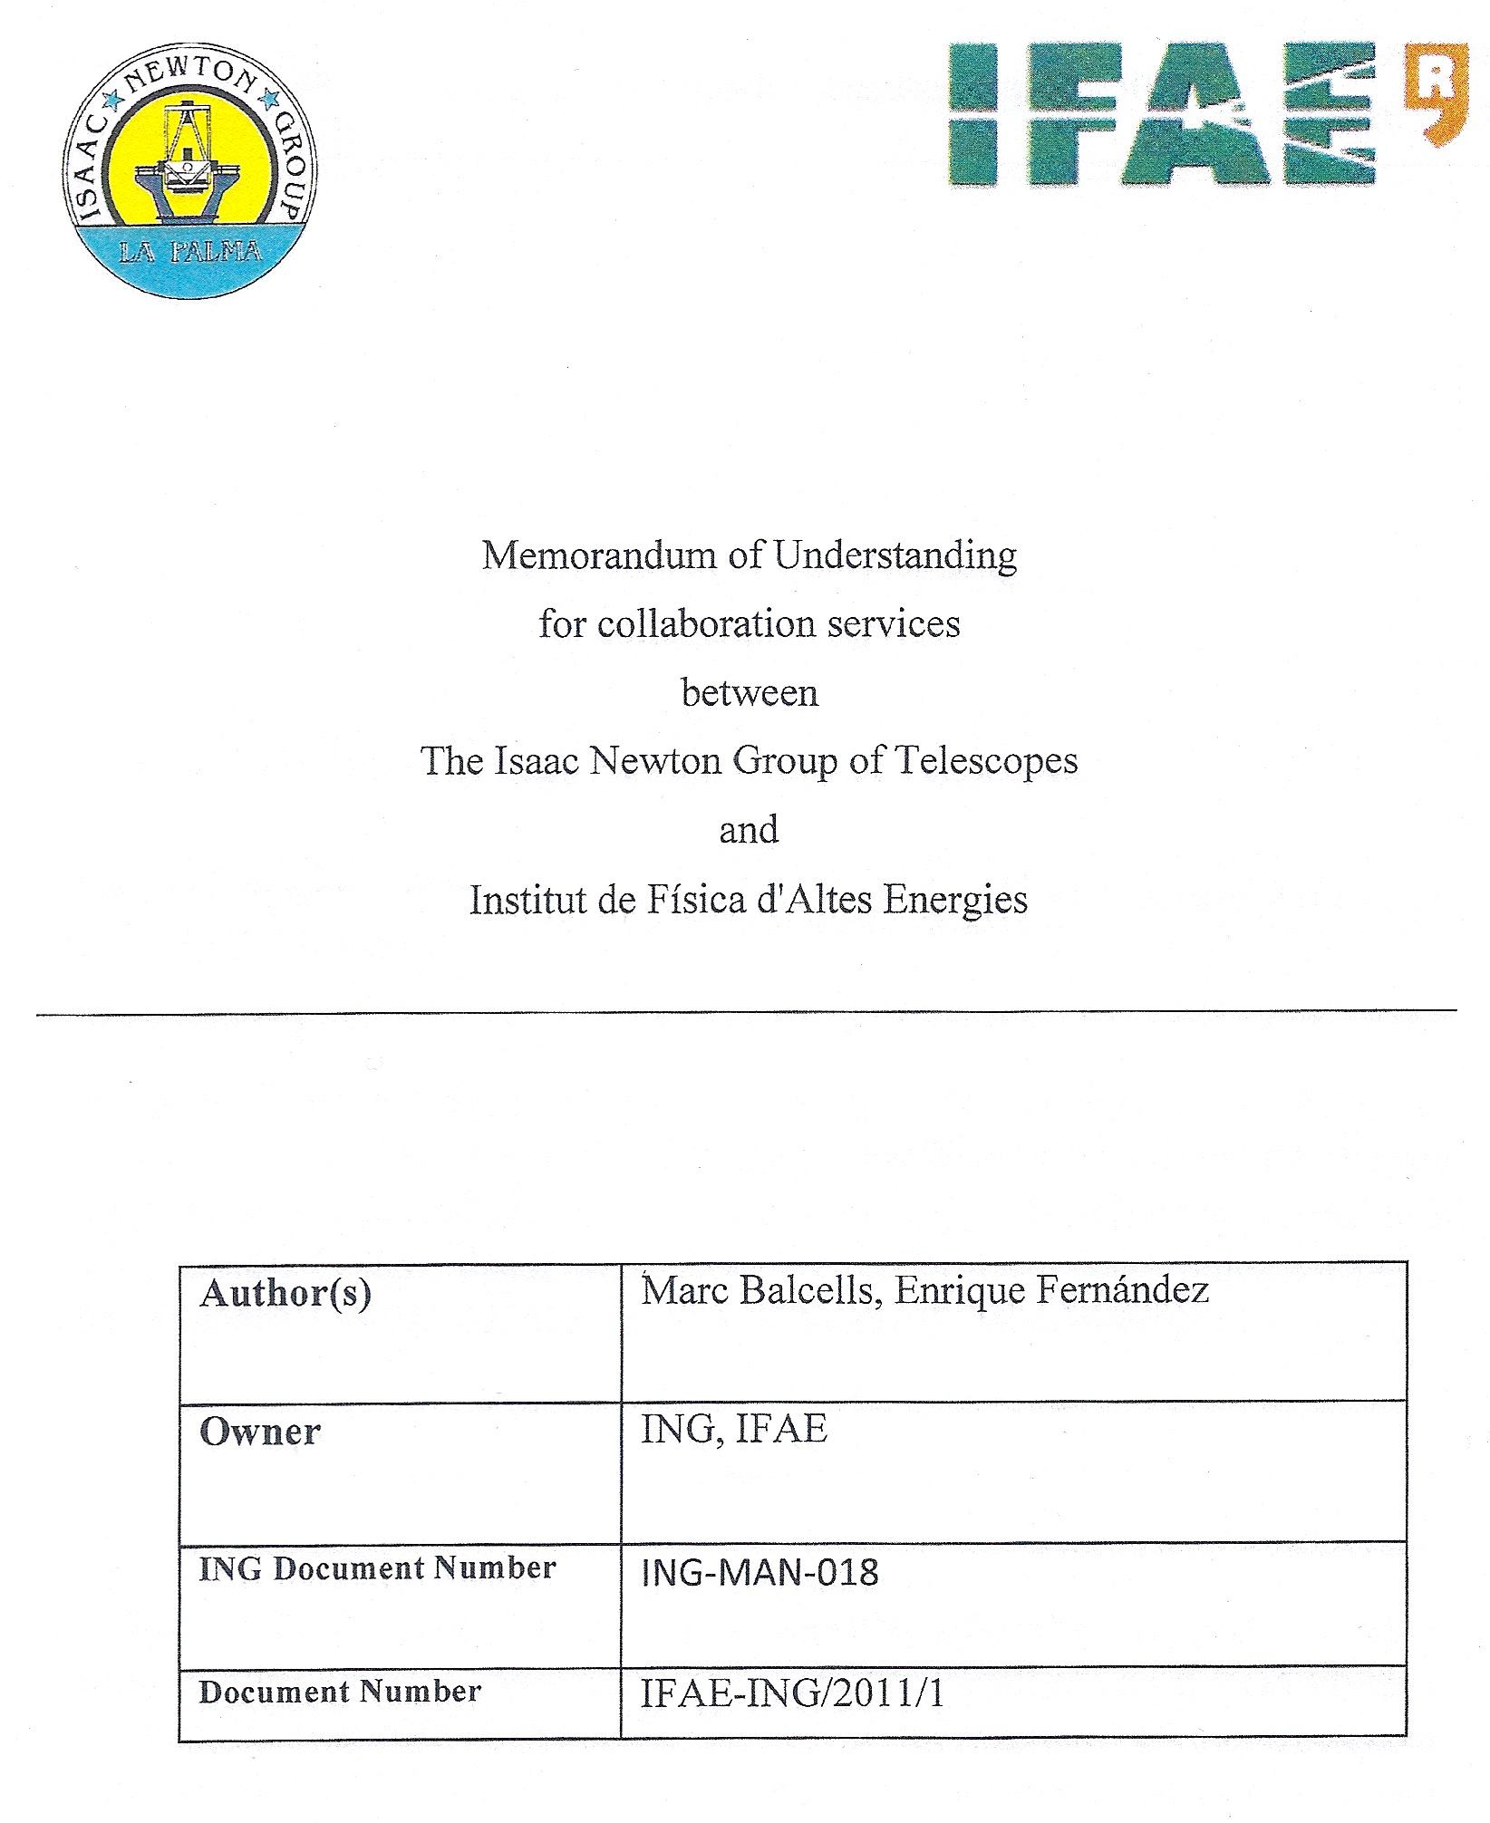
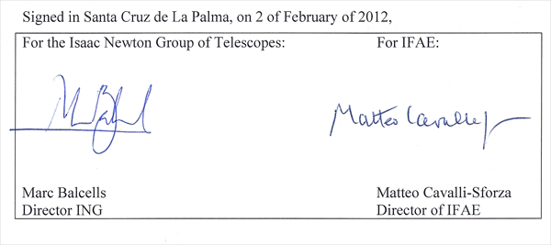
PAU at the WHT (administrative)
An MOU has been signed recently
between the ING and IFAE directors.

Slide 8
PAU at the WHT
Among other things the MOU establishes that:
PAUCam will be a visitor instrument also available for public use. The camera will have 42 narrow-band filters and 6 wide-band filters (u.g.r.i.z.Y).
We will station a “scientific postdoc” at La Palma integrated with the WHT personnel.
We will also provide a public data-reduction pipeline.

Slide 9
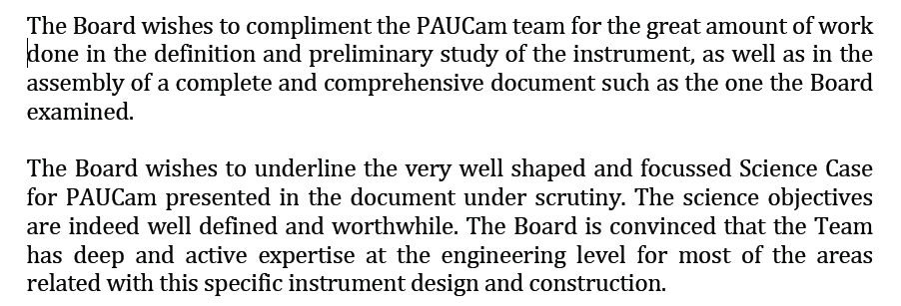
PAU at the WHT (administrative-technical)
We have appointed an External Review Panel, of the design of PAUCam (193 pg. document), which convened in Dec. of 2010.
Members: D. Baade, O. Boulade, M. Riva, O. Iwert, R. Sharples, F. Zerbi.
Also attended: M. Balcells (ING Director) and D. Cano (WHT chief engineer).
From the report:

Slide 10
PAUS (PAU-Survey) Scientific Goals
We expect to obtain ≈ 100 nights during the 4-year period 2013-2016.
Scientific goals for PAU/WHT will focus on measuring:
Red-shift Space Distortions.
Weak Lensing Magnification.
To exploit these, we will measure (over the same area):
Bright galaxy sample (i_{AB} < 22.5) with high redshift resolution of σ_{z} = 0.0035 (1+z).
Faint sample 22.5 < i_{AB} < 24 with σ_{z} = 0.05 (1+z).
➔ PAUCam will use 42 narrow-band (10nm) filters covering ≈ 470-830 nm and six wide-band filters

Slide 11
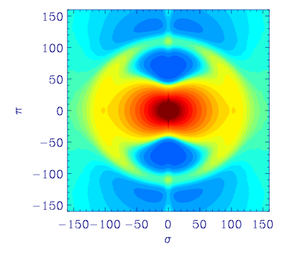
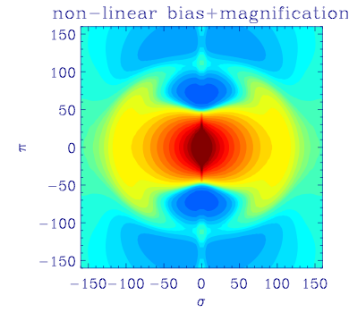
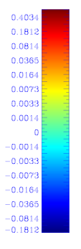
PAUS Scientific Goals
Red-shift Space Distortions.
The Hubble relation between redshift and distance in the radial direction is modified by the peculiar velocity of galaxies.
Large structures give rise to bulk motions which affect the z-r maps.
Galaxies behind over-dense regions will appear nearer, while galaxies in front of dense regions will appear farther ➔ squashing of matter distribution in radial direction at large scales.
σ_{z}=0.000 (1+z)
σ_{z}=0.003 (1+z)
PAU photo-z resolution particularly well-suited for this measurement over bright sample.
Mpc/h

Slide 12
PAUS Scientific Goals
Weak-lensing magnification
Lensing changes area of background image ➔ density fluctuations correlated with density fluctuations in the foreground lenses.
Very precise photo-z’s in foreground lenses allow to perform cross-correlations between well-defined narrow redshift bins.
The combination of RSD and MAG in the same data set is very powerful in breaking degeneracies between cosmological parameters ➔ a unique advantage of PAU.

Slide 13
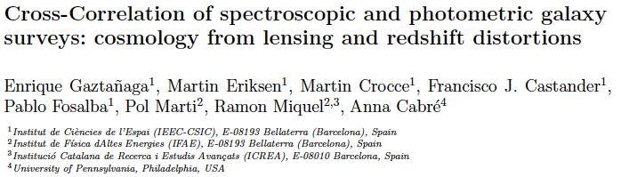
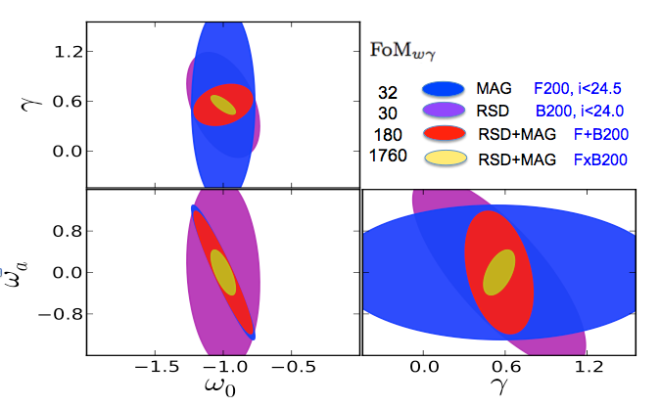
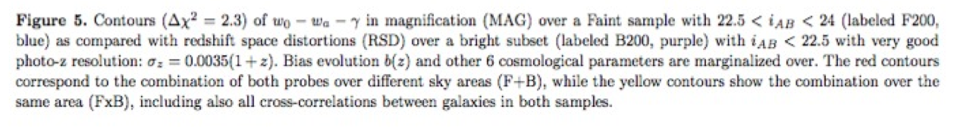
PAU at the WHT
Quantitative study accepted for publication (arXiv:1109.4852, MNRAS in press ):
Effects are sensitive to both the equation of state parameter w and structure growth.
Figure of Merit for w₀, w_{a} and growth factor γ:
Combination of
3D galaxy clustering (degenerate with galaxy biasing)
weak lensing measurements (shear in CFHTLS and magnification) which is unbiased but 2D
Redshift space distortions (which also measures galaxy bias and growth)
Notes:
W (state ea parameter that relates the presion and energy density
A Universe scale relates with z
Gamma measures the structure evelotion when mater has been aggregated
If Dard Energy is a cosmological constant, W is -1 and constant

Slide 14
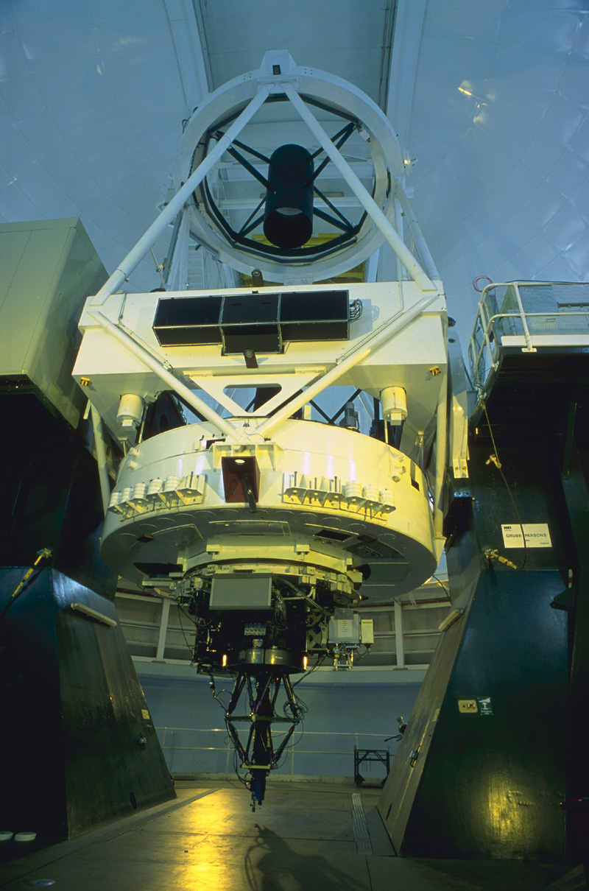
PAUCam
PAUCam will be mounted at the prime focus:
Strong limitation in the weight: max. 235 kg.

Slide 15
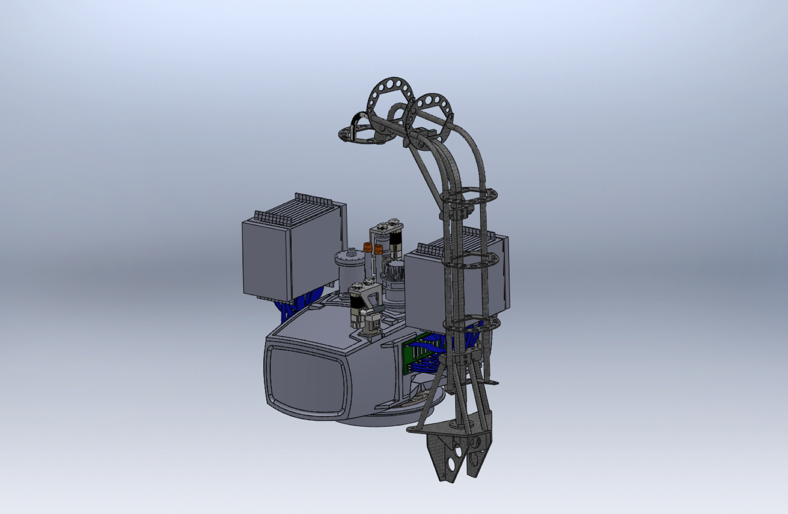
PAUCam
Many pieces are ready.
Mold being fabricated. Takes 2-3 weeks to make enclosure.
Body of camera made of carbon fiber, shaped to minimize wall thickness

Slide 16
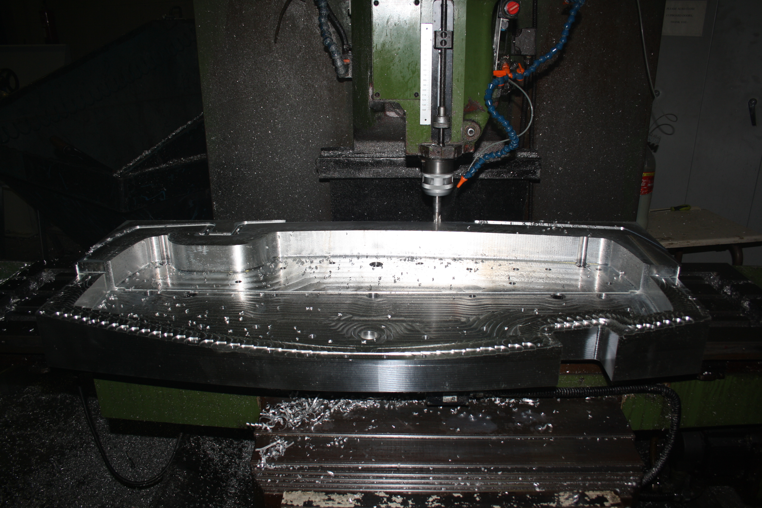
PAUCam

Slide 17
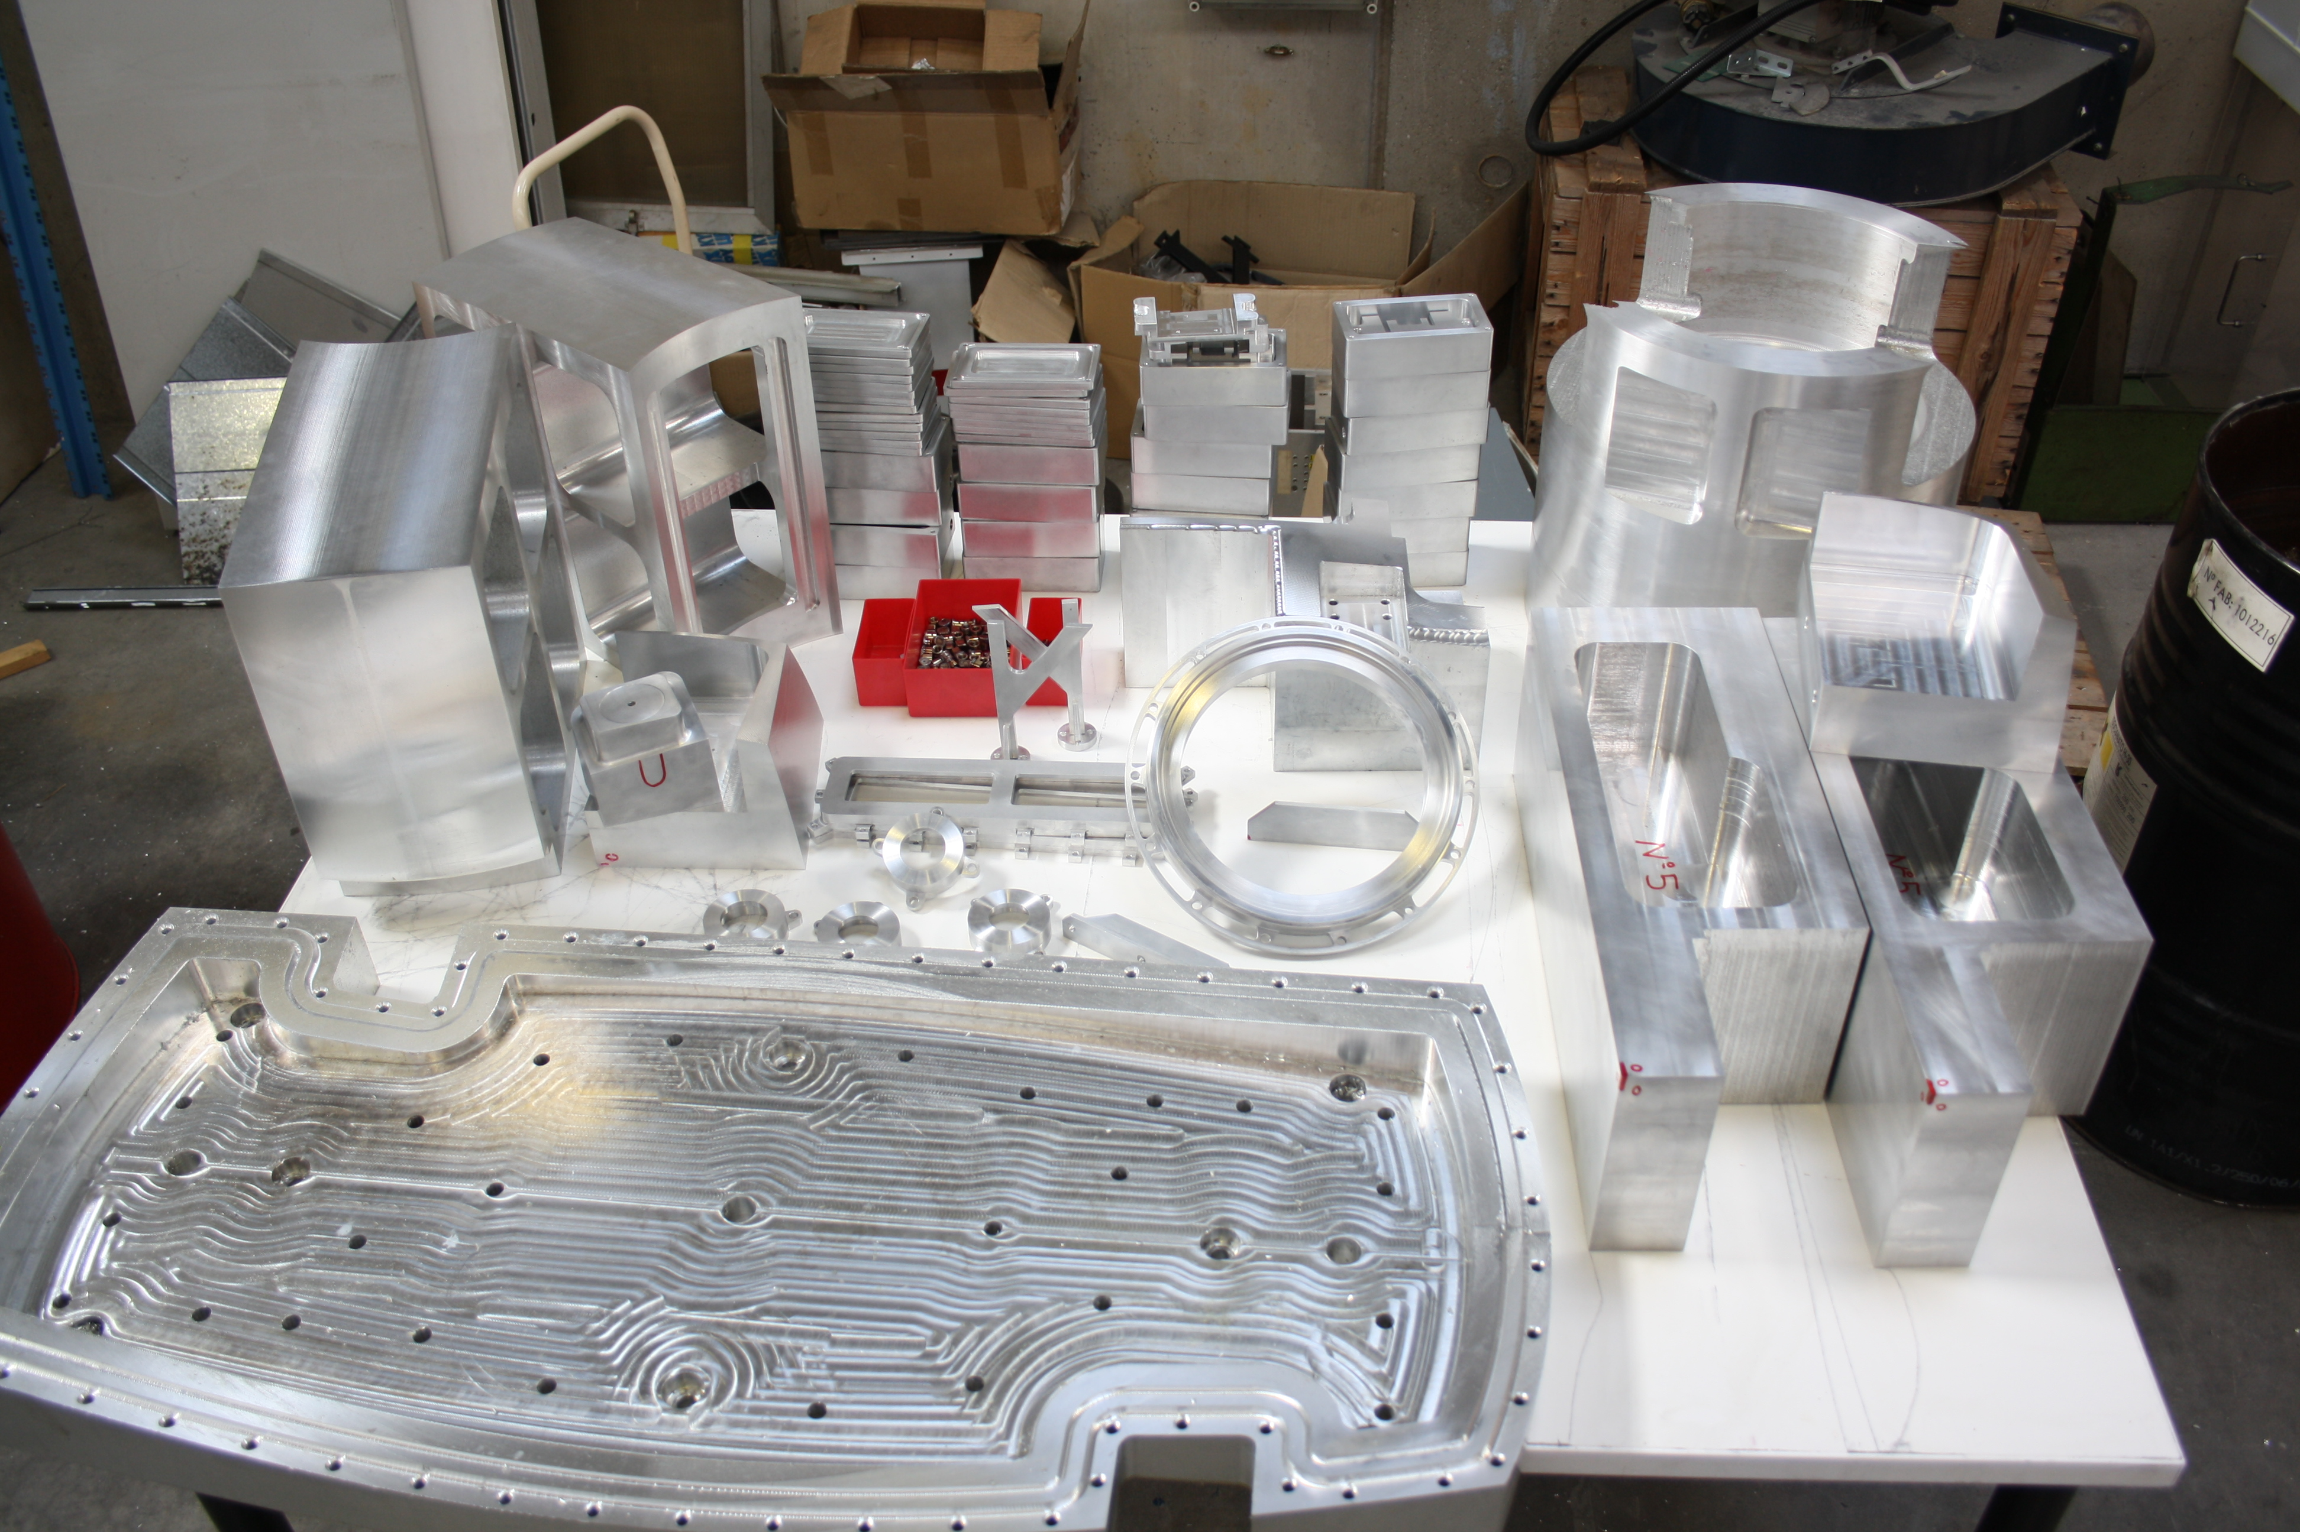
PAUCam

Slide 18
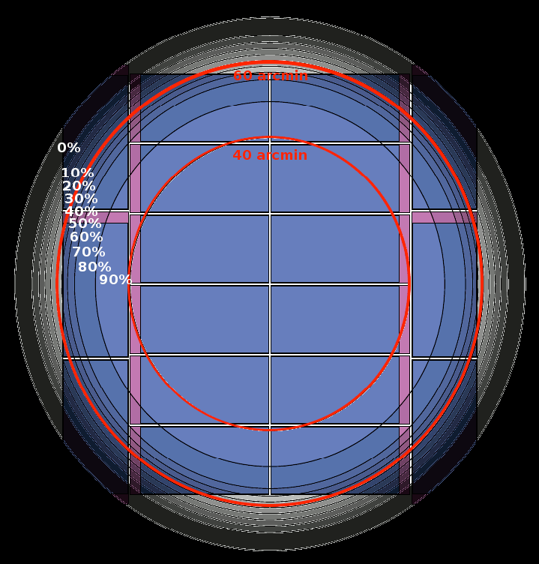
PAUCam focal plane
8 central CCDs with almost 100% illumination.
Rest of the CCDs:
2 for guiding
8 for additional photons
42 narrow band (10nm) filters covering the range ≈ 470-830 nm
6 wide band filters u.g.r.i.z.Y.
Optimization of filter arrangement: 7 narrow band and 1 broad band in central CCDs.

Slide 19
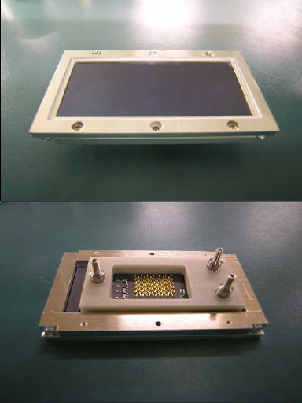
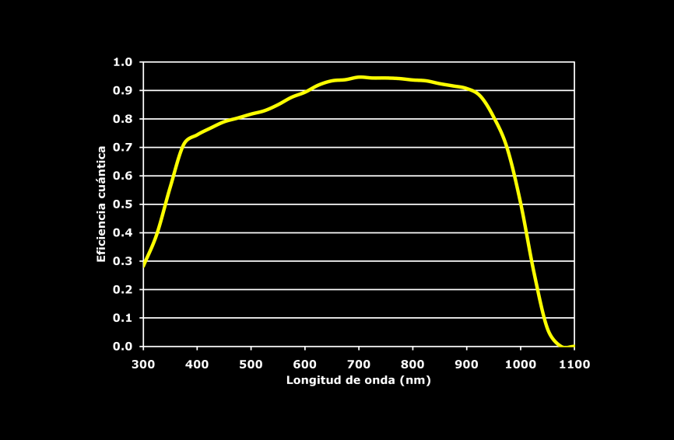
PAUS CCDs
Detectors
Hamamatsu photonics
(2k X 4k) 15μm pixels
Telescope f/2.8 ➔
0.26” /pixel.
All CCD are already in our labs. being characterized.

Slide 20
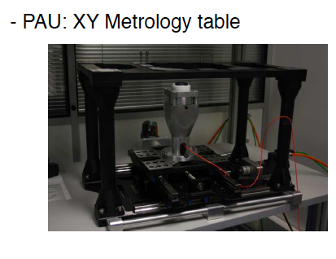
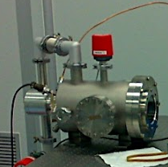
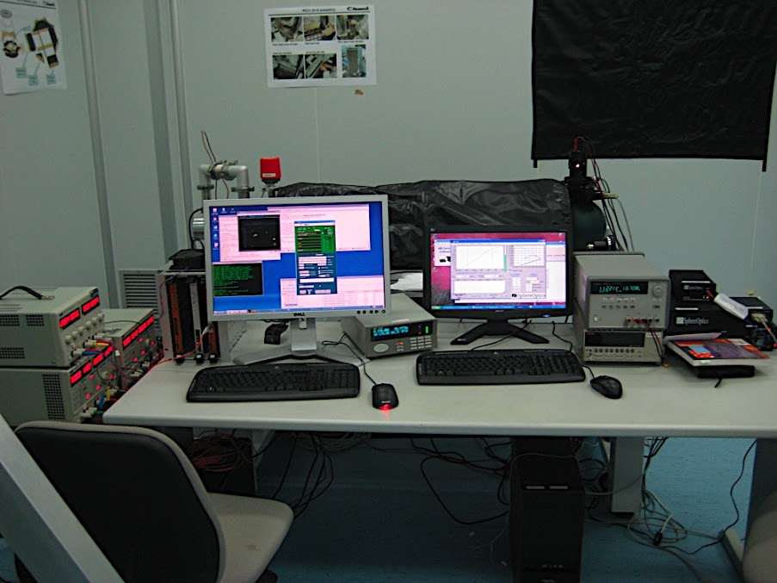
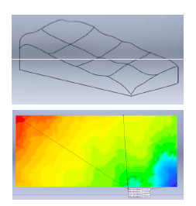
PAUS CCDs
Two set ups to characterize CCDs are ready, including software, one at CIEMAT the other at IEEC-IFAE.
CCD testing station at CIEMAT

Slide 21
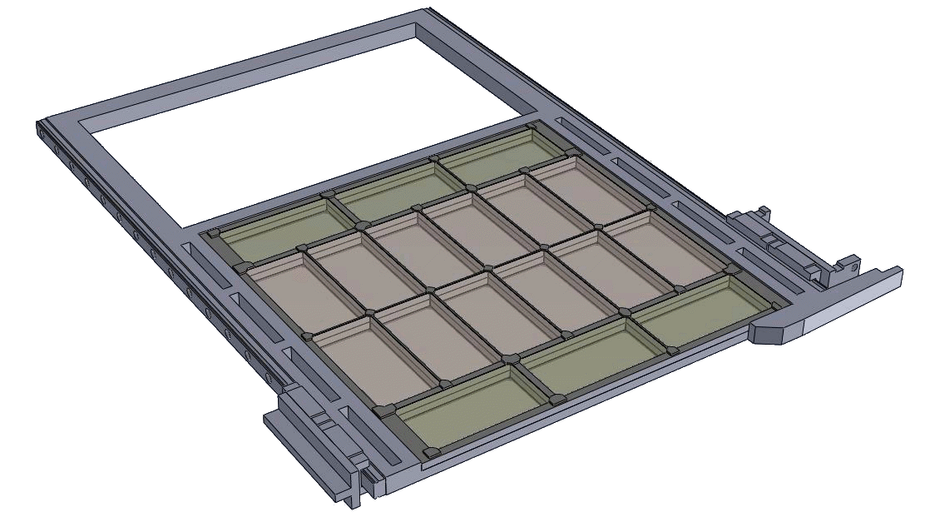
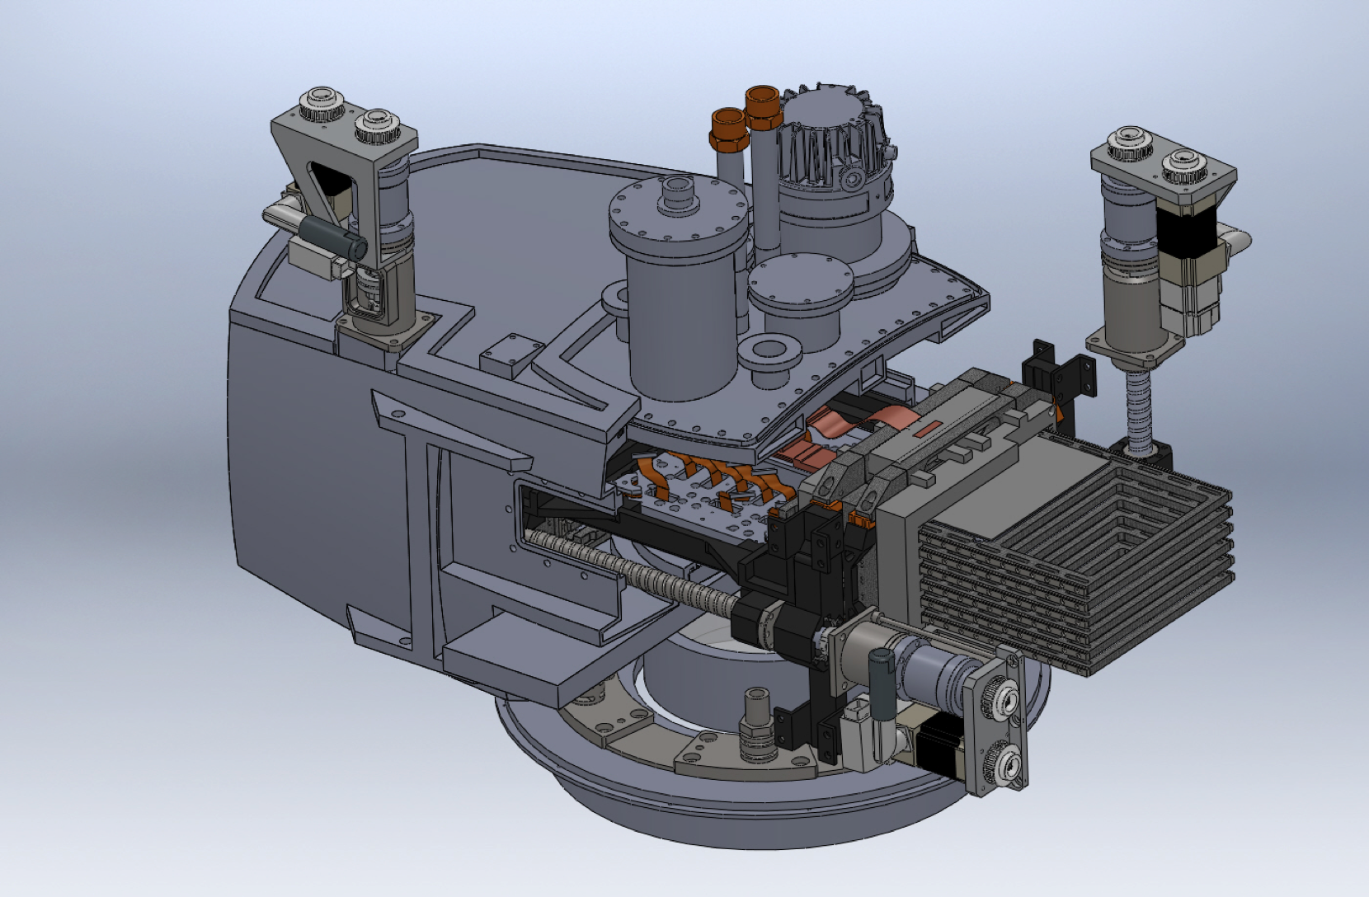
PAUCam
Cut-out showing filter-tray movable system

Slide 22
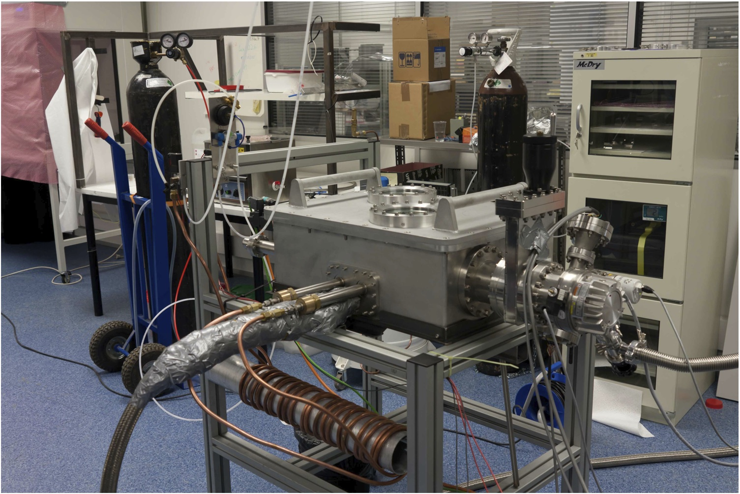
PAUCam (set up as of summer 2011)

Slide 23
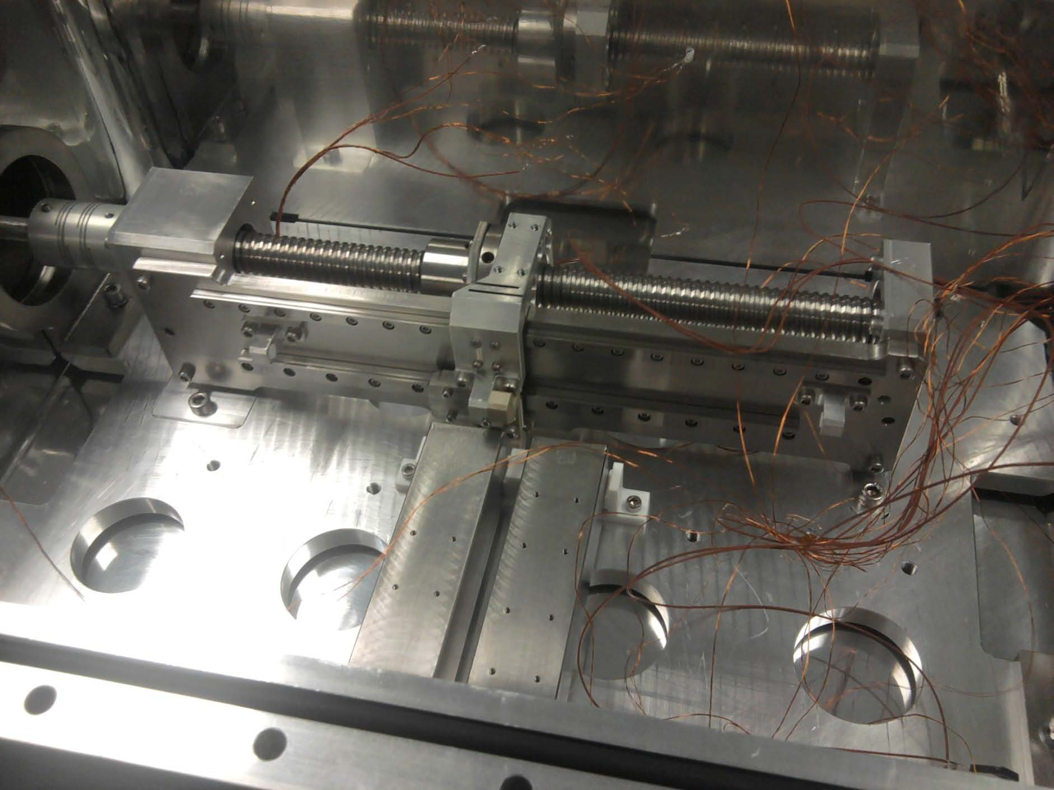
PAUCam

Slide 24
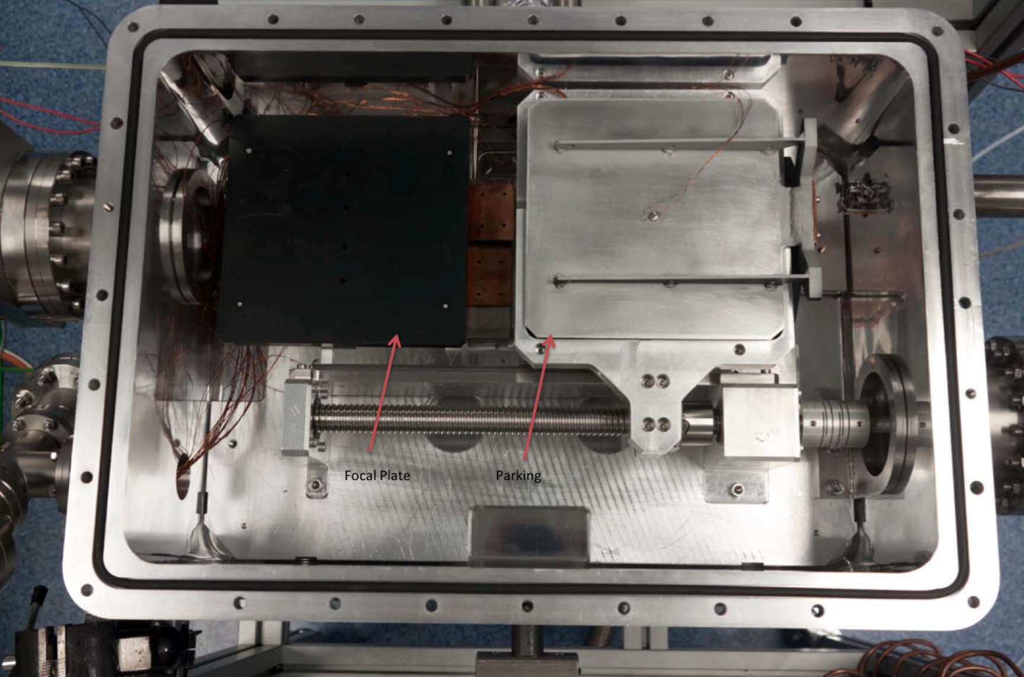
PAUCam
View
from
top

Slide 25
PAUCam
Many other elements of the camera are ready or being fabricated. Examples:
Optics (entrance window): study done by FRACTAL. Ordered.
Shutter: design ready, contract will go out soon.
Cryotigers: one received, preliminary tests vey good.
Assembly done in house. Clean room (an important infrastructure) is ready.

Slide 26
PAUS Data Management
Data Management System
P. Tallada

Slide 27
Data processing pipeline

Slide 28
PAU Camera Control System
Telescope
Control
System
Instrument
Control
System
Slow Control
TCS
In
ter
Alarms
fa
ce
Image View
and
Quality Analysis
Guider
Observation Control System
GUI
Data Acquisition
System
5-day
Storage
Transfer
Focal
Plane
to PAUdm
Science Data Flow
One computer already installed at the WHT. Tests of interface are already taking place.

Slide 29
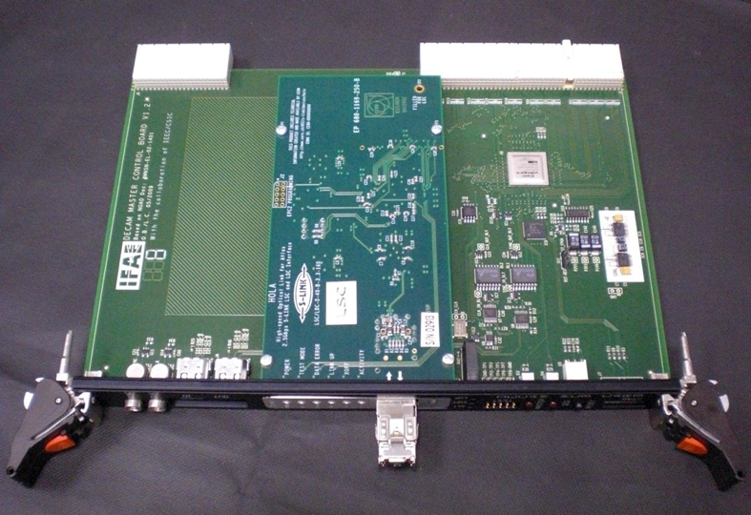
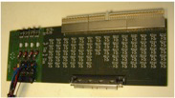
PAUCam main work
Electronics: CCDs in hand. Electronics will follow Monsoon standard. The group has delivered the entire electronics of DECam.
DES Clock & Bias Board
← DES Master Control Board
The aim is to have a working instrument ready by the end of the year.
Final verification, installation, calibrations... Much works remains to be done
Collaborators will be welcomed.

Slide 30
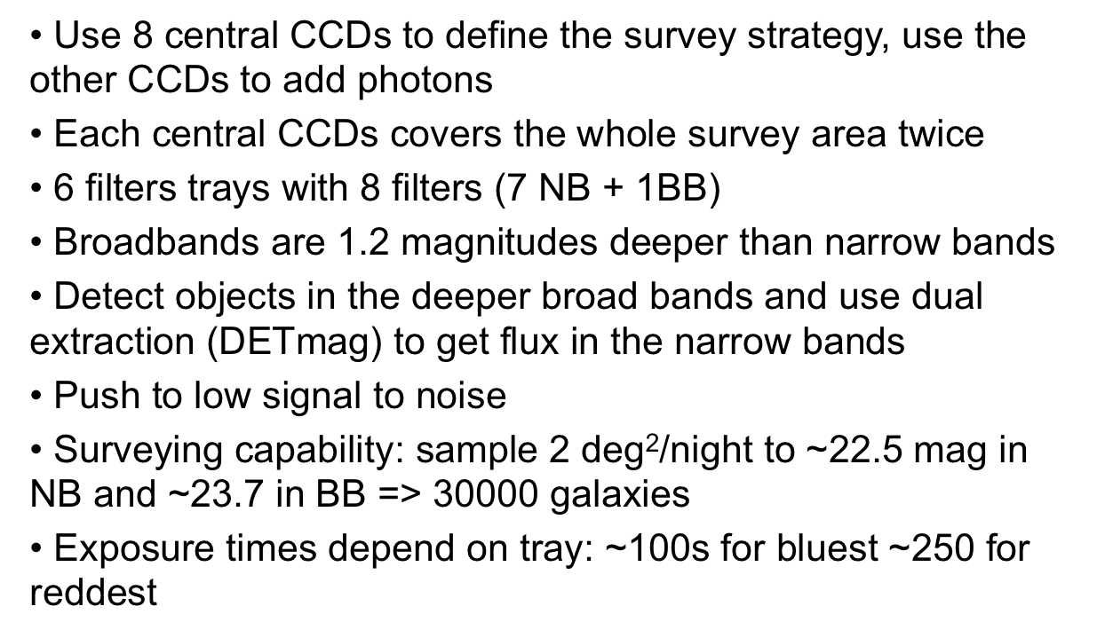
PAUS Survey Strategy

Slide 31
PAUS capabilities
2 deg² per night in all filters (42 narrow-band + 6 ugrizY):
It will deliver (per night) “low-resolution spectra” for:
30,000 galaxies
5,000 stars
1,000 quasars
10 clusters

Slide 32
PAU Survey additional science
Although the survey is designed and optimized for DE, many other science topics could be addressed
Galaxy evolution
High redshift galaxies
Interstellar dust
Quasars and Lyα systems
Clusters
Weak gravitational lensing
Strong gravitational lensing
Galactic astronomy
Stellar populations
Halo stars
Local group galaxies
Serendipitous discoveries

Slide 33
Thank you

