Slide 1
Effects of Modified Dispersion Relations on the Computation of Zero Point Energy
MSQS Benasque
11-7-2012
Remo Garattini
Università di Bergamo
I.N.F.N. - Sezione di Milano

Slide 2
Introduction
Hamiltonian Formulation of General Relativity
and the Wheeler-DeWitt Equation
The Cosmological Constant as a
Zero Point Energy Computation
MDR and Gravity’s Rainbow as a tool for
computing ZPE with applications

Slide 3
Part I: Hamiltonian Formulation of General Relativity and the Wheeler-DeWitt Equation

Slide 4
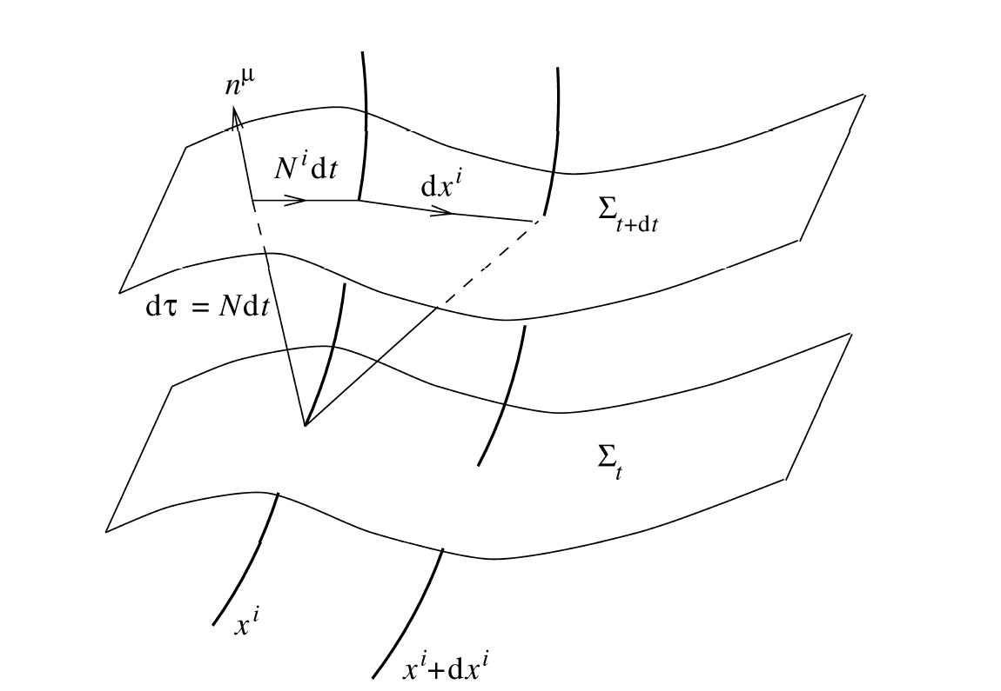
Relevant Action for Quantum Cosmology

Slide 5
Relevant Action for Quantum Cosmology
ADM Decomposition

Slide 7
Wheeler-De Witt Equation
B. S. DeWitt, Phys. Rev.160, 1113 (1967).
G_{ijkl} is the super-metric,
κ =8πG G is the Newton’s constant
Λ is the cosmological constant
R is the scalar curvature in 3-dim.

Slide 8
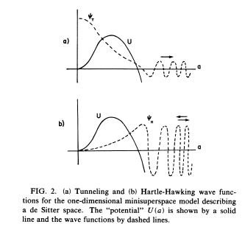
Example: WDW for Tunneling
Factor
Ordering
Formal Schrödinger Equation with zero eigenvalue whose solution is a linear combination of Airy’s functions (q=-1 Vilenkin Phys. Rev. D 37, 888 (1988).) containing expanding solutions

Slide 9
Part II: The Cosmological Constant as a
Zero Point Energy
Computation

Slide 10
Wheeler-De Witt Equation
B. S. DeWitt, Phys. Rev.160, 1113 (1967).
Reconsider the WDW Equation as an
Eigenvalue Problem
Λ can be seen as an eigenvalue
Ψ[g_{ij}] can be considered as an eigenfunction
Define

Slide 11
Wheeler-De Witt Equation
B. S. DeWitt, Phys. Rev.160, 1113 (1967).
Induced
Cosmological
‘‘Constant’’
Solve this infinite dimensional PDE with a Variational Approach
is a trial wave functional of the gaussian type
Schrödinger Picture
Spectrum of Λ depending on the metric
Energy (Density) Levels

Slide 12
Canonical Decomposition
M. Berger and D. Ebin, J. Diff. Geom.3, 379 (1969). J. W. York Jr., J. Math. Phys., 14, 4 (1973); Ann. Inst. Henri Poincaré A 21, 319 (1974).
h is the trace (spin 0)
(Lξ)_{ij} is the gauge part
[spin 1 (transverse) + spin 0 (long.)].
F.P determinant (ghosts)
h⊥_{ij} transverse-traceless → graviton (spin 2)

Slide 13
Form of the background
N(r) ←→ Lapse function
b(r) ←→ shape function
for example, the Ricci tensor in 3 dim. is

Slide 14
Integration rules on Gaussian wave functionals
1 2 3 4 5

Slide 15
Graviton Contribution
W.K.B. method and graviton contribution to the cosmological constant

Slide 16
We can define an r-dependent radial wave number
Standard Regularization
Renormalization →

Slide 17
Modified Dispersion Relations and
Gravity’s Rainbow as a tool for computing
Zero Point Energy

Slide 18
Modified Dispersion Relations
Motivated also by Hořava-Lifshitz theory, NonCommutative geometry, Jacobson L.V.,..
Doubly Special Relativity
G. Amelino-Camelia, Int.J.Mod.Phys. D 11, 35 (2002); gr-qc/001205.
G. Amelino-Camelia, Phys.Lett. B 510, 255 (2001); hep-th/0012238.
Curved Space Proposal → Gravity’s Rainbow
[J. Magueijo and L. Smolin, Class. Quant. Grav. 21, 1725 (2004) arXiv:gr-qc/0305055].

Slide 19
Modified Dispersion Relations
Doubly Special Relativity
G. Amelino-Camelia, Int.J.Mod.Phys. D 11, 35 (2002); gr-qc/001205.
G. Amelino-Camelia, Phys.Lett. B 510, 255 (2001); hep-th/0012238.
Curved Space Proposal → Gravity’s Rainbow
[J. Magueijo and L. Smolin, Class. Quant. Grav. 21, 1725 (2004) arXiv:gr-qc/0305055].

Slide 20
Modified Dispersion Relations
Doubly Special Relativity
G. Amelino-Camelia, Int.J.Mod.Phys. D 11, 35 (2002); gr-qc/001205.
G. Amelino-Camelia, Phys.Lett. B 510, 255 (2001); hep-th/0012238.
Curved Space Proposal → Gravity’s Rainbow
[J. Magueijo and L. Smolin, Class. Quant. Grav. 21, 1725 (2004) arXiv:gr-qc/0305055].
b(r) is the shape function
Λ (r) is the redshift function

Slide 21
Eliminating Divergences using
Gravity’s Rainbow
[R.G. and G.Mandanici, Phys. Rev. D 83, 084021 (2011), arXiv:1102.3803 [gr-qc]]
Curved Space Proposal → Gravity’s Rainbow
[J. Magueijo and L. Smolin, Class. Quant. Grav. 21, 1725 (2004) arXiv:gr-qc/0305055].
Spherically Symmetric Model

Slide 22
Eliminating Divergences using
Gravity’s Rainbow
[R.G. and G.Mandanici, Phys. Rev. D 83, 084021 (2011), arXiv:1102.3803 [gr-qc]]
We can define an r-dependent radial wave number
Standard Regularization

Slide 23
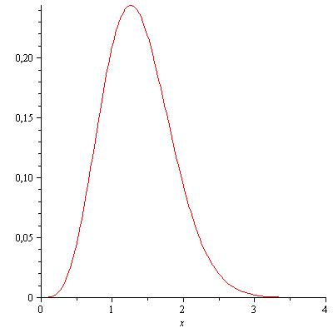
Gravity’s Rainbow and the Cosmological Constant
R.G. and G.Mandanici, Phys. Rev. D 83, 084021 (2011), arXiv:1102.3803 [gr-qc]
Failure of Convergence

Slide 24
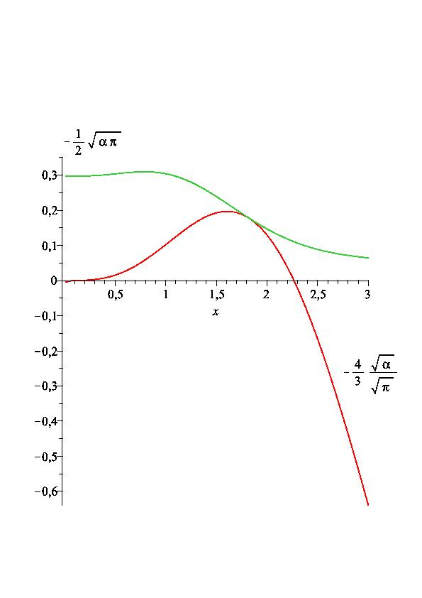
Gravity’s Rainbow and the Cosmological Constant

Slide 25
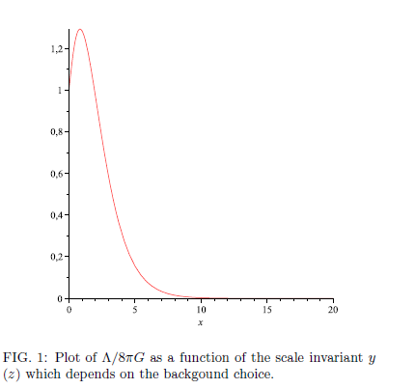
Comparison with the Noncommutative Approach
[R.G. & P. Nicolini Phys. Rev. D 83, 064021 (2011); 1006.4518 [gr-qc] ]

Slide 26
Photon Time Delay
[R.G. and G. Mandanici Phys.Rev. D85 (2012) 023507 e-Print: arXiv:1109.6563 [gr-qc] ]

Slide 27
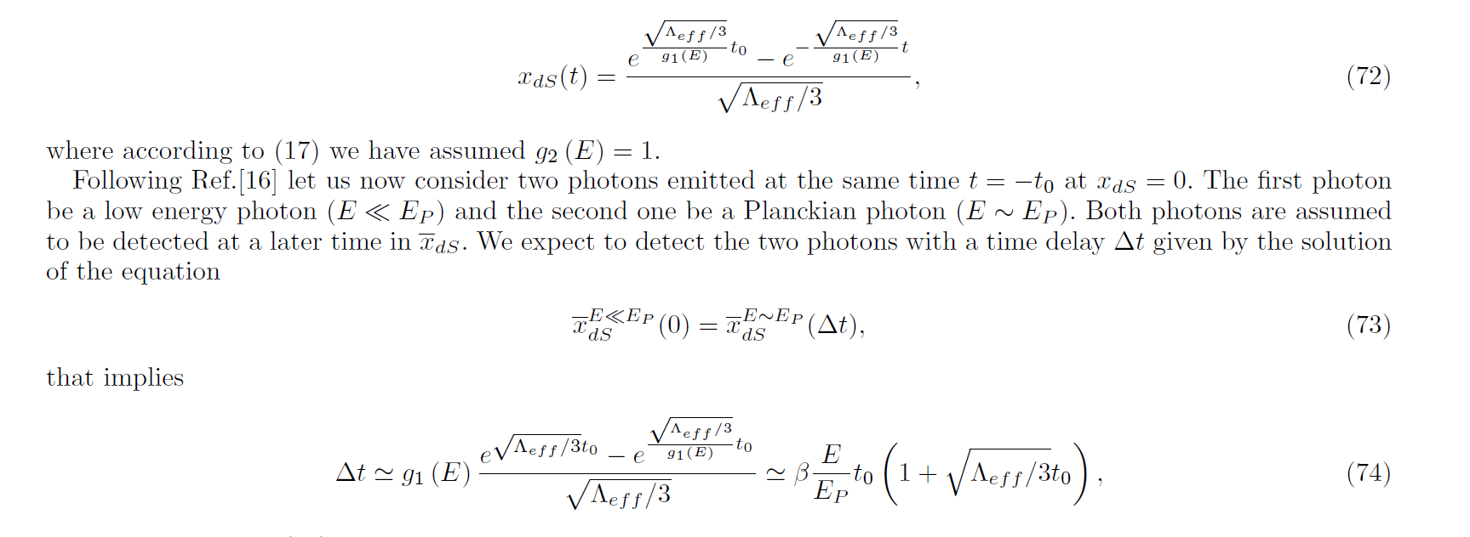
Photon Time Delay
[R.G. and G. Mandanici Phys.Rev. D85 (2012) 023507 e-Print: arXiv:1109.6563 [gr-qc] ]

Slide 28
Tunneling and Inflation???
(Work in Progress in collaboration with M.Sakellariadou)
Factor
Ordering
Formal Schrödinger Equation with zero eigenvalue whose solution is a linear combination of Airy’s functions (q=-1 Vilenkin Phys. Rev. D 37, 888 (1988).) containing expanding solutions

Slide 29
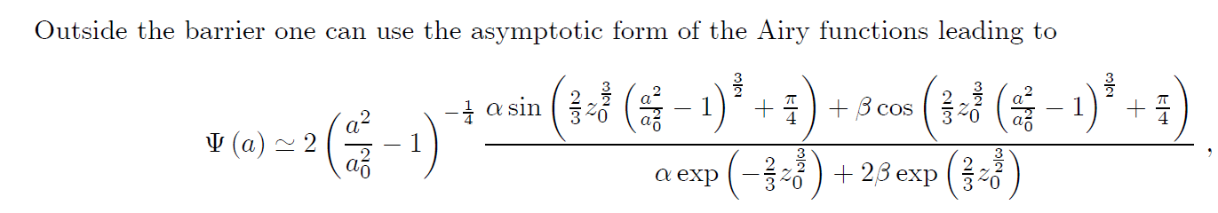
Tunneling and Inflation???
(Work in Progress in collaboration with M.Sakellariadou)
Formal Schrödinger Equation with zero eigenvalue whose solution is a linear combination of Airy’s functions (q=-1 Vilenkin Phys. Rev. D 37, 888 (1988).) containing expanding solutions

Slide 30
Tunneling and Inflation???
(Work in Progress in collaboration with M.Sakellariadou)
With the inflaton
Proposal→ Gravity’s Rainbow alternative to the inflaton
See also S. Alexander and J. Magueijo hep-th/0104093
S. Alexander, R. Brandenberger and J. Magueijo Phys.Rev. D67 (2003) 081301 hep-th/0108190 for inflationary applications

Slide 31
Conclusions and Outlooks
Application of Gravity’s Rainbow can be considered to compute divergent quantum observables.
Neither Standard Regularization nor Renormalization are required. This also happens in NonCommutative geometries
Application to Black Hole Entropy
Application to Traversable Worholes
R.G. and F.S.N. Lobo, arXiv:1102.3803 [gr-qc] Phys.Rev. D85 (2012) 024043
Application to Particle Propagation
Including rotations and more complicated geometries
Tunneling and Inflation?!? In Progress….
Constraints by GW investigated by C. Will and co-workers in arXiV:1110.2720 [gr-qc].
Power Spectrum Test for Inflation e-folding, etc…

