Slide 1




Combining Tensor Networks with Monte Carlo:
Applications to the MERA
Andy Ferris ^{1,2}
Guifre Vidal ^{1,3}
¹ University of Queensland, Australia
² Université de Sherbrooke, Québec
³ Perimeter Institute for Theoretical Physics, Ontario

Slide 2
Motivation: Make tensor networks faster
χ
Parameters: d^{L} vs. Poly(χ,d,L)
Calculations should be efficient in memory and computation (polynomial in χ, etc)
However total cost might still be HUGE (e.g. 2D)

Slide 3
Monte Carlo makes stuff faster
Monte Carlo: Random sampling of a sum
  Tensor contraction is just a sum
Variational MC: optimizing parameters
Statistical noise!
  Reduced by importance sampling over some positive probability distribution P(s)

Slide 4
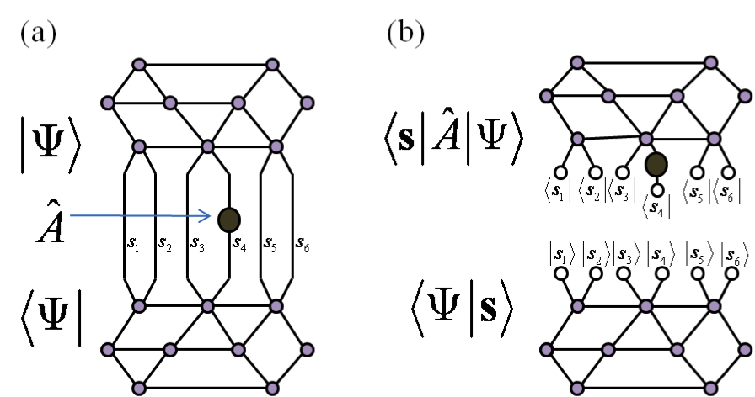
Monte Carlo with Tensor networks

Slide 5
Monte Carlo with Tensor networks

Slide 6
Monte Carlo with Tensor networks
MPS: Sandvik and Vidal, Phys. Rev. Lett. 99, 220602 (2007).
CPS: Schuch, Wolf, Verstraete, and Cirac, Phys. Rev. Lett. 100, 040501 (2008).
Neuscamman, Umrigar, Garnet Chan, arXiv:1108.0900 (2011), etc…
PEPS: Wang, Pižorn, Verstraete, Phys. Rev. B 83, 134421 (2011). (no variational)
…

Slide 7
Monte Carlo with Tensor networks
MPS: Sandvik and Vidal, Phys. Rev. Lett. 99, 220602 (2007).
CPS: Schuch, Wolf, Verstraete, and Cirac, Phys. Rev. Lett. 100, 040501 (2008).
Neuscamman, Umrigar, Garnet Chan, arXiv:1108.0900 (2011), etc…
PEPS: Wang, Pižorn, Verstraete, Phys. Rev. B 83, 134421 (2011). (no variational)
…
Unitary TN: Ferris and Vidal, Phys. Rev. B 85, 165146 (2012).
1D MERA: Ferris and Vidal, Phys. Rev. B, 85, 165147 (2012).

Slide 8
Perfect vs. Markov chain sampling
Perfect sampling: Generating s from P(s)
Often harder than calculating P(s) from s!
Use Markov chain update
e.g. Metropolis algorithm:
  Get random s’
  Accept s’ with probability min[P(s’) / P(s), 1]
Autocorrelation: subsequent samples are “close”

Slide 9
Markov chain sampling of an MPS
Choose P(s) = |<s|Ψ>|² where |s> = |s₁>|s₂> …
Cost is O(χ²L)
2
<s₁|
<s₂|
<s₃|
’
<s₄|
<s₅|
<s₆|
  Accept with probability min[P(s’) / P(s), 1]
A. Sandvik & G. Vidal, PRL 99, 220602 (2007)

Slide 10
Perfect sampling of a unitary MPS
Note that P(s₁,s₂,s₃,…) = P(s₁) P(s₂|s₁) P(s₃|s₁,s₂) …
Cost is now O(χ³L) !

Slide 11
Perfect sampling of a unitary MPS
Note that P(s₁,s₂,s₃,…) = P(s₁) P(s₂|s₁) P(s₃|s₁,s₂) …
if =
Unitary/isometric tensors:

Slide 12
Perfect sampling of a unitary MPS
Note that P(s₁,s₂,s₃,…) = P(s₁) P(s₂|s₁) P(s₃|s₁,s₂) …

Slide 13
Perfect sampling of a unitary MPS
Note that P(s₁,s₂,s₃,…) = P(s₁) P(s₂|s₁) P(s₃|s₁,s₂) …

Slide 14
Perfect sampling of a unitary MPS
Note that P(s₁,s₂,s₃,…) = P(s₁) P(s₂|s₁) P(s₃|s₁,s₂) …

Slide 15
Perfect sampling of a unitary MPS
Note that P(s₁,s₂,s₃,…) = P(s₁) P(s₂|s₁) P(s₃|s₁,s₂) …

Slide 16
Perfect sampling of a unitary MPS
Note that P(s₁,s₂,s₃,…) = P(s₁) P(s₂|s₁) P(s₃|s₁,s₂) …

Slide 17
Perfect sampling of a unitary MPS
Note that P(s₁,s₂,s₃,…) = P(s₁) P(s₂|s₁) P(s₃|s₁,s₂) …
Can sample in any basis…

Slide 18
Perfect sampling of a unitary MPS
Note that P(s₁,s₂,s₃,…) = P(s₁) P(s₂|s₁) P(s₃|s₁,s₂) …

Slide 19
Perfect sampling of a unitary MPS
Note that P(s₁,s₂,s₃,…) = P(s₁) P(s₂|s₁) P(s₃|s₁,s₂) …
Total cost now O(χ²L)

Slide 20
Perfect sampling of a unitary MPS
Note that P(s₁,s₂,s₃,…) = P(s₁) P(s₂|s₁) P(s₃|s₁,s₂) …
Total cost now O(χ²L)

Slide 21
Perfect sampling of a unitary MPS
Note that P(s₁,s₂,s₃,…) = P(s₁) P(s₂|s₁) P(s₃|s₁,s₂) …
Total cost now O(χ²L)

Slide 22
Comparison: critical transverse Ising model
Perfect sampling
Markov chain sampling
Ferris & Vidal, PRB 85, 165146 (2012)

Slide 23
Critical transverse Ising model
Markov chain MC
Perfect sampling
250 sites
50 sites
Ferris & Vidal, PRB 85, 165146 (2012)

Slide 24
Multi-scale entanglement renormalization ansatz (MERA)
Numerical implementation of real-space renormalization group
  remove short-range entanglement
  course-grain the lattice

Slide 25
Sampling the MERA
Cost is O(χ⁹)

Slide 26
Sampling the MERA
Cost is O(χ⁵)

Slide 27
Perfect sampling with MERA

Slide 28
Perfect Sampling with MERA
Cost reduced from O(χ⁹) to O(χ⁵)
Ferris & Vidal, PRB 85, 165147 (2012)

Slide 29
Extracting expectation values
Transverse Ising model
Monte Carlo MERA
Worst case = <H²> - <H>²

Slide 30
Optimizing tensors
Environment of a tensor can be estimated
Statistical noise → SVD updates unstable

Slide 31
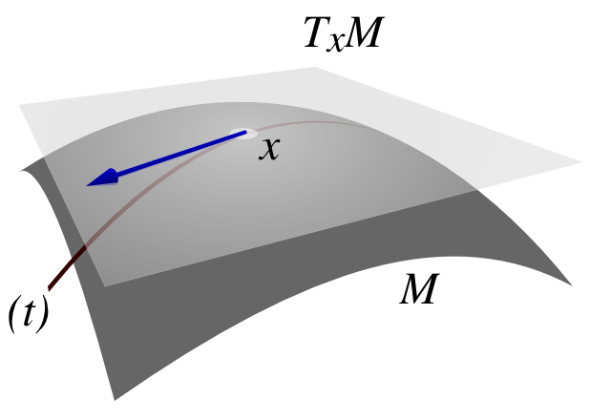
Optimizing isometric tensors
Each tensor must be isometric:
Therefore can’t move in arbitrary direction
  Derivative must be projected to the tangent space of isometric manifold:
  Then we must insure the tensor remains isometric

Slide 32
Results: Finding ground states
Transverse Ising model
Samples
per update
1
2
4
8
Exact
contraction
result
Ferris & Vidal, PRB 85, 165147 (2012)

Slide 33
Accuracy vs. number of samples
Transverse Ising Model
Samples
per update
1
4
16
64
Ferris & Vidal, PRB 85, 165147 (2012)

Slide 34
Discussion of performance
Sampling the MERA is working well.
Optimization with noise is challenging.
New optimization techniques would be great
  “Stochastic reconfiguration” is essentially the (imaginary) time-dependent variational principle (Haegeman et al.) used by VMC community.
Relative performance of Monte Carlo in 2D systems should be more favorable.

Slide 35
Two-dimensional MERA
2D MERA contractions significantly more expensive than 1D
E.g. O(χ¹⁶) for exact contraction vs O(χ⁸) per sample
  Glen has new techniques…
Power roughly halves
  Removed half the TN diagram

Slide 36
Conclusions & Outlook
Can effectively sample the MERA (and other unitary TN’s)
Optimization is challenging, but possible!
Monte Carlo should be more effective in 2D where there are more degrees of freedom to sample
PRB 85, 165146 & 165147 (2012)

