Slide 1
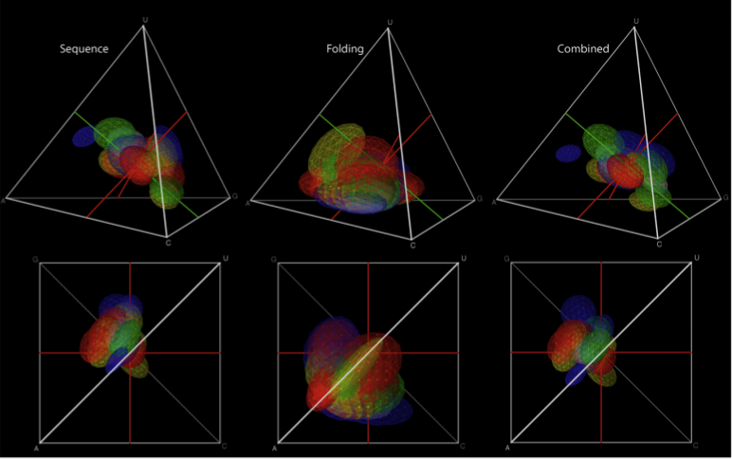
Homology vs Analogy via Motifs
Benasque 2012 – RNA Motifs Session
Manuel Lladser & Rob Knight
Notes:
Dec. 06 2010

Slide 2
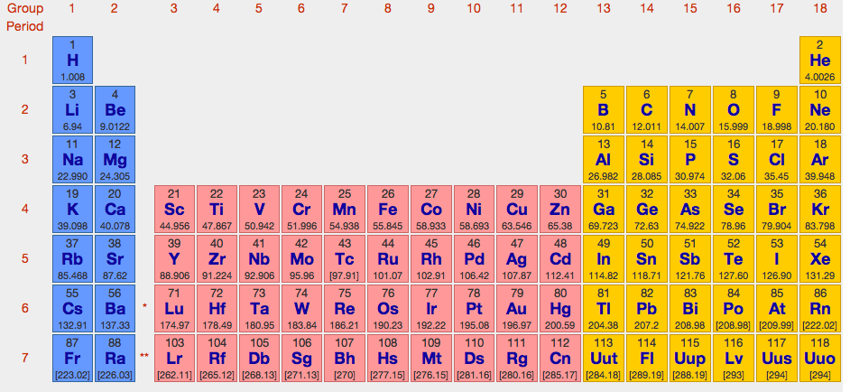
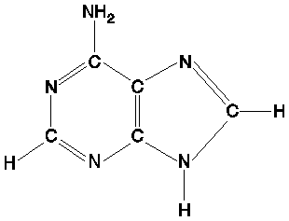
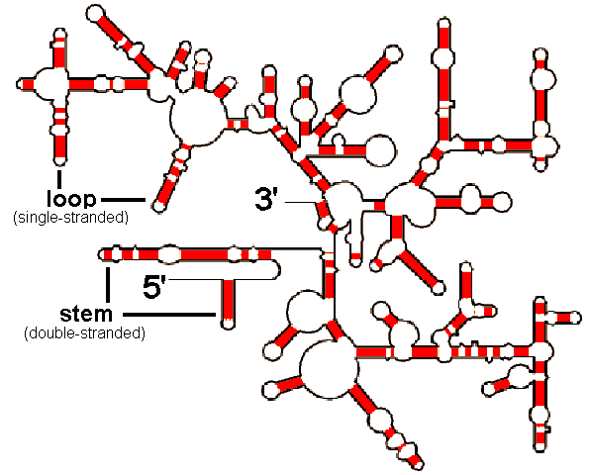
Single Adenine: produced independently
What happens
in between?
Ribosomal RNA:
Evolved from one common ancestor

Slide 3
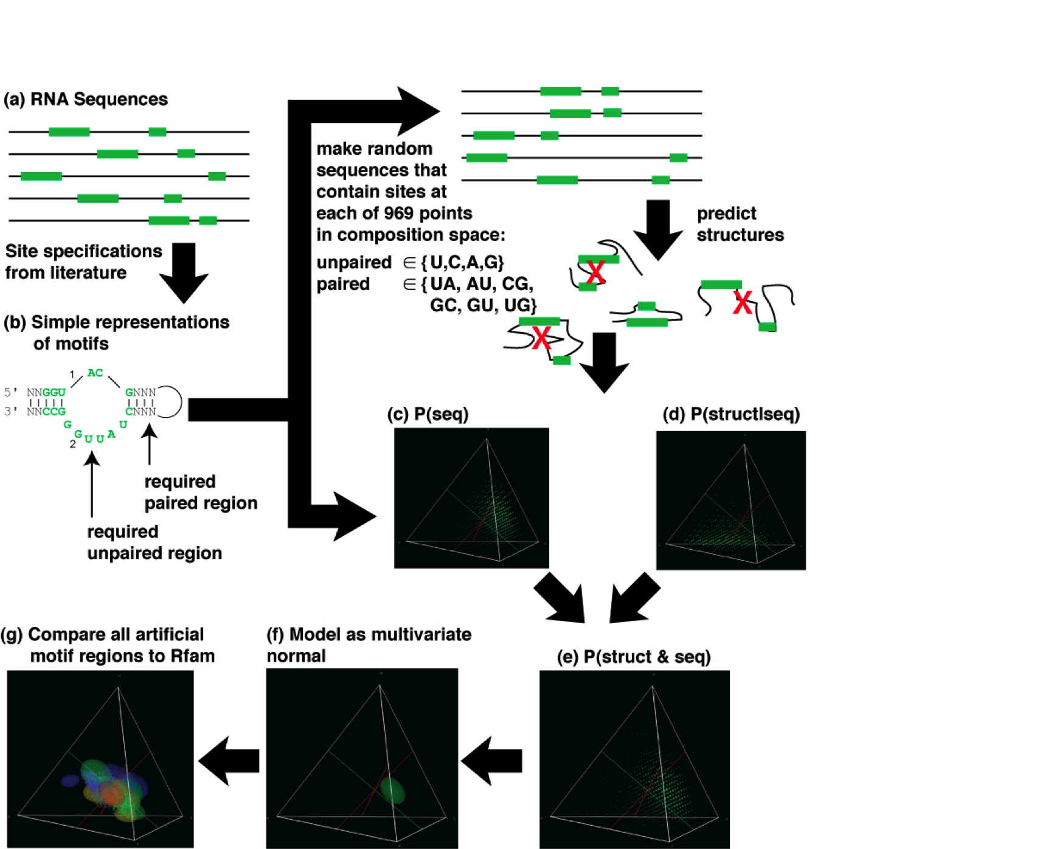
Motifs in random sequences.
[Kennedy, Lladser, Wu, Zhang, Yarus, De Sterck & Knight (2010).]
Notes:
RNA that binds to Isoleucine …

Slide 4
Probability of modular correlated pattern given Memoryless
or Markovian background : Embeddings using automata.
What’s the probability that 1a#b1 occurs in a random binary
text of a’s and b’s of length n? [Lladser, Betterton & Knight (2008)]

Slide 5
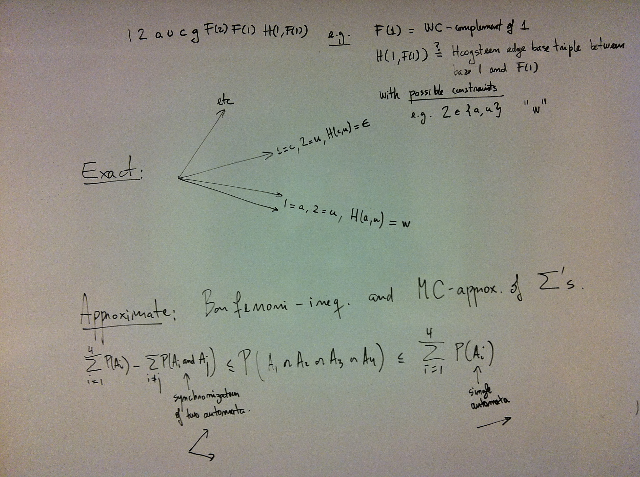
What about more complicated motifs?

Slide 6
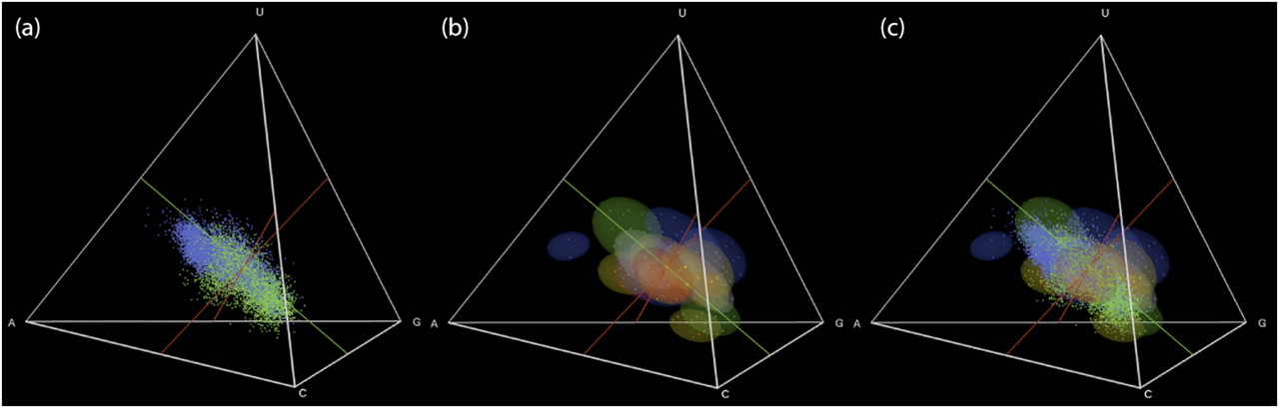
Natural & artificial RNAs occupy the same restricted region of sequence
space: Neutral network hypothesis.
Many natural (left) and artiﬁcial (middle) aptamers and ribozymes occupy the same (right)
restricted region of sequence space. The maximum function probability is achieved with the
Composition A ∼ 30%, C ∼ 15%, G ∼ 30% and U ∼ 25%.
[Kennedy, Lladser, Wu, Zhang, Yarus,De Sterck and Knight (2010)]

Slide 7

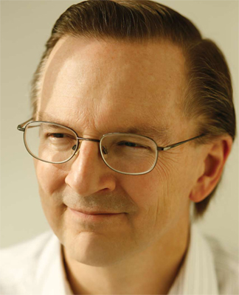
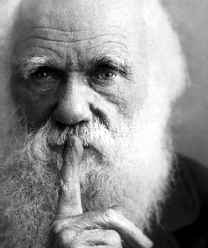
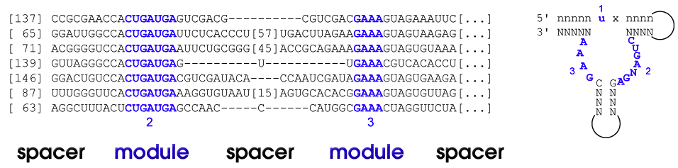
So far we have looked in random seqs, but what if seqs are known?
Example: the hammerhead ribozyme. We know it evolved at least three times…
Modular nature of the motif greatly complicates its analysis and increases its chance of occurring: need Pr(seqs|model)

Slide 8

Pr(seqs|model) for different models
iid (or any Markovian model)
SCFG
Infernal (once model is trained – need to take care for overfitting)
One tree
(but how to align modules?)
Optimize each tree for each origin? Lots of ways to break up tree…
Many trees?

Slide 9
Open questions?
What’s the right way to compute scores?
Non-nested pairing (pseudoknots and tertiary motifs)
Noncanonical interactions
Computational complexity of handling multiple origins
Your thoughts?

