Slide 1
RNASTAR, Greengenes, and QIIMEdb
Rob Knight
HHMI/CU Boulder

Slide 2
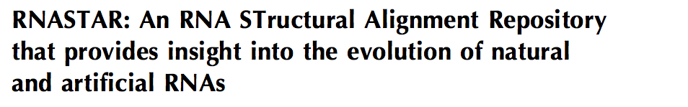
What: collection of RNA alignments backed by crystal or NMR structures (148 alignments, 9600 unique seqs), cleaned up for isostericity (83% -> 94 isosteric bp)
Why: Provide training set for secondary structure and motif prediction, include both natural and artificial RNA
How: Align with BoulderALE
Who: My lab + Paul Gardner + ROC Alignment Ontology group; Eric Nawrocki; Craig Zirbel; NASA/HHMI/ROC ($)
Where: Alignments available from RNA web site with article, doi:10.1261/rna.032052.111 . Adding to Rfam.

Slide 3
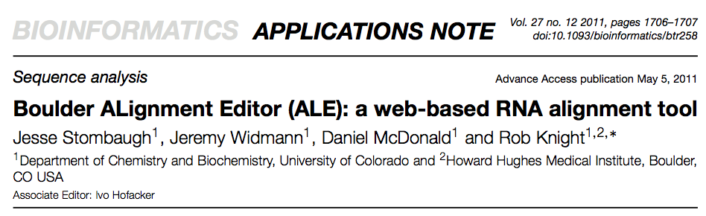
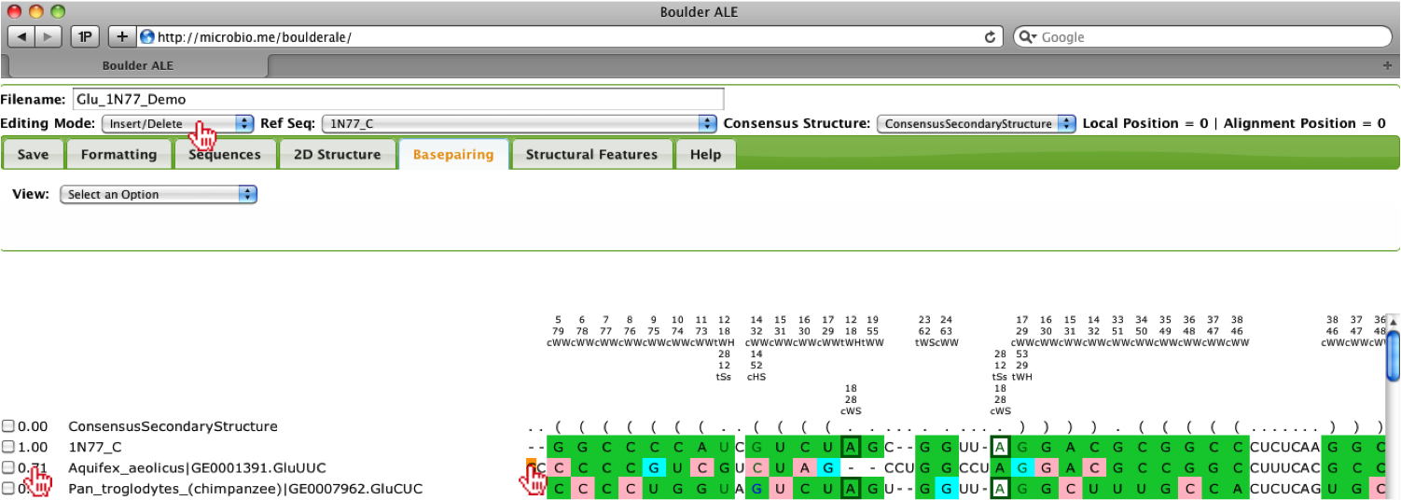

Slide 4
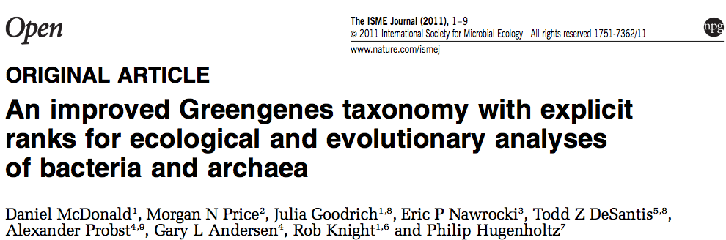
What: 408,315 (>1 million for Aug 1 release) near-full-length SSU rRNA sequences with tree and taxonomy
Why: Match environmental seqs to known SSU rRNA
How: Download seqs from INSDC; align to good seed model with infernal; transfer names from previous taxonomy; manual cleanup
Who: Authors; Adam Arkin, Sean Eddy; DOE/Sloan/HHMI/Gates ($)
Where: http://greengenes.lbl.gov/

Slide 5
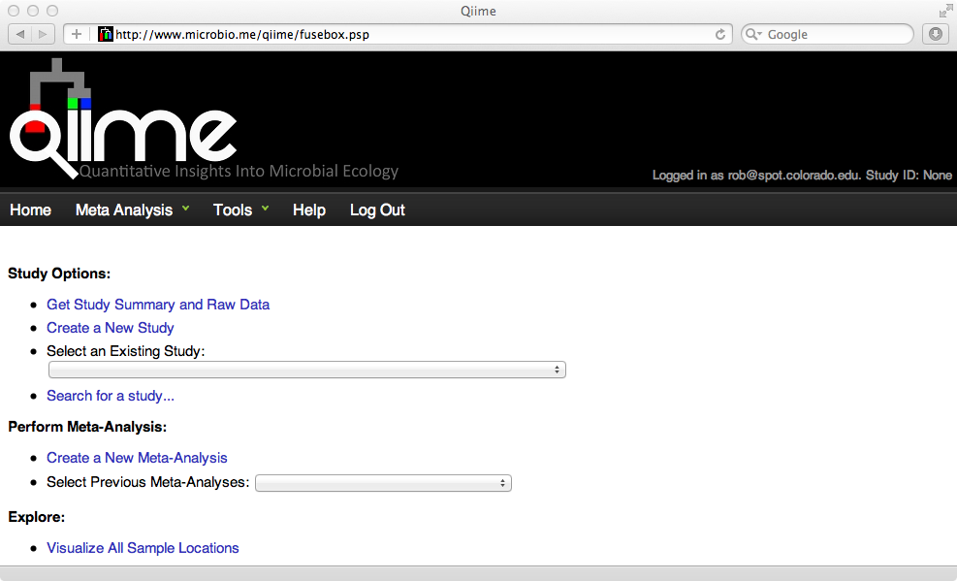
What: >4 billion 16S rRNA fragments from well-characterized environments
Why: Understand distribution of organisms in environment through meta-analyses across studies
How: Use QIIME (Quantitative Insights Into Microbial Ecology) to process next-gen amplicon data with consistent protocol; annotate with MIxS standard for metadata
Who: Jesse Stombaugh, Doug Wendel, Gail Ackermann; Jeff Gordon; Greg Caporaso; GSC; EMP Steering Committee; DOE/NIH/Sloan/HHMI/Gates ($)
Where: http://www.microbio.me/qiime

Slide 6
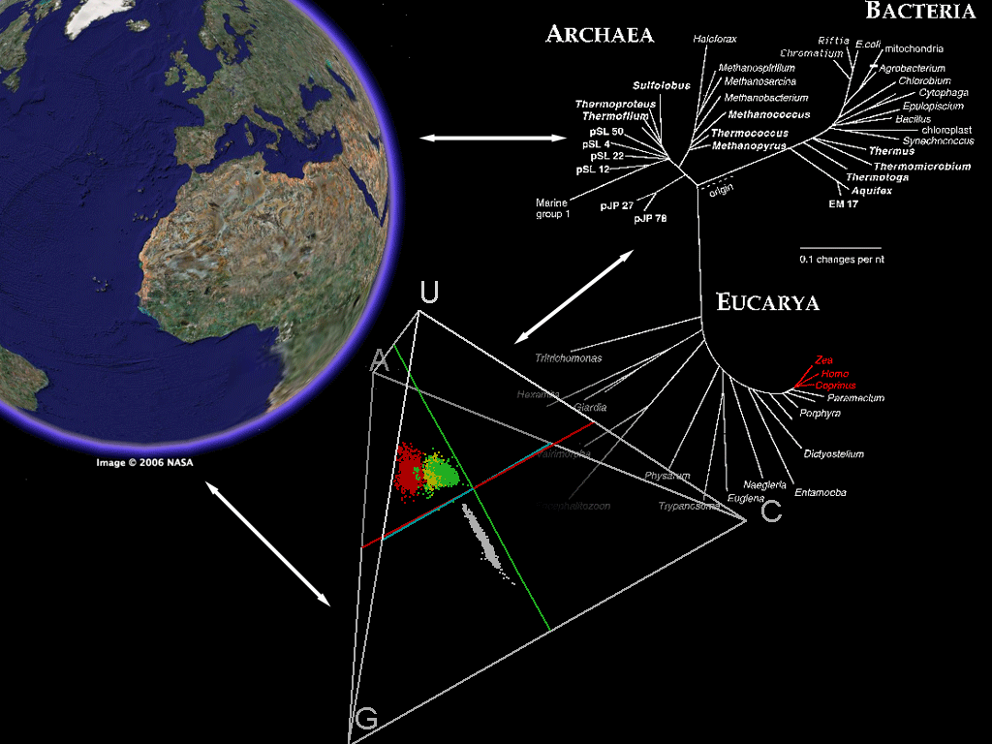

The Future
Move from 16S/shotgun to complete genomes (this is happening now, theoretically 1000/HiSeq run)
Will be able to link all RNAs, not just 16S, to environment they come from
Challenges: find RNAs given very large numbers of incomplete but homologous genomes, align them efficiently, relate to environmental parameters

