Slide 1

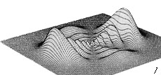


Advanced TDDFT I:
Memory and Initial-State Dependence
… when the adiabatic approximation commits a crime …
Where were you at the time the photon was annihilated?
I..um…I just can’t remember!
V_{xc(}r,t₎
n(r,t)
Neepa T. Maitra
Hunter College and the Graduate Center of the City University of New York

Slide 2
Plan
– introduction to what is memory and some general properties
-- initial-state dependence
-- history-dependence
-- “gedanken” calculation of electronic quantum control
See also Ch. 8 in your “Fundamentals of TDDFT” book

Slide 3
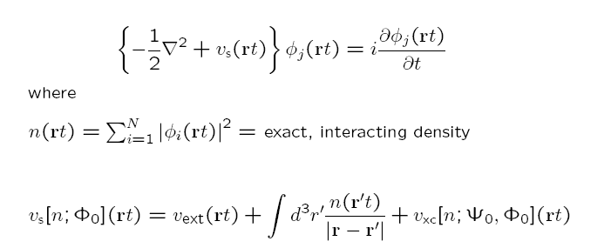
Memory
Ψ₀
Runge-Gross:
n(r t) v_{ext}(r t)
true system
1-1
Φ₀
n(r t) v_{s}(r t)
KS system
1-1
Hartree is naturally adiabatic – depends only on instantaneous density
Actually, v_{ext} [n,Ψ₀] (rt)
functional dependence on history, n(r t’<t), and on initial states of true and KS systems
but as v_{ext} is usually prescribed, functional dependence not considered.
Ψ₀: the true initial state
Φ₀: the initial state to start the KS calculation in -- essentially any (SSD) that has same n(r,0) and n(r,0) as Ψ₀ (R. van Leeuwen PRL 82, 3863 (1999) )
.

Slide 4


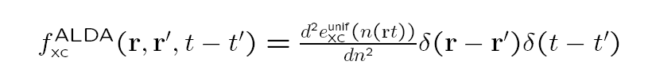
Memory
functional dependence on history, n(r t’<t), and on initial states of true and KS systems
Also, for general observable A[n; Φ₀]
Memory can be thought to arise from using a reduced variable, n(r,t), which traces over N-1 spatial variables → memory-dependence.
But almost all calculations ignore this, and use an adiabatic approximation:

Slide 5
Now, will play with some examples, clarify what is meant by memory, and uncover some exact properties of memory-dependence.
Let’s start with initial-state dependence.

Slide 6

Initial-state dependence (ISD)
The 1-1 n-v mapping formally depends on the initial-state.
But is there ISD in actuality? If we start in different Ψ₀’s, can we get the same n(r t), for all t, by evolving in different potential?
i.e.
Evolve Ψ₀ in v(t) →
The answer is:
No! for one electron, but,
Yes! for 2 or more electrons
n (r t)
t
~
~
? Evolve Ψ₀ in v (t) → same n ?
If no, then ISD redundant, i.e. the functional dependence on the density is enough.
Notes:
Fix – more explanation of example

Slide 7




ISD? One electron case:
Can and
be found, that evolve with the same density for all t ?
means
where α is a real phase
Also, must have
using eqn of continuity,
with
+ surface term
everywhere non-negative
→
→ and differ only by irrelevant t-dep phase
Notes:
Surface term zero

Slide 8
So, for one electron:
Evolve Ψ₀ in v(t) →
n (r t)
~
~
Evolve Ψ₀ in v (t) → same n
No ISD needed in functionals since the time-evolving density itself contains the information about the initial state.
N.T. Maitra and K. Burke, Phys. Rev. A. 63 042501 (2001); ibid. 64 039901 (E) (2001)

Slide 9
More than one electron:
The time-evolving density does not uniquely define the potential
Example:
two non-interacting electrons in 1d
n(x,t)
φ₁,φ₂ orbitals of Φ
~
~
~
φ₁,φ₂ orbitals of Φ
The initial KS potentials in which these two different initial-states evolve with the same n
v
~
v
Say this is the density of an interacting system. Both are possible KS systems.
v_{xc} different for each. Cannot be captured by any adiabatic approximation
N.T. Maitra and K. Burke, Phys. Rev. A. 63 042501 (2001); ibid. 64 039901 (E) (2001)

Slide 10
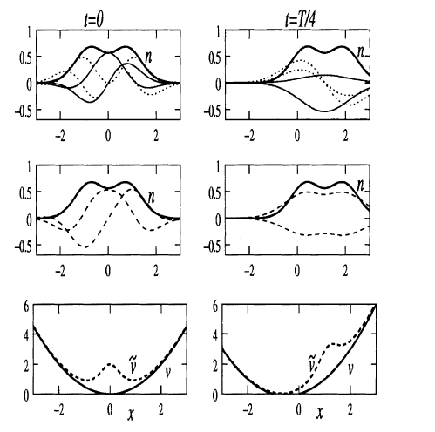
More than one electron: ISD in Floquet states
Reference system:
Another 2-e non-interacting example:
v=
Re and Im parts
φ₁,φ₂ are lowest Floquet orbitals (top panel); n their density
Alternate system:
Same n, but with a doubly-occupied Floquet orbital (middle panel), living in v
Re and Im parts
~
Say this is the density of an interacting system. Both are possible KS systems, and
v_{s}– v_{s} = v_{xc} -v_{xc}
~
~
v_{xc} different for each. Cannot be captured by any adiabatic approximation
Floquet DFT: No 1-1 mapping between densities and time-periodic potentials – need ISD
N.T. Maitra & K. Burke, Chem. Phys. Lett. 359, 237 (2002); ibid. 441, 167 (2007)
Notes:
Fix – more explanation of example

Slide 11
So initial-state-dependence is important for 2 or more electrons
Special case of much practical interest: start in a ground-state.
Then, by the Hohenberg-Kohn thm, Ψ₀ = Ψ₀[n(0)] and Φ₀ = Φ₀ [n(0)]
-- no explicit ISD needed!
But there’s still history-dependence, and we’ll look at this now for the two-electron case, starting in ground-state:
KS gs is doubly-occupied spatial orbital, φ₀(r)

Slide 12
History-dependence: studying it via numerically solvable 2-electron systems
If somehow we can solve the many-electron problem exactly, can we find the exact xc potential, and study its features?
Two electrons in spin-singlet
Assume n(r,t) known. What is v_{s}?
The KS orbital is doubly-occupied, & of form:
Substitute into TDKS eqn
and invert to get:
where α is determined by eqn of continuity,
v_{x} = -v_{H}/2
v_{c} = v_{xc} - v_{x}

Slide 13
History-dependence in 2 e systems
We found for two electrons in spin-singlet:
non-adiabatic (memory)
where α is determined by eqn of continuity,
v_{x} = -v_{H}/2
v_{c} = v_{xc} - v_{x}
V_{s} appears not very non-local in time then – depends only on
But it is not V_{s} that we need approximate – it is V_{xc}, because V_{ext} is given in practise by the problem at hand.
In fact V_{xc} does depend very non-locally in time on the density, in general, and this is what we will now look at…

Slide 14

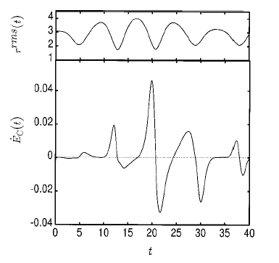
Two-electron example of history-dependence
Eg. Time-dependent Hooke’s atom –exactly numerically solvable
2 electrons in parabolic well, time-varying force constant
k(t) =0.25 – 0.1*cos(0.75 t)
parametrizesdensity
Any adiabatic (or even semi-local-in-time) approximation would incorrectly predict the same v_{c} at both times.
Time-slices where n(t) is locally and semi-locally identical but v_{c} is quite distinct → v_{c} is generally a very non-local functional in time of the density
See also examples in Carsten’s talk!
P. Hessler, N.T. Maitra, K. Burke, J. Chem. Phys, 117, 72 (2002)

Slide 15
Other Explorations of Memory-Dependence in Real-Time
First exploration of memory-dependence in real-time, using 2e in 2D parabolic well, I. d’Amico & G. Vignale, PRB 59, 7876 (1999).
Demonstrating memory in VUC for charge-density oscillations in quantum wells, H.O. Wijewardane and C.A. Ullrich, Phys. Rev. Lett. 95, 086401 (2005)
Comparing exact, ALDA, and VK approximations for 2e in a 2D quantum strip, C.A. Ullrich, JCP 125, 234108, (2006).
Demonstrating memory-dependence using an orbital-dependent functional – exact-exchange via TDOEP in quantum wells, H. Wijewardane & C.A. Ullrich, PRL 100, 056404 (2008)
Strong-field double-ionization of atoms, at intensities/frequencies usually used, memory effects are minimal, M. Thiele, E.K.U. Gross, S. Kümmel, Phys. Rev. Lett. 100, 153004 (2008).
Analytical demonstration that ATDDFT exact for atoms in infinitely-slowly ramped up high-frequency, intense fields, R. Baer, J. Mol. Structure: THEOCHEM 914, 19 (2009).
Rabi oscillations get dynamically detuned in ATDDFT, J. I Fuks, N. Helbig, I. Tokatly, A. Rubio, Phys. Rev. B. 84, 075107 (2011)

Slide 16
Development of Memory-Dependent Functionals…
Gross-Kohn (1985)
Phys. Rev. Lett. 55, 2850 (1985)
Spatially local but time-non-local
Violates zero-force, harmonic potential theorems
from t-dep linear-response of the homogeneous electron gas
In fact, Dobson (PRL 73, 2244, 1994) showed that time-non-locality → spatial non-local n- dependence (…more in Carsten’s lectures)
Dobson-Bünner-Gross (1997)
Phys. Rev. Lett. 79, 1905 (1997)
Apply Gross-Kohn in frame that moves along with local velocity of electron fluid.
Spatially-local relative to where a fluid element at (r,t) was at earlier times t’, R’(t’|r,t)
Vignale-Kohn (VK) (1996) – TD-current-density-FT
Phys. Rev. Lett. 77, 2037 (1996)
→Carsten’s lectures!
Spatially local in current j → spatially ultra-nonlocal in density n

Slide 17
… Development of Memory-Dependent Functionals
Vignale-Ullrich-Conti (1997) – extend VK to non-linear regime.
G. Vignale, C.A. Ullrich, and S. Conti, PRL 79, 4878 (1997)
Kurzweil & Baer (2004, 2005, 2006) – Galilean- invariant “memory action functional”, J. Chem. Phys. 121, 8731 (2004).
Tokatly (2005, 2007) –TD-deformation-FT
Ch. 25 in “Fundamentals of TDDFT” book, I.V. Tokatly, PRB 71, 165104 and 165105 (2005); PRB 75, 125105 (2007)
Formulate density & current dynamics in a Lagrangian frame. Since going with the flow, spatially local xc is sensible & all complications including memory are contained in Green’s deformation tensor g_{i j}
Orbital functionals
– as orbitals incorporate “infinite KS memory”, so may be most promising approach in many situations
Development of true ISD-Functionals? none yet!
Nevertheless, ISD and history-dependence are intimately entangled….next slide..

Slide 18
Trading ISD for more history
Evolve initial states backward in time, in some potential, to a ground-state → no ISD due to Hohenberg-Kohn DFT → instead, must tack on extra piece of “pseudo pre-history”
“memory condition”
~
V_{xc}[n;Ψ₀,Φ₀](r t) = V_{xc}[n](r t)
Starts at t=0 in initial true state Ψ₀ and KS evolves from initial state Φ₀
Starts at some time –T from some ground state:
~
n (r t)
n (r t)
pseudoprehistory
t
t
-T’
-T
“initial” ground-state (any)
The pseudoprehistory is not unique – may find many ground-states that evolve to the same state at t=0, in different amounts of time, in different v’s.
Eqn applies to all – and gives a strict exact test for approximate history-dependent functionals.

Slide 19
A couple of small exercises!
Does ALDA satisfy the “memory condition”?
b) Will a functional with history-dependence but no initial-state dependence (such as Vignale-Kohn, or VUC – see Carsten’s lectures), satisfy the “memory condition”?

Slide 20
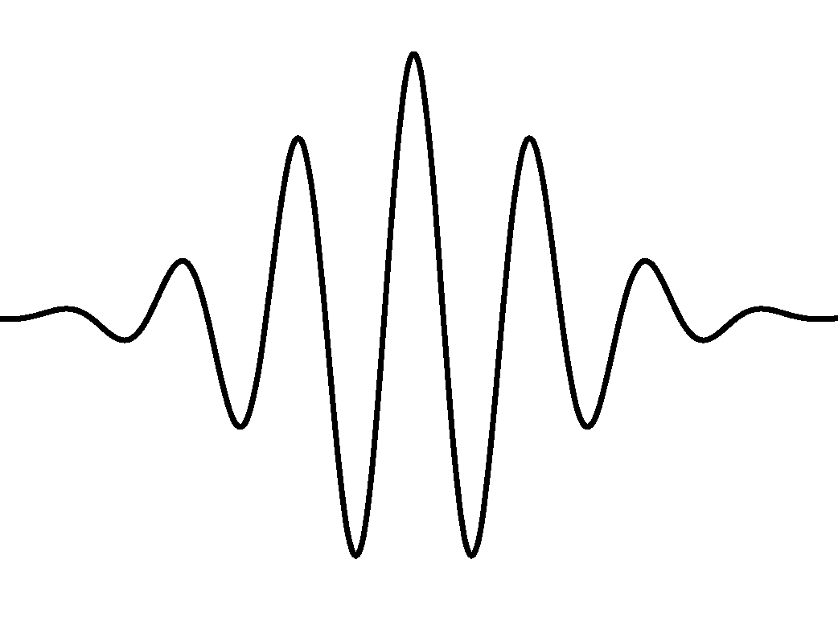
Memory in Electronic Quantum Control
Interacting (true) system: state-to-state control
Density of desired target state – mth excited state
Achieve this by turning on some laser field for some time until mth state reached, at time t*, say,
i.e. evolve in a given v_{ext}(t), s.t.
v_{ext} (t*) = v_{ext} (0)
Density of initial ground state
Kohn-Sham description of dynamics:
? Does the exact v_{s} also return to its initial value ?
? Is an adiabatic approx adequate ?
Maitra, Burke, & Woodward PRL, 89, 023002 (2002); Ch. 8 in “Fundamentals of TDDFT” book

Slide 21
“Gedanken” Calculation of Quantum Control…
? Does the exact v_{s} also return to its initial value ?
No, it cannot!
First note that the KS density n(t >t*) =n_{m}
IF v_{s}(t> t*) = v_{s}(0), then n_{m} would have to be an excited-state density of v_{s}(0).
But v_{s}(0) is the KS potential whose ground-state has the same density as interacting ground-state of v_{ext}(0).
Excited KS states do not have the same density as the excited states of the corresponding v_{ext}
→ v_{s}(0) = v_{s}(t*)

Slide 22
? Is an adiabatic approx adequate ?
No!
2 possibilities:
exact KS potential becomes static, with Φ(t>t*) = Φ_{m’} -- an excited state of v_{s}(t*). But ATDDFT instead finds KS potential which has n_{m} as ground-state density.
The excited state info is encoded in the memory-dependence of the exact KS potential, lacking in ATDDFT.
(ii) exact KS (and xc potential) continue to change in time after t*, with densities of KS orbitals evolving such that their sum remains static, and equal to n_{m}. ATDDFT clearly fails, as static n → ATDDFT v_{xc} static too.

Slide 23
How important is this problem in practise?
Should we give up on doing electronic control until we have good non-adiabatic functionals?
No!
Choose a target functional other than the true excited-state density: e.g. optimize instead the corresponding KS excited state density, or an overlap with it. The optimal field found for the KS system may also achieve a good outcome for the true system
State-control is perhaps the hardest: control of other observables, directly related to the density, is less problematic and also interesting
e.g. transfer of density between quantum wells, bond-cleavage…
Ch. 13 in “Fundamentals of TDDFT” book;
A. Castro, J. Werschnik, E.K.U. Gross arXiv:1009.2241v1; K. Krieger, A. Castro, E. K. U. Gross, Chem. Phys. 391, 50 (2011)

Slide 24
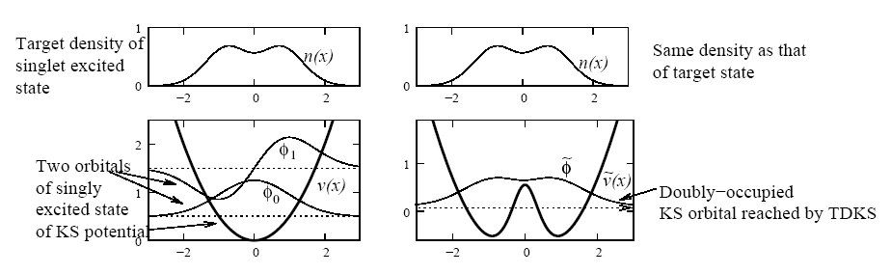
A particularly challenging problem for exact TDDFT:
Consider pumping He from ground (1s²) to first accessible excited state (1s2p).
Problem!! The KS state remains doubly-occupied throughout – cannot evolve into a singly-excited KS state.
Simple model: evolve two electrons in a harmonic potential from ground-state
(KS doubly-occupied φ₀) to the first excited state (φ₀,φ₁) :
TDKS
-- KS achieves target excited density, but with a doubly-occupied ground-state orbital !
-- Yet this is how exact TDDFT describes the dynamics – the exact v_{xc} is unnatural and difficult to approximate, as are observable-functionals of the final state…

Slide 25
… Quantum Control Difficulty …
Different control targets? Instead of targeting the density, what about trying to optimize <Φ(T) |1s2p>?
- max would be ½
(c.f. close to 100% in the interacting He problem – Werschnik & Gross (2005))
i.e. the interacting system is controllable in this sense, but the non-interacting is not
-- But again, the optimist speaks! A clever choice of target functional may yet be found, for which the optimal field found from KS evolution yields a large overlap with the target in the interacting system.
Another Exercise!
Consider exciting a two electron non-interacting ground-state into its first excited state. Pretend that you have found a laser field that gets the target density exactly. Find an expression for the overlap of the state that is reached and the desired state. Evaluate this for a simple potential (eg. Harmonic oscillator, or hydrogen atom).

Slide 26
Summary
Exact xc functionals in TDDFT are generally memory-dependent – but adiabatic approximations are not.
Functionals for more than one electron depend on the initial-state.
Several recent attempts to develop history-dependent functionals, none commonly used.
History-dependence and initial-state dependence are entangled with each other.
Memory appears to be an important feature to capture in many applications, like electronic quantum control processes – orbital functionals may be a good approach – but more study needed.
Next time: memory in linear response – frequency-dependent kernels in double-excitations.

Slide 27
To illustrate how the adiabatic approx can go wrong, can even just consider a stationary excited state:
A Final Exercise!
For a one-electron ground-state, the KS potential-functional, determined by inversion of the TDKS eqn, defines an exact adiabatic KS potential, which could be written as:
Now consider beginning an adiabatic calculation in the first excited state of the 1-d harmonic oscillator. What would the initial exact adiabatic KS potential be at this time be?
(Hint: Inserting its density into the eqn above, you should find a singularity in the adiabatic potential at the origin of the form δ(x)/|x| -- unphysical and not allowed! )
(Note that we wouldn’t usually use a density-fnal for v_{s} – we only use a fnal for v_{xc}, as v_{ext} is given by problem at hand. But for the purposes of this exercise, treat v_{s} as a density fnal as above)

Slide 28
Runge-Gross Theorem
~
Ψ₀
Ψ₀
n
n
○ ■ ♣ ◊ ♦
♠ ▲ ○
…
●
●
●
●
●
●
●
…
Vext
●
●
●
●
Lines from same outer ellipse must point to different points in inner ellipse
Lines from different ellipses may point to same or different points
-- if from identical symbols, must point to different points
Non-v-representable densities are open symbols – no lines emanate
~
~
Ψ₀
□ ▼ ♫
n

