Slide 1


Advanced TDDFT II
II. Frequency-Dependent Kernels: Double Excitations
f_{xc}
Neepa T. Maitra
Hunter College and the Graduate Center of the City University of New York

Slide 2
Plan
-- Double-Excitations in TDDFT
-- Autoionizing Resonances
-- Opening the optical gap – also needs a frequency-dependent kernel

Slide 3



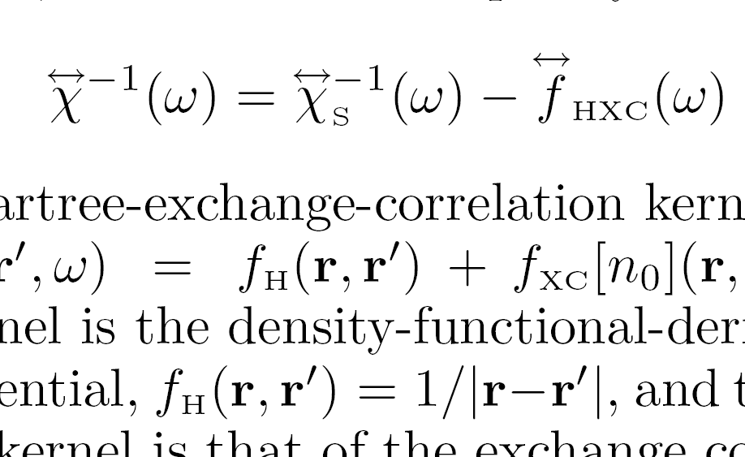
First, quick recall of how we get excitations in TDDFT: Linear response
Petersilka, Gossmann & Gross, PRL 76, 1212 (1996)
Casida, in Recent Advances in Comput. Chem. 1,155, ed. Chong (1995)
Poles at true excitations
Poles at KS excitations
n₀
adiabatic approx: no ω-dep
Need (1) ground-state v_{S,0}[n₀](r), and its bare excitations
(2) XC kernel
~ δ(t-t’)
Yields exact spectra in principle; in practice, approxs needed in (1) and (2).
Notes:
Actually, poles of chi and zeros of chi_inverse etc.
Approxs – in particular, adiabatic, where memory dep negelected entirely, or, in freq domain, this fhxc is constant

Slide 4


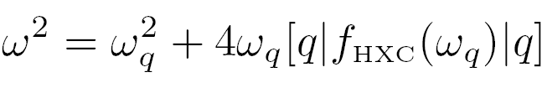

TDDFT linear response in quantum chemistry codes:
q =(i→ a) labels a single excitation of the KS system, with transition frequency ω_{q} = ε_{a} - ε_{i} , and
Eigenvalues → true frequencies of interacting system
Eigenvectors → oscillator strengths
Useful tool for analysis
Zoom in on a single KS excitation, q = i→ a
Well-separated single excitations: SMA
When shift from bare KS small: SPA

Slide 5
Types of Excitations
Non-interacting systems eg. 4-electron atom
Eg. single excitations
Eg. double excitations
near-degenerate
Interacting systems: generally involve mixtures of (KS) SSD’s that may have 1,2,3…electrons in excited orbitals.
single-, double-, triple- excitations

Slide 6

Double (Or Multiple) Excitations
How do these different types of excitations appear in the TDDFT response functions?
Consider:
χ – poles at true states that are mixtures of singles, doubles, and higher excitations
χ_{S} -- poles at single KS excitations only, since one-body operator can’t connect Slater determinants differing by more than one orbital.
χ has more poles than χ_{s}
? How does f_{xc} generate more poles to get states of multiple excitation character?

Slide 7
Simplest Model:
Exactly solve one KS single (q) mixing with a nearby double (D)
Notes:
Add an eqn for Psi i.t.o Phi?

Slide 8
Invert and insert into Dyson-like eqn for kernel →dressed SPA (i.e. ω-dependent):
adiabatic
strong non-adiabaticity!
This kernel matrix element, by construction, yields the exact true ω’s when used in the Dressed SPA,

Slide 9
χ ⁻¹ = χ_{s}⁻¹ - f_{Hxc}

Slide 10
An Exercise!
Deduce something about the frequency-dependence required for capturing states of triple excitation character – say, one triple excitation coupled to a single excitation.

Slide 11
Practical Approximation for the Dressed Kernel
General case: Diagonalize many-body H in KS subspace near the double-ex of interest, and require reduction to adiabatic TDDFT in the limit of weak coupling of the single to the double:
usual adiabatic matrix element
dynamical (non-adiabatic) correction
So: (i) scan KS orbital energies to see if a double lies near a single,
apply this kernel just to that pair
apply usual ATDDFT to all other excitations
N.T. Maitra, F. Zhang, R. Cave, & K. Burke JCP 120, 5932 (2004)

Slide 12
Alternate Derivations
M.E. Casida, JCP 122, 054111 (2005)
M. Huix-Rotllant & M.E. Casida, arXiv: 1008.1478v1
-- from second-order polarization propagator (SOPPA) correction to ATDDFT
P. Romaniello, D. Sangalli, J. A. Berger, F. Sottile, L. G. Molinari, L. Reining, and G. Onida, JCP 130, 044108 (2009)
-- from Bethe-Salpeter equation with dynamically screened interaction W(ω)
O. Gritsenko & E.J. Baerends, PCCP 11, 4640, (2009).
-- use CEDA (Common Energy Denominator Approximation) to account for the effect of the other states on the inverse kernels, and obtain spatial dependence of f_{xc}-kernel as well.

Slide 13

Simple Model System: 2 el. in 1d
Vext = x²/2
Vee = λ δ(x-x’)
λ = 0.2
Exact: ½ : ½
½: ½
Exact: 1/3: 2/3
2/3: 1/3
Dressed TDDFT in SPA, f_{xc}(ω)

Slide 14
When are states of double-excitation character important?
(i) Some molecules eg short-chain polyenes
Lowest-lying excitations notoriously difficult to calculate due to significant double-excitation character.
R. Cave, F. Zhang, N.T. Maitra, K. Burke, CPL 389, 39 (2004);
Other implementations and tests:
G. Mazur, R. Wlodarczyk, J. Comp. Chem. 30, 811, (2008); Mazur, G., M. Makowski, R. Wlodarcyk, Y. Aoki, IJQC 111, 819 (2010);
M. Huix-Rotllant, A. Ipatov, A. Rubio, M. E. Casida, Chem. Phys. (2011) – extensive testing on 28 organic molecules, discussion of what’s best for adiabatic part…

Slide 15
When are states of double-excitation character important?
(ii) Coupled electron-ion dynamics
- propensity for curve-crossing means need accurate double-excitation description for global potential energy surfaces
Levine, Ko, Quenneville, Martinez, Mol. Phys. 104, 1039 (2006)
(iii) Certain long-range charge transfer states!
Stay tuned for next lecture!
(iv) Near conical intersections
- near-degeneracy with ground-state (static correlation) gives double-excitation character to all excitations
(v) Certain autoionizing resonances
Coming up shortly!

Slide 16
How about Doubles in Adiabatic Quadratic Response?
Since two photons are required to excite two electrons, can we get away with the adiabatic approx in quadratic response?
Not really:
The adiabatic quadratic response function does have poles at double excitations but they’re simply sums of linear-response-corrected single excitations,
i.e. no mixing between singly-excited states lying near a double-excitation
See analyses in
P. Elliott, S. Goldson, C. Canahui, N. T. Maitra, Chem. Phys. 135, 104110 (2011), and
S. Tretiak and V. Chernyak, JCP 119, 8809 (2003).

Slide 17
Autoionizing Resonances
When energy of a bound excitation lies in the continuum:
KS (or another orbital) picture
ω
ω
bound, localized excitation
continuum excitation
True system:
Electron-interaction mixes these states → Fano resonance
ATDDFT gets these – mixtures of single-ex’s
M. Hellgren & U. van Barth, JCP 131, 044110 (2009) → Fano parameters directly implied by Adiabatic TDDFT
(Also note Wasserman & Moiseyev, PRL 98,093003 (2007), Whitenack & Wasserman, PRL 107,163002 (2011) -- complex-scaled DFT for lowest-energy resonance )

Slide 18
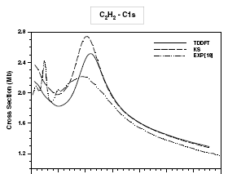
Auto-ionizing Resonances in TDDFT
Eg. Acetylene: G. Fronzoni, M. Stener, P. Decleva, Chem. Phys. 298, 141 (2004)
But here’s a resonance that ATDDFT misses:
Why? It is due to a double excitation.

Slide 19
ω
a
ω = 2(ε_{a}−ε_{i})
i
bound, localized double excitation with energy in the continuum
single excitation to continuum
Electron-interaction mixes these states → Fano resonance
ATDDFT does not get these – double-excitation
e.g. the lowest double-excitation in the He atom (1s² → 2s²)

Slide 20
Getting the cross-section in TDDFT
Photo-absorption cross section:
Where ,
^
^
How does the exact kernel add the resonant bump to χ_{s} ?
Need a degenerate perturbation theory analysis in the continuum, diagonalizing the bound double-excitation with the continuum states.
Aha! Luckily this is closely along the lines of what Fano did in 1961…

Slide 21




Fano’s Universal Resonance Formula
U. Fano, Phys. Rev. 124 , 1866 (1961)
“pre-diagonalized”
Transition probability to continuum modified by the resonance due to Φ_{b}
resonance position
resonance width
coupling Hamiltonian
q = asymmetry parameter…next slide
Ψ_{E} is the resonance-modified continuum state at energy E = ω +E_{i}
Φ_{E} is the unmodified continuum state at energy E = ω +E_{i}
|i> is the initial (ground) state
is a transition operator

Slide 22
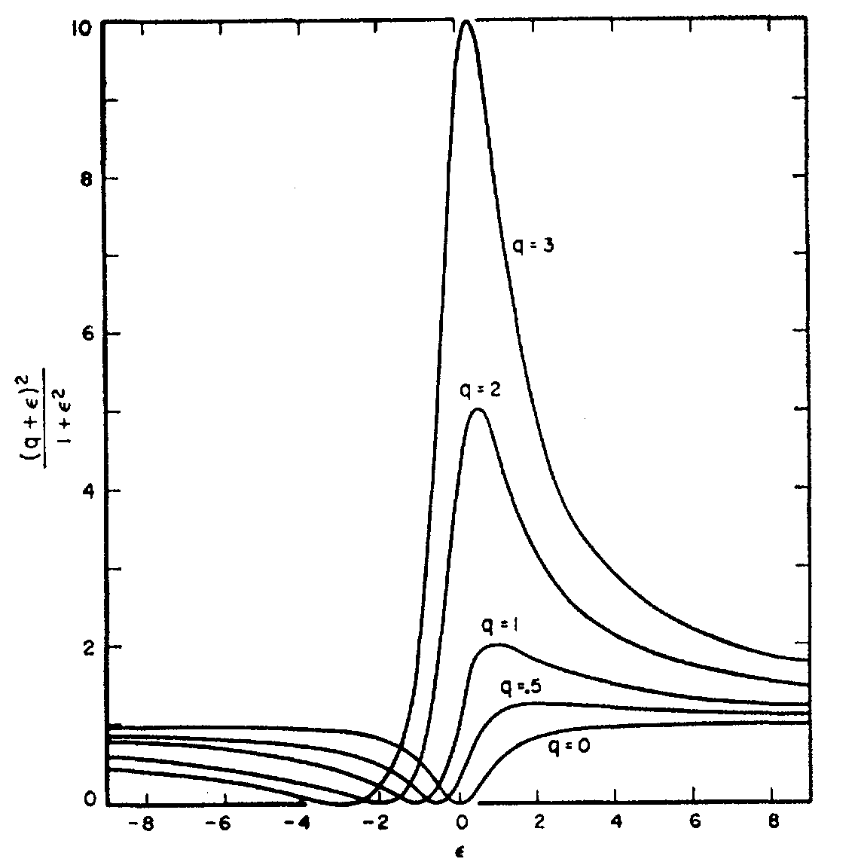
Fano Lineshapes:
Asymmetry parameter:
Note q = ± 1 means total integrated oscillator strength unchanged by resonance .
This is the case when dressing the KS system with a resonance from a bound double-excitation!
ε
Figure from U. Fano, Phys. Rev. 124,1866 (1961)

Slide 23
Fano into TDDFT
^
^
Consider |i >, Φ_{E} and Φ_{b} (double-ex)
to be Kohn-Sham states, and T = n(r),
into Fano analysis:
For
near resonance
Approximations:
-- considered coupling between doubly-excited bound-state and continuum only
-- took Γ as the smallest energy scale in the system.

Slide 24

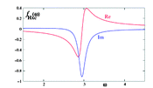
To find
we need
Use Kramers-Kronig relation
… eventually get…
weak-interaction limit
A. Krueger & N. T. Maitra, PCCP 11, 4655 (2009);
P. Elliott, S. Goldson, C. Canahui, N. T. Maitra, Chem. Phys. 135, 104110 (2011).

Slide 25
Frequency-Dependent Kernels, more generally
Note some other recent ω-dep kernels have been developed for calculations of spectra (but not for capturing doubles):
-- Exact-exchange kernel, A. Görling, PRA 57, 3433 (1998); Y. Shigeta, K. Hirao, and S. Hirata, PRA 73, 010502(R) (2006); M. Hellgren & U. von Barth JCP 131 044110 (2009)
-- VK kernel of TDCDFT, G. Vignale & W. Kohn (PRL 77, 20371996); C. A. Ullrich & K. Burke JCP 121, 28 (2004), and M. van Faassen & P. L. de Boeij JCP 120, 8353 (2004)
-- “Nanoquanta kernel”, M. Gatti, V. Olevano, L. Reining, I. V. Tokatly, PRL 99, 057401 (2007), S.Botti, A. Schindlmayr, R. Del Sole, L. Reining, Rep. Prog. Phys. 70, 357 (2007), and citations therein – derive f_{xc} from Bethe-Salpeter equation.
Main motivation behind these is capturing spatial ultranonlocality (this implies time-nonlocality)
Another place where the adiabatic approximation fails is the optical gap in semi-conductors – next slide!

Slide 26
The optical gap: Another place where adiabatic approx fundamentally fails
Meaning, onset of continuous absorption in spectrum ( Im χ(ω) )
Typically KS gap << true gap
-- even with the exact ground-state v_{xc}
Opening the gap requires f_{xc} to have an imaginary part.
Why?
Consider what happens if take a real approximate f_{xc} in imaginary part of:
For ω inside the KS gap,
While, analogously for ω inside the true gap,
Since [….]’s above cannot vanish identically in the whole true and KS gap regions →
wherever
Notes:
[ .. ] don’t vanish everywhere since fHxc = chis^-1 - chi ^-1 and reality assumption in each case

Slide 27




i.e. the KS system and the true system have the same gap when a purely-real approximation for f_{xc} is used
Having an imaginary part means f_{xc} cannot be frequency-independent.
Why?
must be real, since
→ its Fourier transform to ω-domain must then satisfy
adiabatic approx means ω-independent (= ) and therefore f_{xc} real
adiabatic f_{xc} cannot open the gap
Note that also a long-ranged f_{xc} ~ 1/q² is also required.
See more in eg. “Quantum Theory of the Electron Liquid” by G.F. Guiliani and G. Vignale (Cambridge, 2005); also some discussion in Ch. 4 of your “Fundamentals of TDDFT” book.

Slide 28
Summary
ATDDFT fundamentally fails to describe double-excitations: strong frequency-dependence is essential.
Diagonalizing in the (small) subspace where double excitations mix with singles, we can derive a practical frequency-dependent kernel that does the job. Shown to work well for simple model systems, as well as real molecules.
Likewise, in autoionization, resonances due to double-excitations are missed in ATDDFT.

