Slide 1



Advanced TDDFT III
Molecular Dissociation and Long-Range Charge-Transfer Excitations: Effect of Ground-State Static Correlation on fxc
Neepa T. Maitra
Hunter College and the Graduate Center of the City University of New York

Slide 2
Plan
-- Exact KS potential in molecular dissociation
-- Long-range charge-transfer excitations
-- Simplest model of CT to exactly solve to get an idea about f_{xc}(ω)

Slide 3
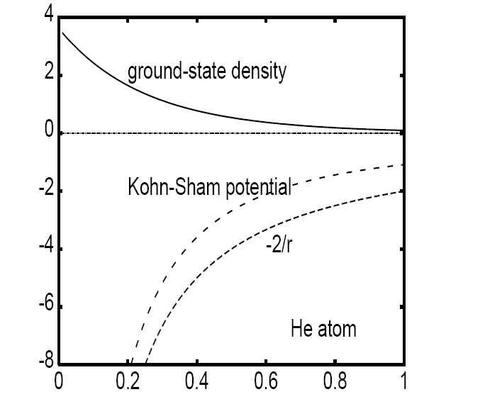
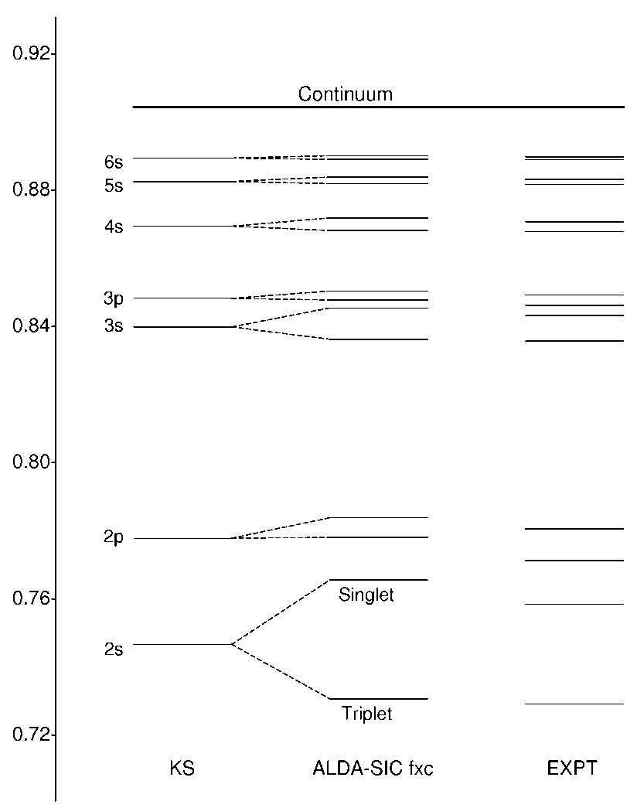
Exact ground-state KS potentials…
For 2-e systems, easy to find if know the exact density, since φ(r) = and so
Eg. the Helium atom:
TDDFT linear response from
exact helium KS ground state:
H
r/a₀
Already the KS excitations are pretty good, and most fxc approxs give similar corrections
Petersilka, Burke, & Gross IJQC 80, 534 (2000)

Slide 4


How about a Simple Model of a Diatomic Molecule?
Model a hetero-atomic diatomic molecule composed of open-shell fragments (eg. LiH) with two “one-electron atoms” in 1-d:
“softening parameters”
(choose to reproduce eg. IP’s of different real atoms…)
Can simply solve exactly numerically Ψ(r₁,r₂) → extract ρ(r) →
→ exact

Slide 5
Exact ground-state KS potentials…
Molecular Dissociation (1d “LiH”)
n
Vs
Vext
x
“Peak” and “Step” structures.
(step goes back down at large R)
Vext

Slide 6
peak
V_{Hxc}
R=10
asymptotic
step
x
J.P. Perdew, in Density Functional Methods in Physics, ed. R.M. Dreizler and J. da Providencia (Plenum, NY, 1985), p. 265.
C-O Almbladh and U. von Barth, PRB. 31, 3231, (1985)
O. V. Gritsenko & E.J. Baerends, PRA 54, 1957 (1996)
O.V.Gritsenko & E.J. Baerends, Theor.Chem. Acc. 96 44 (1997).
D. G. Tempel, T. J. Martinez, N.T. Maitra, J. Chem. Th. Comp. 5, 770 (2009) & citations within.
N. Helbig, I. Tokatly, A. Rubio, JCP 131, 224105 (2009).

Slide 7
The Step
bond midpoint peak
step, size ΔI
Step has size ΔI and aligns the atomic HOMOs
Prevents dissociation to unphysical fractional charges.
v_{s}(r)
ΔI
n(r)
Vext
ΔI
LDA/GGA – wrong, because no step!
“Li”
“H”
At which separation is the step onset?
Step marks location and sharpness of avoided crossing between ground and lowest CT state..
peak
v_{Hxc} at R=10
step
asymptotic
Tempel, Martinez, Maitra, J. Chem. Theory Comp. 5, 770 (2009).

Slide 8





A Useful Exercise!
To deduce the step in the potential in the bonding region between two open-shell fragments at large separation:
Take a model molecule consisting of two different “one-electron atoms” (1 and 2) at large separation. The KS ground-state is the doubly-occupied bonding orbital:
where φ₀(r) and n(r) = φ₁²(r) + φ₂²(r) is the sum of the
atomic densities. The KS eigenvalue ε₀ must = ε₁ = −I₁ where I₁ is the smaller ionization potential of the two atoms.
Consider now the KS equation
for r near atom 1, where and again for r near atom 2, where
Noting that the KS equation must reduce to the respective atomic KS equations in these regions, show that v_{s}, must have a step of size ε₁ − ε₂ = I₂ –I₁ between the atoms.

Slide 9


The Peak
A “kinetic correlation” effect (Gritsenko, van Leeuwen, Baerends JCP 1996). Also occurs in stretched H₂
Another interpretation: peak pushes away density from the bonding region:
Asymptotically,
with
→ peak in v_{s}
but with the LCAO
→ no peak in v_{s}
Error – most significant in bonding region
→ peak in v_{c} acts as a barrier to push back to the atomic regions this extraneous density.
Tempel, Martinez, Maitra, JCTC 5, 770 (2009)
Helbig, Tokatly, & Rubio, JCP 131, 224105 (2009).

Slide 10
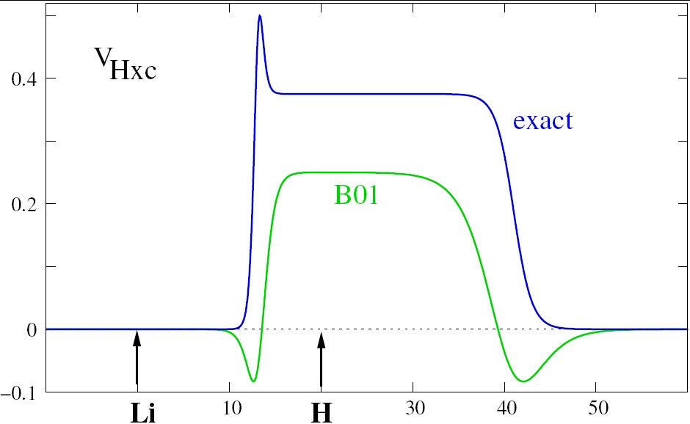
Capturing the Step and Peak in Approximations: Hard! Need non-local n-dependence
Self-interaction-corrected LDA appears to have step- and peak-like features Vieira, Capelle, Ullrich, PCCP 11, 4647 (2009) – quantum well studies)
Baerends functional B01: functional of occupied and selected virtual orbitals (Baerends PRL 87 133004 (2001))
Inspired by density-matrix functional theory.
Does the B01 potential have the step and peak?
Step ~ difference in electron affinities, ΔA < ΔI
What about the peak? It’s actually a dip!!

Slide 11
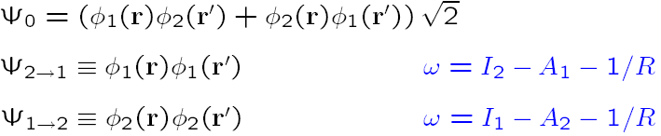
So far:
Discussed step and peak structures in the ground-state potential of a dissociating molecule
Fundamentally, these stark structures arise due to the single-Slater-determinant description of KS (one doubly-occupied orbital) – the true wavefunction, requires minimally 2 determinants (Heitler-London form)
In practise, could treat ground-state by spin-symmetry breaking→ good ground-state energies but wrong spin-densities
Next: What are the consequences of the peak and step beyond the ground state?
Response and Excitations

Slide 12
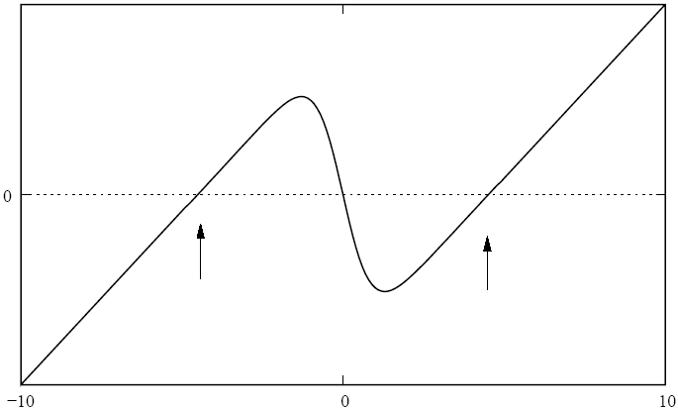
Implications for Static Response
Step: Similar step structure seen with homo-atomics in electric fields
Eg: Stretched-H₂
in E-field, ε = 0.001 au
H ------10au------H
exact v_{s}⁽¹⁾
Field-counteracting step
E-field
exact v_{Hxc}⁽¹⁾
Step-size εR
LDA v_{xc}⁽¹⁾
exactly compensates the field in exact KS potential.
two locally polarized H atoms
But usual functional approximations completely miss this step, and therefore yield fractional charges (global charge transfer)
Related problem: usual functionals overestimate polarizabilities of long-chains.
-- Need non-local spatial dependence
Peaks: appear in zero-field potential (not shown), act as barriers to transport – neglected in present-day transport calculations

Slide 13
What about TDDFT excitations of the dissociating molecule?
Recall the KS excitations are the starting point; these then get corrected via f_{xc} to the true ones.
Step → KS molecular HOMO and LUMO delocalized and near-degenerate
But the true excitations are not!
“Li”
“H”
LUMO
HOMO
Δε~ e^{-cR}
Near-degenerate in KS energy
Static correlation induced by the step!
Find: The step induces dramatic structure in the exact TDDFT kernel ! Implications for long-range charge-transfer.

Slide 14
Plan
-- Exact KS potential in molecular dissociation
-- Long-range charge-transfer excitations
-- Simplest model of CT to exactly solve to get an idea about f_{xc}(ω)

Slide 15
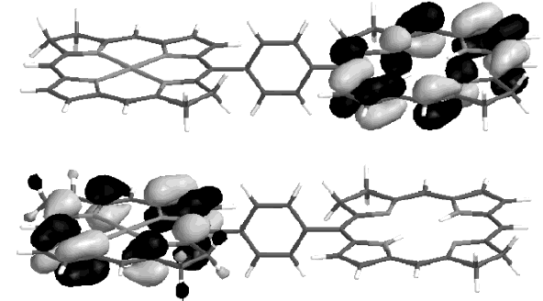
Eg. Zincbacteriochlorin-Bacteriochlorin complex (light-harvesting in plants and purple bacteria)
TDDFT typically severely underestimates Long-Range CT energies
TDDFT predicts CT states energetically well below local fluorescing states. Predicts CT quenching of the fluorescence.
! Not observed !
TDDFT error ~ 1.4eV
Dreuw & Head-Gordon, JACS 126 4007, (2004).
But also note: excited state properties (eg vibrational freqs) might be quite ok even if absolute energies are off (eg DMABN, Rappoport and Furche, JACS 2005)
Notes:
Should I put the energies??
I(ZnBC) = 5.57eV; A(BC) = -0.42eV;expect w_CT = 2.69eV
B3LYP TDDFT gives w = 1.33eV so error at least 1.36 eV

Slide 16
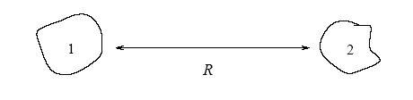

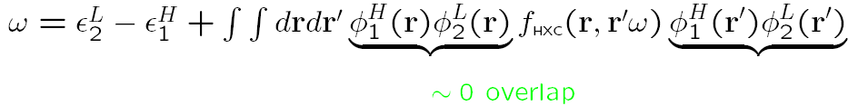

Why usual TDDFT approx’s fail for long-range CT:
First, we know what the exact energy for charge transfer at long range should be:
Ionization energy of donor
e
Electron affinity of acceptor
Now to analyse TDDFT, use single-pole approximation (SPA):
-A_{s,2}
-I₁
i.e. get just the bare KS orbital energy difference: missing xc contribution to acceptor’s electron affinity, A_{xc,2}, and -1/R
Also, usual ground-state approximations underestimate I
Dreuw, J. Weisman, and M. Head-Gordon, JCP 119, 2943 (2003)
Tozer, JCP 119, 12697 (2003)

Slide 17
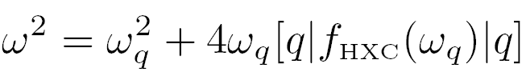
Wait!!
!! We just saw that for dissociating LiH-type molecules, the HOMO and LUMO are delocalized over both Li and H → f_{xc} contribution will not be zero!
Important difference between (closed-shell) molecules composed of
open-shell fragments, and
those composed of closed-shell fragments.
HOMO delocalized over both fragments
HOMO localized on one or other
Revisit the previous analysis of CT problem for open-shell fragments:
Eg. apply SMA (or SPA) to HOMO→LUMO transition
But this is now zero !
q= bonding → antibonding
Now no longer zero – substantial overlap on both atoms. But still wrong.

Slide 18


How to get accurate CT from TDDFT?
Many attempts in the recent literature.
Earlier ones motivated by the fact that CIS (and TDHF) get the correct 1/R asymptote, but, having no correlation, absolute energies are off by ~1eV. So what about a hybrid?
Pure TDDFT:
donor-acceptor overlap → 0
Hybrids with HF:
(1- c_{HF})
Non-zero correction to bare KS energies
But, this asymptotically gives -c_{HF}/R, not -1/R
So, look to other schemes…

Slide 19
Attempts to fix TDDFT for CT…
E.g. Dreuw, Weisman, & Head-Gordon, JCP (2003) – use CIS curve but shifted vertically to match ΔSCF-DFT to account for correlation
E.g. Tawada, Tsuneda, S. Yanagisawa, T. Yanai, & K. Hirao, J. Chem. Phys. (2004): “Range-separated hybrid” with empirical parameter μ
Short-ranged, use GGA
Long-ranged, use Hartree-Fock, gives -1/R
E.g. Stein, Kronik, and Baer, JACS 131, 2818 (2009); Baer, Livshitz, Salzner, Annu. Rev. Phys. Chem. 61, 85 (2010) – range-separated hybrid, with non-empirical “optimally tuned” μ:
Choose μ to give the closest fit of donor’s HOMO to it’s ionization energy, and acceptor anion’s HOMO to it’s ionization energy. → Leeor Kronik talk next week!
Note: idea of range-separated hybrids in ground-state came from Leininger, Stoll, Werner, Savin, Chem. Phys. Lett. (1997)
Note also: hybrids do fall under rigorous “generalized Kohn-Sham theory”, see Görling and Levy, JCP (1997)

Slide 20
…attempts to fix TDDFT for CT:
E.g. Heßelmann, Ipatov, Görling, PRA 80, 012507 (2009) – exact-exchange (EXX) kernel (non-empirical)
E.g. Gritsenko & Baerends JCP 121, 655, (2004) – model kernel to get CT excitations correct in the asymptotic limit, switches on when donor-acceptor overlap becomes smaller than a chosen parameter
E.g. Hellgren & Gross, arXiv: 1108.3100v1 (2011) – shows discontinuity in f_{xc} as a function of # electrons; demonstrates relation to a diverging spatial step in f_{x} (using EXX) that grows exponentially with separation → Maria Hellgren talk next week!!
E.g. Fuks, Rubio, & Maitra, PRA 83, 042501 (2011) – explores use of symmetry-breaking for the case of open-shell fragments, to avoid the static correlation problem.
E.g. Vydrov, Heyd, Krukau, & Scuseria (2006), 3 parameter range-separated, SR/LR decomposition…
E.g. Zhao & Truhlar (2006) M06-HF – empirical functional with 35 parameters!!! Ensures -1/R.

Slide 21
? Can we find a simple model to explicitly solve for the EXACT xc kernel and understand the origin of eg. the exp(cR) behavior better?
Try two-electron system – two “1-e atoms “ at large separation.
This is two open-shells – recall:
“Li”
“H”
Step → KS molecular HOMO and LUMO delocalized and near-degenerate
But the true excitations are not!
LUMO
HOMO
Δε~ e^{-cR}
Near-degenerate in KS energy
Static correlation induced by the step that fxc must undo !

Slide 22
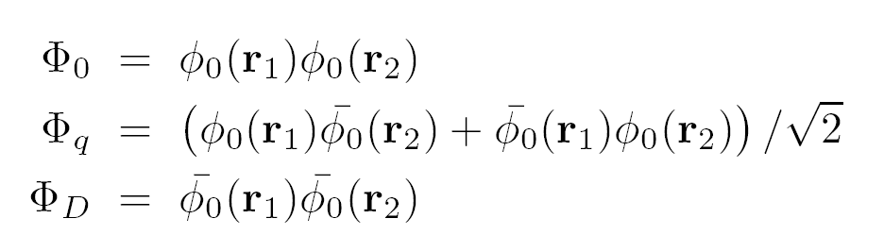
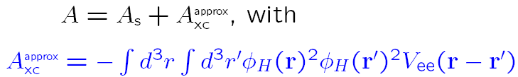
Undoing KS static correlation…
“Li”
“H”
φ₀ LUMO
φ₀ HOMO
Δε~ e^{-cR}
These three KS states are nearly degenerate:
The electron-electron interaction splits the degeneracy: Diagonalize true H
in this basis to get:
atomic orbital on atom2 or 1
Heitler-London gs
CT states
where
Notes:
Haven’t define phi_H, or Vee, or Hs…but no time.
“States rotate…”

Slide 23
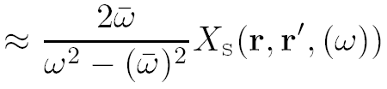


What does the exact fxc looks like?
Diagonalization is (thankfully) NOT TDDFT! Rather, mixing of excitations is done via the f_{xc} kernel...recall double excitations lecture…
KS density-density response function:
only single excitations contribute to this sum
Finite overlap between occ. (bonding) and unocc. (antibonding)
Vanishes with separation as e^{-R}
Interacting response function:
Vanishing overlap between interacting wavefn on donor and acceptor
Finite CT frequencies
Extract the xc kernel from:

Slide 24

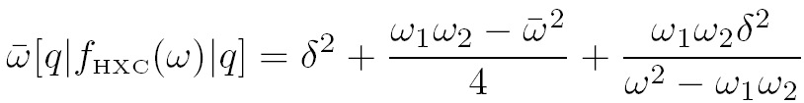
Exact matrix elt for CT between open-shells
Within the dressed SMA
the exact f_{xc} is:…
…
…
_
Interacting CT transition from 2 to 1, (eg in the approx found earlier)
φ₀φ₀ - nonzero overlap
KS antibonding transition freq, goes like e^{-cR}
δ = (ω₁ − ω₂)/2
Note: strong non-adiabaticity!
(i)Also for closed-shell CT, and for homoatomics
(Gritsenko and Baerends (JCP 2004))
Upshot: (i) f_{xc} blows up exponentially with R, fxc ~ exp(cR) (ii) f_{xc} strongly frequency-dependent
Maitra JCP 122, 234104 (2005)

Slide 25
How about higher excitations of the stretched molecule?
Since antibonding KS state is near-degenerate with ground, any single excitation φ₀ → φ_{a} is near-generate with double excitation (φ₀ → φ_{a}, φ₀ → φ_{a})
Ubiquitous doubles – ubiquitous poles in f_{xc}(ω)
Complicated form for kernel for accurate excited molecular dissociation curves
Even for local excitations, need strong frequency-dependence.
N. T. Maitra and D. G. Tempel, J. Chem. Phys. 125 184111 (2006).

Slide 26
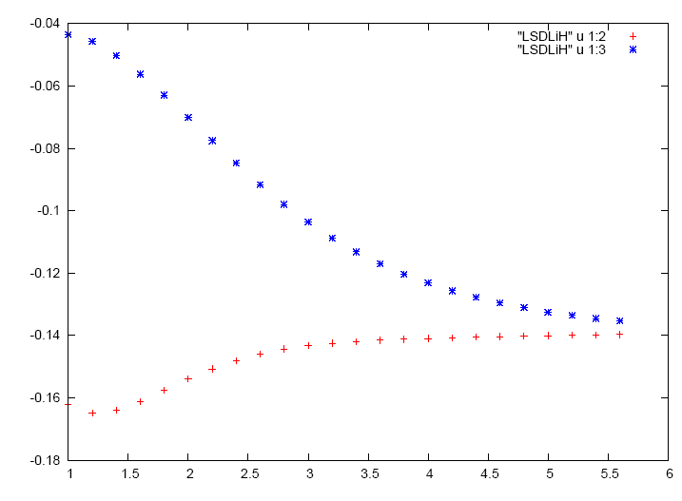
But almost no approximate v_{s} has the step, so is static correlation and ω-dep. relevant practically ??
Yes !
Static correlation is an important feature of LDA and GGA’s too:
LiH in LDA
Orbital energy
LUMO
HOMO and LUMO become degenerate as the molecule dissociates
HOMO
R

Slide 27
LiH in LDA
Orbital energy
LUMO
HOMO and LUMO become degenerate as the molecule dissociates
HOMO
R
As the molecule dissociates into fractional charged species (Li^{+0.25} H^{-0.25} ), the atomic potentials distort so as to align the highest levels of Li and H. The LiH molecular HOMO and LUMO are both delocalized over both atoms.
So, again, any single excitation φ_{H} → φ_{a} is near-degenerate with the double (φ_{H},φ_{H}) → (φ_{a},φ_{L})
requiring again strongly frequency-dependent f_{xc} for both local and CT excitations.

Slide 28
Summary
Long-range charge-transfer excitations are particularly challenging for TDDFT approximations to model, due to vanishing overlap between the occupied and unoccupied states.
Require exponential dependence of the kernel on fragment separation for frequencies near the CT ones.
Strong frequency-dependence in the exact xc kernel is needed to accurately capture long-range charge-transfer excitations in a molecule composed of open-shell species
Origin of complicated ω-structure of kernel is the step in the ground-state potential – making the bare KS description a poor one. Static correlation.
Static correlation problems also in conical intersections.
Note also : general problem with non-overlapping occupied-unoccupied transitions, even when no CT, discussed in Hieringer & Görling Chem. Phys. Lett. 419, 517 (2006)

