Slide 1
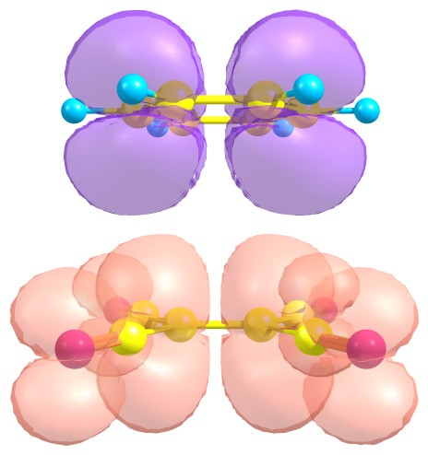
Excitation gaps of finite-sized systems from Optimally-Tuned Range-Separated Hybrid Functionals:
Leeor Kronik
Department of Materials & Interfaces,
Weizmann Institute of Science
5th Benasque TDDFT Workshop, January 2012

Slide 2
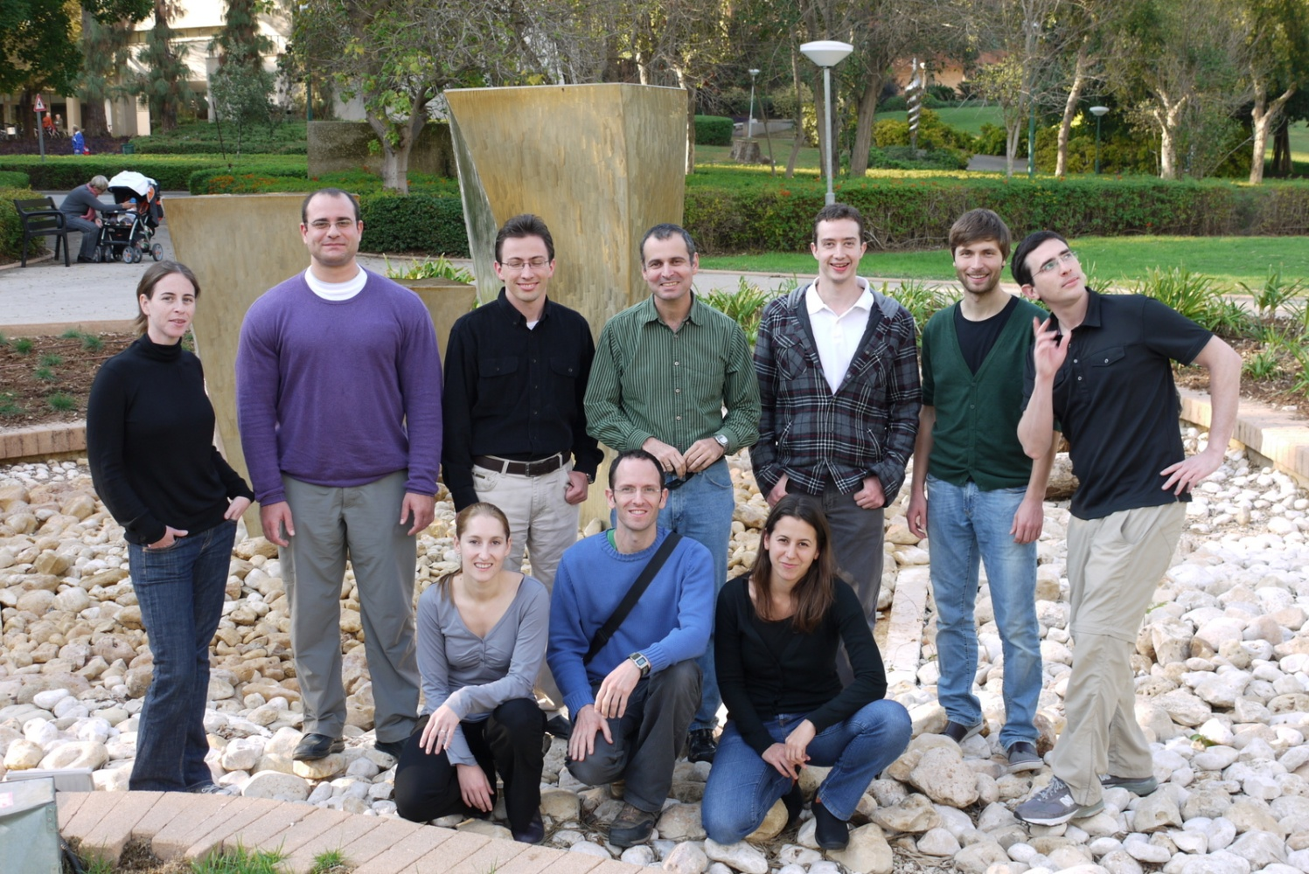
Andreas Karolewski
(visiting)
Ido Azuri
Tami Zelovich
Eli Kraisler
Baruch Feldman
Ariel Biller
The Group
Anna Hirsch
Ofer Sinai
Sivan Abramson
Funding
European Research Council
Israel Science Foundation
Germany-Israel Foundation
US-Israel Binational Science Foundation
Lise Meitner Center for Computational Chemistry
Alternative Energy Research Initiative

Slide 3
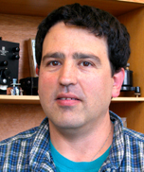



The people
Sivan Refaely-Abramson
Natalia Kuritz
Roi Baer
Tamar Stein
(Hebrew U)
(Weizmann Inst.)
Kronik, Stein, Refaely-Abramson, Baer,
J. Chem. Theo. Comp. (Perspectives Article), to be published

Slide 4
Fundamental and optical gap – the quasi-particle picture
E_{vac}
EA
derivative discontinuity!
IP
E_{g}
E_{opt}
(a)
(b)
See, e.g., Onida, Reining, Rubio, RMP ‘02; Kümmel & Kronik, RMP ‘08

Slide 5
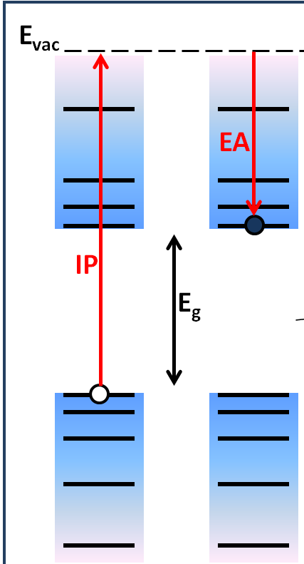
Mind the gap
The Kohn-Sham gap underestimates the real gap
Perdew and Levy, PRL 1983;
Sham and Schlüter, PRL 1983
derivative discontinuity!
Kohn-Sham eigenvalues do not mimic the quasi-particle picture
even in principle!

Slide 6
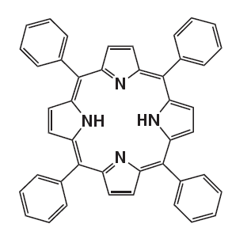
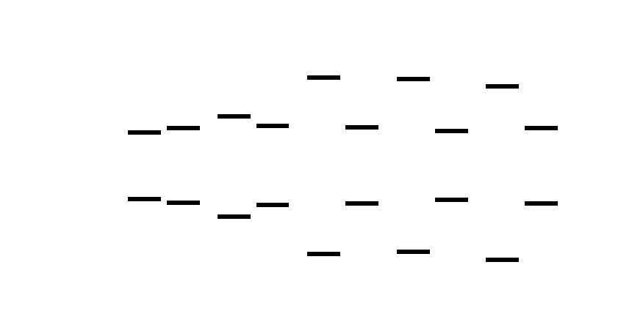
H₂TPP
TD
TD
TD
-1.4
-1.5
-1.7
-2.5
-2.9
1.8
2.0
2.7
2.2
4.8
2.1
4.7
1.9
2.1
Energy [eV]
4.7
-4.7
-5.2
-6.2
-6.2
-6.4
-IP, -EA E_{opt}
GGA
B3LYP
OT-BNL
GW-BSE
EXP

Slide 7
Wiggle room: Generalized Kohn-Sham theory
Map to a partially interacting electron gas that is represented by a single Slater determinant.
Seek Slater determinant that minimizes an energy functional S[{φ_{i}}] while yielding the original density
Type of mapping determines the functional form
Seidl, Goerling, Vogl, Majevski, Levy, Phys. Rev. B 53, 3764 (1996).
Kümmel & Kronik, Rev. Mod. Phys. 80, 3 (2008)
Baer et al., Ann. Rev. Phys. Chem. 61, 85 (2010).
- Derivative discontinuity problem possibly mitigated by non-local operator!!

Slide 8
Hybrid functionals are a special case of Generalized Kohn-Sham theory!
Does a conventional hybrid functional solve the gap problem?

Slide 9
H₂TPP
TD
TD
TD
-1.4
-1.5
-1.7
-2.5
-2.9
1.8
2.0
2.7
2.2
4.8
2.1
4.7
1.9
2.1
Energy [eV]
4.7
-4.7
-5.2
-6.2
-6.2
-6.4
-IP, -EA E_{opt}
GGA
B3LYP
OT-BNL
GW-BSE
EXP

Slide 10
Need correct asymptotic potential!
Can’t work without full exact exchange!
But then, what about correlation?
How to have your cake and eat it too?

Slide 11
Range-separated hybrid functionals
Coulomb operator decomposition:
Short Range
Long Range
Emphasize long-range exchange,
short-range exchange correlation!
See, e.g.: Leininger et al., Chem. Phys. Lett. 275, 151 (1997)
Iikura et al., J. Chem. Phys. 115, 3540 (2001)
Yanai et al., Chem. Phys. Lett. 393, 51 (2004)
Kümmel & Kronik, Rev. Mod. Phys. 80, 3 (2008).
But how to balance ??

Slide 12
How to choose γ?
“Koopmans’ theorem”
Need both IP(D), EA(A) ⇒ choose γ to best obey “Koopmans’ theorem” for both neutral donor and charged acceptor:
Minimize
Tune, don’t fit, the range-separation parameter!

Slide 13
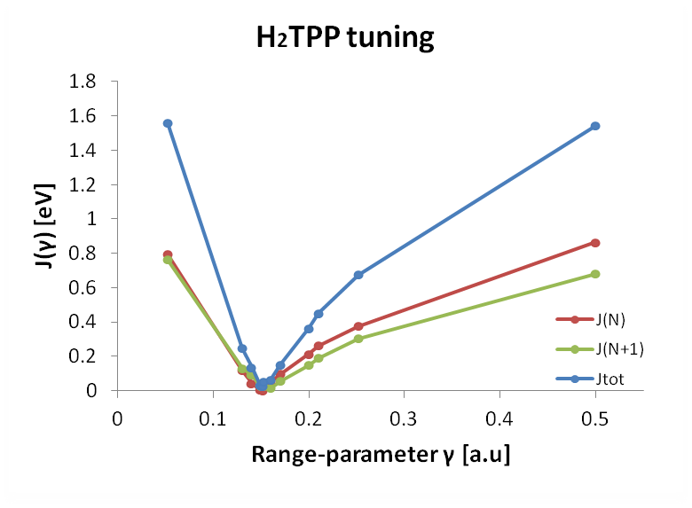
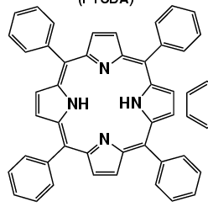
Tuning the range-separation parameter
Neutral molecule (IP)
Anion (EA)
Notes:
Know to explain about basis set

Slide 14
H₂TPP
TD
TD
TD
-1.4
-1.5
-1.7
-2.5
-2.9
1.8
2.0
2.7
2.2
4.8
2.1
4.7
1.9
2.1
Energy [eV]
4.7
-4.7
-5.2
-6.2
-6.2
-6.4
-IP, -EA E_{opt}
GGA
B3LYP
OT-BNL
GW-BSE
EXP

Slide 15
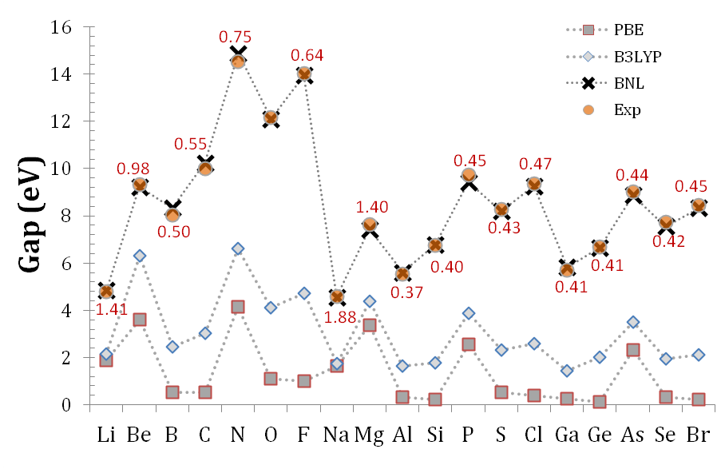
Gaps of atoms
Stein, Eisenberg, Kronik, Baer, Phys. Rev. Lett., 105, 266802 (2010).

Slide 16

Fundamental gaps of acenes
Stein, Eisenberg, Kronik, Baer, Phys. Rev. Lett., 105, 266802 (2010).

Slide 17
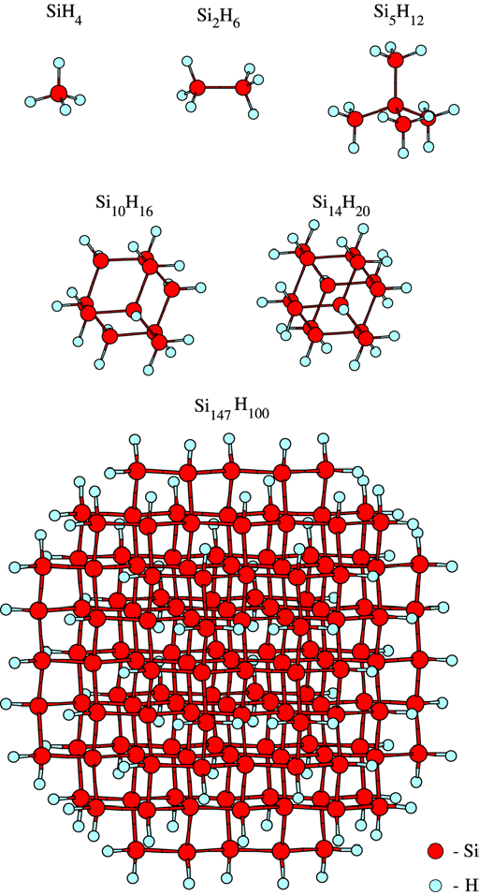
Fundamental gaps of hydrogenated Si nanocrystals
GW: Tiago & Chelikowsky, Phys. Rev. B 73, 2006
DFT: Stein, Eisenberg, Kronik, Baer,
PRL 105, 266802 (2010).
s.

Slide 18

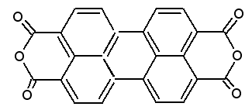

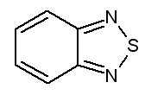
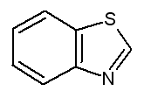
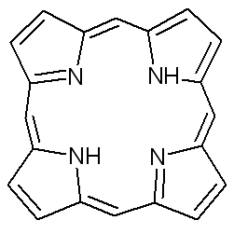
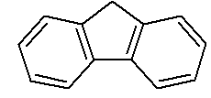
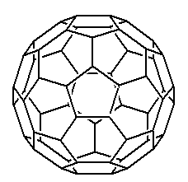
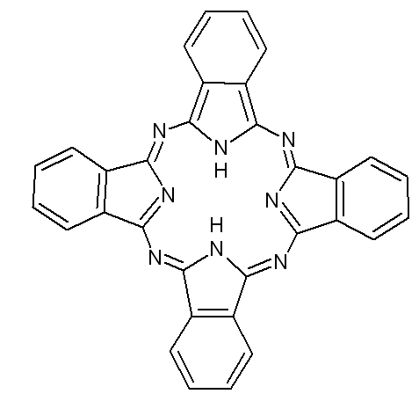
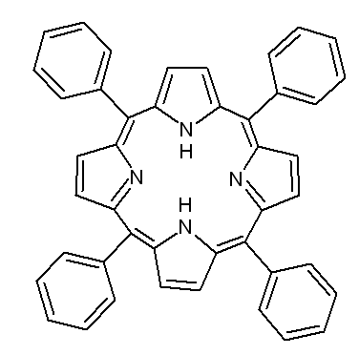
GW data: Blasé et al., PRB 83, 115103 (2011)
S. Refaely-Abramson, R. Baer, and L. Kronik, Phys.Rev. B 84 ,075144 (2011) [Editor’s choice].

Slide 19
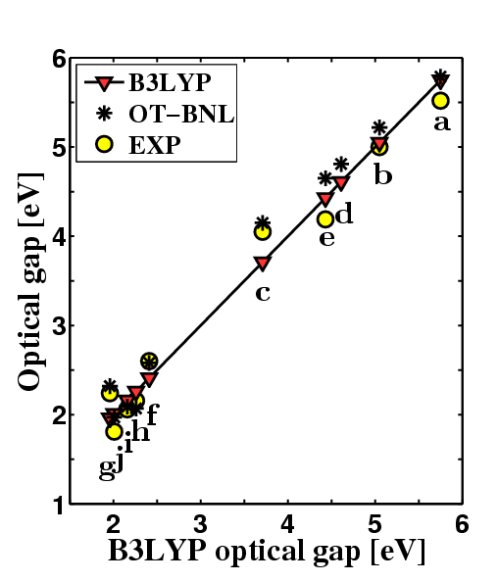
Optical gaps with Time-dependent DFT
TDDFT: BNL results as accurate as those of B3LYP
a – thiophene
b – thiadiazole
c – benzothiadiazole
d – benzothiazole
e – flourene
f – PTCDA
g – C₆₀
h – H₂P
i – H₂TPP
j – H₂Pc
S. Refaely-Abramson, R. Baer, and L. Kronik, Phys.Rev. B 84 ,075144 (2011)

Slide 20
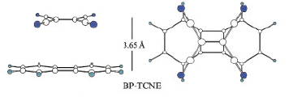
The charge transfer excitation problem
Time-dependent density functional theory (TDDFT), using
either semi-local or standard hybrid functionals, can
seriously underestimate charge transfer excitation energies!
Biphenylene – tetracyanoethylene:
B3LYP: 0.77 eV
Experiment: 2 eV
Liao et al., J. Comp. Chem. 24, 623 (2003).
zincbacteriochlorin-phenylene-bacteriochlorin:
GGA (BLYP): 1.33 eV
CIS: 3.75 eV
Druew and Head-Gordon, J. Am. Chem. Soc. 126, 4007 (2004).

Slide 21
The Mulliken limit
In the limit of well-separated donor and acceptor:
Coulomb attraction
Neither the gap nor the ~1/r dependence obtained for standard functionals!
Both obtained with the optimally-tuned range-separated hybrid!

Slide 22
Results – gas phase Ar-TCNE
Donor | TD-PBE | TD-B3LYP | TD-BNL γ=0.5 | TD-BNL Best γ | Exp | G₀W₀-BSE | GW-BSE (psc)
benzene | 1.6 | 2.1 | 4.4 | 3.8 | 3.59 | 3.2 | 3.6
toluene | 1.4 | 1.8 | 4.0 | 3.4 | 3.36 | 2.8 | 3.3
o-xylene | 1.0 | 1.5 | 3.7 | 3.0 | 3.15 | 2.7 | 2.9
Naphthalene | 0.4 | 0.9 | 3.3 | 2.7 | 2.60 | 2.4 | 2.6
MAE | 2.1 | 1.7 | 0. 8 | 0.1 | --- | 0.4 | 0.1
Thygesen
PRL ‘11
Blase
APL ‘11
Stein, Kronik, Baer, J. Am. Chem. Soc. (Comm.) 131, 2818 (2009).

Slide 23
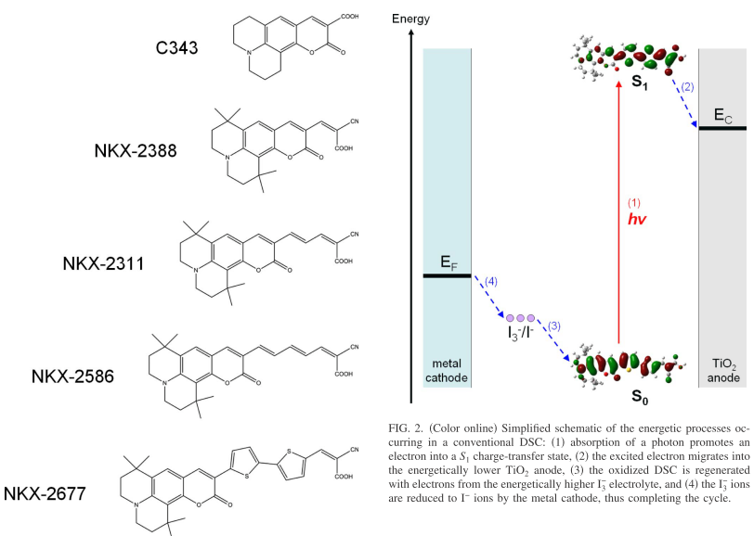
Partial Charge Transfer: Coumarin dyes

Slide 24
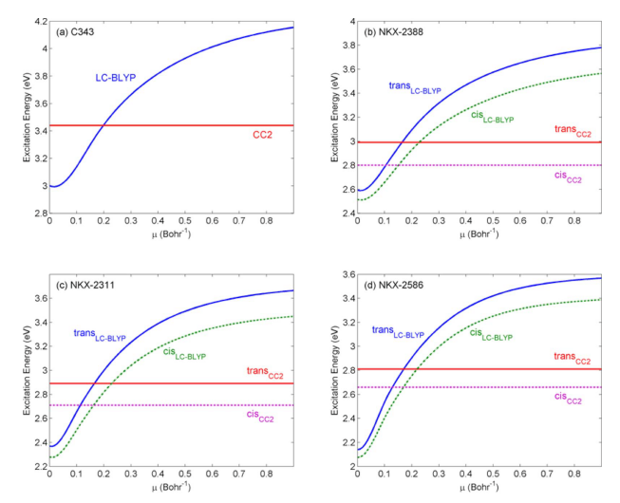
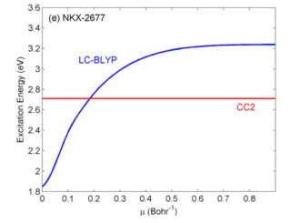
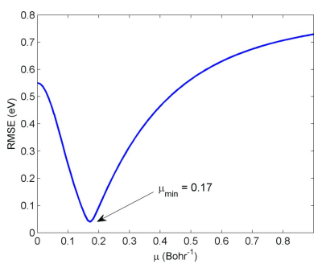
Sensitivity to the LR parameter
Wong, B. M.; Cordaro, J. G., J. Chem. Phys. 129, 214703 (2008).

Slide 25
Instead of fitting: tuning
Stein, T.; Kronik, L.; Baer, R., J. Chem. Phys. 131, 244119 (2009).

Slide 26
Optical excitations:
Fixing the L_{a}, L_{b} problem of oligoacenes
Kuritz, Stein, Baer, Kronik, J. Chem. Theo. Comp. 7, 2408 (2011).

Slide 27
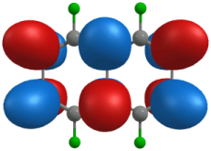
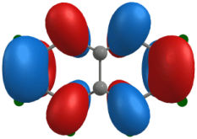
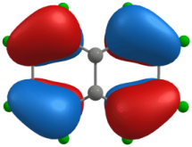
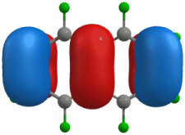
Where’s the charge transfer?
LUMO +1
Energy
LUMO
LUMO
HOMO
HOMO
HOMO-1
¹L_{b} excitation
L_{a} excitation

Slide 28
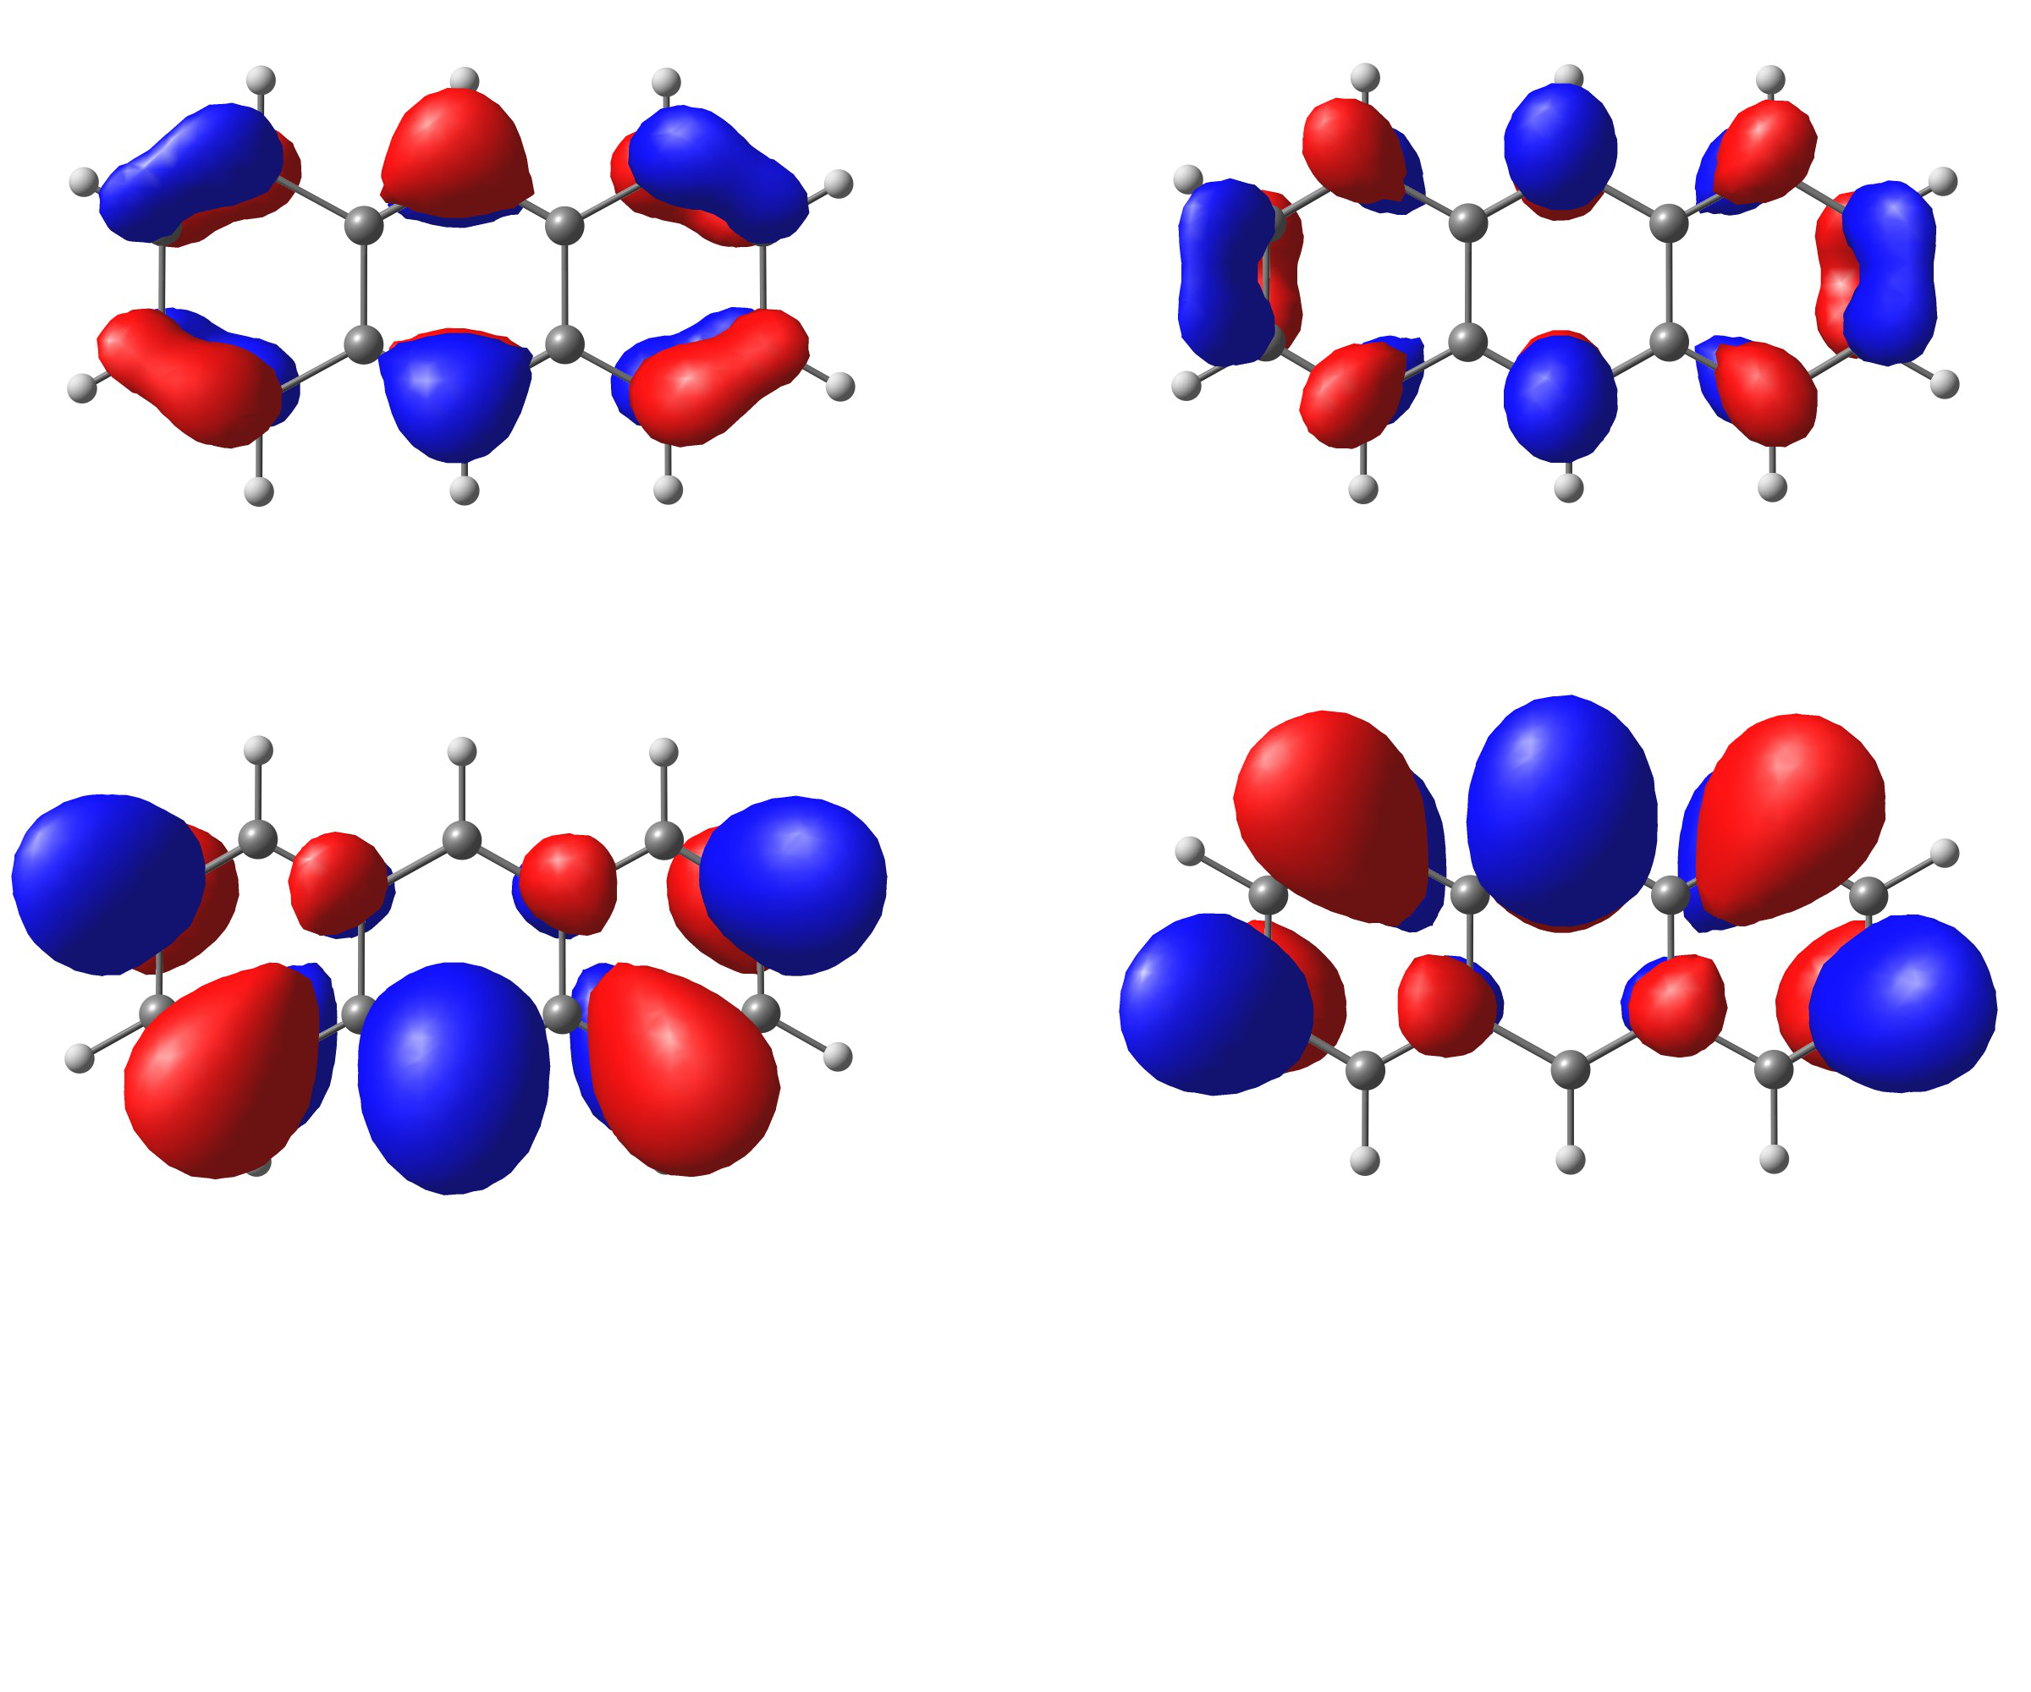
KEY: Mixing HOMO-LUMO
“Charge-transfer-like” excitation
HOMO
LUMO
LUMO+HOMO
LUMO-HOMO
N. Kuritz, T. Stein, R. Baer, L. Kronik, JCTC 7, 2408 (2011).

Slide 29
Conclusions
Kohn-Sham
quasi-particle
Optical
GW
GW+BSE
RSH
TD-RSH
Kronik, Stein, Refaely-Abramson, Baer,
J. Chem. Theo. Comp. (Perspectives Article), to be published

Slide 30


Two different paradigms for functional
development and applications
From
To
Tuning is NOT fitting! Tuning is NOT semi-empirical!
Choose the right tool (=range parameter)
for the right reason (=Koopmans’ theorem)

