Slide 1


Semiclassical Correlation in Density-Matrix Dynamics
Neepa T. Maitra
Hunter College and the Graduate Center of the City University of New York

Slide 2
Outline
Motivation: Challenges in real-time TDDFT calculations
Method: Semiclassical correlation in one-body density-matrix propagation
Models: Does it work? … some examples, good and bad….

Slide 3
Challenges for Real-Time Dynamics in TDDFT
(1) Where memory-dependence in v_{xc}[n;Ψ₀,Φ₀](r,t) is important
“memory dependence” n(r, t’<t), Ψ₀,Φ₀
Taking fails in many situations
Notes:
Remember picasso’s acrobat. Point out cannot prove 1-1 btn mom density and ext pot

Slide 4
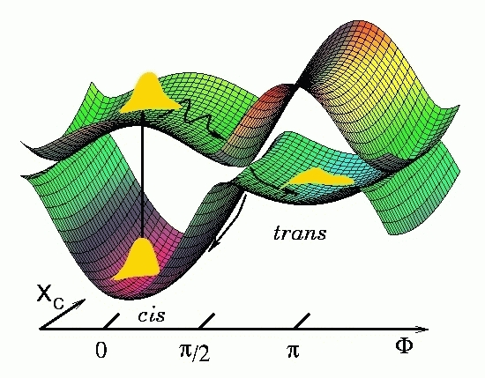
Example: Initial-state dependence (ISD)
v_{xc}[n;Ψ₀,Φ₀](r,t)
Doesn’t occur in linear response from ground state.
Adiabatic functional approximations designed to work for initial ground-states
-- If start in initial excited state these use the xc potential corresponding to a ground-state of the same initial density
initial excited state density
e.g.
Harmonic KS potential with 2e spin-singlet.
Start in 1st excited KS state
KS potential with no ISD
Happens in photochemistry generally: start the actual dynamics after initial photo-excitation.
Notes:
Say we wish to start a calculation in a singlet excited state – say 2 e, and this is the interacting density. Let’s say that we choose our KS state naturally also as excited state – say happens to be states of harmonic oscillator. So 1 e in phi0 and 1 in phi1. In fact, let’s say in the interacting problem no field is applied ot the system, so density remains as is. Choosing these IS’,s KS potential then would be this harmonic potential at all time. Now if instead we had an approximation, it would feed this density into a gs approx, picking out the KS potential for which this density is a gs density – that’s this potential here with the bump. ….would evolve orbitals phi0 and phi1 in the bumped potential. Maybe not so severe as shown since only the xc component that is approximated adiabatically but nevertheless?

Slide 5
Challenges for Real-Time Dynamics in TDDFT
(1) Where memory-dependence in v_{xc}[n;Ψ₀,Φ₀](r,t) is important
“memory dependence” n(r, t’<t), Ψ₀,Φ₀
Taking often (typically) fails
(2) When observable of interest is not directly related to the density
eg. pair density for double-ionization yields (but see Wilken & Bauer PRL (2006) )
eg. Kinetic energies (ATI spectra) or momentum distributions
Notes:
Remember picasso’s acrobat. Point out cannot prove 1-1 btn mom density and ext pot

Slide 6
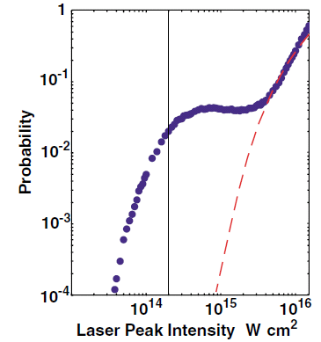
Example: Ion-Recoil Momentum in Non-sequential Double Ionization
Famous “knee” in double-ionization yield – TDDFT approx can now capture [Lein & Kuemmel PRL (2005); Wilken & Bauer PRL (2006) ]
“NSDI as a Completely Classical Photoelectric Effect”
Ho, Panfili, Haan, Eberly, PRL (2005)
But what about momentum (p) distributions?
Ion-recoil p-distributions computed from exact KS orbitals are poor, e.g.
(Wilken and Bauer, PRA 76, 023409 (2007))
Generally, TD KS p-distributions ≠ the true p-distribution
( in principle the true p-distribution is a functional of the KS system…but what functional?!)
Notes:
EKSO is exact KS orbital. Classical calculation also gets good pdists

Slide 7
Challenges for Real-Time Dynamics in TDDFT
(1) Where memory-dependence in v_{xc}[n;Ψ₀,Φ₀](r,t) is important
“memory dependence” n(r, t’<t), Ψ₀,Φ₀
Taking often (typically) fails
(2) When observable of interest is not directly related to the density
eg. pair density for double-ionization yields
eg. Kinetic energies (ATI spectra) or momentum distributions
(3) When true wavefunction evolves to be dominated by more than one SSD
TDKS system cannot change occupation #’s → TD analog of static correlation
Notes:
Remember picasso’s acrobat. Point out cannot prove 1-1 btn mom density and ext pot

Slide 8
Example: State-to-state Quantum Control problems
e.g. pump He from 1s² → 1s2p.
Problem!! The KS state remains doubly-occupied throughout – cannot evolve into a singly-excited KS state under any one-body Hamiltonian.
-- Exact KS system achieves the target excited-state density, but with a doubly-occupied ground-state orbital !!
-- Exact v_{xc} (t) is unnatural and difficult to approximate, as are observable-functionals
-- What control target to pick? If target initial-final states overlap, the max for KS is 0.5, while close to 1 in the interacting problem.
This difficulty is caused by the inability of the TDKS system to change occupation #’s→ TD analog of static correlation
when true system evolves to be fundamentally far from a SSD
Maitra, Burke, Woodward PRL 89,023002 (2002); Werschnik, Burke, Gross, JCP 123,062206 (2005)

Slide 9
Challenges for Real-Time Dynamics in TDDFT
(1) Where memory-dependence in v_{xc}[n;Ψ₀,Φ₀](r,t) is important
“memory dependence” n(r, t’<t), Ψ₀,Φ₀
Taking often fails
(2) When observable of interest is not directly related to the density
eg. pair density for double-ionization yields
eg. Kinetic energies (ATI spectra) or momentum distributions
(3) When true wavefunction evolves to be dominated by more than one SSD
TDKS system cannot change occupation #’s → TD analog of static correlation
For references and more, see: A. Rajam, P. Hessler, C. Gaun, N. T. Maitra, J. Mol. Struct. (Theochem), TDDFT Special Issue 914, 30 (2009) and references therein
Notes:
Remember picasso’s acrobat. Point out cannot prove 1-1 btn mom density and ext pot

Slide 10
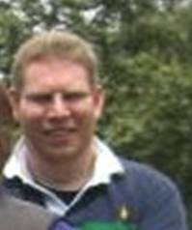
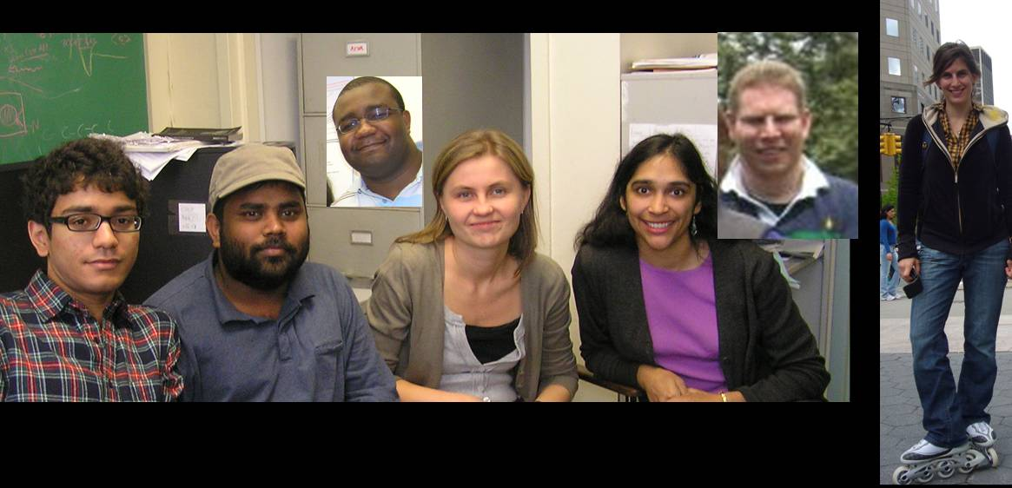
A New Approach:
density-matrix propagation with semiclassical electron correlation
Will see that:
Non-empirical
Captures memory, including initial-state dependence
All one-body observables directly obtained
Does evolve occupation numbers
Dr. Peter Elliott
References
Arun Rajam
Rajam, I. Raczkowska, N.T. Maitra, Phys. Rev. Lett. 105, 113002 (2010)
P. Elliott, S. Goldson, C. Canahui, N. T. Maitra, Chem. Phys. 391, 110 (2011)
P. Elliott and N.T. Maitra, J. Chem. Phys. 135, 104110 (2011).
http://www.hunter.cuny.edu/physics/faculty/maitra/publications
Izabela Raczkowska

Slide 11
Time-Dependent Density-Matrix Functional Theory
Recent Work (Pernal, Giesbertz, Gritsenko, Baerends, 2007 onwards):
replaces n(r,t) as basic variable for linear response applications
No additional observable-functionals needed for any 1-body observable.
Adiabatic TDDMFT shown to cure some challenges in linear response TDDFT, e.g charge-transfer excitations (Giesbertz et al. PRL 2008)
?Memory? : may be less severe (Rajam et al, Theochem 2009)
BUT, adiabatic TDDMFT cannot change occupation numbers (Appel & Gross, EPL 2010; Giesbertz, Gritsenko, Baerends PRL 2010; Requist & Pankratov, arXiv: 1011.1482)
Formally, TDDMFT equivalent to Phase-Space Density-Functional Theory: Wigner function
→ phase-space suggests semiclassical or quasiclassical approximations

Slide 12



Equation of Motion for ρ₁ (r’,r,t)
SC
+
Need approximate ρ_{2c} to change occupation #s and include memory → difficult
E.g. In the electronic quantum control problem of He 1s² → 1s2p excited state
f₁ ~ near 2 → near 1 while f₂ ~ near 0 → near 1
OUR APPROACH → Semiclassical (or quasiclassical) approximations for ρ_{2c} while treating all other terms exactly
Notes:
12

Slide 13
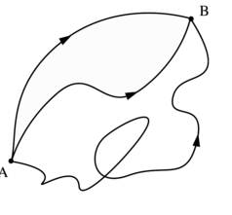
Semiclassical (SC) dynamics in a nutshell
van Vleck, Gutzwiller, Heller, Miller…
“Rigorous” SC gives lowest-order term in h-expansion of quantum propagator:
Derived from Feynman’s Path Integral – exact
S: classical action along the path
h small → rapidly osc. phase → most paths cancel each other out, except those for which
δS = 0, i.e. classical paths
G(r’,t;r,0) = Σ e ^{iS/h}
sum over all paths from r’ to r in time t

Slide 14
Semiclassical (SC) time-propagation for Ψ
General form: runs classical trajs and uses their action as phase
G^{SC} (r’,r, t) =
action along classical path i from r’ to r in time t
prefactor -- fluctuations around each classical path
Heller-Herman-Kluk-Kay propagator:
(HHKK)
coherent state
Pictorially (1e in 1d), “frozen gaussian” idea:
p
Ψ(x,0) = Σc_{n}z_{n}(x)
Ψ^{sc}(x,t) = Σc_{n}z_{n}(x,t)
x
each center x₀,p₀ classically evolves to x_{t},p_{t} via
z_{n}(x) = N exp[–γ(x-x₀)² + ip₀x]
z_{n}(x,t) = N exp[–γ(x-x_{t})² + ip_{t}x + iS_{t}]

Slide 15
Semiclassical methods capture zero-point energy, interference, tunneling (to some extent), all just from running classical trajectories.
Rigorous semiclassical methods are exact to O(h)
Phase-space integral done by Monte-Carlo, but oscillatory nature can be horrible to converge without filtering techniques.
But for ρ₂, have Ψ and Ψ∗ -- partial phase-cancellation → “Forward-Backward methods” …some algebra… next slide

Slide 16
Semiclassical evolution of ρ₂(r’,r₂,r,r₂,t)
Simpler: Quasiclassical propagation
Find initial quantum Wigner distribution, and evolve it as a classical phase-space probability distribution:
N-body QC Wigner function
Heller, JCP (1976); Brown & Heller, JCP (1981)
evolve classical Hamilton’s equations backward in time for each electron
A. Rajam, I. Raczkowska, N.T. Maitra, Phys. Rev. Lett. 105, 113002 (2010)

Slide 17


SC/QC Approximations for correlation only: ρ_{2c}
From the semiclassically-computed ρ₂, extract:
to find the correlation component of the semiclassical ρ₂ via:
Now insert into:
Fully QM
+

Slide 18
Insert ρ^{SC}_{2c}(r’,r₂,r,r₂,t) into (quantum) eqn for ρ(r’,r,t):
-- Captures “semiclassical correlation”, while capturing quantum effects at the one-body level
-- Memory-dependence & initial-state dependence naturally carried along via classical trajectories
-- But no guarantee for N-representability
-- How about time-evolving occupation #’s of TD natural orbitals ?
one of the main reasons for the going beyond TDDFT!
Eg. In the electronic quantum control problem of He 1s² → 1s2p excited state,
f₁ ~ near 2 → near 1 while f₂ ~ near 0 → near 1
Yes!
Examples…

Slide 19
Examples
First ask: how well does pure semiclassics do?
i.e. propagate the entire electron dynamics with Frozen Gaussian dynamics, not just the correlation component.
Will show four 2-electron examples.

Slide 20
Example 1: Time-dependent Hooke’s quantum dot in 1d
Drive at a transition frequency to encourage population transfer:
e.g. ω²(t) = 1 – 0.05 sin(2t)
Changing occupation #’s essential for good observables:
<x²>(t)
exact KS
60 000 classical trajectories

Slide 21
Momentum Distributions:
Exact
FG
KS
t=75au
t=135au
Why such oscillations in the KS momentum distribution?
Single increasingly delocalized orbital capturing breathing dynamics → highly nonclassical
t=160au
t=160au
KS
exact

Slide 22
Example 2: Double-Excitations via Semiclassical Dynamics
Simple model:
single excitation double excitation
electron-interaction strongly mixes these
Two states in true system but adiabatic TDDFT only gives one.
TDDFT: Usual adiabatic approximations fail.
    -- but here we ask, can semi-classical dynamics give us the mixed single & double excitation?

Slide 23
SC-propagate an initial “kicked” ground-state:
Ψ₀(x₁,x₂) = exp[ik(x₁² + x₂²)] Ψ_{gs}(x₁,x₂)
Exact frequencies
Peaks at mixed single and double
(Pure) semiclassical (frozen gaussian) dynamics approximately captures double excitations.
#’s may improve when coupled to exact HX ρ₁ dynamics.
Exact A-EXX SC DSPA
2.000 1.87 2.0 2.000
1.734 ---- 1.6 1.712
non-empirical frequency-dependent kernel
Maitra, Zhang, Cave, Burke (JCP 120, 5932 2004)

Slide 24
Example 3: Soft-Coulomb Helium atom in a laser field
New Problem: “classical auto-ionization” (a.k.a. “ZPE problem”)
After only a few cycles, one e steals energy from the other and ionizes, while the other e drops below the zero point energy.
A practical problem not a fundamental one: their contributions to the semiclassical sum cancel each other out.
? How to increase taxes on the ionizing classical trajectory?
For now, just terminate trajectories once they reach a certain distance.
(C. Harabati and K. Kay, JCP 127, 084104 2007 obtained good agreement for energy eigenvalues of He atom)
Notes:
Lots of interest in the semiclassical community on this problem

Slide 25
Example 3: Soft-Coulomb Helium atom in a laser field
ε(t)
trapezoidally turned on field
2 x 10⁶ → 500000 classical trajectories

Slide 26
Example 3: Soft-Coulomb Helium atom in a laser field
Observables:
Dipole moment→
← Momentum distributions
Exact KS incorrectly develops a major peak as time evolves, getting worse with time.
FG error remains about the same as a function of time.
Notes:
Probably classical AI not so important here since the field is strong enough that in the true system, likely that electrons ionize and get kicked back and forth with the field. QM-forbidden ones may be proportionately small.

Slide 27
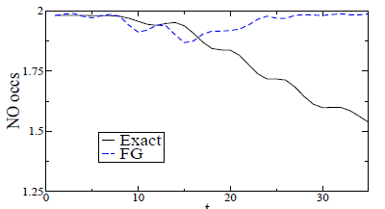

Example 4: Apply an optimal control field to soft-Coulomb He
For simplicity, first just use the control field that takes ground → 1st excited state in the exact system.
Then simply run FG dynamics with this field.
Optimal field
Aim for short (T=35 au) duration field (only a few cycles) just to test waters.
(Exact problem overlap ~ 0.8)
NO occupations from FG not too good. Why not?
Problem!! The offset of ω^{FG} from ω^{exact} is too large – optimal field for exact is not a resonant one for FG and vice-versa.
Hope is that using FG used only for correlation will bring it closer to true resonance.

Slide 28
Summary so far…
Approximate TDDFT faces pitfalls for several applications
-- where memory-dependence is important
-- when observable of interest is not directly related to the density
-- when true Ψ evolves to be dominated by more than one SSD
TDDMFT (=phase-space-DFT) could be more successful than TDDFT in these cases, ameliorating all three problems.
A semi-classical treatment of correlation in density-matrix dynamics worth exploring
-- naturally includes elusive initial-state-dependence and memory and changing occupation #’s
-- difficulties:
-- classical autoionization
-- convergence
-- lack of semiclassical—quantum feedback in ρ₁ equation
– further tests needed!

Slide 29

Muchas gracias à
Dr. Peter Elliott
Alberto, Miguel, Fernando, Angel, Hardy,
and to YOU all for listening!

