Slide 1
Cosmology in extended electromagnetism: numerical results
Roberto Dale^{1,3} & Diego Sáez^{2,4}
¹ Departament d’estadística, matemàtiques i informàtica, Universitat Miguel Hernández, 03202, Elx, Alacant, Espanya
² Departamento de Astronomía y Astrofísica, Universidad de Valencia, 46100 Burjassot, Valencia, Spain.
E-mail: ³rdale@umh.es, ⁴diego.saez@uv.es
ERE 2013 Benasque

Slide 2
Content Summary
The extended electromagnetism (EE) theory basis.
Applications to Cosmology.
  Background equations.
  The perturbation formalism.
  The vector field perturbations.
  The Einstein perturbations equations.
  Numerical estimations.
CMB application.
  Initials Conditions.
  Numerical results.
  Firsts results from Planck.

Slide 3
The extended electromagnetism (EE) theory basis
VT theories were proposed in the early ‘70s by Clifford M. Will^{[1]}.
Recently, a modified Einstein-Maxwell theory has been proposed^{[2]}.
For a charged isentropic perfect fluid of conserved energy density ρ, internal energy Є, and pressure P=ρ(dЄ/dρ), the action is:
The fundamental gauge symmetry is different of the standard U(1):
Both theories are equivalents when: ω=0, 2ε-η=8πG, η=ν=16πG and L_{m}=J ^{µ}A _{µ} -ρ(1+Є)
PPN values for parameterization are the same as in General Relativity.
[1] Clifford M. Will, Theory and Experiment in gravitational Physics (Cambridge University Press, New York, 1993).
[2] J. Beltrán Jiménez and A.L. Maroto, Cosmological electromagnetic fields and dark energy, JCAP 03 (2009) 016

Slide 4
The extended electromagnetism (EE) theory basis
Three fields are varied independently in the action: A_{µ}, U^{µ} and g_{µν} .
Field equations
A_{µ} field variations:
U^{µ} fluid flow lines:
g_{µν} metric tensor:
Fluid evolution
Einstein equation
We observe that:
  Just the total current is conserved, but not .
  The generalized Lorentz force is: .
  The know expression has a new term.

Slide 5
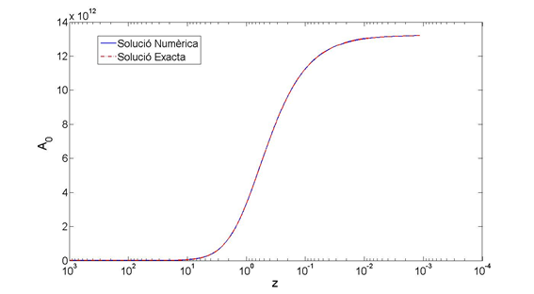
Background Equations
An homogeneous, isotropic and neutral (null density of charge for any time) flat universe is consider.
The field equations and modified Einstein equations are obtained.
Note that:
  The field component A₀(τ) evolves but its divergence remains constant.
  Modified Einstein eq. produces same results as Einstein eq. with cosmological constant .

Slide 6
The perturbation formalism
Bardeen^{[3]} perturbation formalism has been used: so scalar, vector and tensor types have been analysed, fluctuations are written in terms of scalar, vector and tensor harmonics: Q⁽⁰⁾, Q⁽¹⁾_{i} and Q⁽²⁾_{ij}. A neutral universe is consider up to first order
Tensor modes are as GR (no tensor modes are involved in A_{µ} and J_{µ}).
Vector fluctuations are as in Maxwell-Einstein. This because divergences of the field A_{µ} and currents J_{µ} are scalars, so no new vectors modes are involved.
New scalar modes have been found due the electromagnetic extension.
[3] J. M. Bardeen, Phys. Rev. D 22, 1882 (1980).

Slide 7
The vector field perturbations
But, α⁽⁰⁾ and β⁽⁰⁾, seem to be not the best way to expand the field equation, all the equations are coupled among them and their solutions only have been found under special assumptions.
We found that the best way to describe the scalar perturbations is the use of and as the descriptors:
  Those are gauge invariant.
  The amplitudes form a uncoupled differential equation system.
Note that:
Current equation has the same form as the tensor perturbation equation. So, when and for superhorizon scales, the relation holds.

Slide 8
The vector field perturbations
The uncoupled field equations for the field amplitudes have been integrated numerically in terms of the redshift. We set ϒ=-1/2 and J⁽⁰⁾=0.
An exact solution for radiation dominated era was found.
For an initial value of E⁽⁰⁾=0 and small values of ψ(z) (observe that it happens in a large range of z for all the scales) the exact solution for radiation dominated era predicts a constant value for the field divergence perturbation amplitude.
These field perturbation amplitudes evolution for large and small scales (20,000 Mpc. and 200 Mpc. respectively) are presented, when considering a relative initial perturbation of 10⁻⁴ ( ), at the next slide.

Slide 9
The vector field perturbations
Blue line represents the numerical solution and the red one represents the radiation dominated (RD) era analytical solution. Observe that both coincide at RD.

Slide 10
The vector field perturbations
Additionally relative evolution of the field perturbation amplitude is presented for a spatial scale of 3 x 10³ h⁻¹ Mpc, which re-enters the effective horizon at present time. Relative initial perturbation value is 10⁻⁴ for the left panel and 10⁻² for the right one.

Slide 11
The Einstein perturbation equations
The rest of equations to integrate are the modified Einstein equations, we write in synchronous and Newtonian gauges:
Back to slide 14

Slide 12
Numerical estimations for gauge invariants
In order to perform a preliminary numerical evaluation of the theory, the equations were written in terms of gauge invariant quantities as Bardeen.
Next, we defined following rations, that provide us an estimation between the standard theory and the modified one. In that estimation it is assumed that the condition J⁽⁰⁾=0 holds in cosmology (equivalent to current conservation) and we set ϒ=-1/2.
For following estimations on the right side is showed present density of radiation and matter, and the value we took for the Hubble constant.
To evaluate GR terms, adiabatic perturbation and absence of neutrinos (so Π_{T} ⁽⁰⁾=0) have been considered.
Back to slide 13

Slide 13
Numerical estimations for gauge invariants
Following ratios represents the weight of the new terms on the gauge invariant equations respect the GR ones, for a spatial scale of 3 x 10³ h⁻¹ Mpc, which re-enters the effective horizon at present time. Relative initial perturbation value is 10⁻⁴ for the left panel and 10⁻² fo the right one.
The evolutions of the three ratios are similar, for z < 10², there are oscillations whose amplitudes grow as z decreases, that’s because our spatial scale and that of the effective horizon come near as the redshift decreases. For the left panel, maximum values are:
Go to Slide 12

Slide 14
CMB application: initial conditions
Once the firsts estimations were done, next step was to apply this theory to the CMB.
For that purpose we need to establish the initial conditions in order to integrate the equations showed at slide # 11.
We follow the way developed by Ma & Bertschinger^{[4]}.
The synchronous gauge is used, and the Einstein equations have been re-written using same functions as above paper.
Adiabatic perturbations has been considerer.
The two dimensionless constants α₂ and α₄, should be calculated from spectra normalization and field initial conditions respectively.
[4] C. P. Ma and E. Bertschinger, Astrophys. J. 455, 7 (1995).

Slide 15
CMB application: initial conditions
Particle species are: CDM for cold dark matter, B for baryons, ϒ for photons, and ν for relativistic neutrinos.
We also get new terms of higher order for GR (blue), in order to compare numerically with the new terms coming from the new theory (green).

Slide 16
CMB application: numerical results
For numerical calculations some cosmological and statistical codes have been modified, that is CMBFAST and COSMOMC.
The Monte Carlo based software have been run, varying seven parameters , those are:
Where Ω_{B} and Ω_{DM} are the relatives baryonic and dark matter energy densities , respectively, and h is the reduced Hubble constant.
The parameter θ is defined by the relation:
, where d_{A}(z*) is the angular diameter distance at decoupling redshift (z*), and r_{s}(z*) is the sound horizon at the same redshift.
  τ is the reionization optical depth.
n_{s} is the spectral index of the power spectrum of the scalar modes.
A_{s} is the normalization constant of the above same spectrum, that is:
Finally, ,represents the initial value of the divergence perturbation aptitude of the field.
First step has been to look for the best fit in the framework of GR (that is ).

Slide 17
CMB application: numerical results
Statistical method (Markov chains) has been used to fit the theoretical predictions to current observational evidences:
  High red-shift Ia supernovae (SNe Ia).
  CMB temperature anisotropy.
Calculations have been performed under following basic assumptions:
  Flat Background.
  Adiabatic perturbations.
  No lensing effect.
  EOS for dark energy is W=-1.
  No massive neutrinos.
  Just scalar modes (V&T negligible).
  Mean CMB temperature T_{CMB}=2.726.
  Effective number of relativistic species set to 3.046.
  Effective massless degrees of freedom is g*=10.75.
The modified CMBFAST code has been used in order to find the following CMB angular power spectra:
  The coefficients measuring CMB temperature (E-polarization).
  The coefficients that provides the cross correlations between temperatures and E-polarization.
Back to slide 23

Slide 18
CMB application: numerical results
In the next table the best fitting results for General Relativity (GR) and for Extended Electromagnetism (EE) are presented.
Theory | Case
GR | BF | 0.0 | 0.0223 | 0.112 | 1.039 | 0.0836 | 0.962 | 3.067
GR | LL | 0.0 | 0.0207 | 0.096 | 1.030 | 0.0460 | 0.920 | 2.967
GR | UL | 0.0 | 0.0237 | 0.124 | 1.047 | 0.1285 | 1.000 | 3.168
EE | BF | 0.203 | 0.0224 | 0.112 | 1.039 | 0.0866 | 0.963 | 3.074
EE | LL | -5.314 | 0.0189 | 0.082 | 1.022 | 0.0103 | 0.878 | 2.871
EE | UL | 5.320 | 0.02801 | 0.137 | 1.054 | 0.2033 | 1.119 | 3.324
Presented results are compatible with those obtained by the WMAP team obtained from the Wilkinson microwave anisotropy probe seven year database, for details see table 8 at [5].(arXiv:1001.4744)
[5] N. Jarosik et al., Astrophys. J. 192, 14 (2011).
Back to slide 21 Back to slide 22

Slide 19
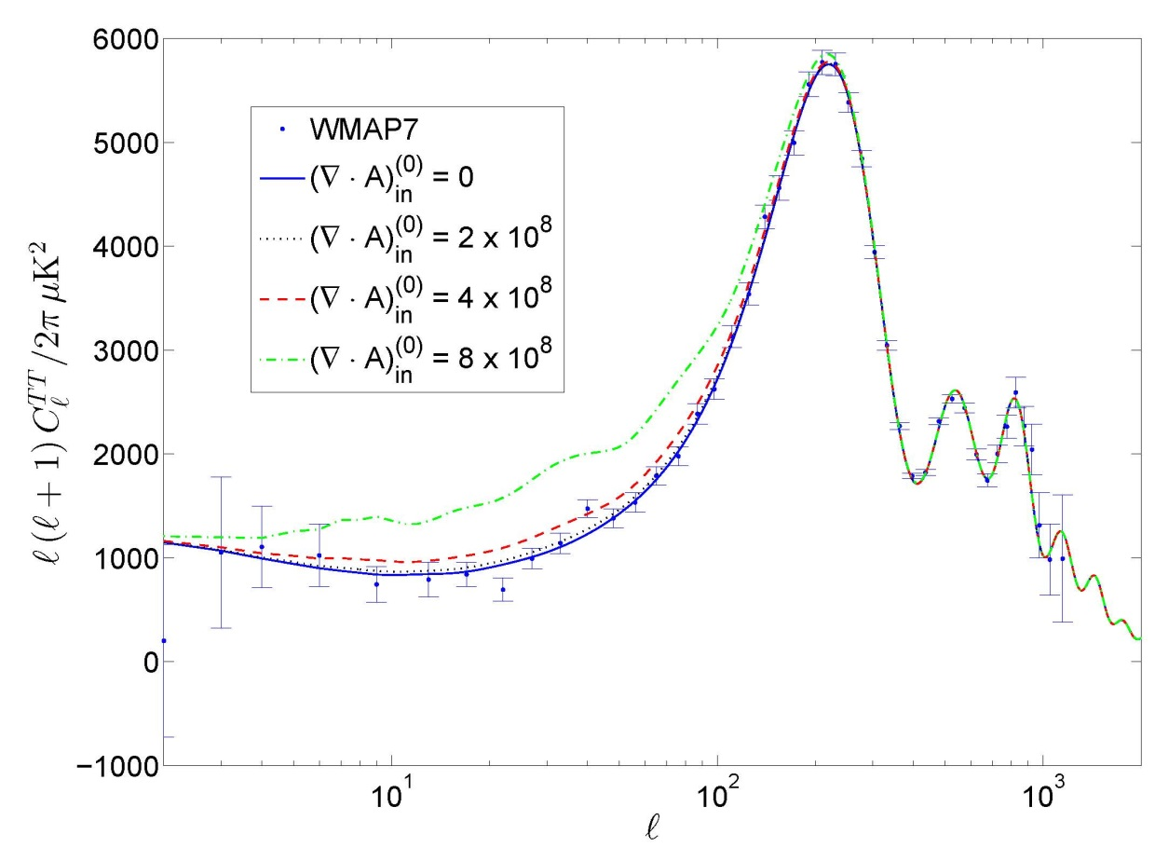
CMB application: numerical results
In order to know, the deviations of the Cl’s compared to GR, lets have a look to following figures that have been set up from GR best fit model.
Once that GR best fit model has been obtained, all the parameters values are fixed, except ,that is varied.
It follows that the deviations respects the solid line increases while grows, and for some values the deviation is so much.
We also observe, that for all those values, the deviations are:
  Negligible for l values greater than ~ 250, so only scales greater than ~ 0.72 degrees are significantly affected by the new scalar modes.
  Very small when l < 4.
Back to slide 21 Back to slide 22

Slide 20
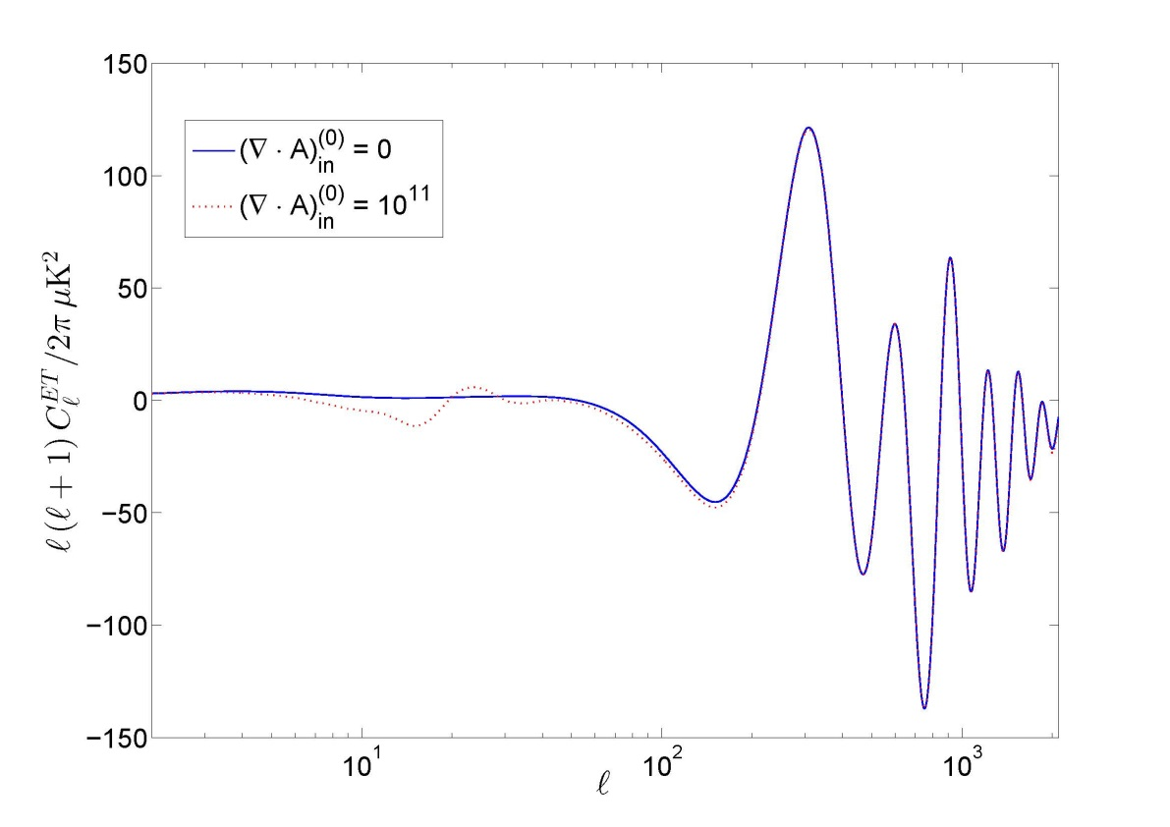
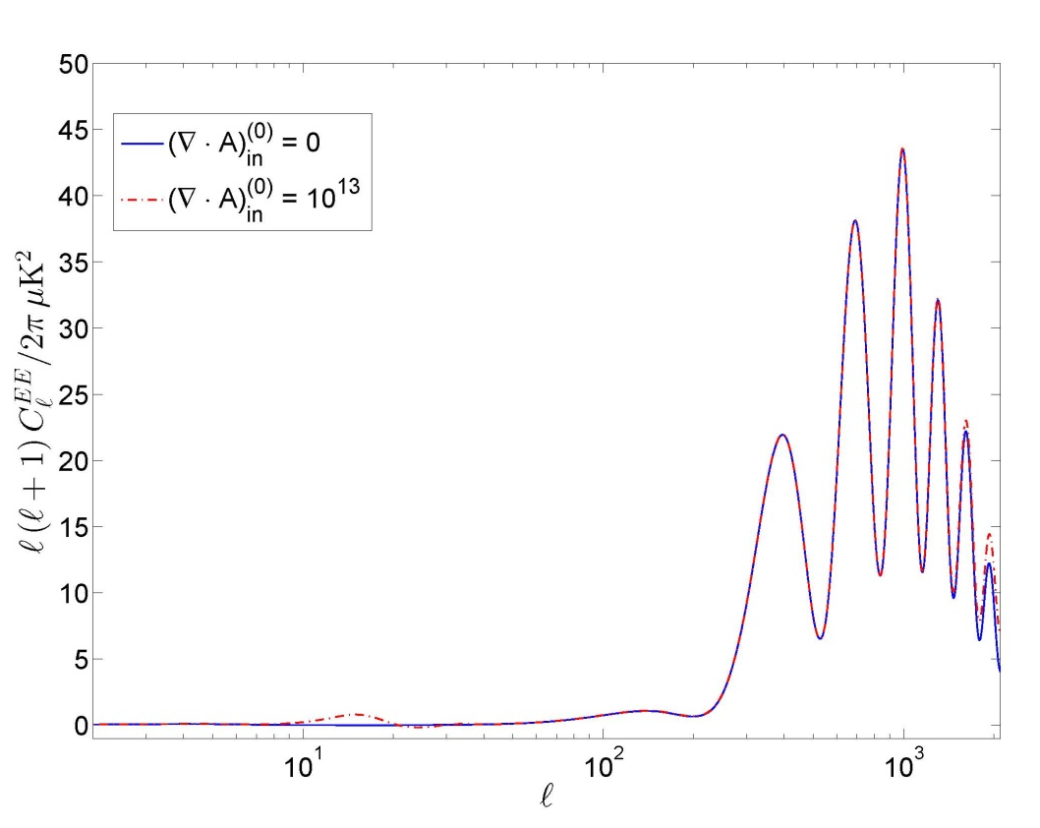
CMB application: numerical results
By the use of the modified code, we’ve verified that:
  For the order of magnitude reasonable for the showed at previous slide, the and spectra, are indistinguishable from those corresponding to GR.
  Deviations from GR, do not depend on the sign of ,but only on

Slide 21
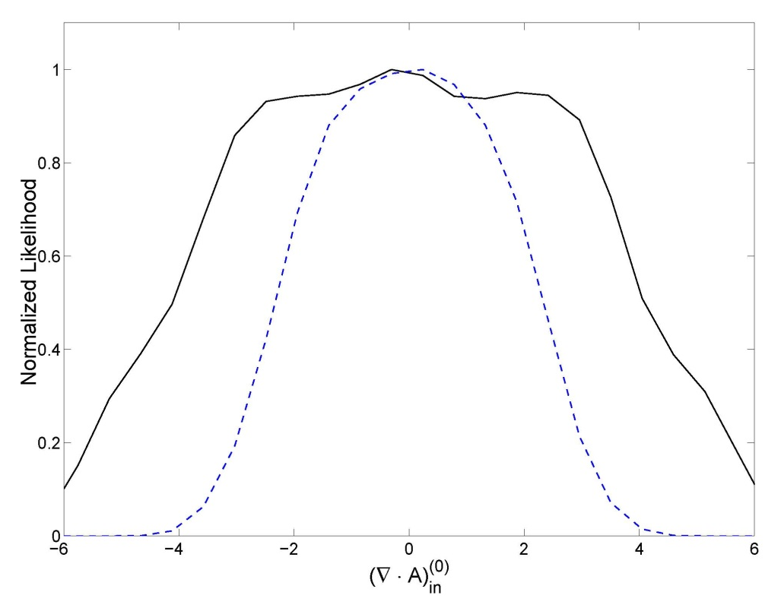
CMB application: numerical results
Under the statistical point of view, the bottom right figure obtained from the modified codes, presents marginalized (blue dashed) and mean (black solid) normalized likelihood function.
Maximum values are around corresponding to BF value at table.
For the marginalized case, the six parameters of the GR models are fixed and their values are taken to be identical to those of the best fit in the EE theory.
Marginalized curve is rather flat around the maximum and stats that values satisfying a range defined by are good enough.
From the solid line (mean) we observe a wide plateau around the maximum in a range defined by
Cls TT slide

Slide 22
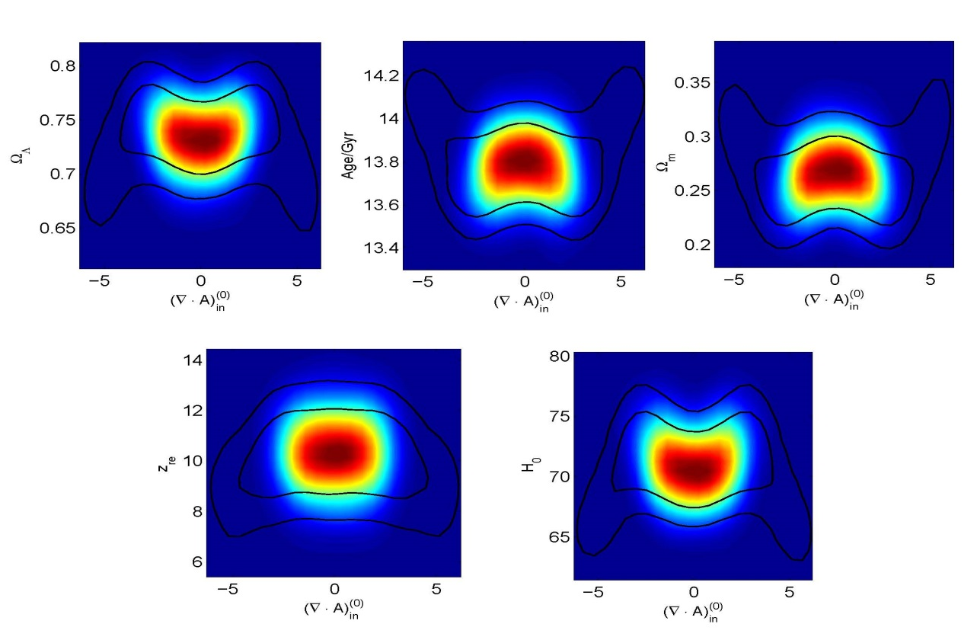
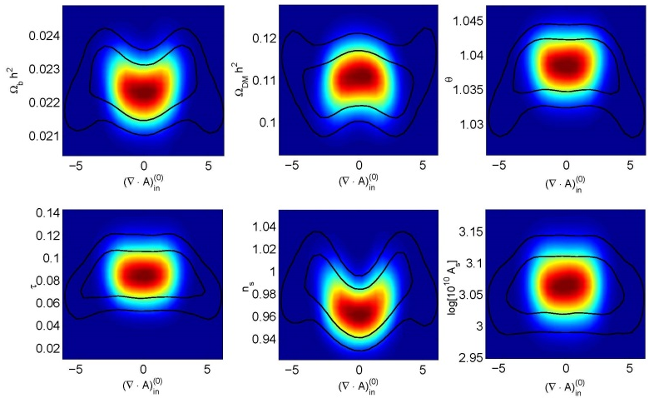
CMB application: numerical results
At the 2D figure, each panel shows likelihood function for a pair of parameters. Colored central zone shows the mean likelihood. Internal and external contours represent the 68% and 95% respectively for confidence limit for the marginalized case.
Observe that for a confidence level of 2σ for the marginalized case, the condition is and regarding ClsTT there should be slights differences for
For the GR six parameters upper and lower 2σ limit are wider than the corresponding to GR model, as can be checked numerically at the table.
Observe the same shape for derived parameters.

Slide 23
Firsts results from Planck
The new application version of CosmoMC has been modified to include the EE theory, also the new sampling method adapted for Planck has been used.
For this preliminary test, we have done same setup as showed at slide 17, except for lensing, where this time linear lensing is included, and the top limit for l range has been increase from 2100 to 2500.
Concerning the parameterization, for the moment the new defaults of CosmoMC has been used, plus the new parameter
The are new 14 nuisance parameters (11 foreground parameters, two relatives calibration parameters and one beam error parameter) that also are varied in the default range. (for details see arXiv:1303.5075).
Theory | Case
GR | BF | 0.0 | 0.0222 | 0.120 | 1.041 | 0.0932 | 0.964 | 3.097
GR | LL | 0.0 | 0.0215 | 0.111 | 1.039 | 0.0536 | 0.946 | 3.014
GR | UL | 0.0 | 0.0230 | 0.128 | 1.044 | 0.1407 | 0.987 | 3.185
EE | BF | 0.615 | 0.0201 | 0.128 | 1.039 | 0.6148 | 0.917 | 3,029
EE | LL | -3.187 | 0.0193 | 0.118 | 1.038 | 0.0407 | 0.900 | 2.987
EE | UL | 2.880 | 0.0211 | 0.137 | 1.041 | 0.1128 | 0.954 | 3.138

Slide 24
In summary…
General EE has been developed from a general variational principle.
EE theory has been applied to Cosmology using a new uncoupled formalism.
The statistical code CosmoMC and CMBFast cosmological code has been adapted.
An exhaustive statistical study has been done using the CMB WMAP 7-years observational data base.
A new testing, now with WMAP9 and Planck Data Base, is runnig and firsts results have been showed.
Acknowledgments
This work has been supported by the Spanish Ministry of Economía y Competitividad, MICINNFEDER project FIS2012-33582 and CONSOLIDER-INGENIO project CSD2010-0064. We thank Javier Morales (Universitat Miguel Hernández) for comments and suggestions about statistics.

