Slide 1
Optical properties of asymmetrical hyperbolic media, based on graphene multilayers
Igor Nefedov and Leonid Melnikov

Slide 2
Outline
Hyperbolic dispersion of electromagnetic waves in graphene multilayers
Properties of asymmetric hyperbolic media
Total absorption in asymmetric graphene multilayers
Thermal emission from asymmetric hyperbolic metamaterial, made of graphene multilayers
Spontaneous emission in hyperbolic media
Radiation of a small dipole, placed inside the asymmetric hyperbolic medium

Slide 3
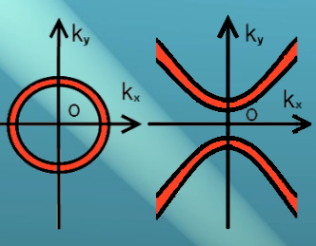
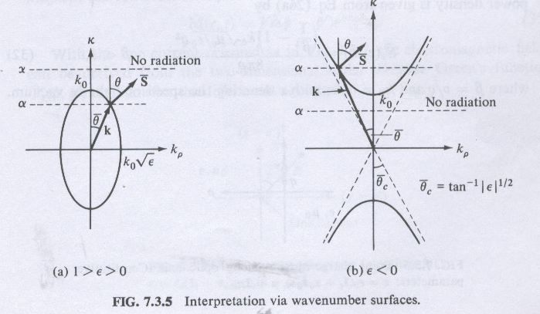
Hyperbolic media
Illustration of inifinite density of modes in hyperbolic media
M. A. Noginov, et al.
Optics Letters 35, 1863 (2010)
Control of spontaneous emission
I.S. Nefedov, PRB, 82, 155423 (2010) Hyperbolic dispersion in 2D periodic arrays of metallic carbon nanotubes.
L.F. Felsen, N. Marcuvitz, Radiation and Scattering of Waves, 1973
(references to E. Arbel, L.B. Felsen, 1963)
infinite power, radiated by a point-like source
I.S. Nefedov, C.R. Simovski, PRB, 84, 195459 (2011)
Giant radiation thermal heat transfer through micron gaps.
D.R. Smith, D. Schurig, PRL 90 2003 Term indefinite medium,
negative refraction, near-field focusing

Slide 4
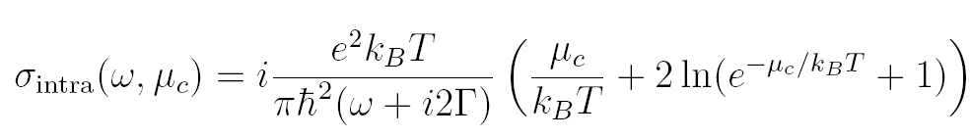
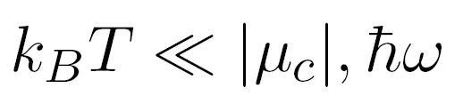
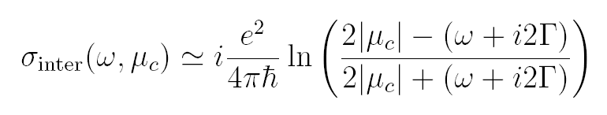
Model of graphene conductivity
intraband conductivity (the Kubo formula)
interband conductivity,
G.W. Hanson, JAP, 103, 064302 (2008)

Slide 5
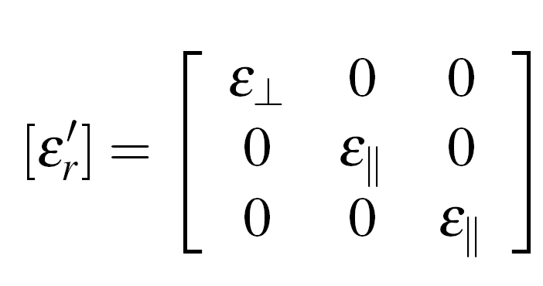
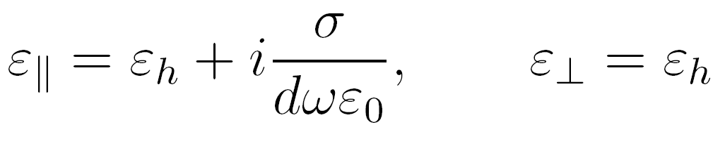
Effective permittivity

Slide 6
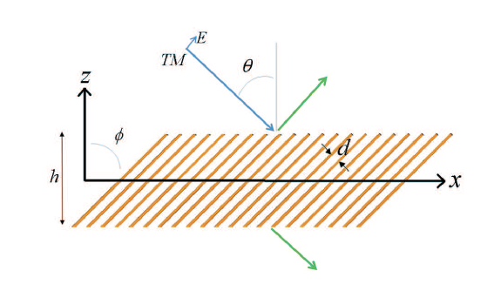
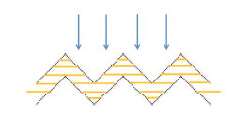
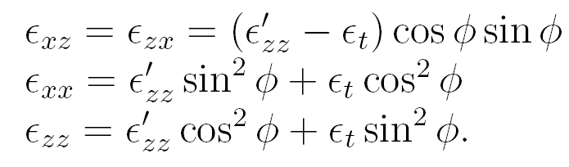
Schematic view
z´
x´

Slide 7
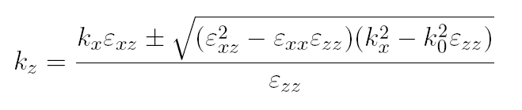



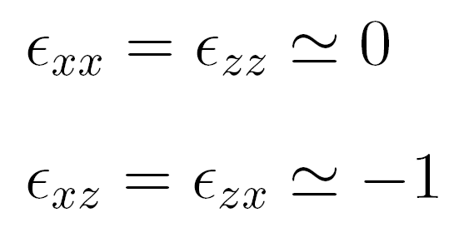
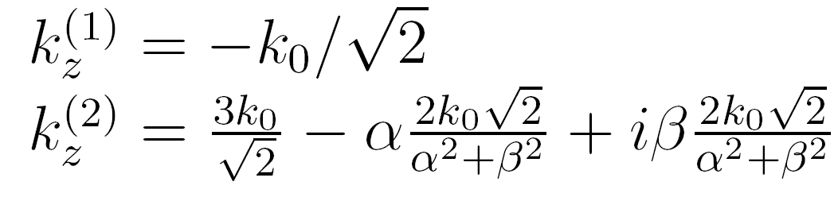
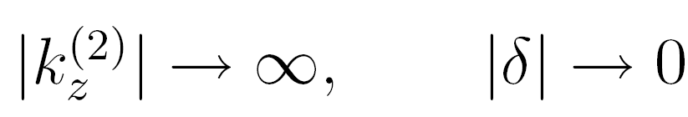
Eigenwaves, non-symmetry with respect to the Z-axis
Indefinite medium: ε_{t} =1; ε’_{zz} =-1+iδ,
special case:

Slide 8
Isofrequencies. Hyperbolic dispersion

Slide 9
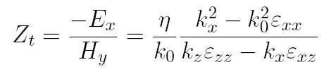

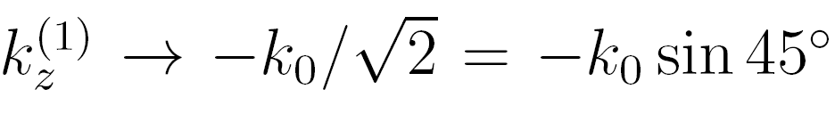

Conditions for the perfect absorption
No reflection! Perfect absorption!
S.M. Hashemi, I.S. Nefedov, PRB, 86, 195411 (2012).

Slide 10
Normal components of wave vectors
θ=45°
z - components of wave vectors for waves propagating in opposite directions under the fixed transverse component k_{x} =ksin(θ)

Slide 11
Absorption in graphene multilayers
Absorption (black) and transmission (red) versus wavelength, calculated for different relaxation times τ. Green line shows absorption in the same thickness multilayer with horizontally arranged graphene sheets

Slide 12
Different interlayer distances
Absorption (black) and transmission (red) versus wavelength, calculated for different distance between graphene sheets d. Chemical potential μ_{c} =0.5 eV.
Number of graphene sheets N_{g} =100.

Slide 13
Absorption, dependence on the incidence angle

Slide 14
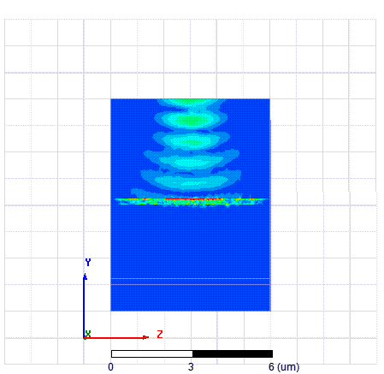
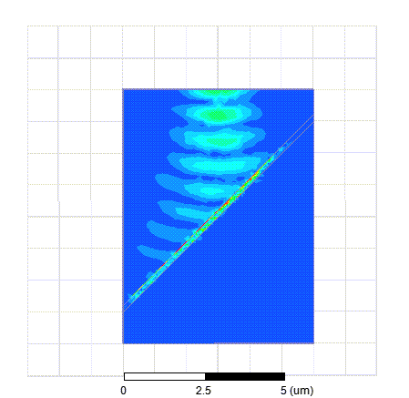
h=λ/10

Slide 15
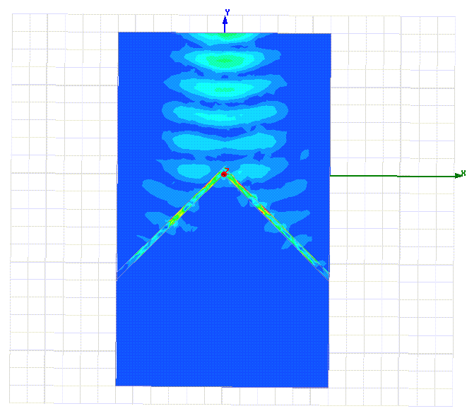
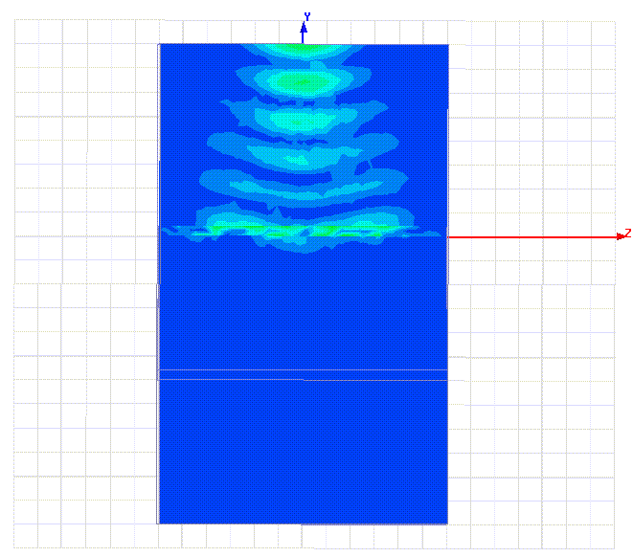
h=λ/10

Slide 16
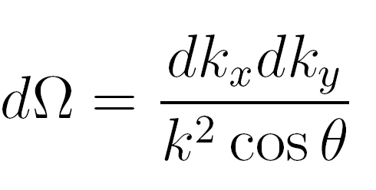
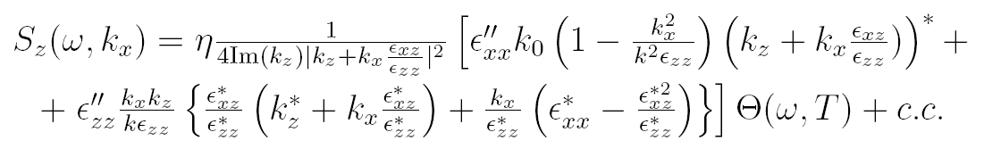
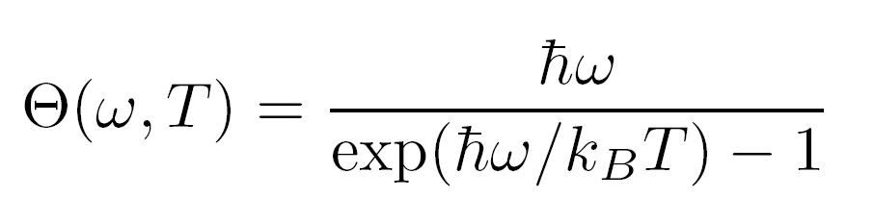
Thermal emission
Ergodic hypethesis
thermal emission into a solid angle
Energy of Planck’s oscillator

Slide 17
Thermal emission
Hyperbolic isofrequencies

Slide 18
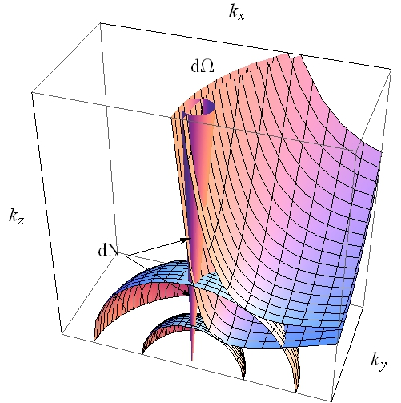
Far-zone thermal emission
Density of modes

Slide 19
Thermal emission

Slide 20


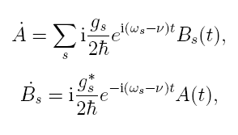
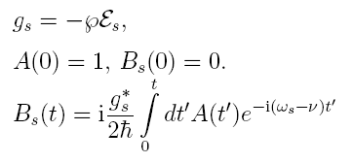
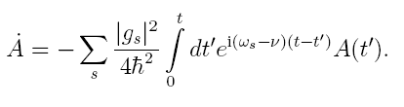


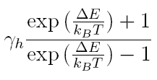
A model of spontaneous emission in HM: two-level atom
- basic states
a
k
Equations:
ω
ν
b
- initial conditions
- ratio of energy stored in the field and in the atoms

Slide 21
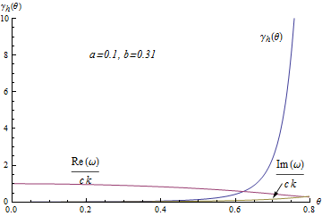
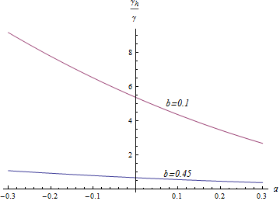
Angle-averaged spontaneous radiation rate in dependence on a and b
Angular dependence of spontaneous radiation rate

Slide 22
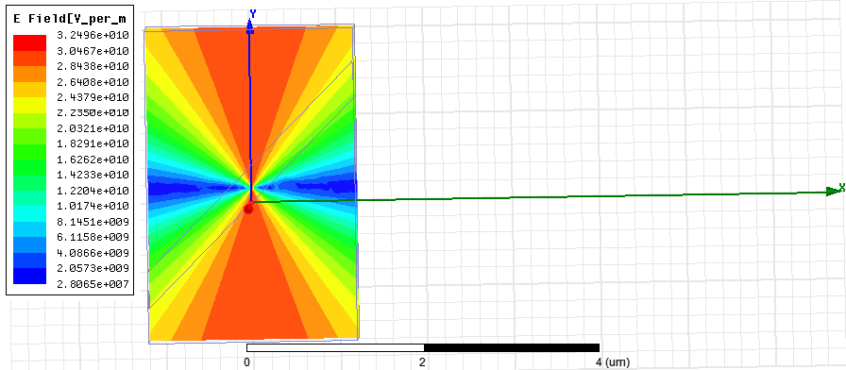
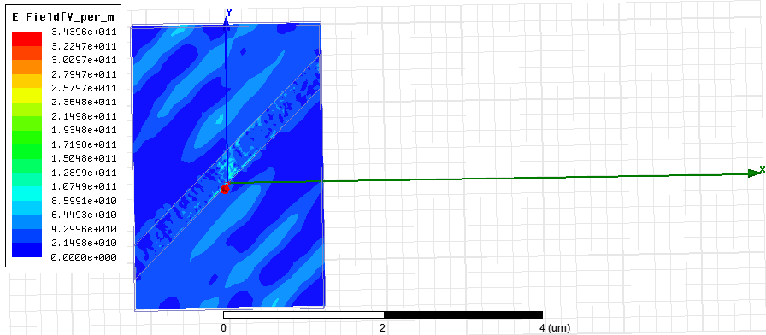
Electric dipole radiation, HFSS simulation
dipole in vacuum
dipole in hyperbolic medium

Slide 23
Conclusions
Graphene multilayers can exhibit properties of hyperbolic media in the near-infrared and visible ranges
Perfect absorption of TM-polarized waves in a considerably wide wavelength range can be achieved in optically ultra-thin graphene multilayer structures with tilted anisotropy axes
The perfect absorption is provided by the perfect matching with free space and a very large attenuation constant.
High-directive thermal emission can be obtained from asymmetric graphene multilayer structures. This effect is caused by enhanced level of spontaneous emission inside hyperbolic media and ability of modes with a very high density to be emitted from ASHM without total internal reflection.
A small source, placed incide a slab of asymmetric hyperbolic medium, can produce a high-directive radiation in far zone.

