Slide 1


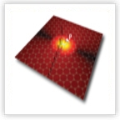

Novel hyperbolic metamaterials based on multilayer graphene structures.
I.V. Iorsh, I.V. Shadrivov, P.A. Belov,
and Yu.S. Kivshar
Notes:
Add Ifmo and ANU logos

Slide 2
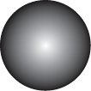
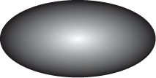
Hyperbolic medium
Isotropic media:
Disp. equation:
Isofrequency
surface:
Anisotropic media:
Disp. equation :
Isofrequency surface:
Hyperbolic medium:
Disp. equation :
Isofrequency surface :
Notes:
I would like to start my talk from a brief explanation of what hyperbolic media actually is. In an isotropic media the displacement and field are connected via a scalar dielectric permittivity. The dispersion equation can be obtained easily and the isofrequency surfaces are spheres. In an anisotropic media permittivity becomes a tensor and the isofrequency surfaces are ellipsoids. hyperbolic medium is an extremely anisotropic unixial medium. Whose components of dielectric permittivity tensor have opposite signs. This results into the hyperbolic shape of the isofrequency surfaces depicted on the slide.

Slide 3
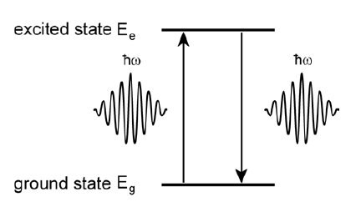
Spontaneous emission
Transition rate (Fermi Golden Rule):
For atom in vacuum:
LDOS
Note: Fermi Golden Rule is not an exact result, but rather a first approximation solution of the integro-differential equation obtained from time-dependant perturbation theory
Notes:
The recent interest in hyperbolic media is very connected with the possibility of drastic spontaneous emission control. So I have to say a couple of words about what spontaneous emission is. The essence of the effect is that if we leave the system in excited state in the first moment of time, than the probability to find a system in an excited state afer time t is proportional to the exponent of ratio of t and characteristic lifetime tau which is referred to as spontaneous emission lifetime. Spontaneous emission lifetime can be calculated using Fermi Golden Rule which states that transition rate is proportional to the product of the transition matrix element and the density of final states. The density of the final states is defined by the surrounding media which allows us to engineer the spontaneous emission lifetime modifying the surrounding media appropriately. For the atom in vacuum spontaneous emission rate is proportional to the cube of the frequency. It should be also noted that although the Fermi golden rule is an extremely powerful instrument for calculating the transition rates it is quite often omitted that it is just a first approximation solution of the integro-differential equation obtained from the time-dependant perturbation theory and the applicability of such simplification should be strictly speaking considered for each problem.

Slide 4
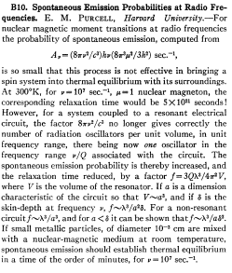
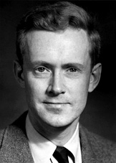
Purcell factor
E.M. Purcell
(1912-1997)
Purcell worked with RF range and small metallic
Cavities: enhancement of the order of
Notes:
Purcell factor or modification of spontaneous emission in media was probably first observed by Purcell in 1940s. Purcell who worked on nuclear magnetic resonance actually strived for bringing the nuclear spins of atoms in magnetic field to the equilibrium with the system. However low, radio frequencies of transitions between states with opposite spin orientations led to the very long relaxation times of the order of 10^(21) s which significantly larger than the current age of the universe. To avoid waiting for so long Purcell itroduced the metallic cavity to the system with the frequency tuned to the transition frequency – which allowed to reduce the relaxation times to several minutes. Here you can see the whole paper published by Purcell in 1940 which now has about 2000 scitations.

Slide 5
Infinite density of states
Narimanov et al, Appl. Phys. B: 100, 215–218 (2010)
Notes:
It has been recently shown by Narimanov and co-authors that the unbound shape of the isofrequency surfaces for the hyperbolic medium leads to the infinite density of states which in its turn should lead to sufficient decrease of the spontaneous emission lifetime. Since that a huge interest emerged for studying Purcell factor in different realizations of hyperbolic medium.

Slide 6
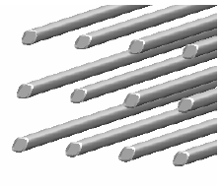

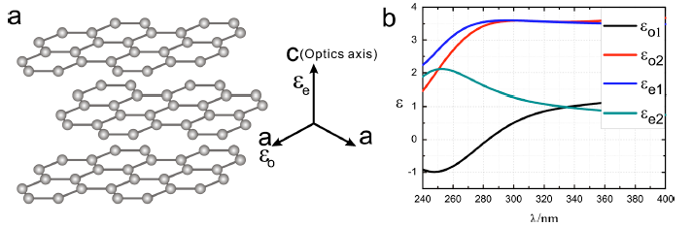
Realizations of hyperbolic media
Wire medium
Magnetized plasma (for RF)
Graphite (for UV)
J. Sun et al. Appl. Phys. Lett. 98, 101901 (2011)
Notes:
Let me say a couple of words on the possible realizations of the hyperbolic medium. It is quite intuitively evident that the system which could be a candidate for the realization of the anisotropic medium should be extremely anisotropic. Indeed, one of the most common realizations of the hyperbolic medium is the wire medium, which is a two dimensional array of the metallic nanorods. One of more exotic systems which demonstrates hyperbolic medium properties is the plasma in strong magnetic field, which is discussed in this paper from 1969. Finally, it has been recently shown that graphite behaves as an hyperbolic medium for the UV frequency range. However in the latter case the losses are quite strong which obscures possible practical applications.

Slide 7
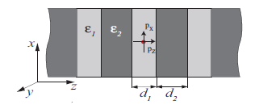
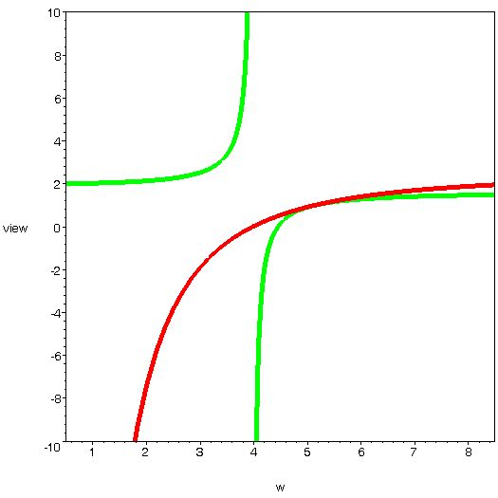
Layered metal dielectric nanostructure – the simplest realization of hyperbolic media
Within the effective media approximation the layered metal dielectric nanostructure can be described as a hyperbolic media
Notes:
Probably the simplest realization of the hyperbolic medium are the layered metal-dielectric nanostructure. Applying standard effective media approach we can see that close to the bulk plasmon resonance components of the resulting dielectric permittivity tensors have opposite signs. Thus it seemed perspective to calculate the spontaneous emission modification of an emitter placed in the structure.

Slide 8
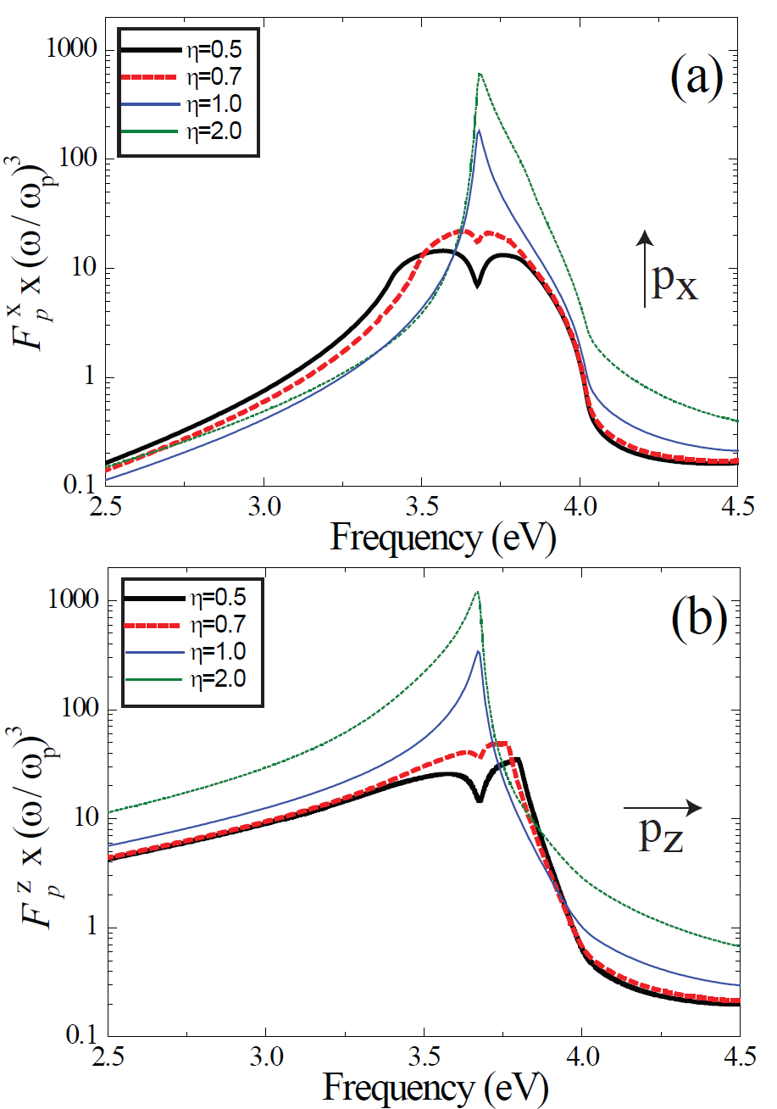
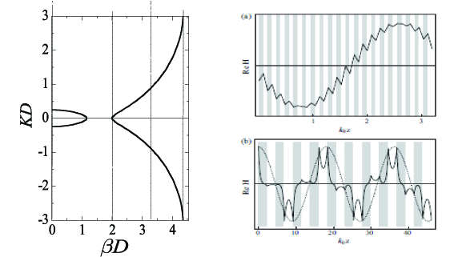
Purcell factor in layered structures. Theory.
Extremum is observed at the bulk plasmon frequency .
Notes:
The Purcell factors for the dipole placed on the top of the MDN exhibit the maximum at the bulk plasmon frequency. Close to these values the Purcell factor is proportional to the cube of the ratio of the wavelength and period of the structure. For the realistic MDNs the Purcell factors reach the values of several hundred. Let me try to show the origin of such high Purcell factors in the case of MDN. The purcell factor is an imaginary part of the green function in the origin. And if we calculate the Green function it can be calculated in to two terms. Thr first term corresponds to the input from the propagating mode and the second one to the response from the evanescent modes. In the conventional cavities no response from the evanescent modes is present. In the case of single metal surface – the evanescent mode can excite the surface plasmon mode which results in pole in the second itegrand and purcell enhancement is observed. However in the case of mdn a whole band of so called near filled bloch modes can be excited which are the coupled surface plasmons at the ind.
Metal dielectric interfaces. On the plot you can see the dispersion of these modes and profiles of some of these modes.

Slide 9
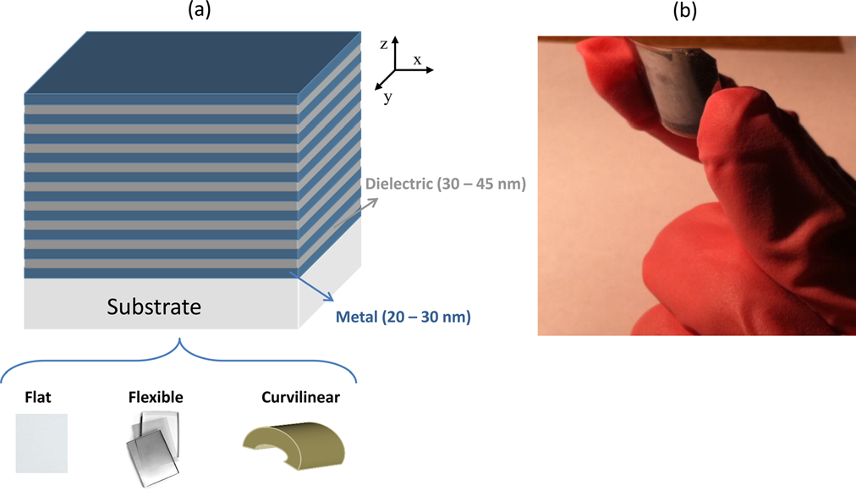
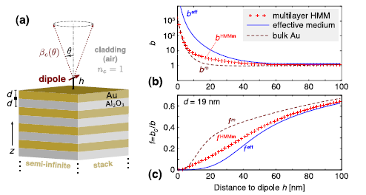
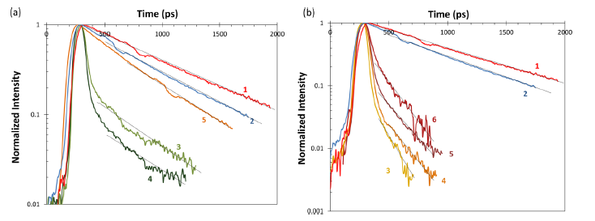
Purcell factor in layered structures. Experiment.
O. Kidway, S.V. Zhukovsky, J.E. Sipe,
OL, 36,13,(2011)
T. Tumkur, G. Zhu, P. Black, Yu. A. Barnakov,
C. E. Bonner, and M. A. Noginov,
APL 99, 151115, (2011)
Notes:
There were many experiments on the spontaneous emission modification of the quasi point source placed on the top of MDN and the Purcell factors of up to 100 have been observed. Most of the experiments concerned the optical and near infra-red frequency range. But what about THZ?

Slide 10
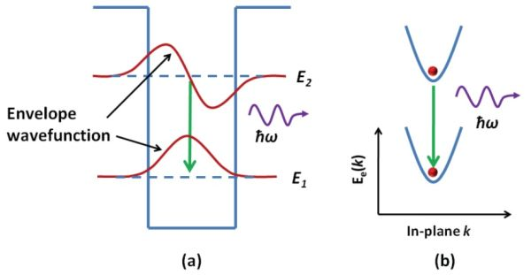
Spontaneous emission enhancement in THz range
Efficiency is very low
But what if to utilize Purcell effect?
From the other hand, THz frequency range lies well below the characteristic bulk
plasmon frequencies in the conventional metal-dielectric multilayers, which
significantly limits the achievable values of the Purcell factors.
Notes:
One of the problems of the semiconductor THz sources based on the intersubband transitions is the small radiative lifetime transitions compared to the nonradiative electron lifetimes. Which limits the efficiency of such devices to very low values
Sufficient decrease of the intersubband transition time by employing the Purcell effect could allow the increase of the efficiency of such THz semiconductor sources.
From the other hand, THz frequency range lies well below the characteristic bulk plasmon frequencies in the conventional metal-dielectric multilayers, which significantly limits the achievable values of the Purcell factors.

Slide 11
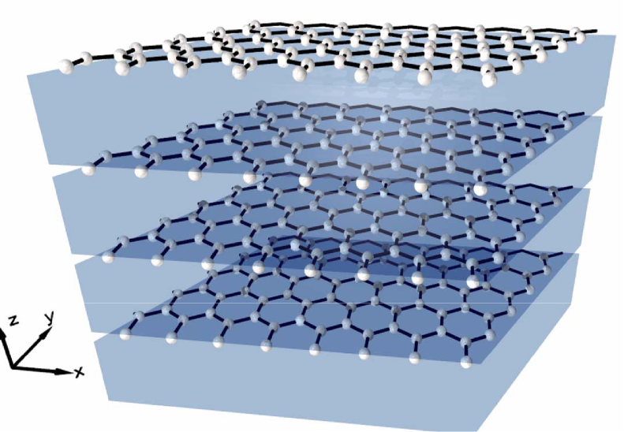
Graphene multilayer structure as hyperbolic metamaterial
1.Hyperbolic isofrequency contours
in metal-dielectric nanostructures
arise due to near field Bloch waves
2.Near field Bloch waves – essentially are
The coupled surface plasmon polaritons
3. Graphene sheet supports surface plasmon modes
which can be coupled if we organise an array
of graphene sheets.
Multilayer graphene structure should behave
As a hyperbolic metamaterial

Slide 12
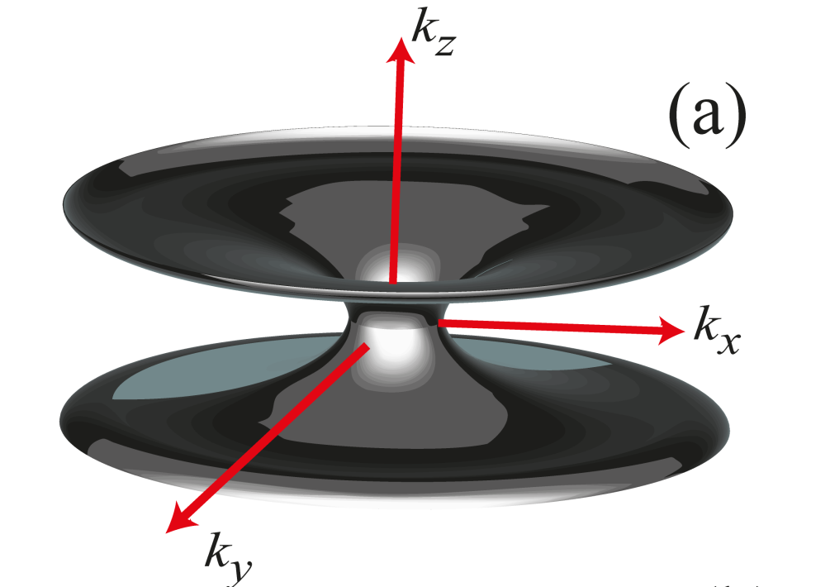
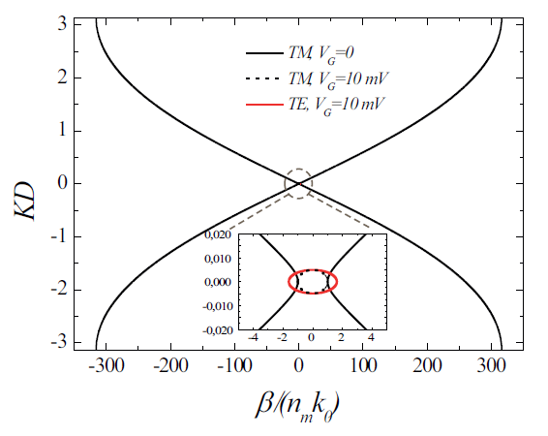
Isofrequency contours
Notes:
The stucture is characterized with hyperbolic
isofrequeAncy contours in a wide frequency range
For TM polarized light. The hyperbolicity can be
In principle switched on and off with an external
Gate voltage. The interesting thing is that while as we know TE plasmons can also propagate in Graphene in a thin frequency range and can in principle be coupled and form hyperbolic bands the calculations show that for TE polarized light even in the absense of losses bands are always elliptic even in the frequency range where imaginary part of conudctivity is negative.

Slide 13
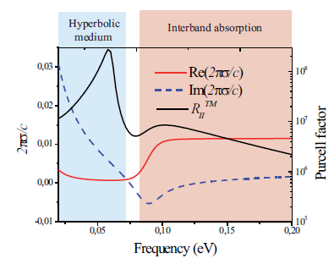
Purcell factor
Phys. Rev. B 87, 075416 (2013)
Notes:
We have calcu lated the purcell factor for the MGS with period 5 nm at temperature of 100 K. The electron electron scattering time was set to 1 ps. We see the value of 10(8) which of course huge but we should keep in mind original Purcell’s result and take into account that in our case the wavelnegth to period ratio is much larger. We can see addition large peak in the high frequency region which corresponds to switching on of the THz transitions.

Slide 14
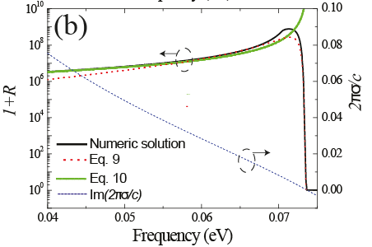
Purcell factor (analytics)
Largest Purcell factors correspond to:
Notes:
We have derived the analytical results for the PF which agrees well with the numerical results. We were able to show that the bulk plasmon resonance occurs when the following relation is observed.

Slide 15
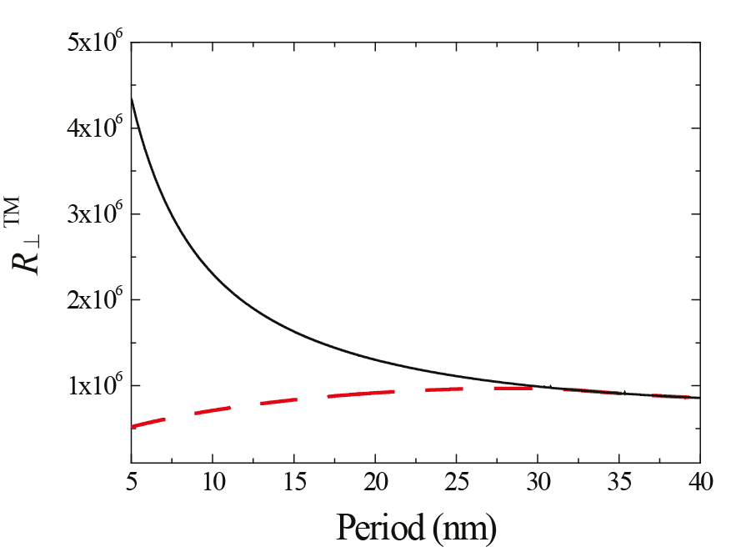
Limitations of the local approach
Notes:
We also were quite surprised with the huge values of the PF and tried to find the possible limitations of the approach. The one thing that we accounted only for the local conductivity which is valid for the in-plane wavevectors less than the fermi wavevector. To estimate the error we have limited our selves inculations of green functions to the values up to fermi wavevector. We found out that the PF is significantly overstimated in the case of small periods. However if we increase the period the two model almost coincide. We have also derived the estimate for the minimal period for which our model should work.

Slide 16
To be done: separating the far-field and near-field input to the Purcell factor
Vogel, Welsch, “Quantum optics”:
To separate the far field and near field:
Notes:
The other thing is that our model calculates only the full purcell factor. Which is total decrease of lifetime and can significantly differ from the radiative decrease of lifetime. To illustrate it imagine a point source close to plasmonic nanoparticle. The density of states is high and the point source very quickly emits energy to the localized plasmon mode. However this mode is very localized and can be poorly coupled to the far field radiation. Afterwards if the damping is high most of the radiation energy can be transferred to the ohmic losses i.e. to the heating of this nanoparticle and now far-field radiation enhancement will be present. The same applies to our structure. The radiation can be very quickly transferred to the localized near field bloch modes which afterwards would be successfully damped bwfore radiating to the far-field.
To check it we are now trying to separate the far-field contribution to PF from the nearfield following the algorithm motivated by the useful equation found in this book. As we know the purcell factor is the imaginary part of the green function. And this in its turn can be presented as a following convolution. Using it we can separate the far field from the near field in a following way.

Slide 17
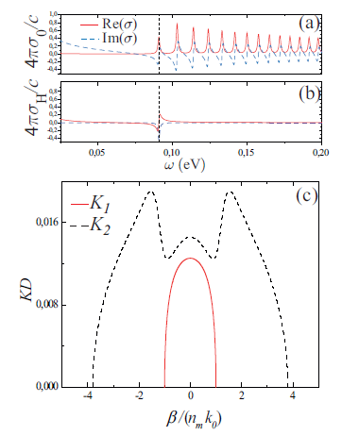
Application of perpendicular magnetic field
Perpendicular magnetic field couples
the TE and TM polarized Bloch waves:
Coupling term
Notes:
Finally I wanted to mention our studies of our HMM in magnetic. As it is has been stated yesterday in the talk of Alexey nikitin TE and TM plasmons are coupled in magnetic field which in its term couples the TE and TM bloch waves. Finally we can effectively change the dispersion and material properties of the metamaterials with magnetic field.

Slide 18
Conclusion
Multilayered graphene structures could be used as a new realization of hyperbolic metamaterials for THz range to boost the terahertz transitions in semiconductor devices.

Slide 19
Thank you

Slide 20
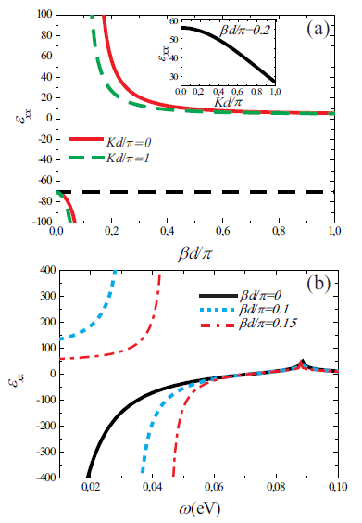
Homogenization: local and nonlocal approaches

