Slide 1
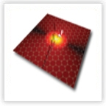


Momentum dependence and losses in graphene plasmons
Graphene Nanophotonics
Benasque, 2013, Mar 03 -- Mar 08
Outline
Damping mechanisms
l Plasmons in ribbons
Experimental results
Mid-infrared plasmons in scaled graphene nanostructures
H. Yan, T. Low, W. Zhu, Y. Wu, M. Freitag, X. Li, F. G., P. Avouris, F. Xia
arXiv:1209.1984, Nature Photonics, in press
L. Martín-Moreno, A. Nikitin, F. García-Vidal, M. M. Fogler

Slide 2

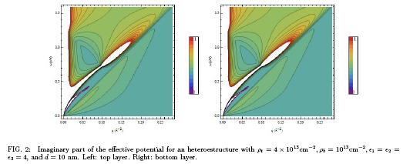
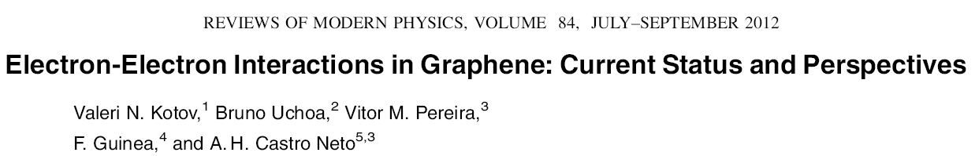
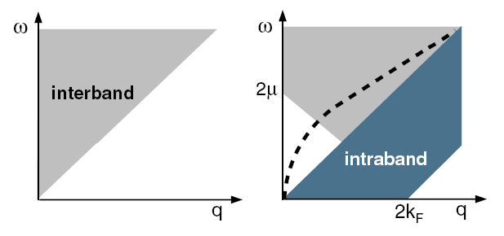
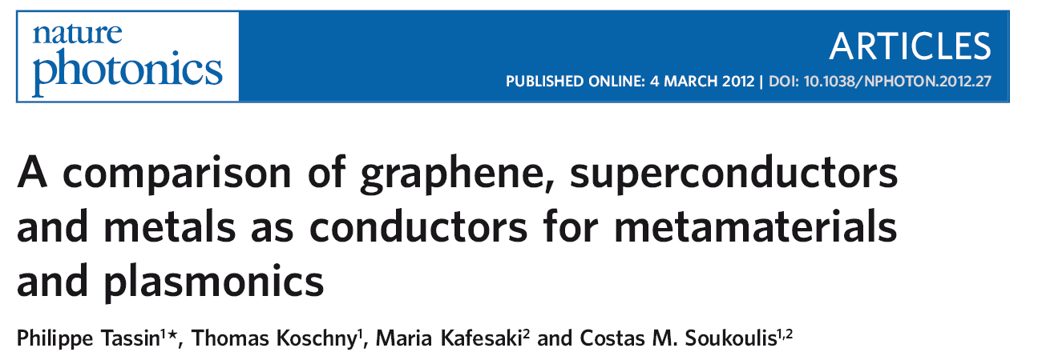
Damping mechanisms
l Higher order processes, multiple electron-hole pairs
Lack of momentum conservation
l Decay into other excitations: phonons, …

Slide 3
Elastic scattering
k
k’
elastic mean free path
k+q

Slide 4
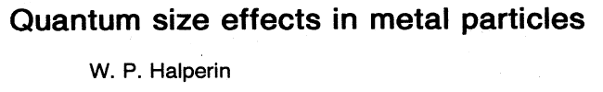
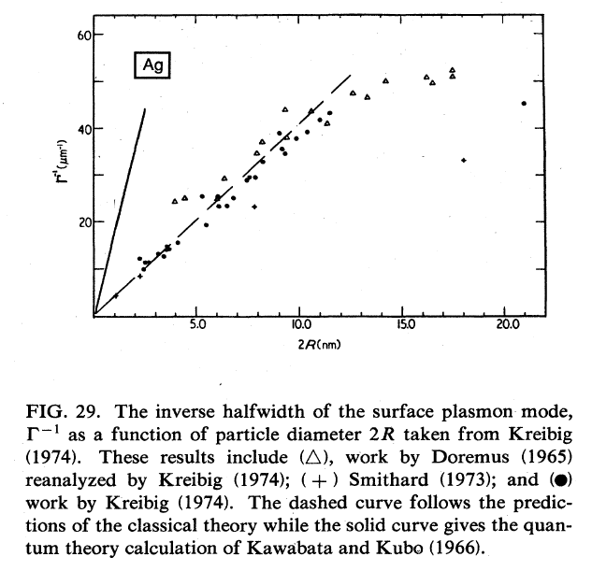
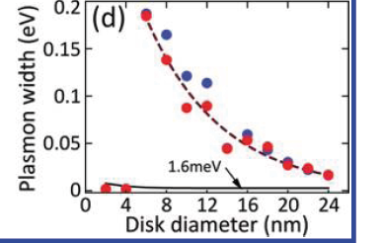
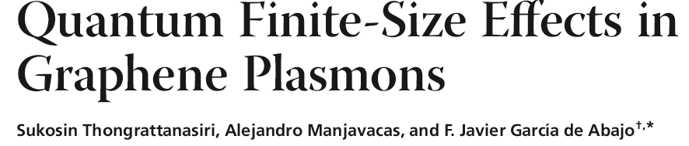

Finite systems
D

Slide 5
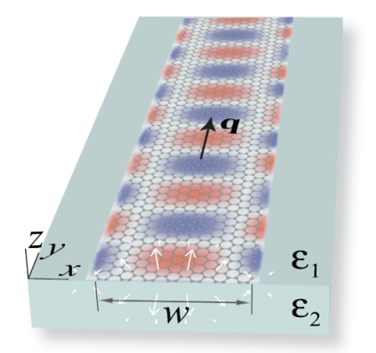
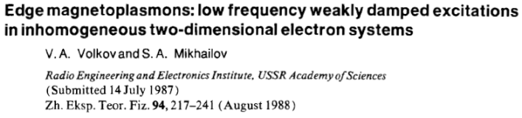
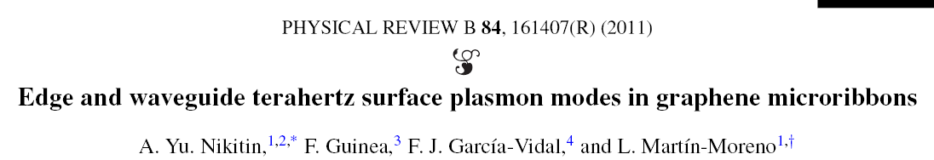
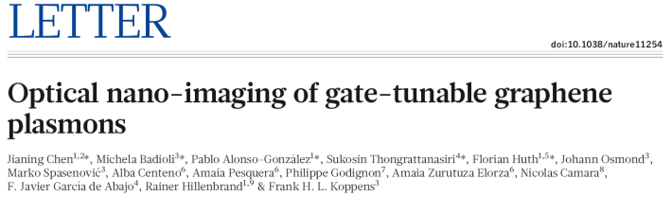
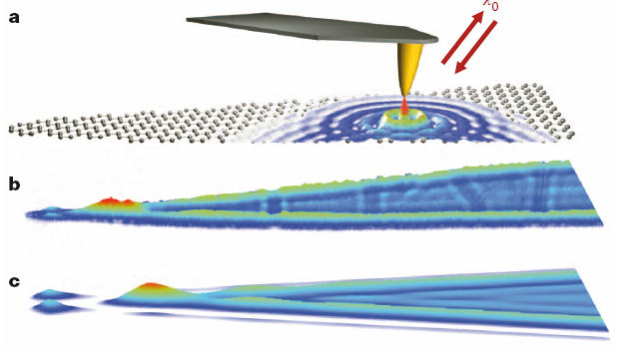
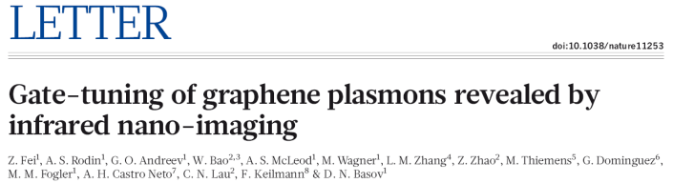
Inhomogeneous electric fields
T. Low, M. M. Fogler, F. G, unpublished
Edges
Local excitations
ω_{p}(q) 4 q 4 L⁻¹

Slide 6
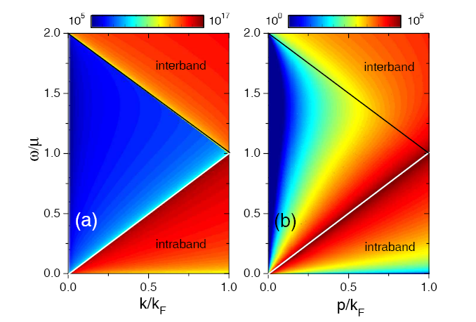
Inhomogeneous electric fields
Non local conductivity, clean system
τ=1μs, E =0.4eV
F

Slide 7
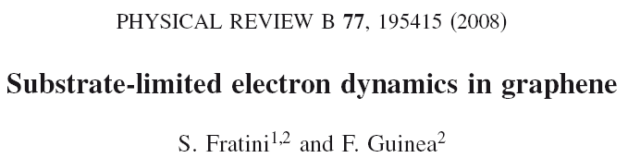
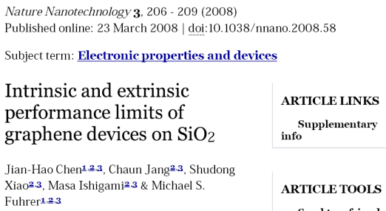
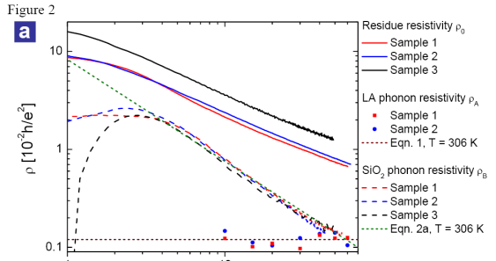
Surface polar modes
Si O has polar modes which induce long range electrostatic potentials. The dielectric constant of the system is modified.
2

Slide 8
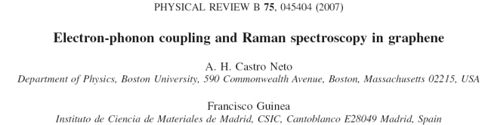
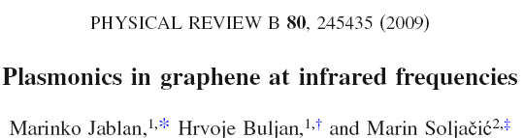
Optical phonons
q
k
k’
k+q
Optical phonons at Γ, ω =0.2 eV
ph
Coupling through changes in bond lengths
Weak dispersion
1/τ
ε

Slide 9
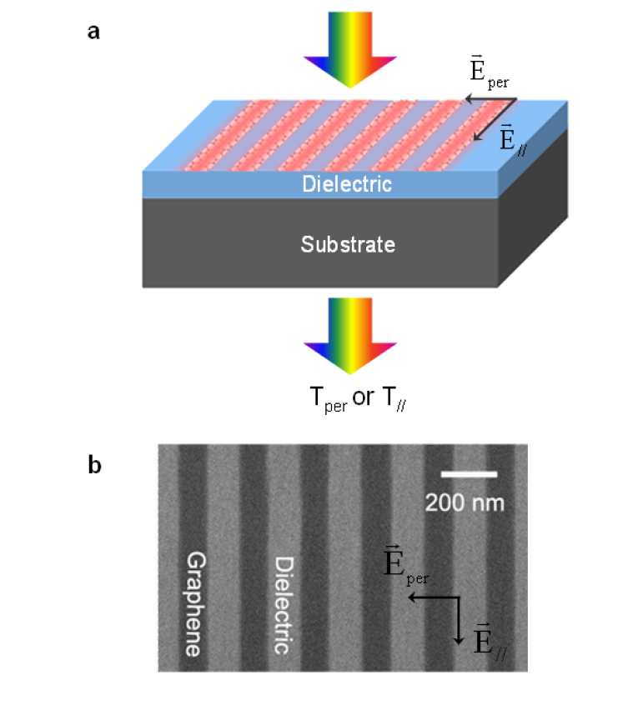
Experiments
Y. Yan, T. Low, W. Zhu,Y. Wu, M. Freitag, X. Li, F. G., P. Avouris, and F. Xia, arXiv:1209.1984, Nature Phys., in press
Nanoribbons, antidots , and nanodisks defined by electron beam litography.
The samples lie on CVD graphene on SiO and diamond like carbon (DLC) substrates.
2

Slide 10
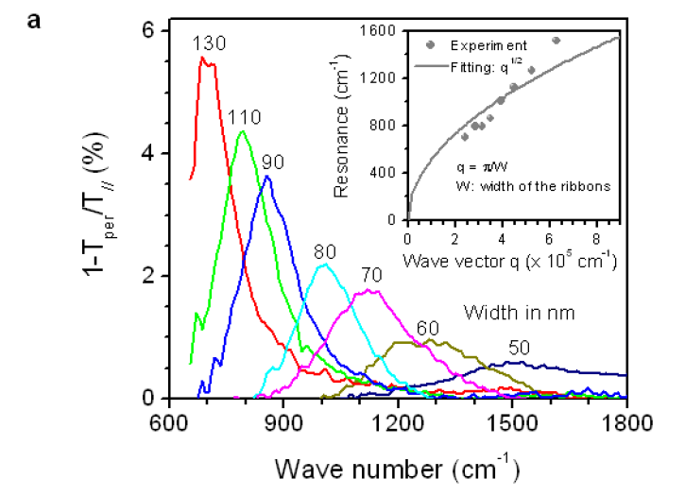
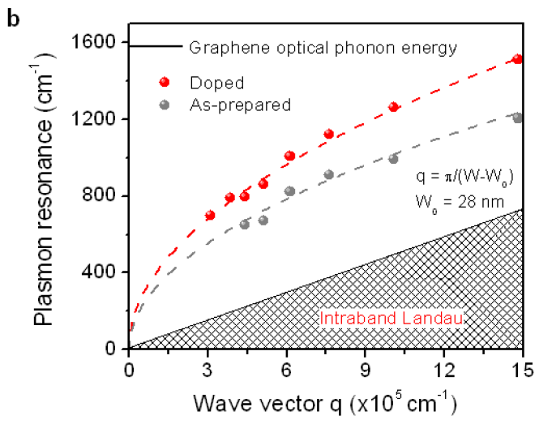
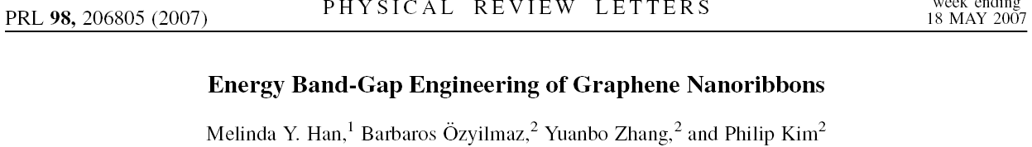
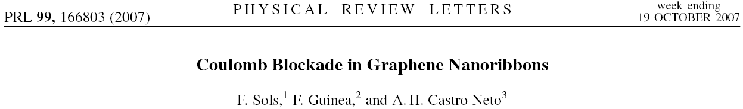
Plasmon dispersion
graphene on diamond like carbon (DLC)
dead layer
asymmetric lineshape

Slide 11
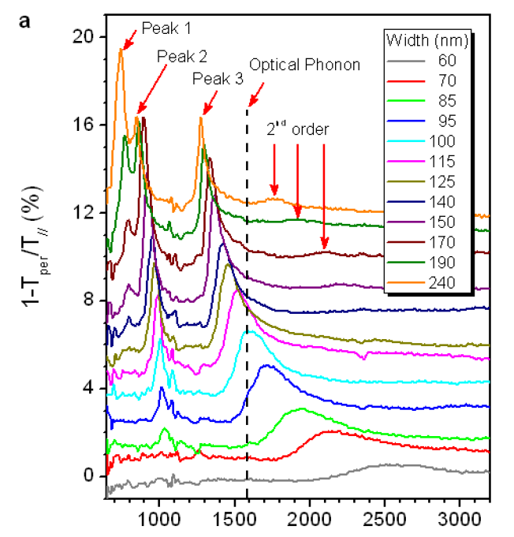
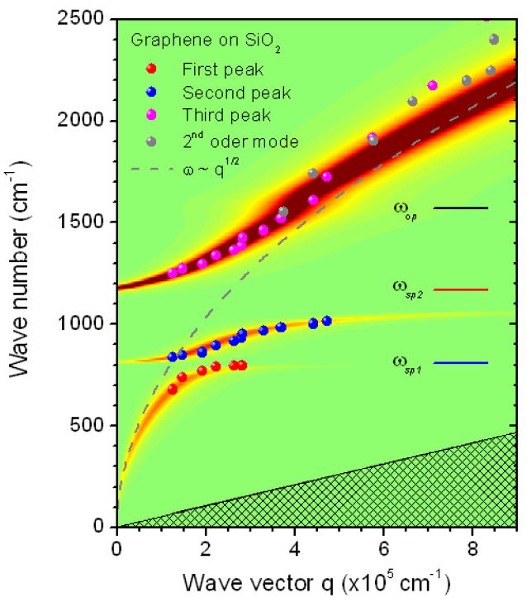
Plasmon dispersion
graphene on SiO
2

Slide 12
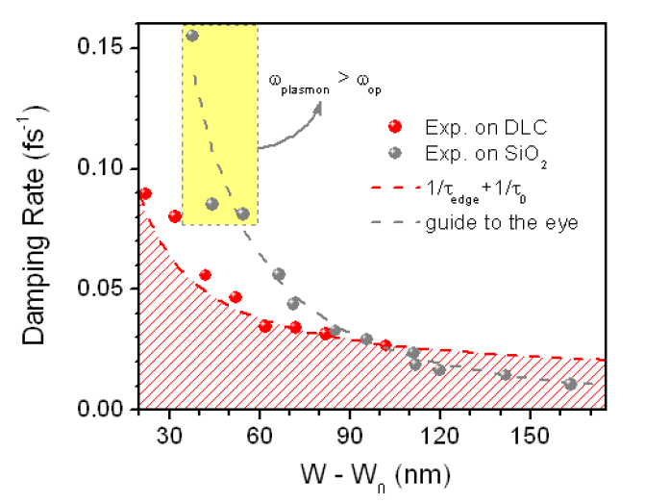
Plasmon damping

Slide 13
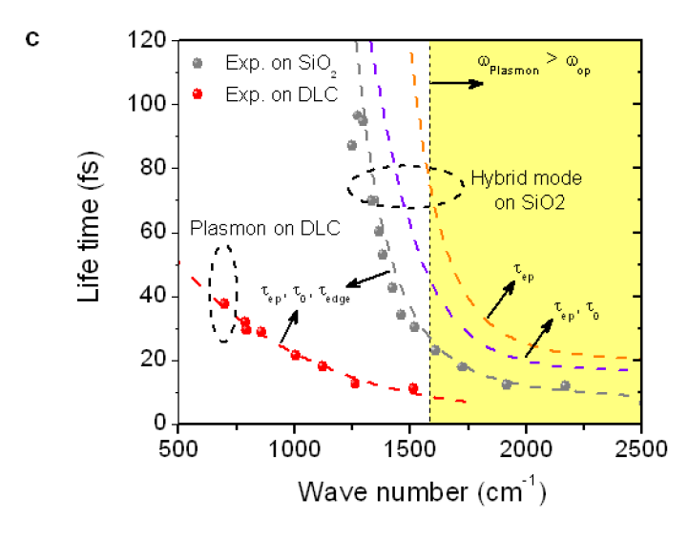
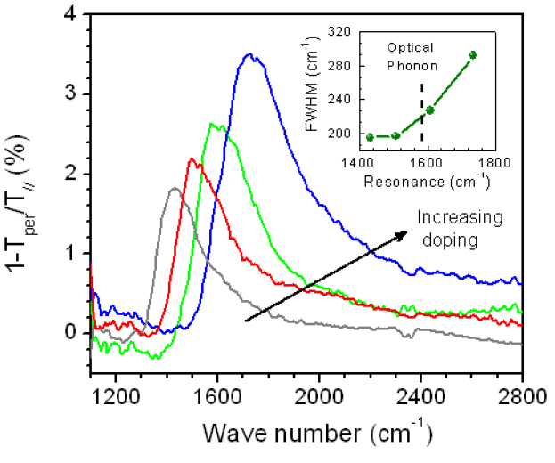
Plasmon damping
Comparison between graphene on SiO and graphene on DLC
2
Doping dependence

Slide 14
Conclusions. Open questions
l Plasmon dispersion can be accurately measured in nanoribbons.
Plasmon linewidth can be explained by simple mechanisms
The main decay channel at high frequencies is decay into optical phonons and electron-hole pairs
The role of other decay channels is in reasonable agreement with simple estimates
l Coulomb blockade, interplay between plasmons and dc transport

