Slide 1
GI PERTURBATIONS, UNITARITY AND FRAME INDEPENDENCE IN HIGGS INFLATION
˚ 1˚
Tomislav Prokopec, ITP Utrecht University
T. Prokopec and J. Weenink, e-Print: arXiv:1403.3219 [astro-ph.CO];
JCAP 1309 (2013) 027 [arXiv:1304.6737 [gr-qc]]
JCAP 1212 (2012) 031 [arXiv:1209.1701 [gr-qc]]
Phys. Rev. D 82 (2010) 123510, [arXiv:1007.2133 [hep-th]]

Slide 2
CONTENTS
˚ 2˚
1) HIGGS INFLATION
2) HIGGS INFLATION IN LIGHT OF BICEP2
3) UNITARITY AND NATURALNESS PROBLEM
4) (PARTIAL) SOLUTION
5) CONCLUSIONS AND OPEN PROBLEMS
SOME LITERATURE:
Barbon, Espinosa, 0903.0355
Burgess, Lee, Trott, 1002.2730
Hertzberg, 1002.2995
Bezrukov, Magnin, Shaposhnikov, Sibiryakov, 1008.5157
Notes:
2

Slide 3
˚ 3˚
HIGGS INFLATION

Slide 4
HIGGS INFLATION
˚ 4˚
Salopek, Bond, Bardeen, PRD 40 (1989)
Bezrukov, Shaposhnikov, 0710.3755 [hep/th]
● HIGGS FIELD ACTION (H=Higgs doublet):
R
● UNITARY GAUGE SINGLE FIELD ACTION: JORDAN FRAME
R
● WEYL (FRAME) TRANSFORMATION TO EINSTEIN FRAME:
$$g_{μν,E}=Ω^{2}\left(x\right)g_{μν}, Ω^{2}\text{(}\text{x}\text{)}\text{=}\frac{F\left(Φ\right)}{{M_{P}^{}}^{2}}, F\left(Φ\right)={M_{P}^{}}^{2}+ ξΦ^{2}$$
● FIELD Φ TRANSFORMS AS:
${\left(\frac{dΦ_{E}}{dΦ}\right)}^{2}={\frac{1+6{M_{P}^{}}^{−2}{Ω′}^{2}}{ Ω^{2} }=\frac{{M_{P}^{}}^{2}+6{Ω′}^{2}}{ F}}^{}\left(1+\frac{3}{2}\frac{{F′}^{2}}{F}\right), { V}_{E}$($Φ_{E}$) = $\frac{{M_{P}^{}}^{4}}{ F^{2} }V(Φ)$
● ACTION IN EINSTEIN FRAME:

Slide 5
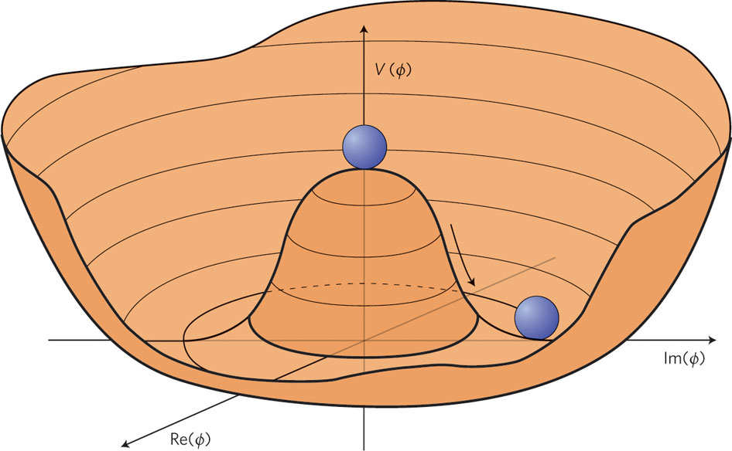
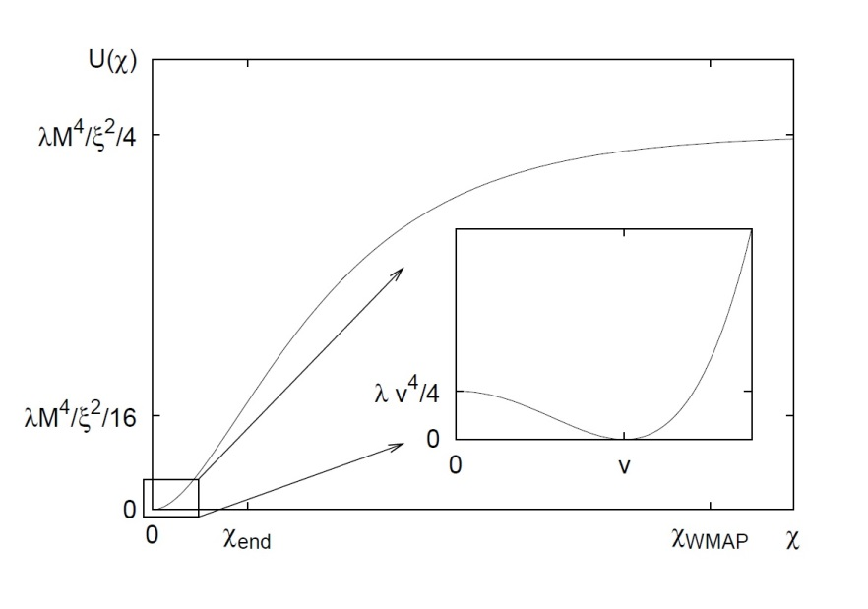
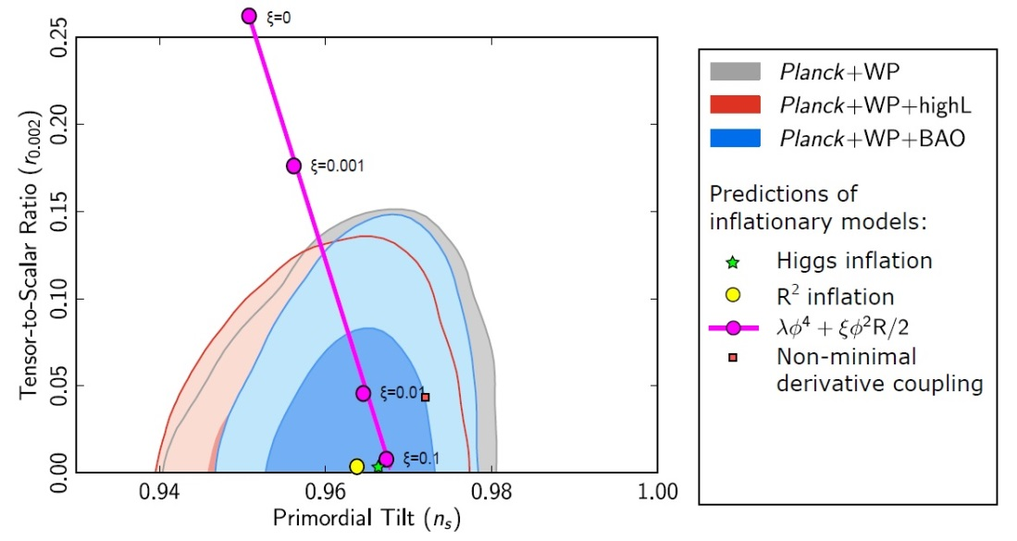
˚ 5˚
HIGGS AS THE INFLATON: POTENTIAL
● HIGGS POTENTIAL: IN JORDAN (left) AND IN EINSTEIN FRAME (right)
FOR LARGE ξ AND λH NOT TOO SMALL, r and ns BECOME UNIVERSAL:
r~0.003, ns~0.96 (SWEET SPOT OF PLANCK, IDENTICAL TO STAROBINSKY MODEL)
Bezrukov, 1307.0708
● BICEP 2 RESULTS r~0.16
ARE A GAME CHANGER.
CAN HIGGS INFLATION BE SAVED.

Slide 6
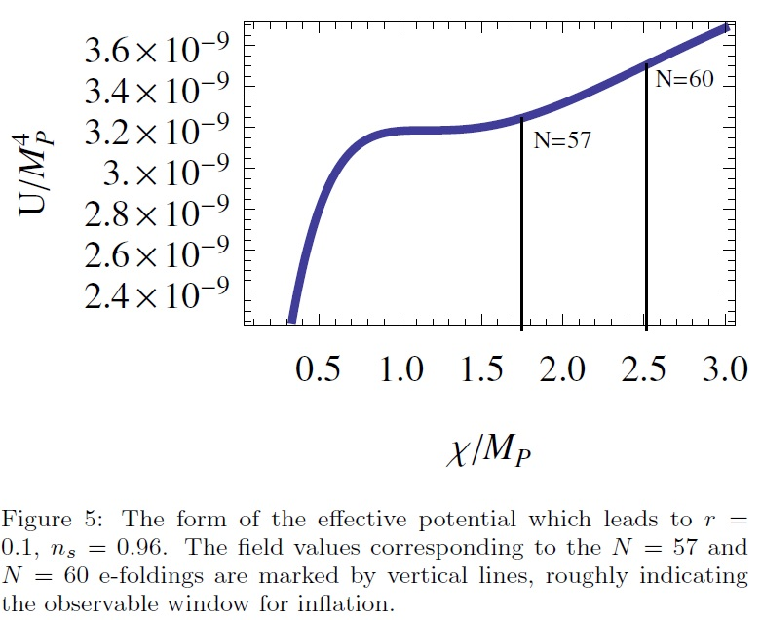
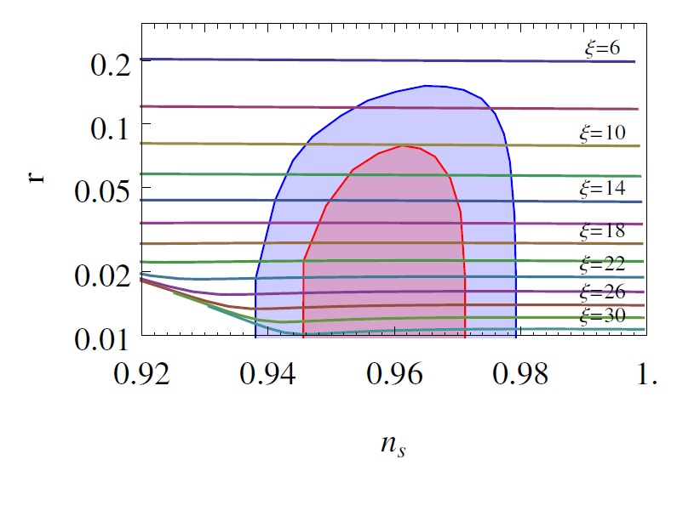
˚ 6˚
HIGGS AS INFLATON: POST BICEP
THE POTENTIAL IN EINSTEIN FRAME DEPENDS ON THE RUNNING OF λH.
Near the critical point (where λH ~0) the potential (in E-frame) can look quite different:
Bezrukov, Shaposhnikov, 1403.6078
NB: TAKE A COLEMAN-WEINBERG POTENTIAL (HOLDS FOR SUFFICIENTLY LARGE φ):
$V_{CW}$(φ) ~$λ_{0}φ^{4}$log$\left(\frac{{λ_{0}φ}^{2}}{{2μ}^{2}}\right)$ ⇒ $V_{E}$($χ$) ~ $\frac{λ_{0}}{ξ^{2}}{M_{P}}^{4}\left[\text{log}\left(\frac{{λ_{0}φ_{0}^{}}^{2}}{{2μ}^{2}}\right)+\frac{6χ^{2}}{{M_{P}}^{2}}\right]$
$$WITH SOME TUNING $\left(\frac{{λ_{0}φ_{0}^{}}^{2}}{{2μ}^{2}}\sim 1\right)$: CAN REPRODUCE THE BICEP RESULT.

Slide 7
˚ 7˚
UNITARITY AND NATURALNESS PROBLEM

Slide 8
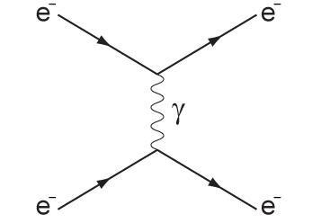
˚ 8˚
UNITARITY: STATING THE PROBLEM
● (TREE LEVEL) SCATTERING AMPLITUDES INVOLVING N PARTICLES GO AS:
$A_{N}∝E^{4−N}$ (E=CM ENERGY)
IF $A_{N}$ GROWS FASTER, PERTURBATION THEORY BREAKS AT SOME SCALE Λ
● FOR 2-2 (TREE LEVEL) SCATTERING AMPLITUDES : WHEN : $A_{2→2}\sim 1,$ UNITARITY PROBLEMS ARISE
E.G.: (COULOMB) SCATTERING OF ELECTRONS IS CONTROLLED BY FINE STRUCTURE CONSTANT αe=e²/4π
$A_{ee→ee}\sim$ $_{e}^{}≪1$
HENCE UNITARITY IS NOT VIOLATED.
NB: SITUATION IS VERY DIFFERENT WHEN GRAVITY/GRAVITONS ARE INVOLVED: UNITARITY IS VIOLATED AT THE PLANCK SCALE E~MP.

Slide 9
UNITARITY: THE PROBLEM
˚ 9˚
● e.g. IN GR THE TWO DIAGRAMS ARE GOVERNED BY CAN. DIM=5 VERTICES:
$V_{eeg}\sim$ $\frac{1}{M_{P}}η^{μν}h_{μν}\overline{ ψ}γ^{α}∂_{α}ψ,{ V}_{ggg}$~$\frac{1}{M_{P}}η^{μν}h_{μν}{\text{(}∂h_{αβ}\text{)}}^{2}$, ${ g}_{μν}=η^{μν}+\frac{1}{M_{P}}h_{μν}$
$A_{ee→ee}\sim \frac{E^{2}}{Λ^{2}}\sim$ $\frac{E^{2}}{{M_{P}}^{2}}\sim 1,{ A}_{gg→gg}\sim \frac{E^{2}}{{M_{P}}^{2}}\sim 1 ⇒ E\sim Λ∼M_{P}$
● VIOLATION OF UNITARITY AT E~MP IS OK. HOWEVER, HIGGS INFLATION HAS A LARGE NONMINIMAL COUPLING, WHICH COULD POTENTIALLY REDUCE THE UNITARITY SCALE BELOW THE SCALE OF INFLATION, INVALIDATING THE MODEL.
COBE NORMALIZATION:
ξ$≈47000\sqrt{λ_{H}}$~${10}^{4}$

Slide 10
UNITARITY: (EARLY) LIT
˚10˚
Barbon, Espinosa, 0903.0355, Burgess, Lee, Trott, 1002.2730, Hertzberg, 1002.2995
● EARLY PAPERS SET THE UNITARITY IN HIGGS INFLATION TO
Λ$\sim \frac{M_{P}}{ξ}$
H$\sim \frac{M_{P}}{ξ}$~ Λ,
WHICH IS AT THE SCALE OF INFLATION: IMPLYING THAT HIGGS INFLATION IS NOT PERTURBATIVE AND REQUIRES UV COMPLETION (HOPELESS). THEREFORE, ONE EXPECTS LARGE TRESHOLD CORRECTIONS DURING INFLATION, MAKING HIGGS INFLATION NOT NATURAL (NATURALNESS PROBLEM).
● MAIN CULPRIT ARE DIM 5 INTERACTIONS:
$V_{ggg}\sim$ $\frac{ξ}{M_{P}}{\left({ η}^{μν}h_{μν}\right)}^{2}η^{αβ}{ ∂^{2} h}_{αβ}$, ${ g}_{μν}=η^{μν}+\frac{1}{M_{P}}h_{μν}$
$A_{gg→gg}\sim \frac{E^{2}}{Λ^{2}}\sim \frac{ξ^{2}E^{2}}{{M_{P}}^{2}}\sim 1 ⇒ E\sim Λ\sim \frac{M_{P}}{ξ}$
●THIS RESULT SEEMS OBVIOUS, HOWEVER IT IS GAUGE (DIFFEO) DEPENDENT!

Slide 11
UNITARITY INCLUDING HIGGS CONDENSATE
˚11˚
Bezrukov, Magnin, Shaposhnikov, Sibiryakov, 1008.5157
● BEZRUKOV et al POINTED OUT THAT PRESENCE OF HIGGS CONDENSATE AND EXPANSION CHANGES UNITARITY SCALE TO
${\text{☹}}_{J}\left(φ\right)\sim \frac{{M_{P}}^{2}+ξ(1+6ξ)φ^{2}}{ξ\sqrt{{M_{P}}^{2}+ξφ^{2}}}$, ${\text{☹}}_{E}\left(φ\right)\sim \frac{M_{P}}{\sqrt{{M_{P}}^{2}+ξφ^{2}}}$ ${\text{☹}}_{J}\left(φ\right)$
WHICH IS ABOVE THE SCALE OF INFLATION ⇒ HIGGS INFLATION PERTURBATIVE
● THEY FIND THAT GAUGE INTERACTIONS HAVE A SOMEHWAT PARAMETRICALLY LOWER CUTOFF SCALE (STILL MARGINALLY PERTURBATIVE)
● STILL: TRESHOLD CORRECTIONS (COMING FROM THE UV COMPLETE THEORY) MIGHT BE SIGNIFICANT, THEY ARE HARD TO ESTIMATE & MAKE HIGGS INFLATION LESS PREDICTIVE (NATURALNESS PROBLEM).
Burgess, Trott, Patil, e-Print: arXiv:1402.1476 [hep-ph]

Slide 12
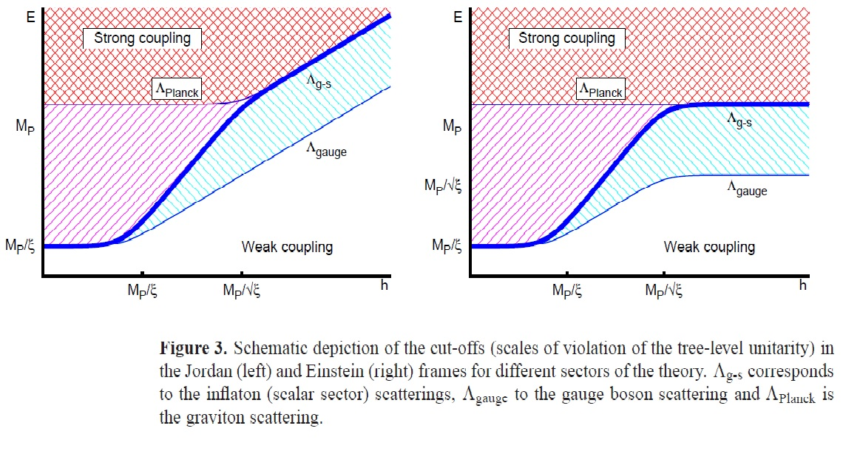
UNITARITY: SUMMARY
˚12˚
Bezrukov, 1307.0708 (review); Bezrukov, Magnin, Shaposhnikkov, Sibiryakov, 1008.5157
● UNITARITY BOUNDS ON SCATTERING AMPLITUDES FOR GRAVITON-SCALAR AND SCALAR-GAUGE INTERACTIONS

Slide 13
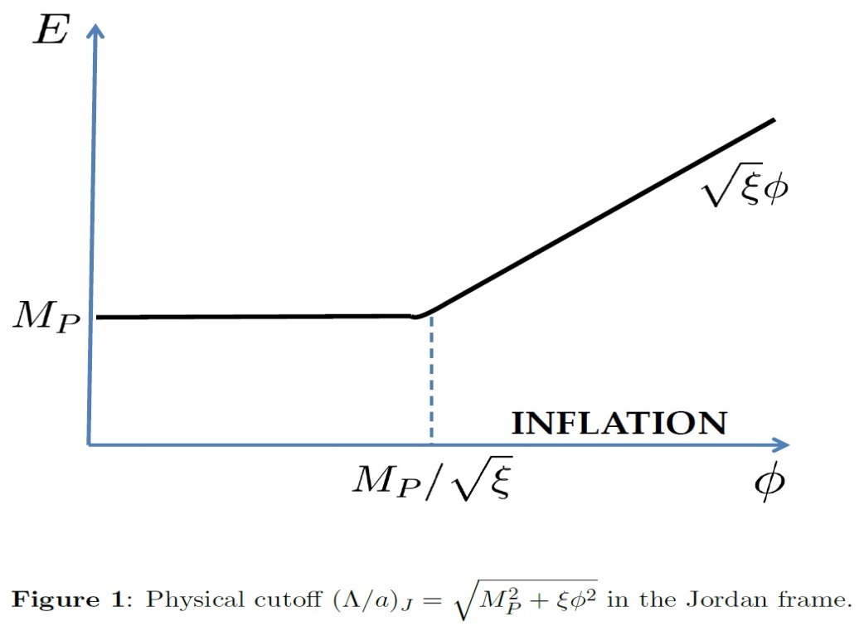
CRITICISM OF BEZRUKOV ET AL
˚13˚
T. Prokopec and J. Weenink, 1403.3219 [astro-ph.CO]
(1) CUTOFF COMPUTATION IS GAUGE (DIFFEO) DEPENDENT
$${\text{m}}_{eff}\left(φ\right)²=−ξ\overline{R}+\frac{d^{2}V(φ)}{dφ^{2}}$$
(naive mass of scalar perturbations: completely wrong!)
(2) REDEFINITION OF FIELDS THAT COUPLES THEM MIXES UP FRAMES
(3) CUTOFF IS NOT(COMPLETELY) FRAME INDEPENDENT
● WE HAVE REVISITED THE PROBLEM FOR SCALAR-GRAVITON CUBIC INTERACTIONS WITHIN FULLY GAUGE INDEPENDENT FORMALISM & OBTAINED:
$\frac{{\text{Λ}}_{J}\text{(}\text{ϕ}\text{)}}{a_{J}}\sim \sqrt{{M_{P}}^{2}+ξφ^{2}}$ = $M_{P,eff}$($φ$),
$\frac{{\text{Λ}}_{E}\text{(}\text{ϕ}\text{)}}{a_{E}}$ $=\frac{M_{P}}{\sqrt{{M_{P}}^{2}+ξφ^{2}}}$ ${\text{☹}}_{J}\left(φ\right)$=$M_{P}$
NB1: THE RESCALING COMES FROM THE RESCALING OF SCALE FACTOR: aJ→aE in Λ/a
NB2: WE HAVE NOT YET INCLUDED
GAUGE-GRAVITON-SCALAR INTERACTIONS

Slide 14
˚14˚
GAUGE INVARIANT PERTURBATIONS

Slide 15
GAUGE INVARIANT PERTURBATIONS
˚15˚
● UNDER COORDINATE TRANSFORMATIONS,
TENSORS AND SCALARS TRANSFORM AS:
$x^{μ}$→${\tilde{x}}^{μ}$(x)=$x^{μ}$+$ξ^{μ}(x)$
${\tilde{g}}_{μν}$($\tilde{x}$) = $\frac{∂x^{α}}{∂{\tilde{x}}^{μ}}$ $\frac{∂x^{β}}{∂{\tilde{x}}^{ν}}$ $g_{αβ}$(x), $\tilde{Φ}$($\tilde{x}$) = $Φ(x)$
● PASSIVE APPROACH: at point
$p∈M: δQ\left(x\right)=Q\left(x\right)−\overline{Q}\left(x\right);$ $δ\tilde{Q}$($\tilde{x}$) = $\tilde{Q}\left(\tilde{x}\right)−\overline{Q}\left(x\right)$
NB: BACKGROUND QUANTITIES ARE FIXED (indep. on coord. transformations)
$Φ\left(x\right)=φ\left(t\right)+φ\left(x\right); φ\left(x\right)→\tilde{φ}$(x) = $φ(x)−\dot{φ}(t)ξ^{0}\left(x\right)$
$g_{μν}(x) →$ ${\tilde{g}}_{μν}$(x) = $g_{μν}(x)$ - $∇_{μ}ξ_{ν}$ - $∇_{ν}ξ_{μ}$ = $g_{μν}(x)$ - $L_{ξ}$ $g_{μν}(x)$
● ACTIVE APPROACH: geometric picture: observable Q on manifold M and $\overline{Q}$ on $\overline{M}$
TWO MAPS $α$ and $\tilde{α}$ (related by diffeo – gauge transform.): map M onto $\overline{M}$
$α:Q→Q_{\overline{M}};$ $\tilde{α}:$ $Q→$ ${\tilde{Q}}_{\overline{M}}$
THEN
${\tilde{Q}}_{\overline{M}}$ = $e^{L_{ξ}}$ $Q_{\overline{M}}$ , $L_{ξ}$ = $\lim_{λ→0}{\frac{1}{λ}}$($α_{∗λ}$Q-Q)
$δQ=$ $λδQ^{(1)}+\frac{1}{2}λ^{2}δQ^{(2)}+O\left(λ^{3}\right); ξ^{μ}=λ {ξ_{}^{μ}}_{(1)}$ $+\frac{1}{2}λ^{2}{ξ_{}^{μ}}_{(2)}+O\left(λ^{3}\right)$
$\tilde{\overline{Q}}=\tilde{Q}; δ{\tilde{Q}}^{(1)}= δQ^{(1)}+L_{ξ^{(1)}}\overline{Q}; δ{\tilde{Q}}^{(2)}= δQ^{(2)}+L_{ξ^{(2)}}\overline{Q}+ {L_{ξ_{}^{(1)}}}_{}^{2} \overline{Q}+2L_{ξ^{(1)}}$ $δQ^{(1)}, etc$
NB: PASSIVE AND ACTIVE APPROACHES GIVE SAME RESULTS TO ALL ORDERS.

Slide 16
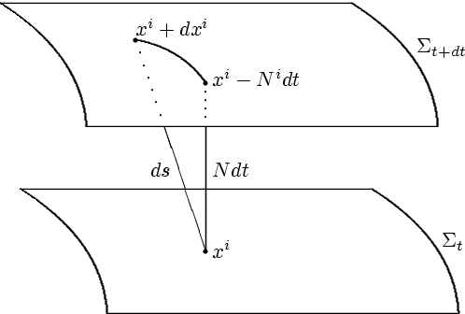
ADM FORMALISM
˚16˚
LAPSE FUNCTION AND SHIFT VECTOR (nondynamical)
$$N\left(x\right)=\overline{N}(t)(1+n(x))$$
$N^{i}\left(x\right)={a\left(t\right)}^{−1}\overline{ N}\left(t\right)[{a\left(t\right)}^{−1}∂_{i}s(x)+{n_{i}}^{T} (x)$]
SPATIAL METRIC AND SCALAR FIELD PERTURBATIONS:
$g_{ij}=a^{2}{(e^{h})}_{ij}$, $Φ=φ\left(t\right)+φ(x$), $h_{ij}=2ζδ_{ij}+\frac{∂_{i}∂_{j}\tilde{h}}{a^{2}}$ + $\frac{∂_{(i}{h^{T}}_{j) }}{a}$ + $γ_{ij}$
GI FIELDS (to linear order):
$γ_{ij}$, ${ γ}_{ii}=0=∂_{i}γ_{ij}$
$w_{ζ}=ζ−\frac{H}{\dot{φ}}φ=−$ $\frac{H}{\dot{φ}}$ $w_{φ}$
$\frac{{n^{T}}_{j}}{a}$ - $\frac{1}{2}\frac{d}{dt}\left(\frac{{h^{T}}_{j}}{a}\right)$, $∂_{j}{n^{T}}_{j}=0=∂_{j}{h^{T}}_{j}$
$\frac{s}{a^{2}}$ - $\frac{1}{2}\frac{d}{dt}\left(\frac{\tilde{h}}{a^{2}}\right)$+$\frac{1}{\acute{φ}}\frac{φ}{a^{2}}$

Slide 17
GAUGE INVARIANT FORMALISM
˚17˚
T. Prokopec and J. Weenink, Phys. Rev. D 82 (2010) 123510, [arXiv:1007.2133 [hep-th]]
● MUKHANOV ACTION FOR GAUGE INVARIANT CURVATURE PERTURBATION
(for GAUGE INVARIANT SCALAR AND TENSOR quadratic perturbations)
$F={M_{P}}^{2}+ξφ^{2}$
$$z^{2}=\frac{{\dot{φ}}^{2}+\frac{3}{2}\frac{{\dot{F}}^{2}}{F}}{{\left(H+\frac{1}{2}\frac{\dot{F}}{F}\right)}^{2}}≡{z_{E}^{}}^{2}\frac{F}{{M_{P}}^{2}}=\frac{{\dot{φ_{E}}}^{2}}{{H_{E}}^{2}}\frac{F}{{M_{P}}^{2}}$$
NB: $W_{ζ}$AND ${\tilde{γ}}_{ζij}$ARE GAUGE INVARIANT SCALAR AND TENSOR PERTURBATIONS, GENERALIZED TO 2nd ORDER IN GAUGE TRANSFORMATIONS $ξ^{μ}$: $x^{μ}$→$x^{μ}+ξ^{μ}(x)$
$W_{ζ}←w_{ζ}{=ζ\left(x\right)−\frac{H}{\dot{φ}}φ\left(x\right), g}_{ij}=a^{2}e^{2ζ}δ_{ij}$, $Φ=φ\left(t\right)+φ(x$)
NB2: GAUGE INVARIANT LAPSE FUNCTION AND
SHIFT VECTOR (OF ADM FORMALISM) DECOUPLE
(to all orders in perturbations!)
AND THUS CAN BE DISCARDED!
LAPSE:
$$N\left(x\right)=\overline{N}(t)(1+n(x))$$
SHIFT:
$N^{i}\left(x\right)={a\left(t\right)}^{−1}\overline{ N}\left(t\right)[{a\left(t\right)}^{−1}∂_{i}s(x)+{n_{i}}^{T} (x)$]

Slide 18
GAUGE INVARIANT CUBIC ACTION
˚18˚
T. Prokopec and J. Weenink, JCAP 1309 (2013) 027 [arXiv:1304.6737 [gr-qc]]
JCAP 1212 (2012) 031 [arXiv:1209.1701 [gr-qc]]
● CUBIC GAUGE INVARIANT ACTION FOR SCALAR & TENSOR PERTURBATIONS:
$$z^{2}=\frac{{\dot{φ}}^{2}+\frac{3}{2}\frac{{\dot{F}}^{2}}{F}}{{\left(H+\frac{1}{2}\frac{\dot{F}}{F}\right)}^{2}}≡{z_{E}^{}}^{2}\frac{F}{{M_{P}}^{2}}=\frac{{\dot{φ_{E}}}^{2}}{{H_{E}}^{2}}\frac{F}{{M_{P}}^{2}}$$
$F={M_{P}}^{2}+ξφ^{2}$
VERTICES:
CUBIC
SCALAR
SCALAR-
SCALAR-
TENSOR
SCALAR-
TENSOR-
TENSOR
CUBIC
TENSOR

Slide 19
GAUGE INVARIANT CUTOFF SCALE
˚19˚
T. Prokopec and J. Weenink, e-Print: arXiv:1403.3219 [astro-ph.CO]
● CONSIDER 2-2 TREE SCATTERINGS (INVOLVING SCALARS ONLY):
USING CANONICALLY NORMALIZED FIELDS:
ONE GETS THE CUBIC SCALAR ACTION:
$$V_{V_{ζ}V_{ζ}V_{ζ}}\sim \frac{ε_{E}max⁡[{E_{c}}^{2},{\left\|\vec{k}\right\|}^{2}]}{a\sqrt{F}}$$
AND SCALAR VERTEX:
AND SCATTERING AMPLITUDE:
$A_{ss→ss}\sim \frac{max⁡[{E_{c}}^{2},{\left\|\vec{k}\right\|}^{2}]}{Λ^{2}}\sim \frac{{V_{V_{ζ}V_{ζ}V_{ζ}}}^{2}}{max⁡[{E_{c}}^{2},{\left\|\vec{k}\right\|}^{2}]}⇒ {\left(\frac{Λ}{a}\right)}_{J}\sim \sqrt{\frac{{M_{P}}^{2}+ξφ^{2}}{ε_{E}}}≳\sqrt{{M_{P}}^{2}+ξφ^{2}}$
ANALOGOUS RESULTS ARE OBTAINED FOR OTHER PARTS OF CUBIC ACTION.

Slide 20
˚20˚
SOLUTION TO THE UNITARITY PROBLEM

Slide 21
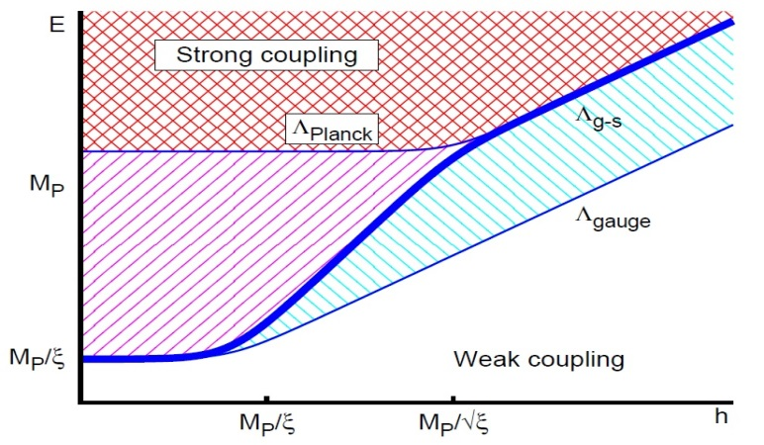
SUMMARY OF OUR RESULTS
˚21˚
T. Prokopec and J. Weenink, e-Print: arXiv:1403.3219 [astro-ph.CO]
● IN SCALAR-TENSOR SECTOR OF HIGGS INFLATION WE GET IN J- & E-FRAME:
$\frac{{\text{Λ}}_{J}\left(φ\right)}{a_{J}}≥\sqrt{{M_{P}}^{2}+ξφ^{2}}$ = $M_{P,eff}$($φ$),
$\frac{{\text{Λ}}_{E}\left(φ\right)}{a_{E}} =\frac{M_{P}}{\sqrt{{M_{P}}^{2}+ξφ^{2}}}$ ${\text{☹}}_{J}\left(φ\right)$=$M_{P}$
THE PHYSICAL CUTOFF IS GIVEN BY
THE PLANCK SCALE IN THAT FRAME.
THE DIFFERENCE BETWEEN THE FRAMES CAN BE
EXPLAINED BY THE FRAME DEPENDENCE OF THE CUTOFF:
$$\frac{a_{E}}{a_{J}}=\frac{\sqrt{{M_{P}}^{2}+ξφ^{2}}}{M_{P}}$$
Q: WHAT ABOUT GAUGE INTERACTIONS?
RECALL THE Bezrukov, Magnin, Shaposhnikov Sibiryakov RESULT

Slide 22
GAUGE INTERACTIONS
˚22˚
● TYPICAL VERTICES THAT MAY CAUSE UNITARITY PROBLEMS:
Burgess, Lee, Trott, 1002.2730
Bezrukov, Magnin, Shaposhnikkov, Sibiryakov, 1008.5157
WORK IN PROGRESS!!

Slide 23
˚23˚
CONCLUSIONS AND OPEN PROBLEMS

Slide 24
DISCUSSION
˚24˚
HIGGS INFLATION IS PERTURBATIVE UP TO THE PLANCK SCALE (in the scalar and tensor sector), HENCE THERE IS NO UNITARITY PROBLEM
TO ARRIVE AT THIS CONCLUSION IT WAS ESSENTIAL TO USE A GAUGE AND FRAME INVARIANT FORMULATION (even though the same conclusion can be reached in a gauge dependent framework).
ONE SHOULD EXTEND THE ANALYSIS TO GAUGE INTERACTIONS,
AND POSSIBLY QUARTIC INTERACTIONS.
IN OUR WORK WEENINK AND I HAVE SHOWN UNIQUENESS (up to boundary terms) OF G.I. CUBIC ACTION FOR INFLATION WITH NON-MIN COUPLED INFLATON.
WITH G.I. QUARTIC ACTION, ONE COULD UNAMBIGUOUSLY STUDY QUANTUM (LOOP) EFFECTS DURING INFLATION.
THE ROLE OF THE BOUNDARY TERMS NEEDS TO BE STUDIED (especially for non-Gaussianities).
Notes:
24

