Slide 1
Nanoantennas for ultrabright single photon sources
R. Filter, K. Słowik, J. Straubel, F. Lederer, and C. Rockstuhl
Institute of Condensed Matter Theory and Solid State Optics
Abbe Center of Photonics
Friedrich-Schiller-Universität Jena, Germany
robert.filter@uni-jena.de
Notes:
2

Slide 2
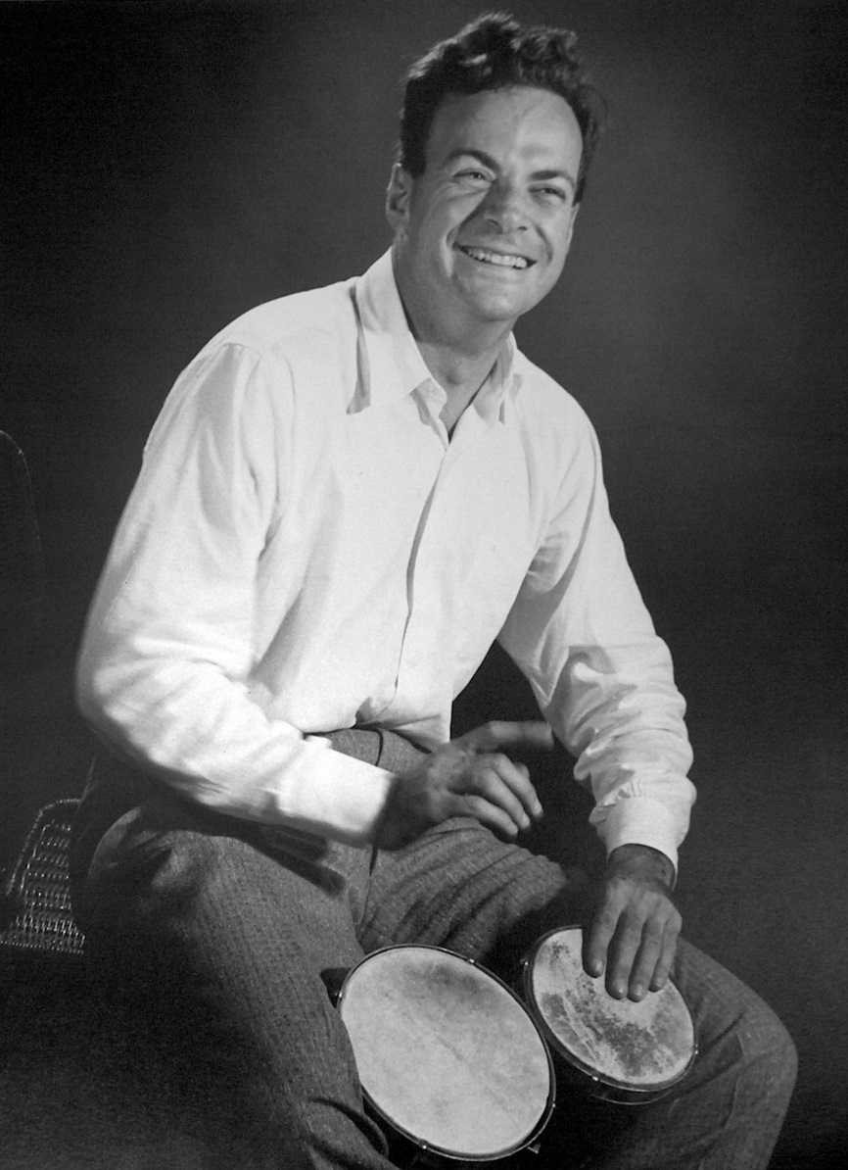
Feynman’s Dream
„There‘s Plenty of Room at the Bottom“
Feynman, Caltech 1959
goal: arrange atoms on the nanoscale
new opportunities for design
laws of quantum mechanics
Conclusion:
Nanoantennas – a dream becoming reality

Slide 3
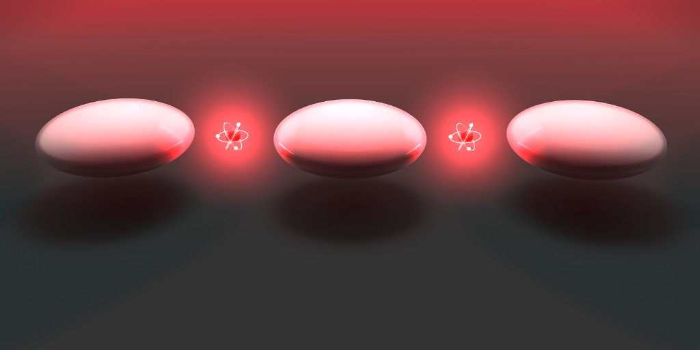
Outline
Nonclassical light basics
Nanoantennas for ultrabright single photon sources

Slide 4
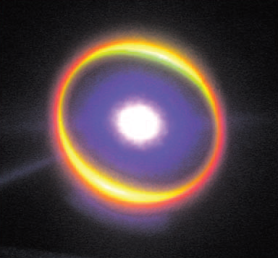
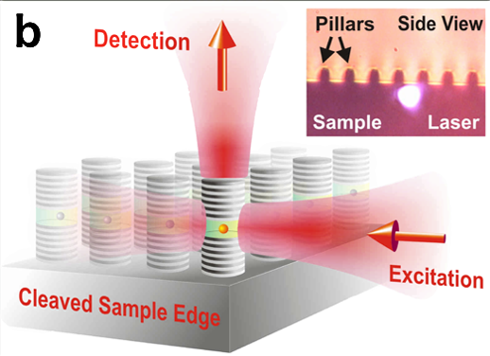
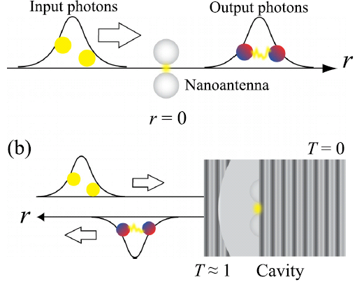
Nonclassical Light
light properties that cannot be explained using classical theories
squeezed light
single photons
entanglement
Han et al, Appl. Phys. Lett. 92 (2008)
Ates et al., Phys. Rev. Lett. 103 (2009)
Oka, Appl. Phys. Lett. 103 (2013)
nonlin. vs. loss time scales
coupling to non-bosonic systems
enhanced emission
via interaction of quantum systems

Slide 5
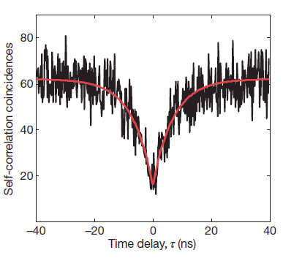
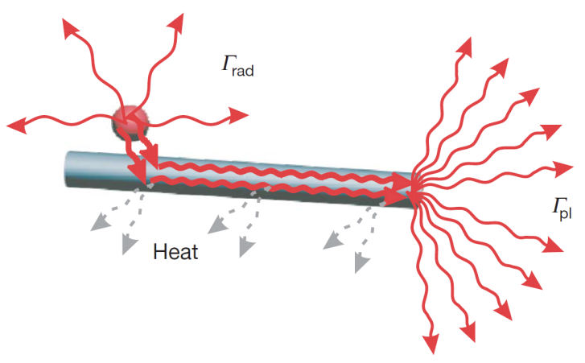
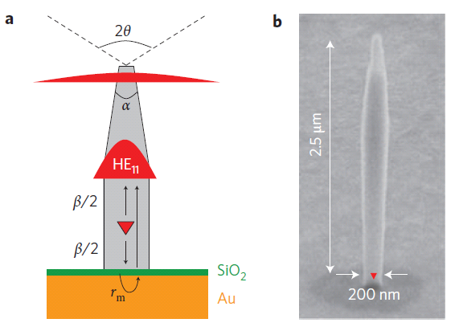

Nanostructures: Single Photon Sources
enhanced single-photon em.
quantum properties survive
Akimov et al., Nature 450 (2007)
Goal: Ultra-bright integrated
single-photon sources
quantum computation
quantum Cryptography
single-photon interactions
…
Claudon et al., Nat. Phot. 4 (2010)

Slide 6
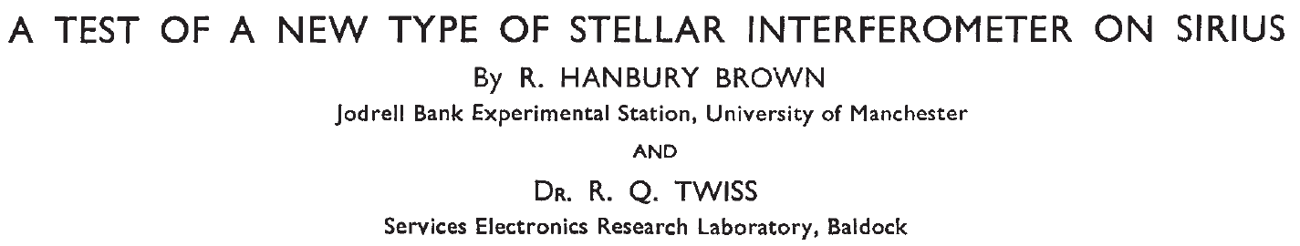
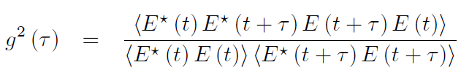
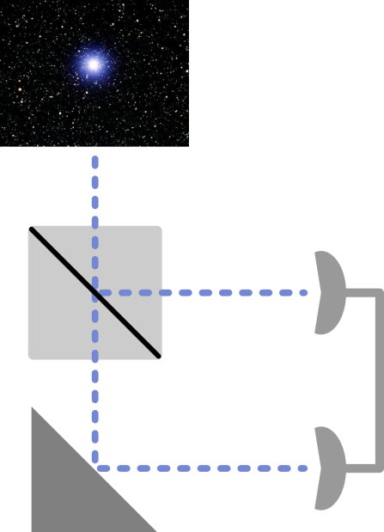
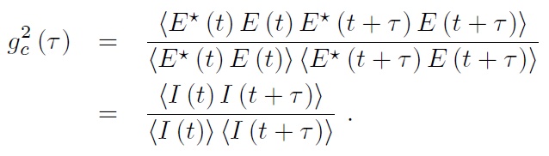




Single-Photon Source Characterization – g²(τ)
Usual quantification: second-order
correlation function
Why? Compare possible classical and quantum values.
Classically: Order not impartant:
at :

Slide 7

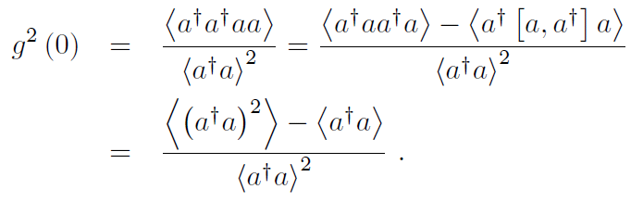
Quantum g²(τ)
Cannot ignore order of operators!
assumption: single mode field (otherwise summation)

Slide 8

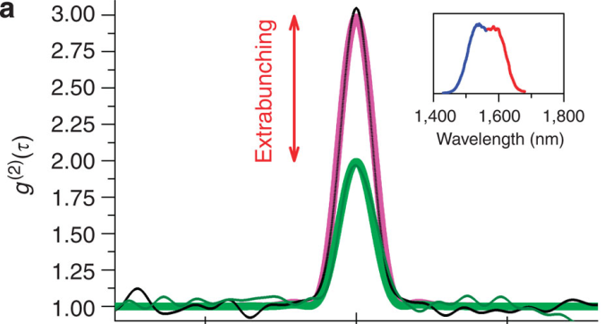
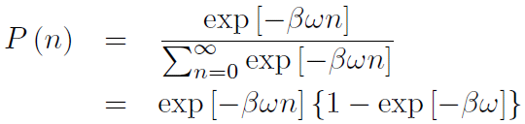
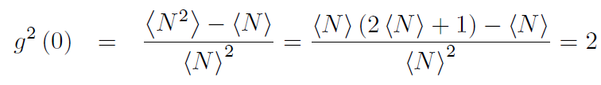
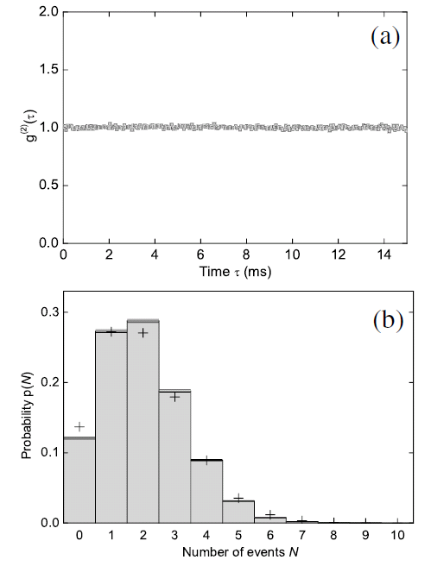
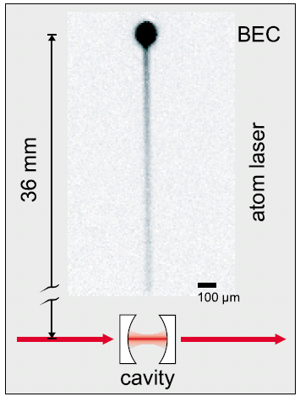




Quantum g²(τ) - examples
Thermal Radiation:
(Boltzmann)
Boitier et al., Nat. Comm. 2 (2011)
Coherent Radiation:
(Poisson)
interpretation: the photons arrive in bunches
Öttl et al., Phys. Rev. Lett 95 (2005)

Slide 9


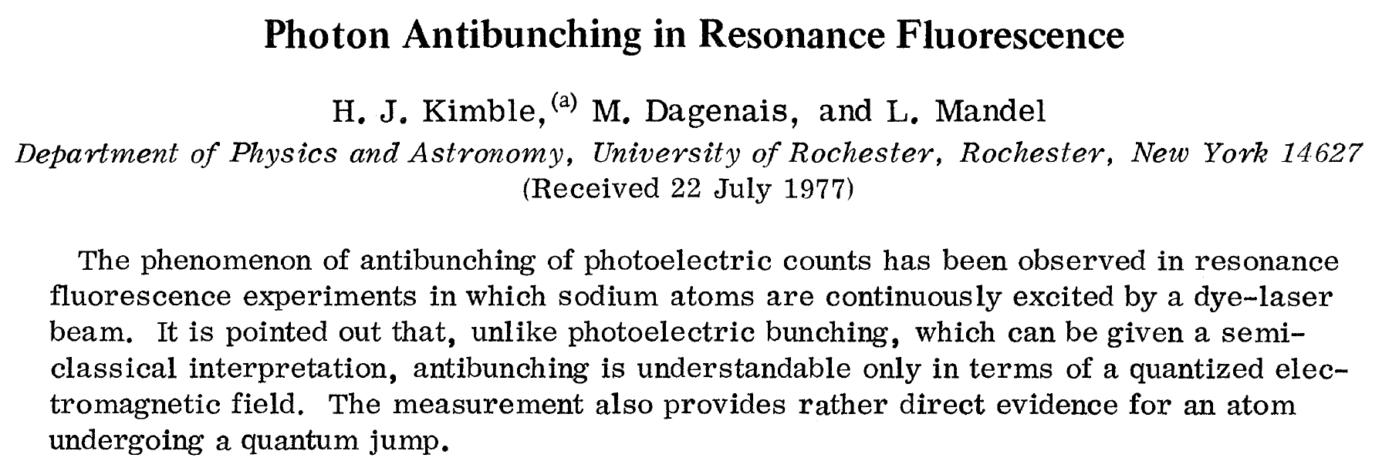
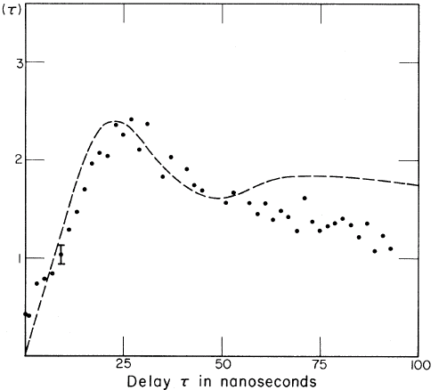
Quantum g²(τ) - examples
n-photon source:
all light is in the n‘th (Fock) state:
n = 1: g²(0) = 0! no classical analogon – antibunching
Kimble et al., Phys. Rev. Lett. 39 (1977)

Slide 10
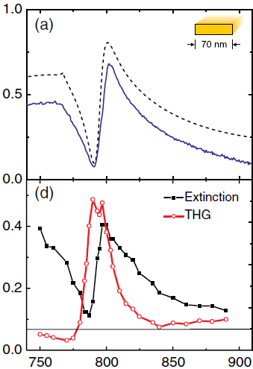
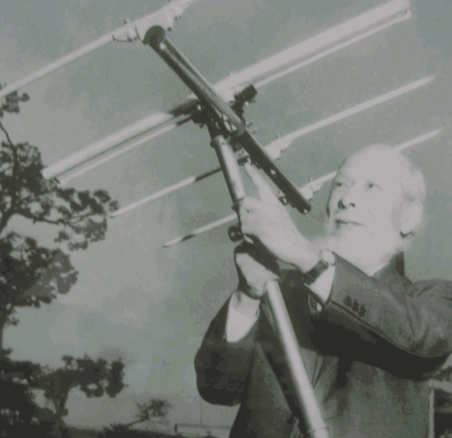
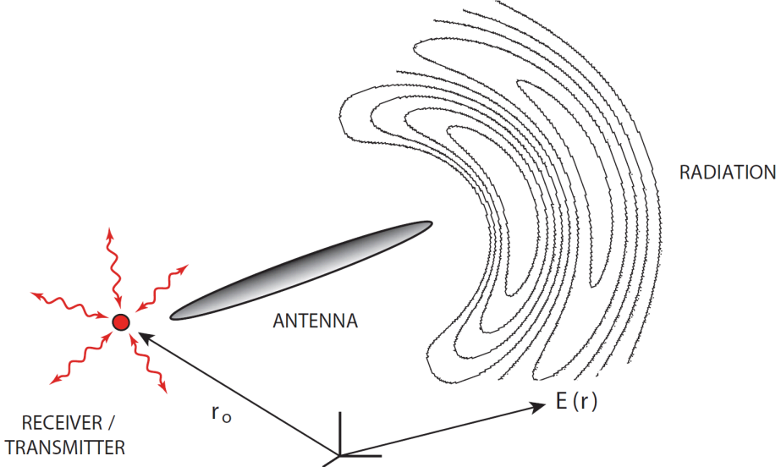
Why Nanoantennas for Single-Photon Sources?
Far field ↔ Near field (passive):
enhanced interaction
Nonlinear Processes (aktive)
H. Yagi & S. Uda, 1926
Utikal et al., Phys. Rev. Lett. 106 (2011)
Bharadwaj et al, Adv. Opt. Phot. 1 (2009)

Slide 11
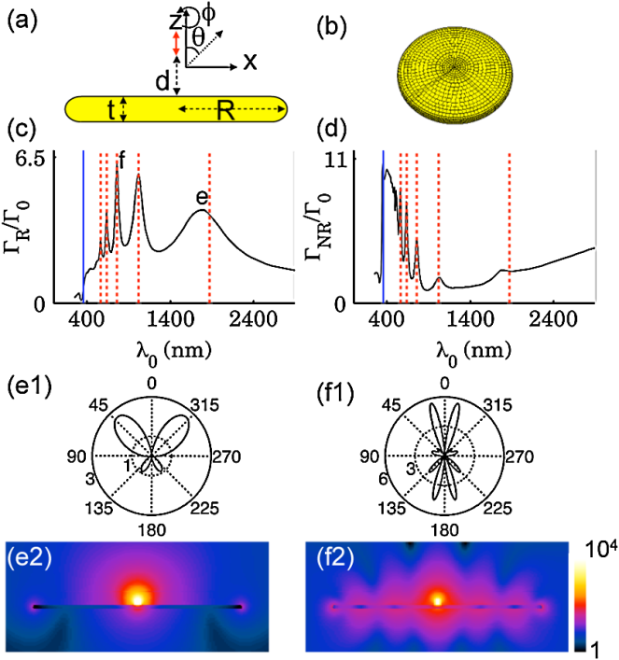
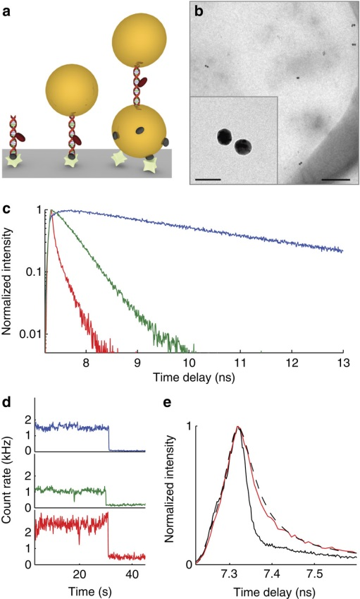
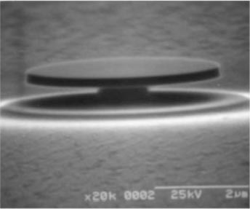
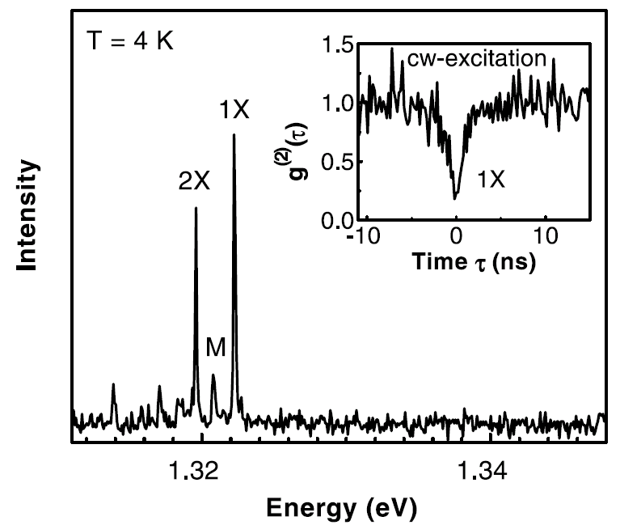
Esteban et al., Phys. Rev. Lett. 104 (2010)
sub GHz
Busson et al., Nat. Comm. 4 (2012)
Michler et al., Science 290 (2000)
main aspects: Emission Rate & Nonclassicality

Slide 12
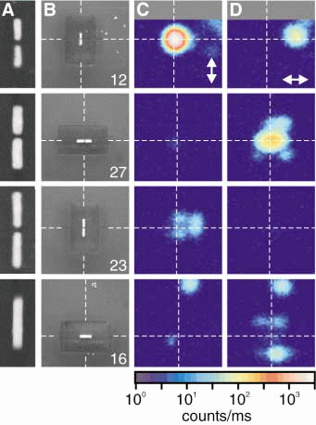
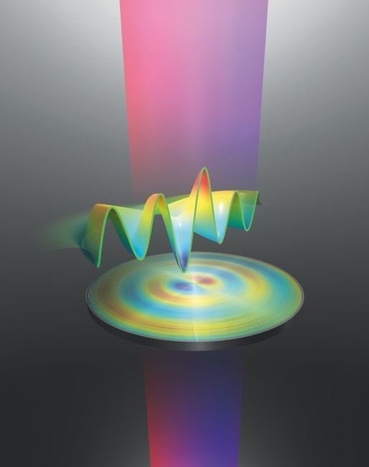
Characteristics of Nanoantennas
Size
Receiver/Emitter
Description
Mühlschlegel et al., Science 308 (2005)
Filter et al., Phys.Rev.B 85 (2012)
Akimov et al., Nature 450 (2007)

Slide 13
nonclassical light properties:
nanoantenna quantization inevitable

Slide 14
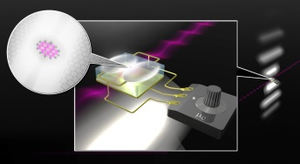
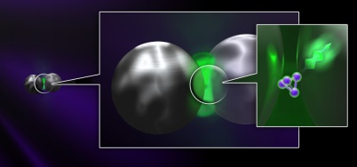
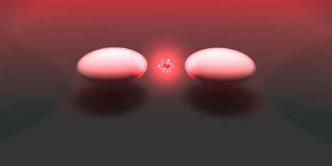
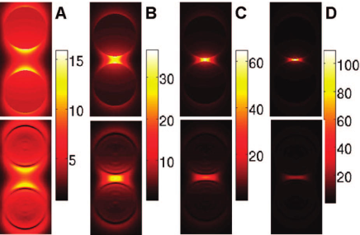
Nanoantenna & Quantum System Interaction
Semiclassical Description
back-action of quantum system negligible
Filter et al., Opt. Expr. 21 (2013) & Phys. Rev. B 86 (2012)
Cavity QED description
back-action of quantum system taken into account
nonclassical field dynamics
Słowik, Filter et al., Phys. Rev. B 88 (2013)
Time Dependent Density Functional Theory treatment
exhaustive and demanding
internal properties of nanoantenna, “exact” near-field
Zuolaga et al., Nano Lett. 9 (2009)

Slide 15
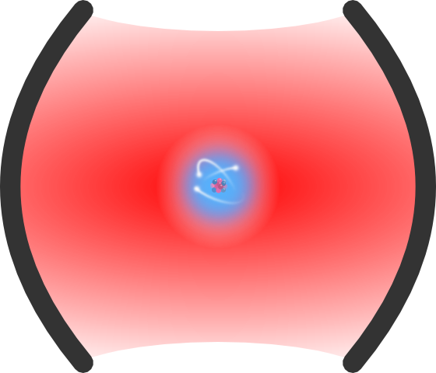
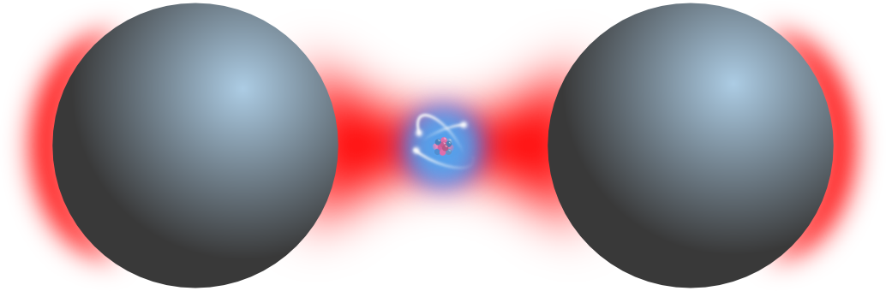
Nanoantenna cQED
cQED working horse: atom in a cavity
Parameters:
loss rate Γ
coupling constant ϰ
cavity and atom frequencies ω_{c} & ω_{at}
Nanoantennas can be treated similar
Loss rate Γ = Γ_{rad} + Γ_{diss}
coupling constant ϰ
nanoantenna mode and atom frequencies ω_{na} & ω_{at}
assumption: bosonic excitation, i.e. harm. oscillator

Slide 16
Cavity Quantization also for Nanoantennas?
cQED approach appealing vs involved Green‘s function quantization
open cavity: losses!
  Mode usage justified? Yes, quasinormal modes
  Basics: Ching et al., Rev. Mod. Phys. 70 (1998), plasmonics calculations: de Lasson et al., JOSA B 30 (2013)
  quantization not trivial
approximate determination:
eigenmode frequency ω_{n} via scattering analysis
normalize scattered near fields to energy ħω_{n} → E_{n}(r) & B_{n}(r)
calculate loss rates via Poynting‘s theorem
e.g. dipole interaction:
Słowik, Filter et al., Phys. Rev. B 88 (2013)

Slide 17
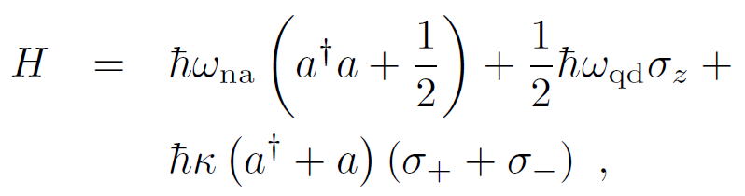
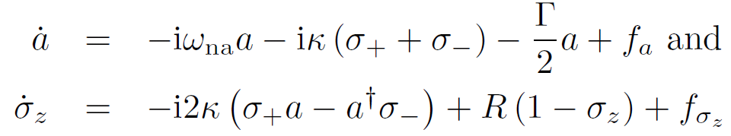


Single-Photon Sources – Real Quantum Approach
Is it possible to build a miniaturized ultra-bright single photon source with nice nonclassical properties?
Answer so far: of course, just a matter of high Purcell factor!
But: Things are not that easy… Need fully quantum approach!
Quantum dot coupled to nanoantenna
in cQED formalism, Jaynes-Cummings
Heisenberg picture with incoherent pump of QD and loss of nanoantenna:
Filter et al., Opt. Lett. 39 (2014)

Slide 18
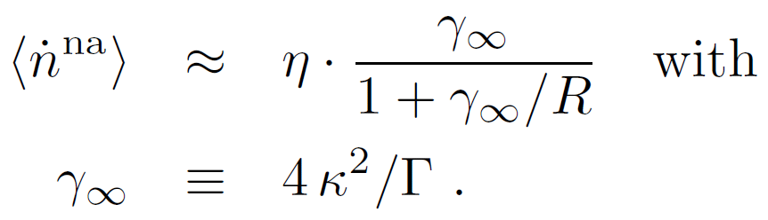





Quantum Single Photon Source – Emission rate
cold reservoir solution:
with nanoantenna efficiency
Purcell factor connection:
Two limiting cases of R vs. :
weak pump:
strong pump:
But usually far away
from strong pump!
Emission Rate: Purcell & pumping rate
Filter et al., Opt. Lett. 39 (2014)

Slide 19
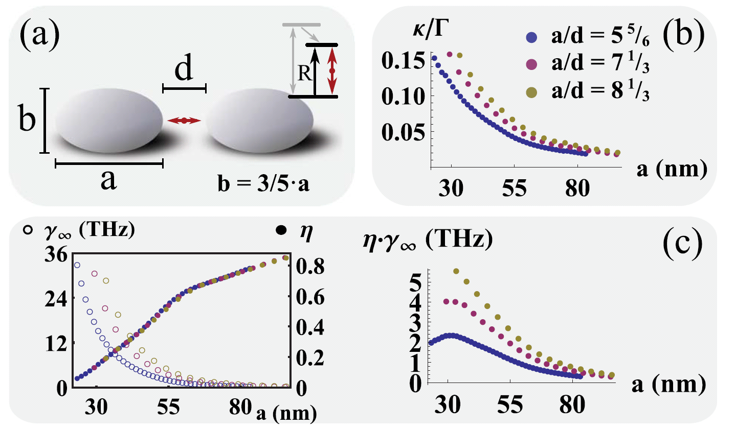
Nanoantenna Design
two-ellipsoid nanoantennas, varying conformal ratios a/d
parameter determination
trade-off: efficiency vs. coupling strength
Filter et al., Opt. Lett. 39 (2014)

Slide 20

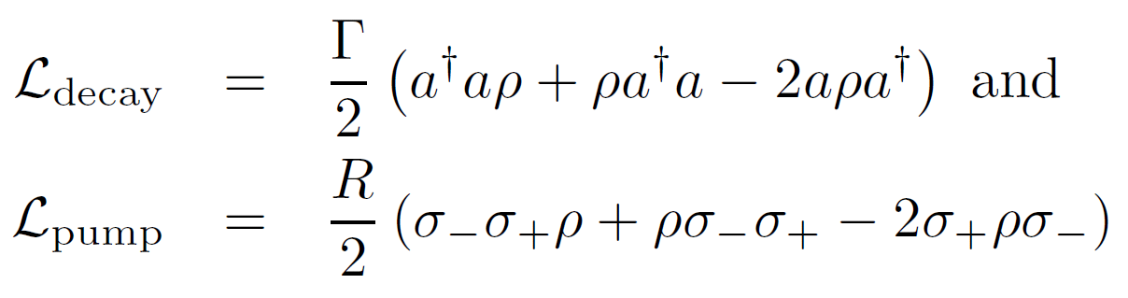
Quantum Calculations
density matrix formulation
include losses
All quantum observables can be calculated!
Filter et al., Opt. Lett. 39 (2014)

Slide 21
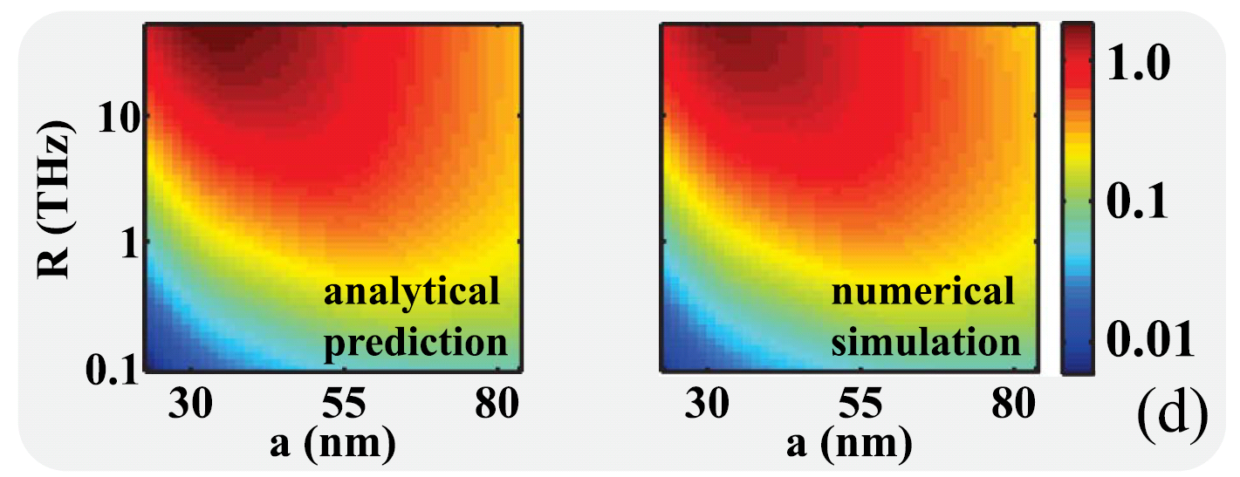
Emission Rate Theory Check
vs. fully quantum computation
Filter et al., Opt. Lett. 39 (2014)

Slide 22
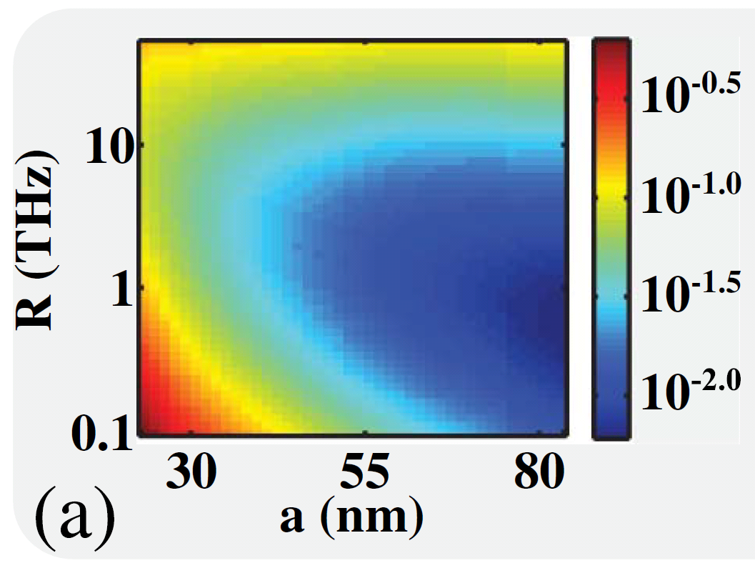
Check for nonclassicality – quantum simulations
trade-off: Purcell factor vs. g²(0)
Filter et al., Opt. Lett. 39 (2014)

Slide 23
Conclusion
Plasmonics:
Electrical engineering – nanoantenna design
Nanofabrication – physical, chemical
Nanophotonics – theoretical description
Quantum optics
nanoantenna cQED:
parameters from classical simulations
true quantum phenomena

Slide 24
Appendix

Slide 25
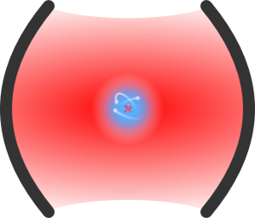

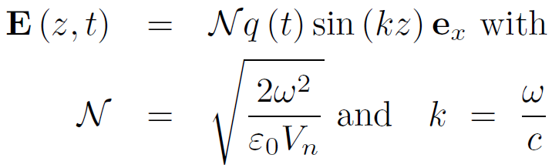
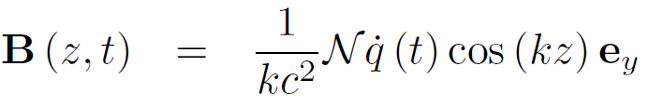

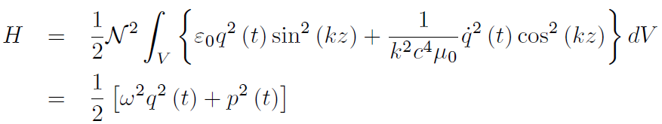
Cavity Quantization in a Nutshell I
Single-mode cavity, Volume
Hamilton function from energy density and with Hamilton eqs:

Slide 26

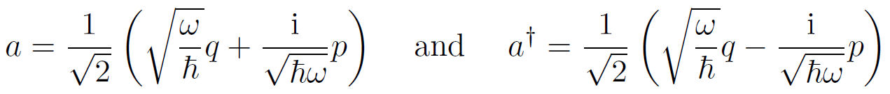
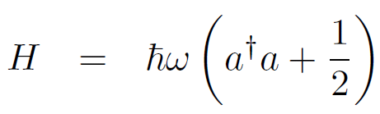

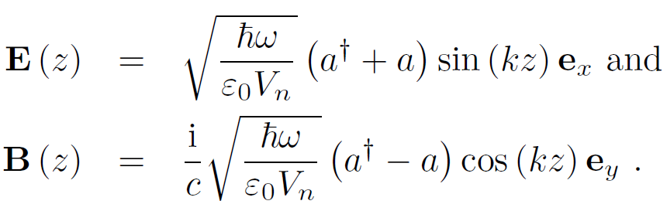
Cavity Quantization in a Nutshell II
Canonical commutation relation
→ annihilation & creation operators
→ Hamilton & interactions
: fully quantum fields:

Slide 27



Squeezed Light - Heisenberg
Heisenberg:
with std. deviation
example:
Possibility: improve one standard deviation at cost of the other
- ex.: defined state with respect to position, but high uncertainty in momentum
Squeezed states: amplitude vs. phase deviation trade-off

Slide 28







Squeezed Light - Operators
Quadrature Operators:
Connection to amplitude and phase:
Squeezed State:

Slide 29





Squeezed State Generation - Theory
Squeeze Operator:
Squeezed vacuum state
Variances of quadrature operators, squeezing strength ~ r:
i.e. amplitude squeezing for

Slide 30



Squeezed State Generation - Physics
Two different nonlinear effects are used to generate squeezed states:
degenerate parametric down conversion
degenerate four-wave mixing
Connection to squeezed states:
assume coherent (classical) state in pump b, with amplitude β
define and
interaction can be written as
Unitary time evolution: squeezed states

Slide 31
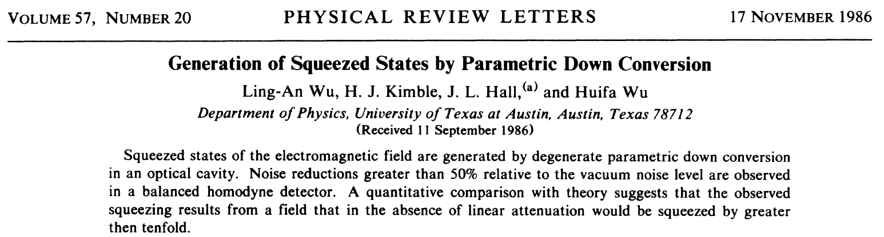

Squeezed states – Opportunities?!
cavity polaritons – strong nonlinearity
Nanoantennas?
Nonlinearities vs. losses very small
negligible squeezing
Karr et al, Phys. Rev. A 69 (2004)

