Slide 1


Computing in LHC
José M. Hernández
CIEMAT, Madrid
Taller Altas Energías 2014
Benasque, septiembre 2014

Slide 2
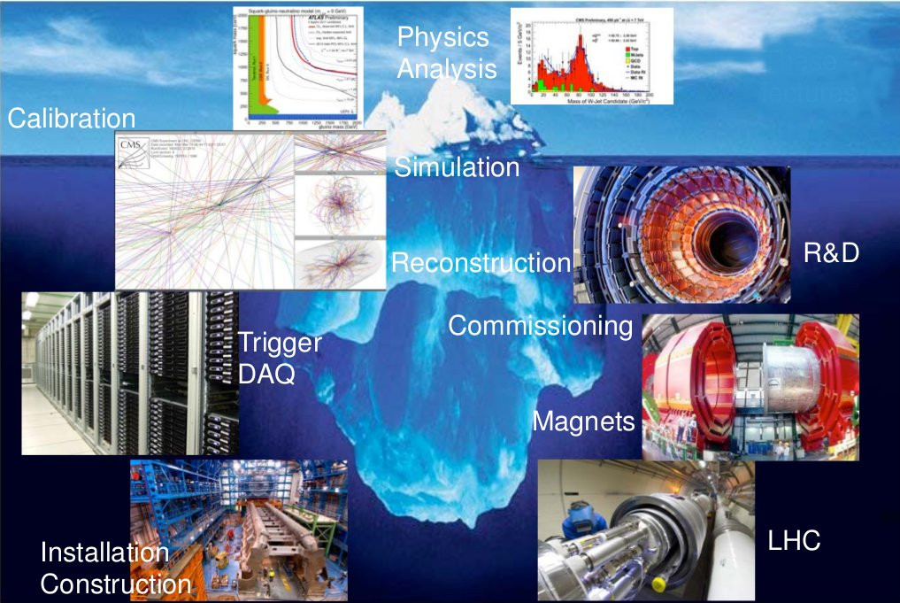
Experimentación en Física de Partículas
Computing

Slide 3
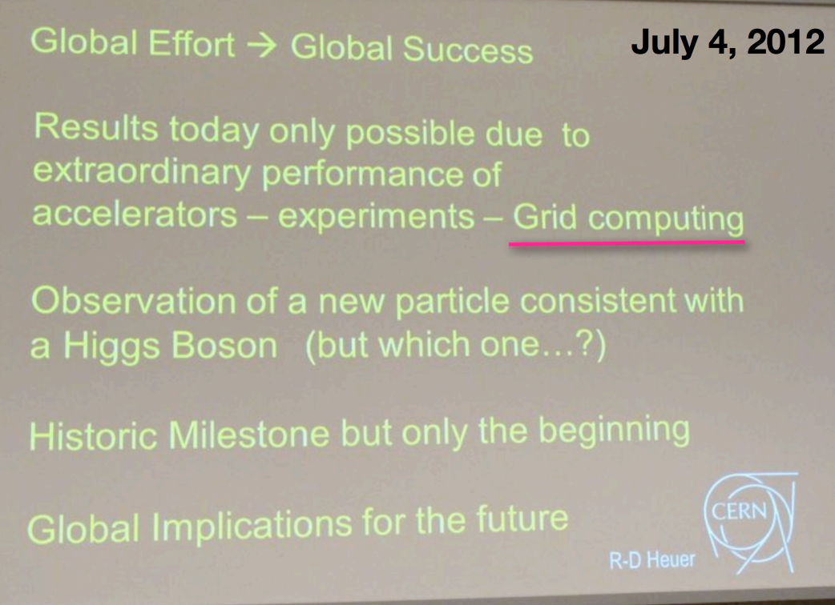
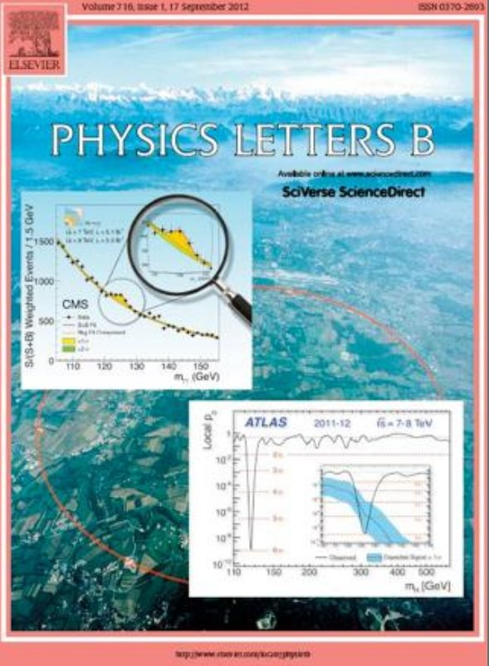

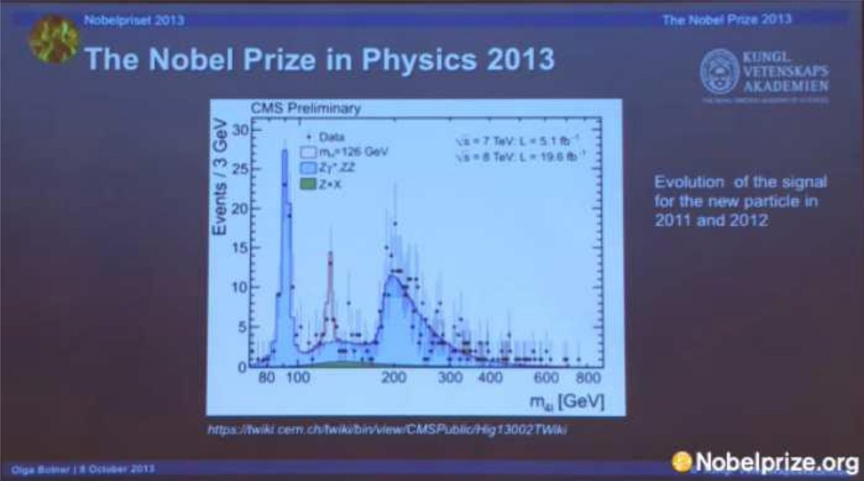
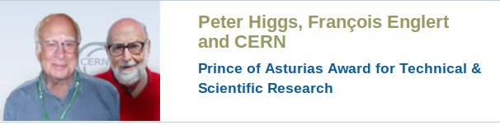
Global effort, global success

Slide 4
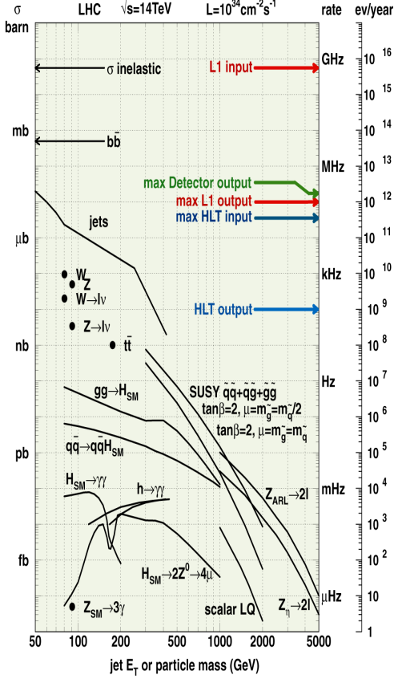
Lots of collisions in LHC
Low production probability for new physics (e.g. Higgs boson)
  Higher collision energy, higher production probability: 7,8 ➔ 13,14 TeV
Highest possible collision rate
  Proton flux (instantaneous luminosity)
  ~3000 bunches of ~10¹¹ protons, transversal section ~10 μm, that cross every 25 nanoseconds (40 MHz)
  ~25 collisions per bunch crossing
Collision rate in LHC: ~1 GHz
New Physics production rate: ~mHz
~1 out of 1.000.000.000.000
needs to be filtered

Slide 5
Data volume
Were all collisions stored, the data volume would be huge
  Average event size: ~ 1 Mbyte
  Number of events/s = 40 MHz
~ 1MB/event x 40x10⁶/s = 40 TB/s
(0.4 Zettabyte/year)
The interesting events need to be filtered in real time down to a manageable rate
➔ “Trigger”

Slide 6
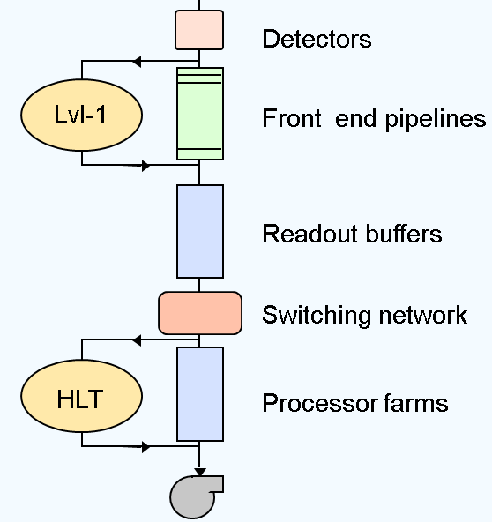
Trigger system
Nowadays we use a very complex electronic system
Multi-level, data buffering, parallel processing
First Level Trigger
  Specialized hardware processors
  Limited information, simple algorithms
  40 MHz → 100 kHz
  3.2 μs latency (128 pipeline), ~100 GB/s throughput
High Level Trigger (software)
  Linux PC farm
  Flexible software algorithms
  100 kHz → 300 Hz
  ~50 ms latency (5000 processors)
40 MHz
100 kHz
300 Hz
40 TB/s
100 GB/s
300 MB/s

Slide 7
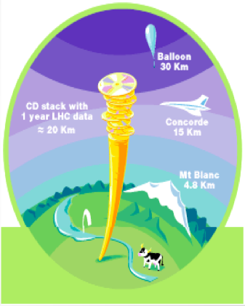
Lots of data
Trigger accept rate: ~300 Hz
Annual data volume:
1 MB/event ×
300 events/s ×
10⁷ s/year =
3.000.000 Gbytes/year =
3 Pbyte/year

Slide 8
That’s a lot of data!
  LEP, 1989-2000
    In more than a decade, LEP generated less than 1 per mille of 1 year-worth LHC data
  Tevatron, 1983-2011
    It generated during its lifetime ~25% of 1 year-worth LHC data

Slide 9
The challenge of LHC data
Reconstruction and analysis add a new challenge to the data management
  Raw data must be processed (reconstruction). This process generates a similar data volume
Simulated data must be generated in order to understand the detector response, study predictions from theoretical models, compare with real data, etc
In total, ~10-20 PB of data are produced annually per LHC experiment
Reconstruction, simulation and analysis involve complex calculations that require a large amount of compute resources equivalent to hundreds of thousands of PCs

Slide 10
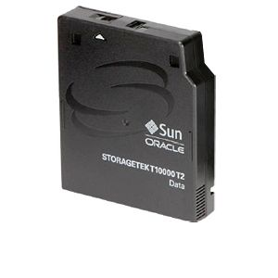
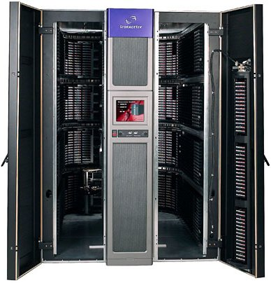
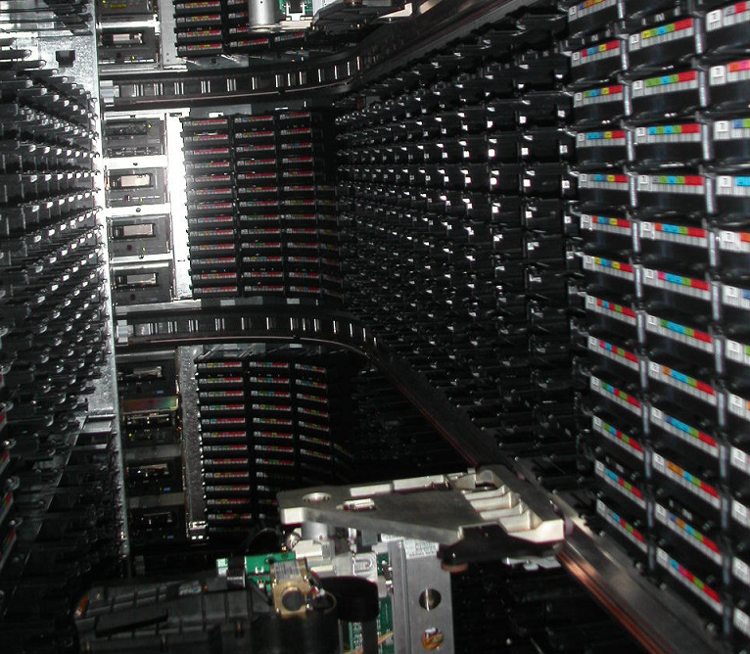
Storage on magnetic tape
Nowadays, in a magnetic tape of about 10 x 10 x 2 cm up to 5 TeraBytes of data can be stored
To manipulate tapes in an efficient way, robotic tape libraries are used to locate/allocate and read/write data

Slide 11
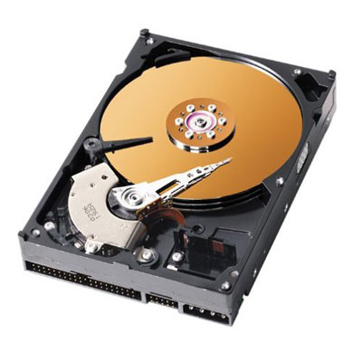
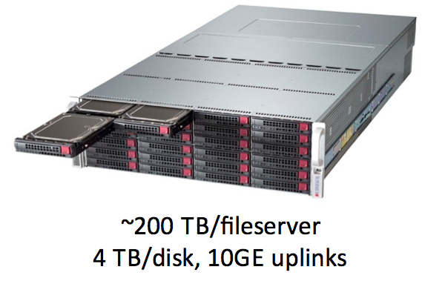
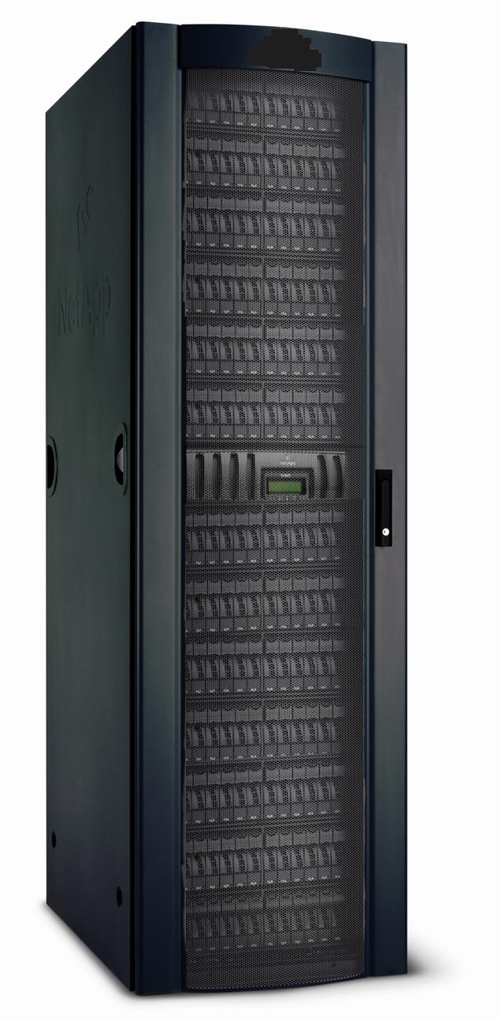
Storage on hard disks
Nowadays, hard disks in disk servers have a typical capacity of 4 TeraBytes

Slide 12
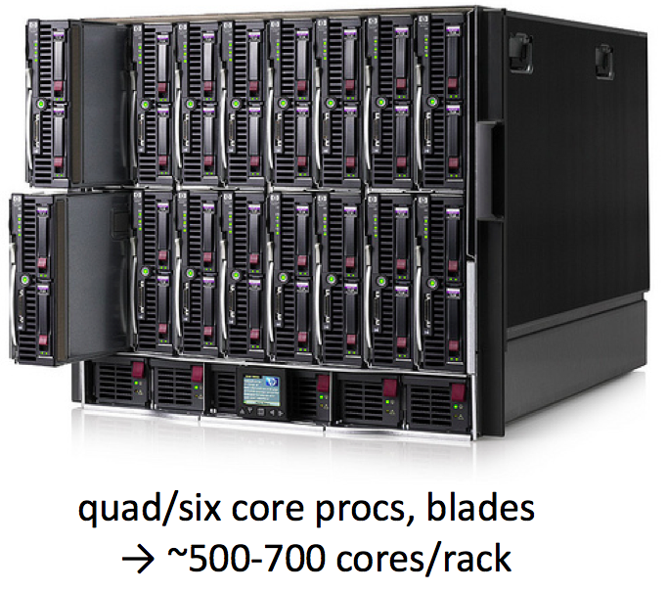
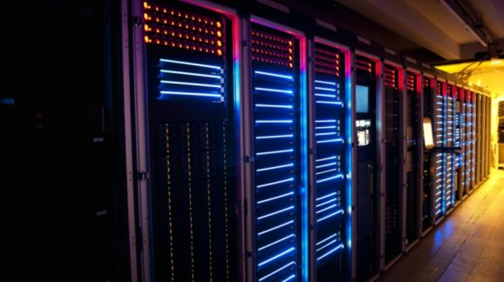
Compute servers

Slide 13
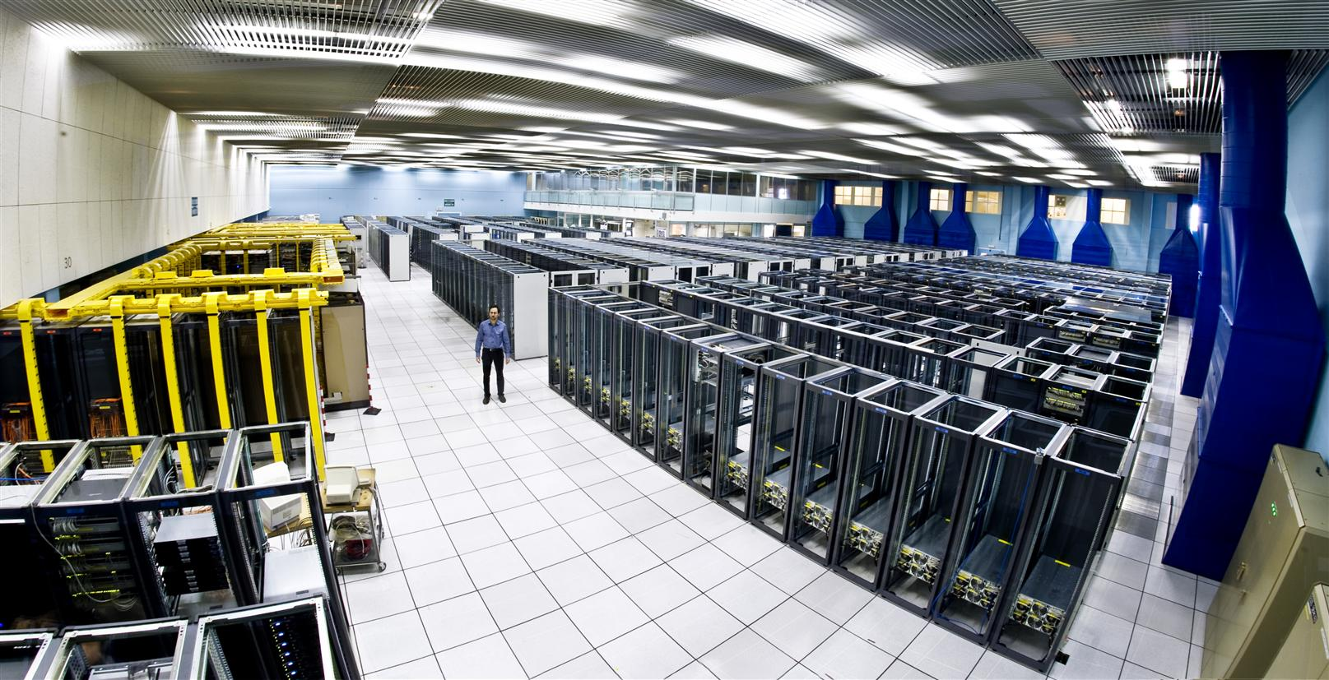
CERN Computing center

Slide 14
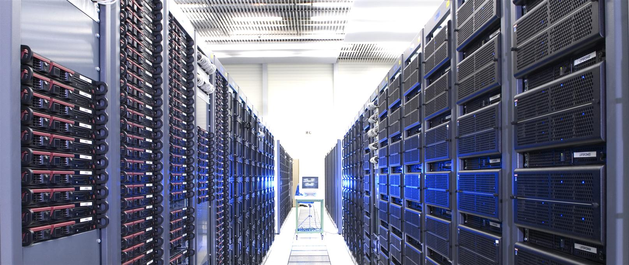
CERN Computing center

Slide 15
Divide and rule
The problem of HEP data processing and analysis can be divided and distributed
  Each registered event can be processed independently
A super-computer is not necessary
  Very expensive facilities and with difficult access
  Typically used for running a single complex application that can be parallelized and execute in many nodes simultaneously, requiring a high speed and low latency internal network between nodes and common access to memory ➔ High Performance Computing
  Stringent requirements of memory, processing, speed
  Applications in meteorology, nuclear fusion, etc

Slide 16
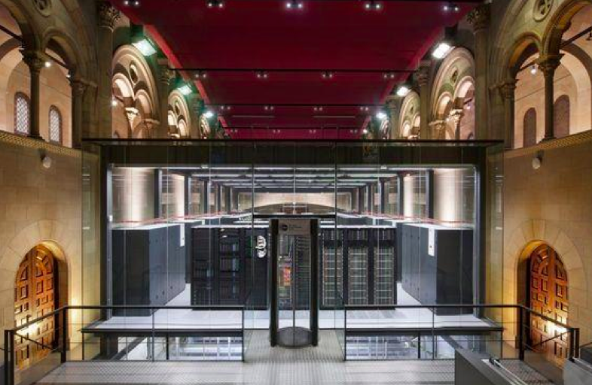
Barcelona supercomputing center

Slide 17
High Throughput Computing
The computing and memory requirements to execute a data processing application in LHC are modest
Commodity hardware (e.g. ordinary PCs) can be used
  Provision of computing resources becomes affordable
What matters is the aggregate result of processing billions of events executing hundreds of thousands of jobs
High Throughput Computing
Proposal for the processing and analysis of LHC data:
  Let’s use computing resources available at the institutions participating in the LHC experiments
  Let’s develop a system to federate those heterogeneous and dynamic resources

Slide 18
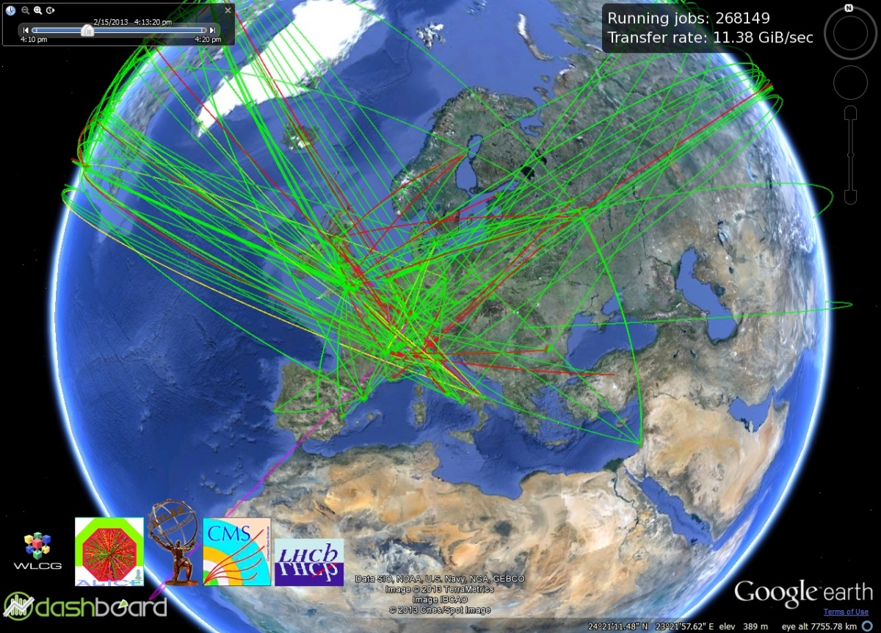
Grid Computing
The Worldwide LHC Computing Grid (WLCG)
In LHC data are stored, processed and analyzed in a worldwide web of computing centers interconnected through Internet
1er servidor web (www) – CERN 1991

Slide 19
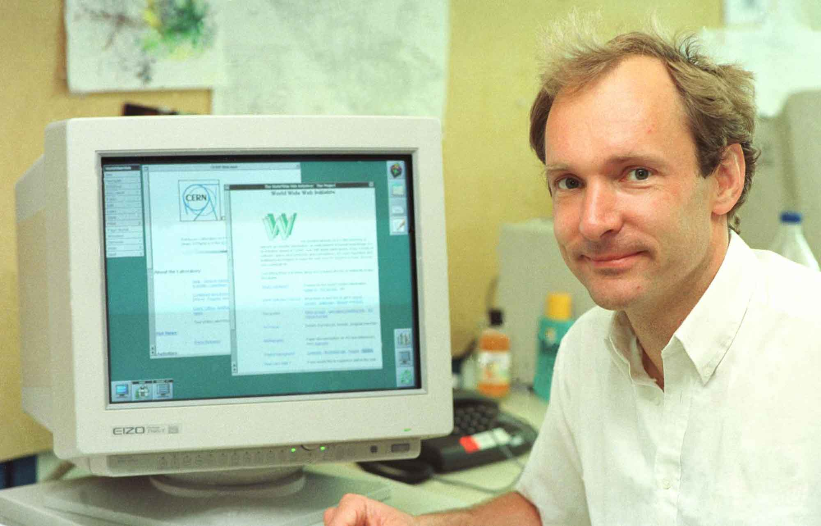
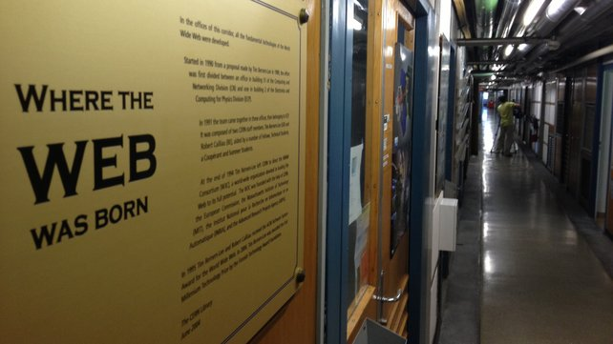
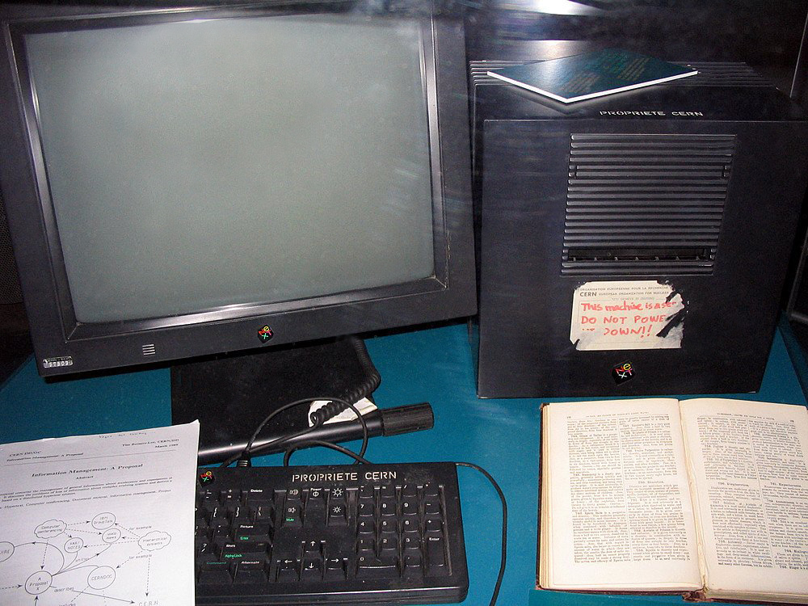

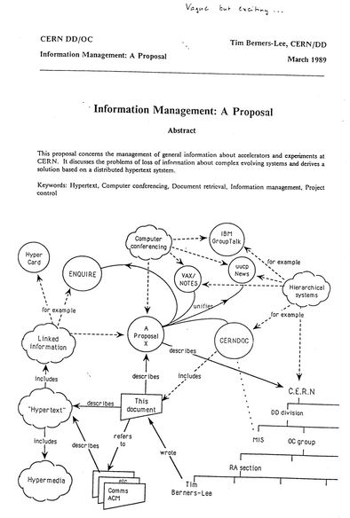
Web → Computación Grid
Tim Berners-Lee
1er web server (www) – CERN 1991

Slide 20
20 years of history: from the WWW to the Grid
1989: Tim Berners-Lee proposes at CERN a project of global hypertext
(http://)
1990: Windows 3.0 – popularization of PC – millions of people can
create digital content
1991: First web site http://info.cern.ch
1993: 12 users of the 1st browser, 50 web servers
1994: barrabes.com
1995: Netscape on the stock exchange– Start of the .com bubble
2001: Collapse of the .com bubble
  The world remains hyper-connected: the projects of Grid deployment at large scale become feasible
2009: First LHC data, analyzed by thousands of researchers around
the globe using the Grid

Slide 21
“The Grid” (Ian Foster y Carl Kesselman, 1998)
1990’s boom of accessible computing (PC, better communication networks, Internet, Linux, etc)
State of computing similar to the development of electricity at the beginning of 1900
The real revolution of electricity was the possibility to distribute it over a network
The use of computational services should be as transparent as using a power plug
Users don’t need to know from where the computing power is coming from
Computing revolution similar to the invention of the Web at CERN

Slide 22
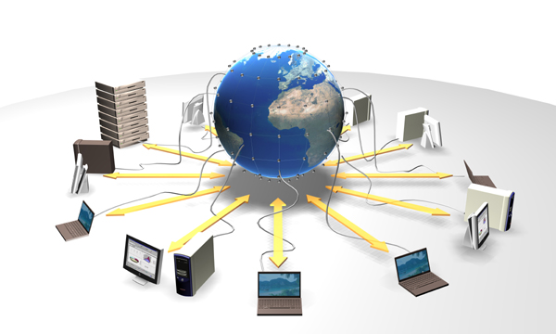
Computing Grid
The Grid, integrating connectivity, computing power and information provides a virtual platform for computation and data management, in the same way the Web integrates resources to create a virtual platform for information
The Grid makes it possible to dynamically link heterogeneous resources that support large scale processing and intensive use of resources and distributed applications
The Grid must provided non-trivial quality of service (specified in service level agreements)
Complex software systems and services are necessary to provide the user with an easy and secure access by means of standard protocols, so that resources can be efficiently utilized and allow the organizations to coordinate their resources in a stable way

Slide 23
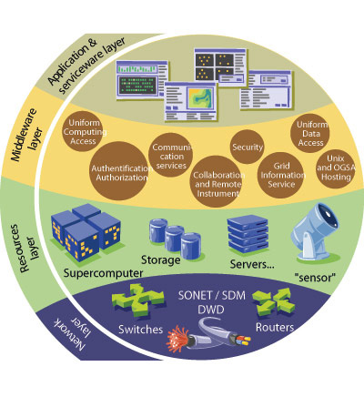
Grid architecture
Resources
  Computers, storage, communication networks
  Heterogeneous, geographically distributed, dynamic
Middleware
  Software to connect and coordinate the resources
  Basic information services, security, data management and execution of tasks, monitoring
Applications
  Interaction of the user with the Grid

Slide 24
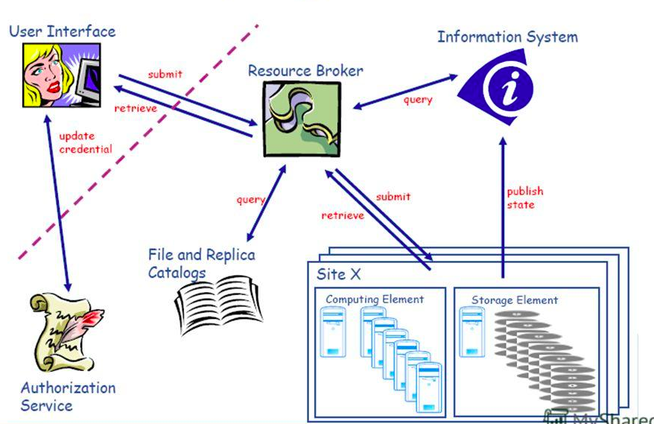
Grid Services at a glance
Notes:
In this cartoon I show you the basic services provided by the Grid. I’m not going to go into details, but the Grid provides services to manage the data and services to manage and execute the tasks that process the data with which the users interact with a simple and standard.
Security is one of the important requirements of the Grid.
Digital certificates are provided to users that are used to authenticate them with the Grid services. In addition to the authentication, there is an authorization service that controls which operations a user can do in the Grid (there are for example power users that can delete detector data, have access to a larger share of the resources, etc)
The information system compiles information about the existing resources in the Grid and provides this information to external clients that take data management of processing decisions based on the existing resources (e.g. where there are free space to store data or free processors to execute user tasks).
There is a service that receives processing requests from the users and controls the execution of the tasks, implements the policy of the organization, priorities, share, etc.
Each site connects to the Grid and provides a number or execution nodes (the so-called worker nodes). The processing requests that reach the site as queued in a local batch system that controls their execution in the worker nodes.
There is a number of data management services in charge of moving data between sites, to aggregate the storage resources at the sites in a global file system (the so-called storage elements) and to register which data is available where (data catalogs)

Slide 25
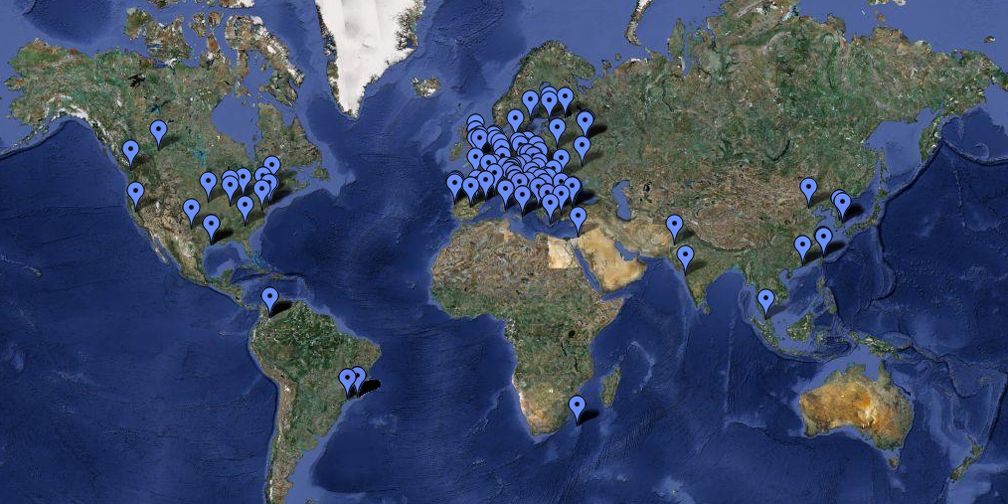
The Worldwide LHC Computing Grid (WLCG)
WLCG is the computing infrastructure that allows
  The connection of all LHC computing centers and its integration in a single “super-computer”
  Make accessible the computing resources to thousands of researchers who in turn are distributed around the globe
WLCG: 150+ centers, 50+ countries, ~300k CPUs, ~ 200PB disk/tape, 10k users
Real globalization of LHC data

Slide 26
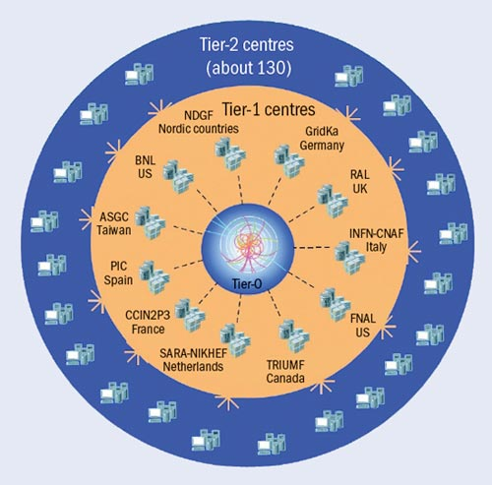
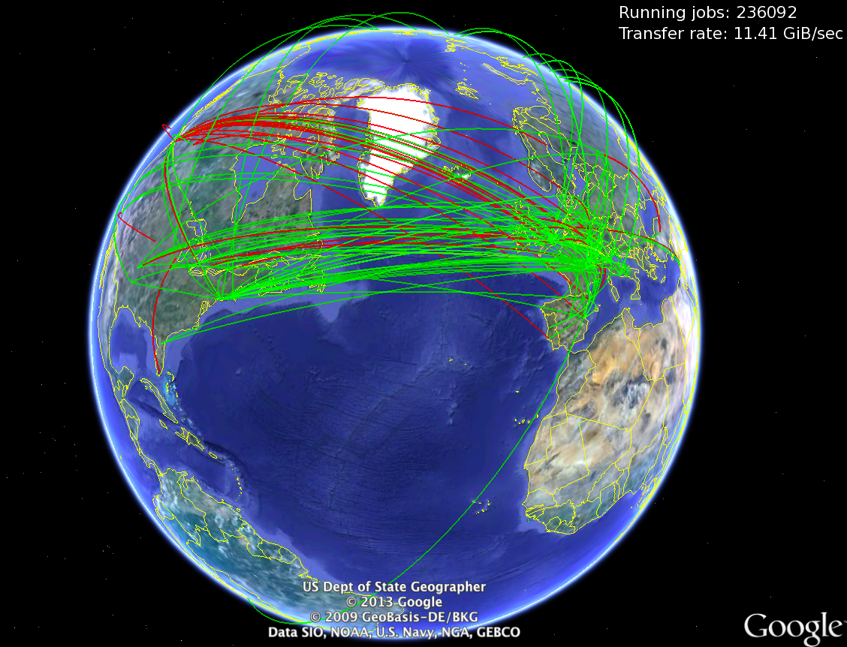
Topology of WLCG
WLCG: 150+ centers,
50+ countries, ~300k CPUs,
~ 200PB disk/tape, 10k users

Slide 27
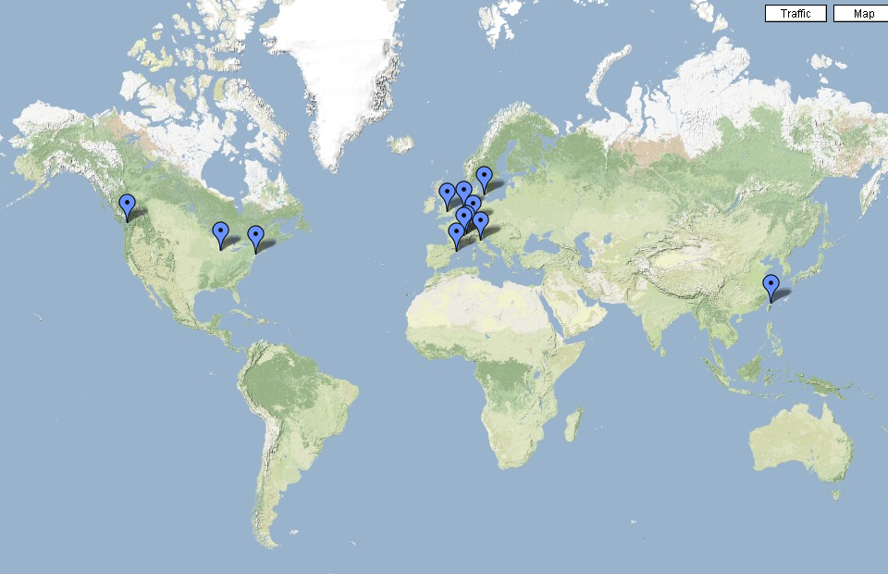
Data distribution in real time
Data taken at CERN (Tier-0) are distributed to 11 main centers located around the world: the so-called Tier-1s
CERN
These centers keep a backup copy of the raw data and perform organized mass data processing (reconstruction)
CERN and the Tier-1 centers are connected through an optical private communications network with a bandwidth of 10.000 Megabits per second – more than 1000 ADSL lines

Slide 28
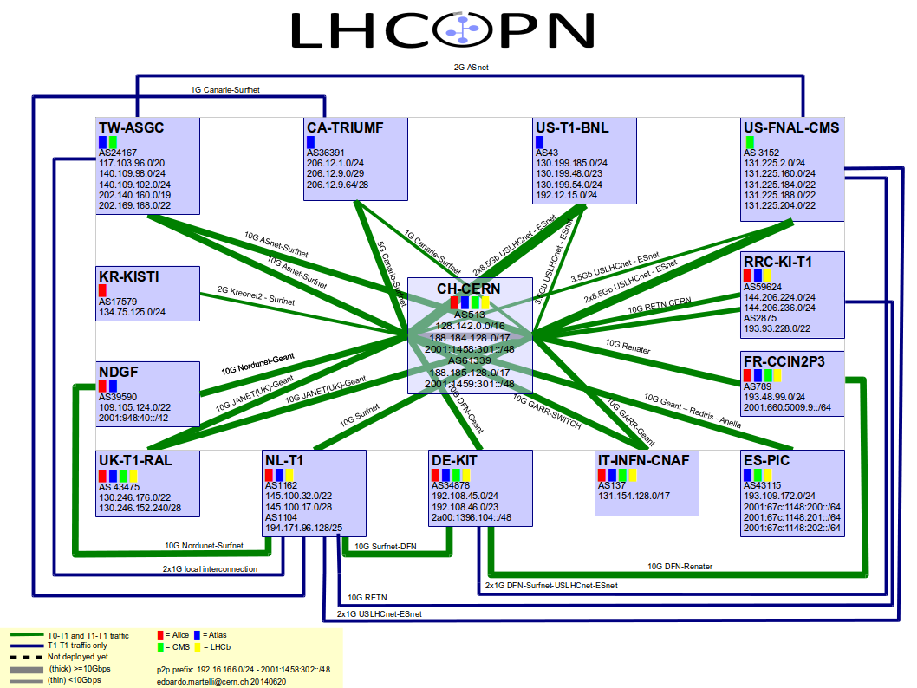

Slide 29
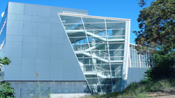
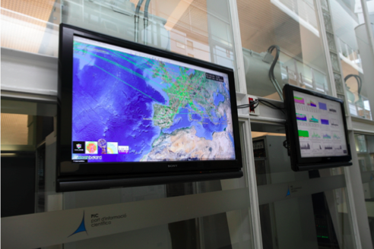

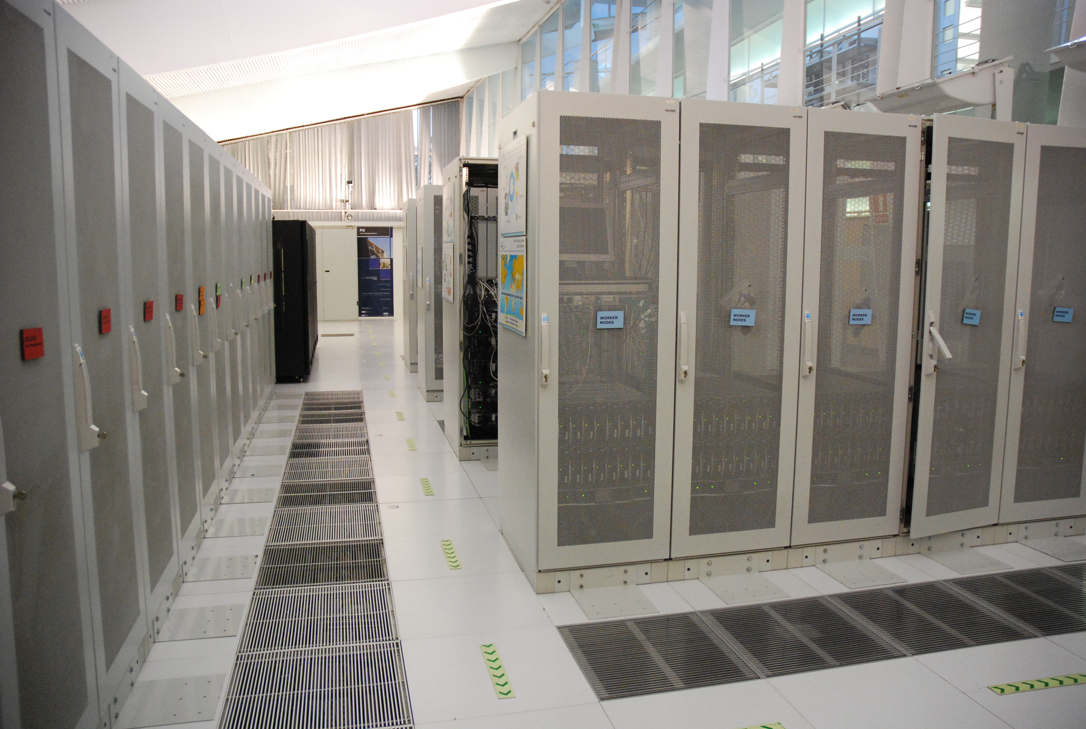
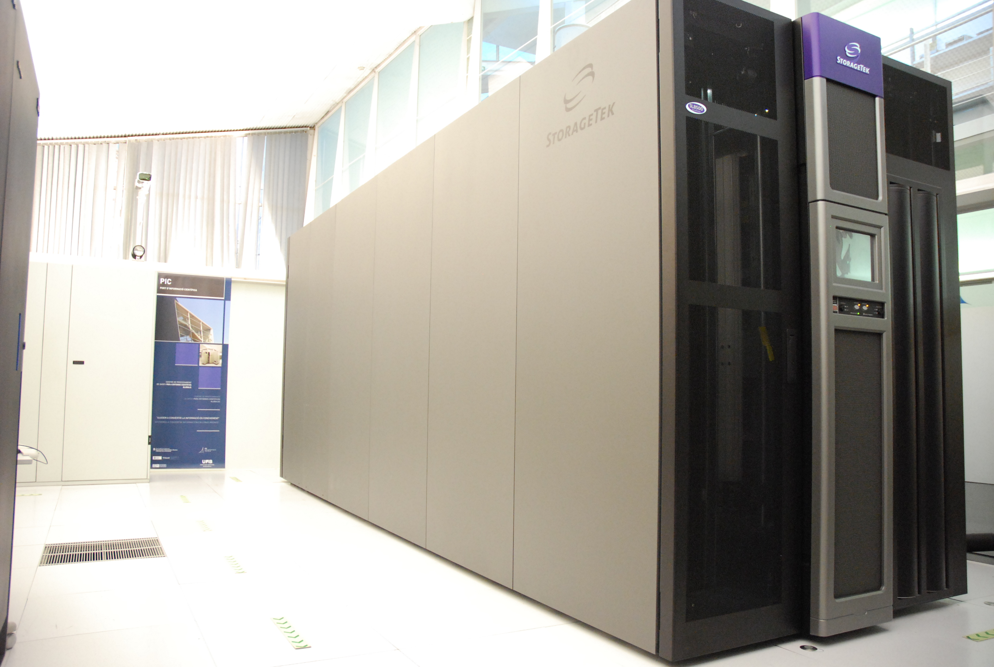
PIC Tier-1 (Barcelona)
The Spanish Tier-1 center:
Puerto de Información Científica (PIC), Barcelona
Managed by CIEMAT & IFAE
4k CPUs, 6 PB disk, 8 PB tape

Slide 30
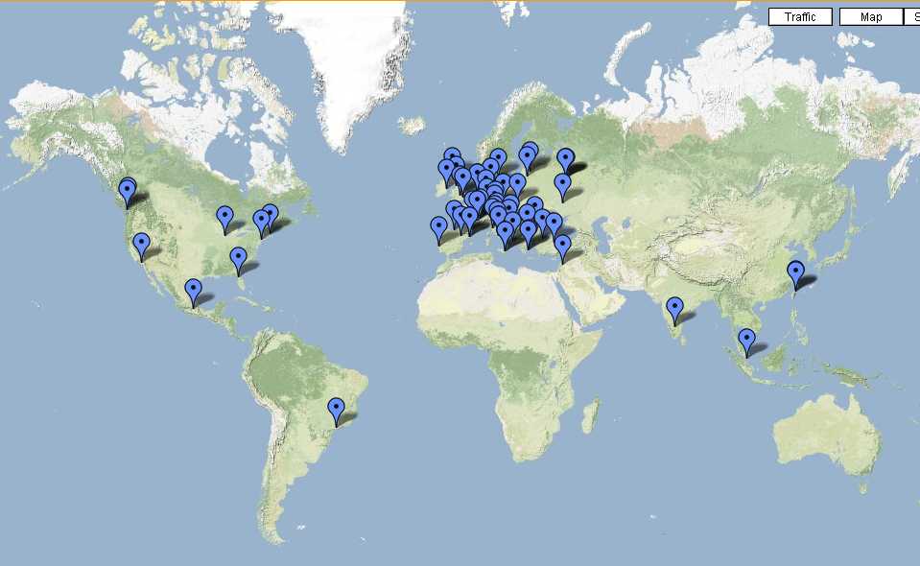
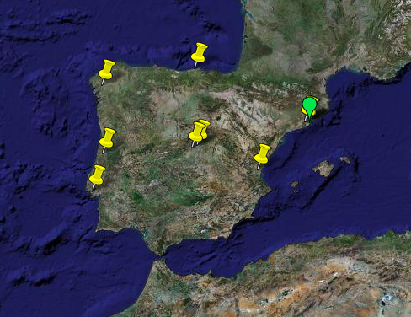
Tier-2 Centers
150+ secondary centers in 50+ countries: Tier-2s
Tier-2s associados a Tier-1 PIC
CERN
IFCA [Santander]
USC [Santiago]
IFAE [Barcelona]
LIP [Coimbra]
CIEMAT [Madrid]
PIC [Barcelona]
UB [Barcelona]
UAM [Madrid]
IFIC [Valéncia]
LIP [Lisboa]
PIC Tier-1
Barcelona
CMS: CIEMAT&IFCA – LIP_Lisbon&LIP_Coimbra
ATLAS: IFAE&IFIC&UAM – LIP_Lisbon&LIP_Coimbra
LHCb: UB&USC
These centers are specialized in production of simulated data and data analysis

Slide 31
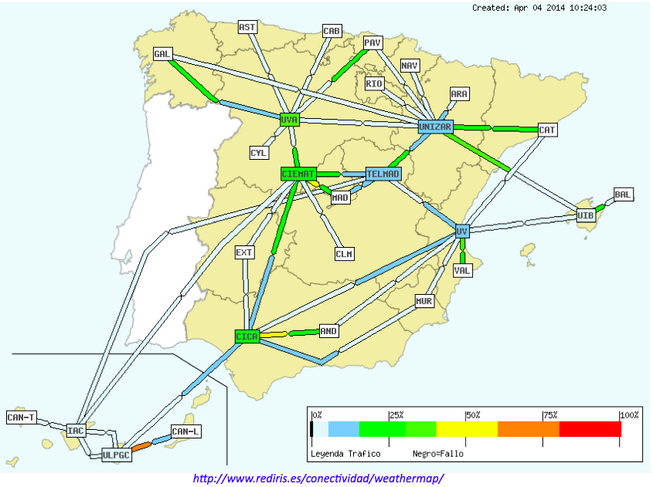
RedIris: Spanish academic network

Slide 32




















LHCONE: A global infrastructure for the LHC Tier1 data center – Tier 2 analysis center connectivity
SimFraU
NDGF-T1a
UVic
UAlb
NIKHEF-T1
NDGF-T1a
NDGF-T1c
TRIUMF-T1
UTor
SARA
Netherlands
NORDUnet
Nordic
CANARIE
Canada
McGilU
Korea
CERN-T1
UMich
CERN
Geneva
KISTI
Korea
UltraLight
Amsterdam
TIFR
India
Geneva
Chicago
KNU
DESY
KERONET2
Korea
GSI
DE-KIT-T1
SLAC
DFN
Germany
ESnet
USA
BNL-T1
New York
India
Seattle
FNAL-T1
ASGC-T1
GÉANT
Europe
ASGC
Taiwan
UCSD
Caltech
NE
Washington
UWisc
UFlorida
SoW
CC-IN2P3-T1
NCU
NTU
PurU
UNeb
MidW
Sub-IN2P3
TWAREN
Taiwan
MIT
GLakes
GRIF-IN2P3
RENATER
France
CEA
Internet2
USA
Harvard
PIC-T1
INFN-Nap
CNAF-T1
RedIRIS
Spain
GARR
Italy
UNAM
LHCONE VPN domain
End sites – LHC Tier 2 or Tier 3 unless indicated as Tier 1
Regional R&E communication nexus
Data communication links, 10, 20, and 30 Gb/s
See http://lhcone.net for details.
CUDI
Mexico
NTU
Chicago

Slide 33
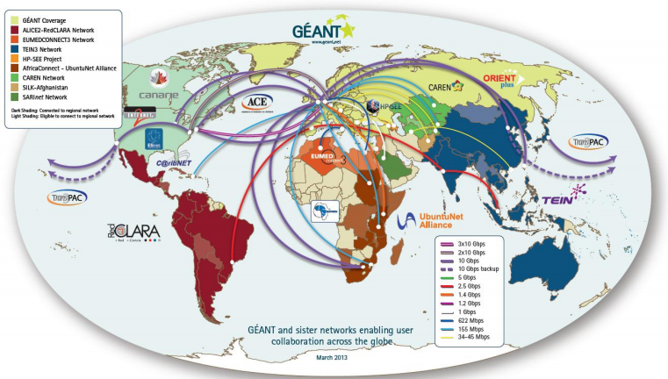
Worldwide academic Internet network

Slide 34
Data processing and reduction
Split data to prioritize processing and facilitate distribution
HLT
Online Selection
Online
streams
physics, calib&align, monitoring, express
Express Processing
CAF
Calibration, alignment, monitoring
Repacking
RAW (~0.5 MB/evt)
Primary
Datasets
~10, based on trigger bits (some overlap, ~20%)
Tier-0
Prompt Reconstruction
Within 48 hours
RECO (~0.5 MB/evt)
AOD (~0.3 MB/evt)
Re-reconstruction
Tier-1
Skimming
Central
skims
≤ 10% selection
Tier-2
Group skims
User analysis
Asymptotically base analysis on highly selected samples & summarized formats

Slide 35
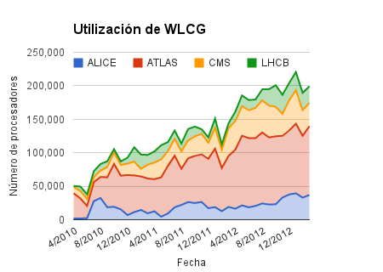
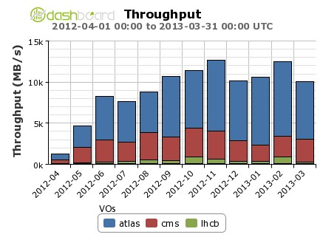
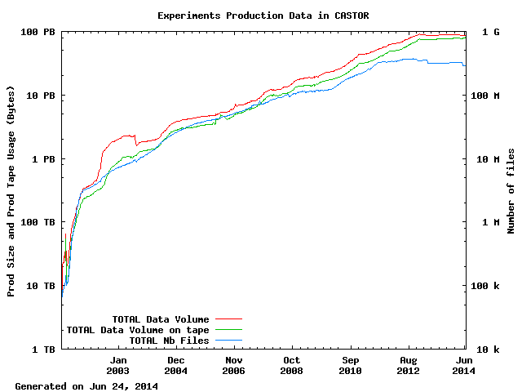
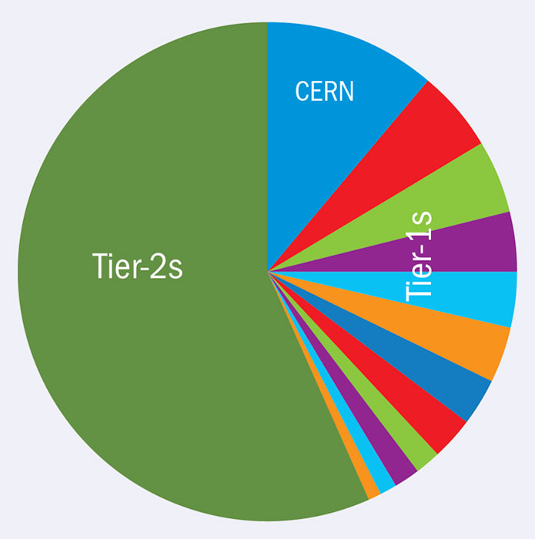
WLCG 2010-2012 utilization
1 PB/day
100 PB
Tape storage at CERN

Slide 36
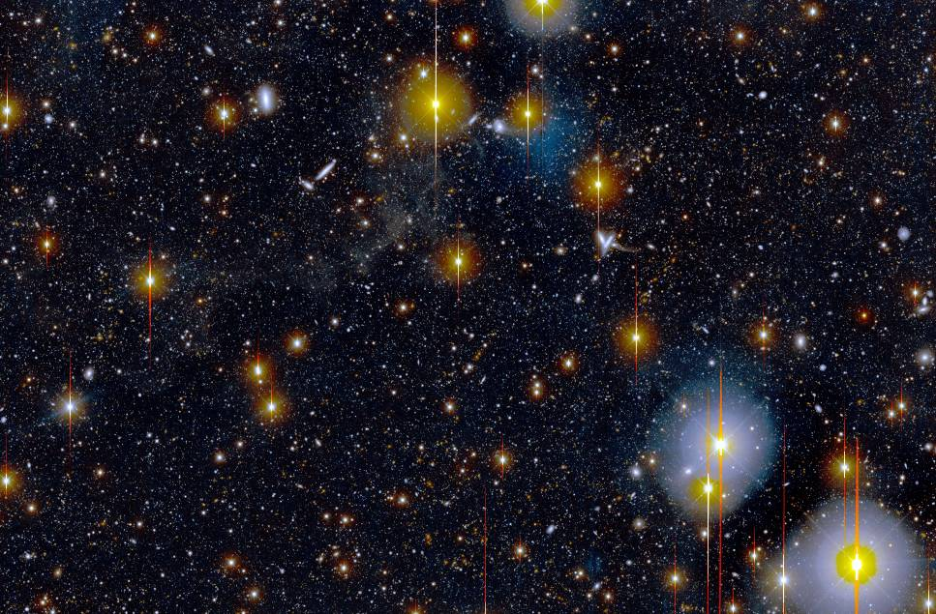
Explosion of scientific data
Particle physics is not the only scientific discipine in which there is an explosion of data
Scientific instruments get digitized, and its precision increases
  Exponential increase of data in many fields
In few year we will have telescopes that will excrutinize the sky every night with an unprecendented precision
10 PetaBytes of images every year

Slide 37
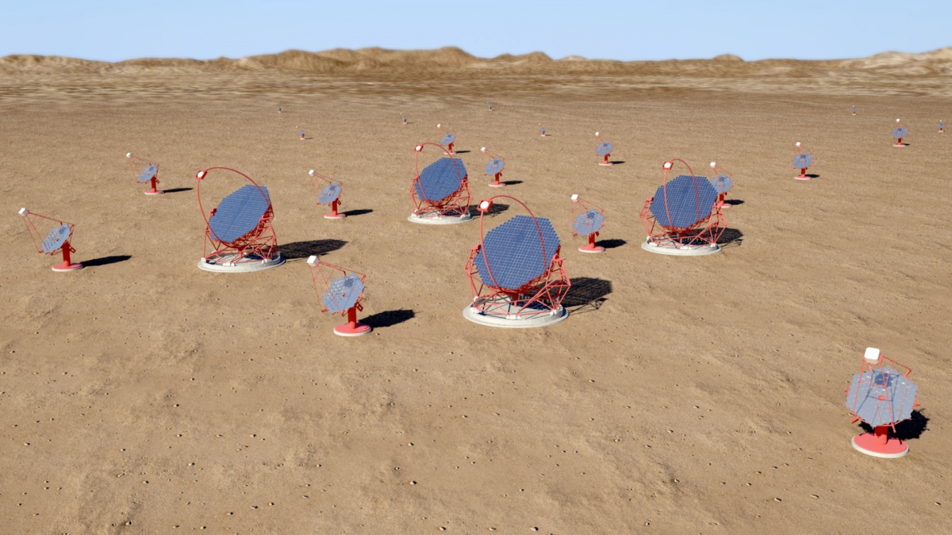
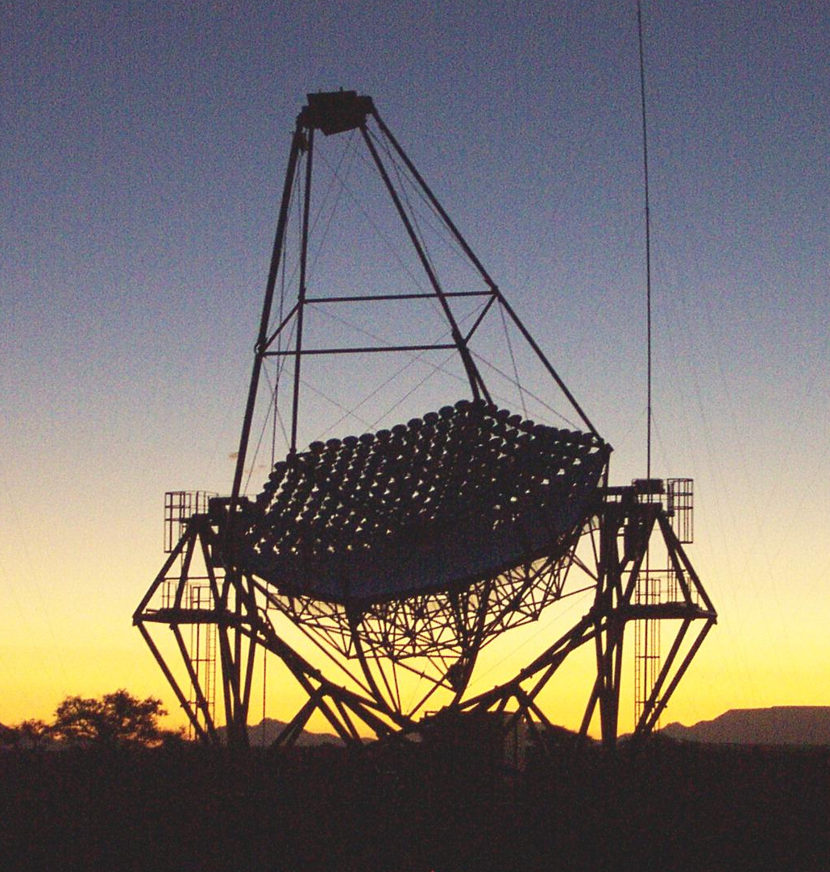
The Cerenkov Telescope Array
Array of cosmic gamma ray detectors
1 site in the norhern hemisphere (1 km²) y 1 site in the southern hemisphere (3 km²)
10-20 PB data annually

Slide 38
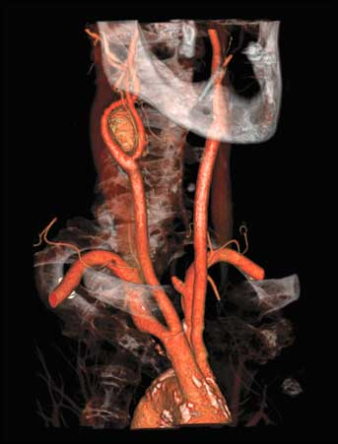
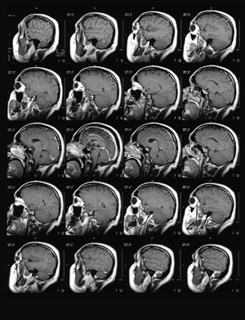
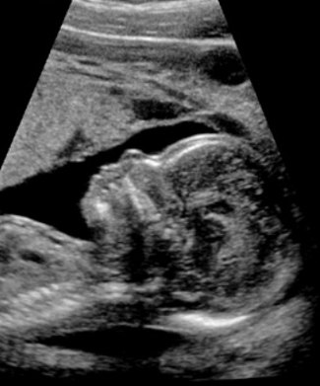
Explosión de datos científicos
In hospitals, diagnosis instruments are getting digitized as well
Databases with medical images are being created for research. Its size will increase at a rate of dozens of PetaBytes per year

Slide 39

Lots of data!
300 million of images uploaded to Facebook every day
400 millions of tweets posted every day
10³ millions of visits to YouTube / month
  And 100 hours of video uploaded / min
10.000 millions of mobile phones connected in 2020
Whatsapp processed́ 27.000 millions of messages in one single day in 2013

Slide 40

… and from everywhere
ADSL, wifi, 3G, 4G...
Mobile phones, tablets, glasses (fridges, cars...)
In 2012, the global volume of data reached 2,7 ZB

Slide 41

Big Data

Slide 42


Gestión de los datos
Where is LHC in Big Data Terms?
Lib of
Congress
Big Data in 2012
Business emails sent
3000PB/year
(Doesn’t count; not managed as
a coherent data set)
Reputed capacity of NSA’s new Utah data center: 5000 PB
(50-100 MW, $2 billion)
We are big…
Climate
DB
Facebook uploads
180PB/year
Current LHC data set, all data products: ~300 PB
LHC data
15PB/yr
Google search
100PB
Nasdaq
US
Census
YouTube
15PB/yr
Digital
health
30PB
Wired Magazine 4/2013

Slide 43

From Grid to Cloud Computing
In industry, Grid computing has evolved into Cloud Computing
  Computing Grids are still too specific and inflexible
  Simplified management of installation and configuration of computing resources
  Transparent environment for user applications
  Pay per use business model
  Interactive applications
  More flexibility and elasticity in the allocation of resources

Slide 44

Virtualization
The technology that enables Cloud Computing
A virtual computer inside a physical computer. Or several!
User application is executed inside a process (virtual machine) that provides a virtual operating system

Slide 45

Virtualization and flexibility
Virtualization allows to start and move applications between servers according to needs

Slide 46

Cloud computing models
Infrastructure as a service
  Basic model
  The provider supplies the physical infrastructure
  The user provides the image with the operating system and the application to be executed
Platform as a service
  The provider supplies the platform to develop and execute applications
Software as a service
  The provider supplies the applications

Slide 47

Everything in the Cloud
Storage
Applications

Slide 48

Services for industry and science

Slide 49

The heart of the Cloud

Slide 50
Cloud Computing in WLCG?
Might be the natural evolution
LHC experiment have added Cloud interfaces
  Allows e.g. to access commercial clouds like Amazon
Some sites have moved to Cloud-managed infrastructure
  For the moment only a small fraction. Not really needed …
Cloud infrastructure has its own difficulties
  No scheduling system
  Management of VMs becomes experiment responsibility

Slide 51
Evolution of the WLCG Computing Grid

Slide 52


Hierarchical processing in LHC Run 1

Slide 53
Evolution towards a more flexible model
More efficient use of the resources if centers could perform different types of workflows
  Possible thanks to the improvements in reliability, performance and Internet connectivity
  Tier-0
    Re-use High Level Trigger farm (~10k CPUs) when no data taking
  Tier-1
    Execute analysis jobs, simulation, and even prompt reconstruction
  Tier-2
    Execute mass re-processing and skimming
Distinguish center by availability level rather than by executed workflows
  Tier-0: reaction time of minutes to a problem
  Tier-1: available 24x7 and reaction time of hours
  Tier-2: available 8x5 and reaction during working hours

Slide 54
More efficient data processing
Initial model of data access in WLCG
  Data are statically distributed/replicated between sites
  Processing jobs are sent to sites hosting the requested data which are accessed locally
Advantages
  Local access to data is a priori faster and more efficient
  Data distribution is centrally controlled
Disadvantages
  Inefficient use of available CPUs globally
  CPUs will be idle at a site if there are no jobs requesting data hosted at that site
  Jobs can be in queue at a site because the requested data are not available at other sites
Towards a hybrid model of dynamic data distribution and cache release together with remote access to data

Slide 55
Remote access to data
Evolution towards a model of distributed storage where processing jobs can access data remotely through the WAN
Latency and bandwidth limitations can impact on remote data access efficiency
Lot of effort spent in optimizing remote data reads
  Read ahead (prediction of data to be read next), vector reads (read parallelization)
  Working on strategies à la bit-torrent to read files from multiple sources
Data Federation
  Federation of storage systems where a central service connects the client with the site hosting the requested data
  AAA in CMS, FAX in ATLAS

Slide 56
Data distribution
Initial model of static collocation of data
  One or several copies of datasets (real data and simulations) are distributed among the Tier-2 sites for its analysis
Simple model but with clear disadvantages
  Manual process
  It does not take into account which datasets are “hot” (accessed frequently) or “cold” (not accessed for a long time)
Evolution towards a dynamic model
  Processing jobs report the data read to a central service
  This “data popularity service” is queried by the dynamic data collocation service to replicate hot datasets
  Another service to delete cold datasets from the caches takes care of deleting replicas de datasets that have not been accessed for long time

Slide 57

Content Delivery Network
Evolution towards a model similar to the one used by Internet content providers
  Video/audio streaming
Servers of contents geographically distributed replicate/delete data on demand
Bring data closer to the application
Optimization of data
access

Slide 58

HEP vs CDN providers
  Similar serving requirements
  LHC has a smaller number of clients, less distribution, a higher bandwidth per client and a larger total data volume

Slide 59

Using the CDN model
Sofware distribution of experiments to processing nodes
  CERN Virtual Machine File system – CVMFS
  Distributed file system
Access to calibration and alignment constants
  FronTier, scalable system to access databases
Hierarchical systems, scalable, based on data caches
  The first copy into the cache takes some time, but subsequent accesses are very fast
  Automatic distribution of new software. Single point of software installation
Technology used by web servers, cache web proxies
  Standard http protocol, security

Slide 60

Processor evolution

Slide 61

Processor evolution
Speed of Intel/AMD processor stuck in ~3 GHz since about a decade
  Too much dissipated heat
Computing power increases by incrementing the number of processing cores
  Multi-core now ➔ many-core soon ➔ finer grained parallelism needed
To take advantage of this architecture the application needs to be parallelizable and use
the available cores simultaneously
  Introduces complexity in the application
  Non-parallelizable code introduces
  inefficiency
Many or most of our codes require
extensive overhauls
  Being adapted: geant4, root, reconstruction code, exp. frameworks

Slide 62

Towards multi-core processing
Processing model during LHC Run 1
  Each processing jobs uses a single core
  In odes with N cores N processing jobs are executed in parallel
LHC experiments’ software is being re-factored to allow for parallelization
  A single application will use several cores
Many advantages
  Better use of RAM and other
  resources (access to hard disk,
  network usage)
  Decrease of the number of jobs
  the experiment’s workload mana-
  gement system has to execute
  Smaller number of files created

Slide 63

LHC roadmap
Increasing amount of data and complexity

Slide 64
Upgrading LHC Computing in LS1 (2013-2015)
The shutdown period is a valuable opportunity to asses
  Lessons and operational experiences of Run 1
  Computing demands of Run 2
  The technical and cost evolution of computing
Undertake intensive planning and development to prepare LHC Computing for 2015 and beyond
  While sustaining steady state full scale operations
  With an assumption of flat (at best) funding
This has been happening internally to the experiments and collaboratively with CERN IT, WLCG, common software and computing projects
  Upgrade in parallel to accelerator and detector upgrades to push the frontiers of HEP

Slide 65


Computing challenges for LHC Run2 (2015-2019)
Computing in LHC Run1 was very successful but Run 2 from 2015 poses new challenges
Increased energy and luminosity delivered by LHC in Run 2
  More complex events to process
    Event reconstruction time (CMS ~2x)
  Higher output rate to record
    Maintain similar trigger thresholds and sensitivity to Higgs physics and to potential new physics
    ATLAS, CMS event rate to storage 2.5x
Need a substantial increase of computing resources that we probably cannot afford

Slide 66




Computing resources increase
HS06
Requests ~conform to expected flat budget
~25% yearly growth requested
Benefit from technology evolution
PB

Slide 67
Computing strategy for Run2
Increase resources in WLCG as much as possible
  Try to conform to constrained budget situation
  Request ~25% yearly growth. Profit from technology evolution
Make a more efficient and flexible use of the available resources
  Reduce CPU and storage needs
    Less reprocessing passes, less simulated events, more compact data format, reduce data replication factor
  Intelligent dynamic data placement and remote data access
    Automatic replication of hot data and deletion of cold data, remote I/O
  Break down the boundaries between the computing tiers
    Run reconstruction, simulation and analysis at Tier-1/Tier-2 indistinctly
  Centralized production of group analysis datasets
    Shrink ‘chaotic analysis’ to only what really is user specific
    Remove redundancies in processing and storage, reducing operational workloads while improving turnaround for users
  Evolve the data processing frameworks towards parallel processing
    More efficient use of multicore processors

Slide 68
Access to new resources for Run 2
Access to opportunistic resources
  Unused capacities at Grid sites that allow opportunistic usage
  Capacities provided to the experiments for a defined period of time at High Performance Computing Centres, etc
  Significant increase in capacity with low cost (satisfy capacity peaks)
  HPC clusters, academic or commercial clouds, volunteer computing
Use HLT farm for offline data processing
  ~10k cores
  During extended periods with no data taking and even inter-fill periods
Adopt advanced architectures
  Processing in Run1 done under Enterprise Linux on x86 CPUs
  Many-core processors, low-energy CPUs (e.g. ARM processors of mobile phones), accelerator cards (GPU)
  Challenging heterogeneous environment
  Parallelization of processing application will be key

Slide 69


Graphics Processing Unit (GPU)
Specialized processors initially used in graphics cards
Used now as general purpose processors
Hundreds of cores in a single card
Good relation power consumption / computing power
NVIDIA is the largest commercial provider. Inventor of GPU in 1999
CUDA is the platform and the parallel programming model created by NVIDIA for the GPUs

Slide 70
Looking ahead: LHC Run 4 (2024+)
Run 4 w.r.t Run 2
  Increase output rate 10x
    1 ➔10 kHz
  Increase event processing time 2.5x
    40 ➔ 140 pileup
  Increase event size 2x
  25x CPU, 20x storage needs
Expected increase of resources with flat budget
  CPU doubling ~every 3 years (25%/year): 8x till 2024
  Disk doubling ~every 4 years (20%/year): 5x till 2024
About factor 3 (CPU) and factor 4 (disk) missing
Need long term I+D+I to achieve a computing revolution needed to meet these huge requirements
  In 1997, the Run 1 challenge was equally daunting. It took 10 years to develop the "WLCG computing revolution" to meet Run 1-2-3 requirements

Slide 71
Conclusions
LHC distributed computing, based on Grid technologies, performed extremely well at all levels in Run 1
  It has allowed experiments to produce great scientific results with unprecedented speed
  We know how to deliver, adapting where necessary
  Excellent networks, flexible and adaptable computing models and software systems paid off in exploiting resources
Massive distributed computing has extended to industry and society thanks to the extraordinary development of Internet and the availability of commodity hardware
  Big data, Cloud computing, …
LHC computing will have to face new challenges in the coming years
  Difficult funding scenario
  Optimization, flexibility, evolution

