Slide 1




Advanced TDDFT I:
Memory and Initial-State Dependence
Alzheimer’s Clinic
Mr. Adiabatic
Ms. Functional-Developer
Neepa T. Maitra
Hunter College and the Graduate Center of the City University of New York

Slide 2
Plan
– introduction to what is memory and some general properties
-- initial-state dependence
-- history-dependence
-- “gedanken” calculation: electronic quantum control
See also Ch. 8 in your “Fundamentals of TDDFT” book

Slide 3
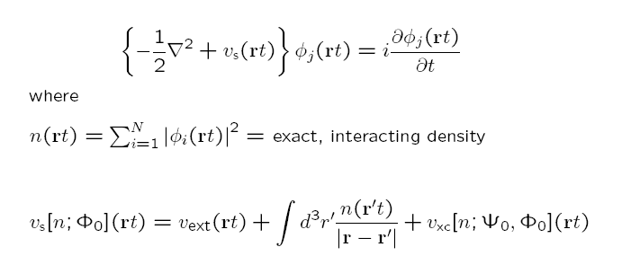
Whence Memory?
Ψ₀
Runge-Gross:
n(r t) v_{ext}(r t)
true system
1-1
Φ₀
n(r t) v_{s}(r t)
KS system
1-1
Hartree is naturally adiabatic – depends only on instantaneous density
Actually, v_{ext} [n,Ψ₀] (rt)
functional dependence: history, n(r t’<t), and, initial states of true and KS systems
but as v_{ext} is usually prescribed, functional dependence not considered.
Ψ₀: the true initial state
Φ₀: the initial state to start the KS calculation in -- essentially any (SSD) that has same n(r,0) and n(r,0) as Ψ₀
.

Slide 4


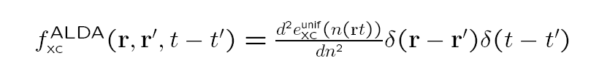
Memory
functional depends on history, n(r t’<t), and on initial states of true and KS systems
Also, for a general observable: A[n; Φ₀]
Memory can be thought to arise from using a reduced variable, n(r,t): tracing over N-1 spatial variables → memory-dependence.
Almost all calculations today ignore memory, and use an
adiabatic approximation:
input instantaneous density into a ground-state approximation

Slide 5
Next, will play with some examples to clarify what is meant by memory, and uncover some exact properties of memory-dependence.
Let’s start with initial-state dependence.

Slide 6

Initial-state dependence (ISD)
The 1-1 n-v mapping formally depends on the initial-state.
But is there ISD in actuality?
Evolve Ψ₀ in v(t) →
n (r t)
The answer is:
No! for one electron, but,
Yes! for 2 or more electrons
t
~
? Does there even exist another Ψ₀ s.t.
~
~
evolving Ψ₀ in v (t) → same n ?
If no, then ISD redundant, i.e. the functional dependence on the density is enough.
Notes:
The time-evol of the one-body denity actually contain a lot of information – could it be that the ay it evolve actually tell u all about the initial tate itelf? If o, then no ID. Even at the initial time alone, there I a limited cla of initial tate that integrate to the initial denity – then if e are alo prescribing that the tate evolve ith a certain denity evoln under ome form for H, that rule out even more poible initial tate.

Slide 7




ISD? One electron case:
Can and
be found, that evolve with the same density for all t ?
means
where α is a real spatially-dependent phase
Also, must have
using eqn of continuity,
with
+ surface term
everywhere non-negative
→
→ and differ only by irrelevant t-dep phase
Notes:
Surface term zero

Slide 8
So, for one electron:
Evolve Ψ₀ in v(t) →
n (r t)
~
~
Evolve Ψ₀ in v (t) → same n
No ISD needed in functionals since the time-evolving density itself contains all information about the initial state.
…but only a nutcase would do DFT for one electron…
Many electrons? The time-evolving density does not uniquely define the potential → ISD needed.

Slide 9
More than one electron:
The time-evolving density does not uniquely define the potential
Example:
two non-interacting electrons in 1d
n(x,t)
φ₁,φ₂ orbitals of Φ
~
~
~
φ₁,φ₂ orbitals of Φ
The initial KS potentials in which these two different initial-states evolve with the same static n
v_{s}
~
v_{s}
Say this is the density of an interacting system. Both are possible KS systems: v_{s}– v_{s} = v_{xc} -v_{xc}
v_{xc} different for each. Cannot be captured by any adiabatic approximation
~
~
N.T. Maitra and K. Burke, Phys. Rev. A. 63 042501 (2001); ibid. 64 039901 (E) (2001)

Slide 10
More 2-electron examples recently demonstrated using a new fixed-point iteration to find the v(r,t) for a given n(r,t), Ψ₀:
M. Ruggenthaler, S. E. B. Nielsen, R. van Leeuwen, Phys. Rev. A 88, 022512 (2013).
S. E. B. Nielsen, M. Ruggenthaler, R. van Leeuwen, EuroPhys. Lett, 101 (2013) 33001

Slide 11
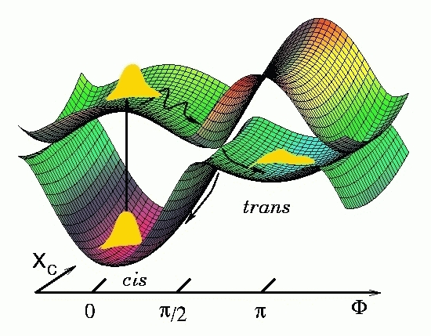
Implications for the Adiabatic Approximation
v_{xc}[n;Ψ₀,Φ₀](r,t)
Adiabatic approx designed to work for initial ground-states
-- For initial Ψ₀ an excited state, these use v_{xc} derived for a ground-state of the same initial n(r).
Important in photoinduced dynamics generally: start the actual dynamics simulation after initial photo-excitation.
How big is the resulting error?
depends on the choice of the initial KS state
Notes:
Initial State Dep in TDDFT arises because the 1-1 density potential map depends on the initial state of the system. The xc potential then depends on both the initial interacting state and the choice of initial KS state used.
If begin in the ground-state (both true and KS) as in linear response, then by HK, there is no ISD – the states are themselves functionals of the gs density. But more generally, this dependence needs to be accounted for.
An adiab fnal is designed to work for ground-states, so if you start in initial excited state, these use a vxc corresp to a ground-state of the same initial density. How big is the resulting error?

Slide 12
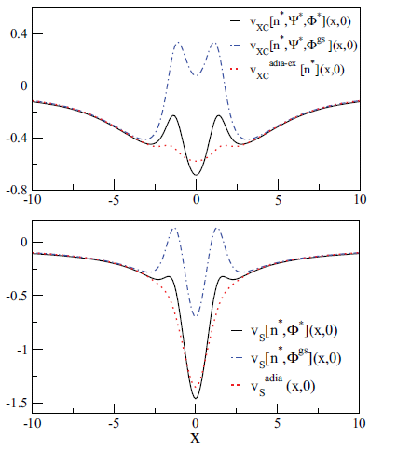
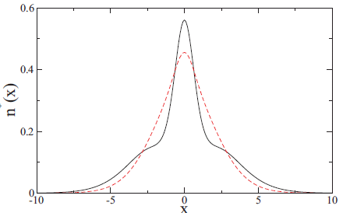
Being practical…
For a given initial excited Ψ₀, how different are the exact Vxc’ s for different choices of KS initial Φ₀ ?
Is there a best choice of KS initial state to use if stuck with an adiabatic approx?
e.g.
Initial exact v_{xc} for Φ^{gs}
for Φ*
Start in 1st interacting excited state of 1D He
density, n*
v_{c} ^{exact-gs}
quite wrong
But is closer to the
choice of Φ* than
Φ^{gs}
Many different choices of initial KS state: e.g:
Φ* = singlet excited state (two orbitals)
Φ^{gs} = singlet ground state (one orbital)
All must have density n*
P. Elliott and N. T. Maitra, PRA 85, 052510 (2012)

Slide 13
So initial-state-dependence is important for 2 or more electrons
Special case of much practical interest: start in a ground-state.
Then, by the Hohenberg-Kohn thm, Ψ₀ = Ψ₀[n(0)] and Φ₀ = Φ₀ [n(0)]
-- no explicit ISD needed!
But there’s still history-dependence, and we’ll look at this now starting in ground-state
→ study the exact xc potential for a given interacting dynamics

Slide 14

History-dependence: studying it via numerically solvable 2-electron systems
If somehow we can solve the many-electron problem exactly, can we find the exact xc potential, and study its features?
Two electrons in spin-singlet
Assume n(r,t) known. What is v_{s}?
The KS orbital is doubly-occupied, & of form:
Substitute into TDKS eqn
and invert to get:
Exercise! show this
where α is determined by eqn of continuity,
v_{x} = -v_{H}/2
v_{c} = v_{xc} - v_{x}
$$∇. \left(n∇ a \right)+\frac{∂a}{∂t}=0$$

Slide 15

History-dependence in 2 e systems
We found for two electrons in spin-singlet:
non-adiabatic (memory)
where α is determined by eqn of continuity,
v_{x} = -v_{H}/2
v_{c} = v_{xc} - v_{x}
$$∇. \left(n∇ a \right)+\frac{∂a}{∂t}=0$$
V_{s} appears not very non-local in time then – depends only on
But it is not V_{s} that we need approximate – it is V_{xc}, because V_{ext} is given in practise by the problem at hand.
In fact V_{xc} does depend very non-locally in time on the density, in general, and this is what we will now look at…

Slide 16
Expression directly for the exact exchange-correlation potential …
Equate equation of motion for $∂^{2}$n(r,t)/$∂t^{2}$ coming from interacting system,
with that of the KS system, and then subtract →
TD one-body density-matrix, interacting, KS
TD exchange-correlation hole
Need to know: - exact/accurate interacting ρ₁ and pair-density (hard for >2e)
- TD KS orbitals. (even harder for >2e !?!...)

Slide 17


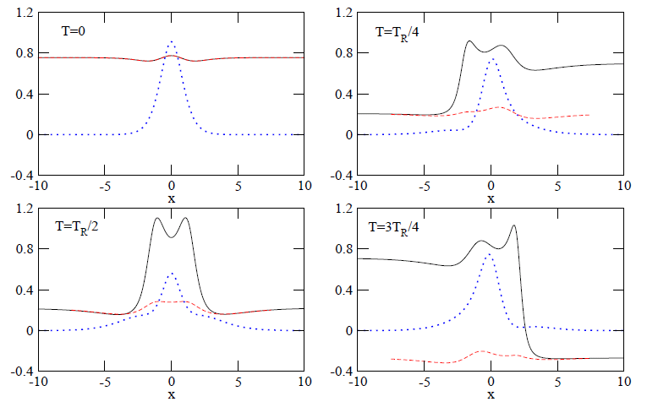
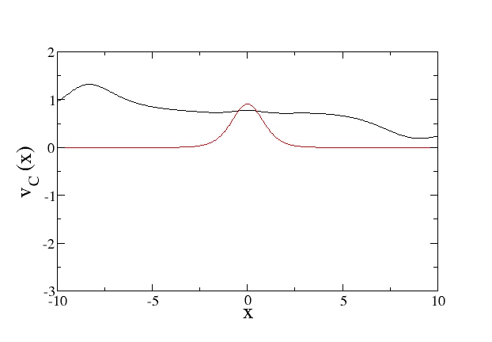

Example: Weak on-resonant driving of a “1D He atom”
2 soft-Coulomb interacting fermions living in and subject to
A = 0.00667 au
ω = 0.533 au (1st excn.)
exact v_{c}
“adiabatically-exact” v_{c}^{adia-ex}=v_{c}^{exact-gs}[n(t)]
density
Snapshots over a Rabi cycle
Movie: credit to Peter Elliott
density
Vc
Notes:
Start playing movie around 26

Slide 18
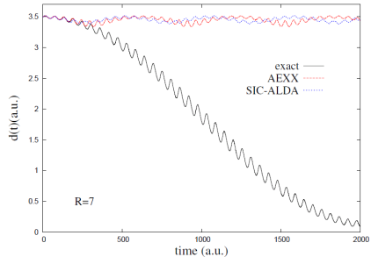
Non-adiabatic steps in v_{c} appear generically in nonlinear dynamics:
But missing in all adiabatic approximations!
Impact on dynamics?
Adiabatic approx tend to yield faster time-scales…
Worst example: Charge-Transfer
(another type of non-adiabatic step develops there…)
SIC-LDA
AEXX
exact
Other explorations of memory-dependence – see refs in Ch8 of book & refs in articles on left.
Elliott, Fuks, Rubio, Maitra, PRL 109, 266404 (2012)
Fuks, Elliott, Rubio, Maitra J. Phys. Chem. Lett. 4, 735 (2013)

Slide 19
Development of Memory-Dependent Functionals…
Gross-Kohn (1985)
Phys. Rev. Lett. 55, 2850 (1985)
Spatially local but time-non-local
Violates zero-force, harmonic potential theorems
t-dep linear-response kernel of the homogeneous electron gas
In fact, Dobson (PRL 73, 2244, 1994) showed that time-non-locality → spatial non-local n-dependence
R’,t’
r,t
Dobson-Bünner-Gross (1997)
Phys. Rev. Lett. 79, 1905 (1997)
Apply Gross-Kohn in frame that moves along with local velocity of electron fluid.
Spatially-local relative to where a fluid element at (r,t) was at earlier times t’, R’(t’|r,t)
Vignale-Kohn (VK) (1996) – TD-current-density-FT
Phys. Rev. Lett. 77, 2037 (1996)
Spatially local in current j → spatially ultra-nonlocal in density n
See also G. Vignale, Chapter 24, in your book

Slide 20
… Development of Memory-Dependent Functionals
Vignale-Ullrich-Conti (1997) – extend VK to non-linear regime.
G. Vignale, C.A. Ullrich, and S. Conti, PRL 79, 4878 (1997)
Kurzweil & Baer (2004, 2005, 2006) – Galilean- invariant “memory action functional”, J. Chem. Phys. 121, 8731 (2004).
Tokatly (2005, 2007) –TD-deformation-FT
Ch. 25 in “Fundamentals of TDDFT” book, I.V. Tokatly, PRB 71, 165104 and 165105 (2005); PRB 75, 125105 (2007)
Formulate density & current dynamics in a Lagrangian frame. Since going with the flow, spatially local xc is sensible & all complications including memory are contained in Green’s deformation tensor g_{i j}
Orbital functionals
– as orbitals incorporate “infinite KS memory”, so may be promising approach in many situations
Development of true ISD-Functionals? none yet!
Nevertheless, ISD and history-dependence are intimately entangled….next slide..

Slide 21
Trading ISD for more history
Evolve initial states backward in time, in some potential, to a ground-state → no ISD due to Hohenberg-Kohn DFT → instead, must tack on extra piece of “pseudo pre-history”
“memory condition”
~
V_{xc}[n;Ψ₀,Φ₀](r t) = V_{xc}[n](r t)
Starts at t=0 in initial true state Ψ₀ and KS evolves from initial state Φ₀
Starts at some time –T from some ground state:
~
n (r t)
n (r t)
pseudoprehistory
t
t
-T’
-T
“initial” ground-state (any)
The pseudoprehistory is not unique – may find many ground-states that evolve to the same state at t=0, in different amounts of time, in different v’s.
Eqn applies to all – and gives a strict exact test for approximate history-dependent functionals.

Slide 22
Another couple of small exercises!
Does ALDA satisfy the “memory condition”?
b) Will a functional with history-dependence but no initial-state dependence (such as Vignale-Kohn), satisfy the “memory condition”?

Slide 23
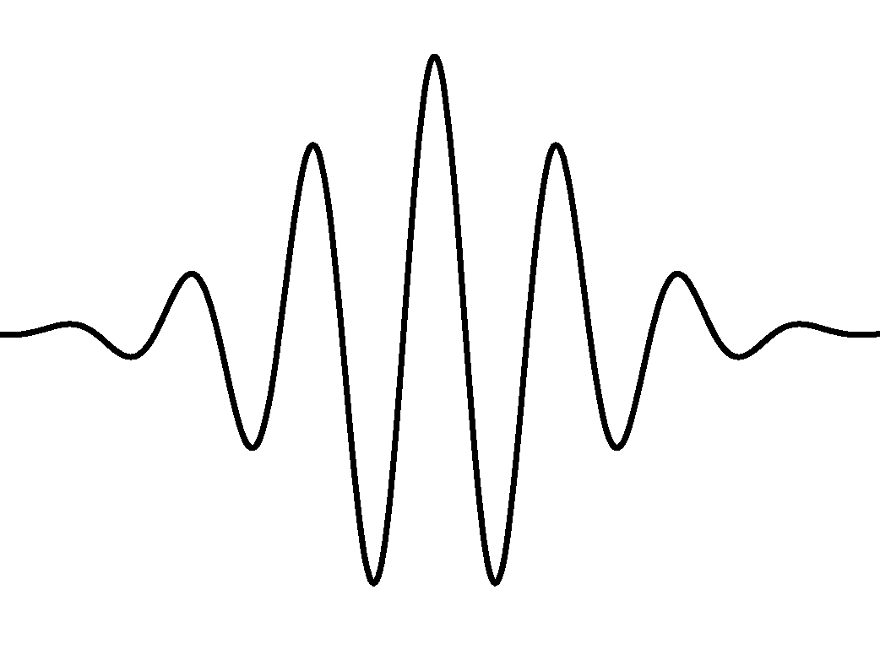
Memory in Electronic Quantum Control
Interacting (true) system: state-to-state control
Density of desired target state – mth excited state
Achieve this by turning on some laser pulse for some time until mth state reached, at time t*, say,
i.e. evolve in a given v_{ext}(t), s.t.
v_{ext} (t*) = v_{ext} (0)
Density of initial ground state
Kohn-Sham description of dynamics:
? Does the exact v_{s} also return to its initial value ?
? Is an adiabatic approx adequate ?
Maitra, Burke, & Woodward PRL, 89, 023002 (2002); Ch. 8 in “Fundamentals of TDDFT” book

Slide 24
“Gedanken” Calculation of Quantum Control…
? Does the exact v_{s} also return to its initial value ?
No, it cannot!
First note that the KS density n(t >t*) =n_{m}
IF v_{s}(t> t*) = v_{s}(0), then n_{m} would have to be an excited-state density of v_{s}(0).
But v_{s}(0) is the KS potential whose ground-state has the same density as interacting ground-state of v_{ext}(0).
Excited KS states do not have the same density as the excited states of the corresponding v_{ext}
→ v_{s}(0) = v_{s}(t*)

Slide 25
? Is an adiabatic approx adequate ?
No!
2 possibilities:
exact KS potential becomes static, with Φ(t>t*) = Φ_{m’} -- an excited state of v_{s}(t*). But ATDDFT instead finds KS potential which has n_{m} as ground-state density.
The excited state info is encoded in the memory-dependence of the exact KS potential, lacking in ATDDFT.
(ii) exact KS (and xc potential) continue to change in time after t*, with densities of KS orbitals evolving such that their sum remains static, and equal to n_{m}. ATDDFT clearly fails, as static n → ATDDFT v_{xc} static too.

Slide 26
How important is this problem in practise?
Should we give up on doing electronic control until we have good non-adiabatic functionals?
No!
Choose a target functional other than the true excited-state density: e.g. optimize instead the corresponding KS excited state density, or an overlap with it. The optimal field found for the KS system may also achieve a good outcome for the true system
State-control is perhaps the hardest: control of other observables, directly related to the density, is less problematic and extremely relevant.
e.g. transfer of density between quantum wells, bond-cleavage, ionization yields
Ch. 13 in “Fundamentals of TDDFT” book;
Castro, J. Werschnik, E.K.U. Gross PRL 109, 153603 (2012);
K. Krieger, A. Castro, E. K. U. Gross, Chem. Phys. 391, 50 (2011);
M. Hellgren, E. Räsänen, and E. K. U. Gross, Phys. Rev. A. 88, 013414 (2013)
Notes:
Maria’s paper found that ionization yields from ATDDFT-optimized pulses (AEXX/ALDA) on the exact system yields of 50% c.f non-shaped pulse of same fluence having 5-10%. Exact opt found higher than 80% though. But still, means some sense can happen

Slide 27
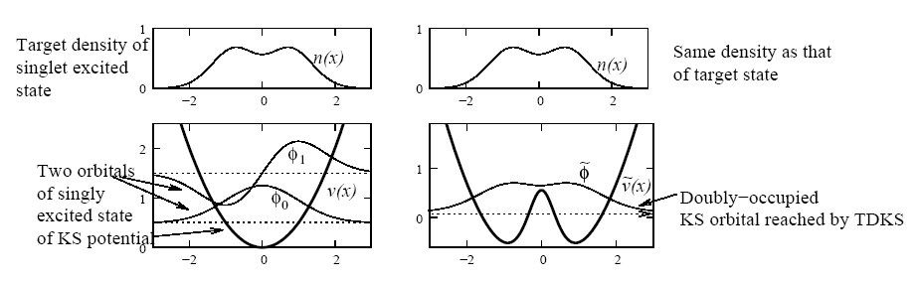
A particularly challenging problem for exact TDDFT:
Consider pumping He from ground (1s²) to first accessible excited state (1s2p).
Problem!! The KS state remains doubly-occupied throughout – cannot evolve into a singly-excited KS state.
Simple model: evolve two electrons in a harmonic potential from ground-state
(KS doubly-occupied φ₀) to the first excited state (φ₀,φ₁) :
TDKS
-- KS achieves target excited density, but with a doubly-occupied ground-state orbital !
-- Yet this is how exact TDDFT describes the dynamics – the exact v_{xc} is unnatural and difficult to approximate, as are observable-functionals of the final state…

Slide 28
… Quantum Control Difficulty …
Different control targets? Instead of targeting the density, what about trying to optimize <Φ(T) |1s2p>?
- max would be ½
(c.f. close to 100% in the interacting He problem – Werschnik & Gross (2005))
i.e. the interacting system is controllable in this sense, but the non-interacting is not
-- But again, there is room for optimism! A clever choice of target functional may yet be found, for which the optimal field found from KS evolution yields a large overlap with the target in the interacting system.
Another Exercise!
Consider exciting a two electron singlet non-interacting ground-state into its first excited state. Pretend that you have found a laser field that gets the target density exactly. Find an expression for the overlap of the state that is reached and the desired state. Evaluate this for a simple potential (eg. Harmonic oscillator, or hydrogen atom).

Slide 29
Summary
Exact xc functionals in TDDFT are generally memory-dependent – but adiabatic approximations are not.
Functionals for more than one electron depend on the initial-state.
Several recent attempts to develop history-dependent functionals, none commonly used.
History-dependence and initial-state dependence are entangled with each other.
Memory appears to be an important feature to capture in many applications, like electronic quantum control processes – orbital functionals may be a good approach – but more study needed.
Next lecture: memory in linear response – frequency-dependent kernels in double-excitations.

Slide 30
To illustrate how the adiabatic approx can go wrong, can even just consider a stationary excited state:
A Final Exercise!
For a one-electron ground-state, the KS potential-functional, determined by inversion of the TDKS eqn, defines an exact adiabatic KS potential, which could be written as:
Now consider beginning an adiabatic calculation in the first excited state of the 1-d harmonic oscillator. What would the initial exact adiabatic KS potential be at this time be?
(Hint: Inserting its density into the eqn above, you should find a singularity in the adiabatic potential at the origin of the form δ(x)/|x| -- unphysical and not allowed! )
(Note that we wouldn’t usually use a density-fnal for v_{s} – we only use a fnal for v_{xc}, as v_{ext} is given by problem at hand. But for the purposes of this exercise, treat v_{s} as a density fnal as above)

